Slide 1

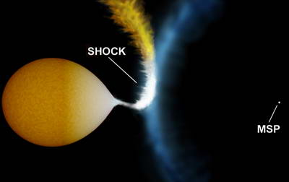
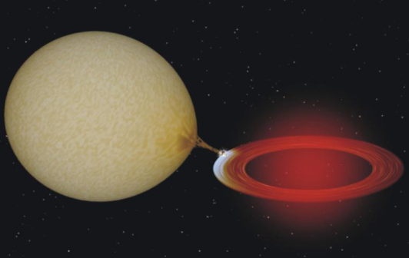
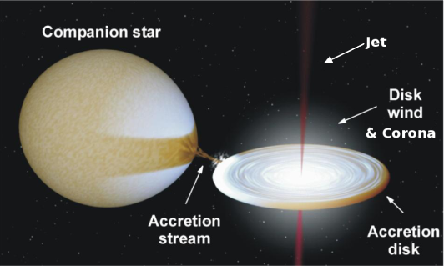


Neutron star metamorphosis
X-ray states of “redback” millisecond pulsars
Altamirano, Bahramian, Bogdanov, Casares, Heinke, Homan, Wijnands, Palomo, Patruno, Pooley, Rodriguez-Gil, Shahbaz
Manu Linares – IAC, Spain
Notes:
Hi, it’s wicked awesome to be back in Boston. Congratulations Chandra team and thanks to my collaborators on the work I’ll present.
I’ll talk about neutron star metamorphosis: binary millisecond pulsars which change appearance in a rather spectacular way. We now know three of these so-called “redback millisecond pulsars” that alternate between accretion- and rotation-powered phases; hence changing their facebook status from “radio pulsar” to “low-mass X-ray binary” and vice versa.

Slide 2
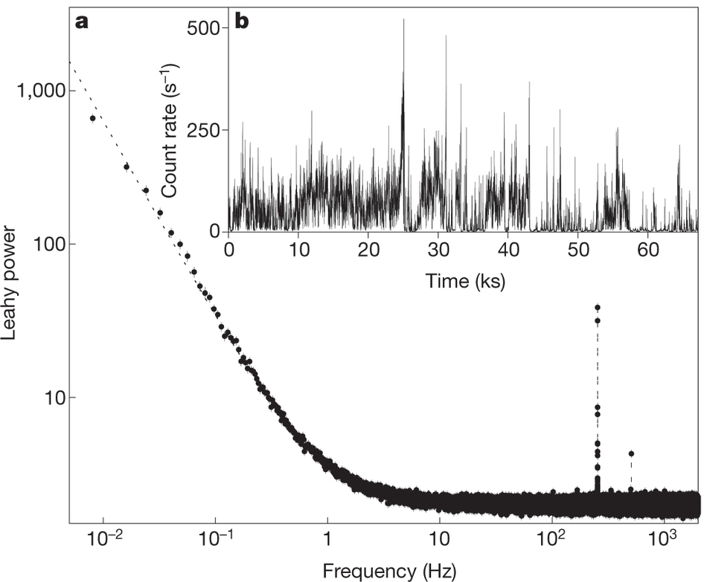
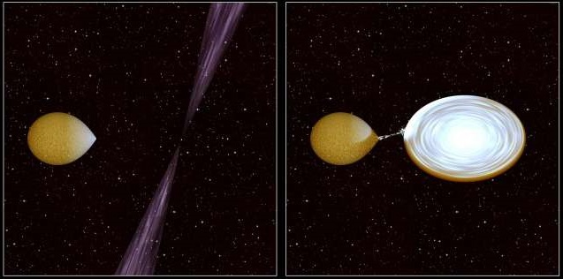
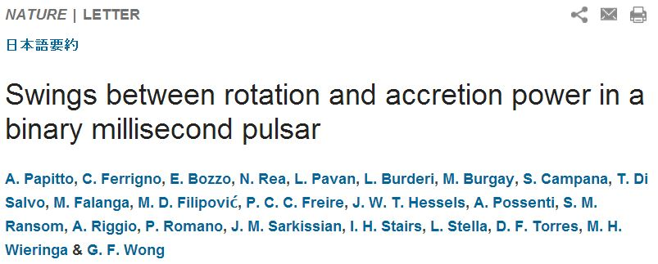
Accretion meets rotation in M28
Spectacular link between radio and X-ray millisecond pulsars
Composite: M. Roberts
PSR J1824-2452I (2006):
A 3.93185 ms radio pulsar in a 11.0258 hr orbit (Begin 2006).
Belongs to the growing class of redback millisecond pulsars (B~10⁸G, compact orb. P_{orb}~4-15hr, MS comp. M_{C}≤0.1-0.5M_{sun}).
= M28-I =
IGR J18245–2452 (April 2013):
A 3.93185 ms X-ray pulsar in a 11.0258 hr orbit (Papitto+2013).
→The same object and the first neutron star seen to “swing” between rotation- & accretion-powered pulsations!
Notes:
Perhaps the most spectacular, but certainly not the first, link between radio and X-ray millisecond pulsars was found last year: this was a known rotation-powered radio pulsar since 2006, and in 2013 it went into a full outburst displaying accretion-powered X-ray pulsations, thermonuclear bursts and all the characteristics of a transient low-mass X-ray binary.
It belongs to the growing class of redbacks,: compact binary millisecond pulsars with low-mass, main-sequence, strongly-irradiated companion stars.
This made it to the headlines, and I’m gonna refer to this pulsar as M28-I…

Slide 3
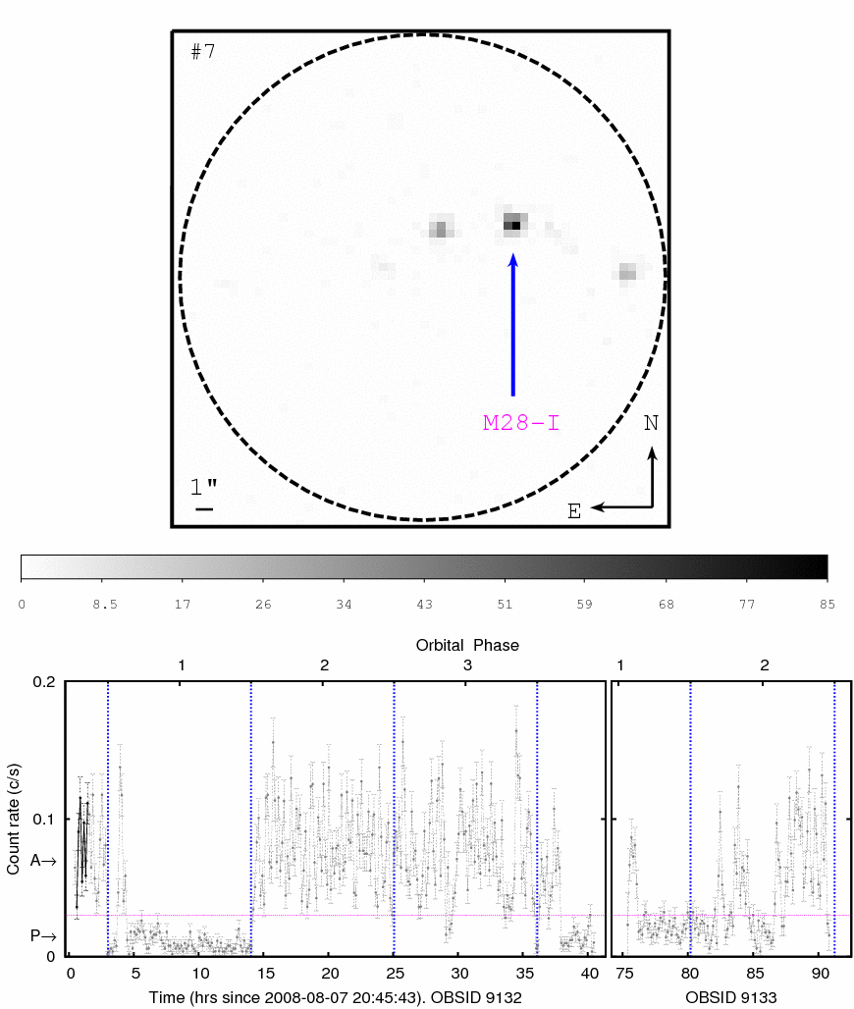
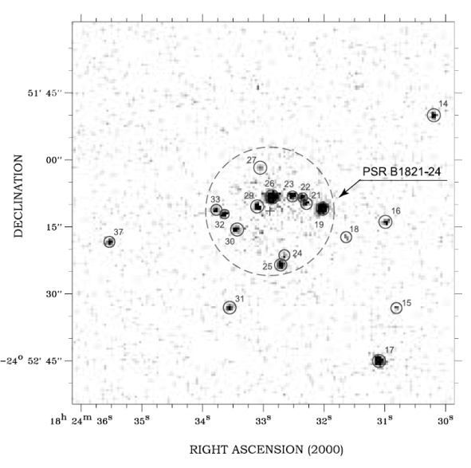
1-hr ACIS snapshots of M28’s core (14.4” radius)
Becker+03, Bogdanov+11
Chandra revealed striking variability from M28-I!
Fast (<500s) transitions between disk-active (L_{X}=3.9×10³³ erg/s) and disk-passive (L_{X}=5.6×10³² erg/s) states, both non-thermal (Γ=1.5)
Linares+ (2014, MNRAS, 438,251)
Notes:
…M28-I because it’s one of the many MSPs lurking in the core of the globular cluster M28. Here you see a Chandra-ACIS X-ray image of the central parts of M28, and a zoom into the core of the cluster.
We looked back at the 2008 Chandra observations of this cluster and found striking and I dare say unprecedented variability in M28-I:
LOWER PANEL: X-RAY LIGHTCURVE OF M28-I: c/s vs. time in hours, and orbital phase along the top axis. This was taken five years before the discovery outburst.
This little snake running along the lightcurve shows the time interval of the image above, so you can see both from the image and the lightcurve how:
M28-I switched very rapidly between active and passive states, at luminosities between a few E32 and a few E33 erg/s.
(These transitions were NOT correlated with orbital period nor due to changes in absorption, and thus have nothing to do with the so-called dipping low-mass X-ray binaries.)
[other notes: core radius is were surface brightness has dropped “by half”. Becker+03 found 12 srcs in the 0.24’ core radius]

Slide 4
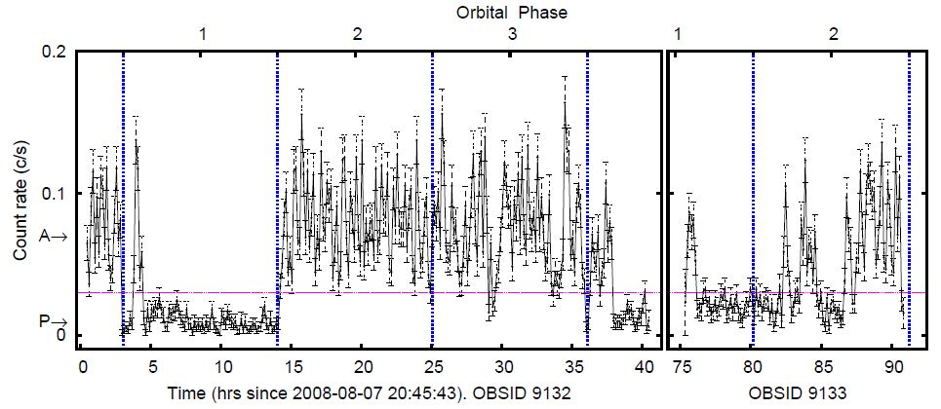

M28-I: mode switching
At the boundary between accretion and rotation power
10³² erg/s
^{Rotation power?}
10³³ erg/s
^{Accretion power}
Balance (tug-of-war) between accretion flow and pulsar wind?
Light cylinder radius at 186 km. For a 10⁸ G magnetic field:
Active states (L_{bol}=1.2×10³⁴ erg/s → R_{m}~130km): magnetospheric accretion.
Passive states (L_{bol}=1.7×10³³ erg/s → R_{m}~230 km): pulsar wind shock.
Notes:
AND WE PROPOSED A SIMPLE TOY MODEL TO EXPLAIN THIS NEW PHENOMENON: MODE SWITCHING IN M28-I: a balance between the accretion flow and the pulsar wind.
In this toy “tug-of-war” model, accretion rate fluctuations move the magnetospheric radius Rm in and out of the light cylinder. This turns the radio pulsar off and on, switching between magnetospheric accretion (at high L) and pulsar wind shock emission regime (at low L).
We quantified this: magnetospheric radius vs light cylinder radius OK.
(click) So in this interpretation this part here is accretion-powered and this down here is rotation-powered.

Slide 5
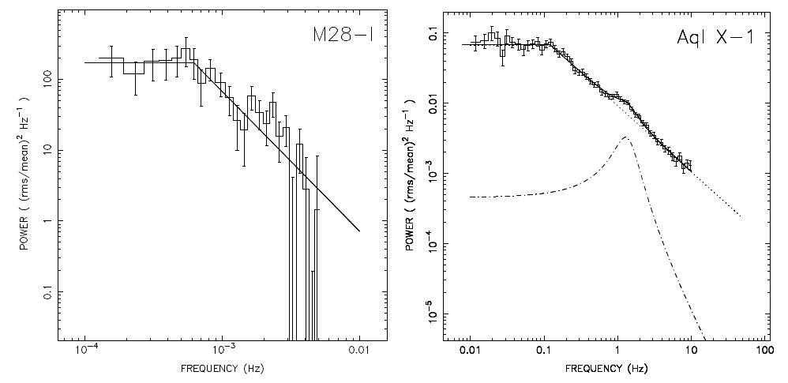
M28-I: Sub-luminous Accretion
Accretion at its lowest: 10⁻⁵ Eddington
L_{X} = 4x10³³ erg/s
ν_{b} = 6x10⁻⁴ Hz
L_{X} = 3x10³⁶ erg/s
ν_{b} = 1x10⁻¹ Hz
Disk-Active state has typical accretion (“hard state”) variability
(fluctuations in mass accretion rate?)
Notes:
And actually there is also variability within the active state, which looks exactly like that seen in “regular” neutron star low-mass X-ray binaries, but at lower luminosity and frequency.
Here I’m comparing the Chandra power spectrum of M28-I (power vs. Fourier frequency) with a well-known neutron star transient, Aql X-1: three orders of magnitude higher Lx and freq.
This variability in LMXBs is thought to be driven by fluctuations in mass accretion rate in the disk, which could be driving also the transitions to the passive state.

Slide 6
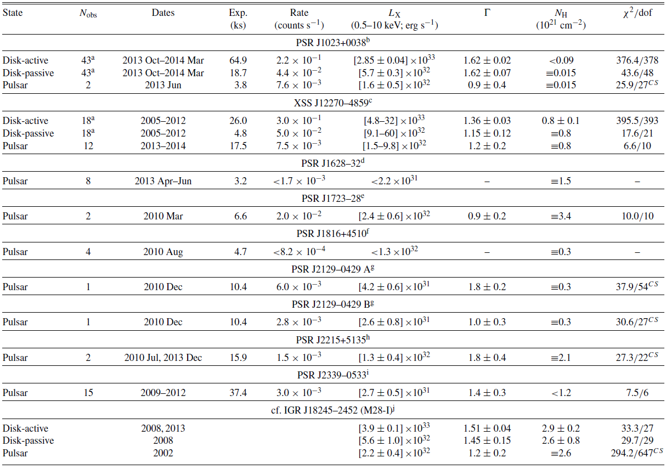
X-ray states of redbacks
Luminosities and spectra of eight nearby redbacks observed by Swift-XRT
Linares (2014, ApJ, 795,72)
The “G8 summit”
See also Deller+12, Bogdanov+11, Patruno+14, Archibald+10, Stappers+14, Takata+14, DeMartino+10,13, Bassa+14, Ray+12, Crawford+13, Bogdanov+14, Hui+14, Kaplan+12,13, Gentile+14, Romani+11, Kong+12
Notes:
Let me zoom out now. In what’s left of this talk I’ll show you a global study of the X-ray states of redbacks, including M28-I which I just described in detail, but also two other redbacks that have developed accretion disks --J1023 and J12270– and six other nearby redbacks that have so far been always seen in the rotation-powered radio “pulsar state”.
Many numbers here, but this is just to introduce the source sample: 8 nearby redbacks within the reach of Swift-XRT.

Slide 7
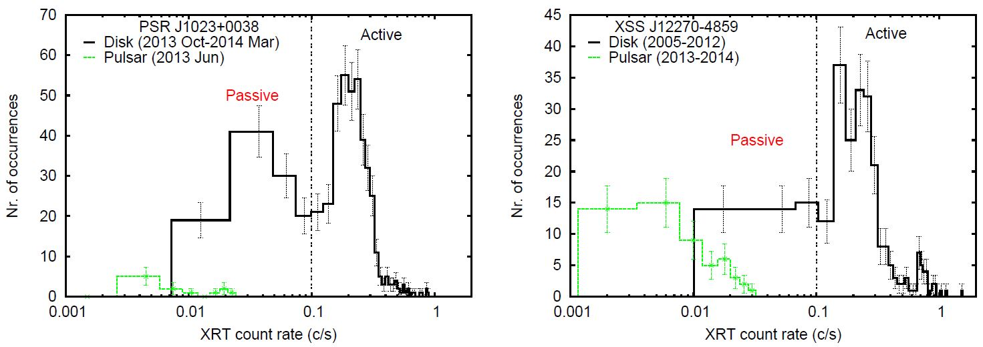
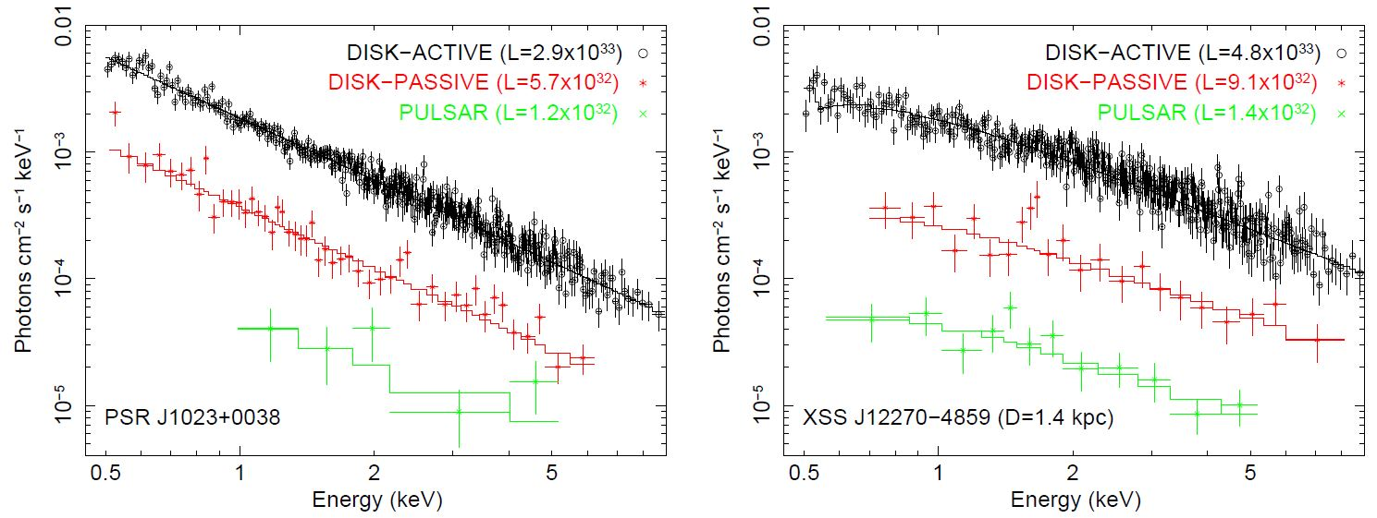
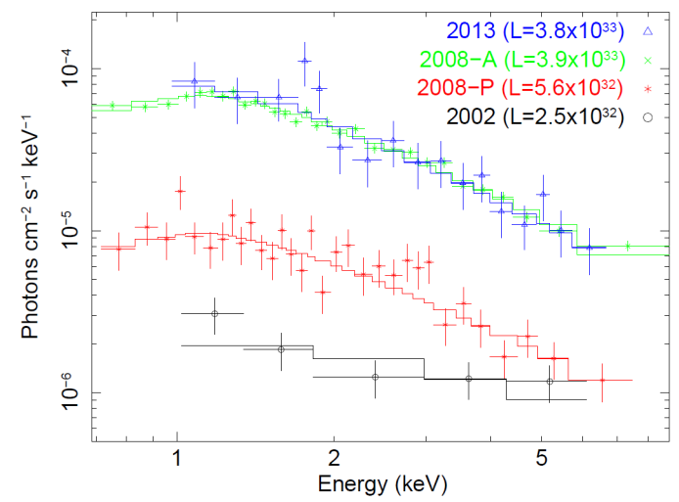
Disk state: X-ray mode switching
Swift finds mode switching in J1023 & J12270
J1023 ✓
J12270 ✓
M28-I ✓
Linares14; deMartino+13, Patruno+13,Tendulkar+14
3/3 accreting redbacks show mode switching!
(“classical” transient NS-LMXBs don’t)
Notes:
WE ALSO FIND MODE SWITCHING IN THE OTHER TWO REDBACKS WHICH HAVE SHOWN ACCRETION EPISODES!
Explain FIGURES in detail.
WE ARE THEREFORE UNCOVERING A UNIVERSAL BEHAVIOR. NOT SEEN IN ‘regular’ LMXBs.

Slide 8
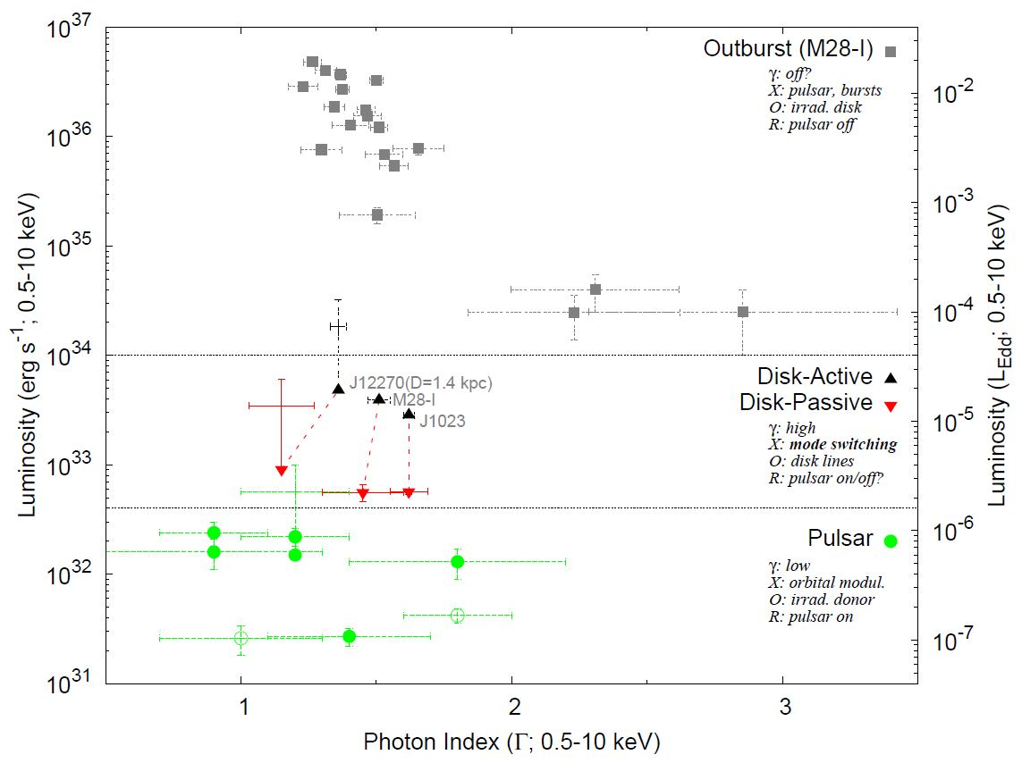
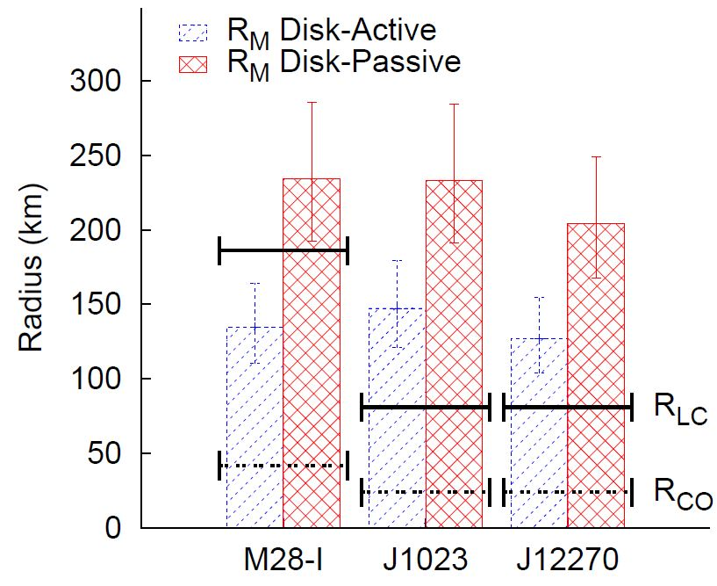
X-ray states of redbacks
Pulsar, disk(active/passive) and outburst states
Linares (2014, ApJ, 795,72)
~10³⁴ erg/s
~4x10³² erg/s
Three main states. Disk state at the crossroads between accretion and rotation power
Notes:
This plot puts it all together: outburst state in M28-I only, disk state in three systems, and pulsar state with at least seven detections.
Note Lx in the disk state is similar.
AND most importantly this implies that the magnetospheric radius in this case is always outside the light cylinder. So the simple toy tug-of-war model doesn’t work for these two nearby redbacks.

Slide 9
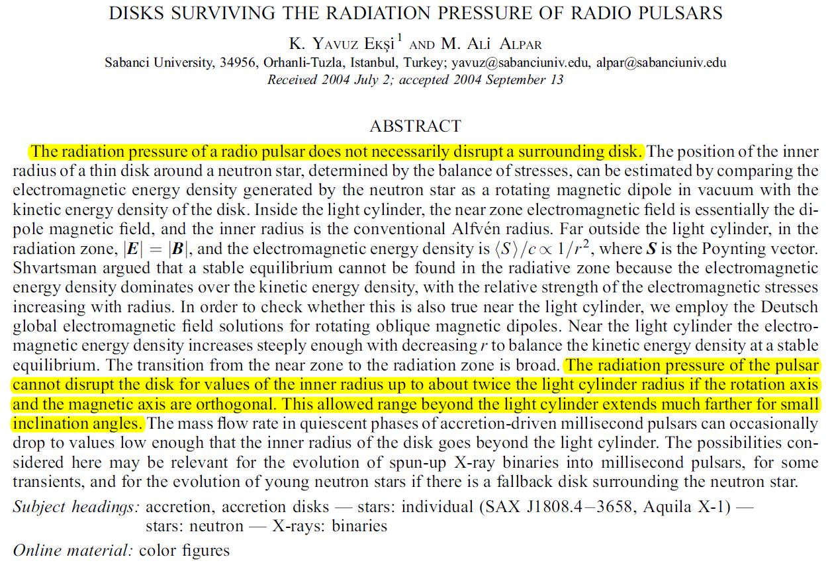
X-ray states of redbacks
A radio pulsar and an accretion disk can coexist
EksI & Alpar (2005): stable accretion disks truncated outside the light cylinder.
Redbacks in the disk state offer a unique probe of this regime.
Notes:
So we obviously need to go beyond this toy model to explain X-ray mode switching in all redbacks. Not surprising, other forces apart from magnetic are expected to act on the inner disk. Radiation pressure when radio pulsar is on can influence disk structure and truncation.
COMMON MISCONCEPTION is that whenever the radio pulsar is on it will sweep away any accretion disk around it.
That’s exactly what Eksi & Alpar studied in this paper. QUOTES. Accretion disks around active radio pulsars can be stable.
In any case we find evidence for disks truncated right outside the light cylinder in J1023 and J12270. A unique probe of accretion flows near the light cylinder!
[Interesting dependence with inclination between magnetic and rotation axes, which applied to our case suggests that these are quasi-aligned.
(Rm/Rlc ~ 1.8 can happen only for i<15deg)]

Slide 10
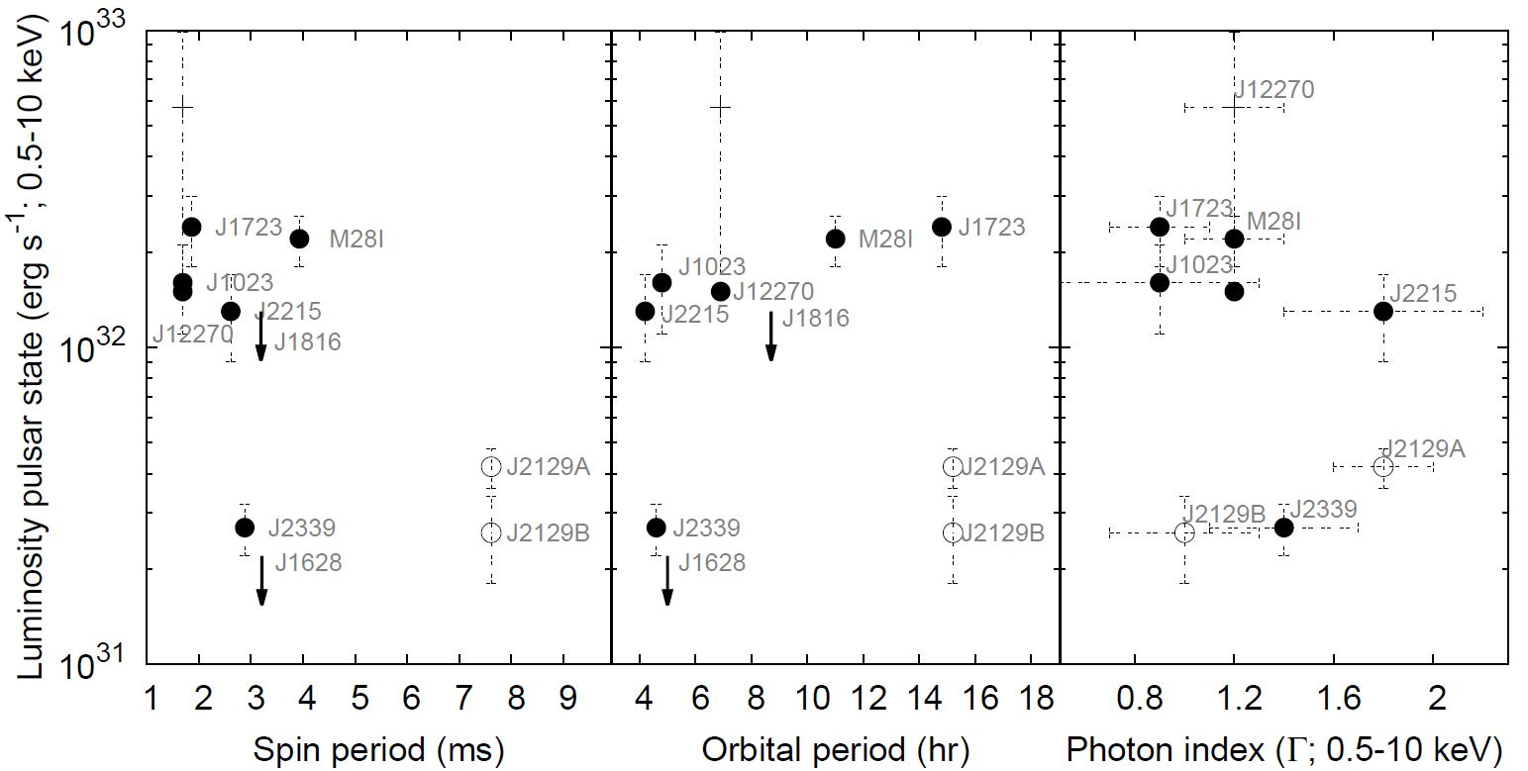
X-ray states of redbacks
Luminosity of the pulsar state: tracing the pulsar wind shock?
Linares (2014, ApJ, 795,72)
Accreting redbacks: relatively luminous pulsar state
(same is true for J1723 & J2215: good candidates to develop disks)
Notes:
And last but not least, a closer look into the pulsar state: SHOW PLOTS.
Note all three accretors are up here (L>1e32 erg/s). Also these two guys, so we suggest these are two good candidates to look for accretion episodes in the future.

Slide 11
Summary & Conclusions
Take home: mode switching is ubiquitous in the disk state of redbacks
Hynes+
The X-ray luminosity of redbacks can vary by ×10⁶, defining three main states: outburst (10³⁴<L_{x}<10³⁷ erg/s; only in M28-I), disk (4×10³²<L_{x}<10³⁴ erg/s; seen in M28-I, J1023 & J12270) and pulsar state (10³¹<L_{x}<4×10³² erg/s; >7 redbacks detected).
All three accreting redbacks (M28-I, J1023 & J12270) have shown mode switching in the disk state (rapid transitions between disk-active, L_{x}=[3-5]×10³³ erg/s, and disk-passive, L_{x}=[6-9]×10³² erg/s, states).
All three accreting redbacks (M28-I, J1023 & J12270) have relatively high luminosities in the pulsar state (L_{x}>10³² erg/s; same true for J1723 & J2215).
Unique probe of accretion flows & pulsar winds near the light cylinder!
Escher
Notes:
CONCLUSIONS:
-6oom Lx, three states.
-pulsar state luminosity may hint at new accretion disks.
TAKE HOME:
-disk state=mode switching.
AND…

Slide 12
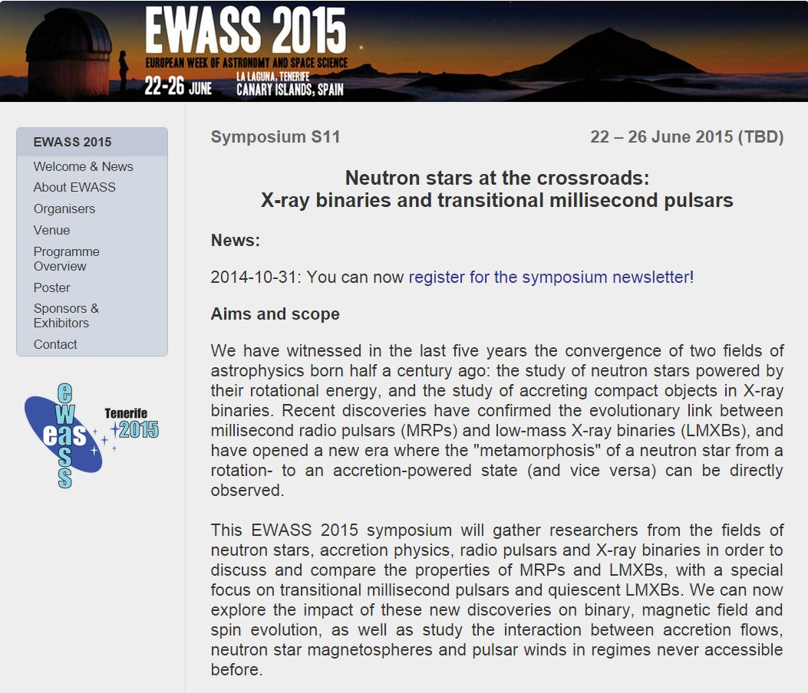

Tenerife, June 22-26, 2015:
Registration opens December 2014: http://eas.unige.ch/EWASS2015/
Notes:
I’ll leave you with this AD. We’re organizing for next June, a symposium within the EWASS focused on transitional millisecond pulsars.
Thanks for your attention!

Slide 14
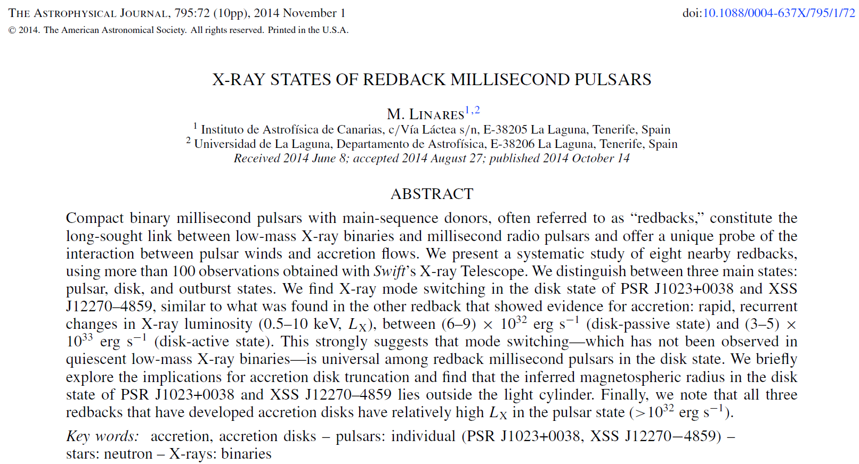
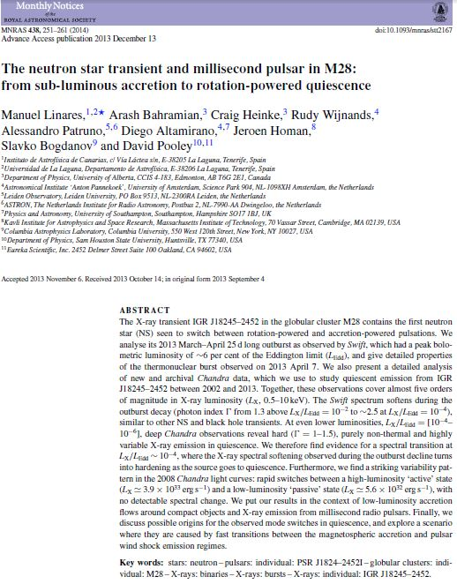
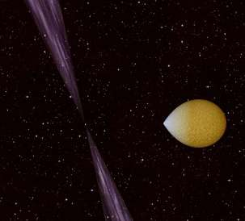
Thanks!
For more:

Slide 15
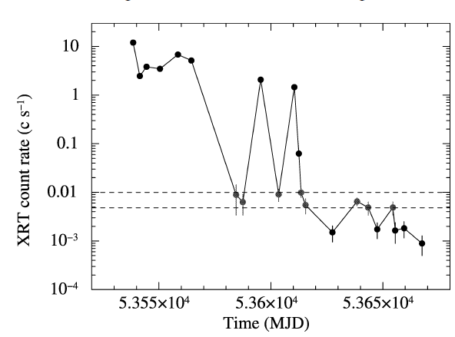
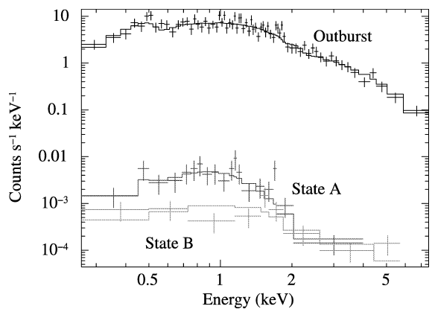
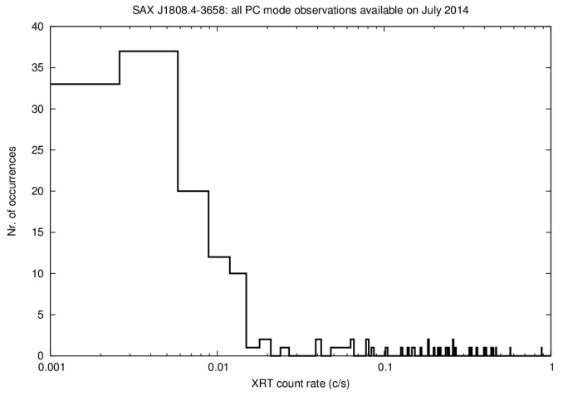
Disk state: X-ray mode switching
Seen so far only in redbacks!
Campana+08
SAX J1808.4-3658 different business…
Notes:
Motivated by this we looked at other nearby redback MSPs with Swift-XRT.
This is the new part, attention back!
WE ALSO FIND MODE SWITCHING IN THE OTHER TWO REDBACKS WHICH HAVE SHOWN ACCRETION EPISODES!
Explain FIGURES in detail.
WE ARE THEREFORE UNCOVERING A UNIVERSAL BEHAVIOR. NOT SEEN IN ‘regular’ LMXBs

Slide 16
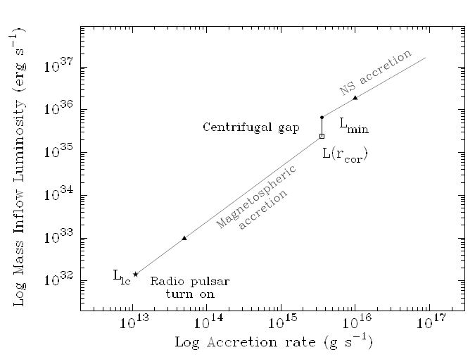
Accretion vs. Rotation
Regimes of accretion onto a neutron star
(Campana et al. 1998; analytic estimates comparing pressures: ram/magnetic/radiation)
Different (non-thermal) emission regimes as mass accretion rate on the neutron star decreases (and the magnetospheric radius R_{m} increases)
Notes:
SO HOW DO WE INTERPRET MODE SWITCHING?
Let’s look at how accretion is expected to proceed at low mass accretion rates:
Different regimes, most importantly MAGNETOSPHERIC ACCRETION: mass is accreted down to the NS magnetosphere. As mdot drops the magnetospheric radius increases (the radius where magnetic and ram pressure balance). When Rm reaches the light cylinder (radius where a corotating field line would reach speed of light), the rotation-powered radio pulsar is expected to turn on.

Slide 17
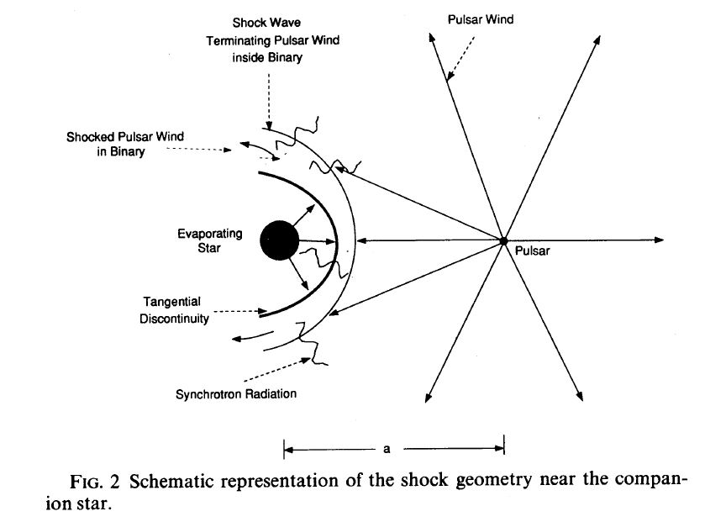
Accretion vs. Rotation
When rotation power takes over
Arons & Tavani (1993)
At the lowest luminosities, when radio pulsar is ON (light cylinder empty), the pulsar wind shocks surrounding material (accretion flow / companion).
Notes:
… And then rotation power takes over, and X-ray emission is thought to come predominantly from a shock between the pulsar wind and surrounding material.

Slide 18

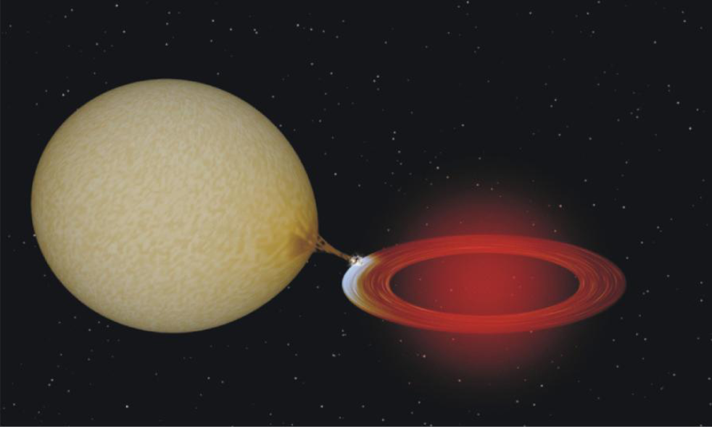
Low-Mass X-ray Binaries
ON (outburst): L_{X} ~ 10³⁶ - 10³⁸ erg/s
OFF (quiescence): L_{X} ~ 10³⁰ - 10³³ erg/s
Credit: Hynes
Notes:
-So THEY ALTERNATE BETWEEN ON AND OFF STATES.
-ON: “in outburst”, luminosities of 1e36-1e38 erg/s or 1e39 for BHs, not far from LEdd
-OFF: “in quiescence”, ~6 ord.of.mag. Fainter; thermal and/or hard ‘powerlaw’ emission

Slide 19
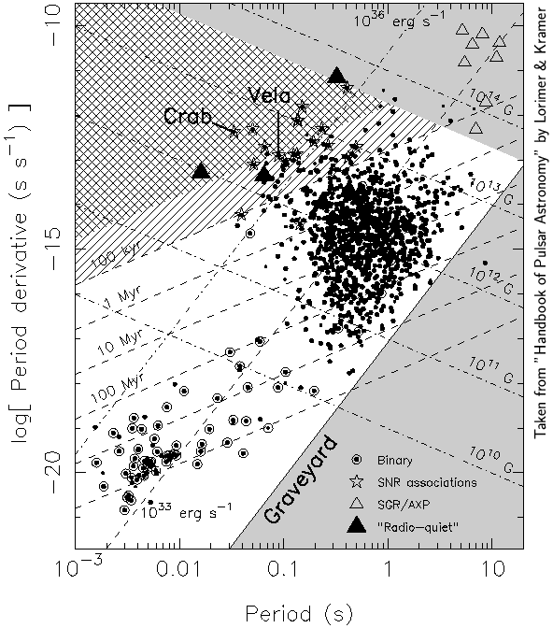
Millisecond radio pulsars
Credit: Hynes
L_{X} ~ 10²⁹ - 10³² erg/s
Soon after MRPs were discovered (Backer+82) it was proposed that NS are spun up through accretion in LMXBs: “the recycling scenario” (Alpar+82)
Are NS-LMXBs progenitors of MRPs?
Notes:
-So THEY ALTERNATE BETWEEN ON AND OFF STATES.
-ON: “in outburst”, luminosities of 1e36-1e38 erg/s or 1e39 for BHs, not far from LEdd
-OFF: “in quiescence”, ~6 ord.of.mag. Fainter; thermal and/or hard ‘powerlaw’ emission

Slide 20
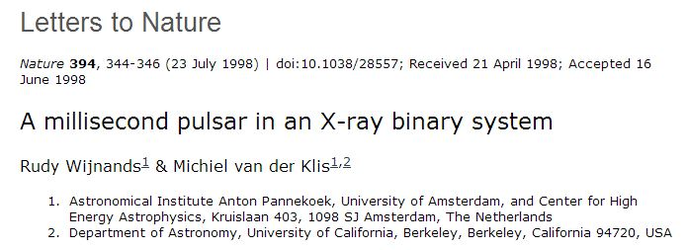
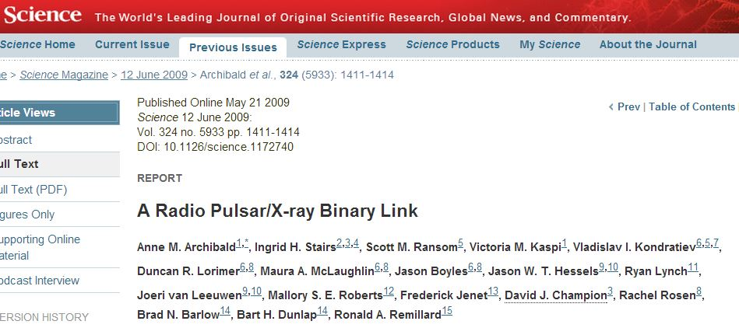
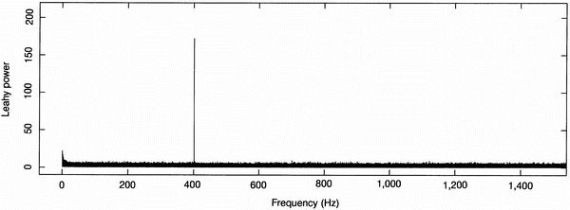
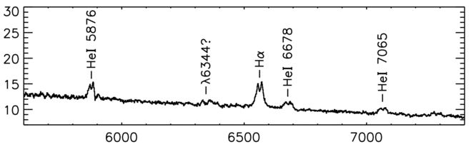
LMXB-MRP “missing links”
In 1998: SAX J1808.4-3658 Wijnands & van der Klis
In 2009: PSR J1023+0038 Archibald et al.
In 2009: PSR J1023+0038 Archibald et al.
Yes, most NSs in LMXBs have ms spins! (Chakrabarty+03)
An MRP with an accretion disk back in 2001, and as we speak! (Wang+09, Stappers+13, Patruno+13)

Slide 21
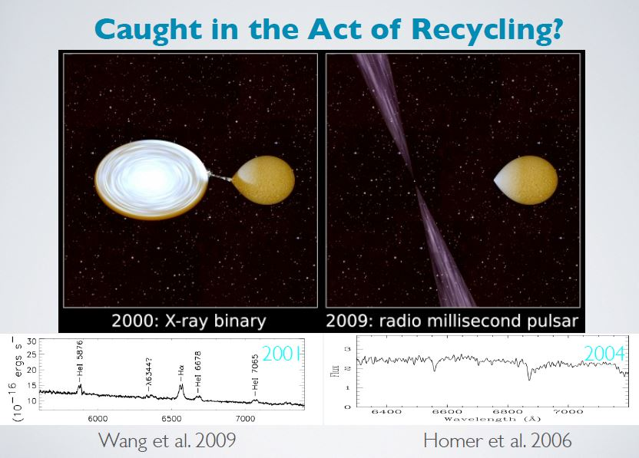
“missing link” v. 2
Slide from M. Roberts (2013)
PSR J1023+0038: A ms radio pulsar with a past (Archibald et al. 2009; note Lx<3e34 erg/s when disk lines were observed).

Slide 22

“missing link” v. 3
IGR J18245–2452: rotation-powered/radio pulsar, then accretion-powered/X-ray, then rotation-powered/radio again (Papitto et al. 2013)

Slide 23
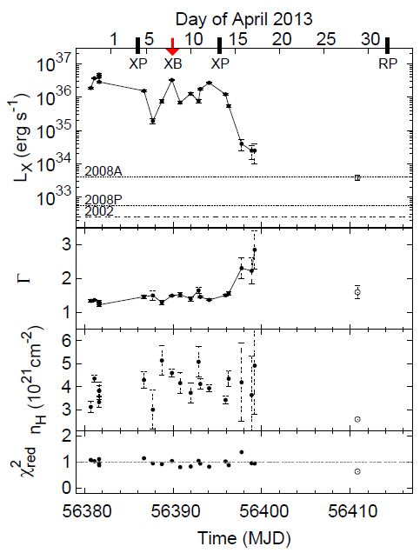
A new transient NS-LMXB in M28
PSR J1824-2452I:
A 3.93185 ms radio pulsar in a 11.0258 hr orbit (Begin 2006).
IGR J18245–2452:
A 3.93185 ms X-ray pulsar in a 11.0258 hr orbit, hence the same object and the first neutron star seen to “swing” between rotation-powered and accretion-powered pulsations (Papitto+ 2013).
Linares et al. (2013)

Slide 24
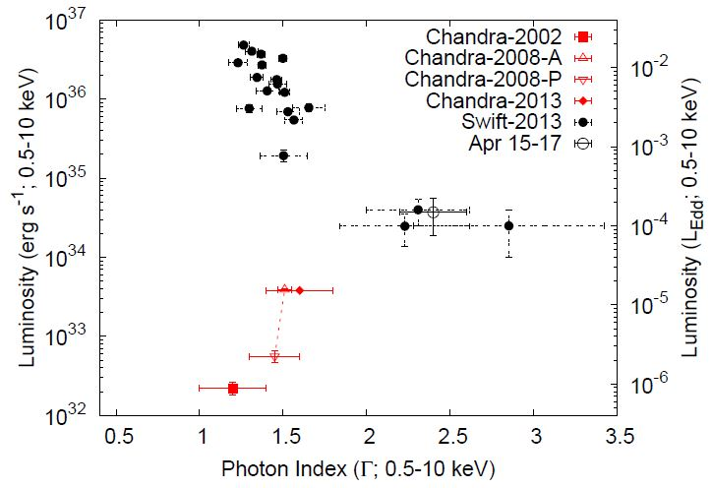
From outburst to quiescence
Spectral evolution thanks to Swift+Chandra
Linares et al. (2013)
With decreasing luminosity: X-ray spectrum softens, then hardens
Different than black hole low-level accretion (where Γ saturates at ~2, Plotkin et al. 2013; Kalemci et al. 2005) → different emission mechanisms?
Notes:
We studied new and archival observations of this unique system, and thanks to CH+SW we could follow the transition between outburst and quiescence over almost 5 orders of magnitude in luminosity.
You can see in this Figure that:
as accretion rate/power/luminosity decreased the X-ray spectrum first became softer, and then harder!
This is different than black hole behavior! and suggests different emission mechanisms are at work at these luminosities in NSs and BHs!!

Slide 25
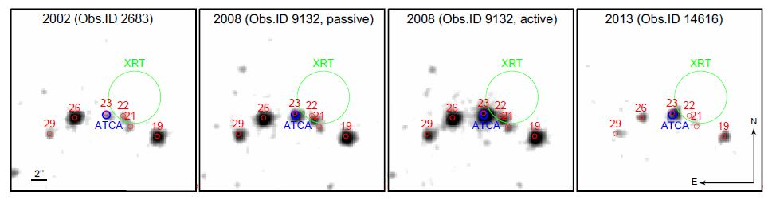
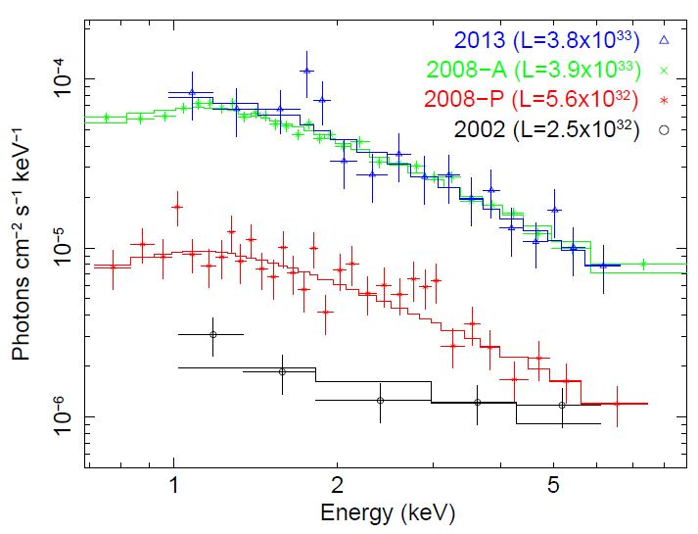
From outburst to quiescence
Variable quiescence
Chandra observations:
IGR J18245–2452 is a hard (Γ=1-1.5), highly variable (10³²⁻³³ erg/s) source in quiescence.
Notes:
Thanks to deep observations with the CXO, we also found that in quiescence this is not only a *hard source, dominated by non-thermal emission*, but also it is *highly variable*

