Slide 1
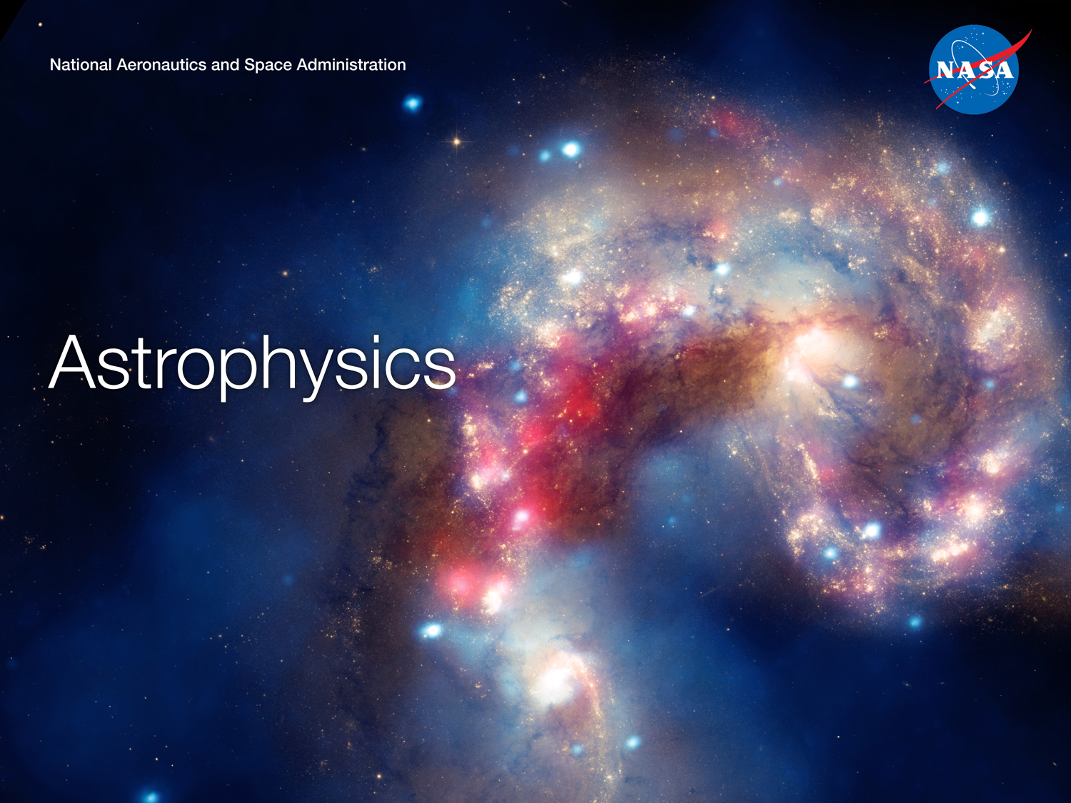
The past, present, and future role of X-ray astronomy at NASA
Paul Hertz
Director, Astrophysics Division
@PhertzNASA
15 Years of Science with Chandra
Boston, Massachusetts
November 19, 2014

Slide 2
The past, present, and future role of
X-ray astronomy at NASA
Pre-NASA
Past
Present
Future
Detection of Cosmic Rays
Detection of Cosmic Radio Sources
Detection of Solar X-rays
< 1962
Sounding rockets
Small Astronomy Satellites
High Energy Astronomy Observatories
Before Chandra
Chandra
XMM-Newton
Swift, Suzaku, NuSTAR
ASTRO-H, NICER
Chandra
Athena
Future of Chandra
2020 Decadal Survey
Chandra and Beyond

Slide 3
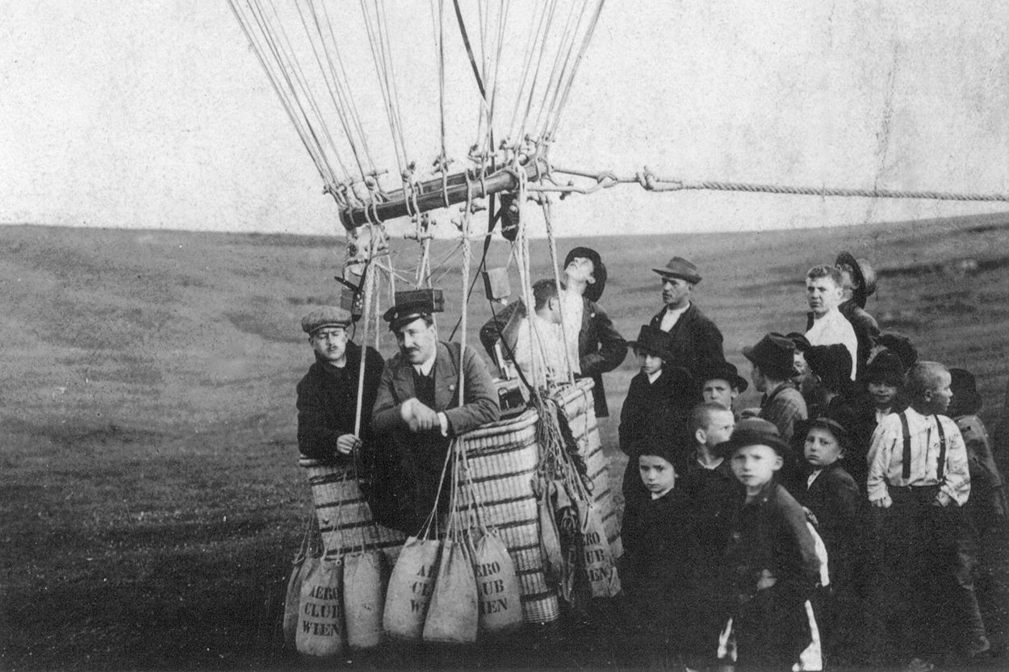
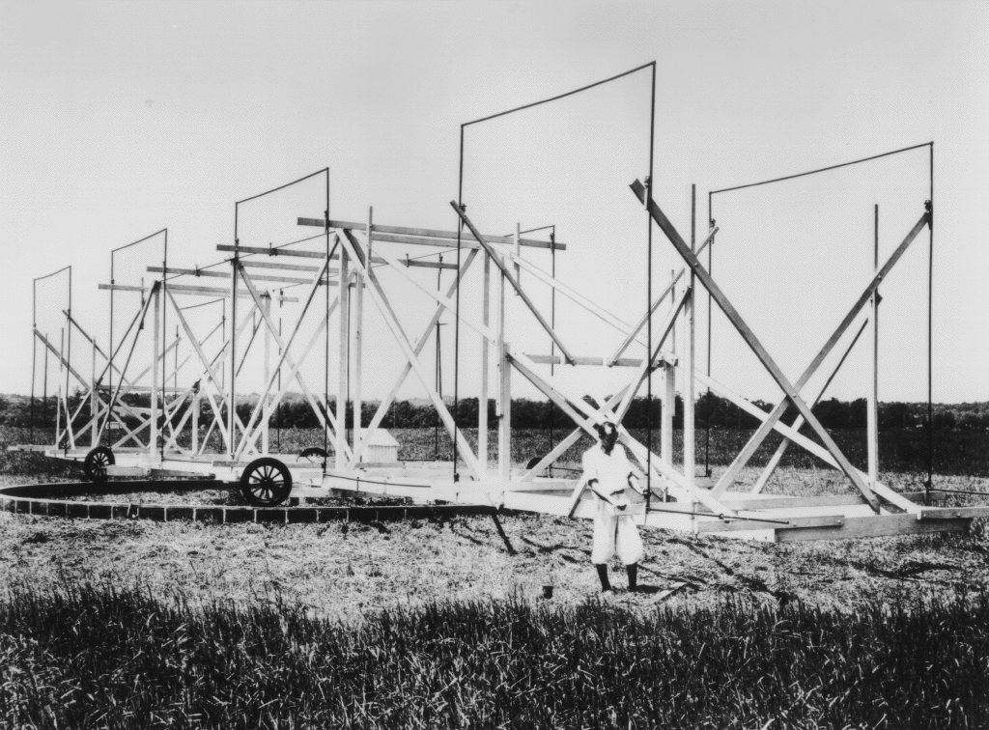
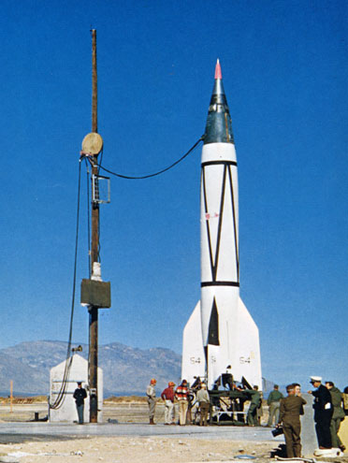
Detection of Cosmic Rays
Victor Hess (1912)
Image Credit: NYTimes.com
Detection of Cosmic Radio Sources
Karl Jansky (1933)
Image Credit: NRAO
Detection of Solar X-rays
Herbert Friedman (1949)
Image Credit: NRL

Slide 4
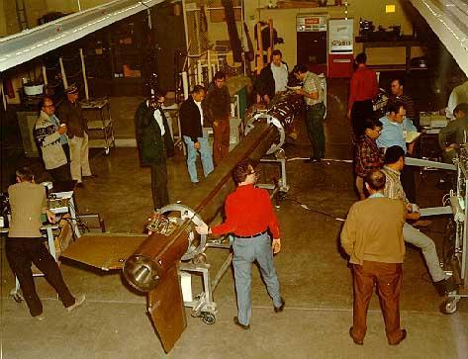
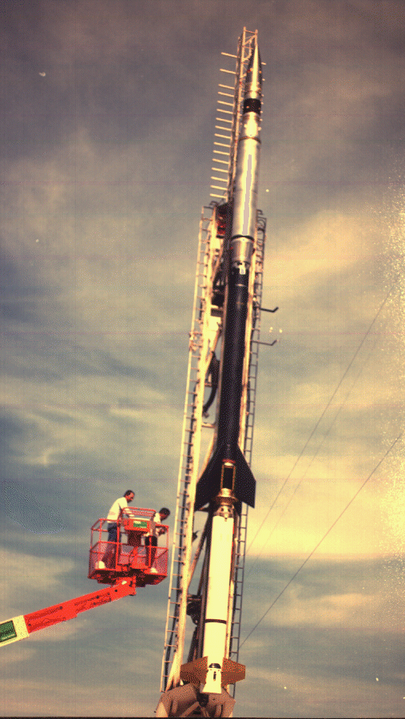
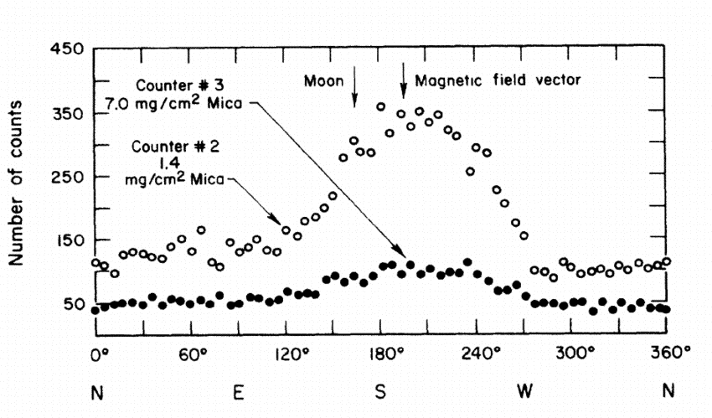
Image Credits: Harvard.edu

Slide 5
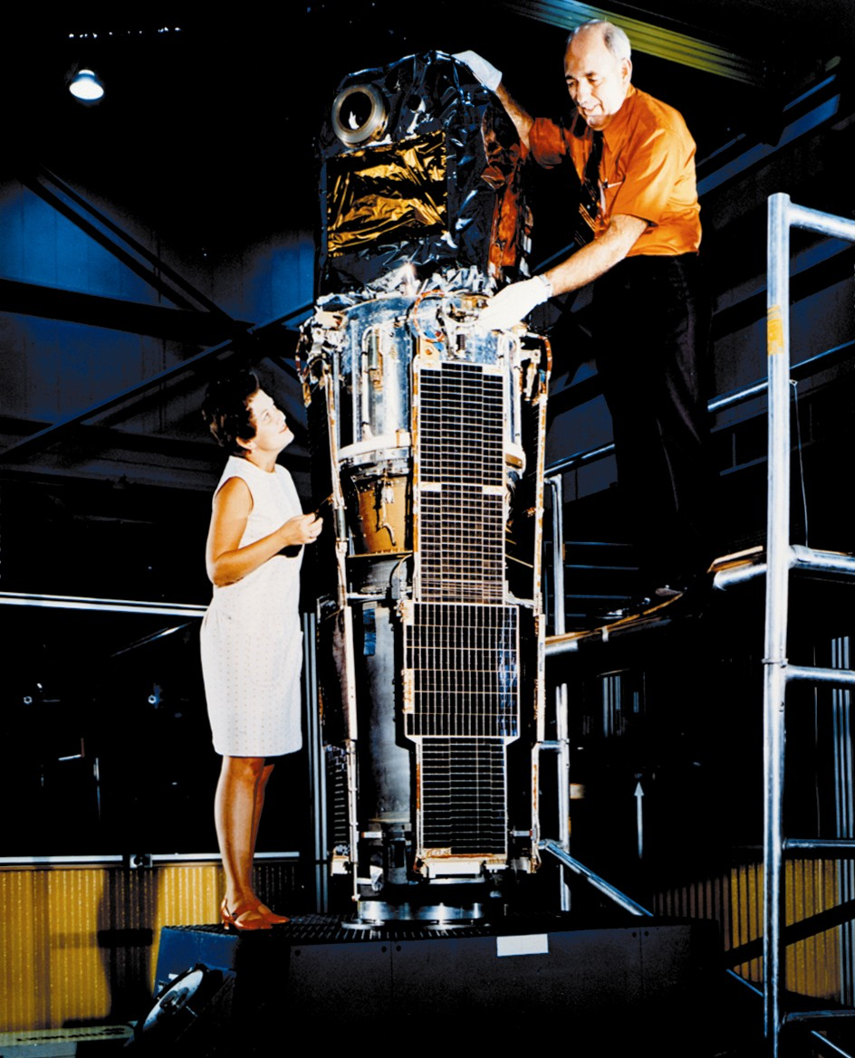
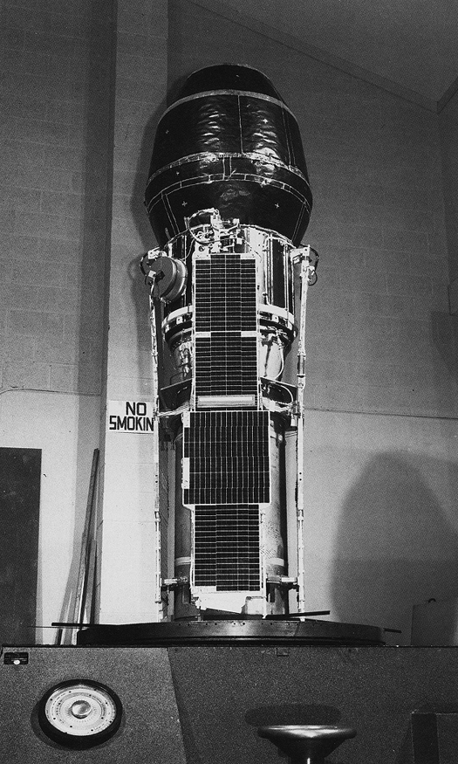
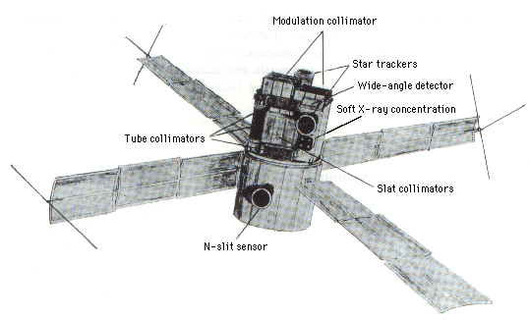
Small Astronomy Satellites (SAS)
SAS-2
1972-1973
SAS-3
1975-1979
SAS-1 (Uhuru)
1970-1973
Image Credits: NASA

Slide 6
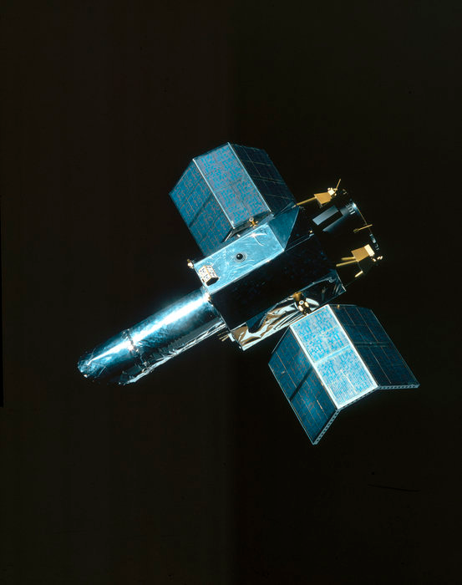
Small Astronomy Satellites (SAS)
SAS-D
International Ultraviolet Explorer (IUE)
1978-1996
Image Credit: NASA

Slide 7
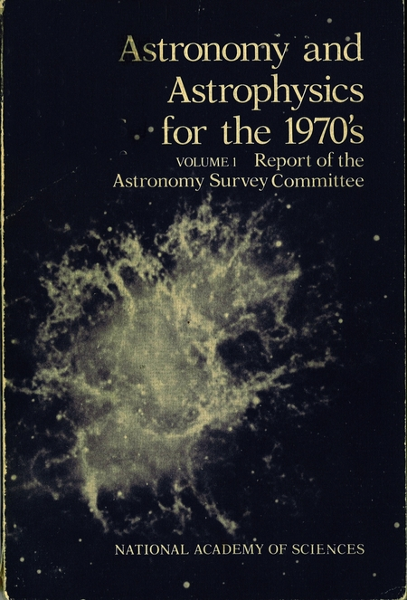
Priority 4. A program for X-ray and gamma-ray astronomy from a series of large orbiting High-energy Astronomical Observatories (HEAOs), supported by construction of ground based optical and infrared telescopes.

Slide 8
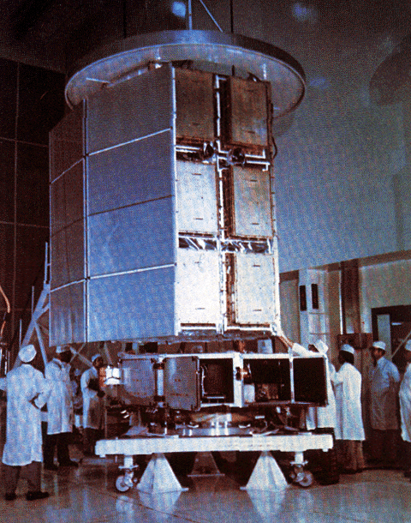
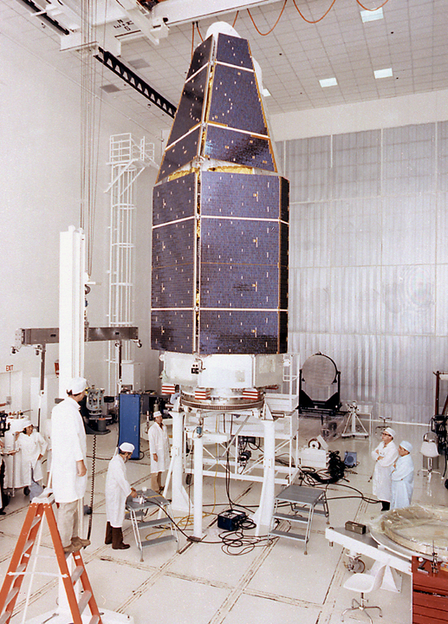
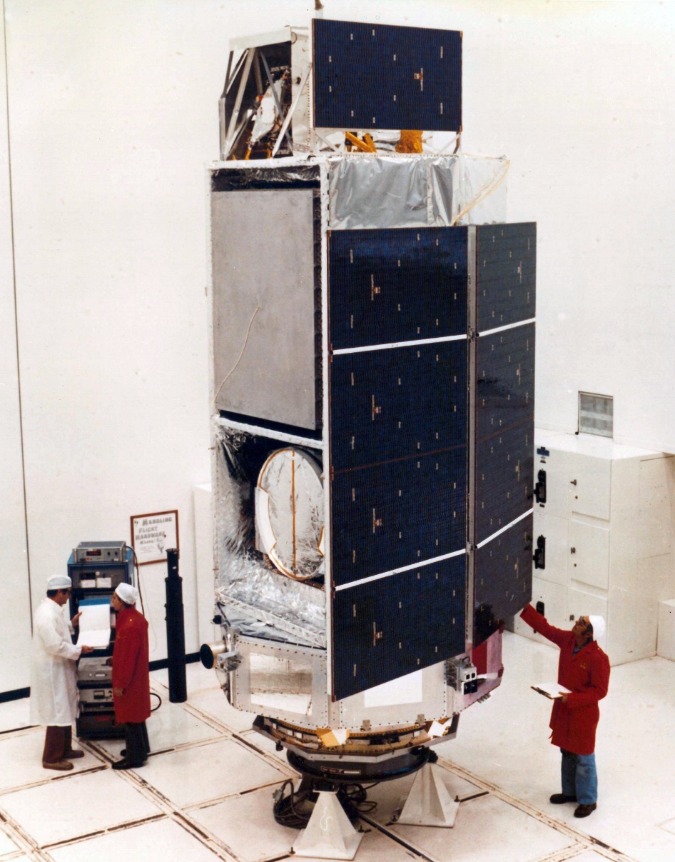
High Energy Astronomy Observatories (HEAOs)
HEAO-1
1977-1979
A1 Large Area Sky Survey experiment
A2 Cosmic X-ray Experiment
A3 Modulation Collimator
A4 Hard X-Ray / Low Energy Gamma Ray Experiment
HEAO-2
1978-1982
Einstein Observatory
Focal Plan Crystal Spectrometer
High-Resolution Imager
Imaging Proportional Counter
Monitor Proportional Counter
Solid-State Spectrometer
HEAO-3
1979-1981
High Resolution Gamma Ray Spectrometer
Cosmic Ray Isotope Experiment
Heavy Nuclei Experiment
Image Credits: NASA

Slide 9
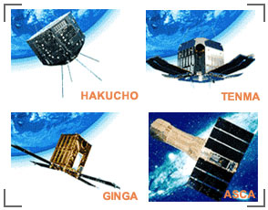
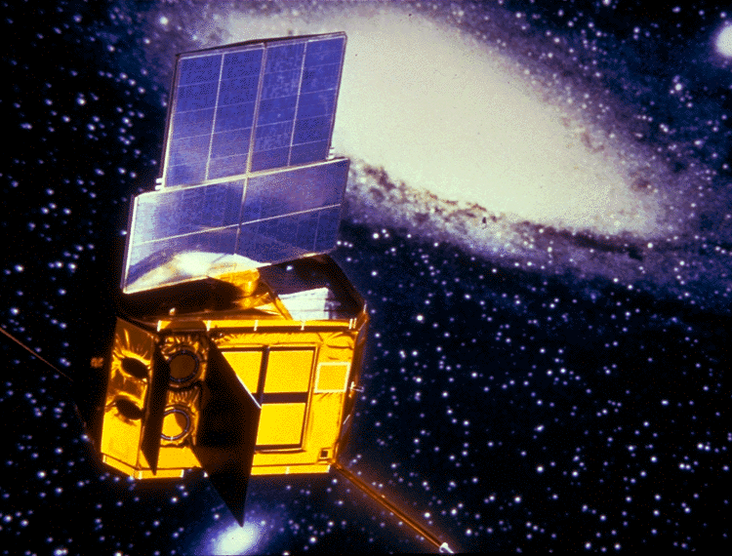
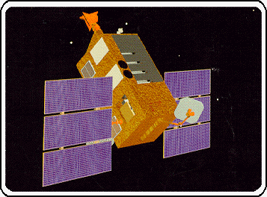
1980s and 1990s
EXOSAT
Illustration Credit: JAXA
Illustration Credit: ESA
RXTE
Illustration Credit: NASA

Slide 10
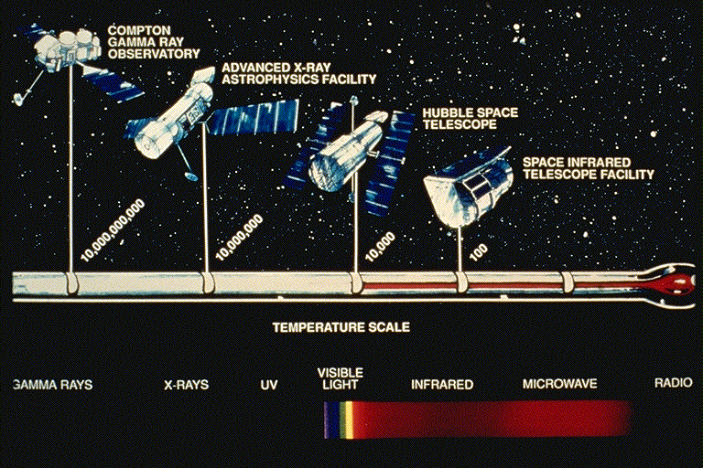
NASA’s Great Observatories
Illustration Credit: NASA

Slide 11
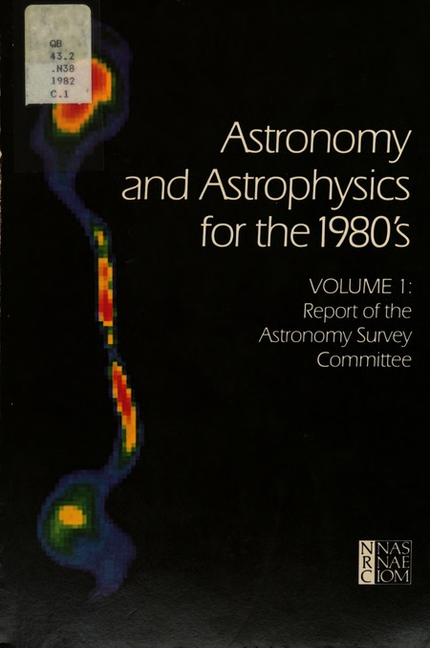
#1. An Advanced X-Ray Astrophysics Facility (AXAF) operated as a permanent national observatory in space, to provide x-ray pictures of the Universe comparable in depth and detail with those of the most advanced optical and radio telescopes. Continuing the remarkable development of x-ray technology applied to astronomy during the 1970's, this facility will combine greatly improved angular and spectral resolution with a sensitivity up to one hundred times greater than that of any previous x-ray mission.

Slide 12
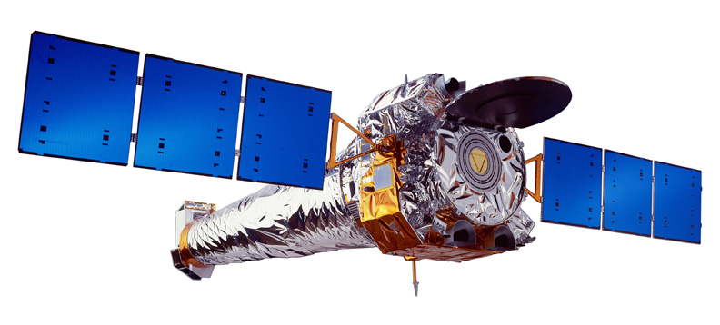
NASA Astrophysics
Cosmic Origins | Exoplanet Exploration | Physics of the Cosmos
How did the familiar night sky of galaxies, stars, and planets come to be? | Are there habitable planets around other stars? Are we alone? | How does the universe work? Use the universe as a laboratory to understand the laws of nature.
Illustration Credit: TRW

Slide 13
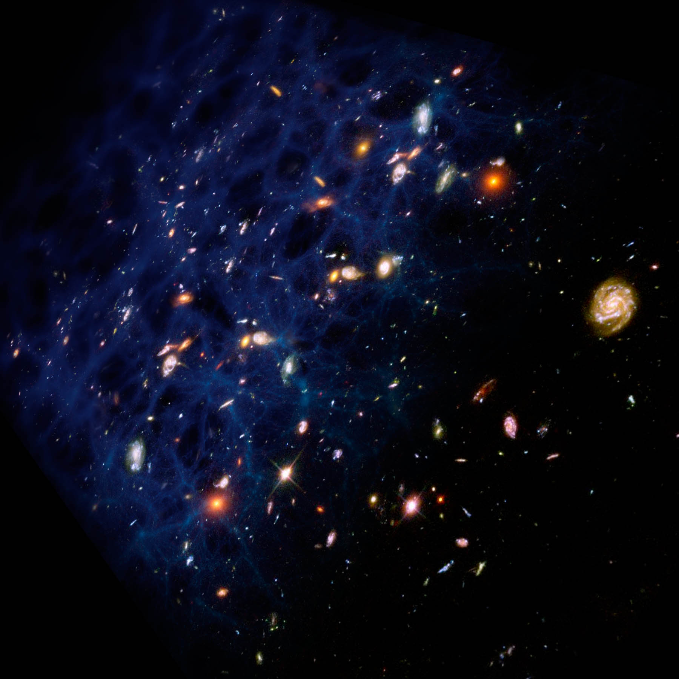
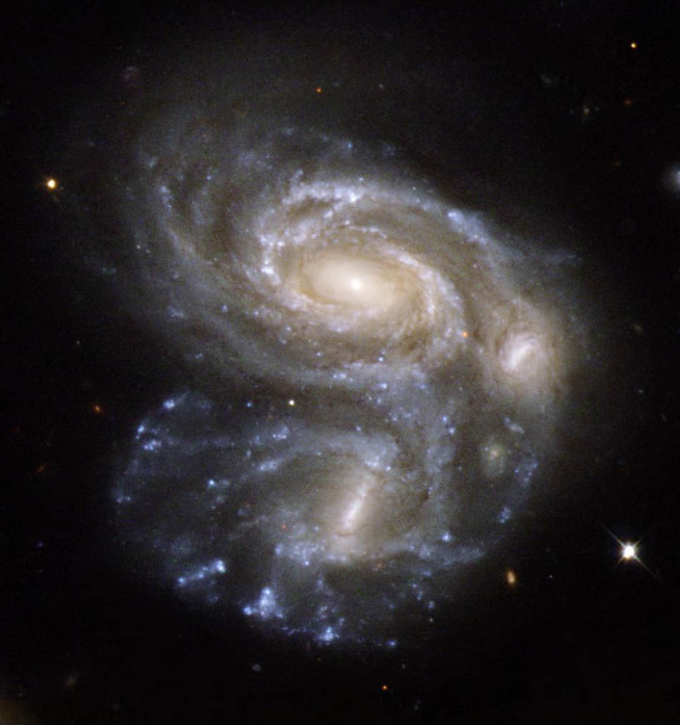
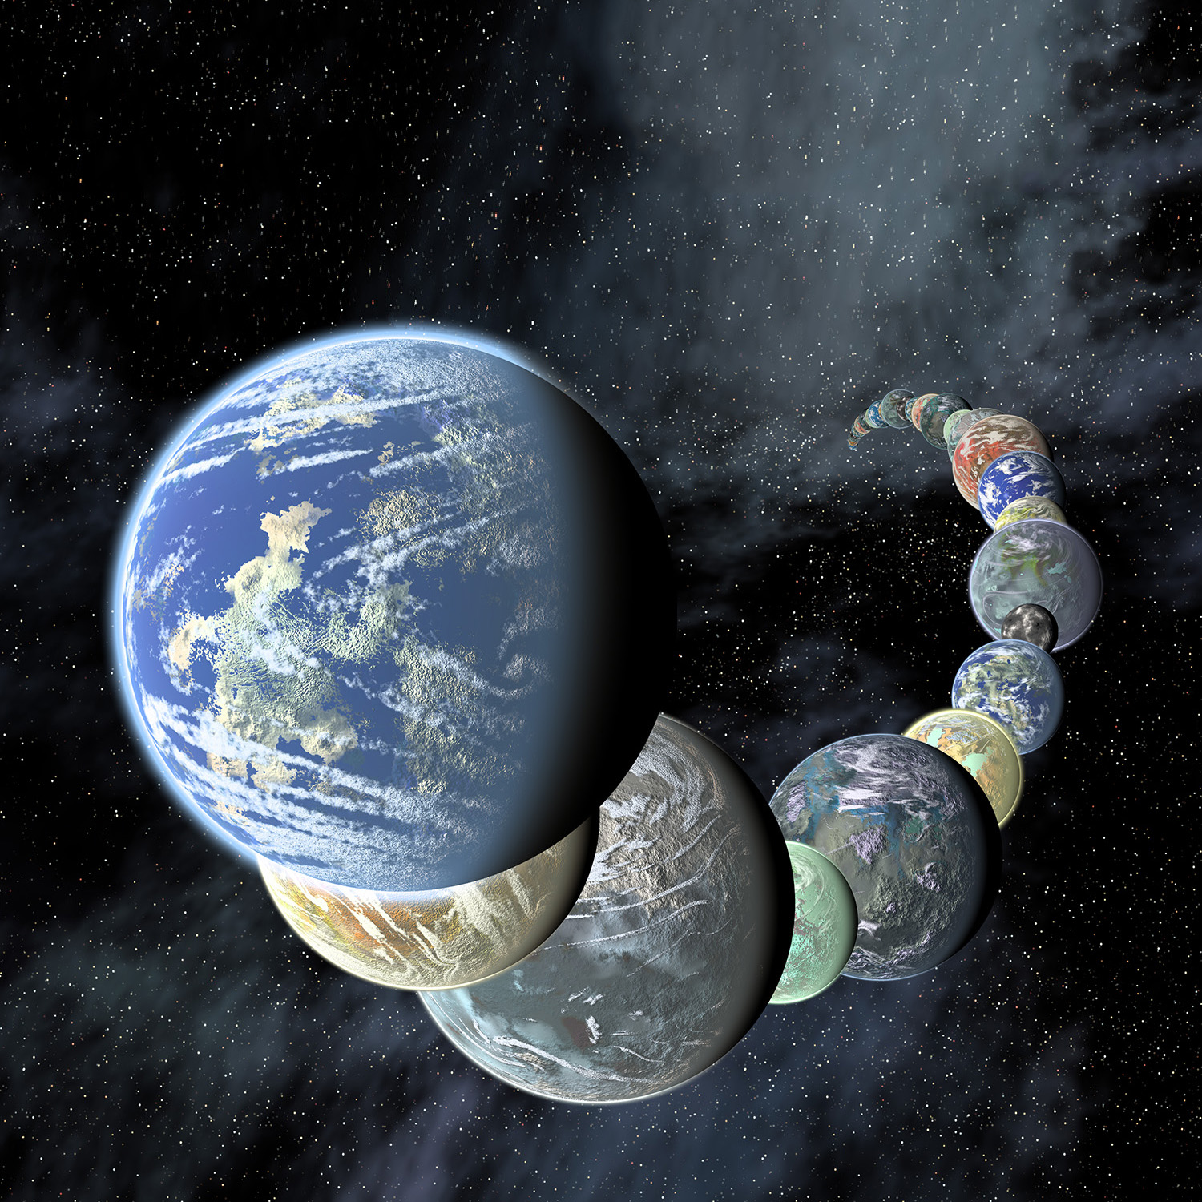
NASA Astrophysics
Physics of the Cosmos | Cosmic Origins | Exoplanet Exploration
How does the universe work? Use the universe as a laboratory to understand the laws of nature. | How did the familiar night sky of galaxies, stars, and planets come to be? | Are there habitable planets around other stars? Are we alone?

Slide 14
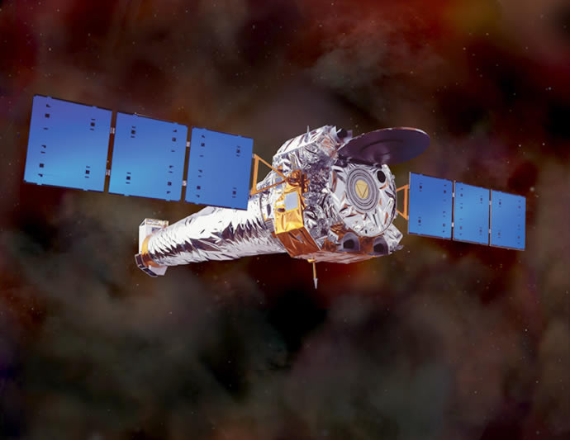
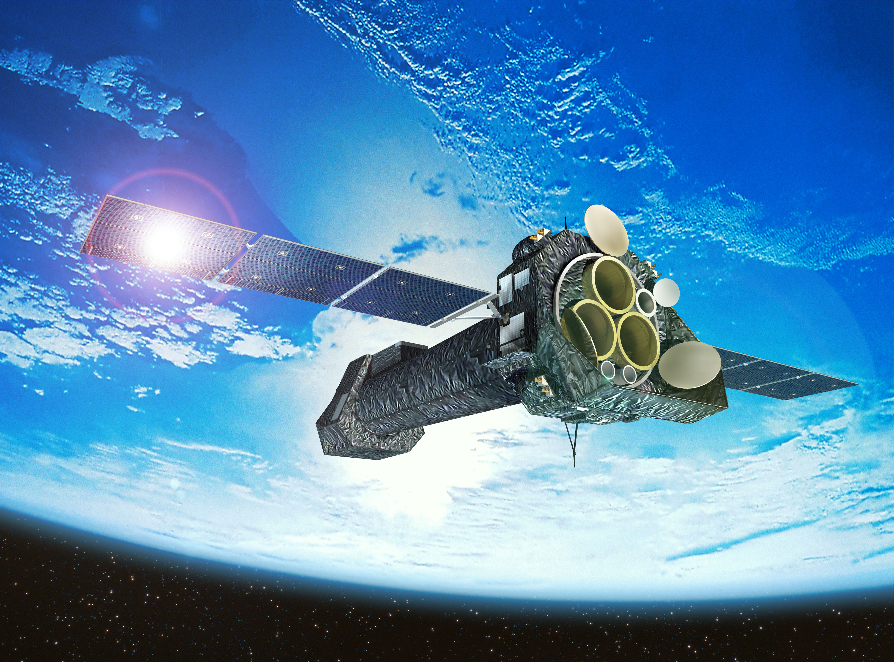
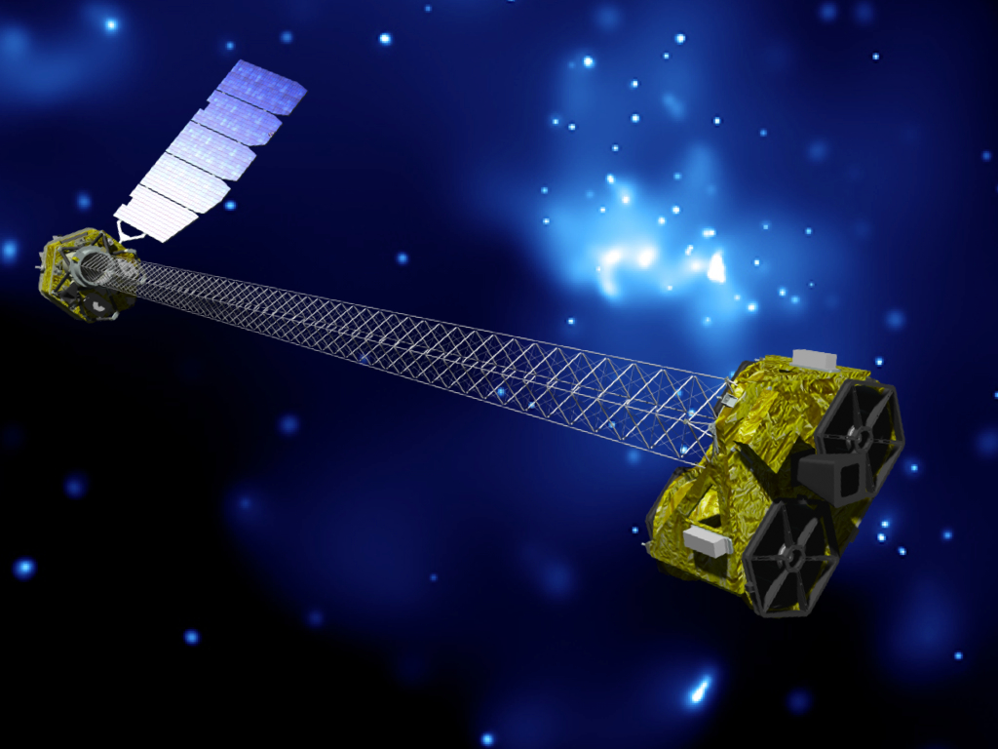
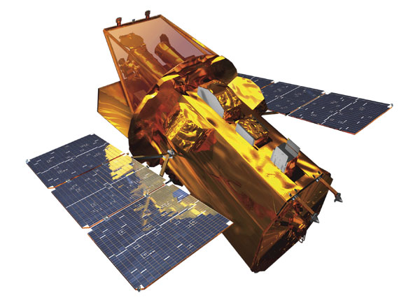
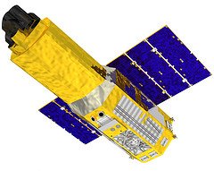
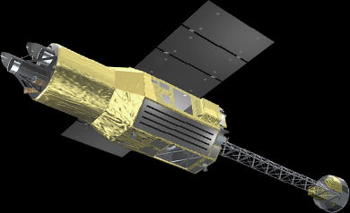
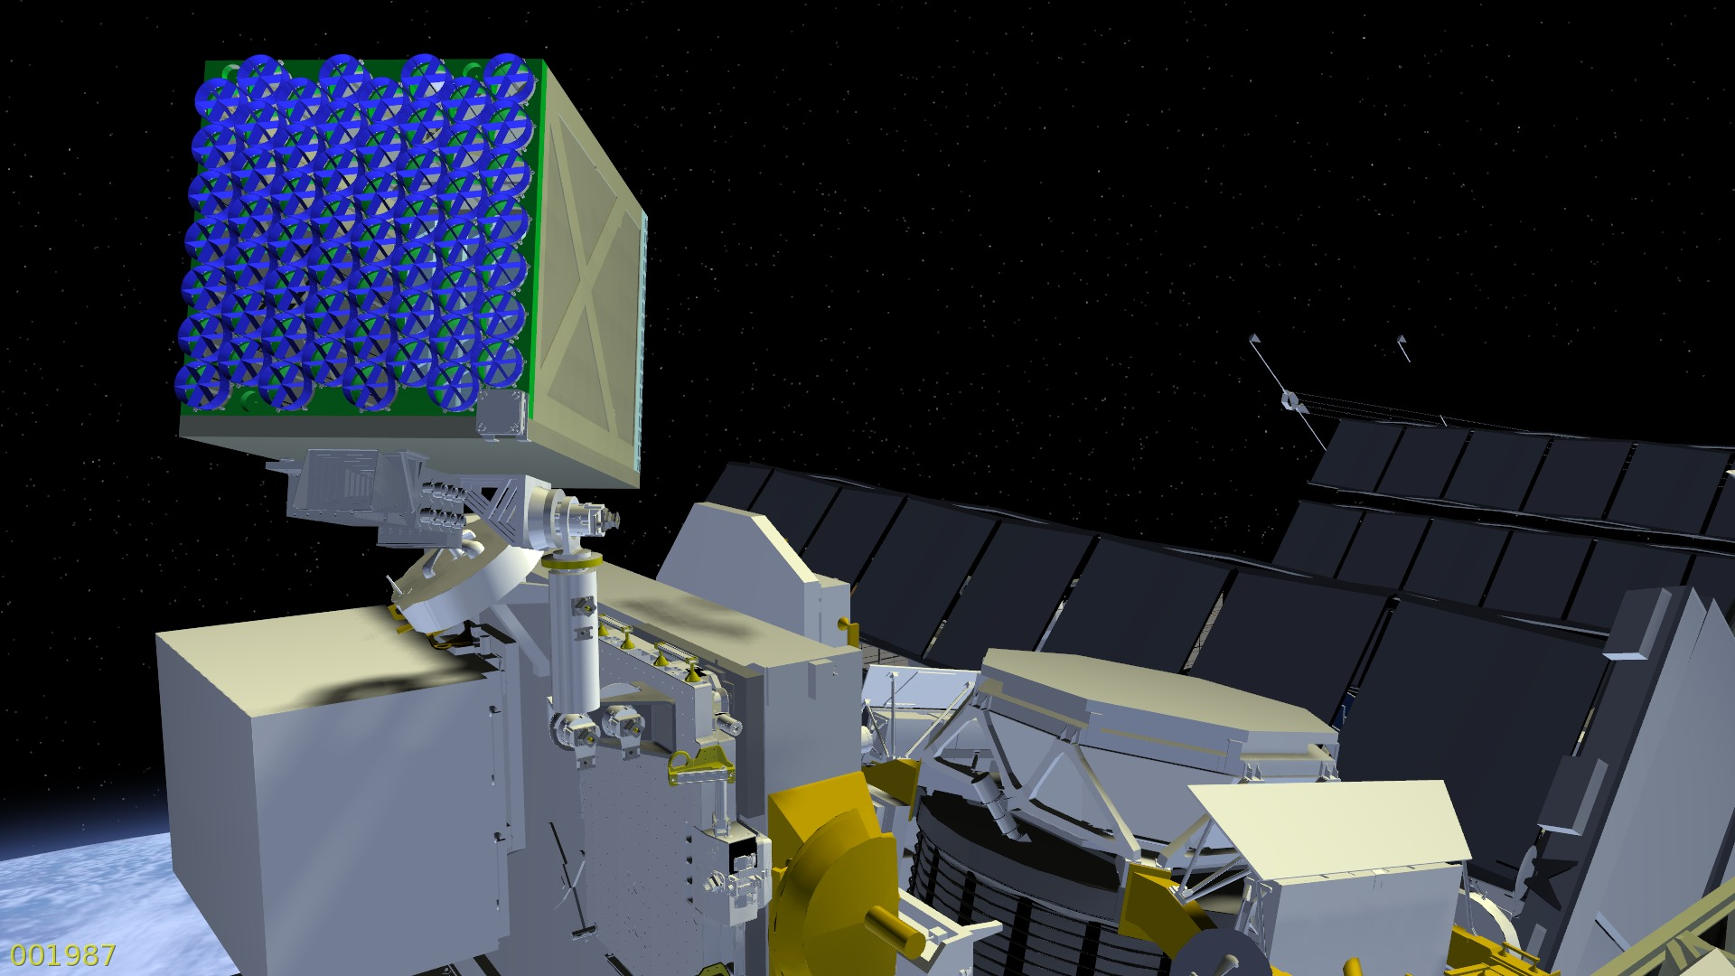
2010s
Illustration Credits: NASA, ESA, JAXA

Slide 15
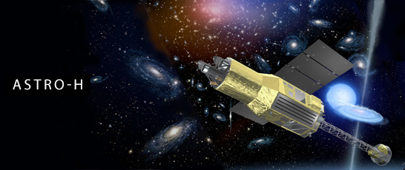
Realizing AXAF-S
 | AXAF-S | ASTRO-H
Energy Resolution | 12 eV | 7 eV
Field of View | 3x3 mm (2.3x2.3 arcmin) | 5x5 mm (3x3 arcmin)
Band pass | 0.3-10 keV | 0.3-12 keV
Effective area | ~ 200 cm² (6 keV) | 210 cm² (6 keV)
Illustration Credit: JAXA

Slide 16
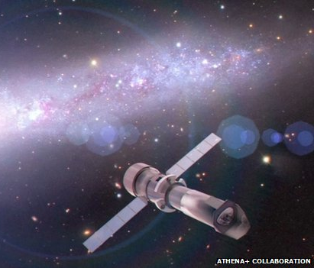
Future
?
Prioritized by 2020 Decadal Survey
Athena (2028)
Illustration Credit: Athena Collaboration

Slide 17
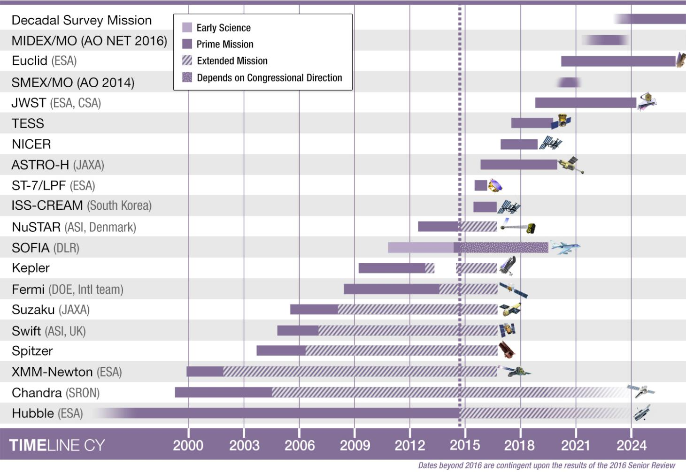
Astrophysics Timeline

Slide 18
Preparing for the 2020 Decadal Survey
Step 1: Identify (large or strategic) mission concepts to study ~2015
  Use Astrophysics PAGs to identify small number of mission concepts to study
Step 2: Initiate studies ~2016
  Community call for Science and Technology Definition Teams (STDTs)
  NASA Center assigned to provide design and engineering support
Step 3: Conduct studies ~2016-2019
Step 4: Identify technology requirements to motivate early technology development ~2017
  NASA will fund some technology through APRA and SAT opportunities
Step 5: Deliver results to 2020 Decadal Survey committee ~2019
  Science case, design reference mission, technology assessment, cost assessment

Slide 19
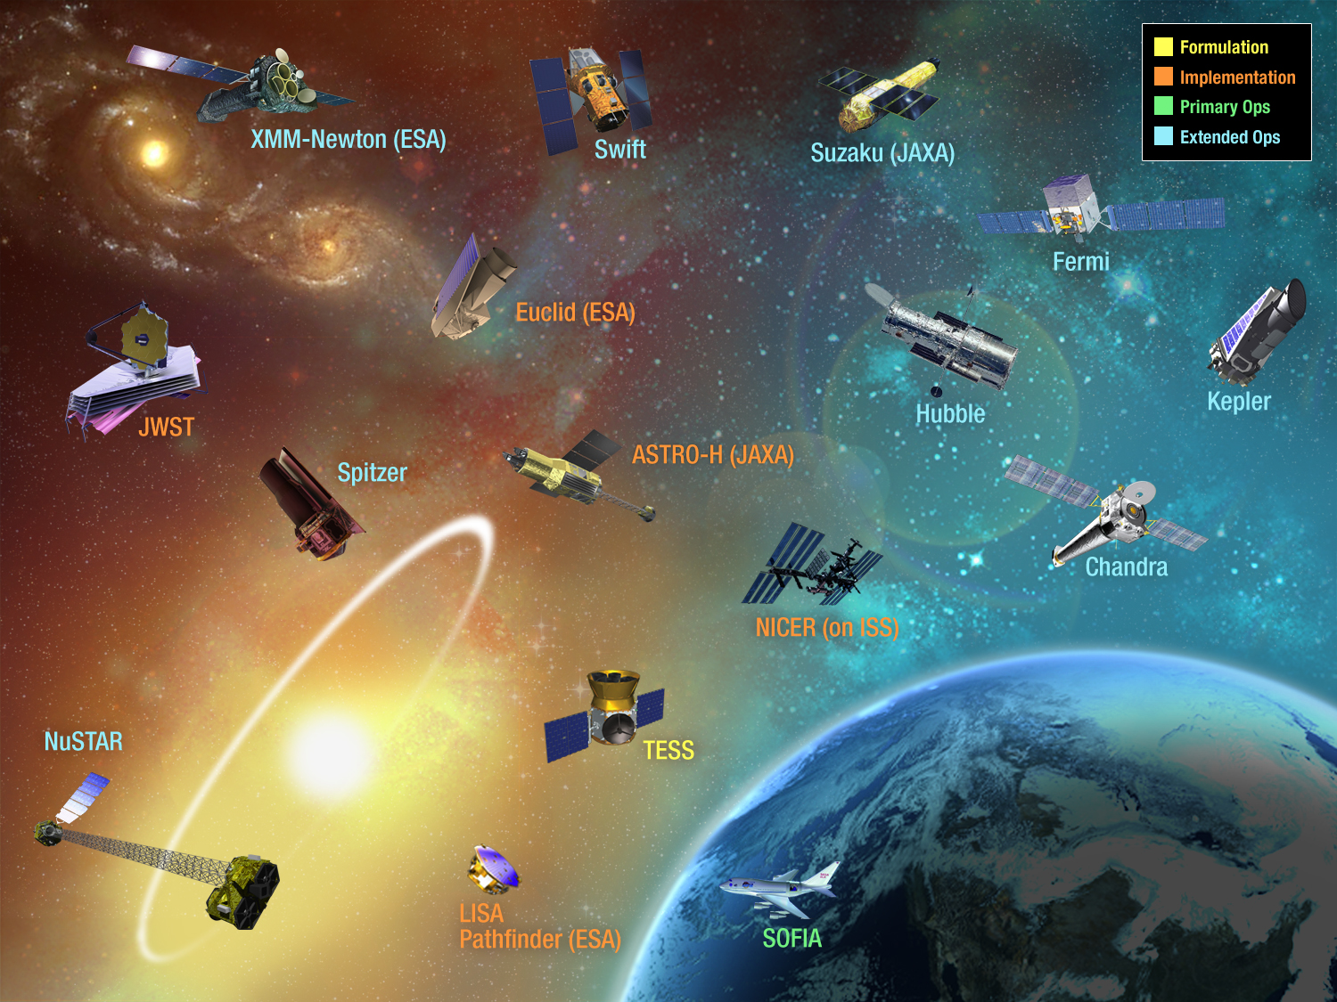
NASA
Astrophysics
2014
19

