Slide 1

X-ray Studies of “Recycled” Pulsars
Slavko Bogdanov

Slide 2
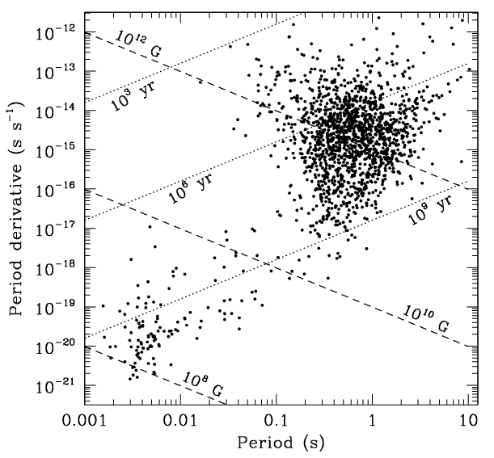
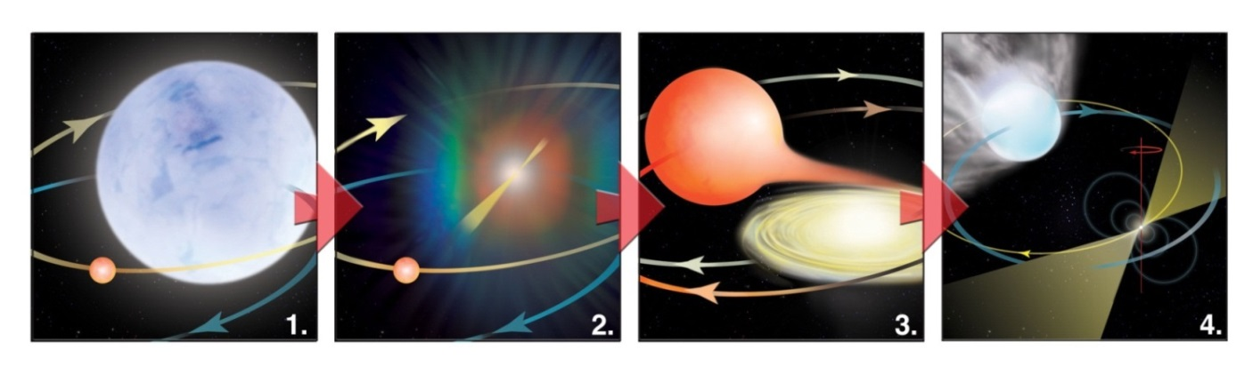
Rotation-powered (“recycled”) millisecond pulsars
Discovered at radio frequencies - PSR B1937+21 with Arecibo (Backer et al. 1982)
Spin-up (“recycled”) by accretion in a compact binary
Abundant in globular clusters
Most are in binaries with WD or very low-mass (~0.03 M) companions
In X-rays, first detected by ROSAT
- PSR J0437-4715 (Becker & Trümper 1993)
Very faint X-ray sources (typical: L_{X} ≈10^{29–31} erg s^{–1})

Slide 3
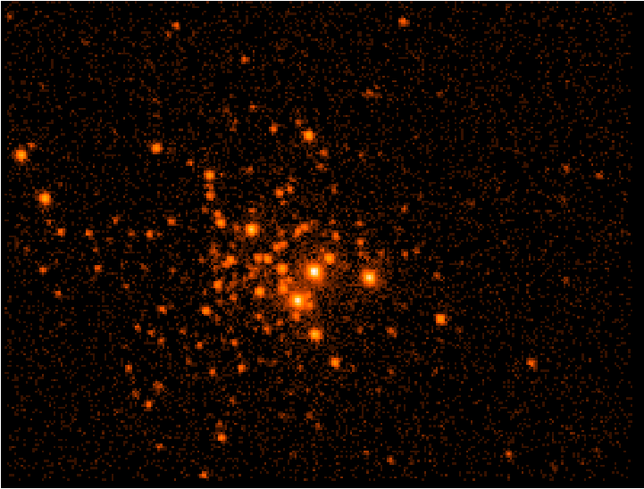
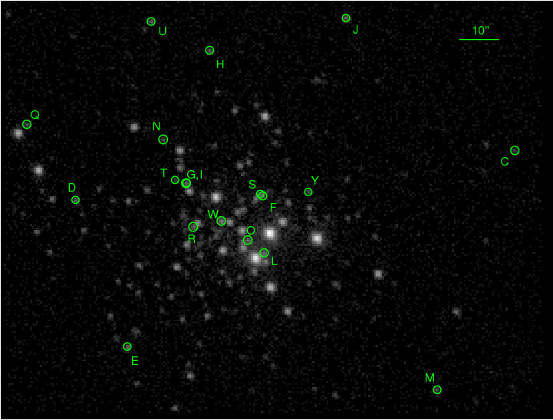
47 Tuc
Chandra ACIS-S
0.3−6 keV
281 ks
Heinke et al. ApJ, 625, 796 (2005)
Bogdanov et al. ApJ, 646, 1104 (2006)

Slide 4
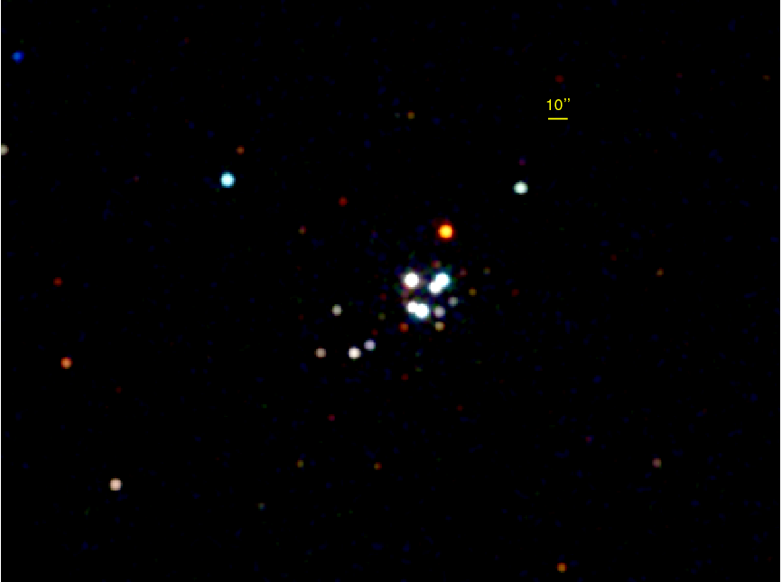
NGC 6397
D ≈ 2.5 kpc
N_{H} ≈ 1 × 10²¹ cm⁻²
PSR J1740–5340
Chandra ACIS-S
0.3−2 keV
290 ks
Bogdanov et al. ApJ, 709, 241 (2010)

Slide 5
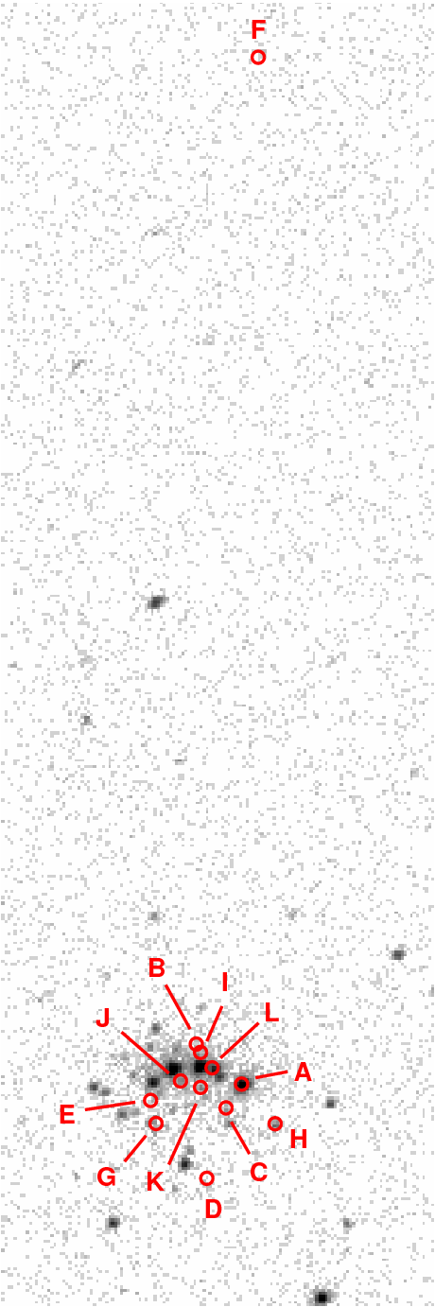
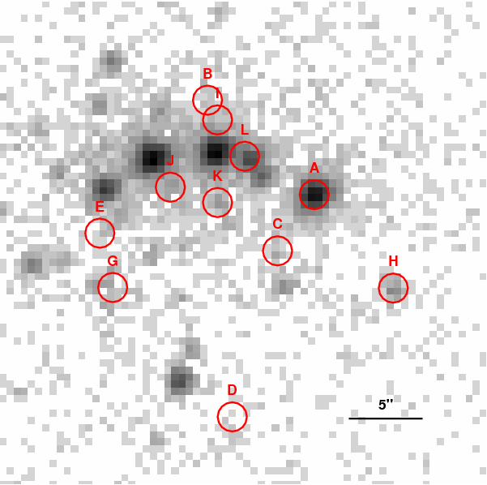
M28
(NGC 6626)
ACIS–S
0.3–6 keV
237 ks
Bogdanov et al. ApJ, 730, 81 (2011)

Slide 6
NGC 6752
D ≈ 4 kpc
N_{H} ≈ 3 × 10²⁰ cm⁻²
B
E
D
Chandra ACIS-S
0.5−6 keV
66 ks
Forestell et al. MNRAS, 441, 757 (2014)

Slide 7
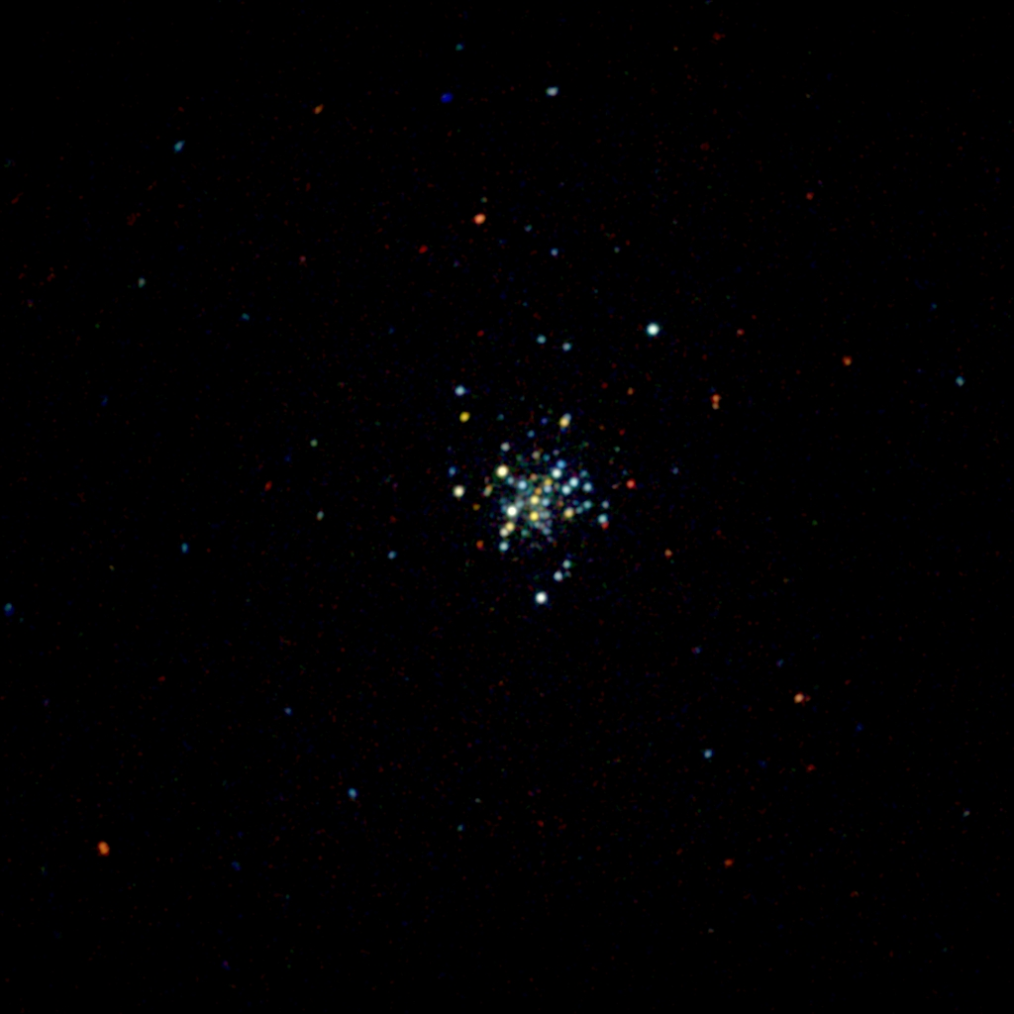
Terzan 5
ACIS–S
0.5–6 keV
620 ks
Courtesy of A. Bahramian

Slide 8
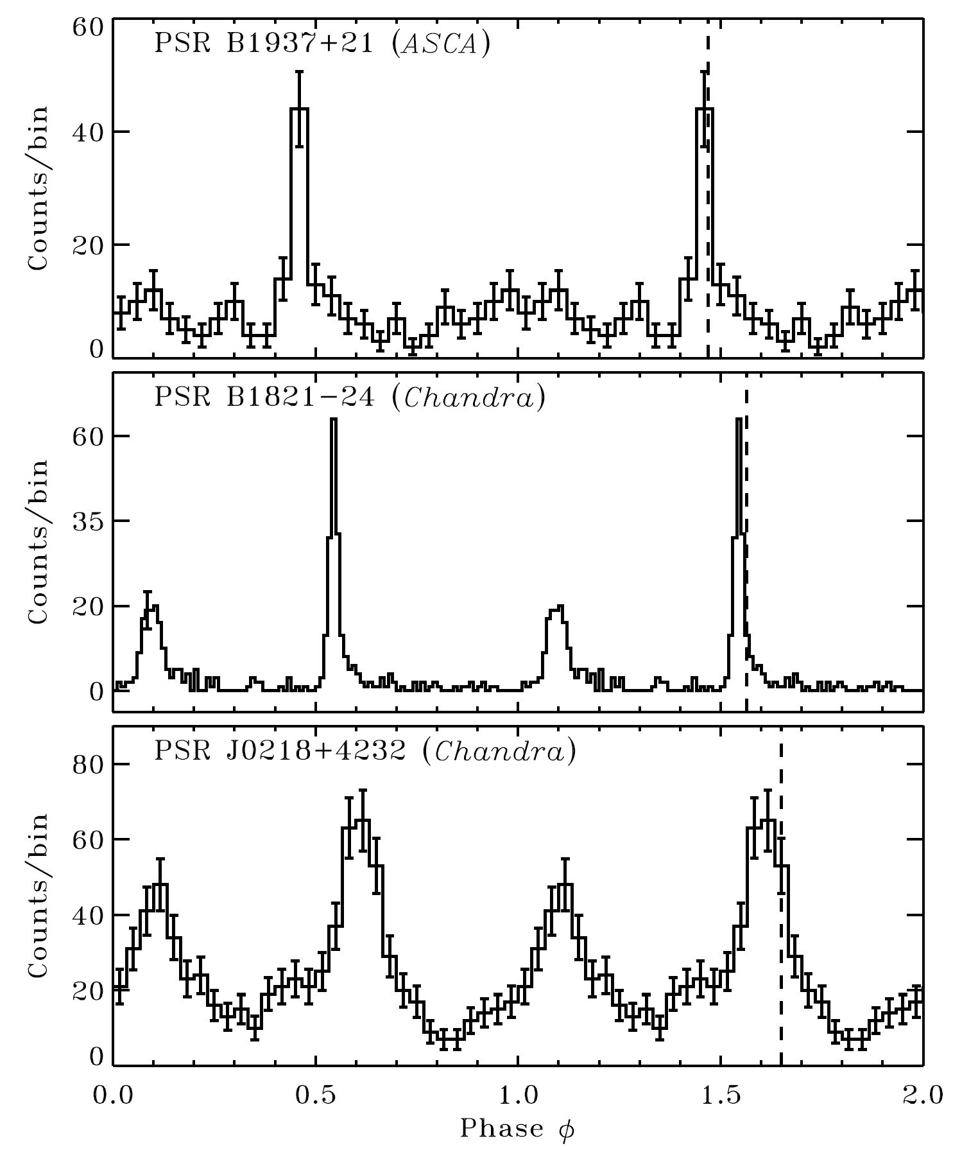
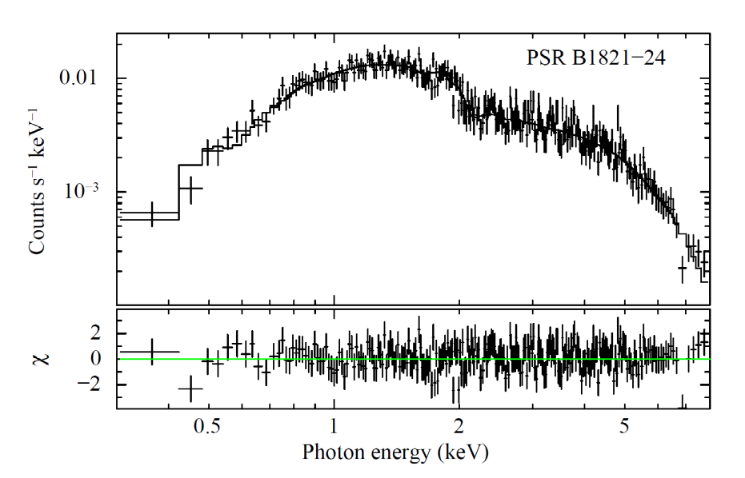
I - Energetic MSPs
Ė ≥ 10³⁶ erg s⁻¹ L_{X} ≈ 10³³ erg s⁻¹
Hard (Γ~1.2), non-thermal radiation
Narrow pulses
⇒ particle acceleration in magnetosphere
Bogdanov et al. ApJ, 730, 81 (2011)
Zavlin AP&SS, 308, 297 (2007)

Slide 9
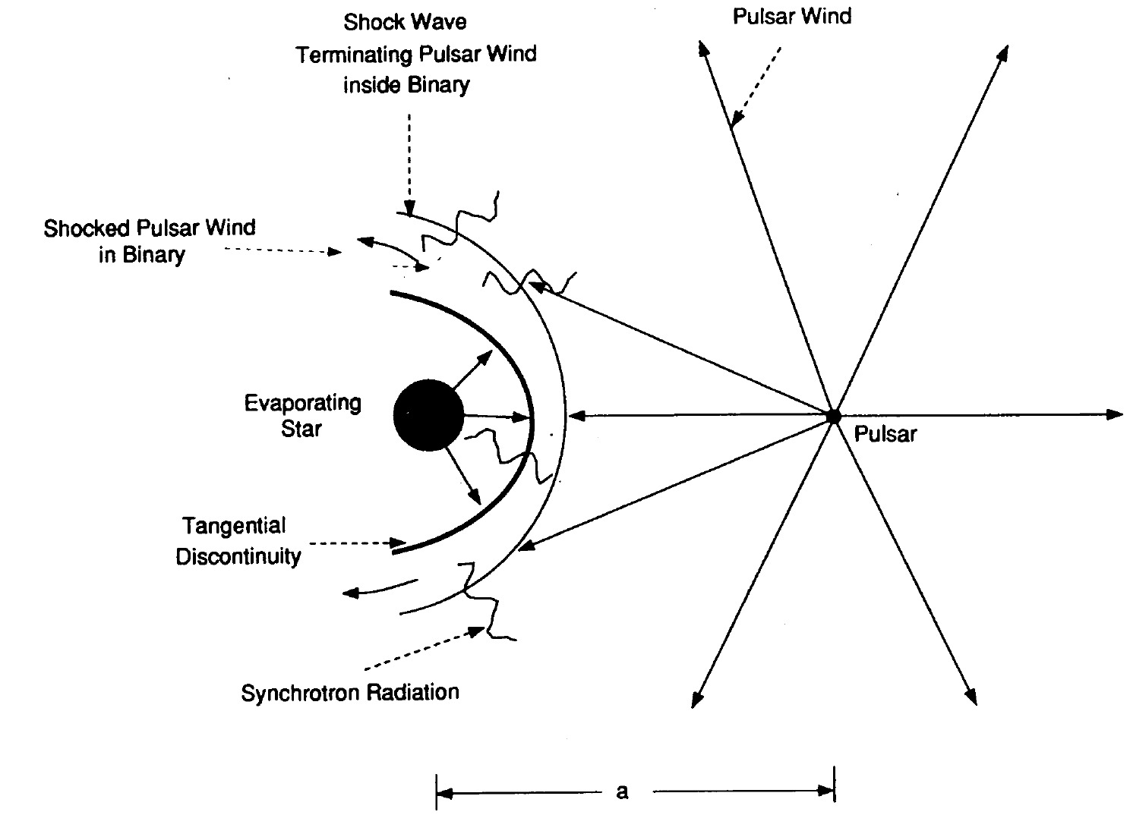
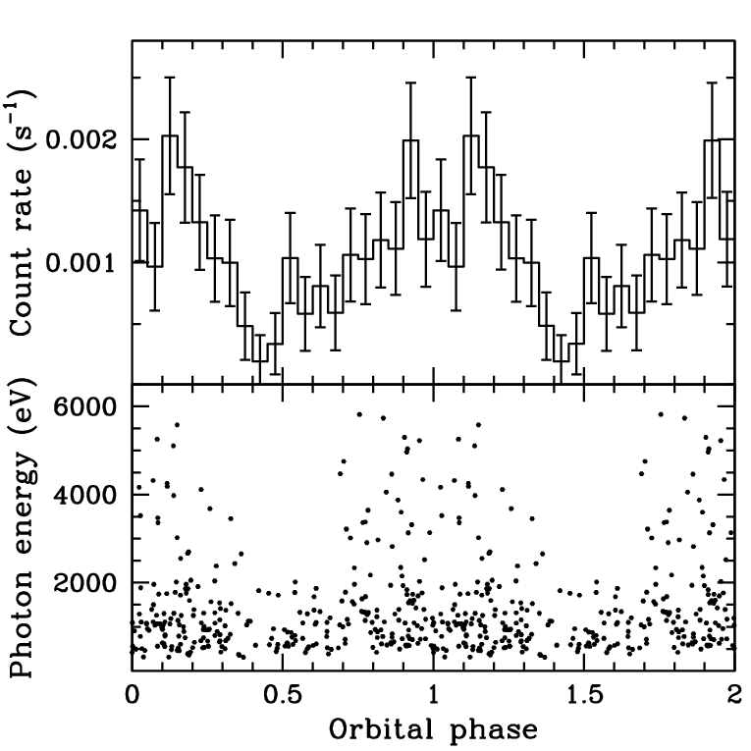
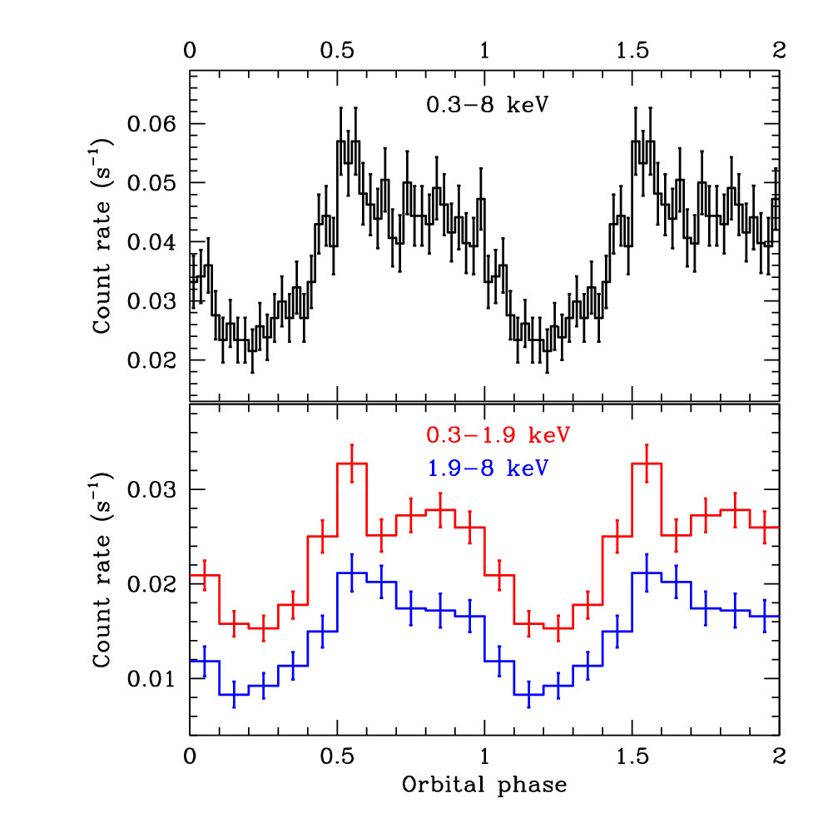
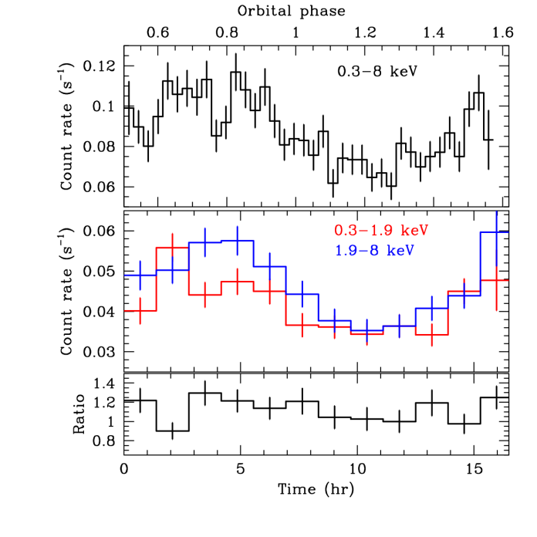
II - Eclipsing Binary MSPs
“Redbacks” – MSP binaries with non-degenerate ≥0.2 M secondary stars
L_{X} ≈ 10³¹⁻³² erg s⁻¹
Hard, non-thermal emission with orbital variability ⇒ intra-binary shock due to interaction of pulsar wind with companion
Emission can serve as diagnostic of pulsar wind and shock physics
Arons & Tavani, ApJ, 403, 249 (1993)
PSR J0024–7204W (47 Tuc)
PSR J1023+0038
PSR J1723−2837
Bogdanov et al. ApJ, 630, 88 (2005)
Bogdanov et al. ApJ, 762, 96 (2011)
Bogdanov et al. ApJ, 781, 6 (2014)

Slide 10
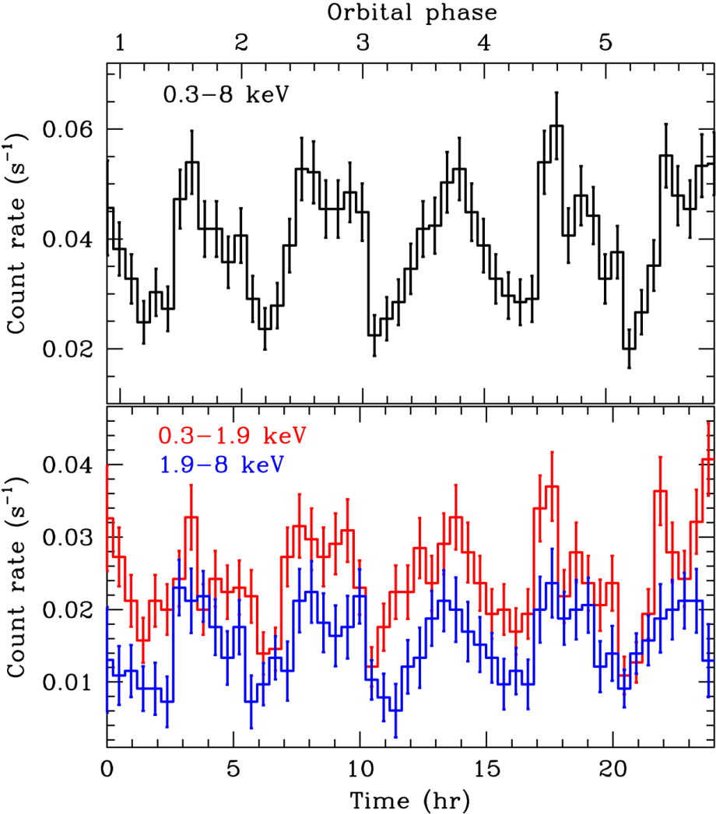
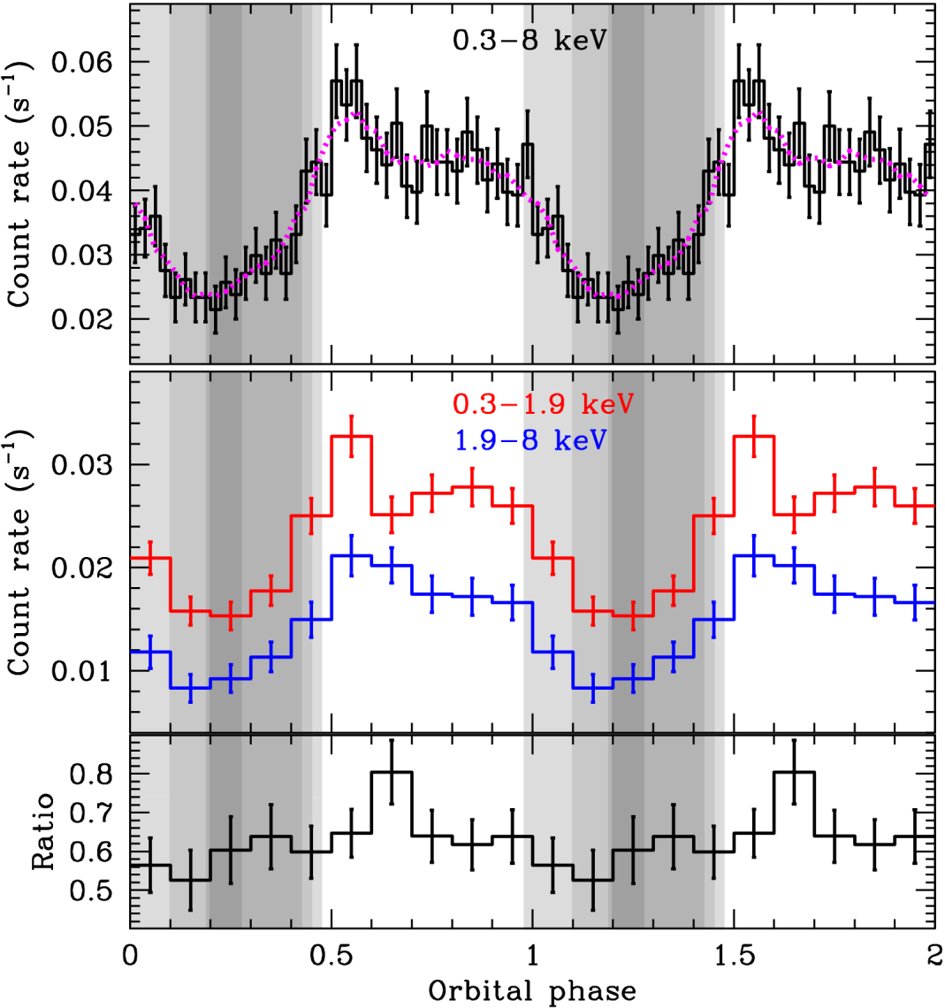
PSR J1023+0038 – the “missing link”
Binary MSP (P_{b}=4.28 h) with bloated ~0.2 Mcompanion (Archibald et al. 2009)
D = 1.37 kpc (VLBI parallax; Deller et al. 2012)
L_{X} = 9 × 10³¹⁻³² erg s⁻¹
Chandra ACIS-S
Bogdanov et al. ApJ, 762, 96 (2011)

Slide 11
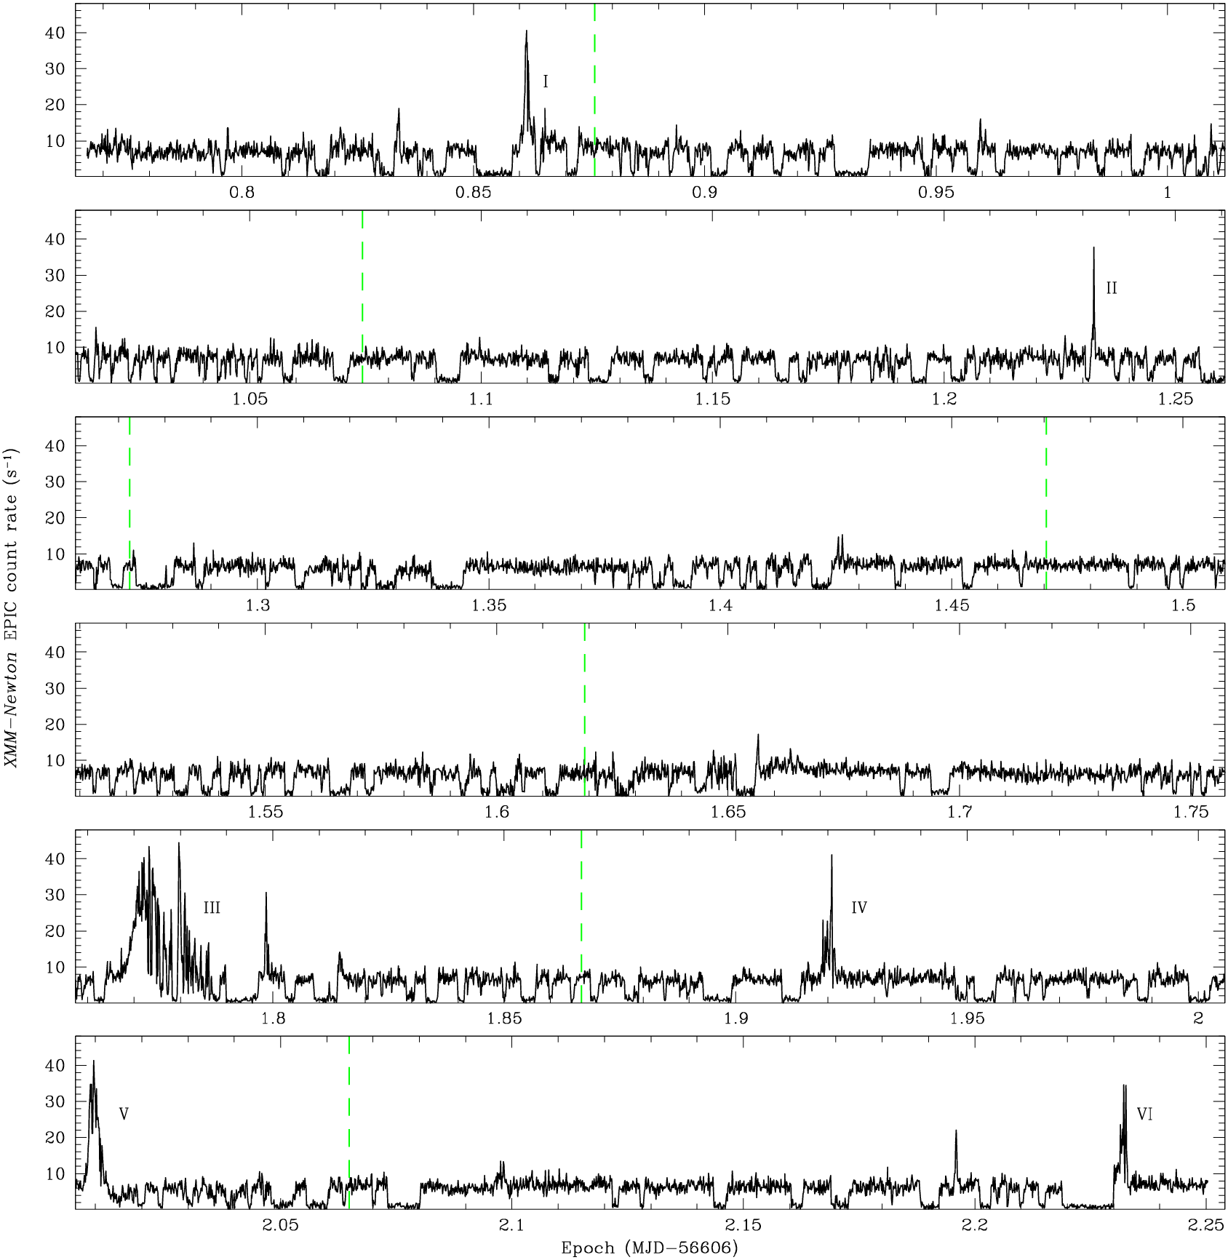
XMM-Newton EPIC
PN+MOS1+MOS2
2013 Nov 10
134 ks
L_{X} ≈ 10³³ erg s⁻¹
0.3-10 keV
Bogdanov et al in prep.

Slide 12
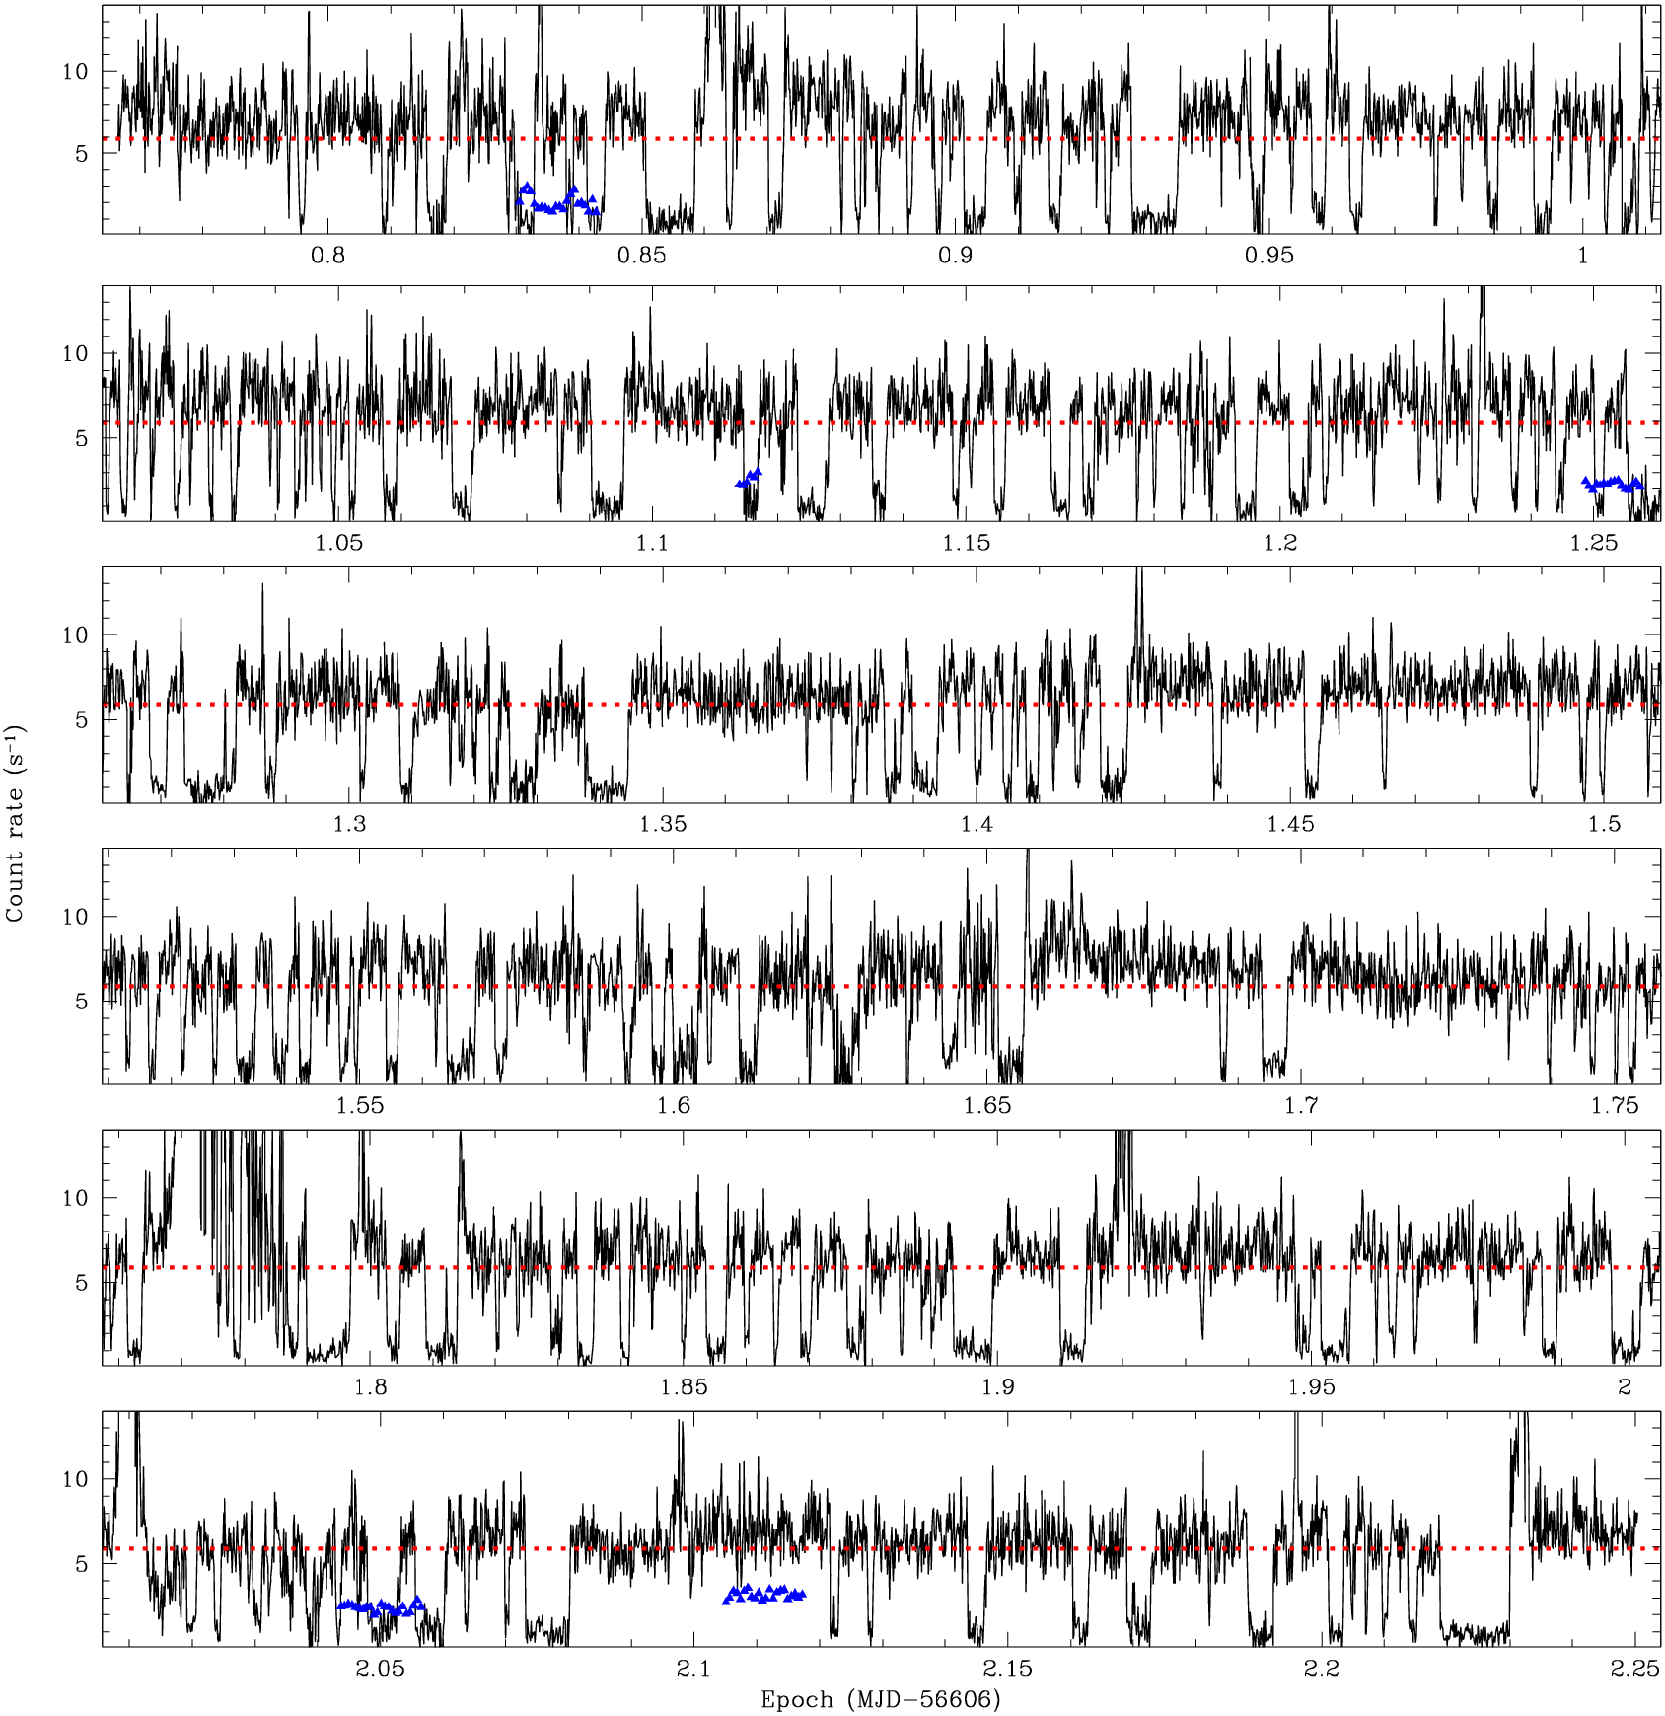
XMM-Newton EPIC
2013 Nov 10
134 ks
L_{X} ≈ 10³³ erg s⁻¹
0.3-10 keV
Bogdanov et al in prep

Slide 13
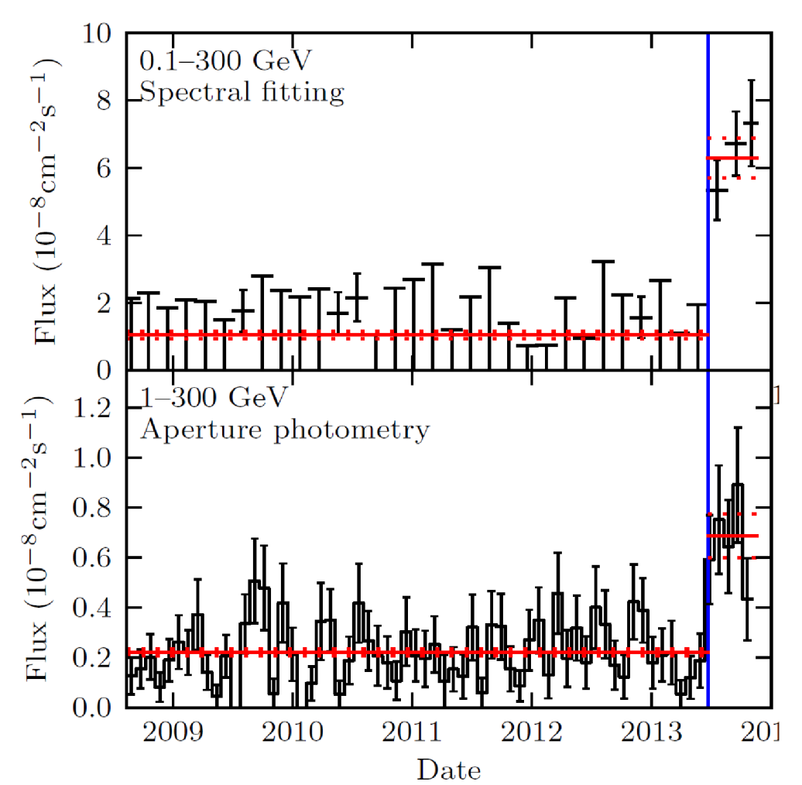
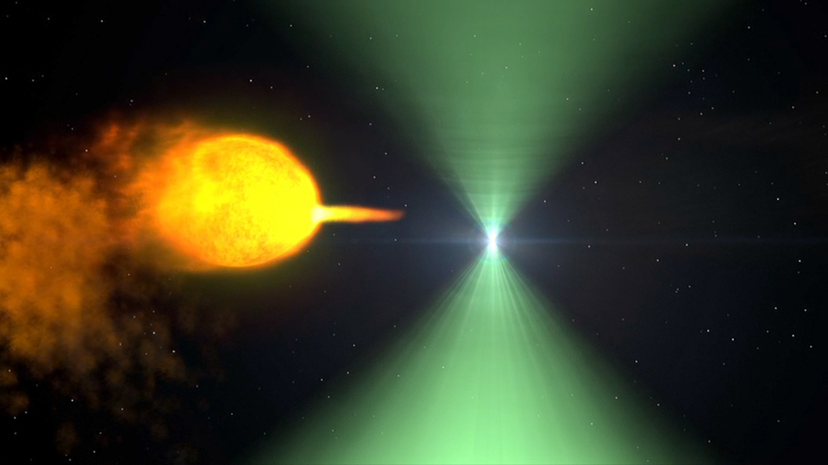
The “Missing Link” PSR J1023+0038: The Accretion Disk Returns
At the end of June 2013, radio emission ceased and has been absent since
Optical, X-ray, and γ-ray brightness increased dramatically
Fermi LAT
Credit NASA GSFC
Stappers et al. 2014, ApJ, 790, 39

Slide 14
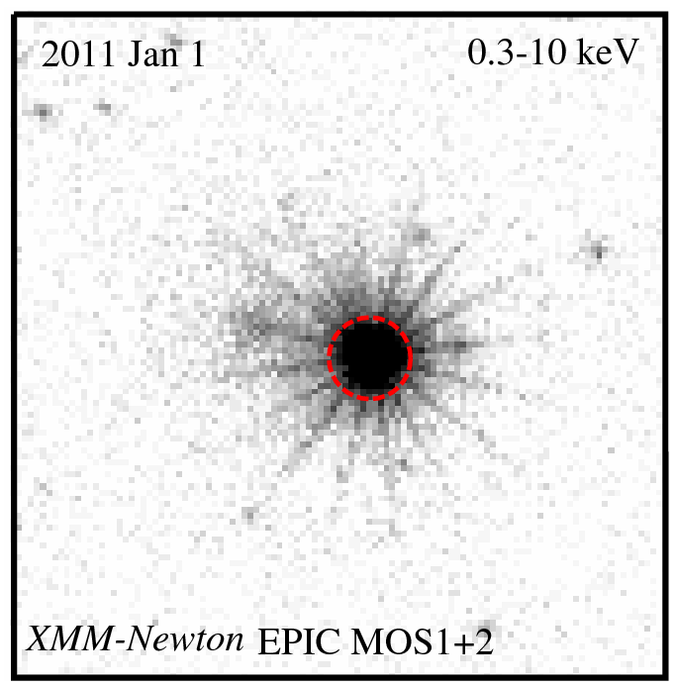
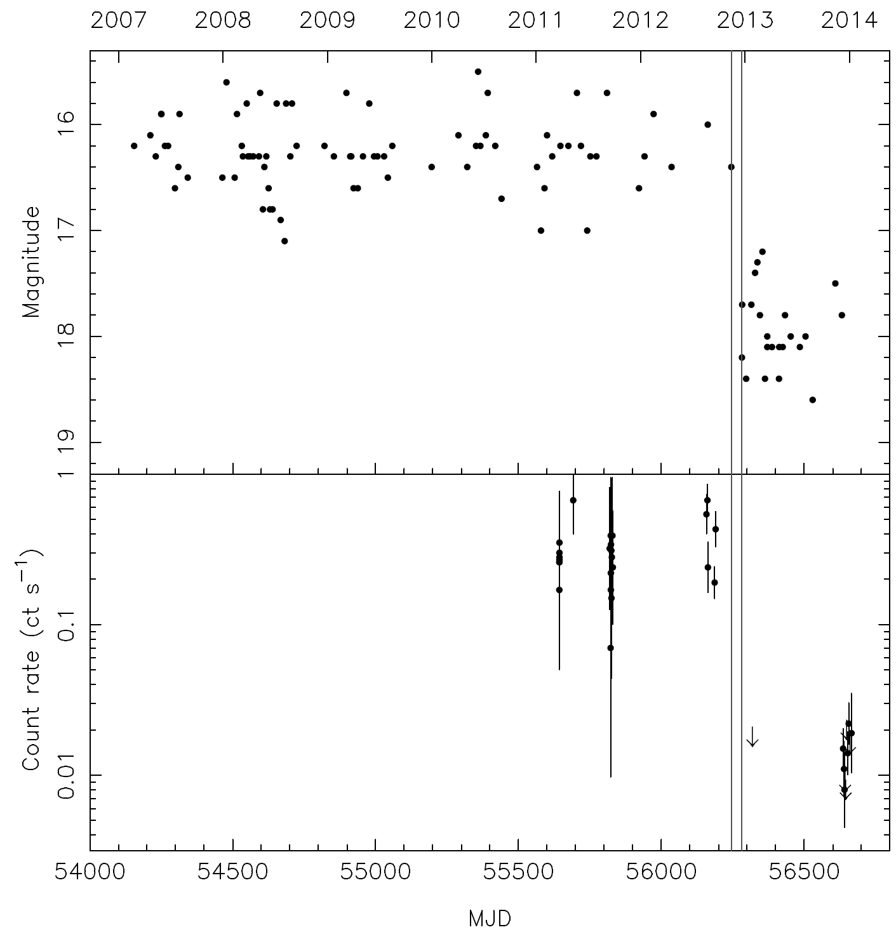
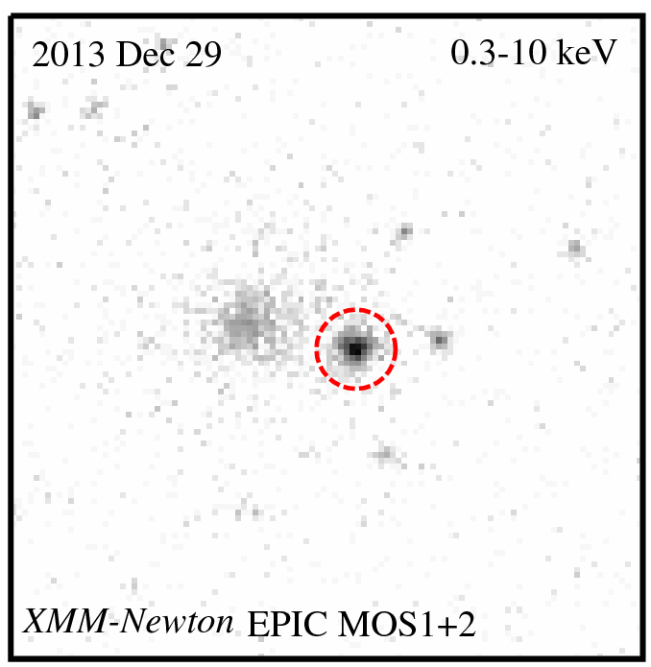
XSS J12270−4859: Another Transforming Pulsar Binary
Swift XRT
Bassa et al. 2014, MNRAS, 441, 1825
Bogdanov et al. 2014, ApJ, 789, 40

Slide 15
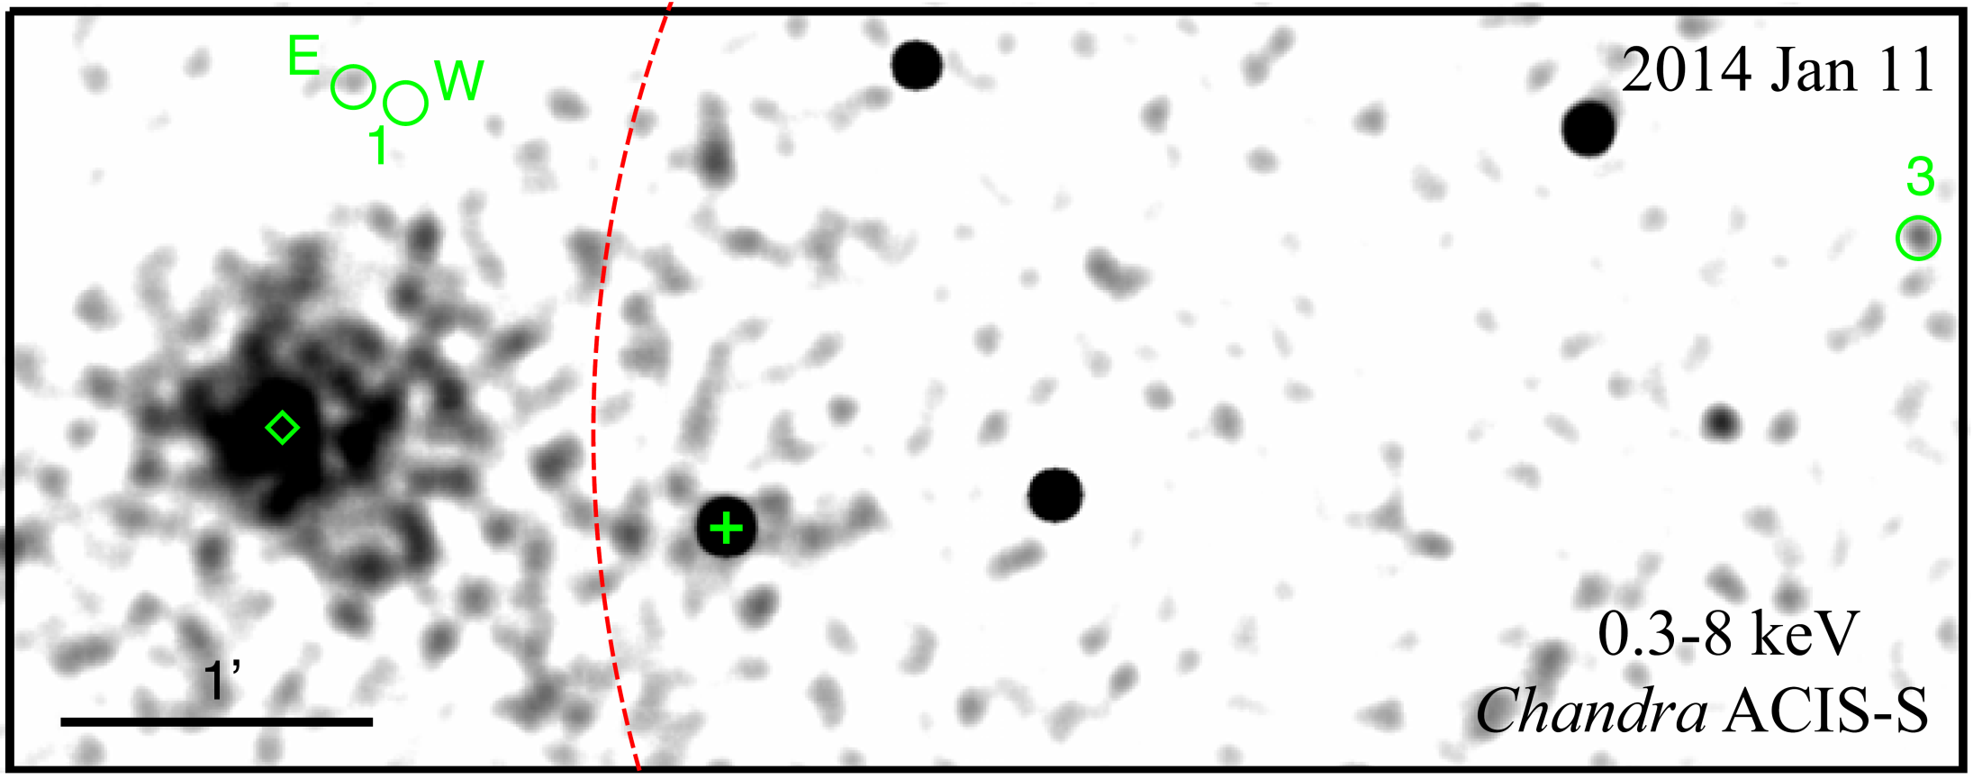
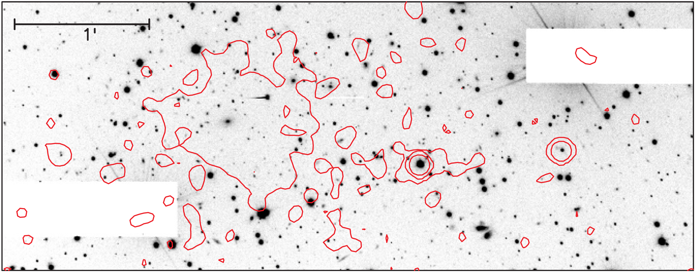
XSS J12270-4859
VLT FORS2
XSS J12270-4859
Bogdanov et al. 2014, ApJ, 789, 40

Slide 16
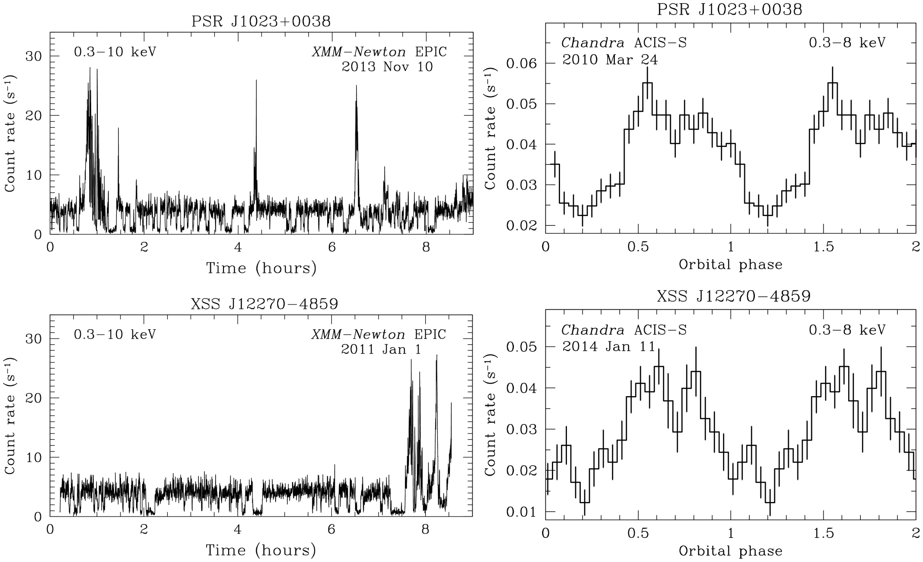
‘Transforming’ MSP Binaries
Bassa et al. MNRAS, 441, 1825 (2014)
Bogdanov et al. ApJ, 789, 40 (2014)

Slide 17
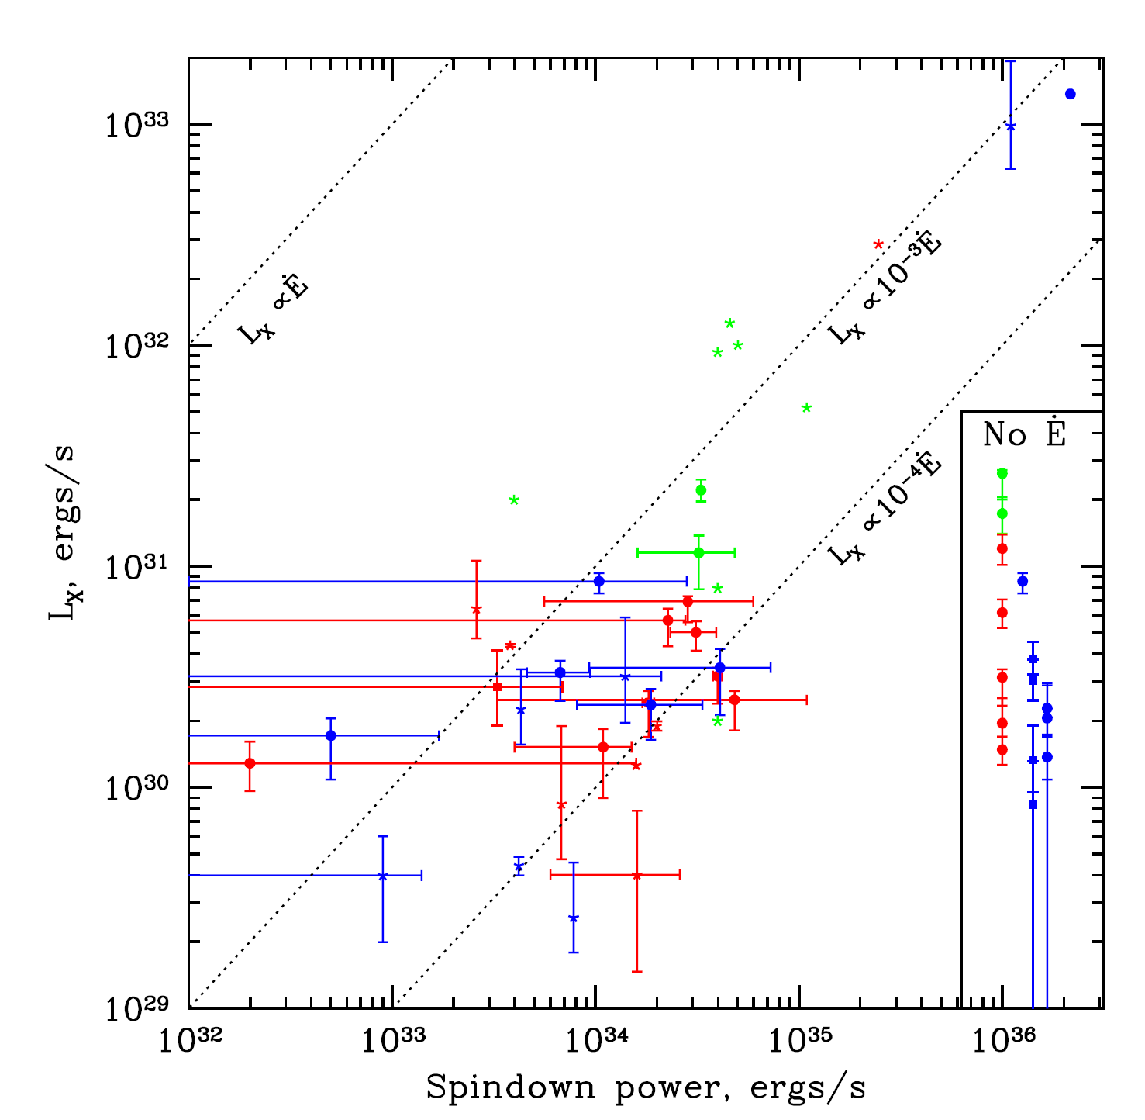
III Typical MSPs
Forestell et al. MNRAS, 441, 757 (2014)

Slide 18
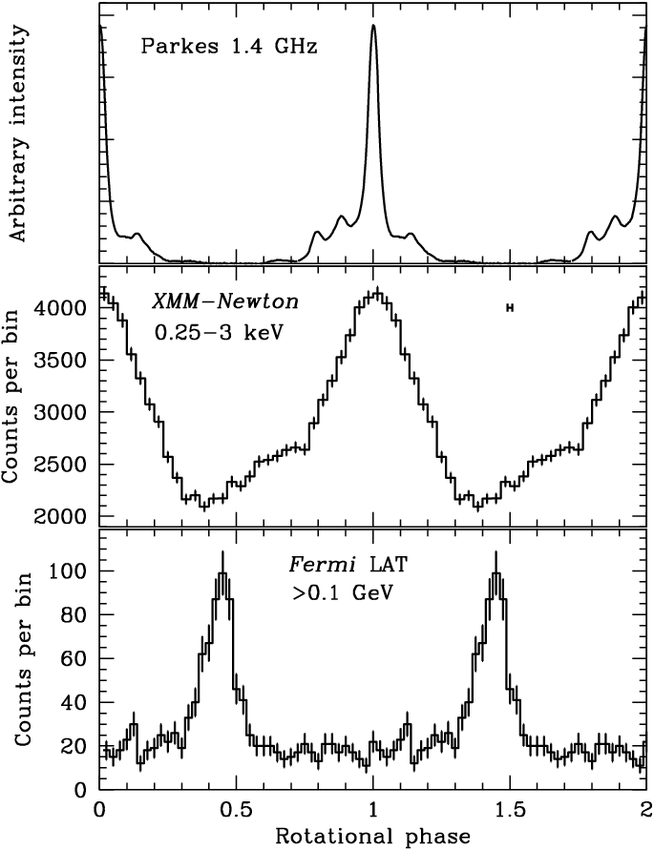
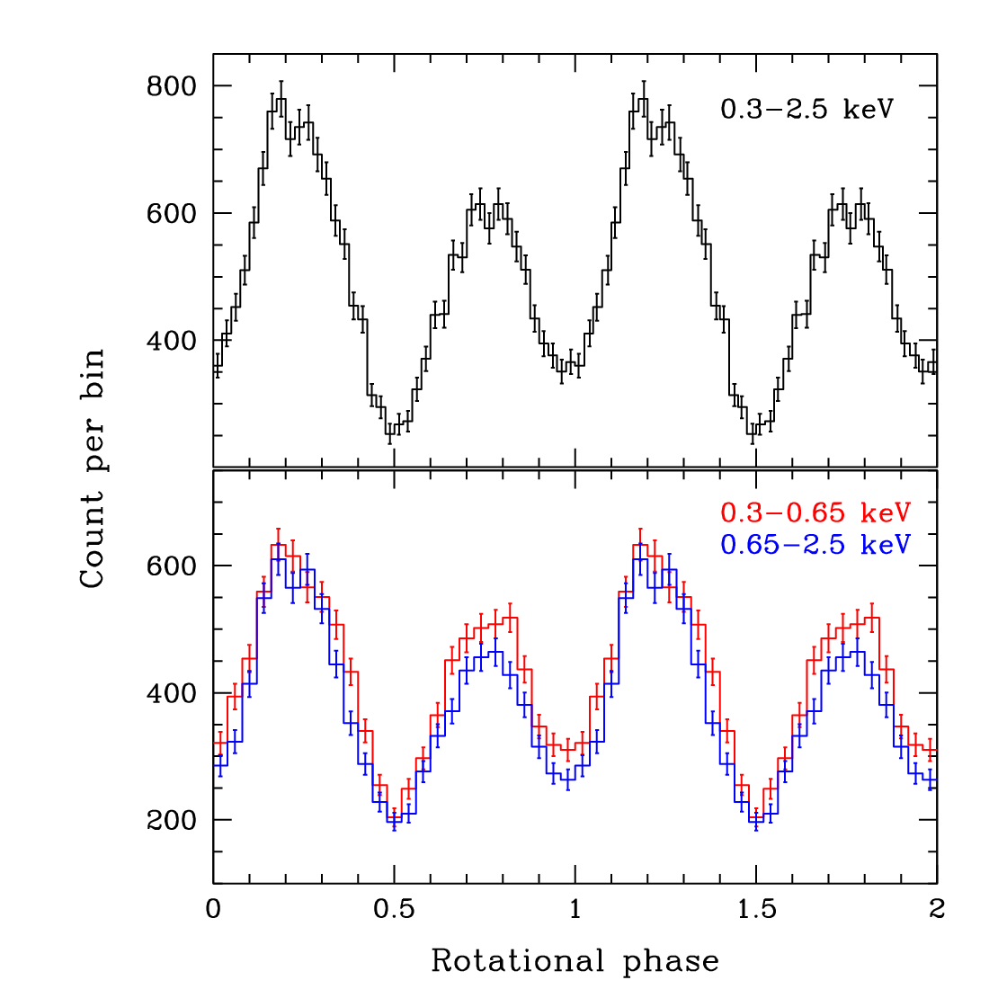
III Typical MSPs
PSR J0437−4715
Ė ≈ 10³³⁻³⁴ erg s⁻¹ L_{X} ≈ 10²⁹⁻³¹ erg s⁻¹
Soft, thermal X-rays from R_{eff} ≤ 2 km
Broad pulses ⇒ surface hot spot emission
PSR J0030+0451
XMM–Newton
130 ks
130 ks
Bogdanov & Grindlay ApJ, 703, 1557 (2009)
Bogdanov ApJ, 762, 96 (2013)

Slide 19
■ Thermal X-ray emission due to polar cap heating by a return current of relativistic particles (e⁻/e⁺) from pulsar magnetosphere
e±
X-rays
e±
X-rays
■ Surface radiation can serve as a valuable probe of neutron star properties (compactness, B-field geometry, surface composition,…)

Slide 20
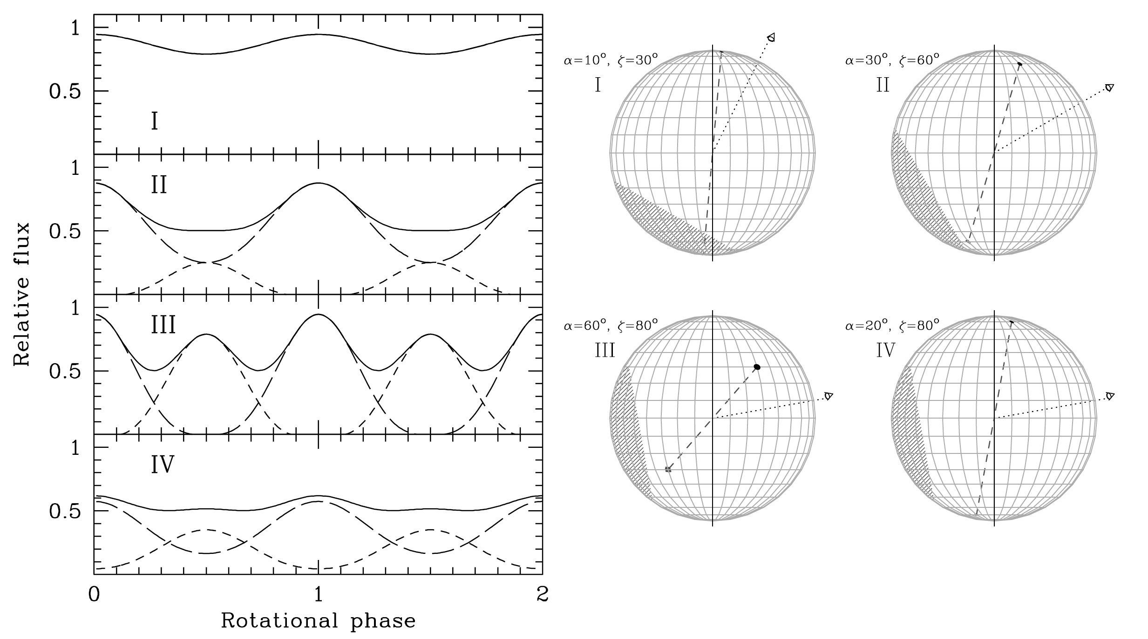
Model MSP X-ray pulse profiles
- R = 10 km, M = 1.4 M
- T_{eff} = 2 × 10⁶ K (H atmosphere)
- 2 antipodal, point-like polar caps
Bogdanov, Grindlay, & Rybicki, ApJ, 689, 407 (2008)

Slide 21
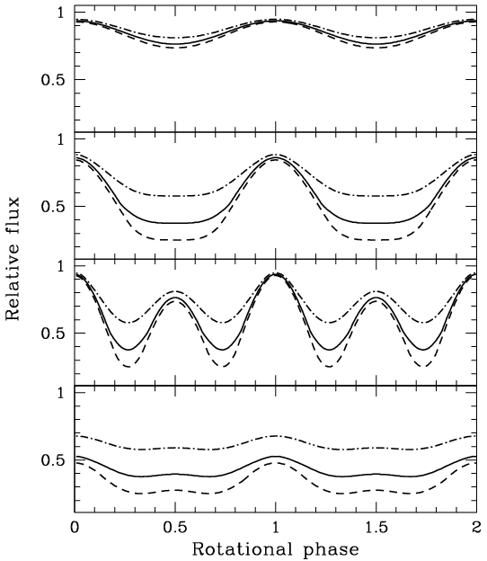
Model MSP X-ray pulse profiles
* Fits to X-ray pulse profiles of MSPs can be used to infer NS compactness
1 + z_{g} = (1 – 2GM/c²R)^{–1/2}
⇒ constrain NS EOS
α=10°, ζ=30°
α=30°, ζ=60°
α=60°, ζ=80°
}
9 km
12 km
16 km
for
M = 1.4 M
α=20°, ζ=80°
Bogdanov, Rybicki, & Grindlay, ApJ, 670, 668 (2007)

Slide 22
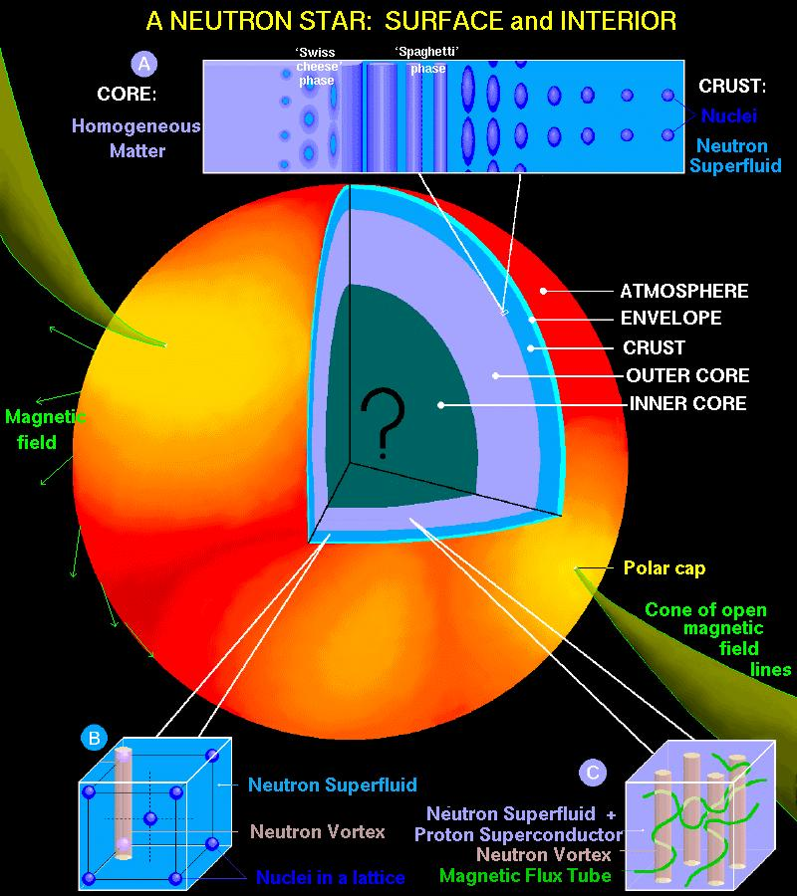
Credit: D. Page

Slide 23
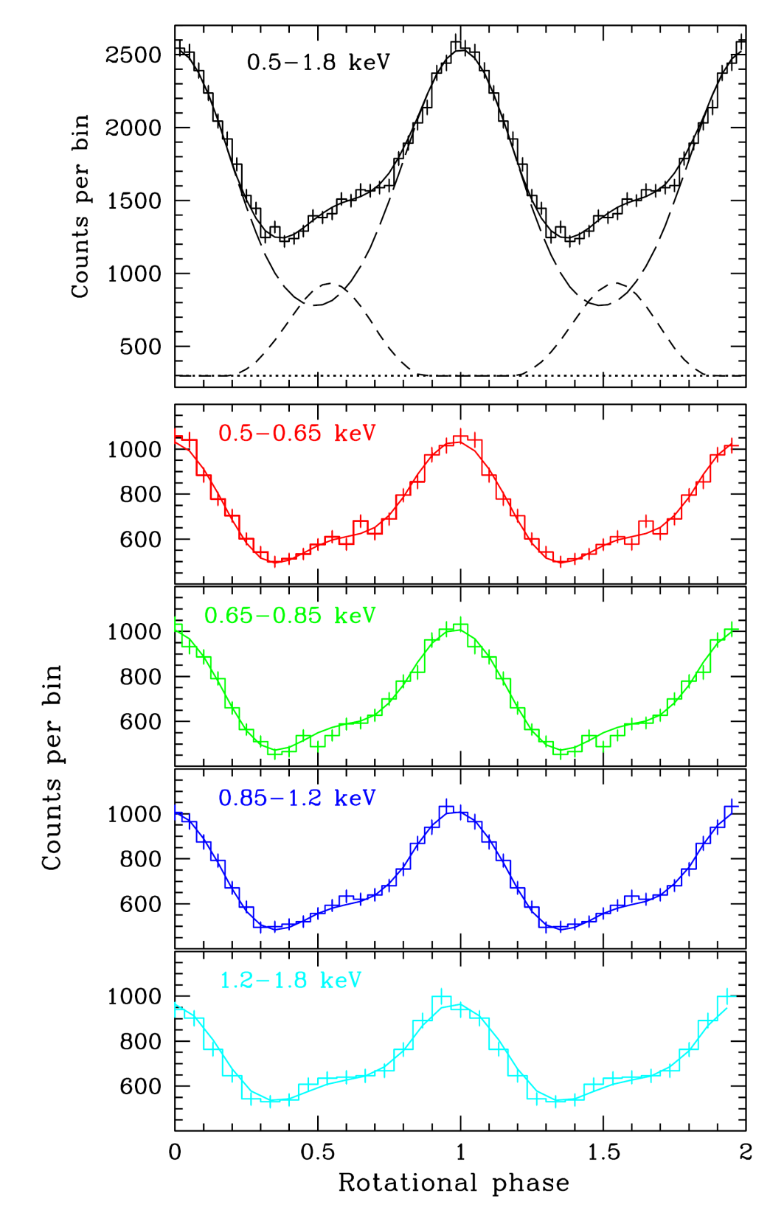
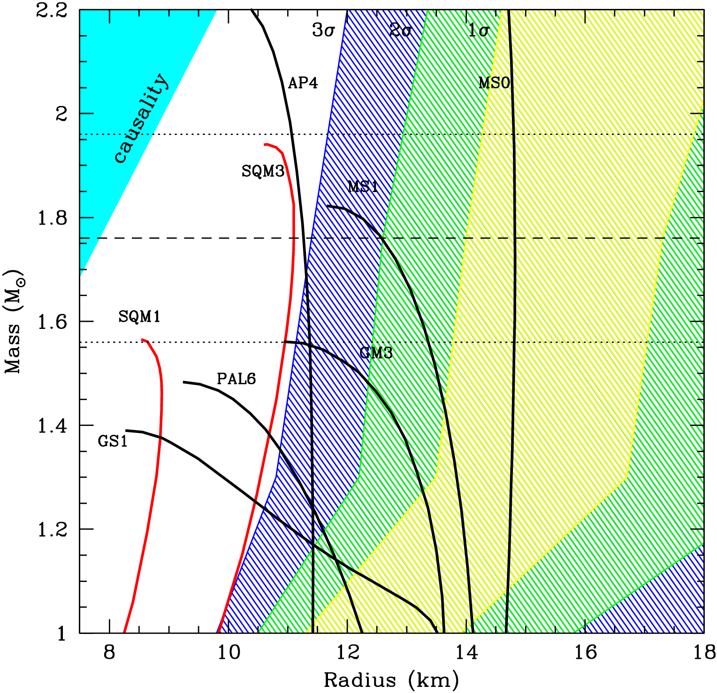
PSR J0437−4715
- Pulsations inconsistent with blackbody
- Anisotropic emission pattern required ⇒ atmosphere on surface
R > 11.1 km (3σ conf.) for M = 1.76 M
Bogdanov, ApJ, 762, 96 (2013)

Slide 24
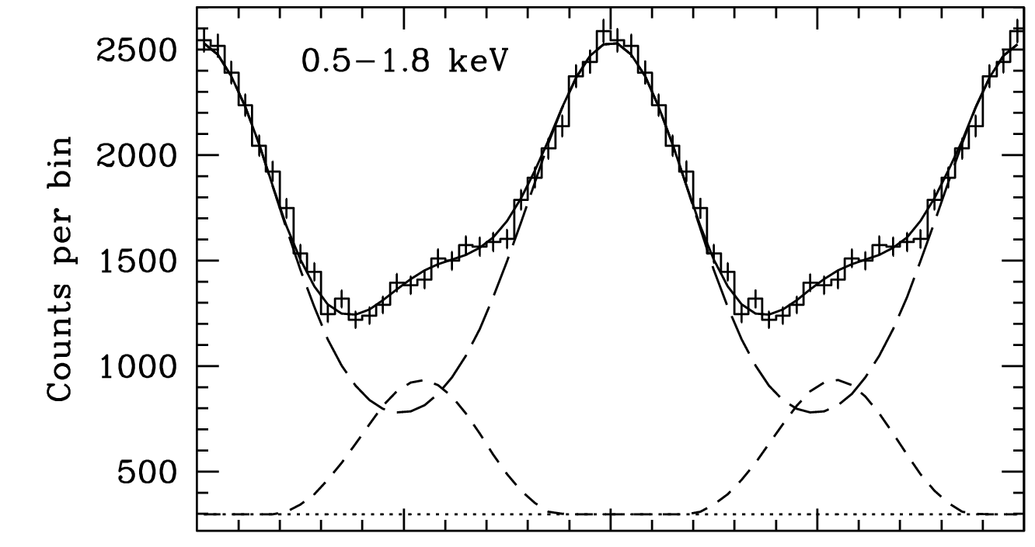
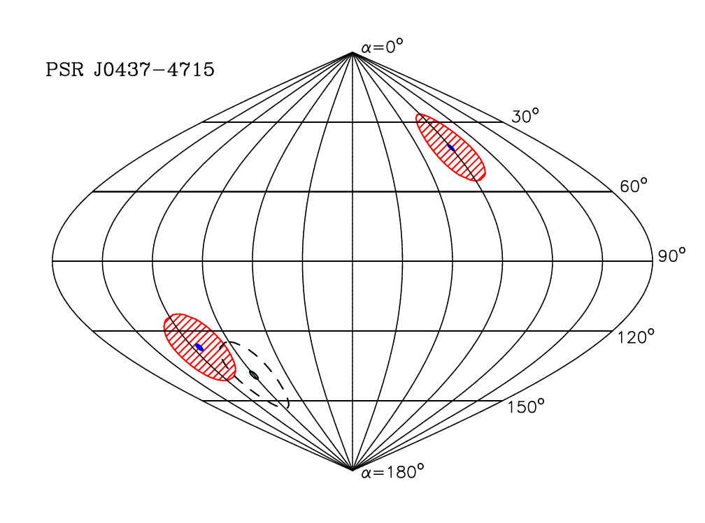
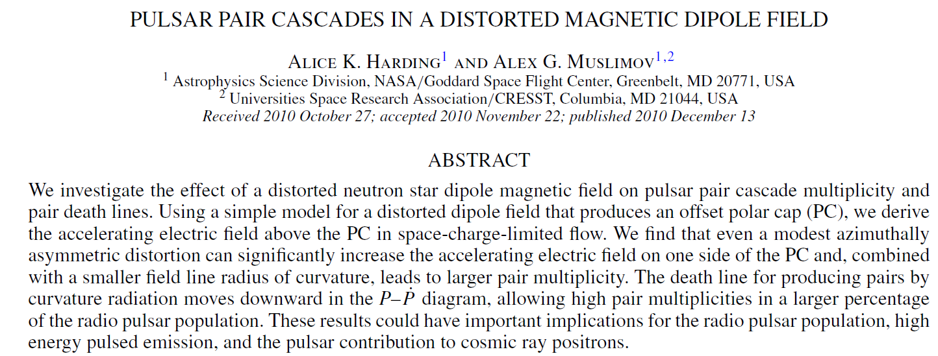
PSR J0437−4715
- Magnetic dipole not centered on star!
Bogdanov ApJ, 762, 96 (2013)

Slide 25
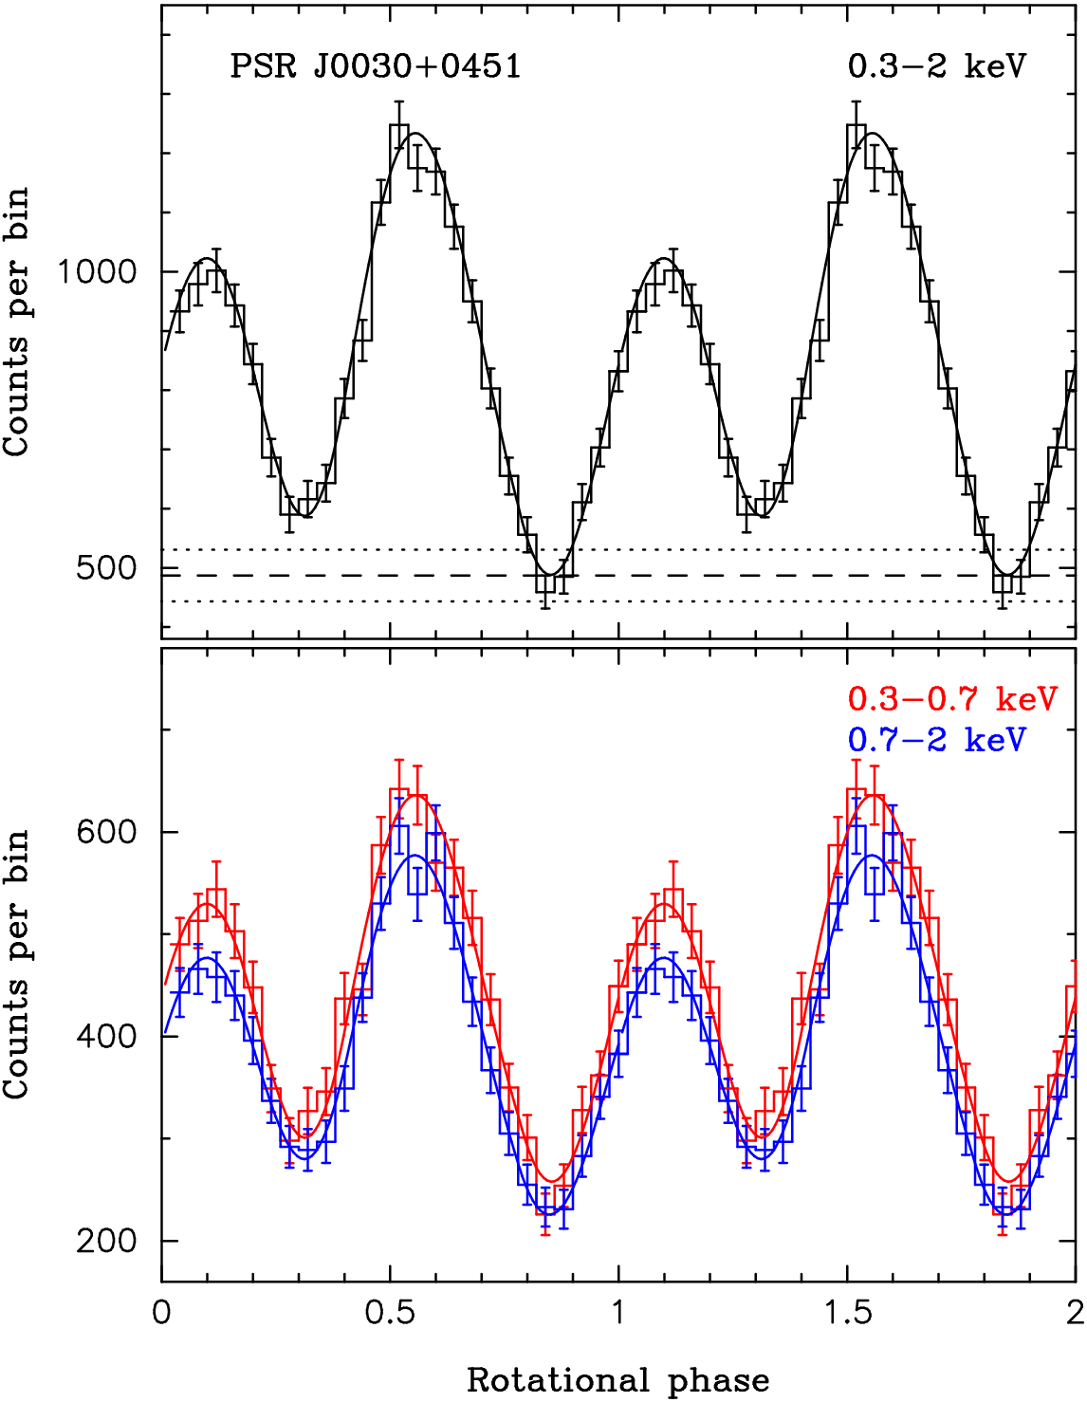
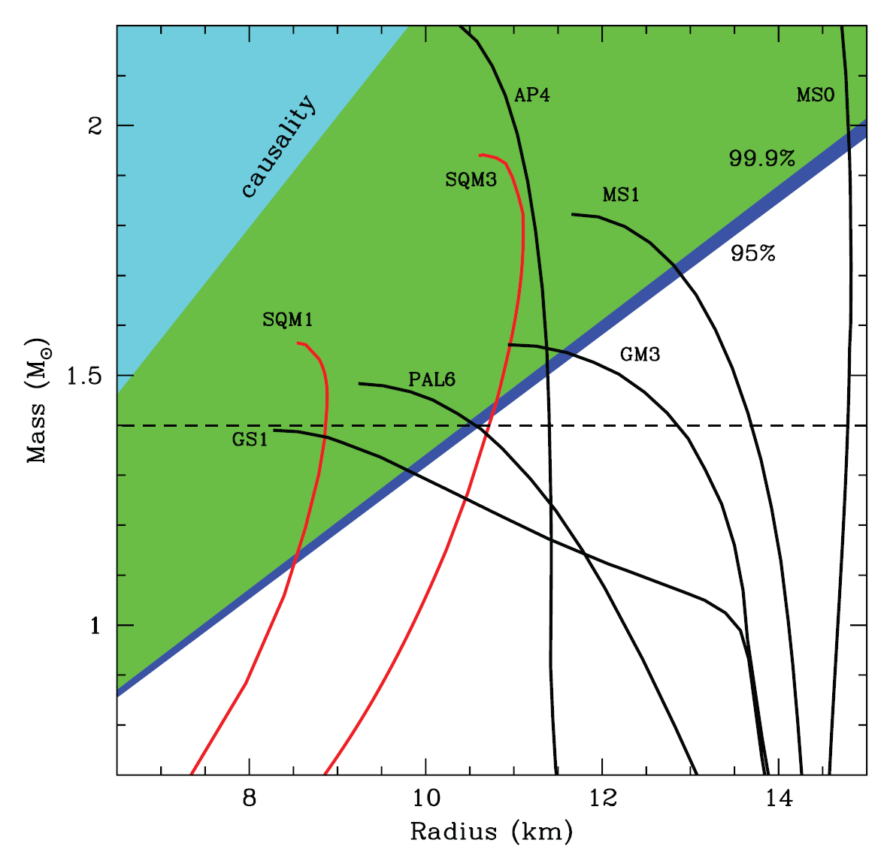
PSR J0030+0451
R > 10.7 km (95% conf.)
R > 10.4 km (99.9% conf.)
for M = 1.4 M
Bogdanov & Grindlay, ApJ, 703, 1557 (2009)

Slide 26
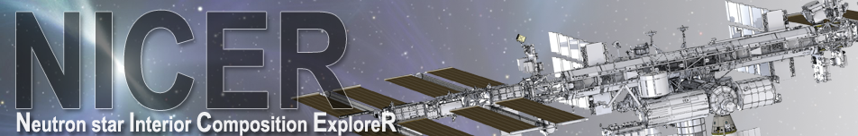
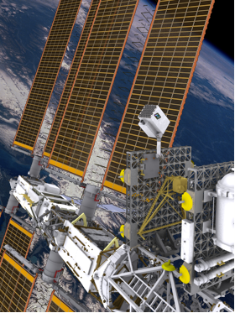
Science: ISS payload dedicated to
the study of neutron stars — a fundamental investigation of extremes in gravity, material density, and electromagnetic fields.
Spacecraft: Hosted on the ISS ExPRESS Logistics Carrier
Launch: Space X Dragon or JAXA HII-B, October 2016
Lifetime: 18 months + optional 12-month GO program
Team:
  Instrument: NASA GSFC and MIT
  Science: USRA, NRL, UMCP, UMBC, Columbia, U. Arizona, McGill, SUNY, MSU, F&M, NRAO, UNAM,
  PI: Keith Gendreau (NASA/GSFC)
  Deputy PI: Zaven Arzoumanian (NASA/USRA)
Courtesy of Z. Arzoumanian

Slide 27
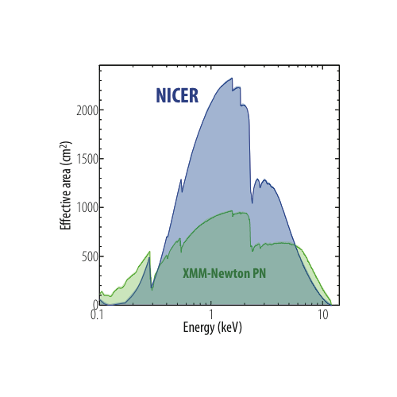
Bandpass: 0.2–12 keV
Effective area:
2200 cm² @ 1.5 keV,
600 cm² @ 6 keV
Collecting area 2x that of XMM-Newton for timing
Energy resolution:
85 eV @ 1 keV,
137 eV @ 6 keV
Comparable to XMM and Chandra
Timing accuracy: 160 nsec (absolute)
25x better than RXTE
Spatial resolution: ~3 arcmin (non-imaging)
Background: Dominated by diffuse cosmic XRB (soft)
Sensitivity: 2.2 x 10^{–14} ergs/s/cm² (0.5–10 keV, 5σ in 10 ksec)
~50x better than RXTE
~5x better than XMM

Slide 28
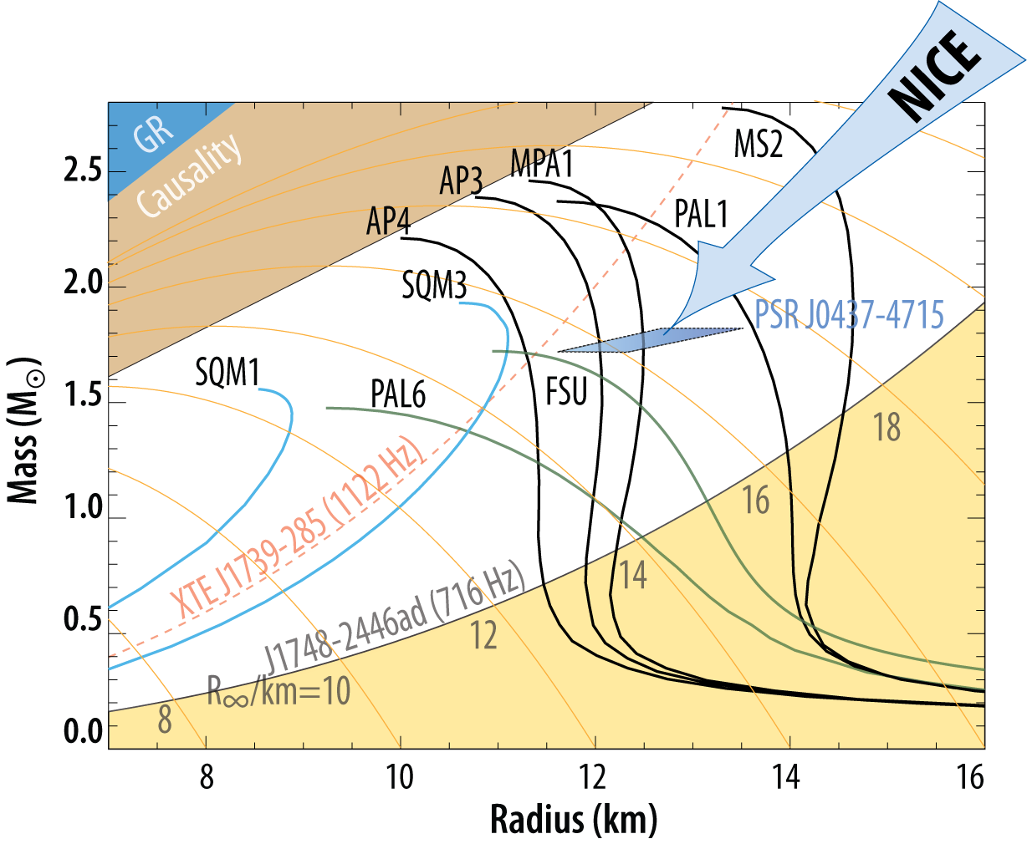
PSR J0437−4715
R

Slide 29
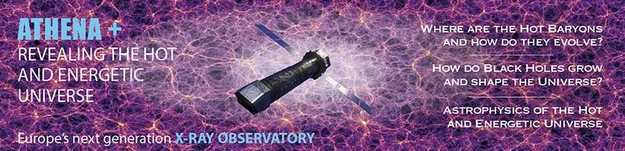
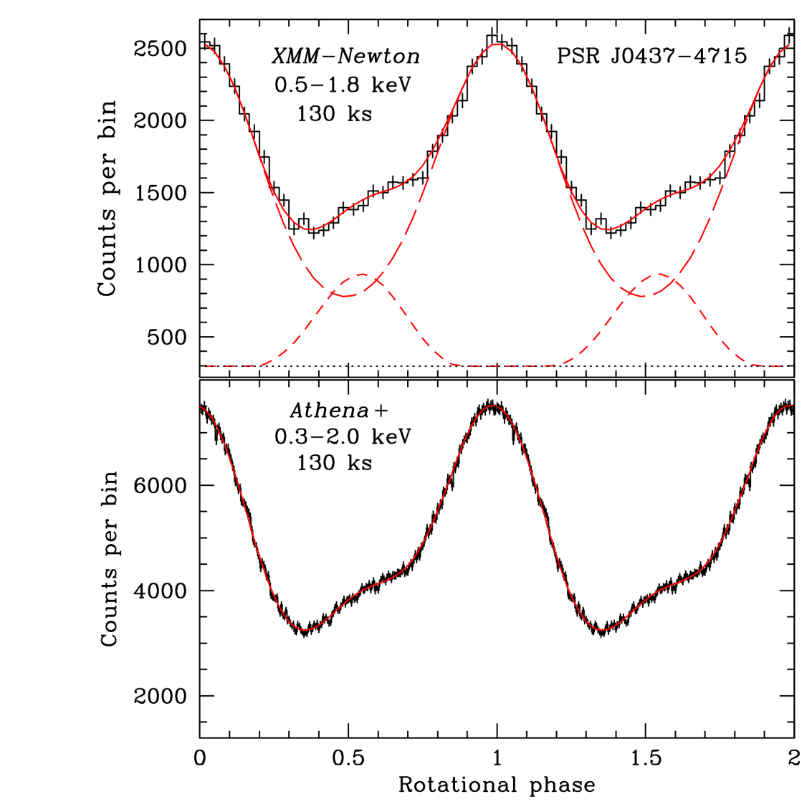
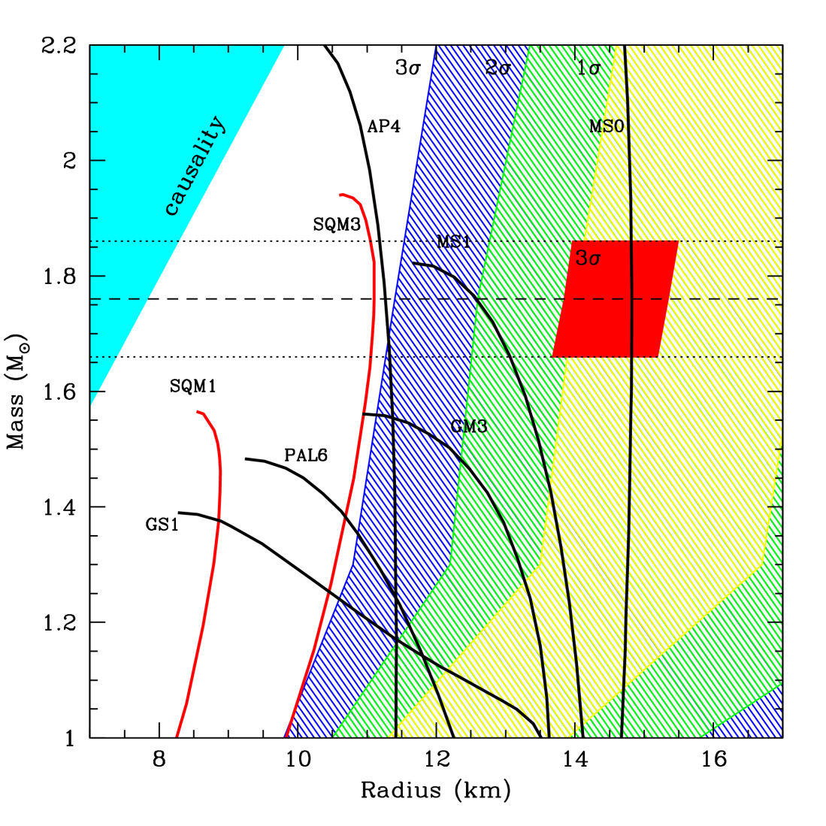
Motch et al. 2013 (arXiv:1306.2334)

Slide 30
X-ray Emission from MSPs
Three varieties of X-ray emission from MSPs:
  Pulsed non-thermal radiation (Crab-like MSPs)
  Intra-binary shock emission (“black widows” and “redbacks”)
  Faint thermally-emitting MSPs
“Redback” (aka “missing link”) MSP binaries can constrain binary evolution and accretion physics, especially in low-luminosity (“quiescent”) regime
Majority of radio MSPs have soft, thermal X-ray spectra due to heated magnetic polar caps (T_{eff} ~ 10⁶ K)
Modeling thermal X-ray Emission: promising method for constraints on elusive NS EOS
“Recycled” pulsars: important targets for current and future X-ray missions, e.g., NICER, ATHENA, LOFT,…

