Slide 1


Chandra HETG Legacy Projects:
X-Ray K-edge Fine Structures
MKI
X-Ray Spectroscopy of diffuse Galactic
Interstellar Matter with Chandra:
The Si K Edge Structure in Galactic Bulge LMXBs
Norbert S. Schulz
Massachusetts Institute of Technology
Kavli Institute for Astrophysics and Space Science
Boston, Chandra 15 yr, November 21st 2014

Slide 2
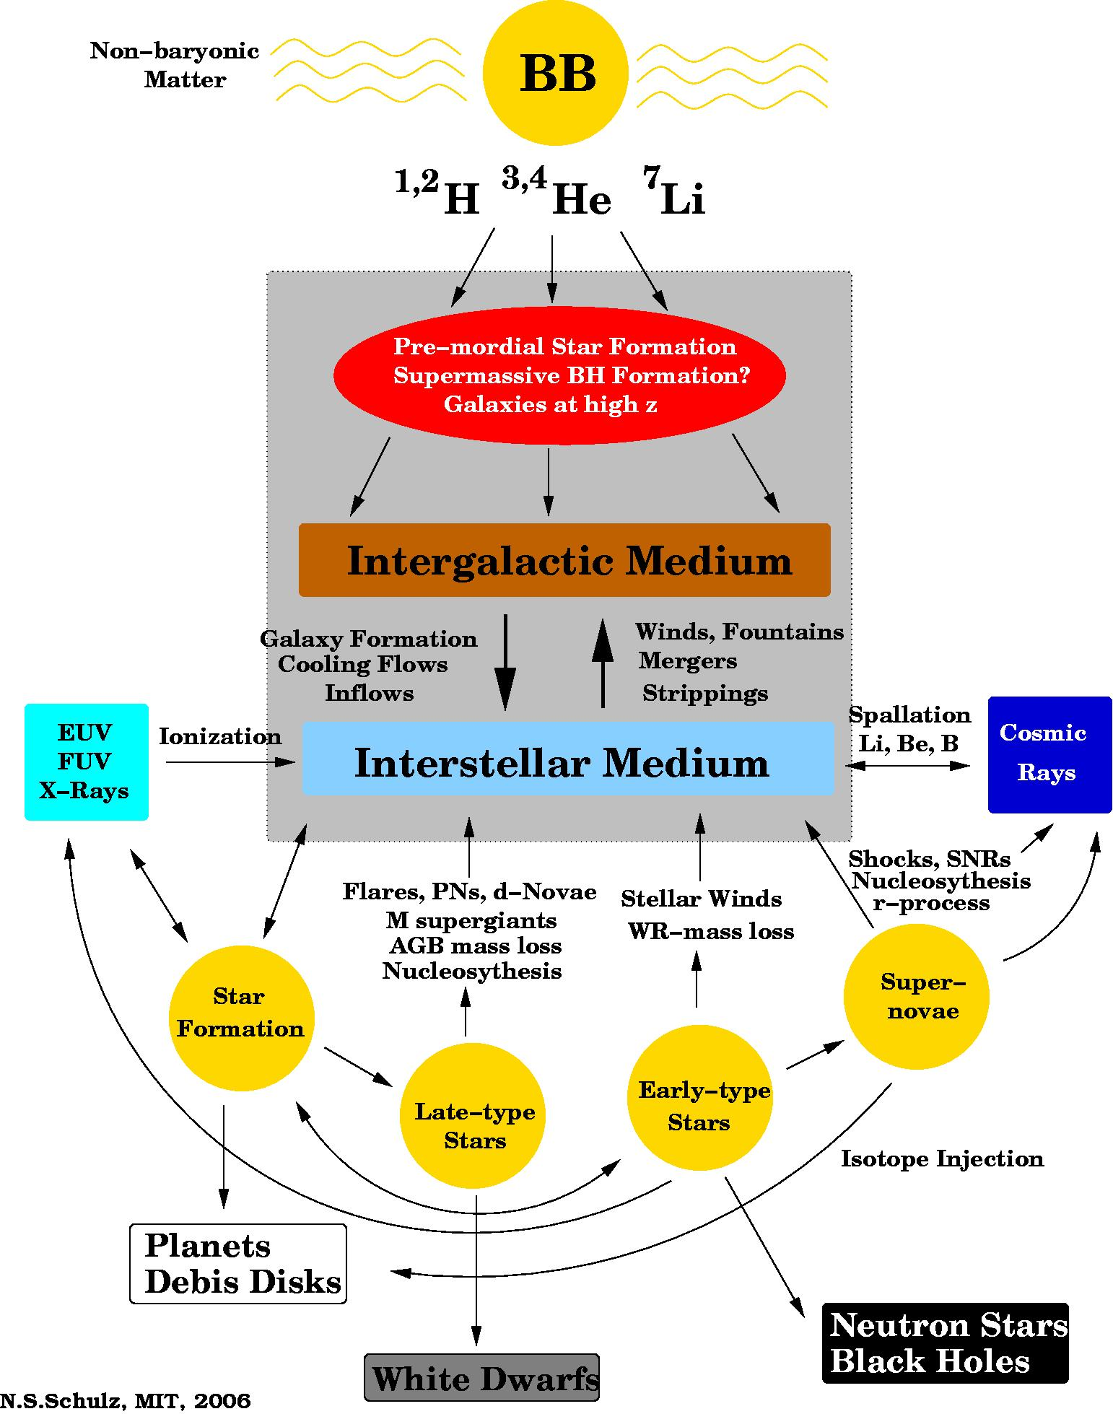
Chandra HETG Legacy Projects: X-Ray K-edge Fine Structures
MKI
Evolution & Recycling of Matter
Chemical Abundance in ISMs:
Elements in the X-Ray band (1.5 – 45 A):
C, O, Ne, Mg, Si, S, Ar, Ca, Fe, Ni
Relevant Molecules (or not):
CO₂, CO, O₂, H₂O, C_{s}H₆O, CH₂ O₂
SiO₂ , SiO₄⁴⁻ deriv. (silicates)
Si₃N₄ deriv. (nitrides)
Dust: Structure & Depletion
Ionization Fractions:
Ionized Abundances
Star Formation Rates
Missing matter
Dynamics
Boston, Chandra 15 yr, November 21st 2014

Slide 3
Chandra HETG Legacy Projects: X-Ray K-edge Fine Structures
MKI
X-Ray Surveys: overview
Principle: Backlighting with bright X-ray continua
Advantage: Long-range view through Galaxy
Cover all ISM phases: C , O , Fe L, Ne
Cold/Warm phase: Mg, Si, S, Ar, Ca, Fe, Ni
Galactic Halo absorption
ISM Studies in other Galaxies
Requirements: Spectral resolution > 1000, bandpass 0.1 - 8 keV
Sources: CVs, LMXBs, BH Binaries, AGN
< 100 available for Chandra/XMM exposures
> 100 available for Astro-H exposures
> 1000 available for Athena and future Explorer
Boston, Chandra 15 yr, November 21st 2014

Slide 4
Chandra HETG Legacy Projects: X-Ray K-edge Fine Structures
MKI
X-Ray Surveys: previous/on-going X-ray studies
Low Z Edges: C K , O K, Fe L, Ne K
Carbon K edge: ACIS Contaminant (H. Marshall)
Nitrogen K Edge: Sant’Anna et al. 2011
Oxygen K Edge: X 0614+091 (Paerels et al. 2001)
LMXB Survey (Juett et al. 2004)
Cyg X-2 (Takei et al. 2002)
Cyg X-1 (Schulz et al. 2002)
XTE J1817-330 (Gatuzz et al. 2013)
Neon K Edge: LMXB Survey (Juett et al. 2006)
X 0614+091 (Paerels et al. 2001
Schulz et al. 2010)
XTE J1817-330 (Gatuzz et al. 2013)
Ne/O resonance
absorption: LMXB survey (Yao&Wang 2005, 2006)
LMC X-3 (Wang et al. 2005)
Cyg X-2 (Yao et al. 2009)
TBNEW in XSPEC: Wilms, Schulz, Nowak et al. 2013
High Z Edges: Mg K, Si K, S K, Ar K. Ca K, Fe K
Magnesium K Edge: GX 13+1, GX 5-1, GX340+0
Ueda et al. 2005
Silicon K Edge: GRS 1915+115 (Lee et al. 2002)
GX 13+1…. (Ueda et al. 2005)
Sulfur K Edge: GX 13+1…. (Ueda et al. 2005)
Argon K Edge:
Calcium K Edge:
Iron L & K Edges: Cyg X-1 (Schulz et al. 2002)
X 0614+091 (Paerels et al. 2001)
MCG 6-30-15 (Lee et al. 2001)
GRS 1915+115 (Lee et al. 2002)
Cir X-1 (Schulz & Brandt 2002)
GX 301-2 (Watanabe et al 2003)
Dust (Lee & Ravel 2005)
ISM Dust (Lee et al. 2009)
Nickel K Edge:
TBDUST in XSPEC Wilms, Lee et al. 2013
Boston, Chandra 15 yr, November 21st 2014

Slide 5
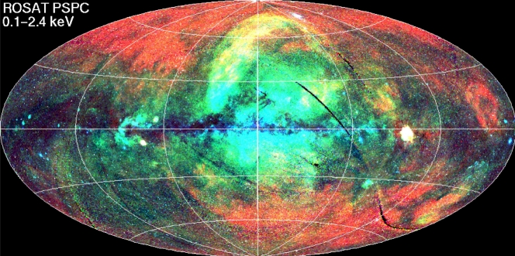
Chandra HETG Legacy Projects: X-Ray K-edge Fine Structures
MKI
X-Ray Surveys: Distribution of Chandra Sources
Galactic Disk
Galactic Bulge
O, Fe (L), Ne
Cyg X-1, Cyg X-2, GX 339-4,
GX 9+9, 4U1820-30, 4U1636-53
4U1735-44, XTEJ1817-33, Ser X-1
4U 0614+091
Mg , Si , S , Ar , Ca , Fe (K)
GX 5-1, GX 13+1, GX 9+1, GX 349+2
GX 340+0, GX 17+2, 4U 1705-44,
4U 1728-34, 4U 1624-49
Boston, Chandra 15 yr, November 21st 2014

Slide 6
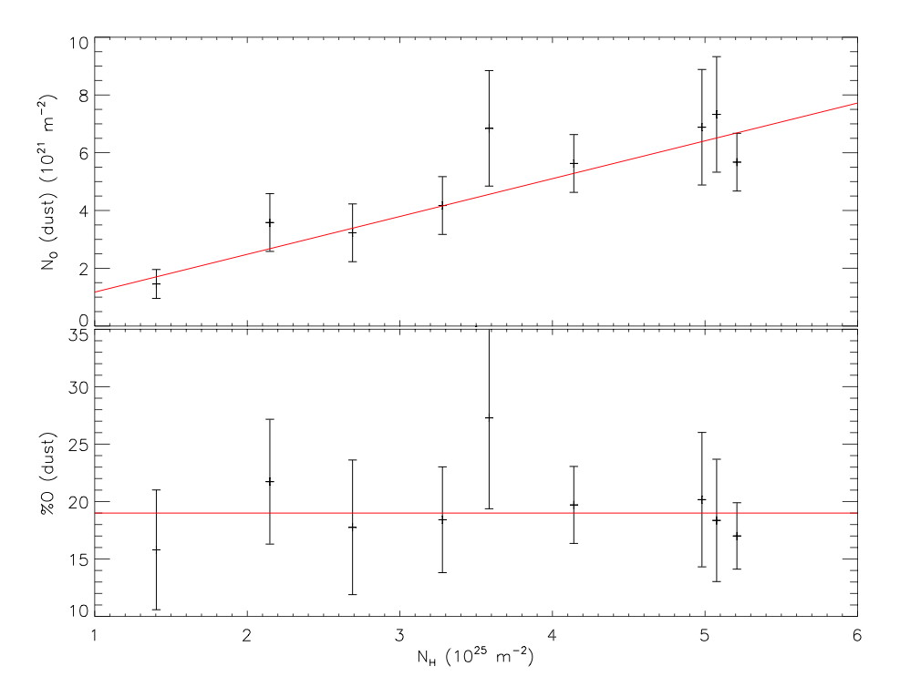
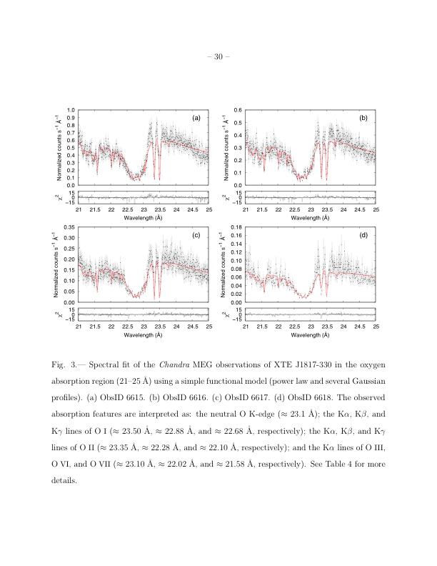
Chandra HETG Legacy Projects: X-Ray K-edge Fine Structures
MKI
X-Ray Surveys: Previous Results on Oxygen – Dust vs. Ionization
Highlights:
A Chandra survey (Juett et al. 2004) of K edges measured the O K edge at 22.89+/-0.02 A and resolved resonance absorption lines for O I – IV with ionization fractions of 5 – 10 %.
Yao&Wang (2006) detect strong absorption from O VII and O VIII from the hot ISM phase in 4U 1820-30
Kaastra et al. (2009) measure abundance and absorption from O, Fe, and Ne towards the Crab and suggest dust contributions
De Vries&Costantini (2009) in an XMM-Newton RGS study in Sco X-1 detect EXAFS at the O K edge
Gatuzz et al. (2013) presented the most detailed modeling of the
O K edge region in XTE K 1817-330 with neutral and ionized oxygen without dust contribution
An XMM-RGS survey by Pinto et al. (2013) of bright LMXBs provided dust contributions in the O K edge region up to 20%
In GS 1826-238 Pinto et al. (2010) deduce dust contributions
between 20-40%.
Garcia et al. 2014 (submitted) re-analysed and remodeled all bright
LMXBs in the Chandra archive and find absorption to be fully con-
sistent with neutral and ionized oxygen and no dust.
Pinto et al. 2013
Gatuzz et al. 2013
Boston, Chandra 15 yr, November 21st 2014

Slide 7
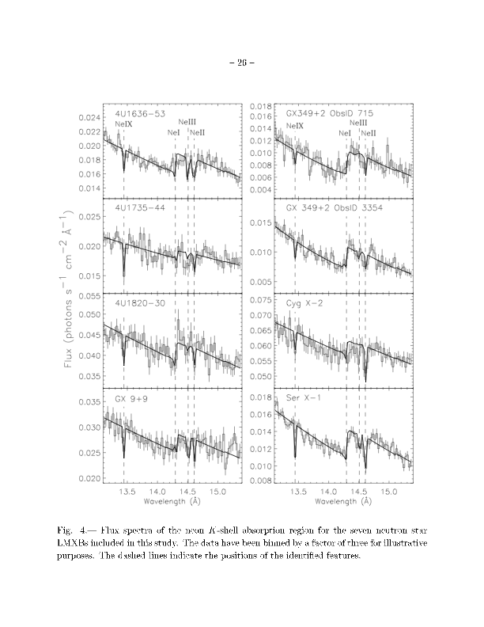
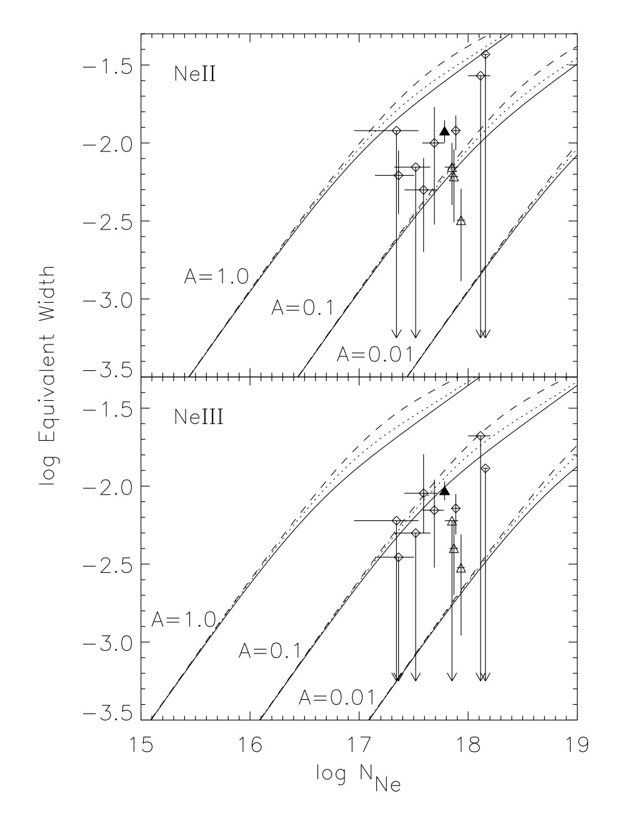
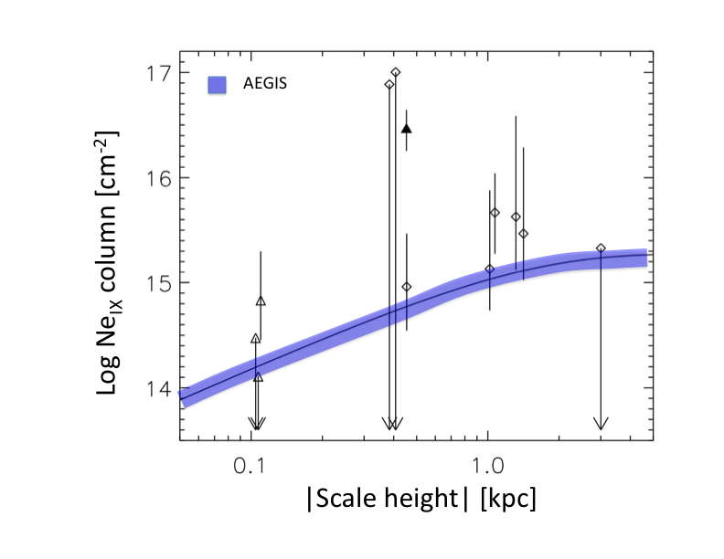
Chandra HETG Legacy Projects: X-Ray K-edge Fine Structures
MKI
X-Ray Surveys: Previous Results on Neon
Juett et al. 2006
Highlights:
A Chandra survey (Juett et al. 2006) of K edges mea-
sured the Ne K edge at 14.31+/-0.02 A and resolved
resonance absorption lines for Ne II, Ne III with ion-
ization fractions of 5 – 10 % . Miller et al. (2004) had
previously identified these in GX 334-4.
Yao&Wang (2005) detect strong absorption from Ne IX
of the hot phase of the ISM and deduce larger columns
at higher Galactic disk scale heights
Yao et al. (2006) constrain O VII and Ne IX columns
in the Galactic halo to < 5 x 10¹⁵ cm⁻², less than 3% of the
Galactic disk contribution.
Pinto et al. (2010) detect possible Ne VIII absorption at 13.7 A
Kaastra et al. (2009) in the Crab pulsar and Pinto et al. (2010)
In GS 1826-239 find overabundance of Ne by a factor of 1.7 to
solar
Yao & Wang 2006
Boston, Chandra 15 yr, November 21st 2014

Slide 8
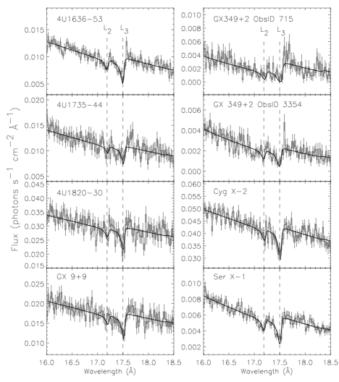
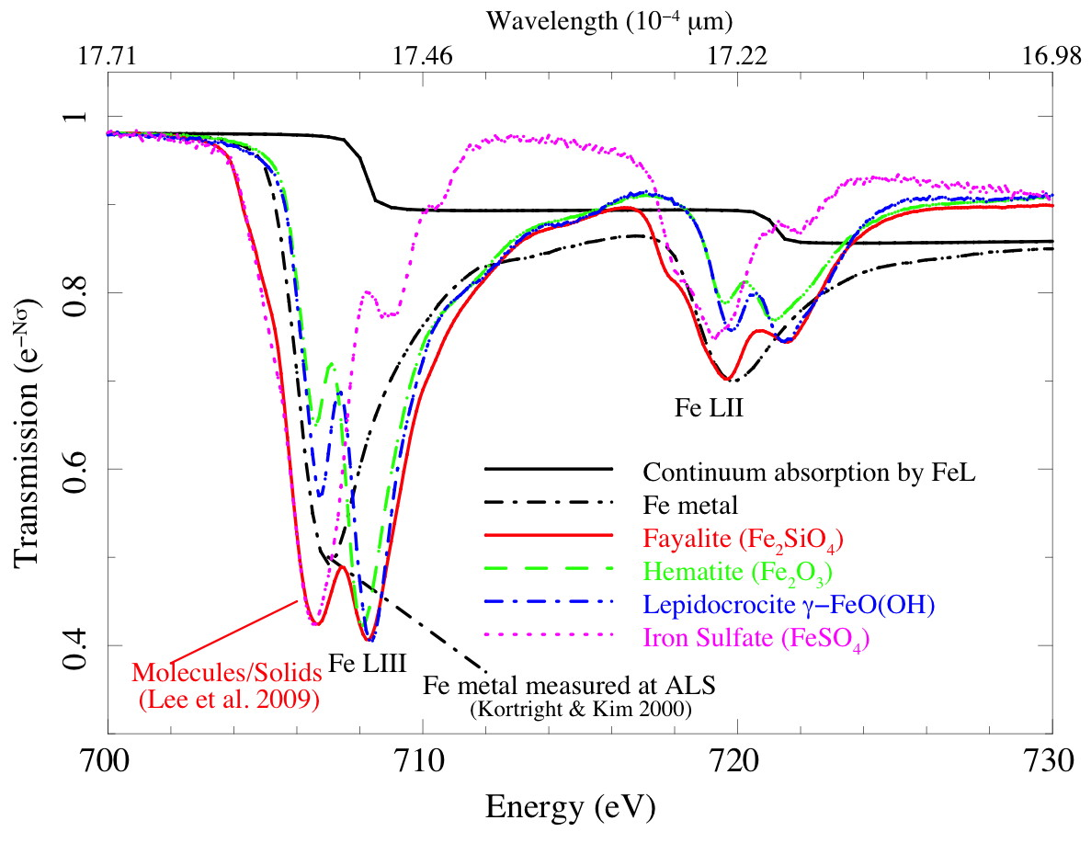
Chandra HETG Legacy Projects: X-Ray K-edge Fine Structures
MKI
X-Ray Surveys: Previous Results on Iron L
Highlights:
Paerels et al. (2001) in X0614+091 detect Fe L₂ and L₃ edges with the
Chandra LETG, Schulz et al. 2002 in Cyg X-1 and Lee et al. in
MGC6-15-30 model the Fe L edges using laboratory measurements
from Kortright&Kim (2000).
A Chandra survey (Juett et al. 2006) of K/L edges used this edge and various other models determine the Fe L₂ and L₃ edges at 17.26+/-0.02 A and 17.51+/-0.02 A, respectively, and conclude that that edges are a result of various dust contributions
Yao et al. (2006) detect Fe VII absorption in 4U 1820-30 and find that the Ne/Fe abundance ratio is solar and all of the dust grains in the interstellar medium have been destroyed in the hot phase of the ISM.
Lee et al. (2009) showed that differences in L edge shape can be directly used to distinguish iron dust compounds assuming that all iron is bound in dust grains. Synchrotron measurement produced cross sections from a variety of Fe dust compound that match the Chandra measurements.
The fact that all or most Fe is bound in dust compounds has been shown by various studies (Draine 2003, Jenkins 2009) and emphasized in most high-resolution X-ray studies to date (Juett et al. 2006, Costantini et al. 2012, Pinto et al. 2013)
Juett et al. 2006
Lee et al. 2009
Boston, Chandra 15 yr, November 21st 2014

Slide 9
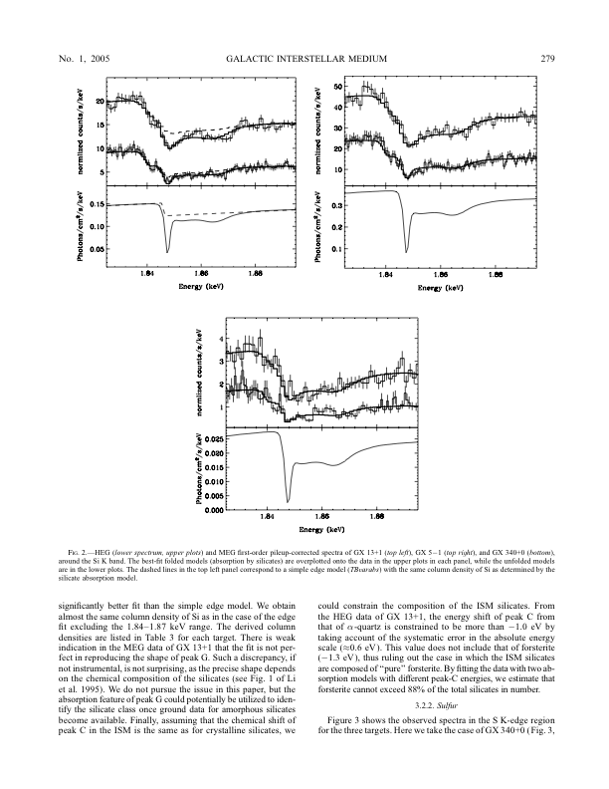
Chandra HETG Legacy Projects: X-Ray K-edge Fine Structures
MKI
X-Ray Surveys: Previous Results on Silicon
Highlights:
In an Chandra HETG observation of GRS 1915+105 Lee et al. 2002 found traces of near and far edges structures in the Si K edge
Ueda et al.(2005) measured XAFS in the Mg K, Si K and Si K edges of three Galactic X-ray binaries and concluded that in the case of silicon most materials exists in silicates.
Through special data selection all of the observed edge structure was modeled as dust
The ISM edge was observed between 1.84 and 1.85 keV
The near edge absorption peak was identified as from SiO₂
Si was determined to be overabundant in all thee sources and columns were measured to be well in excess of 10²³ cm⁻²
GX 13+1
GX 5-1
GX 340+0
Boston, Chandra 15 yr, November 21st 2014

Slide 10
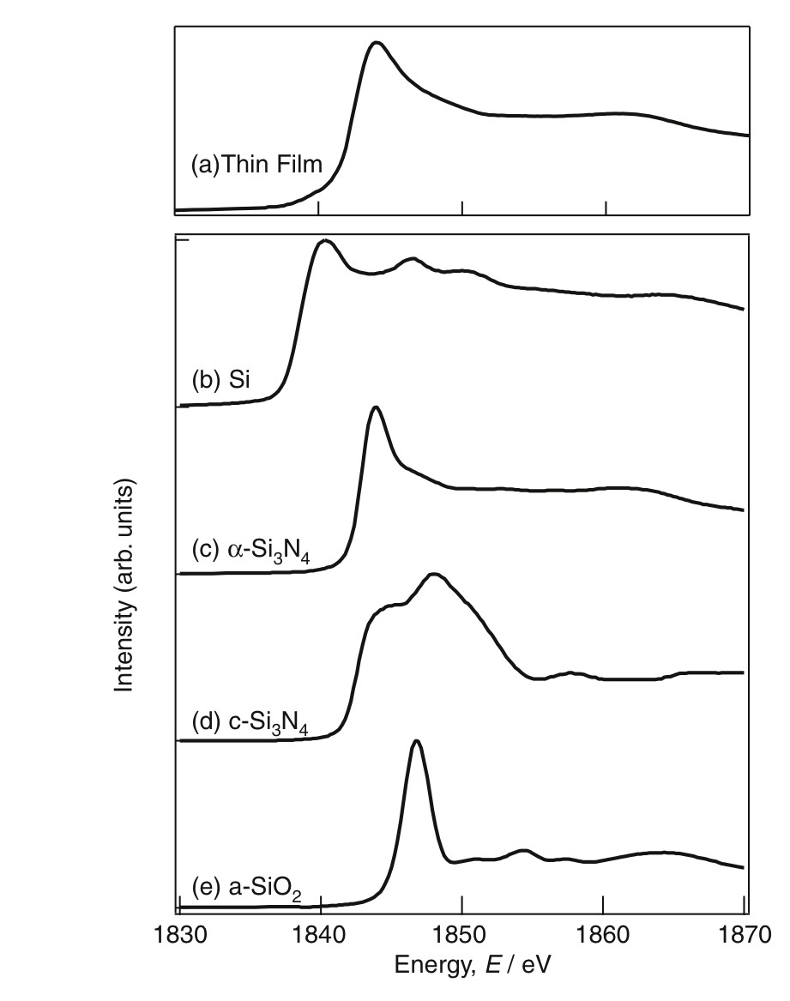
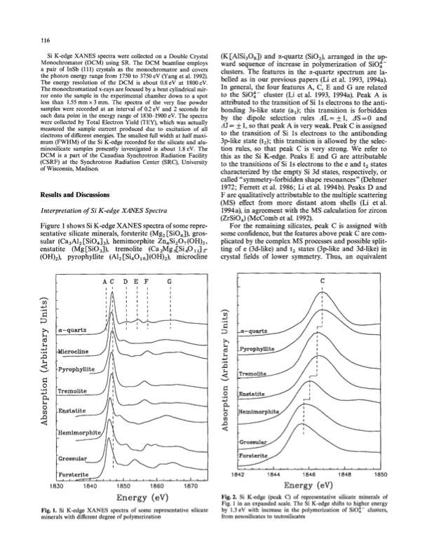
Chandra HETG Legacy Projects: X-Ray K-edge Fine Structures
MKI
Laboratory Measurements: Si K edge
Li et al., Phys. Chem. Minerals, 1995:
Silicon K-edge XANES Spectra of Silicate Minerals
Suga et al., Material Transactions , 2004:
XANES of Si Nitride Thin Film by Pulsed Laser Deposition
XANES features of various silicates with a
steep main absorption peak shifting by about
2.5 eV from Fosterite at 1.844 keV to Quartz at
1.846 keV
Atomic Si has a low energy edge at 1.839 keV
with a shallow near absorption feature and slow
recovery; XANES features of various nitrides
have main absorption peaks between atomic Si
and silicates.
Boston, Chandra 15 yr, November 21st 2014

Slide 11
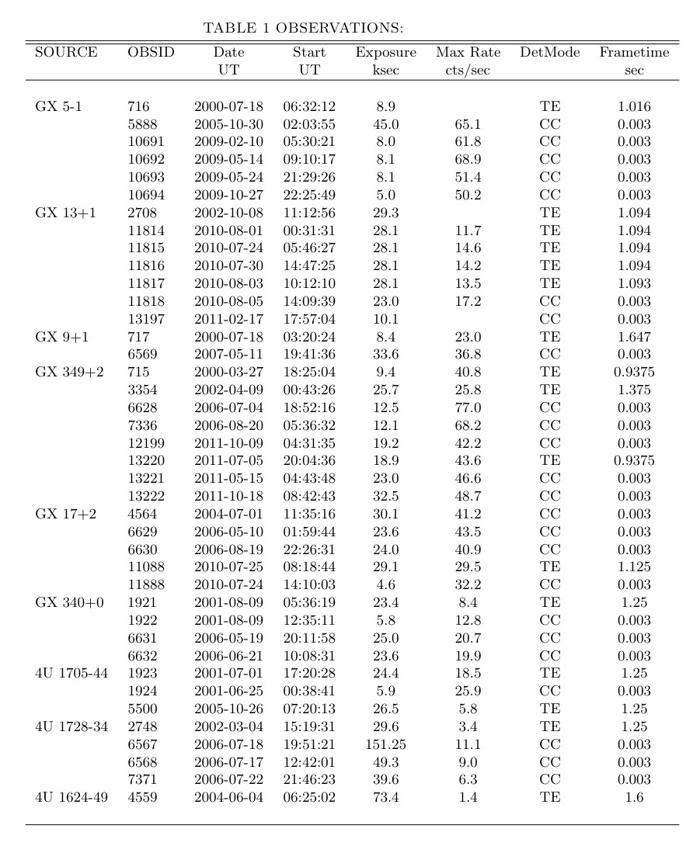
Chandra HETG Legacy Projects: X-Ray K-edge Fine Structures
MKI
Chandra HETG LMXB Si Survey: Observations
40 Observations from the Chandra Archive with
9 Bright LMXB located in or near the Galactic Bulge
Source fluxes range from 5 mCrab (4U 1624-49) to
about 1 Crab (GX 5-1)
Two data modes available:
Timed Event (TE) mode:
Exposure is taken in data frames with a frame time
in this sample varying from about 0.9 to 1.7 sec.
At these high fluxes pileup effects can still be up to
35%, but can be mitigated to < 20% in the worst case
by omitting data from back illuminating devices.
Continuous Clocking (Mode):
Exposure is quasi-continuous by reading out each row
reducing the frame time to 3 msec. At these read out
times there is no pileup but the edge can be filled
in by contributions from a dispersed scattering halo.
Here only data from back illuminated devices are of
use because there is no instrument edge.
Consequence for both modes:
The measured optical depths are likely lower limits and
a systematic uncertainty of 20% has to be added.
Absorptions features are generally unaffected
Boston, Chandra 15 yr, November 21st 2014

Slide 12
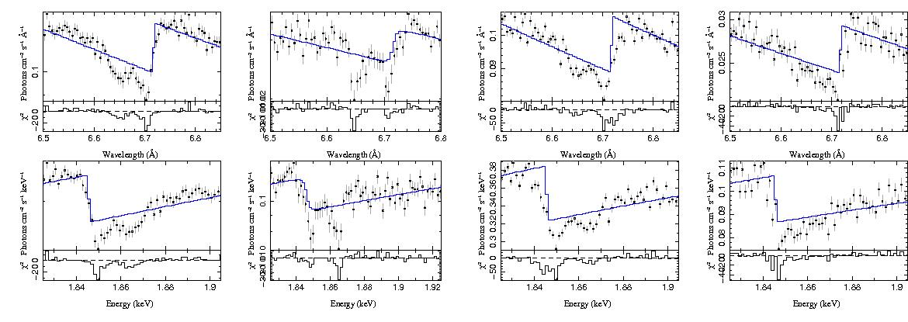
Chandra HETG Legacy Projects: X-Ray K-edge Fine Structures
MKI
Chandra HETG LMXB Si Survey: K Edge Examples
Si K edge examples in four different bright sources, over-plotted a simple edge model
from Verner et al. (1995)
In excess to the step function, there are two resolved absorption features: one near, one far from the edge.
The detailed edge morphology appears different all four sources
The edge morphology cannot be fully reproduced by the edge model used in Ueda et al. (2005) in all cases
GX 5-1
GX 13+1
GX 17+2
4U 1728-34
Boston, Chandra 15 yr, November 21st 2014

Slide 13
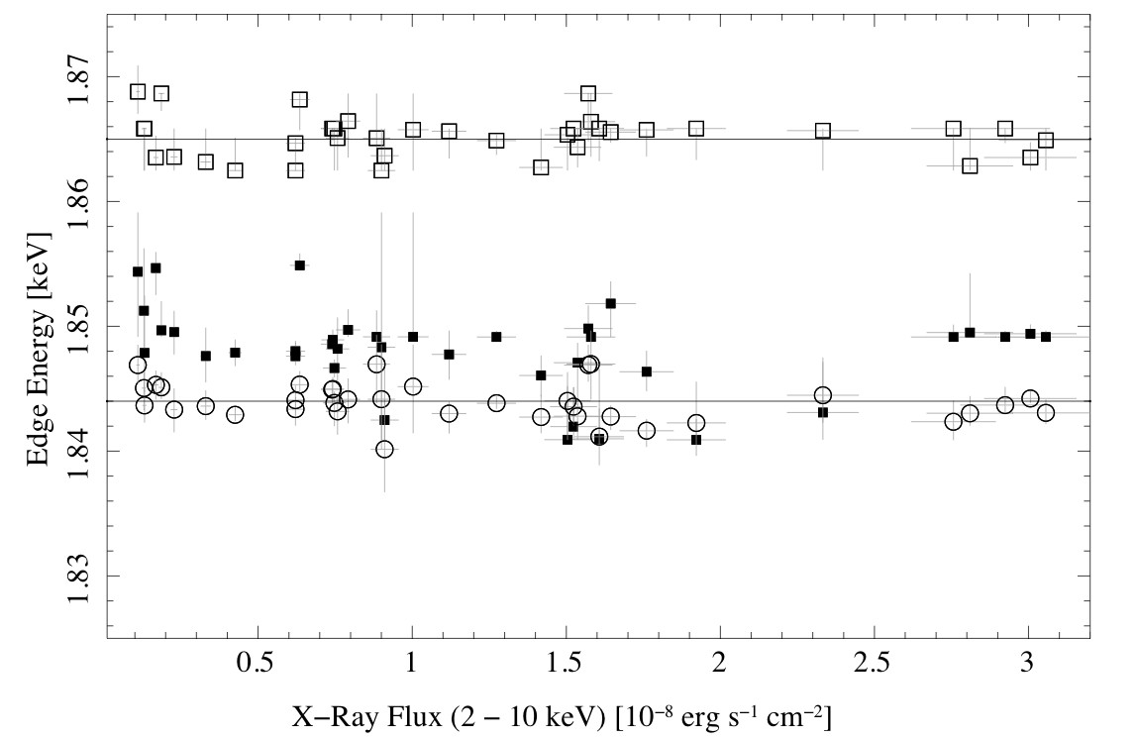
Chandra HETG Legacy Projects: X-Ray K-edge Fine Structures
MKI
Chandra HETG LMXB Si Survey: K Edge Identifications
Dust
Ions
Si XIII
Silicates
Secondaries
Si XII
Silicates Main
Si Nitrides
Atomic Si
Average Si K edge value: 1.844+/-0.001 keV
Average near edge absorption peak at 1.850+/-0.002 keV
Average far edge absorption peak at 1.865+/-0.001 keV
Boston, Chandra 15 yr, November 21st 2014

Slide 14
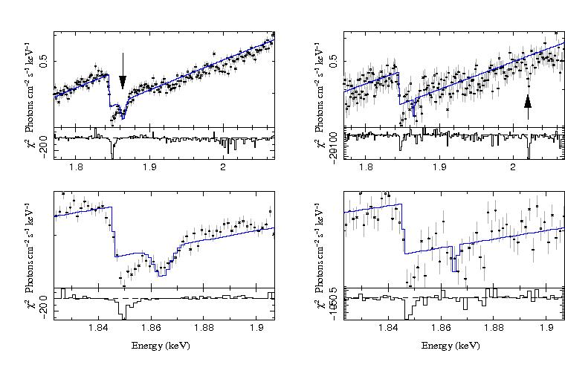
Chandra HETG Legacy Projects: X-Ray K-edge Fine Structures
MKI
Chandra HETG LMXB Si Survey: GX 5-1
-- GX 5-1 is the brightest object in the sample and has one TE, 5 CC mode observations; we only use CC mode here
-- Obsid 5888 exhibits near edge (NE) absorption with an EW of 7.4+/-0.4 mA, far edge (FA) absorption of 5.6+/-0.3 mA
-- Obsids 10691-4 exhibit NE absorption with and <EW> of 4.5 +/-0.8 mA , FA absorption < 1 mA, and a Si XIV resonance
GX 5-1: Obsid 5888
GX 5-1: Obsids 10691-4
Boston, Chandra 15 yr, November 21st 2014

Slide 15
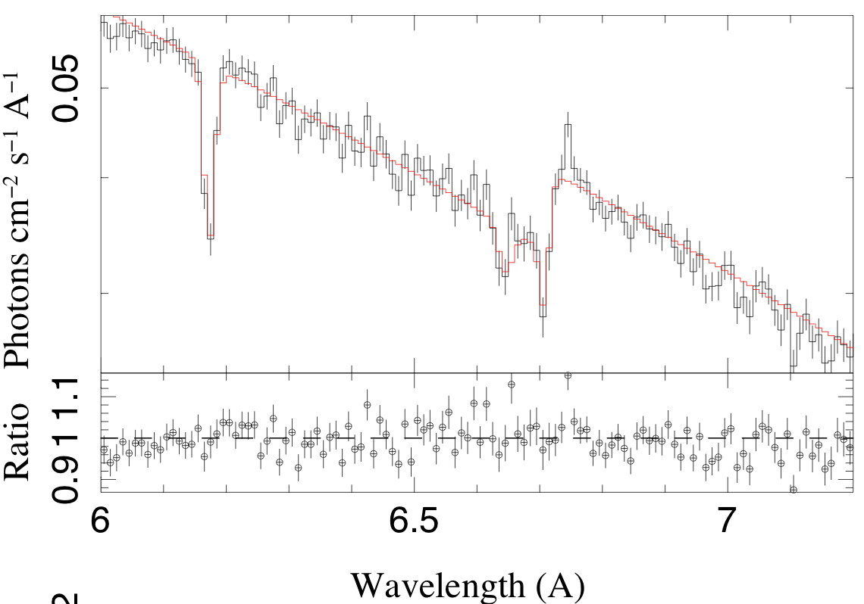
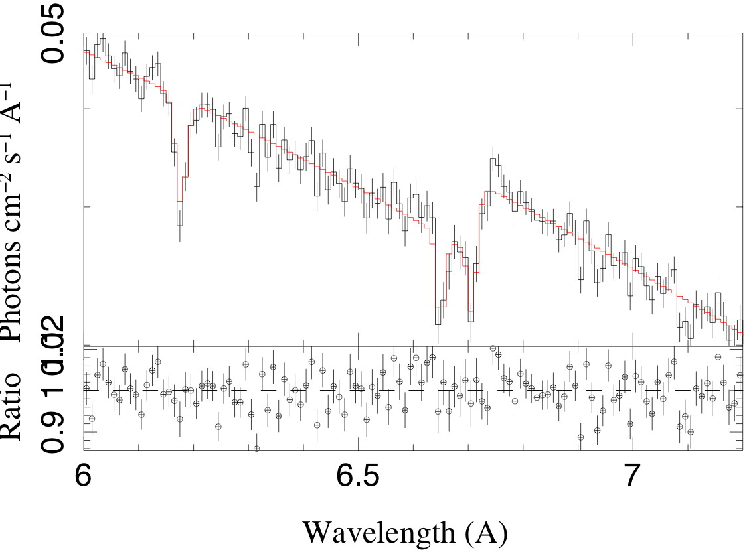
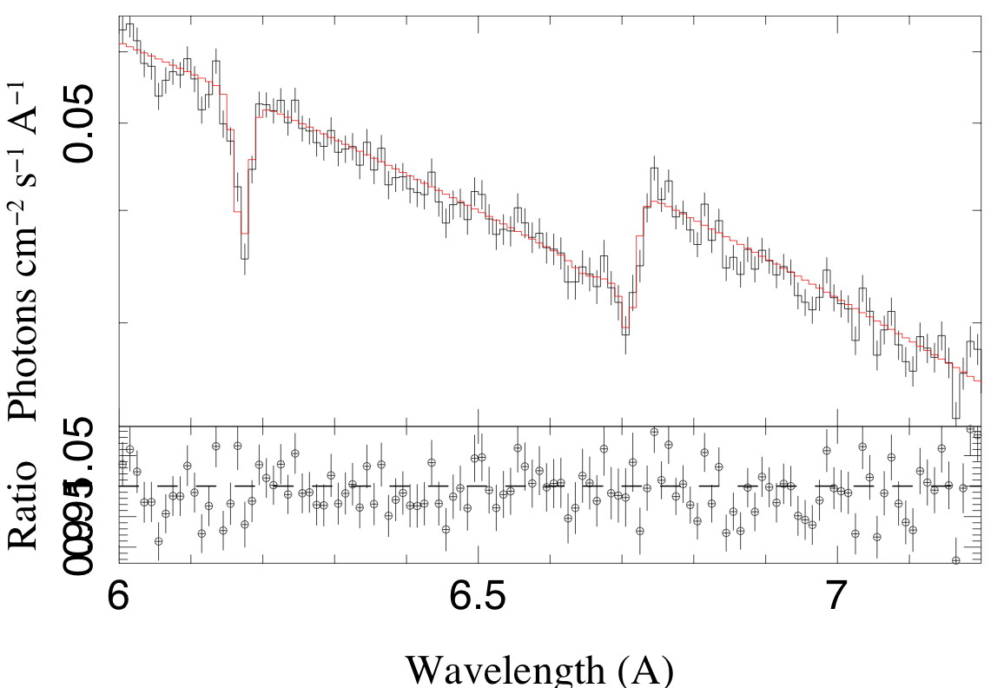
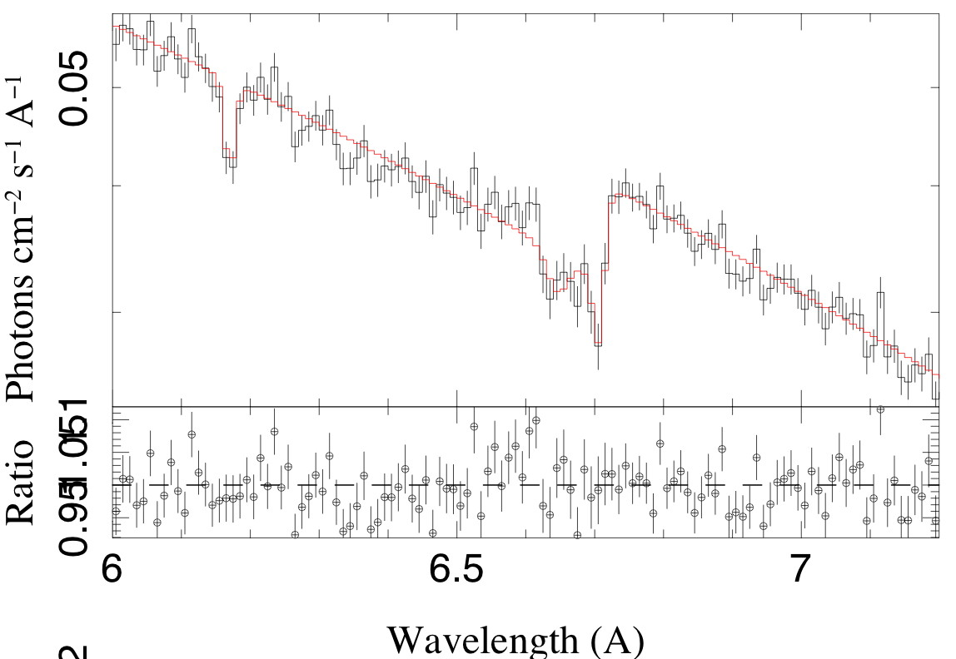
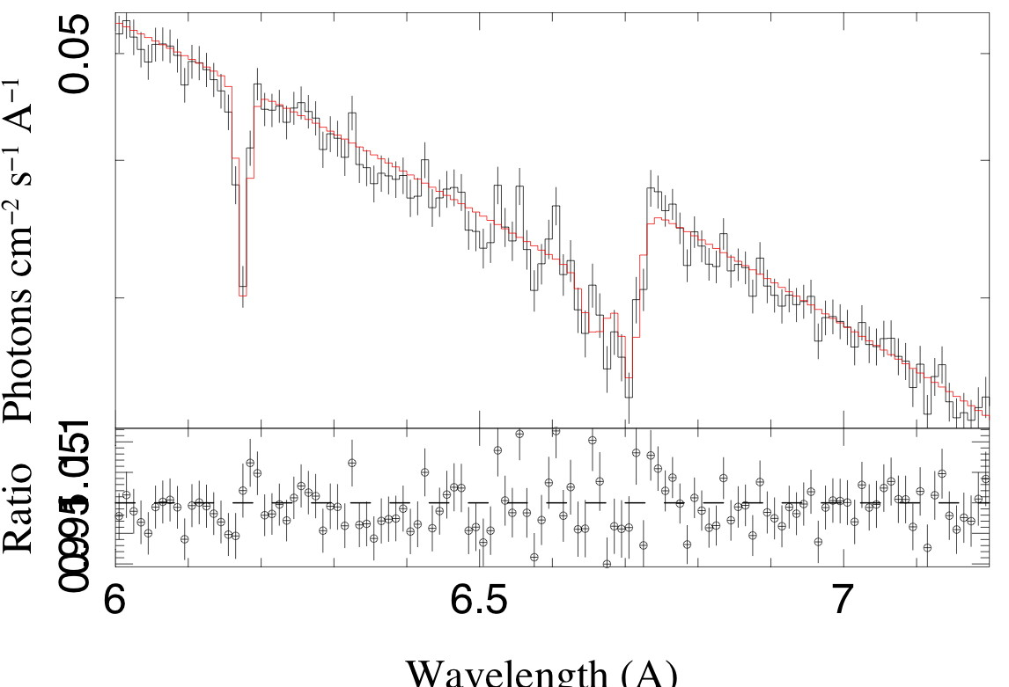
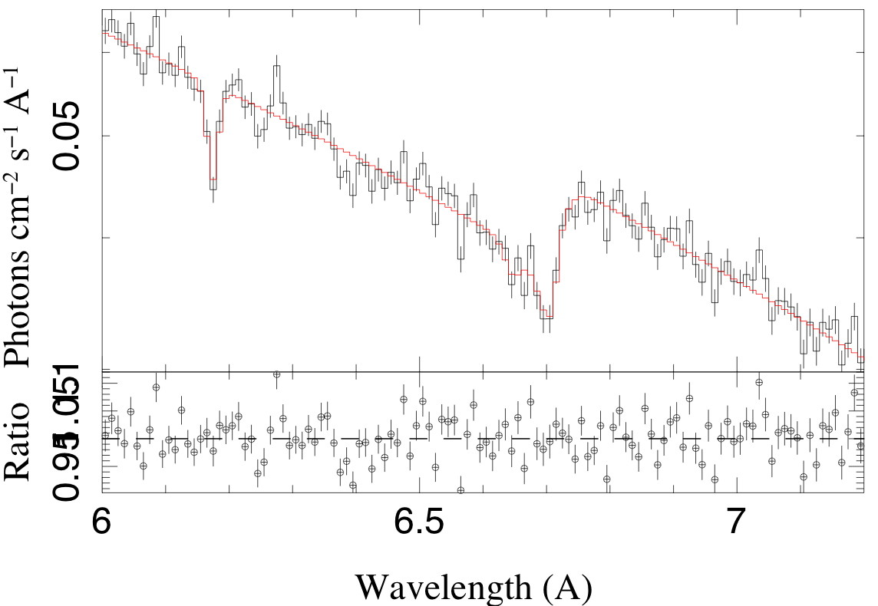
Chandra HETG Legacy Projects: X-Ray K-edge Fine Structures
MKI
Chandra HETG LMXB Si Survey: GX 13+1
-- GX 13+1 is moderately brightest and has 5 TE, 1 CC mode observations at very similar X-ray fluxes
-- All observations exhibit (NE) absorption with an EW ranging from 1.8+/-0.3 to 7.2+/-0.4 mA,
far edge (FA) absorption from below detection to 4.5+/-0.4 mA
-- Ueda et all. (2004) reported on wind outflows and H-like resonance absorption. All observation show Si XIV at
variable strength
Obsid 2708
Obsid11814
Obsid11815
Obsid 11816
Obsid 11817
Obsid 11818
Boston, Chandra 15 yr, November 21st 2014

Slide 16
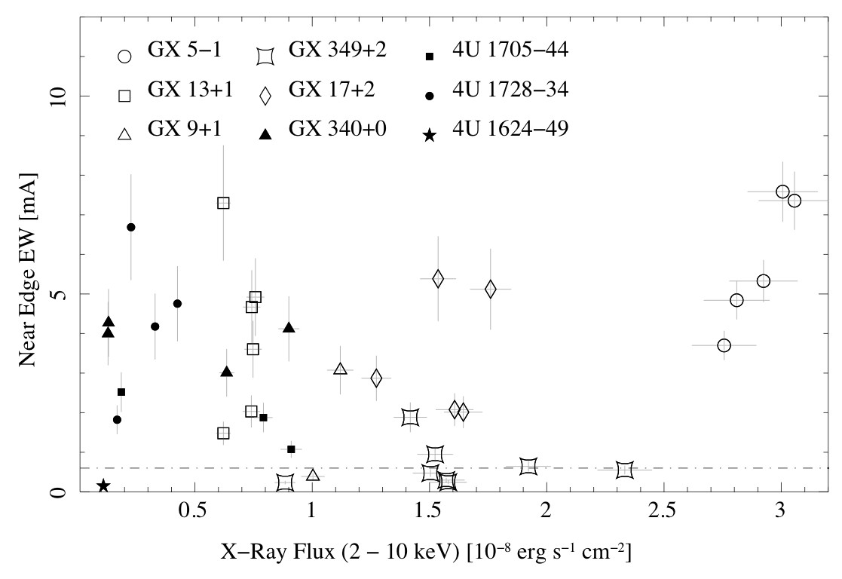
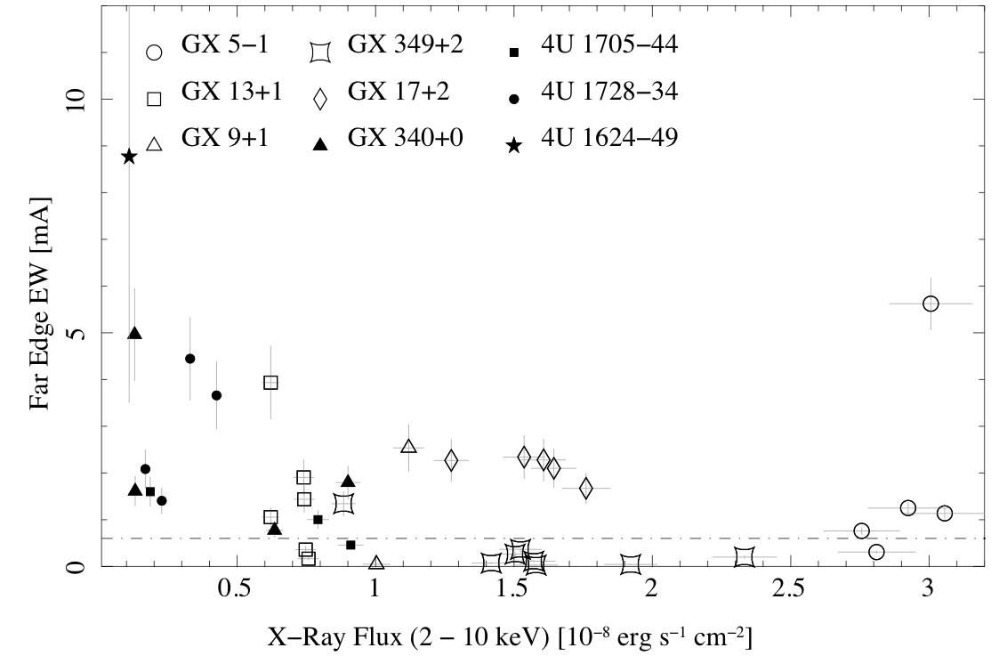
Chandra HETG Legacy Projects: X-Ray K-edge Fine Structures
MKI
Chandra HETG LMXB Si Survey: Structure variability
NE Absorption
The equivalent widths (EWs) of NE absorption features range
between the detection limit of 0.6 mA and 8 mA. Most
observations exhibit NE absorption features above
detection. The EWs show that within sources NE absorption
Is variable well above the expectation from the application
of different detector modes. In many cases we observe varia-
bility within the same detector mode and at very similar
X-ray fluxes
FE Absorption
The equivalent widths (EWs) of FE absorption features range
between the detection limit of 0.6 mA and 6 mA.
(4U 1624-49 only has one observation (Xiang et al. 2011).
More observations have FE absorption close to the
detection limit.. The EWs show that within sources FE
absorption is again highly variable.
Boston, Chandra 15 yr, November 21st 2014

Slide 17
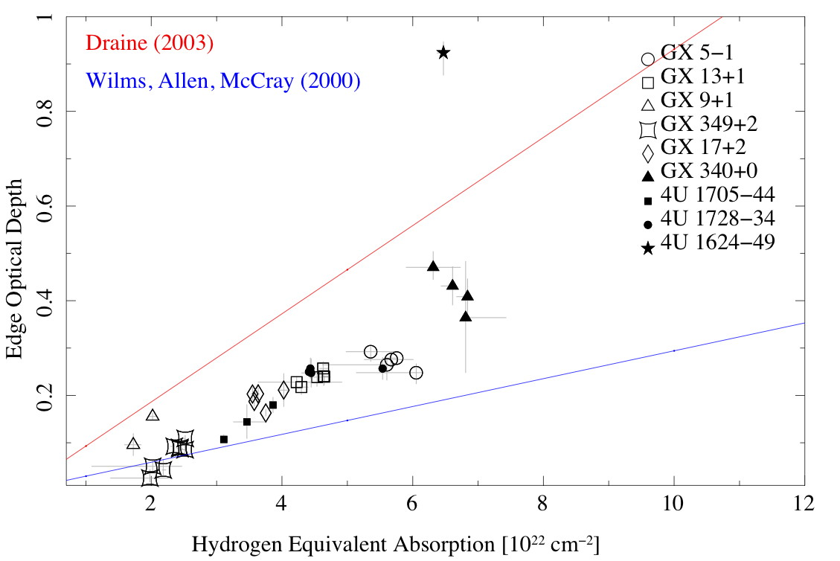
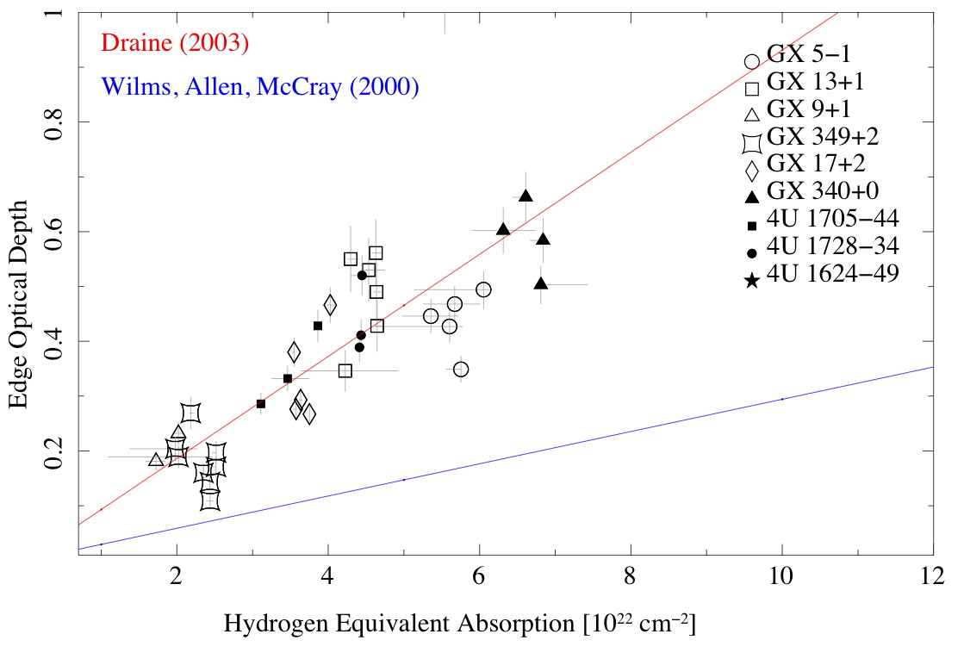
Chandra HETG Legacy Projects: X-Ray K-edge Fine Structures
MKI
Chandra HETG LMXB Si Survey: Optical Depths
Hydrogen equivalent absorption: Tbnew * powerlaw (5 – 9 A, exclude 6.5 – 7.5 A)
Case A: optical depth is determined through a simple step edge function excluding the
NE absorption feature. The depths indicate that for NH > 3x10²² cm⁻² silicon is
significantly overabundant with respect to the ISM solution (Wilms, Allen, McCray 2000)
Case B: optical depth is determined through evaluating top and bottom edge fluxes
including the NE absorption feature. The depths now indicate an overabundance
with respect to the ISM solution (Wilms, Allen, McCray 2000) which is consistent with
predictions for the Galactic Bulge by Draine 2003. Note the variability in these
depths is significantly lower than observed in the EWs!!
Case B: optical depth is determined through evaluating top and bottom edge fluxes
including the NE absorption feature. The depths now indicate an overabundance
with respect to the ISM solution (Wilms, Allen, McCray 2000), which is consistent with
predictions for LMXB dust scattering in the Galactic Bulge by Draine 2003.
Note the variability in these depths is significantly lower than oberved in the EWs
Case A:
Case B:
Boston, Chandra 15 yr, November 21st 2014

Slide 18
Chandra HETG Legacy Projects: X-Ray K-edge Fine Structures
MKI
Chandra HETG LMXB Si Survey: Summary and Conclusions
The Si K edges in absorbed Galactic Bulge LMXBs show distinct structure consisting of two broad line components, a near edge broad line component, and a far edge broad line component. While this is consistent with the findings by Ueda et al. (2005), the interpretation and model thereof is not.
We measure an average edge value of 1.844+/-0.001 keV, the near edge broad line appears at 1.849+/-0.002 keV, and and the far edge line component at 1.865+/-0.002 keV.
The edge value appears consistent with absorption by most silicates (see also Ueda et al. 2005), the corresponding near edge absorption peak, however, in some cases appears beyond the expected location of α-quartz. The far edge absorption in almost all cases is not shallow as assumed by the Ueda et al. model, appear as an absorption line, and at times very strong. This is inconsistent with the adopted silicate model.
The edge itself appears fairly constant, including the average depth of the near edge absorption feature. Near and far edge absorption in general is highly variable. Variability on the observed time scales is inconsistent with dust origins.
Based on these observations we conclude that the Si K edge is produced largely by dust, but shows interference by absorption from ionized atomic Si close to the X-ray source. The near absorption peak is then a mix of dust and a variable ionized Si XII component, the far edge absorption is identified as Si XIII resonance absorption.
The optical depths of the Si K edges produce lower limits of optical depths that indicate a significant overabundance of silicon in all these systems. In that respect dust columns are mostly > 10²³ cm⁻² and appear at least consistent with predictions by Draine (2003) for the Galactic Bulge in general.
The variable ionized component is then a byproduct of ionization processes close to the X-ray sources
Extensive and repeated observations are needed with ASTRO-H in order to further separate and characterize the dust component of the Si K edge
Boston, Chandra 15 yr, November 21st 2014

Slide 19
Chandra HETG Legacy Projects: X-Ray K-edge Fine Structures
MKI
Chandra HETG LMXB Si Survey: References
Sant’Anna et al., Phys Rev Letters, 107, 3, 2011
Costantini et al., A &A, 539, 32, 2012
DeVries & Costantini, A &A, 497, 393, 2009
Draine, ApJ Main, 598, 1026, 2003
Gatuzz et al., ApJ Main, 768, 60, 2013
Garcia et al. , ApJ Main, submitted, 2014
Juett et al. , ApJ Main, 612, 308, 2004
Juett et al. , ApJ Main, 648, 1066, 2006
Kaastra et al., A & A, 497, 291, 2009
Kortright & Kim, Phys Rev B, 62, 12216, 2000
Lee et al. , ApJ Letters, 554, L13, 2001
Lee et al., ApJ Main, 567, 1102, 2002
Lee & Ravel, ApJ Main, 622, 970, 2005
Lee et al. , ApJ Main, 702, 970, 2009)
Li et al., Phys. Chem. Minerals, 22, 115, 1995
Miller et al. ApJ Main, 606, 131, 2004
Paerels et al., ApJ Main, 546, 338, 2001
Pinto et al. , A & A, 521, 79, 2010
Pinto et al. , A & A, 551, 25, 2013
Schulz et al. , ApJ Main, 565, 1141, 2002
Schulz & Brandt, ApJ Main, 572, 971, 2002
Schulz et al., ApJ Main, 725, 2417, 2002
Suga et al., Material Transactions , 45/7, 2039, 2004
Takei et al. , ApJ Main, 581, 307, 2002
Yao&Wang, ApJ Main, 624, 751, 2005
Yao&Wang, ,ApJ Main, 641, 930, 2006
Yao et al. , ApJ Letters, 653, L121, 2006
Yao et al. , Ap J Main, 690, 143, 2009
Ueda et al., ApJ Main, 620, 274, 2005
Wang et al. , ApJ Main, 635, 386,2005
Watanabe et al., ApJ Letters, 597, L37, 2003
Wilms, Schulz, Nowak et al. , in prep. 2014
Wilms, Lee, et al., in study, 2015
Boston, Chandra 15 yr, November 21st 2014

