Slide 1
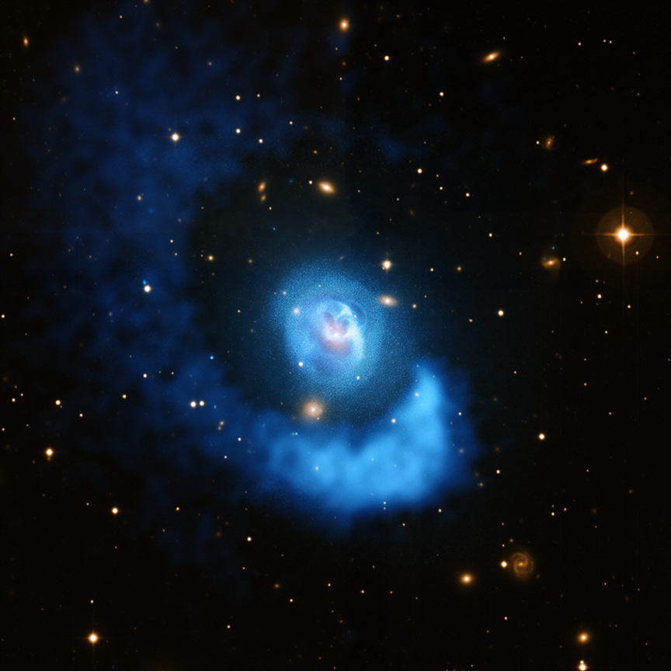
Deep Chandra Observations of Feedback and Sloshing in Clusters of Galaxies
Elizabeth Blanton (BU)

Slide 2
Collaborators
Rachel Paterno-Mahler (BU)
Scott Randall (CfA)
Tracy Clarke (NRL)
Craig Sarazin (UVA)
Brian McNamara (U. Waterloo)
Emmet Golden-Marx (BU)
Joshua Wing (BU)
Mark Brodwin (U. Missouri)
Matt Ashby (CfA)
E. M. Douglass (Farmingdale State / BU)
Michael McDonald (MIT)

Slide 3
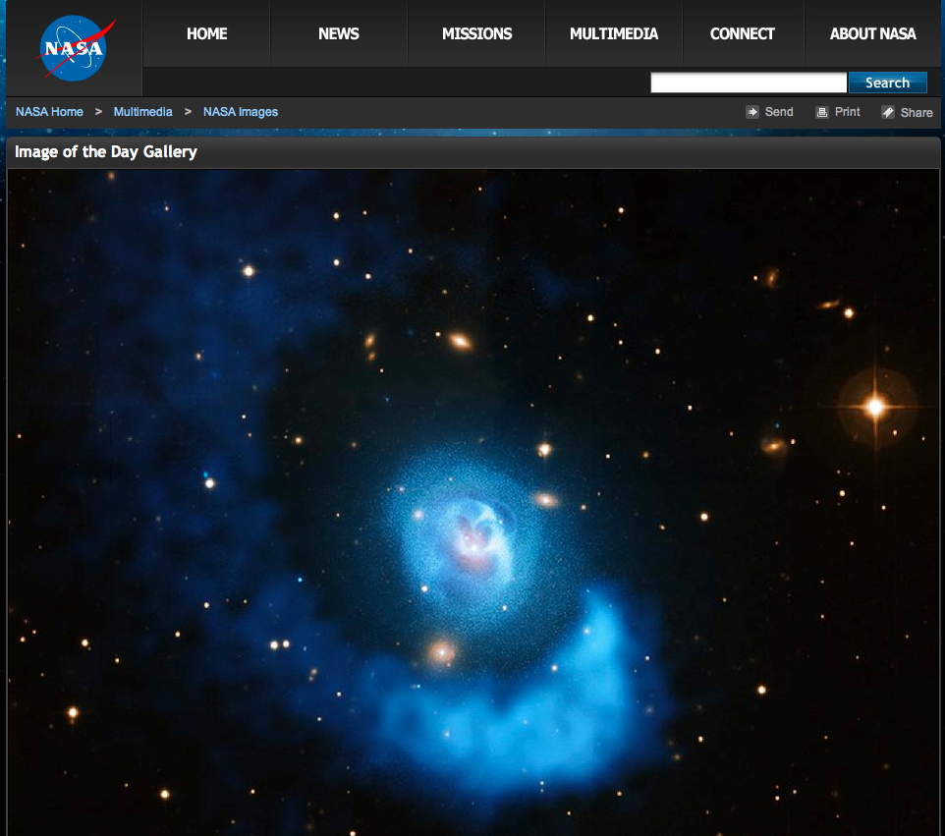
Thanks to Joe DePasquale (CXC)!
NASA/CXC/BU/E. Blanton

Slide 4
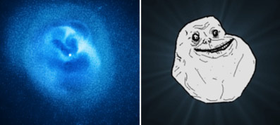
Forever alone guy, from Phil Plait, Discover Magazine

Slide 5
AGN Feedback
Occurs on galaxy to cluster scales
Significant effect on cool cores
Limits star formation, maximum mass of galaxies
Affects global cluster properties, scaling relations
Affects SZ measurements (SZ power spectrum, and direct effect from AGN radio emission)
Important in cosmological studies using clusters

Slide 6
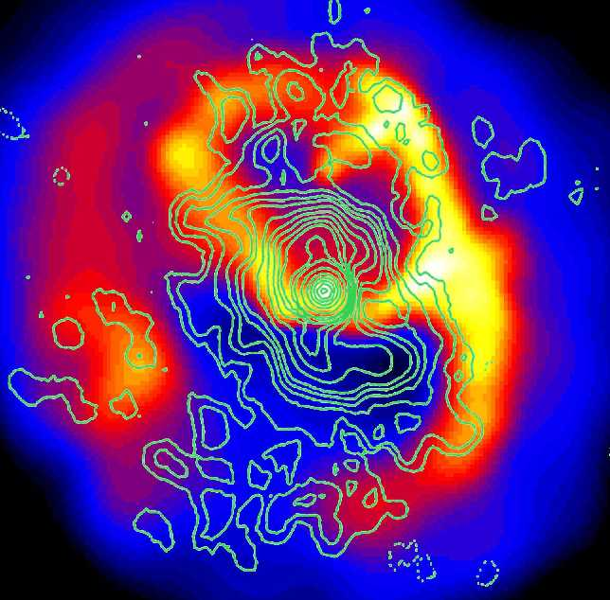
AGN in Cool Cores
>70% of cool core clusters contain central cD galaxies with associated radio sources, as compared to 20% of non-cool core clusters having radio-bright central galaxies (Burns 1990 / Einstein). Recent studies say up to 100% for cool cores and 45% for non-cool cores (Mittal et al. 2009)
This is probably no accident: the cooling gas feeds the AGN.
Radio sources have a profound effect on the surrounding X-ray emitting gas, as seen with Chandra.
In general, the radio sources displace the X-ray gas, which, in turn, confines and distorts the radio lobes. The radio sources create cavities or “bubbles” in the X-ray gas.
Abell 2052 Blanton et al. 2001, 2003, 2009, 2011

Slide 7
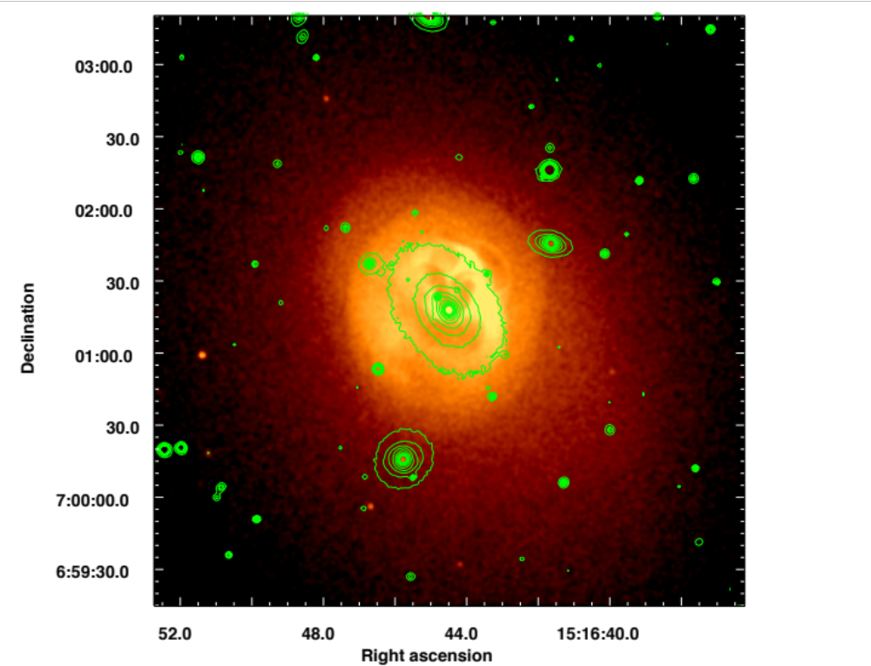
Case Study: Abell 2052
Most deeply observed cool core cluster, other than Perseus and Virgo/M87.
657 ksec with Chandra in Cycles 1, 6, and 10.
Notes:
1.5” Gaussian smoothed

Slide 8
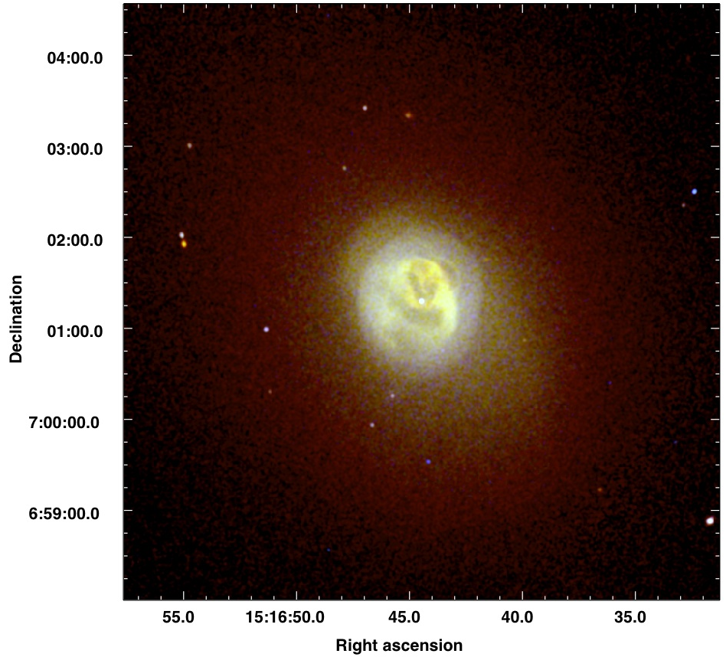
A2052
1’’=0.7 kpc
Red = 0.3-1 keV, green = 1-3 keV, blue = 3-10 keV

Slide 9
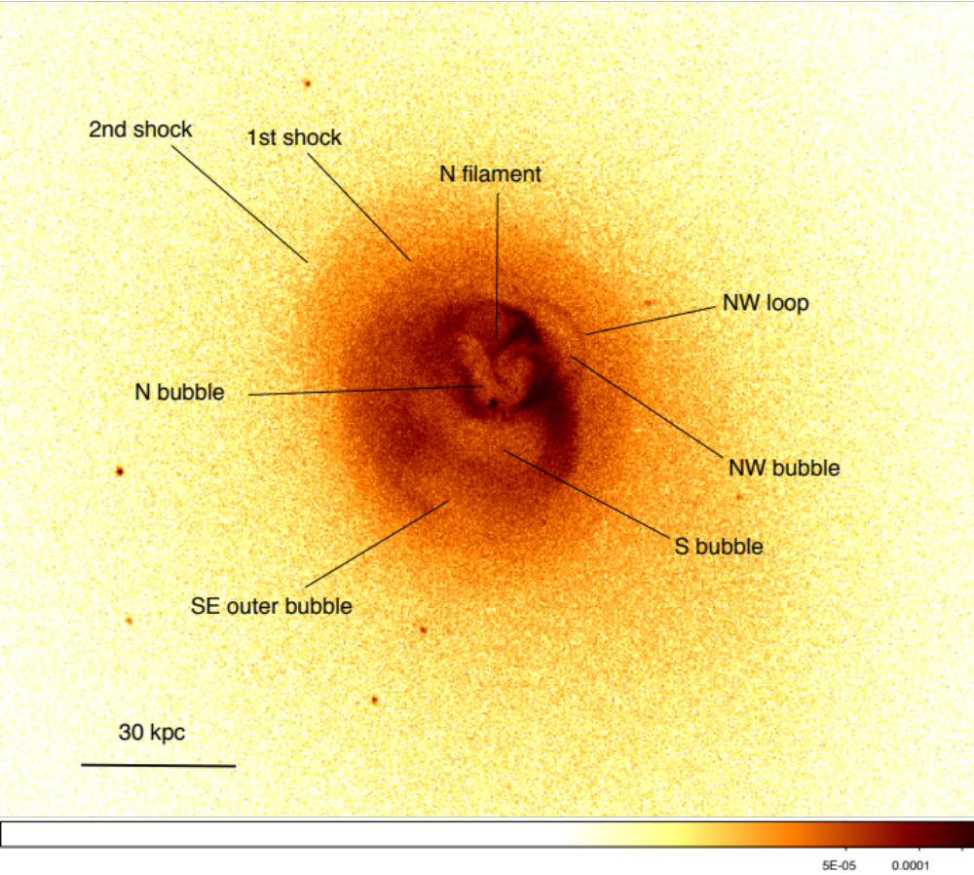
Notes:
unsmoothed

Slide 10
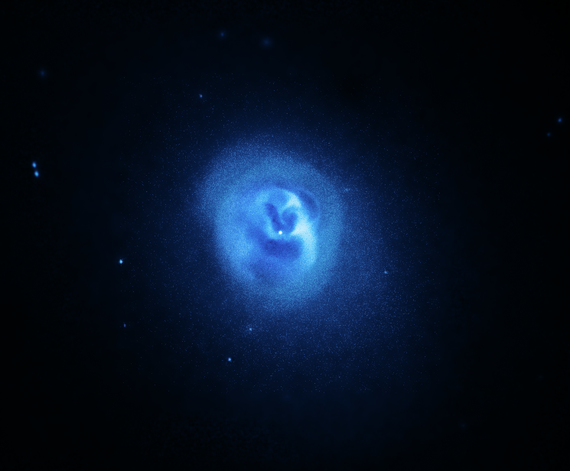

Slide 11
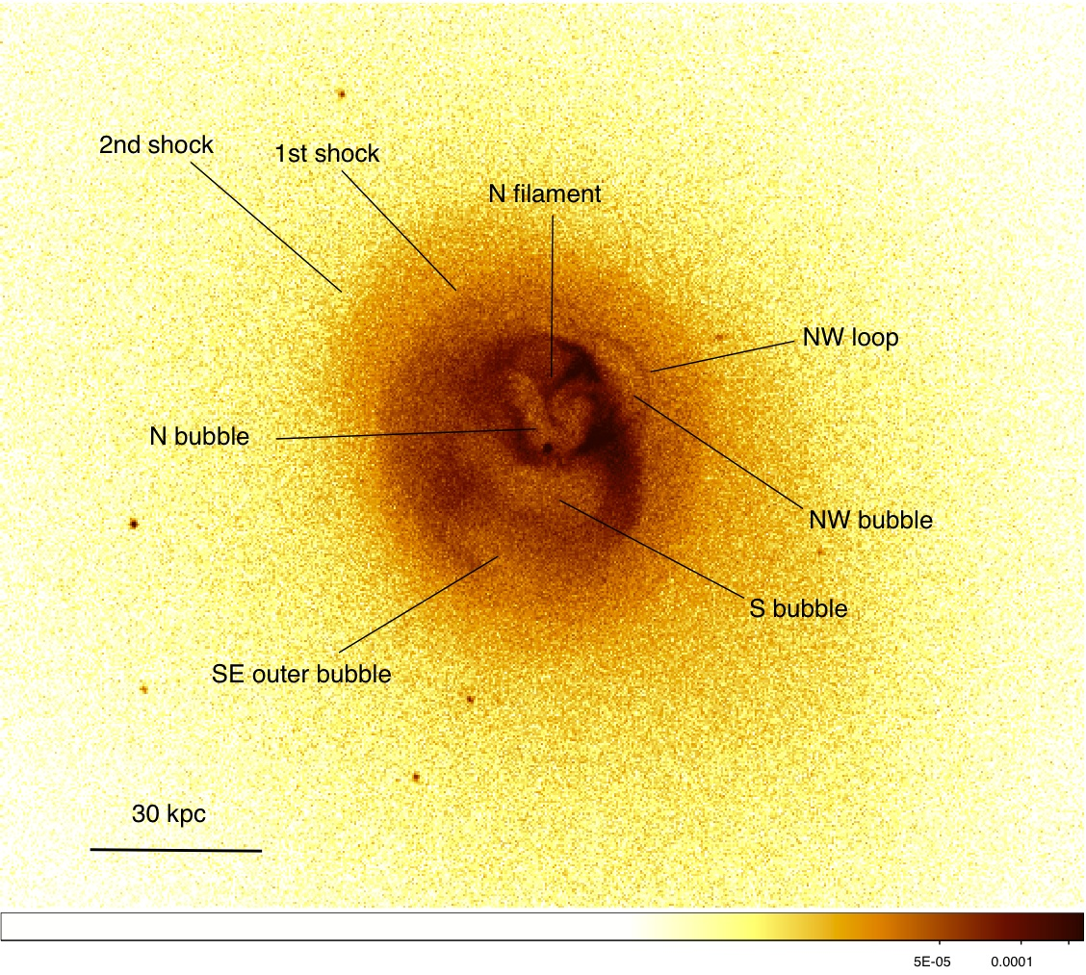
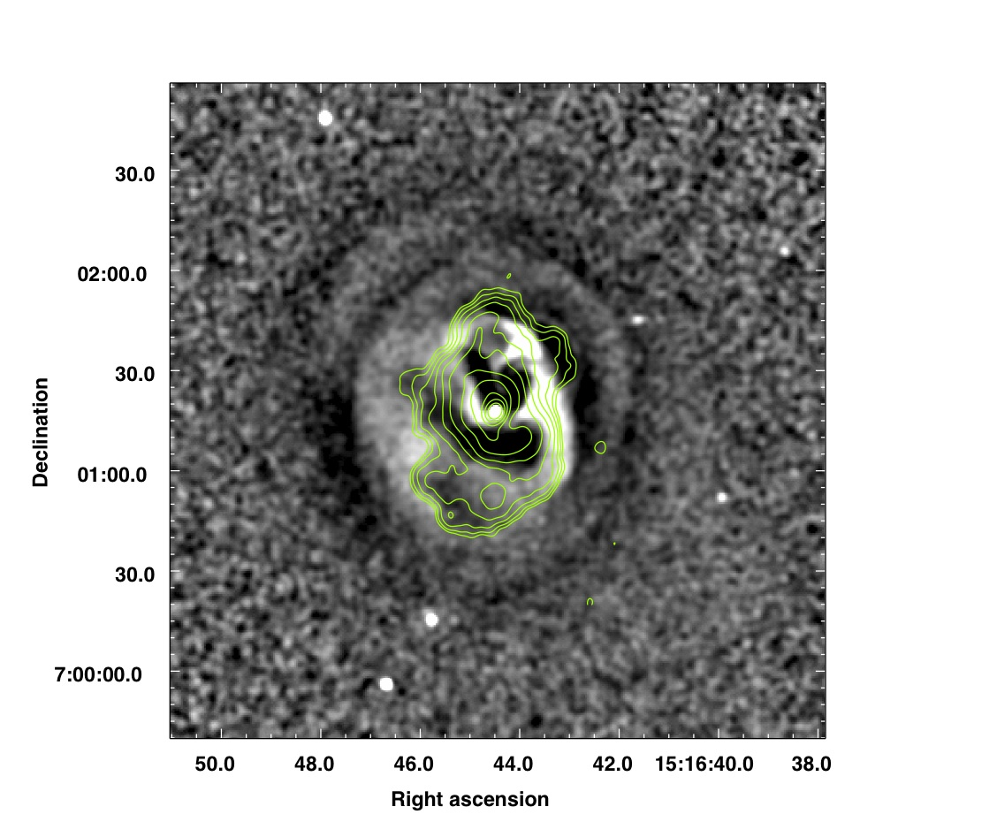
Abell 2052: Shock Heating
Blanton et al. (2011), 657 ksec Chandra ACIS-S
Notes:
Unsharp: 0.98’’ smoothed and 9.8’’ smoothed

Slide 12
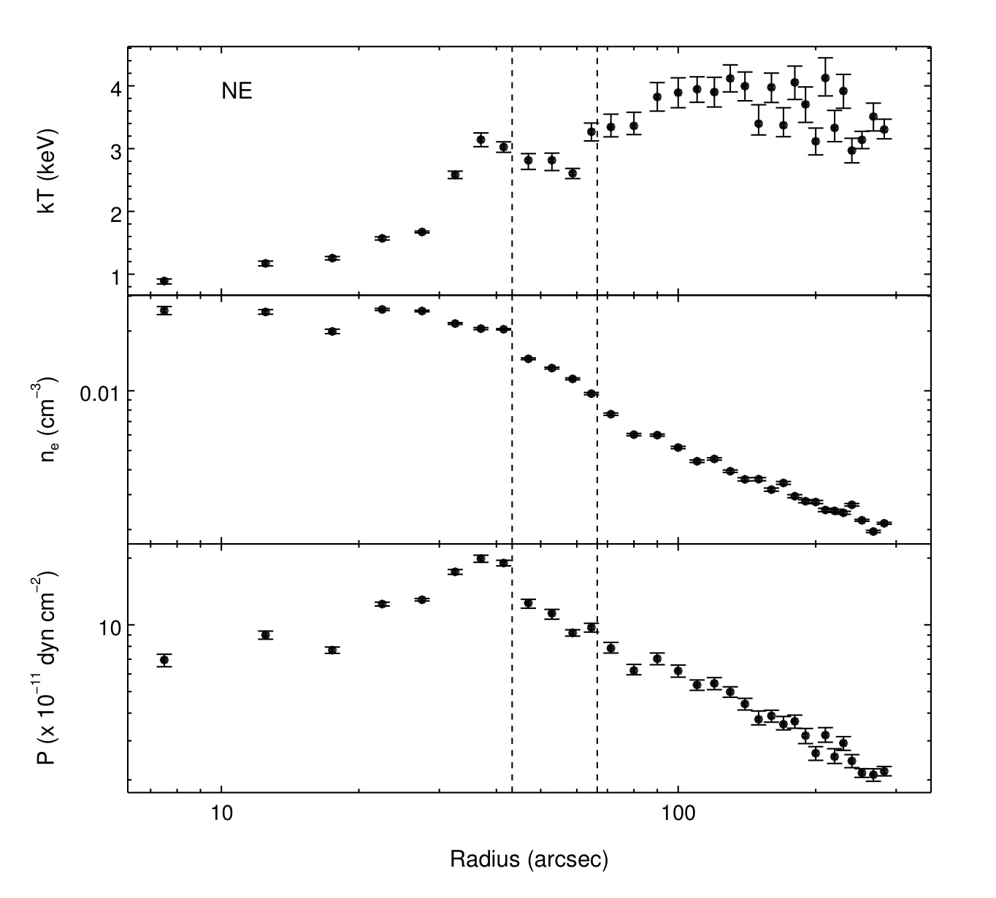
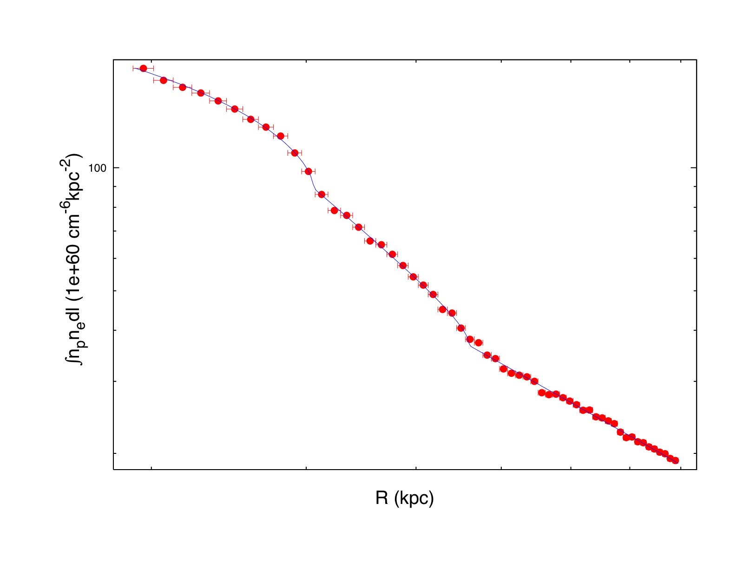
Abell 2052, Shock Heating
Both shocks (at 31 and 46 kpc from AGN) have Mach ~ 1.2 Blanton et al. (2011).
Notes:
Deprojected T profile

Slide 13
Repetition rate of AGN
Estimate cycle time (time between radio source outbursts) using shock velocities and offsets, or buoyantly rising bubbles.
Both methods give t ~ 2 x 10⁷ yr.

Slide 14
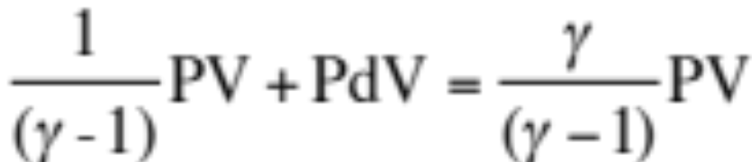
Abell 2052: Bubble Energy Input
Using γ=4/3, the energy input rate is 3.2 x 10⁴³ erg s⁻¹ (6.4 x 10⁴³ erg s⁻¹) assuming the bubbles rose at 0.5 (1) times the sound speed

Slide 15
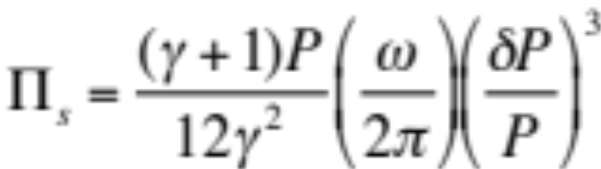
Abell 2052: Shock Energy Input
McNamara & Nulsen (2007)
The shock energy input rate is 1 x 10⁴³ erg s⁻¹, a factor of 3-6 lower than the energy input from buoyantly rising bubbles.
The combination of rising bubble and shock heating offsets the cooling rate of 5.4 x 10⁴³ erg s⁻¹
Blanton et al. (2011)

Slide 16
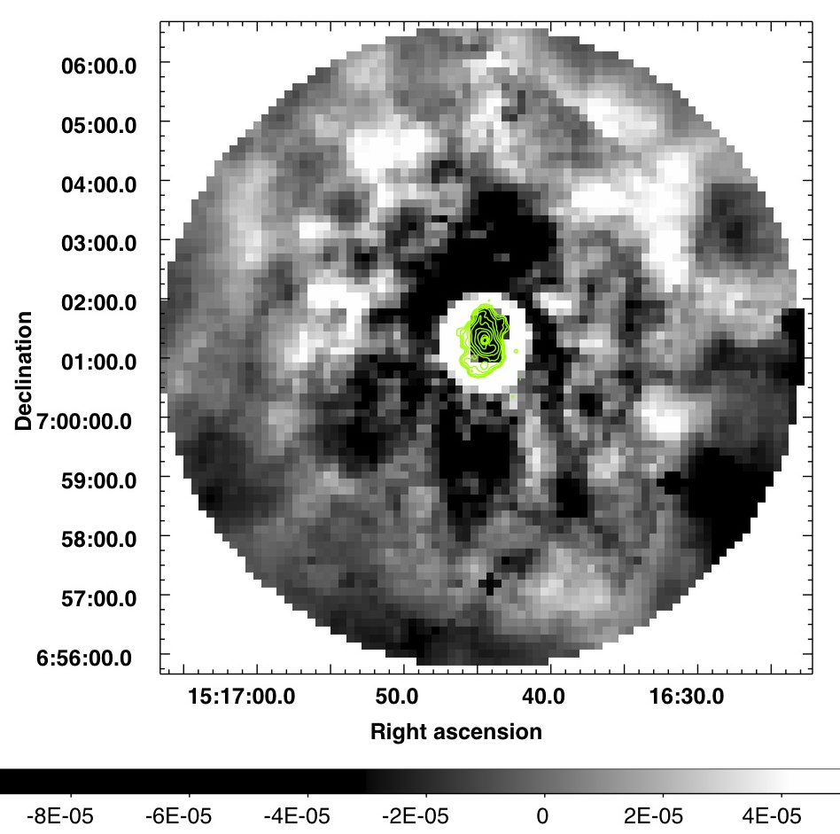
Residual pseudo-pressure map.
Outer bubbles to N and S, each with E~10⁶⁰ erg

Slide 17

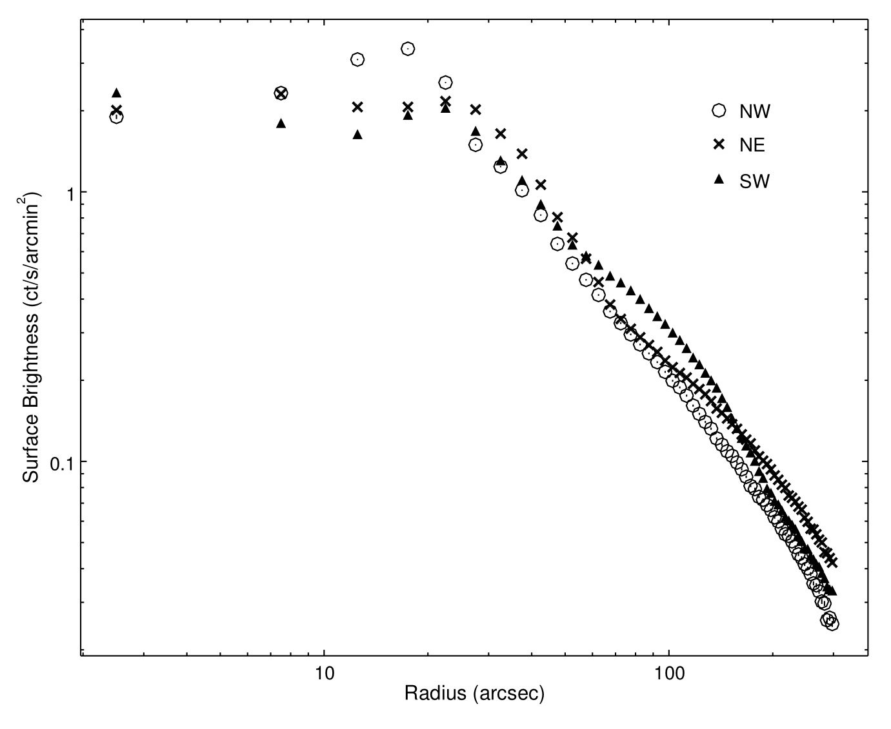
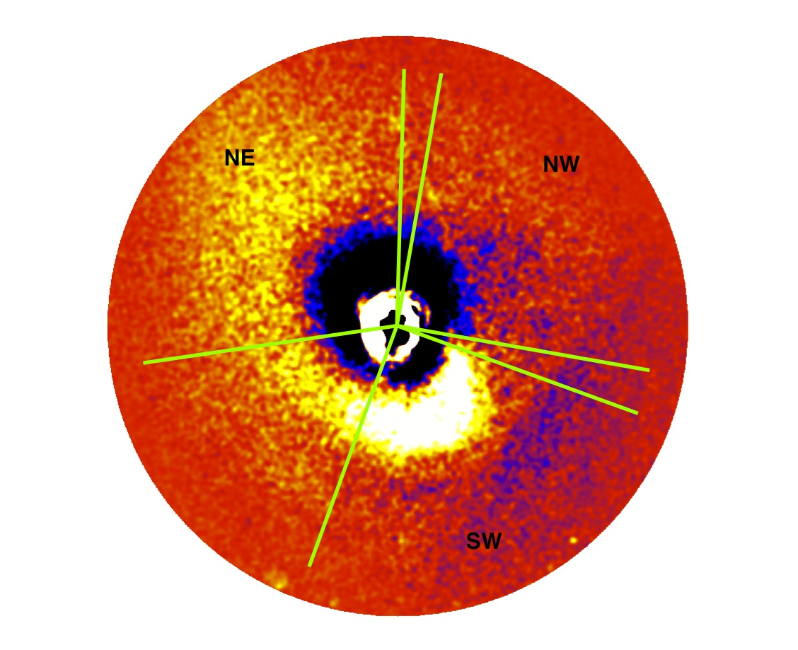
A2052: Sloshing
240 kpc radius circle
model-subtracted image

Slide 18
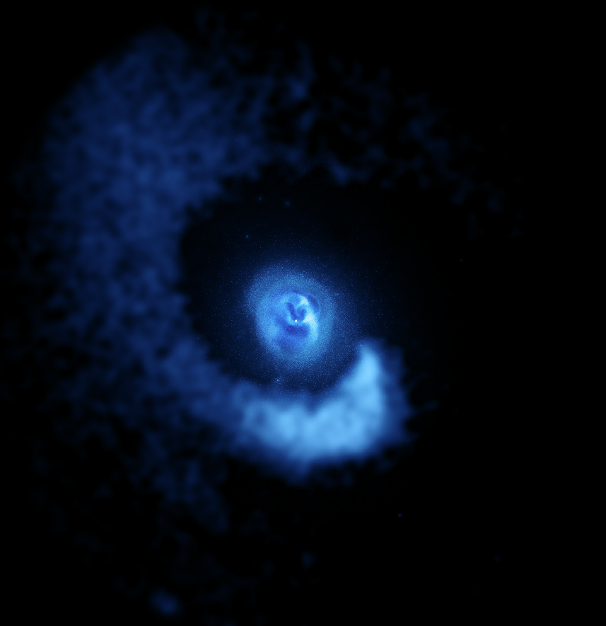

Slide 19
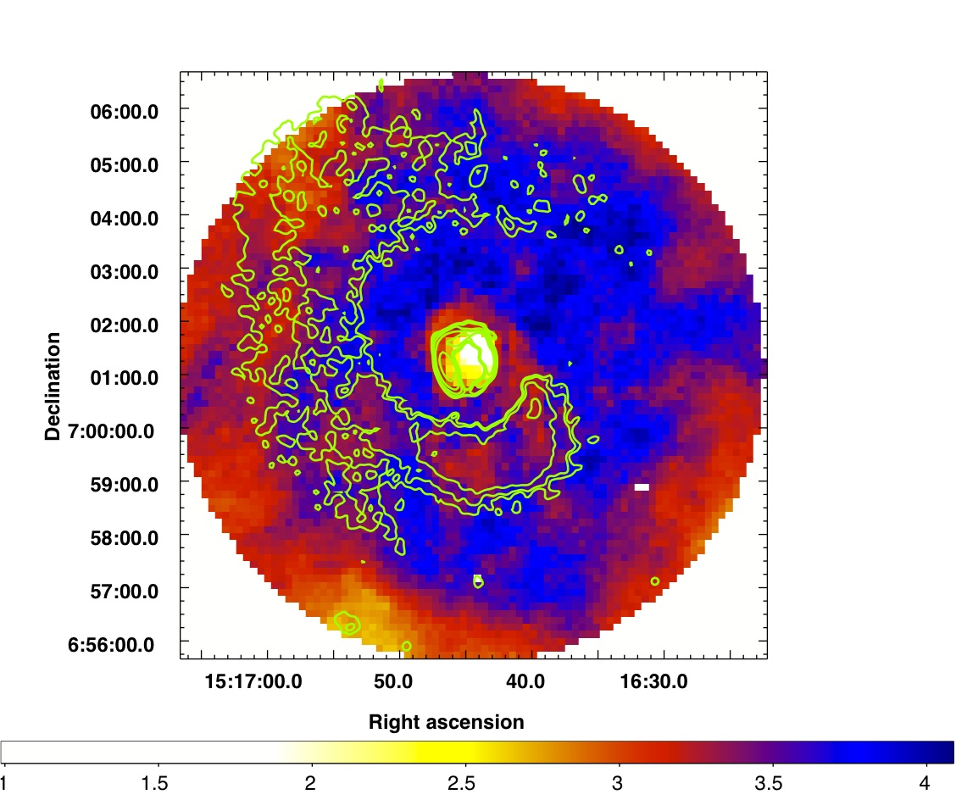
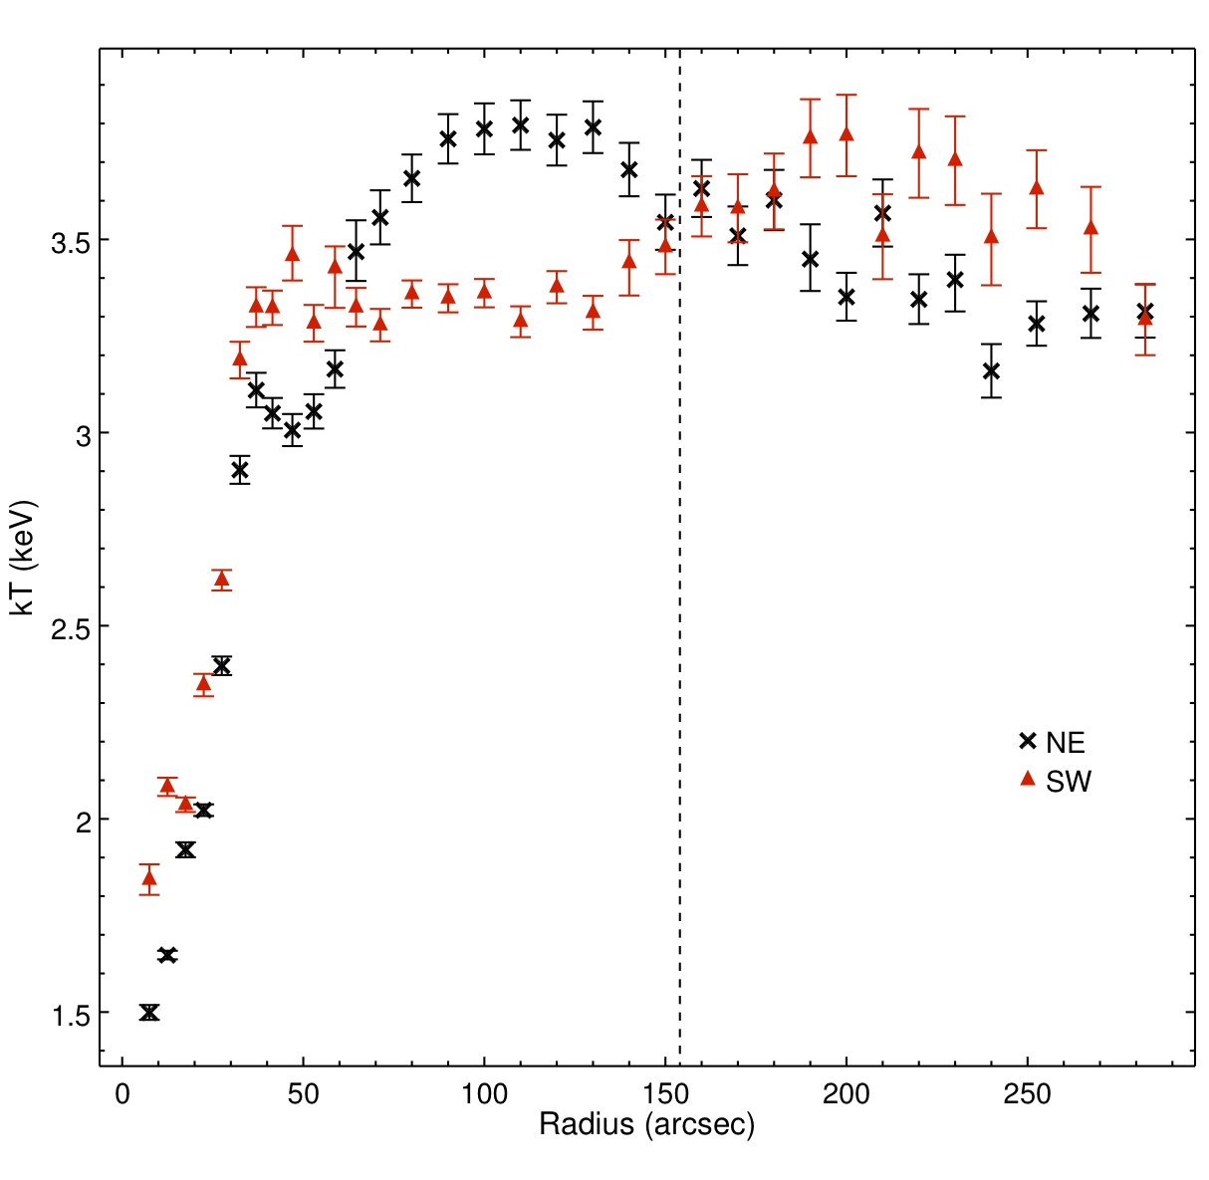
A2052: Sloshing
Temperature map

Slide 20
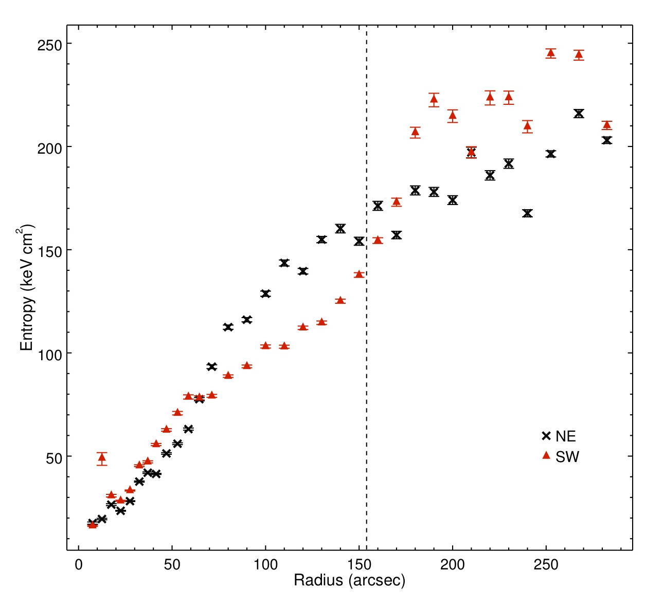
Sloshing / Entropy
S = kT / n^{2/3}

Slide 21
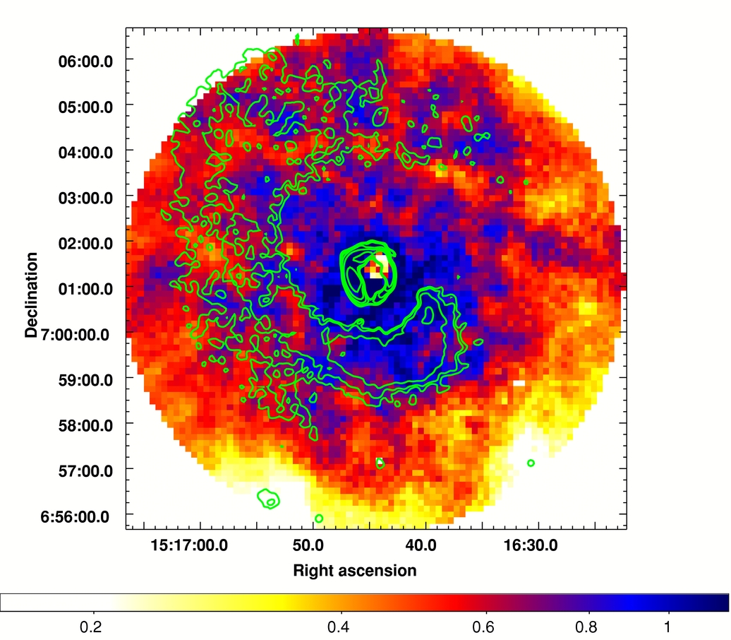
Sloshing / Abundance
Notes:
Errors 10-15% on average

Slide 22
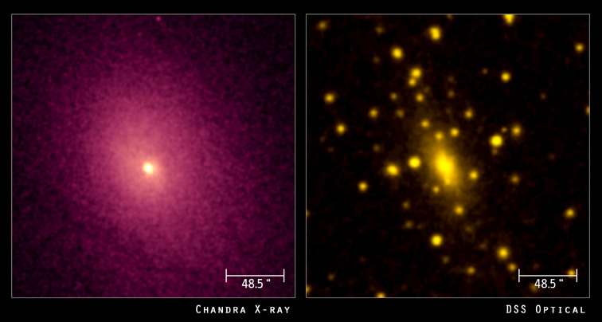
A2029: Can Sloshing Bend Radio Lobes?
NASA/CXC/UCI/A. Lewis

Slide 23
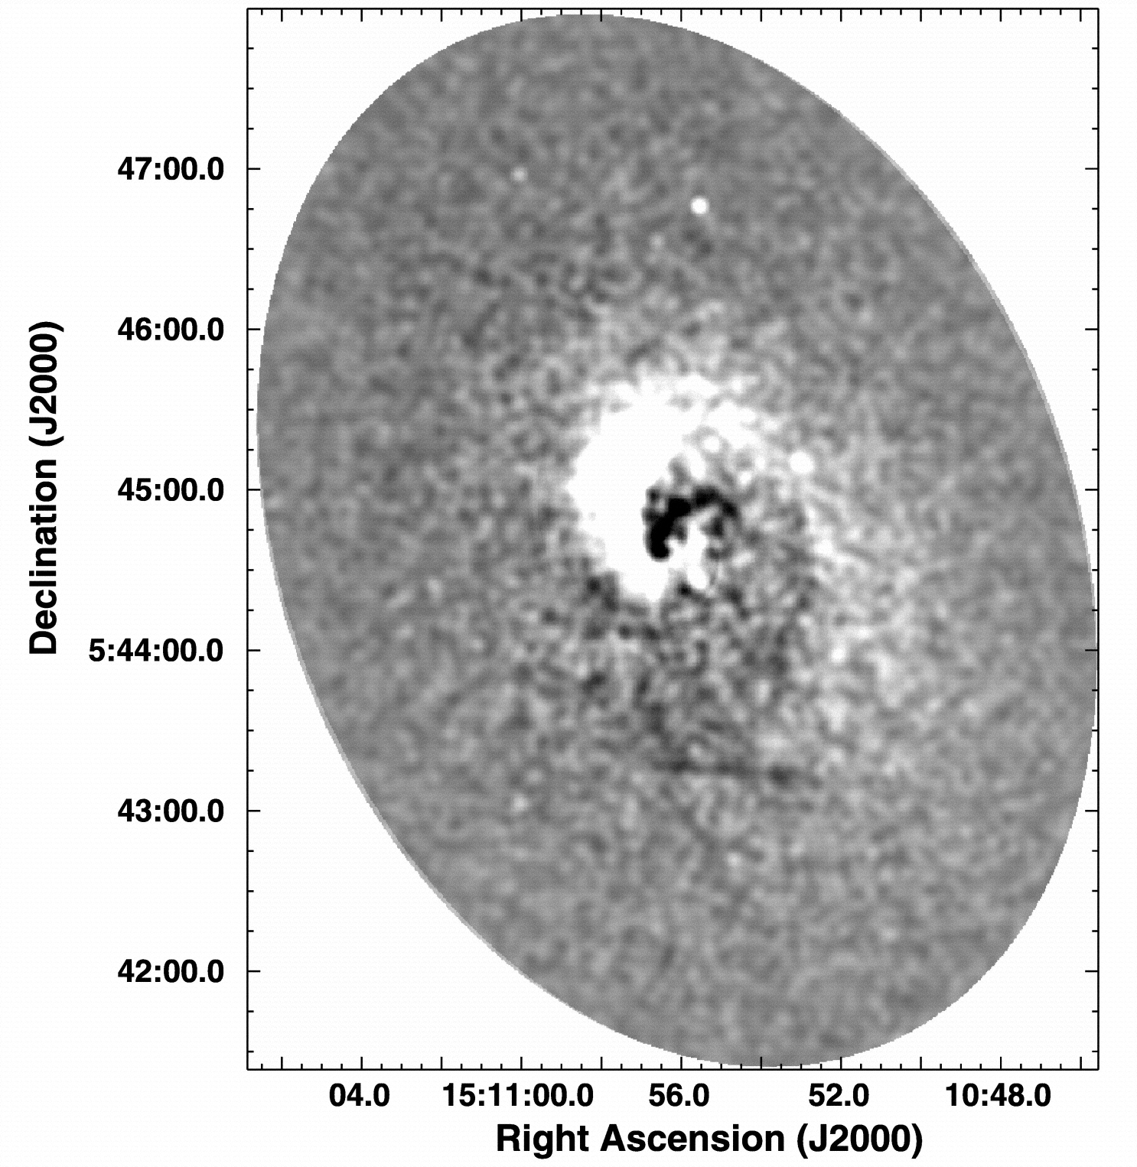
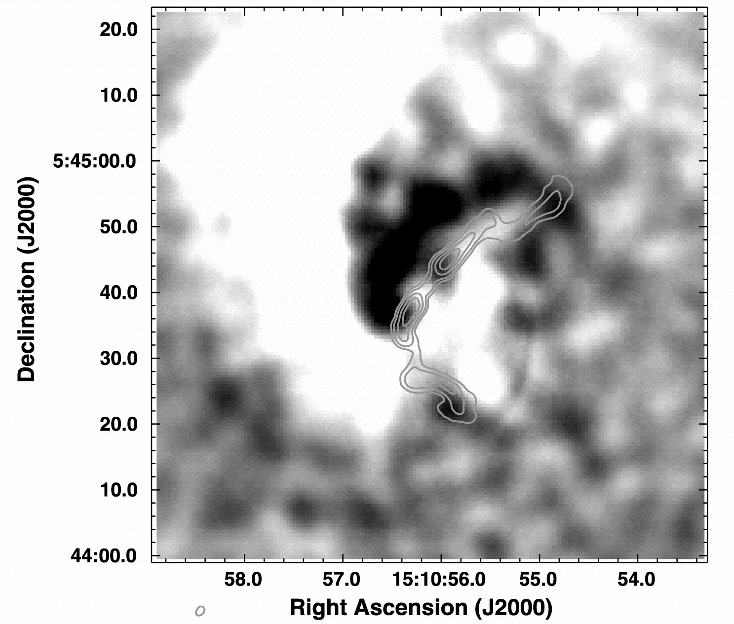
A2029: Sloshing
Clarke, Blanton, & Sarazin (2004)

Slide 24
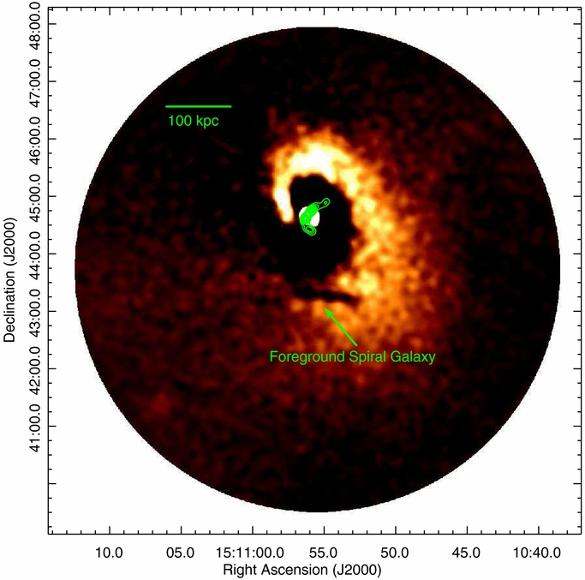
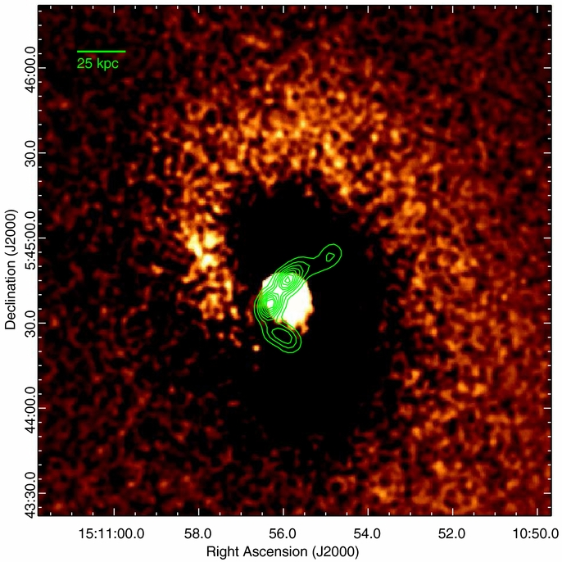
Sloshing: A2029
Paterno-Mahler, Blanton et al. (2013), 97 ksec ACIS-S3
Velocities required for bending ~150-300 km/s (consistent with sloshing sims (Mendygral+ 2012))
Notes:
Spiral extends to ~400 kpc in radius

Slide 25
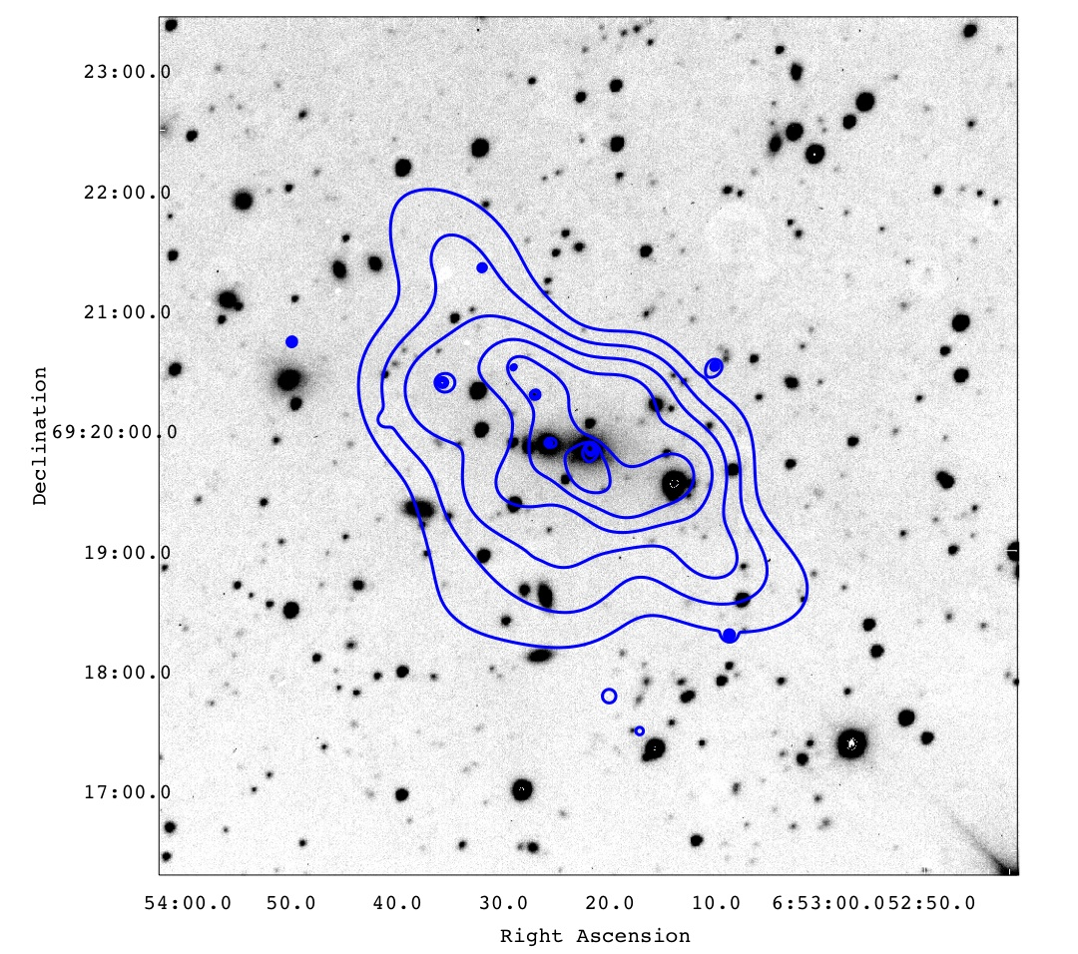
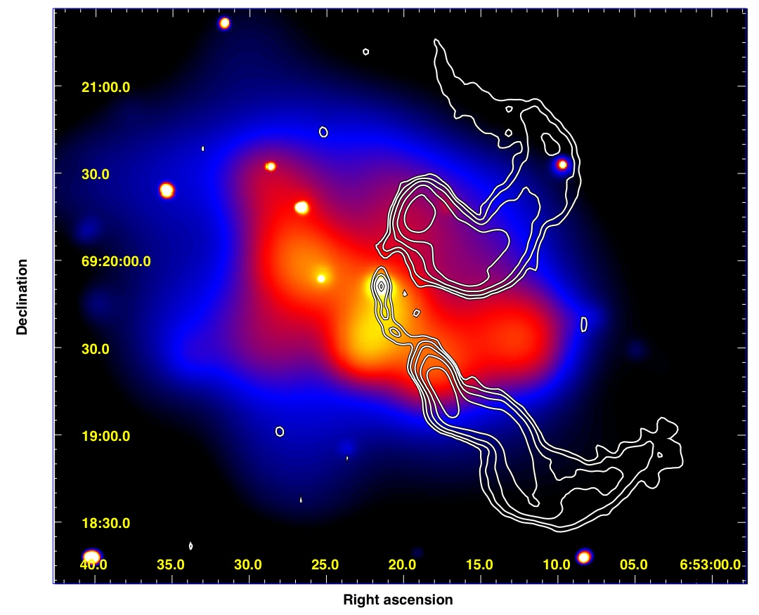
Bent sources are also sometimes in cluster mergers
A562: Douglass, Blanton et al. (2011)

Slide 26
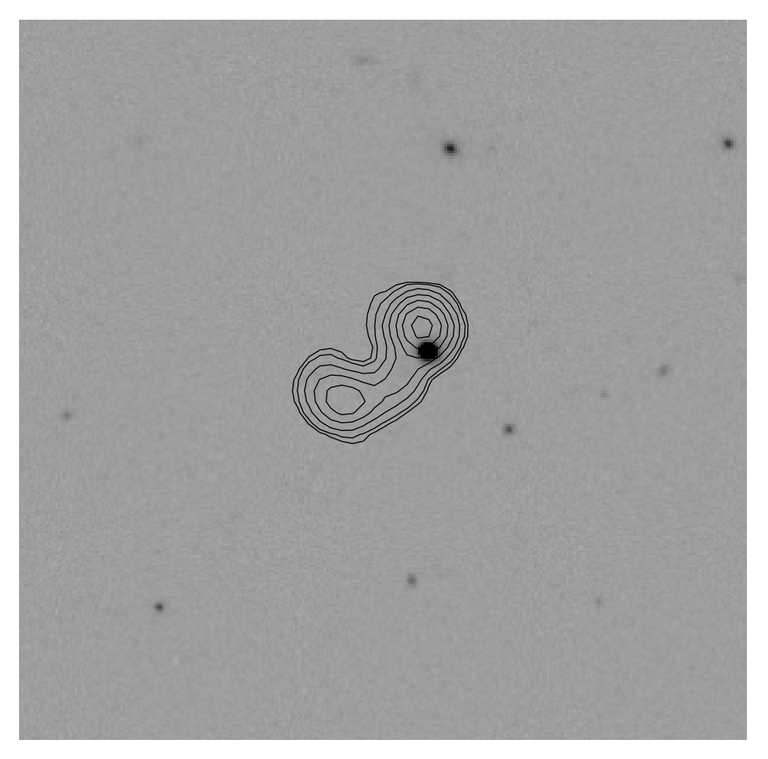
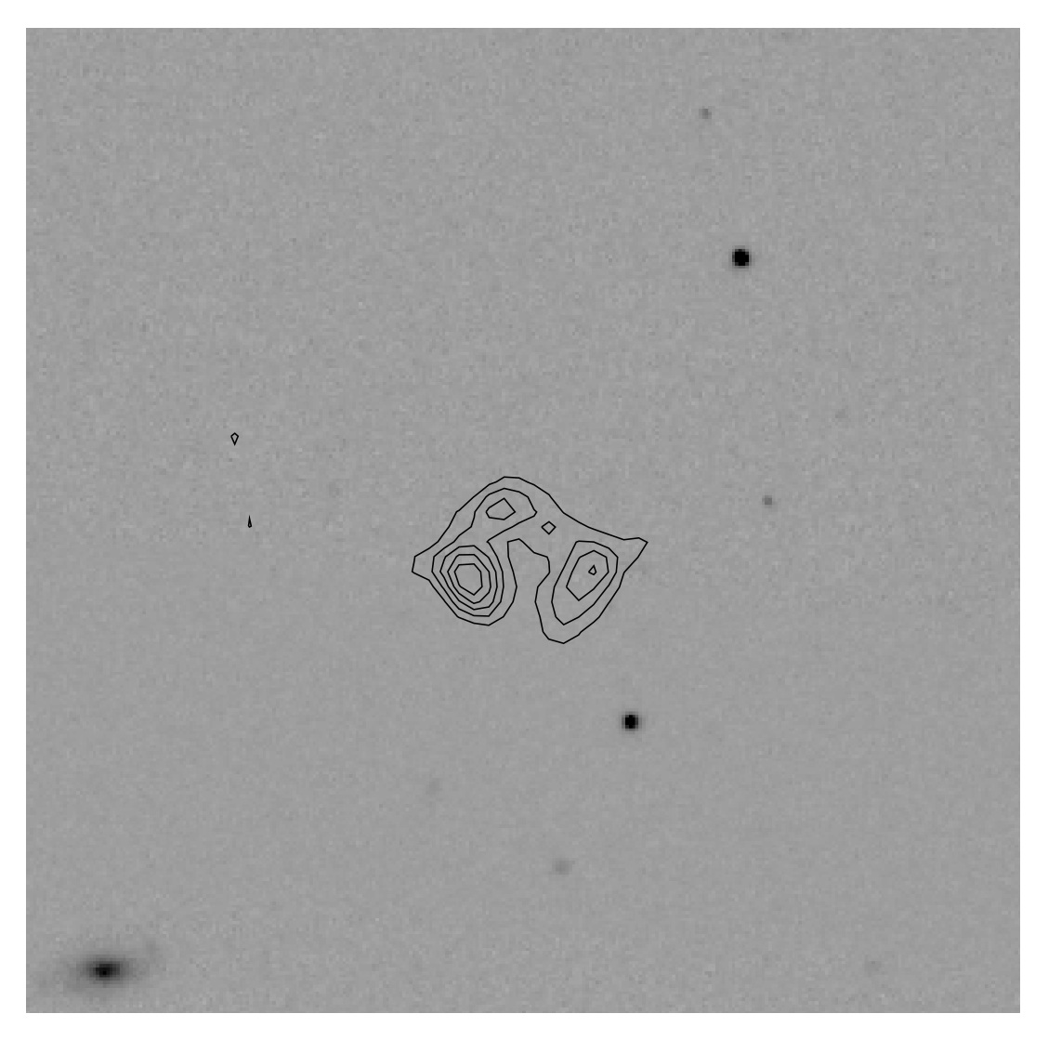
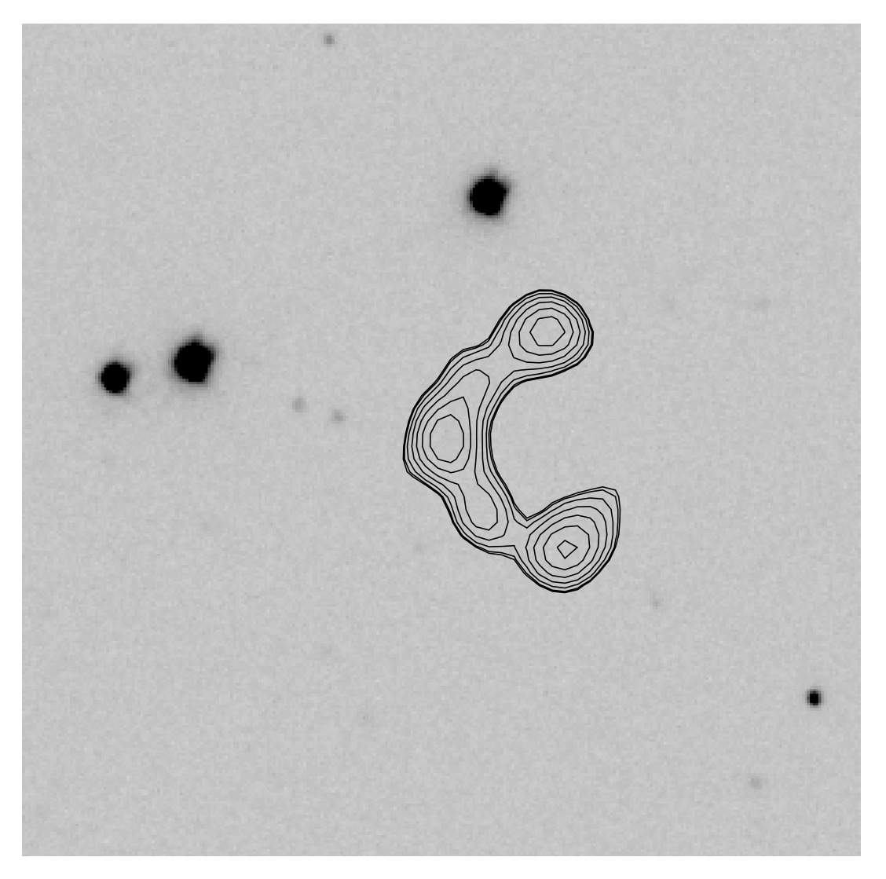
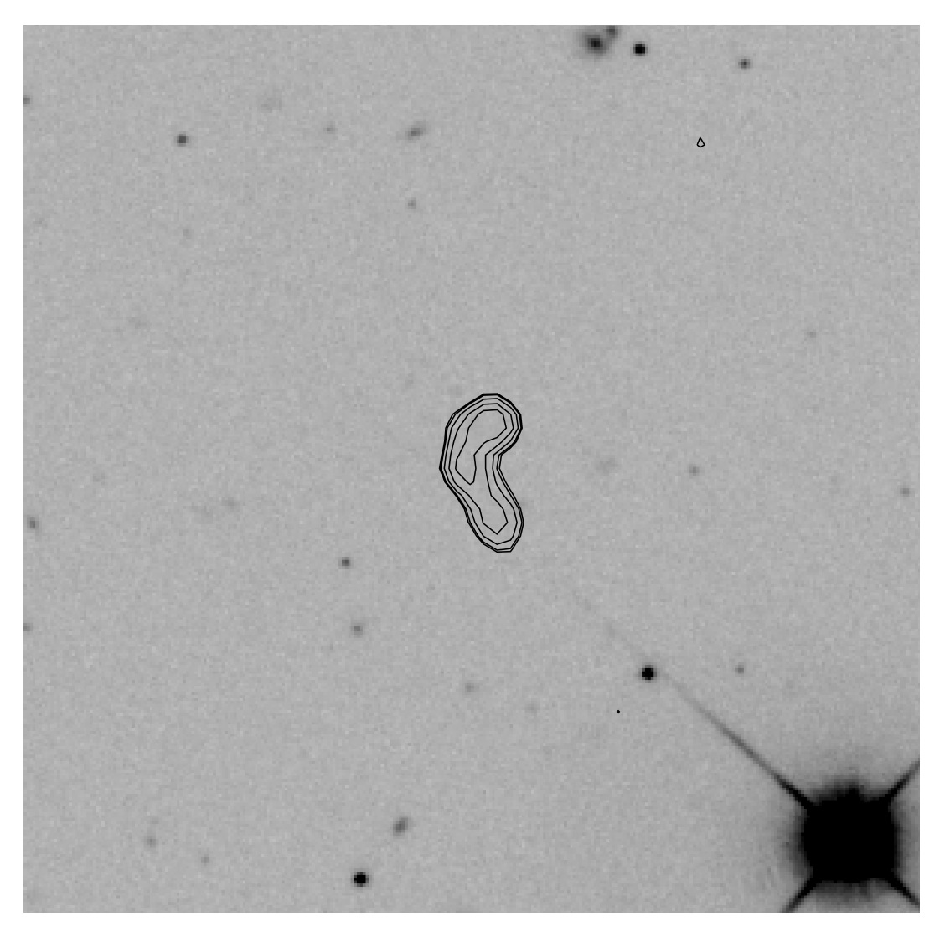
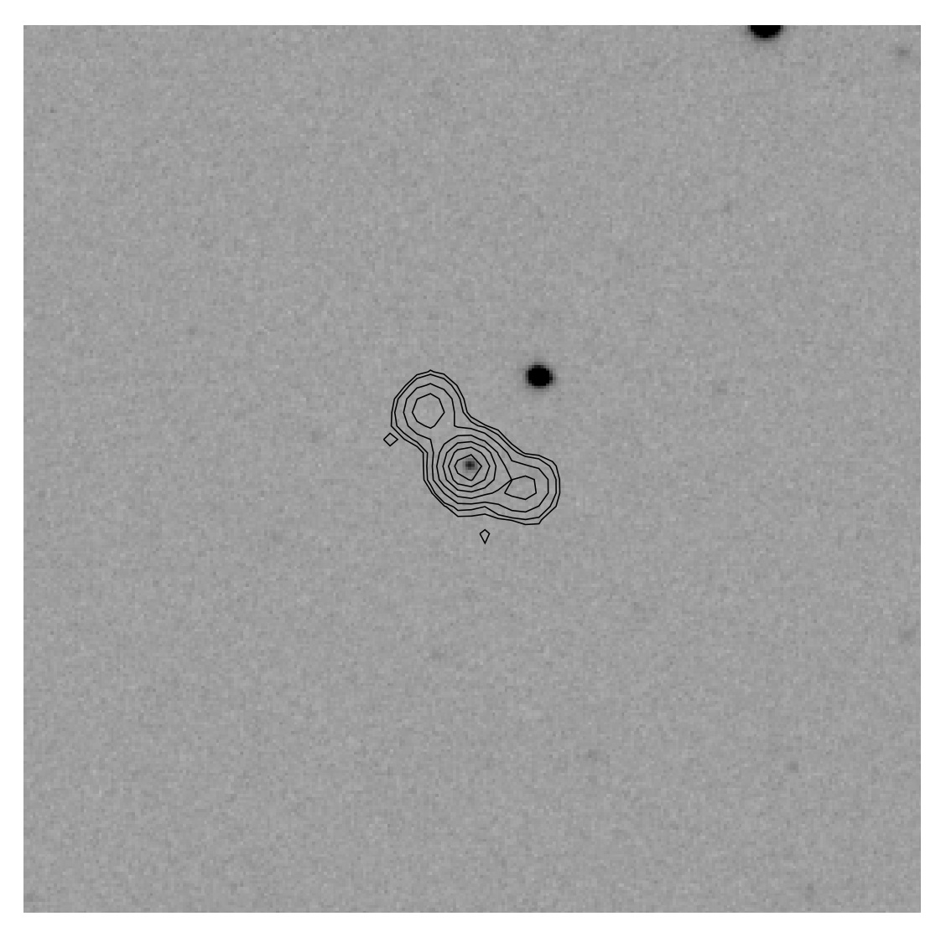
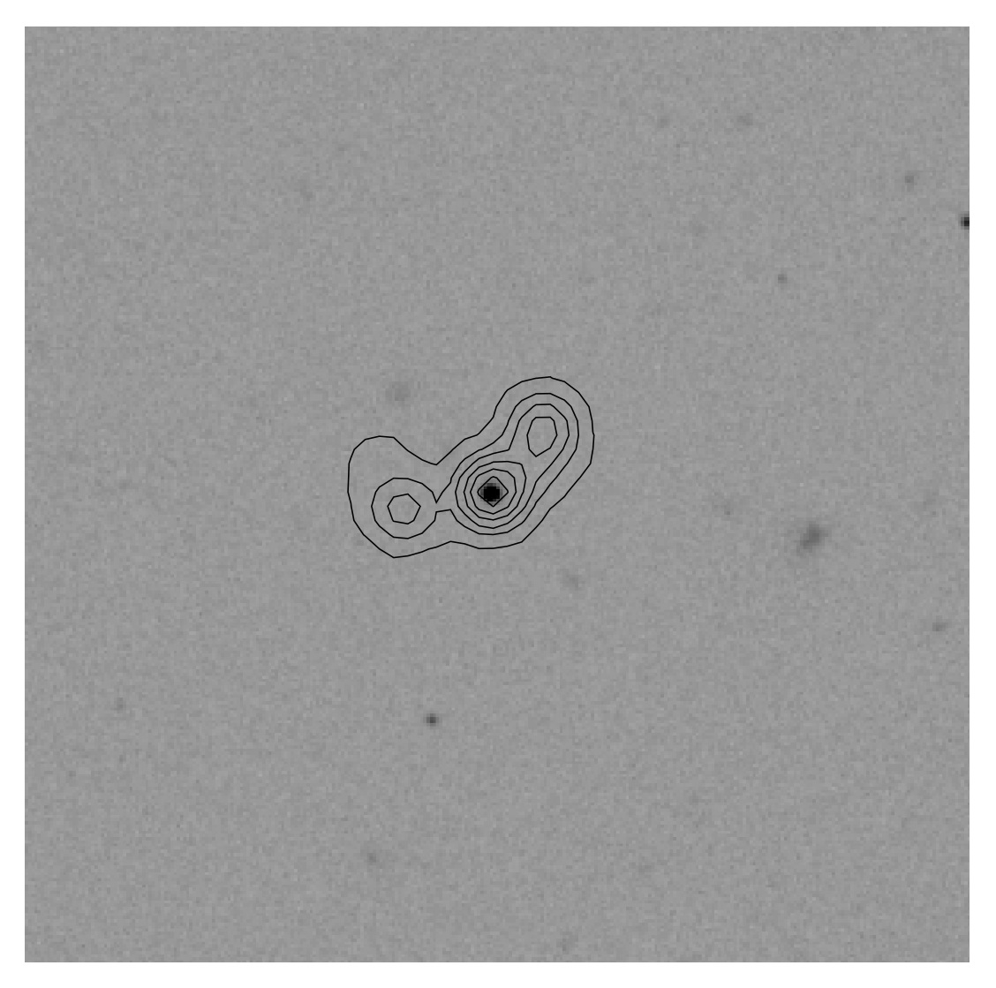
High-z Cluster Candidates
FIRST 1.4 GHz radio contours overlaid on SDSS 2’x2’ r-band images. Wing & Blanton (2011)

Slide 27

Clusters Occupied by Bent Radio AGN
Thanks A. Blanton!

Slide 28
COBRA Survey Features
Objects in the range z ~ 0.7 – 3
Wide range of masses – groups to rich clusters
Sample to examine AGN feedback at a range of z since all objects have radio-loud AGN
Efficient method for generating a sample to study galaxy evolution in group and cluster environments
X-ray follow-up observations of relaxed systems can be used for cosmological constraints via the gas fraction method
May sometimes trace out large-scale filaments and clusters in formation

Slide 29
Spitzer observations of 651 objects in hand reveal approximately 200 new clusters and groups with z > 0.7 (Paterno-Mahler et al., in prep.)
Optical imaging follow-up with 4.3 m Discovery Channel Telescope with the Large Monolithic Imager (12.3 x 12.3 arcmin) for photometric redshifts
Next: spectroscopic z’s and X-ray!

Slide 30
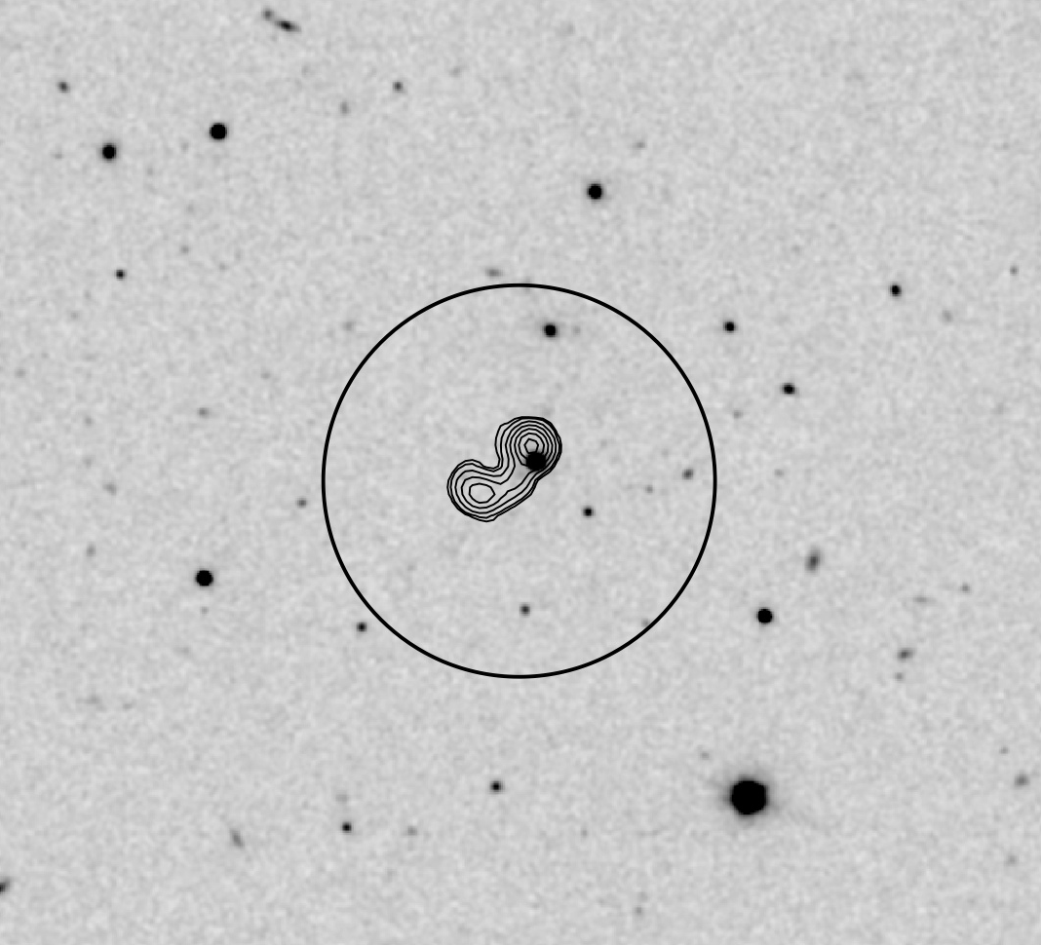
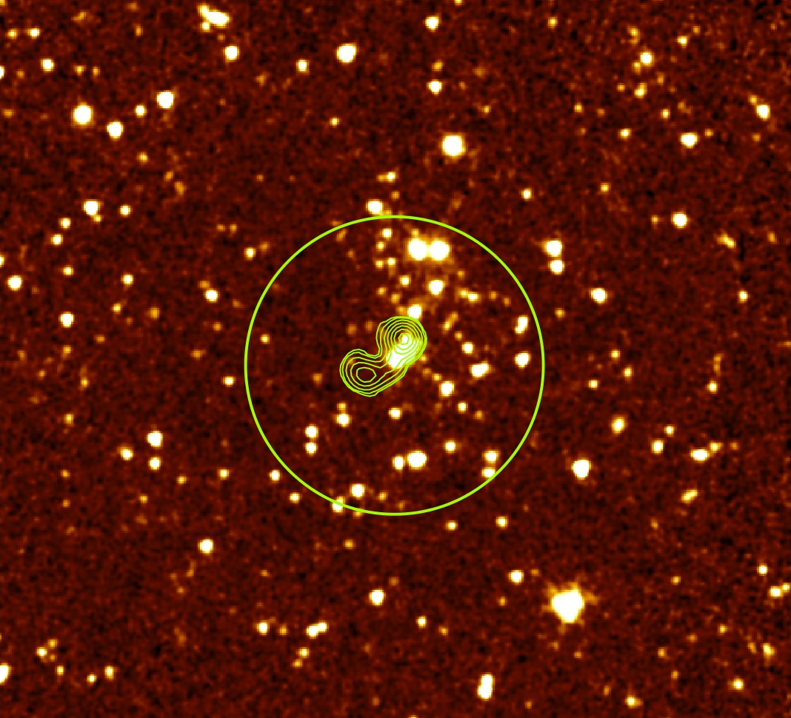
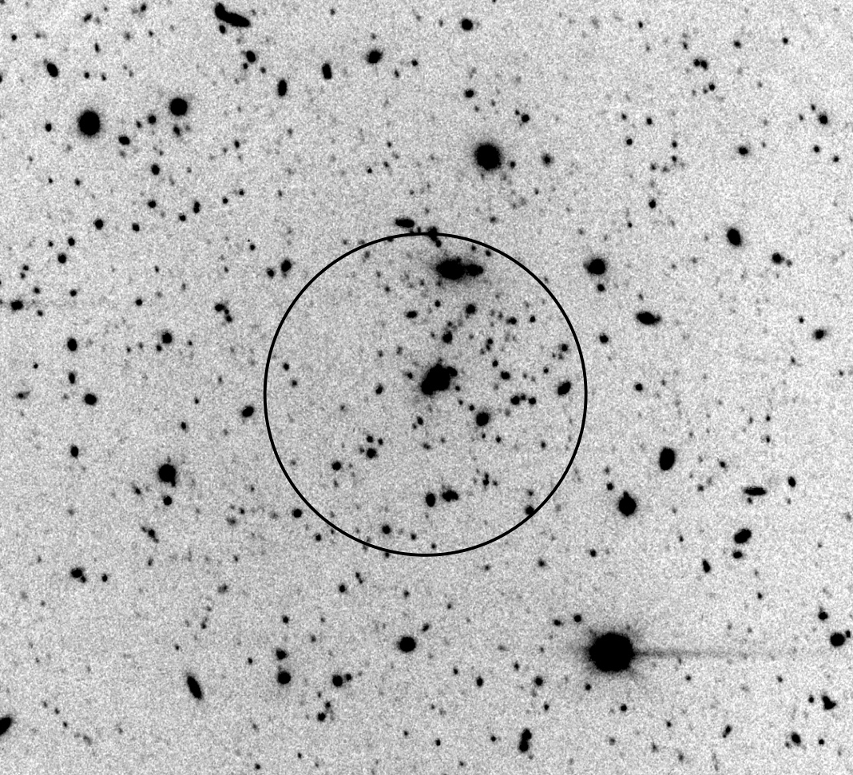
z ~ 0.7
SDSS r-band
Spitzer 3.6 µm
DCT/LMI i-band
Notes:
The radius of the circle is 50’’ (360 kpc), beyond which the density of cluster galaxies falls off sharply. The full f.o.v. shown is 4 x 4 arcmin in each panel. 7 sigma overdensity in i-band.

Slide 31
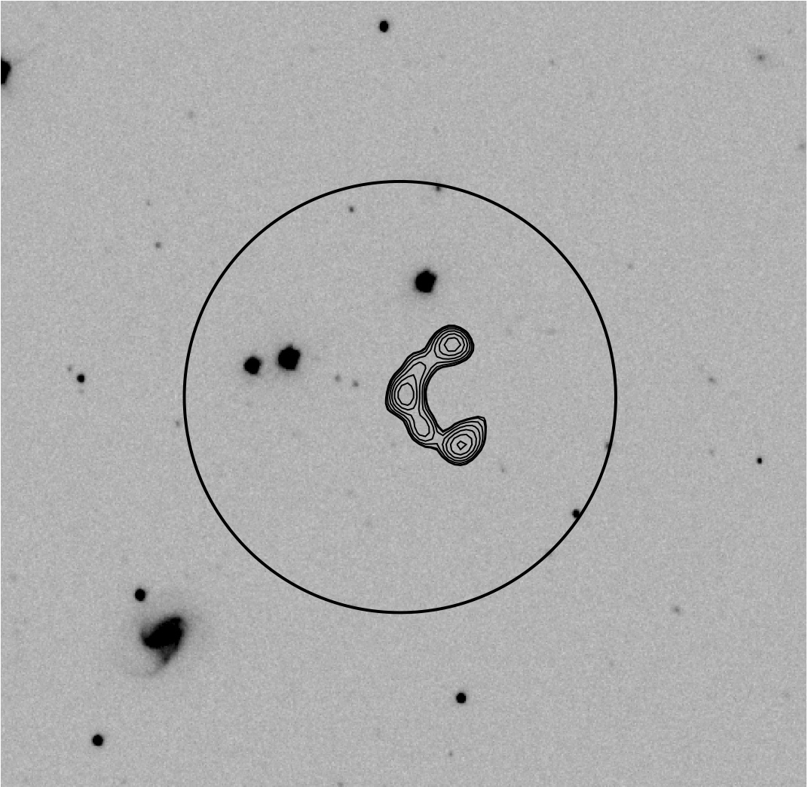
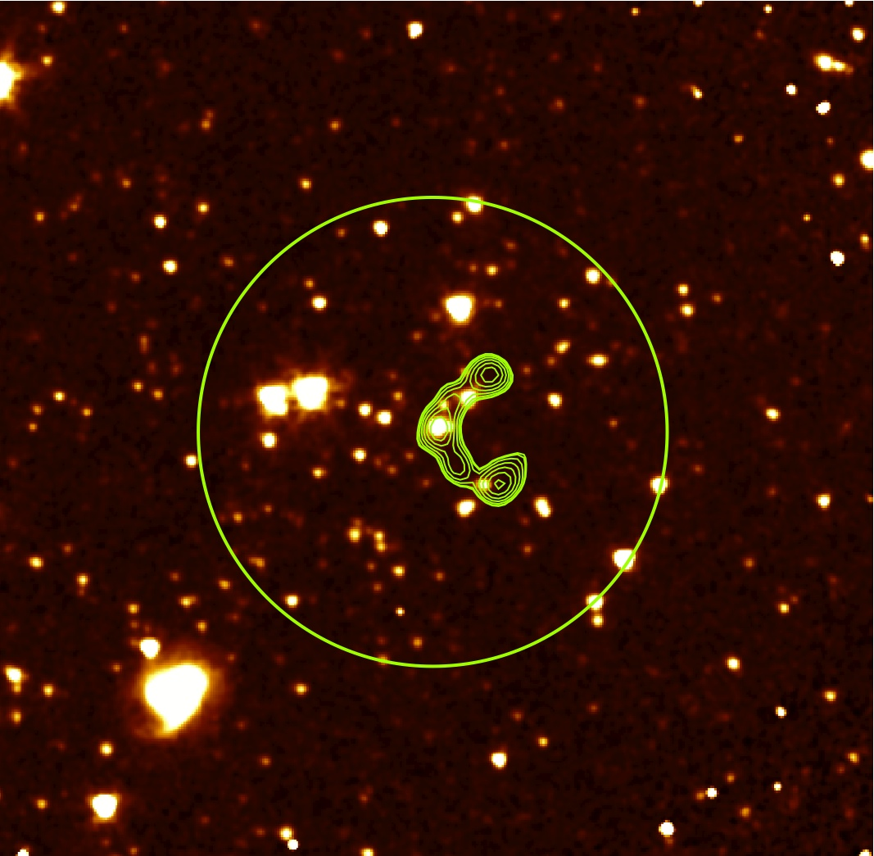
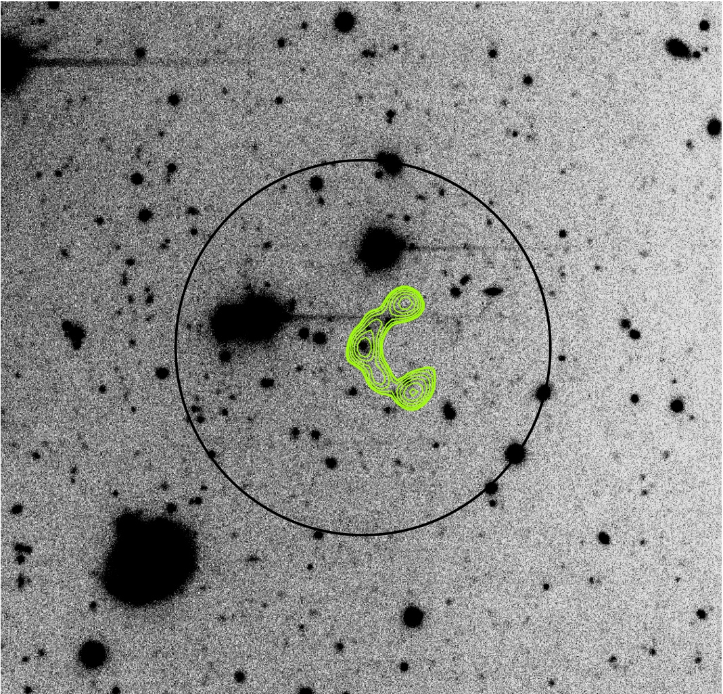
z ~ 1.1
SDSS r-band
Spitzer 3.6 µm
DCT/LMI i-band
Notes:
The circle has a radius of 65’’ (= 550 kpc). 3 sigma overdensity in r-band

Slide 32
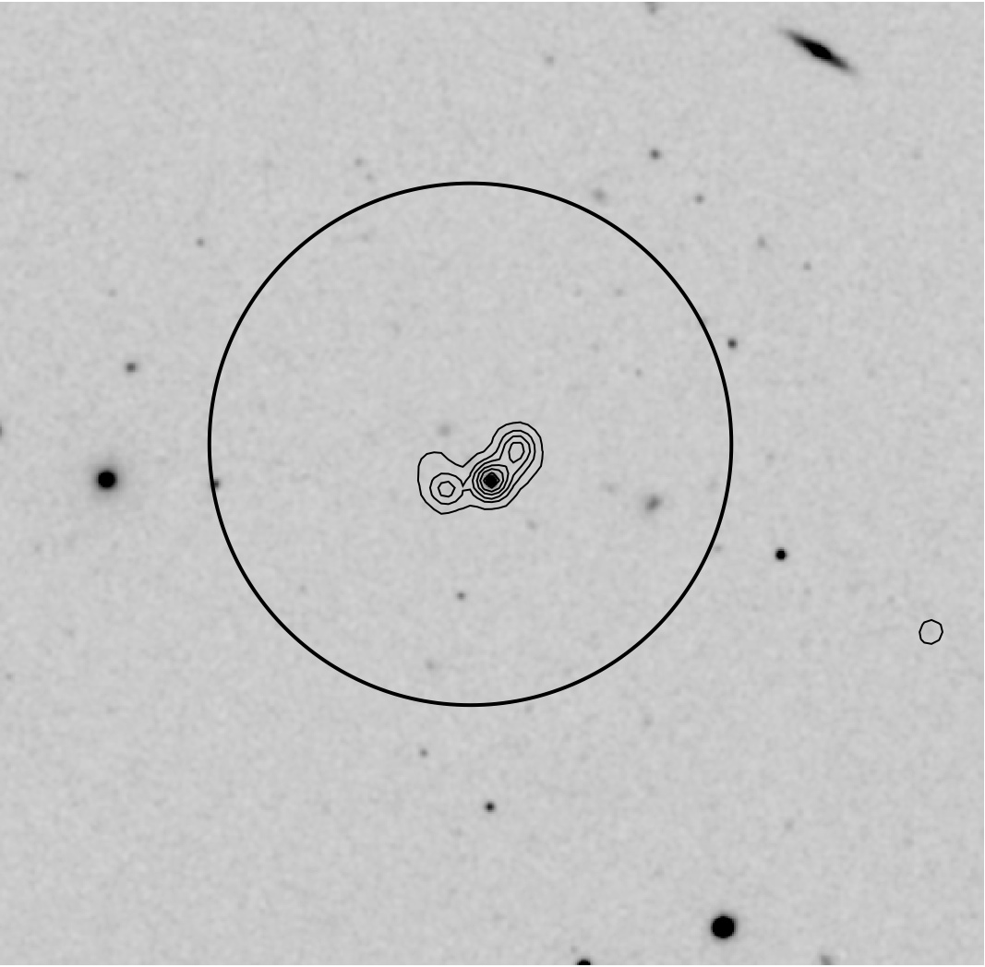
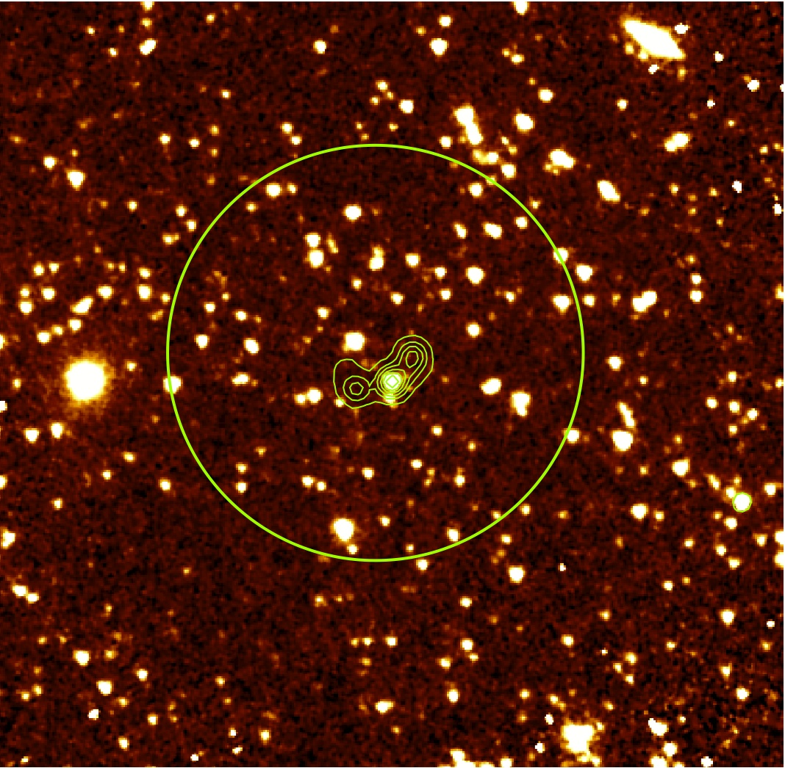
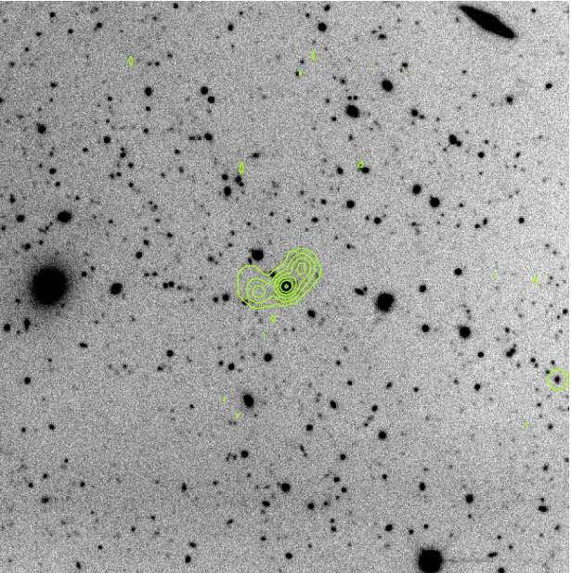
z = 1.82
SDSS r-band
Spitzer 3.6 µm
DCT/LMI i-band
Notes:
The circle has a radius of 65’’ (= 550 kpc). The radio host is a quasar with a measured z from the SDSS. 7 sigma overdensity in i-band.

Slide 33
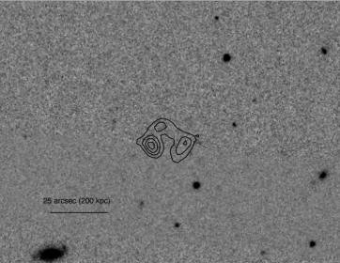
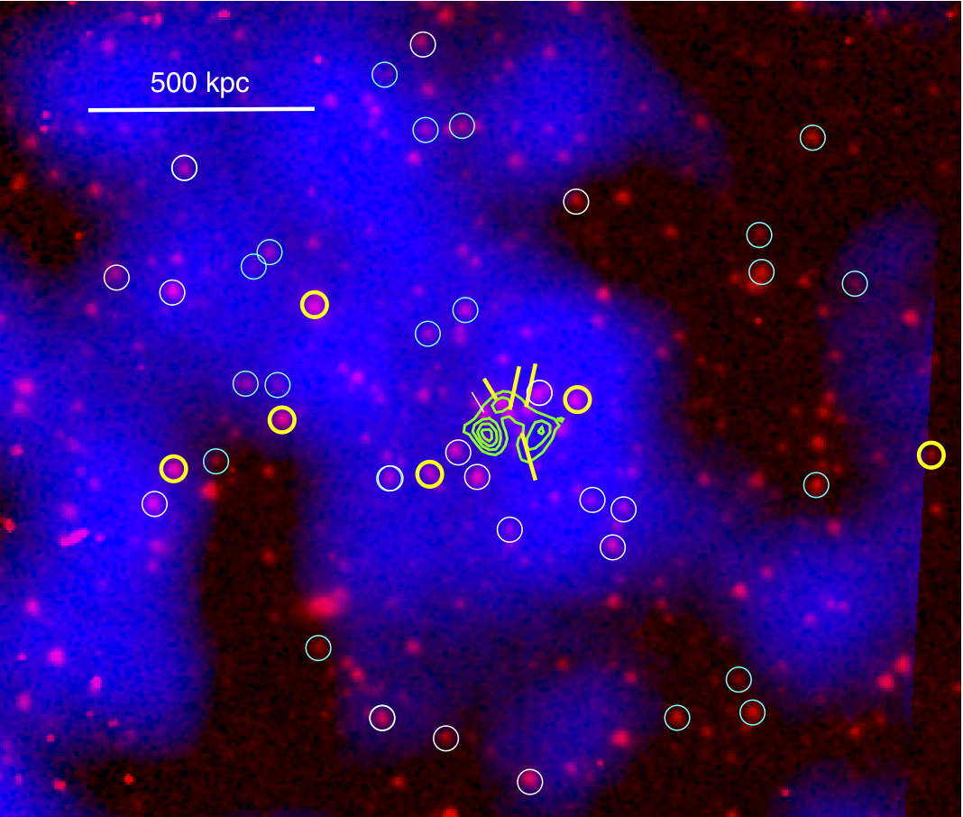
z = 0.96
SDSS r-band
10 galaxies spectroscopically confirmed at z=0.96 with the Keck II and LRIS.
Velocity dispersion = 530 +190/-90 km/s
L_{X},bol = 2 x 10⁴⁴ erg/s (consistent with L_{X}-sigma relation)
kT = 2.4 keV (large errors)
Chandra (20 ksec), Spitzer 3.6 µm, 20 cm radio contours
Notes:
3.3 sigma overdensity in i-band, 4.3 in r-band. Chandra detection ~6 sigma ~200 counts

Slide 35
Extra Slides

Slide 36
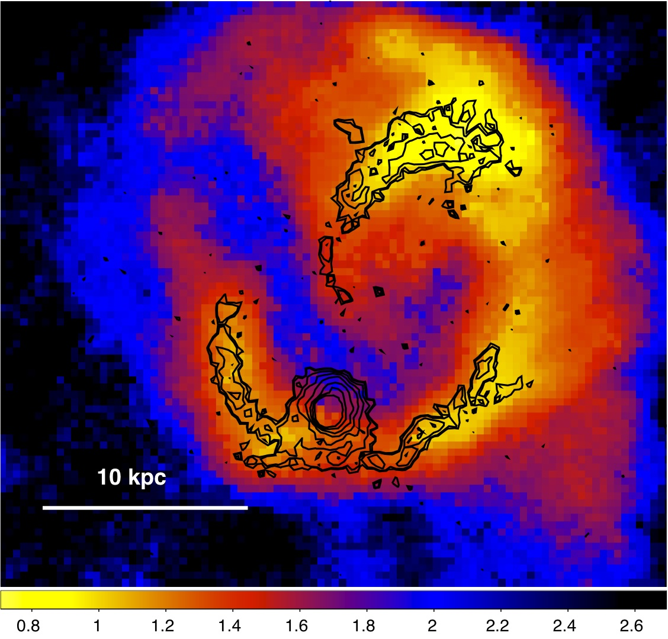
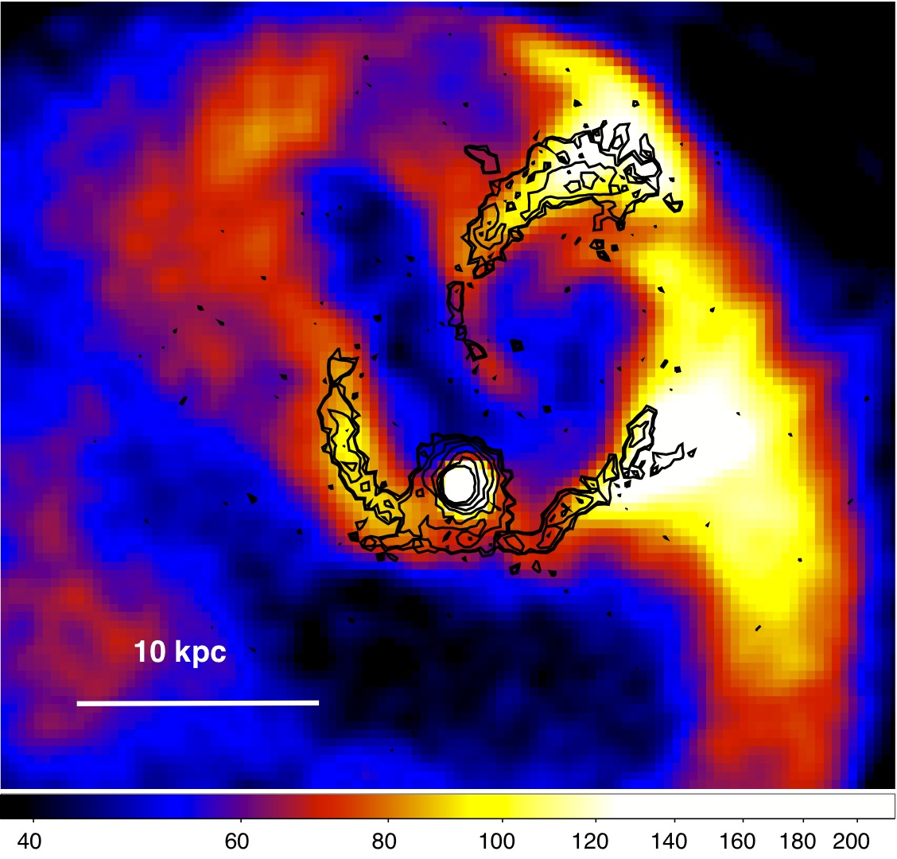
H-alpha/Tmap H-alpha/image

Slide 37
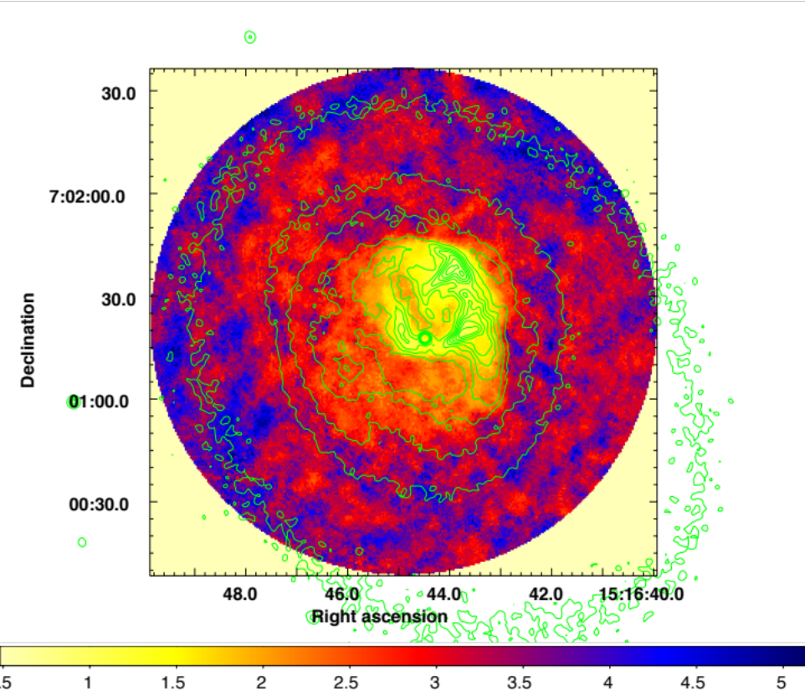
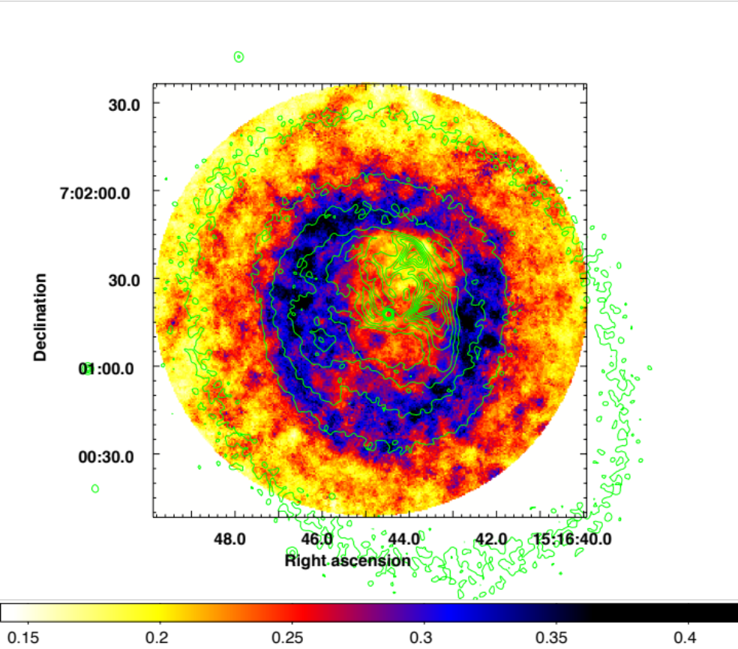
Temp Map Pseudo-Pressure Map

Slide 38


