Slide 1
Deep Chandra/HST study of the spiral galaxy M83
Roberto Soria
ICRAR-Curtin University
Knox Long
Bill Blair, Kip Kuntz, Paul Plucinsky, Frank Winkler
Leith Godfrey, Chris Stockdale, Brad Whitmore

Slide 2
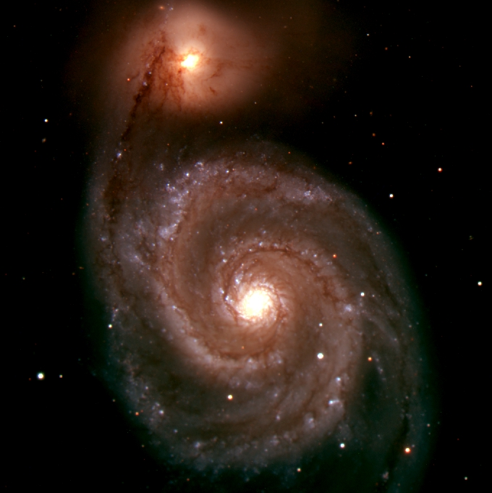
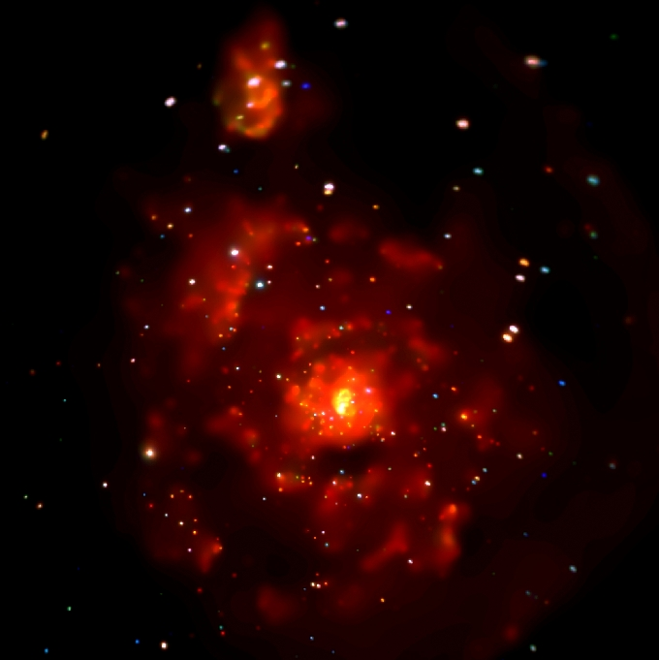
M51 (KPNO/Chandra)
See Poster 4.04 by Kilgard et al

Slide 3
Multiband campaign for M83
X-rays:
Chandra Large Project (730 ks)
XMM-Newton
Swift
Optical:
HST narrow- and broad-band (~ 50 orbits)
Magellan
Gemini
Radio:
Australia Telescope Compact Array (ATCA)
VLA

Slide 4
Overview of results
SNRs:
Knox Long’s talk yesterday
SNRs:
Compact objects:
Discovery of a transient ULX
Discovery of a powerful microquasar
Stellar-mass BHs and NSs
X-ray binary luminosity function
Supersoft sources
Diffuse emission
in starburst nucleus and spiral arms
Star formation
Young, massive star clusters
Wolf-Rayets (super-solar metallicity)
Heritage & outreach
Structure of a “textbook” spiral galaxy

Slide 5
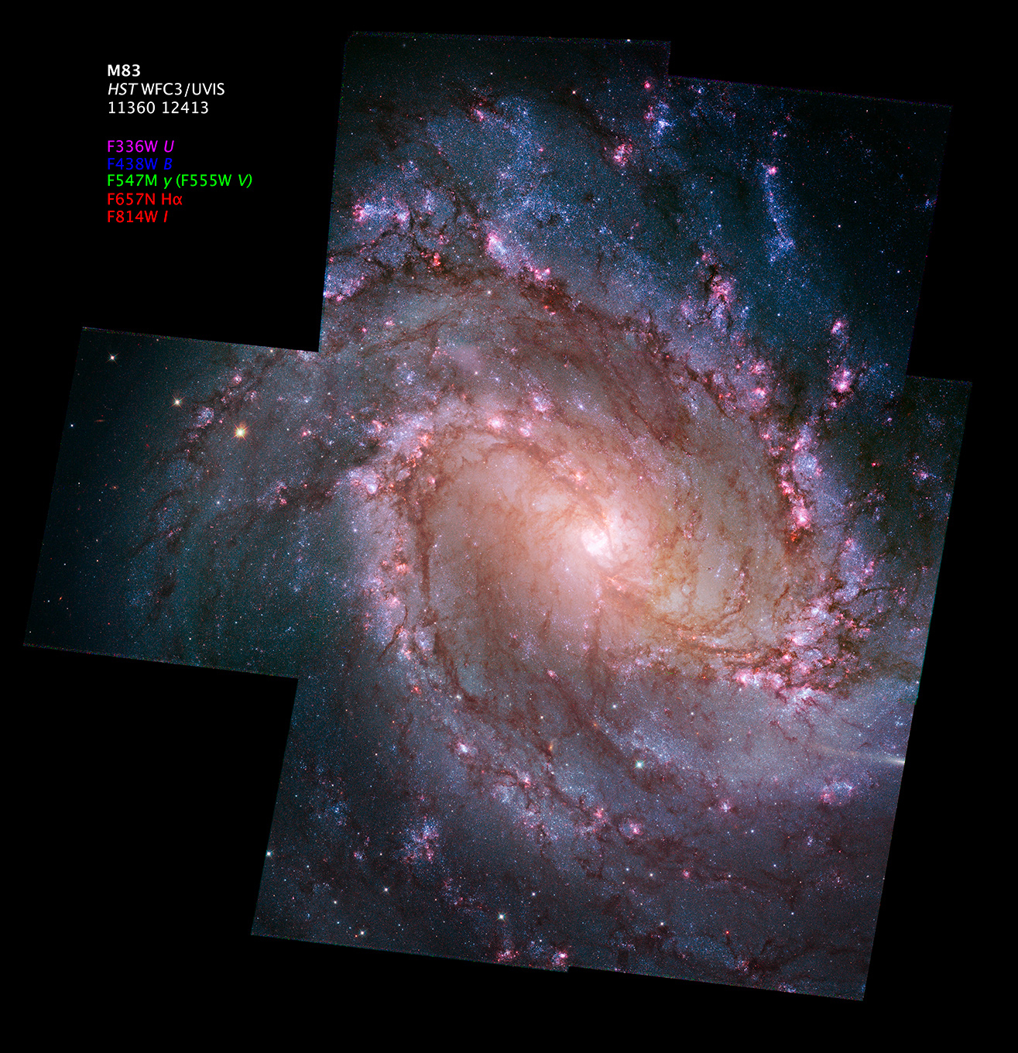
HST/WFC3 mosaic

Slide 6
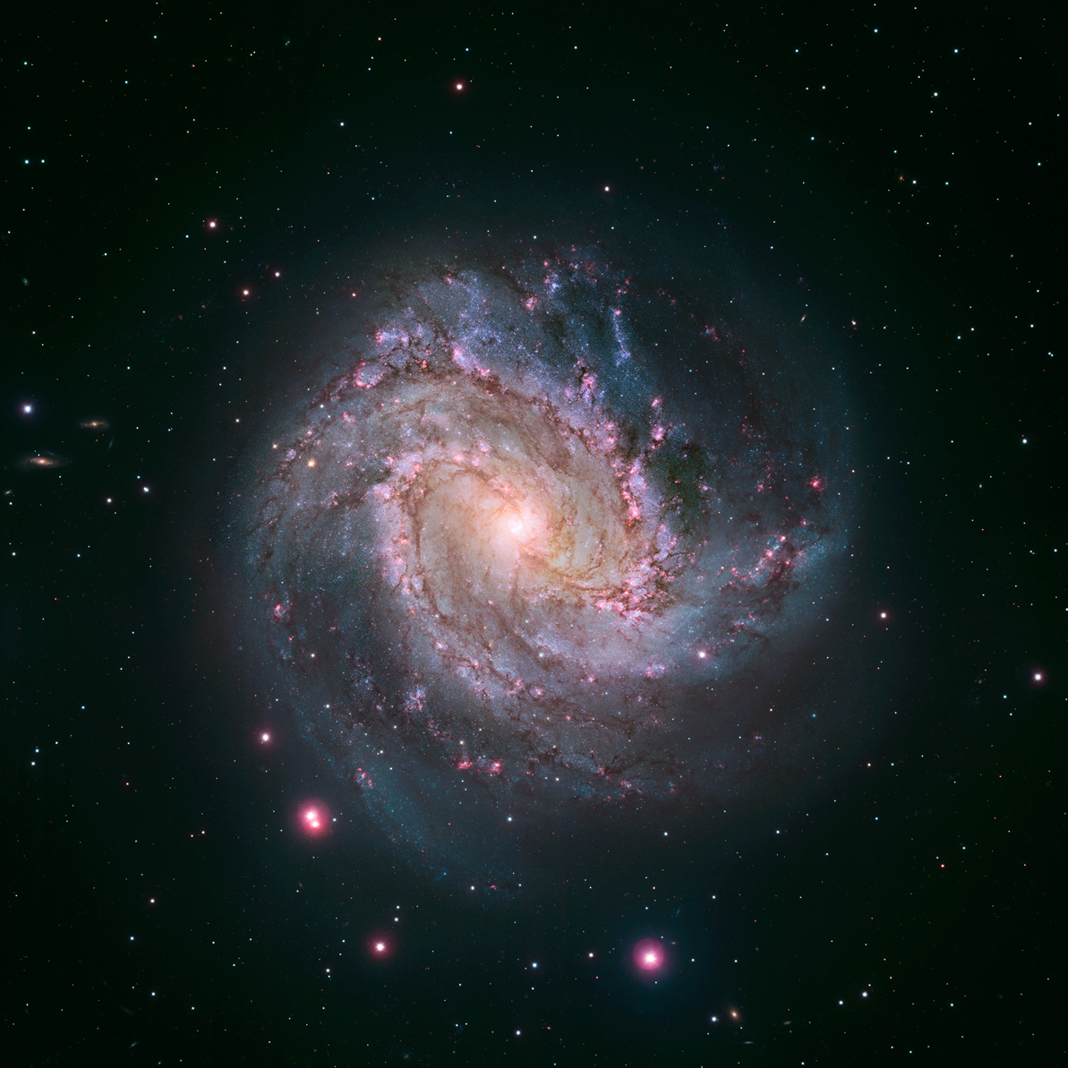

Slide 7
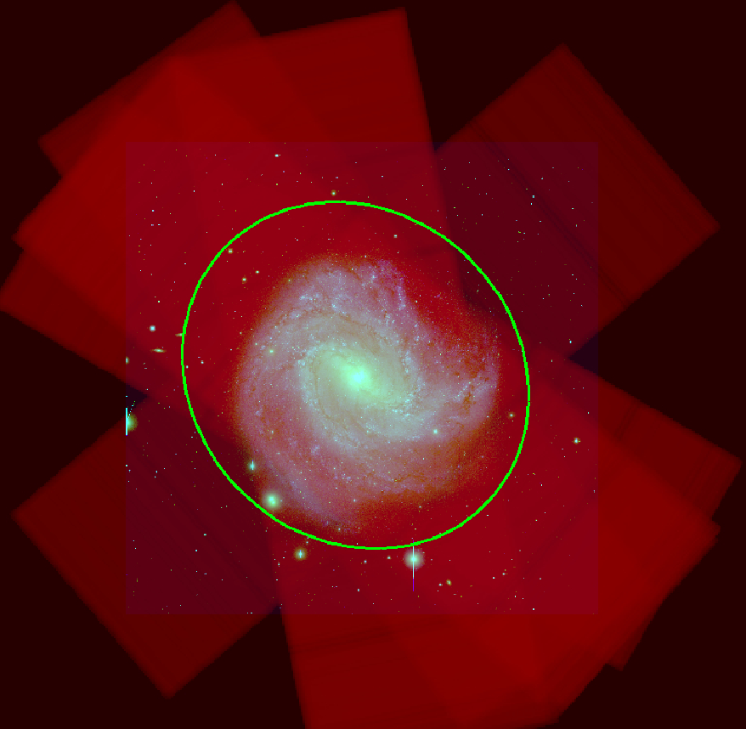
Chandra/ACIS-S:
11 observations (2010-2011)
730 ks

Slide 9
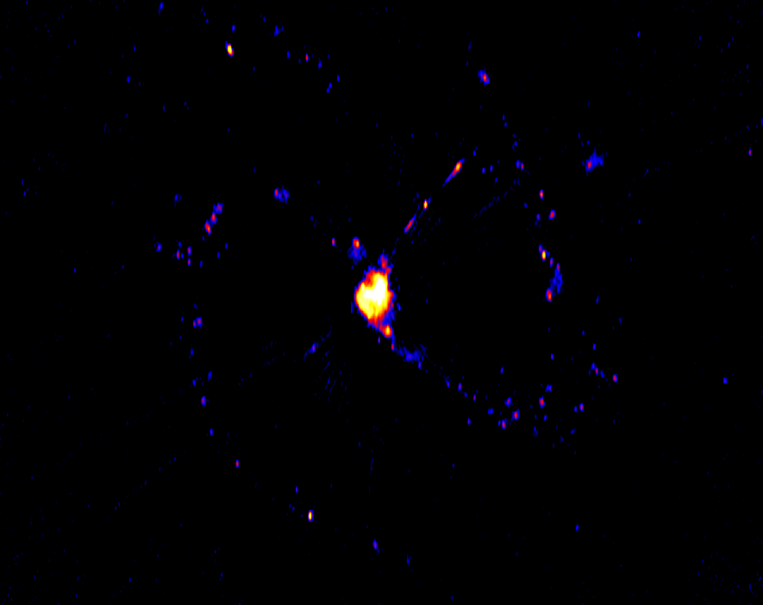
ATCA 6cm

Slide 10
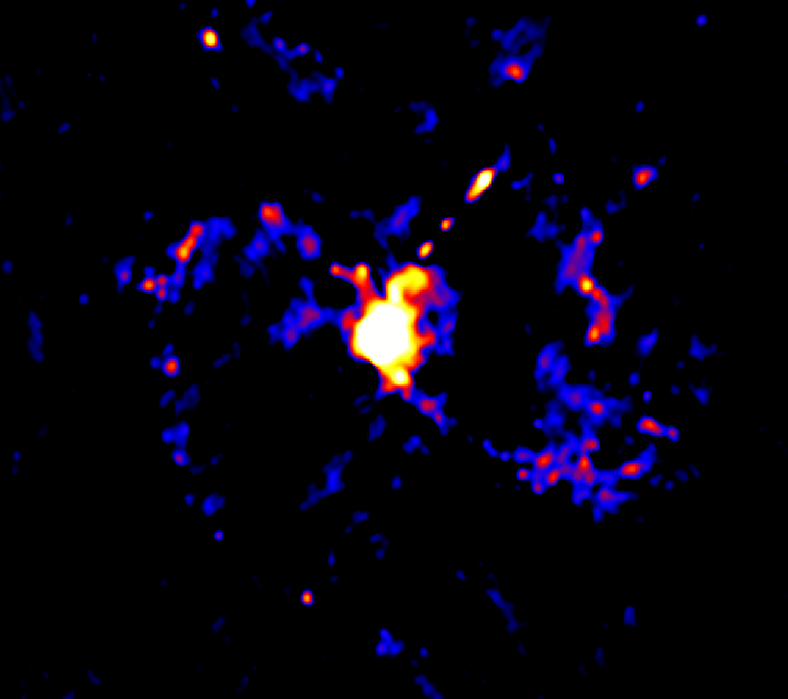
VLA 20cm

Slide 11
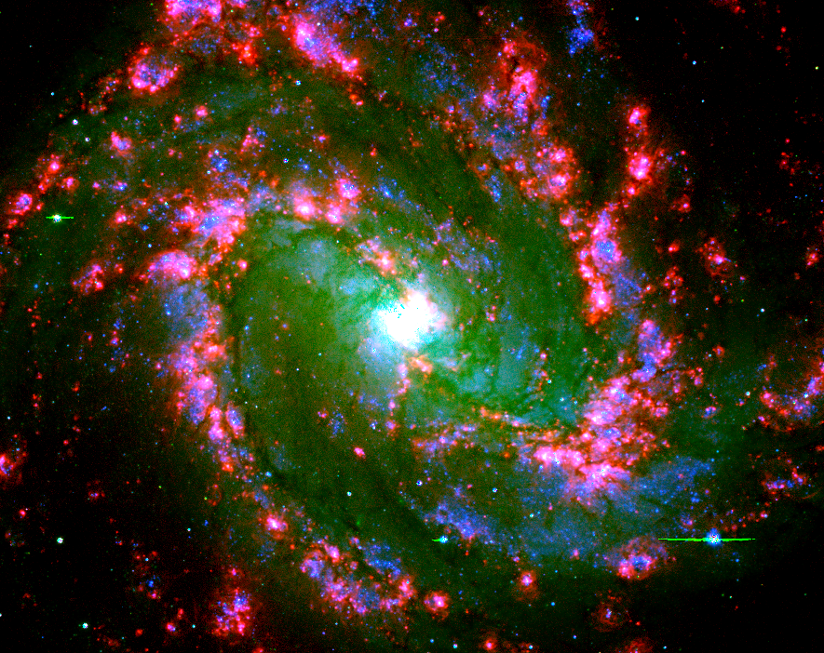

Slide 12
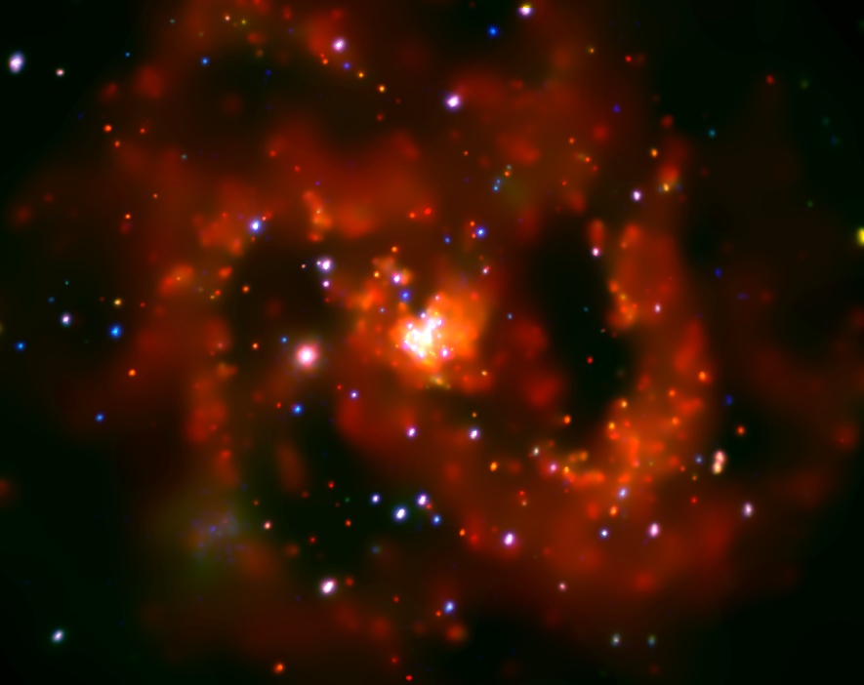

Slide 14
1. Transient ULX

Slide 15
2010-2011

Slide 16
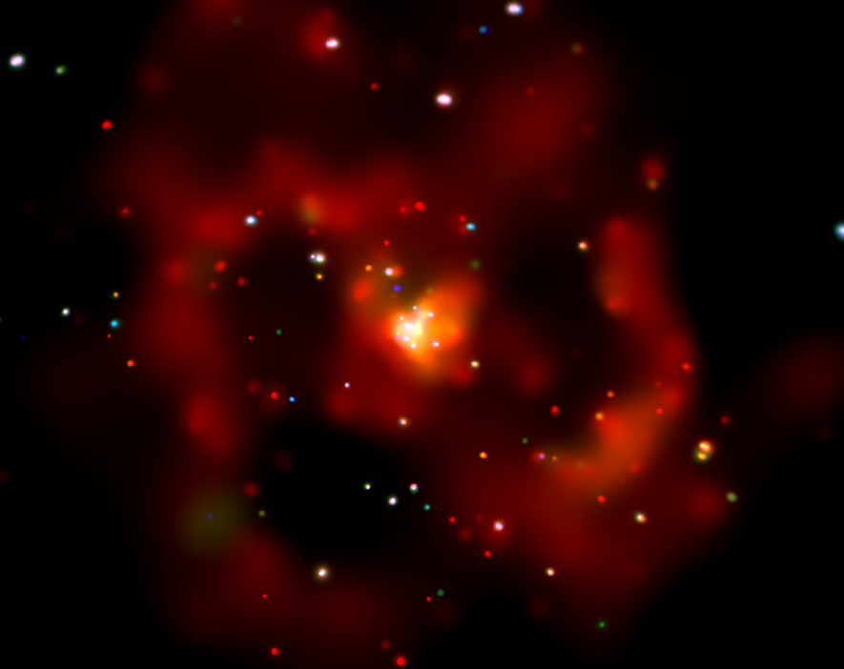
2000

Slide 17
2011

Slide 18
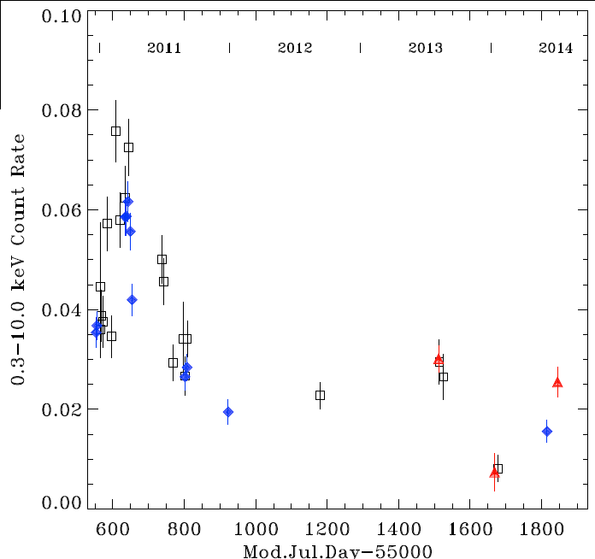
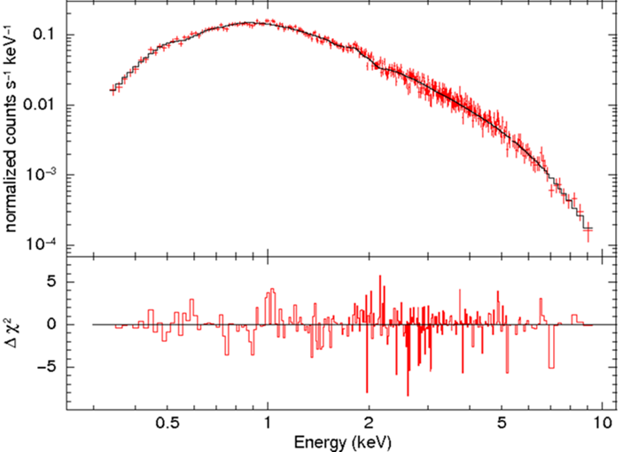
Discovery of a transient ULX
X-ray lightcurve
7E39 erg/s
Never detected before 2010
Went into outburst in 2010
(3000 x brighter than previous limits)
Still in outburst as of July 2014
(Soria et al 2012; Soria et al 2014b)
1E39 erg/s
Chandra 2011:
Power-law + soft excess
L_{X} ~ 5E39 erg/s
Spectral evolution between
L ~ 0.5—5 L_{Edd}
BH mass ~ 10—20 M_{sun}
Key link between
sub-Edd BHs and ULXs

Slide 19
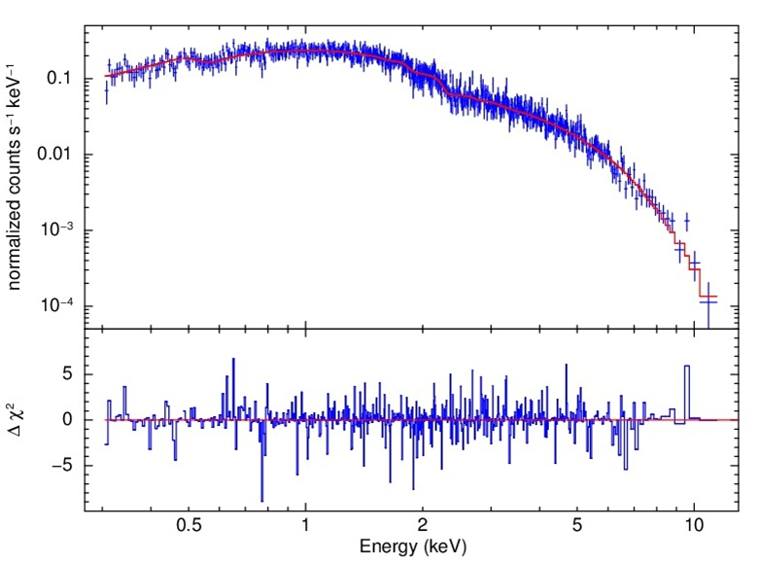
Discovery of a transient ULX
X-ray lightcurve
7E39 erg/s
Never detected before 2010
Went into outburst in 2010
(3000 x brighter than ROSAT limit)
Still in outburst as of July 2014
(Soria et al 2012; Soria et al 2014b)
1E39 erg/s
XMM-Newton 2013:
Slim disk
L_{X} ~ 3E39 erg/s
Spectral evolution between
L ~ 0.5—5 L_{Edd}
BH mass ~ 10—20 M_{sun}
Key link between
sub-Edd BHs and ULXs

Slide 20
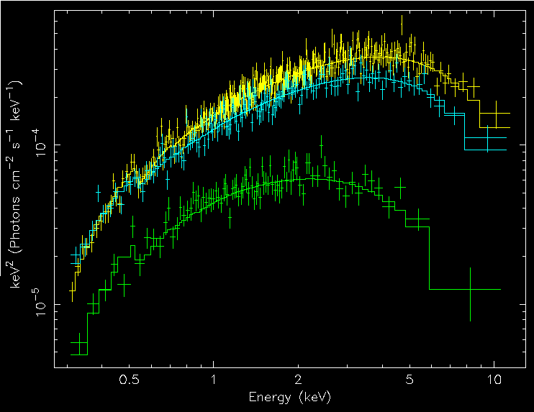
Discovery of a transient ULX
X-ray lightcurve
7E39 erg/s
Never detected before 2010
Went into outburst in 2010
(3000 x brighter than ROSAT limit)
Still in outburst as of July 2014
(Soria et al 2012; Soria et al 2014b)
1E39 erg/s
Slim disk
Spectral evolution between
L ~ 0.5—5 L_{Edd}
BH mass ~ 10—20 M_{sun}
Standard disk
Key link between
sub-Edd BHs and ULXs

Slide 21
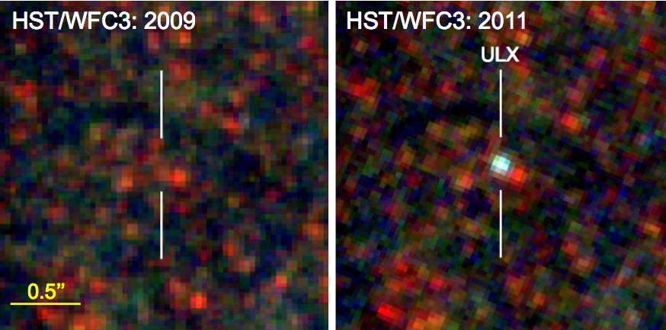
Optical emission in quiescence: low-mass AGB star (T ~ 3400 K)
Optical emission in outburst: irradiated disk (T >~ 20,000 K)
Donor mass <~ 3.5 M_{sun}
Low-mass donor Transient BH
(Soria et al 2012)

Slide 22
2. Microquasar

Slide 23
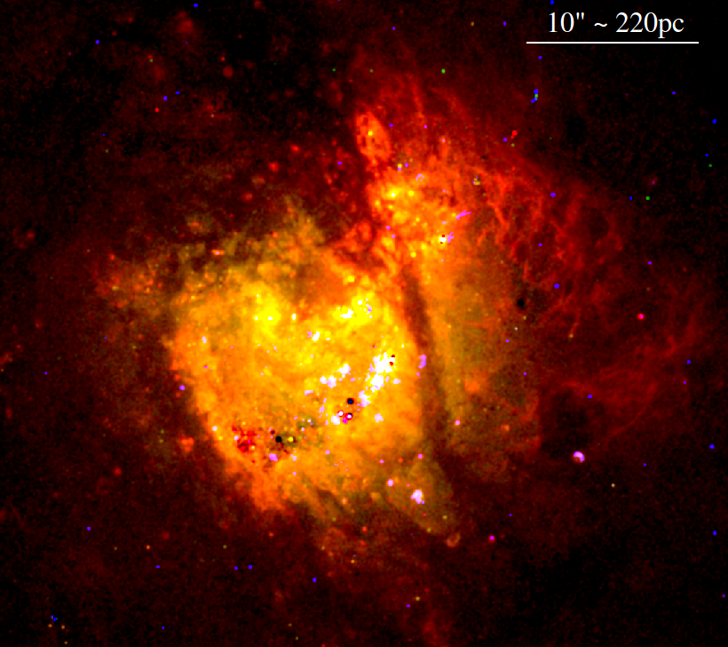
Hα, [S II], [O III]

Slide 24
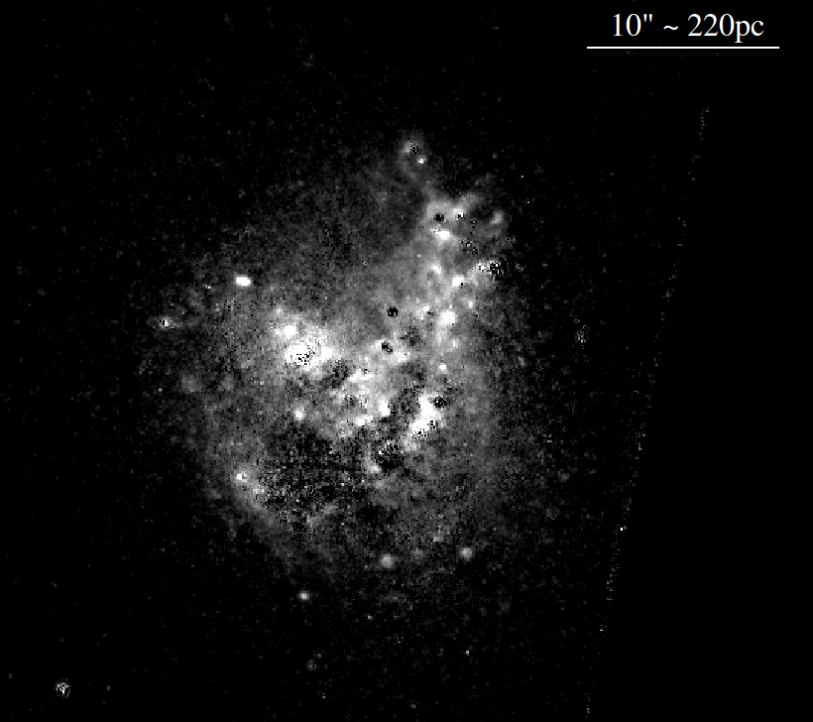
[Fe II] 1.64 μm

Slide 25
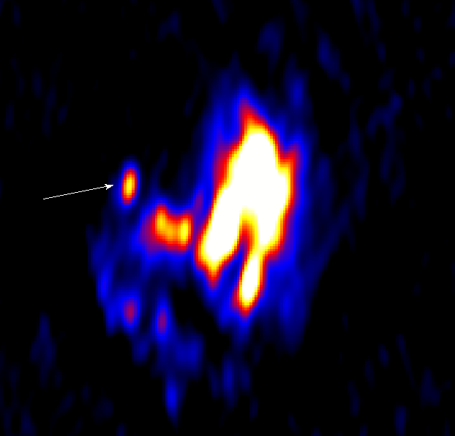
F(5.5 GHz) = 1.6 mJy
L_{R} ~ 3 x Cas A
~ 20 x SS433
ATCA 3cm

Slide 26
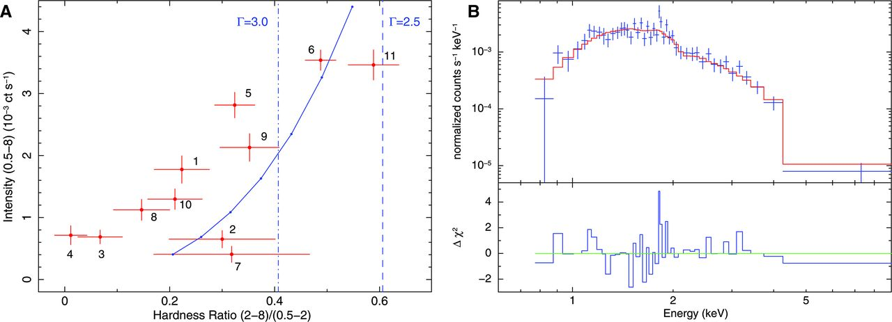
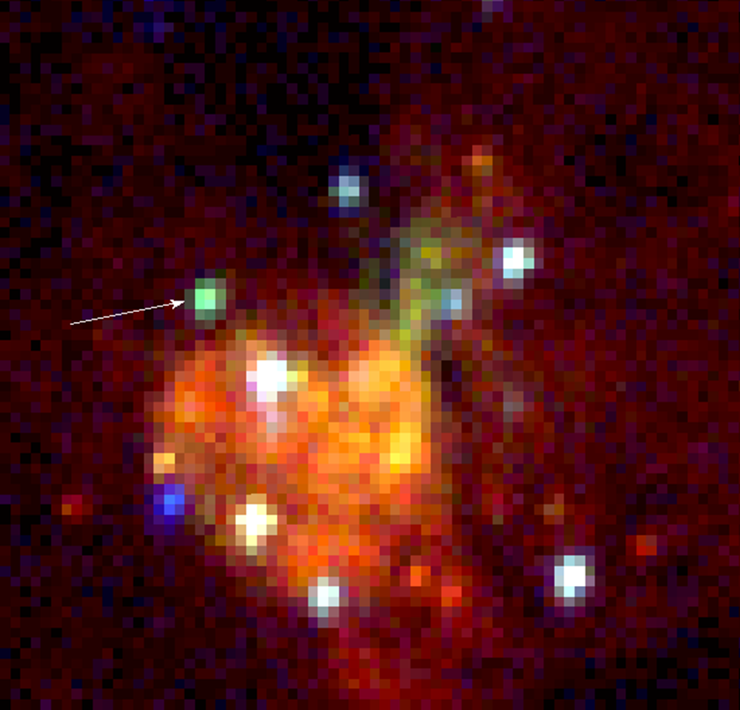
L
Diskbb
T ~ 0.8 keV
T
Chandra

Slide 27
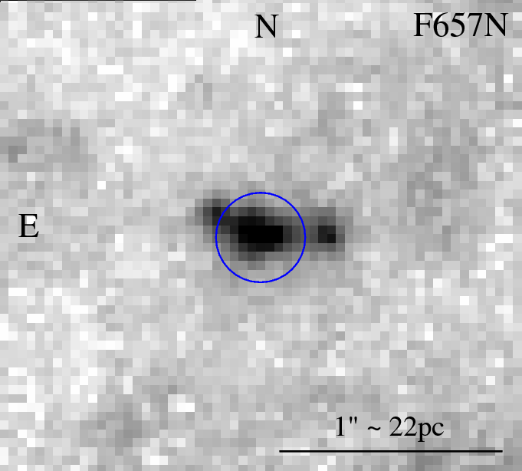
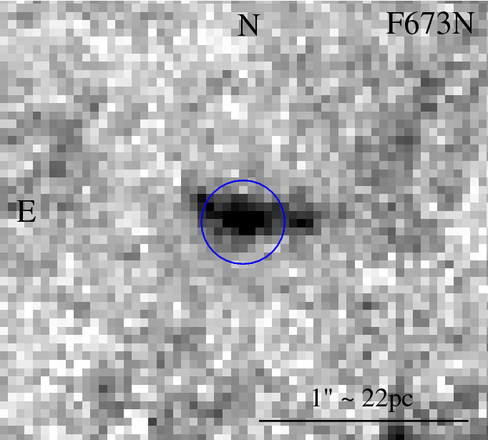
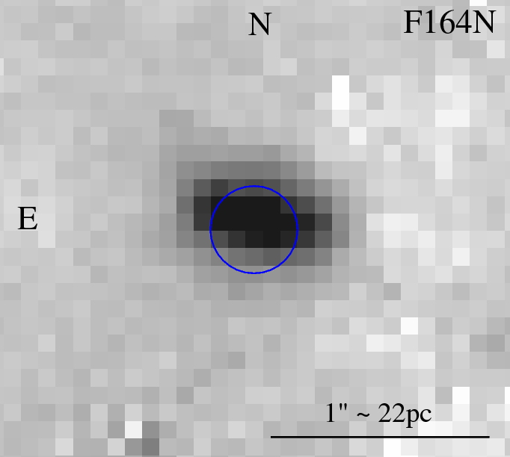
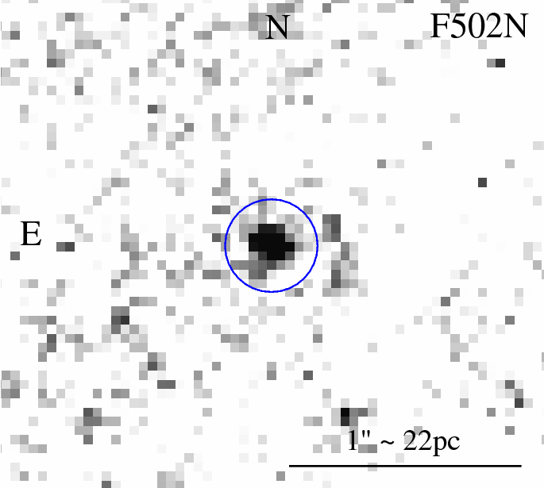

Slide 28
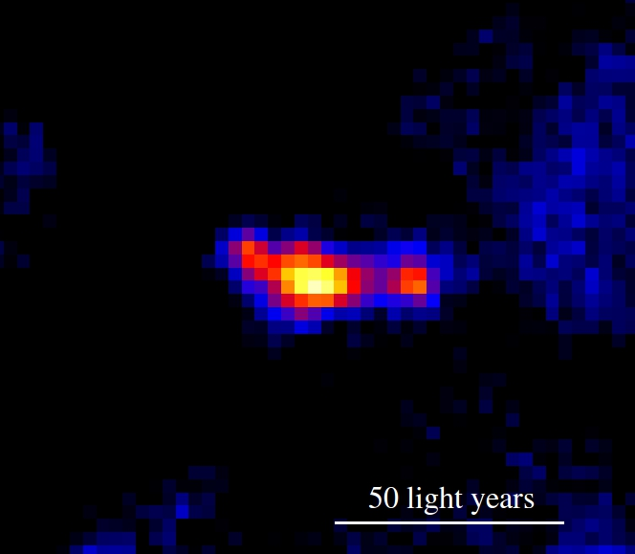
MQ1: the most powerful microquasar in M83
L_{x} ~ a few 10³⁸ erg/s (like typical Galactic BHs)
BH mass ~ 10—30 M_{sun}
Hα + [S II]
Average jet power ~ 10⁴⁰ erg/s
5-GHz luminosity ~ 10³⁵ erg/s
~ 20 times that of SS433
(Soria et al 2014a, Science)

Slide 29
3. Other X-ray sources

Slide 30
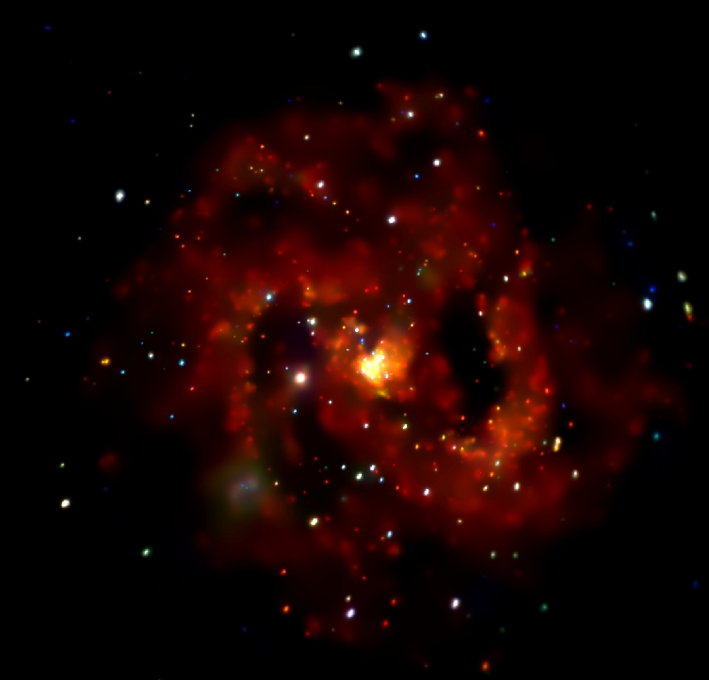
Long et al 2014

Slide 31
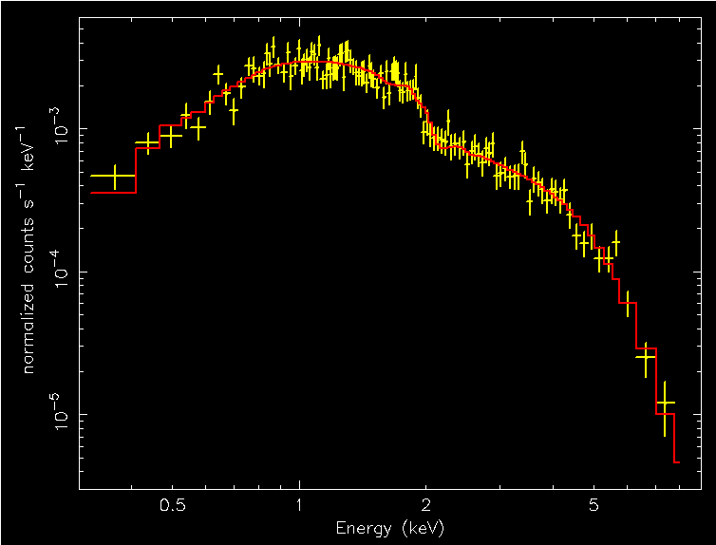
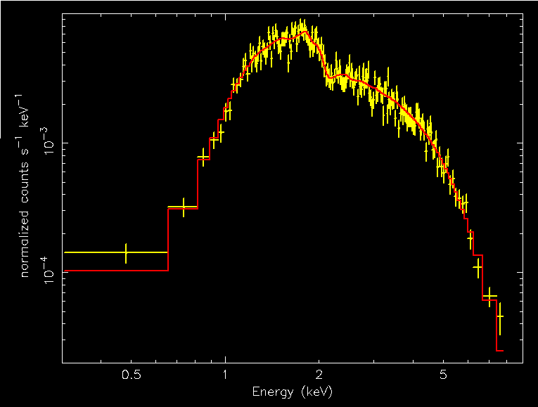
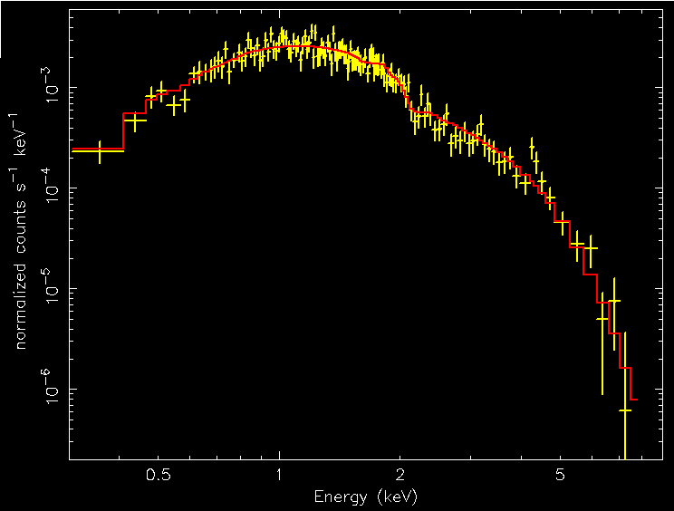
Stellar BH
High/soft state
Stellar BH
High/soft state
Stellar BH
High/soft state

Slide 32
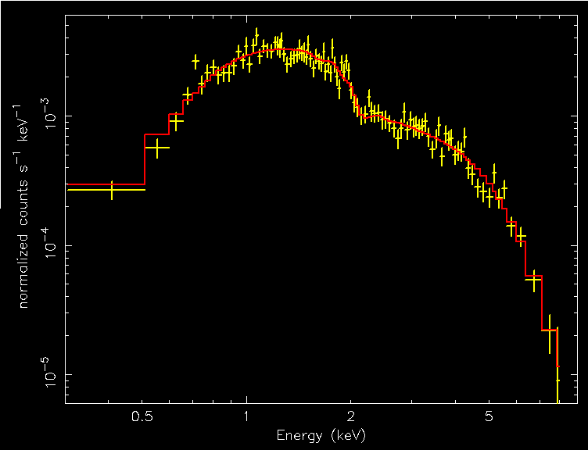
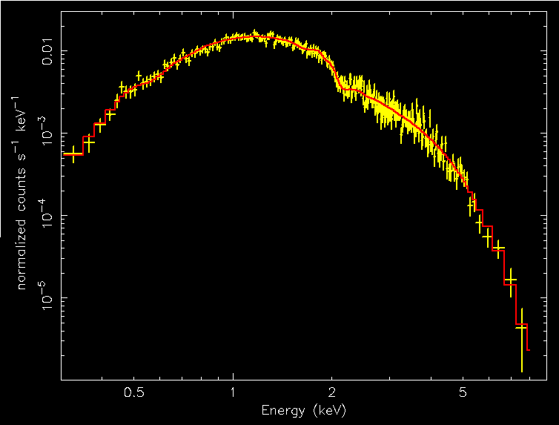
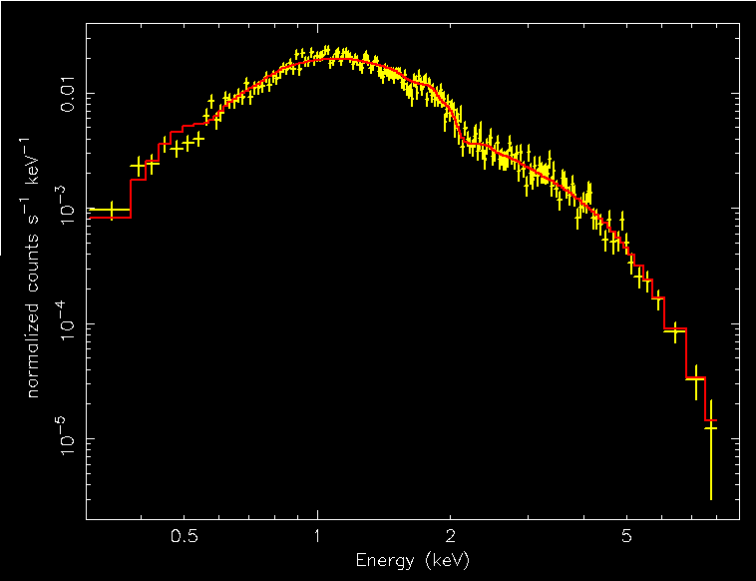
Stellar BH
High/soft state
Stellar BH
High/soft state
Stellar BH
High/soft state

Slide 33
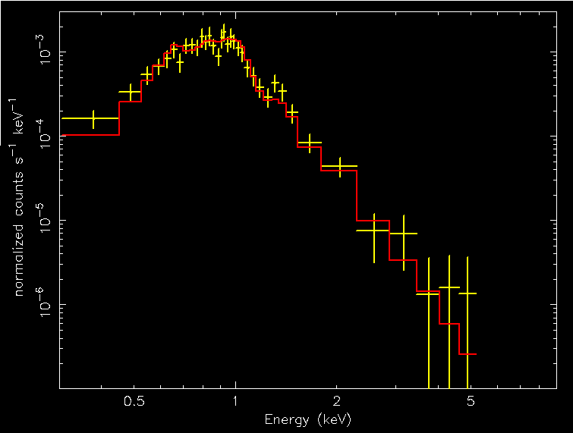
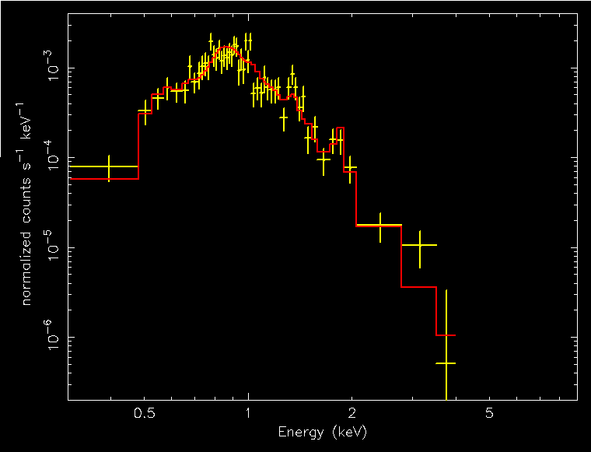
Young SNR
Young SNR

Slide 34
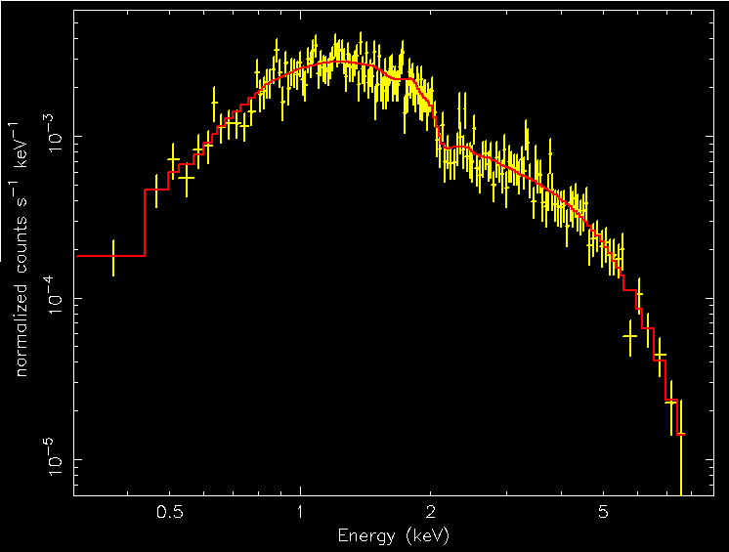
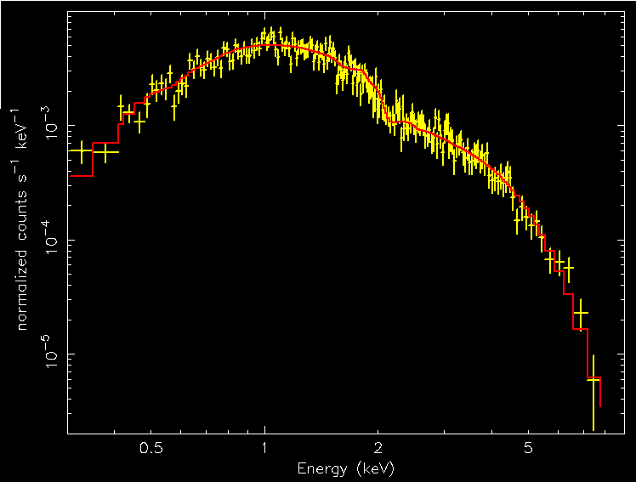
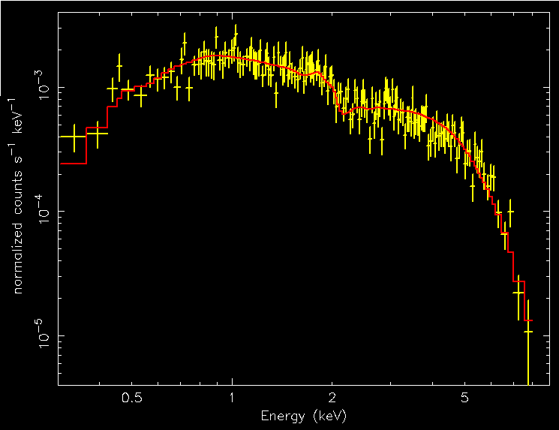
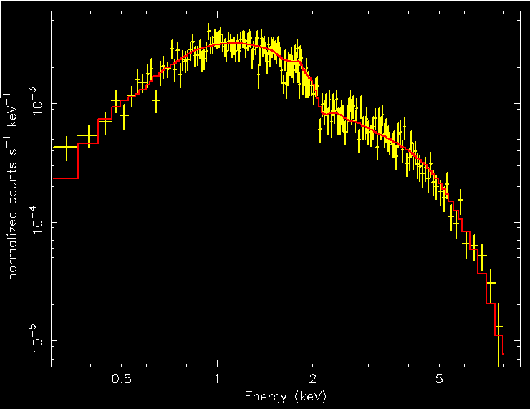
NS
high state
NS
high state
NS
high state
NS
high state

Slide 35
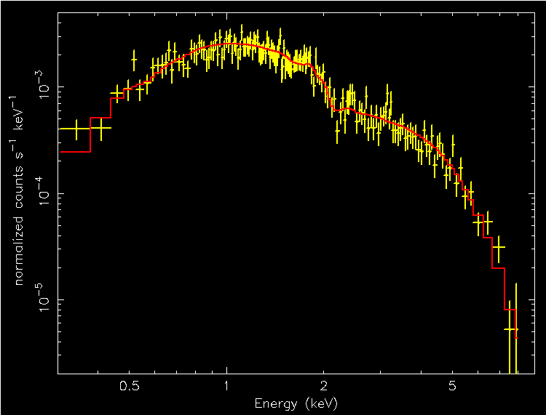
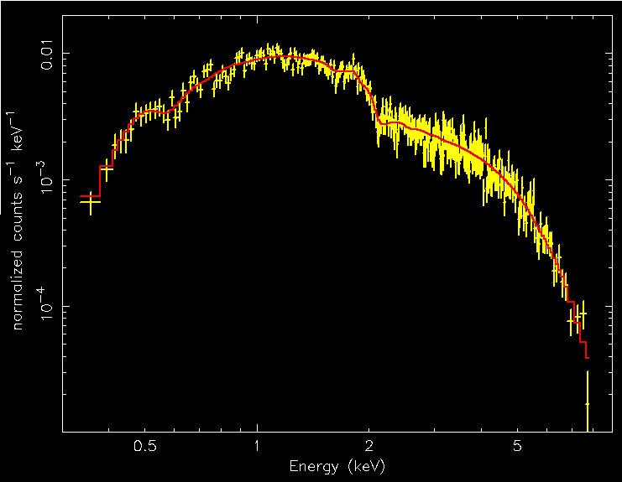
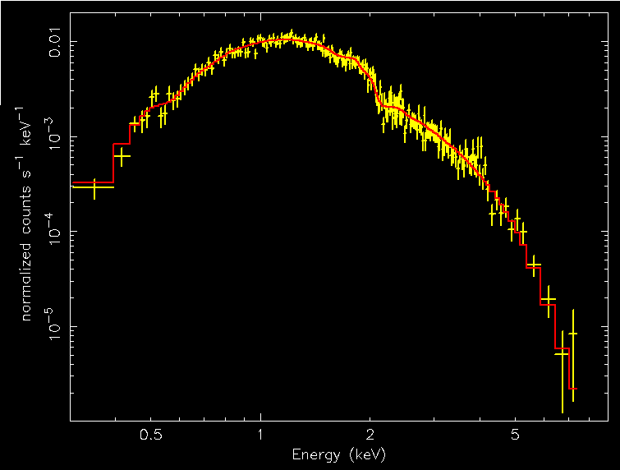
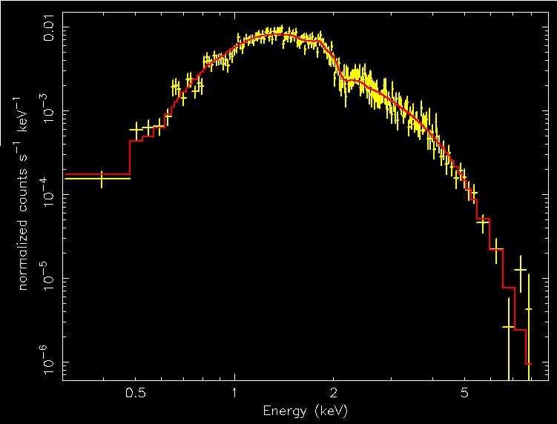
NS
high state
NS
high state
NS
high state
NS
high state

Slide 36
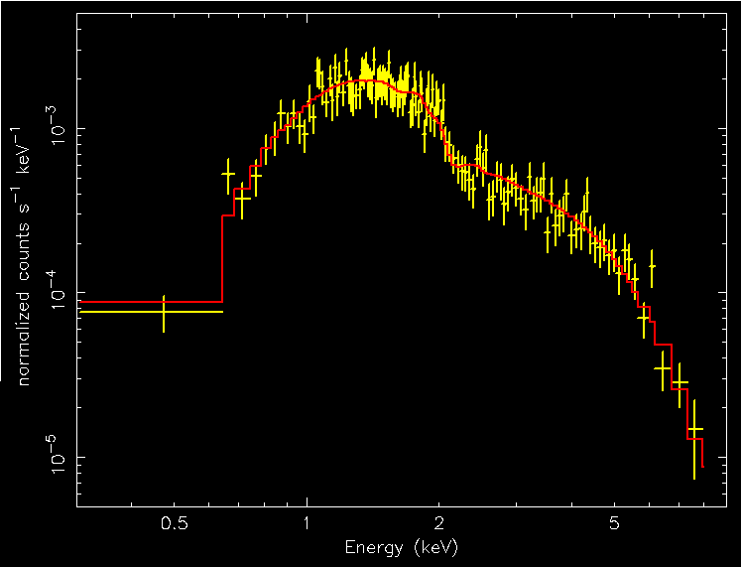
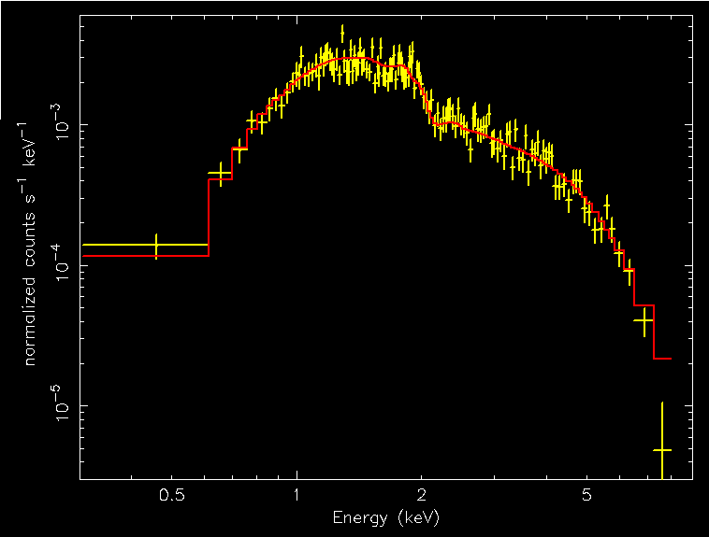
Bg AGN
Bg AGN
Bg galaxy cluster

Slide 38
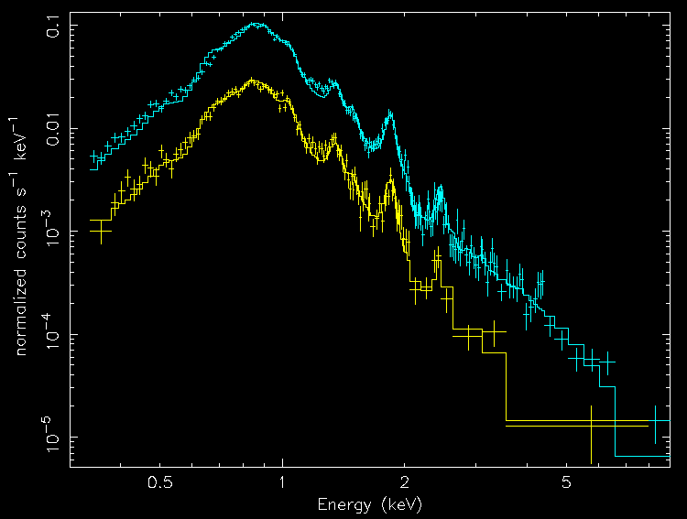
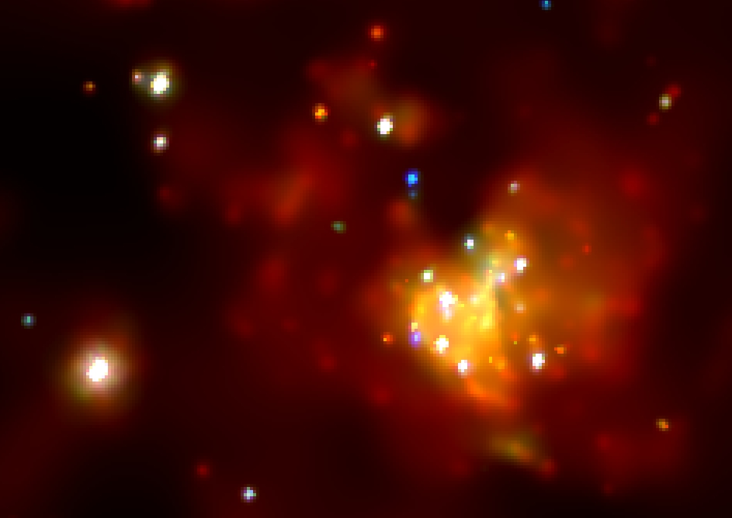
Hot plasma
Diffuse emission in spiral galaxies
Kuntz et al, in prep
Poster 4.06

Slide 39
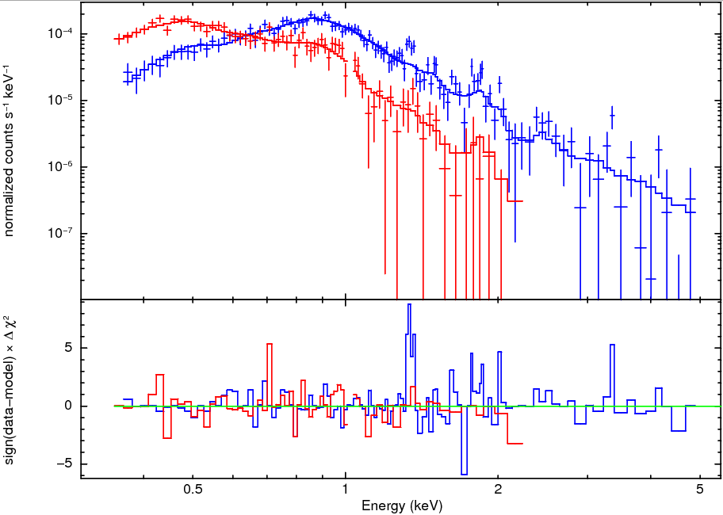
Long et al 2014
SNR
SSS
Two distinct classes
of very soft sources
Blue = stacked X-ray spectrum of faint SNRs
Red = stacked X-ray spectrum of supersoft sources

Slide 40
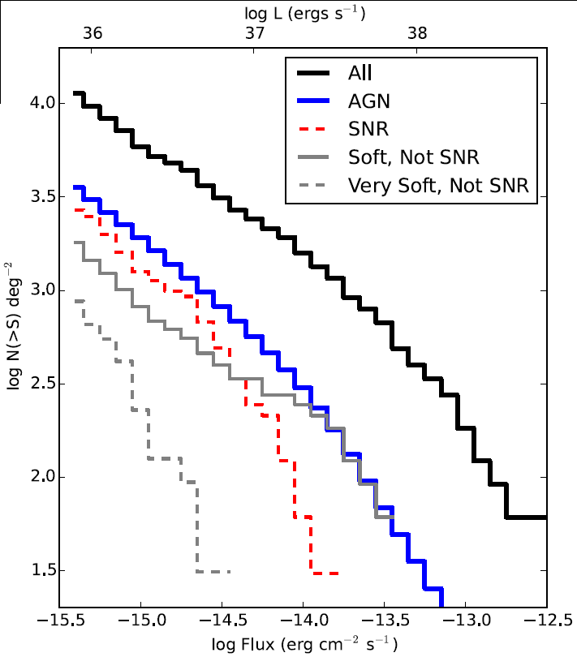

Slide 41
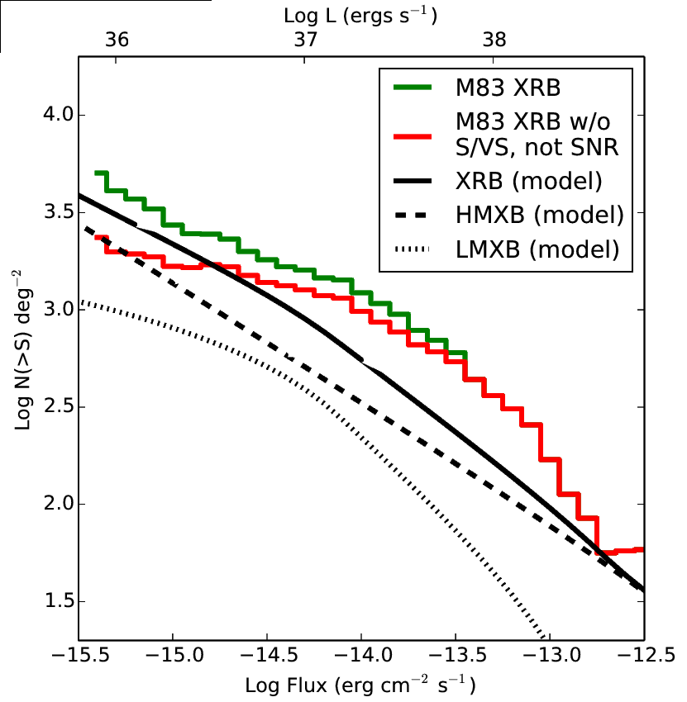
XRB Luminosity Function:
a) has high fraction of LMXBs
b) different from standard LF
predicted from SFR and galaxy mass

Slide 42
4. Outreach

Slide 44
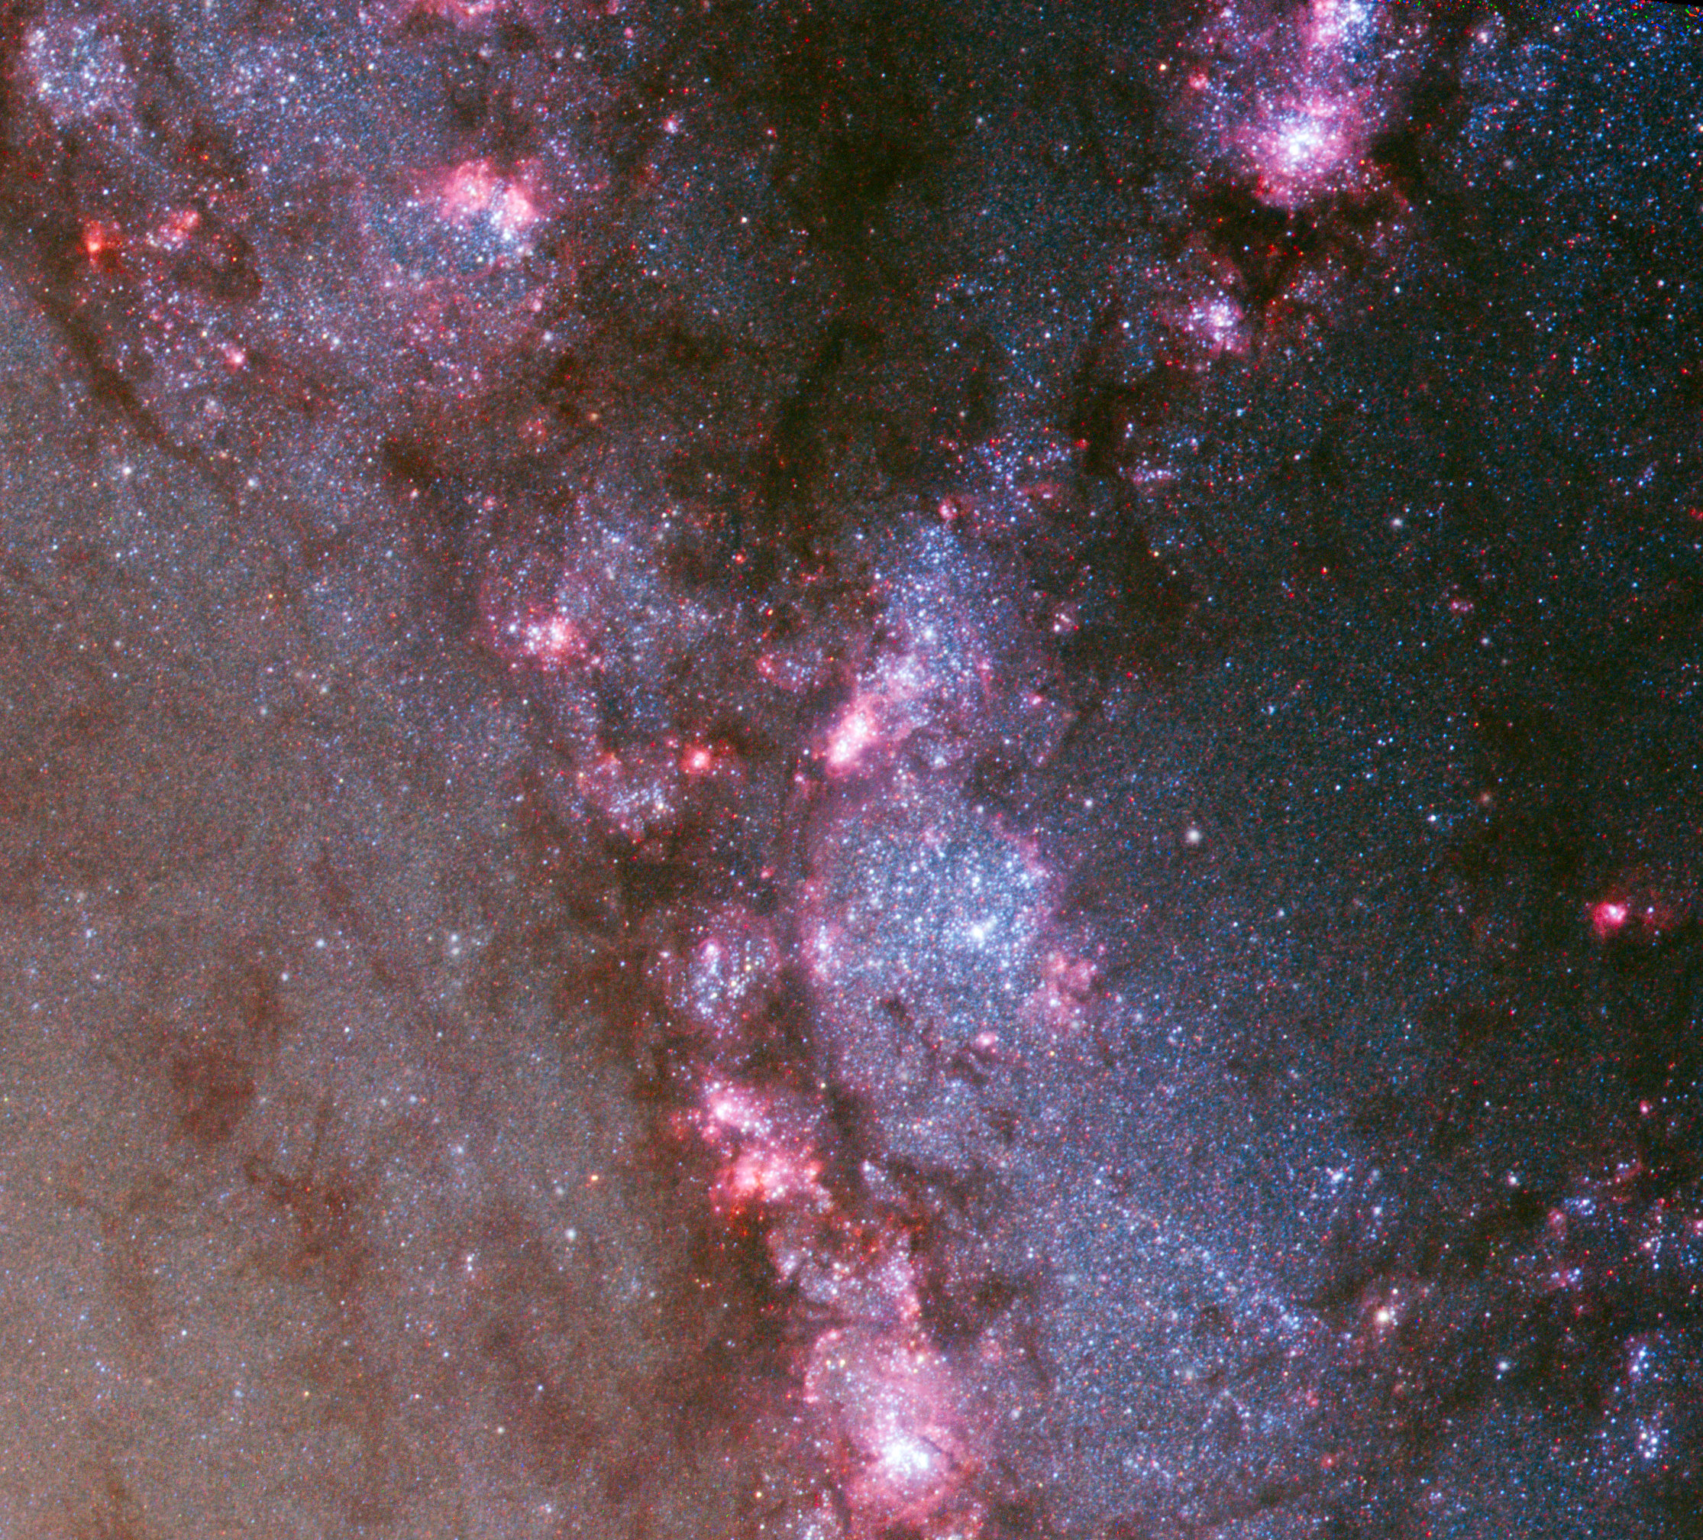

Slide 45


Slide 47


Slide 48


Slide 49


Slide 50


Slide 51


Slide 52

Lot more work
still in progress
Find out more….
Soria et al 2012
Long et al 2012
Blair et al 2014
Soria et al 2014a
Long et al 2014
Soria et al 2014b
Blair et al 2015
Kuntz et al in prep.

