Slide 1
Faint z>4 AGNs in GOODS-S
looking for contributors to reionization
Giallongo, Grazian, Fiore et al. (Candels team) A&A submitted
INAF-Observatory of Rome
Reionization history is a benchmark for galaxy formation and evolution
CHANDRA deep imaging can give an important contribution to this topic
When: z_{ion}=6-11
Gunn-Peterson absorption in QSO spectra z_{ion}>6
WMAP/Planck thomson scattering z_{ion} <11

Slide 2
How: which are the sources responsible for the reionization ?
Obvious candidates: QSOs and/or star forming galaxies
M_{UV}~ -21 (I~25 at z~3)
Faint | Bright
Galaxies | Galaxies
M_{UV}~ -23
Faint | Bright
AGN | QSOs

Slide 3
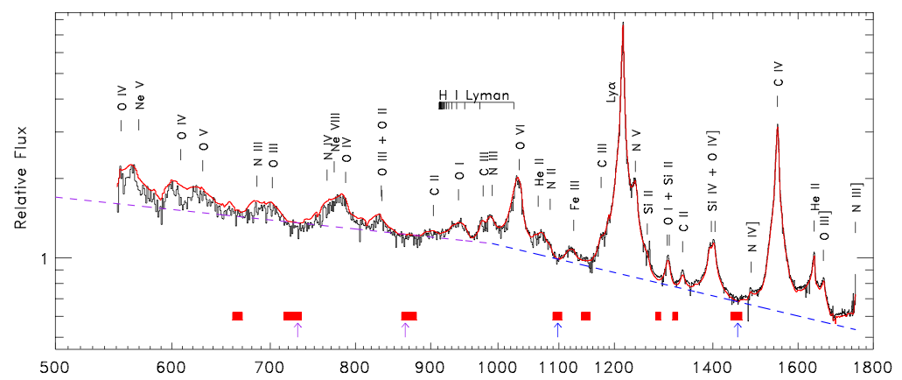

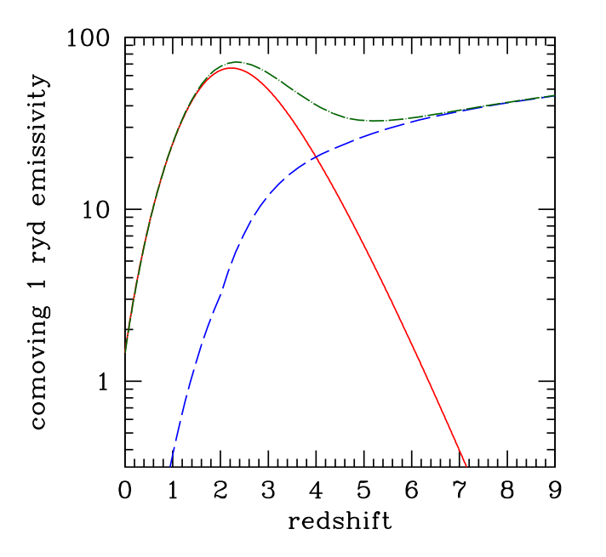
Composite HST/COS spectrum
22 AGNs z<1.44
From Shull, Stevans, Danforth 2012
Stevans, Shull et al. 2014
QSOs are known to ionize their neighbourhood
but they are too few at z>3 to provide the needed
ionizing UV background (e.g. Haardt & Madau 2012)
More common star forming galaxies are thought
to be responsible for reionization at z>4
Their contribution depends on their abundance
at faint magnitudes and on the escape fraction
of ionizing photons which ranges from 15% down
to <2%
f_{esc}=15%
SF Galaxies
QSOs

Slide 4
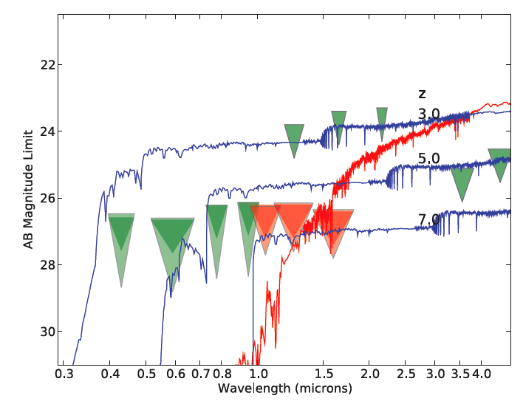
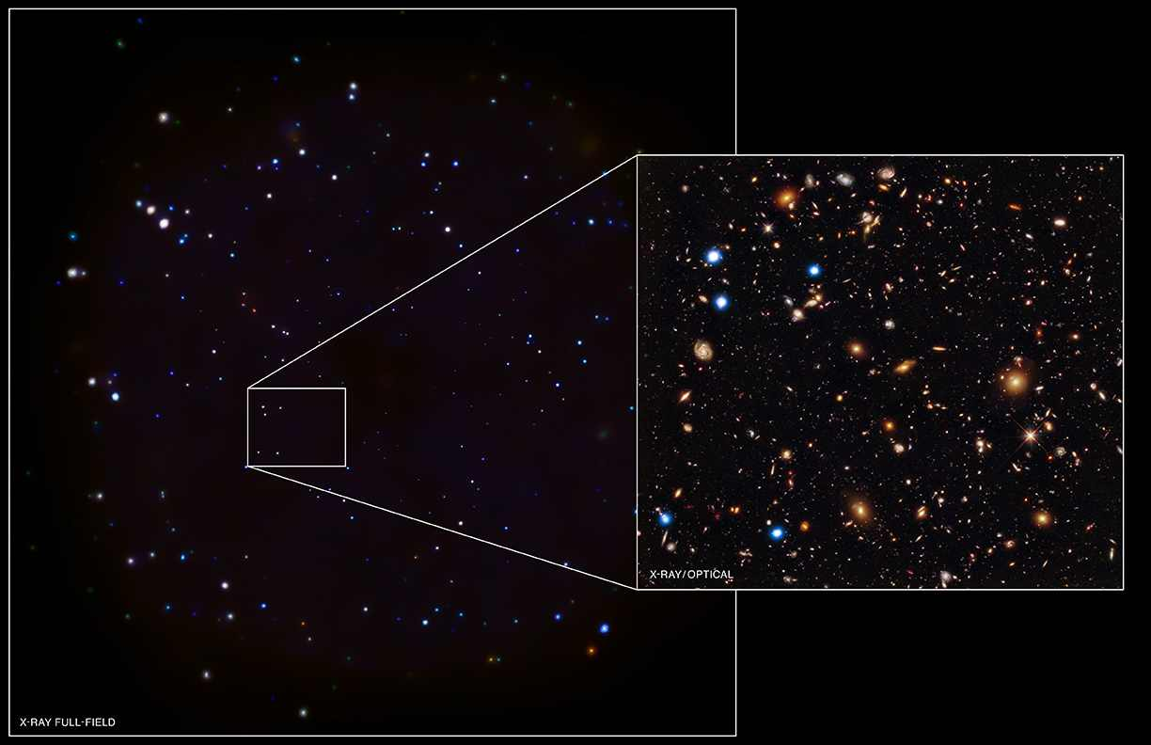
CANDELS
Cosmic Assembly NIR Deep Extragalactic Legacy Survey
Uncertainties on f_{esc} of SF galaxies leave room on a significant contribution
by fainter AGNs if their f_{esc} keeps as high as in the brighter population
First step: looking for faint AGNs close to the reionization epoch
Difficult task: requires very deep multiwavelength surveys like GOODS-S
+
Chandra Deep Field South 4Msec
Orbit Totals: GOODS 483
CANDELS IRAC
WFC3 5σ
Notes:
4

Slide 5
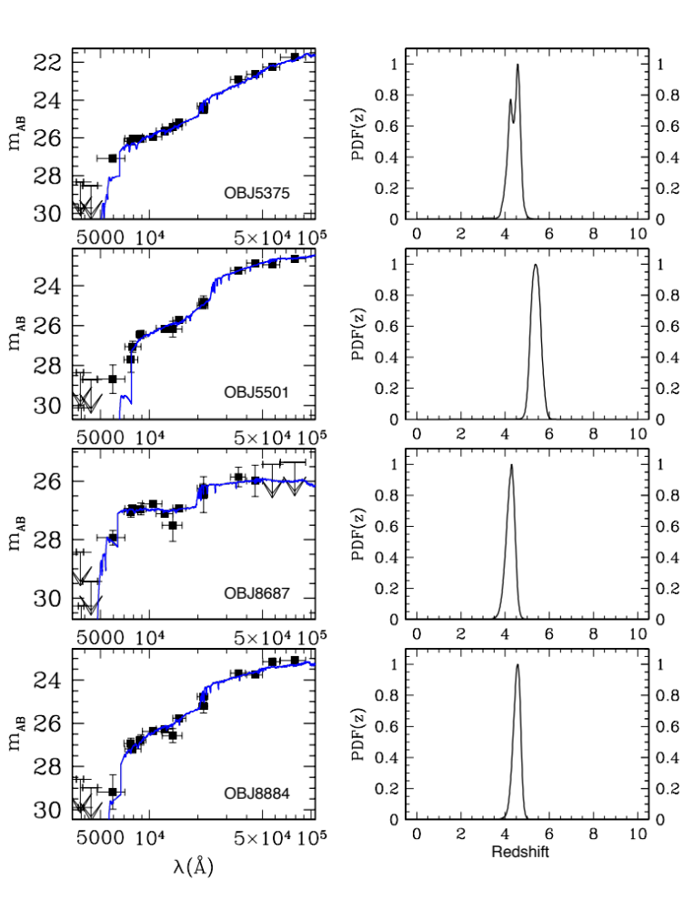
AGN selection proceeds in two steps.
Very deep selection in NIR H band
(UV-rest at z>4) + X-ray detection
(Fiore et al. 2012)
1. Parent sample selection:
CANDELS SEDs and phot. z catalog
(Guo et al. 2013, Dahlen et al. 2013)
CANDELS H_{AB}<27 galaxies
in GOODS-S 170 arcmin²
1113 sources at z>4
Phot. z constrained by UV-rest dropout
due to IGM absorption
Selection of best candidates with narrow
PDFs or PDFs located at high z
Very few low-z interlopers
Notes:
5

Slide 6
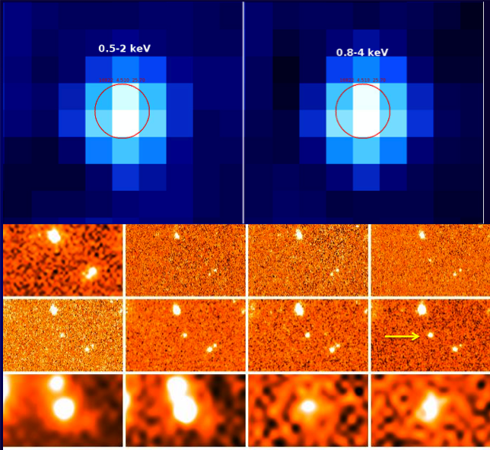
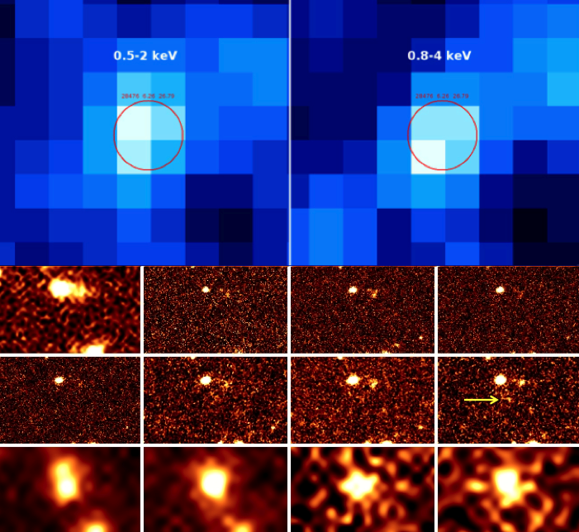
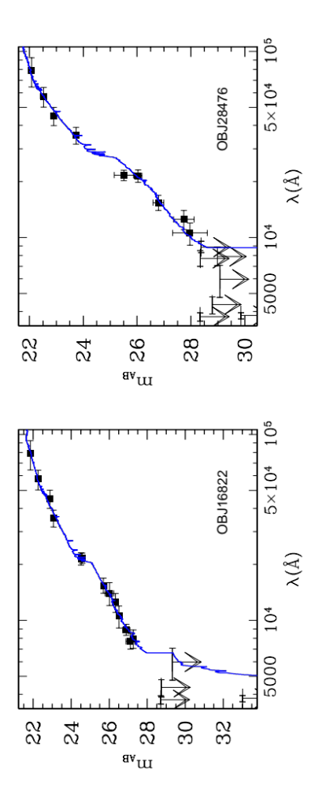
2. AGN selection of z>4 candidates
Measuring X-ray flux in the H band position
AGNs with F_{X} ≥ 1.5x10⁻¹⁷ erg/cm²/s
correspond to a probability of
spurious detection of 2×10⁻⁴
(<1 spurious detection in the field)
Candels 16822 z=4.5 H=25.7
Candels 28476 z=6.3 H=26.8
U
B₄₃₅
V₆₀₆
I₇₇₅
Z₈₅₀
Y_{1.05}
J_{1.25}
H_{1.6}
Irac 3.6
4.5
5.8
8

Slide 7
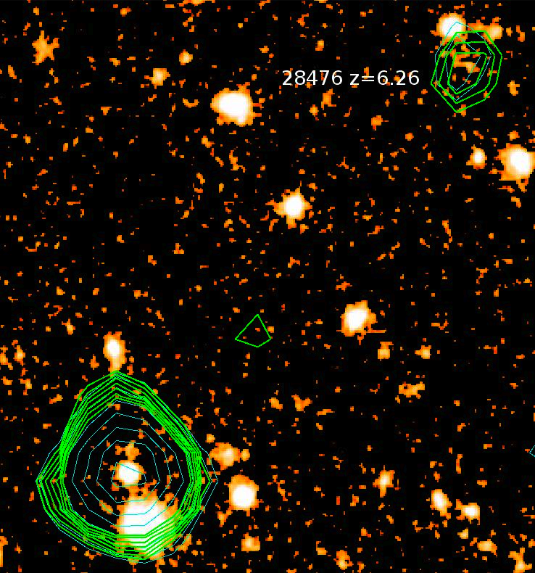
Accuracy of the relative astrometry is ≤ 1 arcsec
up to 9 arcmin off-axis
CHANDRA high resolution is crucial to select
faint high z AGNs some of which near local brigher
H band sources

Slide 8
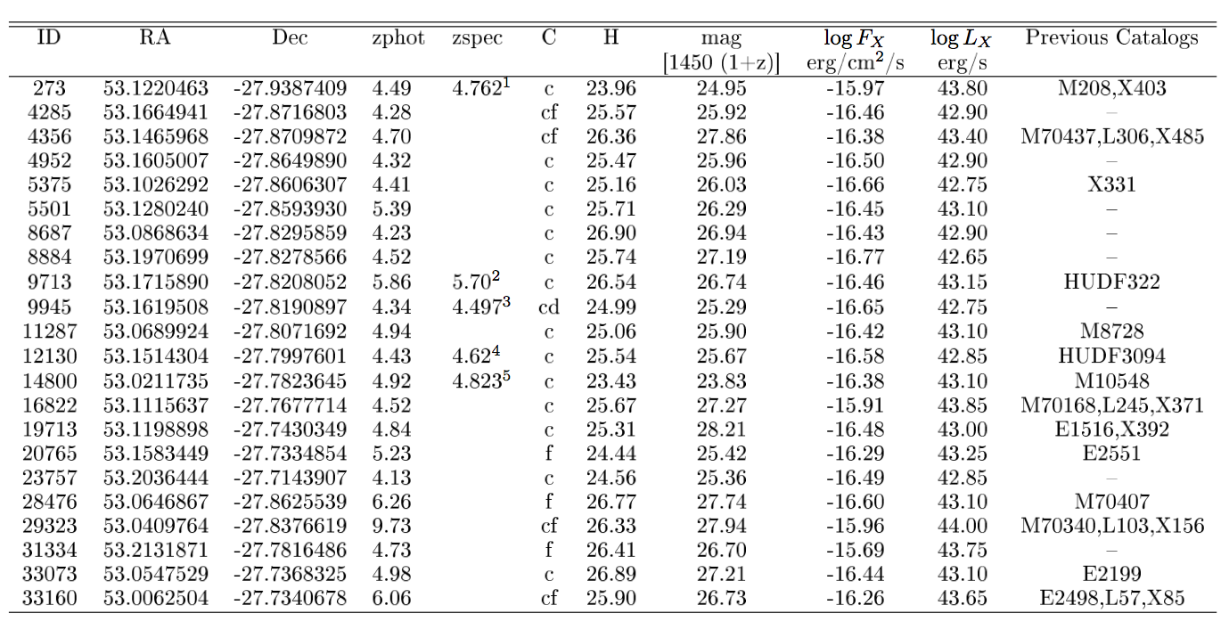
We have selected 22 AGN candidates at z>4
(5 spectroscopic redshifts)
Only 7 previously X-ray selected AGNs
Log L_{X} ~43.2 (2-10 keV)
5 obj. fitted with log N_{H}=23.5 2 obj. with log N_{H}=22.5

Slide 9
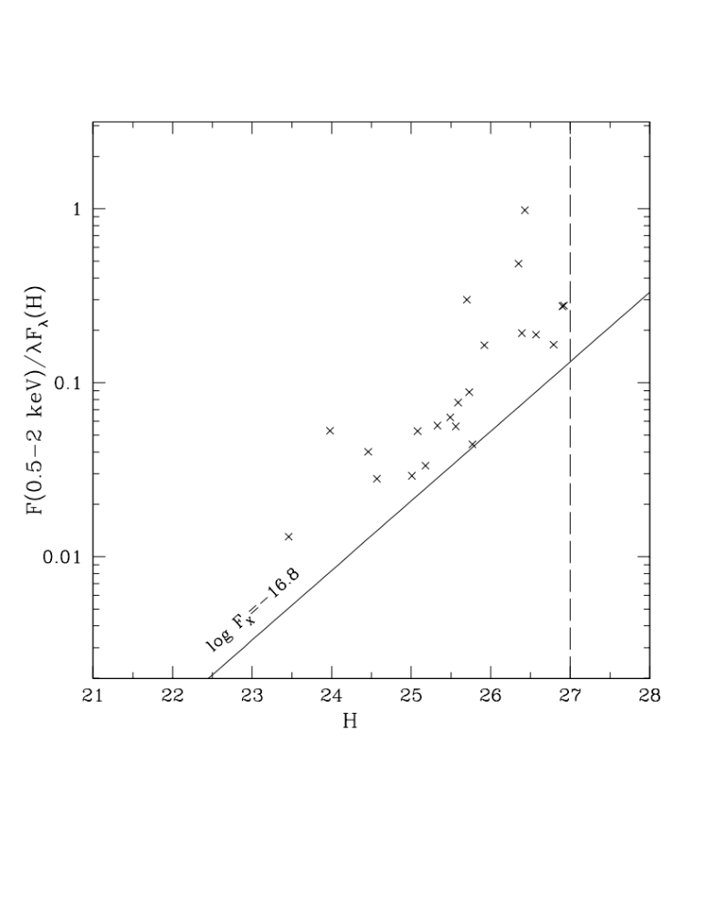
Only relatively bright X-ray sources are detected at H=27
Average correction for incompleteness by more than a factor 2 at the faint end

Slide 10
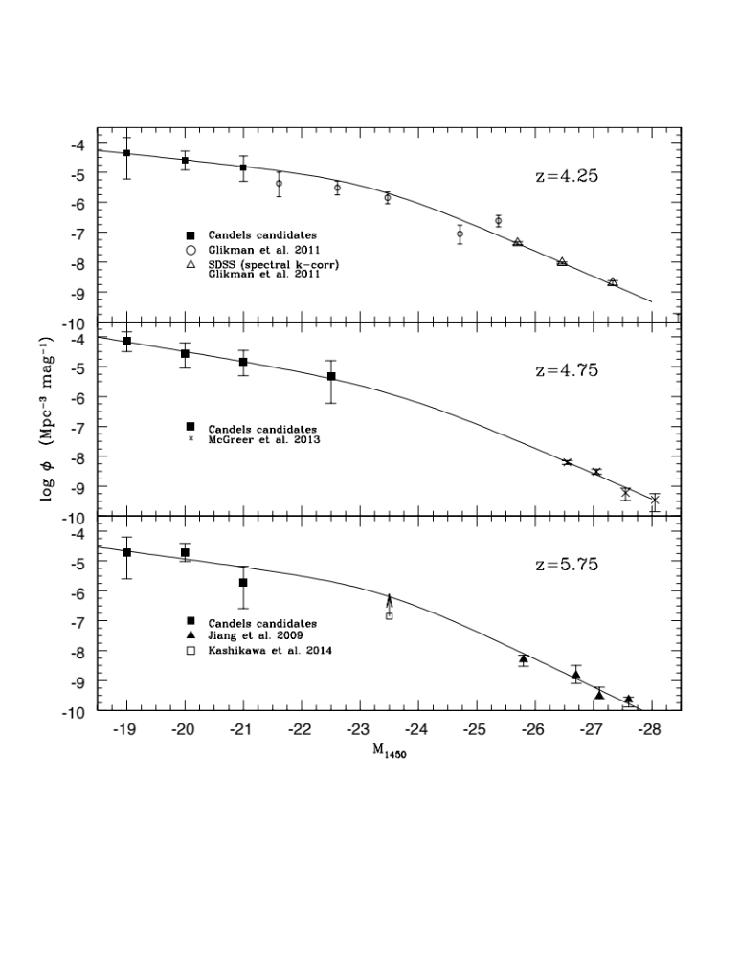
LF corrected for:
H band counts incompleteness
and
X/H incompleteness
Adding SLOAN QSOs
2 power-law fit
Faint slope 1.5-1.8
Bright slope 3.1-3.3
L (break) is unconstrained
M₁₄₅₀ = -23.2 ÷ -23.6

Slide 11
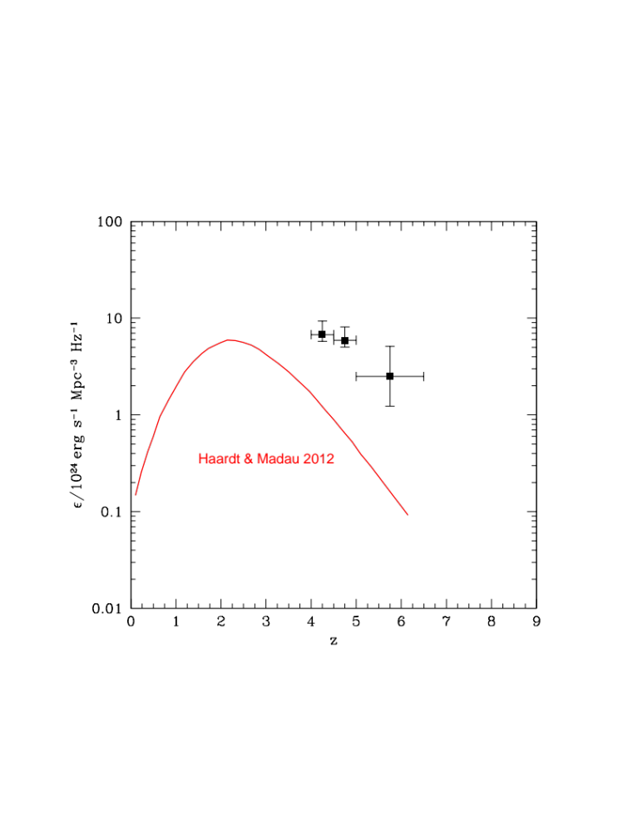
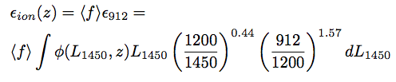
AGNs Ionizing Emissivity at 912 Å
We assume < f > =1
and
average AGN spectral template at λ<1450 Å

Slide 12

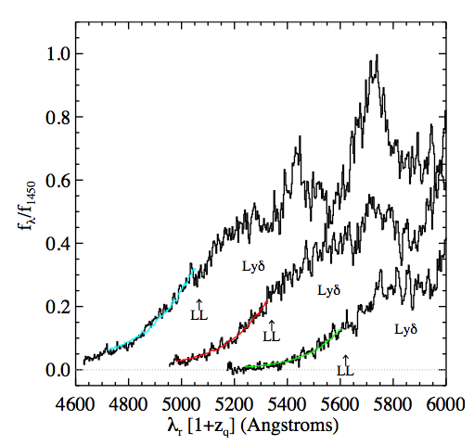
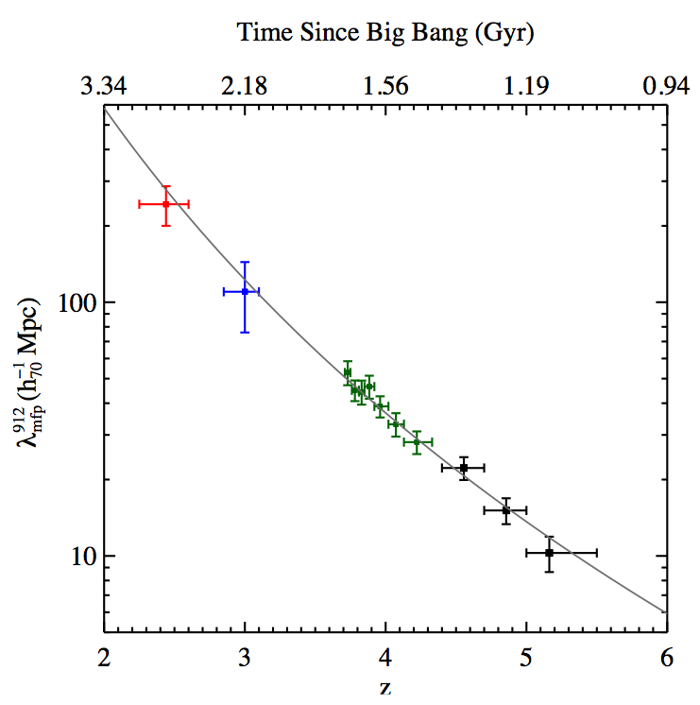
Predicted Photoionization Rate
Γ(z) depends on emissivity and mfp redshift evolution
Z>4.4
Z<5.5

Slide 13
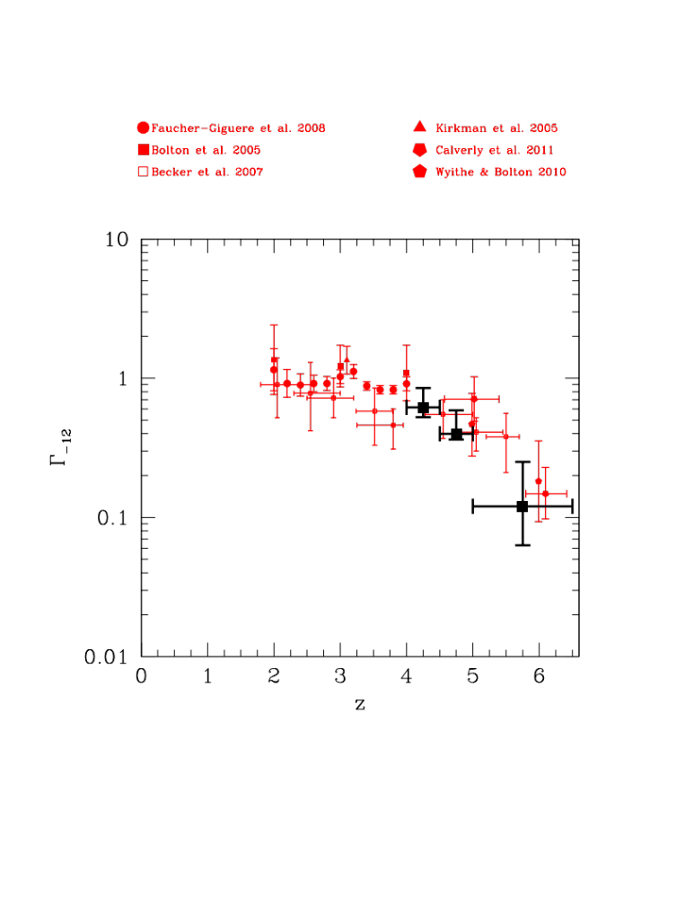
A decline by a factor ~7
from z~4 to z~6
due to decrease of both emissivity and mfp
Still consistent with the level of ionization of the IGM
It’s time to reconsider the role of
AGNs as main driver of the
ionization history of the Universe
Future prospects: we are planning to add Chandra/HST GOODS-N field to the analysis
Inner 1 deg² COSMOS field would be ideal to constrain M_{UV}~-23, log L_{X}~43.5 LF region
if covered by uniform CHANDRA exposure time of 500 Ksec per pointing

