Slide 1
Exceptional X-ray Weak Quasars:
Implications for Accretion Flows & Winds
α_{ox} Distribution of PG Quasars
X-ray Weakness vs. UV Absorption
Brandt, Laor & Wills (2000)
X-ray weak
“skew tail”

Slide 2
Chandra Deep Field-South
5.5 Ms coverage and growing!
465 arcmin²
Giacconi et al. (2002);
Luo et al. (2008);
Xue et al. (2011);
Luo et al. (in prep)

Slide 3
Are Some BAL Quasars
Intrinsically X-ray Weak?

Slide 4

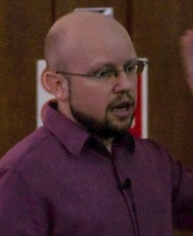

Main Collaborators
Bin Luo
(Penn State)
Dave Alexander
(Durham University)
Stacy Teng
(NASA GSFC)
Also F. Harrison, D. Stern, and the
NuSTAR Obscured AGN Working Group

Slide 5
Role of X-ray Emission / Absorption
Schematic Model of
Equatorial BAL Outflow
e.g., Murray et al. (1995); Proga et al. (2000)
Luo et al. (2013)
Quasar X-ray emission can be problematic for launching winds.
Proposed “shielding gas” is central to BAL wind driving - prevents wind over-ionization.
Such shielding gas is commonly observed in X-ray absorption with N_{H} ~ 10²¹-10²³ cm⁻².

Slide 6
Unusual X-ray Weak BAL Quasars
For many BAL quasars, X-ray absorption explains their X-ray weakness well.
But, some BAL quasars are X-ray weak yet lack sufficient apparent X-ray absorption
below ~ 10 keV to explain their X-ray weakness.
Presumably these just have heavier levels of (complex) X-ray absorption that
could not be penetrated with sub-10 keV X-rays? Compton-thick columns required.
Have now targeted nine such BAL-quasar targets with NuSTAR.
Luo et al. (2014)
Optically bright
X-ray weak

Slide 7
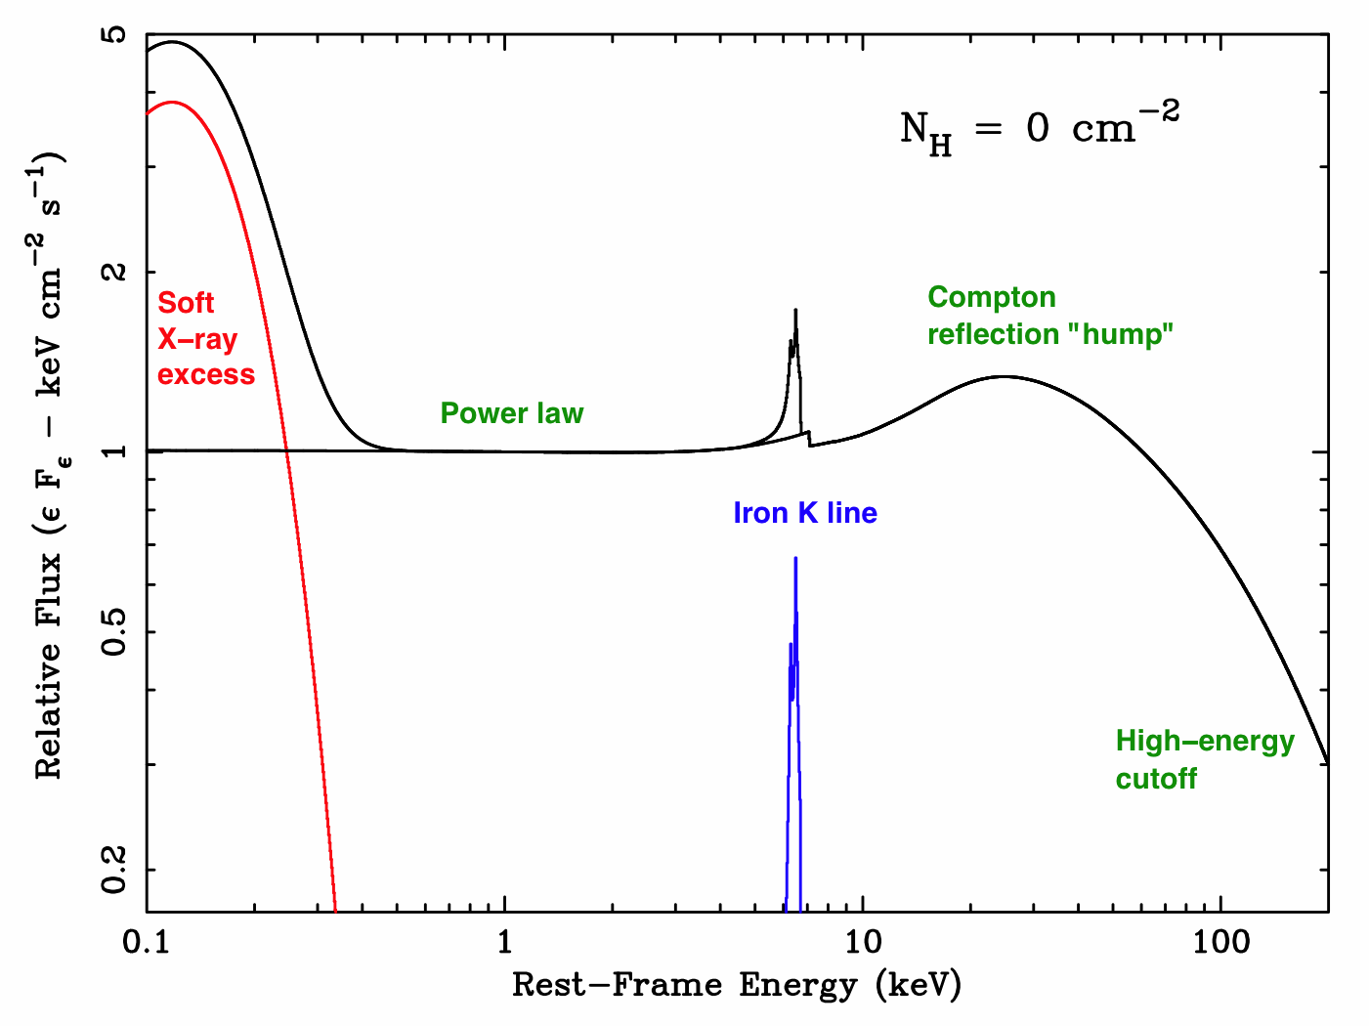
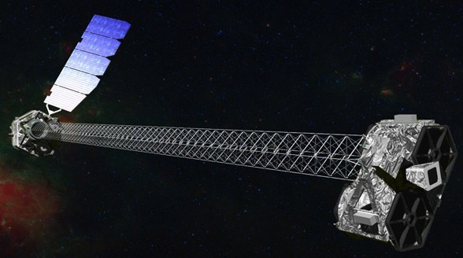
NuSTAR Gives Sensitive Coverage of Penetrating 3-24 keV X-rays
Harrison et al. (2013)
X-rays in the NuSTAR band can penetrate absorbing material
up to the highly Compton-thick regime (N_{H} ~ 10²⁵ cm⁻²).

Slide 8
Even NuSTAR Does Not Detect Underlying Luminous and Absorbed X-ray Continuum
Hard X-rays often detected, but they are weak – do not see the expected level of underlying hard X-ray emission from a typical quasar (no “punch through”).
Moreover, joint spectral analyses reveal a relatively soft 3-24 keV effective photon index of Γ_{Eff} = 1.8 +/- 0.4, disfavoring Compton-thick absorption.
Appears that some BAL quasars might well be intrinsically X-ray weak.
Mrk 231
Teng et al. (2014)
Luo et al. (2013)

Slide 9
Relevance to Wind Launching
Luo et al. (2013)
No luminous X-rays - no problem!
Perhaps intrinsically X-ray weak quasars preferentially launch strong winds with large covering factors, thereby preferentially appearing with BALs.
Using old Chandra upper limits from Gallagher et al. (2006) and new Chandra data to pin down frequency of intrinsic X-ray weakness. Perhaps 20-40% of BAL quasars.
Ultimate cause of intrinsic X-ray weakness? Checked L/L_{Edd}.

Slide 10
PHL 1811 Analogs
(and Kin)

Slide 11


Main Collaborators
Bin Luo
(Penn State)
Jianfeng Wu
(CfA and Penn State)
Pat Hall
(York University)
Also S.F. Anderson, A.M. Diamond-Stanic, G.P. Garmire, R.R. Gibson,
D.W. Just, R.M. Plotkin, G.T. Richards, D.P. Schneider, O. Shemmer

Slide 12
An X-ray Weak Outlier: PHL 1811
Broad-Band SED of PHL 1811
Outlier from Luminosity-α_{ox} Relation
z = 0.192
B = 13.9
Gibson et al. (2008)
X-ray weak by
a factor ~ 60
Leighly et al. (2007)
Appears to be intrinsically X-ray weak.
No apparent X-ray absorption. No UV BALs or mini-BALs. X-ray variability.
Reason for intrinsic X-ray weakness not compellingly understood. Extreme L/L_{Edd}
leading to “trapping” of X-ray radiation from the inner disk/corona?

Slide 13
PHL 1811: SED Impact Upon Lines
Weak and blueshifted C IV emission
NUV spectrum dominated by Fe II, III
No clear forbidden or semi-forbidden lines
Narrow-Line Type 1 optical spectrum
Leighly et al. (2007)

Slide 14
Selecting PHL 1811 Analogs in SDSS
Selected luminous quasars at z ~ 1.7-3 from SDSS with PHL 1811-like spectra:
Low C IV EWs
Large C IV blueshifts
Strong Fe II and Fe III emission
No BALs or mini-BALs
Highly offset from typical quasar
population, in direction of wind-dominated BLRs.
Make up < 1.2% of radio-quiet quasars.
Targeting them with Chandra snapshots to characterize basic X-ray properties.
8 objects in Chandra Cycle 11
10 objects in Chandra Cycle 14
C IV Selection Diagram
Typical
SDSS
Quasars
Wu et al. (2011)
Luo et al. (2014)

Slide 15
Selecting PHL 1811 Analogs in SDSS

Slide 16
They’re X-ray Weak!
Relative X-ray vs. Optical/UV Fluxes – They are Strikingly X-ray Weak (17/18)
Typical
Radio-Quiet
Quasars
Luo et al. (2014)
403 121 37 11 3.3 = Factor of X-ray weakness

Slide 17
Broad-Band SEDs
Luo et al. (2014)

Slide 18
Basic X-ray Spectral Data
Chandra Spectrum of SDSS J1521+5202
These sources are so X-ray weak
that it’s hard to get X-ray spectral
properties for them!
One exception is SDSS J1521+5202,
an extraordinarily luminous quasar.
Unlike PHL 1811 itself, it has a
very hard X-ray spectrum with
Γ_{Eff} = 0.6 +/- 0.2.
Absorption? Reflection?
Luo et al. (2014)
37 ks exposure
Stacking of the other PHL 1811 analogs also indicates a hard X-ray spectrum
with Γ_{Eff} = 1.2 +/- 0.3.
Perhaps can get PHL 1811-like UV spectra for both intrinsically X-ray weak
objects and some X-ray absorbed objects (producing similar soft SEDs at the BLR).

Slide 19
Requirements for X-ray Absorber
Large column density of absorption (at least 10²³ cm⁻²)
Lack of accompanying C IV BALs or mini-BALs
Lies closer to SMBH than Broad Line Region
Large covering factor to screen X-rays from
most of the Broad Line Region
Most likely possibilities are geometrically
thick inner disk or “shielding gas”.

Slide 20
Schematic Cartoon of
Supercritical Accretion
Ohsuga & Mineshige (2007)

Slide 21
Connections with SDSS WLQs
The SDSS has also identified a population
of (radio-quiet) weak-line quasars, some completely lineless.
PHL 1811 analogs are empirically a subset of such objects.
We’ve also targeted WLQs with Chandra
snapshots, and find that a significant fraction (about 50%) are X-ray weak.
Those WLQs that are X-ray weak have
SDSS spectra more similar to those of
PHL 1811 analogs.
Luo et al. (2014)

Slide 22
A Milli-Unified Model?
There is a prospect for “unifying”
PHL 1811 analogs and WLQs using orientation-dependent absorption
on small scales.
Analogous to standard unified model, but with absorption occurring on ~ 1000 times smaller scales.
Quasars have a range of covering factors by this absorbing gas.
At the extreme of large covering
factor, X-rays and other ionizing photons can be largely blocked from the BLR.
Leads to the weak BLR line emission.
Also may lead to strong C IV blueshifts via strong wind acceleration (and orientation).
Wu et al. (2011)

Slide 23
A Milli-Unified Model?
When L.O.S. passes through small-scale absorber, see PHL 1811 analog.
When L.O.S. misses small-scale absorber, see X-ray normal WLQ.
A number of more detailed points here. See Wu et al. (2011) and Luo et al. (2014)
for details.
Wu et al. (2011)

Slide 24


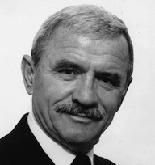
Thank You!

