Slide 1
Studying Galaxy Mergers With Chandra:
From Dual AGN to Recoiling Black Holes
Mike Koss
ETH Zurich, Ambizione Fellow
Richard Mushotzky, Daniel Stern, Laura Blecha, Linda Baronchelli, Sylvain Veilleux, Kevin Schawinski, Ezequiel Treister, Benny Trakhtenbrot,
And NuSTAR Obscured AGN Team

Slide 2
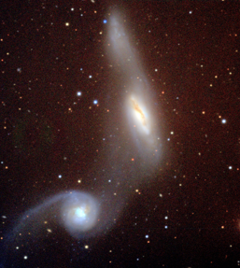
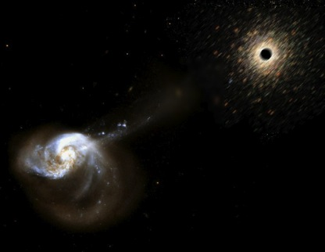
Studying Galaxy Merger Stages With Chandra
Galaxy Merger
BH Recoil
Dual AGN
Binary
AGN
Di Matteo et al 2005
How do Galaxy Mergers Grow BHs?
  Measure Dual AGN fraction at different separations
Very Close dual AGN (<5 kpc)?
  Exquisite PSF uncovers unknown dual AGN (e.g. Komossa et al. 2003)
Is there Evidence of Recoiling BHs?
  Indirect Method to detect GW emission (e.g. Civano et al. 2012)

Slide 3
Results from Simulations of Major Mergers
Van Wassenhove et al. 2011.
AGN activity is brightest at small scales (<10 kpc)
Small scales have very short timescales

Slide 4
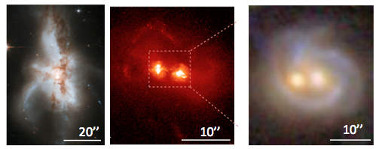
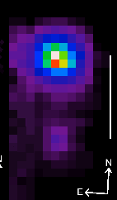
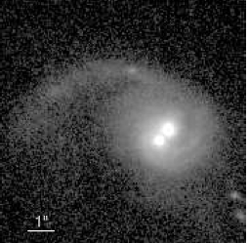
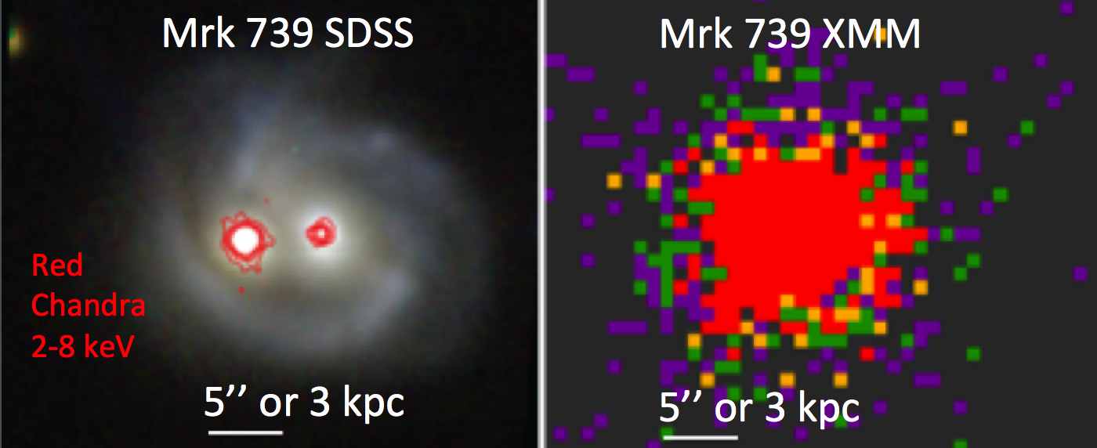
Serendipitously Discovered Dual AGN (kpc scales)
Dual AGN Galore, e.g. Komassa 03, Bianci 08, McGurk 11, Comerford 09)
Relies on exquisite Chandra PSF (Koss et al. 2011)
Interesting but… need systematic study to understand the effect of galaxy interactions on nuclear activities/BH growth! Let’s use Swift BAT all sky AGN…

Slide 5
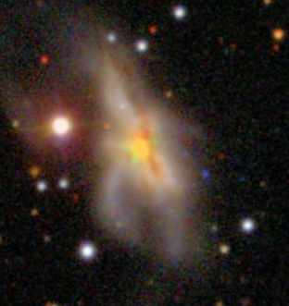
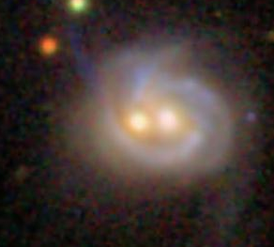
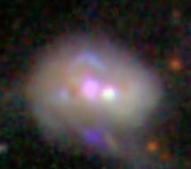
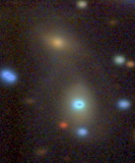
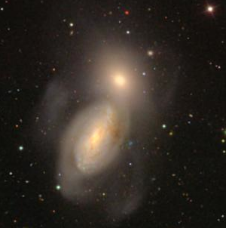
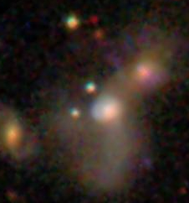
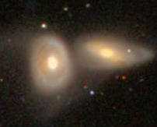
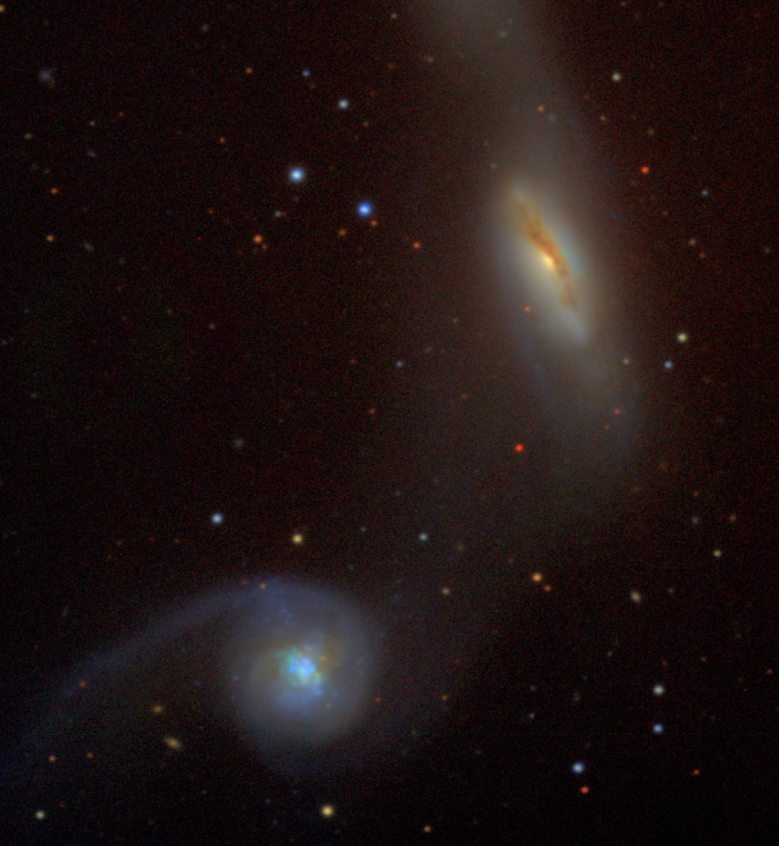
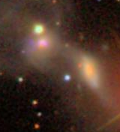
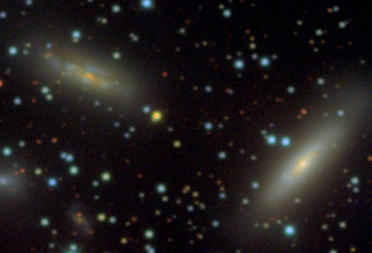
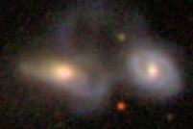
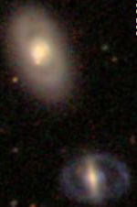
Dual AGN Study X-rays+Optical (16/167)
Notes:
NGC 6240S Mrk 739E Mrk 0463E IRAS 05589+2828
NGC 3227 IRAS 03219+4031 NGC 0835 NGC 2992
UGC 11185 NED02 MCG +04-48-002 UGC 08327 NED02 Mrk0268
Not shown (ESO 509-IG 066 NED01)

Slide 6
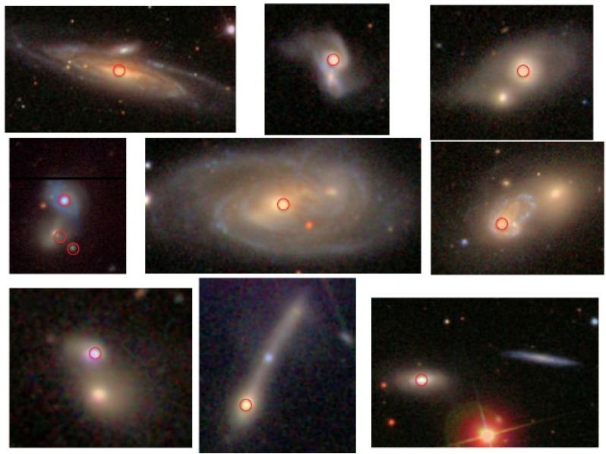
Sample of Non-Detections <30 kpc
Minor Mergers (>3 mass ratio) and absorption line galaxies (elliptical)
Notes:
2MASX J00253292+6821442 NGC 931 NGC 235A
UGC 03995ª 2MASX J11454045-1827149 NGC 1142
FAIRALL 0272 NGC 7469 NGC 5106
Not shown 2MASX J09043699+5536025, ARP 151, NGC 3786
Not shown no good image IC 4518ª, ESO 195-IG 021 NED03, WKK 6092, Mrk279 KP, NGC 7213
Not shown minor merger KUG 1208+386, NGC 5506

Slide 7
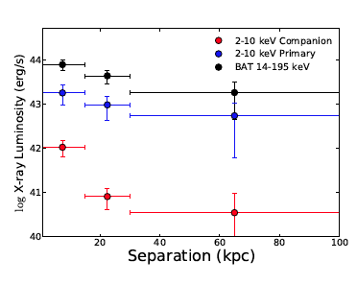
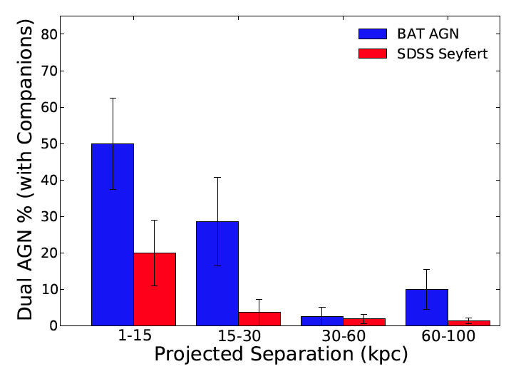
Dual AGN Fraction with Separation
Dual AGN Activity Increases at Smaller Separations
More SMBH growth happens in the later stages of a merger process
All close (<30 kpc), major merger, non elliptical systems are duals!!!
X-ray luminosity (Chandra) increases dramatically at small separations (<10 kpc)
Koss et al. 2012, ApJL 746,22
Notes:
Need to add percentage of all AGN

Slide 8
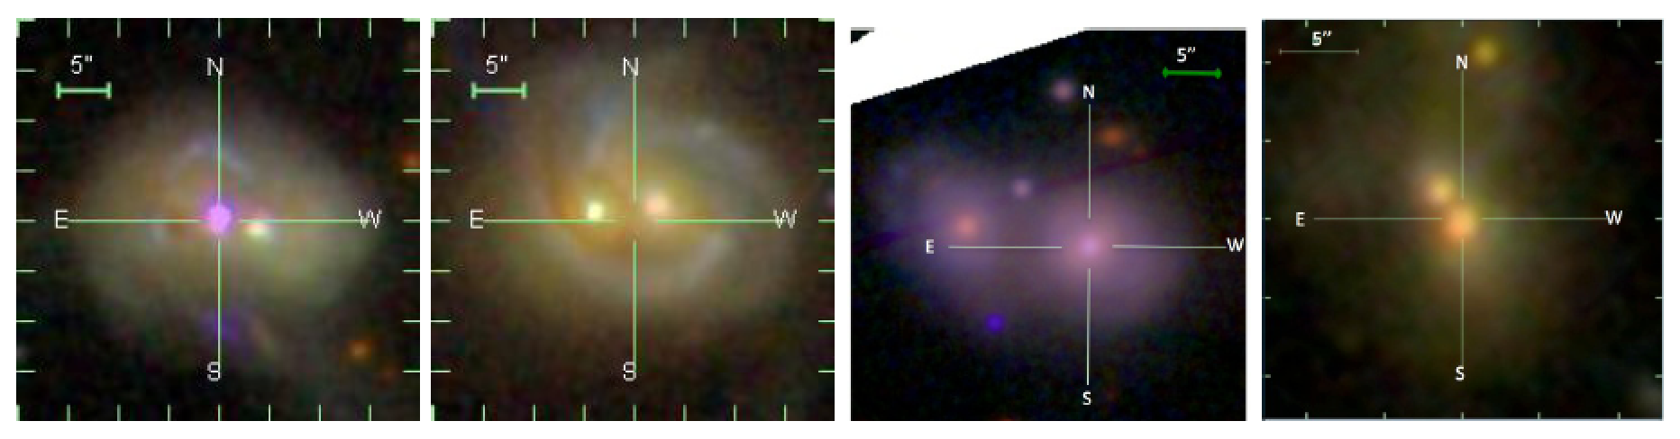
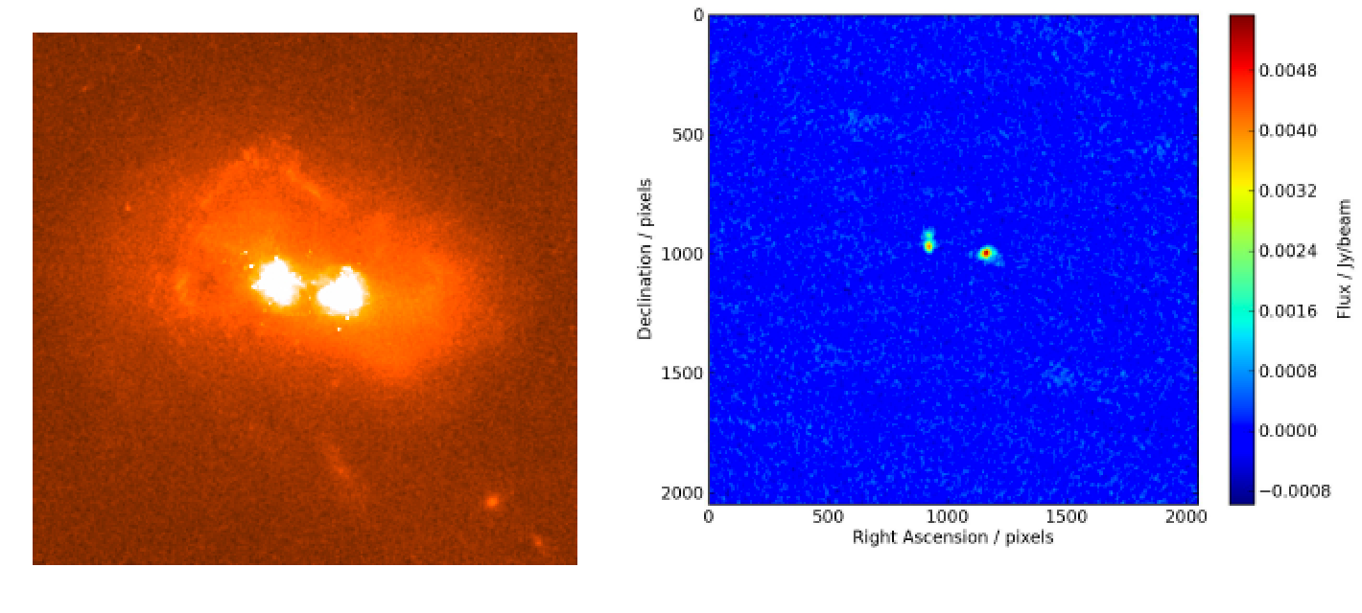
Accepted ALMA Observations of Duals
Gas rotation curves for each dual AGN pair are dominated by a simple rotation
Small scale inflow related to the merger or secular evolution such as bar-driven inflow
Estimate the rate of mass flowing to the nucleus based on residual velocities
Compare to the measured accretion rate from the X-rays for each AGN.

Slide 9
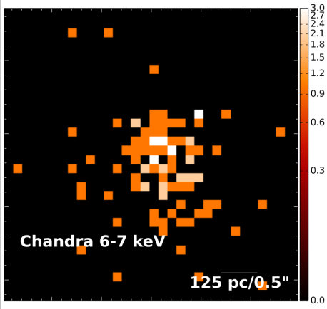
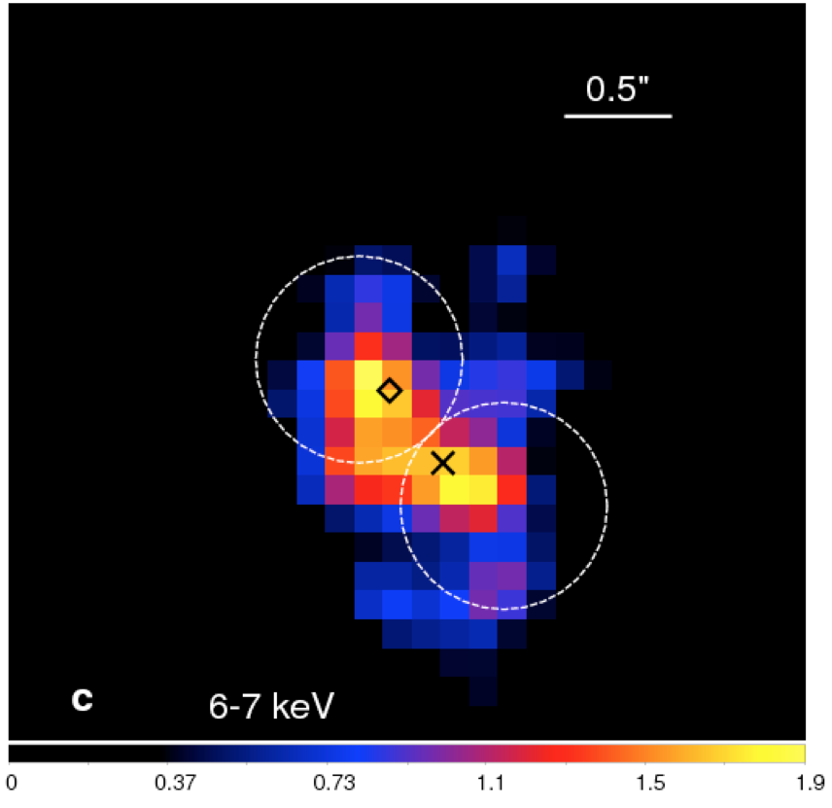
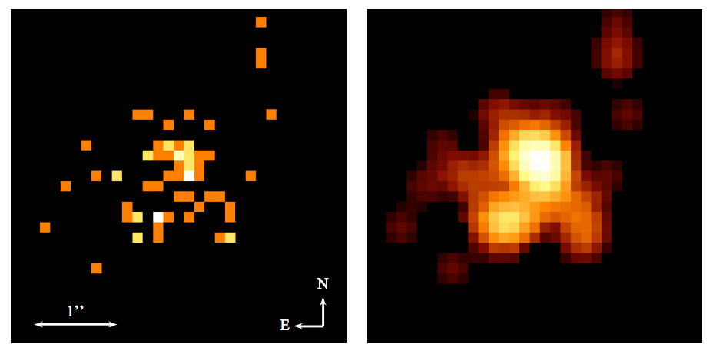
Going to the Limits: Close Dual AGN (<1’’)
Counts Image Smoothed (3 pixel)
NGC 3393 (Fabbiano et al. 2011)
0.6’’ Separation
Single source (NIR/Mid IR AO, HST, Radio)
No tidal tails
Source aligned with angle PSF hook artifact
Not detected in other Chandra obs
Counts Image Smoothed (3 pixel)
SDSS J171544 (Comeford et al. 2011)
0.7’’ Separation
Single source in NIR AO (Fu et al 2011)
No tidal tails
Source aligned with angle PSF hook artifact
Not detected in other Chandra obs
Could these duals be produced by smoothing a single PSF at 0.3’’?

Slide 10
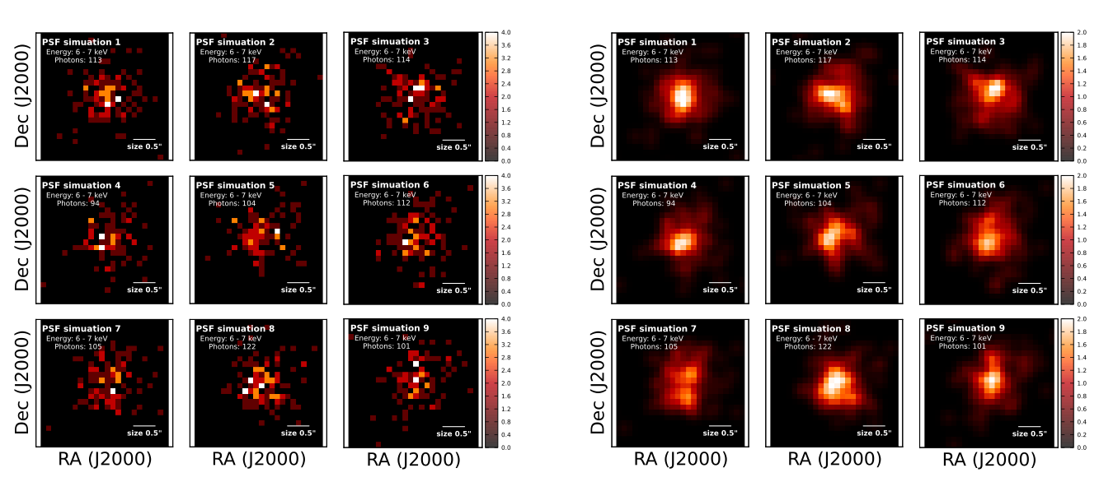
Seeing Double: Simulation of 1 PSF
6-7 keV PSF is worse (0.5’’, 50% ecf radius, 1.7’’ 90% ecf radius)
Low count rate data (few counts per pixel) smooth Gaussian
Smoothed scales much smaller than PSF (0.3’’)

Slide 11
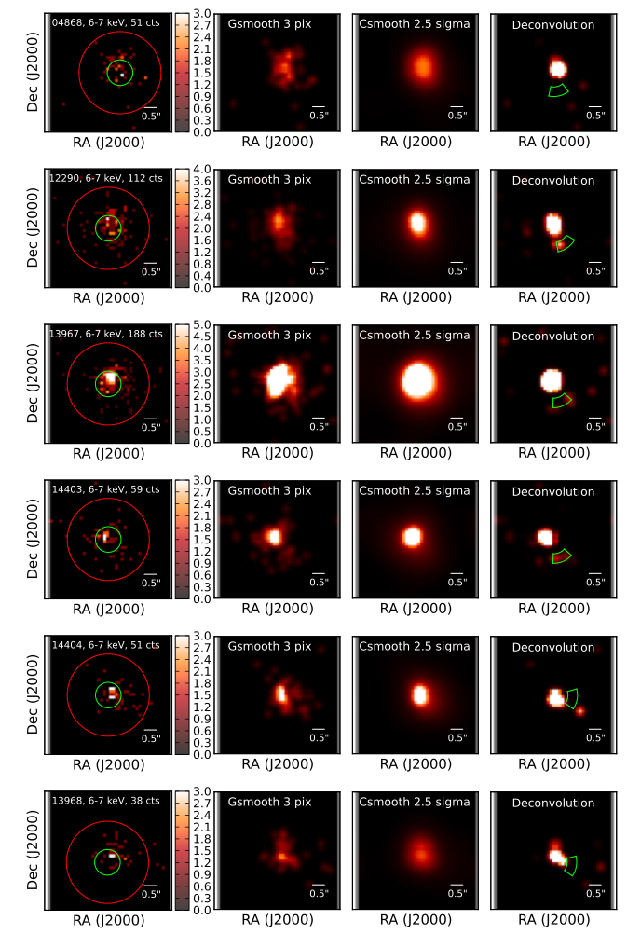
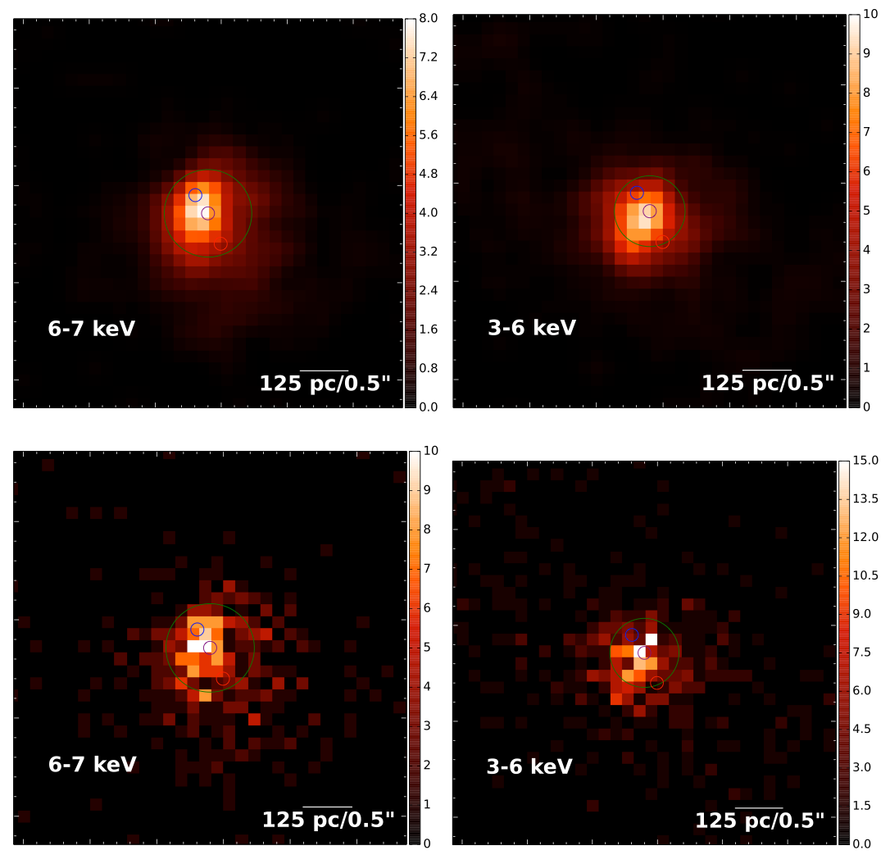
All NGC 3393 Observations 6-7 keV
Only 4868 and 12290 in original paper.
3.1x deeper imaging from Grating Observations
  No Evidence for secondary AGN
Only a few counts per pixels (Poisson)
Compare to Csmooth at 2.5 sigma
  Differences are not statistically significant!
Single Images
Stacked Images

Slide 12
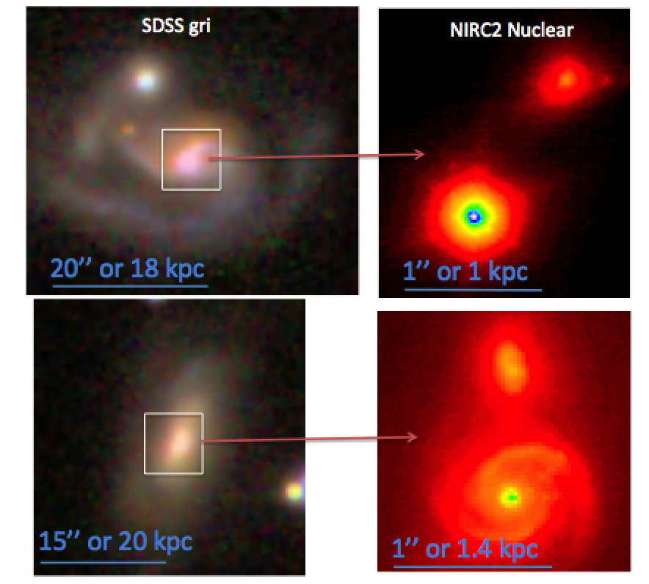
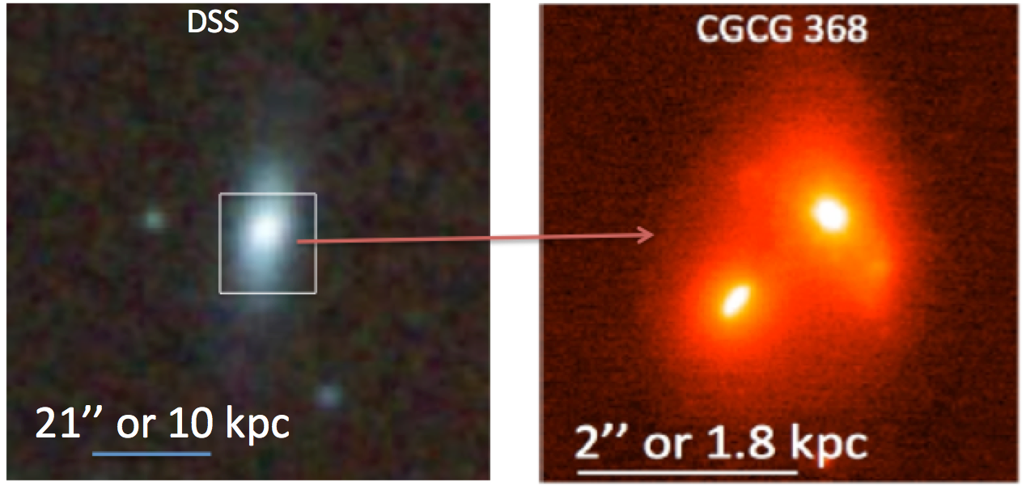
Way Forward:
Target Very Close Mergers in AO
Hidden Mergers in Swift BAT Sample
Keck Pilot Study of BAT AGN
Compared to Inactive Galaxies:
6/110 vs. 1/250 (Malkan et al. 2004, HST).
Hidden mergers at 1-2 kpc are rare, but consider merger timescale
Use merger information in observation
Align Chandra hook perpendicular

Slide 13
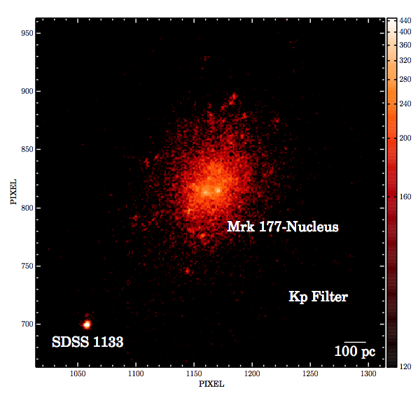
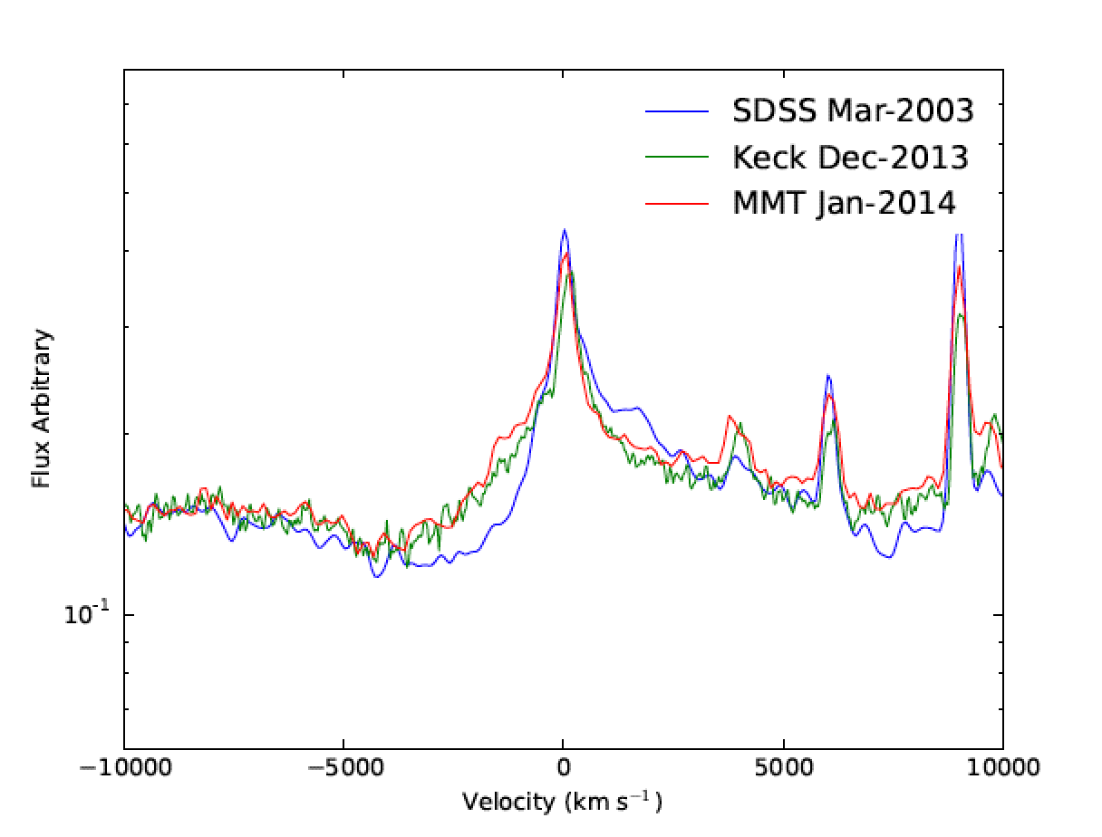
Chandra and Recoiling Black Holes
SDSS1133 in High Resolution
SDSS 1133 Spectra
Consistent with telescope PSF imaging, Kp (12 pc)
From Hbeta, BH mass constant over a decade, Log M_{BH}=6.2
Approved HST observations next fall of C IV line, recently brightened.
Maximum Sensitivity for eLisa! Press Release NASA, ETH, Hawaii, Keck today.
Perfect for Chandra observations because of small offset (5’’)
Koss et al. 2014

Slide 14
Summary
Dual AGN Activity
Chandra shows strong brightening at small separations
Gas-rich, major mergers and avoids elliptical galaxies
Matches Theoretical predictions in merger activity
Close Duals (<1’’) and Recoiling Black Holes
Blind Chandra detection of duals is difficult
  Avoid smoothing low count data on scales much smaller PSF
  Take advantage of multiwavelength data and simulations
Many possibilities in nearby mergers and recoiling black holes
Still Many Unanswered Questions
Gas fueling ALMA+Chandra? Increase in dual AGN with redshift? NH with merger stage?
Low Luminosity AGN duals? Rates of recoiling black holes?
Bright Future for Chandra!!!

Slide 15
Backup

Slide 16
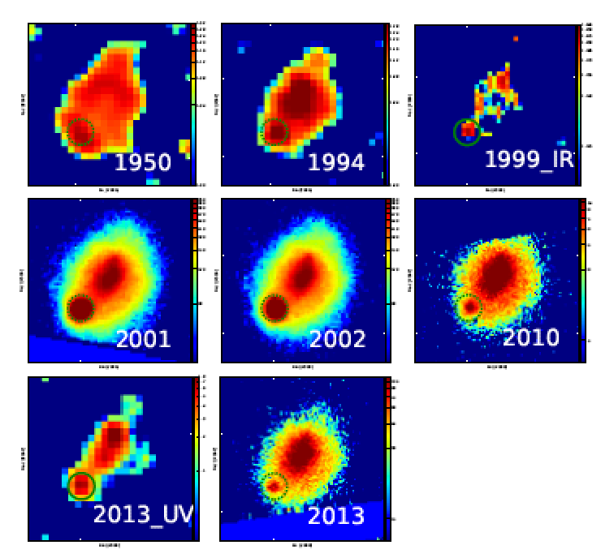
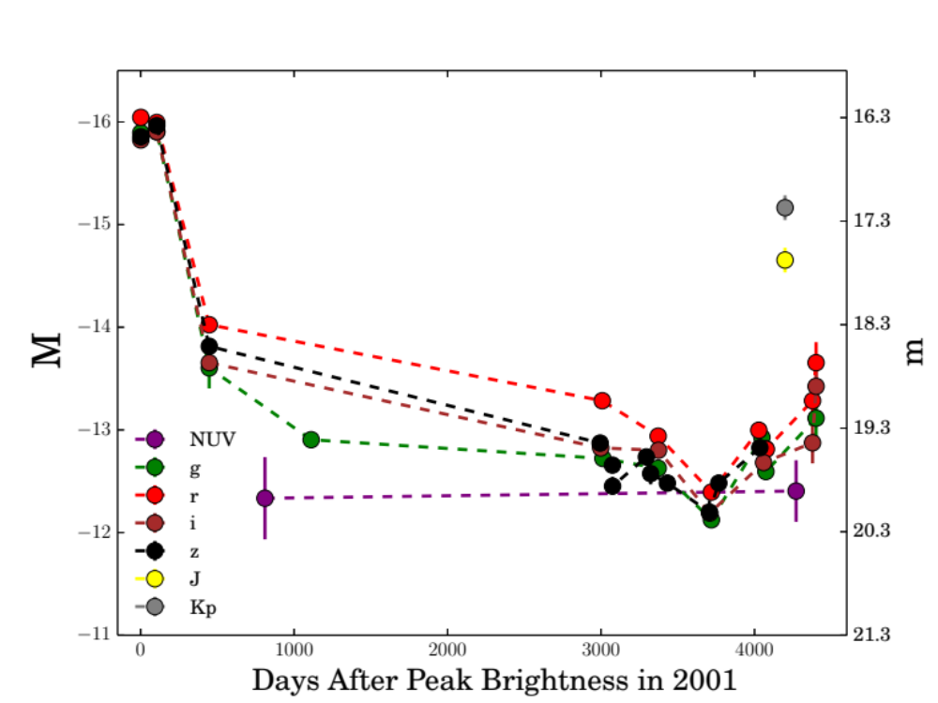
Historical Images
Observed for 60+ years
Makes Sne Unlikely

Slide 17
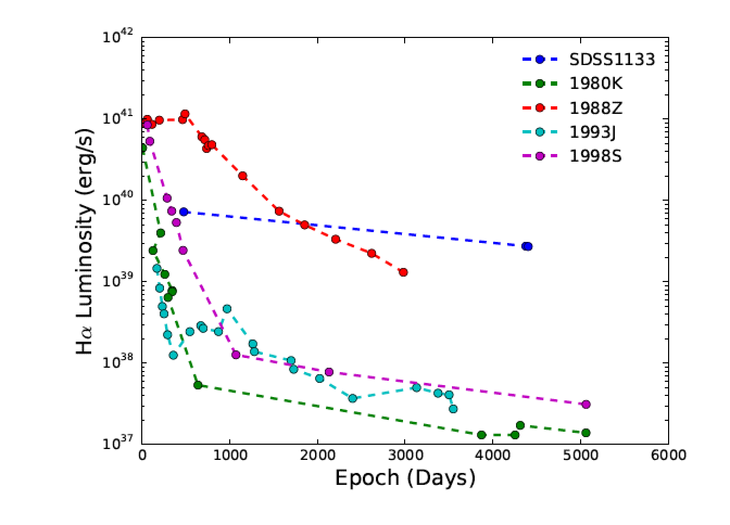
Comparison to Other SNe
1. SDSS1133 would be the most luminous late time Halpha emission ever observed.

Slide 18
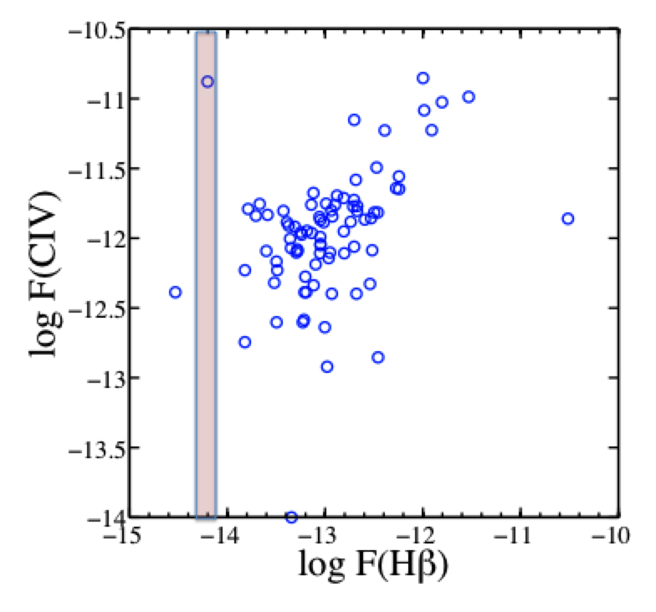
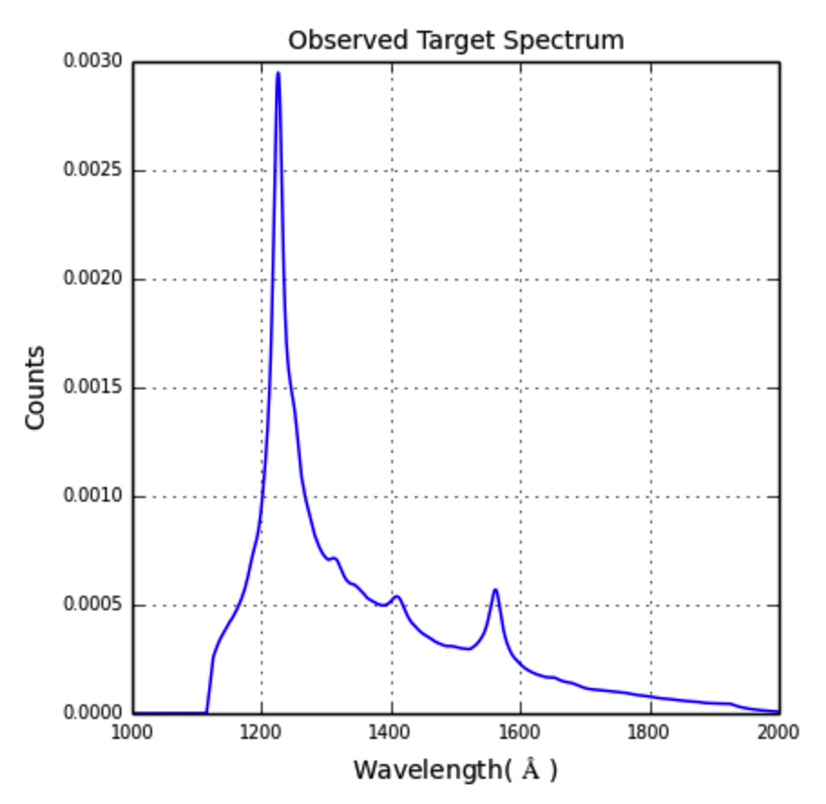
Balmer Lines
From Hbeta, BH mass stays constant over a decade
Log M_{BH}=6.0 (SDSS-2003), 6.0 (Keck 2013), 6.2 (2014).
Maximum Sensitivity for eLisa!
HST: UV spectra to look for broad CIV and other coronal lines. Has recently brightened by over a mag. Accepted!
Press Release NASA, ETH, Hawaii, Keck Nov 21.

Slide 19
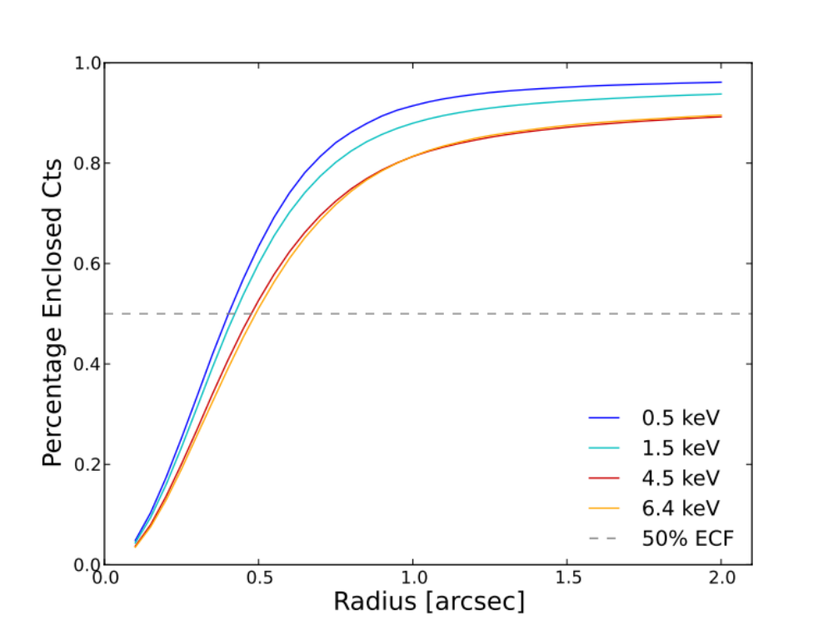
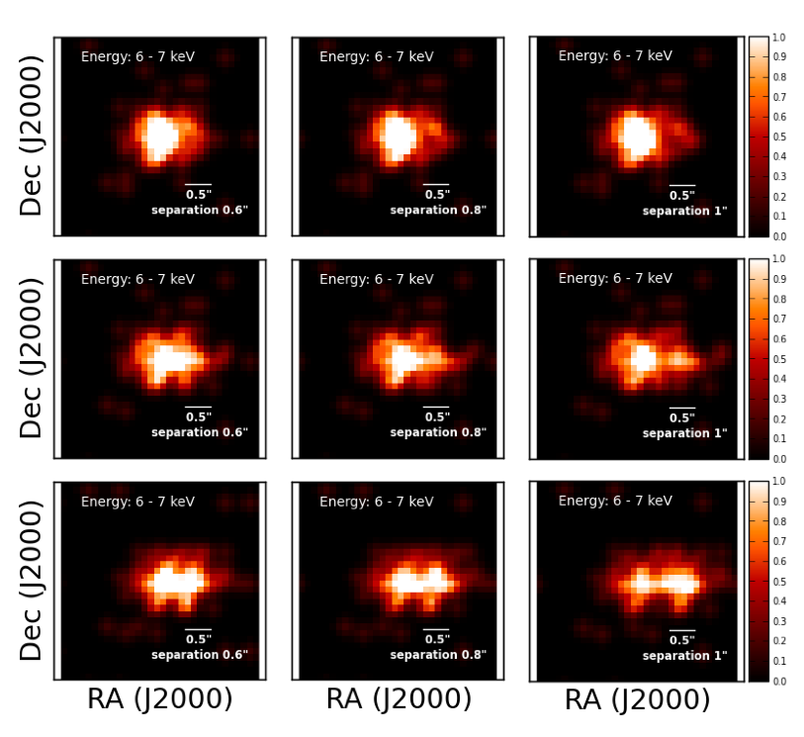
Simulation of Dual AGN
At 0.6’’, not well resolved, a real dual would be blended particularly since this ideal PSF doesn’t include PSF asymmetry like hook, blur from stacking.

Slide 20
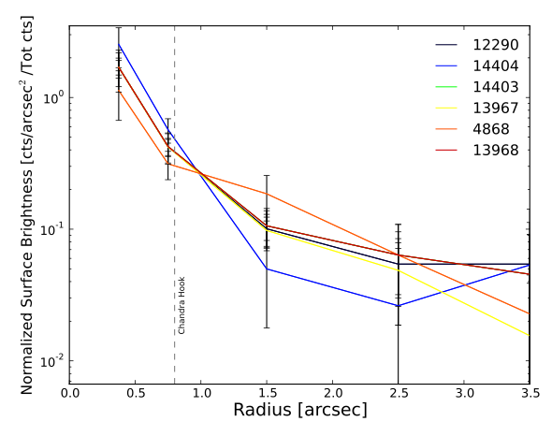
Zeroth Order Grating vs. Images
No significant difference in PSF profile.

Slide 21
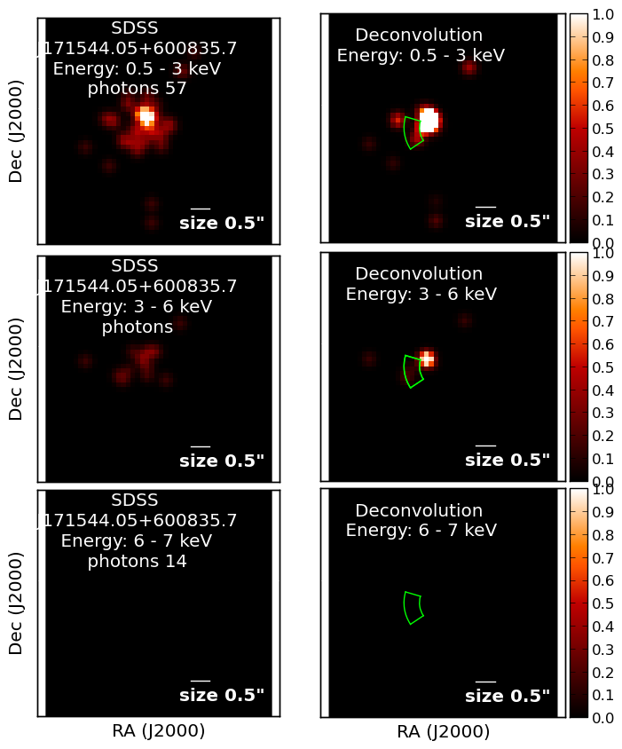
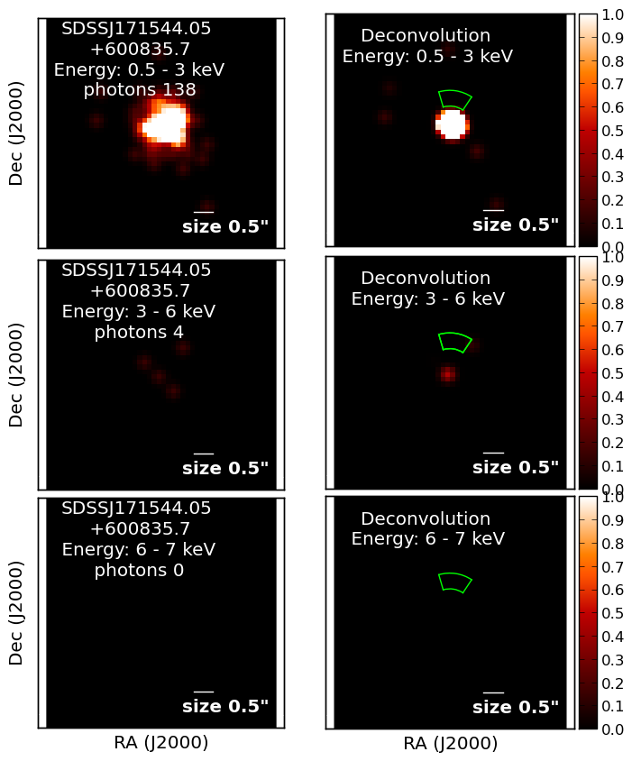
SDSS171544
No Secondary Source in NIRC2

Slide 22
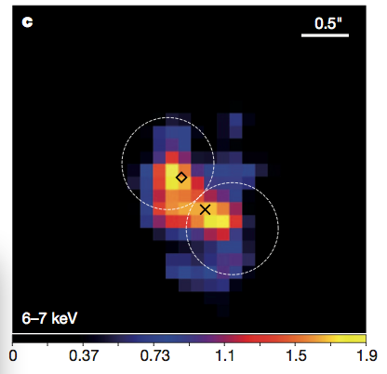
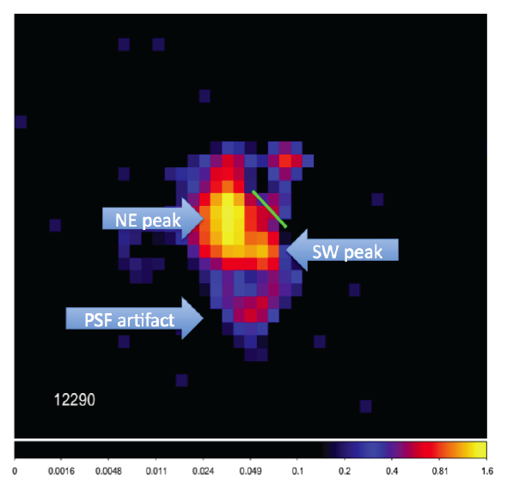
NGC 3393: Double Vision Test

Slide 23
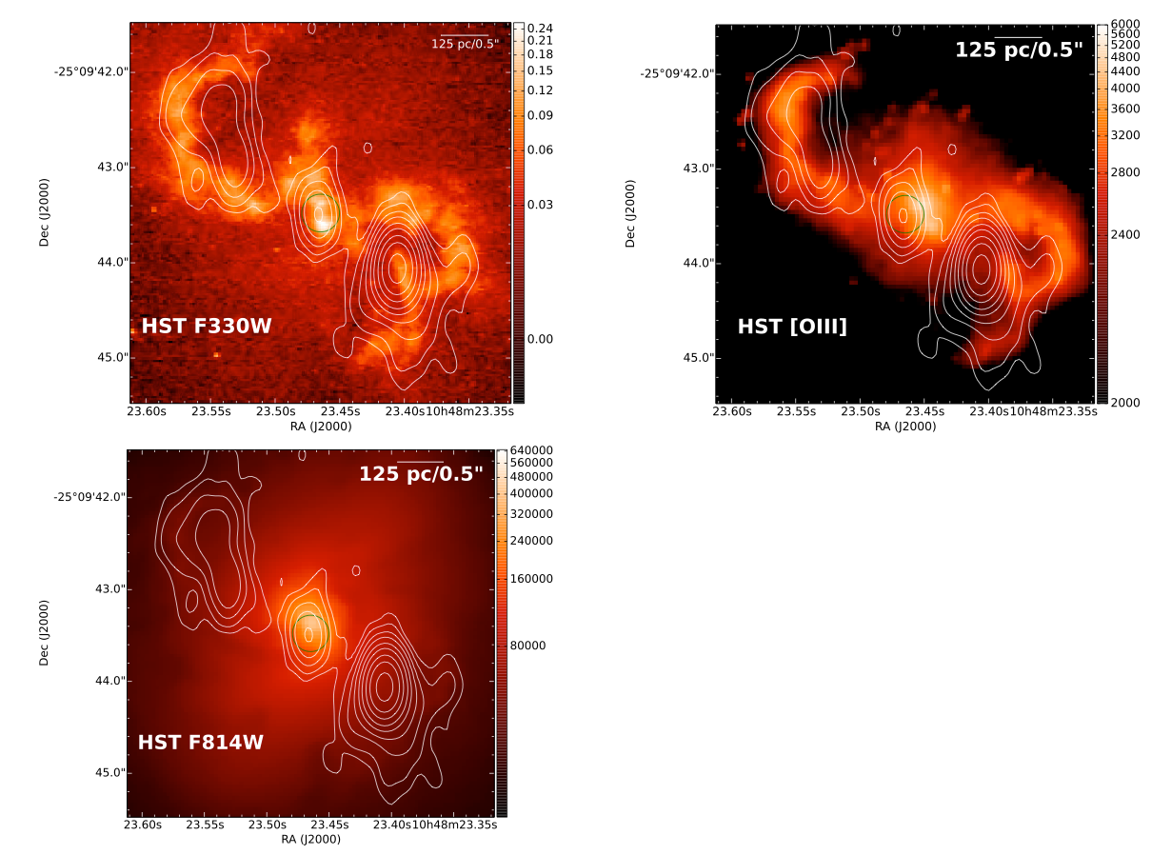

Slide 24
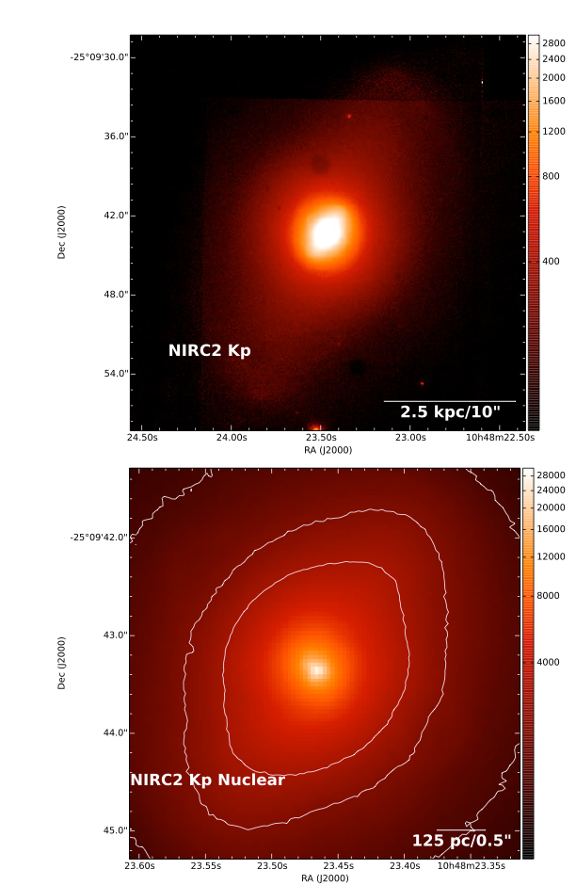
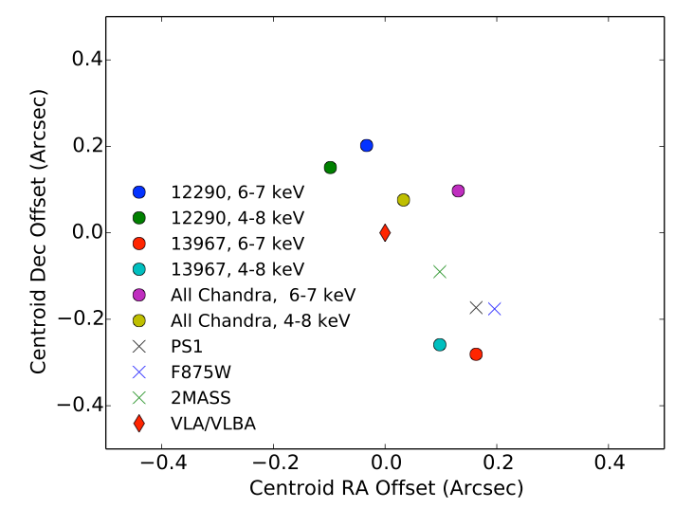

Slide 25
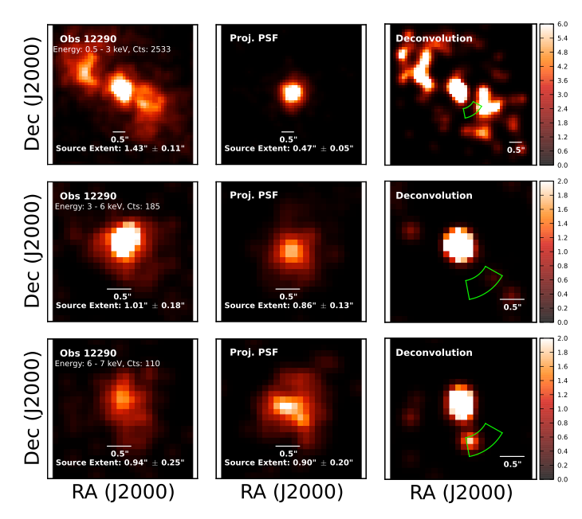

Slide 26
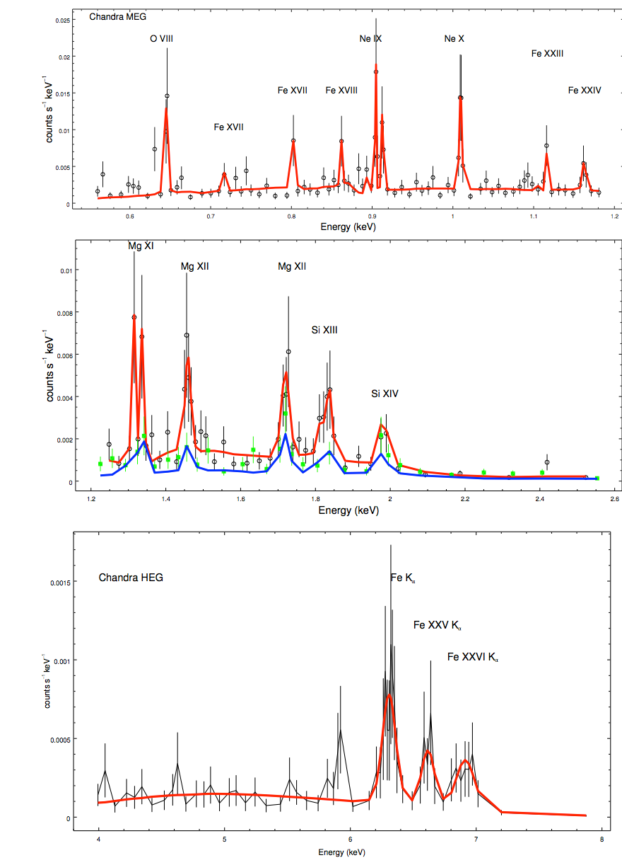


Slide 27


Slide 28


