Slide 1
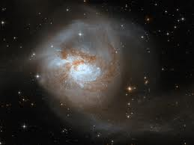

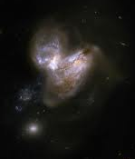

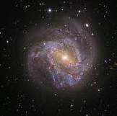
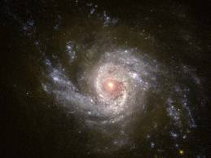
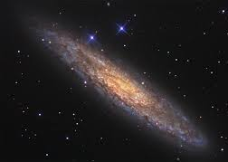
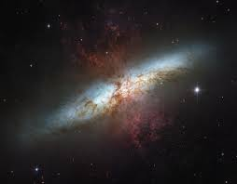
NGC 3256
Extragalactic X-ray binaries from 0.5-30 keV with Chandra and NuSTAR
Arp 299
NGC 3310
Ann Hornschemeier
(NASA GSFC)
Andrew Ptak (GSFC), Bret Lehmer (JHU/GSFC), Dan Wik (JHU/GSFC), Vallia Antoniou (CfA), Meg Argo (ASTRON), Keith Bechtol (Stanford),
Fiona Harrison (Caltech), Roman Krivonos (Berkeley),
Tom Maccarone (Texas Tech), Daniel Stern (JPL), Tonia Venters (GSFC), Mihoko Yukita (JHU/GSFC), Andreas Zezas (CfA), William Zhang (GSFC)
M83
NGC 253
M82

Slide 2
Hard (E>10 keV) observations of Starburst Galaxies
Science goals:
  Compact object (NS & BH) populations
  Nuclear activity (AGN vs. starburst)
  Particle acceleration in SF regions
All six galaxies have concurrent Chandra coverage (P.I. Hornschemeier for five; PI for Chandra Arp 299 observations A. Zezas).
M83 has had two sets of NuSTAR observations concurrent with XMM exposures (PI K. Kuntz; Aug 13, Jan 14)

Slide 3
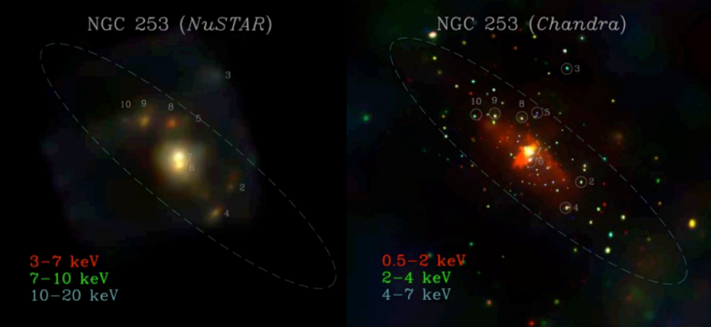
NGC 253 point sources
(495 ks; Lehmer et al. 2013, ApJ, 771, 134,
Wik et al 2014, ApJ, arXiv:1411.1089)
Nearby, can resolve (d ~ 3.9 Mpc)
Hosts a central starburst that drives a superwind
Very bright gamma ray source (Fermi)

Slide 4
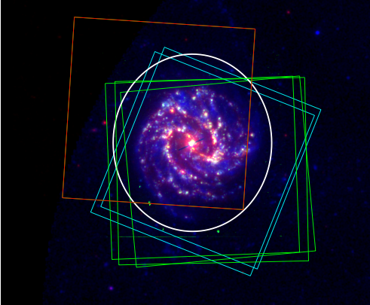
M83: 420 ks NuSTAR Campaign
XMM: PI Kuntz (AO12)
CXO: PI Hornschemeier (AO15)
Jan 2014 w/ XMM
Aug 2013 w/ XMM
d=4.6 Mpc
FUV(blue)
Hα(green)
24μm(red)
June 2014 with Chandra

Slide 5
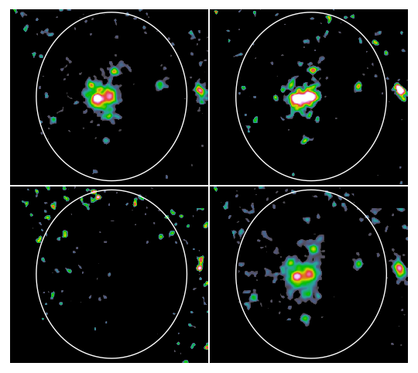
M83 NuSTAR Images
(Yukita et al. 2014, in prep)
4-6 keV
6-12 keV
12-25 keV
4-25 keV

Slide 6
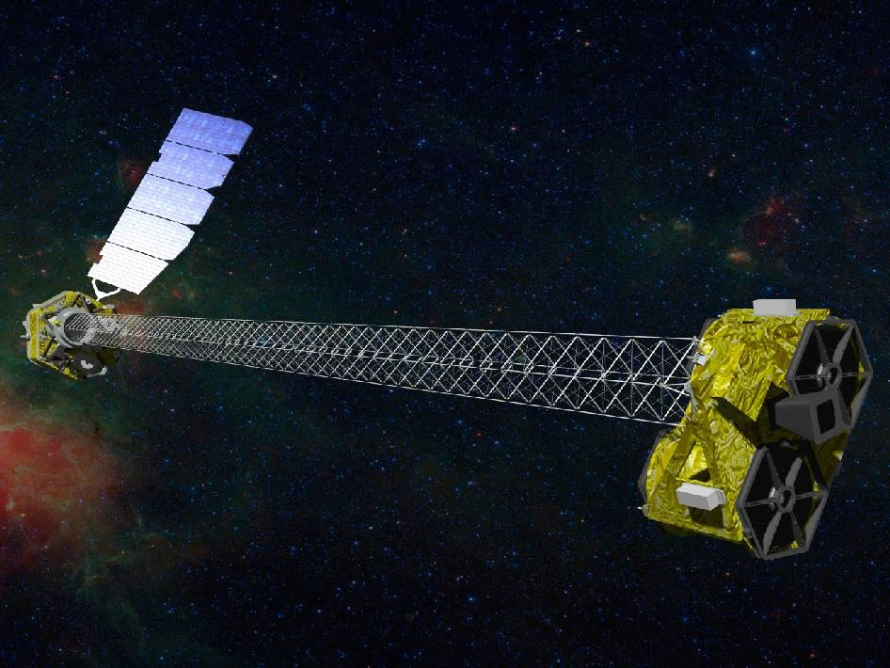
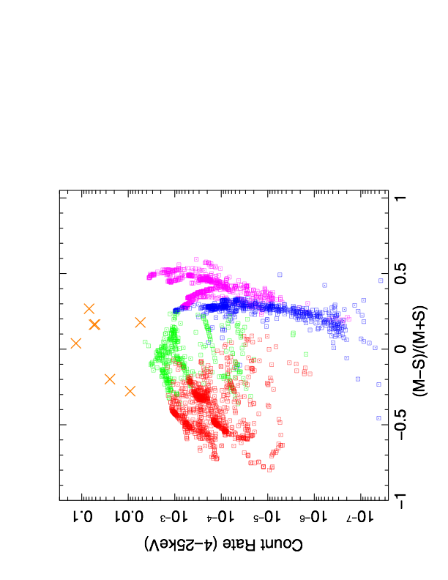
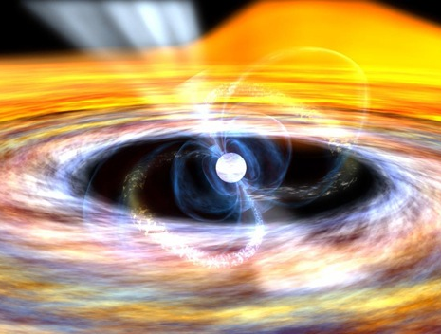
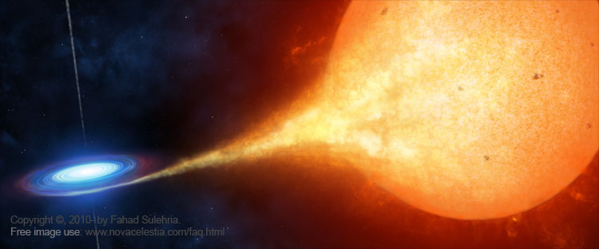
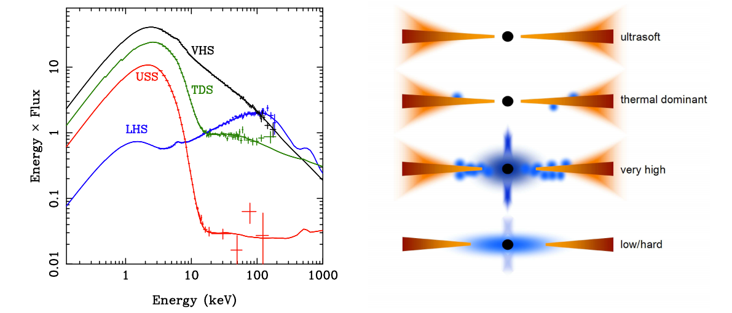
Predicted NuSTAR Colors of MW X-ray Binaries
NuSTAR
Zezas et al. 2014 (in-prep)
(Intermediate)
VHS-TDS
Accreting
Pulsars
X-ray Binaries
Accreting
Pulsars
(Soft)
USS
(USS)
(TDS)
(Hard)
LHS to VHS
(VHS)
(LHS)
Done et al. 2007
S: 4-6 keV, M: 6-12 keV
5
Notes:
More than 1000 observations of approximately half a dozen black hole sources, as well as a large number of observations of accreting pulsars (half a dozen or so)

Slide 7
X-ray Color Diagnostics for Compact Objects
NuSTAR ULXs
Accreting
pulsars
We find more luminous sources in extragalactic environments (ULXs)
NuSTAR ULX spectra from Walton et al. 2013,
Bachetti et al. 2013,
Rana et al. 2014
NuSTAR ULXs are clearly separated from the track of Galactic sources
Soft state
BH binaries
NuSTAR Count Rate (4-25 keV )
@ 4.0 Mpc
Intermediate state
BH binaries
Hard state
BH binaries
S: 4-6 keV
M: 6-12 keV
(M-S)/(M+S)
6

Slide 8
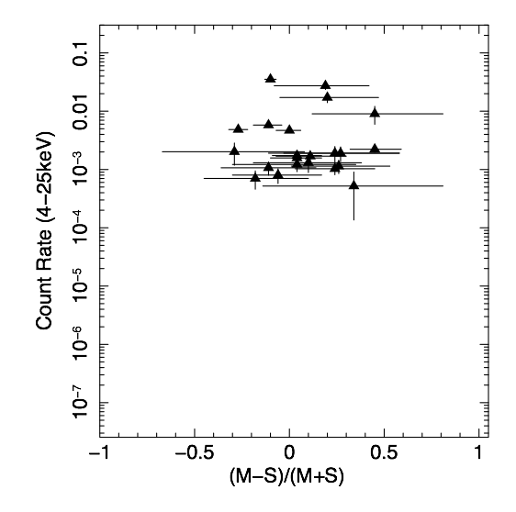
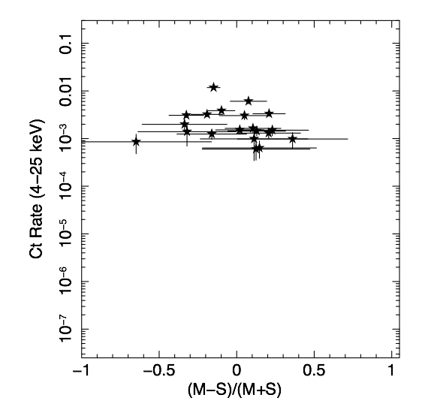
X-ray Color Diagnostics for Compact Objects
NuSTAR ULXs
Accreting
pulsars
~20 X-ray binaries in each of M83 and NGC 253:
NGC 253 has more ULX sources
The vast majority of sources are found in the “intermediate” state (Very High State / Thermal Dominant)
Soft state
BH binaries
NuSTAR Count Rate (4-25 keV )
@ 4.0 Mpc
Intermediate state
BH binaries
Hard state
BH binaries
S: 4-6 keV
M: 6-12 keV
(M-S)/(M+S)

Slide 9
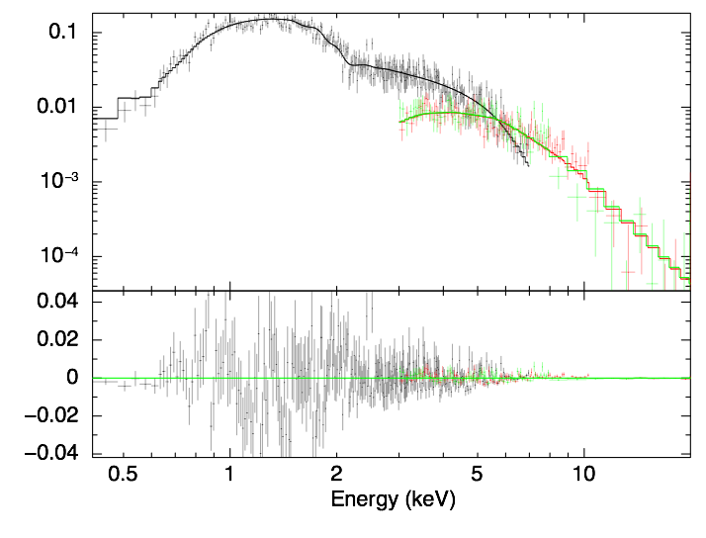
0.4- 20 keV Integrated Galaxy spectrum
For both NGC 253 and M83, as well as nearby ULXs, the
spectrum gets steeper at higher energies
(Wik et al. 2014, arXiv:1411.1089; Yukita et al. 2014, in prep.)
Chandra Point Sources only
Consistent with ULX-like spectra
(Stobbardt et al. 2006; Gladstone et al. 2009; Walton et al. 2013,
Bachetti et al. 2013,
Rana et al. 2014)
NuSTAR
residual ct/s/keV
Broken Power Law
Γ1 ~ 1.9 Γ2 ~ 3.6
Ebreak ~ 5.8 keV
Lx (3-30 keV ) ~ 5x10³⁹ erg/s

Slide 10
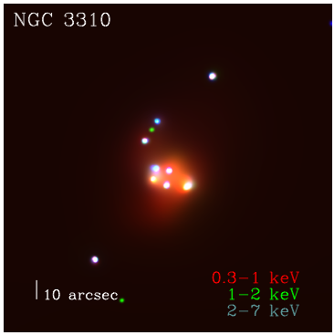
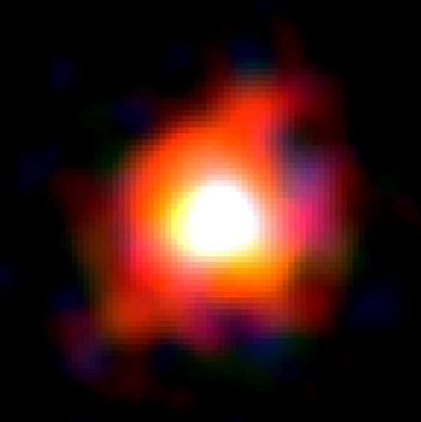
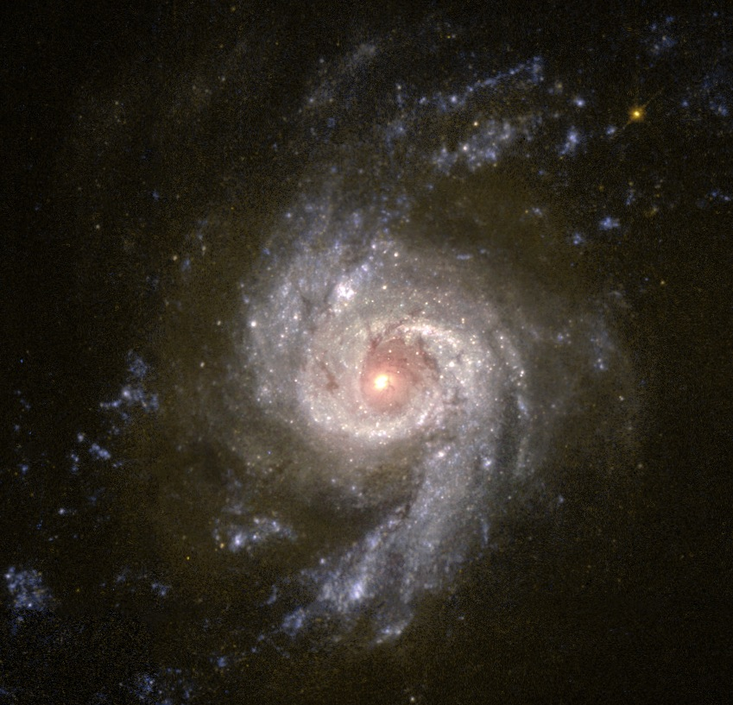
Hard X-ray emission from X-ray binaries at d~20 Mpc: NGC 3310
(Lehmer et al. 2014, in prep)
Lehmer, Tyler et al. (in-prep)
(Chandra)
NGC 3310 (NuSTAR)
4-6 keV
6-12 keV
12-25 keV

Slide 11
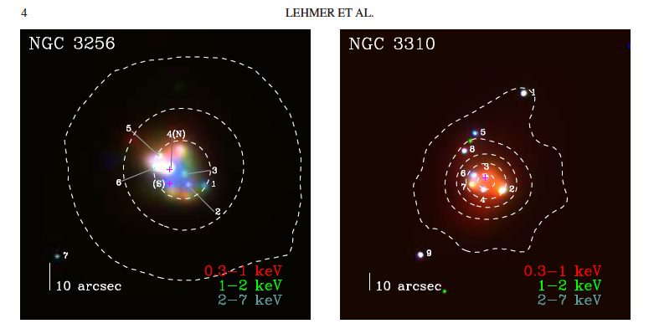
0.5-30 keV emission from distant galaxies (Lehmer et al. 2014 in prep)
184 ks NuSTAR, 16 ks Chandra
7 point sources with L₂₋₁₀ > 10³⁹ erg/s
141 ks NuSTAR, 10 ks Chandra
9 point sources with L₂₋₁₀ > 10³⁹ erg/s

Slide 12
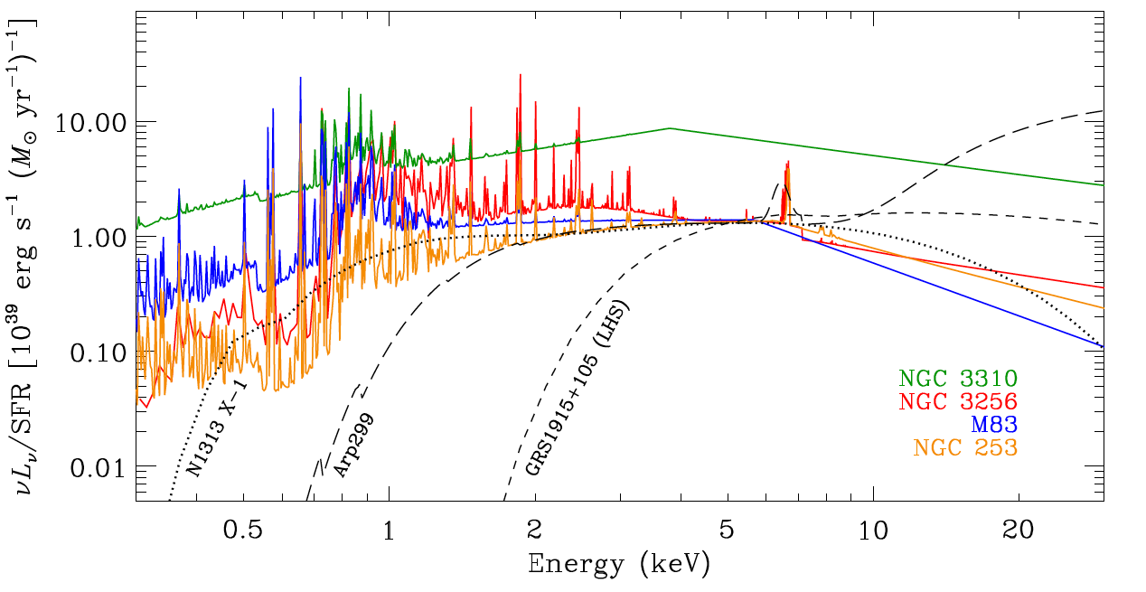
0.5-30 keV SFR-normalized galaxy spectra
Lehmer et al. 2014, in prep
All display turnovers at 3-6 keV and have ULX-type spectra
Do not seem to be explained by anything like a LH state
Note higher LX for lower metallicity NGC 3310
Notes:
NGC 3310 is 0.4 Zsun compared with 1.5 Zsun for M83, NGC 3256 and NGC 253 (stellar metallicity)

Slide 13
Summary
Write your proposal (6 days to go) and join us! Note that at the Seattle AAS there will be a session on community-driven NuSTAR legacy projects
Overall starburst galaxies are relatively soft in the hard X-ray band and appears to be dominated by X-ray emission from ULXs and intermediate-state black hole populations.

Slide 14
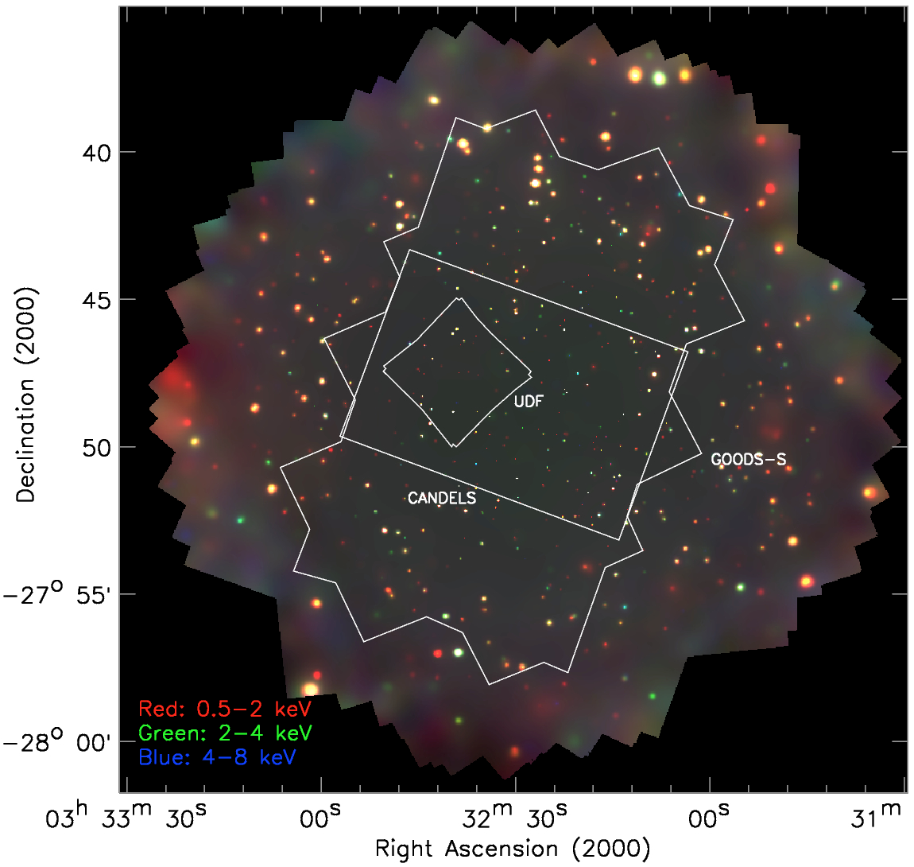
Galaxies over cosmic time
(xraydeep.org)
  Chandra 7 Ms survey (Niel Brandt @PSU is P.I.) being conducted in late 2014 (finishing Dec 2014)
    Deepest ever view of the extragalactic sky!
    Has the potential to detect starbursts at z>4: will be sampling the rest-frame 2.5-40 keV emission (0.5-8 keV band) at z~4
    Given the potential importance of X-ray emission from starburst galaxies to reionization (e.g., Mirabel et al. 2011; Mesinger et al. 2013, Fragos et al. 2013), understanding the X-ray SED of galaxies is critically important.

Slide 15
THANK YOU
Ann.Hornschemeier@nasa.gov xraydeep.org

Slide 16
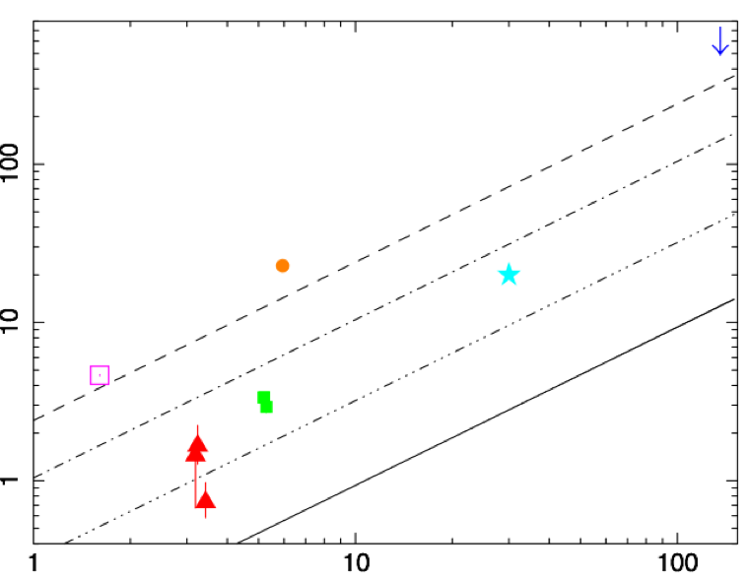
10-30 keV X-ray/SFR Correlation
Arp 299
Compton Thick AGN
Merger
Yukita, M. et al. 2014, in prep.
Γ=1.6
Γ=2.0
NGC 3310
Starburst
Γ=2.5
Γ=2.0
Lx (10-30 keV) (10³⁹ erg s⁻¹)
Γ=3.0
IC 342
Normal Spiral
NGC 3256
Starburst
It will be right here.
Γ=2.5
NGC 253
Starburst
Γ=3.0
M83
Normal Spiral
SFR (Msolar yr⁻¹)

Slide 17
Black Hole binaries in the NuSTAR Color-count rate plots
Source | Number of observations | N_{H} (10²² cm-²) | Distance (Kpc) | MBH
GRO J1655-40 | 503 | 0.8 | 3.2 | 7
XTE J1550-564 | 397 | 0.65 | 5.3 | 6
XTE J1650-500 | 153 | 0.78 | 4 | 3-5
XTE J1859+226 | 127 | 0.3 | 11 | 6
GX 339-4 | 373 | 0.6 | 8 | 8
H 1743-322 | 219 | 2.4 | 8.5 | ?

Slide 18
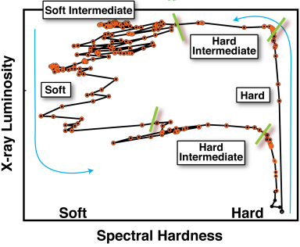
Accretion States of Galactic Black Holes
Maccarone & Coppi (2003), Done et al. 2007, Belloni et al. 2010
Thermal Dominant (TDS)
Very High State
(VHS)
Soft
Hard
Low/Hard State
(LHS)
Hardness:
ratio of
6.3-10.5 keV
to
3.8-6.3 keV counts
17
Notes:
The accretion disk extends all the way down in only at very high accretion rates, where, as the disk fills in closer to the black hole, more soft X-ray emission arises.
Data are from 2002/2003 outburst of GX 339-4
PCA count rate is in the energy range 3.8–21.2 keV.
Hardness is defined as the ratio of counts in the energy bands 6.3–10.5 and 3.8–6.3 keV.

Slide 19
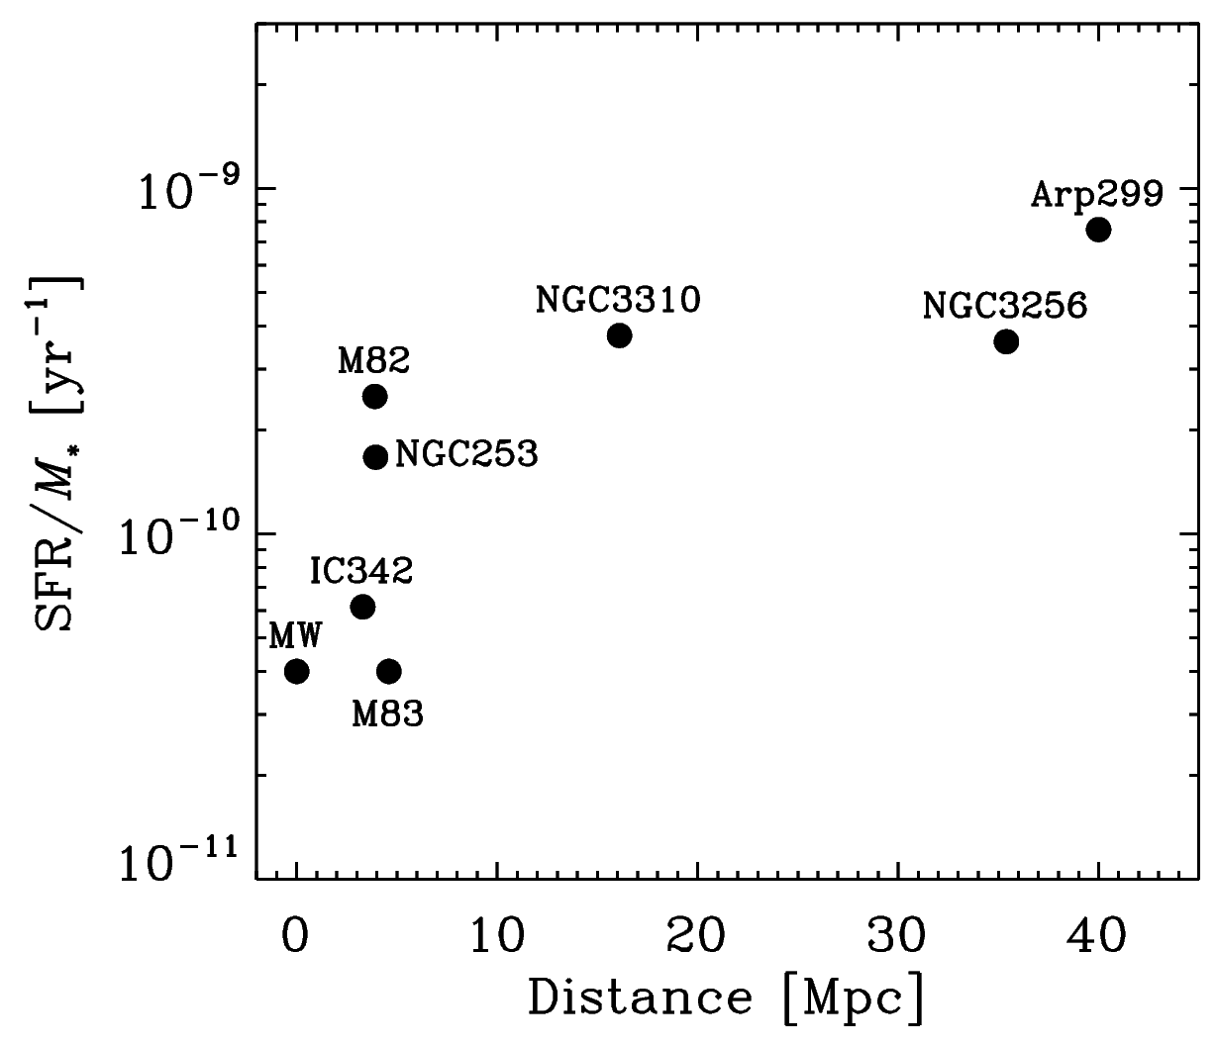
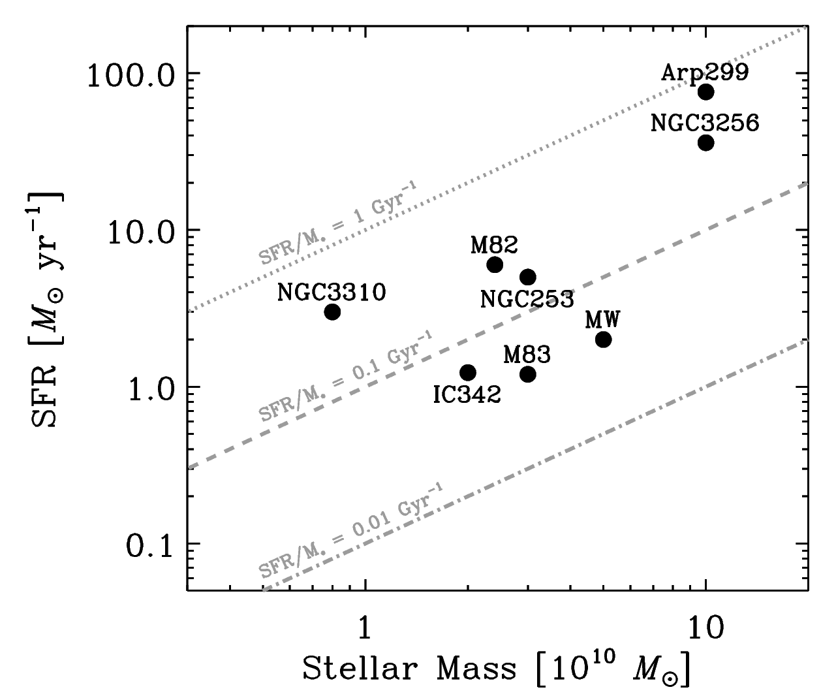
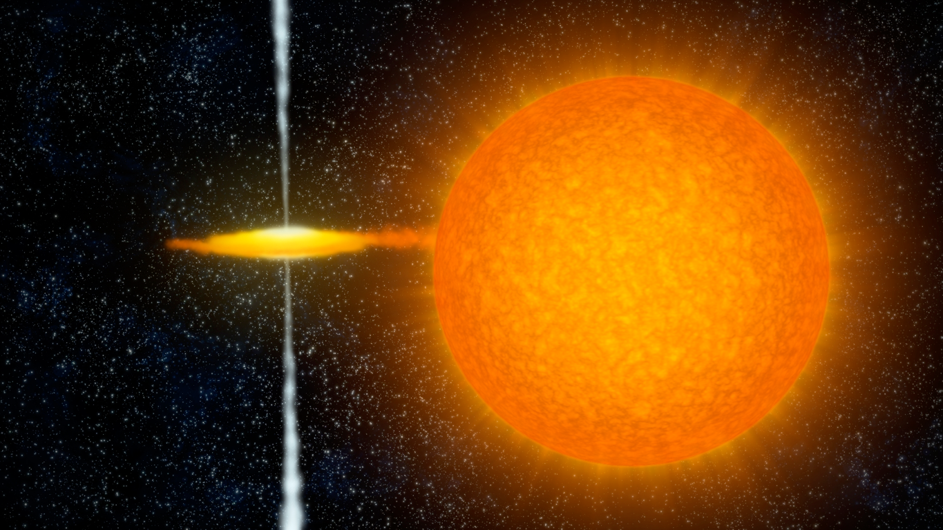
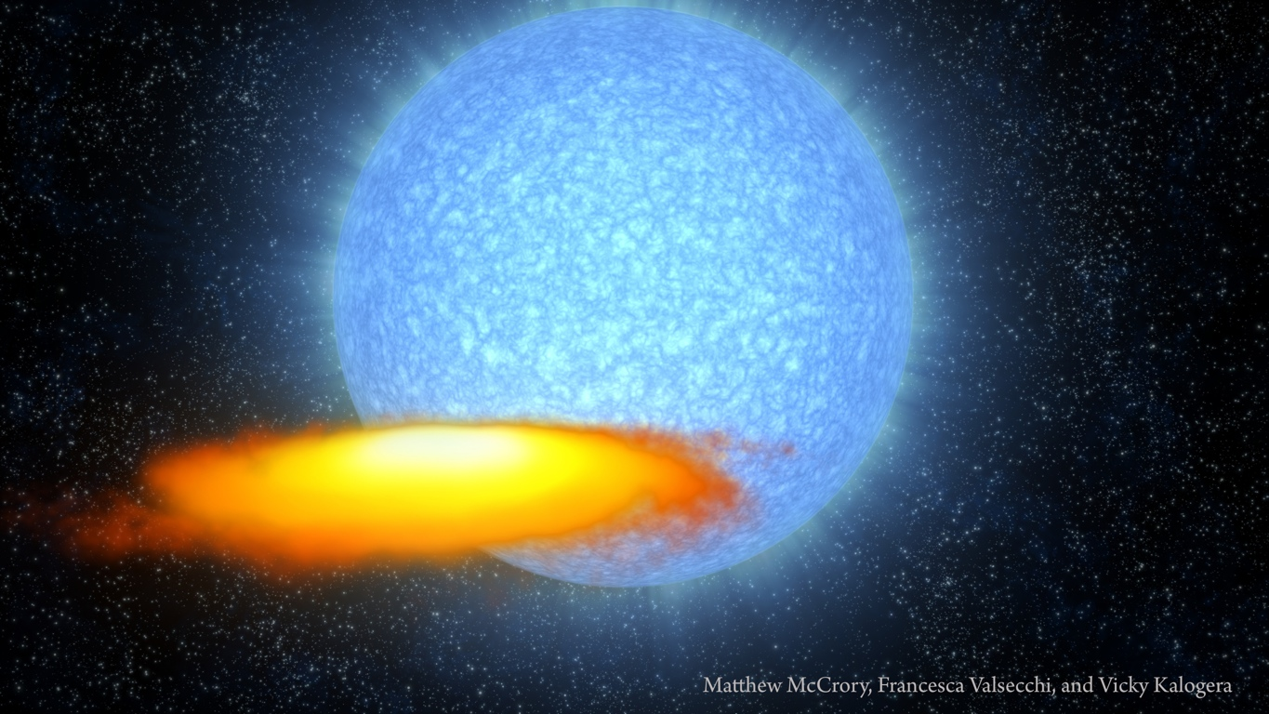
Physical Properties of Starburst Sample
LMXB
HMXB

Slide 20

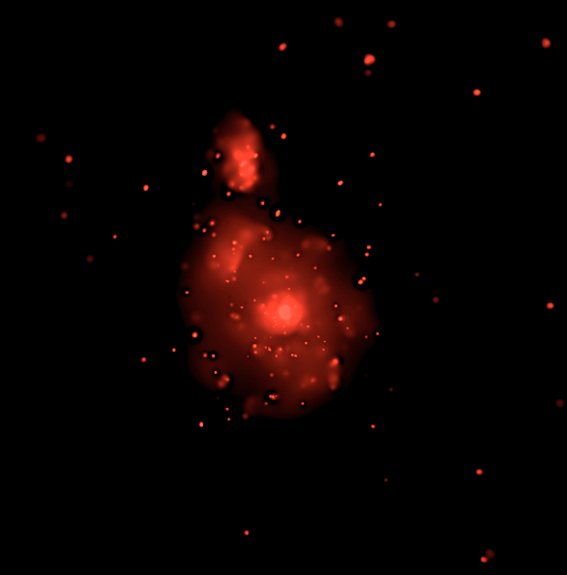
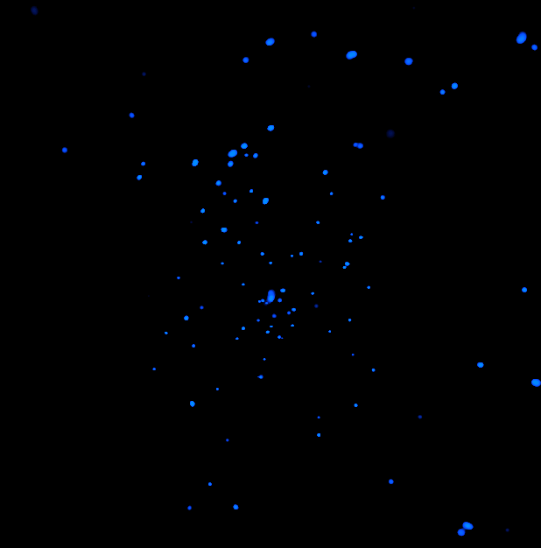
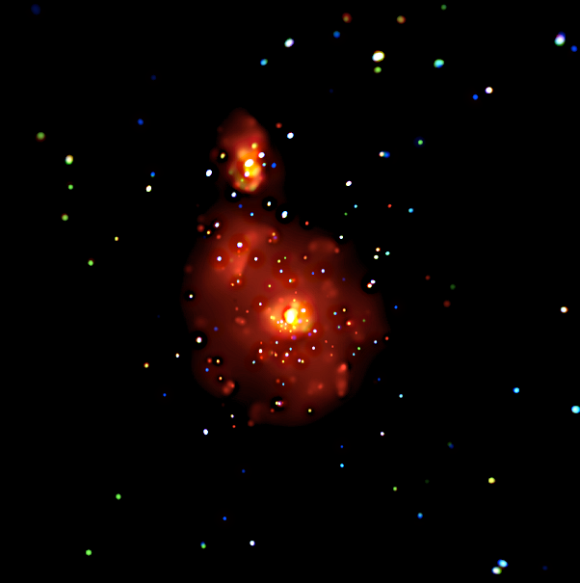
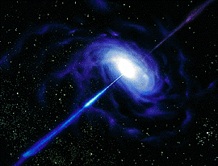
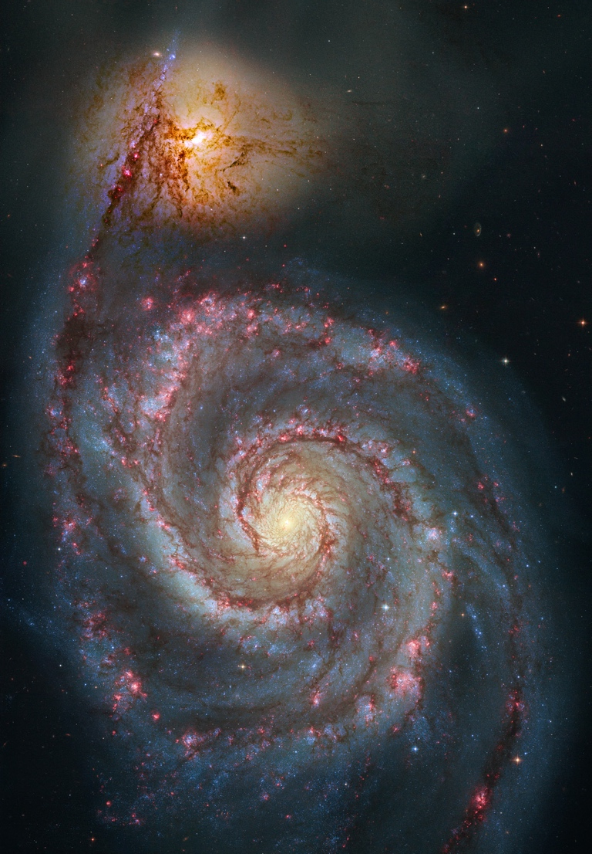
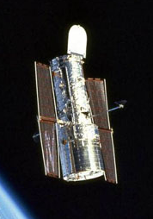
Hard (2-10 keV) X-ray Image
X-ray Binaries
Soft (0.5-2 keV) X-ray Image
Chandra
Accreting SMBH
M51: The Whirlpool Galaxy
Hubble

Slide 21
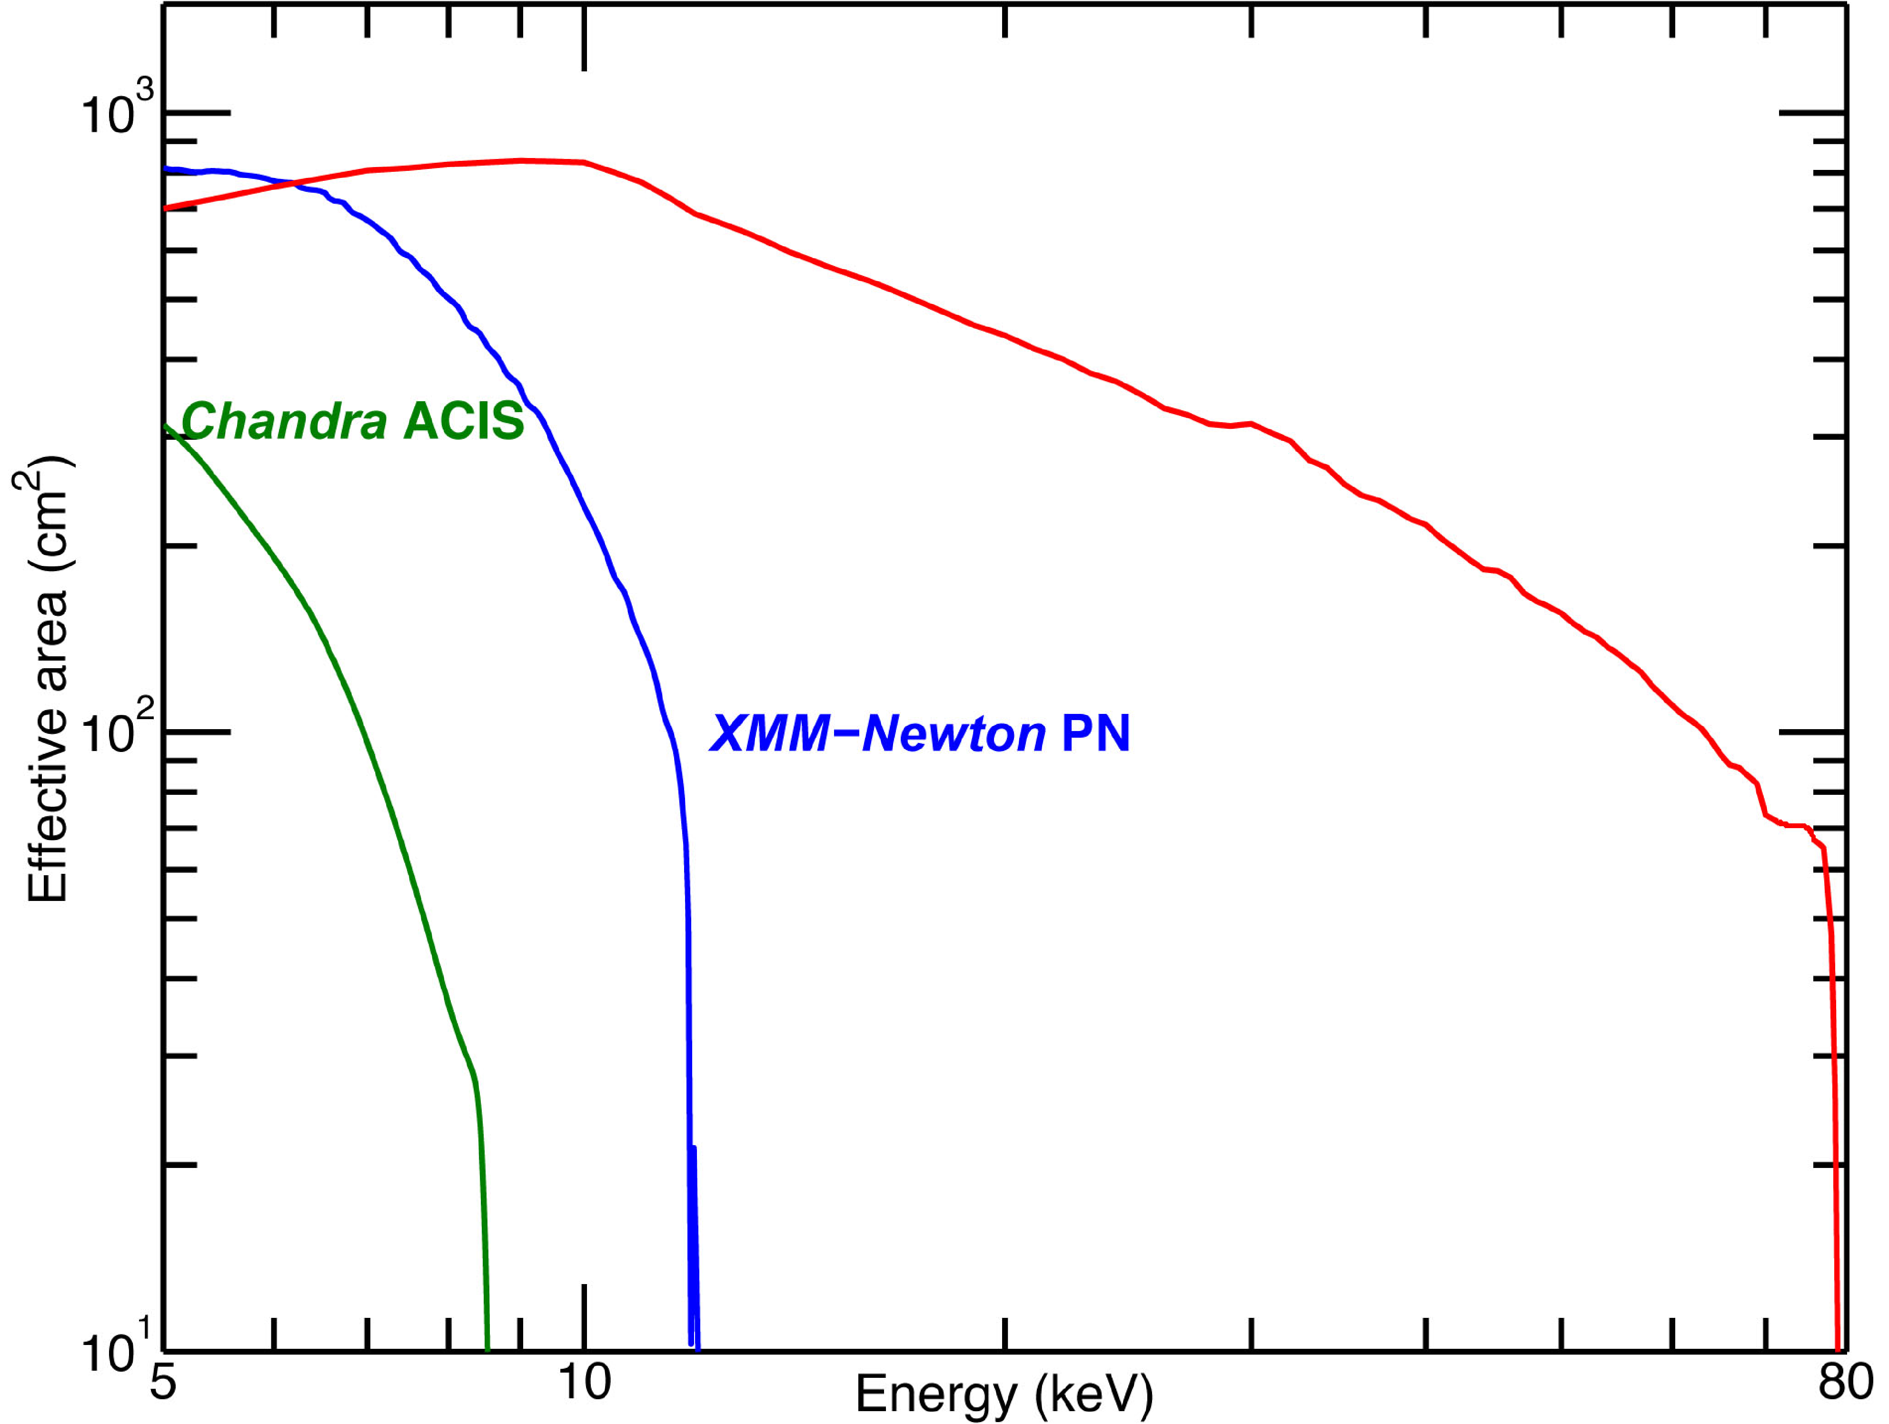
Collecting Area
Satellite (instrument) | Sensitivity
INTEGRAL (ISGRI) | ~0.5 mCrab (20-100 keV) with >Ms exposures
Swift (BAT) | ~0.8 mCrab (15-150 keV) with >Ms exposures
NuSTAR | ~0.8 μCrab (10-40 keV) in 1 Ms
NuSTAR two-telescope total collecting area
Sensitivity comparison

Slide 22
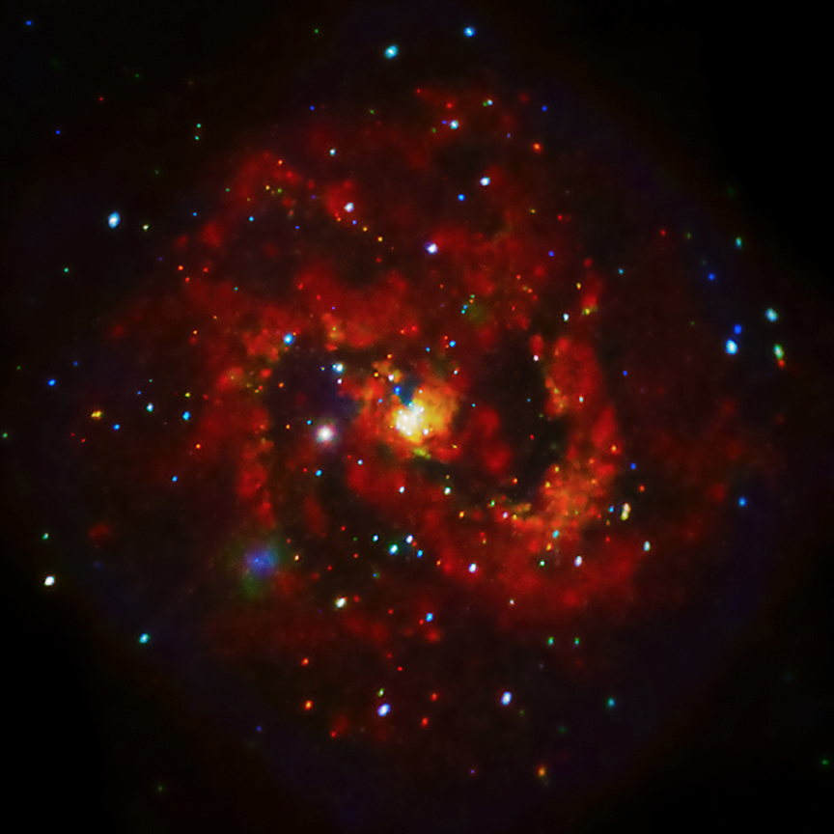
Why study X-ray emission from galaxies?
M83, nearby spiral galaxy
with nuclear starburst
700 ks Chandra press release image
Star formation in heavily obscured areas
Accreting binaries → high mass end of IMF, emission persists for very long time (Gigayears)
Supernovae/winds enrich (add metals) to the ISM & IGM, affecting star formation and galaxy evolution
Notes:
NO SUCH THING AS A NORMAL GALAXY
X-rays provide several advantages : OBSCURING MATERIAL
COMPACT OBJECTS (NS & BH) produced by the death of the the MOST MASSIVE STARS
Fossil record of past massive star formation (billions of years)
The hot X-ray gas in galaxies : repository for metals

Slide 23
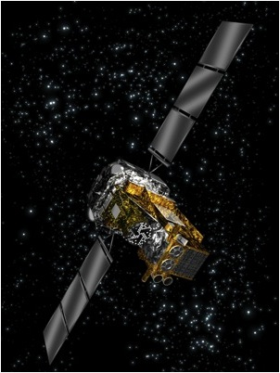
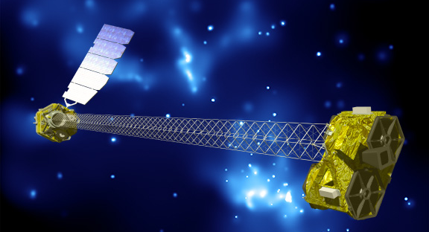
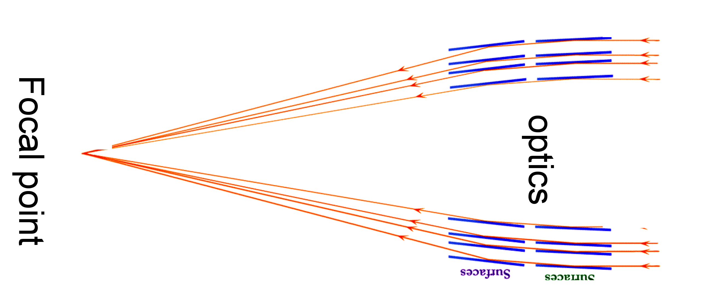
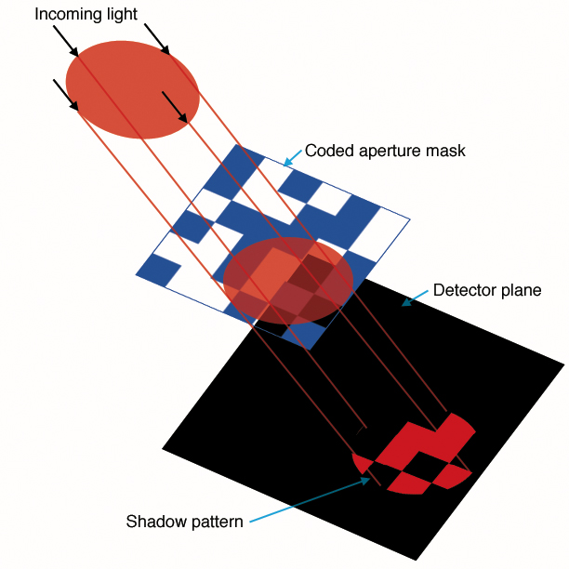
INTEGRAL, Swift BAT
NuSTAR
Focal spot
Grazing incidence
optics
Notes:
Small explorer – NASA’s smallest astro platform
First focusing telescope in orbit – unprecedented combination of sensitivity, angular resolution and spectral resolution

Slide 24
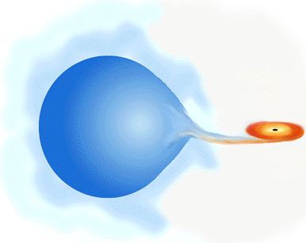
Evolutionary Timescales for X-ray Binaries
Mass transfer driven by nuclear evolution of donor
In high-mass X-ray binaries, timescale is approximately ~2-7 × 10⁶ yrs
low-mass binaries, this timescale is much longer (> 10¹⁰ yrs)
Binaries classified
by donor mass
High mass →
HMXB
Low mass →
LMXB
HMXB emission
follows
CURRENT STAR FORMATION
LMXB emission
follows
PAST STAR FORMATION
Credit: http://chandra.harvard.edu
Notes:
What is the nature of these accreting binaries that dominate galaxy x-ray emission and how do they evolve?
TIMESCALES
Thus, based on the timescales involved, expect that fairly promptly after a star formation even (within 10 million years) that X-ray emission from high-mass X-ray binaries will “turn on” and thus should scale with SFR
However, LMXBs will be associated with past star formation, and thus associated with the stellar mass of galaxies
The timescale is the nuclear timescale for 30 solar mass stars on the low end and for 15 solar mass stars on the high end
FYI, boundary between upper & low main sequence (above which CNO cycle dominates, below which pp chain dominates) is 1.5 solar masses
For LMXBs, mass transfer may also be driven by loss of angular momentum through gravitational radiation and/or magnetic braking processes (shrinking the Roche Lobe of the donor), but the timescale is similarly long…
HMXBs may be more X-ray bright as more likely to contain black hole as compact object

Slide 25
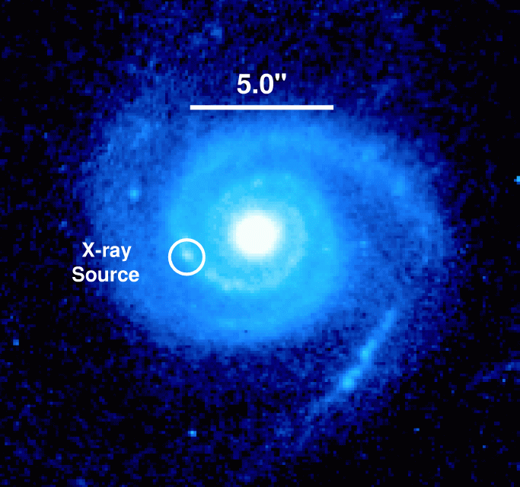
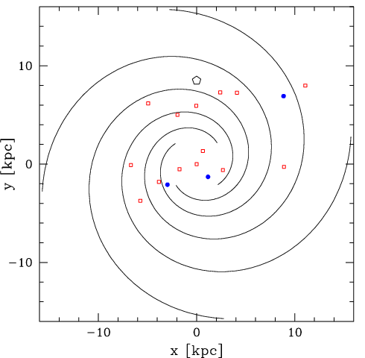
Hard X-ray emission from most “normal” galaxies dominated by accreting binaries
Distant X-ray detected galaxy
(z~0.1)
The Milky Way
(RXTE data, Grimm et al. 2003)
L_{X} (0.5-8 keV) ~ 6 x 10³⁹ erg s⁻¹
“Normal” galaxy = … galaxy whose X-ray emission is dominated by binaries, hot gas, etc. rather than a luminous AGN
HMXBs
LMXBs
Hornschemeier et al. (2004)
Log Lx > 38.3
Notes:
So the title of this talk has to do with normal galaxies, and OF COURSE there is no such thing as normal!
ACTUALLY TALKING ABOUT GALAXIES LIKE OUR OWN MILKY WAY (not dominated by SMBH)
Indeed our own Milky Way has a pathetic excuse for a supermassive black hole… it is hardly accreting any material at all and is easily outshone by many of the accreting binary systems
Just to remind everyone what the Milky Way looks like in the X-ray band, I show a chart, X and Y here are distance in kpc, showing the distribution of accreting binaries more luminous than ~10^38 erg/s
If we compare with this distant galaxy…

Slide 26

Measuring the Accretion States of X-ray Binaries
Chandra
(0.5-8 keV)
NuSTAR
(3-80 keV)
Done et al. (2007)
  RXTE

Slide 27
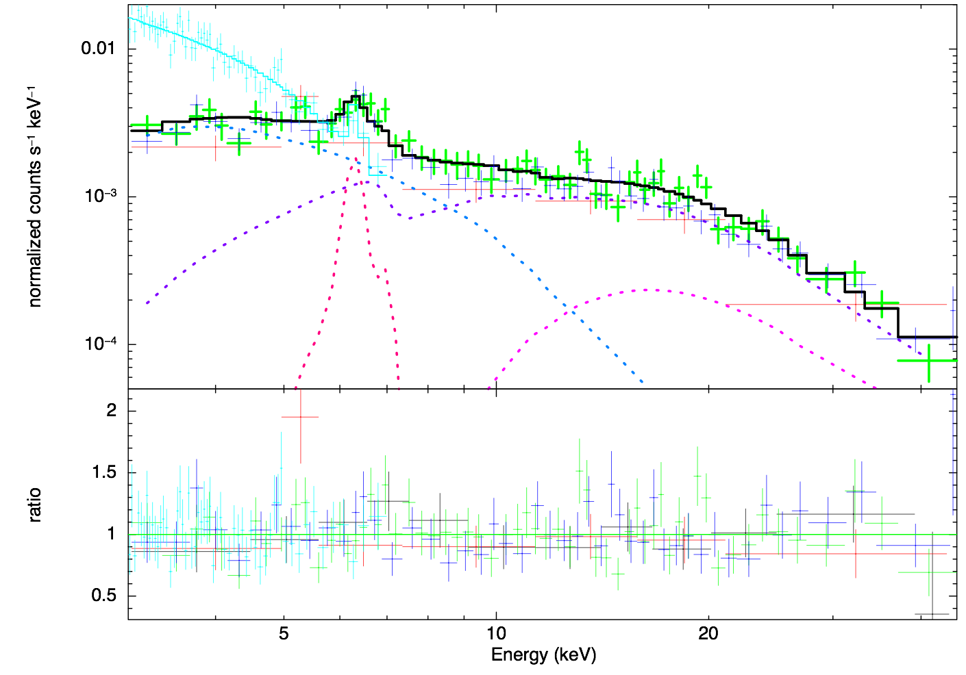
Isolating the hard X-rays from the Compton-Thick AGN in Arp 299
(Ptak et al 2014, in prep)
Chandra
Cut-off power-law represents extranuclear flux (i.e., Arp 299-A and X-ray binaries)
Total Model
Direct AGN
Cut-off PL (XRB)
Fe-K
Scattered AGN
MyTorus fit to full Arp 299 (1’ region) spectrum

Slide 28
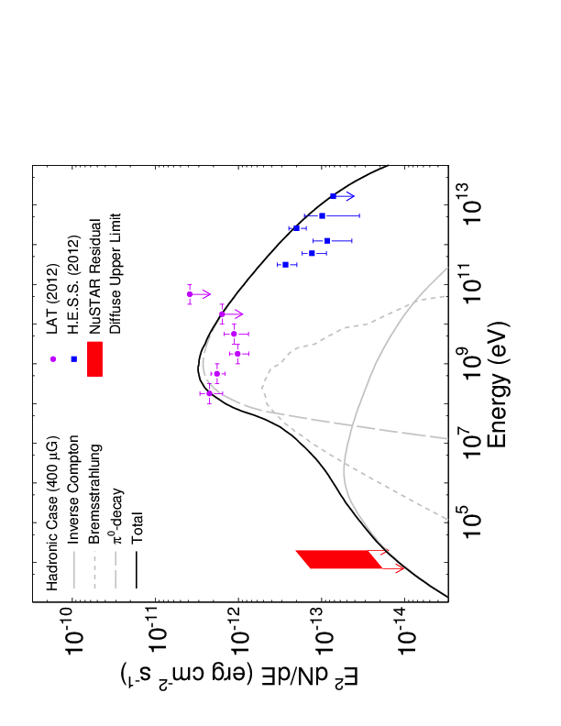
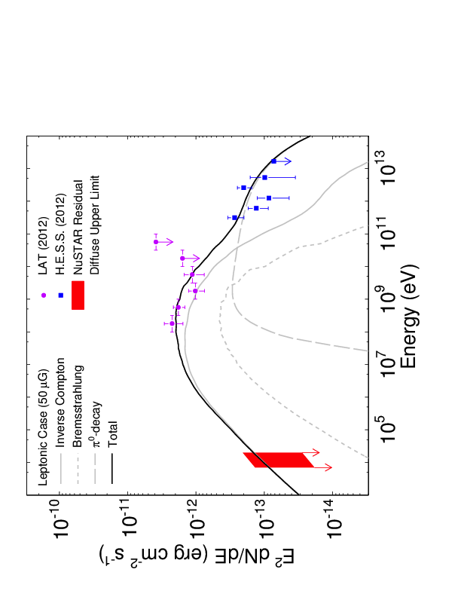
Non-thermal diffuse emission? (Wik et al. 2014, in press)
Leptonic
Hadronic
NGC 253

Slide 29
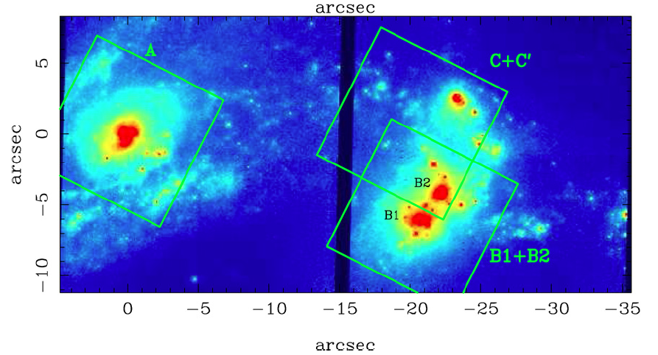
Arp 299,
70 ks NuSTAR observation
LIRG with nuclear spectral characteristics similar to ULIRGs and LIRGs at high-z (Alonso-Herrero et al. 2009)
Dramatic merger: Arp 299-B possible CTAGN
NGC 3690
IC 694

Slide 30
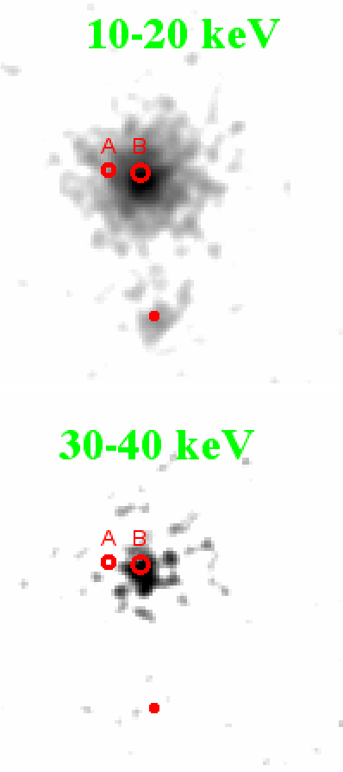
Isolating the hard X-rays from the Compton-Thick AGN in Arp 299
(Ptak et al 2014, submitted)
The Arp 299-B NuSTAR spectrum requires a column density of 1-3 x 10²⁴ cm⁻². This implies a 10-30 keV luminosity of 1 x 10⁴³ ergs s⁻¹ (~ 5% Lbol).
In contrast the 10-30 keV luminosity of Arp 299-A must be < 6 x 10⁴¹ ergs s⁻¹.
BeppoSAX detection of Arp 299 (Della Cecca et al. 2002) was with F(10-30 keV) ~ 3X higher (~ 3 x 10⁻¹¹ vs 1 x 10⁻¹¹ ergs cm⁻² s⁻¹) . Koss et al. (2013) BAT flux ~ consistent with NuSTAR.
Our NuSTAR observations of NGC 253 and M83 detected hard X-ray emission from their nuclear regions as well as several off-nuclear point sources. Both galaxies have an integrated galaxy-wide X-ray spectrum that rapidly declines at hard X-ray energies (see Figure 2).
Our NuSTAR observations of NGC 253 and M83 detected hard X-ray emission from their nuclear regions as well as several off-nuclear point sources. Both galaxies have an integrated galaxy-wide X-ray spectrum that rapidly declines at hard X-ray energies (see Figure 2).
Γ1 ~ 1.8
Γ2 ~ 3
Ebreak ~ 7 keV
Γ1 ~ 1.8
Γ2 ~ 3
Ebreak ~ 7 keV
Figure2: NuSTAR spectra (black: FPMA, red: FPMB) of M83. A broken power law model is applied.
Figure2: NuSTAR spectra (black: FPMA, red: FPMB) of M83. A broken power law model is applied.

Slide 31
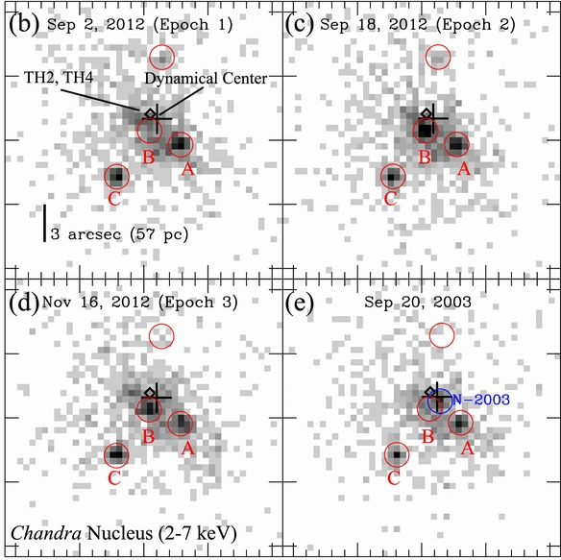

NGC 253: Hard X-ray emission dominated by luminous binaries from 3-30 keV (Lehmer et al. 2013)
20 arcsec radius
total nuclear region
Non-Source B
Source B Only
Source B drives the total variability in the inner ~20 arcsec. Can estimate NuSTAR spectrum of source B by differencing Epochs 2 and 3 from Epoch 1!

Slide 32

NuSTAR Spectral Constraints on Variable Source B
• Difference spectra were fit using an absorbed broken power-law model with NH = 1.6 × 10²³ cm⁻², Γ1 = 2.1, Ebreak = 7.9 keV, and Γ2 = 3.9.
NuSTAR Spectrum of Source B
Expect LLAGN with very low accretion rates (M_{BH} ~5 ✕ 10⁶ M, L/L_{Edd} ~ 10⁻⁴) to have very hard X-ray spectra of Γ = 1.4 (Younes et al. 2011)
By comparison, ULXs have a range of Γ1 = 1-3, Ebreak = 3-8 keV, and Γ2 = 2-7 (e.g., Gladstone et al. 2009)
Source B is most likely a ULX and not an AGN. Have we determined that the black hole in NGC 253 is generally inactive during this starburst phase?

Slide 33




Comparison with 2003 Deep Chandra Observations
• A deep 80 ks Chandra observation in 2003 reveals a similar pattern with three clear X-ray detected point sources; however, the central source is somewhat different...
Dynamical Center
N-2003
It appears that our 2012 observational campaign was conducted when the best AGN candidate N-2003 was off!

