Slide 1
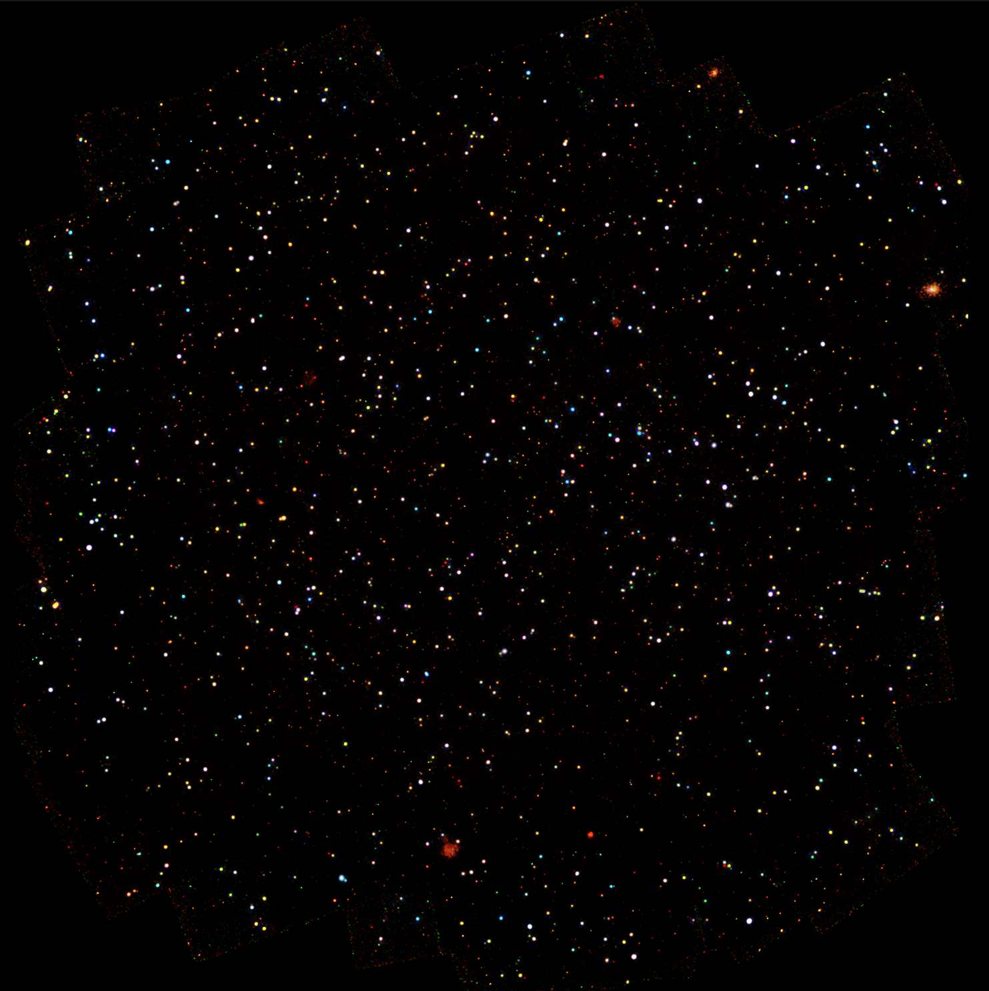
The Chandra COSMOS Legacy Survey
Francesca Civano (YCAA, SAO)
S. Marchesi, H. Suh, V. Allevato, B. Trakhtenbrot, M. Salvato,
M. Elvis; G. Hasinger; A. Comastri; M. Brusa; M.C. Urry; N. Cappelluti; K., Glotfelty; F. Harrison; G. Zamorani; N. Scoville; E. Schinnerer; J. Donley; J. Silverman; E. Treister; P. Capak; T. Aldcroft; D. Alexander; R. D'Abrusco; A. Finoguenov; A. Fruscione; E. Glikman; H. Hao; K. Jahnke; A. Karim; J. Kartaltepe; A. Leauthaud; G. Lanzuisi; T. Miyaji; C. Vignali; F. Fiore; S. Puccetti; P. Ranalli; V. Smolcic; L. Riguccini; M. Sargent; K. Schawinski; D. Stern; R. Gilli; Z. DiMilia.
Chandra Sweet Fifteen!
Notes:
MASTER thesis
My love for X-ray data to my student

Slide 2
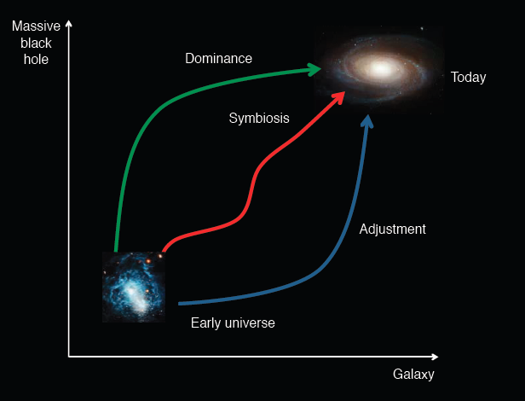
How did the first SMBHs form?
How did SMBHs grow?
?
Volonteri 2012
Chandra Sweet Fifteen!
Notes:
How did we get from the first BHs (super massive or not) to the BH, sometimes quiescent sometimes active we observe in all the galaxies of the local Universe?
SMBHs may have
grown in symbiosis with their hosts; the black hole may have dominated the process, with the galaxy catching up later; or the galaxy grew first, and the black hole adjusted to its host.

Slide 3
Need large samples of active SMBHs over a broad range of luminosities with multiwavelength information to study galaxy properties as well:
EXTRAGALACTIC SURVEYS
Chandra Sweet Fifteen!

Slide 4
Why Chandra extragalactic surveys?
cleanest AGN selection: almost no contaminants - normal galaxies and stars emerge only in deepest exposures
less biased AGN selection: at >2 keV sensitive to all Compton Thin sources
Multiwavelength coverage to assure identification, redshift determination, SED studies, host galaxy properties and alternative AGN selection
Chandra Sweet Fifteen!
Notes:
accretion processes clearly dominates the emission in the x-ray
Therefore perfomring an X-ray selection returns no contamination from inactive galaxies
Moreover X-ray selection is insensitive to obscuration up to columns of 10²³

Slide 5
Why COSMOS Legacy?
“…COSMOS Legacy will address the growth of structure in the universe from re-ionization to the peak of star formation (z≥6 to z=2) and the co-evolution of SMBH and galaxies in these structures…”
Chandra Sweet Fifteen!

Slide 6
Why COSMOS Legacy?
“…COSMOS Legacy will address the growth of structure in the universe from re-ionization to the peak of star formation (z≥6 to z=2) and the co-evolution of SMBH and galaxies in these structures…”
wide enough to span high-z LSS and to have large samples of AGN for clustering studies
Chandra Sweet Fifteen!
Notes:
On this subject in our proposal we wrote we were going to address the growth of structures in the early universe and the co-evolution of BH and galaxies in these structures
For this reason we propose a survey ,,,

Slide 7
Why COSMOS Legacy?
“…COSMOS Legacy will address the growth of structure in the universe from re-ionization to the peak of star formation (z≥6 to z=2) and the co-evolution of SMBH and galaxies in these structures…”
wide enough to span high-z LSS and to have large samples of AGN for clustering studies
deep enough to reach z>3 AGN in significant numbers
Chandra Sweet Fifteen!

Slide 8
Why COSMOS Legacy?
“…COSMOS Legacy will address the growth of structure in the universe from re-ionization to the peak of star formation (z≥6 to z=2) and the co-evolution of SMBH and galaxies in these structures…”
wide enough to span high-z LSS and to have large samples of AGN for clustering studies
deep enough to reach z>3 AGN in significant numbers
yet bright enough that ∼99% of sources can be identified
Multiwavelength is already available + easy accessible for spectroscopic follow-ups
Chandra Sweet Fifteen!

Slide 9
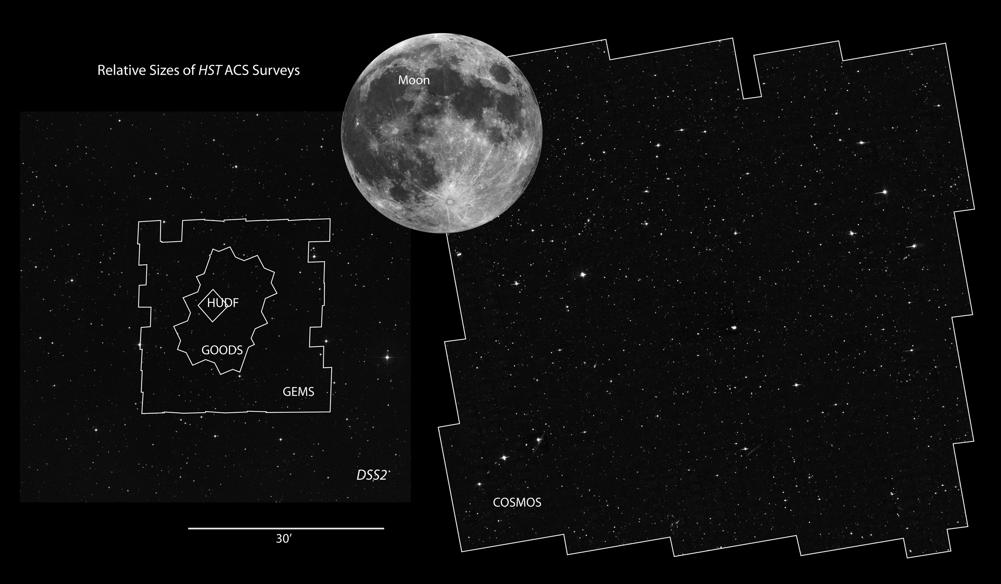
2002-2012: COSMOS survey
COSMOS area
~20x area of other surveys
HST – 2 deg² optical images (600 orbits)
XMM – 2 deg² X-ray imaging (1.5 Msec)
Galex – ultraviolet imaging
Spitzer – Mid IR w/ IRAC (620 hrs)
Chandra – 1 deg² X-ray imaging
Herschel – GTO
Subaru – multiple color imaging
VLA – radio imaging (~300 hrs)
MAMBO – 1.2 mm survey
ESO-VLT – zCOSMOS LP ~ 30,000 gal.
Magellan – optical spectr. ~ 2,000 redshifts
Keck DEIMOS- optical spectra ~ 3,000 redshifts
NIR – NOAO, UH88, UKIRT …
Space
Ground
Chandra Sweet Fifteen!

Slide 10
COSMOS survey: New Wave
COSMOS area
~20x area of other surveys
HST – 2 deg² optical images (600 orbits)
XMM – 2 deg² X-ray imaging (1.5 Msec)
Galex – ultraviolet imaging
Spitzer – Mid IR w/ IRAC (620 hrs) →SPLASH (1650hrs)
Chandra – 1 deg² X-ray imaging →2.2 deg² with XVP
NuSTAR – 3 Ms on 2 deg²
Herschel – GTO
Subaru – multiple color imaging →HSC to 29 mag depth
VLA – radio imaging (~300 hrs)→ JVLA (130hrs at 3GHz)
MAMBO – 1.2 mm survey
ESO-VLT – zCOSMOS LP ~ 30,000 gal.
Magellan – optical spectr. ~ 2,000 redshifts
Keck DEIMOS- optical spectra ~ 3,000 redshifts
NIR – NOAO, UH88, UKIRT …
Space
Ground
Chandra Sweet Fifteen!

Slide 11
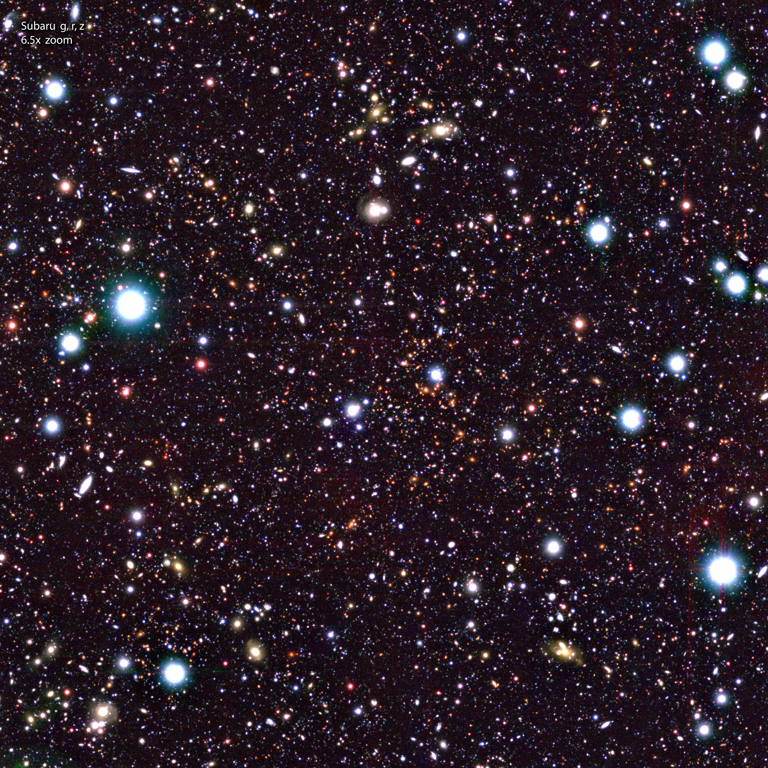
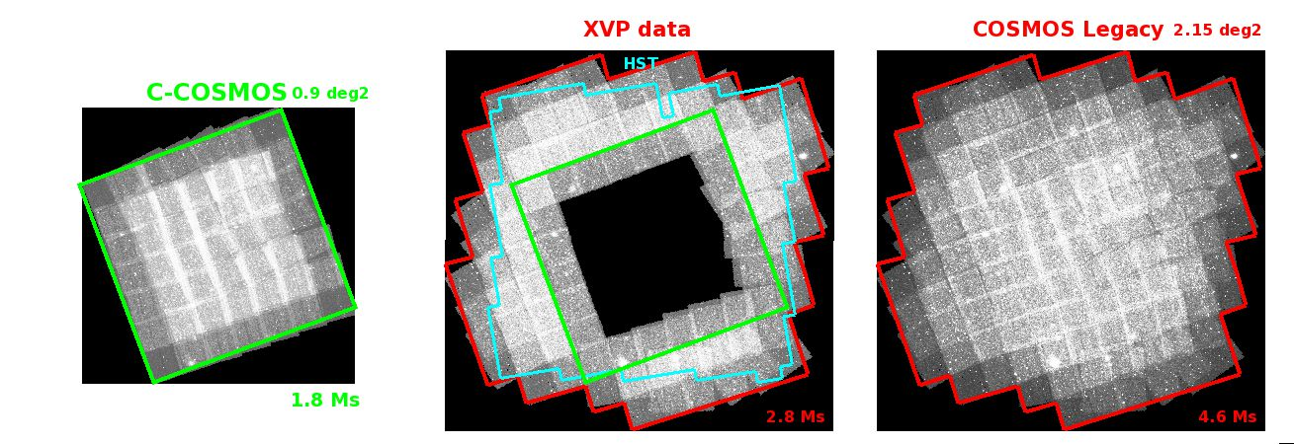
Chandra Survey Layout
C-COSMOS
PI: M. Elvis
1.8 Ms
0.9 deg²
36 ACIS-I pointings
50 ks exposure
Constant roll
2 epochs:
2006-2007
Elvis, FC+ 2009
Puccetti+ 2009
FC+ 2012
500,000 galaxies
COSMOS Field, 2 deg², Subaru Telescope
Subaru Telescope
Chandra Sweet Fifteen!

Slide 12
Chandra Survey Layout
XVP
PI: FC
2.8 Ms
1.3 deg²
56 ACIS-I pointings
50 ks exposure
Constant roll
3 epochs:
2012-2013-2014
Chandra Sweet Fifteen!
Notes:
----- Meeting Notes (11/17/14 11:49) -----
cover same exposure hst area

Slide 13
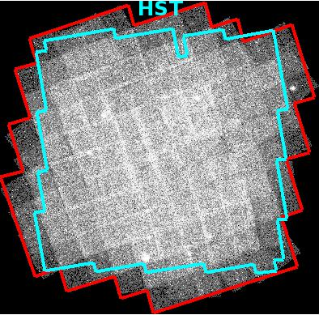
Chandra Survey Layout
Chandra COSMOS
Legacy Survey
4.6 Ms
2.2 deg²
HST area fully covered at same
~150 ks depth
Chandra Sweet Fifteen!
Notes:
----- Meeting Notes (11/17/14 11:49) -----
addd hst

Slide 14
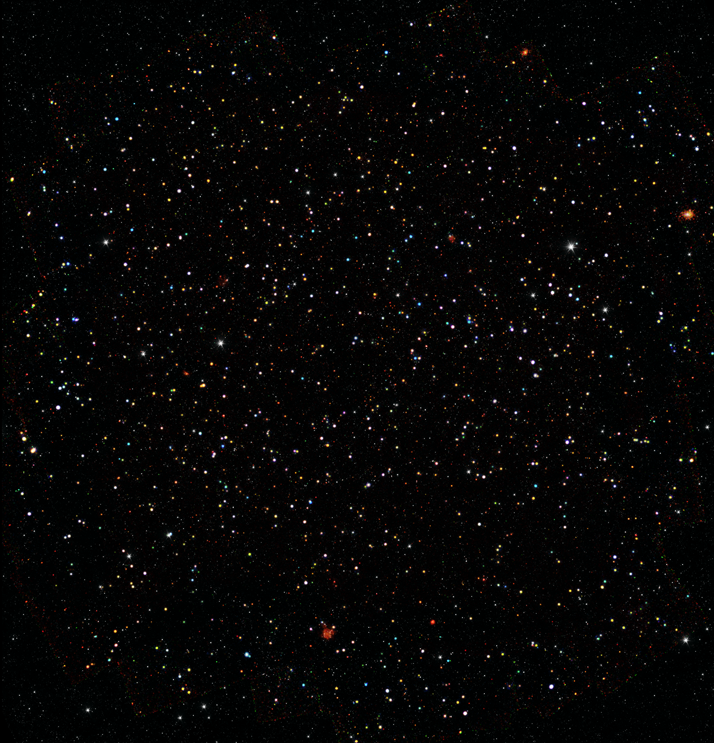
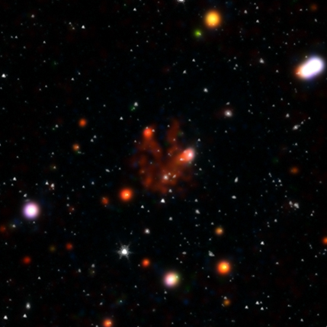
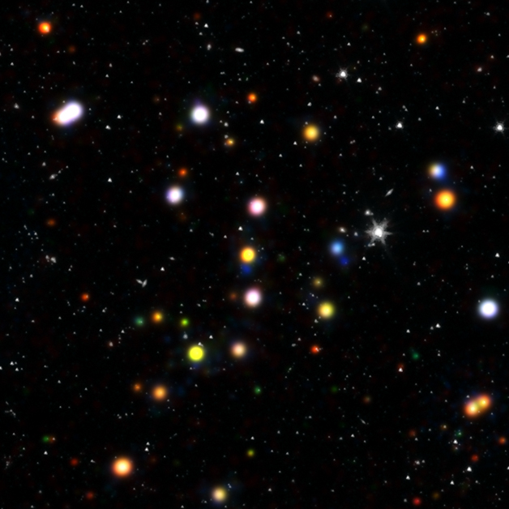
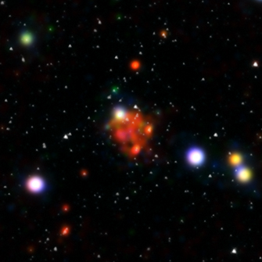
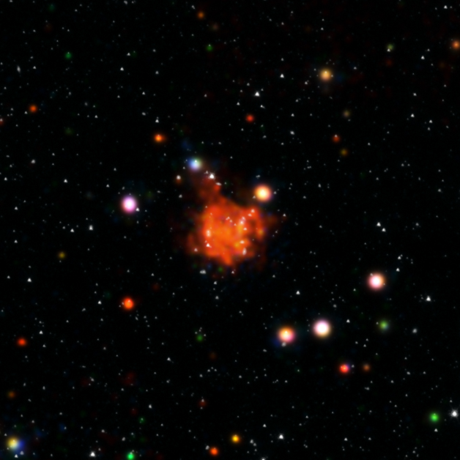
0.5-2 keV
2.0-4.5 keV
4.5-7 keV
IRAC Spitzer
Joe DePasquale
Chandra press
Notes:
ADD zoom IN

Slide 15
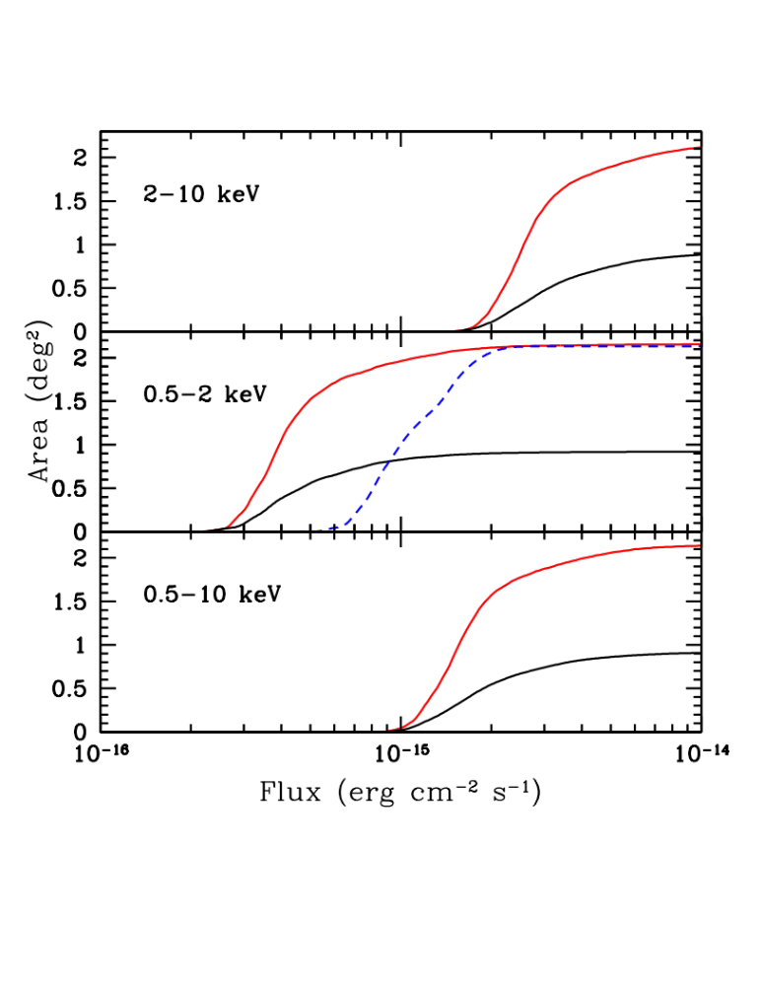
Survey Sensitivity
COSMOS
Legacy
→ 3 times fainter than XMM-COSMOS
→ 2.5 times more area at bright fluxes
→ 3 times at faint fluxes
XMM-COSMOS
C-COSMOS
Chandra Sweet Fifteen!
Notes:
----- Meeting Notes (11/17/14 11:49) -----
separate
add legacy bolder line

Slide 16

15 years of Chandra X-ray surveys
Birthday cake not wedding cake!
10⁻¹⁷
10⁻¹⁶
10⁻¹⁵
10⁻¹⁴
CDFN-CDFS 0.1deg²
Alexander+ 2003; Luo + 2008; Xue+ 2011; Comastri+2011
0.1
1
10
100
E-CDFS 0.3deg²
Lehmer et al. 2005
EGS/AEGIS 0.7deg²
Laird et al. 2008, Goulding et al. 2012
C-COSMOS
0.9 deg²
Depth
X-ray Flux Limit
COSMOS Legacy
AREA deg²
XMM-COSMOS
2 deg²
Champ 1.5deg2
Silverman et al. 2005
XBOOTES 9 deg²
Murray et al. 2005
XXL 50 deg²
Pierre+ 2012
Stripe82 70 deg²
LaMassa+ 2013

Slide 17
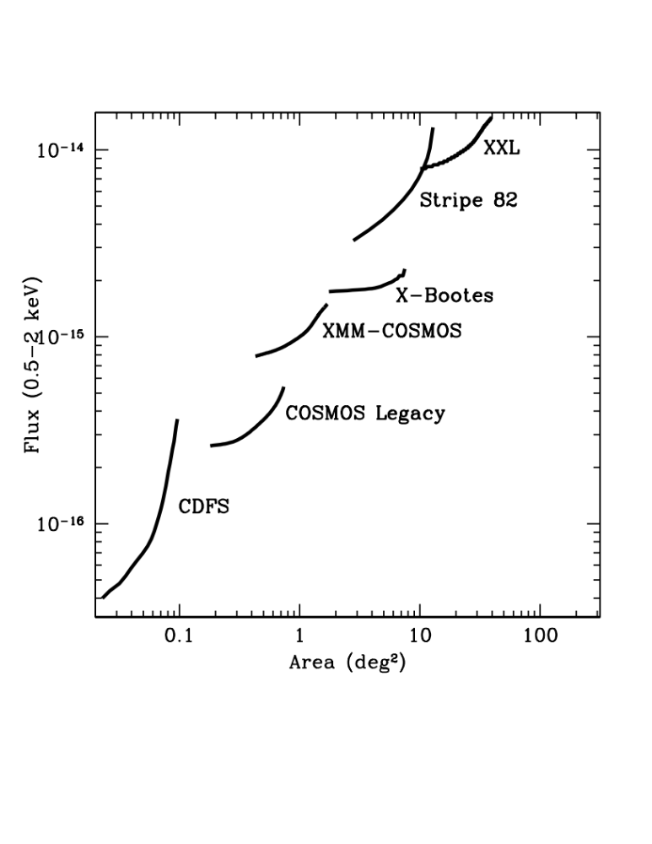
COSMOS Legacy bridges the gap
Sensitivity versus area of current X-ray surveys
XMM
Chandra
XMM
Deeper
Chandra
XMM
Chandra
Chandra
Wider
Chandra Sweet Fifteen!

Slide 18
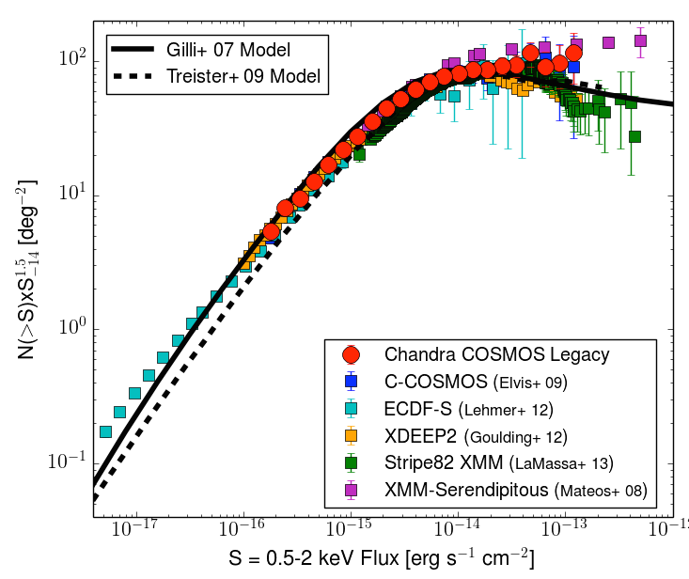
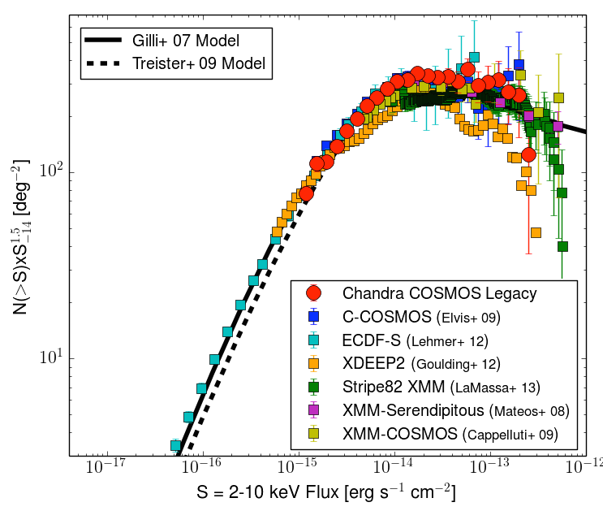
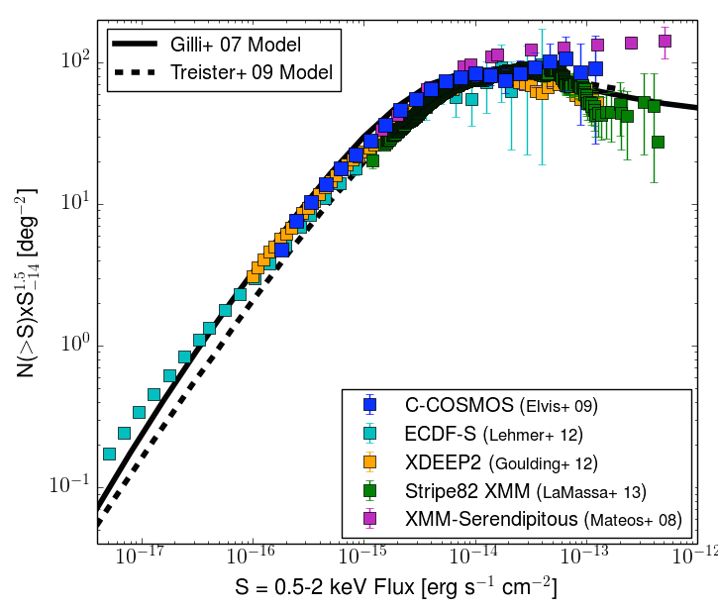
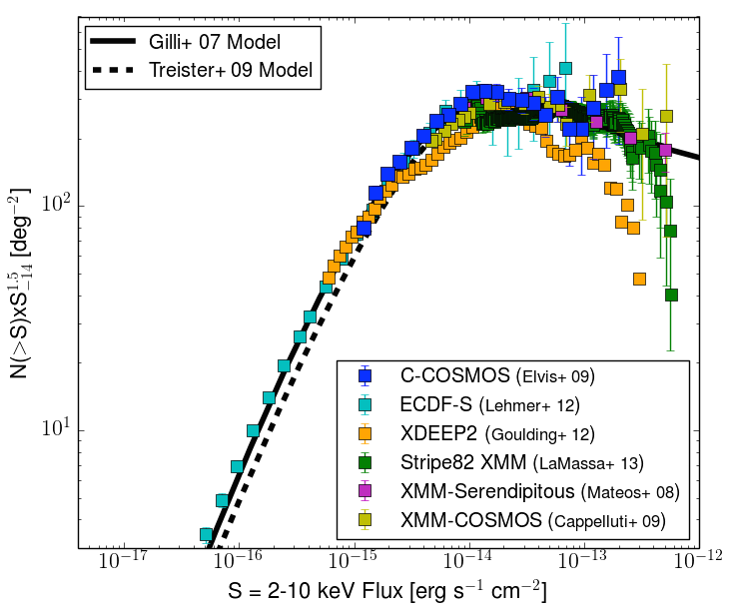
Number Counts
FC+ in prep.
Marchesi, FC+ in prep.
 | Total (P>2x10⁻⁵) | Soft | Hard | Spec-z | Photo-z
Number | 4054 | 2895 | 2351 | 1467 | 3920 (96.6%)
Chandra Sweet Fifteen!
Notes:
----- Meeting Notes (11/17/14 11:49) -----
c-cosmos then add legacy

Slide 19
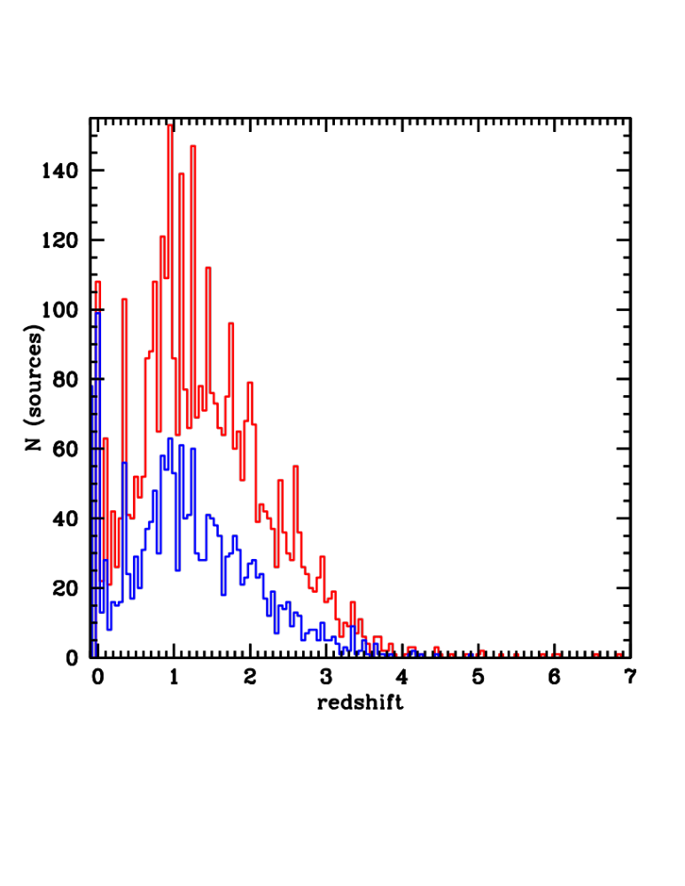
Redshift and Luminosity (1)
COSMOS Legacy
XMM-COSMOS
3920 photo-z (96.6%)
1467 spec-z
Spectroscopic campaign with:
Keck/DEIMOS (PI: Hasinger)
Keck/MOSFIRE (PI: FC)
Subaru/FMOS (PI: Silverman; Suh)
Photo-zs:
Salvato+ in prep.
Salvato+ 2011
Chandra Sweet Fifteen!
Notes:
Many structures

Slide 20
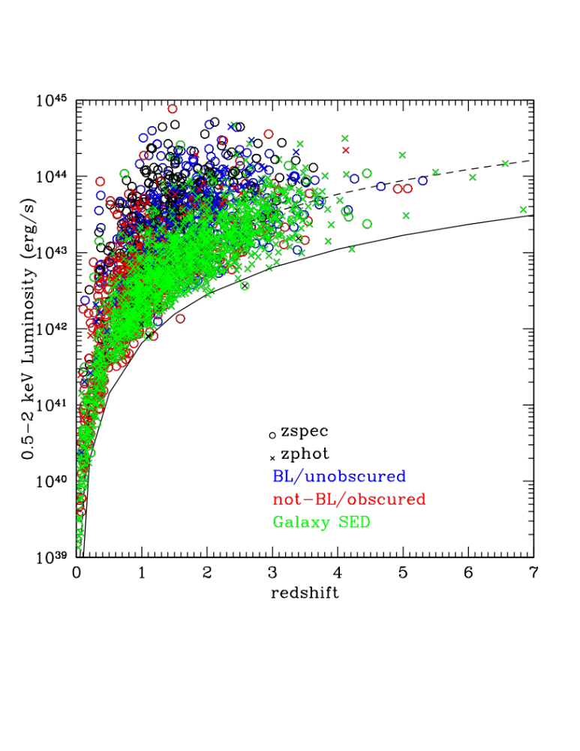
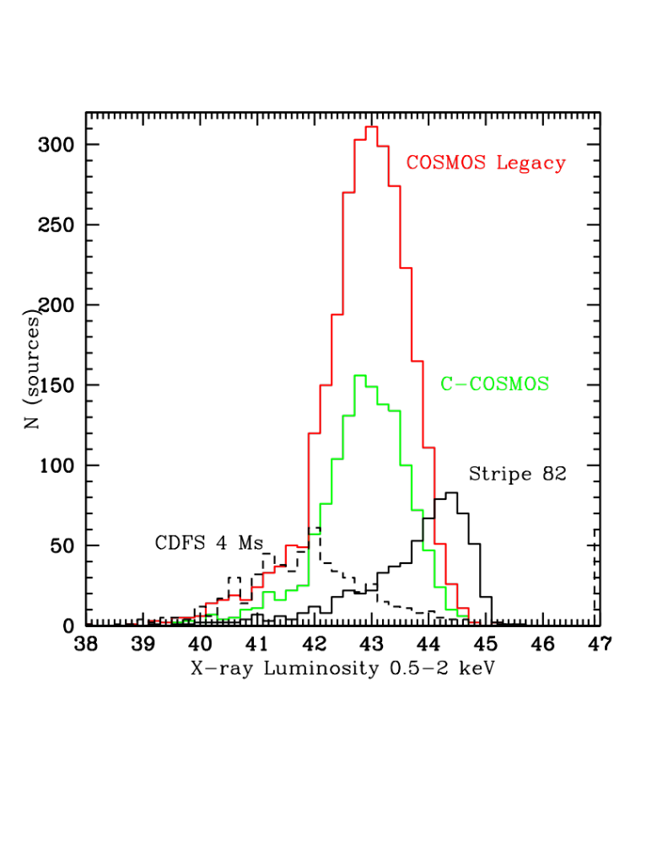
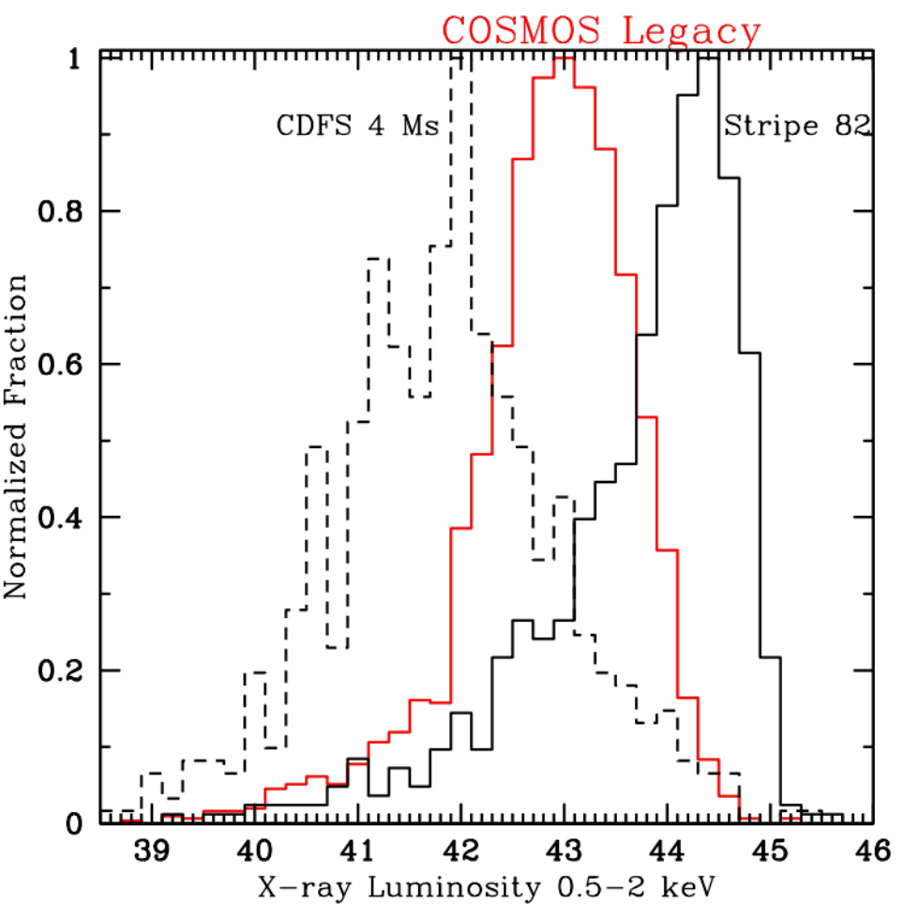
Redshift and Luminosity (2)
Type 1
Galaxy
SED
Type 2
Obscured AGN population dominates on the unobscured sources
COSMOS Legacy:
sweet spot in the Lx-z plane
Chandra Sweet Fifteen!
Notes:
Stripe 82 only 27% complete in redshift

Slide 21
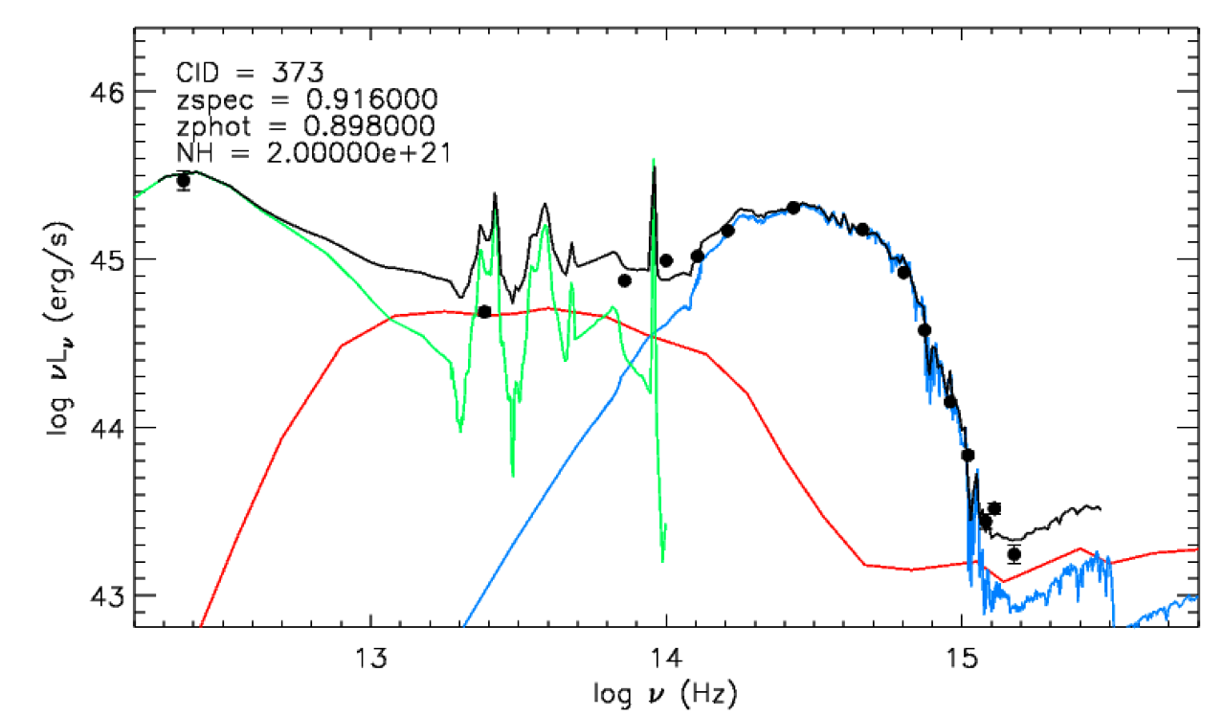
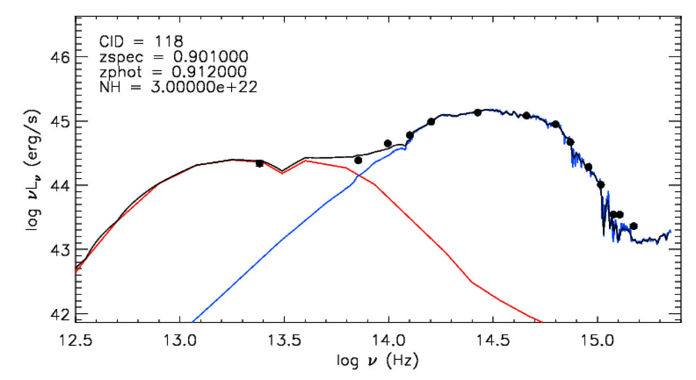
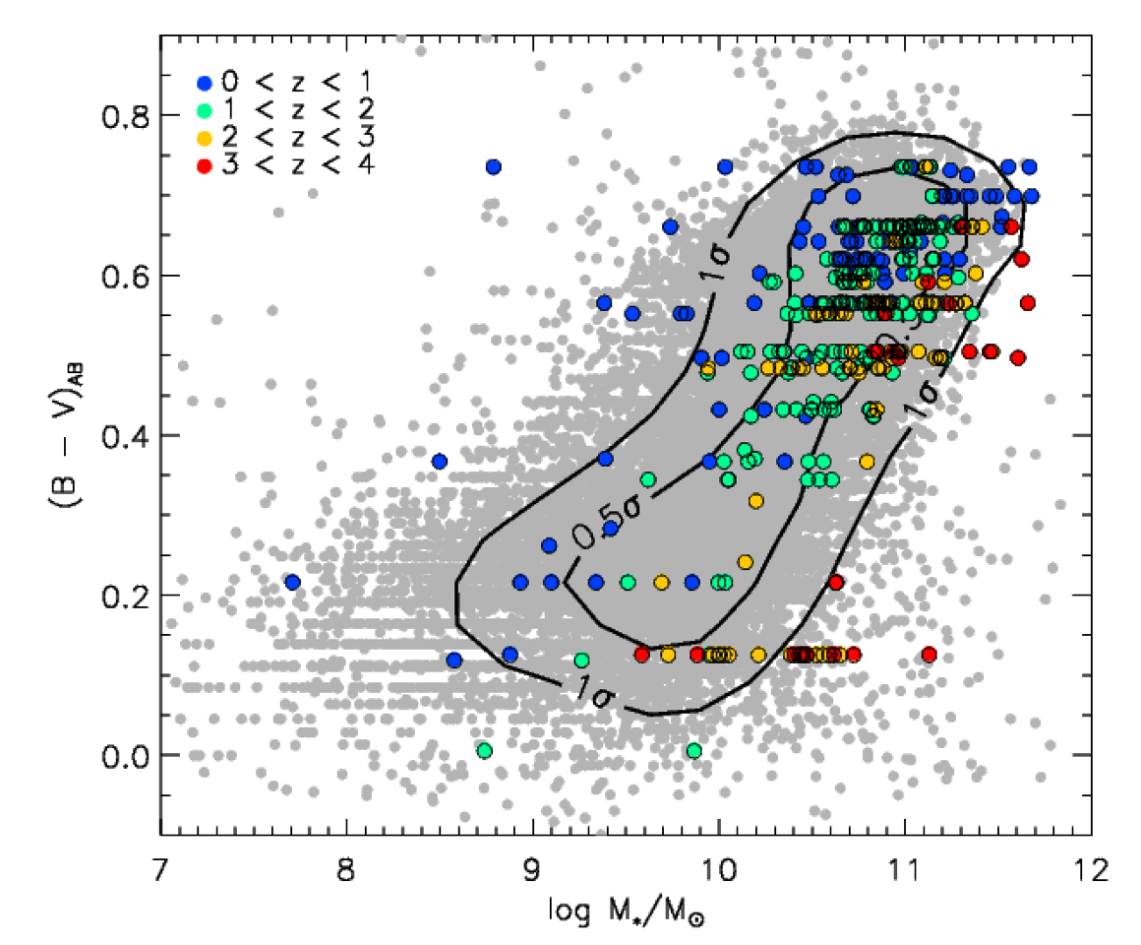
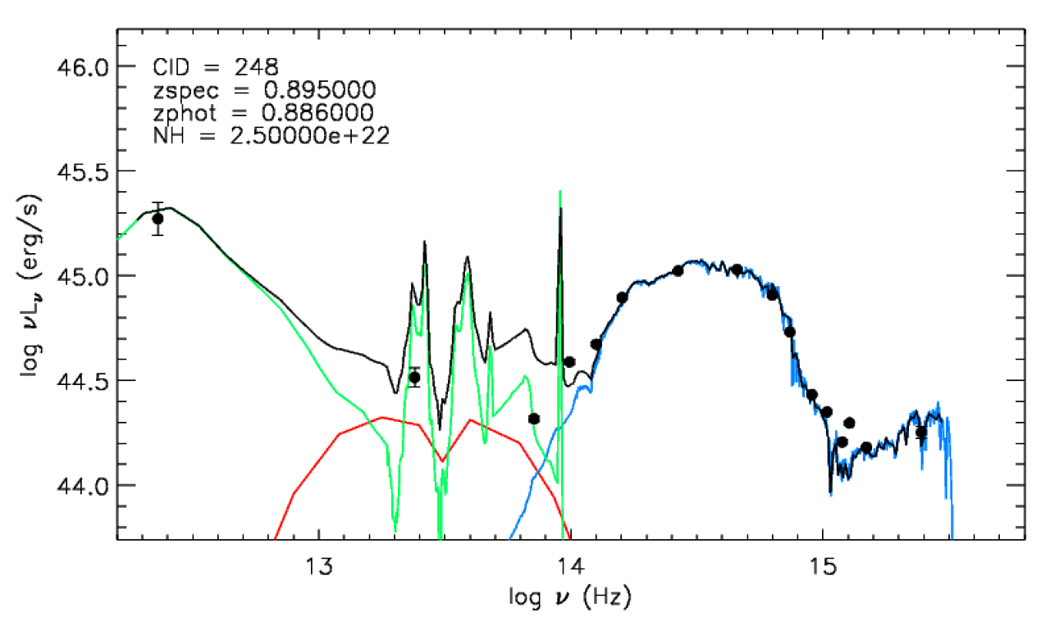
Galaxy properties
Suh, FC+ in prep.
COSMOS multiwavelength data:
→SED characterization from FIR to NUV
→AGN to Galaxy decomposition
→Galaxy Mass and SFR
Chandra Sweet Fifteen!

Slide 22
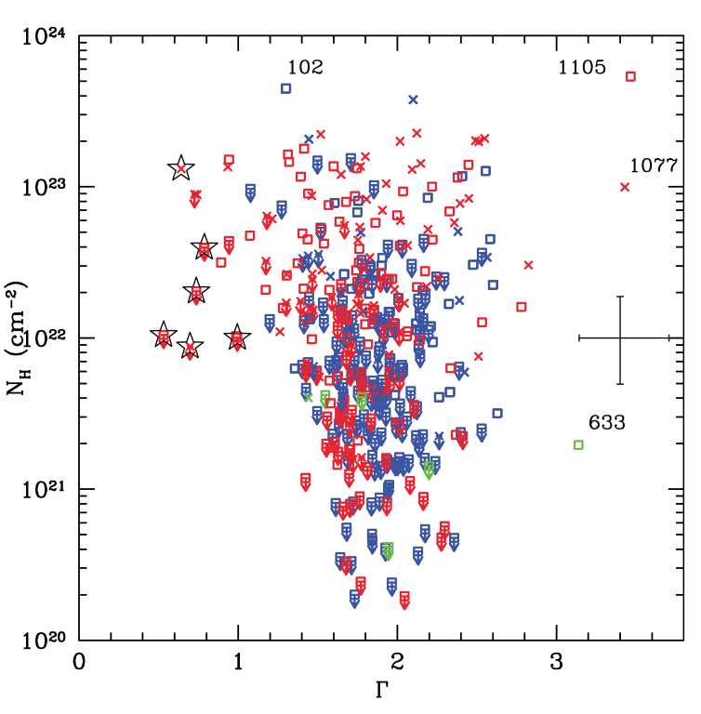
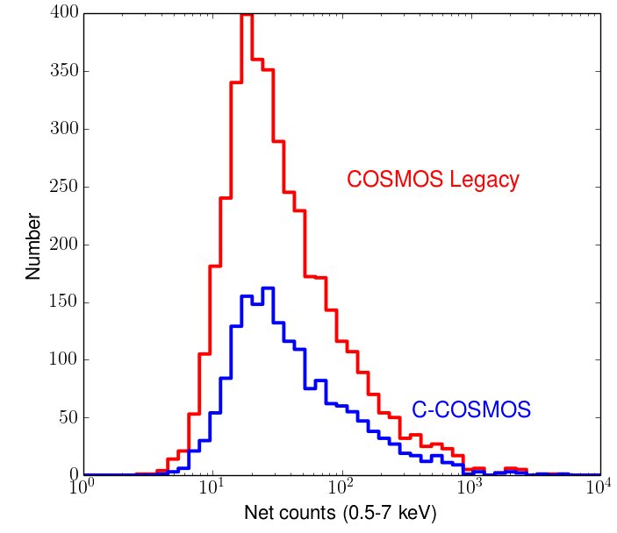
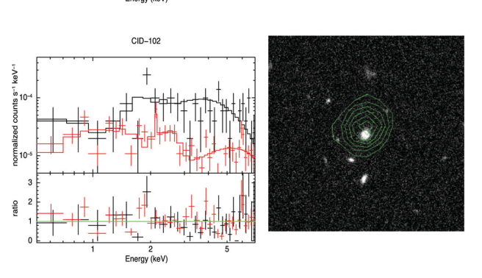
X-ray spectral properties
Lanzuisi, FC+ 2013
>70 counts
880 sources
z=1.84
NH=4x10²³ cm⁻²
390 sources
Chandra Sweet Fifteen!
Notes:
Selected also by xmm cosmos but only with chandra is possible to perform spectral analysis

Slide 23
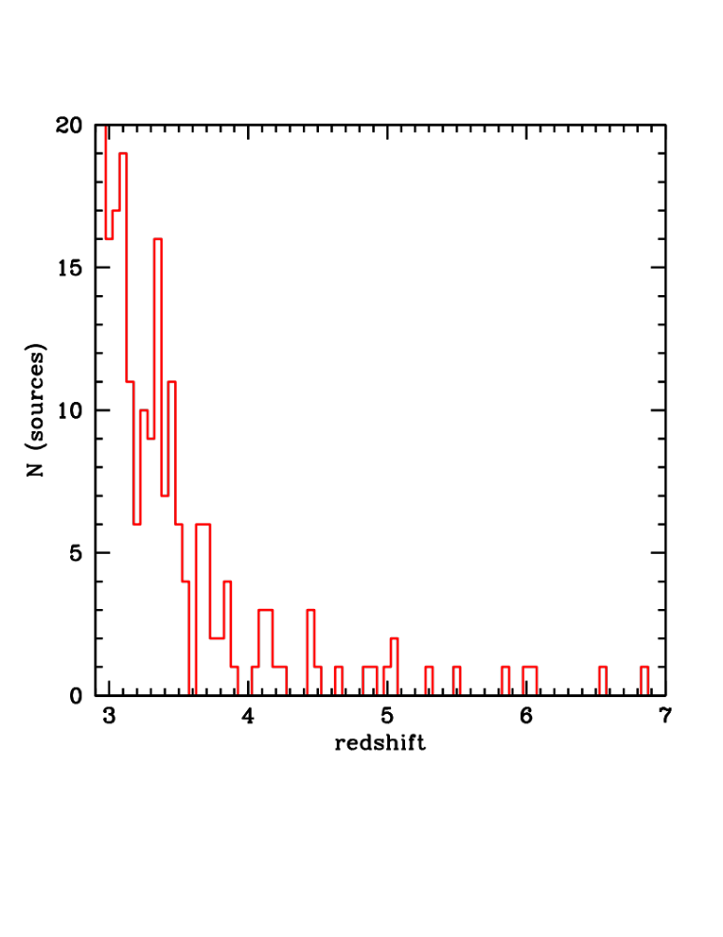
COSMOS Legacy high-z sample
174 z>3 sources
51 spectroscopic redshifts
123 photometric redshifts
(σ_{Δz/(1+zspec)} = 0.011 at z>2.5)
Most of studies focus on z=2, epoch of peak of SMBH accretion and neglect higher-z, which is though important to distinguish BH formation scenarios
26 sources at z>4
9 sources at z>5
4 sources at z>6
Compare to
→ 65 sources in CDFS (Xue+2012)
→81 sources in C-COSMOS (FC+ 2011)
→ 40 sources in XMM-COSMOS (Brusa+2009)
→141 sources in CDFS, C- XMM-COSMOS, XSDS (Vito+2014)
→209 sources in C-COSMOS + Champ (Kalfountzou, FC+2014)
Chandra Sweet Fifteen!
Notes:
----- Meeting Notes (11/17/14 11:49) -----
just z>3

Slide 24
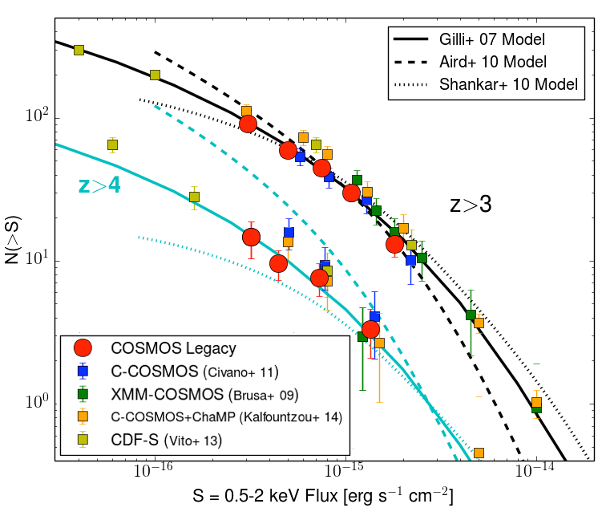
z>3 Number Counts
Extrapolations of
phenomenological models
calibrated at lower z.
Luminosity density
Dependent evolution is
preferred at z>4
Predictions from physical
models of quasar evolution:
M_{DMH} 3 × 10¹² M_{sun}/h
Chandra Sweet Fifteen!

Slide 25
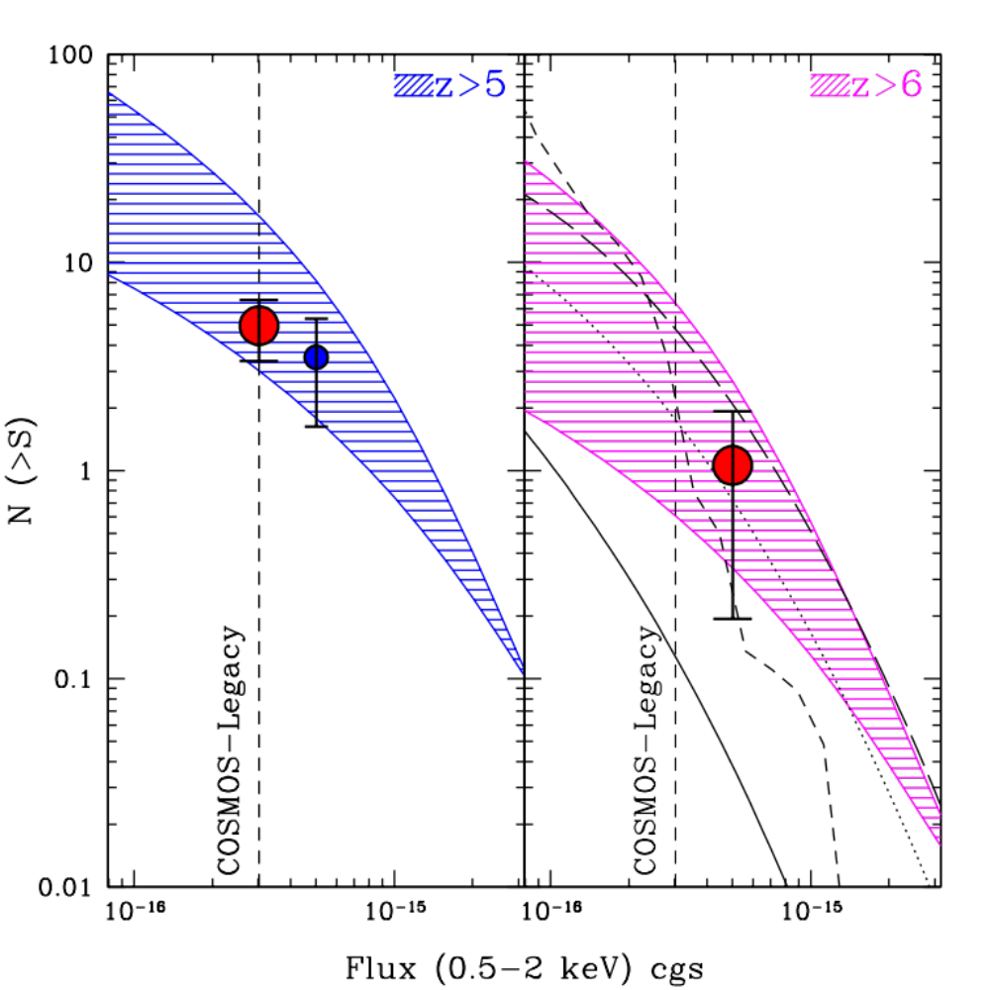
The impact of COSMOS Legacy
Chandra Sweet Fifteen!
Notes:
This regime, not otherwise sampled, will allow to understand the SMBH growth in the early universe.

Slide 26
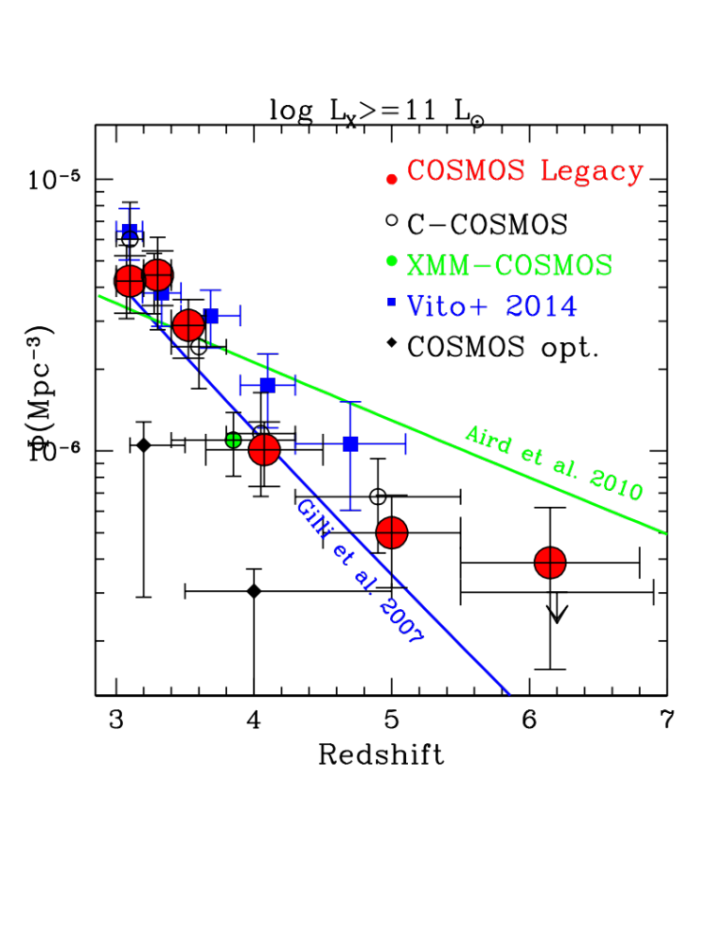
Space density: bright end
DOWNSIZING:
Declining space density with
a break at z=3 as
observed in the optical at same L
→Optical surveys miss part of the obscured AGN
→LDDE preferred to LADE but
at z=6 (change in SMBH physics??)
Optical QUASARs
See also, Brusa+ 2009, Civano+ 2011, Ueda+ 2014, Kalfountzou, FC+ 2014, Vito+ 2014
Chandra Sweet Fifteen!

Slide 27
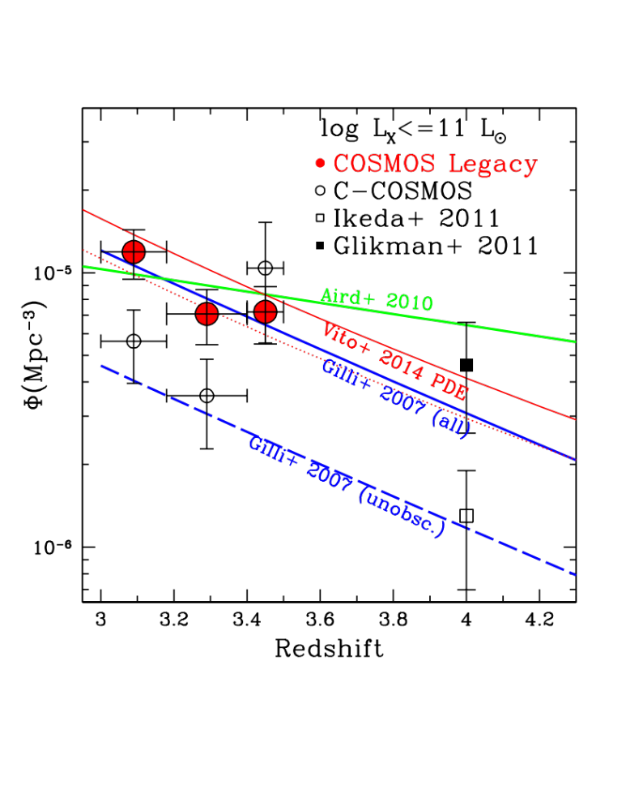
Space density: faint end
No conclusive X-ray space density for these redshifts has been reported previously at low luminosities
→Optical surveys: controversial results
→ Impossible to discriminate between models: LDDE, PDE or LADE?
Possible Upsizing?: faint sources space density evolves at a slower rate
(Ueda et al. 2014)
Optical QUASARs
Chandra Sweet Fifteen!
Notes:
I punti di vito: toglierli o meno?

Slide 28
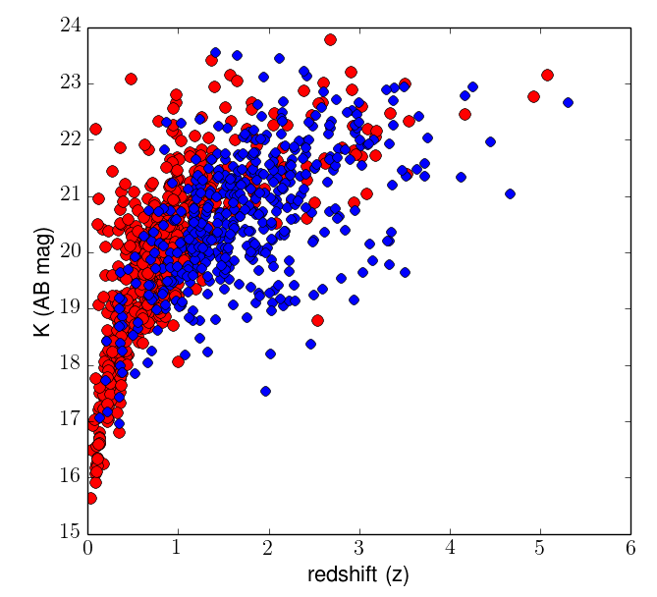
BH mass function at z>3
Hβ emission line
at 4861Å:
MOSFIRE
@Keck
K band filter
2 nights in 2014
5 nights in 2015
Chandra Sweet Fifteen!
Notes:
Nuova figura chiedi a Stefano!!!

Slide 29
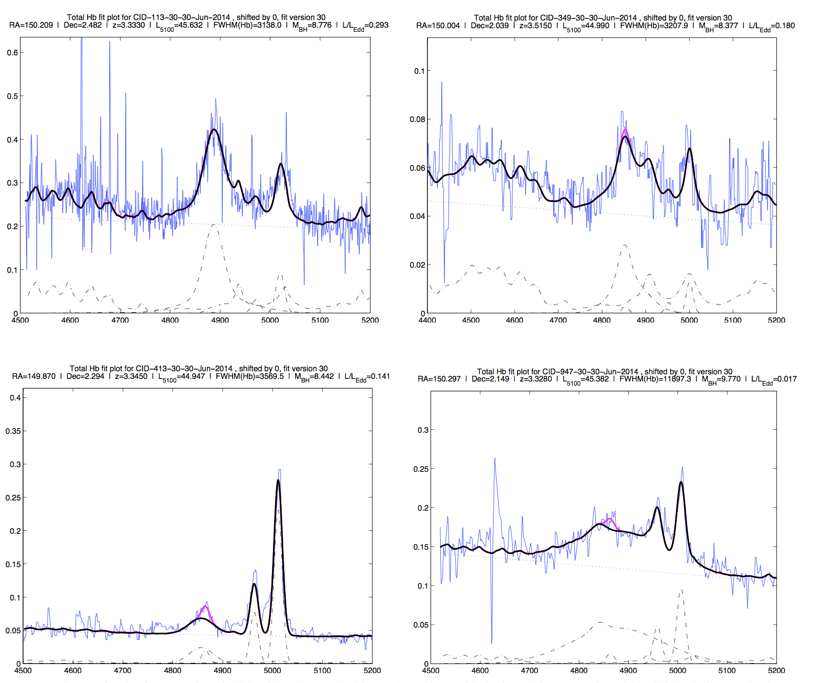
Keck/MOSFIRE Spectra
2-3 hrs integration; S/N>10 on the continuum; K<20
Chandra Sweet Fifteen!

Slide 30
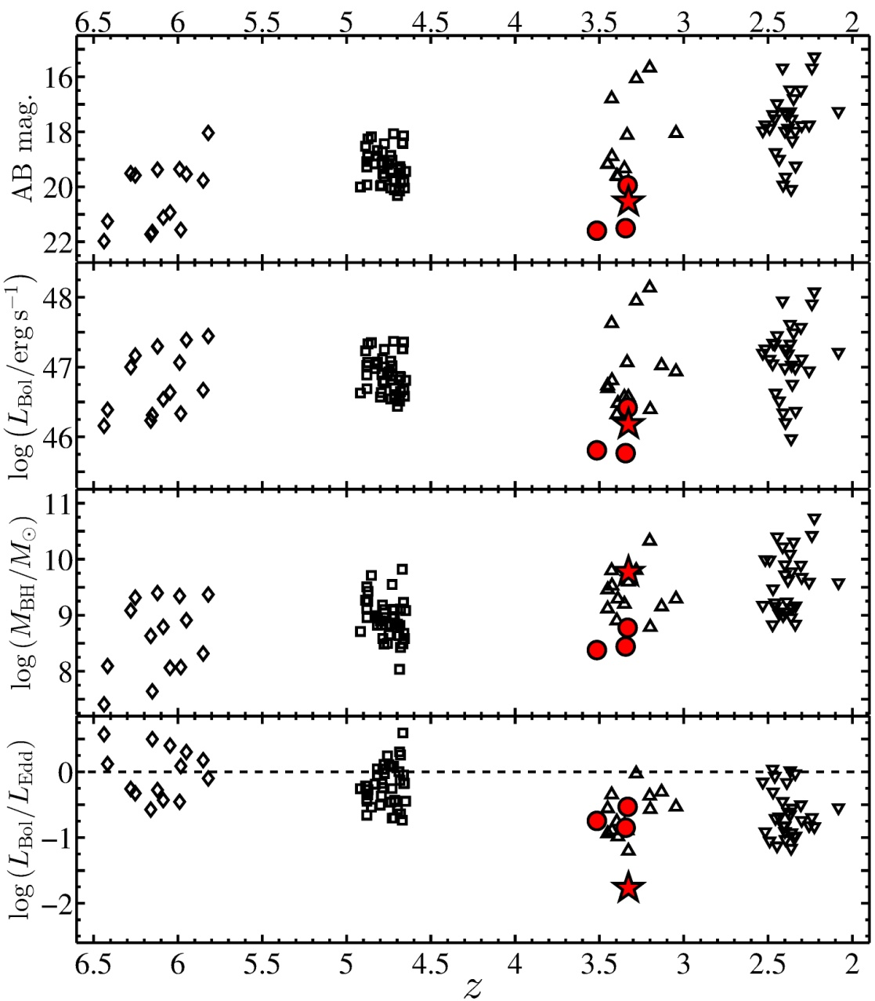
Probing Typical AGN at z=3
Trakhtenbrot, FC et al. (in prep.)
L_{bol}* is considerably lower than bright SDSS QSO at same z
M_{BH} is smaller
Comparable L/L_{Edd}
*estimated from both L5100 and also from SED fitting
SDSS QSOs
Chandra Sweet Fifteen!

Slide 31
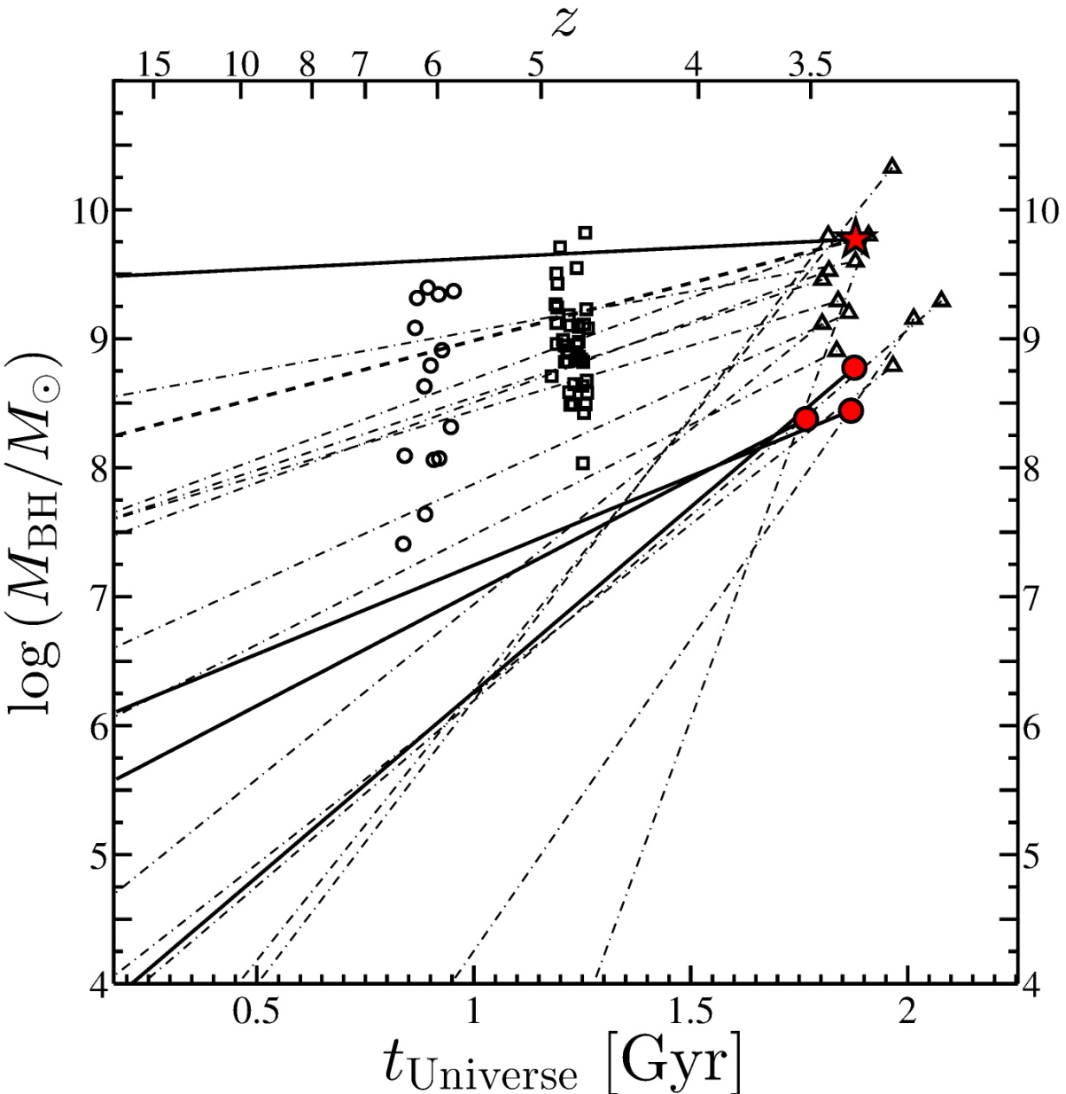
SMBH toy model: BH seeds
Trakhtenbrot, FC et al. (in prep.)
Chandra Sweet Fifteen!

Slide 32
AGN Clustering at high-z
Clustering provides a unique way to study AGN formation and evolution at z>2:
Typical environment AGN live in: DMH mass→ bias factor → correlation function
AGN triggering mechanisms: secular processes vs major mergers
The clustering of AGN depends:
- DMHs distribution
- how AGN populate DMHs
Chandra Sweet Fifteen!
Notes:
2pcf measures the difference between the AGN distribution and a random unclustered random distribution,
as a function of the AGN separation;
b reflects the amplitude of the AGNs two-halo term relative to the underlying DM distribution,

Slide 33
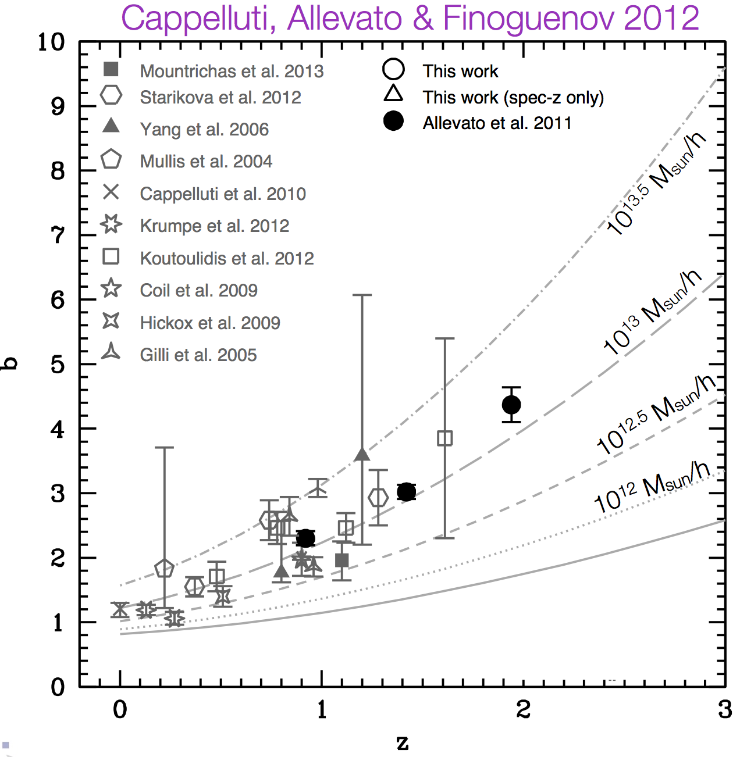
Clustering of X-ray AGNs
Cappelluti, Allevato & Finoguenov 2012
X-ray selected AGN reside in more massive halos than optically selected
logM_{DMH} >13 up to z=2;
Optical QSO:
logM_{DMH} ~12.5
→evidence against cold gas accretion via major mergers in X-ray AGNs and/or as support for multiple modes of BH accretions
Allevato et al. 2011, Fanidakis et al. 2013, Mountrichas & Georgakakis 2012
Optical QUASARs
Chandra Sweet Fifteen!

Slide 34
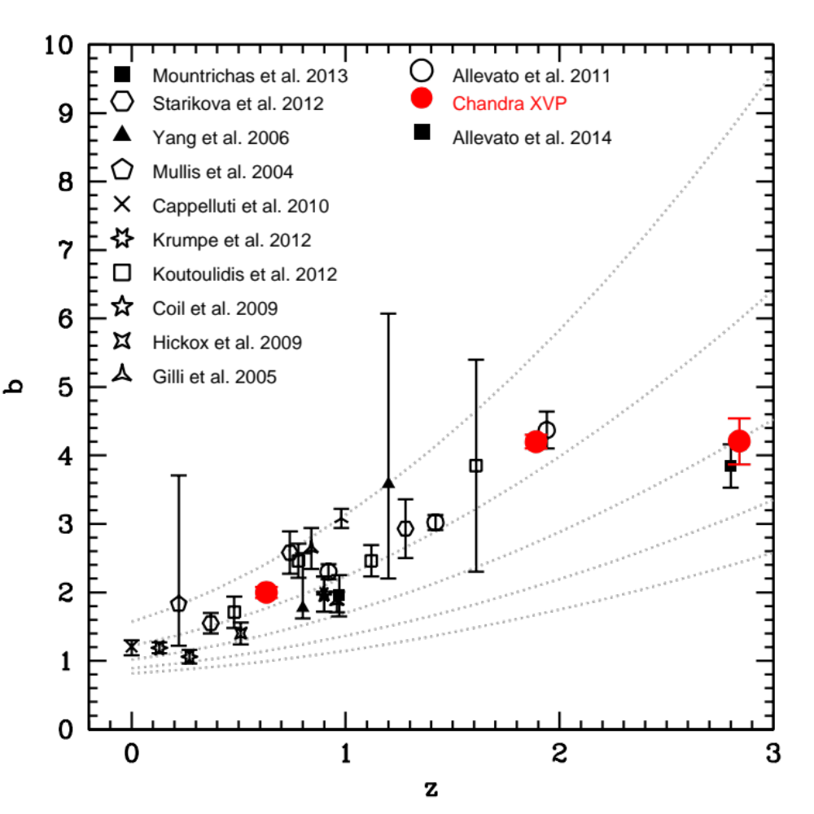
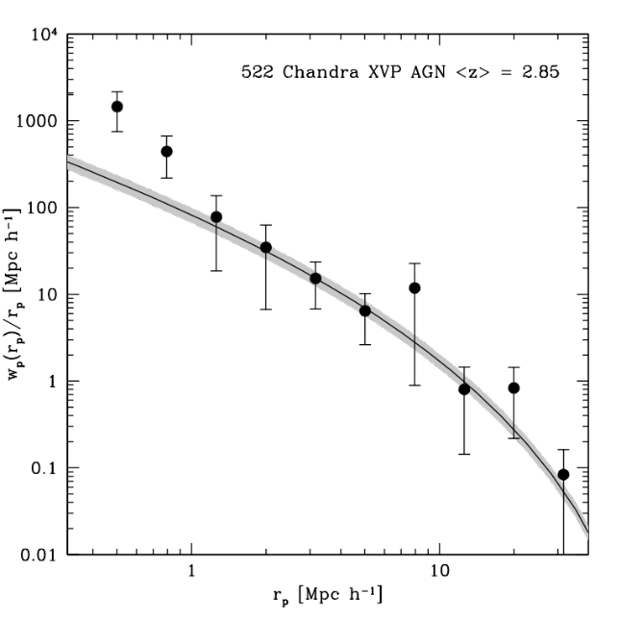
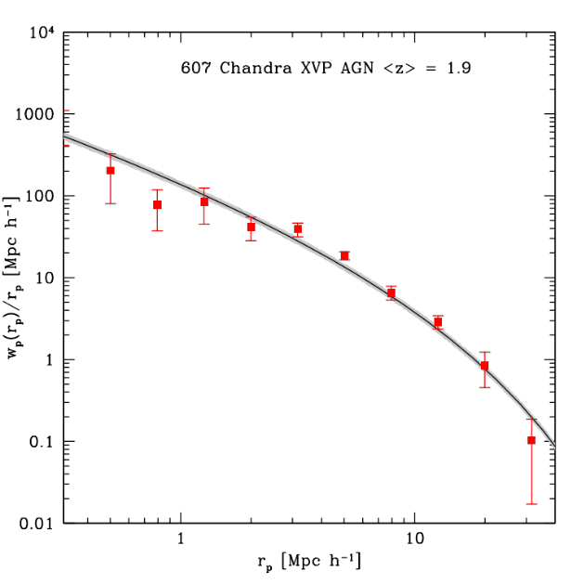
Clustering of X-ray AGNs: the contribution of COSMOS Legacy
Increasing the sample reduces the error bars and allows for multiple bins
Allevato, FC+ in prep.
COSMOS Legacy
10^{13.5} Msun/h
10^{12.5}Msun/h
Chandra Sweet Fifteen!

Slide 35
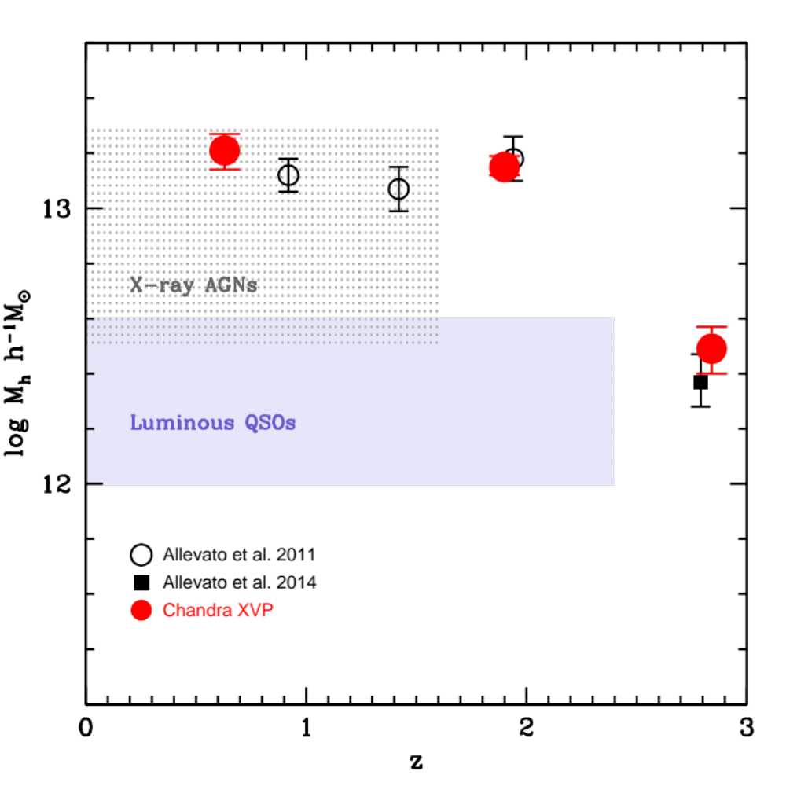
Dark Matter Hosting Halo Mass
(redshift evolution of bias)
Allevato, Finoguenov, FC+ 2014; Allevato, FC+ in prep
z<2: the bias of moderate luminosity AGNs increases with z tracing a constant halo mass
z~3: a drop in the hosting halo mass→ progressive drop in the abundance of massive and rarer host halos at high redshift
z~3 DMH mass consistent with number density modeling
from z>3 Number Counts
COSMOS Legacy
Chandra Sweet Fifteen!
Notes:
UPDATE with latest viola plot for LEGACY

Slide 36

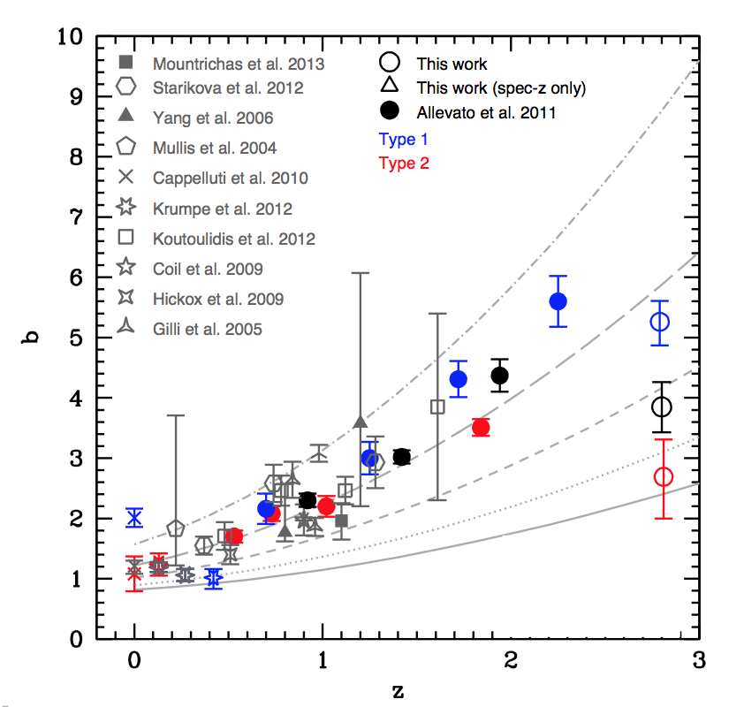
AGN triggering mechanism
(clustering of obscured and unobscured AGN)
AGN unification models→
no difference in the clustering
vs
Evolutionary models→
difference in the clustering
X-COSMOS
10^{13.5} Msun/h
10¹³Msun/h
‣ Obscured cluster less than Unobscured
(Cappelluti et al. 2010, Allevato et al. 2011, 2014)
‣ Obs. And Unobs. cluster similarly
(Gandhi et al. 2006, Gilli et al. 2009, Krumpe et al. 2012)
‣ Mid-IR selected AGNs (obscured) found in more massive DMHs (∼10^{13.5} Msun/h)
than X-ray Type 2 AGN
(Donoso et al. 2013, Hickox et al. 2011, Di Pompeo et al. 2014)
10^{12.5}Msun/h
10¹²Msun/h
Chandra Sweet Fifteen!

Slide 37
Summary
X-ray extragalactic surveys have been an important piece of Chandra 15 years of science
COSMOS was observed by Chandra for a total of 4.8 Ms
With COSMOS Legacy we provide a unique sample of ~4000 sources with ready high quality multiwavelength data
Survey was completed 8 months ago and we already have exciting results on the properties of high-z AGN
Number counts and space density finally constraints models
Large sample constraints bias measurements in small z-bins
Papers are in preparation and the community is welcome to make use of this sample
Chandra Sweet Fifteen!

Slide 38


Slide 39
Back up

Slide 40
Atypical source CID-947
lg(M_{BH})=9.8
→ final stage of its growth
L/L_{Edd}=0.02
M*(from SED fitting)= 10.75
SFR=100-1000 M_{sun}/yr (from SED in optical and FIR with Herschel +AzTEC detection)
U-synchronous growth of SMBH and galaxy mass

Slide 41
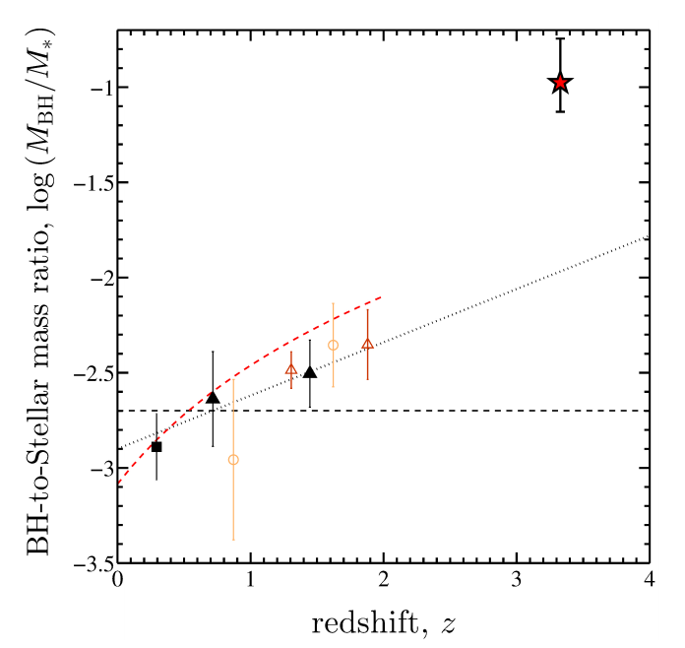
M_{BH}-M_{host} relation through cosmic time
M_{BH}/M*~0.1
→way smaller then expected from scaling relation (~0.001)
Galaxy mass need to increase of a factor 10 to 100 tomatch the extrapolation of the local scaling relation
Merloni et al. (COSMOS)
Peng et al. 2006
Mc Lure et al. 2006
Decarli et al. 2010

Slide 42
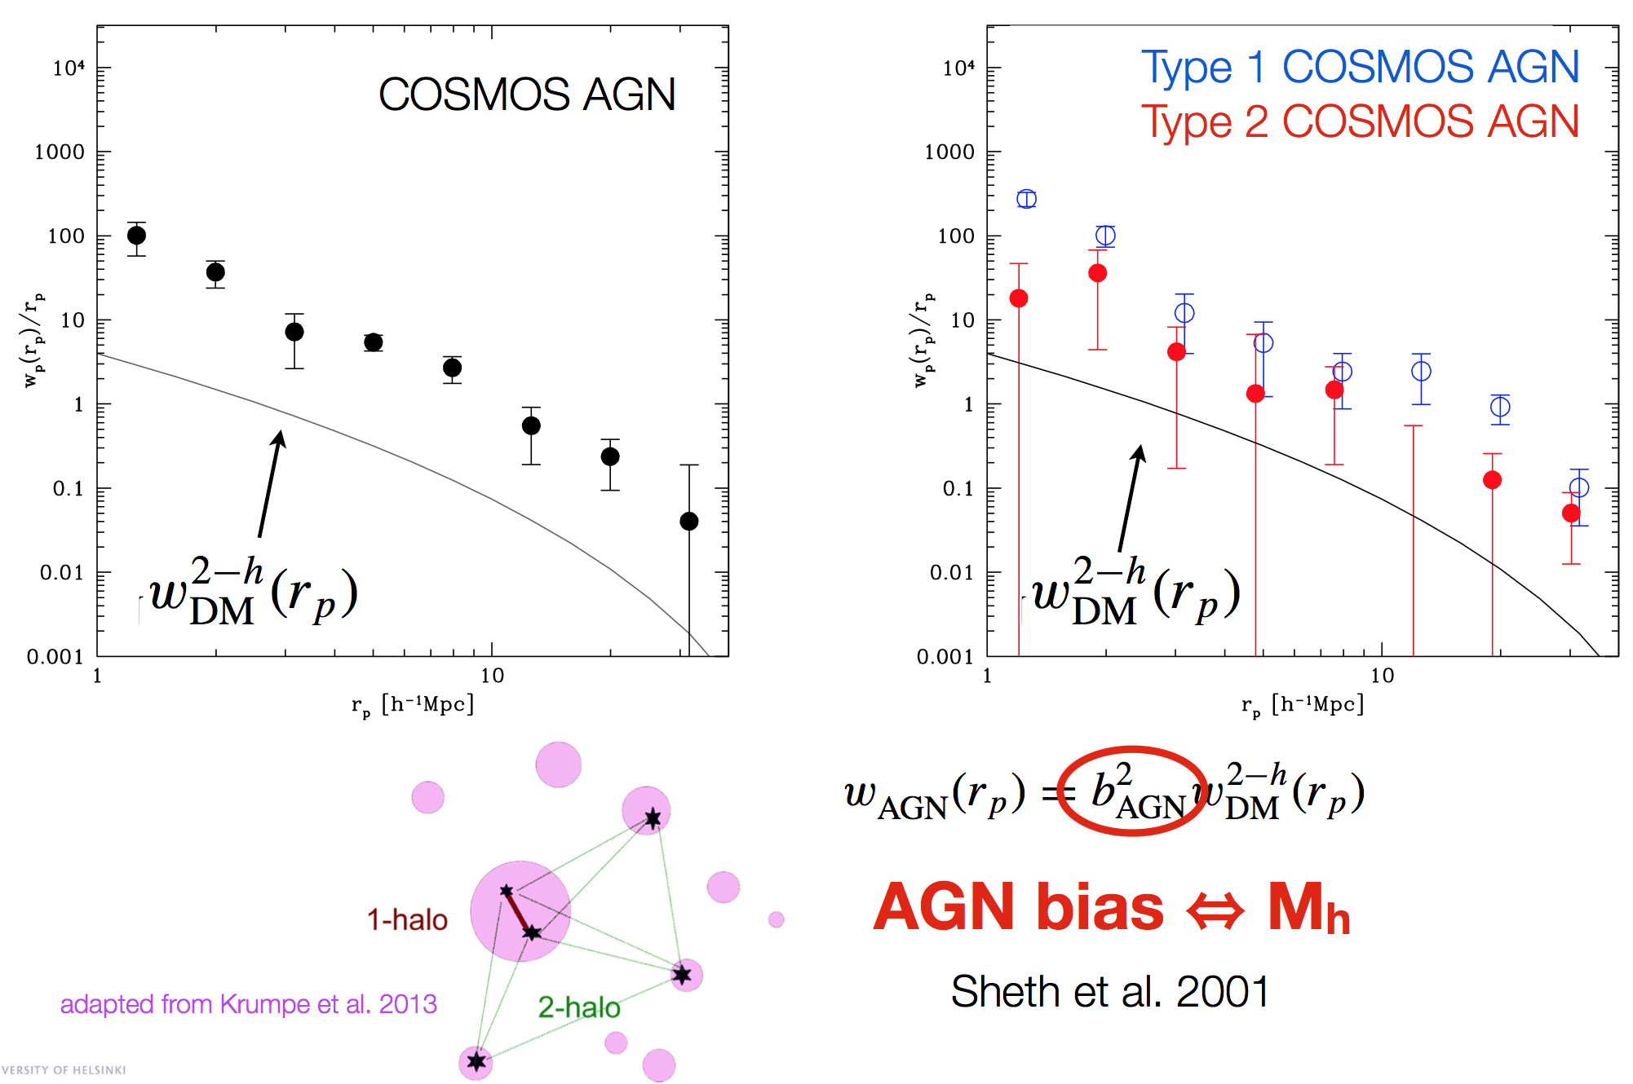
BIAS

Slide 43
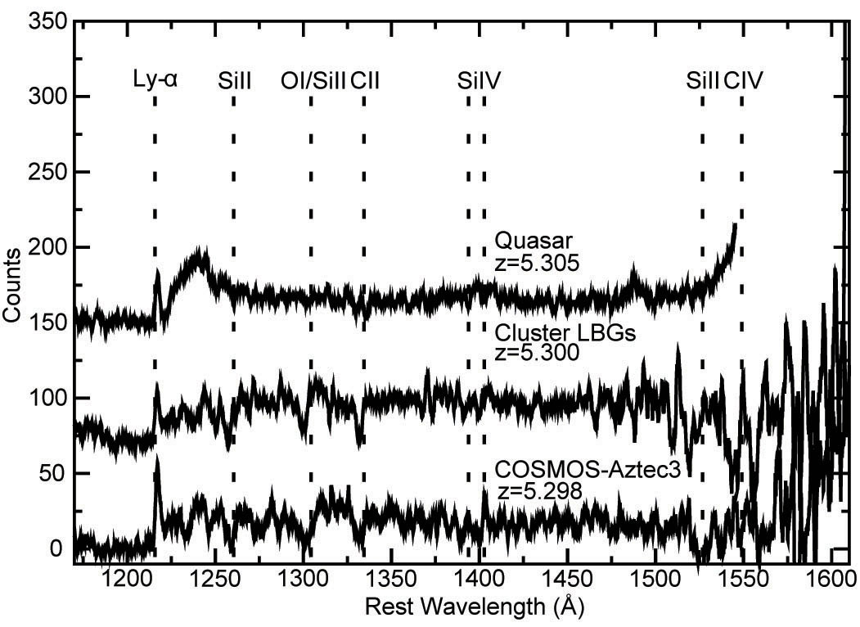
Where do first SMBH live?
AGN in protoclusters are needed to shut down star formation and form massive elliptical galaxies found in local clusters
QSO in a massive protocluster
13 comoving Mpc
~25 spectroscopic members
Capak et al. 2011
As predicted by simulations (Overzier et al 2009)

Slide 44
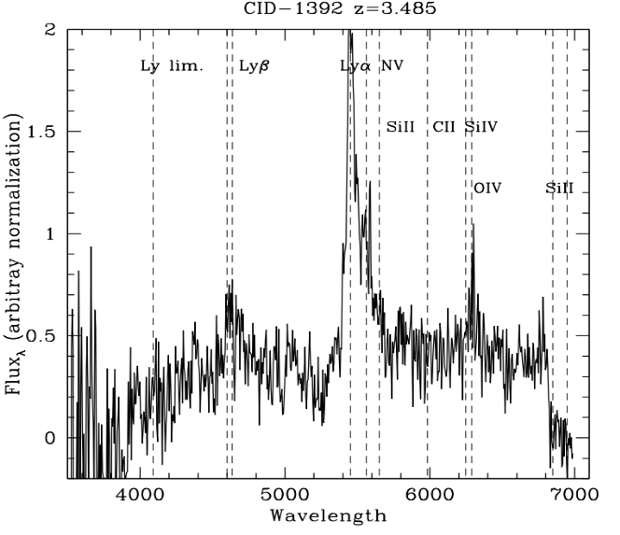
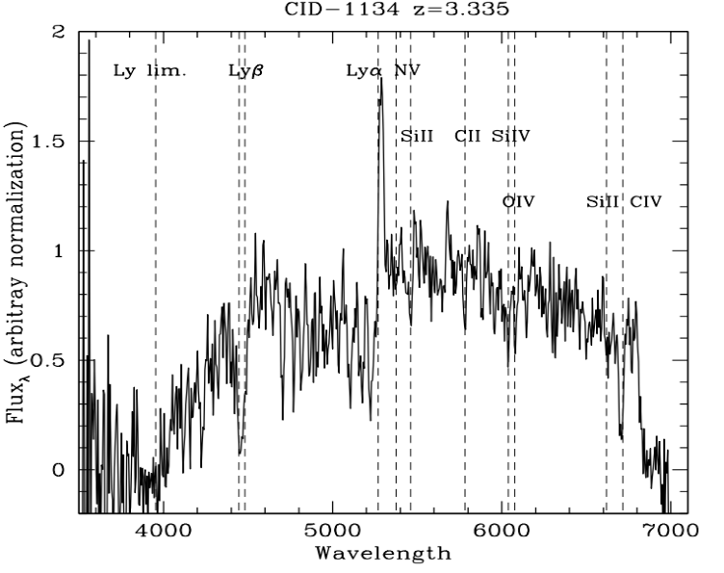
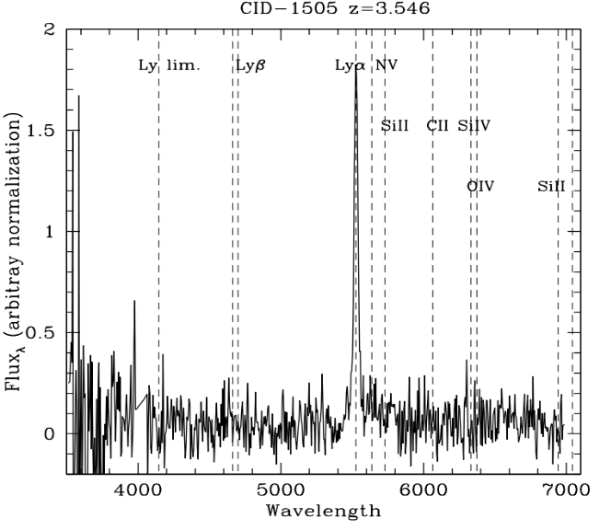
Demography of high-z sources
Keck/ Deimos and VLT/VIMOS
FC+ 2011
Broad line AGN
Typical of normal SFGs
(narrow Ly emission and stellar absorption lines, No CIV in emission)
Not otherwise recognized as AGN
Some in ECDFS
(Silverman et al. 2011)
Only Lyα over a faint
continuum
Chandra Sweet Fifteen!

