Slide 1
Quasar Rain
Chandra and the Inner Structure of AGNs
Warm Absorbers, X-ray Eclipses and
Broad Line Region Inflows, a unification
Martin Elvis
Harvard-Smithsonian Center for Astrophysics

Slide 2
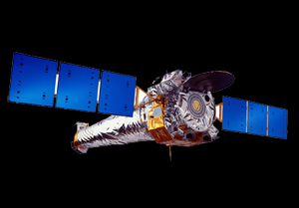
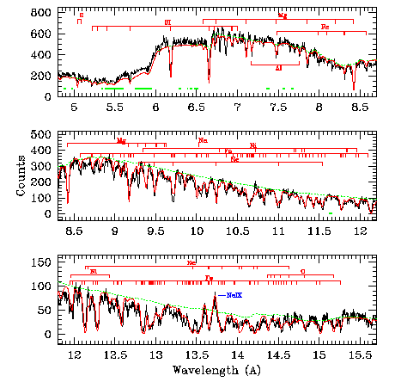
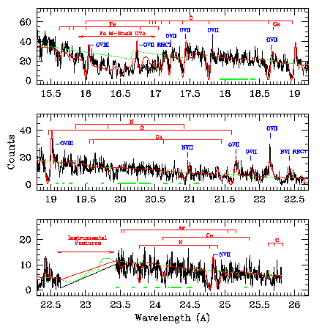
Chandra taught us about AGN structure
1. X-ray Warm Absorber Outflows
AGN Wind @750 km s⁻¹ : 2-3 phase gas in pressure equilibrium to 5%
Chandra HETGS 850ksec spectrum of NGC 3783
Krongold, Nicastro, Brickhouse, Elvis, Liedahl & Mathur, 2003 ApJ 597, 832
>100 absorption features - 6 parameter model

Slide 3
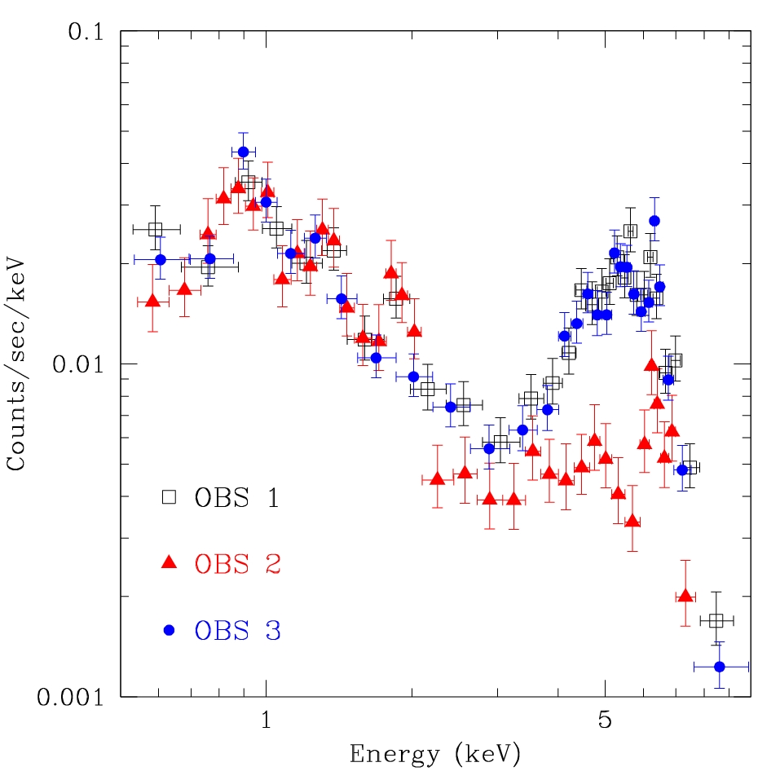
Chandra taught us about AGN structure
2. Rapid eclipses by thick, cool gas clouds
Compton ThinThickThin in 4 days
ΔN_{H}>~10²⁴cm⁻² in 2 days
> n_{e}>10⁹ cm⁻³
> R(N_{H}) < few 1000 R_{s}
> NOT the “torus”
Risaliti et al., 2007, ApJL, 659, L111
Chandra monitoring
2 days
2 days

Slide 4
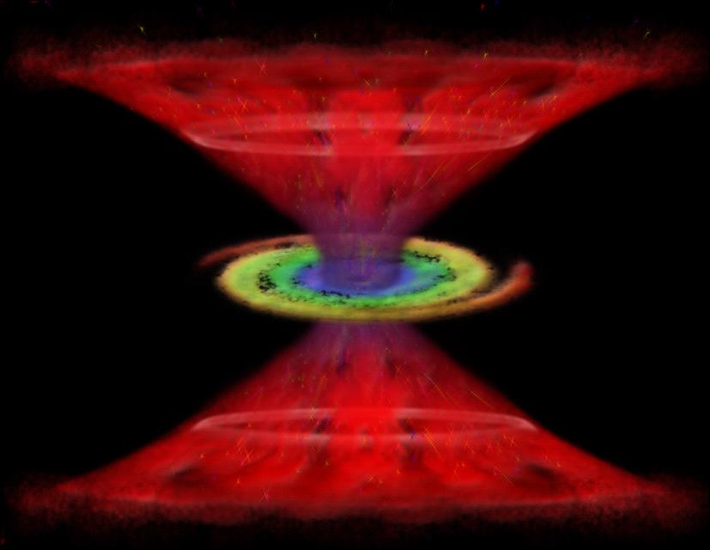
I thought I knew AGN structure
Disk Winds solve everything – it’s all outflows and rotation
Bi-conical Extended Narrow Line Region
Accelerating bi-conical disk wind
hollow cone
no absorption lines
Broad Absorption Lines
Reflection features
Narrow absorption lines
Thin Vertical wind
Supermassive black hole
X-ray `warm’ absorbers
Broad High ionization Emission Lines
Accretion disk
X-ray/UV ionizing continuum
Broad Low ionization Emission Lines
Failed Disk wind
Elvis 2000

Slide 5
Do Broad Line Region Inflows spoil it all?
But…
A Theory of Everything must explain
Every. Single. Thing.

Slide 6
Reverberation Mapping
δ-function flash from quasar
Produces δ-function response in an emission line from a gas cloud at distance R
after “lag” time t=R/c
Central Continuum Source
Flash
flux
time
R/c
Emission Line Response
flux

Slide 7
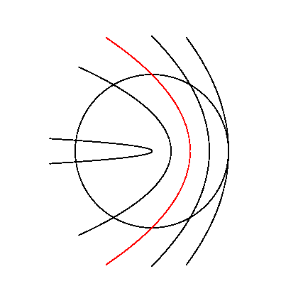
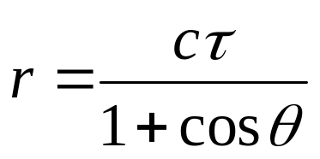
Isodelay Surfaces
Parabolas of equal delay time:
Zero delay ONLY possible on our line-of-sight to continuum
τ = r/c
τ = r/c
Brad Peterson, OSU

Slide 8
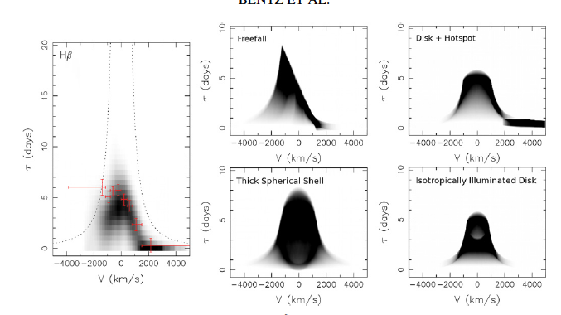
Broad Line Region Inflows
Isodelay Surfaces
ARP 151
Velocity Resolved Reverberation Mapping (VRRM)
  Bentz et al. 2010
Redshifts at zero lag
  → Infall !
Redshifts
at zero lag
Lag time
Infalling gas
MUST be here
0
← Redshifts
Blueshifts→
Peterson 2003

Slide 9
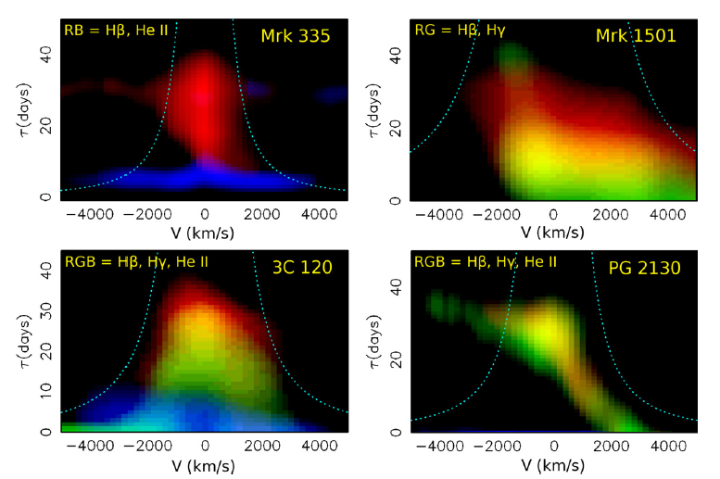
Broad Line Region Inflows
Inflows seem to be common
  Grier et al. 2013
More blueshifts at zero lag

Slide 10
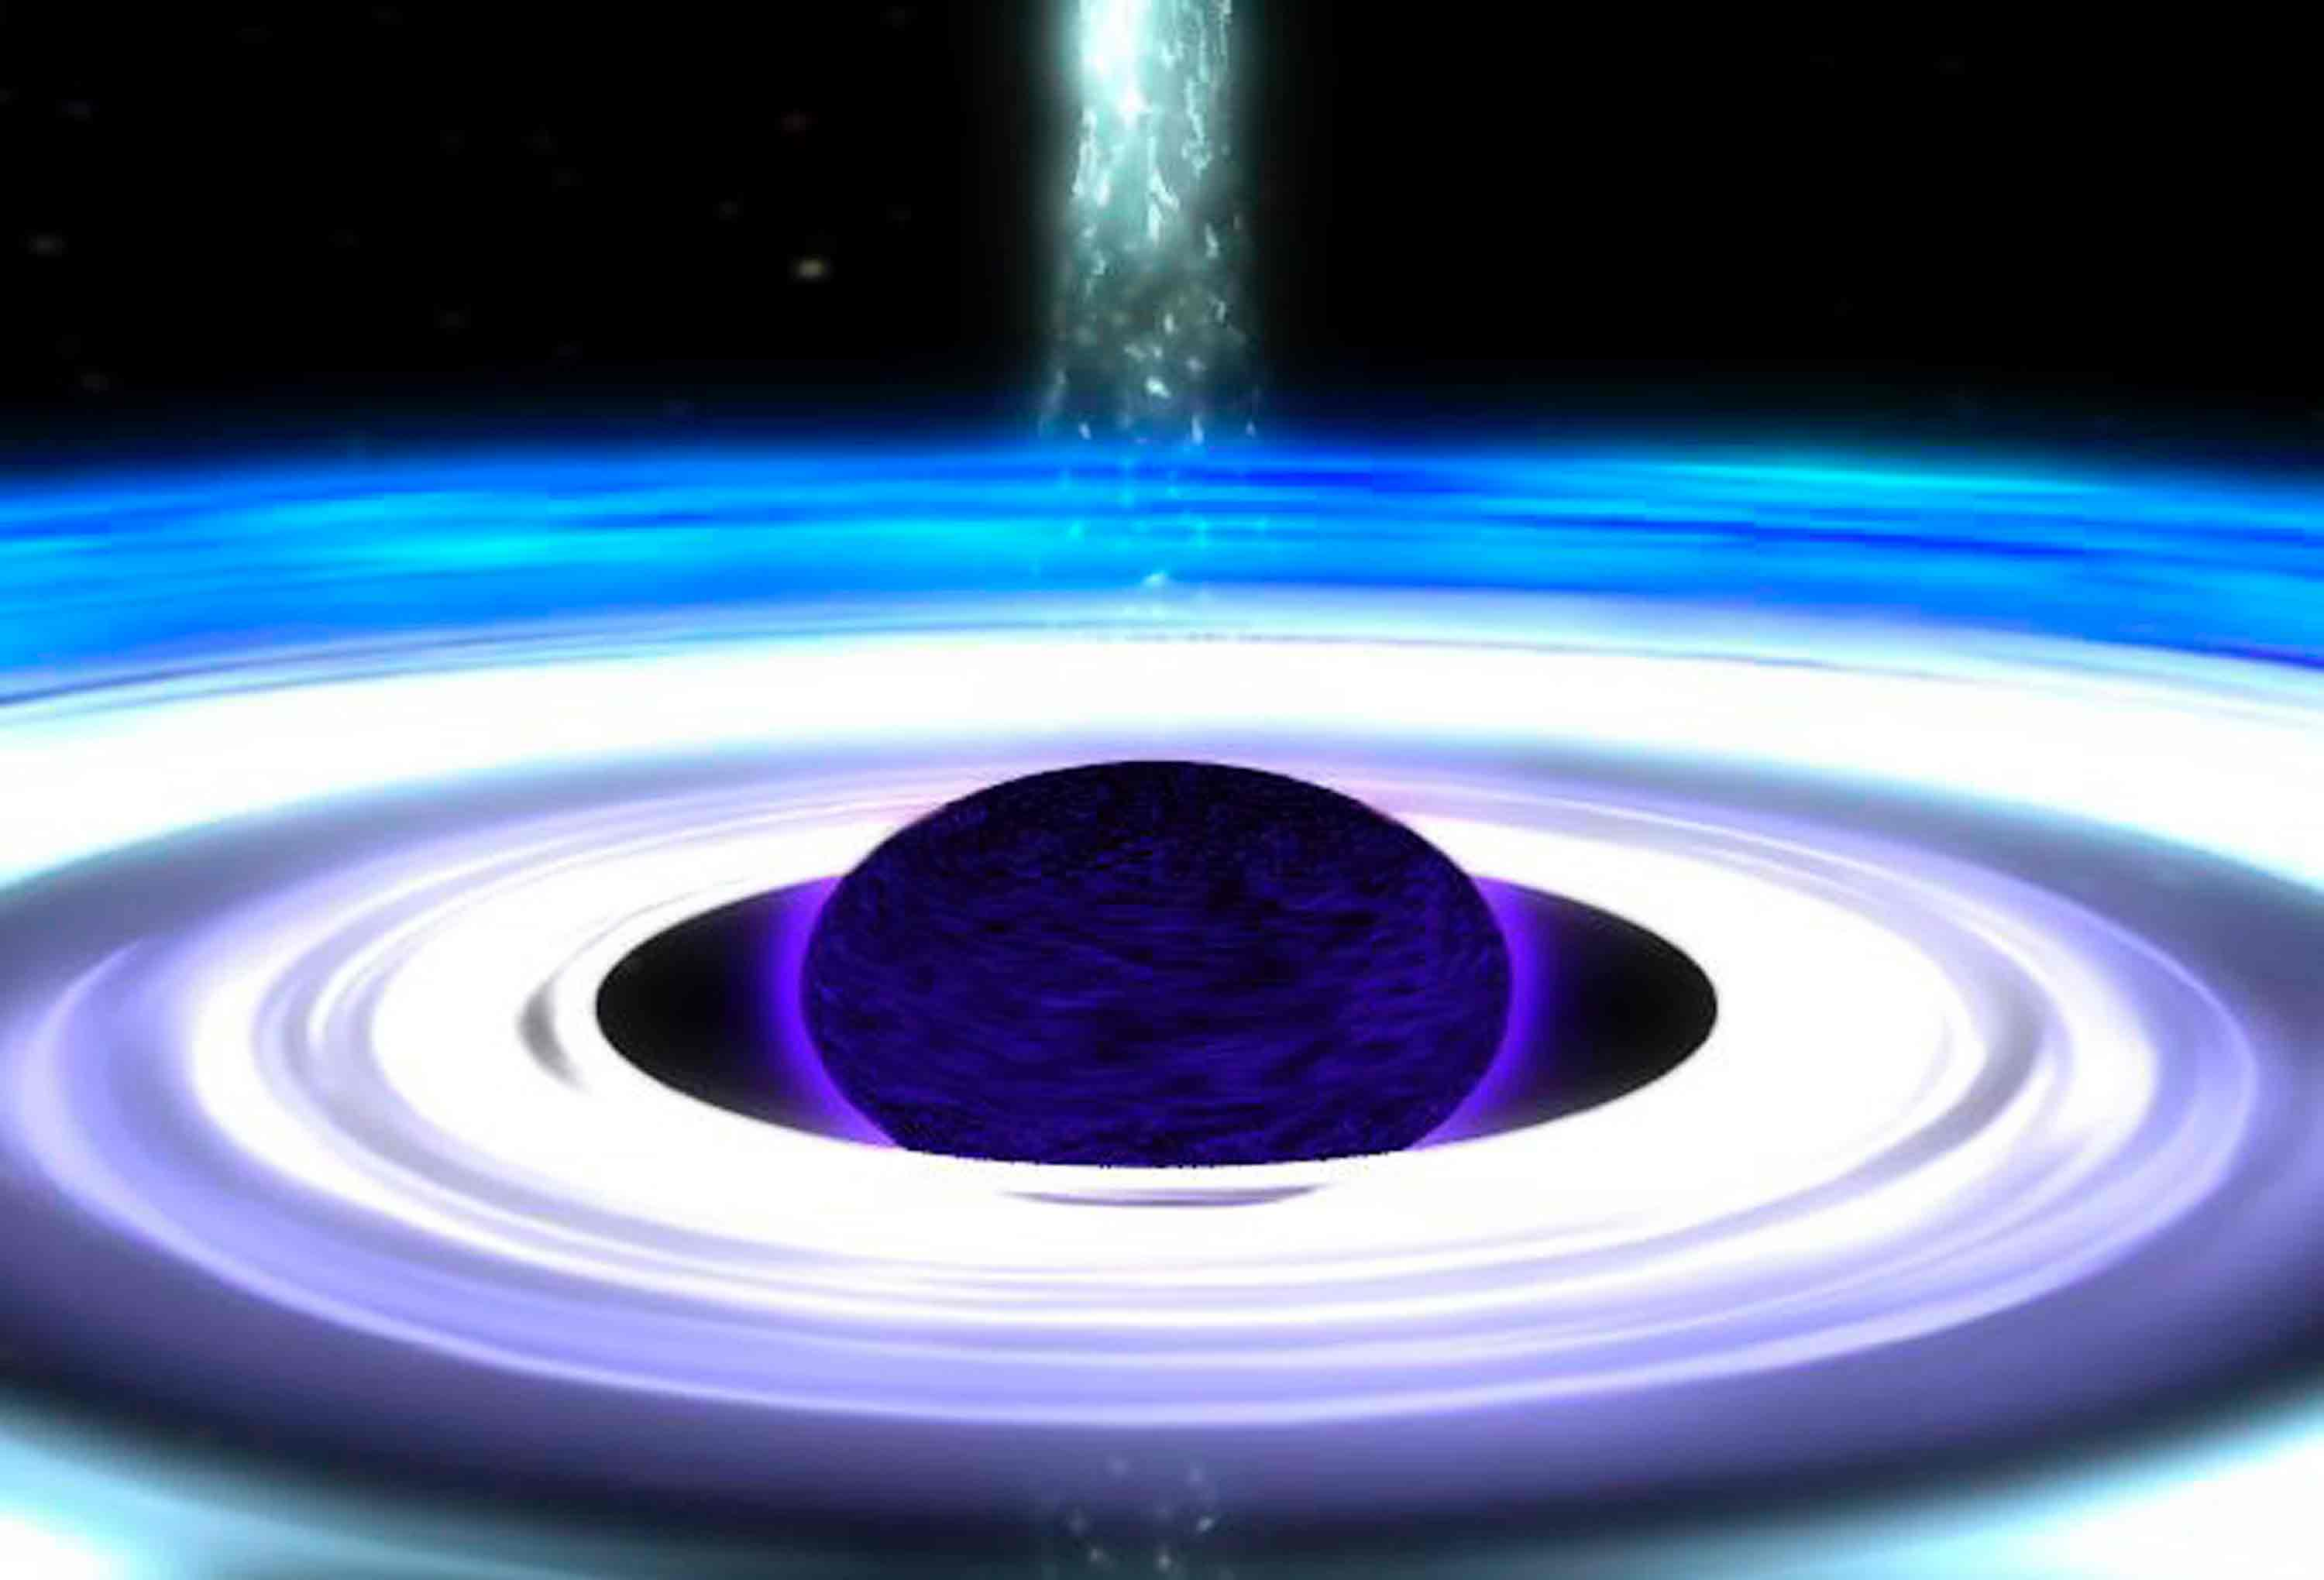
Inflow leads to disks
Can’t fall far without angular momentum creating a disk
Broad Line Region is not a disk:
  covers ~10% of 4π
  Accretion disk covers ~0.1% of 4π .
UMBC

Slide 11
Broad Line Region Inflow
?

Slide 12
the outflow is the inflow

Slide 13
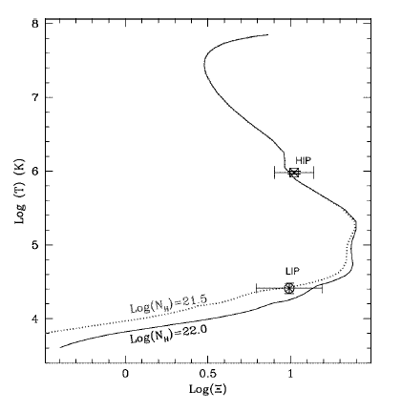
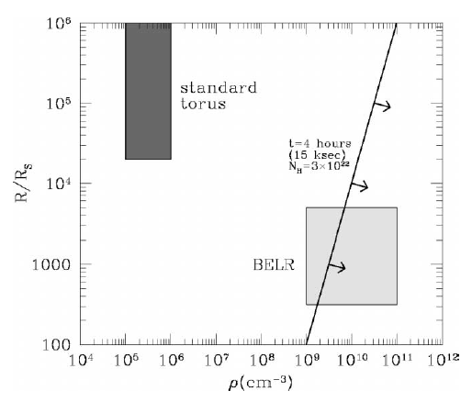
Can outflows solve Broad Line Region Inflows?
Use the Chandra results:
1. X-ray Warm Absorbers,
Low Ionization Phase
2. X-ray Eclipsing Clouds
Krongold et al. 2003
Elvis et al. 2004
X-ray Eclipsers
Log Temperature
Schwartzchild radii
BLR
Density (cm⁻³)
Log Ionization parameter

Slide 14
Can outflows solve Broad Line Region Inflows?
Same physical conditions
Same gas?
But WA is an OUTFLOW
Outflow
 | Broad Emission Line Region | Warm Absorber (LIP)* | X-ray eclipsing clouds
Temperature T(K) | (1-2) X 10(4) | Few X 10(4) | <10(5)
log[Density n_{e} (cm⁻³)] | 8 - 10 | 9 - 11 | 9 - 10
log[Ionization parameter, U] | -1.5 – 10 | -3 - -1 | < 100
* LIP = Low Ionization Phase, Krongold et al. 2003

Slide 15
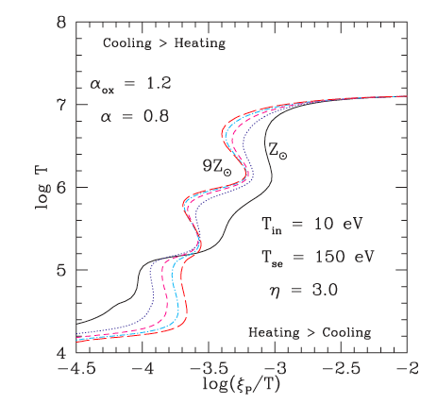
Cool Phases in the Warm Absorber Outflow
Form naturally in gas illuminated by quasar spectrum
Krolik, McKee & Tarter 1981; Chakravorty+08,09
High metallicity helps
-- Chakravorty et al. 2012
Found often (always?):
  NCG 3783 (Krongold et al. 2003; Netzer et al. 2003 ),
  NCG 985 (Krongold et al. 2005b , 2009 ),
  NGC 4051 (Krongold et al. 2007 ),
  Mrk 279 (Fields et al. 2007 ),
  NGC5548 (Andráde-Velasquez et al. 2010)
Thermal equilibrium
9Z
Log(Temperature)
Log(1/Pressure)

Slide 16
Cool Phase is dense
100 x denser than Warm Absorber: n_{e} ~ 10⁸ cm⁻²
Column Density, N_{H} ~ 30 x N_{H}(WA) ≤ 10²⁴ cm⁻²
Size, d ~ 10¹⁶ cm ≈ 300 M₈ R_{g} ≈ 60 R_{X-ray}(M₈)
Hard to accelerate
High Mass/cross-section ratio
  Mushotzky, Solomon & Strittmatter 1972
  Risaliti & Elvis 2010
Stops accelerating while warm phase continues up to escape velocity?

Slide 17
Dense condensed phase, below v_{escape}
Falls back after ~1 dynamical time ~ 1 year
= Quasar Rain

Slide 18
Quasar Rain: How quickly does it form?
Cooling time:
τ_{cool} = 1.8x10¹⁰ Λ₀(T)/Λ(T) T₆^{1/2} n_{e8}⁻¹ sec.
  Λ(T) ~60 Λ₀(T) Tucker 1975, Gehrels & Williams 1993
τ_{cool} = 3 T₆^{1/2} n_{e8}⁻¹ days ≈ 3 days
Collapse time:
τ_{sound} = c_{s}/R = 300 km s⁻¹ / 10^{12.5} cm ≈ 23 days

Slide 19
How quickly does wind reach v_{escape}?
Acceleration time to v_{escape}:
τ_{acc} ~ 4M₈ days (Risaliti & Elvis 2010 model)
τ_{cool} < τ_{acc} < τ_{sound}
Similar ballpark – competitive processes
Some condensations escape, some fall back

Slide 20
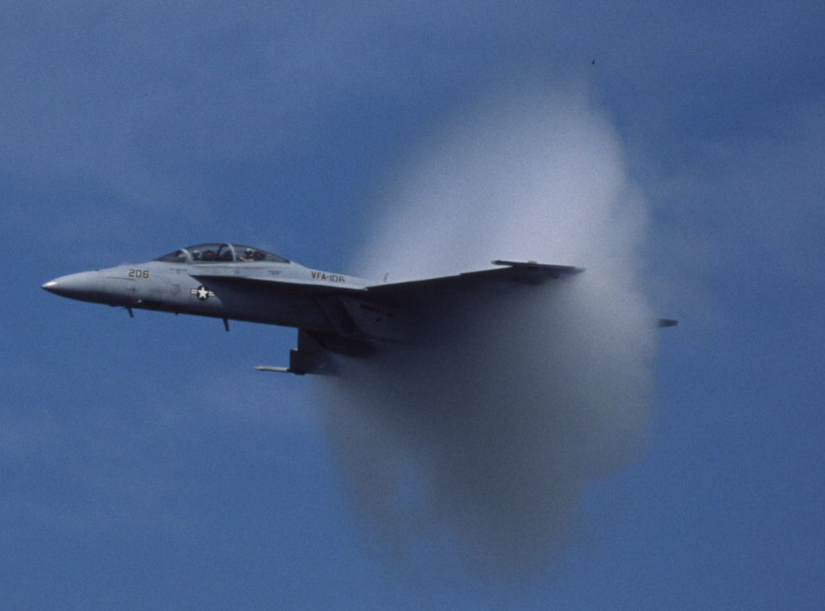
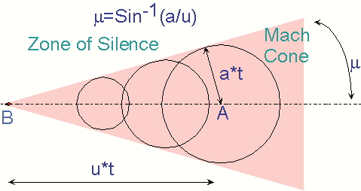
Fate of the infalling rain?
Feels ram pressure of warm outflowing gas
Mach ~20
Strips away gas into a tail
“raindrops” destroyed
On elliptical orbits
→ Non-radial tails

Slide 21
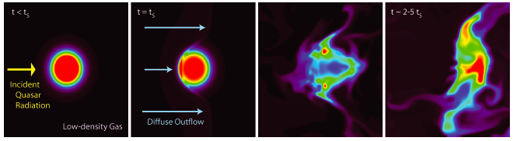
Fate of the infalling rain?
Feels ram pressure of warm outflowing gas
Mach ~20
Strips away gas into a tail
“raindrops” destroyed
Timescale:
  Ram Pressure needs ~10x cloud mass to sweep by (Nulsen, 1982) :
  3 v₁₀₀₀ n_{e}(cloud)/n_{e}(wind) years ~ 300 years!
  But: pancakes on few sound crossing times (e.g. Hopkins & Elvis 2010) ~ xxx
On elliptical orbits
→ Non-radial tails

Slide 22
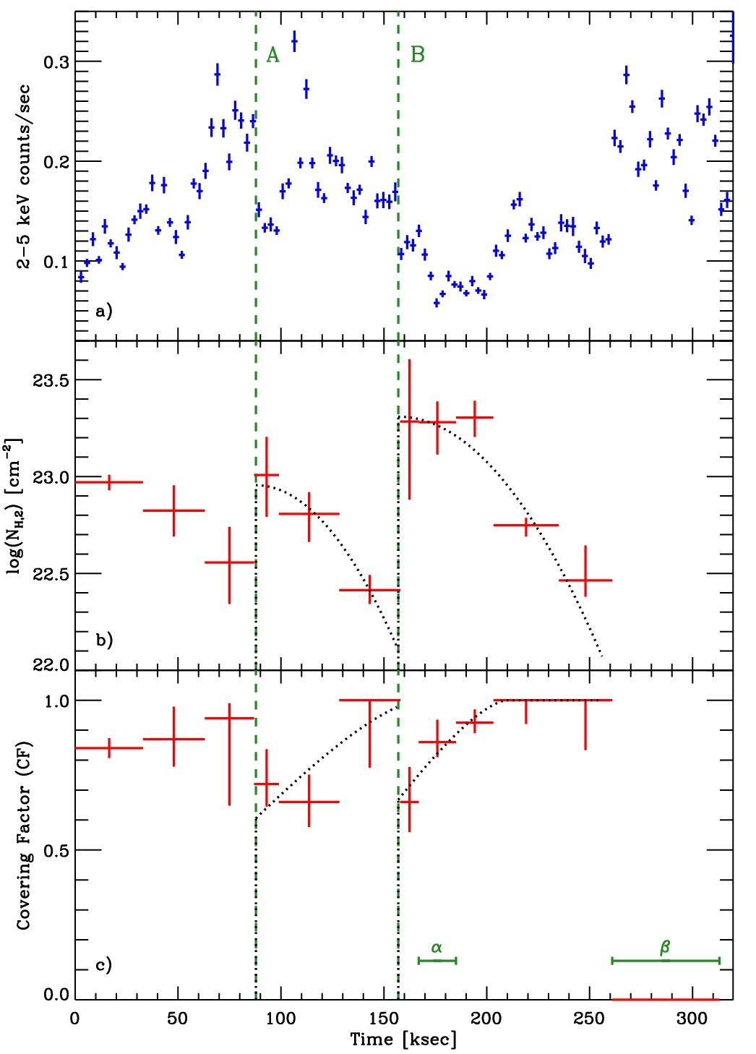
We see these ablating “raindrops”
NGC1365 X-ray eclipsing clouds
N_{H} rises fast at low covering factor, f_{c}
Then N_{H} drops as f_{c} increases
“Cometary” tail – non-radial
Lifetime ~60 days
Cannot reach high infall velocity
1 day
N_{H}
Covering factor
Maiolino et al. 2012

Slide 23
Quasar Rain
Explains:
  Infalling Broad Line Region Gas
  at moderate infall velocities
Unifies:
  Broad Line Region clouds
  Low Ionization X-ray Warm Absorber
  X-ray eclipsing clouds
  Cometary tails on X-ray eclipsing clouds
Forms naturally
Appealing: Disk winds still solve everything

Slide 24

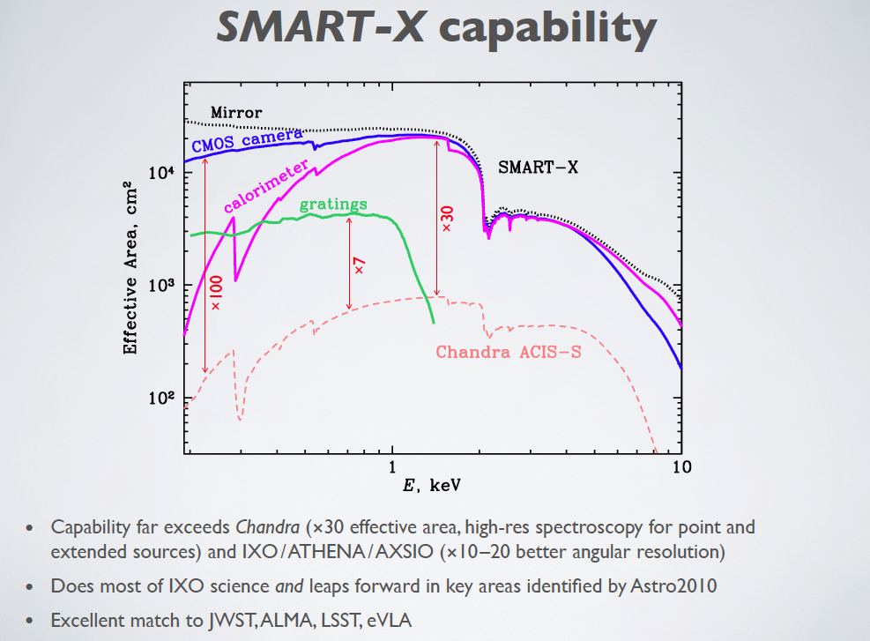
The Way Forward
Calorimeter
A(0.5)~10,000cm²
700 X Chandra
NGC3783 in 1ksec
dE ~< 5 eV
R>~100 @ 0.5keV
Similar to Athena
Vikhlinin et al. 2013
NGC3783 spectrum in 3 ksec
Variability -> density, radius
Large Surveys: M•, L/L_{Edd}, …
High z
>250 X Chandra
R ~ 5000
>10 X Chandra
60 km s⁻¹
Resolves thermal line widths
Turbulence, T_{thermal} vs T_{ion}
Curve of growth n(ion)
Diagnostic line ratios
Resolves UV-like components
×100
Chandra gratings
10
Chandra HRC-LETGS
0.2
0.5
Nearer term: “ARCUS” – see Randall Smith poster 8.11

Slide 25
Quasar Rain does not reach “ground”
Rain that does not reach the ground is “Virga”

Slide 26
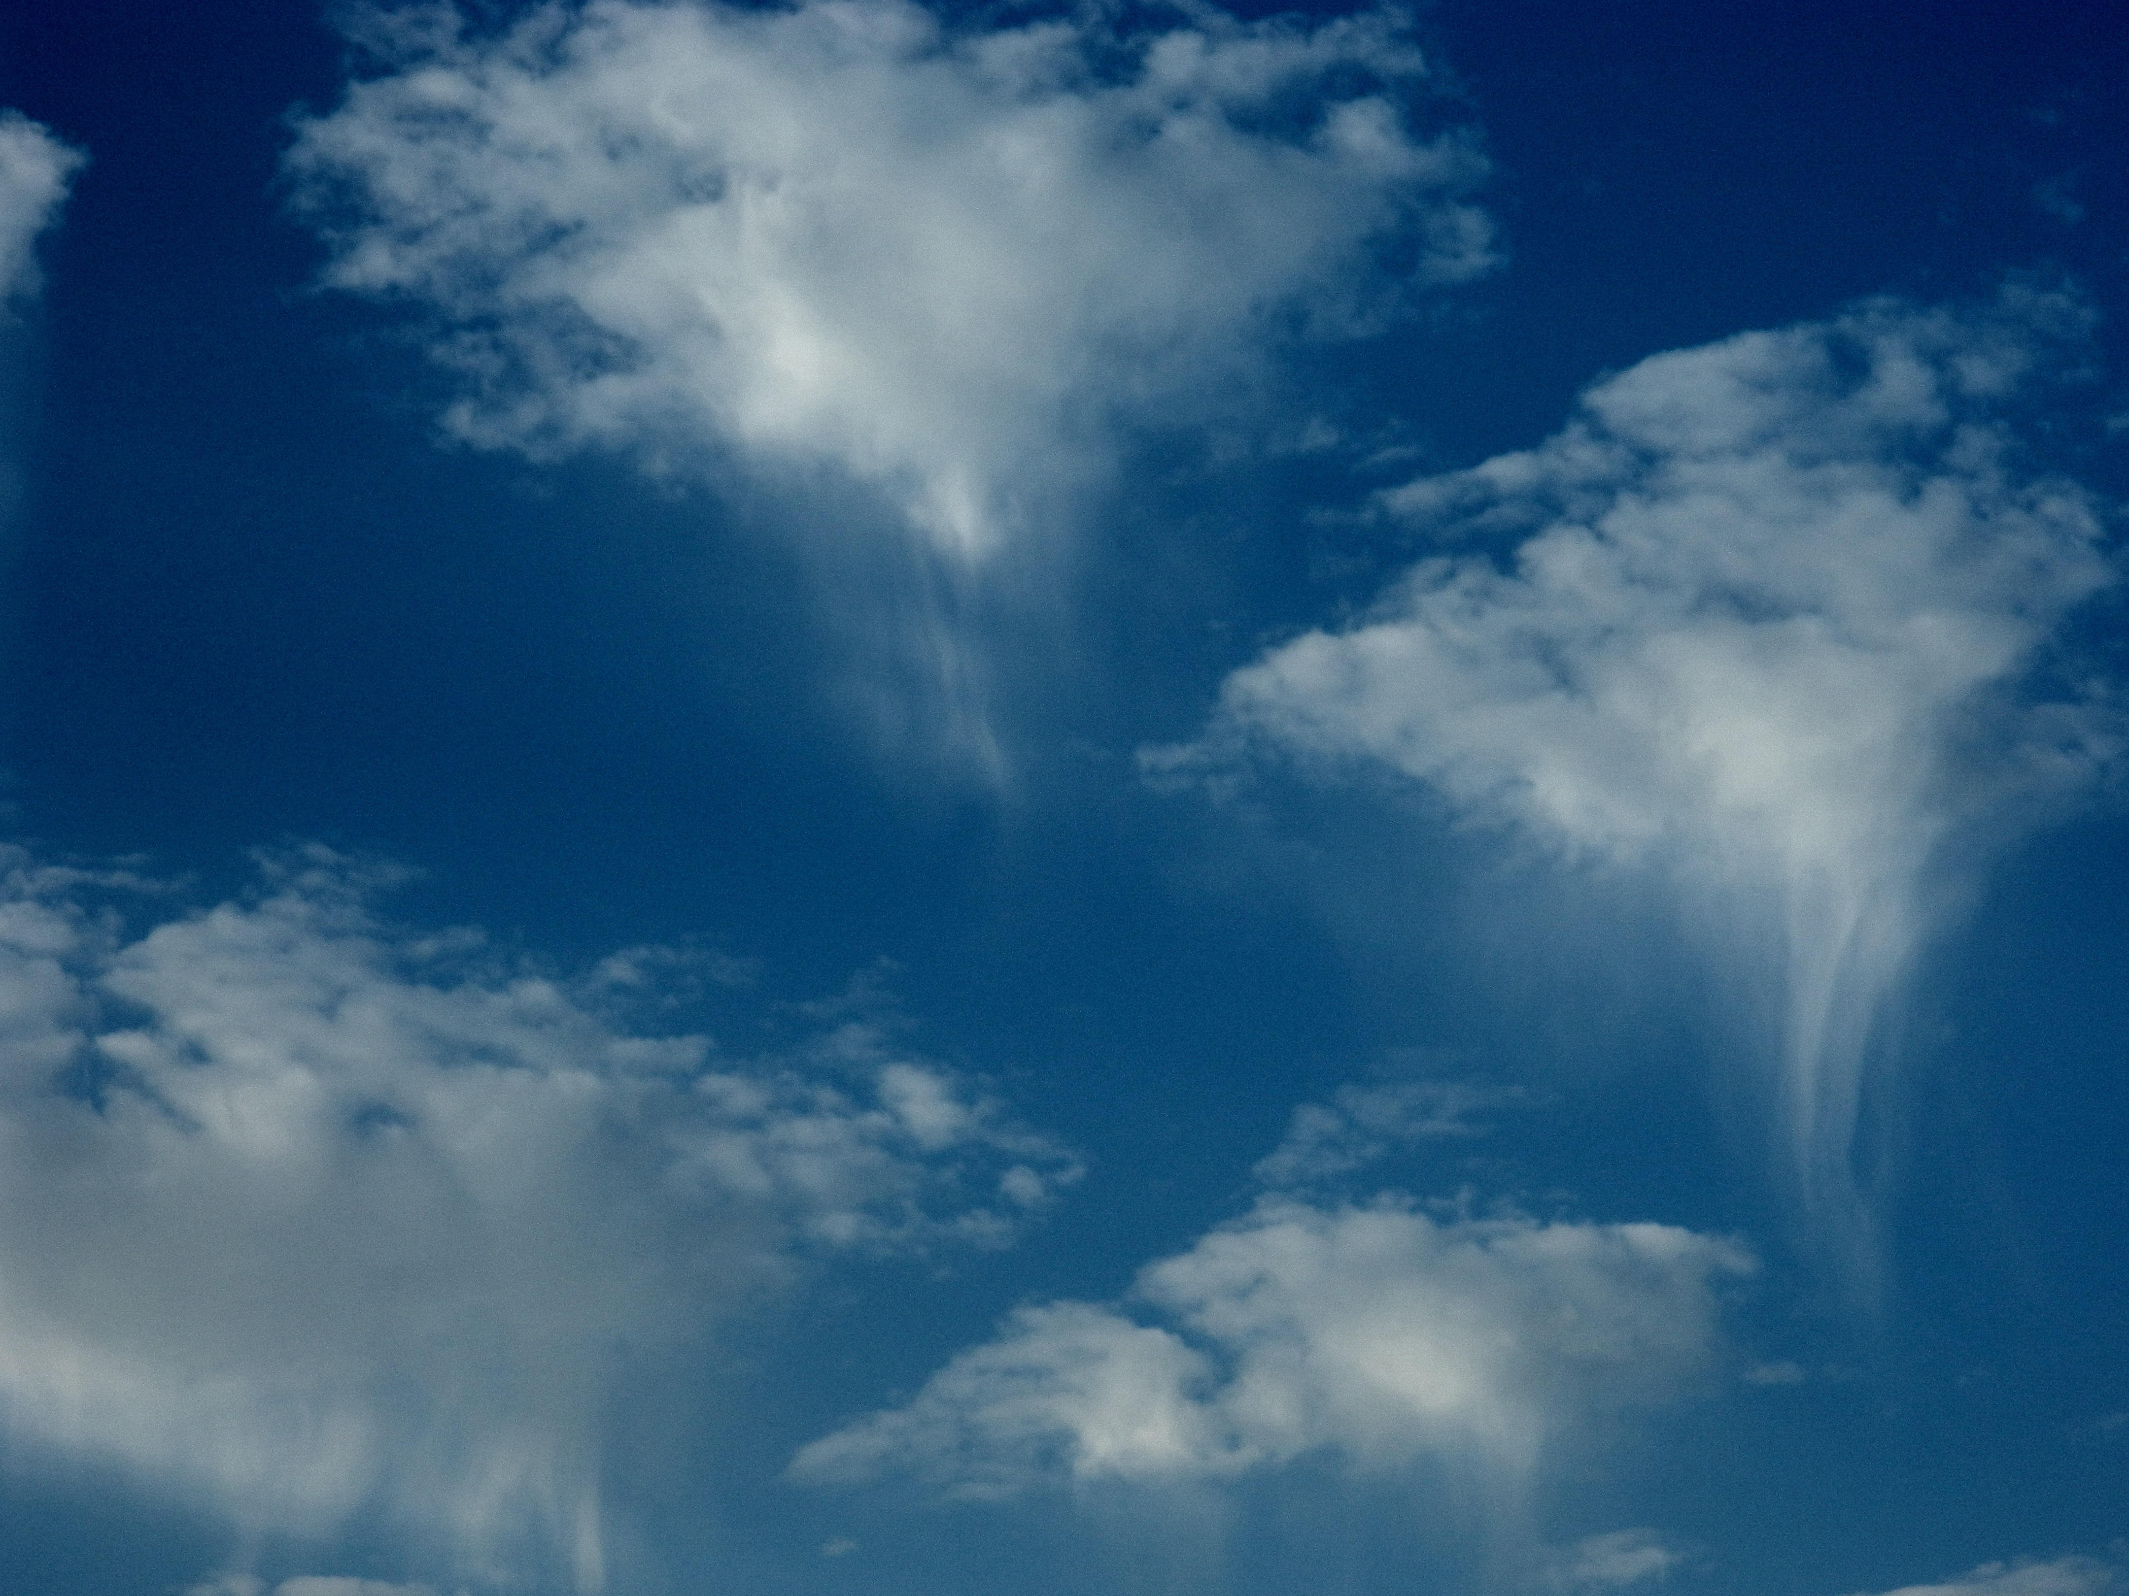
Quasar Virga
Thank you
KWWL.com

Slide 27
Quasar Rain/Virga
Explains:
  Infalling Broad Line Region Gas
  at moderate infall velocities
Unifies Chandra and reverberation results:
  Broad Line Region clouds
  Low Ionization X-ray Warm Absorber
  X-ray eclipsing clouds
  Cometary tails on X-ray eclipsing clouds
Forms naturally
Appealing: Disk winds still solve everything
KWWL.com

Slide 28
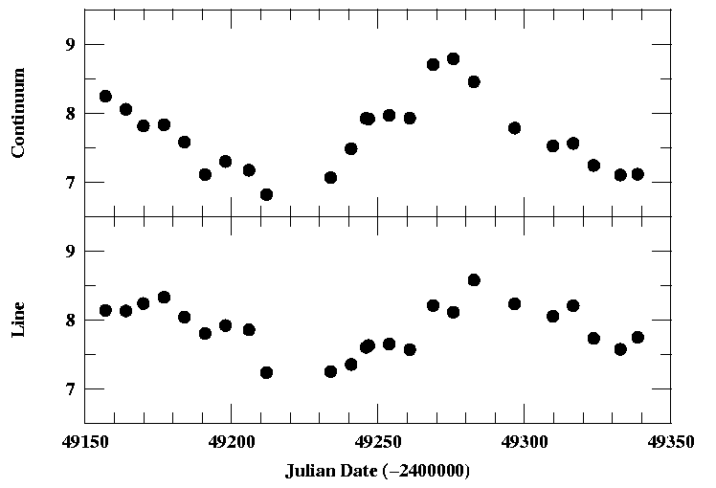
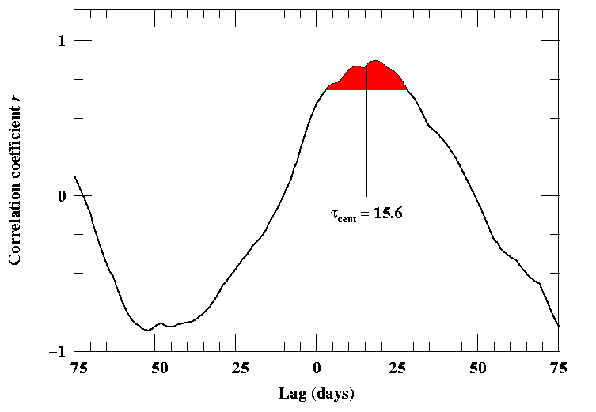
Distribution of gas clouds
Response is a convolution
“Response Function”
Central
Continuum
Source
Zero
Delay
Cross-
correlate
1 month
Emission Line Response
Mean
Delay
“lag”
time
Brad Peterson, OSU

Slide 29
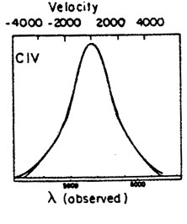
Do Broad Line Region Inflows spoil it all?
Velocity Resolved Reverberation Mapping (VRRM)
  Bentz et al. 2010
Isodelay Surfaces: Quasar flash followed by emission line flash

Slide 30
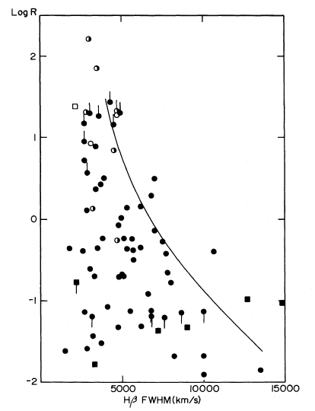
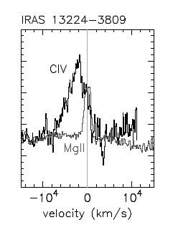
BLR was Supposed to Rotate, Outflow
Rotation
  Wills & Browne 1986
  Young et al. 1999
  Peterson & Wandel 1999
Outflow
  Gaskell 1982
  Leighly & Moore 2004
face-on
blueshift
Radio Core/Lobe ratio
edge-on
Hβ FWHM

