Slide 1
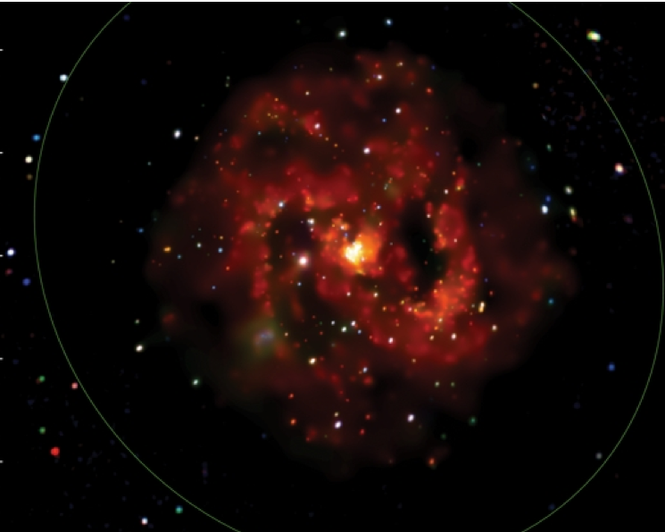
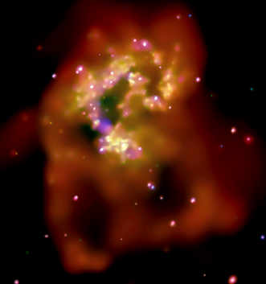
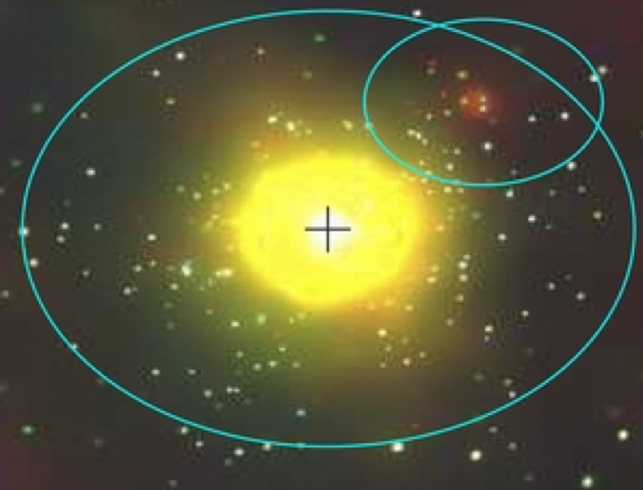
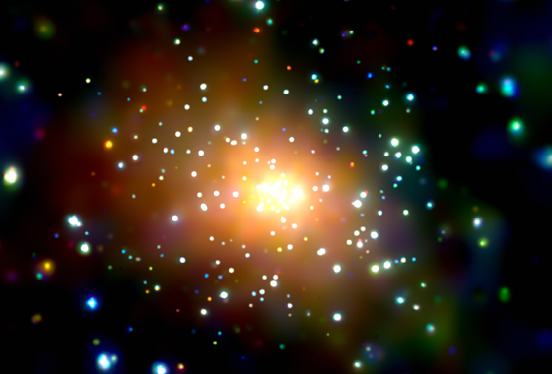
Galaxies and X-ray Populations
G. Fabbiano
Harvard-Smithsonian Center for Astrophysics

Slide 2
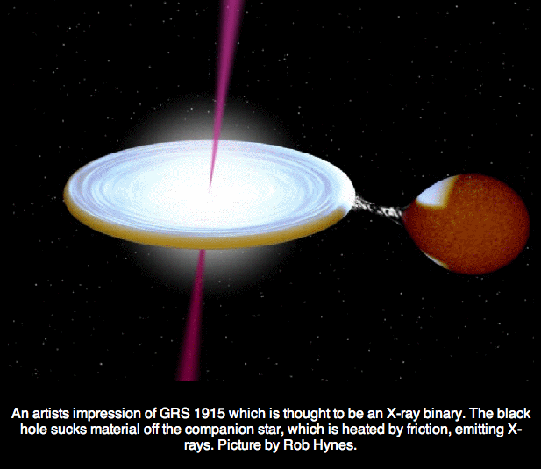
What are these X-ray sources?
See Fabbiano 1989, 2006 ARAA
L_{X} >10³⁷ erg s⁻¹
  Accreting NS and BH in
  binary system (XRB)
  LMXB
  HMXB
L_{X} >10³⁹ erg s⁻¹
  ULX
L_{X} <10³⁷ erg s⁻¹
  XRB + WD binaries
  SNR

Slide 3
Two Topics
The XRB XLF and ULXs
  ‘special’ XRB or IMBH?
LMXB populations in elliptical galaxies

Slide 4
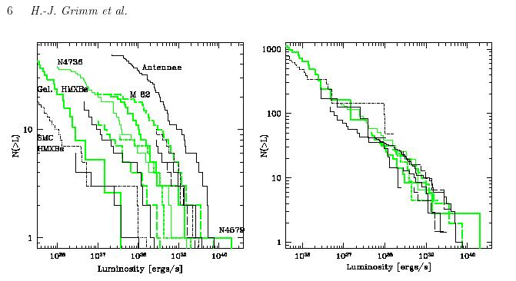
Chandra HMXB XLF
Star-Forming Galaxies
Normalization
  ~ SFR
Slope
  Flat power-law
ULXs
  high luminosity HMXB XLF
Grimm, Gilfanov & Sunyaev 2003

Slide 5
Chandra HMXB XLF
Star-Forming Galaxies
Normalization
  ~ SFR
Slope
  Flat power-law
ULXs
  high luminosity HMXB XLF
ULX
Grimm, Gilfanov & Sunyaev 2003

Slide 6
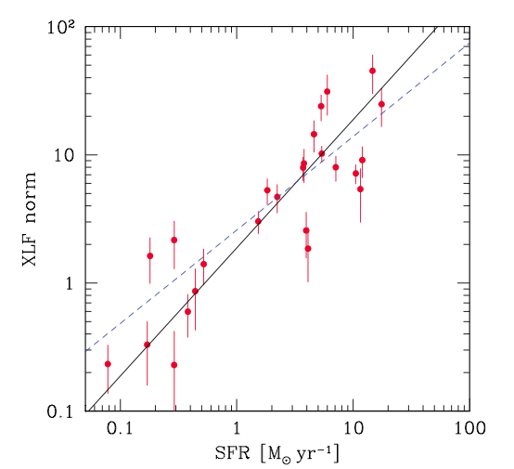
ULXs and HMXB populations
Higher XLF normalization in higher SFR galaxies
Mineo et al 2012
From complete nearby sample of 125 galaxies
  1 ULX per 0.5 M yr⁻¹ SFR
  Swartz et al 2011
➔ more ULXs with increased star formation
Mineo et al 2012

Slide 7
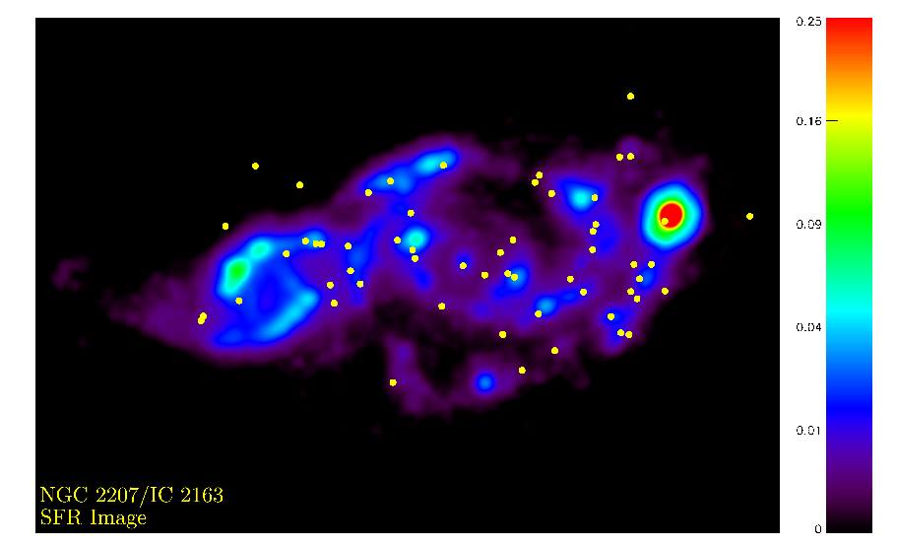
The Local XLF – SFR relation
NGC 2207/ IC 2163
Mineo et al 2014
  28 ULXs
Number density and luminosity density of ULXs increases with SFR

Slide 8
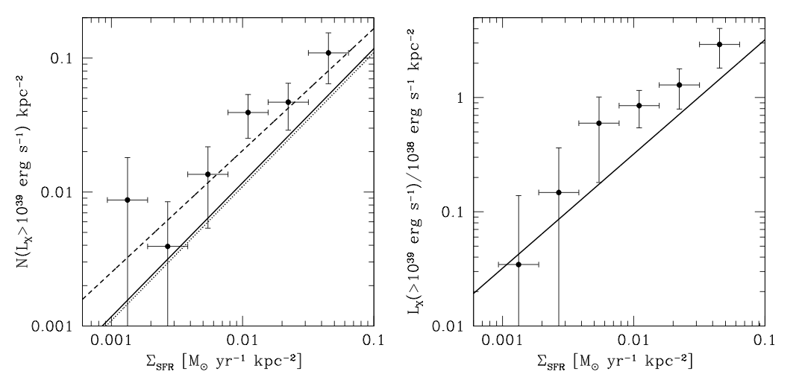
The Local XLF – SFR relation
NGC 2207/ IC 2163
Mineo et al 2014
  28 ULXs
Number density and luminosity density of ULXs increases with SFR

Slide 9
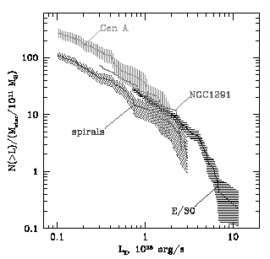
Chandra LMXB XLF old stellar populations
Kim & Fabbiano 2004; Gilfanov 2004
Steeper at high luminosity than HMXB XLF
  lack of high L_{X} sources in older stellar populations
To first order normalization
depends on integrated stellar mass
    L_{X(LMXB)}~L_{K} or M
Gilfanov 2004

Slide 10
Chandra LMXB XLF old stellar populations
Kim & Fabbiano 2004; Gilfanov 2004
Steeper at high luminosity than HMXB XLF
  lack of high L_{X} sources in older stellar populations
To first order normalization
depends on integrated stellar mass
  L_{X(LMXB)}~L_{K} or M
Gilfanov 2004

Slide 11
ULXs in LMXB populations
Galaxy stellar Mass
  1 ULX per 3.2×10¹⁰ M⊙
  Swartz et al 2011
Rejuvenated stellar populations
  Flatter XLF
  Kim & Fabbiano 2010
107 ULXs in complete sample of 127 galaxies
D < 14.5 Mpc

Slide 12
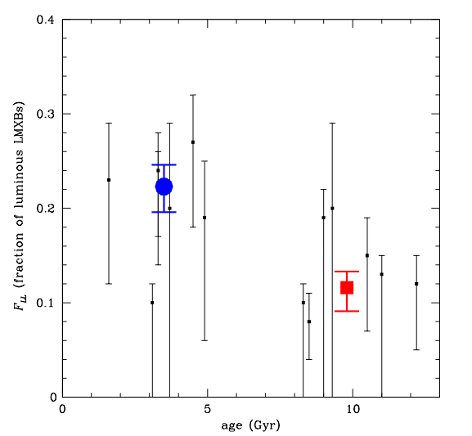
ULXs in Elliptical galaxies
Galaxy stellar Mass
  1 ULX per 3.2×10¹⁰ M⊙
  Swartz et al 2011
Rejuvenated stellar populations
  Flatter XLF
Young E
Old E
  Kim & Fabbiano 2010

Slide 13
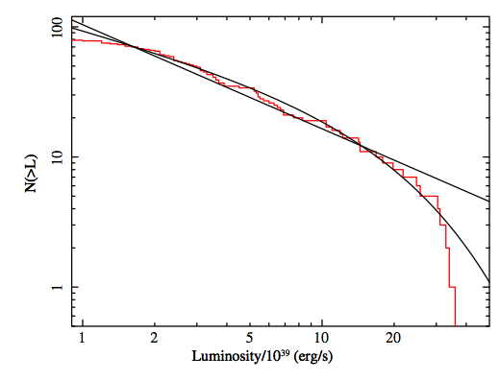
XLF of ULX in all types of galaxies
XLF consistent with XRB population
Cut-off at 2-4×10⁴⁰ erg s⁻¹
Swartz et al 2011
Complete nearby sample

Slide 14
XLF of ULX in all types of galaxies
XLF consistent with XRB population
Cut-off at 2-4×10⁴⁰ erg s⁻¹
L_{X}>2×10⁴¹ erg s⁻¹ require new population
  IMBH
Swartz et al 2011
Complete nearby sample

Slide 15
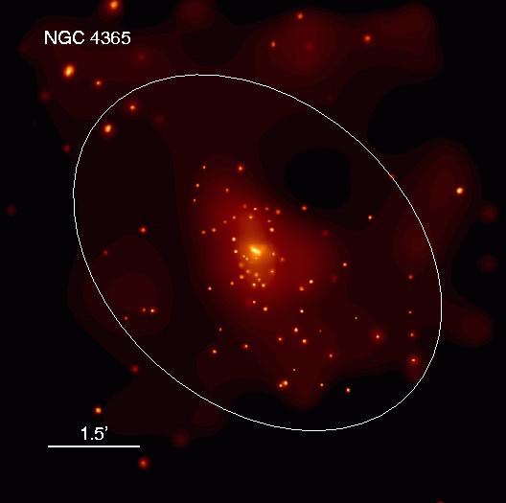
LMXB populations and their origin
Found in GCs and in the stellar field
  GC formation ~100 times more efficient
  Clark 1975
  Evolution of native field binary also possible see Verbunt & Lewin 2006
    L_{X} ~ L_{K}
With the large Chandra LMXB samples and Hubble GC identification
  Parameters governing GC-LMXB formation
  Are field-LMXBs from GCs?
  LMXB properties and galaxy evolution

Slide 16
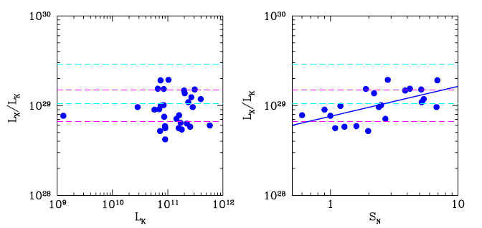
Chandra: LMXB populations are linked to GCs
1. Global properties / correlations
Boroson, Kim & Fabbiano 2011
The XLF normalization depends both on galaxy stellar mass and GC Specific frequency - Kim & Fabbiano 2004
  L_{X} (Total, LMXBs) / L_{K} ~10²⁹ × S_{N}^{0.334} erg s⁻¹ L_{K}⁻¹

Slide 17
Joint Chandra - Hubble studies of LMXB and GC populations
Which are the parameters governing GC-LMXB formation?
Are field-LMXB also formed in GCs?
What can we learn from the spatial distributions of GCs and LMXBs?
  LMXB properties and galaxy evolution

Slide 18
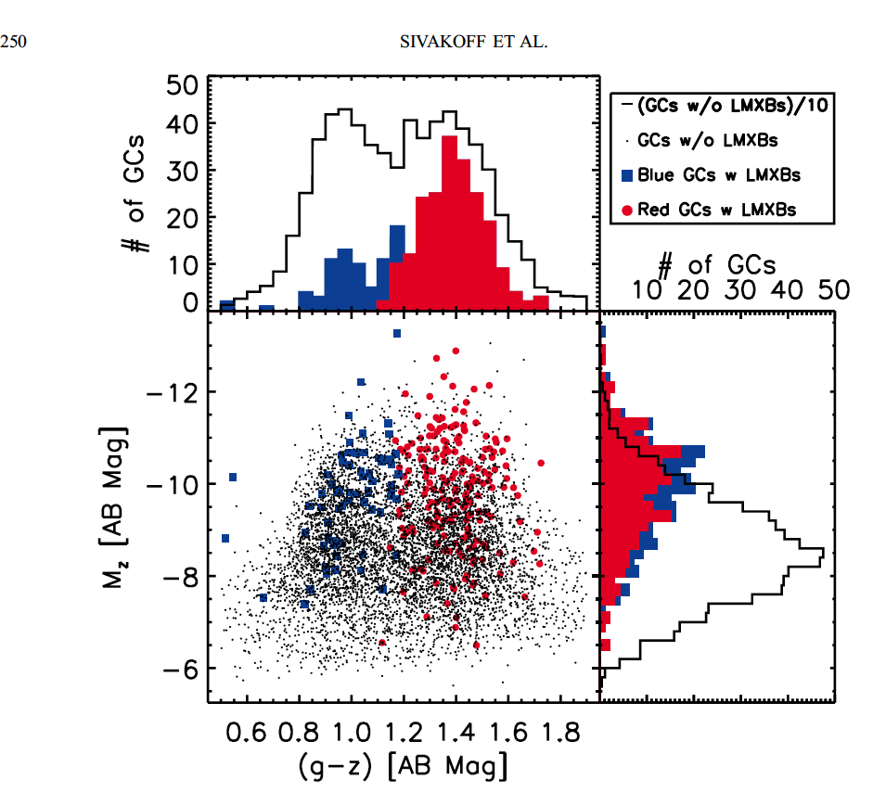
GC-LMXBs and GC parameters e.g., Angelini et al. 2001; Kundu et al. 2002, 2007; Sarazin et al. 2003; Jordan et al. 2004; Kim et al. 2006; Sivakoff et al. 2007; Paolillo 2011; Kim et al 2013
Not all GCs are equally good at making LMXBs
Mass
  LMXBs are preferentially found in more massive GCs
Color / metallicity
  LMXBs are preferentially found in red (higher metallicity) GCs
Compactness (r_{c} or r_{h})
  Encounter probability higher for small r_{h}: Γ~M^{1.5}r_{h}^{-2.5}
Sivakoff et al 2007
Virgo Survey, 11 galaxies

Slide 19
GC-LMXBs and GC parameters e.g., Angelini et al. 2001; Kundu et al. 2002, 2007; Sarazin et al. 2003; Jordan et al. 2004; Kim et al. 2006; Sivakoff et al. 2007; Paolillo 2011; Kim et al 2013
Not all GCs are equally good at making LMXBs
Mass
  LMXBs are preferentially found in more massive GCs
Color / metallicity
  LMXBs are preferentially found in red (higher metallicity) GCs
Compactness (r_{c} or r_{h})
  Encounter probability higher for small r_{h}: Γ~M^{1.5}r_{h}^{-2.5}
Sivakoff et al 2007

Slide 20
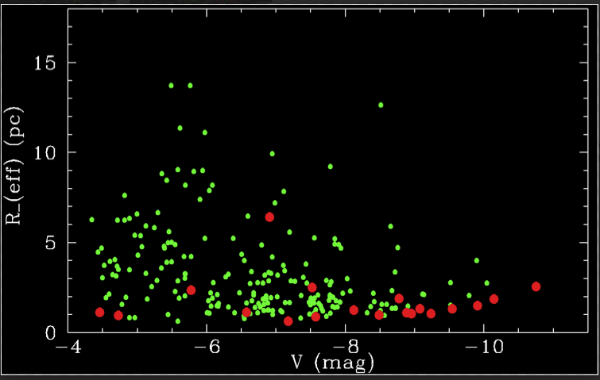
GC-LMXBs and GC parameters e.g., Angelini et al. 2001; Kundu et al. 2002, 2007; Sarazin et al. 2003; Jordan et al. 2004; Kim et al. 2006; Sivakoff et al. 2007; Paolillo 2011; Kim et al 2013
Not all GCs are equally good at making LMXBs
Mass
  LMXBs are preferentially found in more massive GCs
Color / metallicity
  LMXBs are preferentially found in red (higher metallicity) GCs
Compactness (r_{c} or r_{h})
  Encounter probability higher for small r_{h}: Γ~M^{1.5}r_{h}^{-2.5}
M81 GCs and GC-LMXBs
Courtesy Andreas Zezas

Slide 21
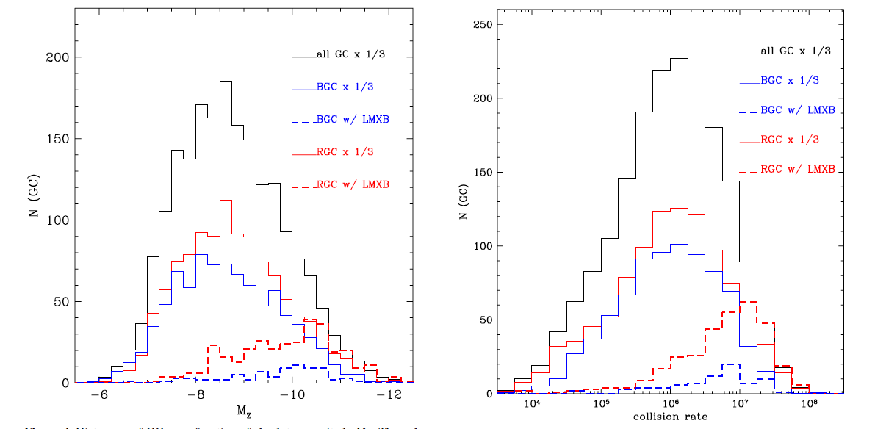
Metallicity / Color is driving effect
3 times more red than blue GC host LMXBs
+Kim et al 2013
GC - LMXB
GC - LMXB
MASS
Compactness/ Collision rate

Slide 22
Joint Chandra - Hubble studies of LMXB and GC populations
Which are the parameters governing GC-LMXB formation?
Are field-LMXB also formed in GCs?
What can we learn from the spatial distributions of GCs and LMXBs?
  LMXB properties and galaxy evolution

Slide 23
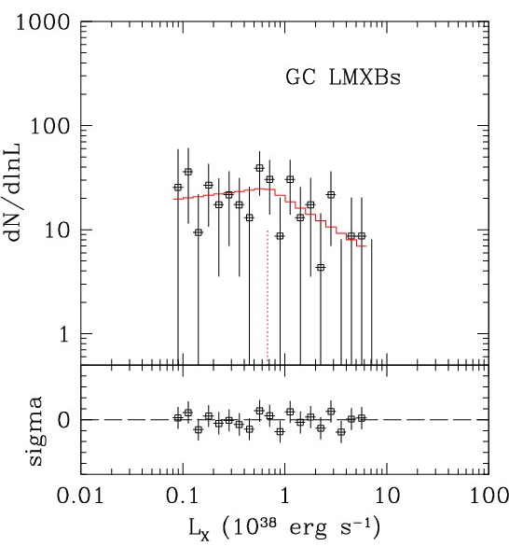
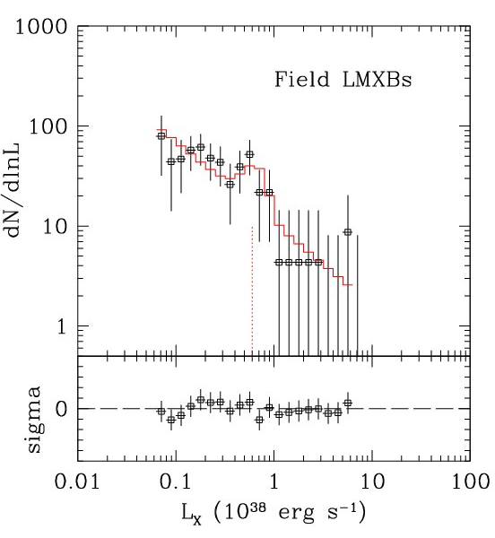
….Shape of XLF suggests different GC and Field LMXB populations
Kim et al 2009
The GC-LMXB XLF flattens at L_{X} < 5×10³⁷ erg s⁻¹
  lack of low-luminosity GC-LMXB
  Voss & Gilfanov 2007; Voss 2009; Kim et al 2009; D’Ago et al 2014
It may also be flatter at high L_{X}
  More high L_{X} LMXBs in GCs than in the field
  Paolillo et al 2011; Luo et al 2012 – but better statistics are needed

Slide 24
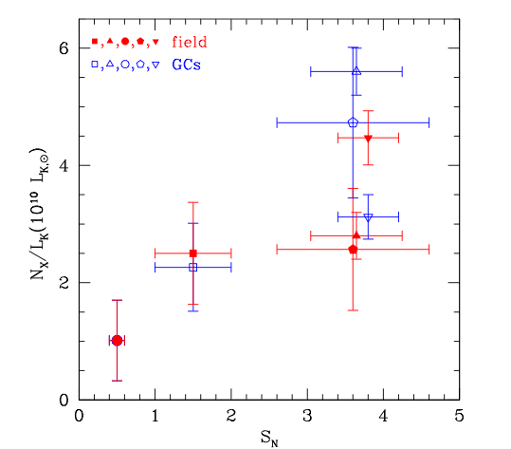
…but the field-LMXB population could contain some GC-born LMXBs
Irwin 2005, Kim et al 2009, Paolillo et al 2011; Mineo et al 2014
Specific frequencies of
GC-LMXBs and GCs are correlated
There may be some correlation for field-LMXBs
  Native + GC?
Mineo et al 2014

Slide 25
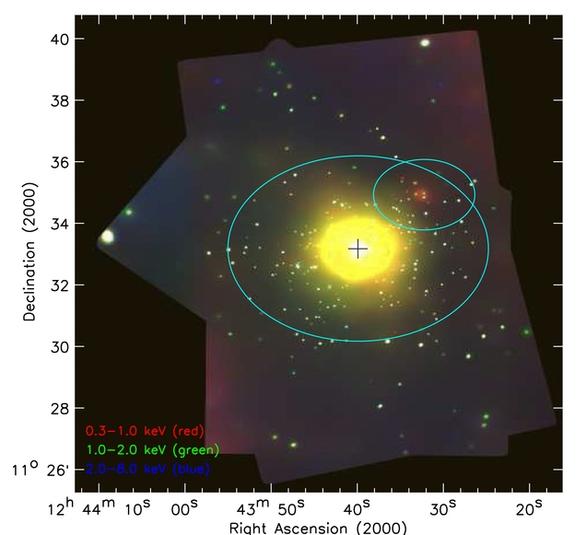
NGC 4649 – full coverage
PI-Fabbiano
Chandra - Luo et al (2012), Hubble - Strader et al (2011)
425 LMXBs - 1516 GCs - 157 GC-LMXBs

Slide 26
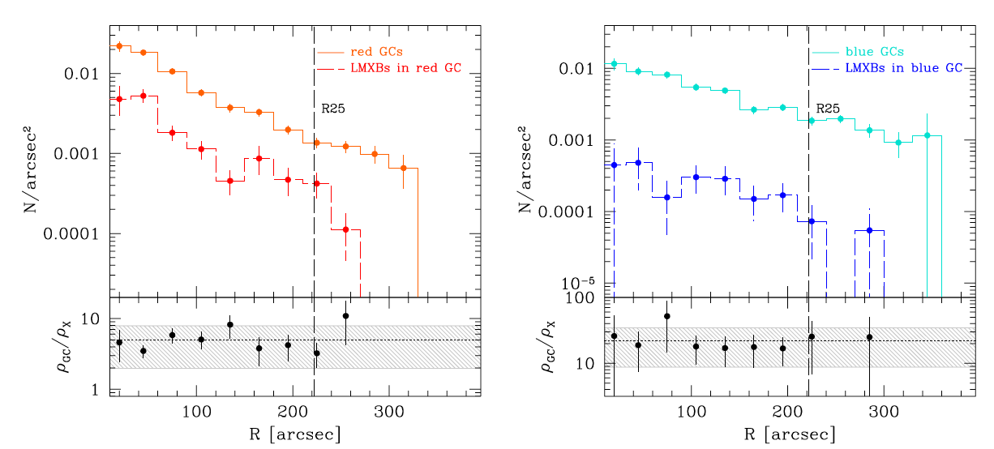
NGC 4649 Radial Profiles
- with full Chandra and Hubble coverage:
Mineo et al 2014
LMXB radial distributions follow those of parent GC population

Slide 27
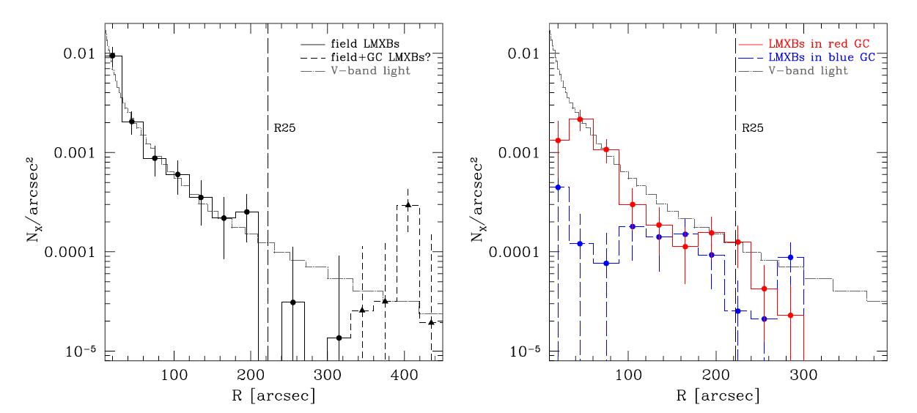
NGC 4649 Radial Profiles
- with full Chandra and Hubble coverage:
Mineo et al 2014
Field-LMXB follow stellar light –possible discrepancies at large radii (see also Zhang et al 2012) – these are luminous LMXBs
GC-LMXB distribution similar to stellar light except at center – lack of GCs

Slide 28
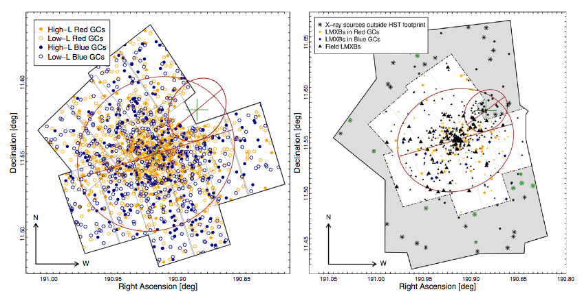
What can we learn from 2D distributions?
NGC4649 - D’Abrusco et al 2014a
Positions of 1516 GCs and 425 LMXBs

Slide 29
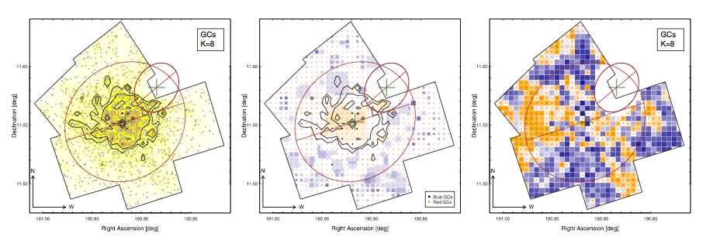
What can we learn from 2D distributions?
Method - D’Abrusco et al 2013
K-th Nearest Neighbor density map D_{K}=K/πR_{K}² - Dressler et al 1980
Derive residual map relative to homogeneous distribution (radial dependence only)
Use Monte Carlo to establish Gaussianity and significance of residual features
  Overall residuals
  Contiguous spatial features

Slide 30
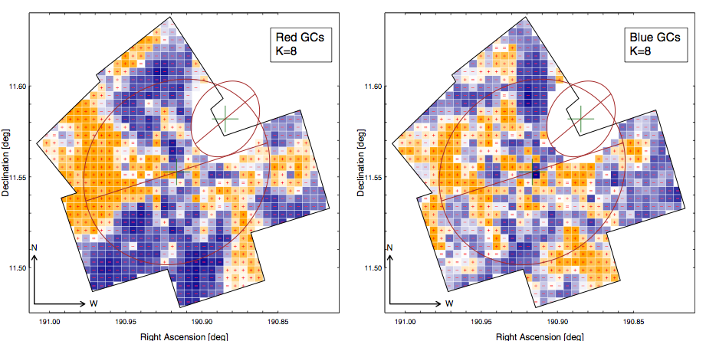
What can we learn from 2D distributions?
NGC 4649
Red GC
Blue GC
Highly significant 2D features detected
in both red and blue GC distributions

Slide 31
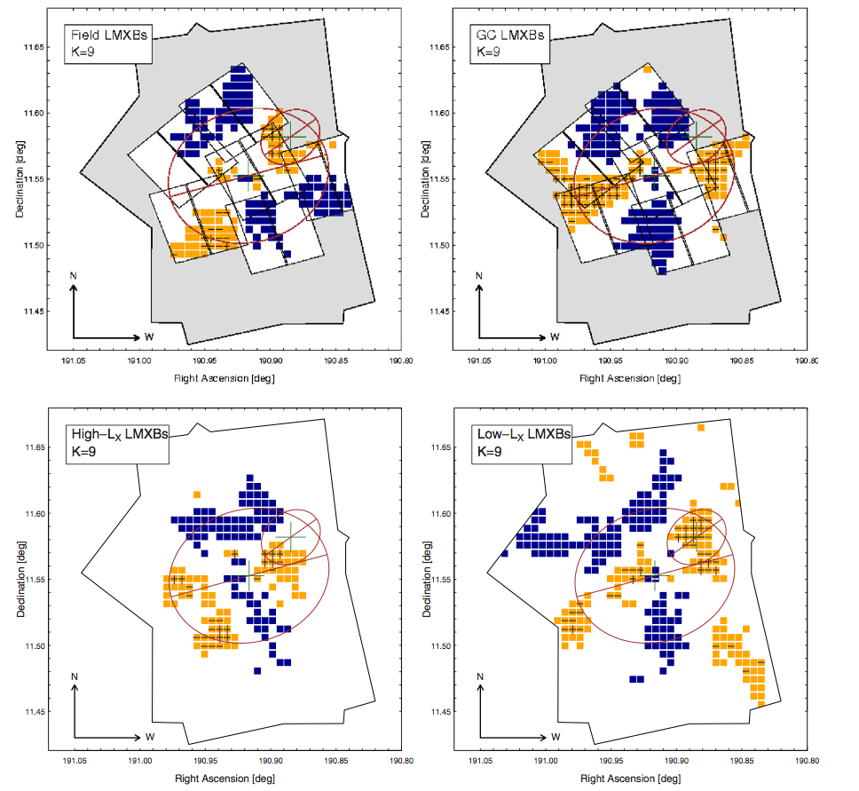
2D features in the LMXB spatial distributions
NGC4649 - D’Abrusco et al 2014a
Seen in GC-LMXBs following that of red GCs
Also seen in luminous field-LMXBs
GC ejection + differential dynamic friction?
Red GC
GC LMXB

Slide 32
2D features in the LMXB spatial distributions
NGC4649 - D’Abrusco et al 2014a
2D feature in field-LMXBs
GC ejection + differential dynamic friction?
FIELD LMXB
GC LMXB

Slide 33
2D features in the LMXB spatial distributions
NGC4649 - D’Abrusco et al 2014a
These are luminous field-LMXBs
GC formation
+
GC ejection
+
differential dynamic friction?
FIELD LMXB
GC LMXB
LMXB – L_{X} > 1×10³⁸
LMXB – L_{X} < 1×10³⁸

Slide 34
Conclusions
Chandra allows population studies of X-ray sources in galaxies
ULXs consistent with the high L_{X} part of the XRB XLF
  Most ULXs due to massive highly accreting binaries
  ULX with LX~10⁴² erg s⁻¹ candidate IMBH
LMXBs detected in both in GCs and in the stellar field
Dynamical GC formation enhanced in high metallicity (red) GCs, consistent with a red giant role in the formation of these luminous LMXBs. GC mass and compactness are also factors
Both GC formation and field binary evolution are important for producing LMXB populations
  Correlations
  Shape of XLF
  Radial profiles
2D features in the GC and LMXB spatial distribution point to these sources as fossil remnants of the merging evolution of galaxies
  More of this type of work is needed
  We need Chandra and HST full coverage

Slide 35
Conclusions
Chandra allows population studies of X-ray sources in galaxies
ULXs consistent with the high L_{X} part of the XRB XLF
  Most ULXs due to massive highly accreting binaries
  ULX with L_{X}~10⁴² erg s⁻¹ candidate IMBH
LMXBs detected in both in GCs and in the stellar field
Dynamical GC formation enhanced in high metallicity (red) GCs, consistent with a red giant role in the formation of these luminous LMXBs. GC mass and compactness are also factors
Both GC formation and field binary evolution are important for producing LMXB populations
  Correlations
  Shape of XLF
  Radial profiles
2D features in the GC and LMXB spatial distribution point to these sources as fossil remnants of the merging evolution of galaxies
  More of this type of work is needed
  We need Chandra and HST full coverage

Slide 36
Conclusions
Chandra allows population studies of X-ray sources in galaxies
ULXs consistent with the high L_{X} part of the XRB XLF
  Most ULXs due to massive highly accreting binaries
  ULX with LX~10⁴² erg s⁻¹ candidate IMBH
LMXBs detected in both in GCs and in the stellar field
  Dynamical GC formation enhanced in high metallicity (red) GCs, consistent with a red giant role in the formation of these luminous LMXBs. GC mass and compactness are also factors
Both GC formation and field binary evolution are important for producing LMXB populations
  Correlations
  Shape of XLF
  Radial profiles
2D features in the GC and LMXB spatial distribution point to these sources as fossil remnants of the merging evolution of galaxies
  More of this type of work is needed
  We need Chandra and HST full coverage

Slide 37
Conclusions
Chandra allows population studies of X-ray sources in galaxies
ULXs consistent with the high L_{X} part of the XRB XLF
  Most ULXs due to massive highly accreting binaries
  ULX with LX~10⁴² erg s⁻¹ candidate IMBH
LMXBs detected in both in GCs and in the stellar field
  Dynamical GC formation enhanced in high metallicity (red) GCs, consistent with a red giant role in the formation of these luminous LMXBs. GC mass and compactness are also factors
Both GC formation and field binary evolution are important for producing LMXB populations
  Correlations
  Shape of XLF
  Radial profiles
2D features in the GC and LMXB spatial distribution point to these sources as fossil remnants of the merging evolution of galaxies
  More of this type of work is needed
  We need Chandra and HST full coverage

Slide 38
Conclusions
Chandra allows population studies of X-ray sources in galaxies
ULXs consistent with the high L_{X} part of the XRB XLF
  Most ULXs due to massive highly accreting binaries
  ULX with LX~10⁴² erg s⁻¹ candidate IMBH
LMXBs detected in both in GCs and in the stellar field
  Dynamical GC formation enhanced in high metallicity (red) GCs, consistent with a red giant role in the formation of these luminous LMXBs. GC mass and compactness are also factors
Both GC formation and field binary evolution are important for producing LMXB populations
  Correlations
  Shape of XLF
  Radial profiles
2D features in the GC and LMXB spatial distribution point to these sources as fossil remnants of the merging evolution of galaxies
  More of this type of work is needed
  We need full coverage with Chandra and HST

Slide 39
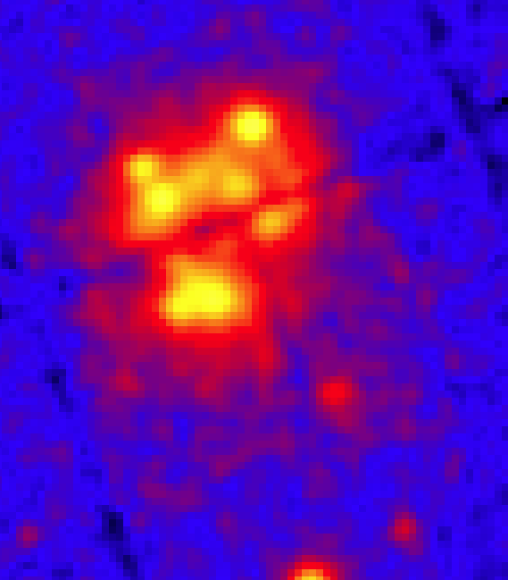
Why Chandra? Angular resolution is essential
The Antennae galaxies – Chandra versus XMM-Newton

Slide 40
The End

Slide 41
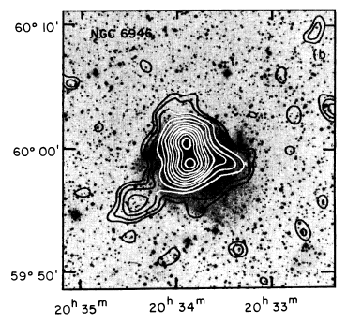
XRB populations: pre-Chandra see Fabbiano 1989, ARAA
Outside the Local Group
  Only most luminous XRBs
  detected
    a few ULX
    ??? IMBH ???
NGC 6946 –
Einstein Observatory

Slide 42
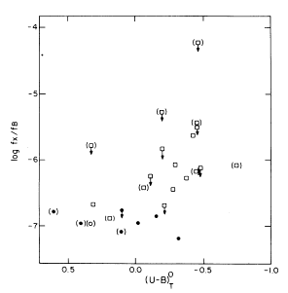
XRB populations: pre-Chandra see Fabbiano 1989, ARAA
Outside the Local Group
  Integrated emission of galaxy (L_{X})
    HMXB ➔star-formation rate L_{X} ~ L_{FIR}
    LMXB ➔ stellar mass L_{X} ~ L_{H}
Einstein Observatory
Fabbiano, Feigelson
& Zamorani 1982

Slide 43
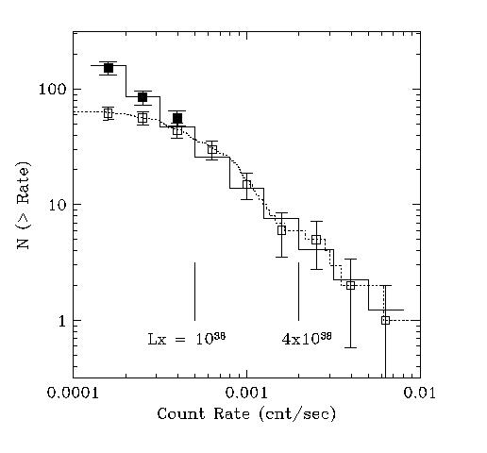
Chandra – XRB population studies
XRB populations characterized by
  luminosity functions (XLF)
  X-ray photometry
  Source variability
NGC1316: Observed and corrected XLF Kim & Fabbiano 2003

Slide 44
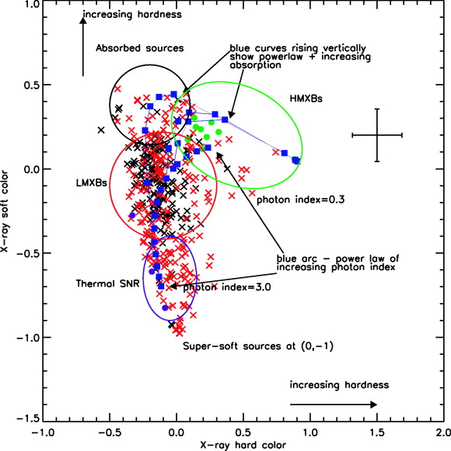
Chandra – XRB population studies
XRB populations characterized by
  luminosity functions (XLF)
  X-ray photometry
  Source variability
Chandra color-color diagram
Prestwich et al 2003

Slide 45
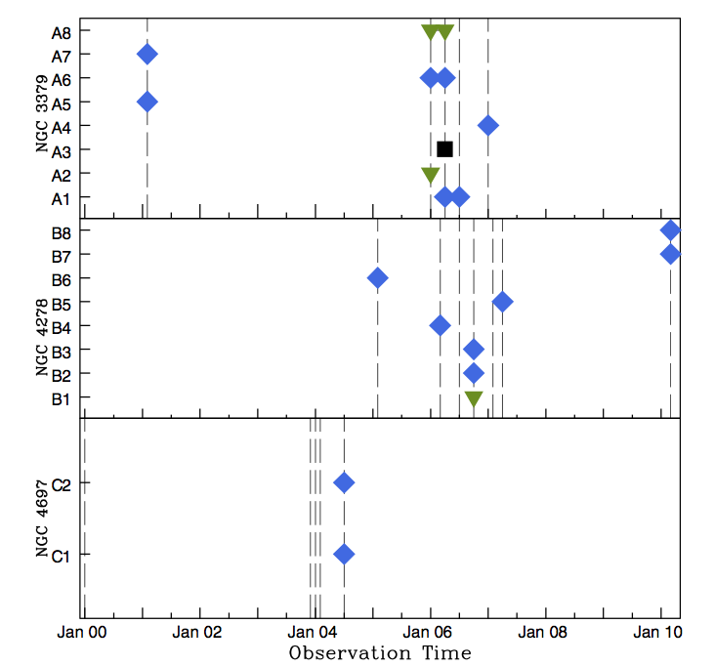
Chandra – XRB population studies
XRB populations characterized by
  luminosity functions (XLF)
  X-ray photometry
  Source variability
X-ray Transients in 3 E galaxies
Brassington et al 2012

Slide 46
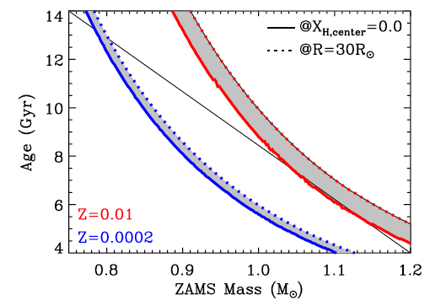
Metallicity affects Red Giants properties – seeds for GC-LMXB formation
Ivanova et al 2012
Average masses and number densities of red giants increase with metallicity
LMXBs with high-metallicity giant donors drive higher MT rates and can appear as persistent systems

Slide 47
GC-LMXBs and GC parameters e.g., Angelini et al. 2001; Kundu et al. 2002, 2007; Sarazin et al. 2003; Jordan et al. 2004; Kim et al. 2006; Sivakoff et al. 2007; Paolillo 2011; Kim et al 2013
Not all GCs are equally good at making LMXBs

Slide 48
Joint Chandra - Hubble studies of LMXB and GC populations
Which are the parameters governing GC-LMXB formation?
Are field-LMXB also formed in GCs?
What can we learn from the spatial distributions of GCs and LMXBs?
  LMXB properties and galaxy evolution

Slide 49
Radial Profiles
Do the spatial distributions of LMXB follow those of GCs or of the diffuse stellar light?
  Insufficient GC identification of LMXBs and mixed GC samples led to controversy
  see review Fabbiano 2006
  Complete Chandra and Hubble coverage of the main stellar body (including D₂₅) have led to large samples and consistent results in NGC 1399 and NGC 4649
  Paolillo et al 2011; Mineo et al 4649

Slide 50
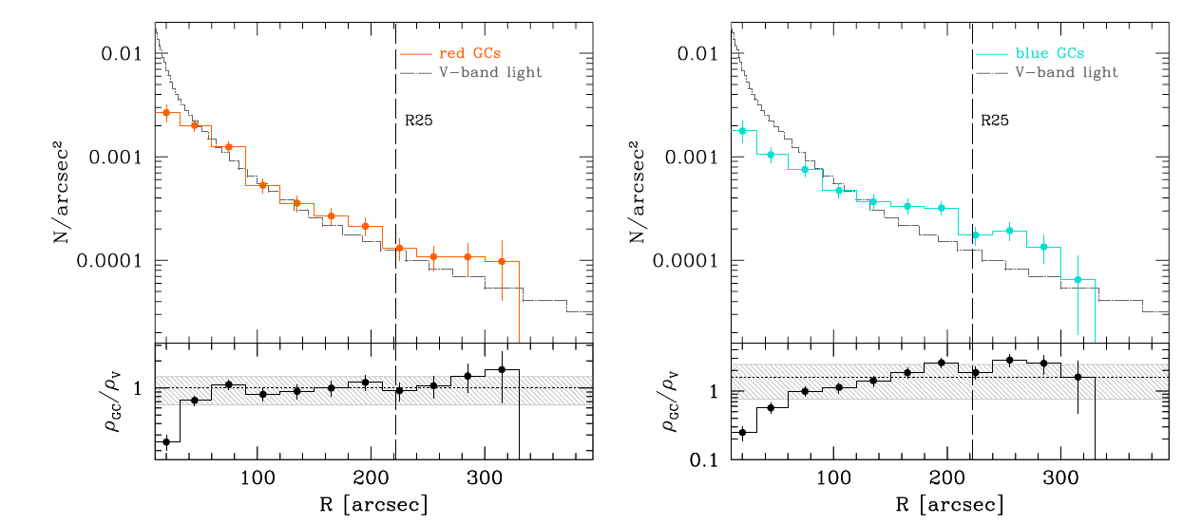
NGC 4649 Radial Profiles
- with full Chandra and Hubble coverage:
Mineo et al 2014
Red GCs lacking in center and perhaps in excess at large radii, relative to stellar diffuse emission
Blue GCs more radially extended than red

Slide 51
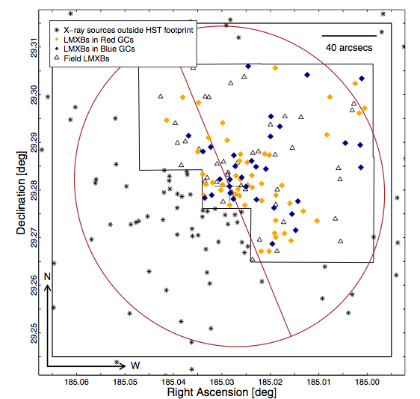
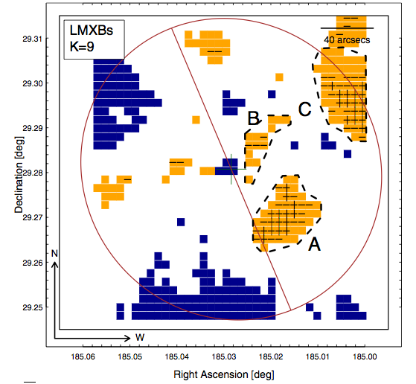
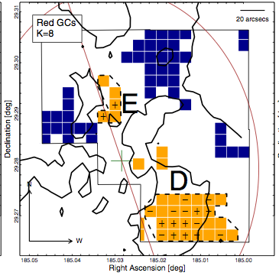
2D features in the LMXB spatial distributions
NGC 4278
D’Abrusco, Fabbiano & Brassington 2014

