Slide 1
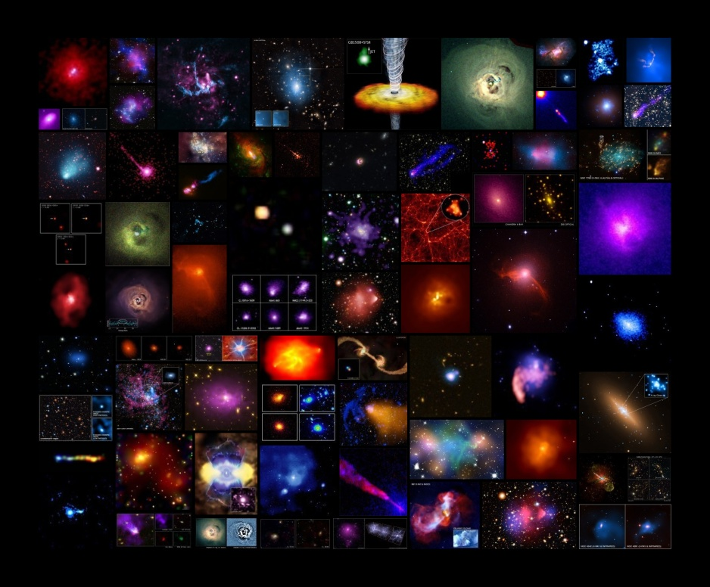

Physics of Clusters
and
AGN Feedback
Julie Hlavacek-Larrondo
Assistant Professor,
Université de Montréal
Collage of all Chandra press releases on clusters and massive black holes.
Notes:
Over 70 Chandra press releases on clusters or Agn feedback.

Slide 2
Collage of all Chandra press releases on clusters and massive black holes.
Notes:
Over 70 Chandra press releases on clusters or Agn feedback.

Slide 3
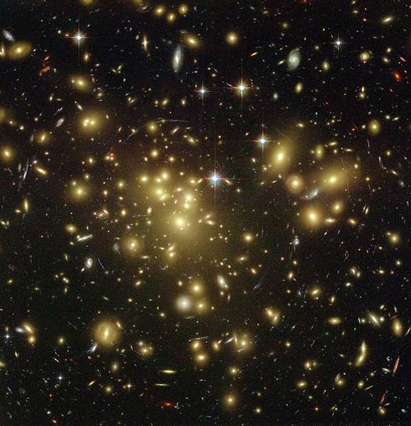
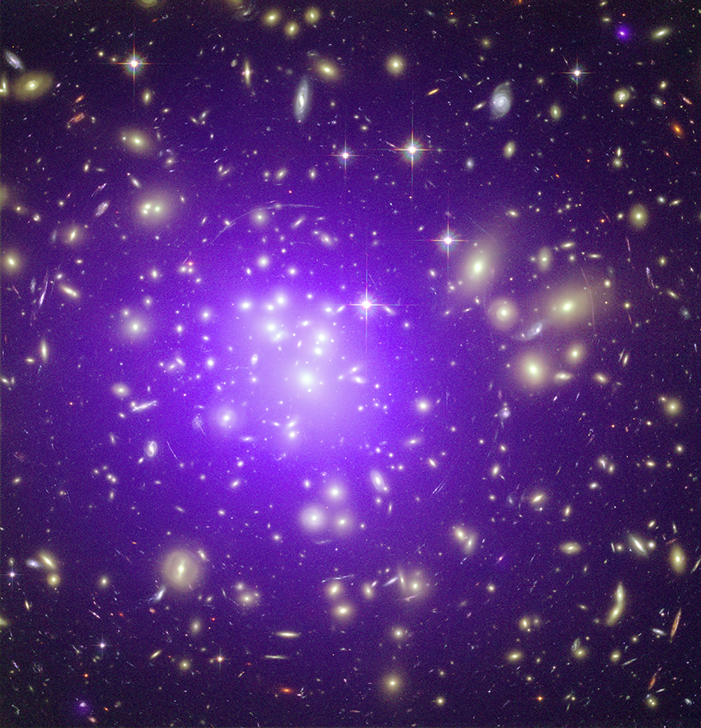
Clusters of Galaxies
Center:
→ Brightest Cluster Galaxy (BCG)
Total mass: 10¹⁴⁻¹⁵ M
  3% Stars
84% Dark matter
  13% ICM
  → T=10⁷-10⁸ K
L_{X-ray} = 10⁴³⁻⁴⁶ erg /s
(quasars L_{X-ray} = 10⁴⁷ erg /s)
1 Mpc
Abell 1689, Hubble (yellow) + Chandra X-ray (violet)
Abell 1689, Hubble (yellow)
Notes:
Galaxy: center BCG, dozens kpc in size galaxies in clusters tend to be red and dead, because of various phenomena gas stripping (little or no star formation). Whereas sfield are bluer and forming more stars.
ICM discovered 70s with rockets, Forman & Jones 1982.
Extremely hot: at these temperatures, most of the atoms are ionized and you therefore have a lot of free-free interaction also known as thermal bremsthalung emission – and at these temprature, peaks in the X-rays.
Einstein discovered surface brightness depression in perseus
Chandra: interpreted as feedback

Slide 4
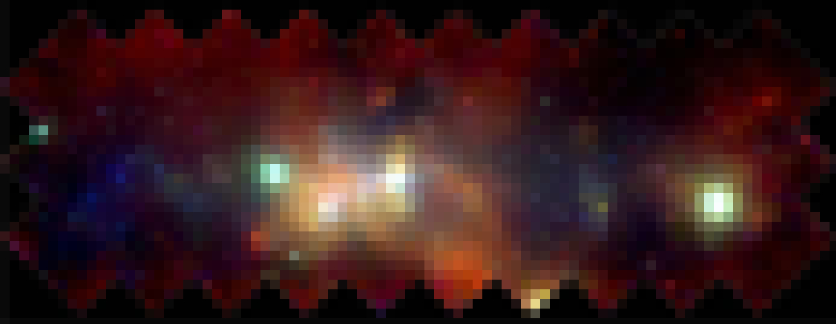
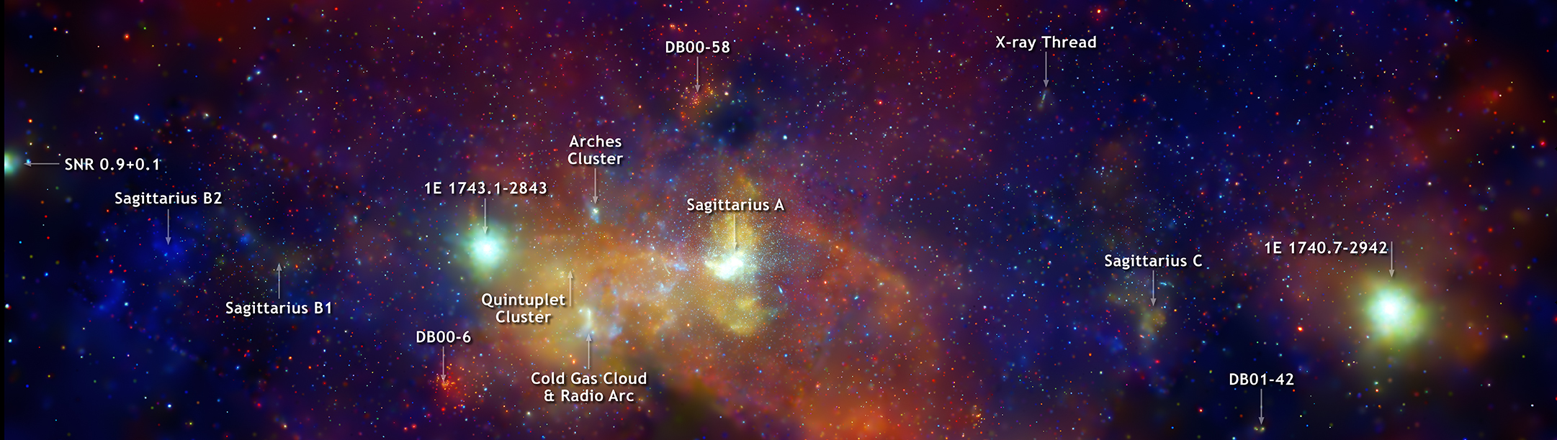
180 parsecs
Deep Chandra X-ray Image of the Galactic Center (26 days). Credit: NASA/CXO/Wang et al.
Notes:
Awesome picutre: blurred version is before Chandra (ROSAT PSF) and then show beautiful picture with Chandra!
Explain collect light for 34 days shutter, show camera.
B2:
Giant molecular cloud, where stars form. But too cold to emit X-rays and yet see X-rays, so think that it’s a luminous source like one here, that illuminating this region, and this region then reflects the light back at us.
1E 1743 binary black hole system, but still not sure.
Ashes cluster: compact cluster of massive stars.

Slide 5
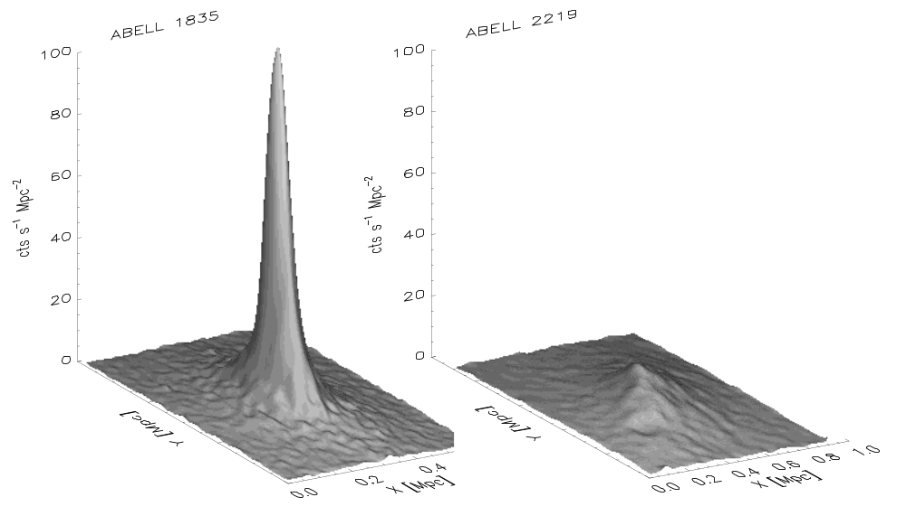
Clusters of Galaxies
MS0735, McNamara et al. 2005
Hydra A, Kirkpatrick et al. 2009
Cool core
Non cool core
X-ray cts/s/Mpc²
X-ray cts/s/Mpc²
X [Mpc = Millions light years]
X [Mpc = Millions light years]
Perseus
Fabian et al. 2008
Notes:
One of richest actually + box mention
BCG not brightest (but domant one, 30kpc and 1012 Msol)
Gravitational arcs
Advanced Camera for Surveys aboard NASA's Hubble Space Telescope
Mgalaxy = 1010-10^11 Msol
Magalaxy 10 kpc

Slide 6
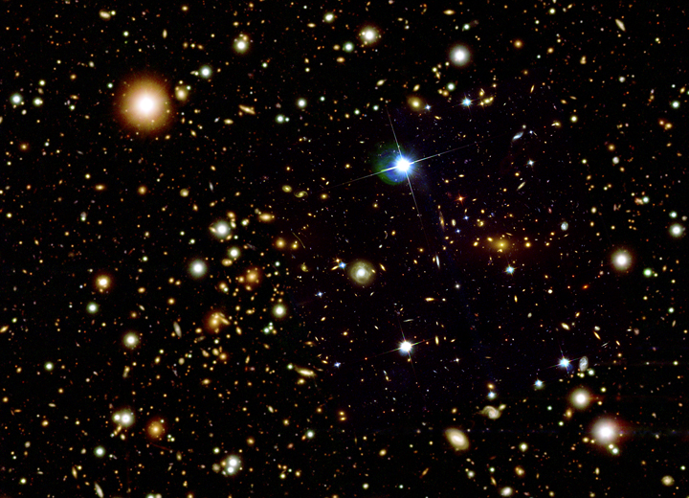
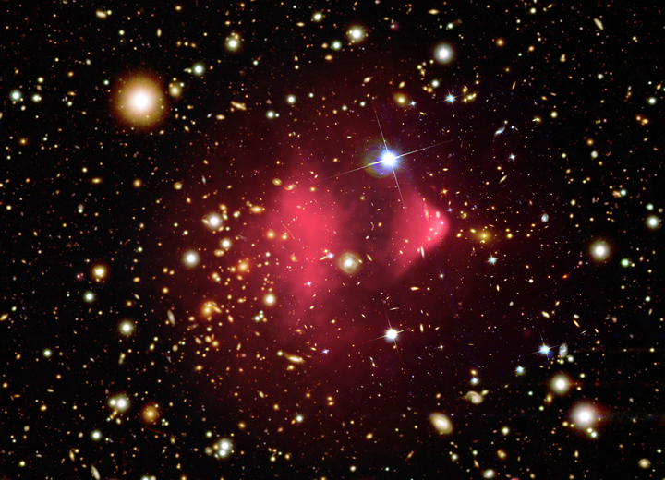
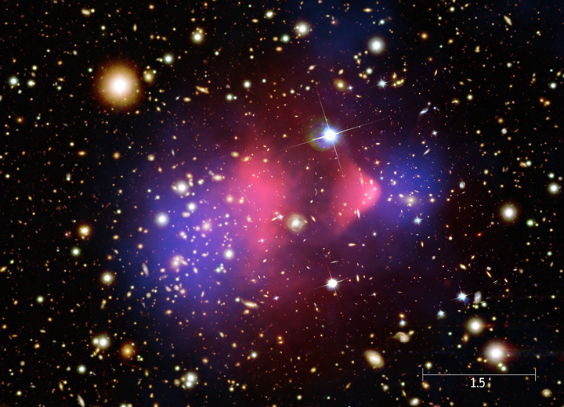
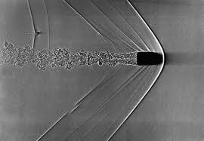
Clusters of Galaxies: Mergers
Lensing Map
X-rays (Chandra)
Bullet. Credit: A. Davidhazy RIT.
Bullet cluster. Credit: X-ray: Markevitch ; Optical: Clowe.
Notes:
A bullet traveling through air at about 1.5 times the speed of sound can be seen in this image.
KPC CHANGE!!!!

Slide 7
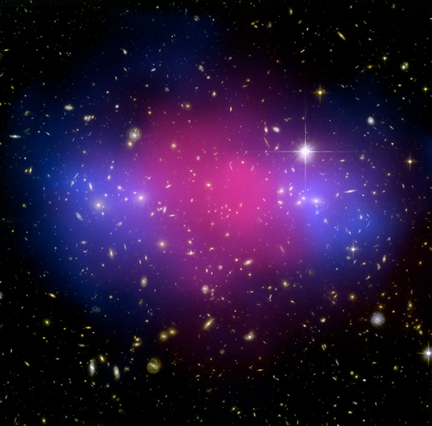
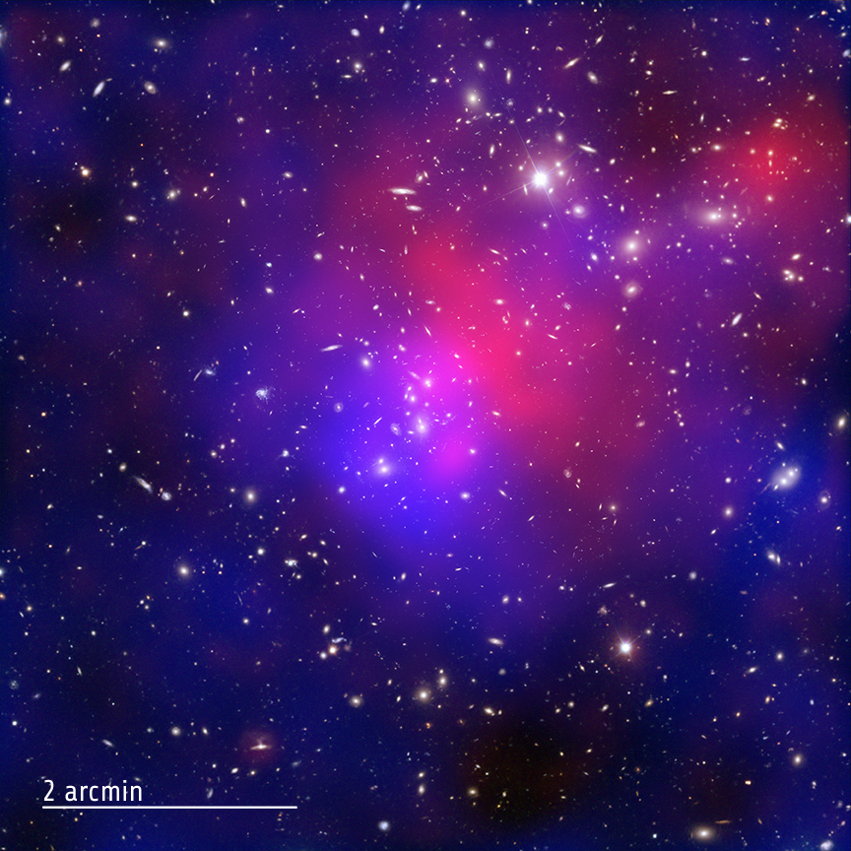
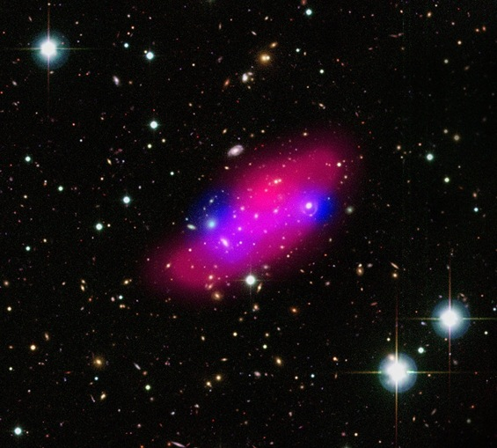
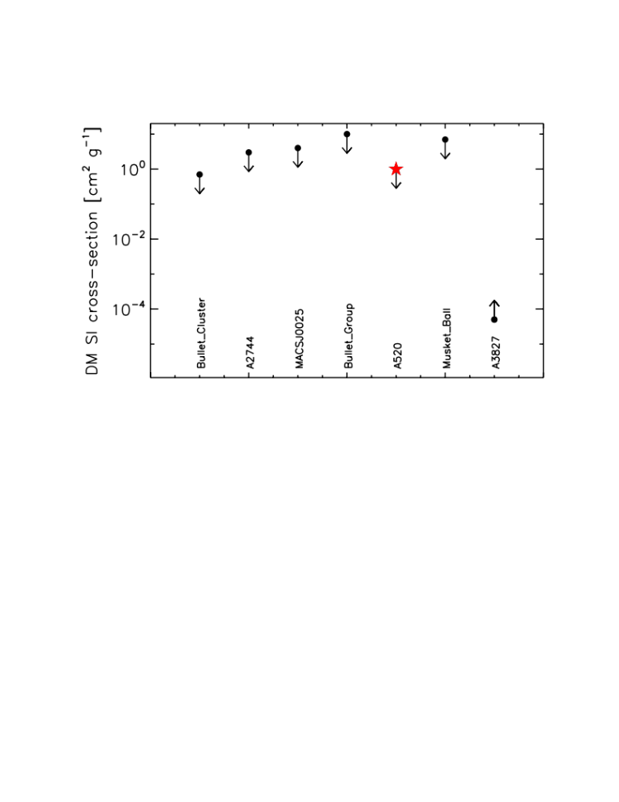
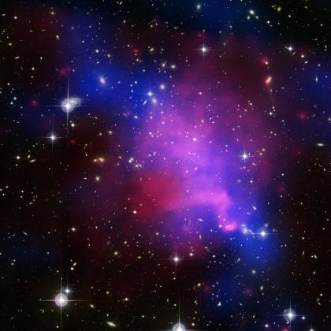
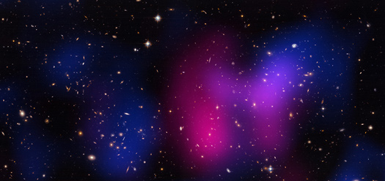
Clusters of Galaxies: Mergers
Dark Matter (DM) self-interaction cross-section
Bullet Cluster
MACSJ0025
A2744
Bullet Group
Markevitch+2004, Randall+2008
Bradac+2008
Merten+2011
Gastaldello+2014
A520
Muskett Ball cluster
Clowe+2012,
Mahdavi+2007
Dawson+2012
However: Williams+2011 find a seperation between DM and BCG in A3827 (i.e. DM would be collisional), σ/m > 5*10⁻⁵ cm²/g.
Notes:
While there are many more mergers knowns, these are the ones where data quality and configuration of the merger allowed estimates of the cross-section – or at least where the authors tried to estimate (one of the methods, is the separation between DM and gas).

Slide 8
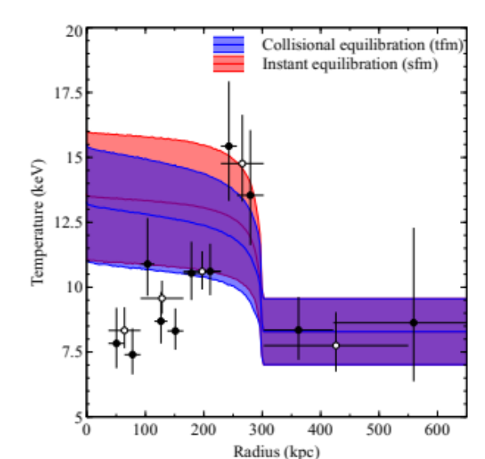
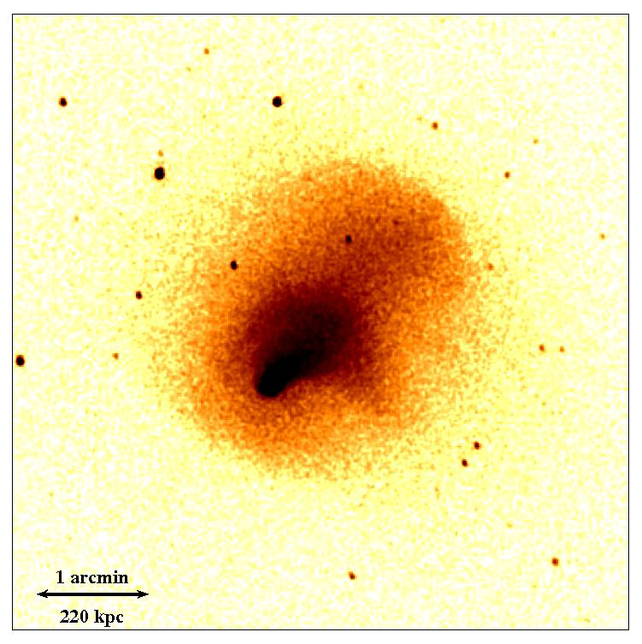
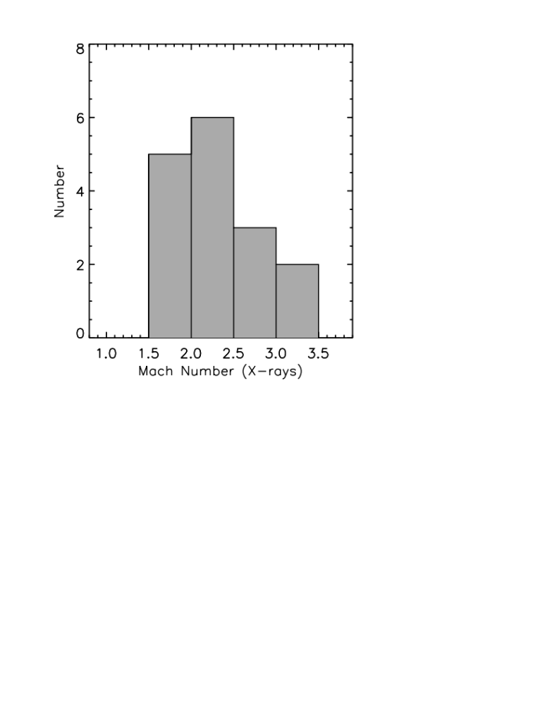
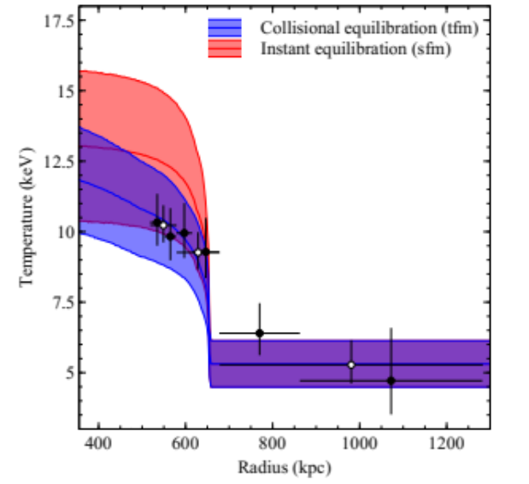
Clusters of Galaxies: Mergers
Shock Fronts (X-rays)
Electron-Ion Equilibrium Timescale
Abell 2146, z=0.23
Upstream
shock
Upstream
shock
Subcluster core
Bow shock
Bow shock
Russell+2010,2012
e.g. Markevitch+2004, 2005, Randall+2008, Owers+2011, 2014 Belsole+2004, Russell+2010,2012,2014, Akamatsu+2012a,2012b, Finoguenov+2010, Bourdin+2013, Ogrean+2013a,2013b,2014, Macario+2011, Simionescu+2013, Clarke+2013.
Notes:
Deep 400ks observation of Abell 2146, two clusters have collided. Their speed exceeds speed of sound, typically a couple of thousands km/s.
Compilation of all merging clusters with shock fronts as seen in the X-ray (Chandra, XMM, Suzaku). Be careful, not all show a clear temperature jump, several only show density jumps interepreted as shock fronts. But when you can measure clear temperature – like in A2146 and Bullet, you can get meaningul infor on electron ion equi.

Slide 9
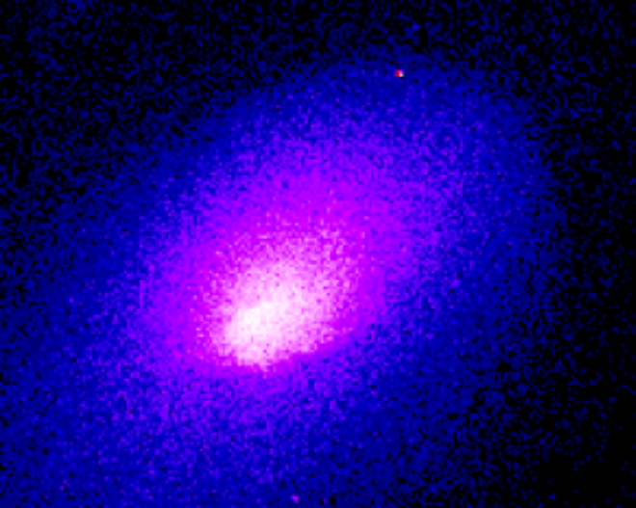
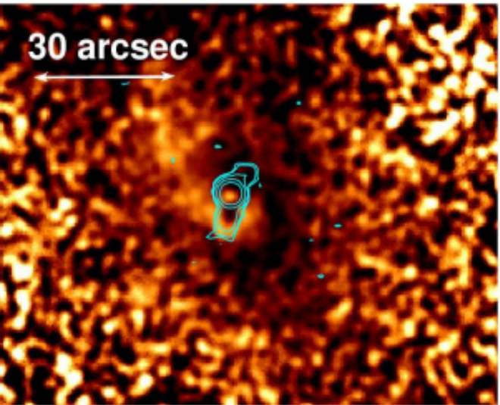
Clusters of Galaxies: Mergers (minor)
Cold Fronts
A2142, Markevitch+2000
200 kpc
T ⬆
Anatomy of cold fronts (Chandra):
Δρ = 1.1-3 (✓ shock front).
ΔT > 0, Δ_{Pressure} = 0, Δ_{Entropy} > 0 (≠ shock front).
Seen in >45 merging clusters/groups AND relaxed clusters/groups.
Spiral structures (sloshing motion):
Now seen in relaxed clusters, out to ½ virial radius (e.g. r=800 kpc, Walker+2014).
Future:
ICM transport properties (see Roediger+2013, Zuhone+2010, Werner+ in prep with deep observations of Coma).
T ⬇
4C+55.16, Hlavacek-L.+2011
Notes:
Can be formed

Slide 10
Clusters of Galaxies
MS0735, McNamara et al. 2005
Hydra A, Kirkpatrick et al. 2009
Cool core
Non cool core
Predicted Star Formation: 100-1000 M/yr
Observed Star Formation: 1-100 M/yr
→ Cooling Flow Problem
X-ray cts/s/Mpc²
X-ray cts/s/Mpc²
X [Mpc = Millions light years]
X [Mpc = Millions light years]
Perseus
Fabian et al. 2008
Notes:
One of richest actually + box mention
BCG not brightest (but domant one, 30kpc and 1012 Msol)
Gravitational arcs
Advanced Camera for Surveys aboard NASA's Hubble Space Telescope
Mgalaxy = 1010-10^11 Msol
Magalaxy 10 kpc

Slide 11
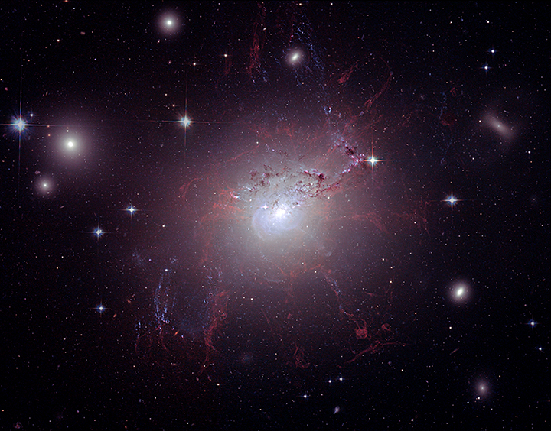
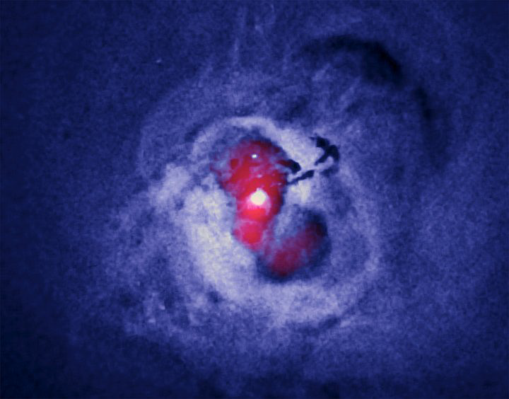
Perseus Cluster (z=0.018). Credit: Fabian et al. 2006.
X-rays (Chandra)
Radio (JVLA)
“X-ray cavity”
Notes:
Explain jet – radio
MEGANTIC PROPRIETE IR, OPTIQUE MEGANTIC
PLASMA PHYSICS ! Processus d’emission, aussi ntre autre comme l’energie peut etre redistribuer a travers un plasma.
Z=0.22 = 890 Mpc = 2000 fois plus loin que andromede = 2.6Gyrs dans le passe
NASA, ESA, and B. McNamara (University of Waterloo and Ohio University)
AGN is inflating cavities through jets of relativistic plasma that emits at radio wavelengths. So as these jets propagate, they push the hot gas outwards : these AGN-driven outflows appear as cavities in the Xray.

Slide 12
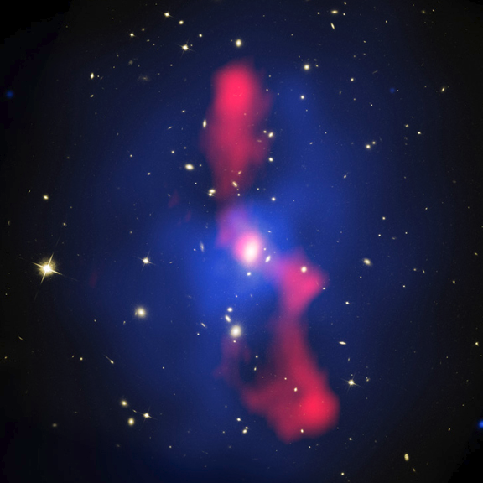
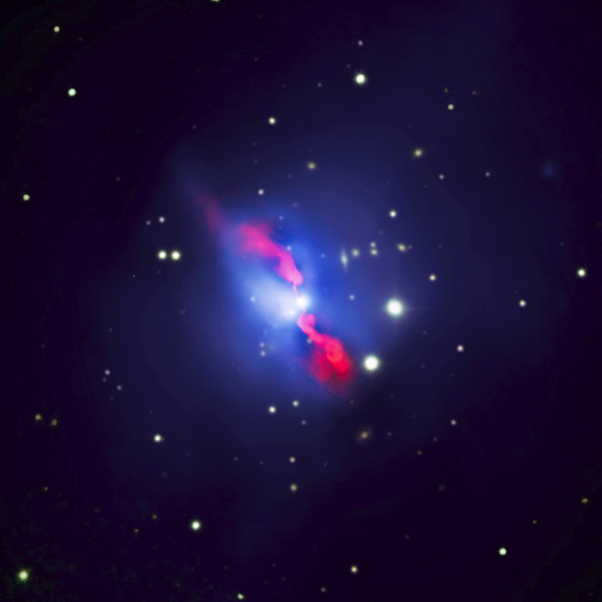
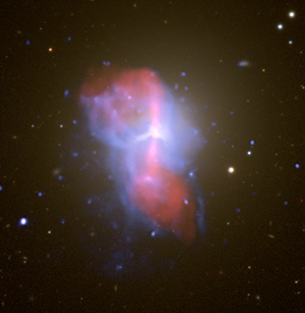
AGN feedback in clusters of galaxies
MS0735, McNamara et al. 2005
Hydra A, Kirkpatrick et al. 2009
20 kpc
20 kpc
200 kpc
Perseus, Fabian et al. 2006
M84, Finogeunov et al. 2008
X-rays (Chandra)
E_{cavities} = 4PV
= 10⁵⁹⁻⁶¹ ergs
P_{cavities} = 4PV/t_{buoyancy} = 10⁴³⁻⁴⁶ erg/s
Radio (JVLA)
20 kpc
Notes:
Indice adiabatique
Coefficience de traine, resistance.

Slide 13
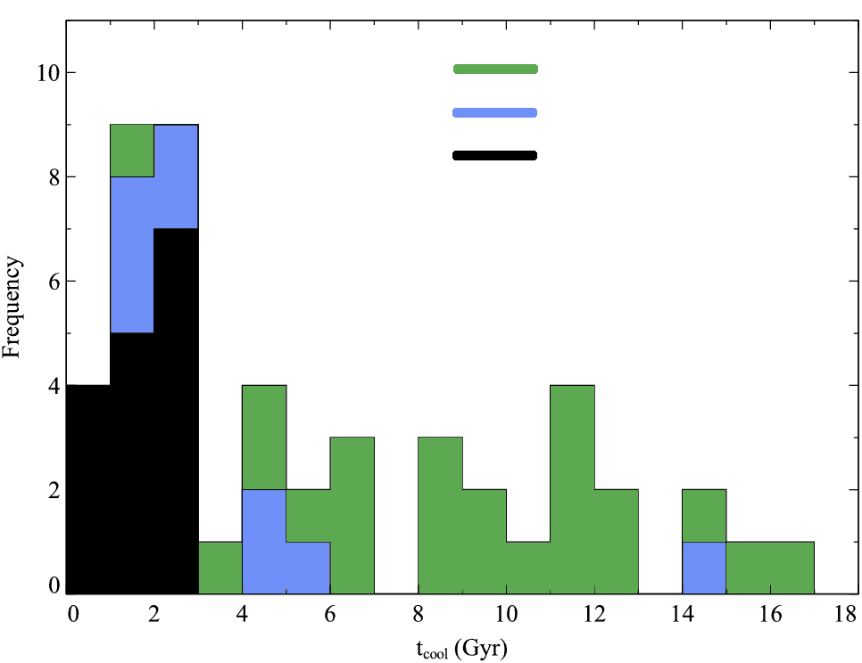
AGN feedback in clusters of galaxies
Cool Cores
No X-ray cavities + no radio
No X-ray cavities + radio
X-ray cavities + radio
Dunn & Fabian 2006; updated
Number
Cooling time (Gyr)
1) ≥ 90 % of central AGN in cool core clusters are active.
Birzan et al. 2004, Rafferty et al. 2006, Dunn & Fabian 2006, 2008, Dunn et al. 2010, Birzan et al. 2008, Cavagnolo et al. 2010, Dong et al. 2010, Hlavacek-Larrondo et al. 2012a
Notes:
Here emphasize: radio for all sources with clear cavities (13) + radio for 4 out of 7 with potential have radio!
Based on 55 Brightest nearby galaxy clusters – lots of data avilable. The B55 sample is a 2 − 10 keV flux-limited sample of clusters of galaxies which are close enough to have been imaged by previous X-ray satellites, and is nearly flux complete at high galactic latitudes (all but nine are at b > |20|circ|). 48 shown here:
1. Cavities are vast majority found in systems that require some heating
2. They are common in these systems

Slide 14
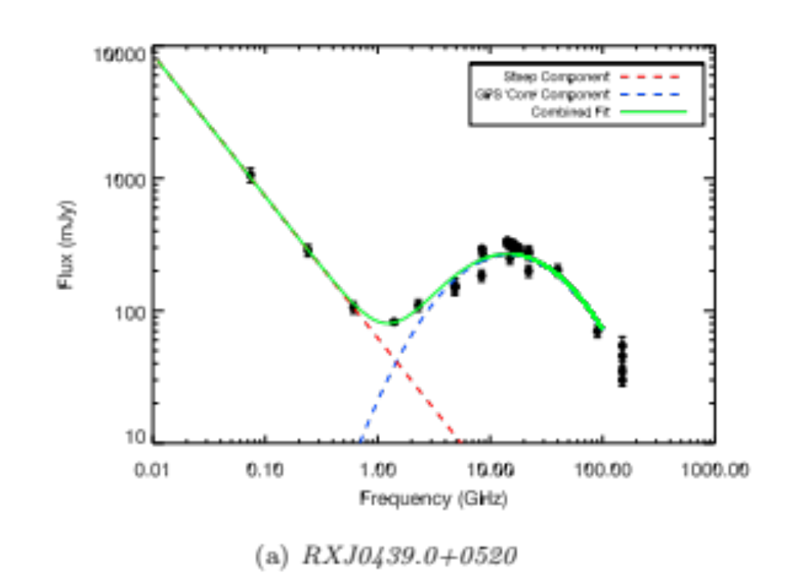
AGN feedback in clusters of galaxies
RXJ0439.0+0520
Preliminary!
Radio Flux [mJy]
Steep
Component
Core
Frequency [GHz]
1) ≥ 85 % of central AGN in cool core clusters are radio luminous (60% of these have a radio “core”, i.e. are actively accreting).
Hogan+2014, submitted to MNRAS
Notes:
Here emphasize: radio for all sources with clear cavities (13) + radio for 4 out of 7 with potential have radio!
1. Cavities are vast majority found in systems that require some heating
2. They are common in these systems

Slide 15
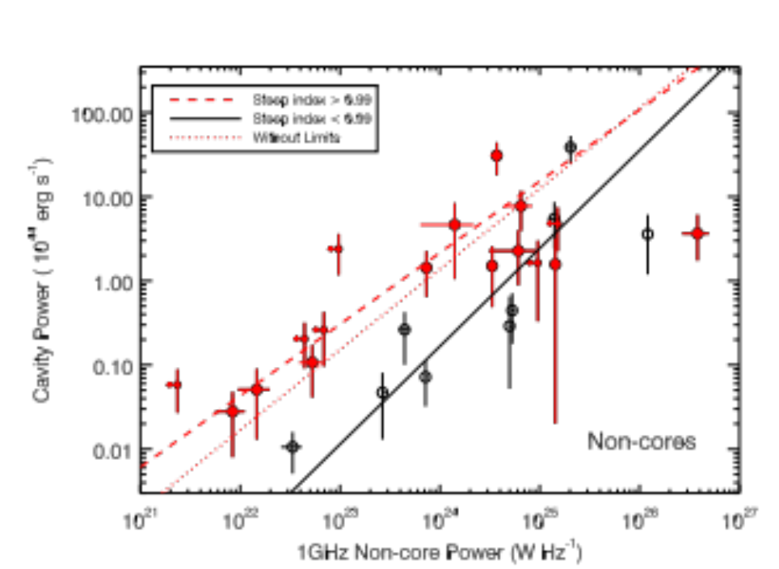
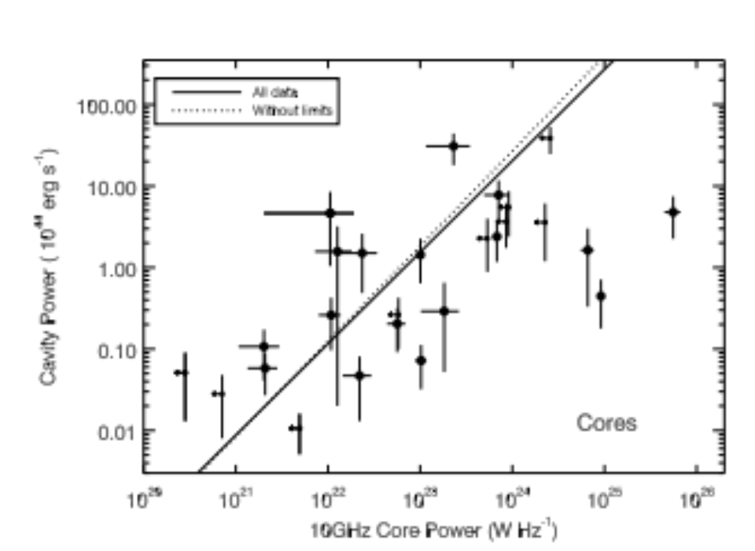
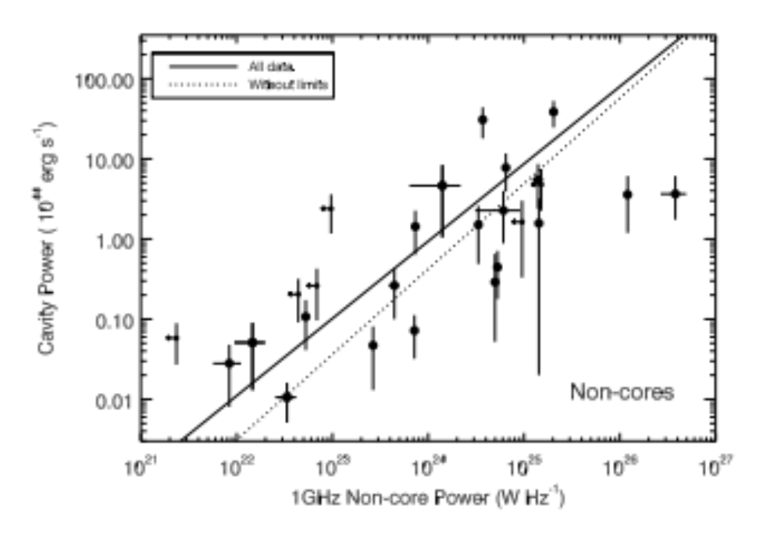
AGN feedback in clusters of galaxies
Preliminary!
P_{cavities} [10⁴⁴ erg/s]
P_{cavities} [10⁴⁴ erg/s]
Steep Component
Core
Component
P_{1 GHz steep component} [W/Hz]
P_{10 GHz core} [W/Hz]
2) Radio luminosity of central AGN correlates with cavity power.
Hogan+2014, submitted to MNRAS
Notes:
Here emphasize: radio for all sources with clear cavities (13) + radio for 4 out of 7 with potential have radio!
1. Cavities are vast majority found in systems that require some heating
2. They are common in these systems

Slide 16
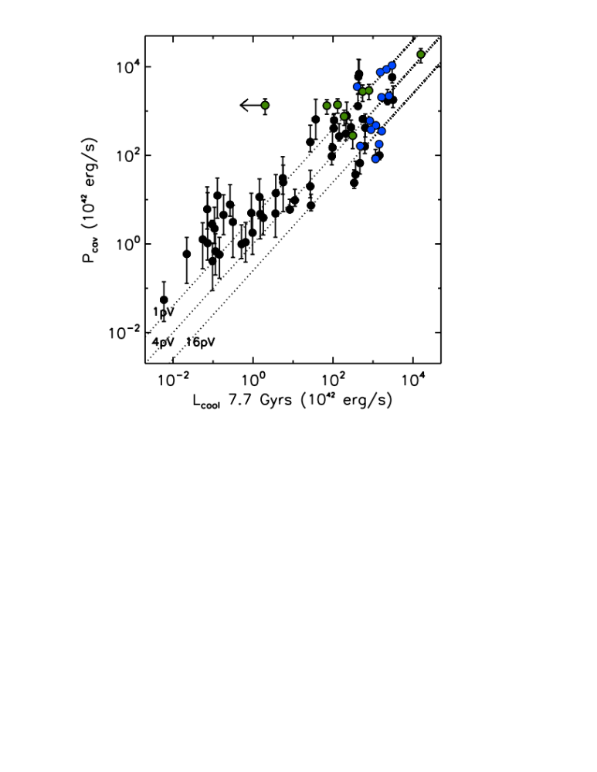
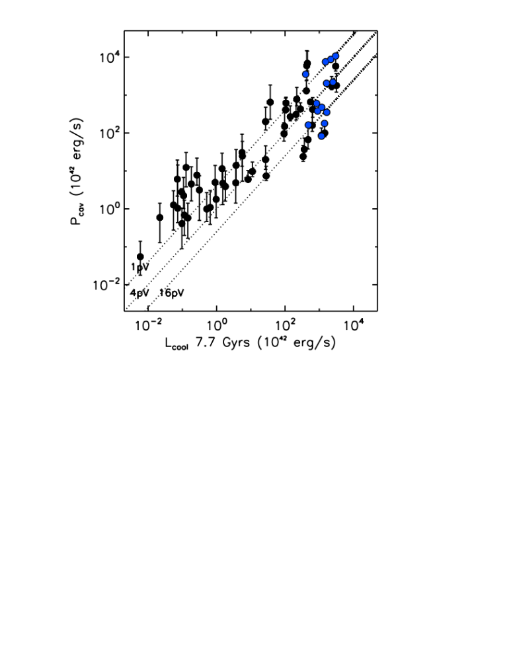
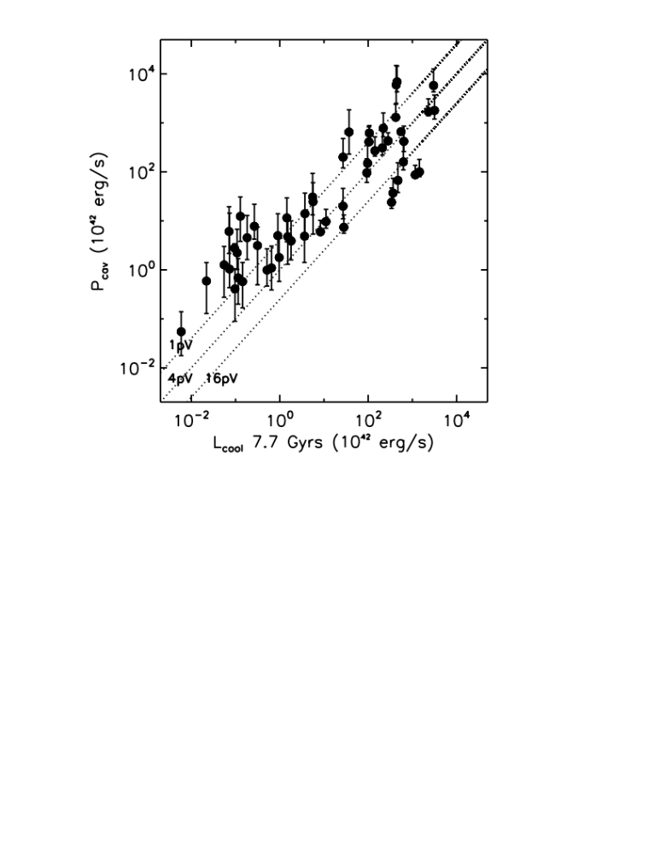
AGN feedback in clusters of galaxies
P_{cavities} [10⁴² erg/s]
SPT: 0.3 < z < 1.2 (Hlavacek-L.+2014)
MACS: 0.3 < z < 0.6 (Hlavacek-L.+2012)
L_{cooling} [10⁴² erg/s]
3) Mechanical AGN feedback can prevent the hot gas from cooling.
3) Mechanical AGN feedback can prevent the hot gas from cooling for over 8 Gyrs.
Birzan et al. 2004, Rafferty et al. 2006, Dunn & Fabian 2006, 2008, Dunn et al. 2010, Birzan et al. 2008, Cavagnolo et al. 2010, Dong et al. 2010, Hlavacek-Larrondo et al. 2012a, Panagoulia et al. 2014.
Hlavacek-Larrondo et al. 2012a,2014
Notes:
Here emphasize: radio for all sources with clear cavities (13) + radio for 4 out of 7 with potential have radio!
Based on 55 Brightest nearby galaxy clusters – lots of data avilable. The B55 sample is a 2 − 10 keV flux-limited sample of clusters of galaxies which are close enough to have been imaged by previous X-ray satellites, and is nearly flux complete at high galactic latitudes (all but nine are at b > |20|circ|). 48 shown here:
1. Cavities are vast majority found in systems that require some heating
2. They are common in these systems

Slide 17
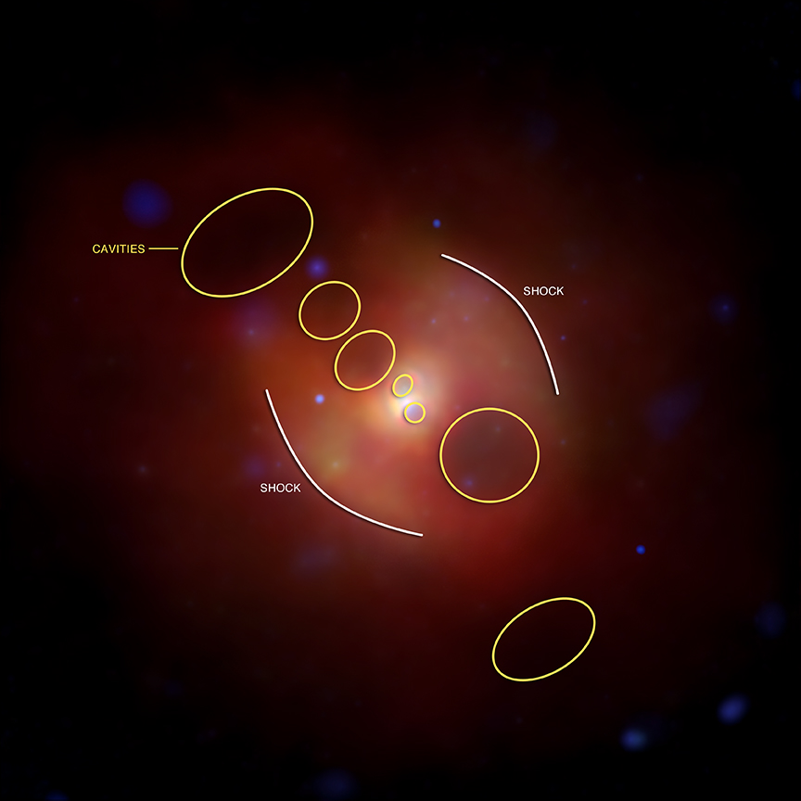
AGN feedback in clusters of galaxies
Randall+2011
Graham+2008
N_{e} (cm-3)
T (keV)
Chandra X-ray image of NGC 5813
10 50 Radius (kpc)
4) Shock Fronts (Mach=1-2). Power (heating) ~ 10⁴⁴⁻⁴⁵ erg/s (same as X-ray cavities).
Nulsen et al. 2005, Simionescu et al. 2009, McNamara et al. 2005, Gitti et al. 2010, Croston et al. 2007, 2011, Stawartz et al. 2014, Randall et al. 2011, Forman et al. 2007, Kraft et al. 2007, Graham et al. 2008…
Notes:
NGC5813: clear shock fronts, temperature jump as expected, not always the case.
Here emphasize: radio for all sources with clear cavities (13) + radio for 4 out of 7 with potential have radio!
Based on 55 Brightest nearby galaxy clusters – lots of data avilable. The B55 sample is a 2 − 10 keV flux-limited sample of clusters of galaxies which are close enough to have been imaged by previous X-ray satellites, and is nearly flux complete at high galactic latitudes (all but nine are at b > |20|circ|). 48 shown here:
1. Cavities are vast majority found in systems that require some heating
2. They are common in these systems

Slide 18
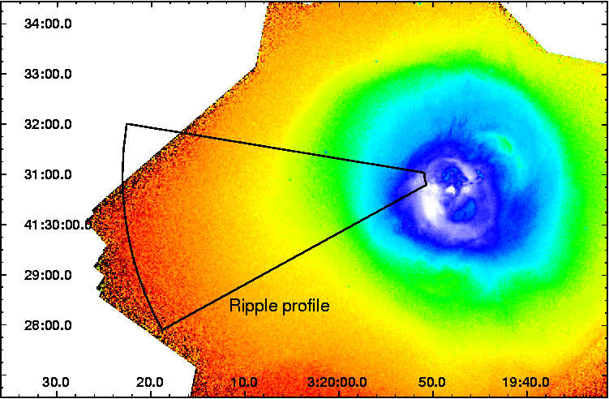
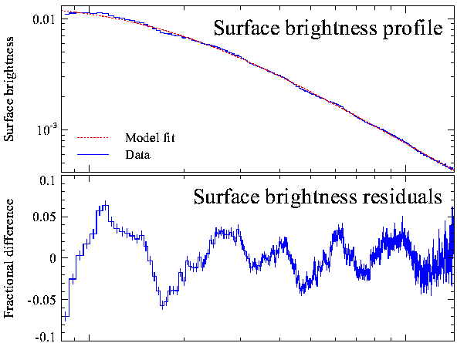
AGN feedback in clusters of galaxies
Chandra of Perseus (10 days, 900ks)
Surf. Brightness
Frac. Diff.
Sanders & Fabian 2007
10 100 Radius (kpc)
5) Sound waves (B flat, but 57 octaves lower than middle C). Power ~ 10⁴⁴⁻⁴⁵ erg/s (same as X-ray cavities).
Fabian et al. 2003, Sanders et al. 2008, Blanton et al. 2011, Paggi et al. 2014. However, see Zhuravleva+2014.
Notes:
On larger scales, shocks fade into sound waves…
Perseus
Centaurus
A2052
NGC4649
Here emphasize: radio for all sources with clear cavities (13) + radio for 4 out of 7 with potential have radio!
Based on 55 Brightest nearby galaxy clusters – lots of data avilable. The B55 sample is a 2 − 10 keV flux-limited sample of clusters of galaxies which are close enough to have been imaged by previous X-ray satellites, and is nearly flux complete at high galactic latitudes (all but nine are at b > |20|circ|). 48 shown here:
1. Cavities are vast majority found in systems that require some heating
2. They are common in these systems

Slide 19
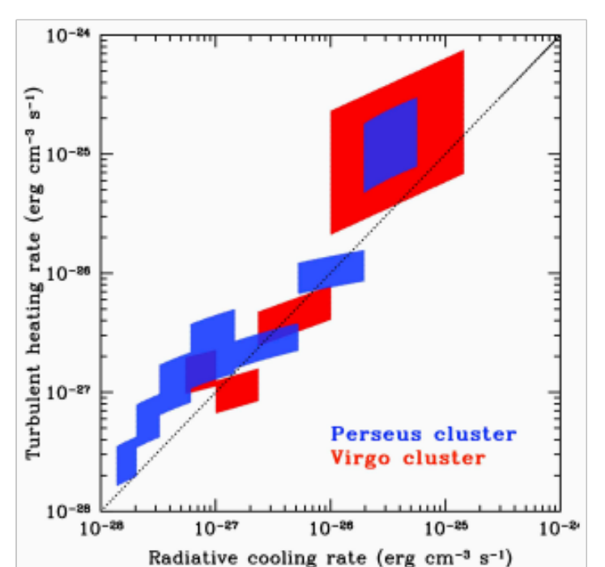
AGN feedback in clusters of galaxies
Chandra of Perseus (1.4Ms) and M87/Virgo (600ks)
Turbulent heating rate (erg cm-3 s-1)
Zhuravleva et al. 2014, Nature
Radiative cooling rate (erg cm-3 s-1)
6) Density fluctuations are proportional to velocity fluctuations. Turbulent heating (as measured from velocity fluctuations) can offset cooling.
Fabian et al. 2003, Sanders et al. 2008, Blanton et al. 2011, Paggi et al. 2014. However, see Zhuravleva+2014.
Notes:
Figure 3 | Turbulent heating (Qheat) versus gas cooling (Qcool) rates in the Perseus and Virgo cores. Each shaded rectangle shows the heating and cooling rates estimated in a given annulus (top right – the innermost radius; bottom left – the outermost radius; see Extended Data Fig. 3). The size of each rectangle reflects 1σ statistical and stochastic uncertainties in heating, variations of the mean gas density and temperature across each annulus (affecting estimates of both cooling and heating) and the deviations of the measured spectral slope from the Kolmogorov law.
On larger scales, shocks fade into sound waves…
Perseus
Centaurus
A2052
NGC4649
Here emphasize: radio for all sources with clear cavities (13) + radio for 4 out of 7 with potential have radio!
Based on 55 Brightest nearby galaxy clusters – lots of data avilable. The B55 sample is a 2 − 10 keV flux-limited sample of clusters of galaxies which are close enough to have been imaged by previous X-ray satellites, and is nearly flux complete at high galactic latitudes (all but nine are at b > |20|circ|). 48 shown here:
1. Cavities are vast majority found in systems that require some heating
2. They are common in these systems

Slide 20
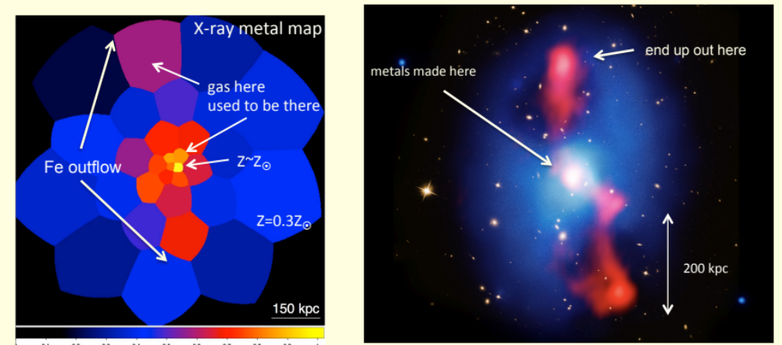
AGN feedback in clusters of galaxies
MS0735.6+7421: McNamara et al. 2009, 2012
7) AGN feedback drives metals out of the central galaxy.
Kirkpatrick et al. 2009, 2011; McNamara et al. 2009, 2012; Hlavacek-Larrondo et al. 2011,
See also new ALMA results (McNamara et al. 2014, Russell et al. 2014).
Notes:
Projet de doctorat!

Slide 21
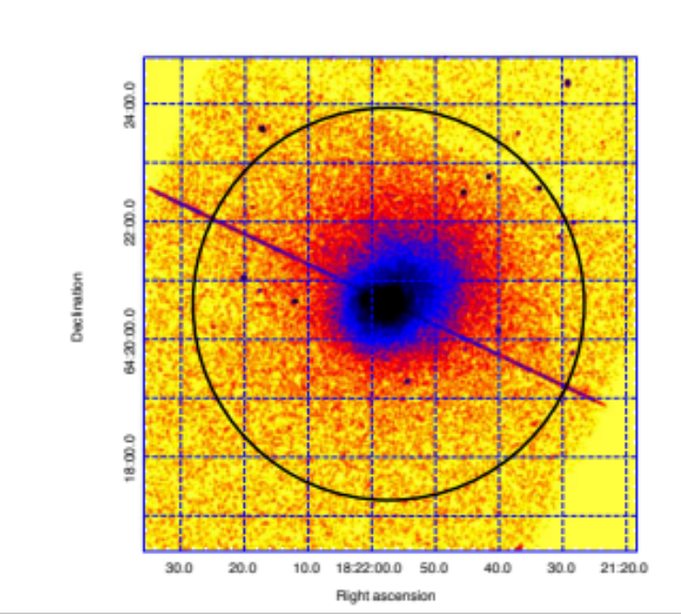
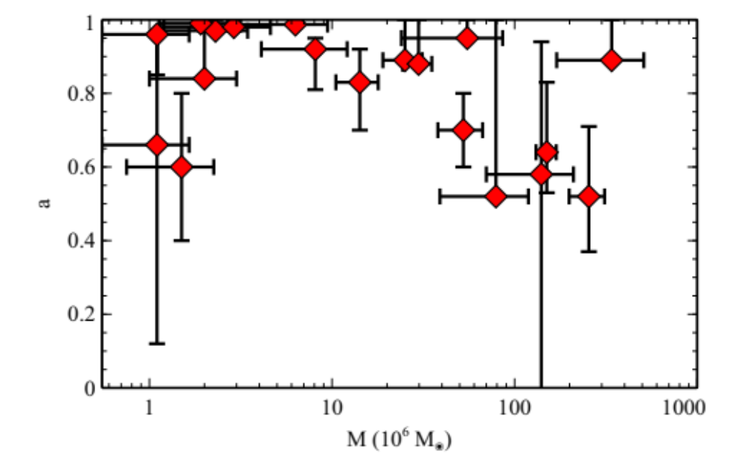
AGN feedback in clusters of galaxies
Reynolds et al. 2014
(Chandra + 400ks Suzaku)
Spin Parameter (a)
Chandra X-ray image of H1821
M_{BH} (10⁶ M)
8) Spin-powered central AGN in cool core clusters?
Reynolds et al. 2014, McNamara et al. 2009, 2011, Hlavacek-Larrondo & Fabian 2011
Notes:
Stress that result would have been impossible without Chandra (to remove the ICM contribution from the X-ray specturm and isolate the spctrum of the AGN).
Other interesting fact: abundance in the disk matches that of the ICM, so black hole fed by ICM?
Here emphasize: radio for all sources with clear cavities (13) + radio for 4 out of 7 with potential have radio!
Based on 55 Brightest nearby galaxy clusters – lots of data avilable. The B55 sample is a 2 − 10 keV flux-limited sample of clusters of galaxies which are close enough to have been imaged by previous X-ray satellites, and is nearly flux complete at high galactic latitudes (all but nine are at b > |20|circ|). 48 shown here:
1. Cavities are vast majority found in systems that require some heating
2. They are common in these systems

Slide 22
Future: The next 15 years
Julie Hlavacek-Larrondo, juliehl@astro.umontreal.ca
Serendipitous?
Joint observations?
Bullet cluster
Markevitch+
H1821, Chandra + 400ks Suzaku
→ Several cluster surveys now online (or coming online): SPT (e.g. Phoenix, see McDonald+2012), Planck, eRosita, etc.
Reynolds+2014
→ NuSTAR (2012), Astro-H (2015/2016), eROSITA (2016), Athena+ (2020s), SMART-X (?)
Ultradeep observations?
A1795?
(PI Vikhlinin, 2Ms)
see also Vikhlinin+2014 (in prep)
→ Many discoveries *only* possible with deep *Chandra* observations: electron-ion equilibrium (shocks), ICM transport processes (cold fronts), metal transport (by AGN), ripples (sound waves).

Slide 24
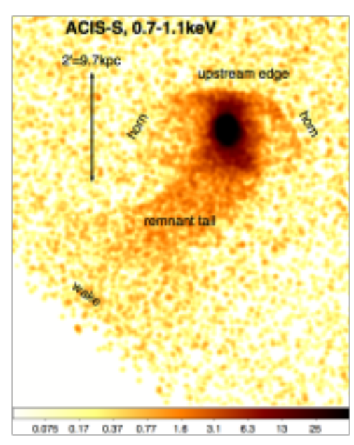
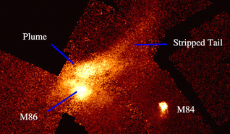
Clusters of Galaxies: Mergers (minor)
Gas-stripped Cluster Ellipticals
ICM transport properties:
Low-viscosity = turbulent mixing, smaller faint wake.
High-viscosity = supresses mixing, long bright wake.
Tailored simulations vs observations:
→ ICM is turbulent (low viscosity, see Roediger+2014a,b).
Chandra X-ray image of M89 (Virgo, Roediger+2014)
Chandra X-ray image of M86 (Virgo, Randall+2008)
Notes:
M89 (NGC 4552) is located 350 kpc east of M87: gas tail, horns

Slide 25
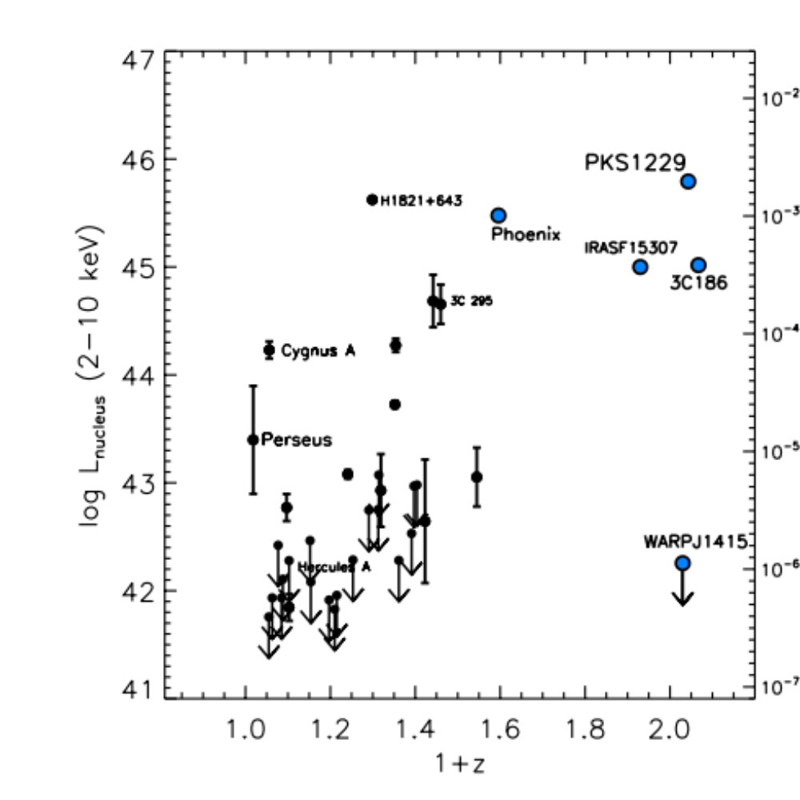
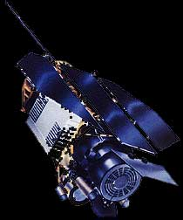
AGN feedback in clusters of galaxies
Rosat X-ray telescope (1990-1999)
Log L_{nucleus}(2-10 keV)
→ z ≈ 1 « cool core » clusters missed in ROSAT surveys..
1 + z
8) Significant evolution of radiative AGN feedback (i.e. nuclear luminosity)?
Hlavacek-Larrondo et al. 2013b
Notes:
ROSAT: X-ray observatory 1990 launched – all sky survey.
High redshift population of clusters hints AGN activity + cool core → equiavlent
Luminosity: L=10^45-46erg/s: quasars

Slide 26
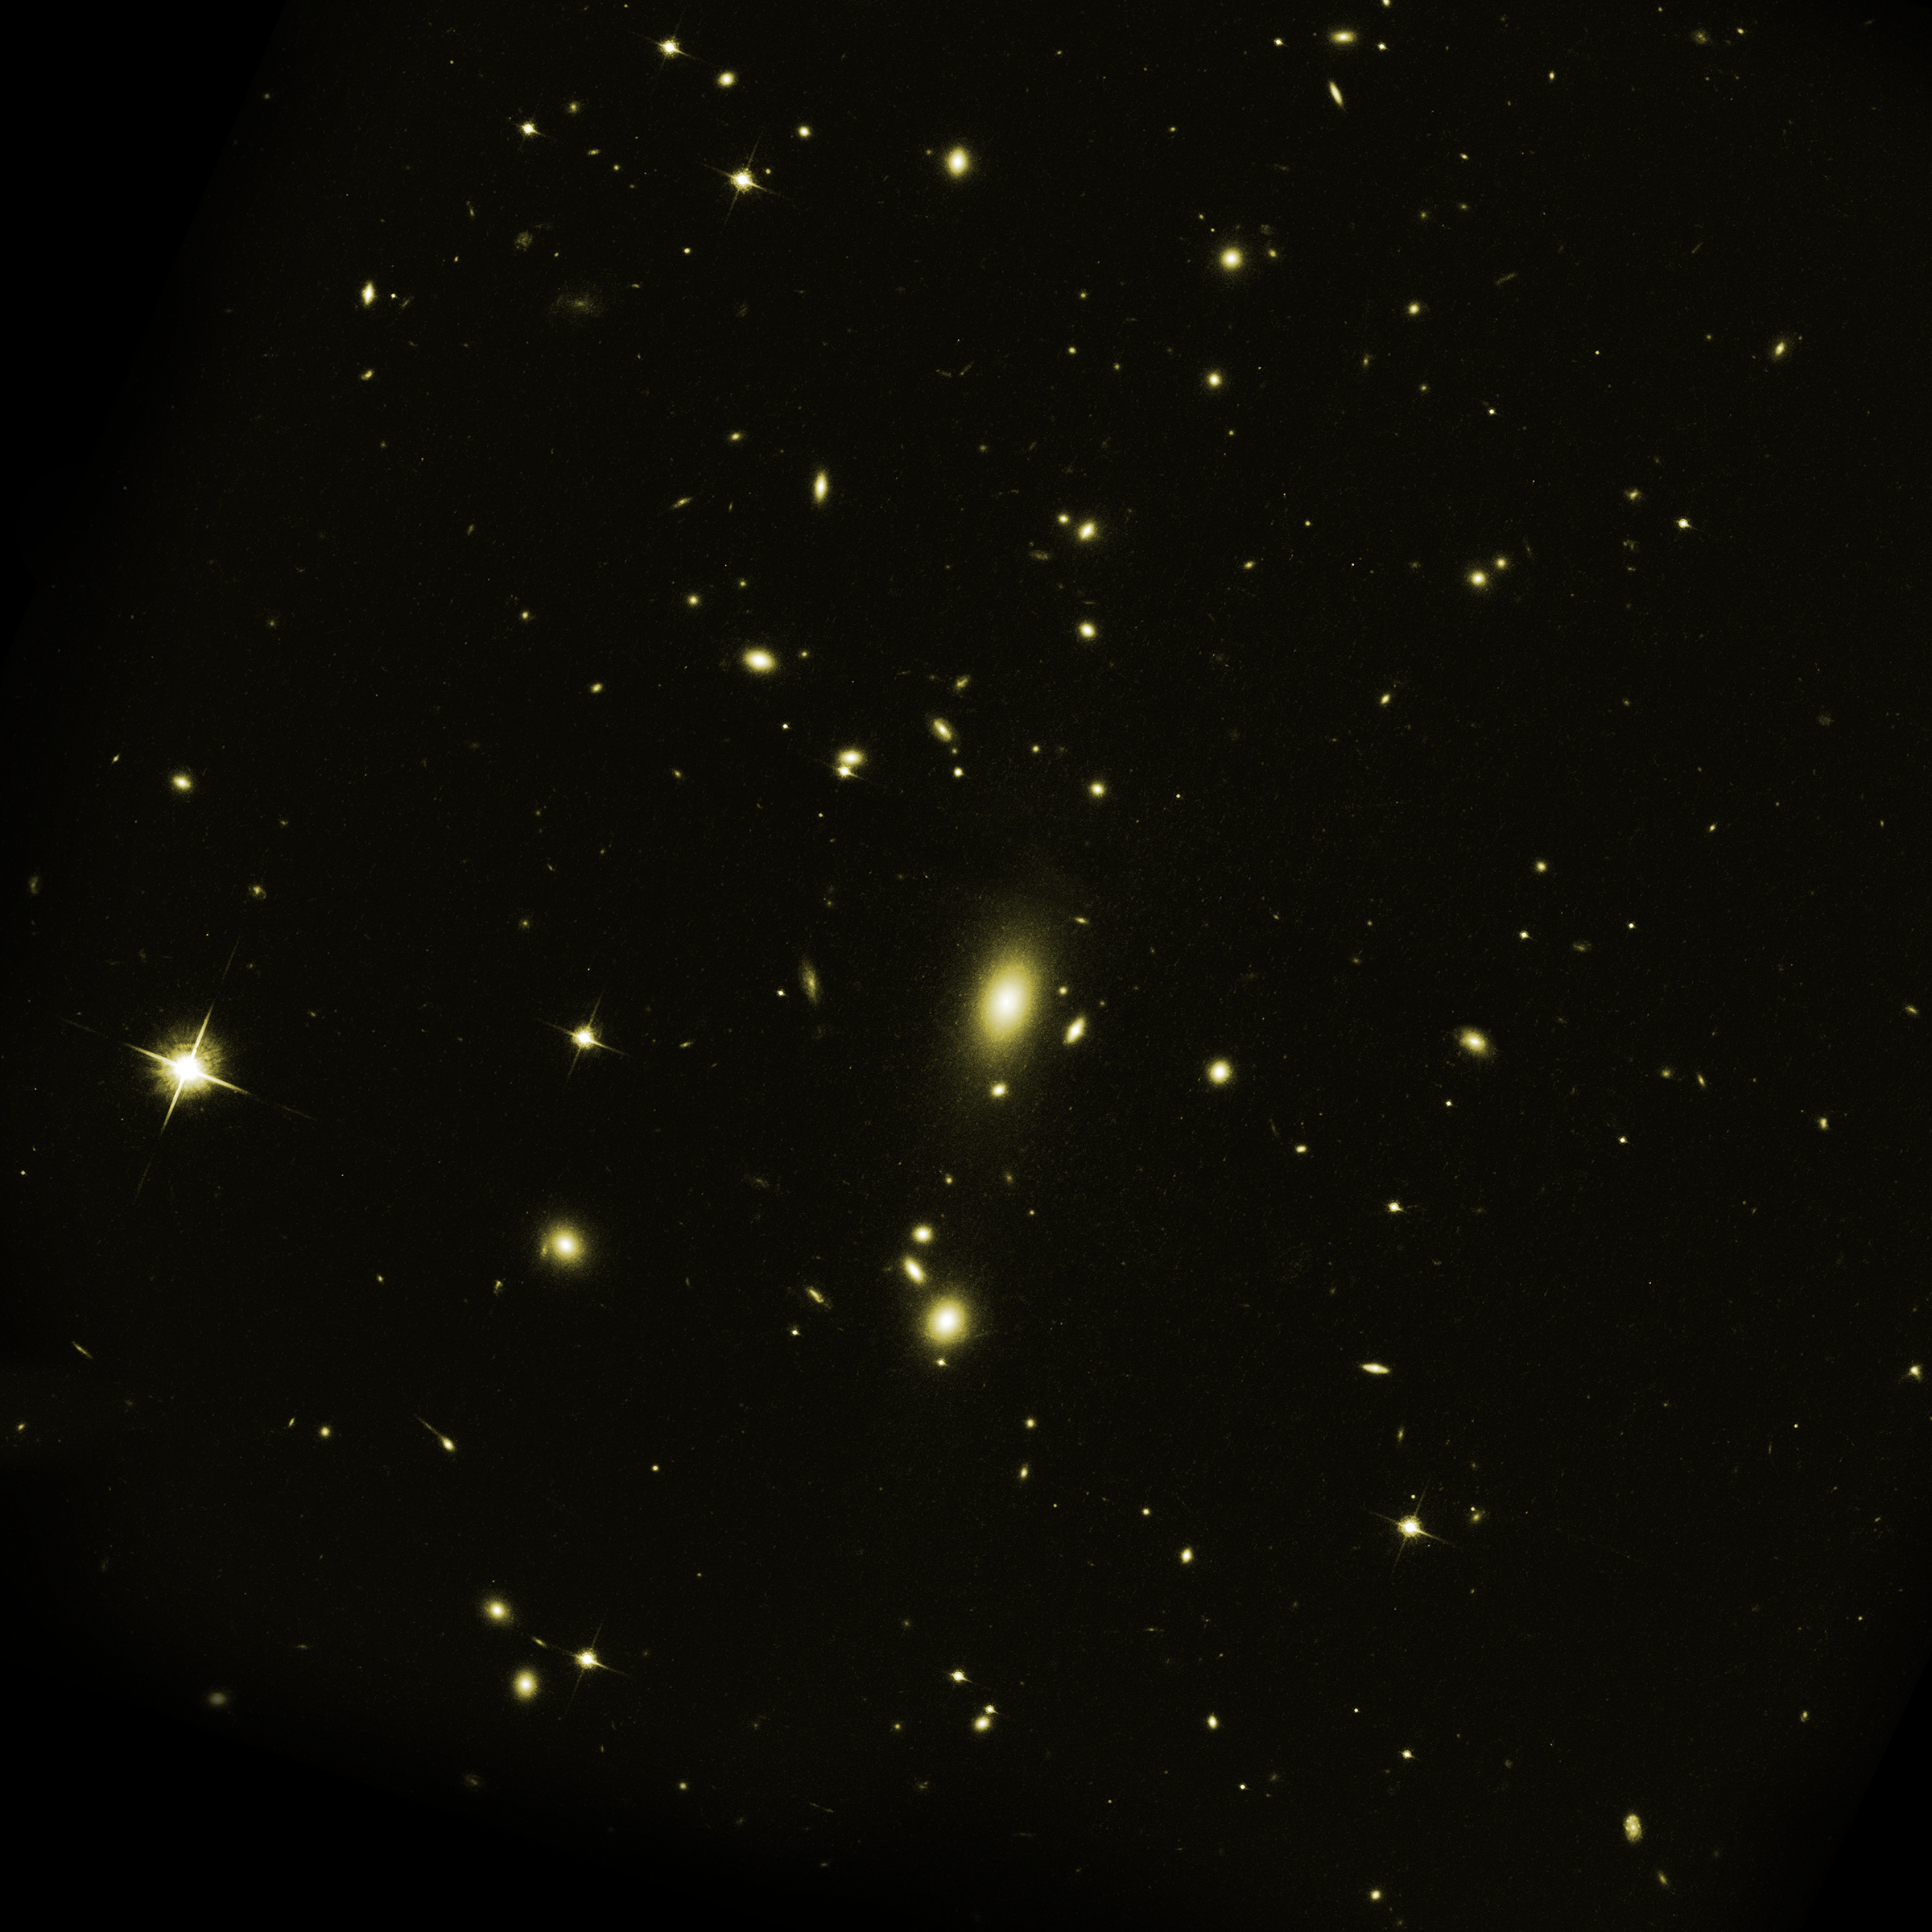
Evolution of AGN feedback in clusters of galaxies
Redshift = 0.0
z = 1.0
Redshift = 0.0
Redshift = 0.0
Preliminary!
8 Gyrs
MACS + SPT: First systematic study of X-ray cavities at z > 0.3:
→ No evolution in mechanical AGN feedback in central cluster galaxies (z = 0.0 – 1.0)
2) MACS: Nuclear X-ray luminosities of central galaxies are rapidly evolving:
→ Most will host a quasar by z=1 (i.e. outshine the host cluster).
  Future (in preparation):
  → South Pole Telescope (SPT), Planck – many new high redshift clusters discovered.
Hlavacek-Larrondo et al. 2014, in prep
Notes:
Projets d’ete: jouer avec les donnees.
Say ici juste nomme eRosita (satellite lance en 2014), mais il y a aussi (NuSTAR – McGILL) + Astro-H (debut 2014) – Astronomy hautes energies est en plein effort, et c’est le temps ideale pour que Montreal s’investisse dans cette recherche.

Slide 27
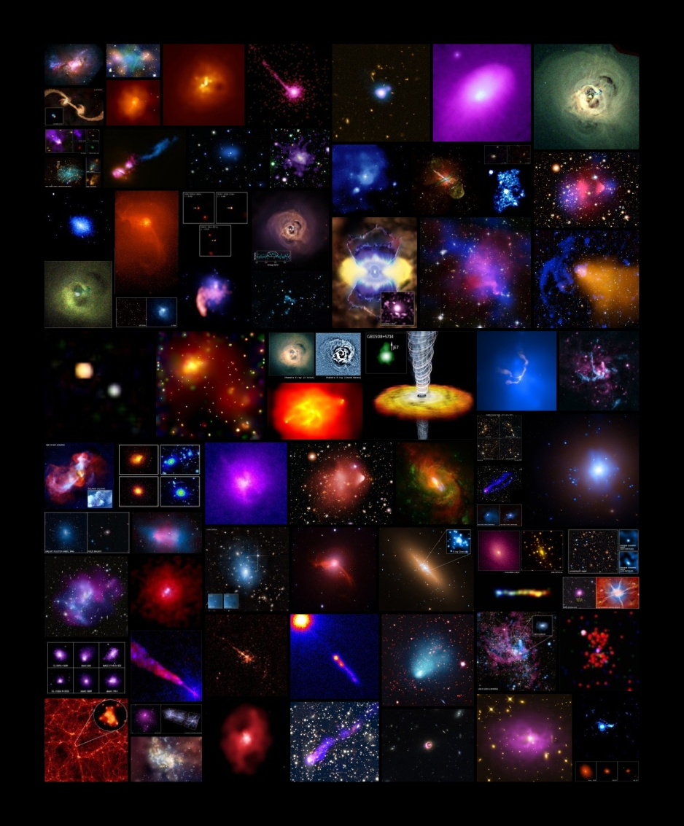
Physics of Clusters
and
AGN Feedback
Julie Hlavacek-Larrondo
Assistant Professor,
Université de Montréal
Collage of all press/image releases on clusters and massive black holes.
Notes:
Over 70 Chandra press releases on clusters or Agn feedback.

Slide 28
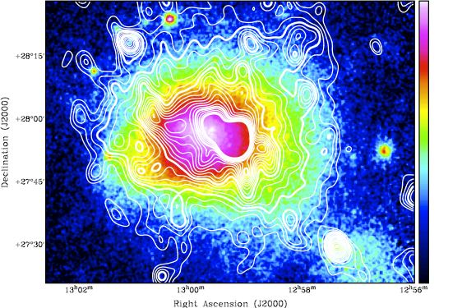
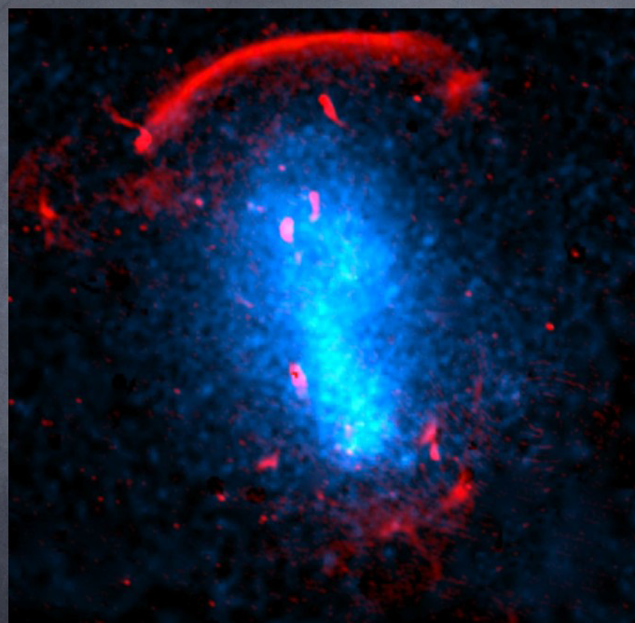
Clusters of Galaxies: Mergers
Radio Emission in Merging Clusters
Radio Halos Radio Relics
RADIO contours (350 Mhz WSRT)
RADIO (GMRT 610MHZ)
Properties: Diffuse (~Mpc), Unpolarized, Found in merging clusters.
Explanation: re-accelerated electrons (turbulence from mergers) or, secondary electrons (proton-proton collisions).
Properties: Elongated (~Mpc), Often polarized, Found in merging clusters.
Classes: Gischt (shock wave), AGN relics (old outbursts), Radio phoenices (AGN relics, compressed by shock wave).
Coma cluster, Brown+2010
C2248 toothbrush, Ogrean+2013

Slide 29

Fundamental Plane of Black Hole Activity
logM_{BH} = a*logL_{X-ray} + b*logL_{radio} + c
All radiatively-inefficient black holes follow the plane:
3M - 10¹⁰M
→ Theoretically derived by Heinz & Sunyaev 2003 (if black holes are scale invariant).
→ Neutron stars also follow a similar plane (different coefficients).
Merloni et al. 2003, Falcke et al. 2004, Kording et al. 2006, Gultekin et al. 2009, Plotkin et al. 2012,
Hlavacek-Larrondo et al. 2012b.
Notes:
FP: one of the most promissing pieces of evidence that support the idea that SMBH are scaled up version of Stellar mass black holes
FP arrises naturally from scale invariance: which states that the only quantity relevant to determining size of jet, power, magnetic field is rg (related to mass)
Once normalised by gravitational radii: the process that regulates the fraction of energy accreted onto black hole converted into luminosity is universal : just how much is radiated (radio and X-ray) is the same.
The parameters you get tell you about the kind of emission (seem to be more consistent with synchroton emission therefore Xrays dont come from inverse scattering of a hot corona.

Slide 30

AGN feedback in z > 0.3 clusters of galaxies
Time in the past : 3Gyrs 5Gyrs 6Gyrs
Ebeling et al. 2010
L_{X-ray, cluster} (10⁴⁴ erg/s)
Redshift
Massive Cluster Survey (MACS)
124+ spectroscopically confirmed massive/luminous clusters at 0.3 < z < 0.7
83 clusters have Chandra X-ray observations.
Hlavacek-Larrondo et al. 2012a
Notes:
So our aim was to study X-ray cavities at higher redshift: and to do that we used MACS survey.
Say that if we want to do high redshift then we need very luminous clusters so that we can distinguish cavities better so MACS is ideal. On top of that, if cool core since highly-luminous one would expect some of the most extreme examples of AGN feedback.
MACS launched in 1999…To obtain the sample they applied an X-ray flux and X-ray hardness-ratio cut to select distant cluster candidates from the ROSAT Bright Source Catalogue and fromt here they inspected visualy the clusters, and then followed spectroscopically.
The Brightest Cluster Survey, the Einsitein Medium Sensitivity Survey, the Wide Angle Rosat Pointing Survey (Warps) and the 400square degree Survey…onavaerga 10-20 times more luminous for the same redshift range.

Slide 31

Bullet cluster. Credit: X-ray: Markevitch ; Optical: Clowe.
Chandra
(X-ray)
Dark Matter (lensing)
50,000 light years
Bullet. Credit: A. Davidhazy RIT.
Notes:
A bullet traveling through air at about 1.5 times the speed of sound can be seen in this image.
KPC CHANGE!!!!

Slide 32

Fundamental Plane of Black Hole Activity
Plotkin et al. 2012
Plotkin et al. 2012
log L_{radio, 5 GHz} (erg/s)
log L_{radio, 5 GHz} (erg/s)
log L_{X-ray} + 0.88log M_{BH}
log L_{X-ray} + 0.88log M_{BH}
Notes:
Sample: 7 BCGs MH2007, 18 Table 1 (include Cyg A, Cent, M87).
Most of the Plotking sample (taken from Kording et al. 2006) have flat spectra. (90 per cent have inverted)
Flat/inverted synch self absorbe (when intensity becomes high, then radi absorbed by same relativisitc electrons.
Xrays produced by optically thin synchrtron emission from jet.

Slide 33



Fundamental Plane of Black Hole Activity
Black holes at the centre of clusters (M_{BH} – K-band)
Black holes at the centre of clusters (M_{BH} – σ)
log L_{radio, 5 GHz} (erg/s)
Plotkin et al. 2012
log L_{X-ray} + 0.88log M_{BH}
Hlavacek-Larrondo et al. 2012b
Notes:
Flat inverted: blue light
Sample: 7 BCGs MH2007, 18 Table 1 (include Cyg A, Cent, M87).
Most of the Plotking sample (taken from Kording et al. 2006) have flat spectra. (90 per cent have inverted)
Flat/inverted synch self absorbe (when intensity becomes high, then radi absorbed by same relativisitc electrons.
Xrays produced by optically thin synchrtron emission from jet.

Slide 34

Fundamental Plane of Black Hole Activity
M_{BH} (M)
Black holes at the centre of clusters (in BCGs)
σ_stars (km/s) ≈ Mass / luminosity of the bulge
McConnell & Ma 2013, McConnell et al. 2012
Notes:
NGC 1332: belong group NGC 1407 + IC 1459 (part of loose group) + M60 (part of vrgo) + N4261 (Virgo) + N3998 (SO galaxy)
IC 1459 (part of loose group) + M60 (part of virgo) + N4261 (virgo) + N4374 (=M84 part of virgo) + N1316(part of fornax)
Difficult to build such large black holes althought discovering supermassive (quasars at z`6-7)
Quasar at 7: 770 millions years after big bang: Mass quasar is 2*109Msun : quasar are believed to be powered by accretion onto black hole and MBH = fct(Lum, width MgII)
We have discovered quasars at z=6.42 with MBH around3 *10^9Msun so based on accretion with efficiency 0.1, black hole mass grows as exp(t/0.04Gyr) sp MBH at 770 million years after big bang would be bellow 0.5*10^9Msun
Maybe BCG are what these quasars become
UMBH in M87 and Coma average clusters – our objects are extreme side : where AGN must be and is powering an incrdiable amount of energy, so I wouldnt be surprised if these objects are even more massve (several 10^10Msol).

Slide 35

Fundamental Plane of Black Hole Activity
Hlavacek-Larrondo et al. 2012, submitted to MNRAS
1. Standard BH – host galaxy correlations may not be valid for BCGs:
→ underestimate M_{BH} by a factor of ≈ 10.
2. a) For « normal » BCGs: those belonging to moderate mass clusters and/or with a moderate cool core (P_{cavities}≈ 10⁴³⁻⁴⁴ erg/s).
M_{BH}(FP) ≈ 10⁹⁻¹⁰ M ✔ Agrees with the observations
b) For the « extreme » BCGs: those belonging to
very X-ray luminous and strong cool core clusters
(P_{cavities} ≈ 10⁴⁵ erg/s).
M_{BH}(FP) ≈ 10¹⁰⁻¹¹ M
None of these extreme BCGs yet have dynamical mass measurements of their BHs, but this can be accomplished with Hubble + AO + ALMA.
Hlavacek-Larrondo et al. 2012b
Notes:
Difficult to build such large black holes althought discovering supermassive (quasars at z`6-7)
Dyn mod: model based on assump that ionized gas is moving under influence of gravita potential of star + SMBH. Find best fitting parameters.

Slide 36

Evolution of AGN feedback in clusters of galaxies
Light travel time: 3Gyrs 5 Gyrs 8Gyrs
Number of sources: 32
Rosat X-ray telescope (1990-1999)
Fraction with a detectable
X-ray nucleus
Log L_{nucleus}(2-10 keV)
1 + z
Hlavacek-Larrondo et al. 2013b
Notes:
ROSAT: X-ray observatory 1990 launched – all sky survey.
High redshift population of clusters hints AGN activity + cool core → equiavlent
Luminosity: L=10^45-46erg/s: quasars

Slide 37

AGN feedback in SPT clusters of galaxies
Preliminary!
P_{cavities} [10⁴² erg/s]
L_{cool} ( z=2 ) [10⁴² erg/s]
→ X-ray cavities at high redshift may be injecting an excess of ≈0.9 keV per particle in heat assuming high duty cycles (explain excess entropy?).
→ Somehow these black holes have been mechanically active for >8Gyrs
Hlavacek-Larrondo et al. 2014, in prep (in collaboration with Michael McDonald)
Notes:
Preliminary: Cavity versus Lcool
Note that some blue and green points shifted new definition of cooling luminosity.

Slide 38

Cool Core Clusters of Galaxies
A1835, Peterson & Fabian 2006
Cooling flow problem
1. Optical and UV:
Newly formed stars are seen but only 10% of the rate predicted (dozens, not hundreds of M/ yr).
2. H₂ and CO (cold molecular gas):
Same, just 10% of the predicted rates.
3. Soft X-rays (“cold” X-rays):
→ Cooling flow is not continuous.
T: 10⁸ K → 0 K
Predicted: 100-1000 M/yr
Observed: 1-100 M/yr
→ Cooling Flow Problem
Fe XVII
T: 10⁸K → 3*10⁷ K
Notes:
IRON 17 sensitive to gas between 0.2-0.8kev or 7x10^6K ….so there is a gas of gas at this temperature
Observed CO is about 10¨9-10 Msol
In cooler clusters, there is Iron 17…but not the level expect for all clusters
First one (isobaric) is described when heating (thermal + contract)= cooling, gives you mass deposition rate
FeL missing, which allows precise measure of amount of gas at 1keV
We do not see continuous cooling flow ….so some form of gentle continuous and sitributed heating is needed

Slide 39
Fundamental Plane of Black Hole Activity
Hlavacek-Larrondo et al. 2012, submitted to MNRAS
(assuming that L_{X-ray} and L_{radio} are correct)
1. Standard BH – host galaxy correlations may not be valid for BCGs:
→ underestimate M_{BH} by a factor of ≈ 10.
2. a) For « normal » BCGs: those belonging to moderate mass clusters and/or with a moderate cool core (P_{cavities}≈ 10⁴³⁻⁴⁴ erg/s).
M_{BH}(FP) ≈ 10⁹⁻¹⁰ M ✔ Agrees with the observations
b) For the « extreme » BCGs: those belonging to
very X-ray luminous and strong cool core clusters
(P_{cavities} ≈ 10⁴⁵ erg/s).
M_{BH}(FP) ≈ 10¹⁰⁻¹¹ M
None of these extreme BCGs yet have dynamical mass measurements of their BHs, but this can be accomplished with Hubble + AO + ALMA.
Hlavacek-Larrondo et al. 2012b
Notes:
Difficult to build such large black holes althought discovering supermassive (quasars at z`6-7)
Dyn mod: model based on assump that ionized gas is moving under influence of gravita potential of star + SMBH. Find best fitting parameters.

Slide 40

Kording+2006

Slide 41
Evolution of radiative AGN feedback in BCGs
Light travel time: 3Gyrs 5 Gyrs 8Gyrs
Number of sources: 32
Fraction with a detectable
X-ray nucleus
Log L_{nucleus}(2-10 keV)
1 + z
A significant fraction of massive strong cool core clusters at z=1 may host quasars at their centre (70-80%).
Problem for cluster surveys (see also Russell et al. 2012)
1 + z
Hlavacek-Larrondo et al. 2013
Notes:
Point:
Now the second, is that a significant fraction of these massive cool cores, will host a quasar at their centre. And I show this in more detail in this plot. So by z=0.8, about 70% of these strong cool core clusters that are presently actively forming caviites, will have a bright quasar at their centre.
Now why is this so interesting: its because : cluster surveys based on moderate angular resolution data, like Rosat.
Note importantly: no bias, volume increase.

Slide 42


Slide 43


Slide 44



1. Stellar mass BHs: 3M – 40M
Artist impression of GRO J1655-40. M. Weiss (CXC), NASA
2. Intermediate mass BHs: 40M – 10⁵M
Stellar cluster G1, Image from HST (NASA/M, Rich UCLA)
3. Supermassive BHs: >10⁶M
Centaurus A (nearest galaxy with an active nucleus)
Notes:
GRO J1655-40 consists of a relatively normal star about twice as massive as the Sun co-orbiting with a black hole of about seven solar masses. This striking artist's vision of the exotic binary system helps visualize matter drawn from the normal star by gravity and swirling toward the black hole. But it also includes a wind of material escaping from the black hole's accretion disk. In fact, astronomers now argue that Chandra Observatory x-ray data indicate a high-speed wind is being driven from this system's disk by magnetic forces. Internal magnetic fields also help drive material in the swirling disk into the black hole itself.
A Hubble Space Telescope view of the star cluster G1, which orbits the center of the Andromeda galaxy. The bright stars above the cluster are foreground stars inside the Milky Way galaxy. [NASA/M. Rich (UCLA)] ABOUT 10^4 MSOL.

Slide 45

Fundamental Plane of Black Hole Activity
McConnell et al. 2013
The black holes at the centre of clusters may be significantly more massive than previously thought: 10¹⁰⁻¹¹M black holes.
How to measure the mass of a black hole?
→ Model the kinematics of the gas or stars within the sphere of influence of the black holes.
→ For our objects, this can be accomplished with HST (and ALMA!).
M_{BH} (M)
ALMA
σ_stars (km/s)
Hlavacek-Larrondo et al. 2012b

Slide 46




2010

Slide 47

Evolution of radiative AGN feedback in BCGs
Light travel time: 3Gyrs 5 Gyrs 8Gyrs
“High/Soft state”
Radiatively-efficient
Shakura & Sunyaev 1973
1%
0.01%
0.0001%
“Low/Hard state”
Radiatively-inefficient
Narayan & Yi 1994, 1995
Eddington ratio
Log L_{nucleus}(2-10 keV)
Quiescent state
(e.g. Sgr A*)
1 + z
Hlavacek-Larrondo et al. 2013b

Slide 48

Nature, 2012

Slide 49


Slide 50



Slide 51

Radiative evolution of the black holes?
Hlavacek-Larrondo et al. 2013
Evolution of the star formation rate (peaks at z=2-3; Madau et al. 1996)
Evolution of the quasar luminosity function (also peaks at z=2-3; Hopkins et al. 2006)
(1+z)⁴

Slide 52

The importance of AGN feedback
in massive galaxies
Sample of clusters of galaxies
P_{X-ray cavity} (10⁴⁴ erg/s)
10000
0.000001 0.00001 0.0001 0.001
L_{radio} (10⁴⁴ erg/s, at 1GHz)
2) Establish a relation: mechanical input versus radio luminosity.
Birzan et al. 2008, Cavagnolo et al. 2010, Hogan, Edge, Hlavacek-L. et al. 2013, en preparation
Notes:
Here emphasize: radio for all sources with clear cavities (13) + radio for 4 out of 7 with potential have radio!
1. Cavities are vast majority found in systems that require some heating
2. They are common in these systems

Slide 53


The importance of AGN feedback in clusters
Perseus: 250 hours with Chandra + 235 MHz GMRT contours
Flux density ( mJy )
  X-ray cavities in Perseus cluster: excellent for studying how relativistic particles age.
  New JVLA facilities at low frequencies (230-470MHz).
Perseus; X-ray from Fabian et al. 2011
Notes:
Projet maitrise * 2!
Prelimanary results concerning the 235 MHz data on GMRT for Perseus…although more work is needed to obtain the deepest image and search for radio emission extending to outer bubbles…we find emission associated with the North-West …this gives a rare occation to do a detailed spectral aging analysis.
Contours: 5 sigma where sigma = 10 mJy/beam and we are aiming to get down to 0.5 mJy/beam

Slide 54


Building an Ultramassive BH
Quasars in the distant Universe (Fan et al. 2006+, Mortlock et al. 2011)
→ z = 7.085 = 0.77Gyrs after Big Bang
= 5% of the current age of the Universe
→ M_{BH} = virial argument = f*σ_{velocity}*R_{BLR}/G = 2*10⁹M
IR/ESO/UKIDSS/SDSS
Notes:
Une des prevues les plus directes quon a pour dire que oui, ces tns monstrent peuvent exister, c’est l’observations des quasars lointian.

Slide 55


Building an Ultramassive BH
= 0.1
= 1 (si L=L_{Edd})
MBH, z=7.085=770 Myrs after Big Bang =2*10⁹M
M₀=100M → Δt = 840 Myrs
M₀=1000M → Δt = 730 Myrs

Slide 56
Building an Ultramassive BH: M₀>1000M
Massive Halo collapses at z >>
Metallicity ≈ 0
H₂
Metallicity <<
Pop III Stars
30-300M
Gas cools
Break down of H₂ + star formation suppressed
Formation of BHs
10-150M
Quasistar 10⁶M=
Very massive BH 10⁴-10⁵M
e.g. Couchman & Rees 1986
Volonteri, A&AR, 2010
e.g. Begelman 2006, 2008
Notes:
H2 an effective coolant at temperatures below 104 K. Helium is in a
neutral state and does not actively. you need a way to keep the matter cool so that gravity can pull the matter into a dense ball without pressure ripping it apart. In modern stars, heavy elements do this by releasing energy through photons.
Since modern stars contain some but not many heavier elements, the photons that get released by heavier elements never get reabsorbed and exit the star cooling it off.
→ Collions entre H et H2 = molecule excite qui va desexcitter et emettre un photon, donc le gas va refroidir.

Slide 57


AGN feedback – Sound Waves
Perseus – X-ray
Perseus– « Unsharp-masked X-ray image »
Notes:
Dissipation of energy from sounds waves and weak shocks generted by AGN outflows is most promising mecanisms to heat medium

Slide 58
Here be Monsters: Black Holes
Chandra image of Perseus cluster (10 days)
Emission
X-ray brightness
30,000 300,000
Radius (light years)
Sound waves in space.
B flat, but the note is 57 octaves lower
than middle C.
Notes:
KPC!!!!!! CHECK EVERYWHERE!!!!!
Brem = libre-libre
One of the unexpected and exciting results in the past 8 years or so has been the dicovery of sounds-pressure waves and weak shock fronts.
King model (power law + core)
It is difficult to measure T and surface brightness prop n^2T^1/2 so difficult to measure T (errors on T remain large, but what they have now indicates no significant variation of T)…not n: The wave ﬂux decreases outward with radius, consistent with energy being dissipated. The period of the waves is about 10 Myr, close to the expected age of the bubbles due to buoyancy.
Sector is centered on inner bubble and not AGN – errors are so small because this is one of the deepest (900ks) observations…so counts/arcsec is very precise.
Model in top panel:King model fit
Second is fractional residuals to fit
P = nkT so if you see ripples in n then you see in P, so they are interepeted as sound waves

Slide 59

Image from Rob Fender – turtle diagram
Notes:
Fig. 5. A schematic of our simplified model for the jet-disc coupling in black hole binaries. The central box panel represents an X-ray hardness-intensity diagram (HID); ‘HS’ indicates the ‘high/soft state’, ‘VHS/IS’ indicates the ‘very high/intermediate state’ and ‘LS’ the ‘low/hard state’. In this diagram, X-ray hardness increases to the right and intensity upwards. The lower panel indicates the variation of the bulk Lorentz factor of the outflow with hardness – in the LS and hard-VHS/IS the jet is steady with an almost constant bulk Lorentz factor Γ < 2, progressing from state (i) to state (ii) as the luminosity increases. At some point – usually corresponding to the peak of the VHS/IS – Γ increases rapidly producing an internal shock in the outflow (iii) followed in general by cessation of jet production in a disc-dominated HS (iv). At this stage fading optically thin radio emission is only associated with a jet/shock which is now physically decoupled from the central engine. As a result the solid arrows indicate the track of a simple X-ray transient outburst with a single optically thin jet production episode. The dashed loop and dotted track indicate the paths that GRS 1915+105 and some other transients take in repeatedly hardening and then crossing zone (iii) – the ‘jet line’ – from left to right, producing further optically thin radio outbursts. Sketches around the outside illustrate our concept of the relative contributions of jet (blue), ‘corona’ (yellow) and accretion disc (red) at these different stages.

Slide 60



X-ray emission from clusters of galaxies
1 keV (1.2x10⁷K) plasma
7 keV (8.1x10⁷K) plasma
Fe-L (niveau n= 2)
Fe K
Fe L
Fe-K
Fe K
X-rays give temperature, abundance, density
Notes:
As you can see, slope of continuum can vary so from Brem - …
This is how X-ray tells us T, n, abundance
Bremm dominates for T>3x107K , below you have discrete line emission. In most

Slide 61



Slide 62
Fundamental properties black holes
Rs = 2GM/c^2 = 3km pour M=1Msol
Rinfluence = GM/sigma^2
= 5pc pour 10^8Msol et 300k/s
= 0.5 kpc pour 10^10Msol et 300km/s (=0.3’’ a z=0.1)

Slide 63


Mesurer le moment angulaire des TNs

Slide 64


Hlavacek-Larrondo et al. 2012, arXiv: 1110.0489
Cavity properties: energetics
E_{cavity}=4pV_{total}
L_{mech} = 4pV_{total}/t_{age}
z < 0.3
L_{mech} (10⁴² erg/s)
L_{cool} (< r_{cool}) (10⁴² erg/s)
Notes:
Difference: red : RBS797 MACS 0947 (Cavagnolo et al. 2011 study we agree with)
the bubble is slowly inﬂated and thereafter expands adiabatically as it rises buoyantly through the cluster core, it releases an energy of approximately [γ bubble /(γ bubble − 1)]pV
We have indication that bubbles liberate 4pV of energy (Graham et al. 2008) who should that energy stored within weack shock around bubble is 4pV : calculate extra energy in pressur profile and gives 3.5pV
E = Enthalpy= Einternal + worked to create it: ideal gas 4pV (non relvaistic): Gamma= adiatbacted index of gas
Here plot Lmech (t buyancy) verses Lcool…LCOOL so not corrected for mass deposition rates. …difficult to fit but only 10% so shouldnt modify our results. MACS powerful and capable of offseting cooling.
Distribution : very powerful outburst…and peaked distribution.
About 50 in total
Mckflow is a steady state continusouly cooling model
Higher end of Pvtot Raf: MS0735, Z2701 and Z3146 and extends to lower energetics (including Centaurus)

Slide 65
Societe:
Technologie des telescopes, pousse les detecteur sensible, influence physique medicale (detecteur)
Simulations cosmologique: on pousse l’etude et le besoin des capacite d’ordinateur/informatique (plein d’autre domaine)
Comphrehension du soleil (pour atmosphere/meteo/solar flares).
Comprendre gravite, pour les satelittes
Imagination: capacite d’influence la jeuness (a travers images, visuel), fair epousse imagination.
Historiquement: benefice pour la societe, progression…

