Slide 1
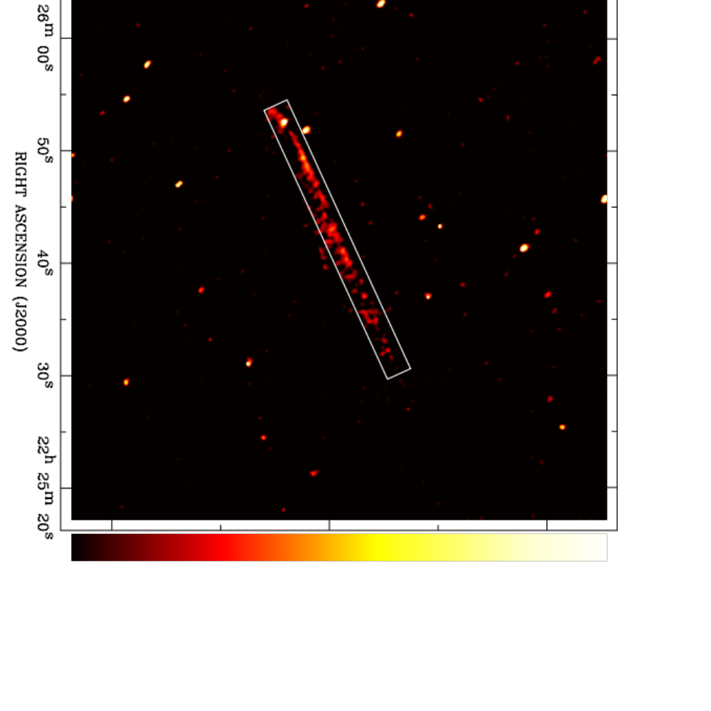
X-ray jets from B2224+65:
A Middle-aged Pulsar's New Trick
Q. Daniel Wang & Seth Johnson
University of Massachusetts
Notes:
The poor knowledge about the outflows, driven by galactic feedback, is the weakest link in our understanding of galaxy formation and evolution.

Slide 2
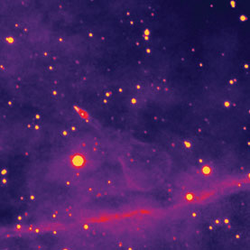
B2224+65 and Guitar Nebula
Period = 0.68 s
Ė_{s} =1.2 x 10³³ erg s⁻¹
t_{s} ~ 1.1 Myr
Distance ~ 1 kpc
Proper motion ~ 900 km/s
A bow shock nebula in Hα (Cordes et al. 1993).
A linear X-ray feature apparently stemming from pulsar, but ∼118º offset from its proper motion direction (Wong et al. 2003; Zavlin & Pavlov 2004; Hui & Becker 2007).
This linear feature (main jet) showing a consistent proper motion (Johnson & Wang 2010).
Pulsar proper motion direction
Image: Courtesy of Shami Chatterjee and James M. Cordes Cornell University

Slide 3
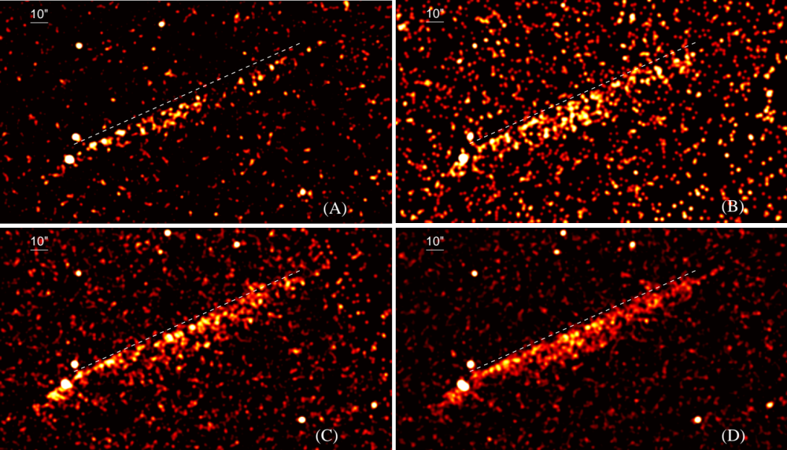
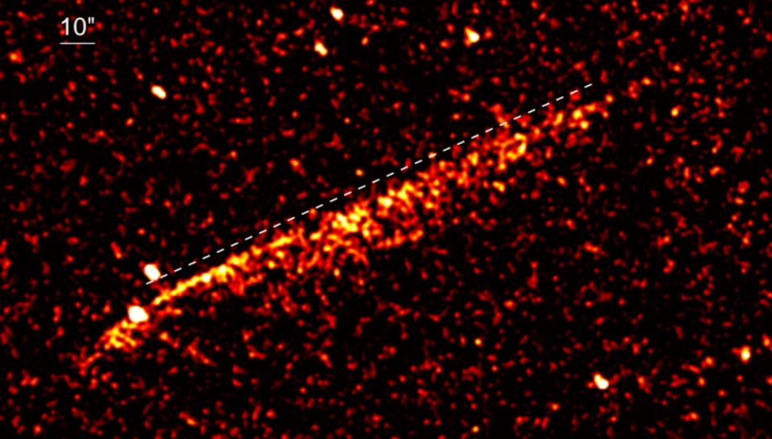
Three epoch Chandra/ACIS-S observations
Reference line
pulsar
  2000 48 ks
  2006 45 ks
Elongation due to pulsar motion
  Combined in pulsar rest frame
  2012 87 ks
  Combined 189 ks

Slide 4
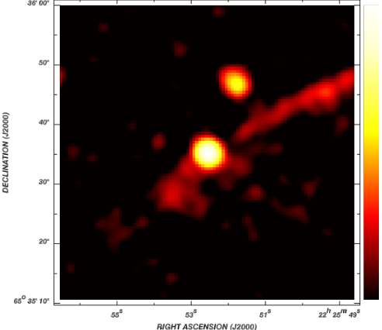
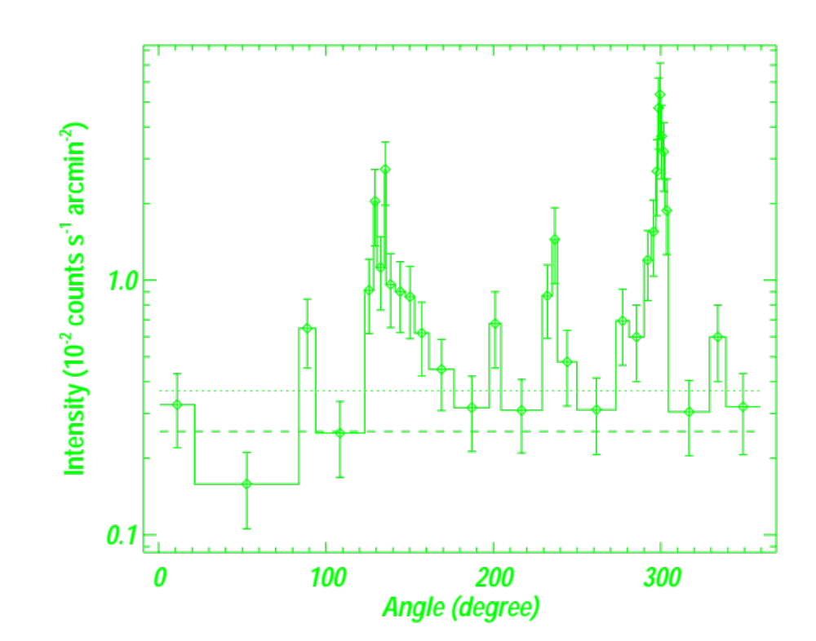
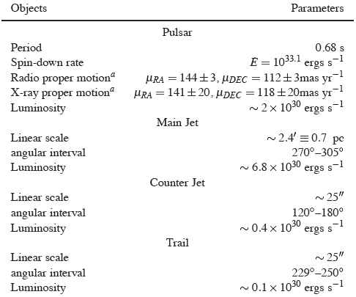
Consistent proper motions of the pulsar and the main jet.
Sharp leading edges of the jets, slightly bended backward.
A gap between the pulsar and the main jet.
Broadening with the distance from the pulsar.
Jet
Counter
Jet
  Combined in pulsar rest frame
Trail
Azimuthal intensity plot; angle E from N
Away from pulsar’s motion
Counter jet
Trail
jet

Slide 5
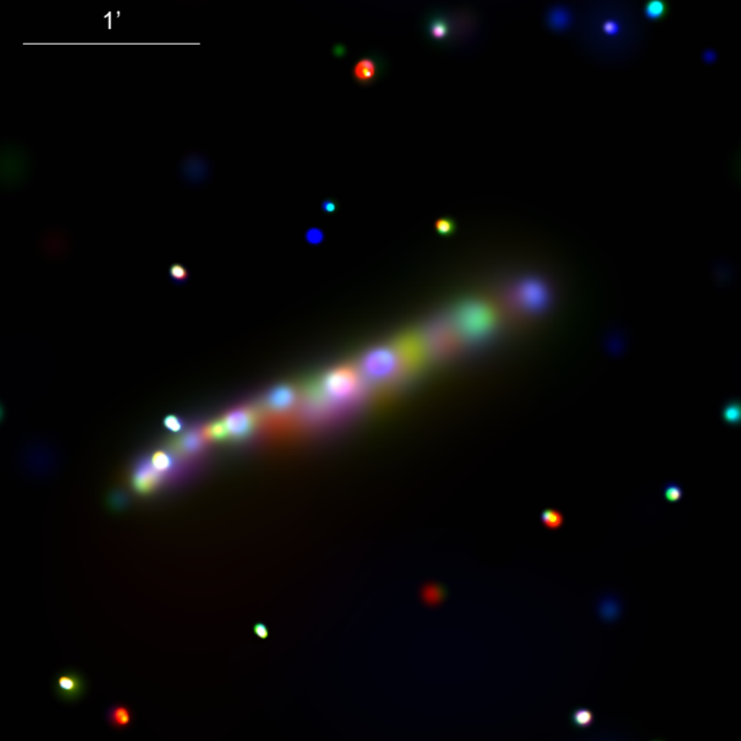
Spectral characteristics
No systematic variation in the spectral shape with time or across the main jet.
Flat spectrum with a power law photon index 1.2 (0.9-1.5; 90% error interval), compared to 1.7 (1.3-2.0) for the pulsar.
Thus the jet is not simply due to the diffusion of particles from the pulsar or its bow shock.
In-situ particle acceleration in the jets is required and probably at the emission peaks, which tend to be spectrally harder.
0.7-1.5 (red), 1.5-3 (green), 3-7 (blue) keV

Slide 6
Implications
The results are most intuitively explained by ballistic ejecting jets, similar to those seen in AGNs.
The straightness of the main jet, under the expected large ram-pressure of the ISM, indicates that it is largely hadronic.
The intensity contrast between the two jets requires a strong Doppler effect and predicts their nearly orthogonal direction relative to the pulsar motion.
This orientation of the spin (jets) and the large pulsar velocity may be due to a fast kick in an asymmetric SN.
The scenario can be tested by a radio polarization measurement of the pulsar.
The energetic jet-like ejection may be a common phenomenon of pulsars and may be an important source of cosmic-rays.
Notes:
, which has so far received little attention and needs to be understood

Slide 7
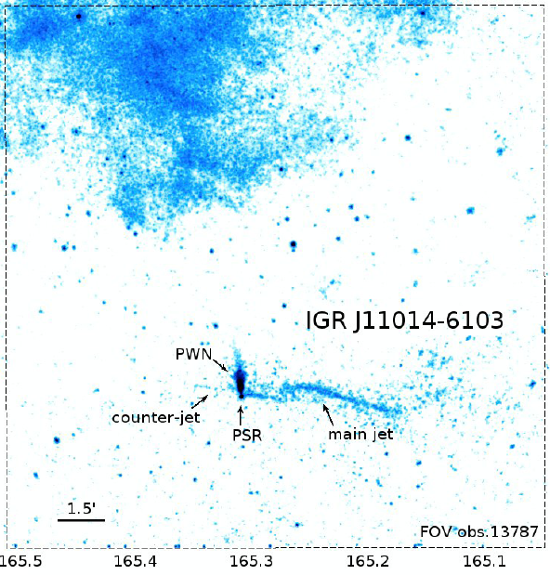
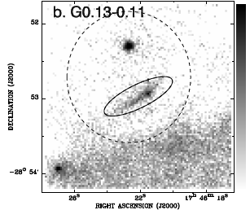
Examples of other similar linear X-ray features
SNR MSH 11-61A
An example of linear nonthermal X-ray filaments as candidates (Wang et al. 2002).
The jet, >11 pc long, displays a helical shape and propagates nearly perpendicular to the pulsar motion (Pavan et al. 2014).
Notes:
long helical jet

