Slide 1
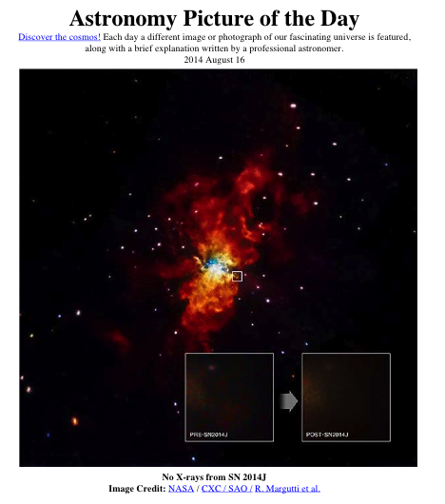
nothing
A Chandra view to Exploding Stars
SN2014J
R. Margutti
Harvard
Notes:
Ok So thank you for having me here today. In these 12 minutes I am going to try to give you a flavor of the tremendous impact of Chandra observations that we carried out in the past few years to observe supernovae. And it is true that sometimes it really turns out to be NOTHING, but even in this case, these observations are highly constraining as it was the case for 14J, the nearest type Ia SN in the last 3 decades.

Slide 2
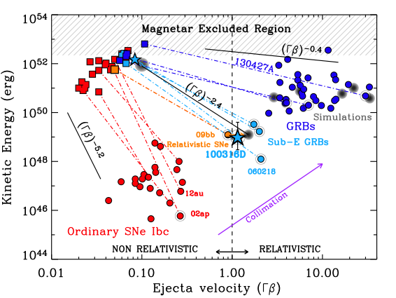
Energy partitioning
SNe are an OPTICAL
phenomenon
10⁵¹ erg
OPTICAL
X-rays/Radio
10⁴⁷ erg
Margutti +13, +14; Kamble +13; Soderberg +06, +10
Notes:
SNe have been studied for decades in the OPTICAL and there is a reason. Most of the energy is carried by slowly moving material that emit in the optical window, If we were to compute the amount of energy releases in the optical, we would find something like 10^51 erg, while fast moving material in the ejecta carries 10^47 erg. WHAY SHOULD I CARE ABOUT SOMETHING THAT CONtriBUTES TO 0.1% to the total energy budget? Well, there are a number of reasons. Let’s see what produces X-ray emission first.

Slide 3
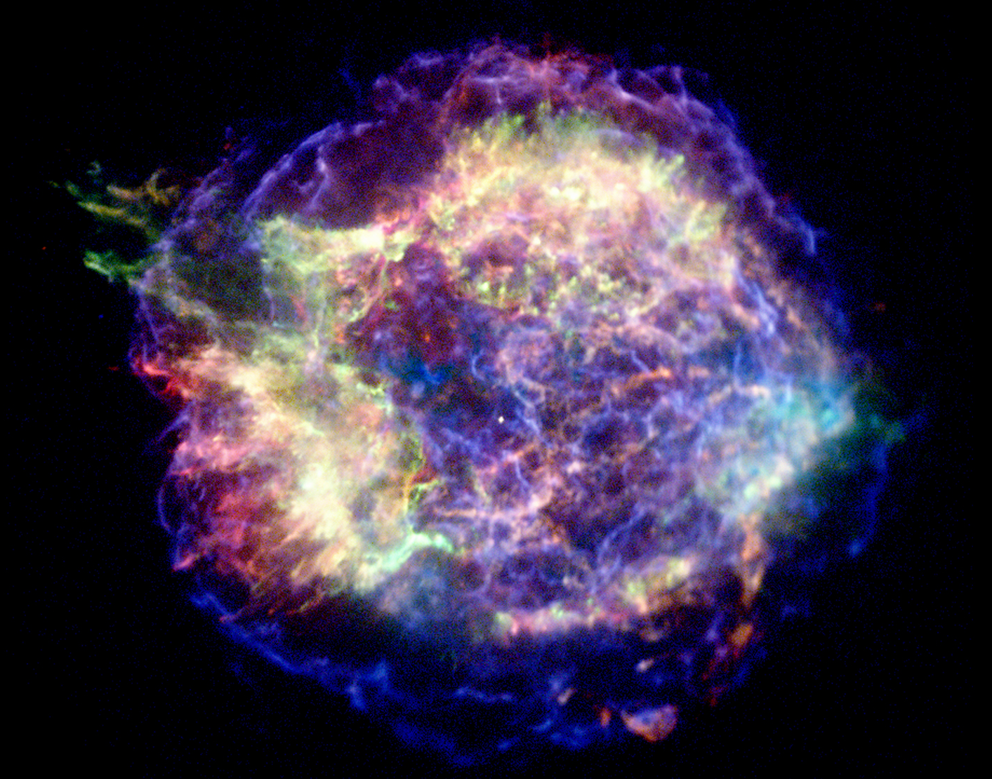
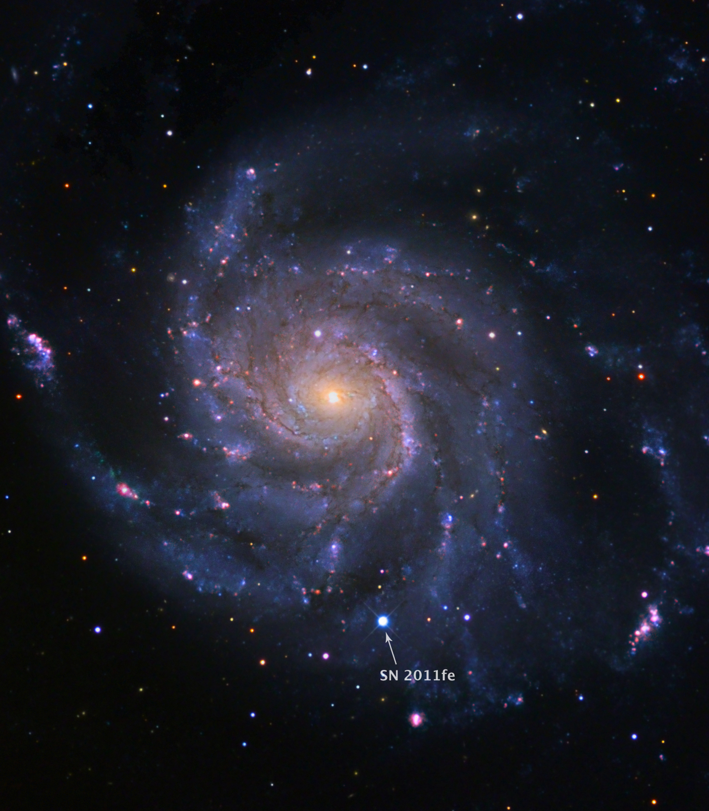
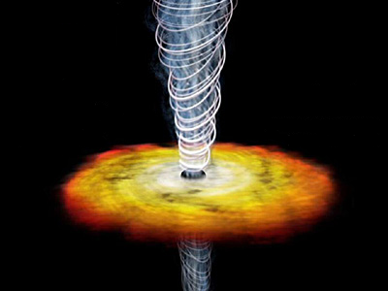
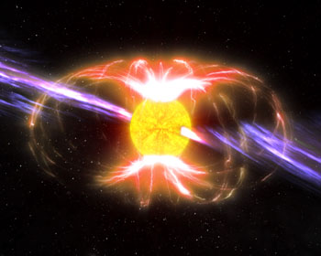
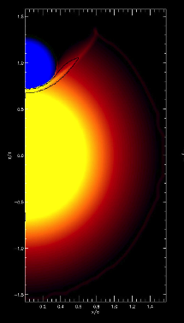
X-rays from Supernovae
Log Lx
SHOCK INTERACTION
w. COMPANION
(R and distance of
the companion)
SHOCK/JET INTERACTION w. the MEDIUM
(mass-loss of the progenitor)
SHOCK BREAK OUT
(R exploding star)
Δt≈ 2ms
T≈250 keV
E≈3 10⁴¹ erg
MASS-LOSS
Δt≈ hrs
(@ T0+5hrs)
T≈ X-rays
E≈10⁴⁶⁻⁴⁷ erg
L~10⁴⁴ erg/s
RADIATION from the REMNANT
SOURCE of ENERGY
PROGENITORS
Log Time
< hr
Kasen +10
> 10 years
< several hrs
Notes:
So why do we need X-rays in the first place? What are the physical processes that produce X-rays in SN explosions? I am going to try to given an overview of our efforts, while Sayan just after me will zoom in into a specific case of IIP SNe. The very first signal is that coming from the SN shock break out, very short signal, that carries direct information about the exploding star. We wait a little bit more and IF there is a companion, the shock is going to interact with the companion star on a time-scale of a few to several hours.We have then the most obvious source of X-rays is ht einteraction of the shock/jet with material in the environment. This can be the dominating source of X-rays from days after the explsooin all the way to centuries after the explosion as SN remnant people here know. At some point however, radiation from the remnant of the explosion might dominate, in the form of radiation from accretion onto the newly formed BH or magnetar. Depending on the nature of the explosion this might start to dominate as early as days after the explosion or years.
So I want to draw your attention on the fact that in principle, using X-rays we can constrain: progenitors mass-loss, source of energy, which are the three major questions of massive stellar evolution and stellar explosion. Another way of putting this is that we can constrain the PRESENT, the PAST and the FUTURE of our stellar explosion.

Slide 4
…BUT…

Slide 5
X-rays from Supernovae
Log Lx
SHOCK INTERACTION
w. COMPANION
(R and distance of
the companion)
SHOCK/JET INTERACTION w. the MEDIUM
(mass-loss of the progenitor)
SHOCK BREAK OUT
(R exploding star)
Δt≈ 2ms
T≈250 keV
E≈3 10⁴¹ erg
Δt≈ hrs
(@ T0+5hrs)
T≈ X-rays
E≈10⁴⁶⁻⁴⁷ erg
L~10⁴⁴ erg/s
MASS-LOSS
RADIATION from the REMNANT
PROGENITORS
SOURCE of ENERGY
Log Time
< hr
Kasen +10
> 10 years
< several hrs
Notes:
BUT, this is difficult here (at early times) and here (late-times) and I want to emphasize that this is because of techological limits. We know the science. We do not have the right instrument. So most of our observations are obtained from days to a few years after the explosion (I call it the magic window).
And I am going to highlight 3 major results from our program = (1) progenitors of Ia (and as of yesterday the deepest constraints on Iax too) (2) central-engine driven explosions (3) Very turbulent history of mass-ejections (envelope ejection). Go over the 15 slides of the other talk quickly to emphasize your points and stress the points about the future. Finally 2 words on a risky project that I am leading and I am very excited about Major impact in the near future→ SLSNe late-times, stay tuned.

Slide 6
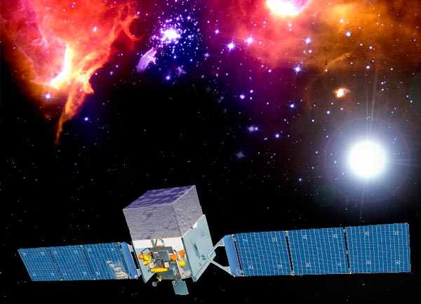
Type Ia SNe, Type Iax , Type Ibc, Type IIb, Strongly interacting SNe, Relativistic SNe, GRB-SNe, Super-Luminous SNe
Type Ia
Direct probe of EVOLUTION,
Indirect probe of PROGENITORS
MASS-LOSS
Relativistic SNe
Explosion Mechanism
SOURCE of ENERGY
Notes:
So what have I been doing: I have different programs BUT 2 main scientific drivers: I am using the X-rays to constrain the mass-loss history and the evolution fo the star in the years before explosion and as indirect probe of the progenitor itself. By asking to my self: is there a magnetar a BH that is powering a jet, I am trying to get and hendle on the explosion mechanism. In the next 5 minutes I am going to tell you something about what I believe are the 2 major results from my programs and I will spend the last 2 minutes on a somewhat risky but potentially very rewarding project that I am very excited about.

Slide 7
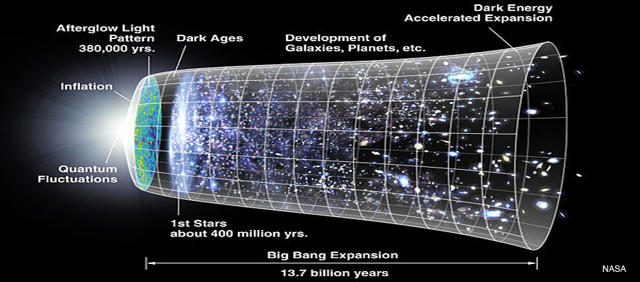
The PROBLEM
?
Type Ia SN explosion
Progenitor System
“…The end is
where we start
from…”
The Little Gidding by T. S. Eliot
Notes:
So the first is about Type Ia SN. They have been used for years as our cosmic ladders and they showed that our Universe is accelerating BUT we still do no know what progenitor system produces these explosions.

Slide 8
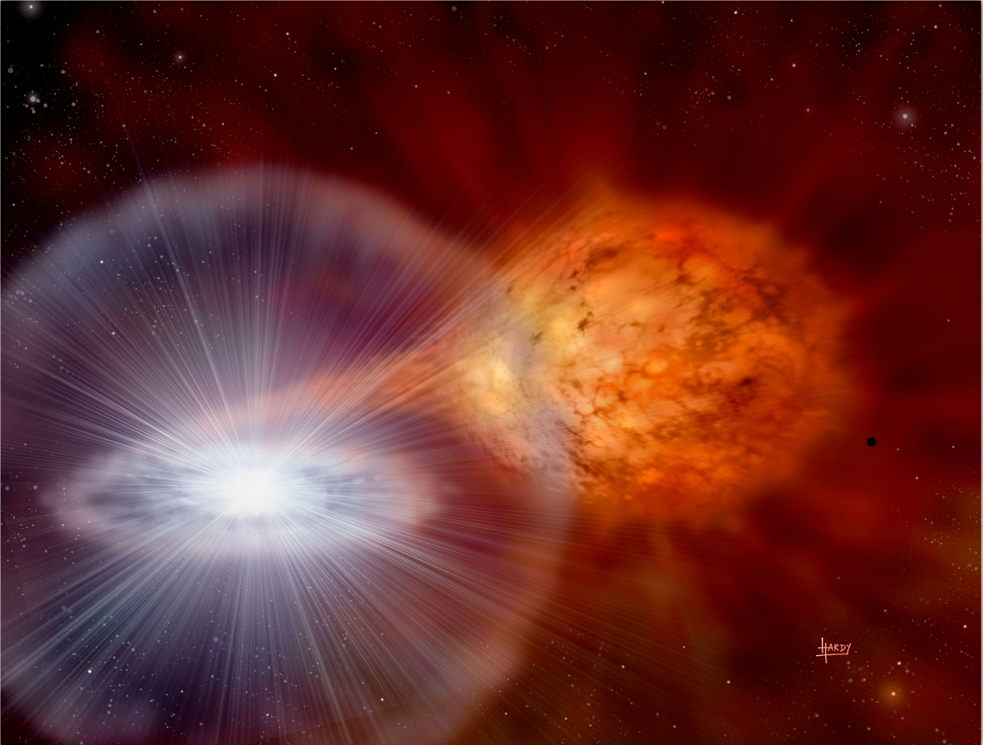

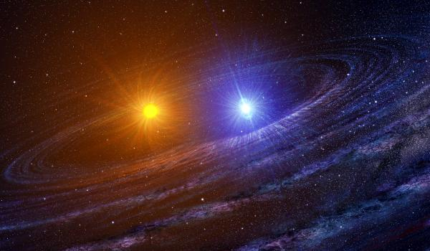
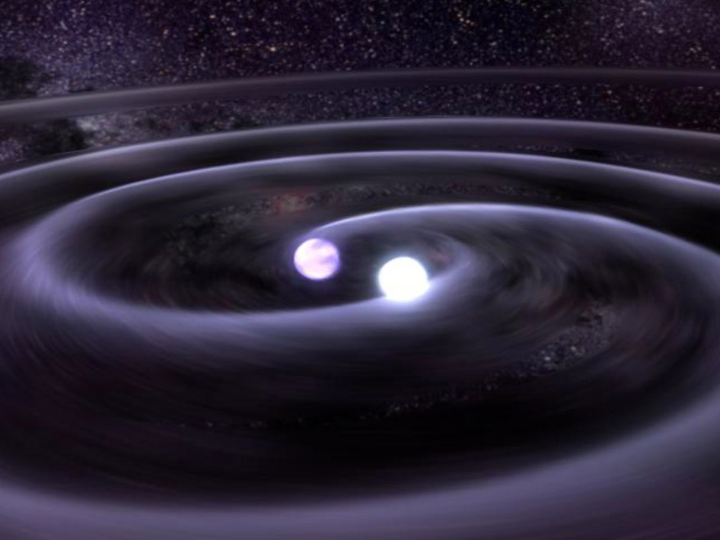

Two possible answers
Single Degenerate
(SD)
HIGH-density environment
DIRTY
?
“Traditional” way of thinking
Double Degenerate
(DD)
WD
LOW-density environment
Exploding star
CLEAN
Notes:
So not only the question is well defined, but it seemed that the problem only allowed for two possible answers: SD (where the companion is a non-degenerate star) and the DD (where the companion is a degenerate star – another WD). The OLD view was that these two scenarios could be easily differentiated based on the close environment of the SN explosion. The SD is expected to greatly enrich the environment with material lost during the accretion process, leading to a “dirty” environment with relatively high densities. The DD, on the contrary this accretion phase is NOT present and it was expected to be associated with a “clean” environment with ISM-like densities. So, great, we have ONE question, two possible answers, two possible scenarios with very different predictions. This is like heaven for an observer, we just need to think about a test. In this case we just need a way to sample the environment and measure its density.

Slide 9
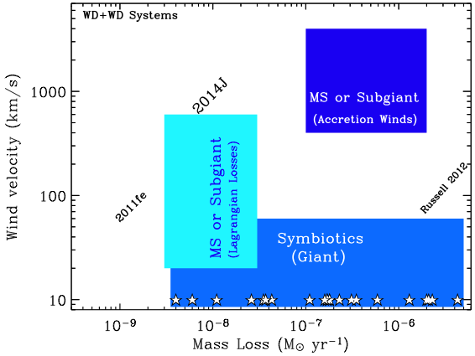
@ R≈10¹⁶ cm
SD systems with STEADY mass-loss
Margutti +14
Notes:
Remember that the traditional view of the DD system no mass-loss is foreseen to happen. Let’s see what happens if your system is an SD. We can parametrize the density of the environment as a function of the mass loss rate and of the velocity of the lost material and we are going to concentrate on what happens around 10^16 cm, since this is the typical distance probed by the SN shock around 20 days after the explosion. There are basically 3 ways to loose mass to the environment: the WD accreted material from the donor, but the mass transfer is not conservative and some mass is lost at the Lagrangian point. How much mass is actually lost is not well understood. Here we will make the conservative assumption that we are very efficient in transferring the material and that we loose only 1% of mass to the environment. The second obvious way is through winds from the companion star. From the study of symbiotic systems in our Galaxy, here is where they ar in this diagram. Finally, accretion winds from the WD are also expected to enrich the environment

Slide 10
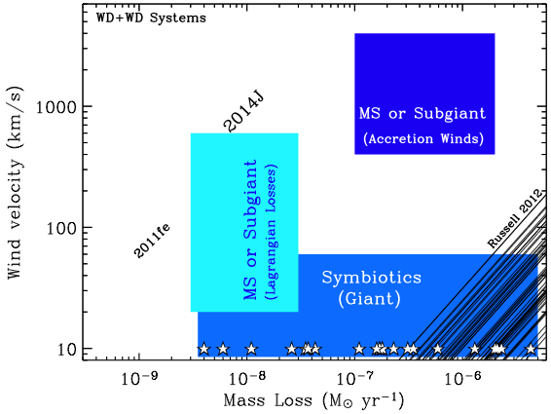
SD systems with STEADY mass-loss
Ruled Out
Margutti +14
Notes:
So ok. Let’s put the results from the X-ray observations we had until 201. The limits translate into the thick black lines. So we were basically able to rule out in the best cases the pink region of the parameter space. Not that great. We have most of the parameter space still available with MS, Giant and Subgiant companions, all still possible.

Slide 11
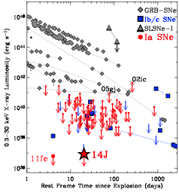
… “It’s black cats in dark rooms”… (S. Firenstein)
Notes:
Our goal is easily stated: we wanted to be able to probe the entire parameter space associated with SD systems with stable mass-loss. So basically we wanted to cover the entire pink region. It is easy to show that if you want to be able to probe this edge, we needed to go deep and probe X-ray luminosities that have never been probed before. So we did it.

Slide 12
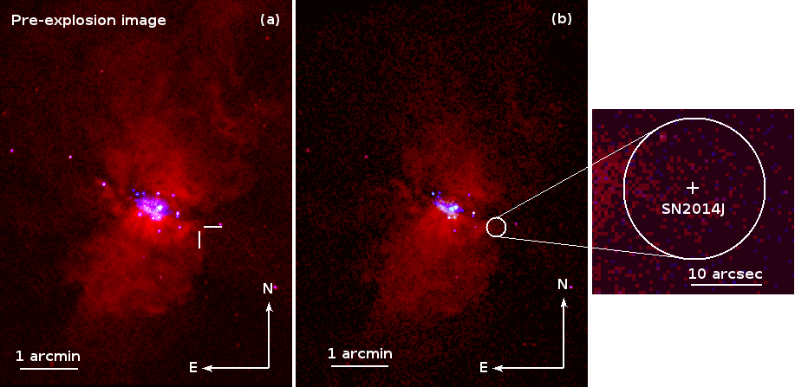
Margutti +12; +14
Notes:
The Universe has been extremely kind and in a little more than 24 months has given us 2 Type-Ia SNe very very nearby, SN2011fe and SN2014J. I had the chance to speak about 11fe a couple of years ago, I will now speak about 14J. In both cases you can see that there is no X-ray detection, hence the title of the talk.

Slide 13
Margutti +12; +14
Notes:
The Universe has been extremely kind and in a little more than 24 months has given us 2 Type-Ia SNe very very nearby, SN2011fe and SN2014J. I had the chance to speak about 11fe a couple of years ago, I will now speak about 14J. In both cases you can see that there is no X-ray detection, hence the title of the talk.

Slide 14
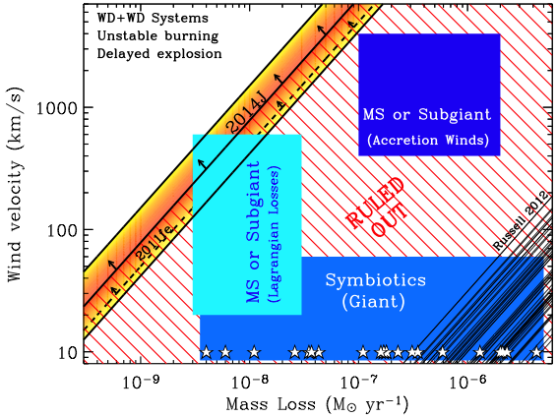
Symbiotic systems with stable mass-loss are ruled out
Margutti +14
… “Its black cats in dark rooms… and there may be no cat in the room” (S. Firenstein)
Notes:
So excellent: for these 2 SNe we can basically rule out most of the parameter space associated with SD progenitors with stable mass stransfer until the WD explosion.The environment here is very CLEAN. Excellent.

Slide 15
TAKE AWAY MESSAGES:
Type Ia
Symbiotic systems with stable mass-loss are ruled out
MASS-LOSS
Relativistic SNe
SOURCE of ENERGY
Notes:
If you do not remember anything about this talk just remember this (Type Ia). What abuot Relativistic SNe?

Slide 16
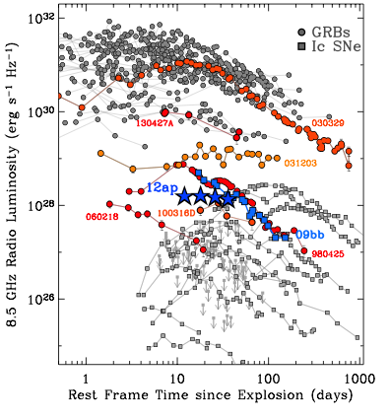
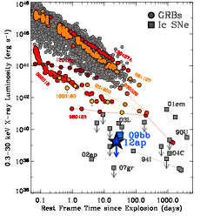
Radio
X-rays
Rel SNe
Faint GRBs
Margutti+14
Relativistic SNe are an intrinsically different class of explosions
In the Radio/optical relativistic SNe looks the same as faint GRBs
Notes:
So what are Relativistic SNe? Let’s have a look at them in the radio, you can see that relativistic SNe look exactly the same as GRBs in the radio, they are even brighter. So no way to dostonguish them in the radio/optical. This led to the belief that relativistc Sne were just faint GRbs for which we missed the high-energy trigger. But this is actually not true. Thanks to the X-rays I was able to show that relativistic SNe are intrinsically different from GRBs. And this is actually obvious fro this plot.They are 100 times fainter than the faintest GRB. So what do we believe is going on?

Slide 17
Jet
There is some good in every person
SN
GRB
Relativistic SN
Faint GRB
Fully successful jet break out
Barely successful
Barely failed

Slide 18
TAKE AWAY MESSAGES:
Type Ia
Symbiotic systems with stable mass-loss are ruled out
MASS-LOSS
Relativistic SNe
Jets might be ubiquitous
SOURCE of ENERGY
Notes:
And here we comes to the second message. Jets might be more common hat previously thought in hydrogen stripped core-collapse explosions.

Slide 19
X-rays from Supernovae
Log Lx
SHOCK BREAK OUT
(R exploding star)
SHOCK/JET INTERACTION w. the MEDIUM
(mass-loss of the progenitor)
COOLING ENVELOPE
(R envelope)
RADIATION from the REMNANT
(accreting BH, MAGNETAR)
SHOCK INTERACTION
w. COMPANION
(R and distance of
the companion)
RADIATION from the REMNANT in engine driven SNe
Successful JET
ACCRETION onto the progenitor
PRESENT
PAST
FUTURE
Log Time
< few hr
10-100 days
> 10 years
Very early observations
(DIFFICULT)
Faint
(DIFFICULT)
Notes:
So let me now go back to the initial slide, especially since we have been asked to comment about the future. And a big step forward in my field of exploding stars would come from the coverage of this portion of the parameter space. Here is our chance to learn about the progenitor systems. A wide field sensitive X-ray instrument, that would keep the pace with what is happening at ALL the other waves. While I strongly advocate for that to happen, what can we do? Well I embarcade on a risky but fun project that has to do with the most luminous SNe of the Universe.

Slide 20
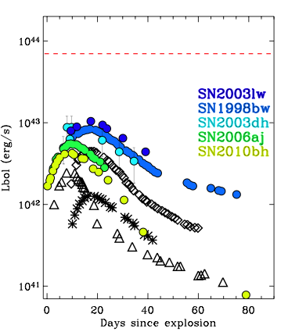
Super-Luminous SNe
Hydrogen-poor
Super Luminous SNe (M<-21)
(e.g. Gal-Yam 2012)
7x10⁴³ erg/s
GRB/SNe
“Standard”, envelope stripped SN Ibc
SN2002ap
SN1994I
Notes:
Whoever in this room thought that GRB SNe were the most luminous is basically wrong. As a few years ago, we know that there is a new class of explosions which is 10-100 times more luminous than even GRB-SNe. SLSNe. The question is here: WHAT POWERS THESE EXPLOSIONS? ONE of the possibilities that seems to get credit with time is a magnetar central engine. How can we test it?

Slide 21
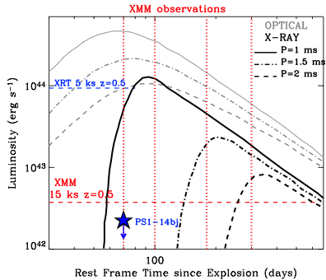
Super-Luminous SNe

Slide 22
TAKE AWAY MESSAGES:
Type Ia
Symbiotic systems with stable mass-loss are ruled out
MASS-LOSS
Relativistic SNe
Jets might be ubiquitous
SOURCE of ENERGY
Super-Lum I
Notes:
There is an empty box there, this is why you need to stay tuned.

Slide 23
Thanks to the Chandra Team!!
FUTURE
X-rays from Supernovae
Log Lx
SHOCK BREAK OUT
(R exploding star)
SHOCK/JET INTERACTION w. the MEDIUM
(mass-loss of the progenitor)
COOLING ENVELOPE
(R envelope)
RADIATION from the REMNANT
(accreting BH, MAGNETAR)
SHOCK INTERACTION
w. COMPANION
(R and distance of
the companion)
RADIATION from the REMNANT in engine driven SNe
Successful JET
ACCRETION onto the progenitor
MASS-LOSS
SOURCE of ENERGY
PRESENT
PAST
FUTURE
PROGENITORS
Log Time
< few hr
10-100 days
> 10 years
Very early observations
(DIFFICULT)
Faint
(DIFFICULT)
< hours

Slide 24
BACK UP

Slide 25
Jet
There is some good in every person
SN
Fully
successful jet
break out
Barely successful jet
break out
Barely failed jet break out
Consistent with hydrodynamical explosion (No need for a jet/engine)
Notes:
And I will leave you with this slide here.

Slide 26
Type Ia SN2014J
Host Galaxy: M82, D=3.5 Mpc
Explosion image
Margutti +14
Chandra X-ray images
Notes:
So SN2014J is a Type Ia SN that exploded in January 2014, in M82, at the distance of 3.5 Mpc, so very very close. I re-pointed Chandra, 50 ks and we found no detection.

