Slide 1
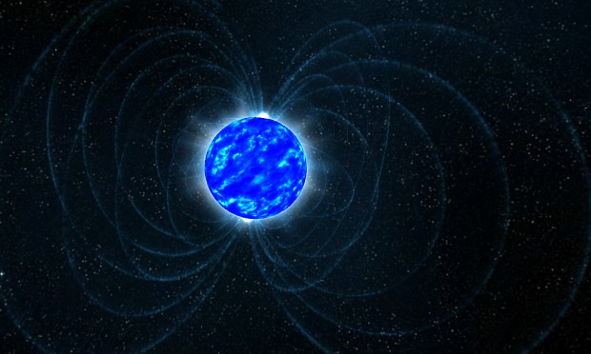
Chandra & Magnetars
Nov 18, 2014
Chandra 15th anniversary
Boston, MA
Vicky Kaspi, McGill University, Montreal, Canada

Slide 2
A few reminiscences about the past 15 yrs…
I was young MIT junior faculty just prior to launch of AXAF
I remember working on AO1 proposals for weeks
  I submitted 10, nearly all on pulsar wind nebulae
  (I got 3 but almost all the targets got time)
  I remember getting an idea 24 hrs before AO1 deadline, pulling all nighter… (it won!)
    Never give up! Or I’m crazy!
I remember the ACIS door not opening in a test prior to launch! I recall feeling panic.
I salute the fine engineers and scientists who devoted so much of their professional lives to Chandra…you should be extremely proud!

Slide 3
Overview
Introduction to Magnetars
Magnetar Outbursts
Magnetar Origins
Magnetar Field Strengths
Magnetars and High-B Radio Pulsars
Galactic Center Magnetar

Slide 4
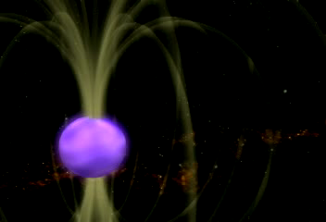
Introduction to Magnetars
23(28) known today
Volatile NSs:
X-ray/soft g-ray bursts
Young (<~ 10 kyr)
  Galactic Plane
  Supernova remnants
X-ray pulsations
  Some optical, radio
Periods 2-12 s, spin-down
Luminosities exceed spin-down flux
No companions
Emission powered by decay of
enormous internal magnetic field,
10¹⁴ – 10¹⁵ G: “Magnetars”
coined by R. Duncan & C. Thompson

Slide 5
Magnetar Radiative Activity
3 broad categories:
  Giant flares
    Outshine all cosmic X-ray sources combined
    Observably affects Earth’s ionosphere
    3 seen so far
  Outbursts
    Long-lived flux enhancements
    Rise suddenly (< hrs) and decay over months
    Often accompanied by timing anomaly
  Bursts
    Short duration: few ms to 1 sec
    Common during outbursts but seen alone

Slide 6
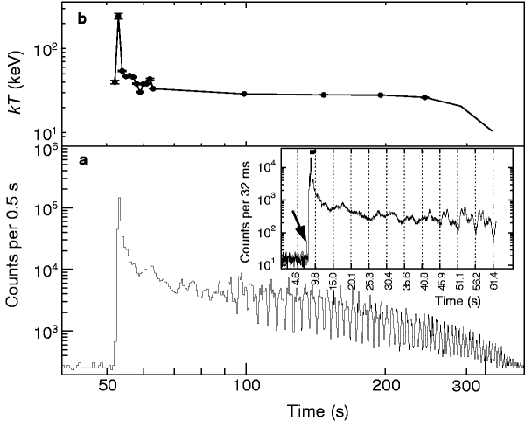
2004 Giant Flare in SGR 1806-20
Most intense
cosmic transient
or solar flare
ever observed.
Clear effect on
Ionosphere from
9 kpc!
L=10^47 erg/s
In 0.2 s same energy
released as by Sun
in 250,000 yrs
Hurley et al. 2005, Nature
10

Slide 7
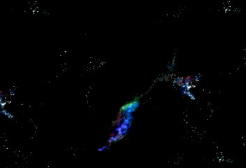

Slide 8
AXPs vs SGRs?
Previously 2 classes:
  Soft Gamma Repeaters (SGRs)
  Anomalous X-ray Pulsars (AXPs)
Today classes clearly not distinct
  Same spatial distribution
  Same P, B distribution
  Both show pulsations, spin-down, glitches
  Both show bursts, outbursts
  Raises interesting nomenclature issues!
Magnetars

Slide 9
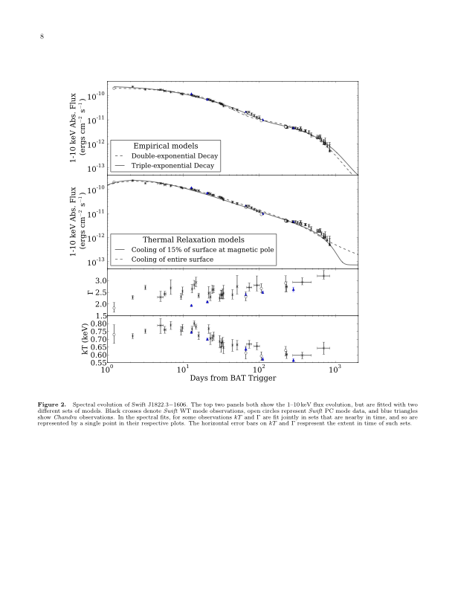
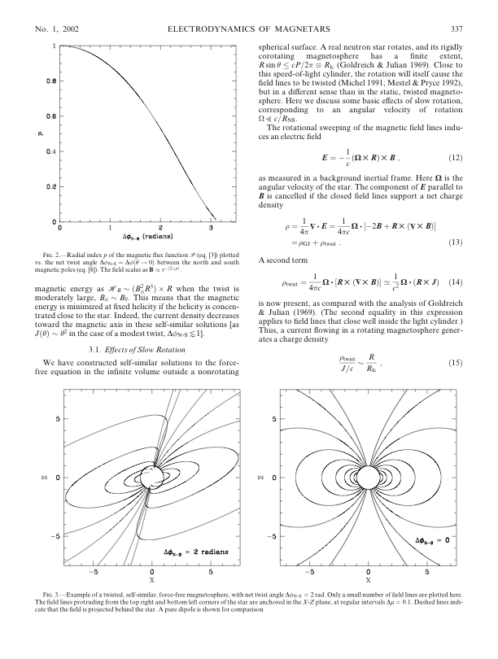
Magnetar Outbursts
Why do they go into outburst?
  Internal heat release
  stresses crust,
  magnetosphere?
  Only magnetospheric?
How do the outbursts relax?
  Twisted magnetosphere
  (Beloborodov 2009) vs crustal cooling (Cumming in prep.)?
Regardless we are grateful as magnetar outbursts let us find them!
Thompson et al. 2002
Scholz, VK, Cumming 2014

Slide 10
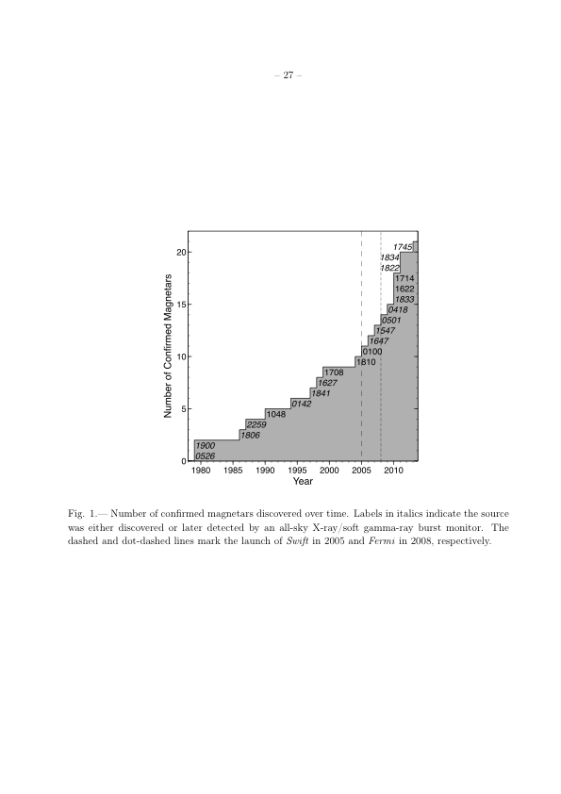
Magnetar Discovery: Bursts
23 known + 5 candidates
Swift/BAT and Fermi/GBM great for finding magnetars via bursts
Spatially unbiased view of Galaxy
BAT
GBM
Online magnetar catalog:
www.physics.mcgill.ca/~pulsar/
magnetar/main.html
Maintained by “MagneTsar”
Scott Olausen
Olausen & VK 2014

Slide 11
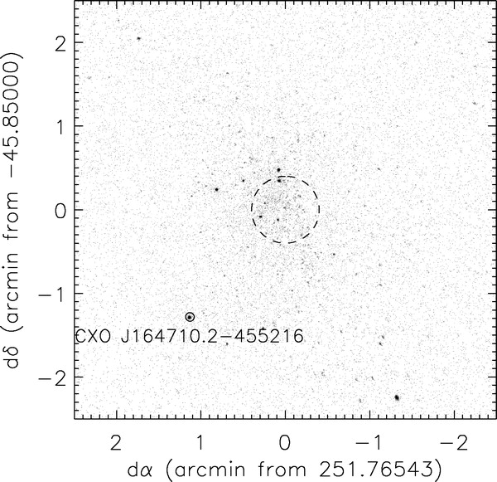
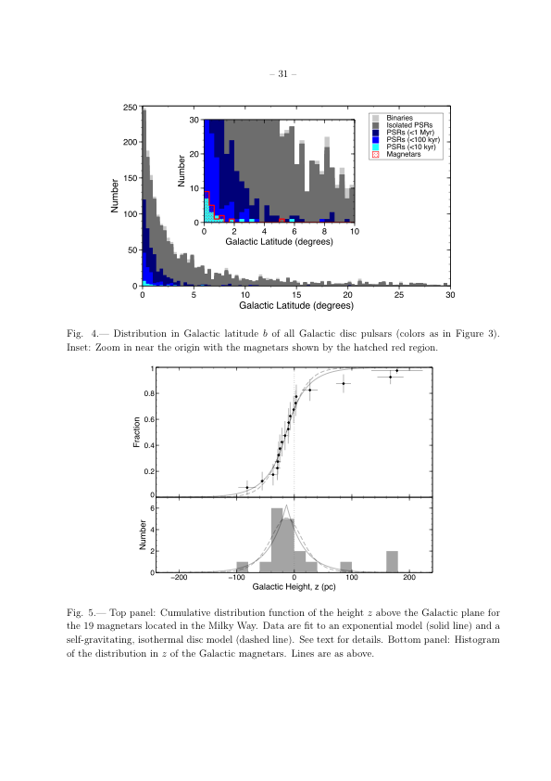
Magnetar Spatial Distribution
Very low
Galactic scale
height: 20-30 pc
→ massive progenitors?
Consistent
with location in
massive star
clusters
(eg Wes 1;
Muno et al.
2006)
Westerland 1
Olausen & VK 2014

Slide 12
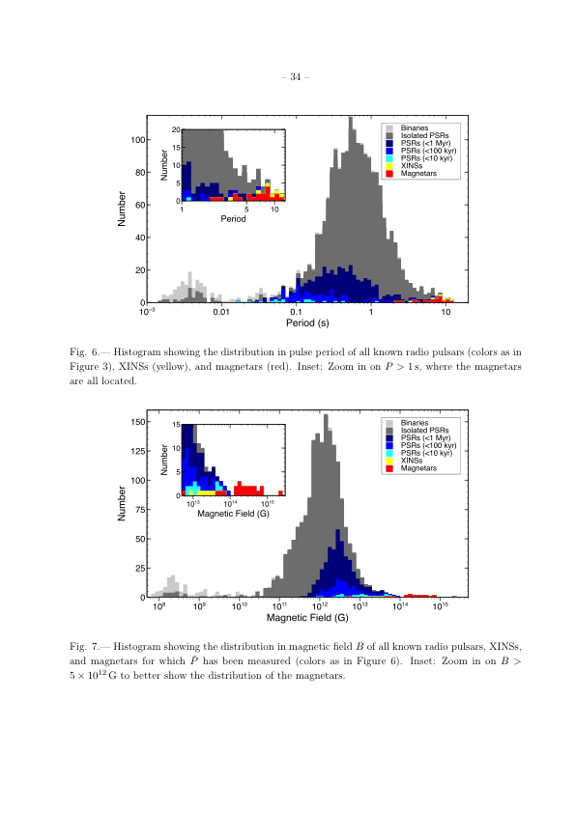
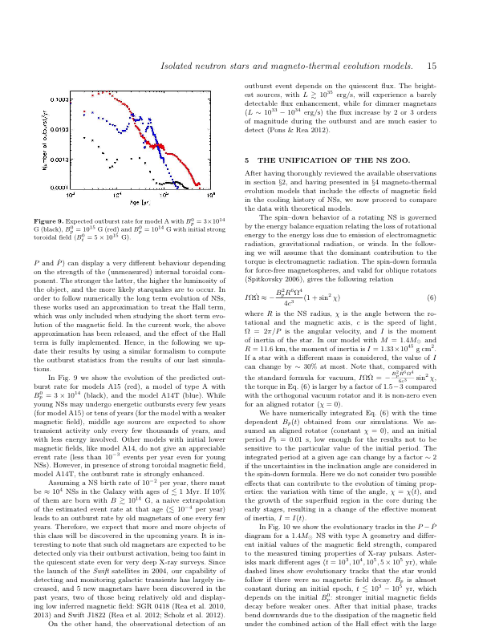
Magnetar B Distribution
Vigano et al. 13
Rea et al. 2010, Science
SGR 0418+5729
Is B distribution truly bimodal?
Or do high-B NSs burst more?

Slide 13
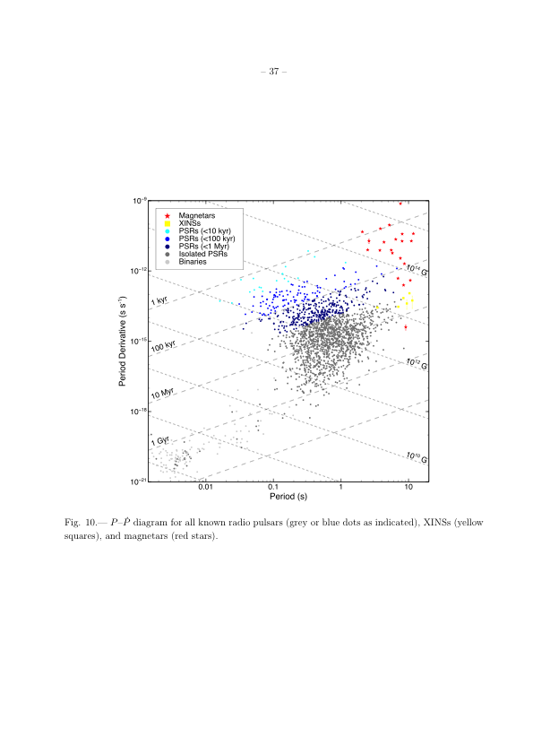
P-Pdot Diagram
*

Slide 14
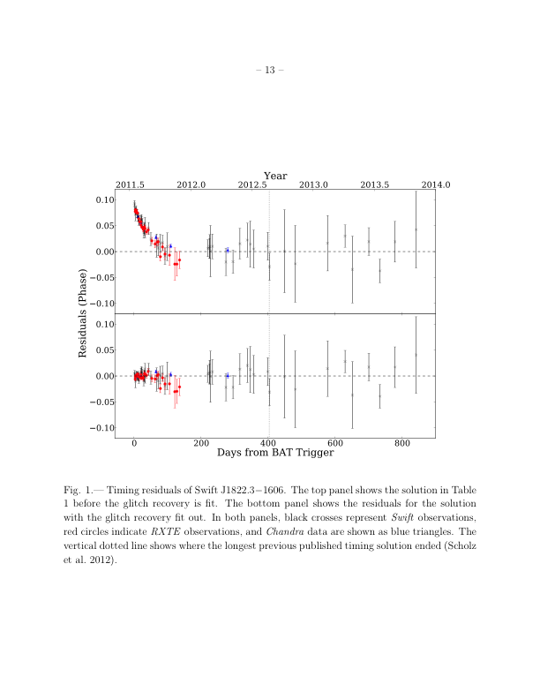
Another Low-B Magnetar:
Swift J1822.3-1606
8.4 s pulsar appeared in July 2011 outburst
Initial spin-inferred B ~3-5 x 10¹³ G (Scholz et al. 2011, Rea et al. 2011)
Longer-term monitoring shows initial spin-down unusually rapid
Long-term spin-down B=1.4 x 10¹³ G
Scholz et al. ApJ, 2014
Evidence for higher-order magnetic multipoles
on the star; true surface B higher than dipole component

Slide 15
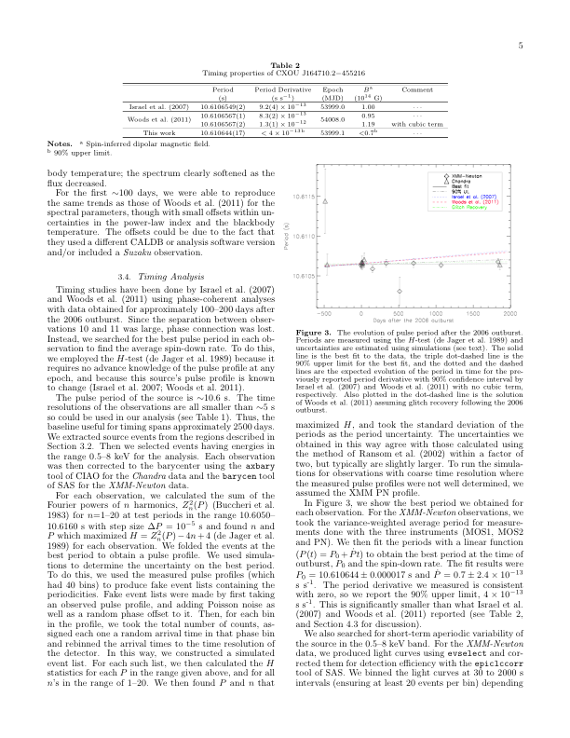
Yet Another low-B Magnetar?
CXOU J1647-4552
in Wes 1
Discovered
with Chandra
(Muno et al.
2006)
P=10.6 s
Pdot < 4e-13
B < 7e13 G
Another one:
Rea et al. 14
B<4e13 G
Period (s)
An, VK, Archibald, Cumming 2013

Slide 16
P-Pdot Diagram
*

Slide 17
Unification?
B
Radio pulsars
Magnetars
Suggests other transition
objects should exist;
Pons & Perna (2012); Vigano et al. (2013); Gourgouliatos & Cumming (2014)

Slide 18
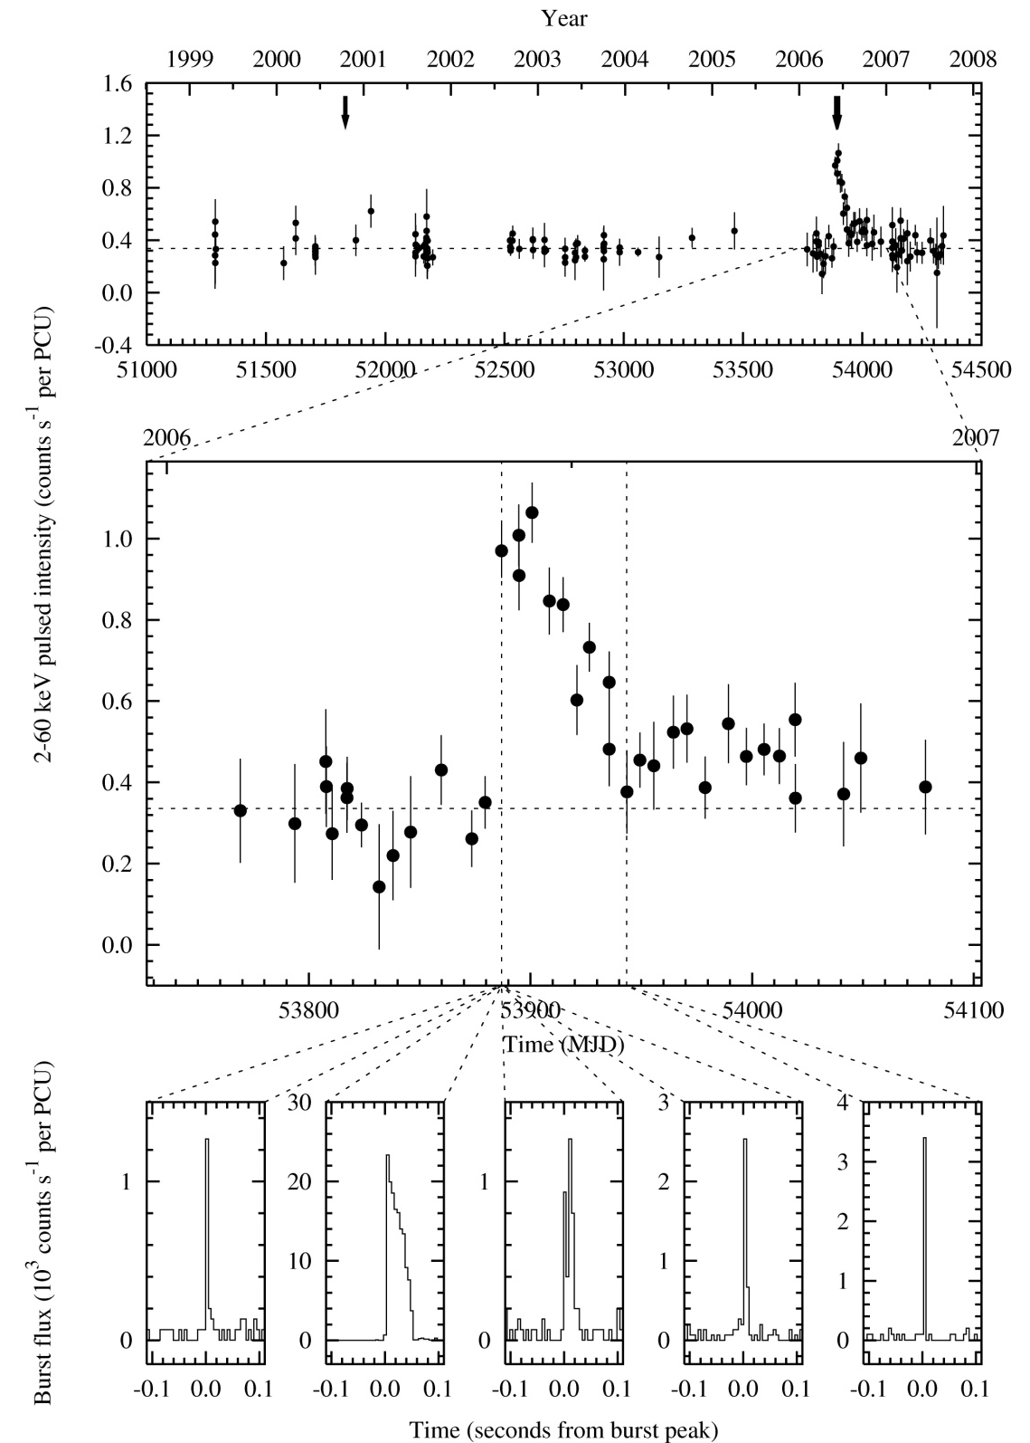
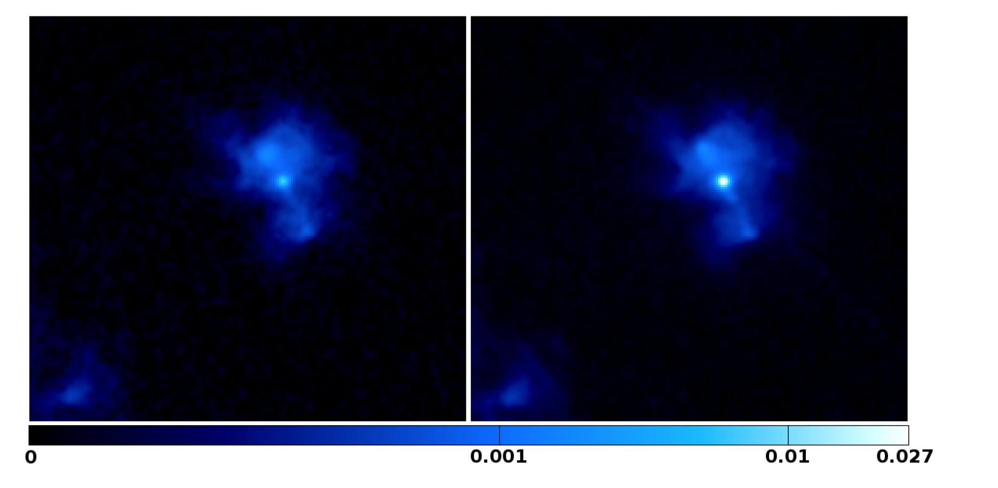
A Magnetar Metamorphosis:
Magnetar-like
Behavior in
Rotation-Powered Pulsar
PSR J1846-0258: bursts, outburst, large glitch
2000
2006
Gavriil et al., Science, 2008

Slide 19
High-B Psrs vs Magnetars
Can high-B radio pulsars produce “anomalous” X-rays?
  YES! One unambiguous event from Kes 75 pulsar
  Other hints?
Experiment: for long-P, low Edot, nearby sources, look at thermal X-ray emission

Slide 20
High-B Radio Pulsars: “Anomalous” X-rays?
Name | P (s) | Pdot | B (G) | D (kpc)
J1119-6127 | 0.4 | 4.1e-12 | 4.1e13 | 8.4
J1718-3718 | 3.4 | 1.6e-12 | 7.4e13 | 4.9
J1734-3333 | 1.2 | 2.3e-12 | 5.2e13 | 7.4
J1814-1744 | 4.0 | 7.4e-13 | 5.5e13 | 9.8
J1819-1458 | 4.3 | 5.7e-13 | 5.0e13 | 3.6
J1846-0258 | 0.3 | 7.1e-12 | 4.8e13 | 6
J1847-0130 | 6.7 | 1.3e-12 | 9.3e13 | 8.4
(RRAT)

Slide 21
High-B Radio Pulsars: “Anomalous” X-rays?
Name | P (s) | Pdot | B (G) | D (kpc)
J1119-6127 | 0.4 | 4.1e-12 | 4.1e13 | 8.4
J1718-3718 | 3.4 | 1.6e-12 | 7.4e13 | 4.9
J1734-3333 | 1.2 | 2.3e-12 | 5.2e13 | 7.4
J1814-1744 | 4.0 | 7.4e-13 | 5.5e13 | 9.8
J1819-1458 | 4.3 | 5.7e-13 | 5.0e13 | 3.6
J1846-0258 | 0.3 | 7.1e-12 | 4.8e13 | 6
J1847-0130 | 6.7 | 1.3e-12 | 9.3e13 | 8.4
(RRAT)

Slide 22
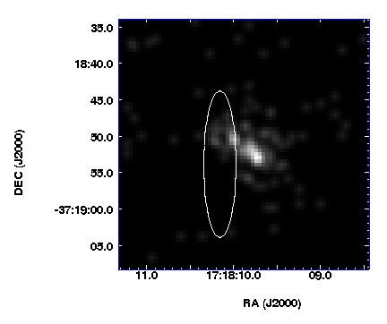
PSR J1718-3718
P=3.4 s, B=7.4e13G, D=4.9 kpc
Age = 34 kyr
50 ks archival Chandra/ACIS obs 7’ off axis
formal positional offset:
0.2σ in DEC, 1.6σ in RA
probability of chance < 1%
Need more time!
radio timing error box
VK & McLaughlin 2005

Slide 23
PSR J1718-3718
Spectrum, flux:
  kT possibly high but poorly determined
  Lx > 3 orders of magnitude fainter than for any known persistent AXP
  …but consistent with transient AXP in quiescence…
“This raises the interesting possibility that
PSR J1718-3718, and other high-B radio pulsars,
may one day emit transient magnetar-like emission,
and conversely that the transient AXPs might be more likely
to exhibit radio pulsations.” (VK & McLaughlin 05)

Slide 24
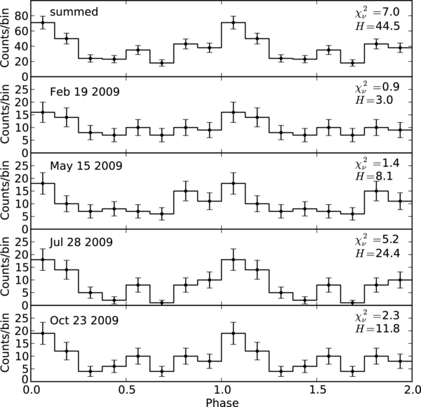
PSR J1718-3718: More Data
130 ks new Chandra
observations, split in 4
Pulsations detected
with high significance:
confirms ID
Pulsed fraction
52 +/- 13 % (0.8-2keV)
Zhu, VK, McLaughlin, Pavlov, Ng et al. 2011

Slide 25
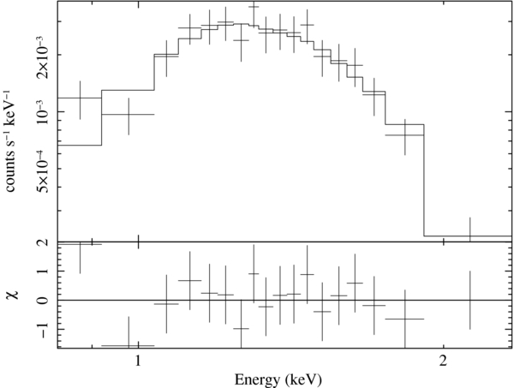
PSR J1718-3718: New Data…
Soft X-ray spectrum
Blackbody:
kT = 0.186+/-0.019 keV
H atmosphere:
kT = 0.057+/-0.012 keV
Zhu, VK et al. 2011

Slide 26
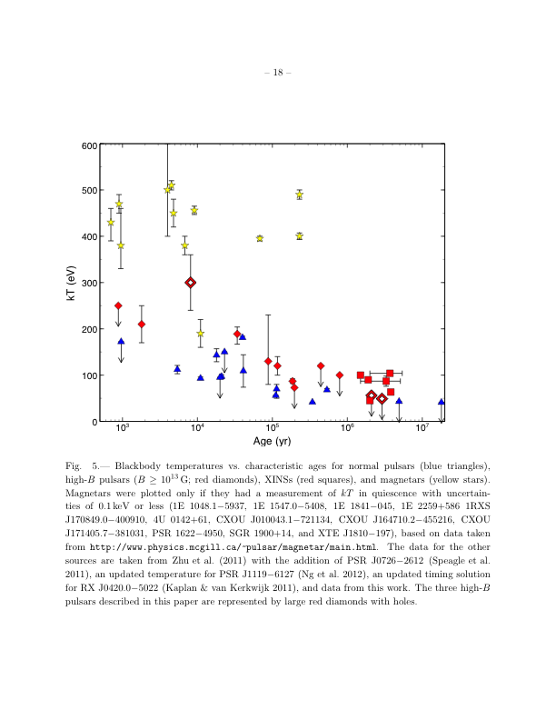
Other Evidence of Unification?
B>10^13 G PSR
B<10^13 G PSR
Magnetar
Olausen et al. 2013

Slide 27
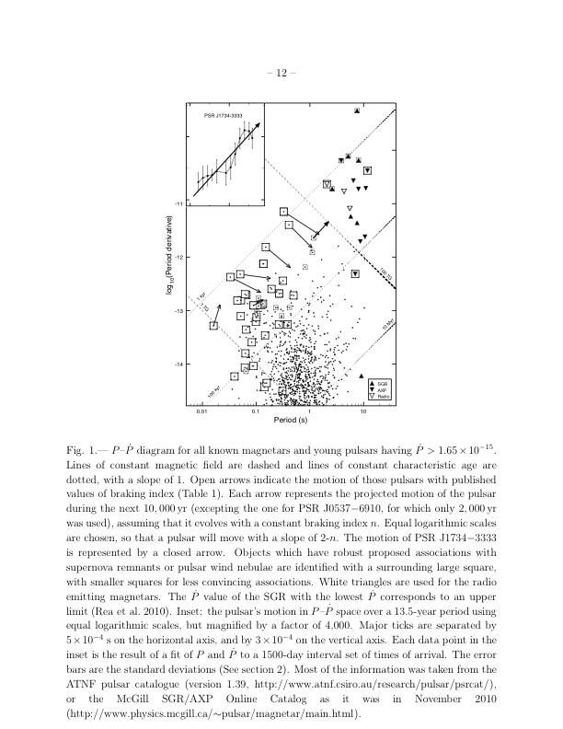
PSR J1734-3333: n=0.9+/-0.2
P=1.17 s, age=8 kyr
B=5e13 G
n=0.9 +/-0.02
(Espinoza et al. 2012)
Deep 125 ks XMM obs shows
kT=0.30+/-0.06 keV
(Olausen et al. 2013)
General trend: high-B RPPs show higher kT than lower-B of same age

Slide 28
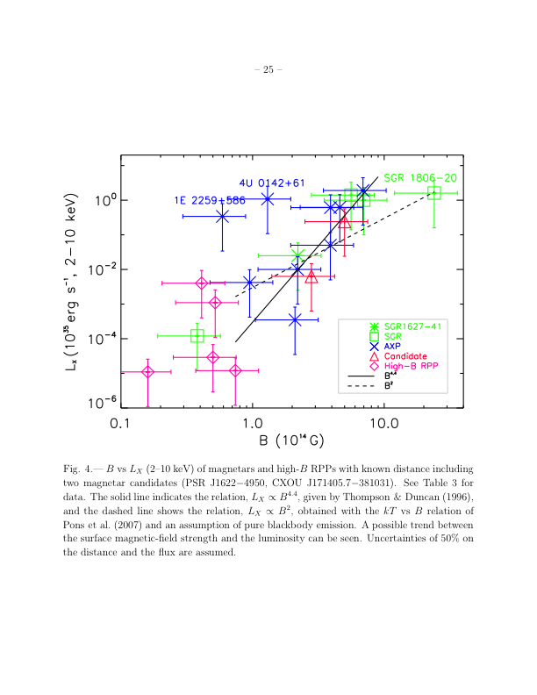
Other Evidence of Unification?
An et al. 2012

Slide 29
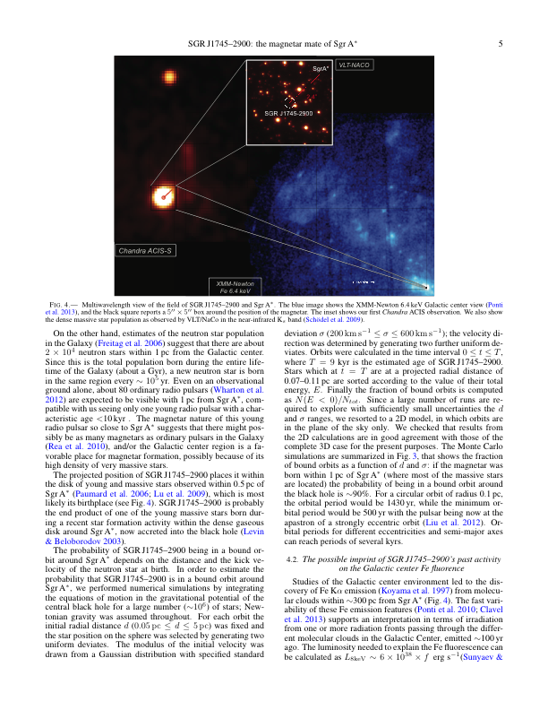
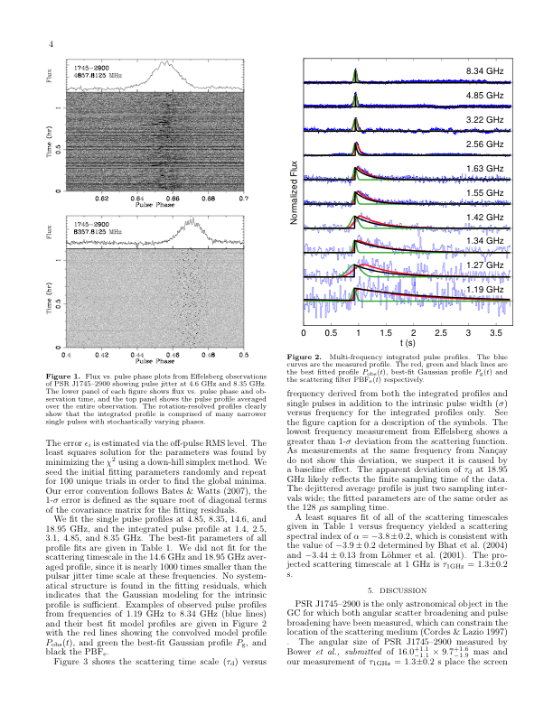
Galactic Center Magnetar:
SGR J1745-2900
Spitler et al. 2014
3.76 s magnetar near Sag A* (NuSTAR; Mori et al. 13)
Chandra localization
Magnetar poor dynamics probe (VK et al. 14)
Radio pulsar!
DM = 1778 pc/cm3
Scattering time
1.3 s @ 1 GHz <<
expected!!
Find radio pulsars???
Rea et al. 13

Slide 30
Future Progress with Chandra
Physics of Magnetar Outbursts:
  Follow outbursts, particularly back to quiescence
    Flux modelling
    Rotational evolution
  Identify new magnetars (~1/yr)
Connection with rest of NS population
  Deep observations of high-B pulsars
  ToO observations of glitching high-B pulsars

