Slide 1
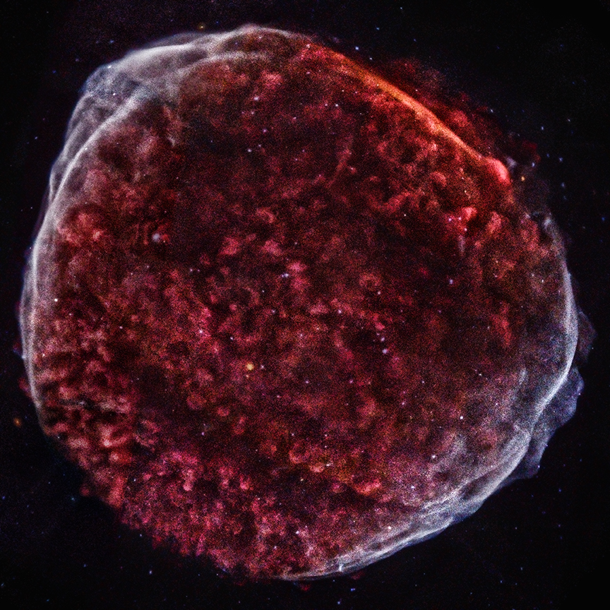
A Highlight of Science Results from a Deep Chandra Observation of SN 1006
Brian J. Williams (NASA GSFC)
on behalf of
Frank Winkler
Stephen Reynolds
Sean Ressler
Rob Petre
Knox Long
Satoru Katsuda
Una Hwang
and recapping the work of
Winkler et al. 2013
Katsuda et al. 2013
Winkler et al. 2014
Ressler et al. 2014
Chandra image of SN 1006

Slide 2
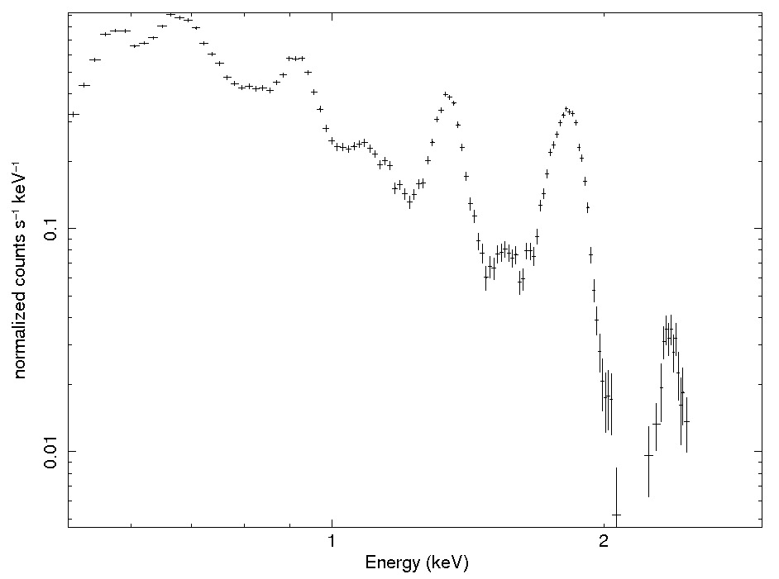
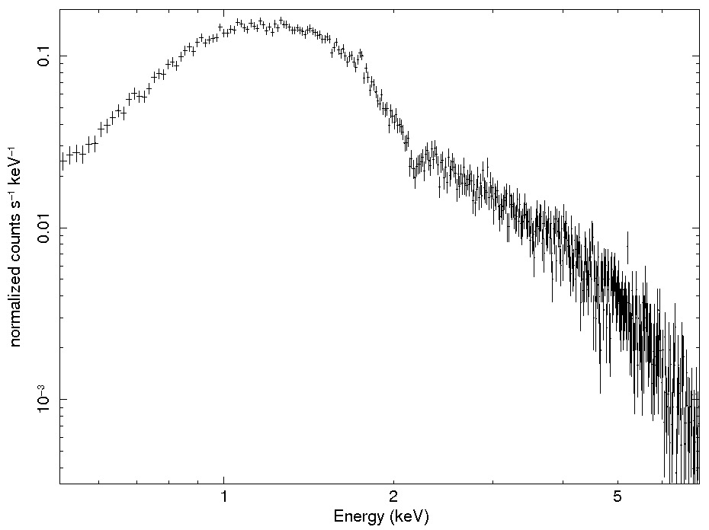
SN 1006
Type Ia SN
D = 2.2 kpc
NH = 7 x 10²⁰ cm⁻²
30’ diameter
brightest recorded SN (MV = -7.5); faintest SNR
O
S
Ne
Mg
Si

Slide 3
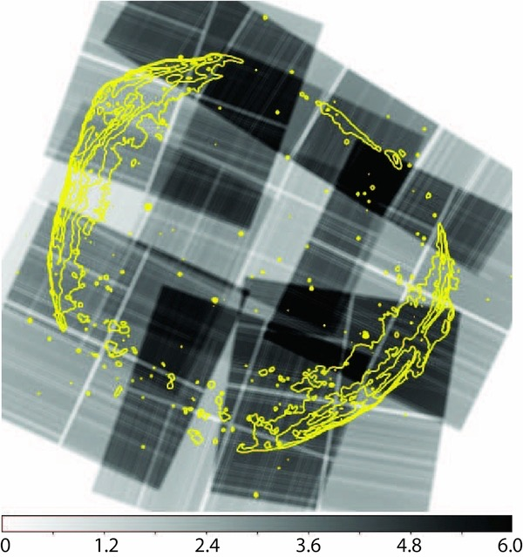
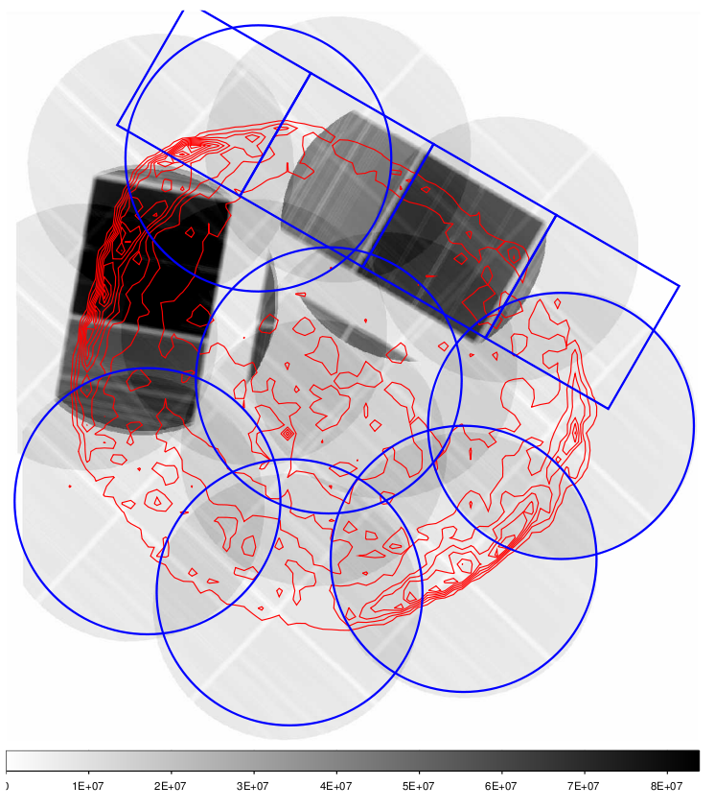

Motivation for Chandra LP
670 ks
Proper motions
Detailed nonthermal emission study
small-scale ejecta structure
Need Chandra resolution for these!
2012 Exposure Map
(PI - P.F. Winkler)
Previous Exposure Map
(PI - J. Hughes)

Slide 4
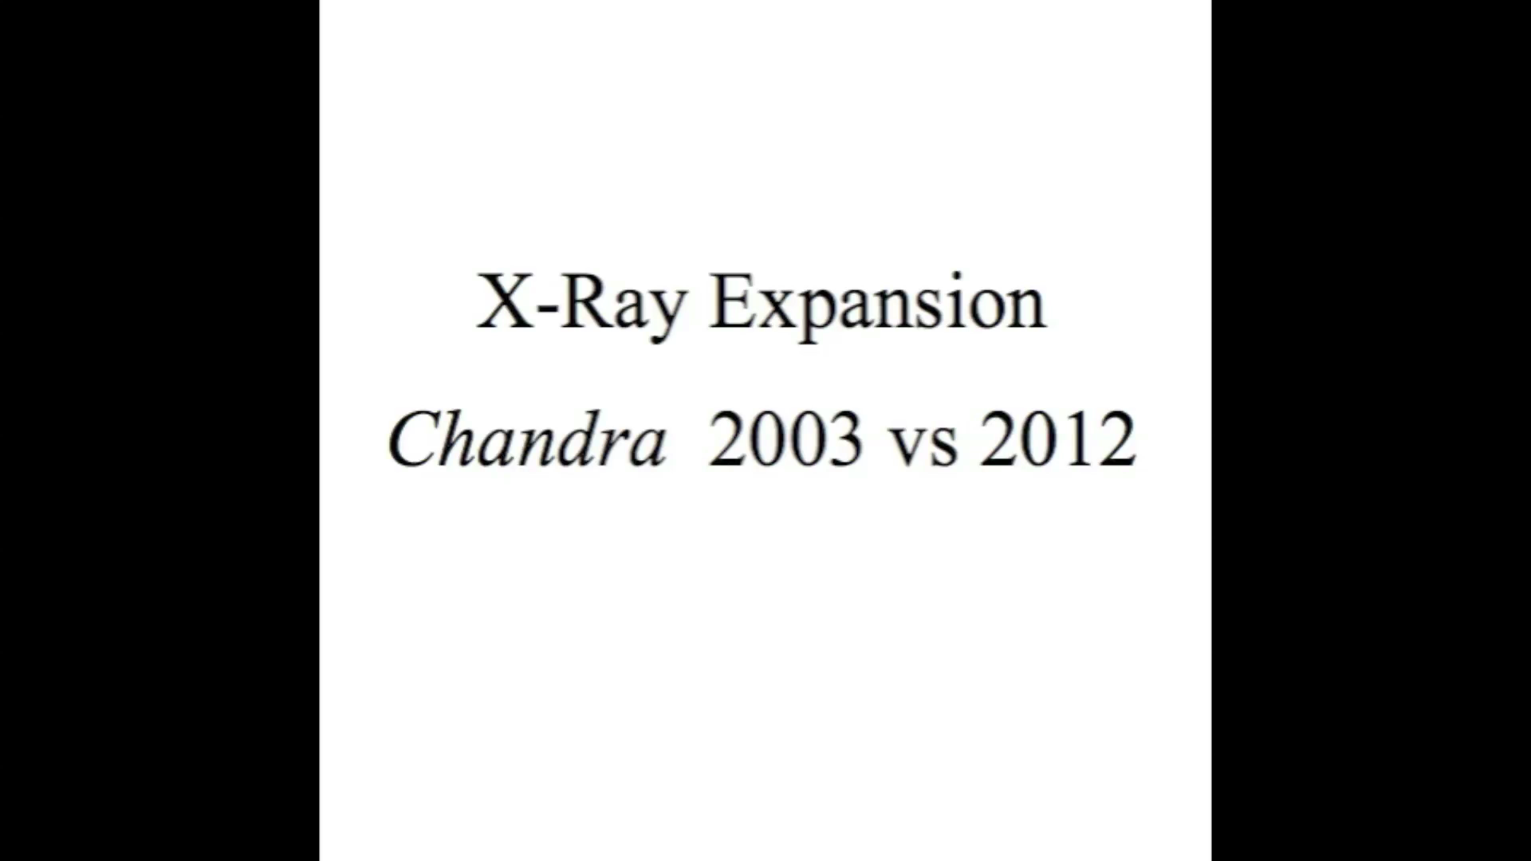

Slide 5
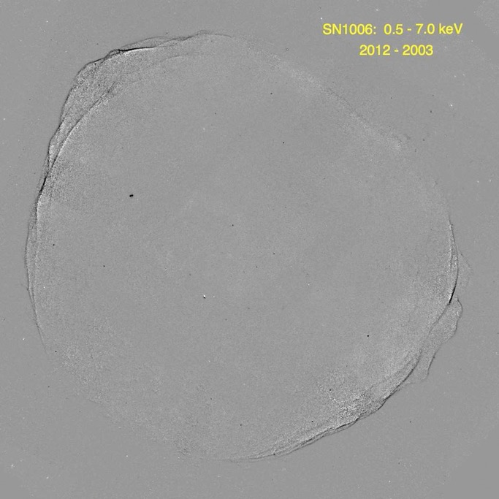
2012-2003 difference image

Slide 6
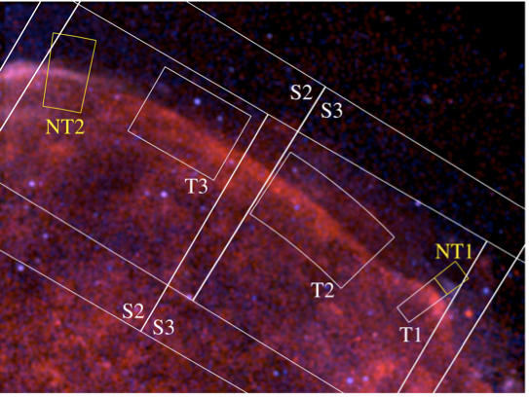
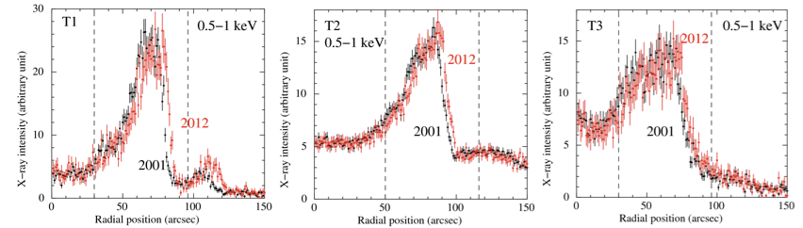
Shock speeds in thermally-dominated NW regions 3,000 km/s
Katsuda et al. 2013

Slide 7
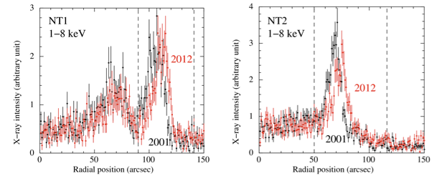
But nonthermal regions move at 5000 km/s!
Katsuda et al. 2013

Slide 8
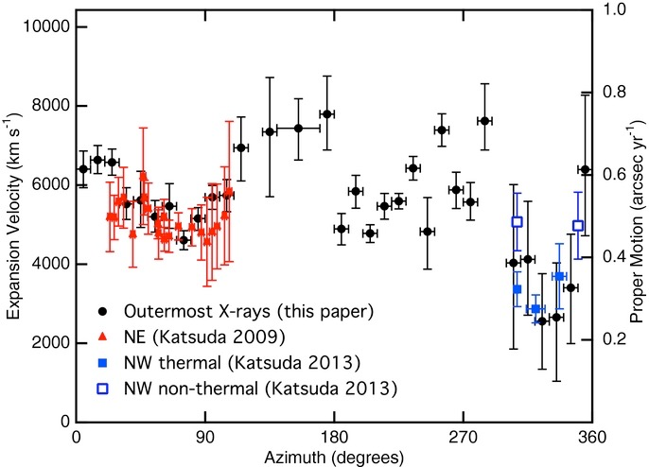

Ejecta?
Winkler et al. 2014

Slide 9
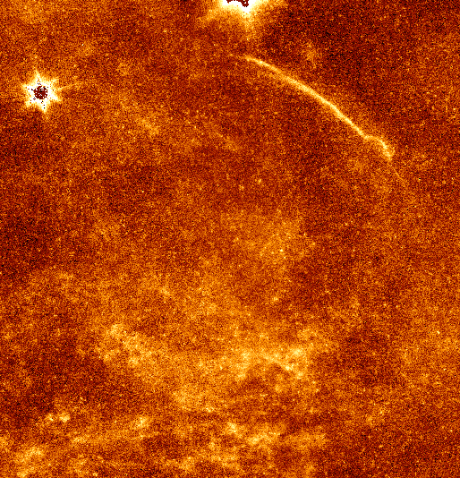
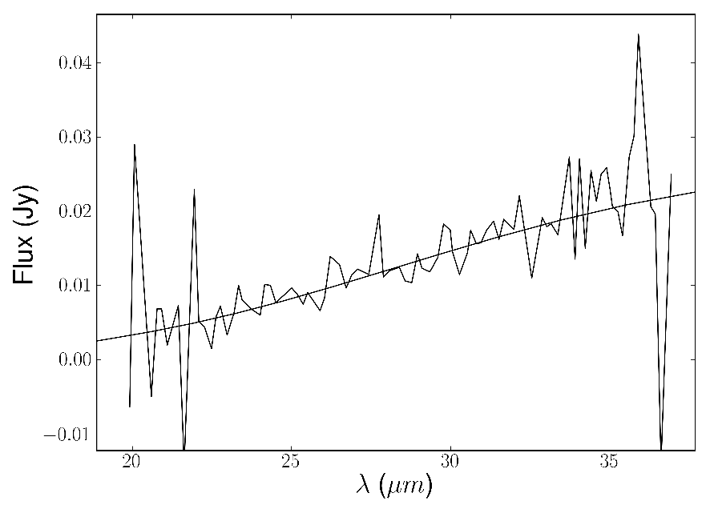
Spitzer IRS spectrum
Spitzer 24 µm image
IR fits imply density in NW n0 = 0.25 cm⁻³
Much denser than elsewhere

Slide 10
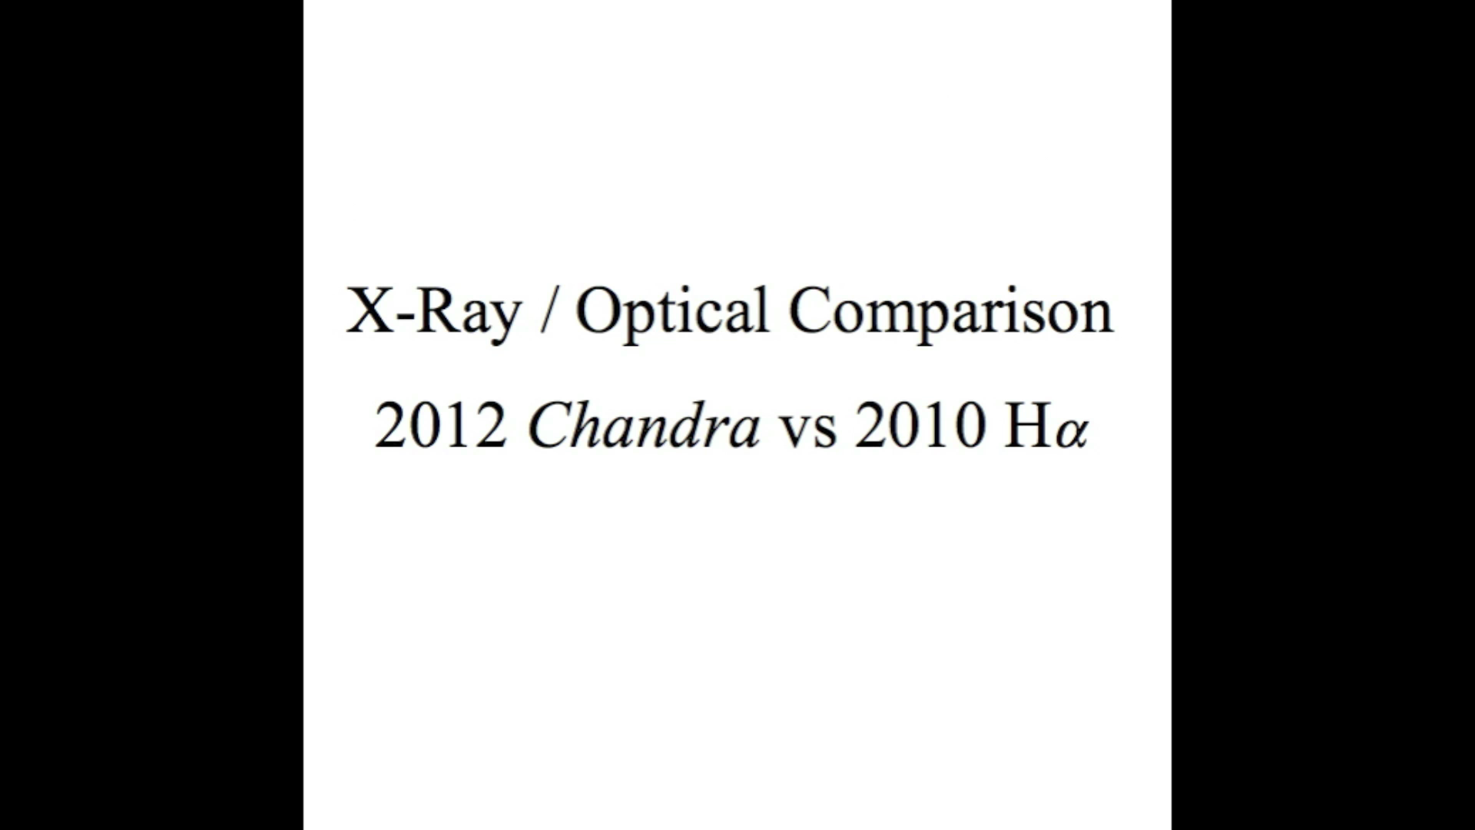

Slide 11
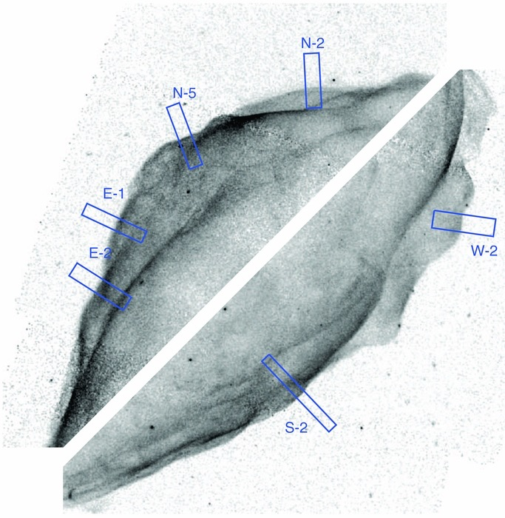
Shock Precursor?
Prediction of diffusive shock acceleration theory that electrons should spend some time ahead of shock
Might be visible as “precursor” emission, or “halo”
Searched in regions of sharp shocks and low backgrounds
NE and SW rims, overlaid with precursor search regions

Slide 12
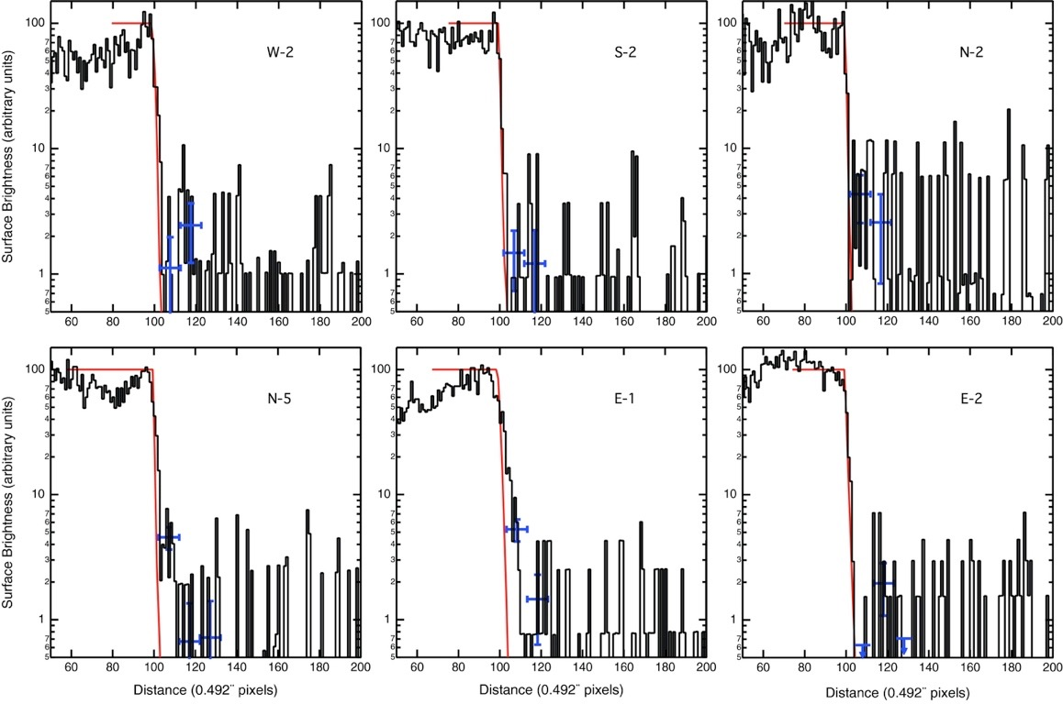
Shock Precursor? No.
Implies high magnetic field; B >= 100 μG

Slide 13
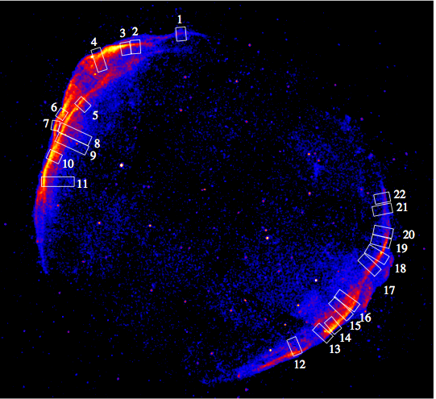
Why are synchrotron rims so thin?
Get rid of electrons -> synchrotron losses, need high B-field
Get rid of B-field -> magnetic damping
Rims only a few arcsecs wide

Slide 14
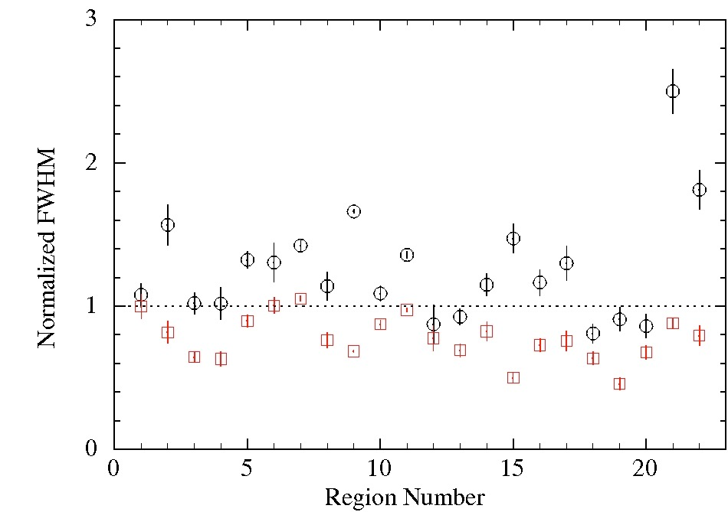
black circles: 0.7-1 keV
------- line: 1-2 keV
red boxes: 2-7 keV
Clear dependence on energy
B-field damping model disfavored
B ~100 μG; energy-dependent diffusion coeff.
Ressler et al. (2014)

Slide 15
Summary
Shock velocities high; faster in nonthermal regions
No evidence for synchrotron precursor
synchrotron losses, not B-field losses, probably account for thin nonthermal rims
Brian J. Williams
NASA GSFC
brian.j.williams@nasa.gov
@bjwilli2

