Slide 1
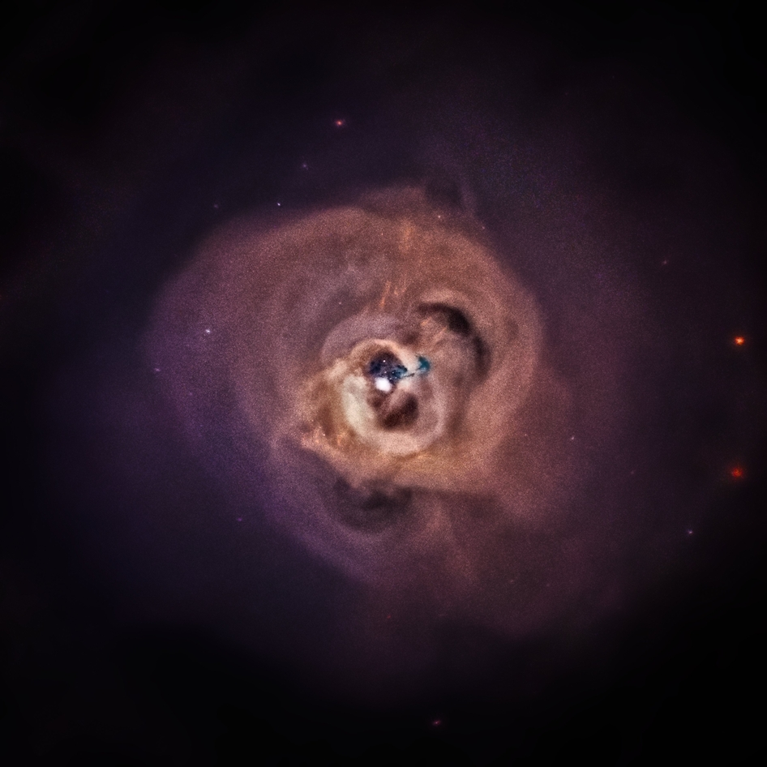
Search for the Unidentified 3.55 keV Line in Galaxy Clusters
Esra Bulbul
Harvard-Smithsonian Center for Astrophysics
ApJ, 789, 13B, submitted in Feb 2014, published in June 2014

Slide 2
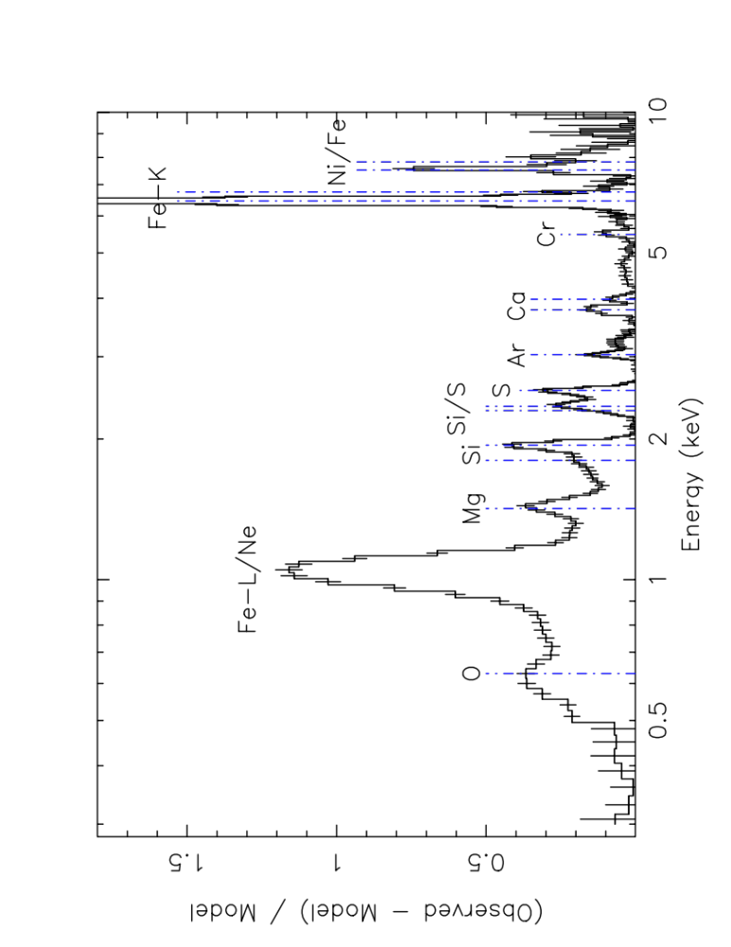
Largest gravitationally bound aggregations of hot ICM and DM
Emission lines are now being discovered through X-ray spectroscopy
Not enough sensitivity for very weak emission lines due to short exposures, background and instrumental artifacts
2A 0335+096
(data - model) / model
Energy (keV)
Werner et al. (2006)
Notes:
Background and instrumental noise
We think it is a pretty good spectrum…
Look at the width
Lower expectations now.

Slide 3
Stacked 73 galaxy clusters at their rest frame
Increased S/N
Smeared non-source features, e.g. instrumental, background
Notes:
2.3 months of xmm data

Slide 4
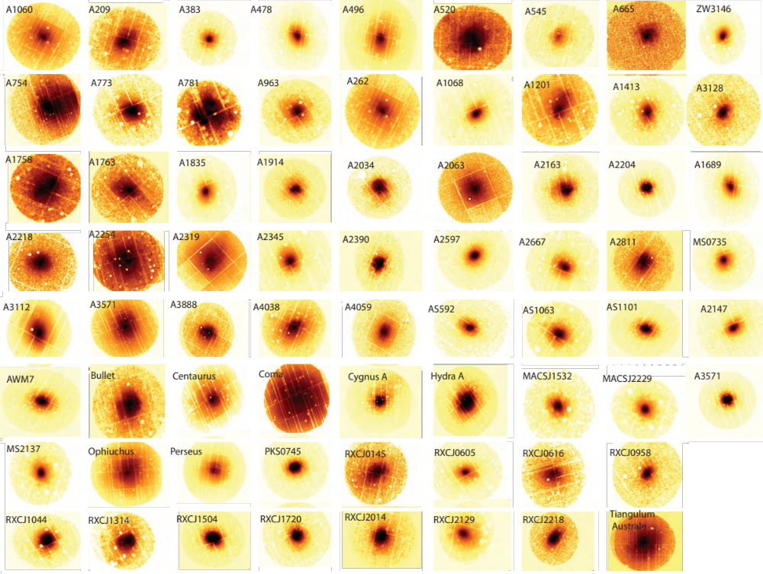

Slide 5
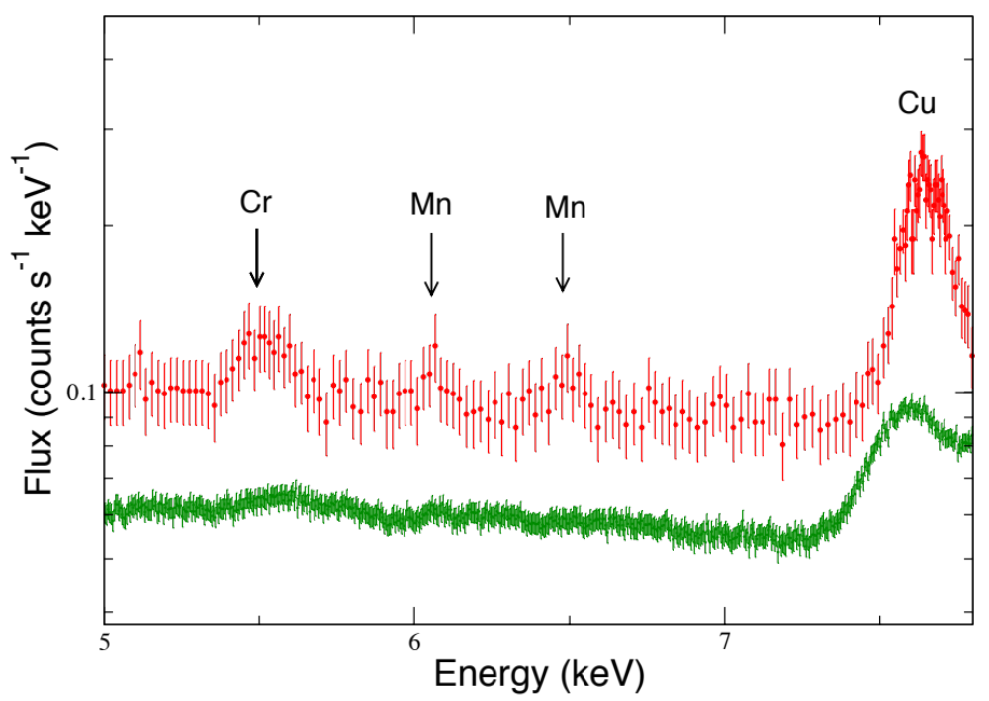
Background Before Stacking
Notes:
keV broadening after stacking compared to the resolution
De not incude perseus which is dominating to show the effect

Slide 6
Background After Stacking
Notes:
keV broadening after stacking compared to the resolution
De not incude perseus which is dominating to show the effect

Slide 7
Modeled 2-10 keV band (Continuum and Atomic Lines)
Detected a weak line at 3.55-3.57 keV (rest frame energy)
Notes:
Thermal spectrum, thermal models used
Very weak dominated by systematic.. Particle physics we would measure the detector electronics
Our instrument is half a way to moon! We cannot get systematic as good as partice physicists. We cannot pick sample
We have to look out to sky.
To get rid of systematic best we could!

Slide 8
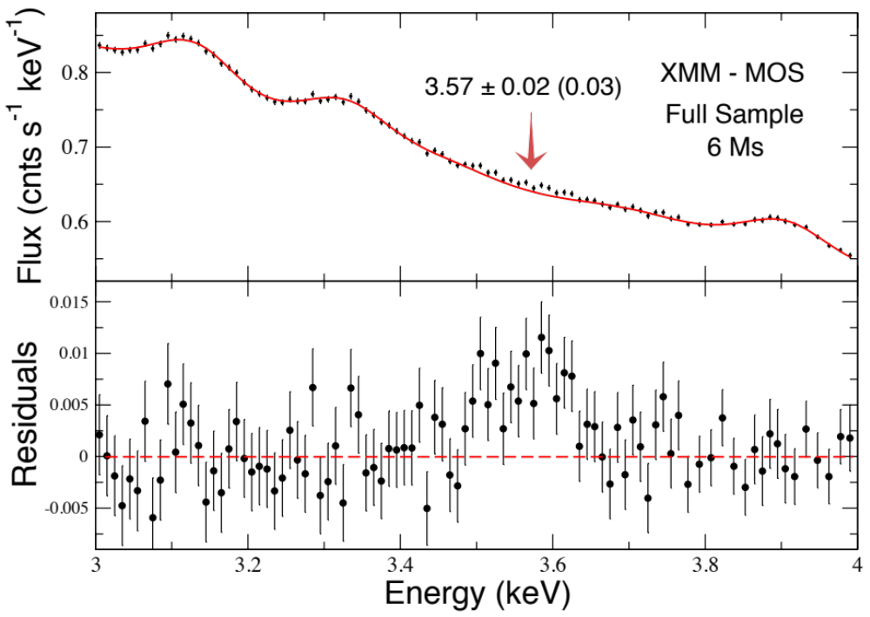
Line Detected in the Full Sample
No Line Added
Notes:
We used a continuum model and emission line floated – slight gain shifts to get best continuum fits roughly know the energy and flux
To increase the sensivity! we can use the thermal models fixed but we cannot get a good model to detect weak line
Switch back and forth

Slide 9
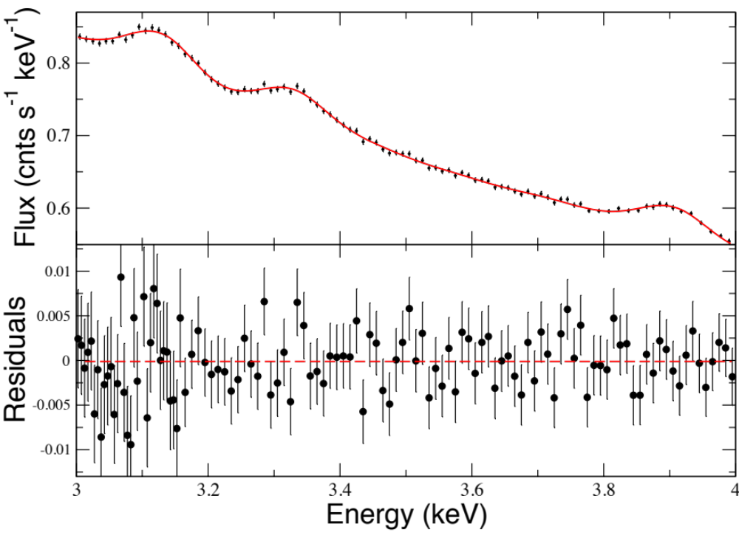
with a Gaussian Line Added…
XMM - MOS
Full Sample
6 Ms

Slide 10
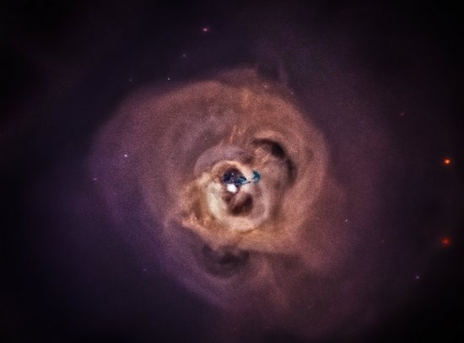
Credit: J. DePasquale
NASA/CXC PR Image
XMM MOS:
Full Sample,
Bright nearby clusters
Distant Clusters, and
Perseus cluster
XMM PN (a different instrument!)
Full Sample,
Distant Clusters
Chandra (a different satellite!)
Perseus cluster
Suzaku (another satellite!)
Perseus cluster
(also detected by Urban et al. 2014; arXiv:1411.0050 )

Slide 11
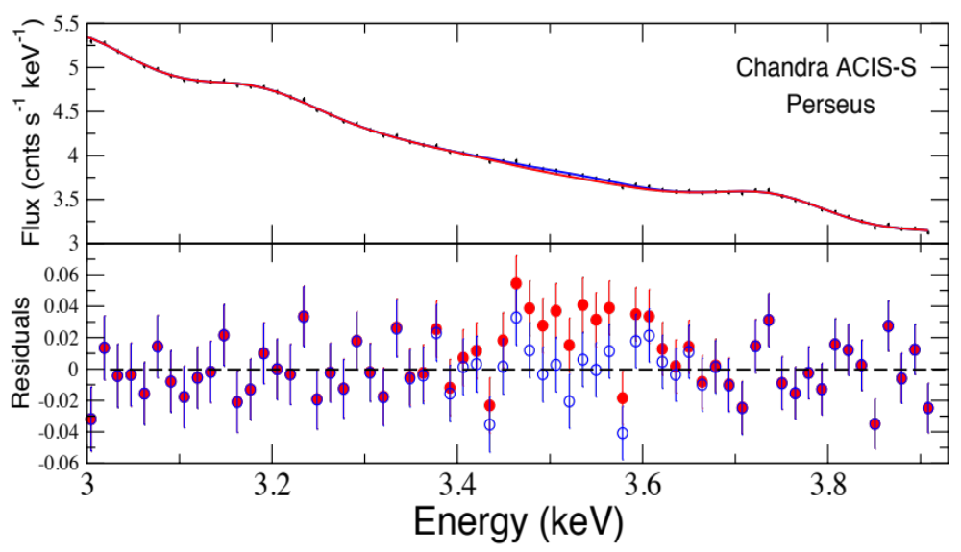
Chandra Detects the Line in Perseus
See also Urban et al 014

Slide 12
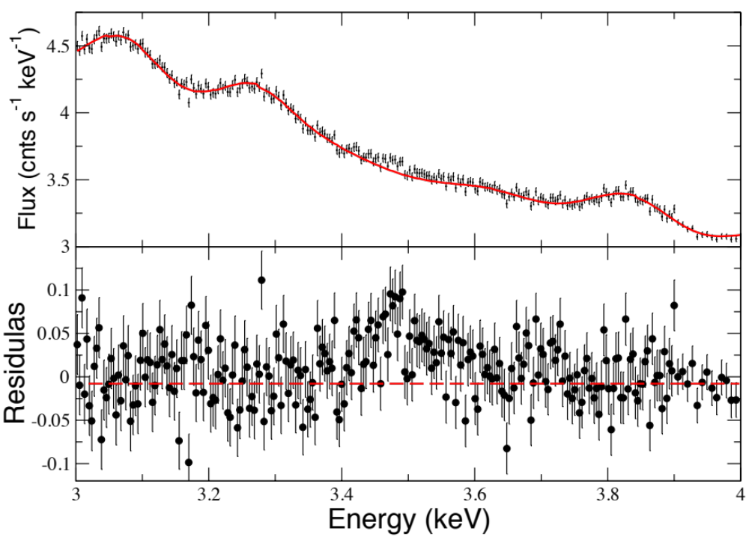
Suzaku Detects the Line in Perseus
3.55 keV (Rest frame )
REDSHIFTED!
See also Urban et al 014

Slide 13
What is the origin of this line?
Notes:
Palusible other impossible ones

Slide 14
Astrophysical Line?
K XVIII at 3.51keV ➔ 10A
Ar XVII DR at 3.62 keV ➔ 30A
Cl XVII Lyβ at 3.51keV ➔ >30A
Radiative Recombination Feature
Charge Exchange
Any other astrophysical explanations?
More exotic than sterile neutrinos!
E₂
E₁

Slide 15
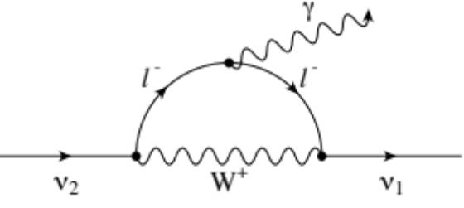
Dark Matter?
Sterile neutrinos can decay into an X-ray photon and an active neutrino (Dodelson & Widrow 94)
γ
ν₂
W⁺
ν₁
Notes:
Palusible other impossible ones

Slide 16
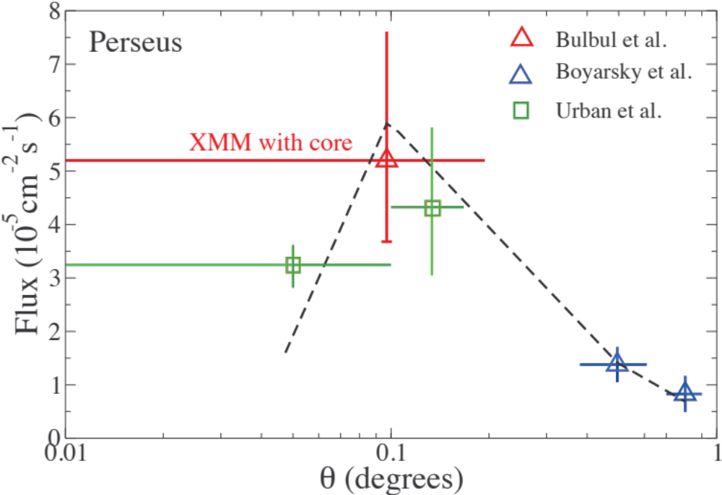
Decaying Sterile Neutrinos?
Bulbul et al. (2014, ApJ,789,13B)
Urban et al. (2014, arXiv:1411.0050)
Boyarsky et al. (2014, arXiv:1402.4119)
Cline & Frey (2014, arXiv:1410.7766)

Slide 17
Current Status
Detections
Perseus Cluster (core and outskirts) ✓
Stacked clusters ✓
Nearby Clusters ✓
Distant clusters ✓
M31 (Boyarsky et al, arXiv:1402.4119) ✓
Galactic Center (Boyarsky et al.,arXiv:1408.2503) ✓
Follow scaling
for simplest
DM decay model
Non-Detections
Virgo Cluster (Bulbul et al., ApJ,789,13B); consistent ✓
Dwarf Spheroidals (Malyshev et al., arXiv:1408.3531); inconsistent at 2.5σ?
Stacked galaxies (Anderson et al., arXiv:1408.4115); inconsistent 12σ ?
Notes:
Check marks
Question mark
Probing different regions

Slide 18
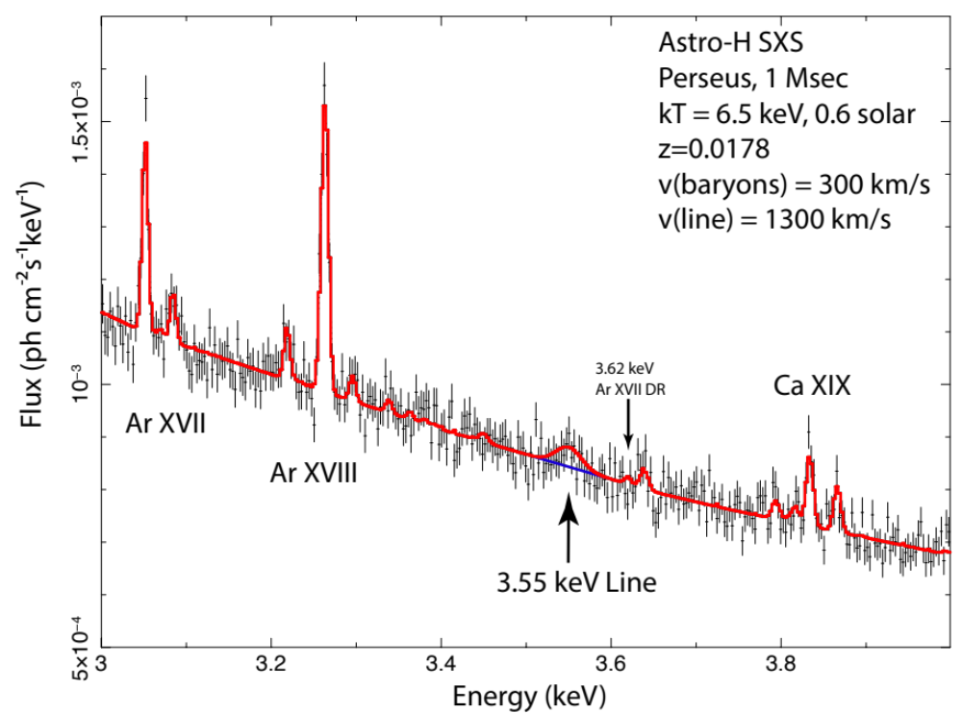
Dark Matter vs Astrophysical Line?
Astro-H Spectrometer
Observations of the Perseus cluster
1 Ms
3.55 keV Line
Notes:
3.57keV
Gve brief introduction on AstroH
Next generation instrument looking towards in the feature picture of astroH

