Slide 1
Hot Jupiters and their Exoplanet hosts – an X-ray Perspective
With Katja Poppenhaeger (CfA),
Ignazio Pillitteri (INAF- O.A.Pa.),
H. Moritz Guenther (CfA), Javier Lopez-Santiago (UCM)

Slide 2
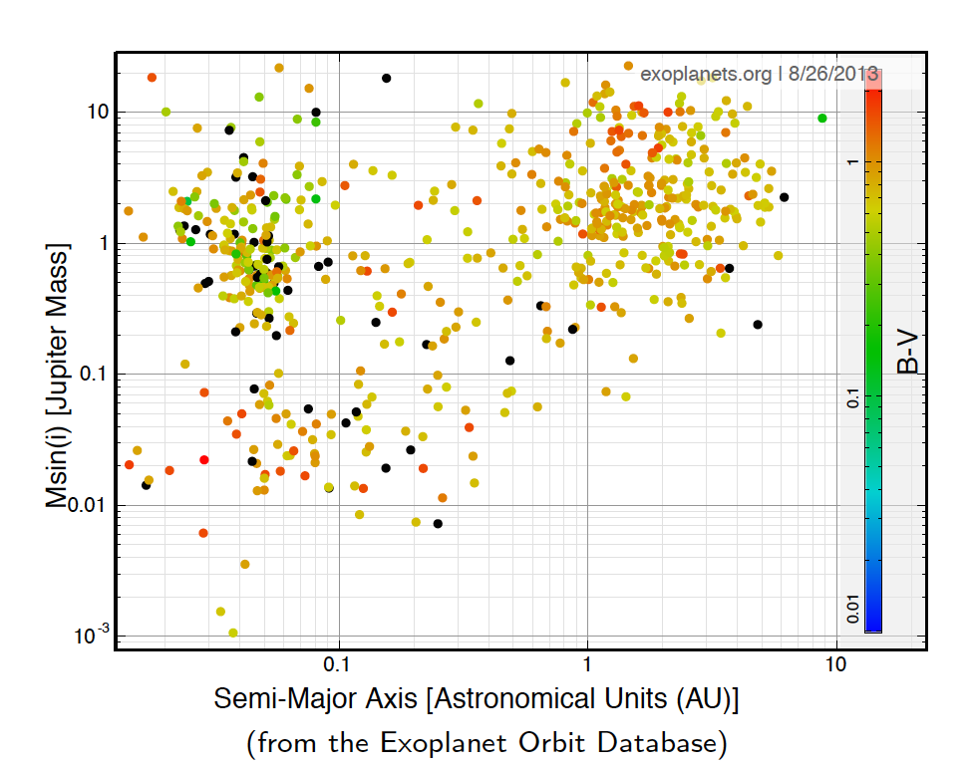
The Exoplanet zoo

Slide 3
The Exoplanet zoo
Hot Jupiters
Notes:
They are the most likely to interact with stars

Slide 4
What is Star Planet Interaction?
Rotational Synchronization
Yes ?
t_{syn} < t_{age}?
Planet
Star
Tidal Interaction
Magnetosphere
Magnetic Interaction
Increase Dynamo Activity
Cuntz et al. 2000

Slide 5
Why do we care about SPI?
X-rays from stars affect exoplanets…
  Some hot Jupiters appear inflated beyond what the bolometric luminosity would predict.
    X-Ray/UV flux ➔ atmospheric expansion (Lammier et al. 2003).
    X-Ray flux ➔ photochemistry changing the thermal budget (Laing et al. 2004; Burrows et al. 2008).
  Coronal radiation produces rapid photoevaporation of the atmospheres of planets close to young late-type stars (Sanz Forcada et al. 2011).
…Exoplanets may affect their host stars.
  Analytic Studies show ➔ F_{recon} α a_{p}⁻³ (Saar et al. 2004)
  Analytic models indicate field lines can connect the star to the planet, ruptures of the lines could give rise to flare-like activity (Lanza 2008).
  MHD simulations show strong feedback visible in X-rays (Cohen et al. 2011).
  Tidal forces can work in two directions

Slide 6
Takeaways
(in order of confidence)
We have seen a planetary transit in X-rays and the planet is much “bigger” in X-rays than in any other wavelength.
Through tidal effects, Hot Jupiter’s can spin-up stars with large convective zones.
Through magnetic effects planets can induce active spots on the stellar surface.
This activity can include system scale stellar flares.

Slide 7
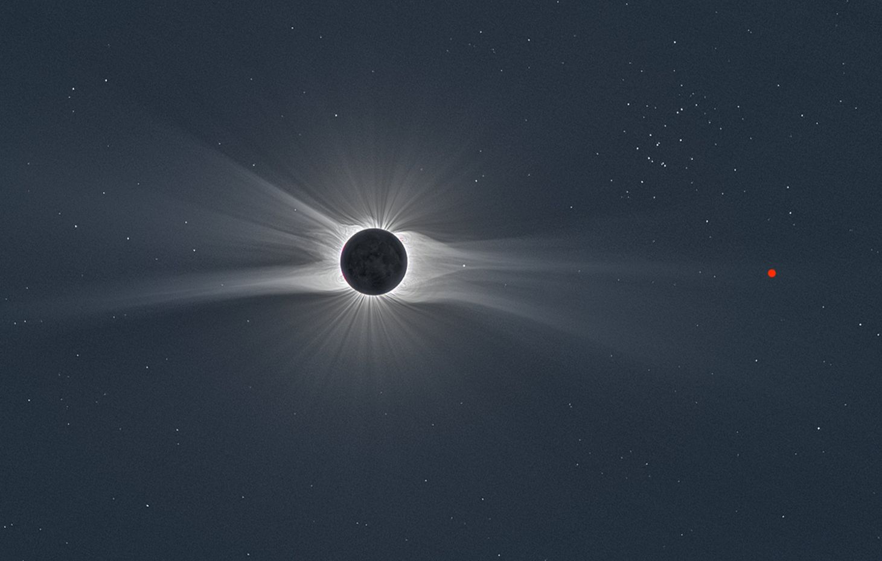
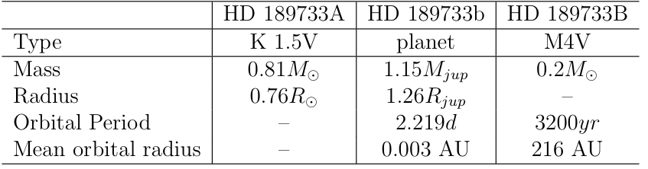
HD 189733
Notes:
planetary orbits within few stellar radii
strong irradiation of planets (~100 000 flux at Earth)

Slide 8
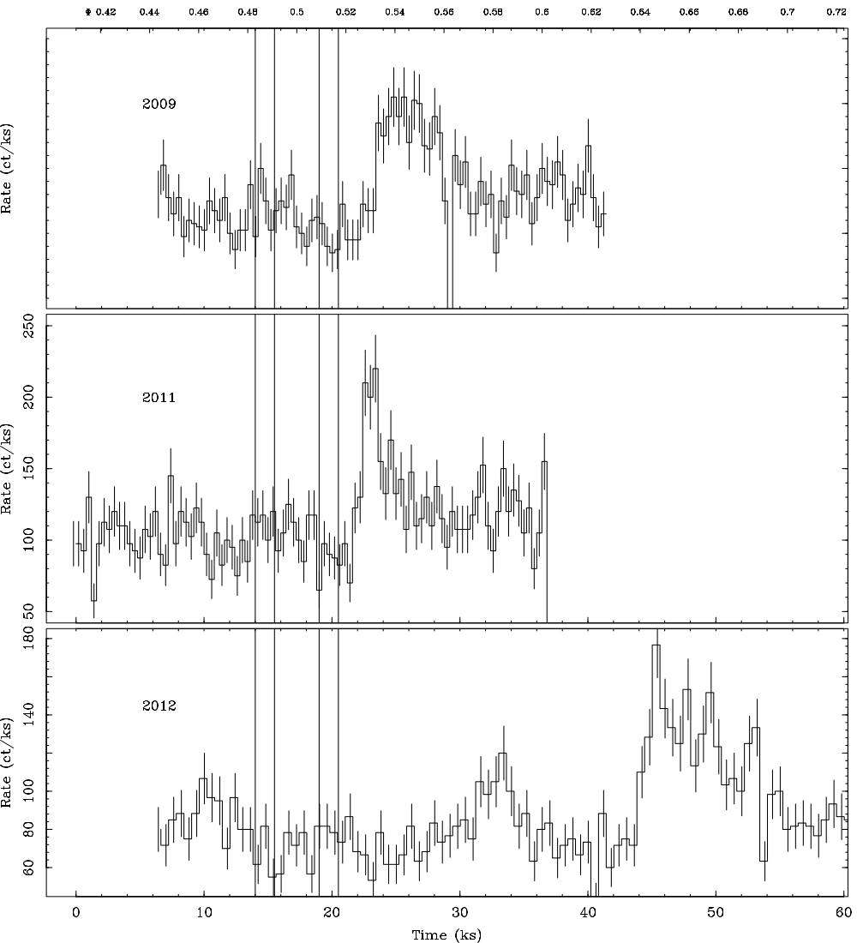
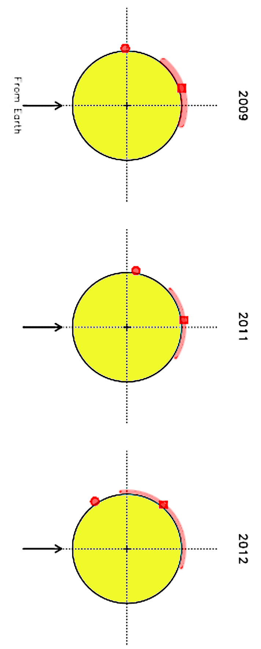
X-ray Observations of Planetary Eclipse
0.40 0.5 phase 0.6 0.7
2009
2011
Count Rate
2012
10 20 Time (ks) 40 50
Notes:
Phase .54 and .65

Slide 9
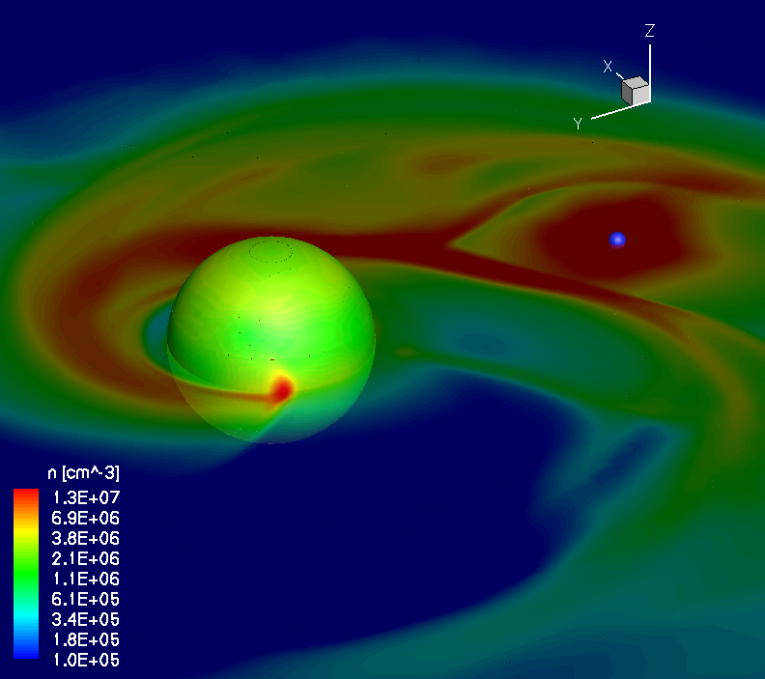
Cohen et al. (2011)
Notes:
MICHIGAN code no stellar wind, only B fields and gravity

Slide 10
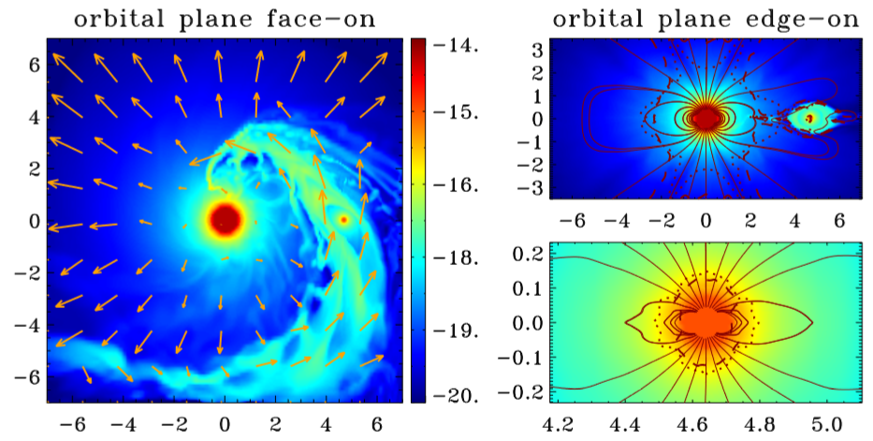
Plausibility Argument:
Accreting Streams and Tails
High UV, ~ M_{jup}
see Matsakos et al. (2014)
Notes:
PLUTO – MHD TURIN

Slide 11
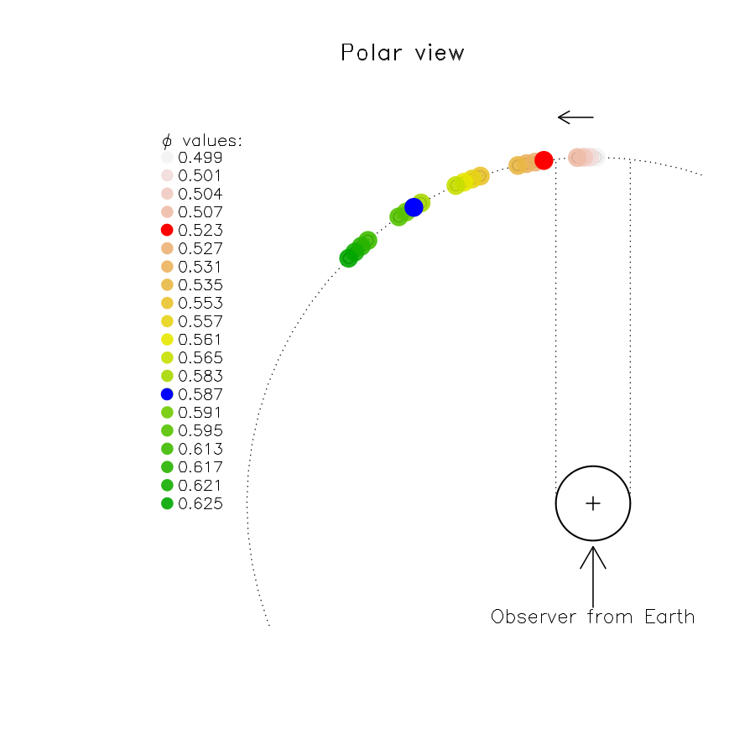
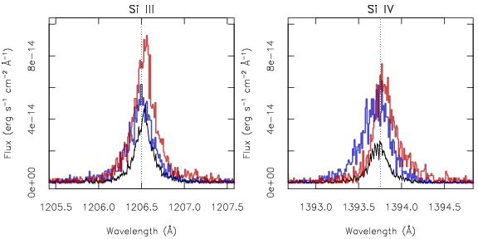
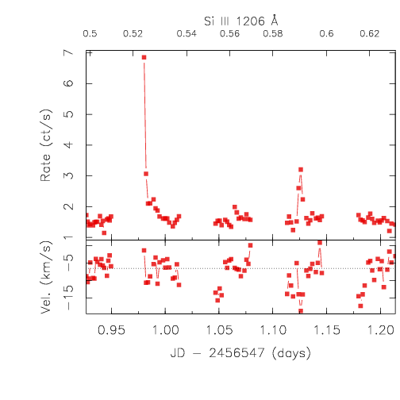
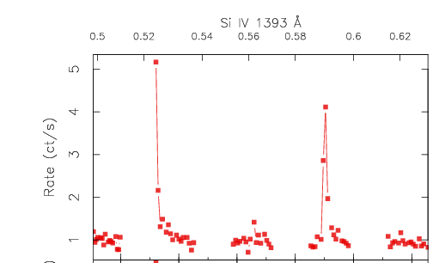
UV Variability at the
same phases
Two flares
0.5 .52 .56 0.6
0.5 .52 .56 0.6
Notes:
Other UV data but not at the high energy lines.

Slide 12
Phased Time Variability?
0.40 0.5 phase 0.6 0.7
2009
2011
Count Rate
2012
10 20 Time (ks) 40 50
Notes:
Åß∂ƒ©˙∆˚¬œ∑´®†¥¨ˆøπΩ≈ç√∫˜µ≤≥÷ø

Slide 13
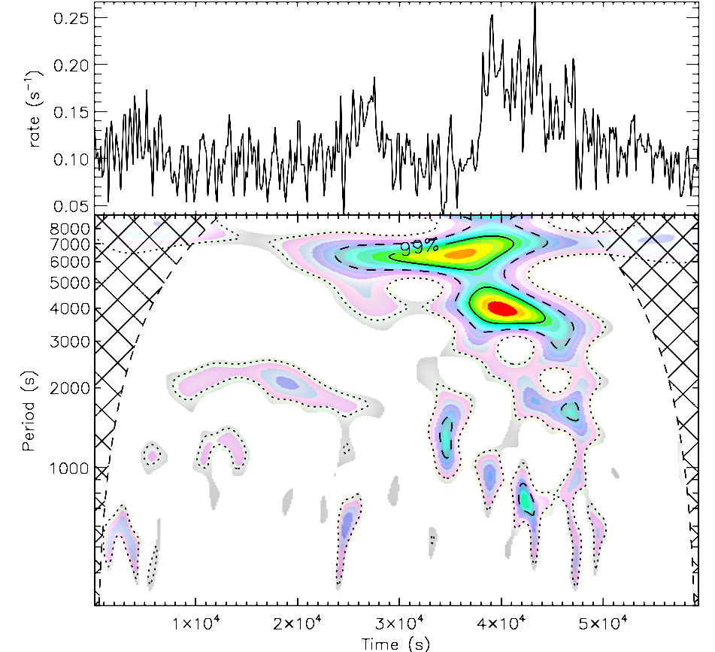
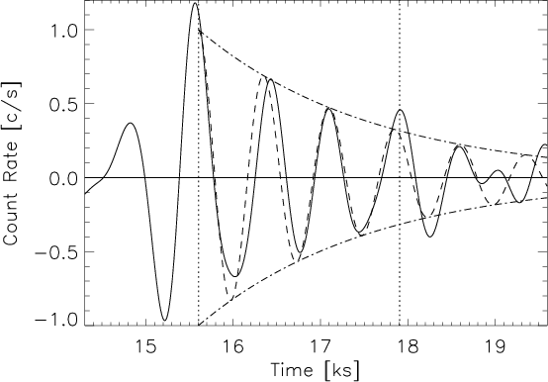
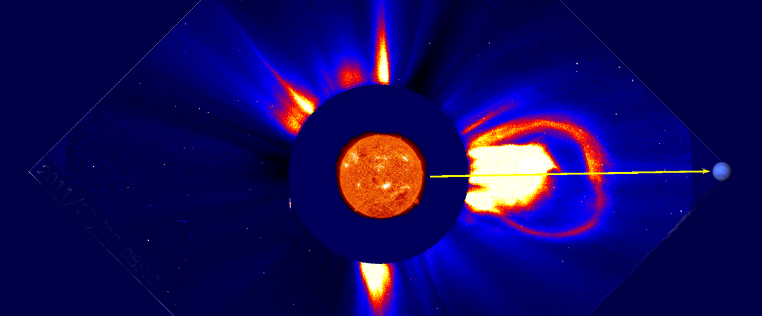
2D wavelet analysis of 2012 light curve
Description: A damped magneto acoustic oscillation in the flaring loop.
∆I/I ~4πnk_{B}T/B²
T~ 12 MK
n: density=5x10¹⁰ cm⁻³
(from RGS data)
B 40-100 G
[see Mitra-Kraev et al. (2005)]

Slide 14
2D wavelet analysis of 2012 light curve
Description: If a single loop it travels a fair fraction of the distance to the planet.
τ~ L/c_{s}
c_{s} = ~T^{0.5}
τ= oscillation period ~ 4 ks
L=Const. X τ_{osc}NT^{0.5}
assuming N=1
L 2-4 R*
Pillitteri et al. (2014)

Slide 15
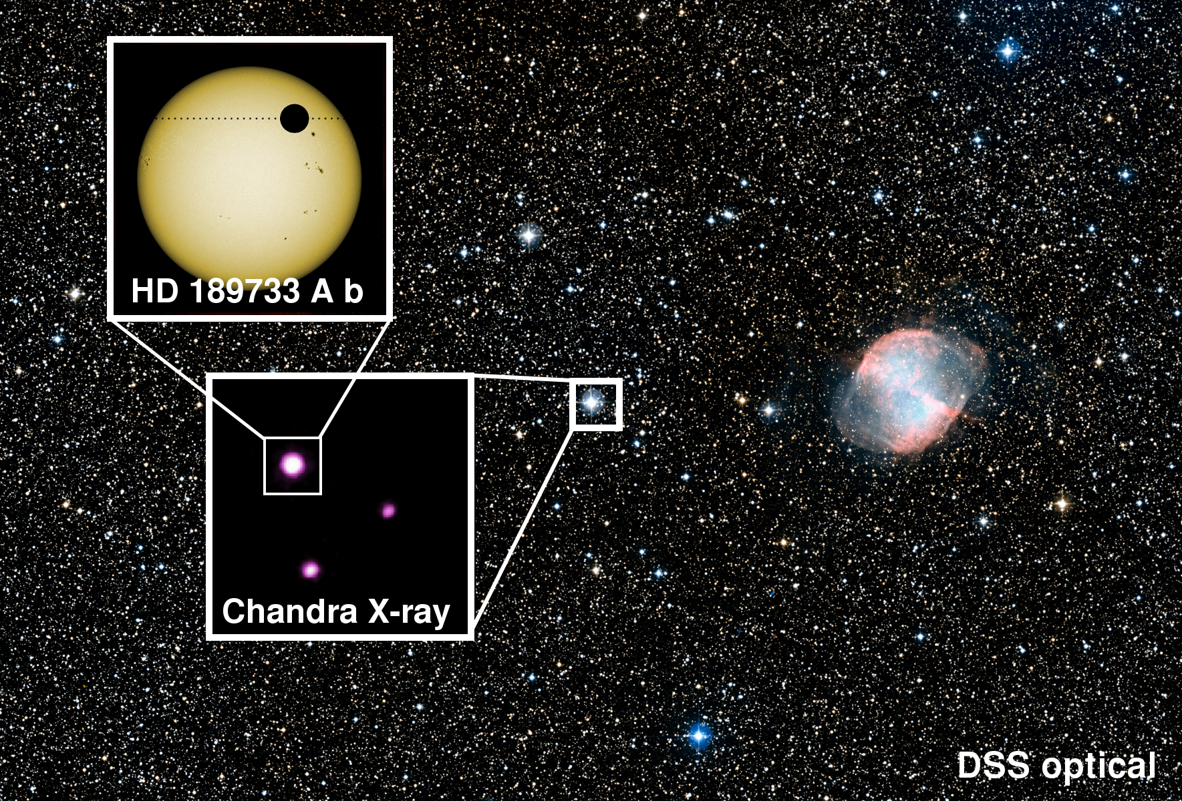
  An active K1V at 19 pc (L_{x}~10L_{x})
  Age estimated at 0.6 Gyr
  Hot Jupiter in a 2.2 day orbit

Slide 16
  An active K1V at 19 pc (L_{x}~10L_{x})
  Age estimated at 0.6 Gyr
  Hot Jupiter in a 2.2 day orbit
  Wide M4 Companion (very inactive)

Slide 17
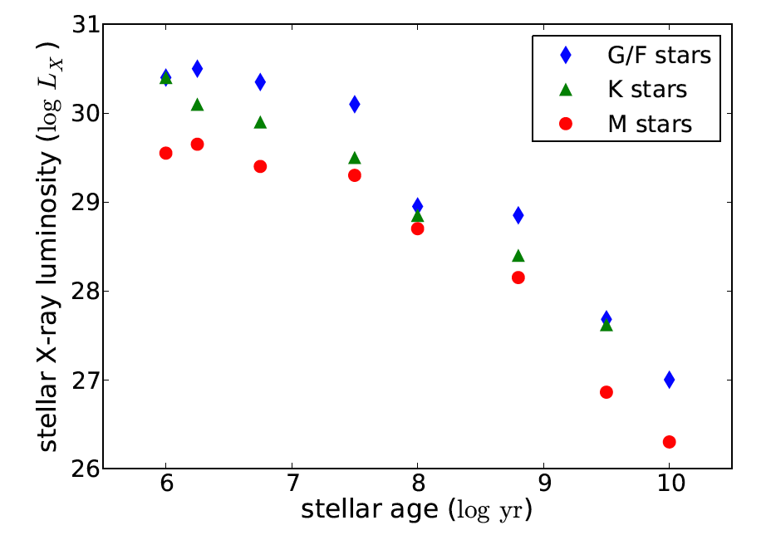
Activity decline with stellar age
X-ray Saturation
Evolution due to
Angular Momentum Loss
Data from Preibisch et al. 2005, Jeffries et al. 2006, Schmitt et al. 1995, Schmitt 1997, Maggio et al. 1987, Hawley et al. 1994

Slide 18
Age/activity in the strong tidal interaction case
CoRoT-2
HD189733

Slide 19
Age/activity in the strong tidal interaction case
CoRoT-2
HD189733
Poppenhaeger & Wolk (2014)

Slide 20
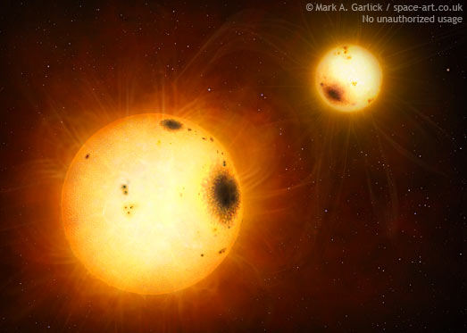
Tidal Evolution can effect gyrochronolgy – RS CVns

Slide 21
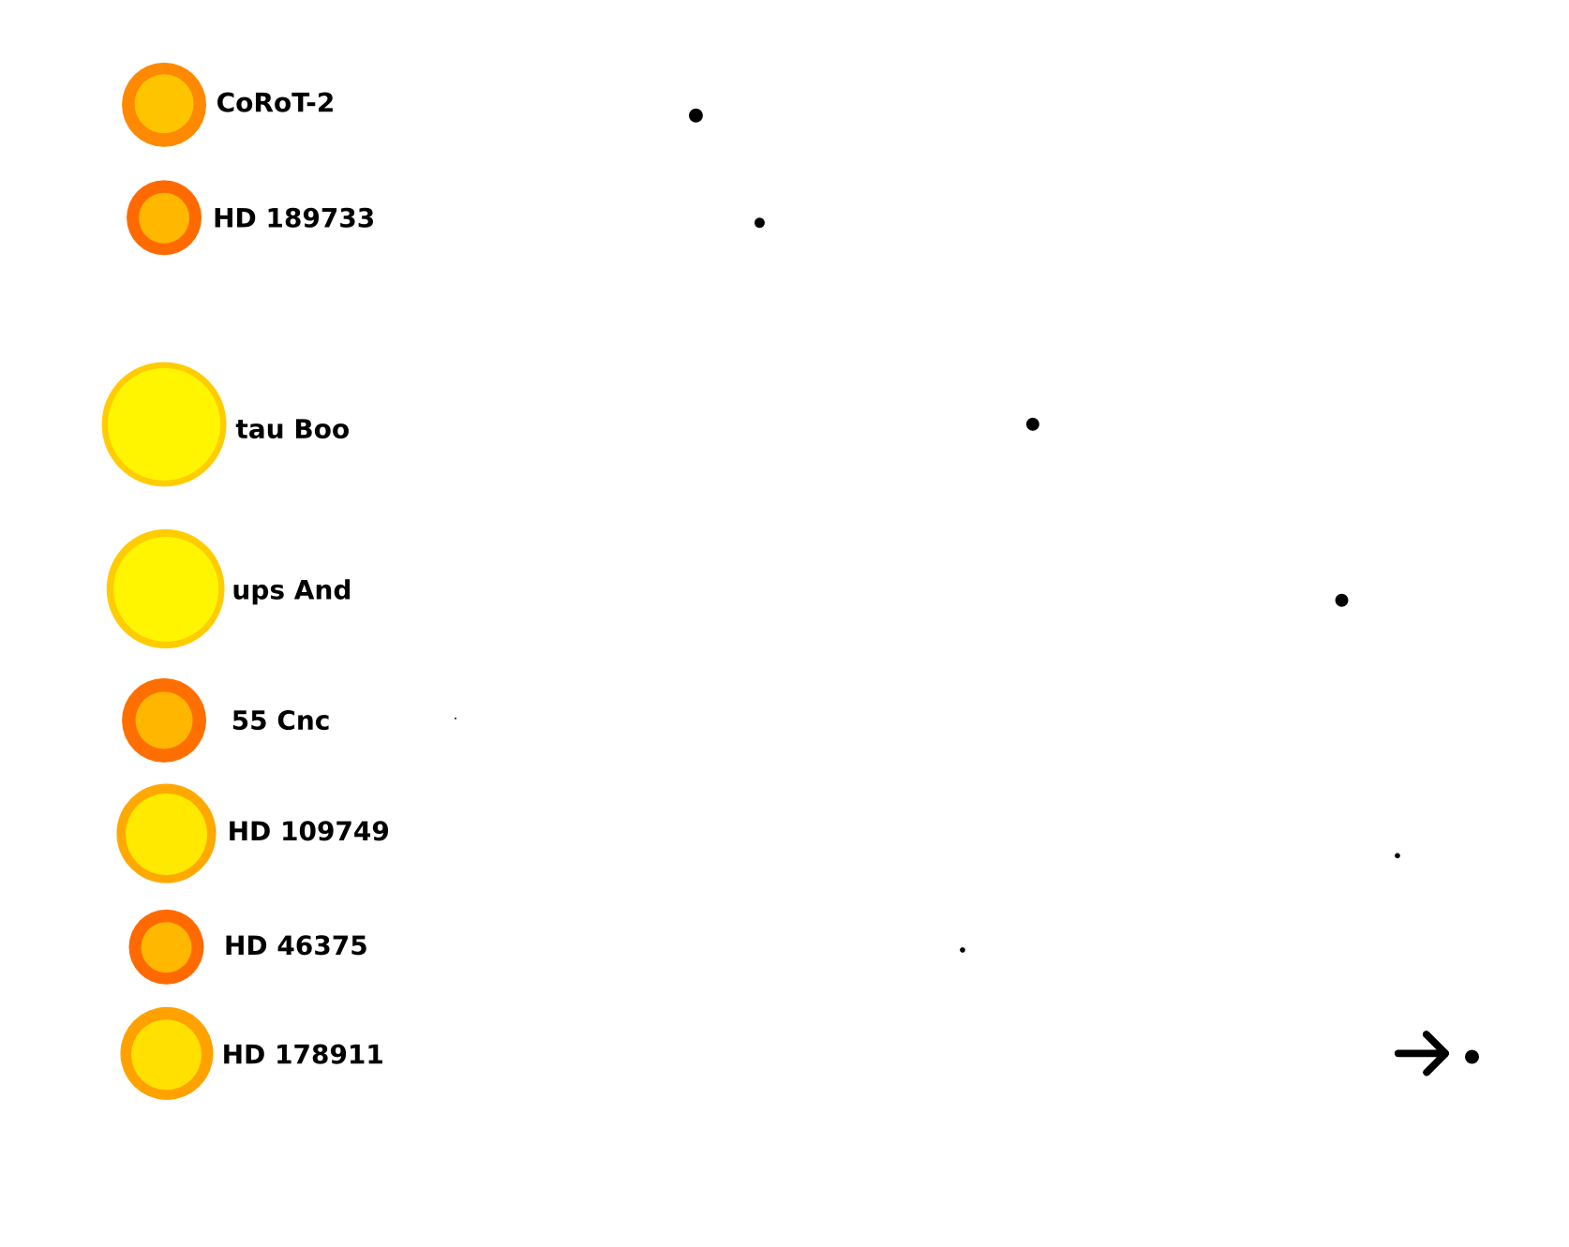
Planet Hosting Stars With Stellar Companions
Strong Tidal Interactions
Weak Tidal Interactions

Slide 22
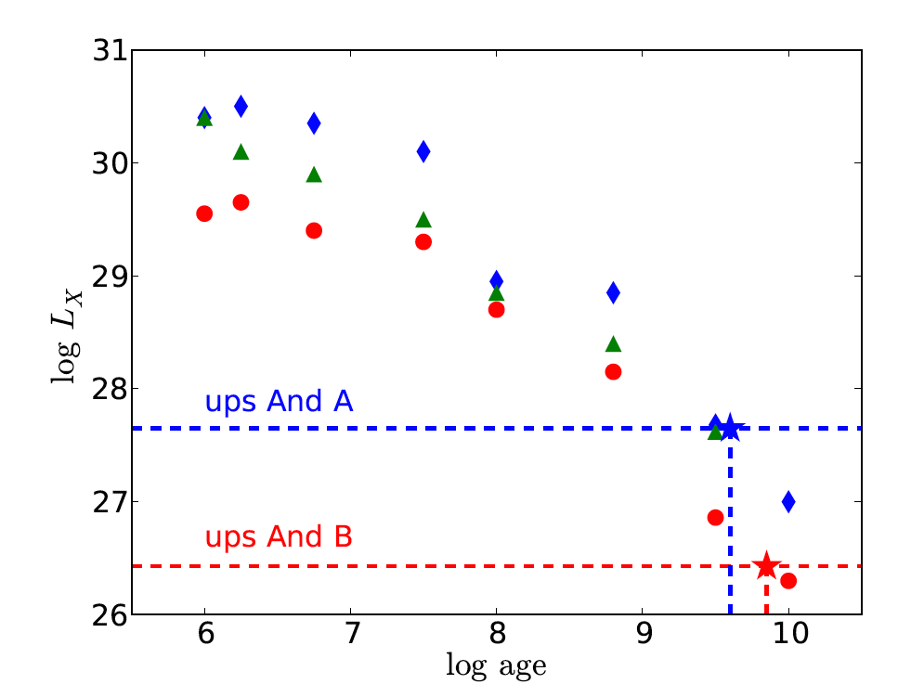
Age/activity in the weak tidal interaction case
Poppenhaeger & Wolk (2014)

Slide 23
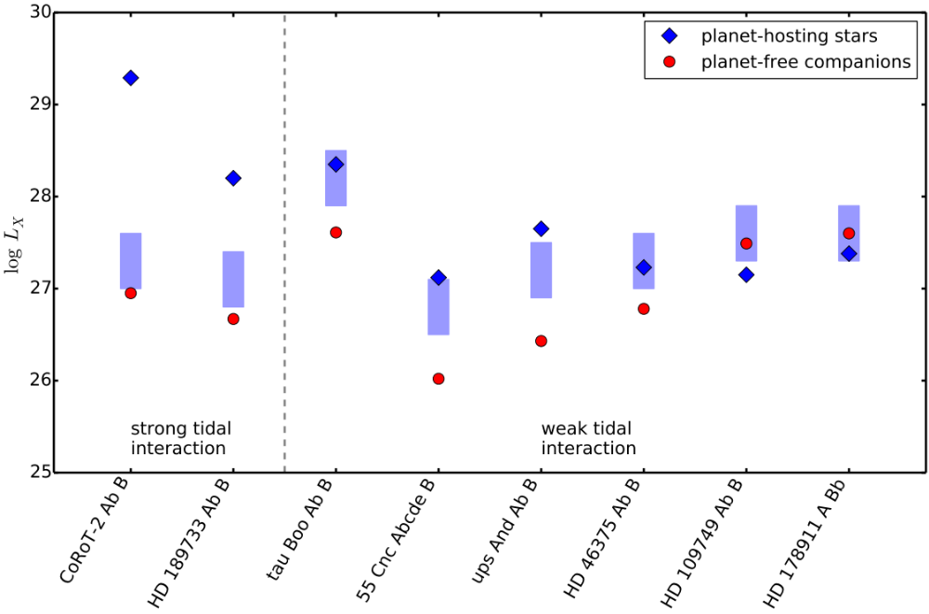
X-ray Activity for 8 Systems
Poppenhaeger & Wolk (in prep)

Slide 24
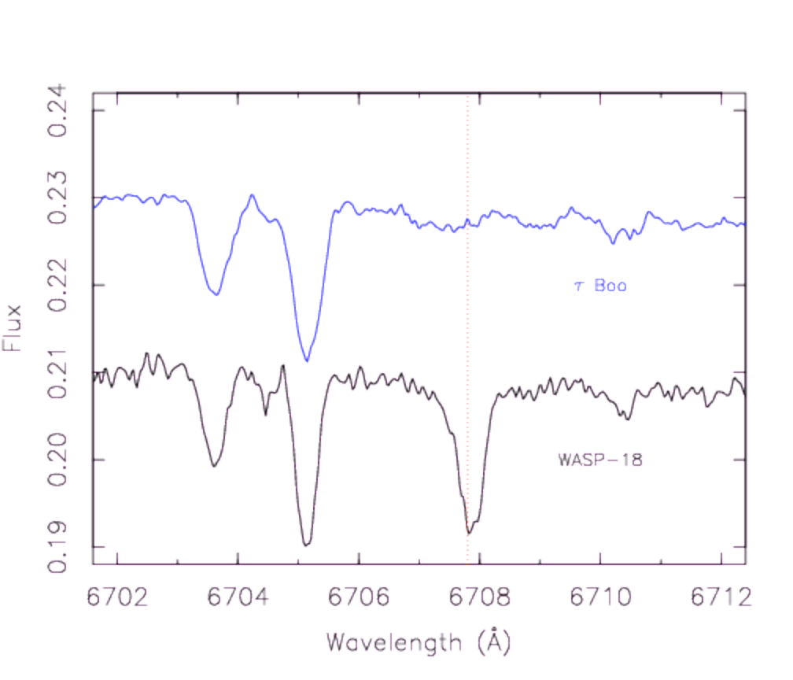
WASP-18
WASP 18 is YOUNG
Single F6 star:
M_{p}~ 10M_{Jup}
Per ~ 23 hours
WASP-18 vs. other F stars
L_{x} WASP-18 < 10^{26.5} erg/s
L_{x} Tau Boo ~ 10²⁸ erg/s
L_{x} Procyon ~ 10²⁸ erg/s
Pillitteri et al. (2014)
Notes:
With out X-rays, the lack of UV activy

Slide 25
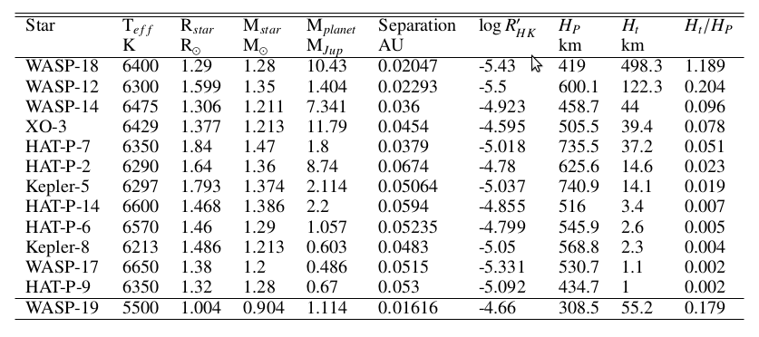
Pillitteri et al. (2014)

Slide 26
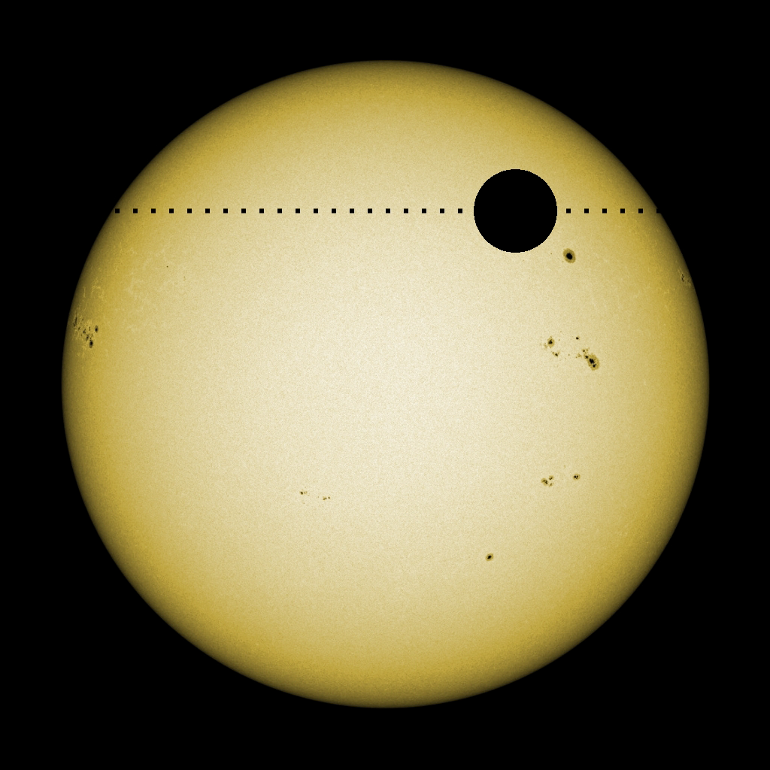
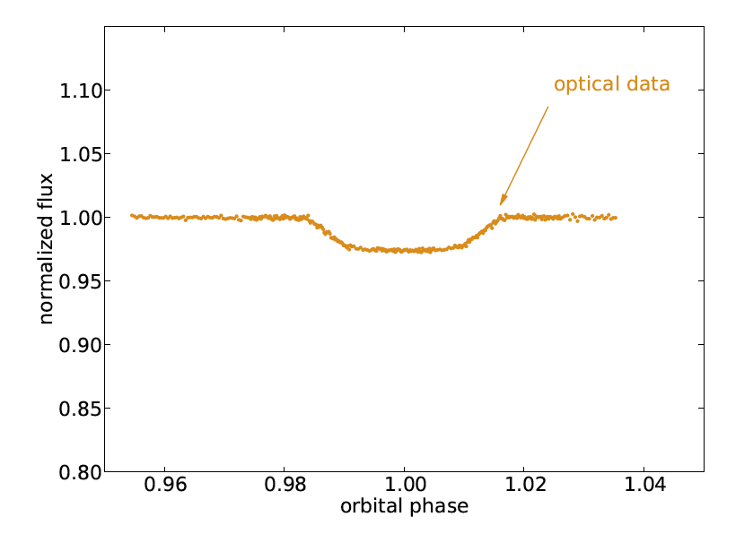
Transit of HD 189733

Slide 27
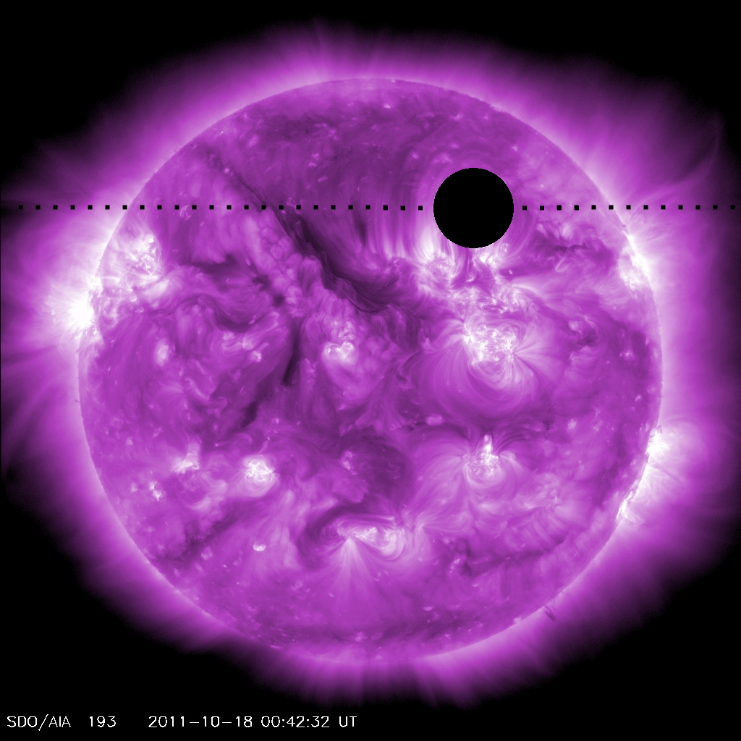
Transit of HD 189733

Slide 28
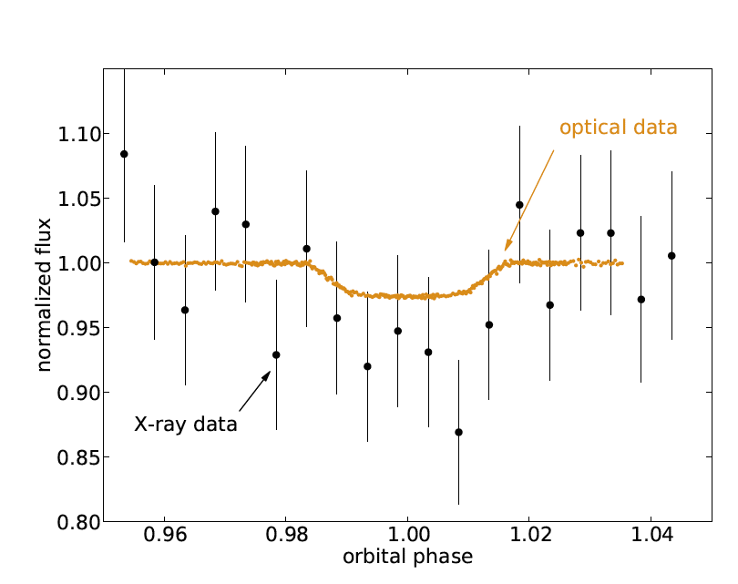
Transit of HD 189733

Slide 29
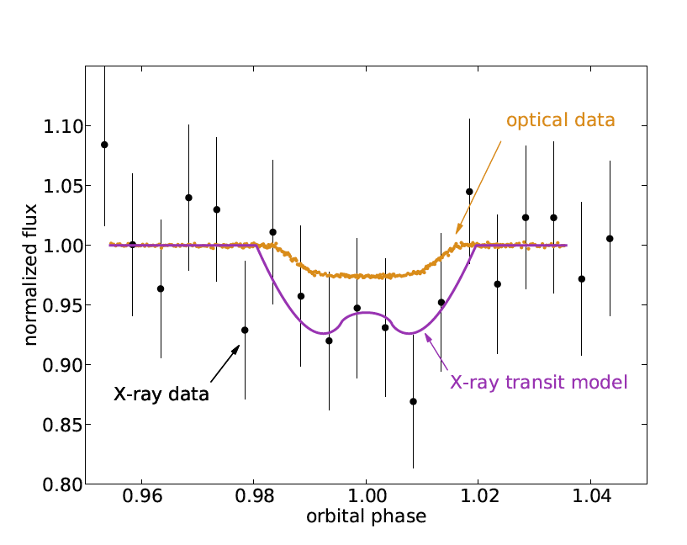
Transit of HD 189733

Slide 30
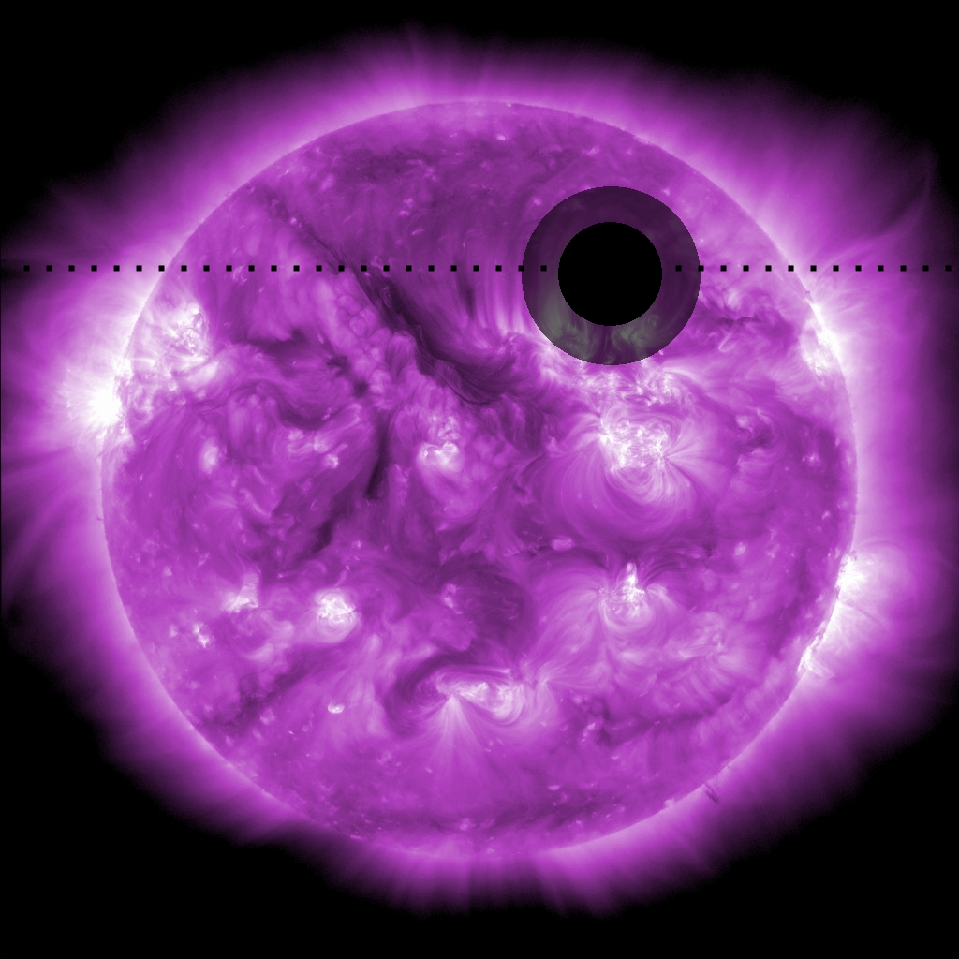
Transit of HD 189733
Poppenhaeger, Schmidt & Wolk (2013)

Slide 31
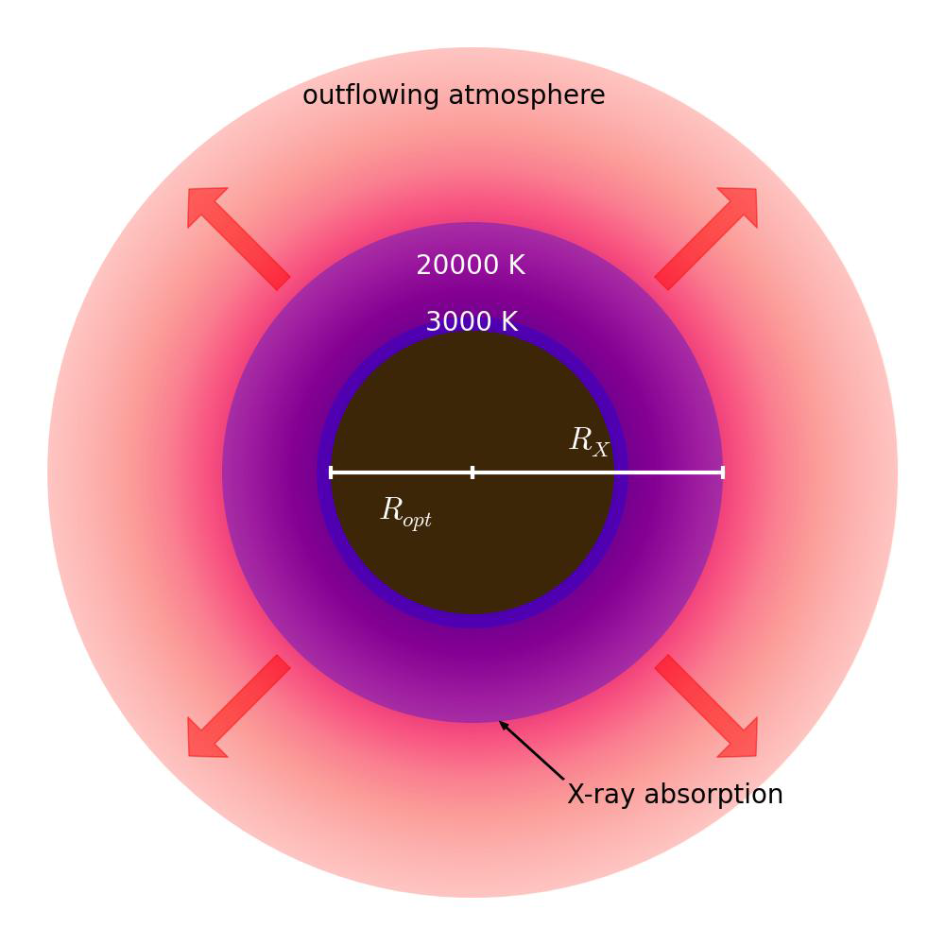
Planetary Atmosphere: Toy Model
H=kT/µ_{m}g
ΔD~2 HR_{Pl}/R*
_{Miller-Ricci & Fortney (2010)}
To be X-ray opaque
density at 1.75R_{Pl}: 10¹¹ cm⁻³
high-altitude temperature:
~ 20,000K
Poppenhaeger, Schmitt & Wolk (2013)
Notes:
(assuming 10 solar
metallicity)

Slide 32
Chandra is essential for exoplanet studies
Extended planetary atmospheres can lead to deep X-ray transits.
  X-rays are the only way to study the upper atmospheres and exospheres of exoplanets
When a hot Jupiter host has a strong convective zone there is strong tidal coupling.
  Hot Jupiter’s keep their host planets looking young…or not
  Corollary: You cannot use activity to date stars with close in planets.
Strong evidence of a planet induced hot spot on which may have served as the launching point of a long flare.
TESS should provide several additional nearby X-ray bright transiting hot Jupiters.
ARCUS could spectrally resolve atomic lines in the exospheres of such planets.
Notes:
Chandra

Slide 33

Backup Slides

Slide 34
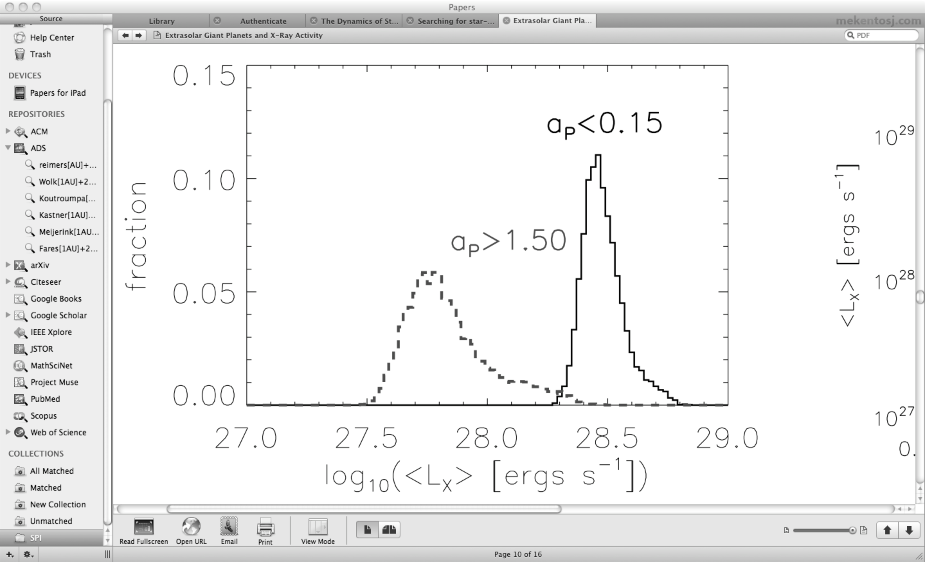
What is the evidence exists for
Star-Planet Interaction?
Direct observation of phased emission from Ca II HK lines (Shkolnik et al. 2003, 2008)
Stars with hot Jupiters are brighter in X-rays (Kashyap et al. 2009)
But both results are disputed. (Poppenhager et al. 2010, 2011)
Kayshap et al. 2009

Slide 35
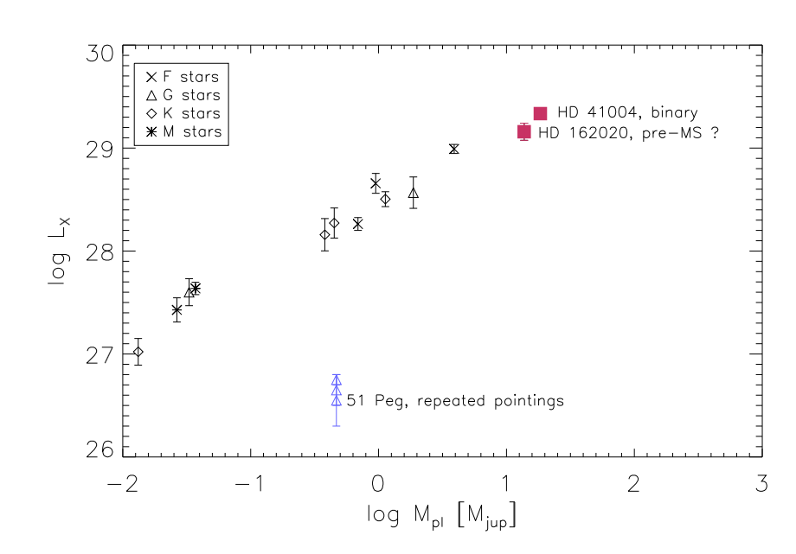
What is the evidence exists for
Star-Planet Interaction?
Scharf et al. 2010, Poppenhaeger et al. 2011

Slide 36
What is the evidence exists for
Star-Planet Interaction?
Activity Selection Bias?
Poppenhaeger et al. 2011

Slide 37
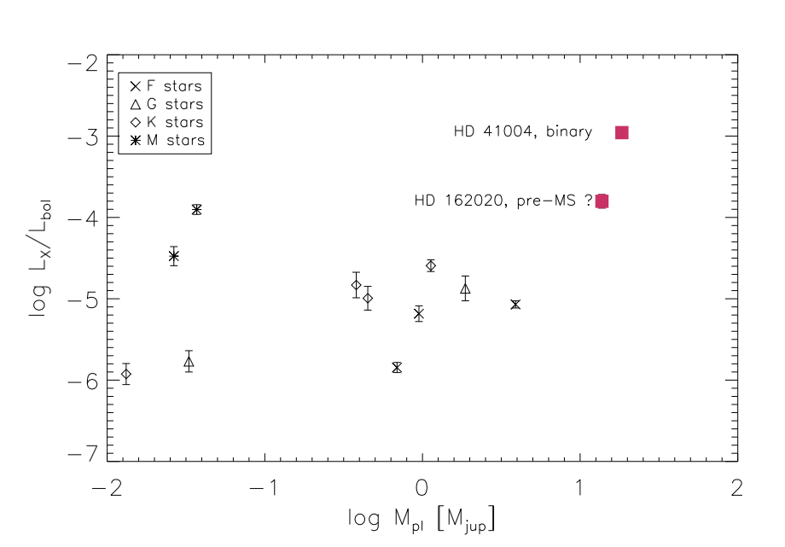
What is the evidence exists for
Star-Planet Interaction?
Poppenhaeger et al. 2011

Slide 39
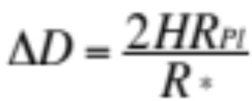
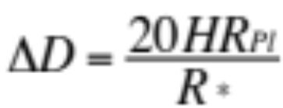
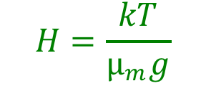
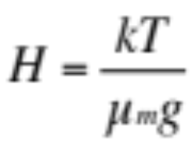


Slide 40
…and the rest
WASP-18
HD 162020
WASP-19,WASP-52 WASP-59

Slide 41
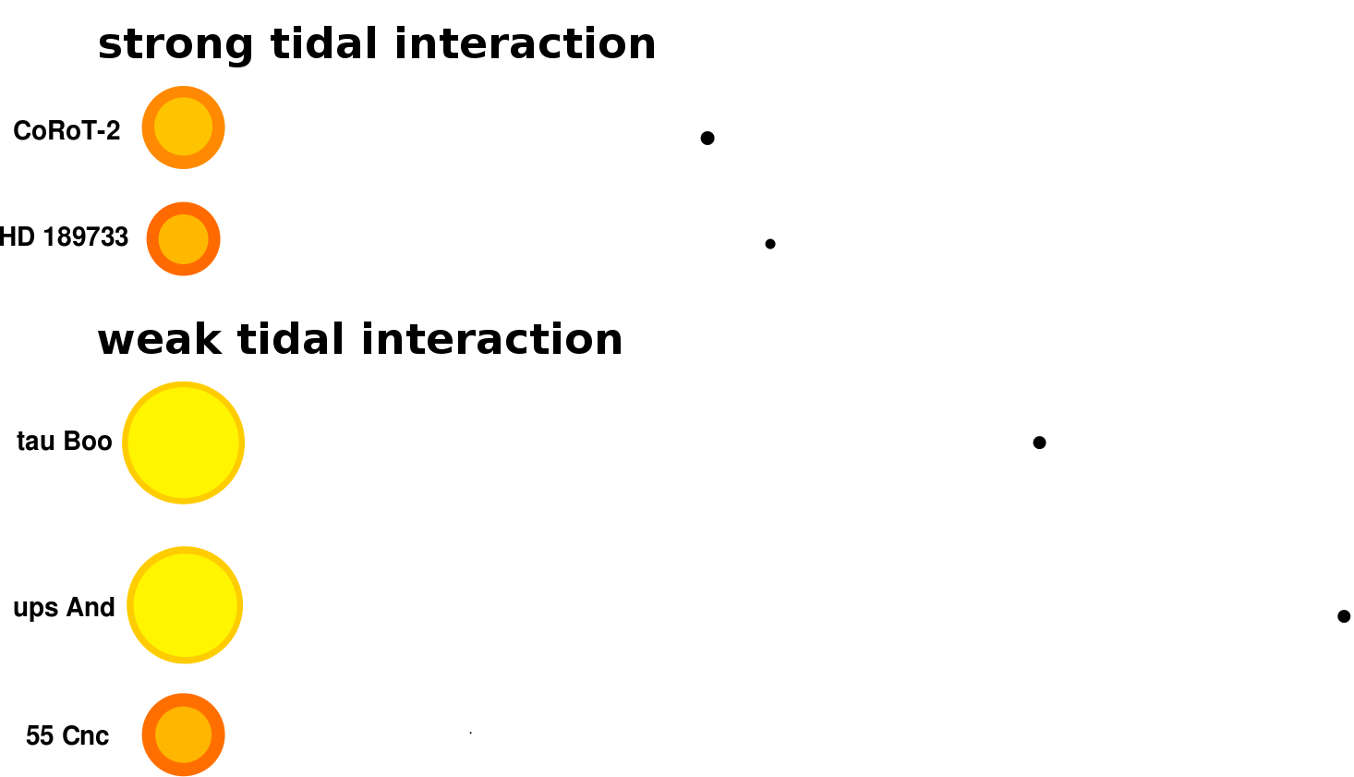
Planet Hosting Stars With Stellar Companions
Notes:
There are about 25 relevant systems that we are now surveying

Slide 42
Strong Tidal Interactions
Weak Tidal Interactions

Slide 44
Exoplanet portion
The zoo – HJ
WASP -18 system to scale
High energy emission and Exoplanets
HD 189733 and it hot Jupiter
  Transit
  Planetary atmosphere
  Magnetic breaking broken
  Binaries as Control
  MSPI – HD 189733
WASP 18

Slide 45
Exoplanets
Extended planetary atmospheres: deep X-ray transits
Strong X-ray emission/activity, possibly over long timescales
age calibration: stellar companions
age calibration: asteroseismology (get to lower stellar masses)

Slide 46
(Cohen et al. 2011)

Slide 47
Cluster Census
&
Transition Disk Timescales

Slide 48
Key Questions
Questions about populations.
  How does one obtain a “complete” census of a cluster?
  What is the general sequence of events by which a star goes from having a full optically thick disk to being “naked”?
  How does the flaring process impact the development of the system.
  Are brown dwarfs formed independently, via ejection or both?
Questions about Disks
  What is the feedback between ionization and disk accretion?
  What produces the inner disk clearing in transitional disks?
  Does the inner disk fill again? Are there repeated episodes of disk clearing?
Questions Exoplanets
  How do exoplanets and their host stars interact?

Slide 49
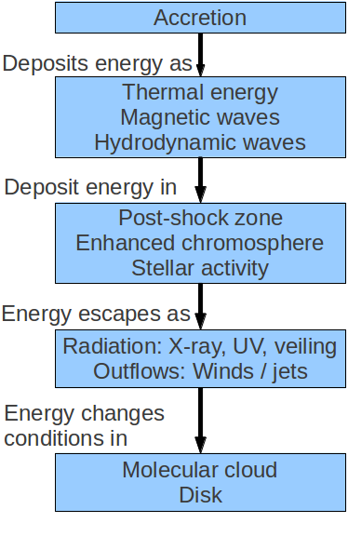
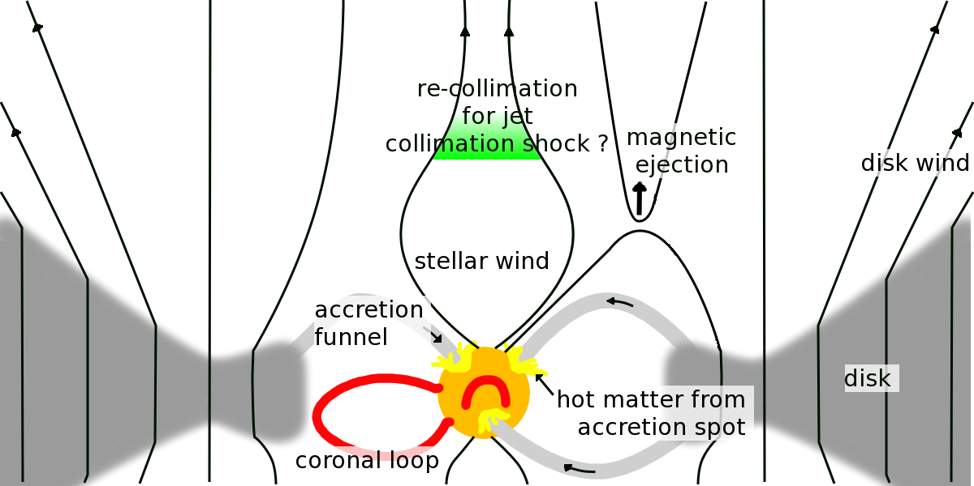
Accretion: Where does the energy go?
Günther (2013)

Slide 50
Multiwavlength Studies of Star Formation
The X-ray detection of thousands of stars, including brown dwarf candidates. X-ray emission originates from Class 0, I, II, and III YSOs.
A Key Aspect of the X-ray is that is supplies a nearly unbiased sample from which to ascertain IR and Radio properties.
Conversely the IR can be used to compare the X-ray properties as a function of disk properties.
  This only works because disk seem to have a second order effect on X-rays and Vice Versa.
  X-ray sources not associated with any optical/infrared counterpart can trace a yet-to-be-discovered stellar population of deeply embedded, relatively massive cluster members.
New simultaneous observations of NGC 1333 and IC 348 are limited by the radio sensitivity; only a very low detection fraction of YSOs in both bands is found.
  On the on hand sources detected in the radio are brighter than Expected.
  On the other hand most PMS stars are not detected at cm wavelength
(All PMS) stars are variable.
  Optical variability is a hallmark of YSOs
  Young stars have both constant and flaring X-ray components.
  X-rays can both heat protostellar disks and cause in situ nucleosynthesis.

Slide 51
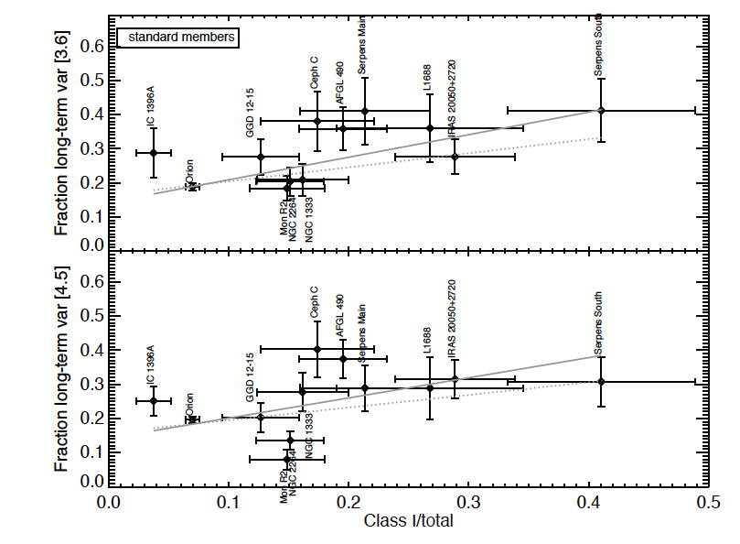
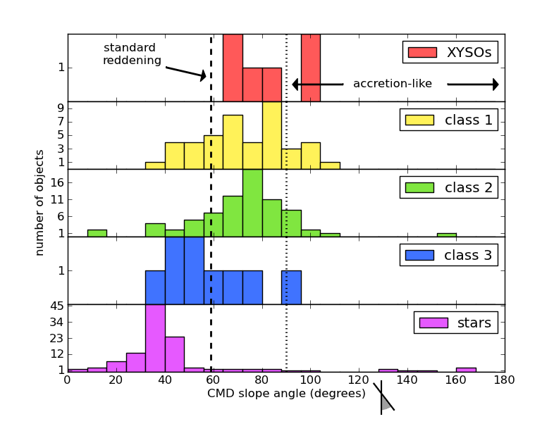

Slide 52
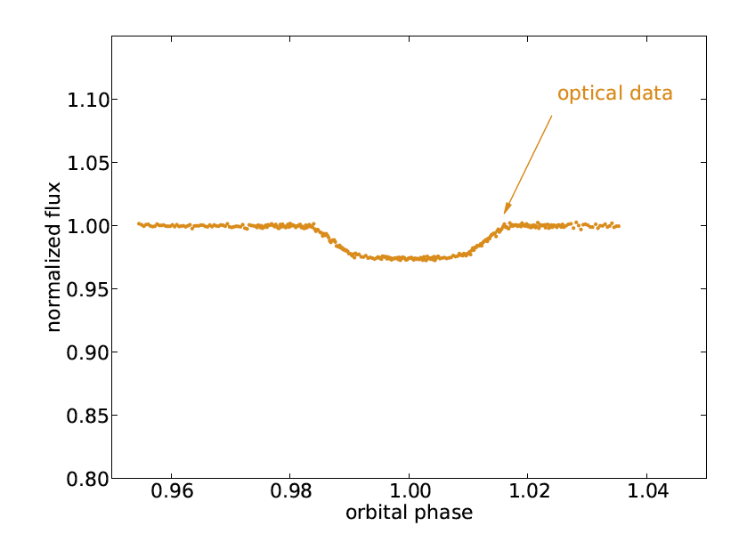

Slide 54
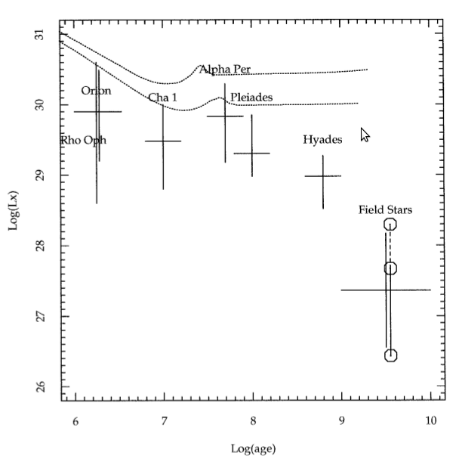
Evolution of Lx for Low Mass Stars
Log L_{X}
X-ray Saturation
Evolution due to
Angular Momentum Loss
Age
Favata & Micela (2003)

Slide 58
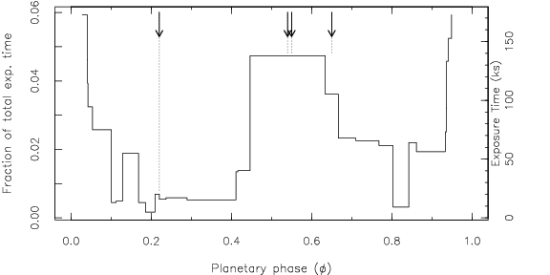
Phased Time Variability?
High flare frequency in the post eclipse phases
(φ=0.55-0.65)
Flare rate: 3 / 135 ks
PMS stars: 1/700 ks (Wolk et al. 2005, Caramazza et al. 2007)
2009
2011
2012
3 flares XMM
1 flare Swift

