Slide 1
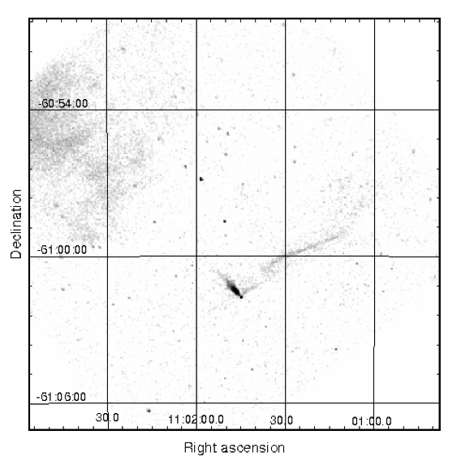
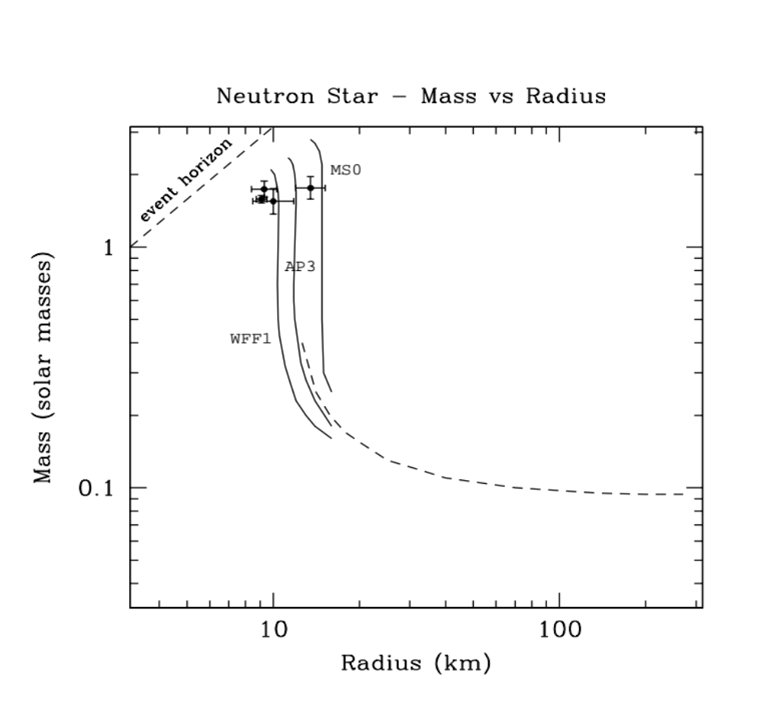
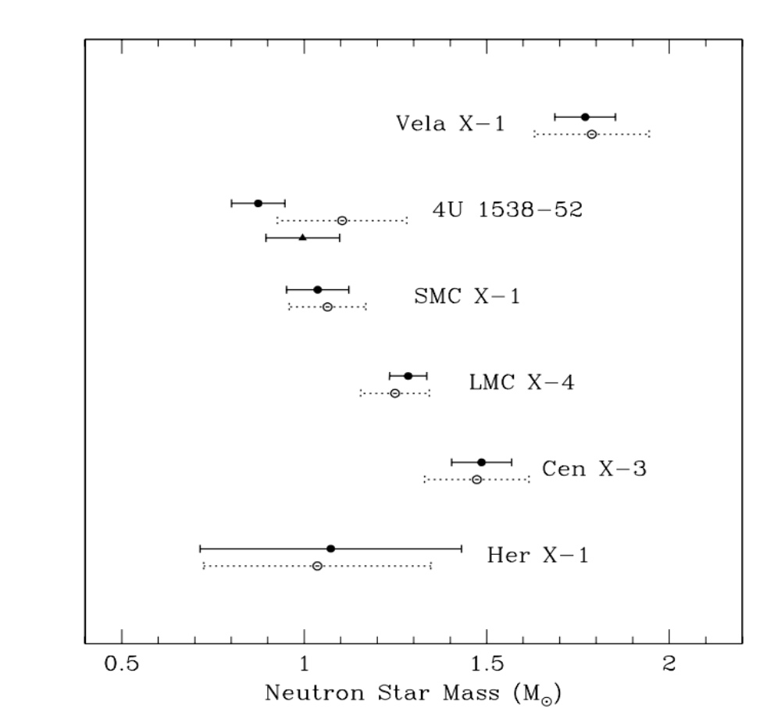
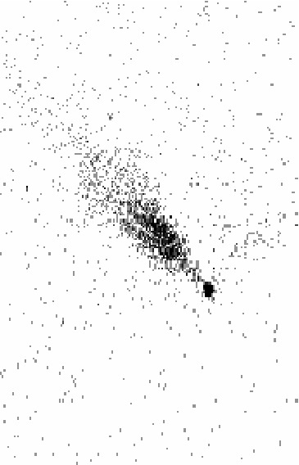
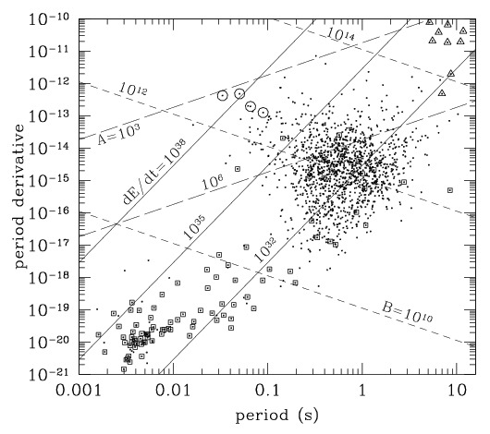
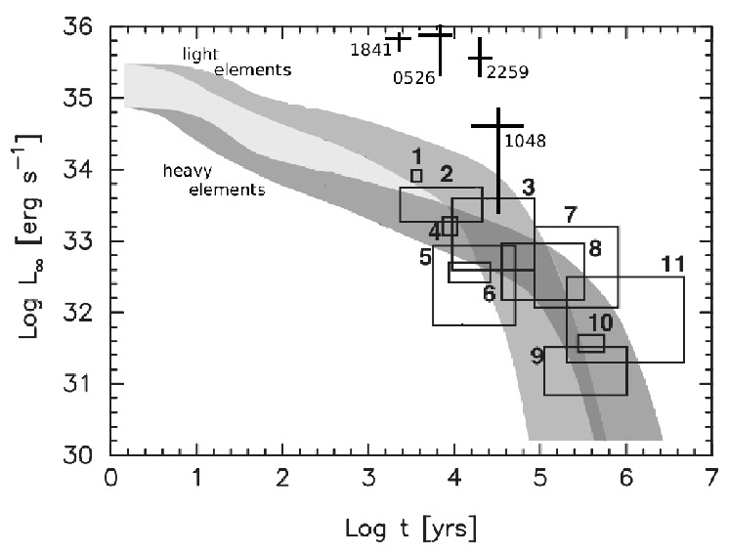
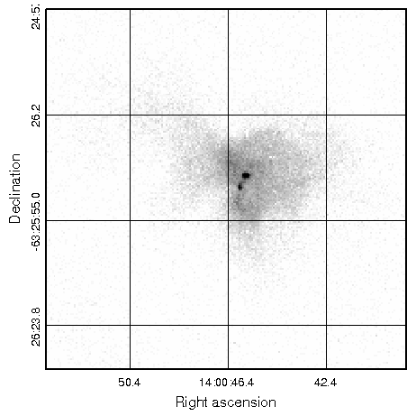
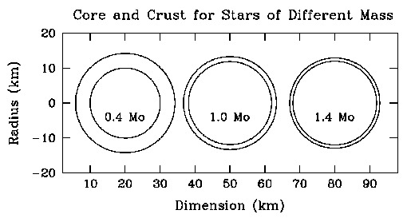
Where are the Low-mass Neutron Stars?
Frederick Seward
ABSTRACT
Neutron stars are predicted to be stable over the mass range ≈ 0.1 to ≈ 3M⊙. At 1.4 M⊙, 98% of the mass is in a core with supernuclear density and 1-2 % forms a thin crust and atmosphere . As mass decreases, the fraction of mass in the crust increases until at ≈ 0.1 M⊙, all material is at nuclear density or below and the star is all crust. The masses of ≈ 60 neutron stars have been measured and all fall between 1 M⊙ and 2 M⊙. It is of interest to search for neutron stars with M < 0.5 M⊙. These low-mass objects should have different characteristics and might be found in high-mass binaries, as high-velocity objects, and perhaps as Anomalous Pulsars.
Collapse of a rapidly rotating star, however, could produce a different result. This is not a new idea (Michel 1970). Colpi & Wasserman (2002) consider in some detail collapse to a binary system where the mass of the shrinking core is shared between two neutron stars and one is a low-mass object.
Note that the lowest NS masses so far observed are in early-star binaries, the HMXBs. Since the stars in a binary are probably formed at the same time, the neutron star precursor was even more massive than the present companion and rotation is common in early stars. One can imagine a collapse which produces unbound low-mass stars.
6. Anomalous Pulsars/Soft Gamma Repeaters/Magnetars
The ∼ 25 AXP exhibit major differences from the ∼ 1500 other known pulsars.
The spindown is irregular (Tam et al. 2008). They are not rotation powered, and the older ones are more luminous (Figure 7). On the P-Pdot diagram (Figure 6), they form a group with large P and large Pdot in the upper right corner. This appears as a separate grouping rather than the tail of a distribution. It is believed (Kaspi 2004) that energy is supplied by decay of a very strong magnetic field (10¹⁴ - 10¹⁵ G) calculated using the dipole model which predicts large values for the magnetic moment and the surface field, B. This accounts for the large value of Pdot and is the source of the radiated energy.
Low-mass NS are also rare objects in which properties of the crust should have a more dominant role. Perhaps some (or all) of the AXPs are low-mass NSs. Certainly the gamma bursts from SGR are a crustal phenomenon. Probably a high B is necessary to account for the high Lx shown in Figure 7, however, cooling calculations in the literature are only for masses above 1.0 M⊙. Because the low-mass stars are less dense, neutrino cooling should be less rapid and the core temperature higher at formation. The thicker crust might cause slower cooling, higher surface temperature and increased thermal X-ray emission. Extending cooling calculations to lower NS masses would be interesting.
Particle emission probably accounts for much of the spin-down, so predictions of the dipole model about magnetic field and age are not accurate (see e.g. Harding et al. 1999). Also, for a given magnetic moment, a greater volume requires a lesser field so for a large low-mass NS the magnetic field need not be so high.
7. Cooling
A neutron star, born in gravitational collapse with initial temperature ∼ 10¹¹ K, cools rapidly through neutrino emission from the core. At an age of 10-100 years, the crust is thermally coupled to the core and is transparent to neutrinos. The surface temperature, T, is 10⁶ − 10⁷ K. Core neutrino emission dominates the cooling until an age of ∼ 10⁵ years after which photon emission from the surface cools the star (Yakovlev et al. 2004).
Figure 7 shows a calculation of neutron star cooling (surface temperature as a function of time). The cooling curves are for a Minimum Model of neutron star cooling applied to a 1.3 M⊙ star (Page et al. 2009). In this model there are no direct UCRA reactions and no cooling from pions or kaons in the core, which would cause more rapid cooling. This curve is applicable to neutron stars having 1.3 M⊙ or somewhat less, independent of the equation of state (soft or stiff) used. The figure also shows temperatures ”measured” for 10 neutron stars . Blackbody radiation is assumed and temperature has been converted to X-ray luminosity. Data for a few AXP have also been included. These objects are within supernova remnants and the remnant age, calculated from a Sedov analysis, has been used for the age of the internal object. AXP 1048.1-5937, however, has been assumed to have originated in the nearby Carina Nebula and to have reached its present position with velocity of ≈ 500 km s−1.
1. Introduction
A neutron star (NS) is generally assumed to have mass, M = 1.3 − 1.4 M⊙ and radius, R = 10−15 km. It consists of a gaseous atmosphere with thickness of a few cm, a solid crust with thickness ≈ 1 km, and a liquid core with R ≈ 10 km and central density ≈ 10¹⁵ g cm⁻³, appreciably more dense than the material in an atomic nucleus which has density ≈ 2.8 × 10¹⁴ g cm⁻³. For this canonical NS, ≈ 98% of the mass is in the core.
In theory, neutron stars can exist with mass ranging from ≈ 0.1 to ≈ 3 M⊙. (Lattimer and Prakash 2001). Above the high-mass limit, the NS becomes a black hole. Below the lower limit, dynamic instability and β-decay lead to disintegration of the star (Colpi et al 1989). The few accurate measurements of radii that exist indicate that canonical-mass NSs are understood and, since the low-mass theory is based on observations of atomic nuclei (Hansel et al 2002), the M vs R relation should be about as shown in Figure 1.
It is characteristic of most models that the radius does not change much in the range 0.5 M⊙ < M < 1.5 M⊙ but as mass decreases below 0.5 M⊙, the radius starts to increase and the mass and thickness of the crust increase (see Figure 2) until at the minimum mass of ≈ 0.1 M⊙ the radius is ∼ 200 km and the NS is all crust. As mass decreases, there should come a point, probably in the range 0.1 M⊙ < M < 0.5 M⊙, where characteristics of the star are determined more by the crust than the core.
A low-mass object, however, is expected to be difficult, perhaps impossible, to form. Indeed, there may be none available for study. However, the gravitational collapse of a massive rotating star, is a possible formation mechanism. Already there is evidence that M = 1.1 M⊙ is possible and since masses lower than this are not forbidden, they may well exist.
4. High-velocity objects
A recent Chandra observation (Figure 4) of the INTEGRAL source IGR J11014- 6103 shows evidence for a rotating gravitational collapse. It is an X-ray point source located 11’ SW of the center of the supernova remnant MSH 11-61A and a long narrow X-ray nebula points to the center of the SNR. This appears to be a pulsar with synchrotron nebula extended along the assumed line of travel. A second fainter but longer jet extends from the point source and, surprisingly, is perpendicular to the direction of travel. Pavel et al. (2014), assuming origin at the site of the nearby remnant, derive a velocity of 1000-2000 km s⁻¹. The existence of a synchrotron nebula implies rotation and a magnetic field but no pulsations have been detected.
If this object were created in the collapse and fragmentation of a rapidly rotating core, the angular momentum vector of any objects thrown outward would indeed be perpendicular to the direction of travel. Since the pulsar jet has to be along the rotation axis, the alignment of the pulsar jet perpendicular to the trail indicates the pulsar axis is oriented as expected from this process. The angular momentum alignment is a powerful argument for rotational ejection. Knowledge of P, Pdot, and the pulse shape would be useful, although, since the NS is isolated, a mass measurement seems impossible.
Fig. 4.— Chandra ACIS observations of the high-velocity object southwest of supernova remnant MSH 11-61A. This 15′ × 15′ figure shows the sky SW of the 13′ × 17′ remnant, part of which fills the northeast corner. Energy range is 0.5-10 keV and smoothing is 5′′. The distance between the pulsar and the out-of-view center of the remnant is 11′. The bright NE-SW emission indicates the direction xx xx xx xx xx of travel and the fainter xx xx xx xx xx NW-SE jet indicates the xx xx xx xx xx pulsar spin axis. The xx xx xx xx xx magnified unsmoothed xx xx xx xx xx insert shows the point- xx xx xx xx xx like appearance of the xx xx xx xx xx neutron star. (Pavan et xx xx xx xx xx al. 2014)
Fig. 6. Characteristics of 1474 pulsars from the ANTF 2006 catalog. Boxes show binary systems, 4 bright rotation-powered pulsars are circled and AXPs are triangles. Straight lines are from the magnetic dipole model and show constant spin-down energy, Edot ̇ (ergs s⁻¹), magnetic field , B (Gauss), and age, A (years).
5. Supernova remnants with multiple compact objects
If the collapse of rapidly rotating high-mass stars can produce multiple compact objects, there might be young remnants with more than one internal NS.
The remnant G310.6-1.6, shown in Figure 5, has two apparent point-like X-ray sources imbedded in a central PWN. The brighter source is a 31 ms pulsar with characteristic age of 13 kyrs (Renaud et al. 2010). The fainter source could be a bright jet but a second compact object is also compatible with the observation. The spectrum is not soft and is probably a power law but background is high and uncertain. Separation of the two sources is 3′′ or 0.10 pc at 7 kpc distance. The age of the remnant is estimated to be ∼ 1000 yrs. If the two sources were products of the collapse, the separation velocity is ∼ 100 km s⁻¹.
There are other remnants which show evidence for multiple compact objects within or nearby. A transient magnetar is located just south of the galactic remnant Kes 79, which also contains a central CCO (Zhou et al. 2014). The southern end of the Kookabura nebula has a region called ”The Rabbit” with at least two candidates for pulsars and associated PWN (Ng et al. 2005). IC443 (Bykov et al. 2005) and 3C 396 (Olbert etal. 2003) are also interesting.
Fig. 1. The dependence of neutron star radius on mass. If mass is too high, a black hole is formed. If mass is too low, the star is unstable. Three high-density models are shown as solid curves labeled as in Lattimer and Prakash (2001). WFF1 is a soft EOS, MS0 is stiff. The dashed curve is from Hansel et al (2002) and is based on laboratory measures of nuclear properties (with some modeling). Three data points are from bursts and the forth, with largest radius, is from the pulse profile of a millisecond pulsar.
Fig. 3. Observed masses of neutron stars in eclipsing binary systems with early stars (Her X-1 excepted) from Rawles et al (2011). Error bars are one sigma. Solid circles indicate calculation of eclipse using companion star bounded by Roche lobe. Open circles indicate calculation for spherical companion. The triangle shows a result for 4U 1538-52 assuming a circular orbit.
Fig. 7 Thermal luminosity of canonical neutron star as a function of age (adapted from Page (2009). The calculation for the Minimum Model of neutron star cooling is compared with measured blackbody luminosities of several pulsars. The two families of calculated cooling curves are for light and heavy element atmospheres. Boxes show observations of ther- mal X-rays from rotation powered pulsars. We have added crosses showing information for AXPs, with uncertainties due to inaccurate distances, extrapolation of measured luminosity to the range 0.3 to 10 keV, and variability.
2. Known neutron star masses
All actual mass measurements have been for objects in binary systems (Thorset and Chakrabarty 1999, Kiziltan et al. 2010, Rawles et al 2011). The highest accuracies have been achieved for 6 binary NS systems and individual NSs definitely do not all have the same mass. The system J1756-2251, for example, contains two NSs with masses of 1.18 ± 0.03 and 1.40 ± 0.03 M⊙, a difference of 17%.
If the companion is a large early star, uncertainties are large and NS masses range from 1.0 to 1.8 M⊙ with one-sigma uncertainties allowing masses as low as ≈ 0.8 M⊙. Figure 3 shows the NS masses calculated for early-star binaries. Note that two stars with small uncertainties, 1/3 of the sample, have most-likely NS masses of ≈ 1.0 M⊙.
Fig. 5. The central region of the 2′ diameter supernova remnant G310.6-1.6 in the energy range 0.3-10 keV as seen by Chandra. The brightest source is a Crab-like pulsar and the associated PWN almost fills the central region. Note the second point-like source SE of the bright pulsar.
8. Summary
There is currently no evidence that low-mass neutron stars exist. However, the angular momentum vector of a fast pulsar is as expected from the breakup up a collapsing rotating core, a plausible mechanism for creating low-mass NSs. Several search areas are suggested.
3. Formation
The current belief is that low-mass NSs are impossible to form through gravitational collapse of the core of a non-rotating massive star, the only mechanism so-far proposed for NS formation. When the Fe core mass reaches the Chandrasekhar limit the core collapses, resulting in a supernova and a neutron star with mass ≈ 1.3 M⊙. Since almost all measured neutron star masses have this value or more (via accretion from a companion) there is little doubt that this picture is correct.
When first formed the protoneutronstar is hot and large (’bloated’ is the usual description), temperature and radius are perhaps 20 MeV and 35 km (Carriere 2005).
At this temperature, the protoneutronstar is not stable at lesser mass. It cools rapidly by neutrino emission and in a few minutes has shrunk to its final cold (Fermi statistics) configuration. Because gravitational collapse requires at least 1.4 M⊙, it has been concluded that formation of a low-mass neutron star is unlikely through this single-star-formation process. Yet Figure 3 shows masses of 1.1 M exist.
References
Baym, C., Pethick, C. & Sutherland, P. 1971, ApJ 170, 299
Bykov, A, Bocchino, F. &. Pavlov 2005, ApJ 624 L41
Colpi, M., Shapiro, S.L. & Teukolsky, S.A. 1989, ApJ 339, 318
Colpi, M. & Wasserman, I 2002, ApJ 581, 1271
Carriere, J., Horowitz, C., & Piekarewicz, J. 2003, ApJ 593,
Haensel, P., Zdunik, J.L., & Douchin, F. 2002, A&A 385, 301
Harding, A.K., Contopoulos, I. & Kazanas, D. 1999, ApJ 525, L125
Kaspi, V. 2004, IAU Sym. 218, ed F. Camilo & B. Gaensler, 231
Kiziltan, B., Kottas, A. & Thorsett, S. 2011, arXiv:1011.4291v1
Lattimer, J.M. & Prakash, M. 2001, ApJ 550, 426
Michel, F. C. 1970, Nature 228, 1072
Ng, C.-Y., Roberts, M.S.E. & Romani, R.W. 2005, ApJ 627, 904
Olbert, C.M., et al. 2003, ApJ 592, L45
Page, D., Lattimer, J.M., Prakash, M. & Steiner, A.W. 2009, ApJ 707, 113
Pavan, L., et al. 2014, A&A 562, A122
Rawles, M.L. et al 2011, ApJ 730, 25
Renaud, M., Marandan, V., Gotthelf, E., et al. 2010 ApJ 716, 663
Tam, C. et al. 2008, ApJ 677, 503
Thorsett, S.E. & Chakrabarty, D. 1999, ApJ 512, 288
Xu, Jun, Chen, Lie-Wen, Li, Bo-An & Ma, Hong-Ru 2009, ApJ 697, 1549
Yakovlev, D.G. & Pethick, C.J. 2004, ARA&A 42, 169
Zhou, Ping, et al. 2014, ApJ 781, L16
Fig. 2. Neutron star geometry (from Xu et al. 2009). Crust thickness of the 0.4 M⊙ star is 4× that of the 1.4 M⊙ star and crust volume is ≈ 5× greater.

