Slide 1
Chandra Insights on
Young Stellar Objects
Giusi Micela
INAF – Osservatorio Astronomico di Palermo
15 Years of Science with Chandra

Slide 2
YSO were identified as important targets for Chandra at the beginning of the mission
Orion Trapezium was chosen as a GTO target with all the available instruments at the beginning of the mission
TRAPEZIUM | 05:35:14 -05:23:29 | ACIS-S HETG | 40.00 | Canizares | GTO | 01200028
TRAPEZIUM | 05:35:14 -05:23:29 | ACIS-S HETG | 33.00 | Canizares | GTO | 01200028
TRAPEZIUM CLUSTER | 05:35:14 -05:23:20 | ACIS-I NONE | 13.74 | Garmire | GTO | 01200039
TRAPEZIUM CLUSTER | 05:35:14 -05:23:20 | ACIS-I NONE | 36.26 | Garmire | GTO | 01200039
ORION TRAPEZIUM SF | 05:35:16 -05:23:24 | HRC-I NONE | 69.00 | Murray | GTO | 01200061

Slide 3
Several Large and VL projects + tens of GO programs
04200331 | NORMAL STARS AND WD | Feigelson | LP | 700 ksec | AN ULTRADEEP CHANDRA STUDY OF THE ORION NEBULA
07200124 | STARS AND WD | Micela | LP | 450 | The Initial Mass Function in the Outer Galaxy: The star forming region NGC 1893
07200367 | STARS AND WD | Townsley | LP | 300 | Winds, OB Populations, and Young Stars: New Science from M17
08200704 | STARS AND WD | Brickhouse | LP | 500 | Accretion or a Corona? Definitive Observations of the Young Accreting Star TW Hydrae
11200169 | STARS AND WD | Oskinova | LP | 300 | Cosmic archaeology with Chandra: from a susupergiant shell to young stellar objects in NGC 602
11200420 | STARS AND WD | Guedel | LP | 360 | New Thrust for Jets: Understanding the Physics of Young Stellar Jets and Outflows
1120069 | STARS AND WD | Drake | VLP | 1080 | The Chandra Cygnus OB2 Survey
13200221 | STARS AND WD | Micela | LP | 300 | Simultaneous Chandra - CoRoT - Spitzer Observation of the Star Forming Region NGC 2264
09910161 | GALACTIC DIFFUSE EMISSION AND SURVEYS | Townsley | VLP | 1080 | The Great Nebula in Carina: Protoplanetary Disks to Starburst Galaxies

Slide 4
Chandra is (and it will be for long time) unique to observe YSO in crowded regions
Spatial resolution
Low background → very good sensitivity
Band coverage
Simultaneous availability of large facilities in other bands – see the NASA great telescopes
Field of view – well matching the typical size of several SFRs up to few kpc or mosaics of large regions (see Carina or Cyg OB2)

Slide 5
The COUP observation of the Trapezium SFR (~800 ACIS-I ksec) Getman et al. 2005

Slide 6
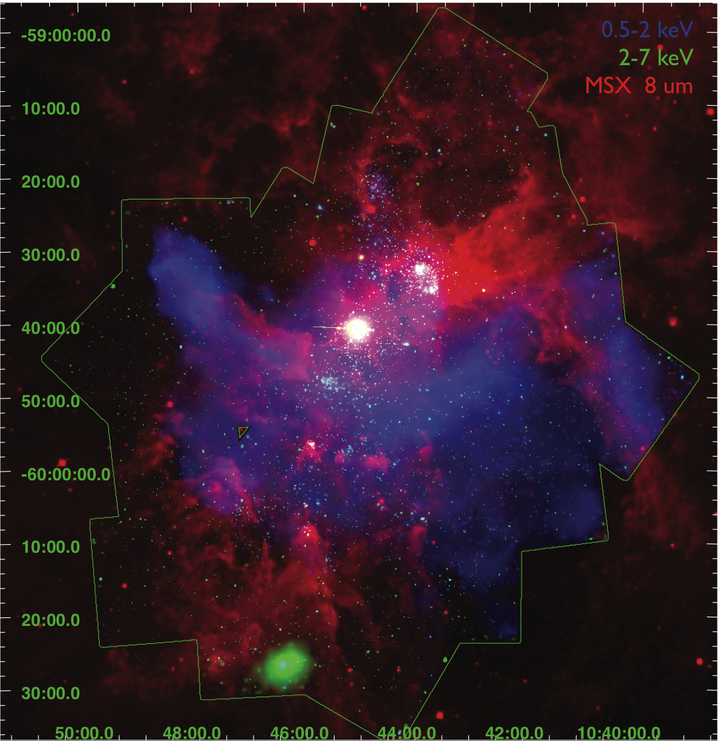
The Carina mosaic: point sources and diffuse emission
PI: L. Townsley

Slide 7
Several aspects of YSO: here a personal choice
YSO identification – implications on star formation and initial evolution:
  Example: disk frequency evolution
Needs for multiwavelength (possibly simultaneous) observations

Slide 8
Young stars are 10³-10⁴ more active than “normal” field stars
X-ray emission is the most powerful tool to find young stars, mainly those without disk (first @Einstein time) and embedded objects
Chandra is unique to pick up YSO in crowded environments typical of Star Forming Regions
  Mass content;
  Initial Mass Functions;
  age spreads and sequential star formation;
  Cluster morphologies;
  Disk frequency;
  mass segregation;
  …

Slide 9
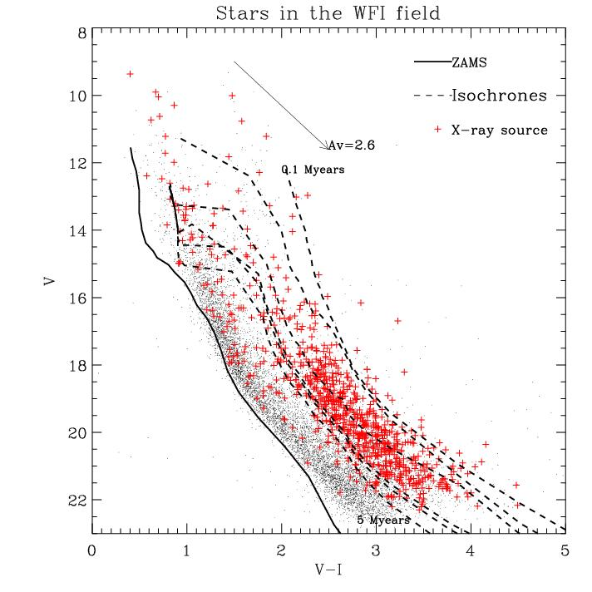
V vs. V − I CMD of NGC 6611 (Guarcello et al. 2007)
Small points: stars in ACIS FOV.
Red symbols: stars with an X-ray counterpart
DISTANCE: 1750pc
AGE: <1 – 3 Myears
<A_{v}> : 2.6^{m}
Core radius = 1.3 pc
More than 1100 diskless members

Slide 10
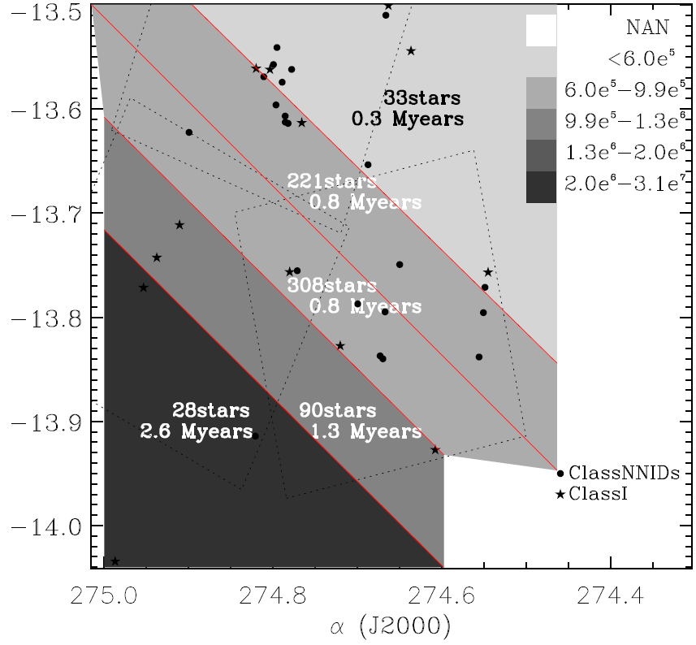
Sequential star formation
NGC 6611: Age distribution suggests a star formation sequence in the south-east → north-west direction
.

Slide 11
Disk frequency determination requires to observe disk and diskless stars: X-rays & NIR
Observed disk frequency as a function of age
Timescale for disks dissipation ~10 Myrs (Hernandez et al. 2007)
Timescale for giant planet formation ~10 Myrs (Lissauer & Stevenson 2007)
Timescale for cluster dissipation is ~10Myrs
→ all these phenomena evolve on similar timescales

Slide 12
Disk frequency vs. environment
Environment role:
Can massive stars in young clusters affect the evolution of circumstellar disks in low-mass members?
Disks heated by incident UV radiation. Heated gas flows away from the disk and disperse into space in few Myr

Slide 13
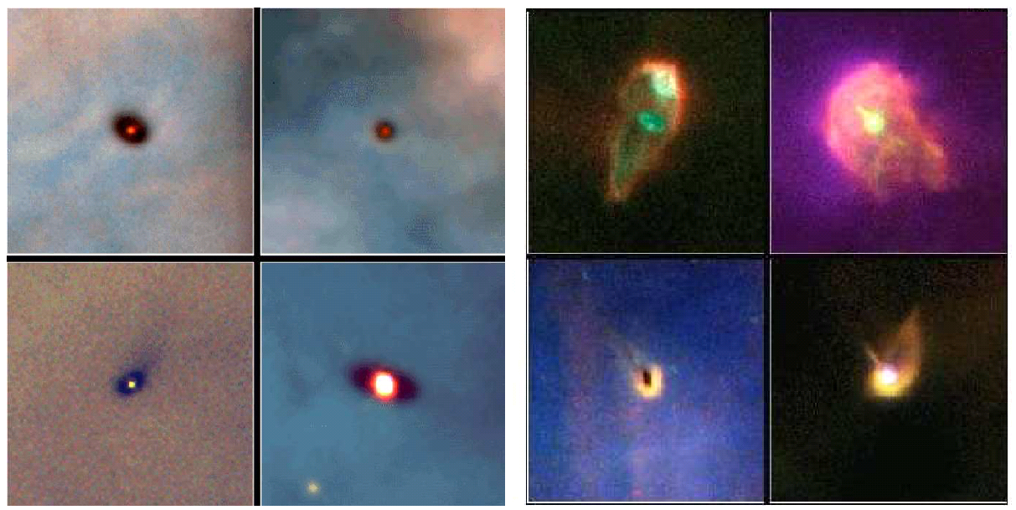
Environment may modify the disk dissipation timescale
Massive stars (M > 5 M⊙) may externally induce disk evaporation
Evidence for photoevaporation induced by nearby ionizing source (OB star).
., 2008
HST observations of proplyds in the Orion Nebula Cluster

Slide 14
A complete sample of stars with disks and without disks allows us to test the influence of massive stars on disk frequency
The Eagle Nebula
1750 pc (Guarcello et al. 2007)
NGC6611 in the central cavity, with:
54 OB stars (Hillenbrand et al. 1997)
A population of YSOs ( <1 – 3 Myr) (Guarcello et al. 2007)
~1100 diskless members
Cygnus OB2
1400 pc away from the Sun (Rygl, 2012);
72 O stars
242 B stars
Likely many more (Knodlseder 2000)
Thousands of low mass PMS (3-5 Myr) (Wright & Drake 2009, Guarcello et al. subm.)
~3300 diskless members

Slide 15
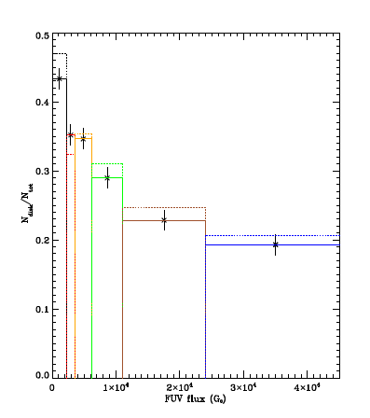
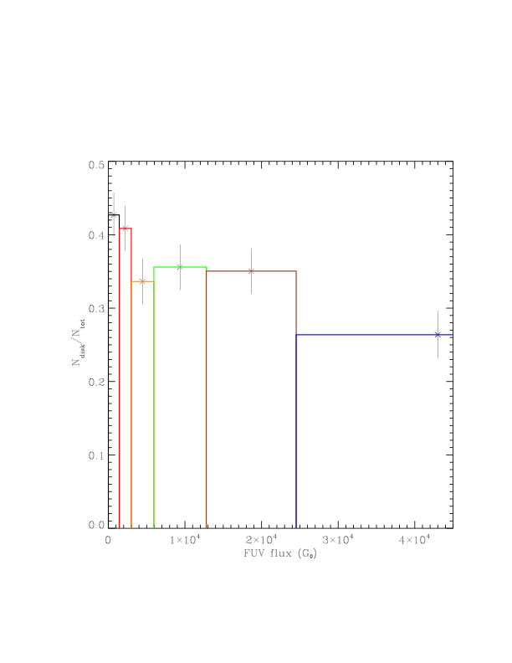
A decline of disk frequency with FUV flux is clearly present, more evident in Cyg OB2
NGC 6611
Guarcello et
al. 2007
CygOB2
Guarcello et al in prep.
NGC 6611

Slide 16
The needs of multiwavelength observations
X-rays complement optical and infrared observations
Roughly:
  Optical → photosphere
  Infrared → disk
  Hα → accretion
  X-rays → Corona, young stars

Slide 17
The MYStIX project
(Massive Young stellar complex
Study in Infrared and X-ray)
Feigelson, Townsley et al.
GOAL: Multiwavelength surveys of 20 massive SFRs
(archive data)
Systematic, coherent and sophysticated analysis

Slide 18
MYStIX scientific questions
Formation
  Monolithic or clumps
  Rapid or slow
  Massive stars
Evolution
  Early dynamics
  Mass segregation
  Disks
Feedback
  OB star wind / UV
    inhibit or trigger star formation
    Disk evolution
  Supernovae effects

Slide 19
MYStIX: some results
Age
determination
Getman et al. 2013

Slide 20
Surface density in 17 regions using identical spatial scale and intrinsic surface density scale for each region
Kuhn et al. 2015

Slide 21
The relevance of simultaneous multiwavelength observations
Multiwalength coverage monitor several components of the target
YSO are variable objects
Simultaneous multiwavelength coverage monitor the relation of variations of emission of the various components → insight on the physics of the mechanisms
Simultaneous multiband campaigns are very precious

Slide 22
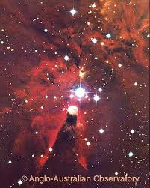
Coordinated Synoptic Investigation of NGC 2264
(CSI 2264)
PI: J.Stauffer, G. Micela
Age ~ 3Myr
Dist ~ 750pc
Multiple star
formation sites
The only nearby SFR in the CoRoT “eyes”

Slide 23
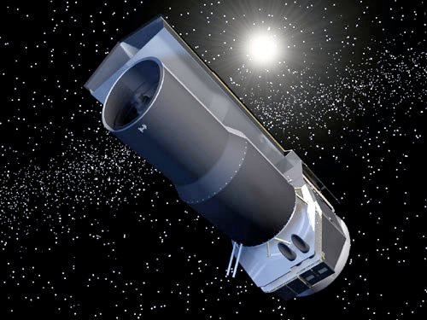
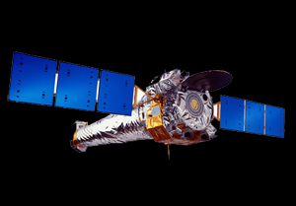
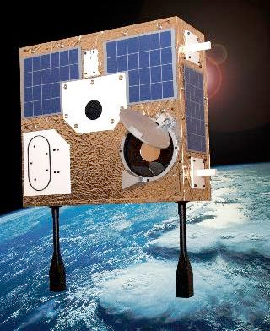
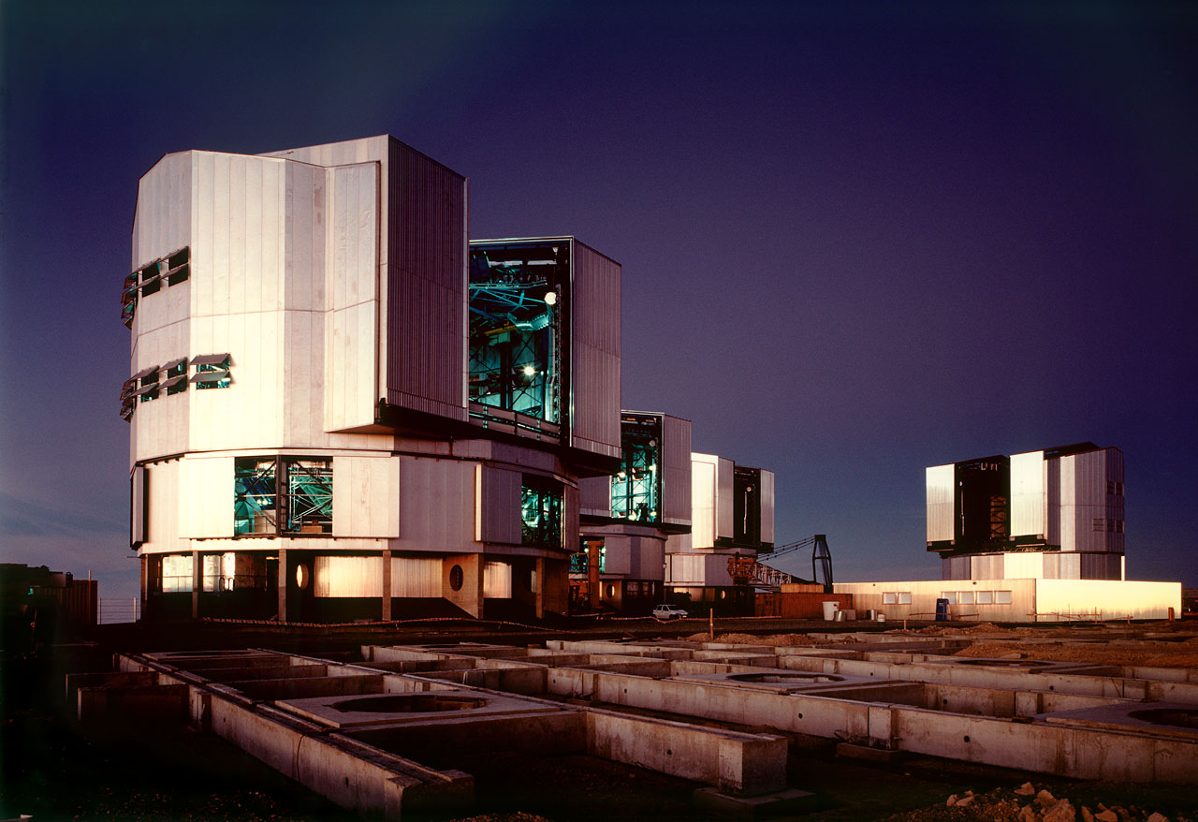
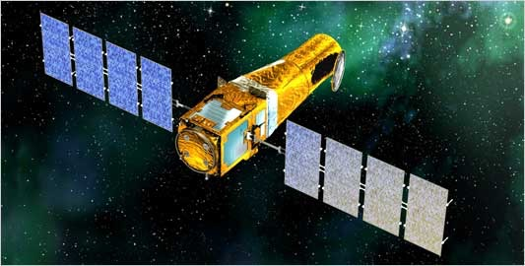
Coordinated Synoptic Investigation of NGC 2264 (CSI 2264)
PI: J.Stauffer, G. Micela
CoRoT: 40d, optical
Spitzer: 30d @ 3.6, 4.5 μm
Chandra/ACIS: 300ks (3.5d)
MOST: 40d, optical
VLT/Flames: ~20 epochs
Ground-based monitoring
U-K bands: ~3 months
Cody et al. 2014

Slide 24
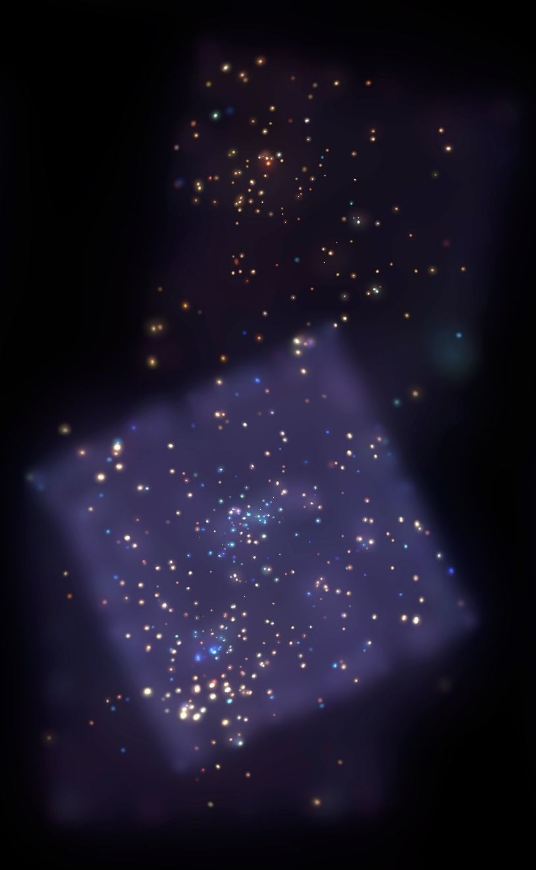
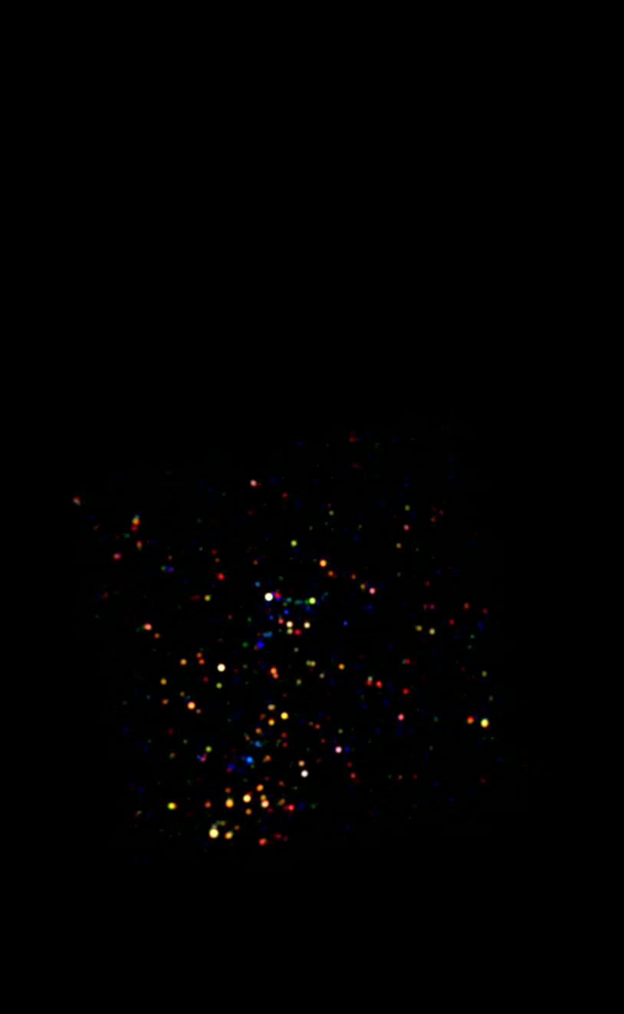
CSI 2264 - Chandra data
1043 sources detected
Analyzed with ACIS-Extract (Broos et al. 2010)
Spectral analysis for 770 sources => LX, NH
matches with optical/IR objects
Flaccomio et al. in prep

Slide 25
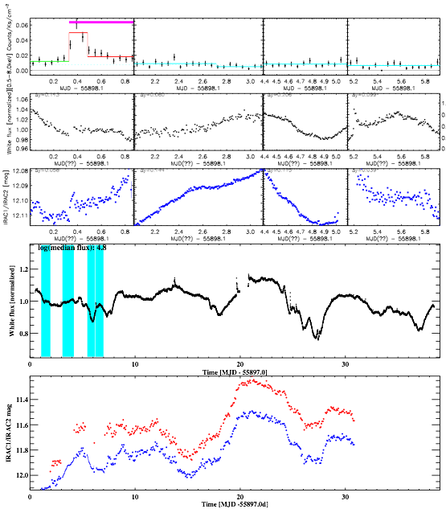

Lightcurves
Chandra
CoRoT
Four observation segments
Total exposure time:
297 ks (75 + 94 + 61 +67)
Time span: ~6 days
> 0.5 Prot for most stars
Spitzer - IRAC 1,2

Slide 26
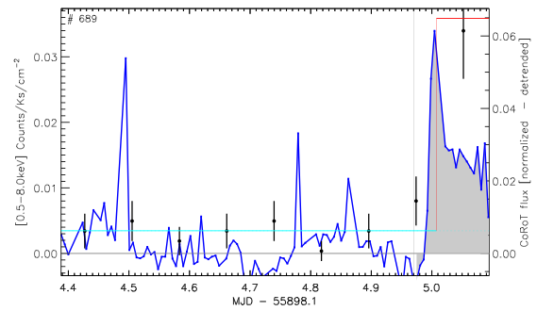
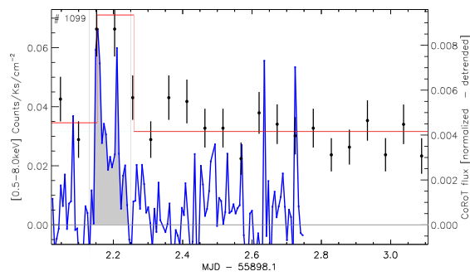
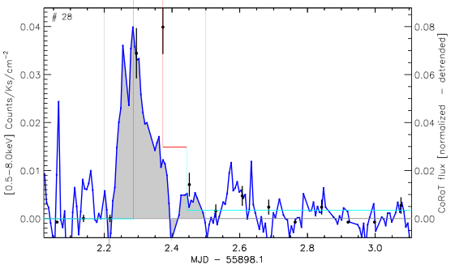
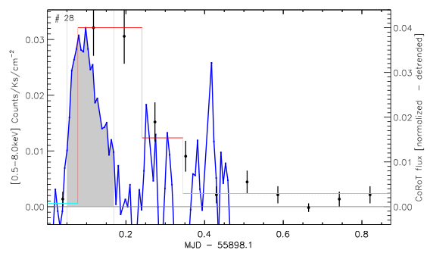
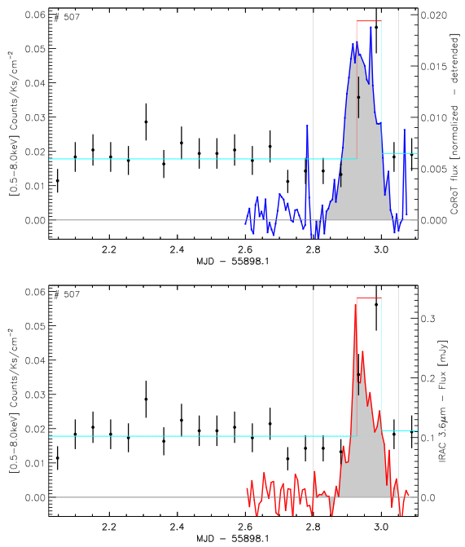
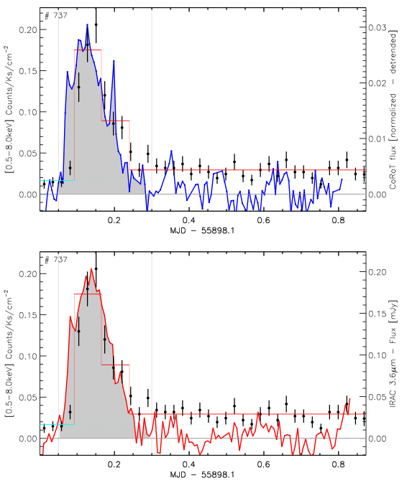
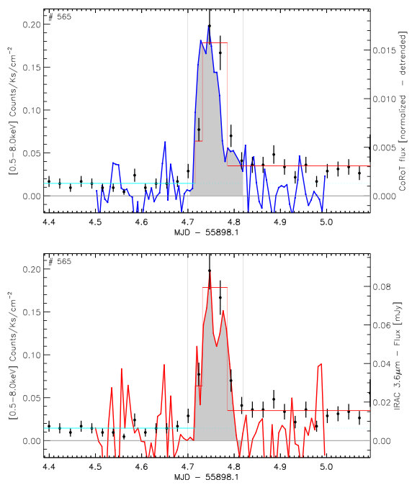
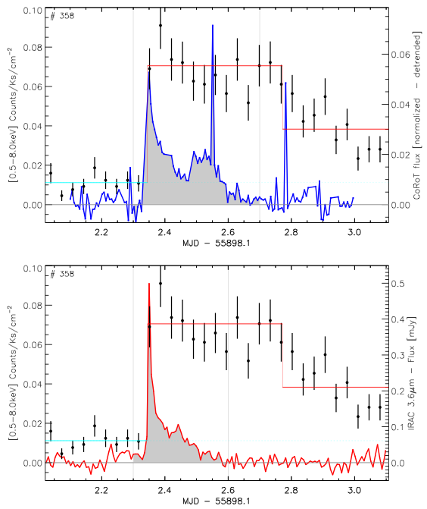
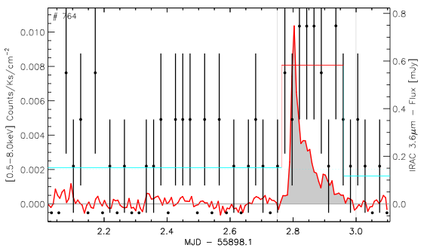
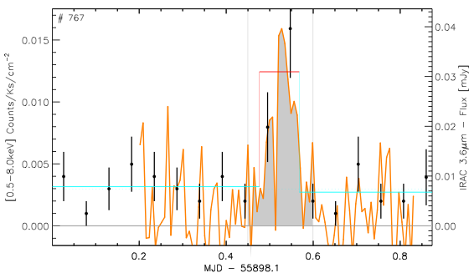
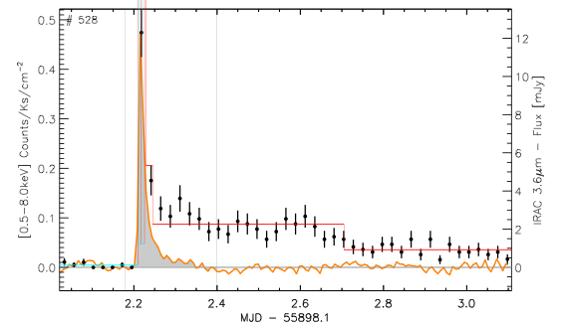
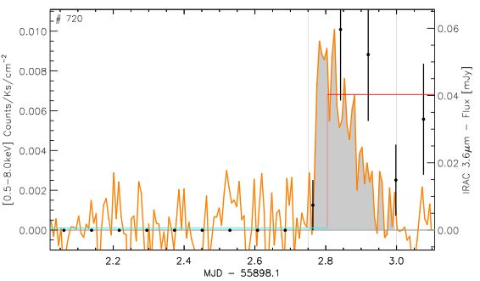
Observed flares
Disk-bearing

Slide 27
Initial results
Correlation between optical and X-rays emitted energy
  Optical flares trace the plasma heating at the foot-points of magnetic loops. A small (10-20%) fraction of the energy deposited at the foot-points is converted into X-ray emission.
  Flares on stars with disks have large mIR excesses with respect to flares on disk-less stars. This might be due to the heating of dust grains at the inner disk edge due to irradiation from the optical flare.
  Flaccomio et al. (in preparation)
WORK IN PROGRESS

Slide 28
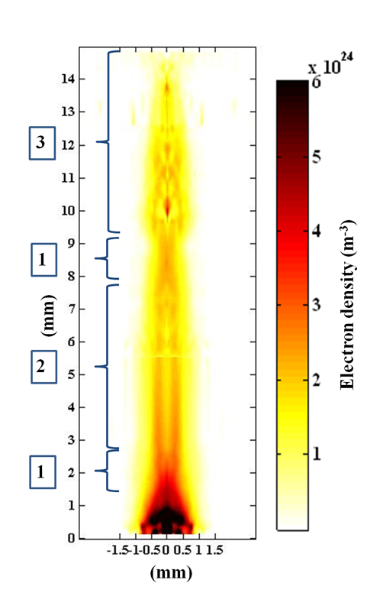
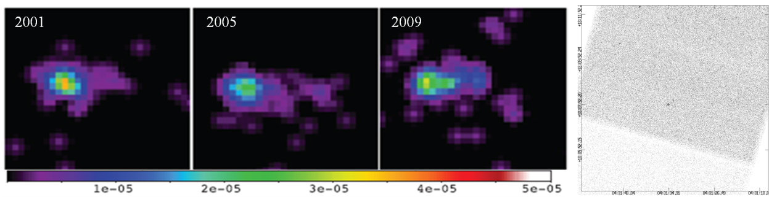
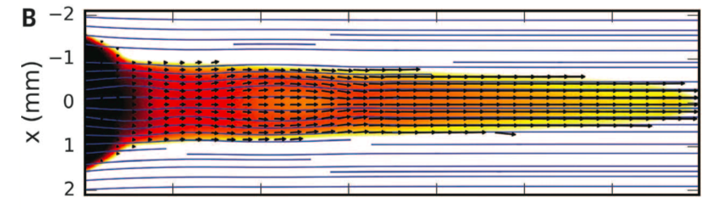
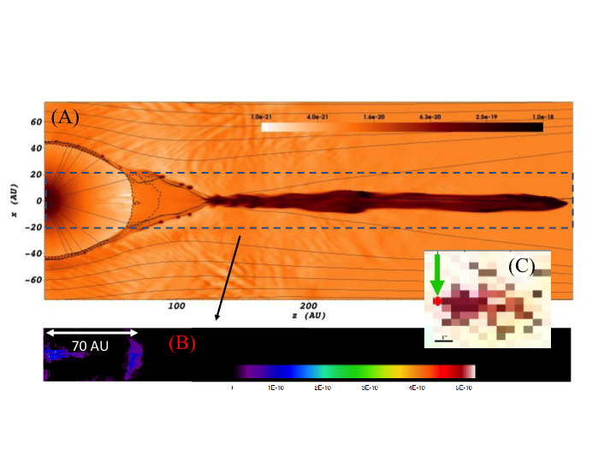
A new approach: observations, model, laboratory
Bonito et al. 2011
Albertazzi et al. 2014 Science
Chandra observations and
Modeling of HH 154
Laboratory formation of a scaled protostellar jet by coaligned poloidal magnetic fields

Slide 29
Conclusions
I have discussed only few of the relevant contribution of Chandra to YSO. Many other important topics: protostars, spectroscopy, massive stars…
Without Chandra our knowledge on SFR and YSO (see also other talks in this conference) would be much more limited
The complexity and diversity of physics of SF ensure that Chandra can still have a brilliant future in the field of YSO
Deeper exposure capture low mass tail of the MF – important for the SF process
Deep observations of very massive SFRs in our Galaxy – different environments
SFRs in other galaxies down to stars as small as possible – different environments

