Slide 1
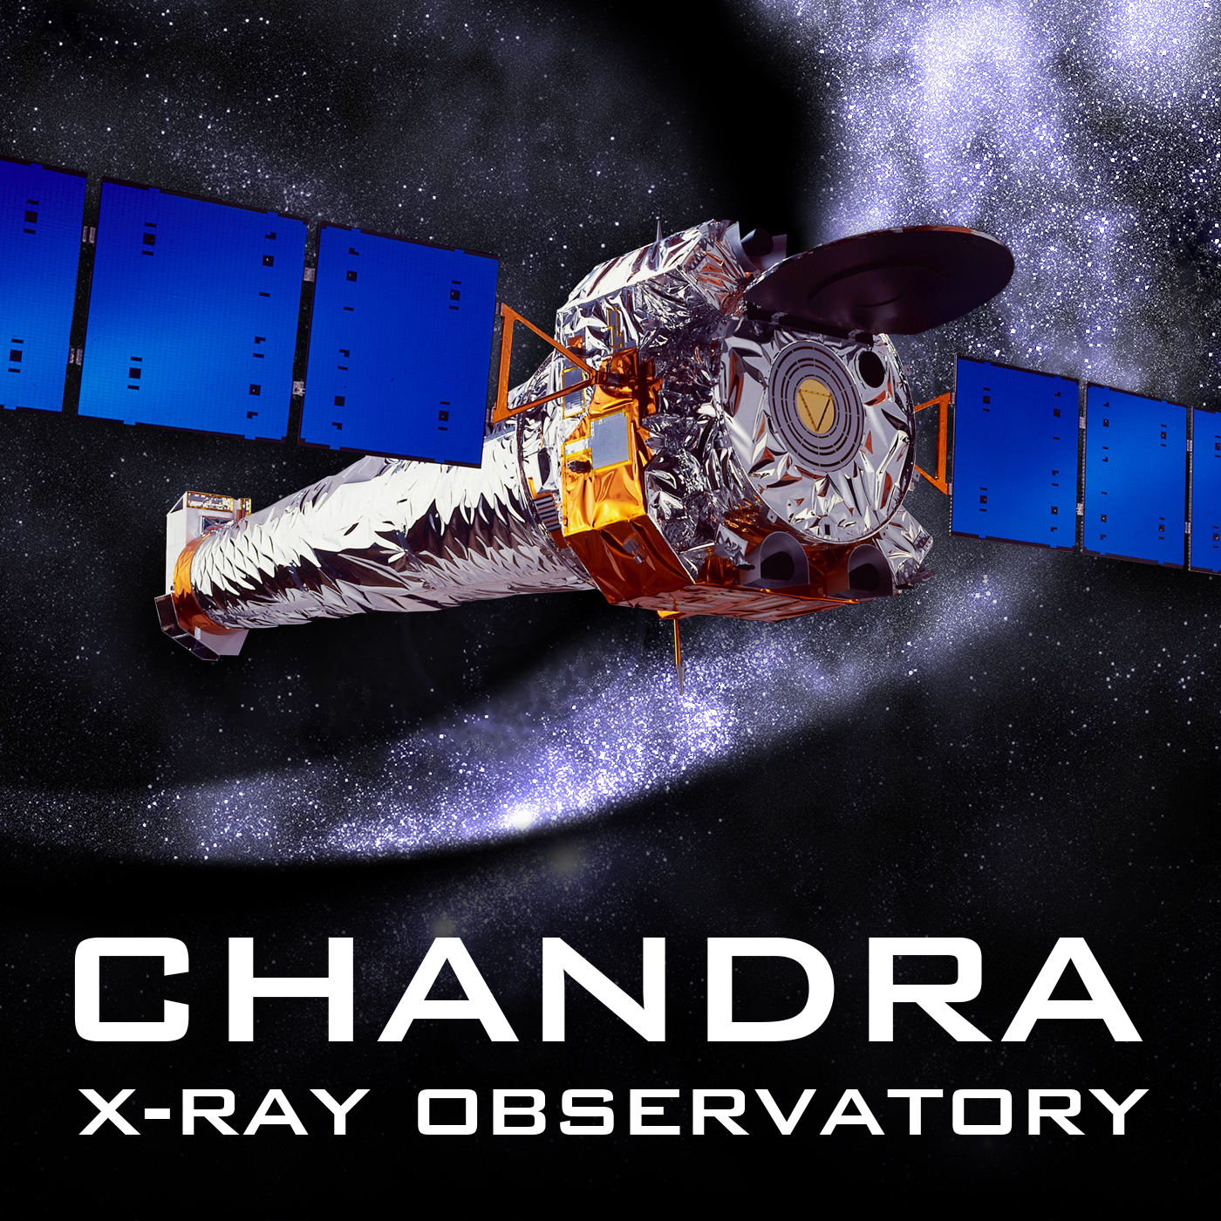
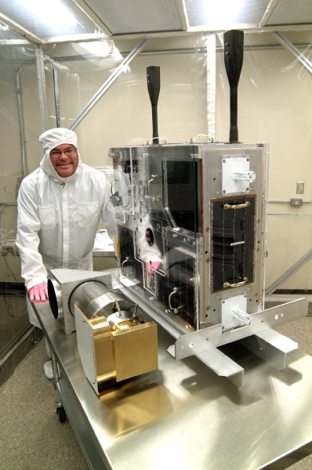
The Chandra Delta Ori (Aa1+2) Large Project:
An Attempt at Direct Localization Of the Corona
of a Massive Star
Mike Corcoran, Joy Nichols, Bert Pablo, Tomer Shenar, Nancy Evans, Ken Gayley, Ted Gull, Tabetha Hole, Kenji Hamaguchi, Wolf-Rainer Hamann, Jennifer Hoffman, Dave Huenemoerder, Richard Ignace, Rosina Iping, Jennifer Lauer, Maurice Leutenegger, Jamie Lomax, Jesus Maiz-Apellaniz, Anthony Moffat, Yael Naze, Lida Oskinova, Stan Owocki, Andy Pollock, Gregor Rauw, Noel Richardson, Chris Russell, Nolan Walborn, Wayne Waldron, the MOST Team, and the Convento Group
Contributing spectroscopists: Christian Buil, Thierry Garrel, Keith Graham, Bernard Heathcote, Thierry Lemoult, Dong Li, Benjamin Mauclaire, Mike Potter, & Jose Ribeiro

Slide 2
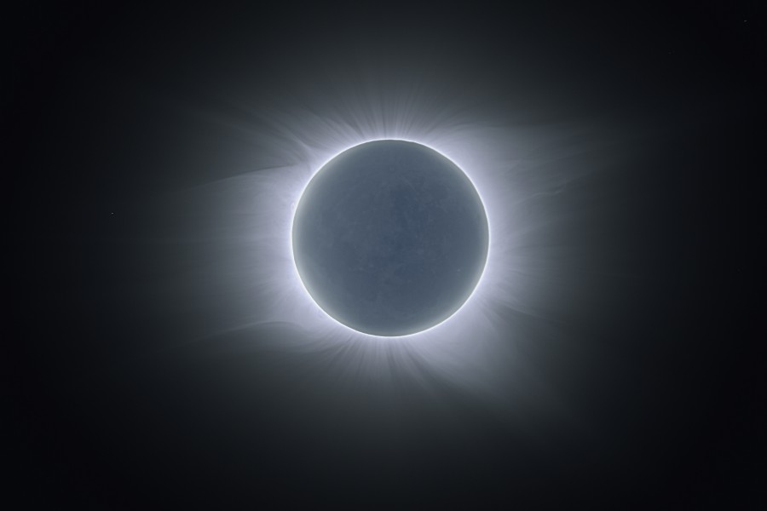
Locating a Corona via Occultation
Solar corona seen via lunar occultation from Easter Island, July 11 2010

Slide 3
Nature’s Coronal Probe
We can’t directly image the coronal gas distribution around a massive star
Massive binaries with high inclination offer occultation test of the hot gas distribution
  need an “X-ray dark” companion
  also need a nearby X-ray bright binary with high inclination
While the binary fraction of O stars is high (~30%), only one massive binary fits all these characteristics:
δ Ori Aa1+2

Slide 4
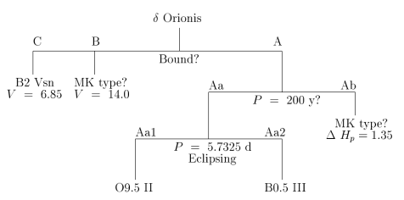
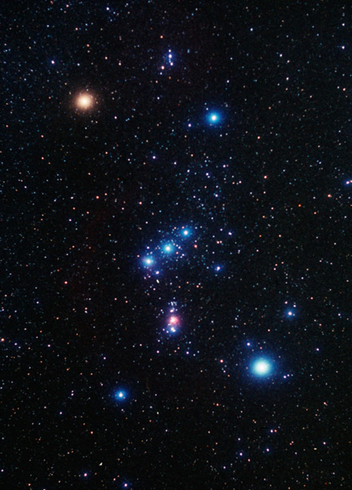
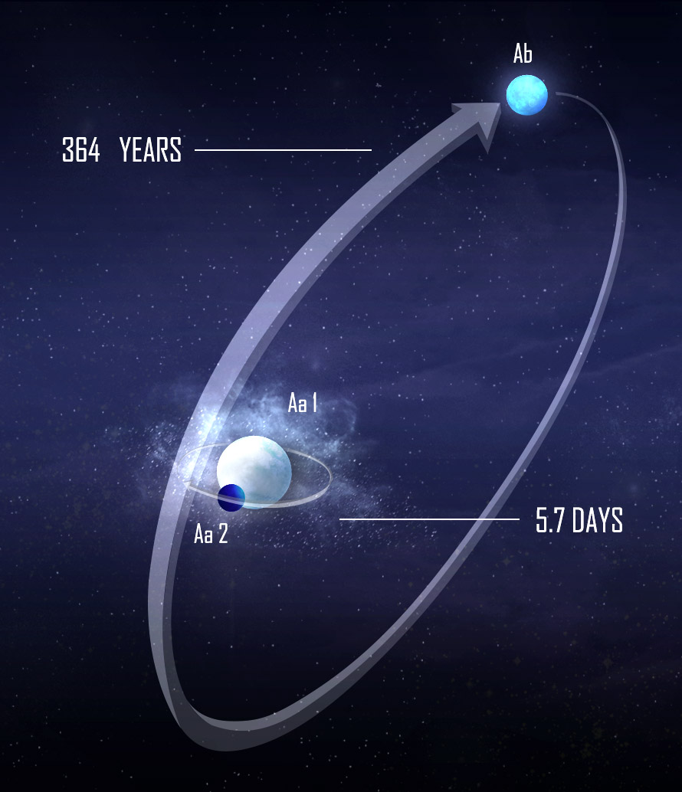
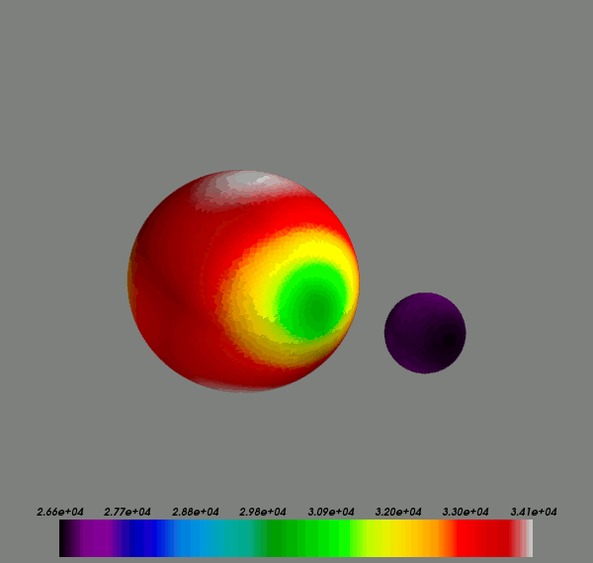

The Mintaka Hierarchical Multiplet
Harvin et al. 2002
Ptolemy, et al.
Pablo et al. 2014
Figure courtesy of Jessica Mayo

Slide 5
Chandra/HETGS Delta Ori Large Project
The Test Case: Delta Ori Aa1+2
the nearest eclipsing O star
Key mass-luminosity indicator in upper HRD
X-ray bright
Large, X-ray faint companion
Goals:
Define the spectrum down to 2 A (S XV) at higher S/N
Optical/X-ray variability correlations in lines and continuum
study response of X-ray line profiles to motion of the companion (occultation/aberration)

Slide 6
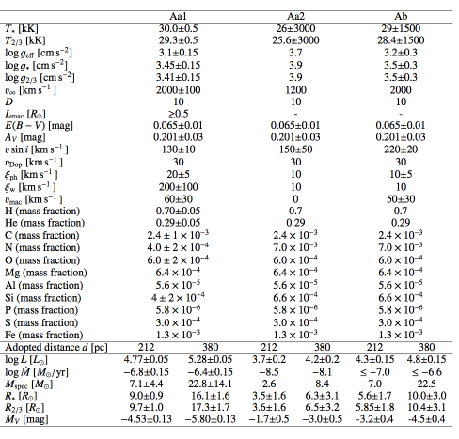
System Parameters
Consistent system parameters derived from:
Modeling of stellar spectra from optical-UV-X-ray spectra via POWR code (Shenar, Oskinova, Hamann et al. 2014)
Modeling of simultaneous high-precision photometry from MOST satellite and ground-based optical spectra (Pablo, Richardson, Moffat et al. 2014)
Suggests distance nearly twice that of Hipparcos!

Slide 7
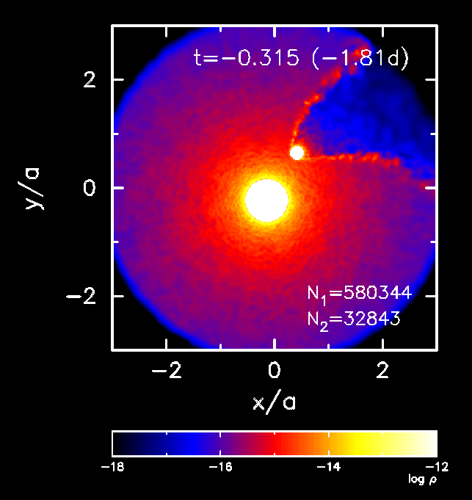
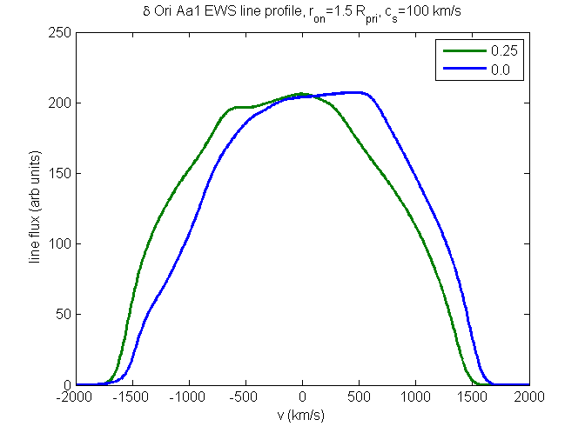
Colliding Wind
Collision of Aa1’s wind with companion wind could produce X-ray excess (high temperature?); not too important
But wind-star collision opens a cavity behind the secondary (Aa2) which disturbs the wind behind the secondary
As cavity sweeps around, should have a phase-dependent change on X-ray emission/line profiles originating at r>2a

Slide 8
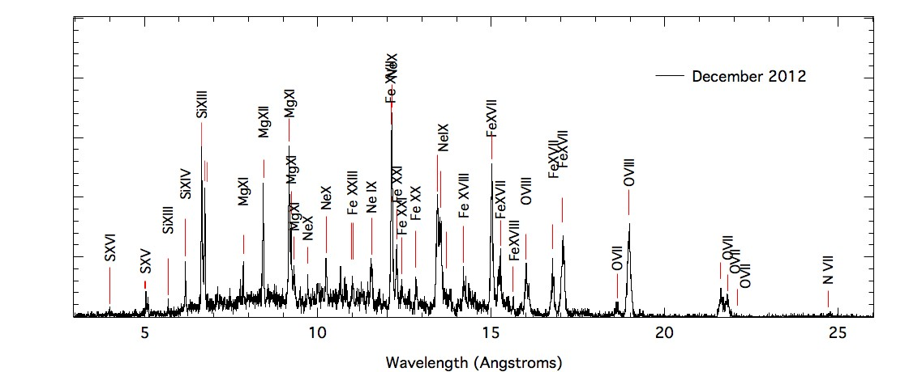
The 500ksec HETGS Spectrum
Corcoran Nichols et al. 2014
Combined HETGS spectrum well described by 3-temperature APEC model
Similar to earlier results (HETG: Miller et al 2002; LETG: Raassen & Pollock 2013)

Slide 9
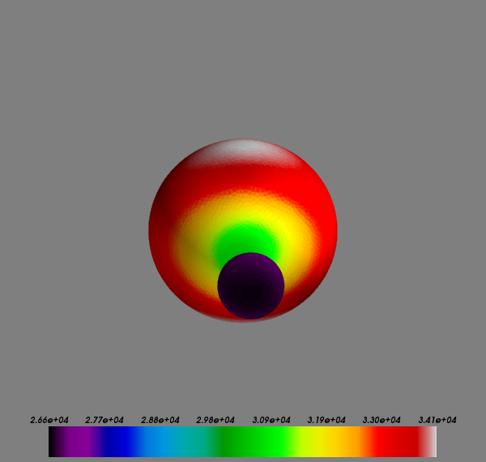
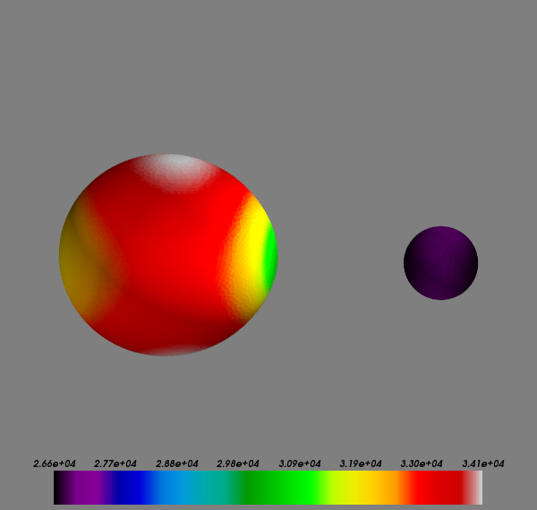
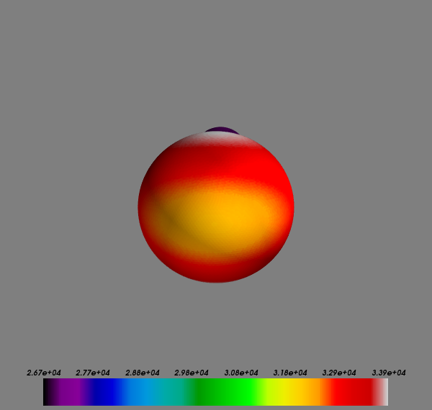
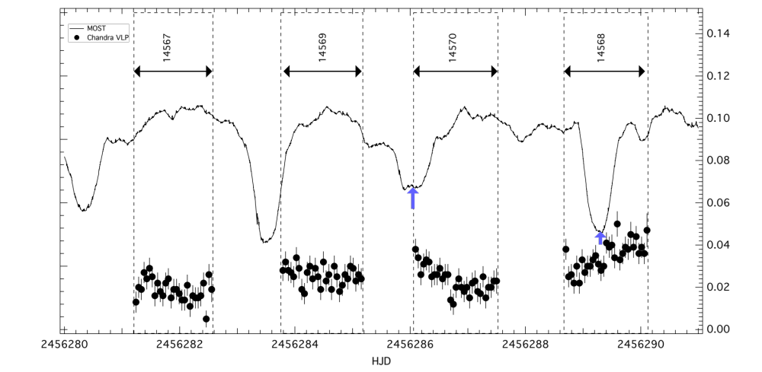
The Observations: MOST + Chandra
Nichols, Corcoran, Pablo, Mofatt et al. 2014
Changes in optical lightcurve from cycle-to cycle
Small but significant variations in X-ray count rate
Optical periods of 4.62 days (rotation?) 2.54 days (pulsation?) and 1.08 days (?)

Slide 10
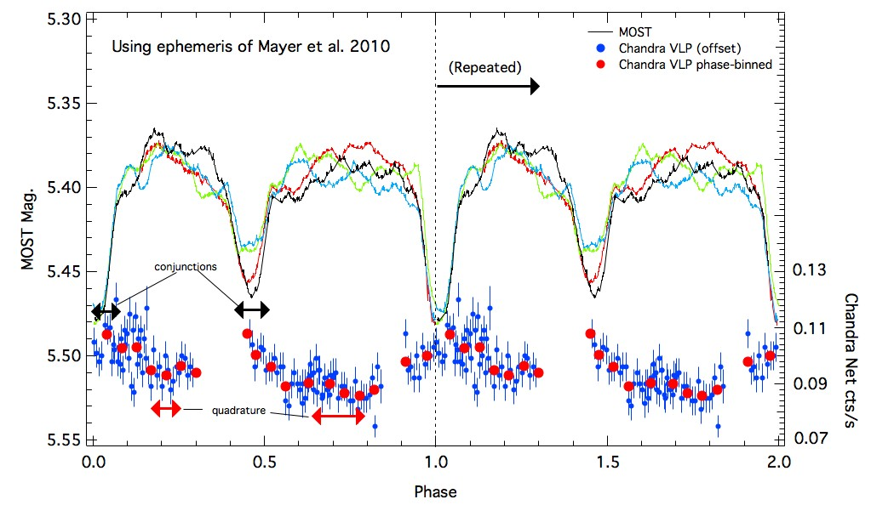
Phase-Folded Lightcurves
Nichols, Corcoran, Pablo, Mofatt et al. 2014
X-rays maximum during eclipse, minimum at quadrature?
Significant of non-phased-locked variability in both optical and X-ray lightcurves

Slide 11
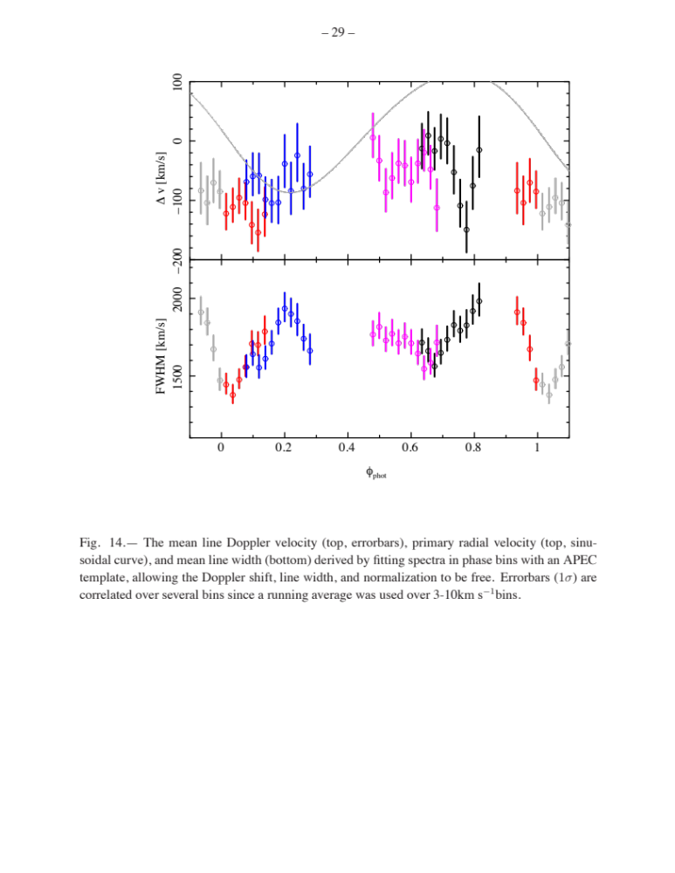
Line Width Variations
Nichols, Corcoran, Pablo, Mofatt et al. 2014
Fits to the ensemble of lines in phase intervals show apparently phase-dependent changes
Lines are broader near quadratures
Narrower near primary (secondary?) minimum

Slide 12
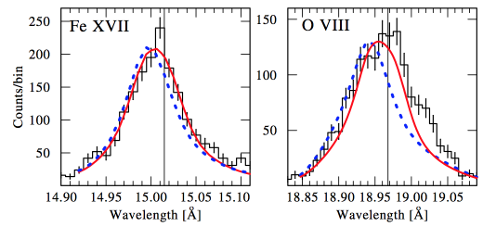
X-ray Line Modeling
Shenar, Oskinova, Hamann et al., 2014
Blue Dashed: Smooth wind model
Red: Clumped wind model
X-ray onset radius: 1.2 R_{Aa1}

Slide 13
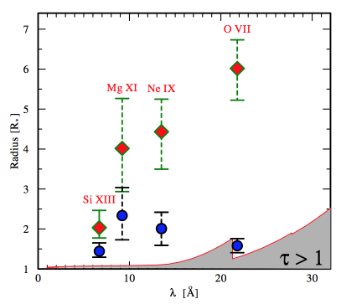
He-Like Line Analysis
Location of the X-ray emitting region based on forbidden to intercombination ratio for the He-like triplets
Red: assumes emission originates in a thin shell
Blue: Onset radius from integrating emission through the wind (Leutenegger et al. 2006) accounting for diluted photospheric and local diffuse UV field.
Dashed Line: Average stellar separation (Pablo et al. 2014)

Slide 14
Conclusions I
First ever simultaneous X-ray/optical spectrophotmetric monitoring of a massive binary star from space spanning more than an entire orbit
We found orbital and secular variations in X-ray and optical which are not yet fully understood: Pulsations? EWS instabilities?
Secondary (probably) too small to provide much geometric occultation; but wind cavity behind the secondary acts as a spatial constraint on the location of the coronal gas
X-ray hardness peaks near quadratures: some colliding wind emission?
Significant variation of the X-ray lines, which appear dependent on orbital phase

Slide 15
Conclusions II
Possible occultation effect in broad-band X-ray lightcurve (and in some lines)
No significant X-ray RV variations correlated to the motion of the primary
X-ray line modeling + X-ray variability imply onset radii of the X-ray emission inside the orbit of the secondary
Modeling of MOST lightcurve plus ground-based RV curve + optical-UV-X-ray + apsidal motion shows “normal” stellar parameters for the primary for distance of 380 pc (“Mintaka Cluster” distance, Caballero & Solano 2008) not Hipparcos distance (212pc)
MOST lightcurve shows non-orbital periods of 4.6 and 2.5 days; X-ray lighcurve also shows non-orbital variations

Slide 16
Thank You for Your Attention

Slide 17
Previous Observations
1 HETG observation (Miller et al. 2002, 49 ksec) and 1 LETG observation (Raassen & Pollock, 2013, 97 ksec)
He-like forbidden to intercombination line ratios (sensitive to density or UV photoexciting flux) constrain X-ray line emitting regions
R/R*
Raassen & Pollock 2013
Miller et al. 2002

Slide 18
Owocki & Cohen(2006)
Leutenegger et al. (2010)
X-ray Onset radius
Radius (R*)
Cassinelli et al. (2008)
Radius (R*)

Slide 19
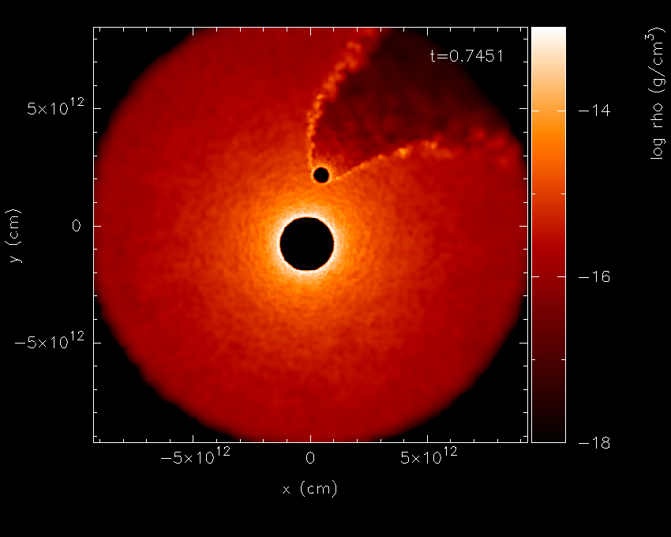
X-ray Maximum
R(Mg)
X-ray Minimum

Slide 20

Wind-Star interaction
The primary wind collides with the secondary star near the photosphere of the secondary:
Cavity carved in primary’s wind where embedded wind shocks should be weak or non-existent
Possible excess (hot) emission from the interaction boundary

Slide 21
X-ray diagnostics of LDI/Mdot
All hot stars have strong, soft X-ray emission due to LDI (shocked gas around blobs)
X-ray diagnostics (eg. f/i ratios in He-like ions) sensitive to photospheric UV/FUV and gas density, and serve to constrain distances
But can we directly determine the location of the X-ray emitting regions?

Slide 22
The Delta Ori (Aa1+2) Large Project
500 ksec phase-resolved HETG spectra (Dec 2012)
21 days of high-precision photometry with the Microvariability and Oscillations of STars telescope (MOST) covering the HETG observations
21-day Pro-AM spectroscopic campaign at H-alpha and He I 6678
Optical-UV-X-ray spectral modeling
Lightcurve solution

Slide 23
Understanding Massive Stellar Winds
Winds idealized as smooth flows from the stellar surface
Evidence (DACs, NT radio emission, X-ray emission) shows that winds are structured
  dense blobs in a thin wind
  Co-rotating streams (CIRs)
  wind-wind bow shocks
where is most of the mass?
what are the true mass loss rates?

