Slide 1
the missing satellite problem re-examined
Zachary Slepian
Einstein & Chamberlain fellow, lbnl
einstein symposium: cfa
12 October 2017
with Andrew Song, Matt Craigie, lehman Garrison, & Daniel Eisenstein
Notes:
Say title, who I work with, what year I’m in.

Slide 2
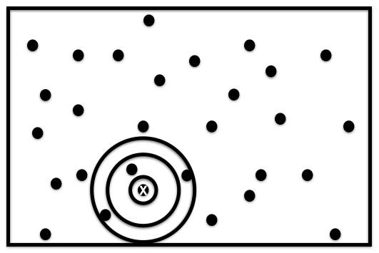
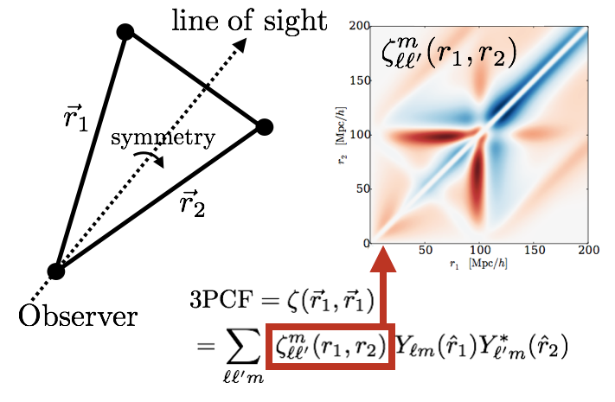
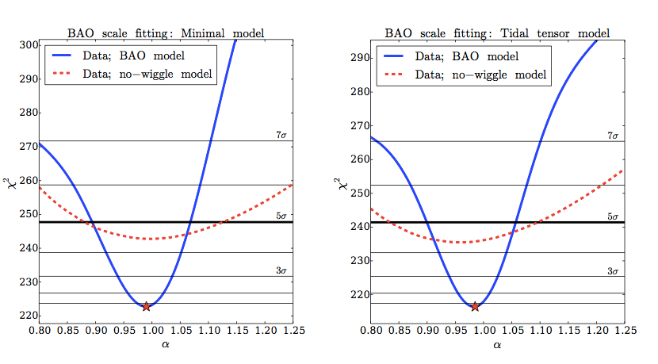

but first, a message from our sponsors . . .higher-point stats
Estimate 3PCF around a given galaxy by binning density into spherical shells and then expanding angular dependence in spherical harmonics
3PCF: ZS+DE16a, with FTs 16b
Full redshift space 3PCF: ZS+DE17
NPCF: ZS, DE, RM Cahn17

Slide 3
And now to our featured programme . . .
Well-known problem with CDM: excess of small halos predicted by simulations relative to observations
Could be baryon feedback, could be reionization, could be modified gravity . . .
One piece of physics we know is there has generally not been included

Slide 4
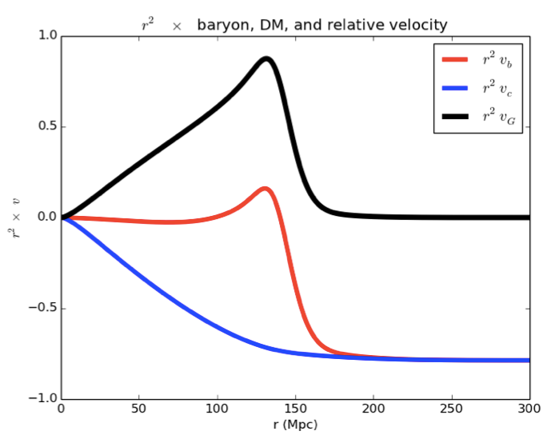
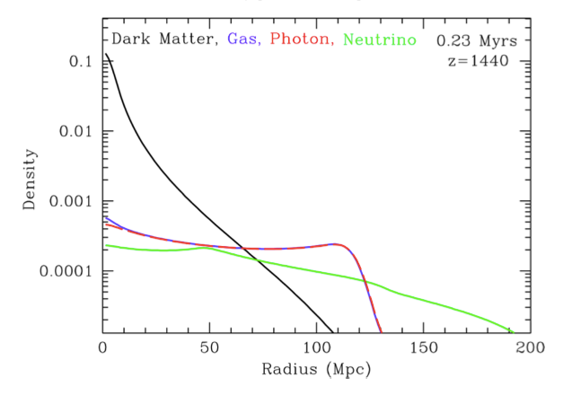
baryon-cdm relative velocity
Velocity Green’s functions
rs
r²v
relative
baryon
CDM
Baryon-photon pulse outgoing
r (Mpc)
z =1020
Figures: ZS&DE 2015a,
Eisenstein Seo & White 2007, ZS & DE 2016
RV effect: Tseliakhovich & Hirata 2010
Notes:
structure of relative velocity from a point-source perturbation
DM infalls
Baryons in hydro equilibrium except at sound horizon, where pulse is moving outwards

Slide 5

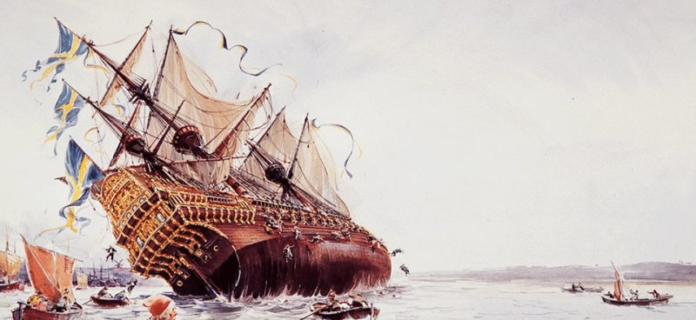
baryons
CDM halo
A wind can really sink galaxy formation!
Relative velocity is sourced by overdensities and so varies over different patches of Universe.
1 sigma = 10% of typical circular velocity for 10⁶ Msun halos at z = 50

Slide 6
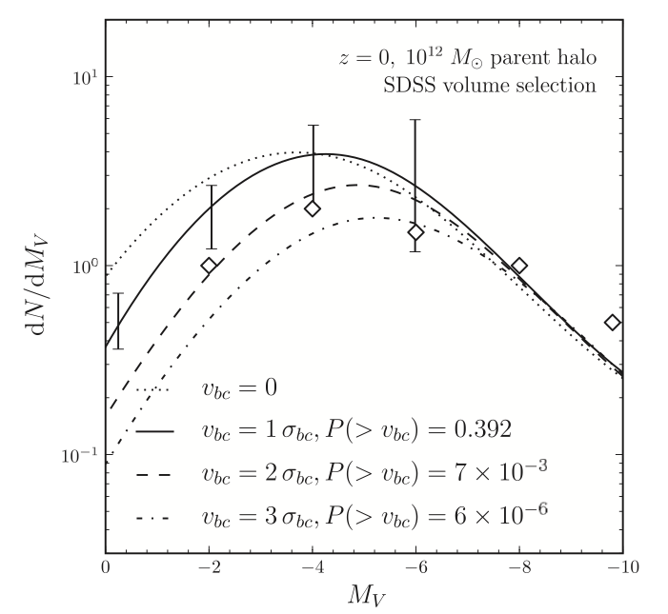
a modest proposal
(Not my own)
Bovy & Dvorkin 13: RV could suppress low-mass halos before reionization
Diamonds = data from Koposov+09

Slide 7
so what do we need?
A 1.5 to 2.5 sigma above-average baryon-CDM relative velocity in the Milky Way
For the Milky Way, we can in fact simply go ahead and measure it.
We have the Green’s function.
We have the galaxy density field around us.

Slide 8
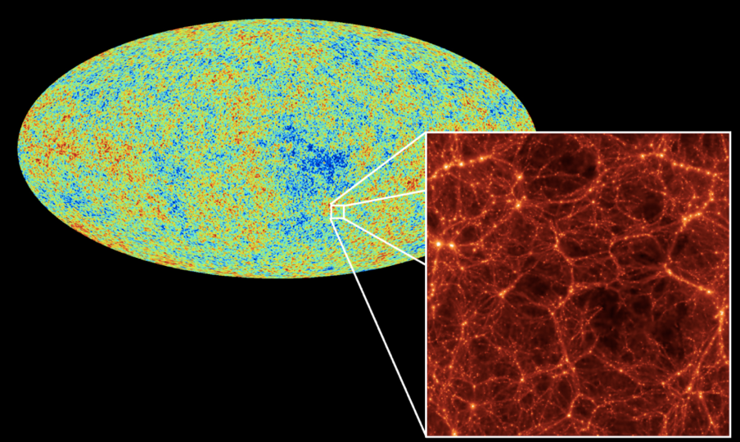
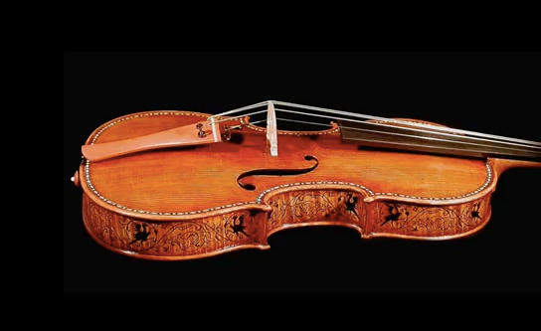
imagine the universe a violin

Slide 9

A single pluck launches a single wave
Each galaxy around the Milky Way is like a single pluck

Slide 10
Direction is always along separation from external galaxy to MW
Magnitude is set by Green’s function (crudely drawn)

Slide 11
2mass redshift survey
91% sky coverage, ~45,000 galaxies, ~98% complete, magnitude limit of Ks =11.75 mag, census of galaxies within local 300 Mpc
Recall Green’s function only is non-zero up to 150 Mpc. Unlike traditional velocity reconstruction (sorry POTENT!), we have a tractable problem.
We create a volume-limited sample (~15,000 galaxies) so that we can ignore bias evolution: bias will be a constant.
Huchra+10, ZS, AS, MC, LG & DE17

Slide 12



Ignore non-linear evolution and ignore RSD.
We can test if these approximations are good using simulations, and we do (preliminary).
Can also use optimal weights to mitigate, and can invert some of RSD operator.

Slide 13

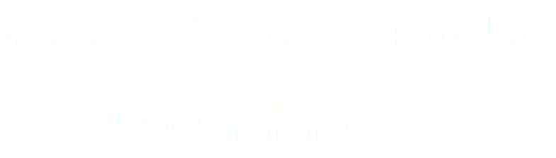
What about boundary effects?
9% of sky is missing: does that matter? (we make azimuthally-symm. cuts)
Three methods:
1) Simulate
2) Throw randoms on full and cut sky and compute the change in relative velocity: ~7%
2) Model analytically: can impose an azimuthally -symmetric cut and solve for the change in variance: ~4%

Slide 14
What do we get?
Assuming galaxy bias ~2, our preliminary result is 2.25 sigma.
I.e., enough for the Bovy & Dvorkin picture to work and, by itself, solve the missing satellite problem.
There are caveats, so we are doing further testing with simulations.
Hope I haven’t “boared” you, and thanks to the organizers!

Slide 15
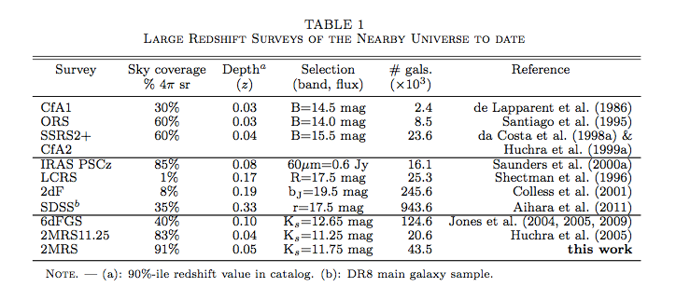
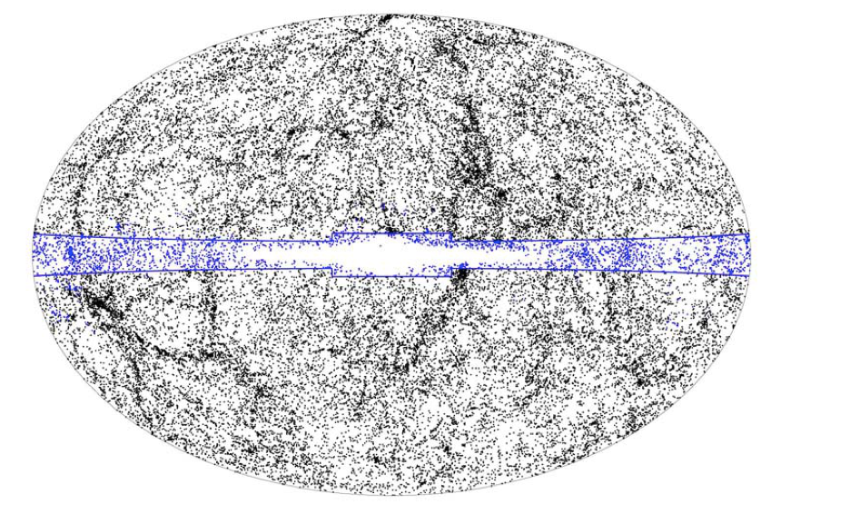
Huchra+10

Slide 16
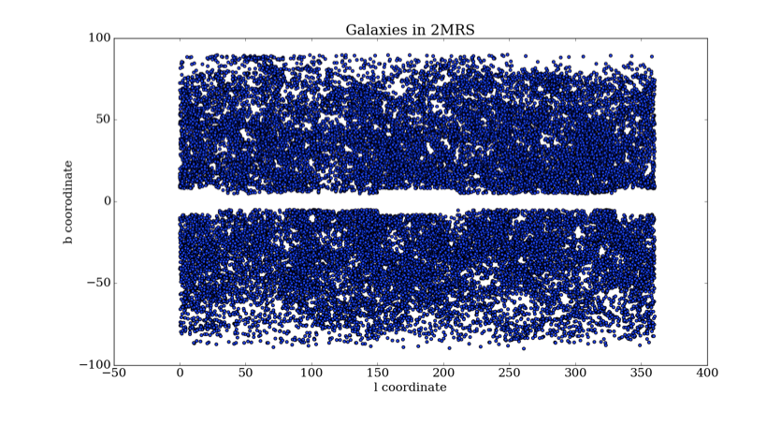
ZS, AS, MC, LG & DE17

Slide 17
{\rm 3PCF\; multipoles} = \sum_m a_{lm}(r_1)a^*_{lm}(r_2)
{\rm 4PCF\; harmonics} = \sum_m \left(\begin{array}{ccc}
l_{1} & l_2 & l_3\\
m_1 & m_2 & m_3
\end{array}\right)
a_{l_1m_1}(r_1)a_{l_2m_2}(r_2)a_{l_3m_3}(r_3)
\vec{v}_{bc}(0) = \int d^3\vec{r}\; \delta_{\rm lin}(\vec{r}) v_G(r)\hat{r}
\delta_{\rm g}(\vec{r}) = b_1 \delta_{\rm m}(\vec{r}) = b_1\left[\delta_{\rm lin}(\vec{r}) + \delta^{(2)}(\vec{r}) \right]
\delta_{\rm lin}(\vec{r})\approx \delta_{\rm g}(\vec{r})/b_1
\sigma_{\rm bc,full\;sky}^2 = \int \frac{k^2 dk}{2\pi^2}P(k)\tilde{v}_G^2(k)

