Slide 1
The Kepler Light Curves of Active Galaxies: Insights into Accretion
Krista Lynne Smith
Richard Mushotzky (UMD)
Padi Boyd (GSFC)
Robert Wagoner (Stanford)

Slide 2
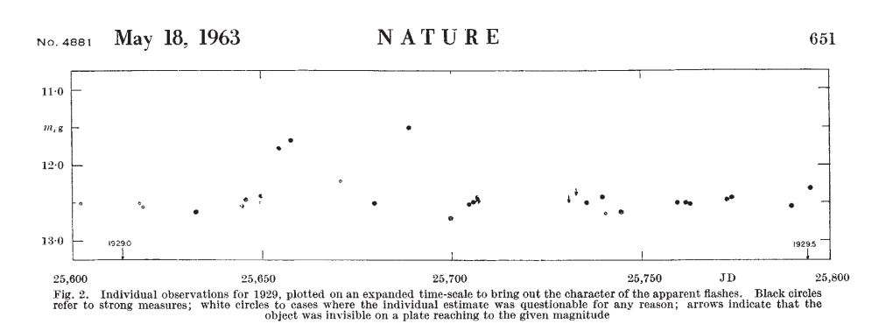
Optical Variability of AGN
Objective: Understand how matter is accreted onto the supermassive black hole.
Problem: The accretion disk is too small to be resolved by our best current or future instruments!
Solution: The variations in optical flux caused by fluctuations of some kind in the accretion disk.
3C 273, Smith & Hoffleit (1963)

Slide 3
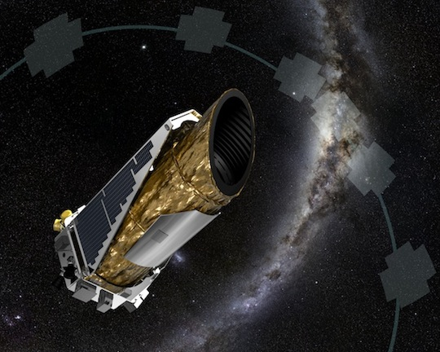
The Kepler Mission:
The Best Light Curves.
Ever.
BUT! Two major problems:
Almost no AGN in the field of view
Data optimized for the opposite of AGN science
Single pointed field
Continuous 30-minute sampling
Up to 4 year baseline
Unprecedented photometric precision

Slide 4
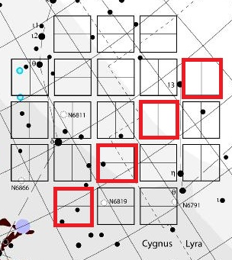
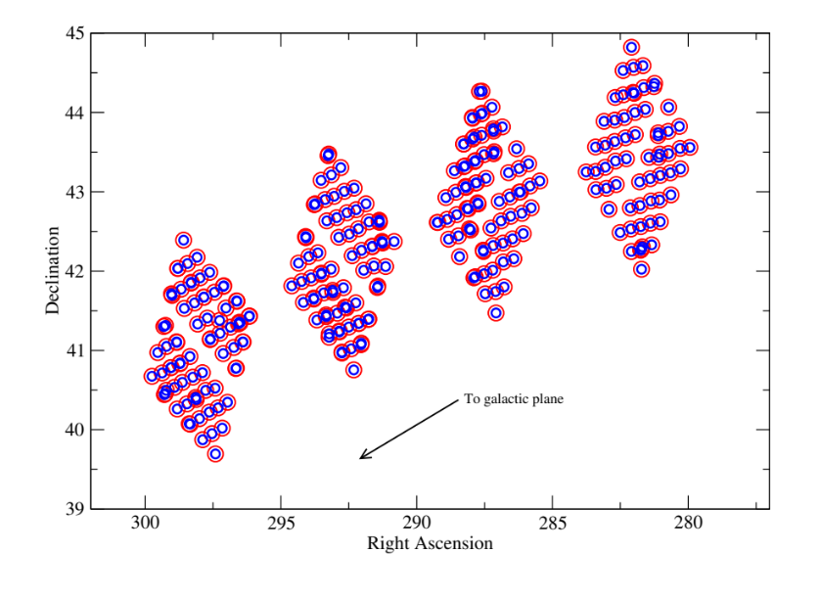
Solving the lack of AGN: KSwAGS
The Kepler-Swift Active Galaxies Survey (KSwAGS) was conducted in the hard X-ray of four modules of the Kepler field of view.
Smith et al. (2015)
K.L. Smith et al. (2015)
K.L. Smith et al. (2015)
K.L. Smith et al. (2015)

Slide 5
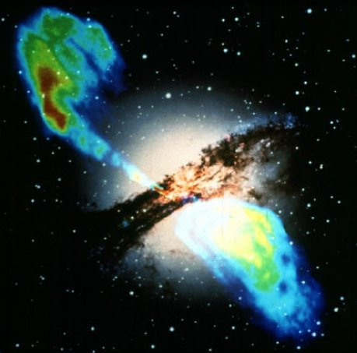
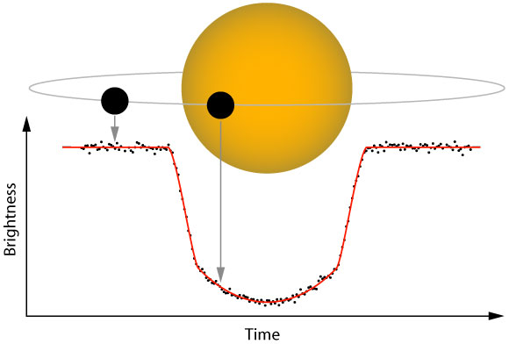
Solving the Data Optimization Problem:
A New Pipeline
AGN: aperiodic, stochastic variability in extended sources
Exoplanet hosts: highly periodic variability in point sources
(I spent about 80% of my time on this project building this pipeline and it occupies exactly 2% of the space in this presentation in the interest of showing you some results.)

Slide 6
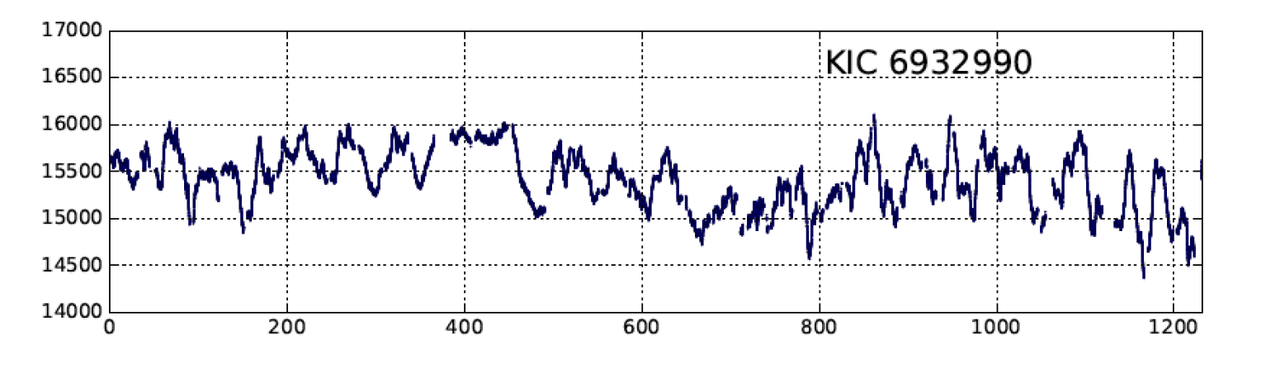
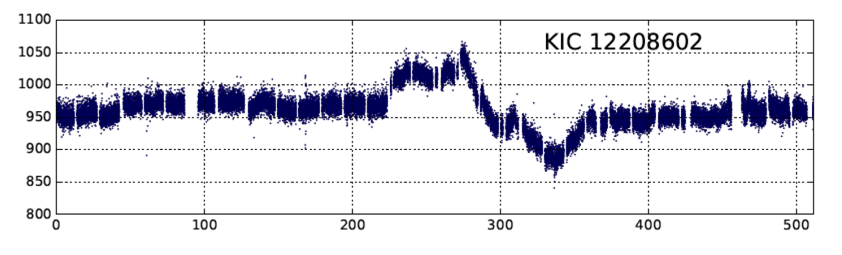
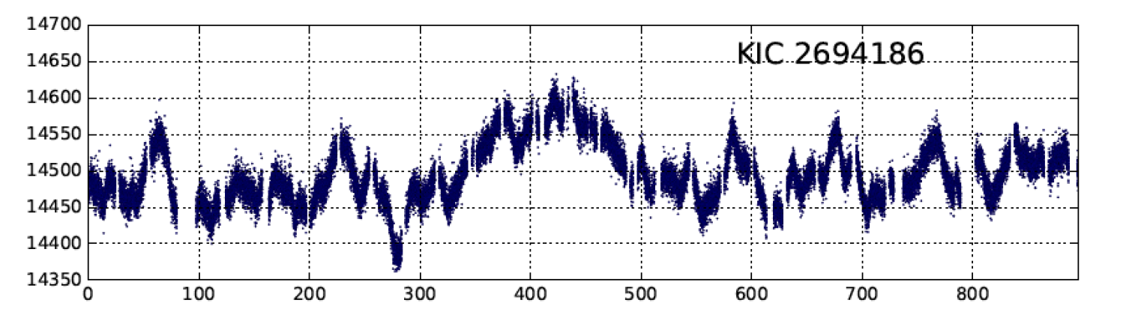
Light Curves and Power Spectra
Flux (cts /s)
Rest Frame Time (days)
Notes:
Really stress that this is a TOTALLY NEW REGIME of variability!

Slide 7
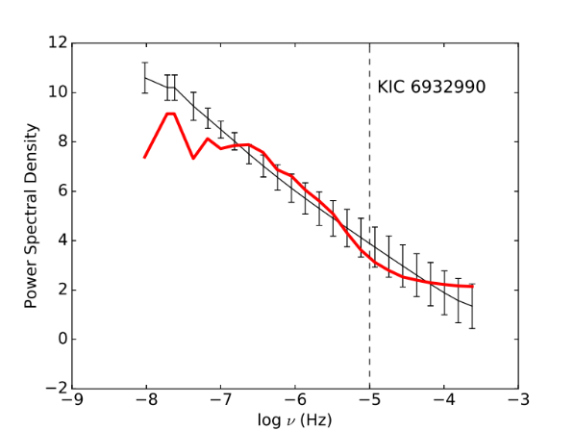
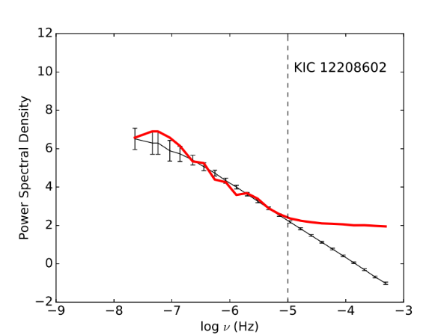
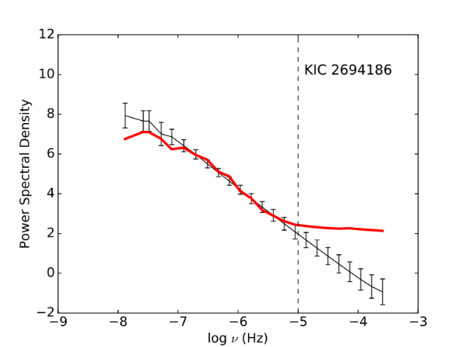
Light Curves and Power Spectra

Slide 8
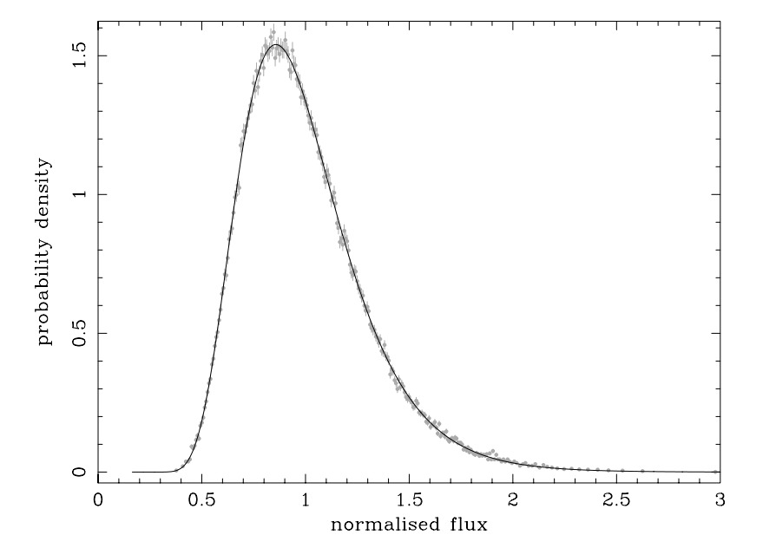
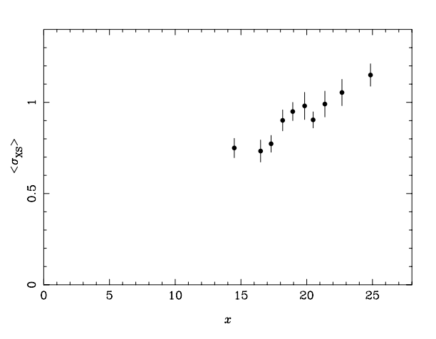
Testing Theoretical Predictions: X-ray Light Curve Comparisons
X-ray AGN light curves have long shown two ubiquitous properties: log-normal histograms of fluxes, and a correlation between flux and variableness.
Uttley et al. (2005)
If optical variability is reprocessed X-ray variability, we might see many of the same properties.

Slide 9
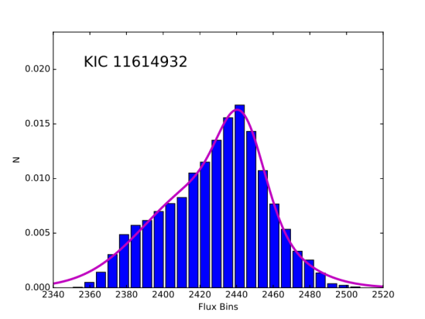
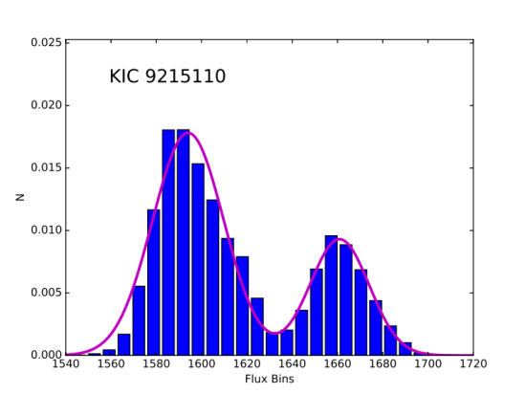
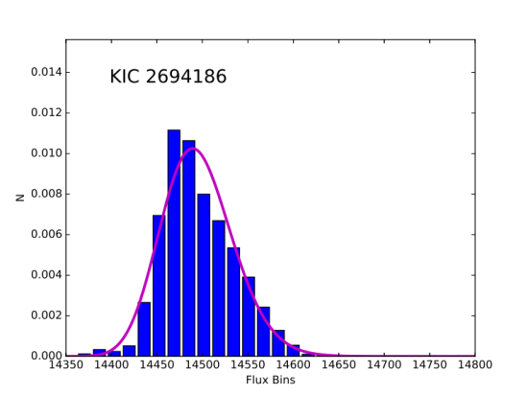
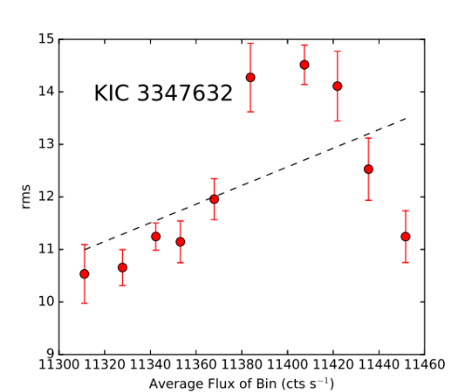
Testing Theoretical Predictions: X-ray Light Curve Comparisons
Result: We do not! Optical timing behavior is entirely different from X-ray, and much more diverse.

Slide 10
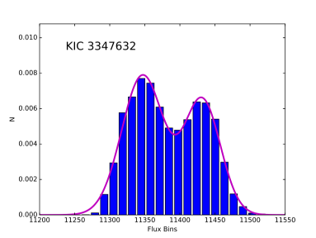
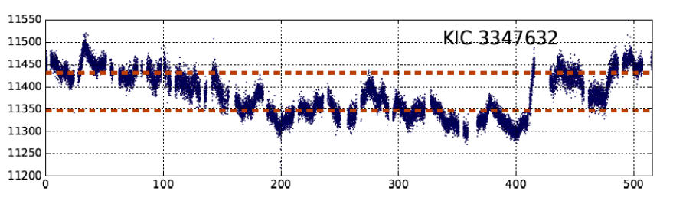
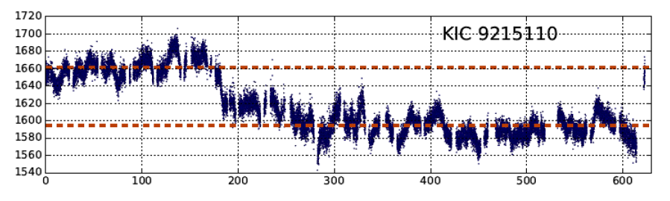
Bimodal Flux Distributions: Passing Clouds or Preferred States?

Slide 11
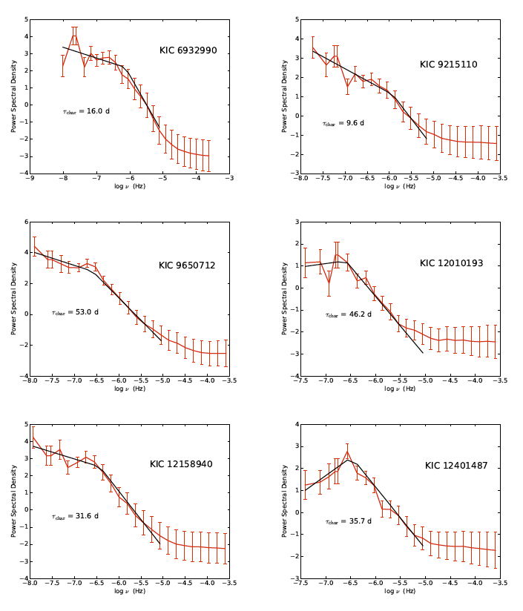
Characteristic Variability Timescales

Slide 12
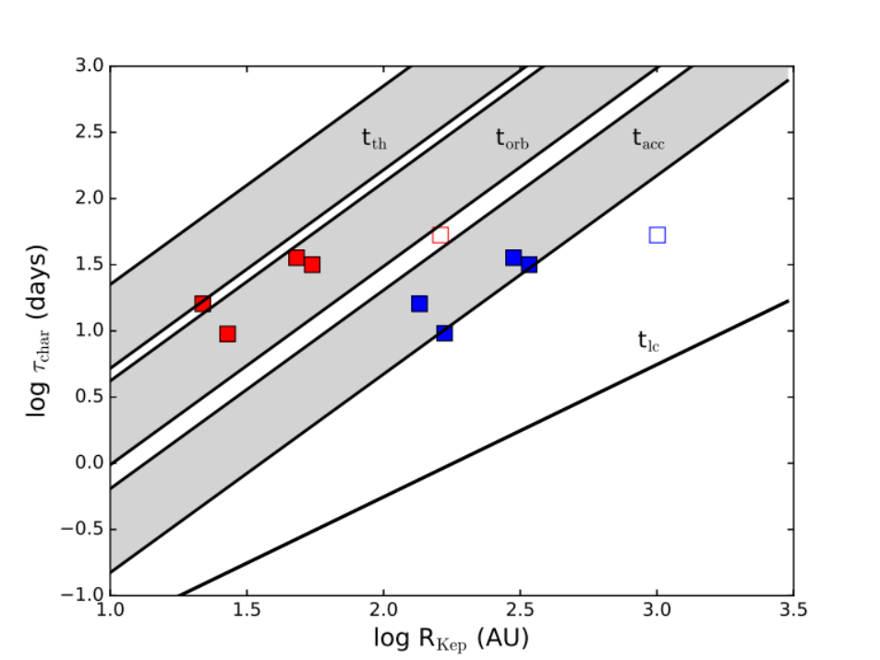
Characteristic Variability Timescales
Characteristic timescales are consistent with Keplerian orbital timescales or freefall timescales, depending on radius calculation.

Slide 13
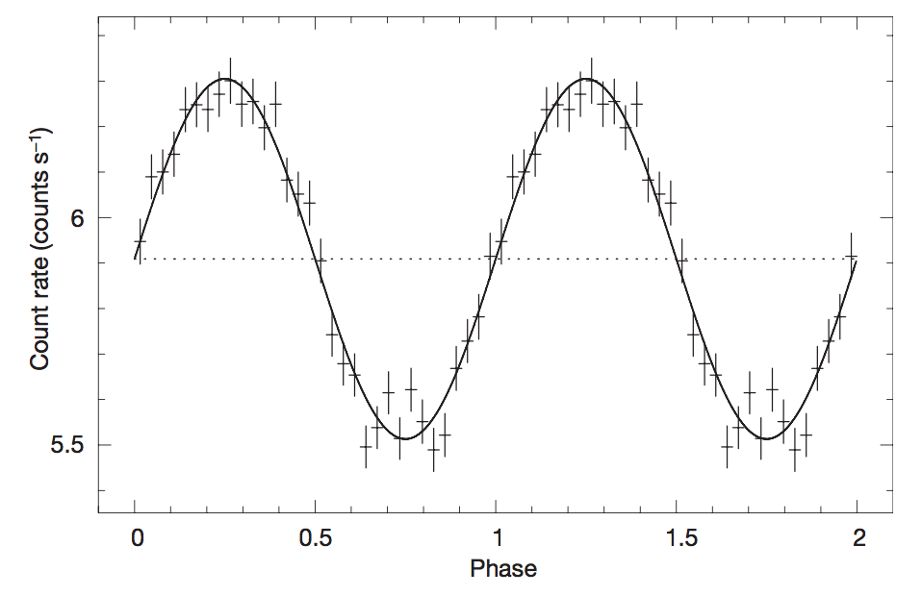
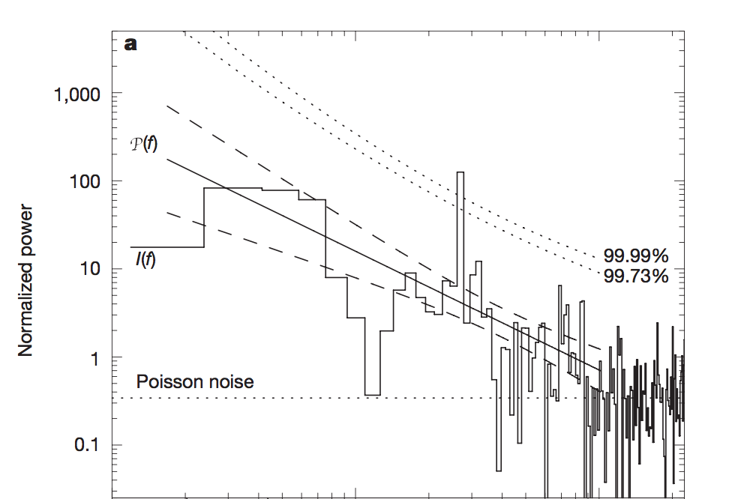
An Optical Quasi-Periodic
Oscillation
Quasi-periodic Oscillations (QPOs) are seen in X-ray power spectra of X-ray binaries and recently a few AGN.
Folded light curve
Power spectrum
Gierlińksi et al. (2008)

Slide 14
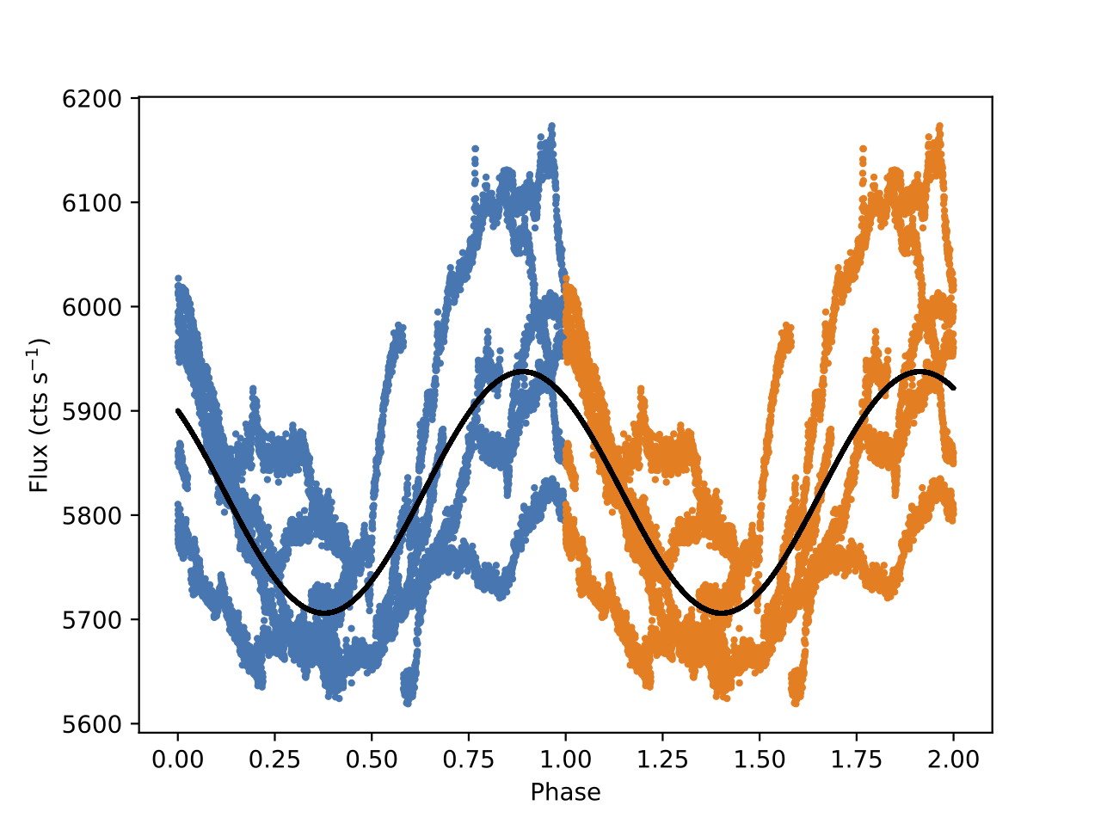
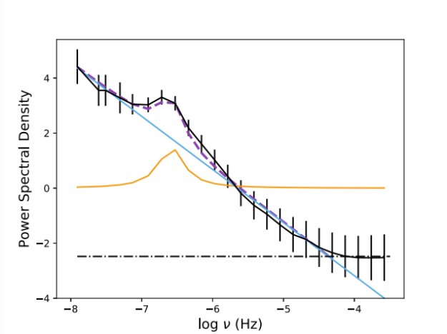
An Optical Quasi-Periodic
Oscillation
Quasi-periodic Oscillations (QPOs) are seen in X-ray power spectra of X-ray binaries and recently a few AGN.
Folded light curve
Power spectrum
Smith et al. (2017), in prep.

Slide 15
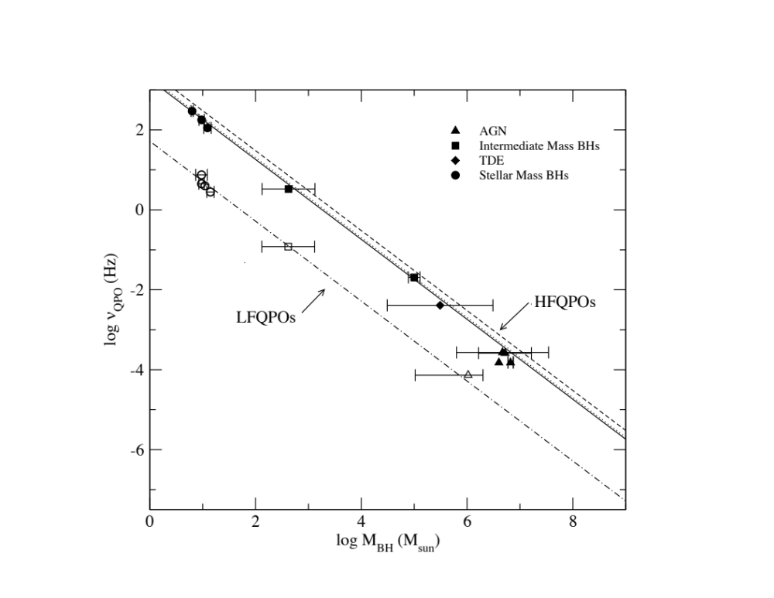
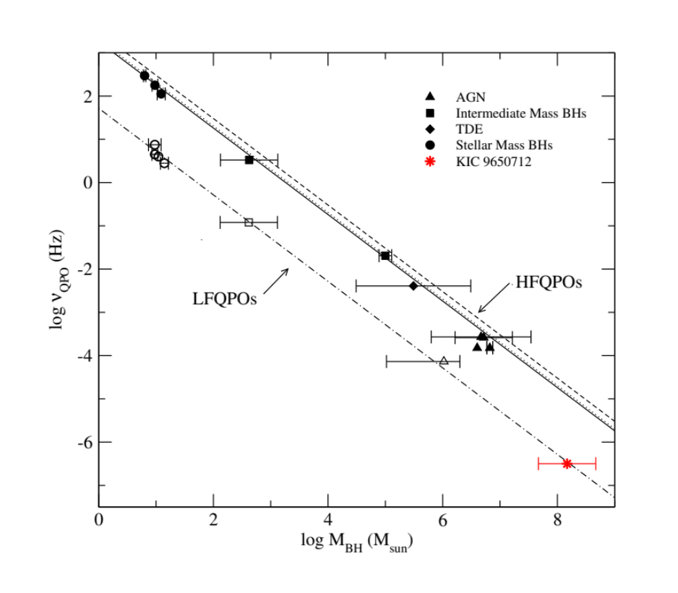
An Optical Quasi-Periodic
Oscillation
Quasi-periodic Oscillations (QPOs) are often seen in X-ray power spectra of X-ray binaries. Recently, some have been found in AGN.
Zhou et al. (2015), Smith et al. (2017) in prep.

Slide 16
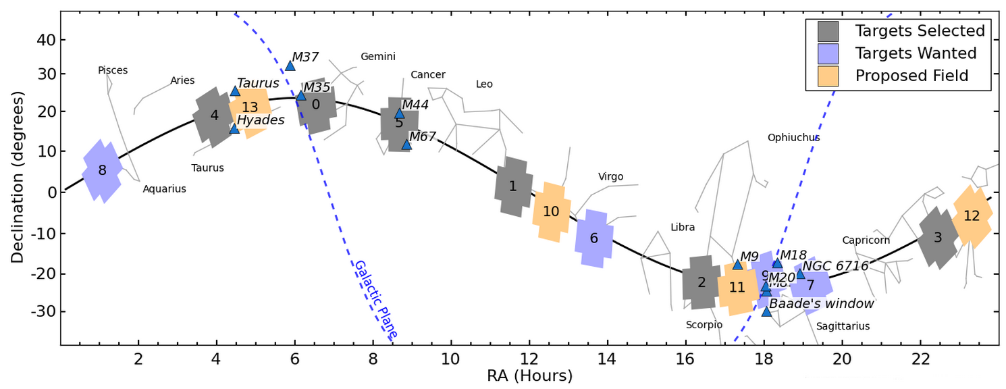
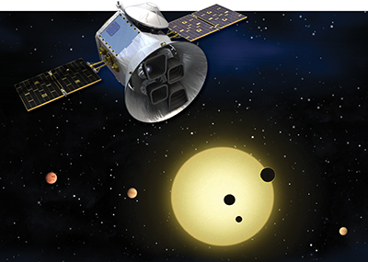
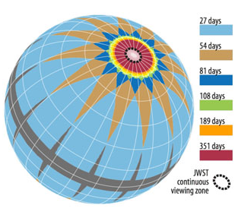
Looking Forward:
K2 and TESS
How can we use the 70-day baseline K2 data on ~300 new AGN targets?
Planning pipeline approaches and simultaneous X-ray observations for the TESS mission in 2018.

Slide 17
Thank you!

Slide 18
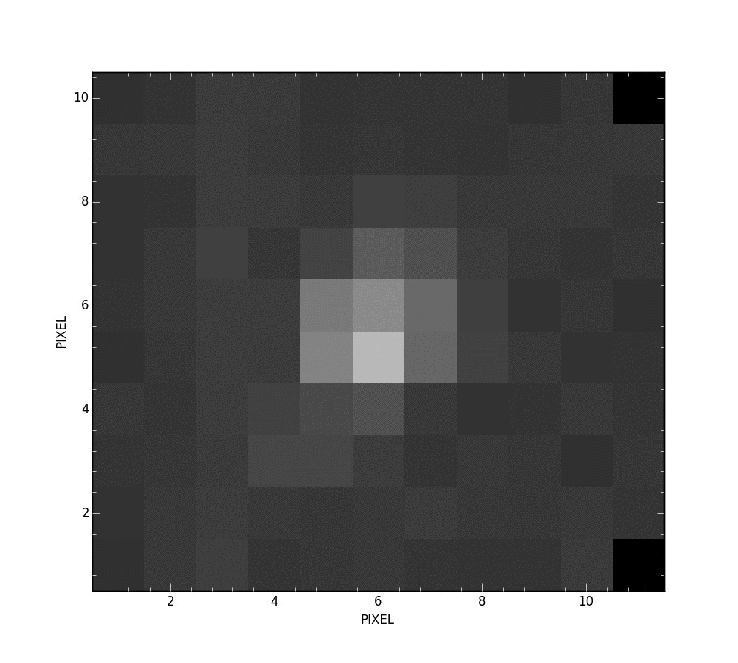
Source Drift within Extraction Aperture

Slide 19
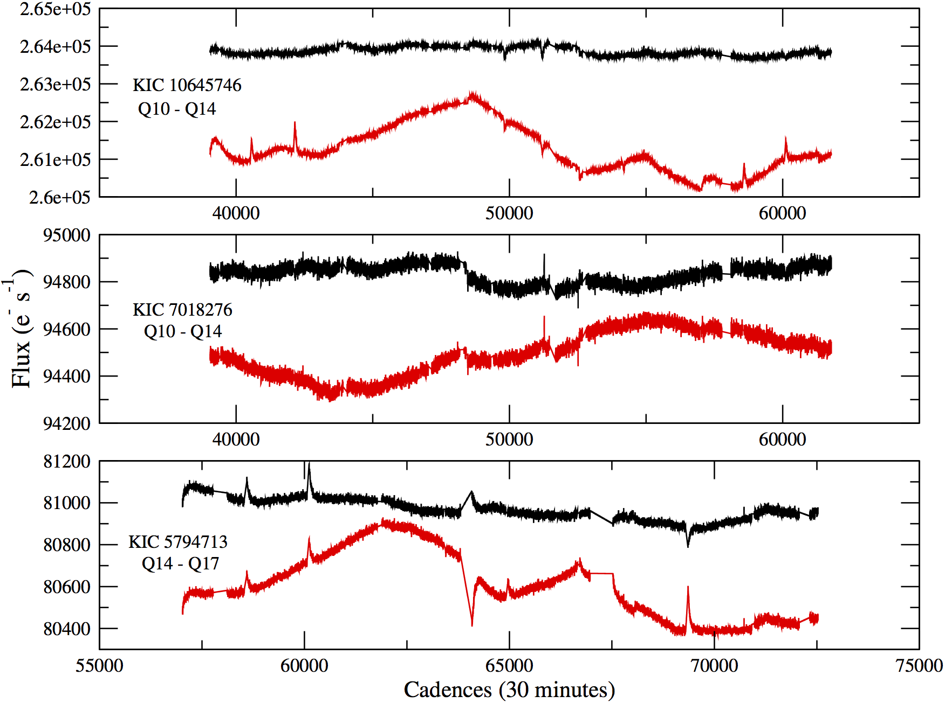
Effect of Pipeline on Quiet Stars

Slide 20
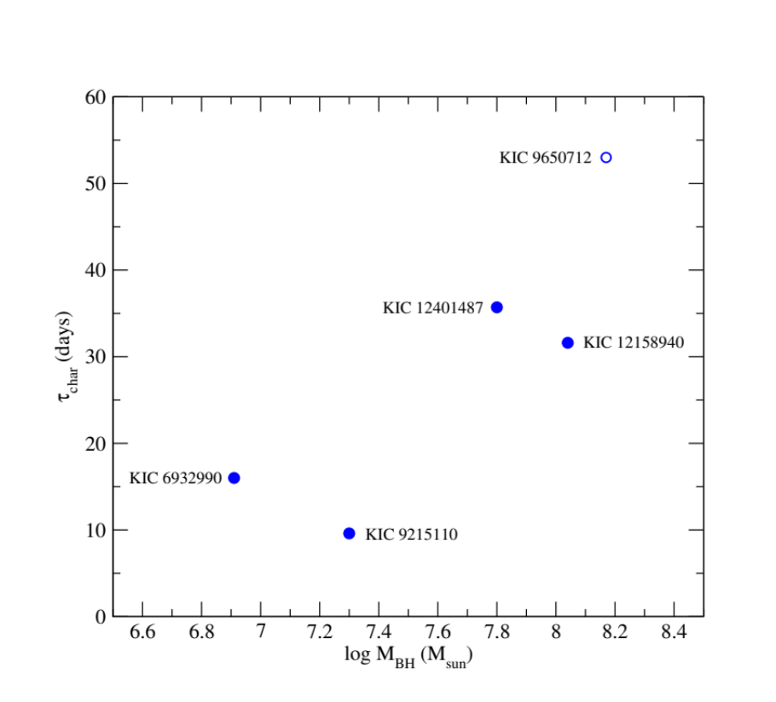
Correlations with Physical Parameters
Black Hole Mass:

Slide 21
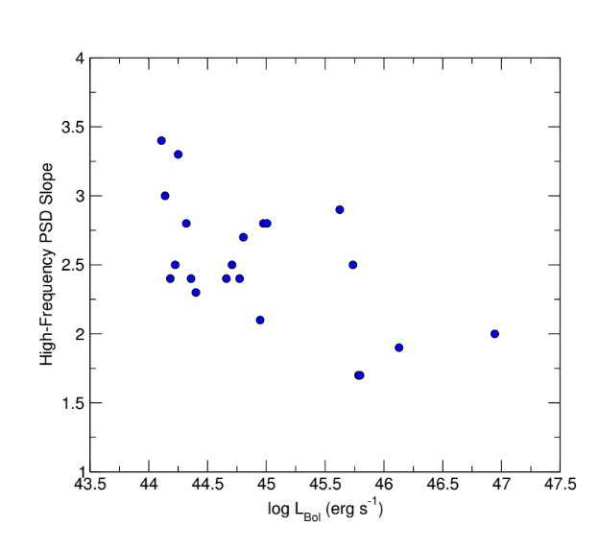
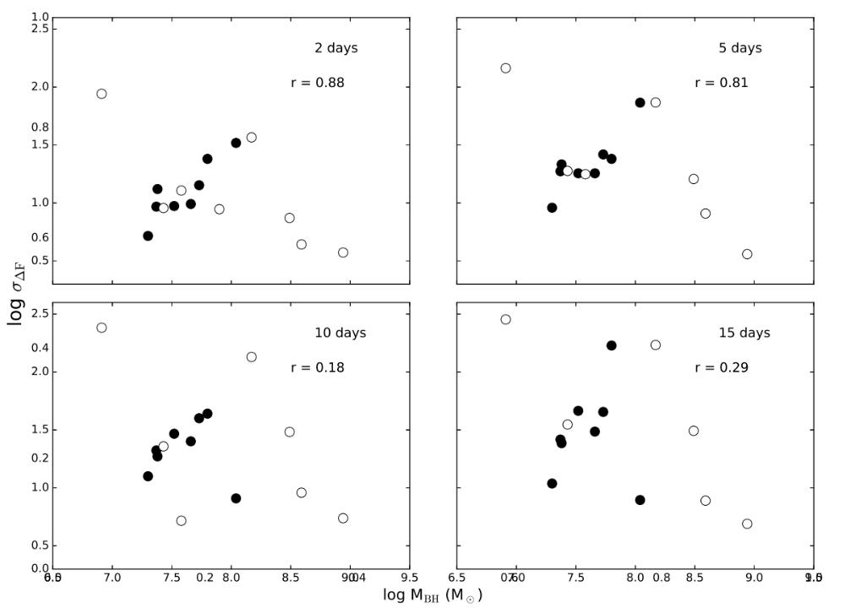
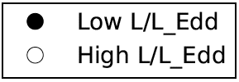
Correlations with Physical Parameters
Black Hole Mass
and Variability:
Bolometric Luminosity
and PSD slope:
Variability
log M_{BH}
Correlation depends on the accretion rate.

Slide 22
Accretion Disk Answers from Optical Variability
Can we tell apart different accretion disk models using variability behavior?
To what degree is the optical variability simply a reprocessing of the X-ray (or vice-versa)?
Can we find any correlations with black hole mass, luminosity, or accretion rate?

Slide 23
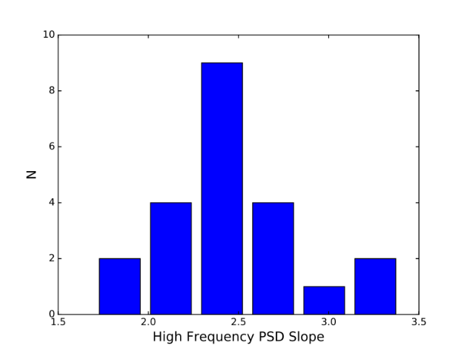
Testing Theoretical Predictions: The DRW Model
The popular “damped random walk” model of accretion physics predicts a power spectral slope of α = 2, where the PSD ~ ^{ν-α}
Result: Our slopes are steeper on average, reaching α = 3.4. The DRW model is insufficient.

