Slide 1
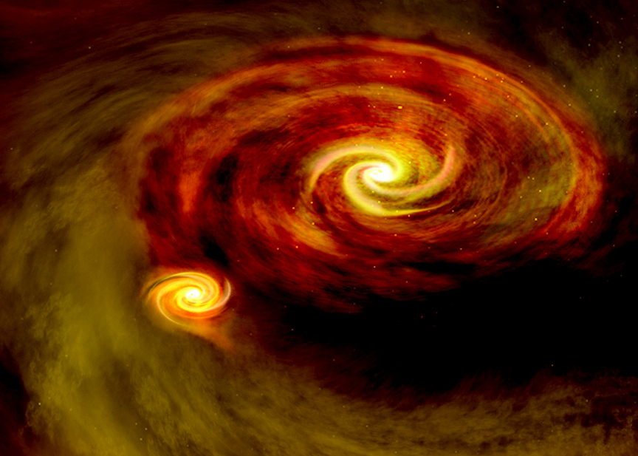
The Formation, Evolution,
and Future of Binary Stars
Max Moe (University of Arizona)
Einstein Fellows Symposium – Oct. 12, 2017

Slide 2
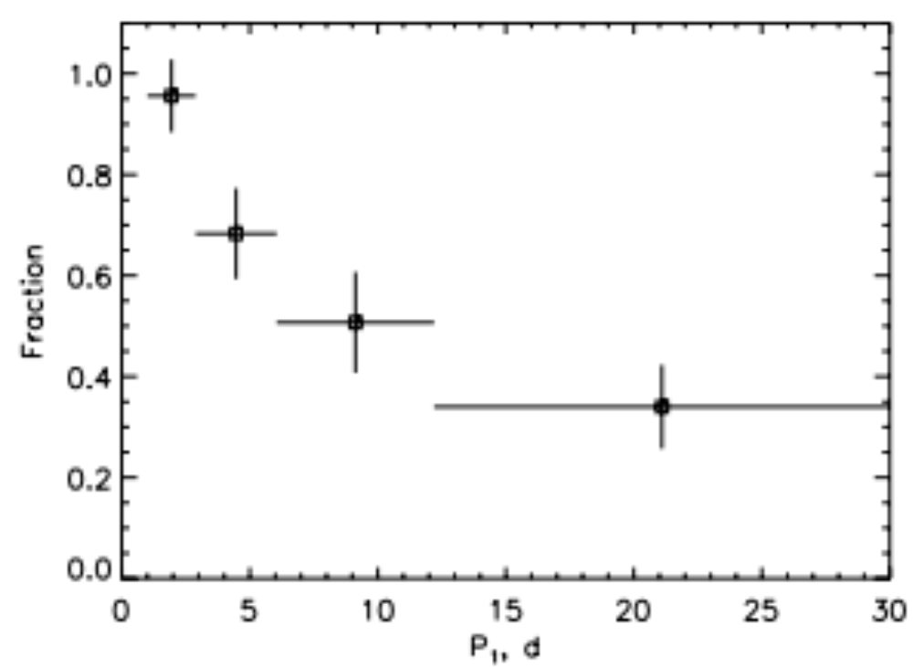
Formation of Very Close Binaries
Close binaries cannot form in situ, but instead
initially fragment in the primordial disk on scales of ~10s of AU
(Boss 1986; Bate et al. 1998, 2009)
Tokovinin et al. 2006
~80% of solar-type binaries with P_{inner} < 7 days have tertiary companions,
suggesting Kozai-Lidov oscillations and tidal friction produce very close binaries
(Kiseleva et al. 1998; Tokovinin et al. 2006; Fabrycky & Tremaine 2007; Naoz & Fabrycky 2014)

Slide 3
Formation of Very Close Binaries
However, the close binary fraction of T Tauri stars is consistent with that of solar-type MS stars in field
(Matheiu 1994, Melo 2003, Moe & Di Stefano 2017)
Moreover, very close binaries exhibit an excess twin fraction, demonstrating
co-evolution through shared accretion in the disk or mass transfer during pre-MS
(Tokovinin et al. 2000, Bate & Bonnel 1997, Bate 2000, Moe & Di Stefano 2017)
Migration to P < 10 days must generally occur
in first 𝜏 < 5 Myr when there was still a disk

Slide 4
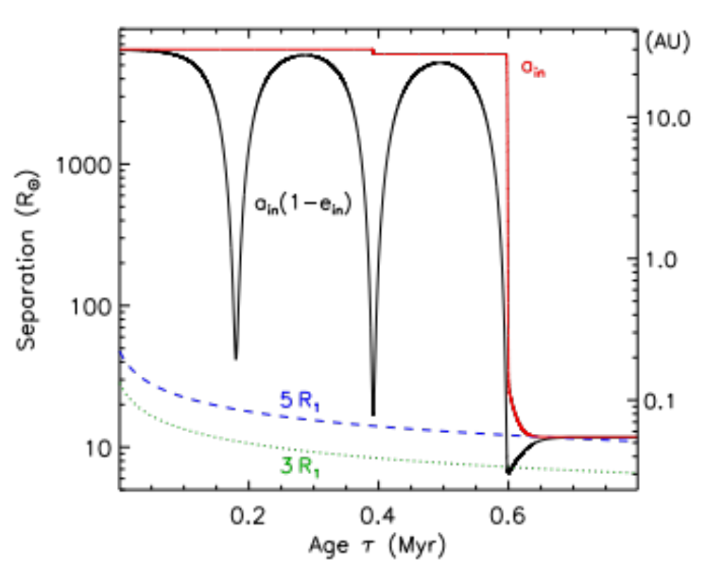
Dynamical Formation of Close Binaries during Pre-MS Phase
Triple star population synthesis model (Moe & Kratter 2017) with:
1) More realistic initial conditions (a_{in,0} ~ 10s of AU; a_{out,0} ~ 1,000s of AU)
2) Octupole-level secular equations
3) Weak-friction equilibrium tides at small e_{in} < 0.8 and
dynamical tides at large e_{in} > 0.8
4) Larger tidal radius of pre-MS primary

Slide 5
Dynamical Formation of Close Binaries during Pre-MS Phase
Two channels for producing close binaries in triples:
Moe & Kratter 2017
20%
MS
Inclined tertiaries with a_{outer} = 500 - 5,000 AU
1) Kozai-Lidov oscillations in stable triples coupled with tidal friction (Kiseleva et al 1998; Fabrycky & Tremaine 2007)
20%
pre-MS
Inclined tertiaries with a_{outer} = 10 - 1,000 AU
2) Dynamical unfolding of unstable triples combined with significant energy dissipation in disk
(Bate et al. 2002, 2009)
60%
pre-MS
Coplanar tertiaries with a_{outer} = 0.5 - 50 AU

Slide 6
Massive Helium Stars in Evolved Binaries
Massive helium stars (M_{He} = 2 - 5 M☉; M_{ZAMS} = 10 - 20 M☉) can possibly explain
four phenomena better than single, massive O-type MS stars (M_{ZAMS} > 40 M☉)
SN Ib/c: 25% of CCSN (Li et al. 2011); only 10% of CCSN have M_{ZAMS} > 40 M☉
Non-detections in pre-explosion images: M < 20 M☉ (Eldridge et al. 2013)
M_{ejecta} ~ 2 - 5 M☉ (Drout et al. 2011; Cano et al. 2014)
2) Long GRBs and SN Ic-BL: binary interactions can strip H & He envelopes while
sustaining necessary angular momentum to collimate jet (Izzard et al. 2004)
3) C IV and He II emission in high-redshift galaxies (Stark et al. 2015; Strom et al. 2017):
>55 eV photons: T_{O-MS} = 30,000K - 50,000K (too cool)
T_{HeStar} = 50,000K - 120,000K predicted (Gotberg et al. 2017)
4) Epoch of reionization at z ~ 10 (log Z/Z☉ = –2 - –3):
Must invoke top-heavy IMF to explain reionization with single,
massive O-type MS stars (Ciardi et al. 2013; Daigne et al. 2004)

Slide 7
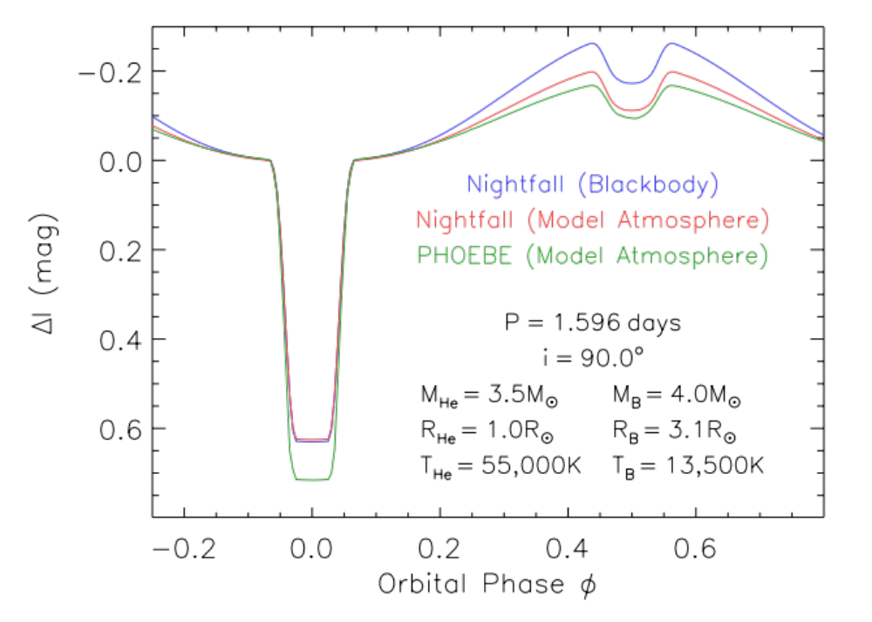
Prototype for Massive Helium Stars in Binaries
Only one system known in our Milky Way!
HD 41566 has a nearly face-on P = 1.6 day orbit, a mid-B MS primary (B7V; dominates at optical wavelengths) and a hot, compact helium star companion
(Steiner & Oliveira 2005; Groh et al. 2008)
If edge-on . . .

Slide 8
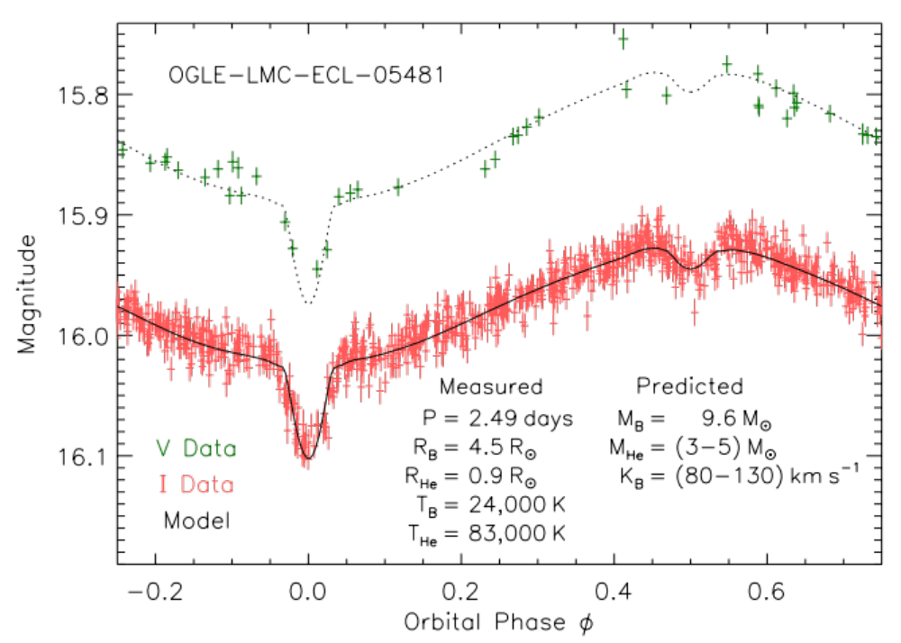
Massive Helium Stars in LMC EBs
Searching the OGLE database of EBs in the LMC (Gracyzk et al. 2011),
we found 8 candidate B-type MS + He Star EBs with P = 1.1 - 2.5 days

Slide 9
Massive Helium Stars in LMC EBs
After accounting for selection effects, we estimate
120 ± 50 massive He stars in binaries in the LMC
Given 𝜏_{He} ~ 1 - 2 Myr, formation rate of massive He stars in LMC
is (8 ± 4)✕10⁻⁵ yr⁻¹, consistent with LMC SN Ib/c rate of (2 ± 1)✕10⁻⁴ yr⁻¹
(van den Bergh & Tammann 1991; Leahy et al. 2017)
Estimate Q_{HeStar} / Q_{O-MS} ~ 0.2, but observed He stars in LMC EBs
are in older (𝜏 ~ 10 - 40 Myr), more diffuse environments,
so f_{esc,HeStar} ~ 90% > f_{esc,O-MS} ~ 20%
Q_{HeStar} / Q_{O-MS} predicted to significantly increase below Z < Z_{LMC} = 0.007
(Gotberg et al. 2017)

Slide 10
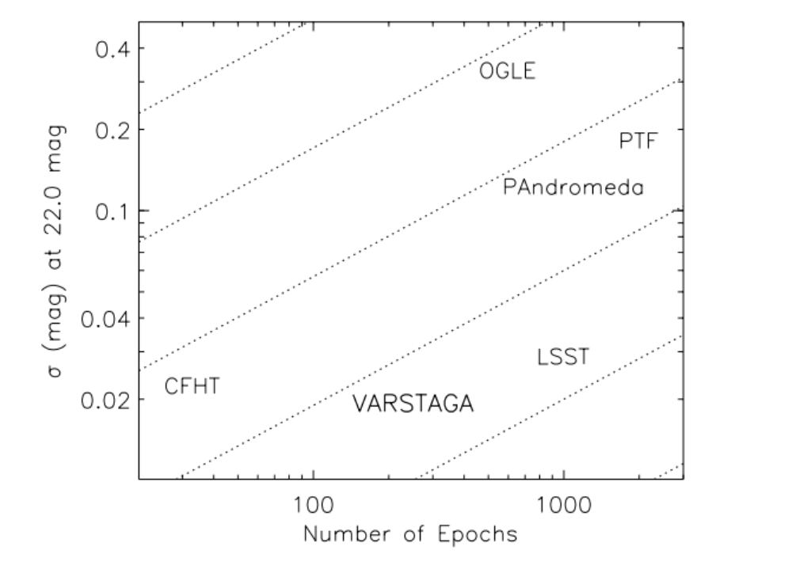
VARiability Survey of the TriAngulum GAlaxy (VARSTAGA)
First simultaneously deep (~24 mag per epoch), high-cadence (~250 epochs),
multi-band (ugriJK) survey of a local group galaxy
Will find 50,000 variables, including 15,000 EBs, 10s of FU Orionis outbursts, and other variables and transients related to binary stars

Slide 11
Summary
Secular evolution in triples alone and disk-driven migration alone cannot form close binaries: need non-secular evolution of triples embedded in disks
Discovered a population of massive helium stars in LMC EBs,
which are numerous enough and hot enough to explain SN Ib/c and reionization
VARSTAGA and other time-domain surveys (Gaia, LSST) are treasure troves for studying EBs and other binary-related variables and transients

