Slide 1
A Physical Mechanism for Mass Loss in Failed Supernovae
Eric Coughlin
UC Berkeley
Collaborators: Eliot Quataert, Rodrigo Fernandez (Alberta), Dan Kasen
arXiv:1710.01746

Slide 2
Overview
(Core-collapse) Supernovae?
Neutrino-induced mass loss
  Linear perturbation theory
  Polytropes
  Energetics
  Comparison to Simulations
Summary+Conclusions

Slide 3
Supernovae
Core loses pressure support
Collapse proceeds until form neutron star
Neutron degeneracy pressure+nuclear force stabilize flow
  Overpressured bounce launches shock wave
  Shock propagates through star, unbinds envelope = supernova

Slide 4
Supernovae
Doesn’t really work:
  Shock usually stalls
  Maybe neutrino heating?
  Maybe instabilities (SASI)?
  Maybe magnetic fields?
Do know: certain stars easier to explode than others
  High compactness – harder to explode (O’Connor & Ott 2010; Ertl+2016)
What happens if the star doesn’t explode?
Any signature of these ``failed supernovae?’’

Slide 5
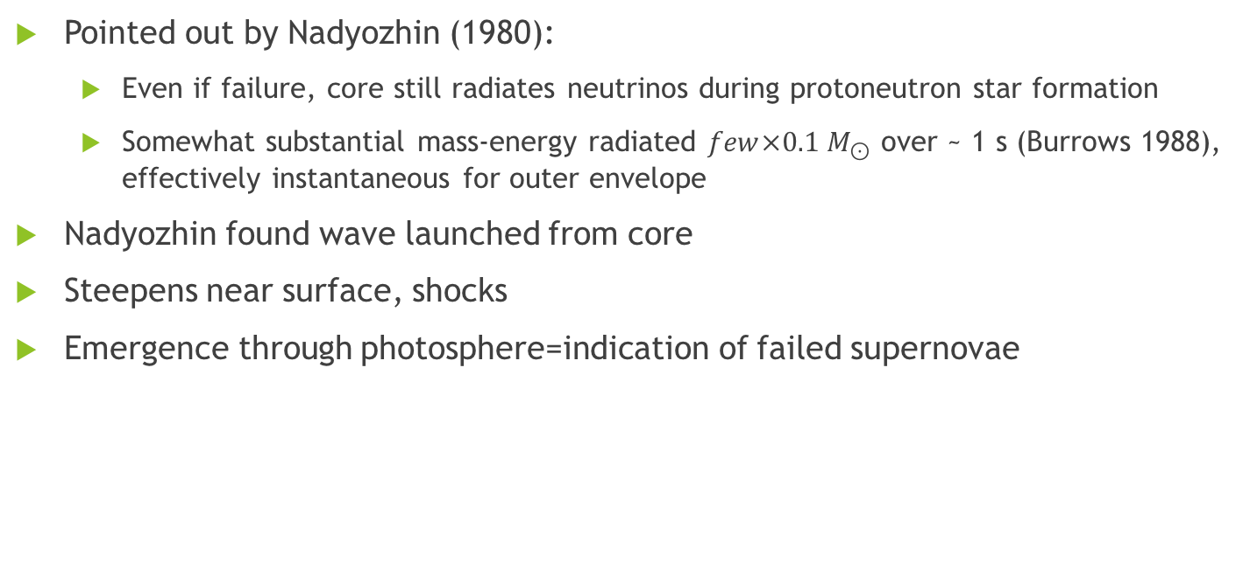
Neutrino-induced mass loss
Pointed out by Nadyozhin (1980):
  Even if failure, core still radiates neutrinos during protoneutron star formation
  Somewhat substantial mass-energy radiated $few×0.1 M_{⊙}$ over ~ 1 s (Burrows 1988), effectively instantaneous for outer envelope
Nadyozhin found wave launched from core
Steepens near surface, shocks
Emergence through photosphere=indication of failed supernovae

Slide 6
Neutrino-induced mass loss
Questions:
  Why and how?
  Energetics?
  Where does the shock form?
  How does all this depend on stellar properties?

Slide 7
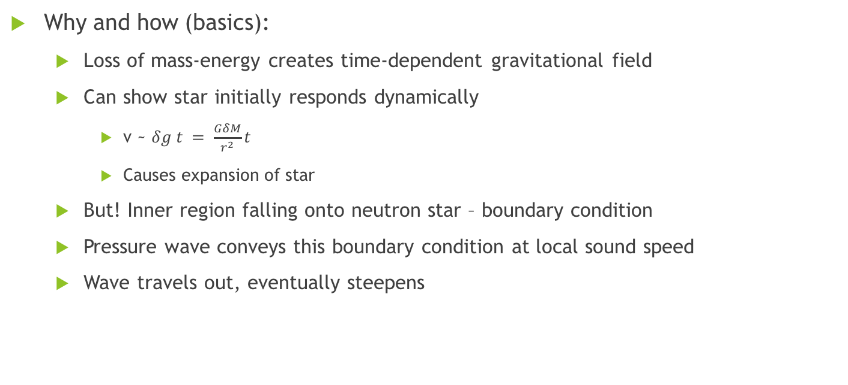
Neutrino-induced mass loss
Why and how (basics):
  Loss of mass-energy creates time-dependent gravitational field
  Can show star initially responds dynamically
    v ~ $δg t = \frac{GδM}{r^{2}}t$
    Causes expansion of star
  But! Inner region falling onto neutron star – boundary condition
  Pressure wave conveys this boundary condition at local sound speed
  Wave travels out, eventually steepens

Slide 8
Neutrino-induced mass loss
Why and how (details):
  Linear perturbation theory
  Construct Eigenmodes
  Work out coefficients
For definiteness, analyzed polytropes

Slide 9
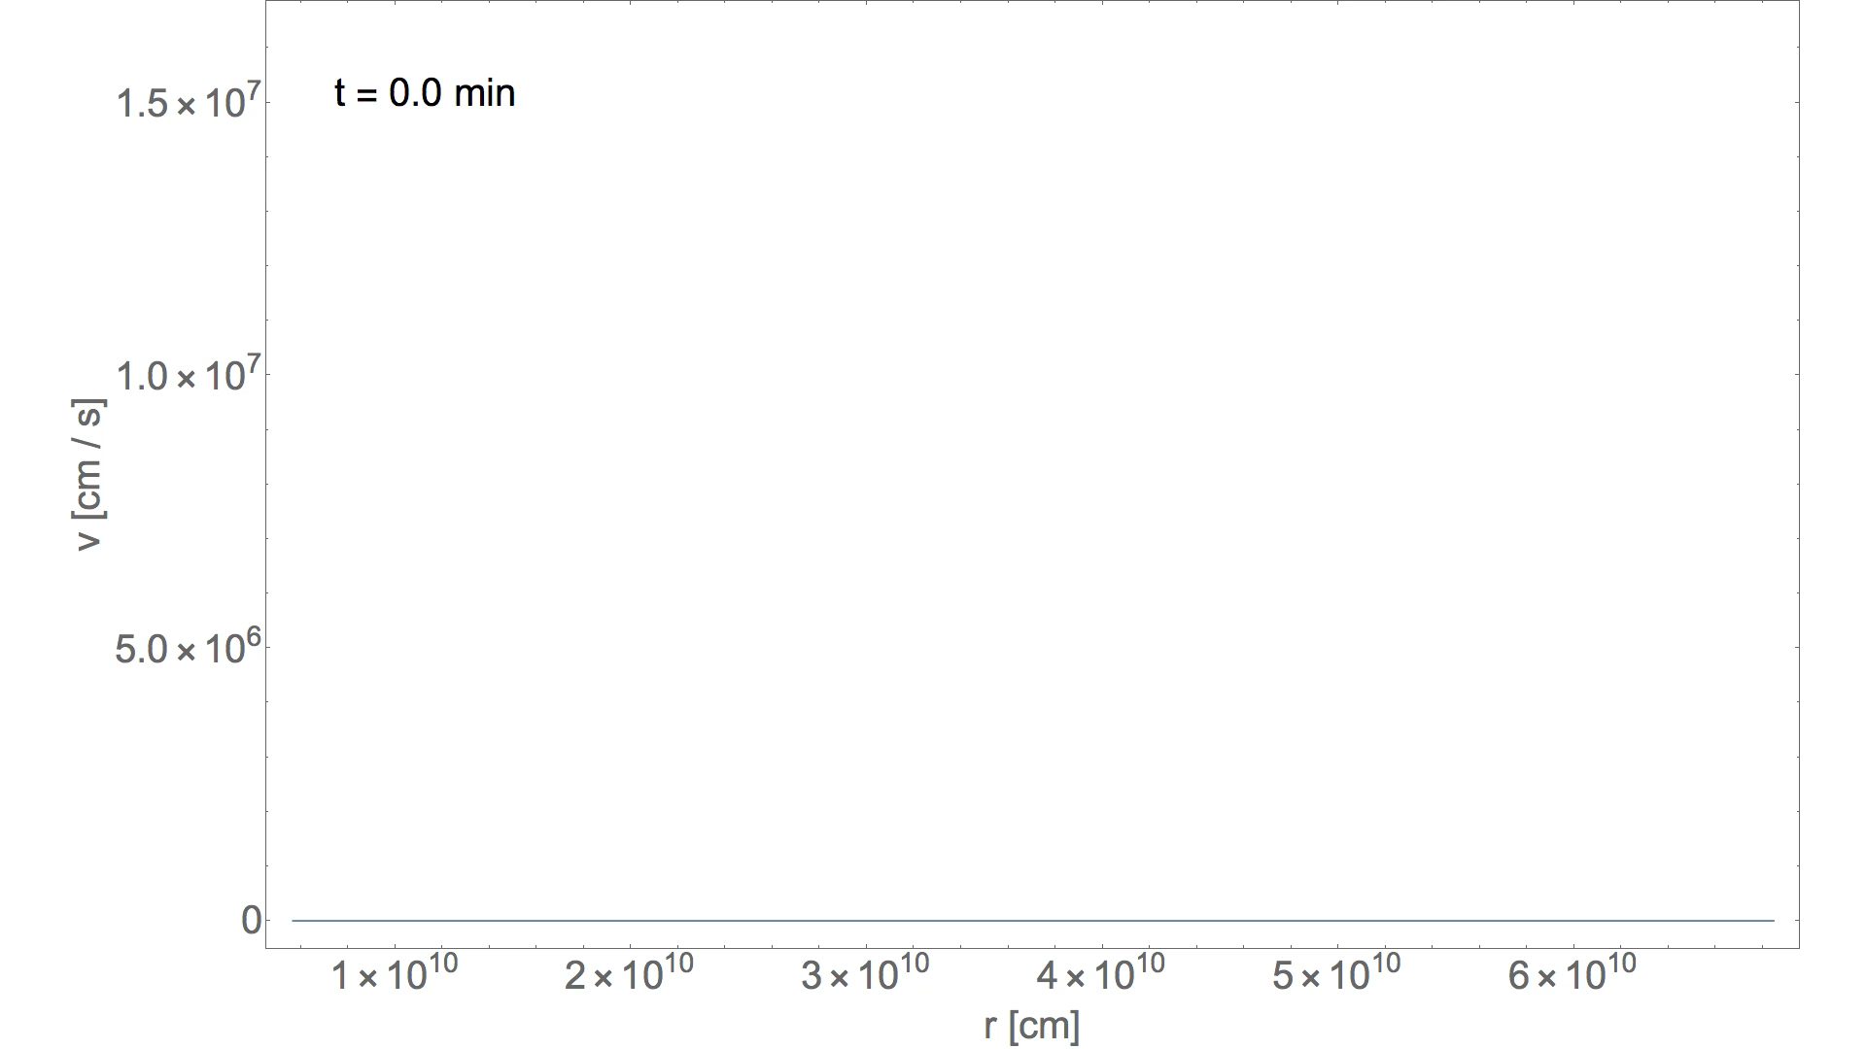

Slide 10
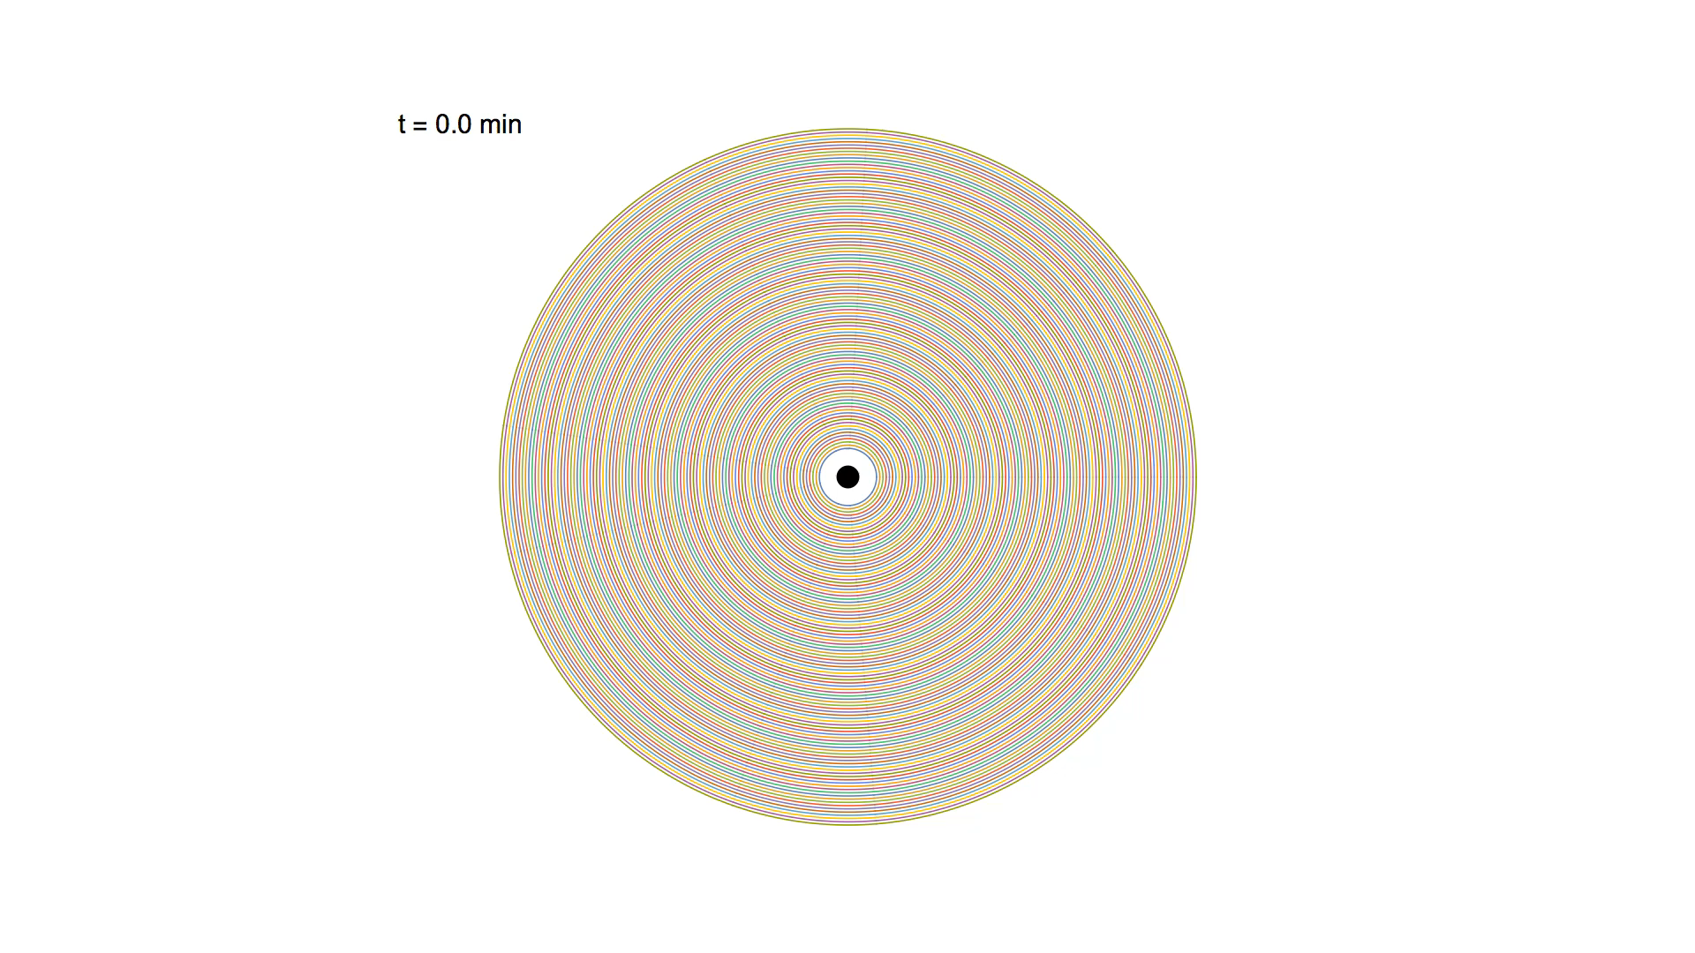

Slide 11
Neutrino-induced mass loss
Important point:
  Linear theory, pulse propagates out, reflects off of surface
  Realistically, shocks once Mach ~ 1
Comparison to 1D-hydro shows agreement w/ this expectation

Slide 12
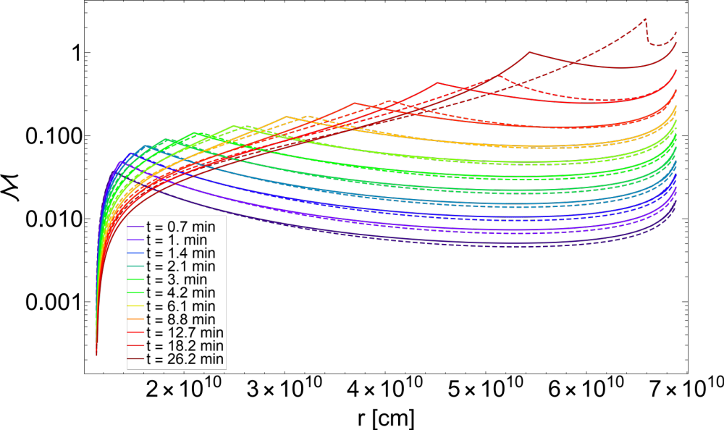
Solid=analytical
Dashed=numerical

Slide 13
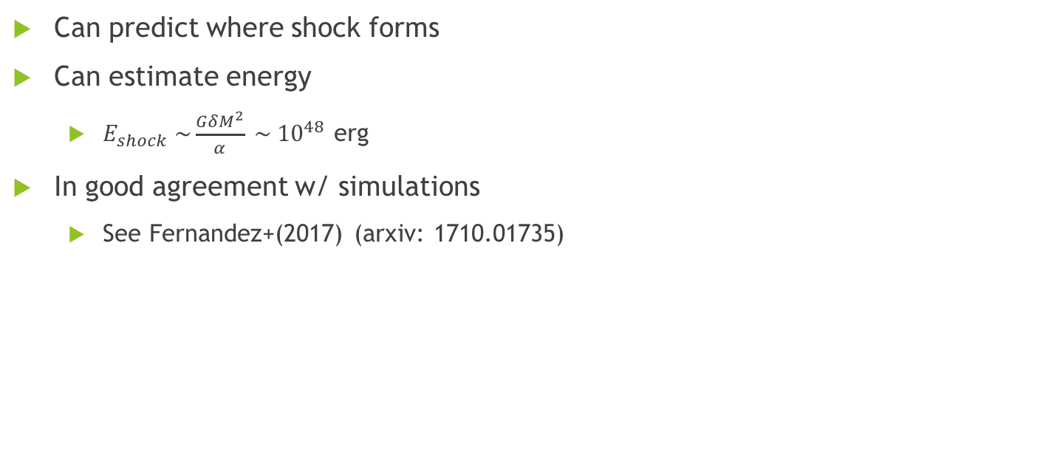
Neutrino-induced mass loss
Can predict where shock forms
Can estimate energy
  $E_{shock} \sim {\frac{GδM^{2}}{α} \sim 10}^{48}$ erg
In good agreement w/ simulations
  See Fernandez+(2017) (arxiv: 1710.01735)

Slide 14
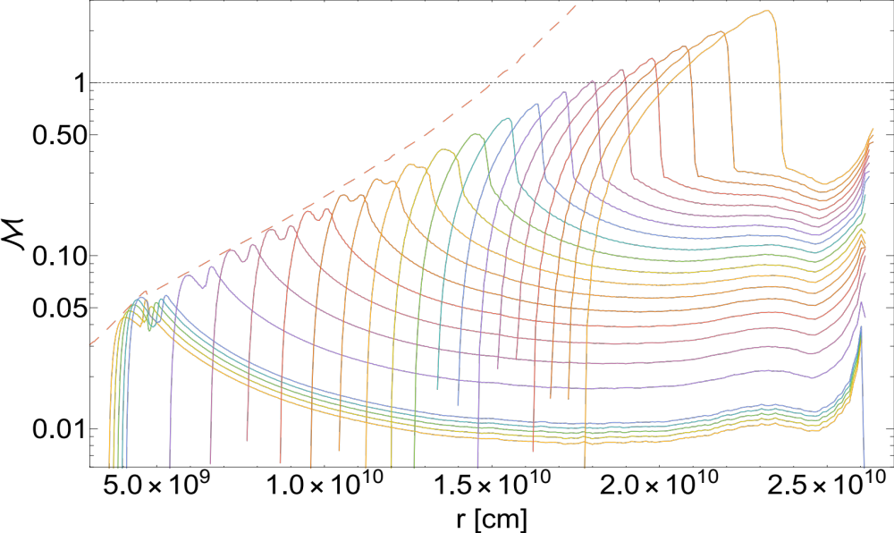

Slide 15
Summary
Failed supernovae – maybe not so failed?
Neutrino mass loss induces grav field, causes star to respond
  Sound pulse launched from interior
  Propagates out
  Steepens and shocks in nonlinear theory
Injected energy ~ 10⁴⁸ erg
Generates low-luminosity outburst to indicate disappearance of star.

Slide 16
Questions?

Slide 17
