Slide 1
Observations of Sco X-1 with Rockets
1965-1969

Slide 2
Rocket timeline, 1962-1965

Slide 3
Credits (mostly people at Livermore)
G. A. Burginyon G. Chodil W. A. Hiltner C. Curry
R. J. Grader C. D. Swift D. Mook C. Cornell
R. W. Hill Hans Mark G. Wallerstein M. McGee
T. Palmieri R. E. Price E. J. Mannery J. Ronchetto
P. J. Stoering R. C. Jopson H. Knoll
A. Toor R. Rodrigues J. Harri
J. Scudder A. Iantuano
A MacGregor C. Nuenschwander
I. Turiel D. Salmi
T. Ervin
J. Zickuhr
Sandia Corporation Rocket Division T. Krein

Slide 4
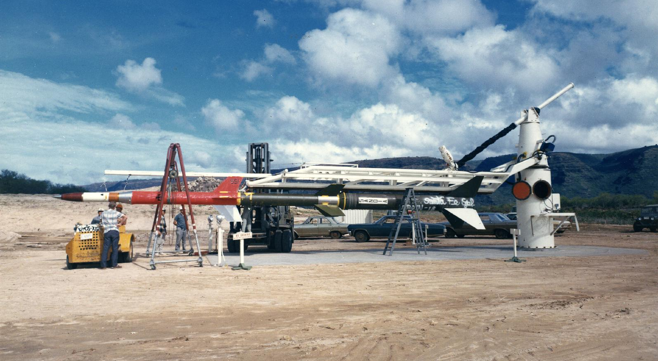
Honest John/Nike/Nike

Slide 5
1965 June 12
Honest John Nike Nike rocket
Barking Sands, Kauai, Hawaii
12” diameter payload
Spin-stabilized @ 6 rev/s
Apogee 170 km, 250 s above 104 km
Xe-methane filled proportional counter
3 mil Be window: 9 sq cm area, 2-20 keV
Collimation: 10 deg X 45 deg

Slide 6
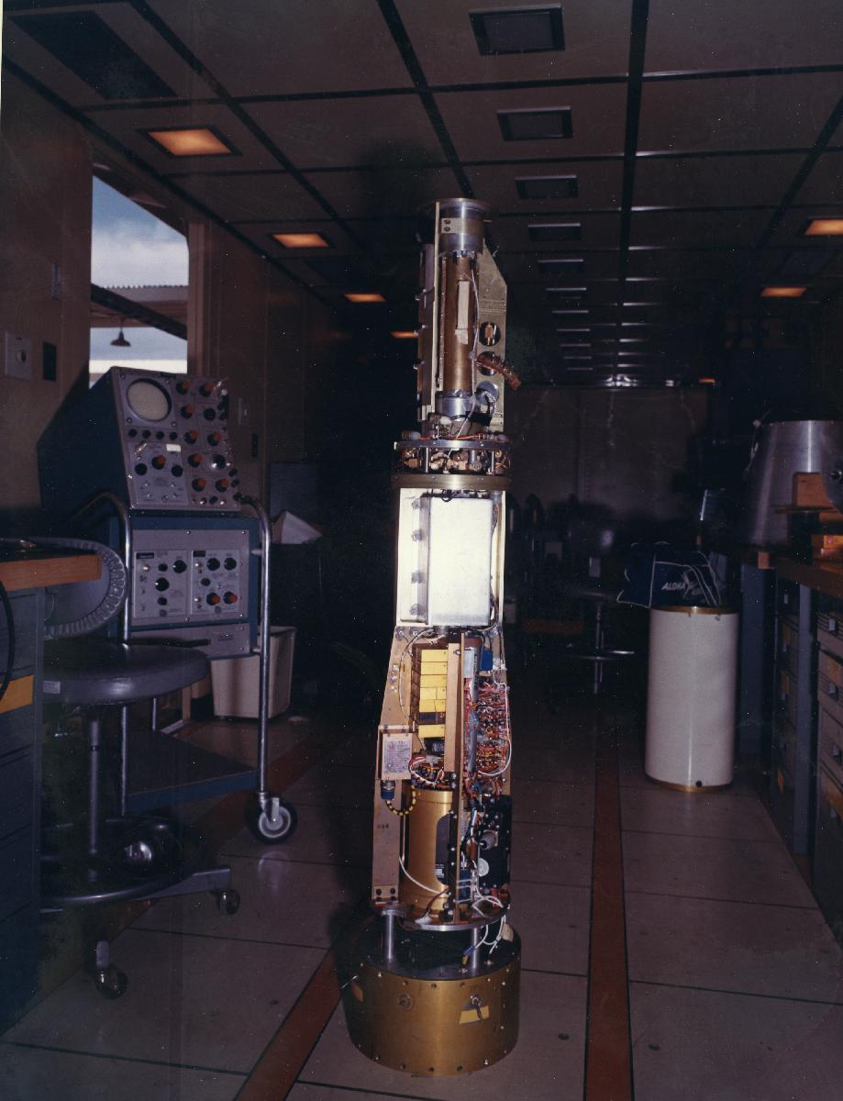
First cosmic X-ray payload

Slide 7
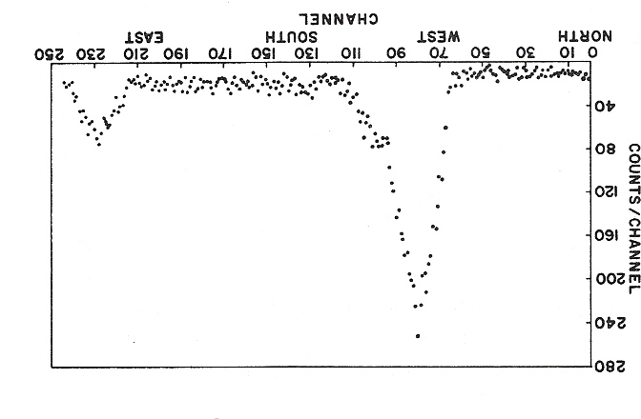
Counts vs Azimuth, Sco X-1 and Sun
9 sq cm
7 s
3600 counts
Chodil et al. 1965, Phys Rev Lett 15, 1

Slide 8
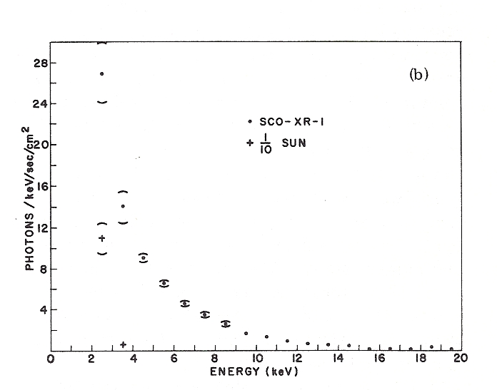
Pulse height spectra, Sco X-1 and Sun

Slide 9
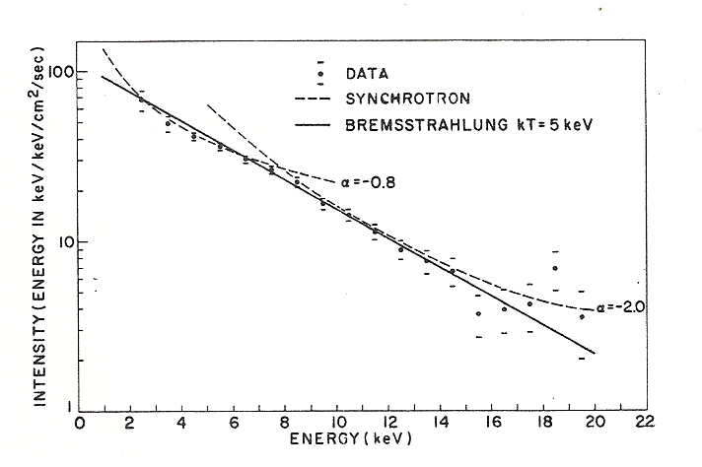
Energy spectrum, Sco X-1

Slide 10
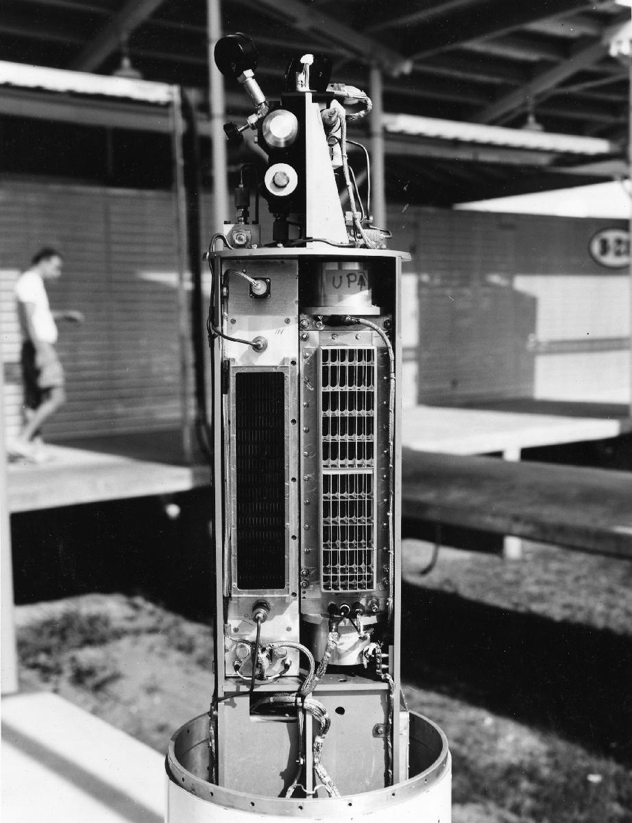
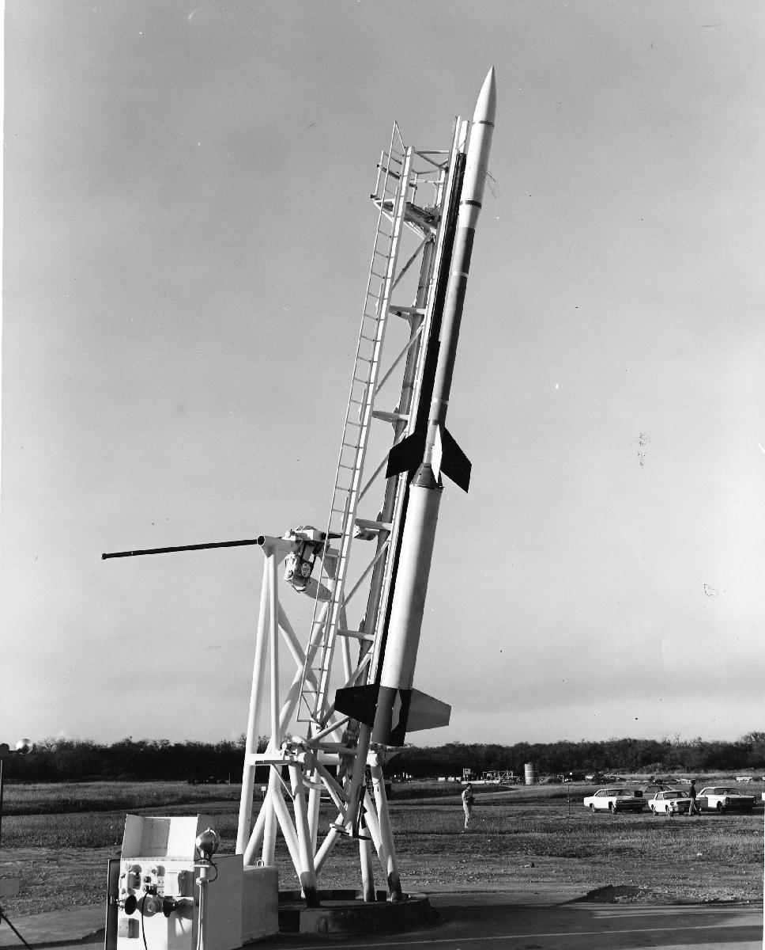
Second cosmic X-ray payload and rocket

Slide 11
Rocket Timeline, 1966-1969

Slide 12
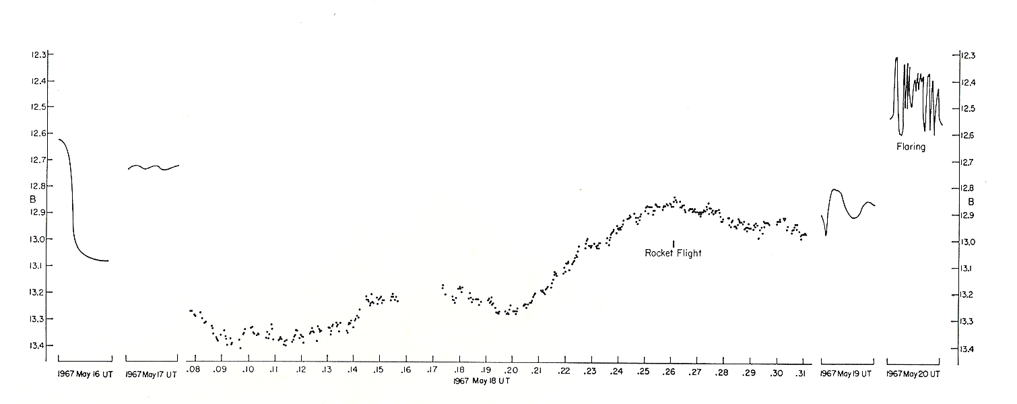
Simultaneous X-ray/optical observation
1967 May 16-20
W.A. Hiltner, E.J. Mannery, G. Wallerstein
Cerro Tololo, Chile, Rattlesnake Ridge, U. Washington

Slide 13
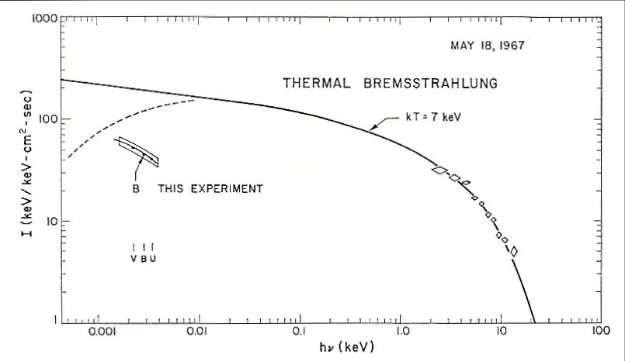
Simultaneous X-ray/optical observation
1967 May 18
Chodil, Mark, Hiltner, et al 1967, ApJ 154, 645

Slide 14
Model for Sco X-1
Semitransparent spherical volume of plasma.
Transparent to X-rays.
Opt attenuation by free-free absorption – more in red than blue.
Absorption chosen so emission spectrum plus ISM reddening reproduces optical obs.
Density and radius determined. kT = 7 keV
distance density radius/solar radius mass/solar mass
1 kpc 5X10^15 0.045 6X10^-13
2.8 kpc 2X10^15 0.18 1X10^-11
kT – 4 keV, X1.3 X1.1

Slide 15
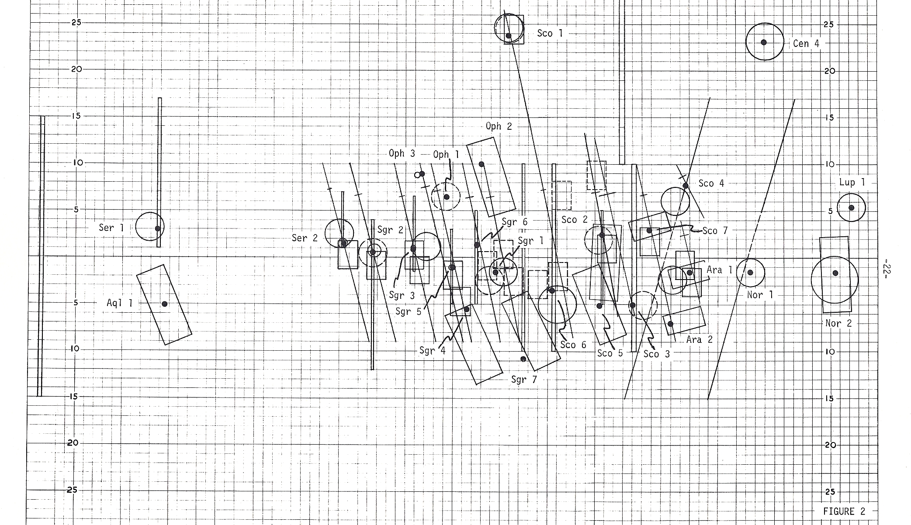
1969 X-ray sky determined by rockets

Slide 16
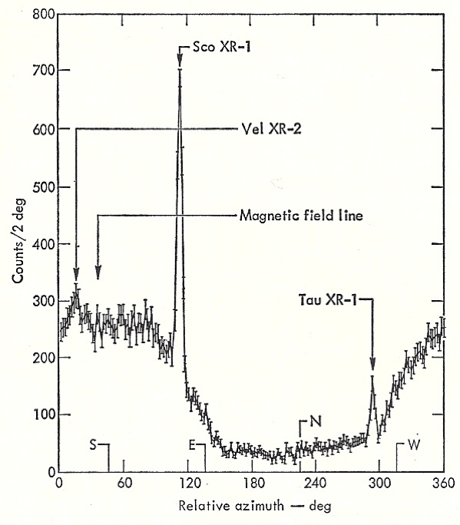
Sco X-1 X-ray/Optical correlation
Burginyon et al, 1970,
ApJ 161, 987

Slide 17
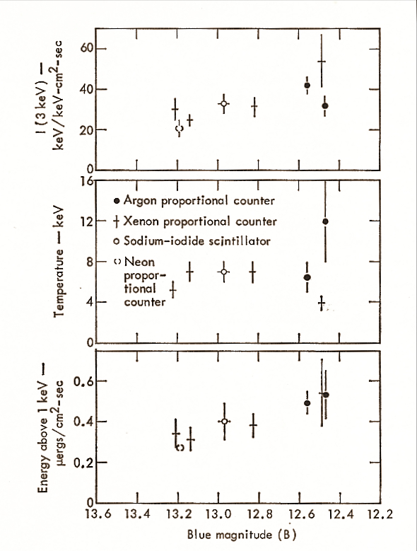
Sco X-1 X-ray/optical correlation
1967 May 18
to
1969 May 24
Burginyon et al 1970,
ApJ 161, 987

Slide 18
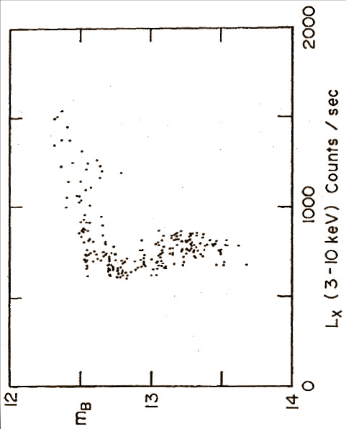
Simultaneous X-ray/optical observations
Sco X-1, OSO 7 satellite, 1972
Counts/s
|
13.2
|
12.5
B magnitude
Canizares, Clark, Mook, Hiltner, et al. 1975, ApJ 197, 457

Slide 19
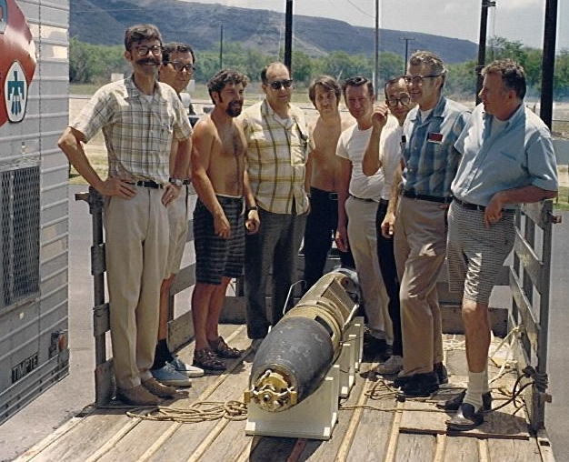
Recovered LRL payload, 1970

Slide 20
Rocket survey of Galactic plane, 1970
Hill et al 1974, ApJ 187, 505

