Slide 1
CONSIDERATIONS ON METHOD
RICCARDO GIACCONI
2012

Slide 2
TABLE I METHOD SCIENCE SYSTEM ENGINEERING
Ø
LEARN:
OBSERV
E, READ, REACH STATE OF THE ART
Ø
THINK:
CRI
TICALLY EXAMINE MATERIAL ABOVE
IS
THE FIELD WORTH PURSUING?
WHAT CAN YOU BRING TO THE FIELD?
DECIDE
Ø
PLAN:
AS FAR AHEAD AS YOU CAN SEE,
AT LEAST >5 YEARS ?
Ø
DO: DESIGN, OBTAIN SUPPORT, EXECUTE, USE DATA (END TO
END DATA SYSTEMS)

Slide 3
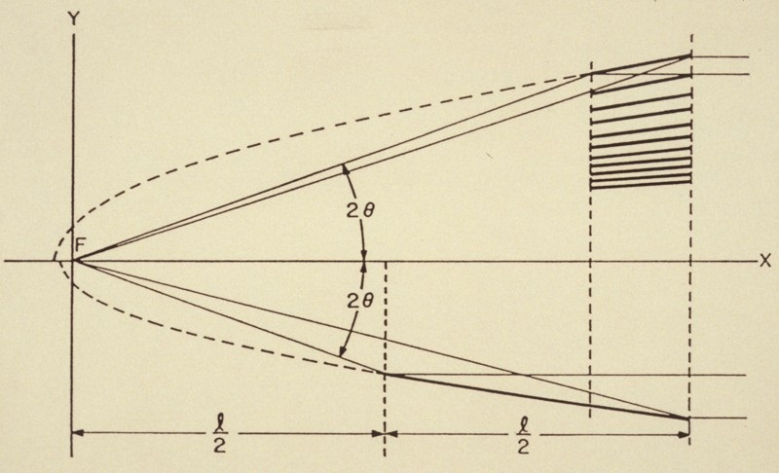

Slide 4
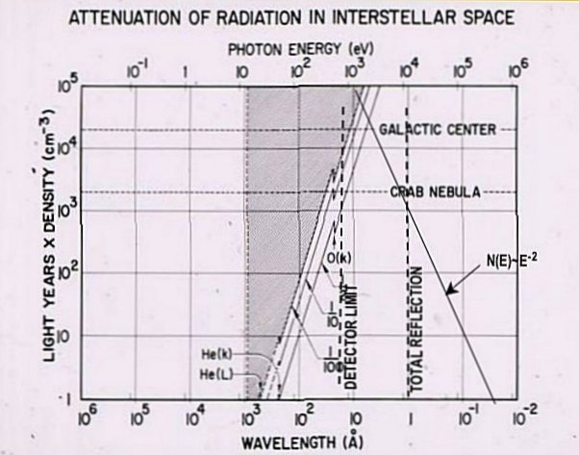

Slide 5
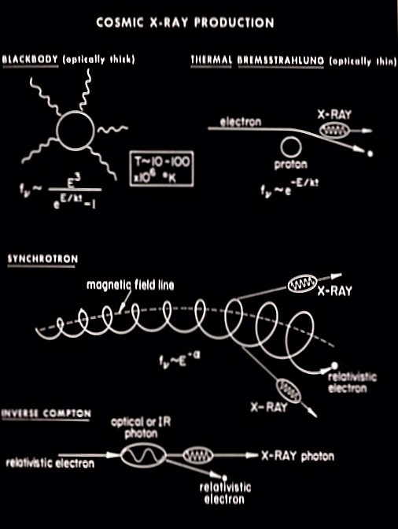

Slide 7
TABLE II THE LEARNING PHASE

Slide 8
TABLE III CHANGES IN INSTRUMENTATION (1960)

Slide 9
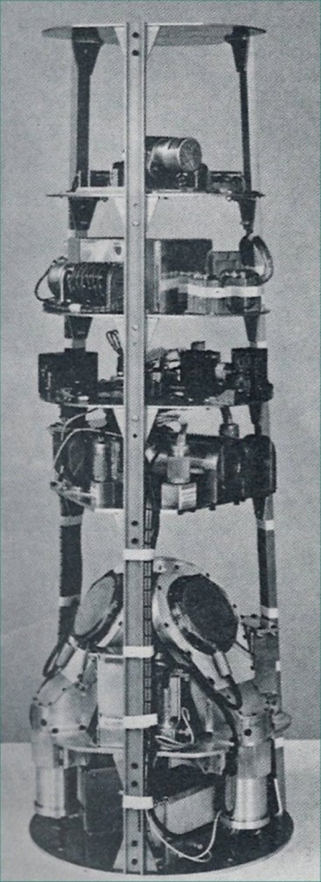
20x LARGER AREA
10x IMPROVEMENT ON S/N DUE TO ANTI-COINCIDENCE
60° TO IMPROVE CHANCE OF DETECTION

Slide 10
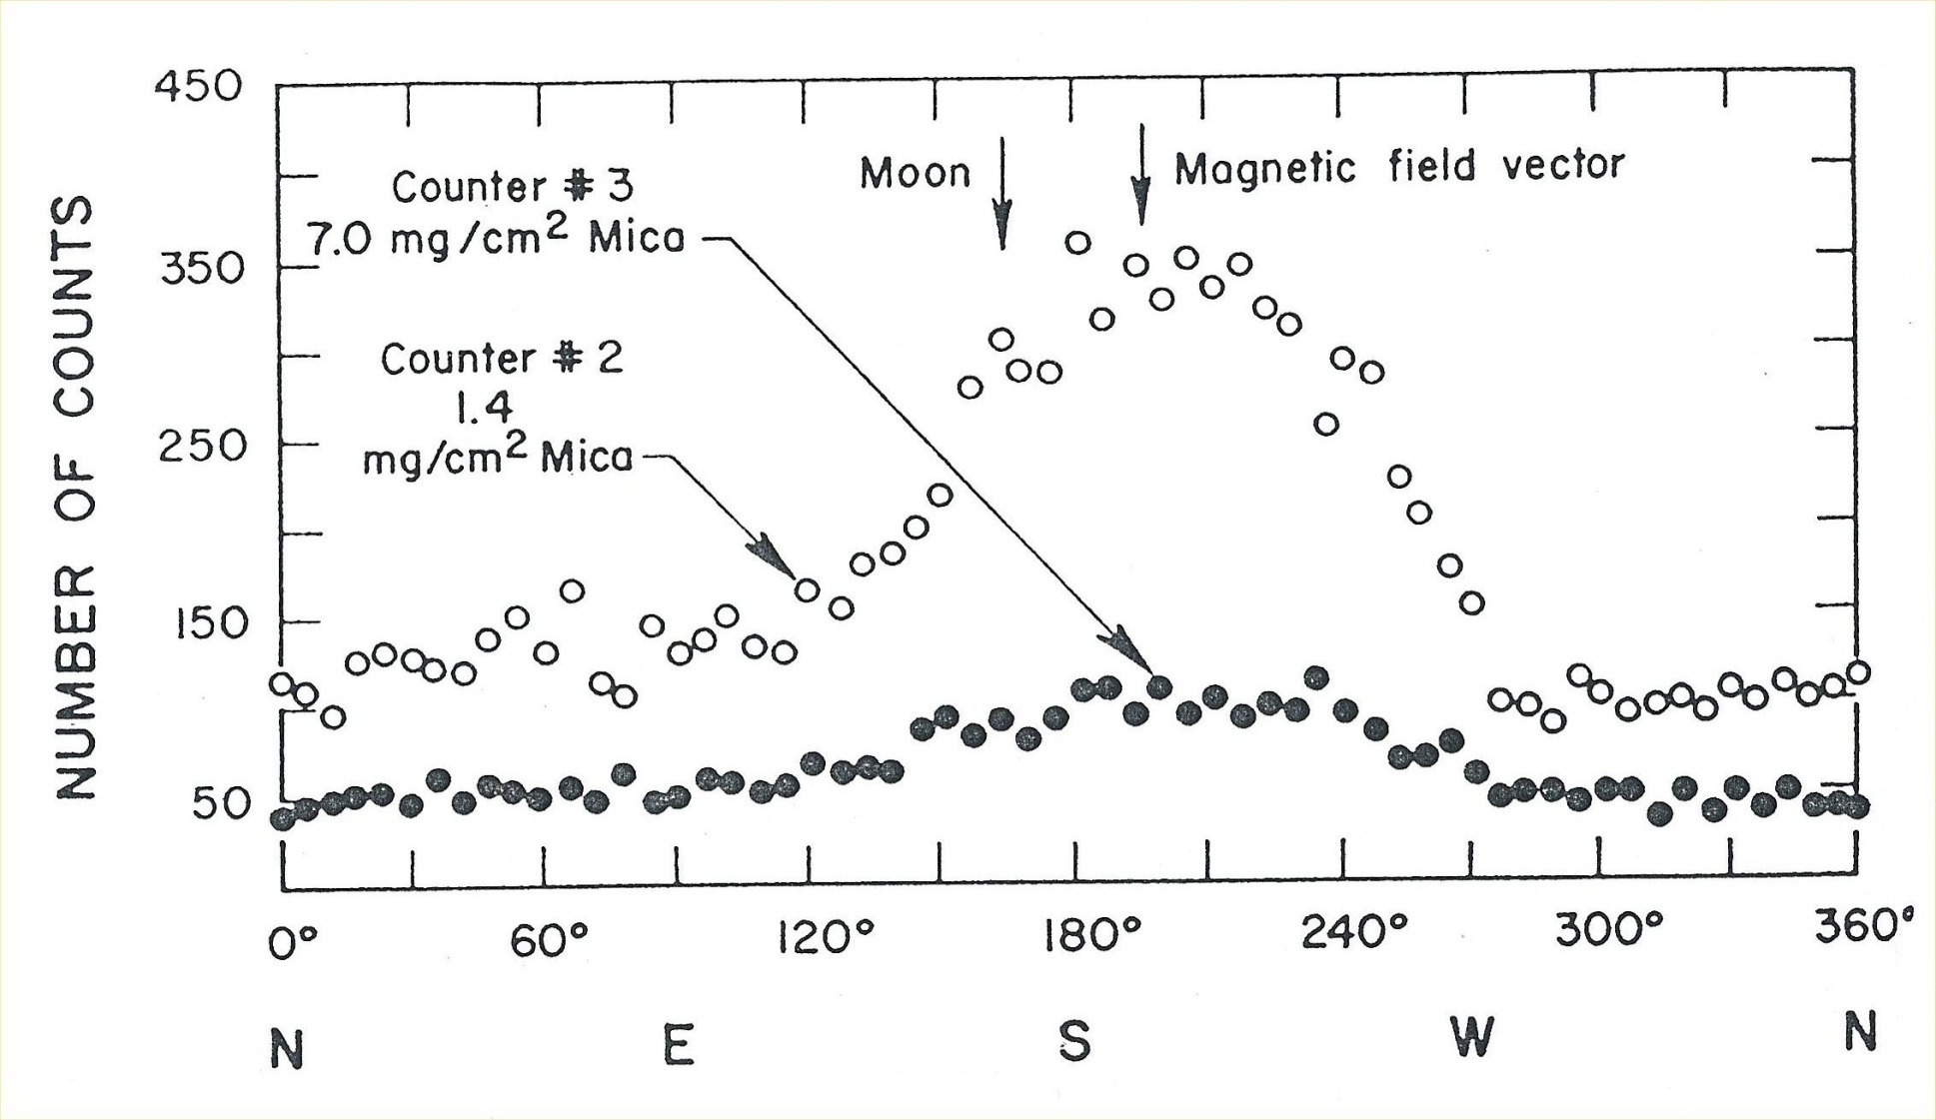

Slide 11
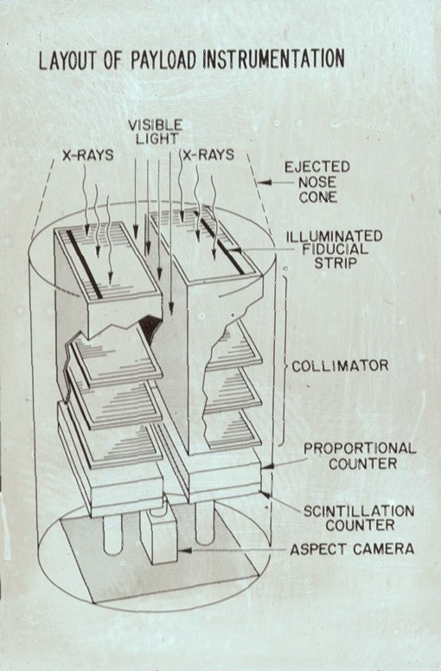

Slide 12
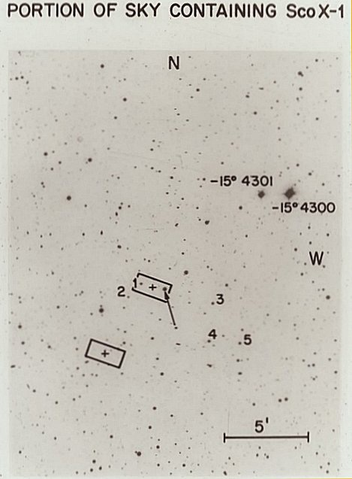

Slide 13
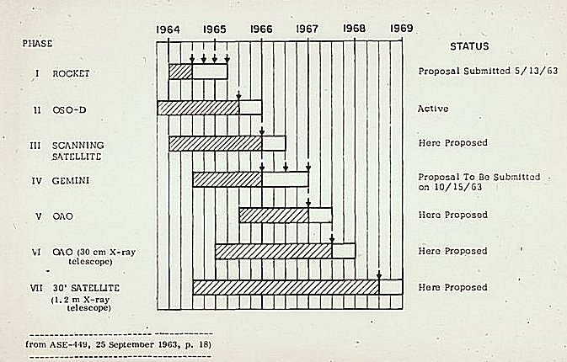

Slide 14
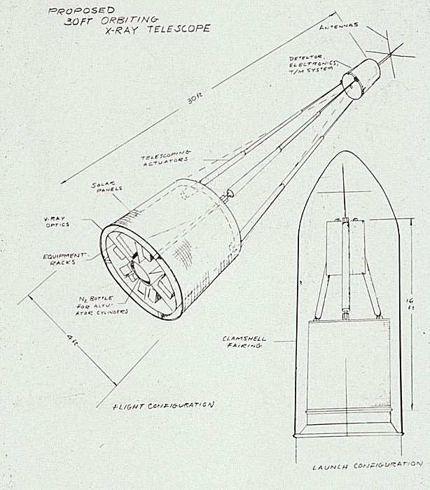

Slide 15
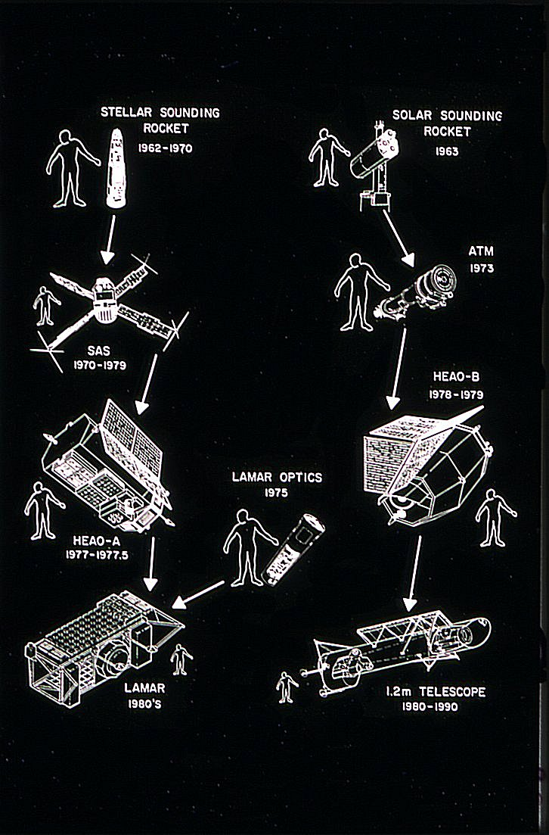

Slide 16
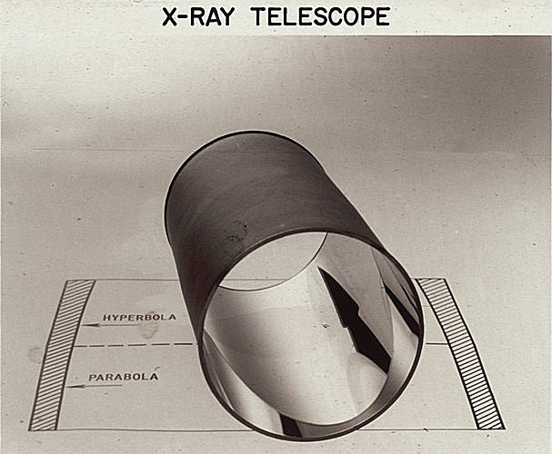

Slide 17
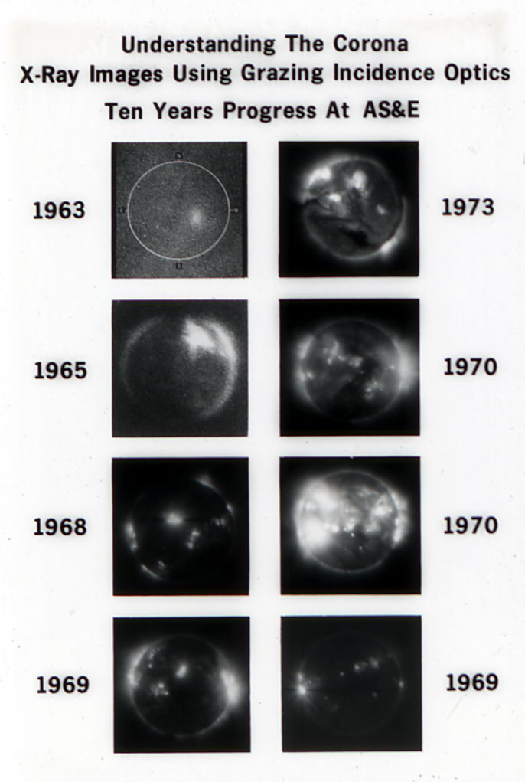

Slide 18
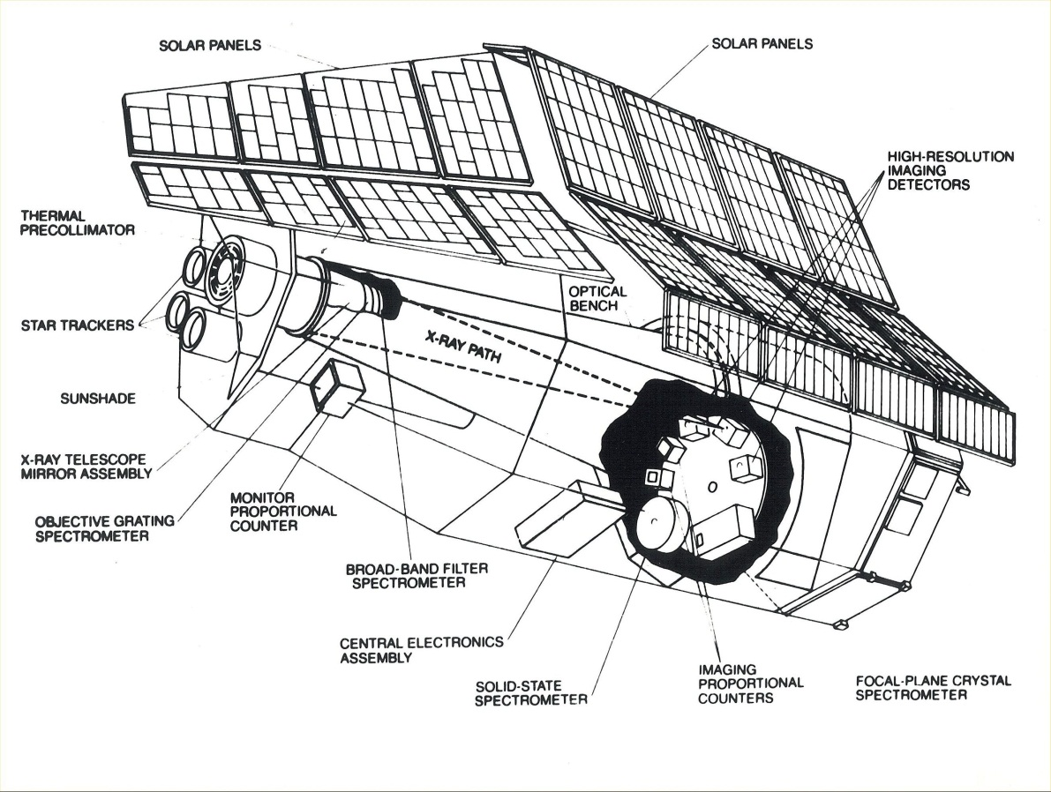
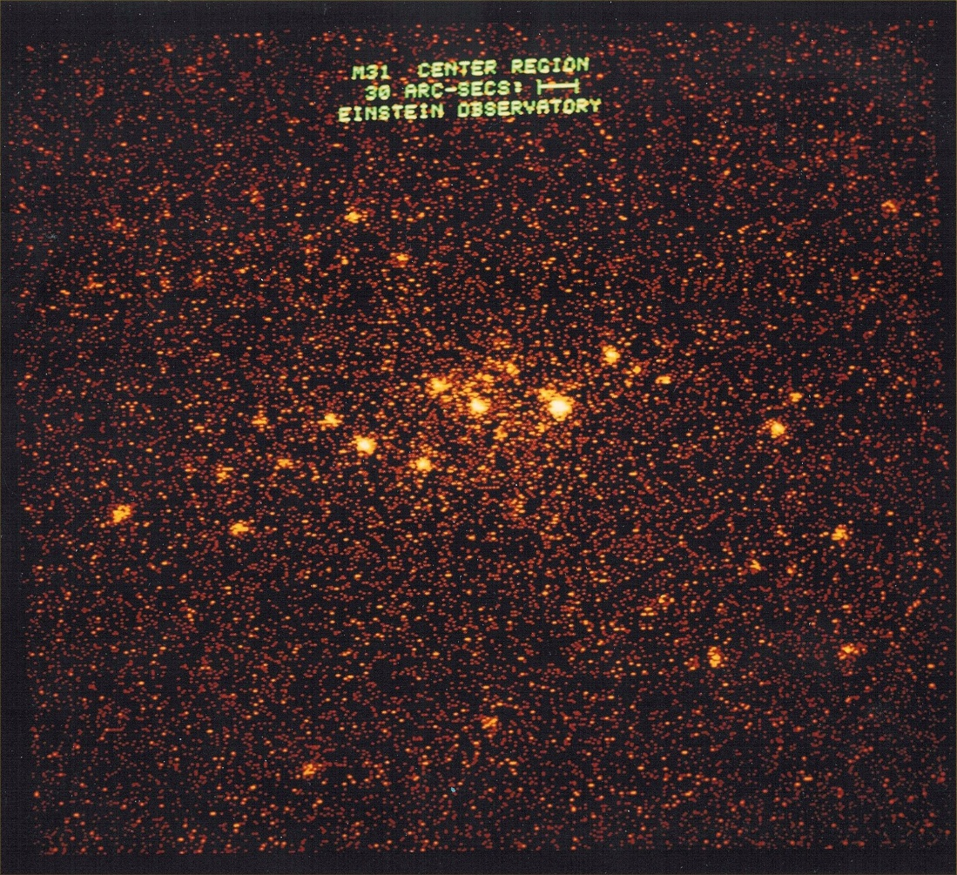

Slide 19
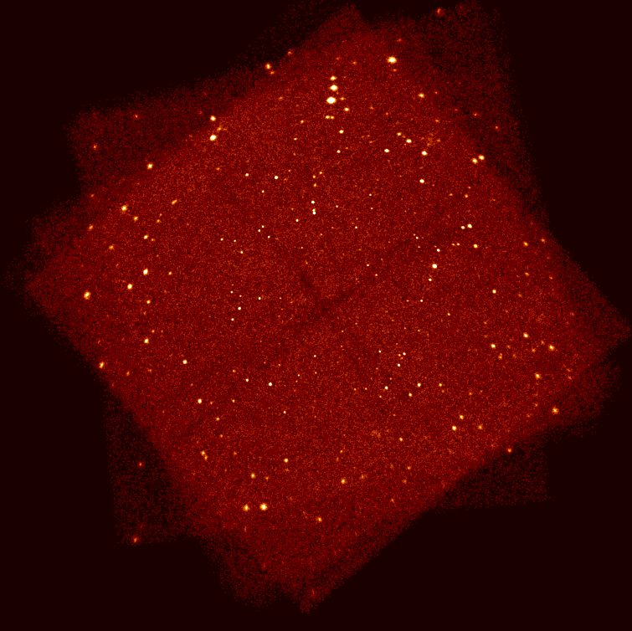
Nobel Fig. 19
Notes:
Nobel Fig. 19

Slide 20
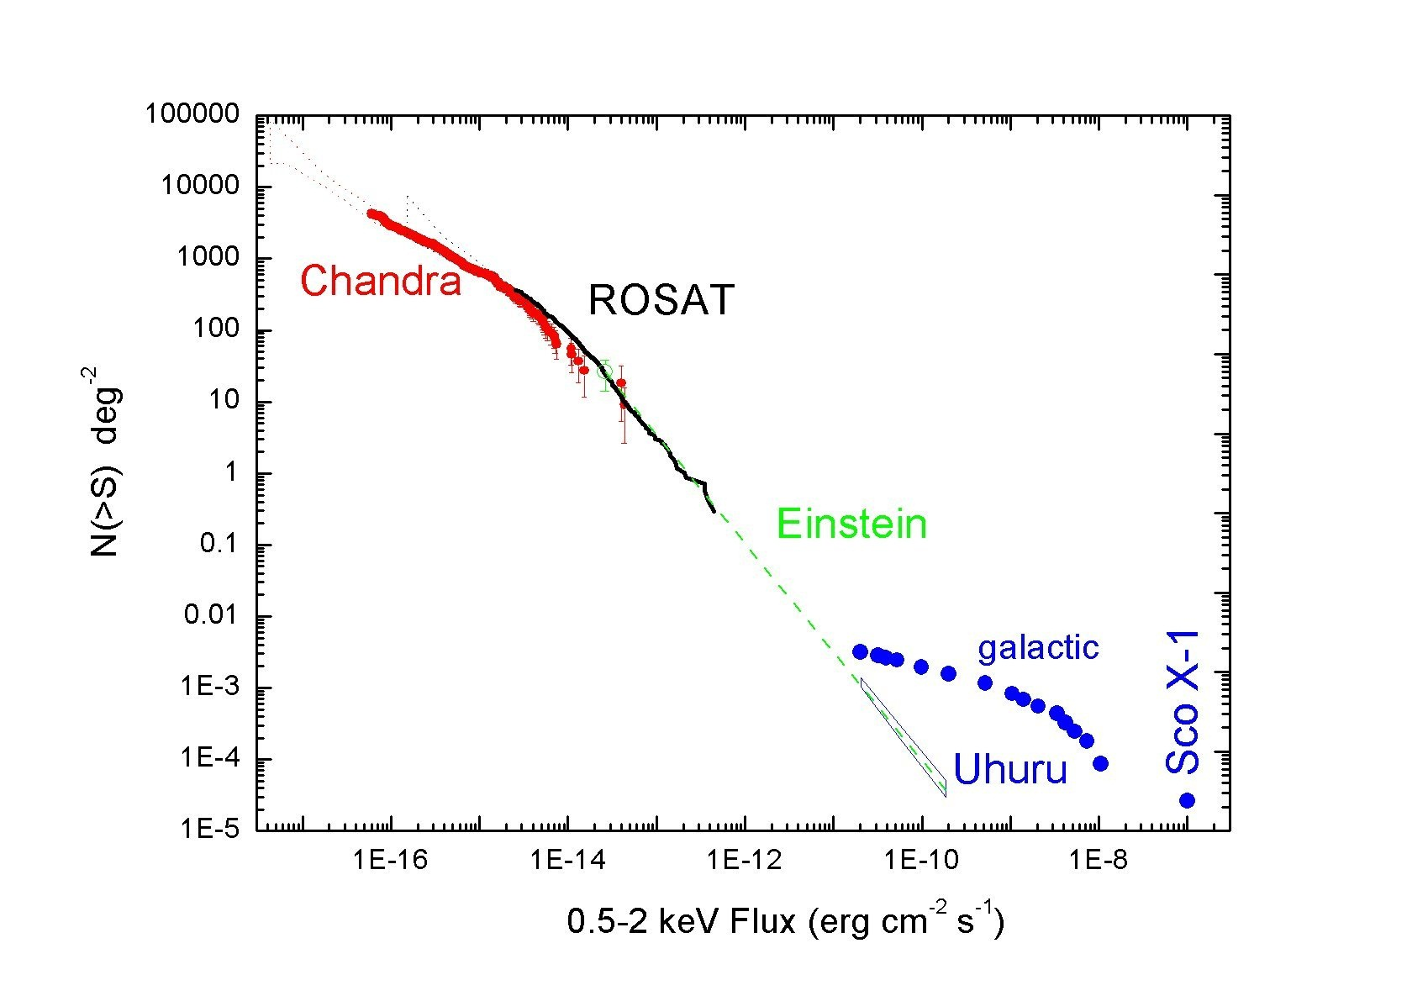

Slide 21
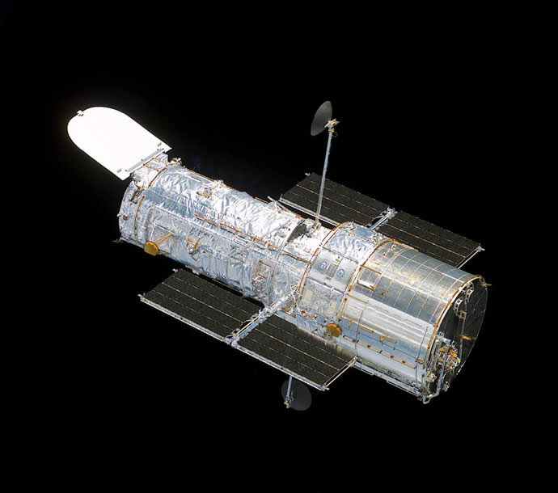
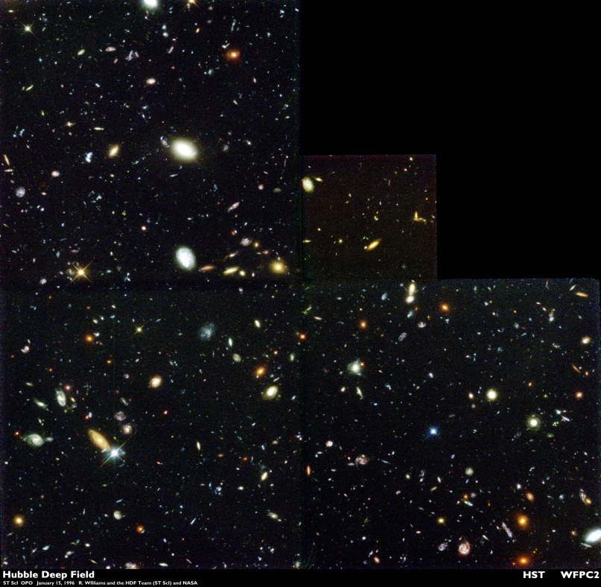
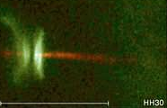
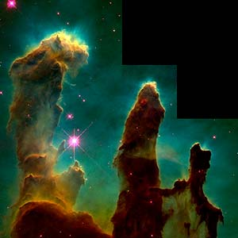

Slide 22
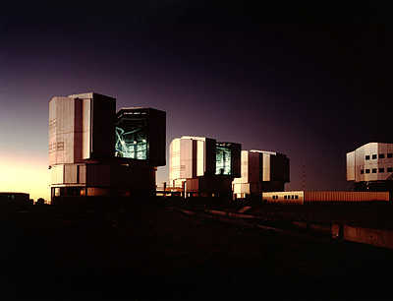
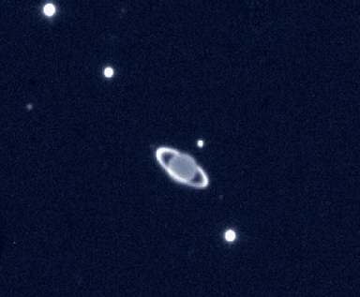
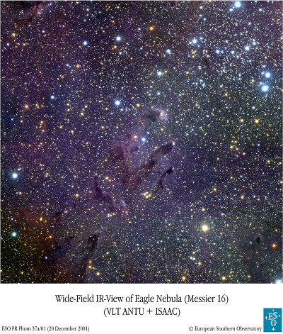
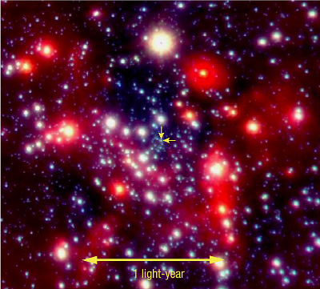

Slide 23
TABLE IV CONCLUSIONS
GIVEN THAT THE PHYSICAL NATURE OF 97% OF MATTER IN THE UNIVERSE IS UNKNOWN, IT SEEMS PREMATURE TO THINK THAT THE DISCOVERY ERA IS OVER . I THINK THAT 2012 IS MORE LIKE 1609, WHEN ASTRONOMY LED PHYSICS.
HIGH ENERGY PHENOMENA ARE KEY TO STRUCTURE FORMATION AND EVOLUTION. THEY ARE THE NORM, NOT THE EXCEPTION.
X-RAY OBSERVATIONS HAVE SHOWN TO BE ESSENTIAL TO THEIR UNDERSTANDING AND PROVIDE A POWERFUL AND UNIQUE TOOL FOR THEIR STUDY
WE HAVE THE KNOW-HOW AND THE METHODS TO DEVELOP NEW TECHNOLOGY AND BUILD MORE POWERFUL OBSERVATORIES. IN THE LAST 50 YEARS WE HAVE MADE PROGRESS OF TEN BILLIONS.
I AM THEREFORE QUITE CERTAIN THAT IN THE NEXT 50 YEARS X-RAY ASTRONOMY WILL REACH NEW HEIGHTS. WE MUST HOWEVER ENSURE THAT THE NEW GENERATION OF ASTRONOMERS WILL HAVE THE OPPORTUNITY TO LEARN – THINK – PLAN AND DO.

