Slide 1
Mass Measurements of Black Holes in X-Ray Transients: is there a Mass Gap?
Will M. Farr
Northwestern University, CIERA
(See Kreidberg, Bailyn, WMF, Kalogera, arXiv:1205.1805)

Slide 2
The Mass Gap
Strange, because main-sequence mass distribution rising at low M. (Özel, et al (2010))
Not expected in evolutionary theory (Freyer & Kalogera (2001))
Provides a clue about SNe? (Belczynski, et al (2011))

Slide 3
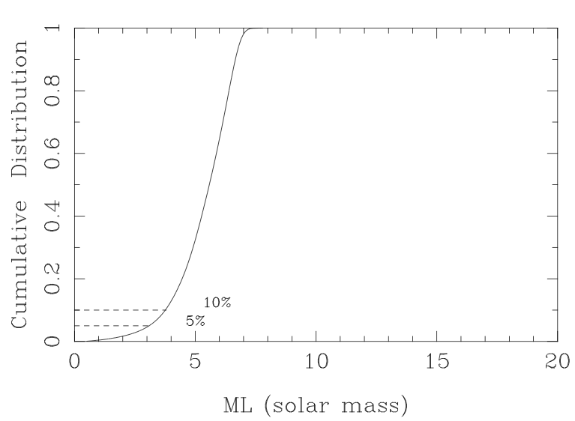
Mass Gap History I: Bailyn, et al (1996)

Slide 4
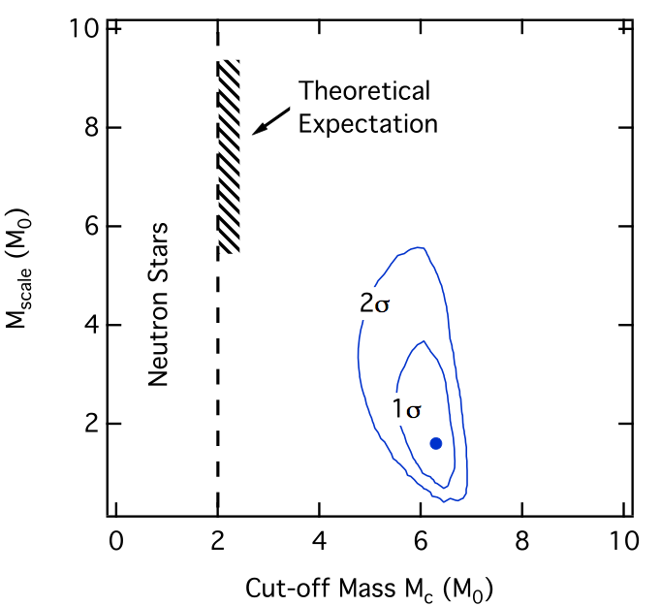
Özel, et al (2010)

Slide 5
Farr, et al (2011)

Slide 6
A Systematic Effect?

Slide 7
Mass Measurements (A Theorist’s Perspective)
Uncertainties in inclination can have a large effect on mass.
Uncertainties in mass ratio are relatively unimportant.

Slide 8
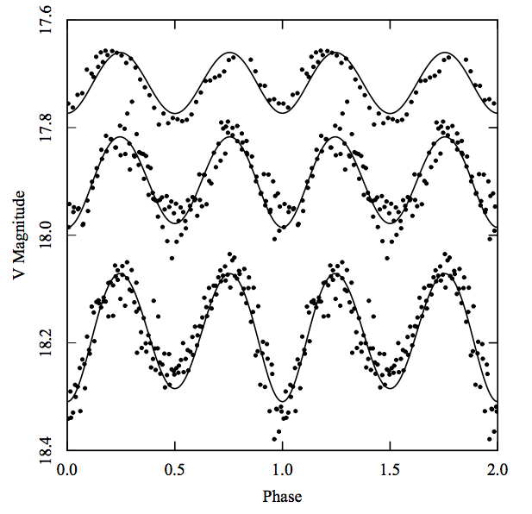
Measuring Inclinations
Measure inclination by looking at ellipsoidal variations in light from secondary.
Any additional non-stellar light (NSL) reduces variation => lower inclination.
Lower inclination => higher masses.

Slide 9
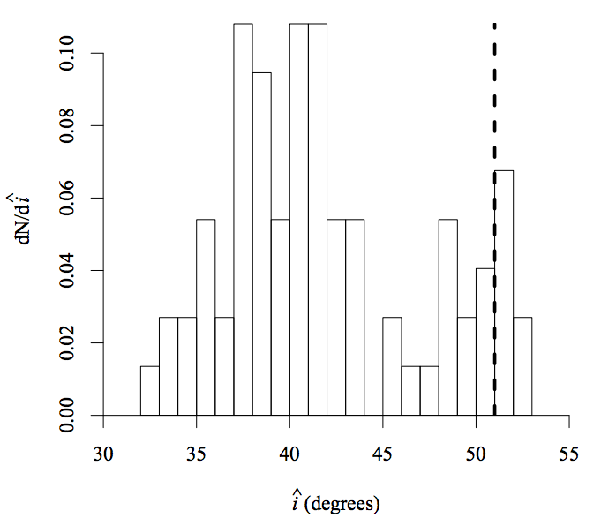
Cantrell, et al (2010): A0620
Measurements of inclination bimodal
Lower in active state than passive
Can we model the NSL that is contaminating the active phase?

Slide 10
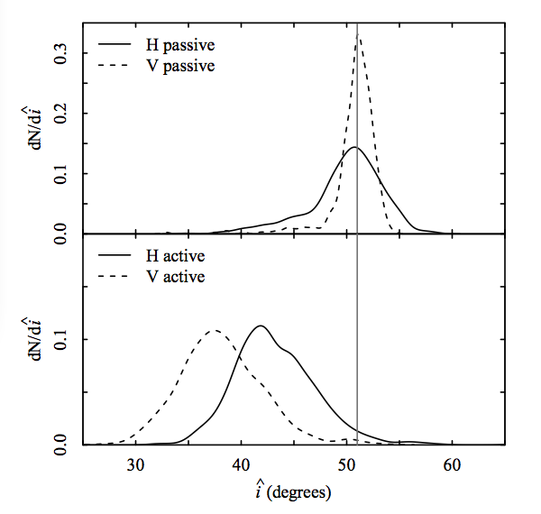
Modeling the Active State
The NSL is mostly due to the disk, and is therefore correlated in time.
Produce synthetic NSL, and examine star-only fits to inclination

Slide 11
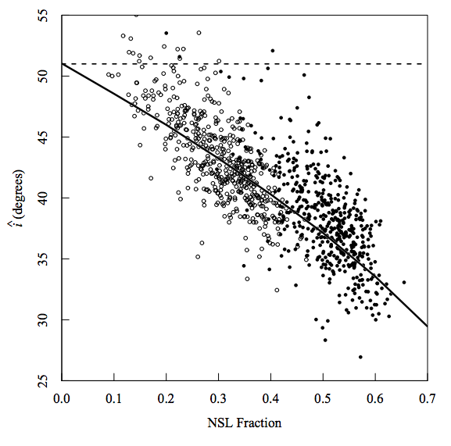
Inclination Corrections
Generate a fitting formula for inclination correction based on synthetic A0620 NSL.

Slide 12
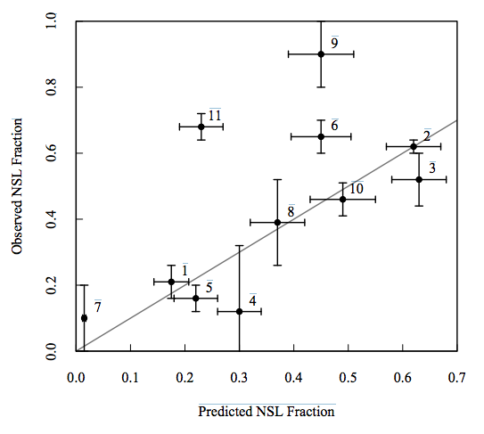
Adjust NSL Fraction
Different spectral types
Different mass ratios
Different inclinations

Slide 13
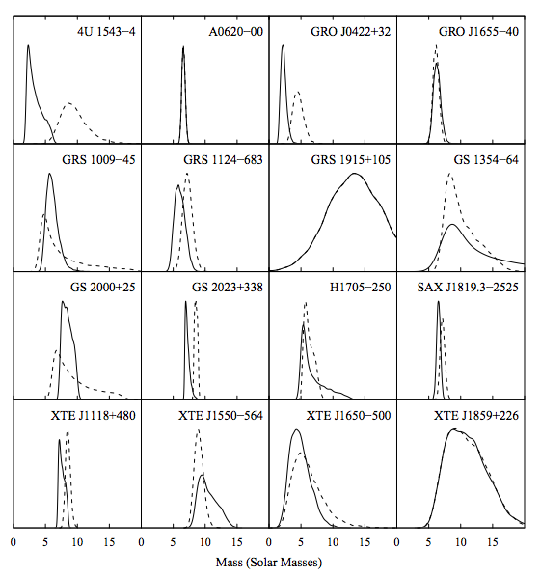
Corrected Masses

Slide 14
Which Systems Could Matter for Mass Gap?

Slide 15
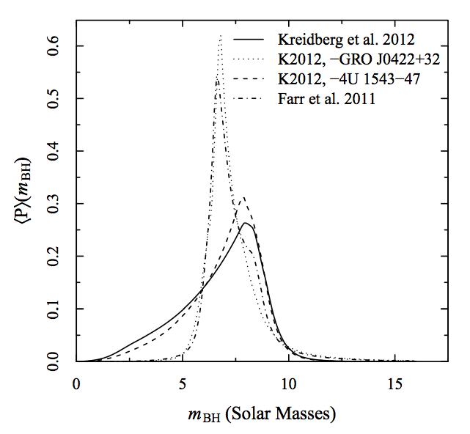
Corrected Mass Distribution

Slide 16
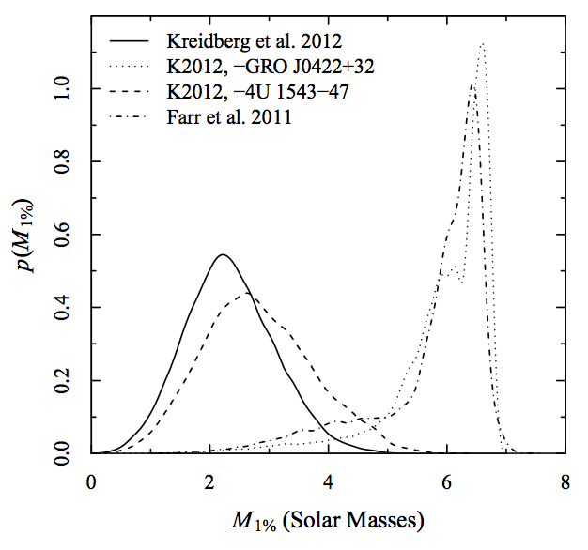
Corrected Minimum Mass

Slide 17
Why You Should Trust J0422+32’s Correction
One of smallest and coolest (M type) secondaries in sample.
Sometimes observed to have no ellipsoidal variations (Reynolds, et al (2007)).
Very faint in quiescence: R ~ 21.
Points toward ease of NSL distortion.
Distortion may not mimic A0602, though?
Further observations warranted.

Slide 18
4U 1543-47 Could Still Contribute
Very low inclination: small changes mean a lot.
Conflicting inclination measurements (Orosz, et al (1998) vs. Orosz, et al (2002)).
Small ellipsoidal variations => precise observations required.
Data currently in the pipeline---stay tuned!

Slide 19
Conclusions
Previous studies found strong evidence for a mass gap from 3 to 5 MSun.
Careful study of effects of NSL suggest that inclinations may be systematically underestimated.
Applying sensible correction to data eliminates mass gap.
Other properties of distribution remain unchanged.

