Slide 1

G. Fabbiano
Harvard-Smithsonian CfA
July 2012
X-Ray Binaries in Galaxies

Slide 2
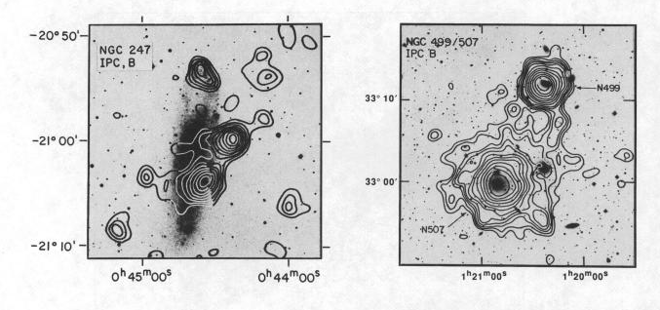
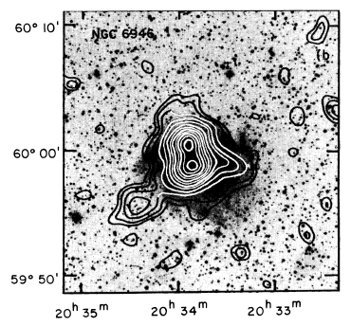
XRB populations – the beginning
Detection – needs high resolution & sensitivity
Einstein Observatory (review Fabbiano 1989; catalog Fabbiano, Kim & Trinchieri 1992; followed by ROSAT, ASCA)
  Detect individual XRBs in Local Group
  Study integrated galaxy properties

Slide 3
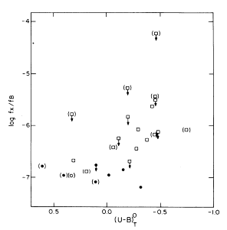
XRB populations – the beginning
HMXB – SFR
  L_{X}-L_{FIR} correlation in star-forming galaxies
  (Fabbiano & Trinchieri 1985;…….)
  Bluer galaxies are more X-ray luminous
  (Fabbiano, Feigelson & Zamorani 1982)

Slide 4
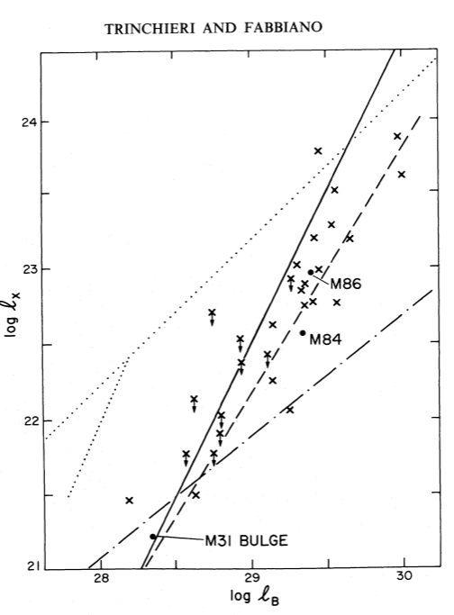
XRB populations – the beginning
LMXB – Stellar mass
  L_{X}-L_{H} correlation in bulge dominated galaxies
  (Fabbiano & trinchieri 1985,….)
  Baseline emission of E and S0
  (Trinchieri & Fabbiano 1985)

Slide 5
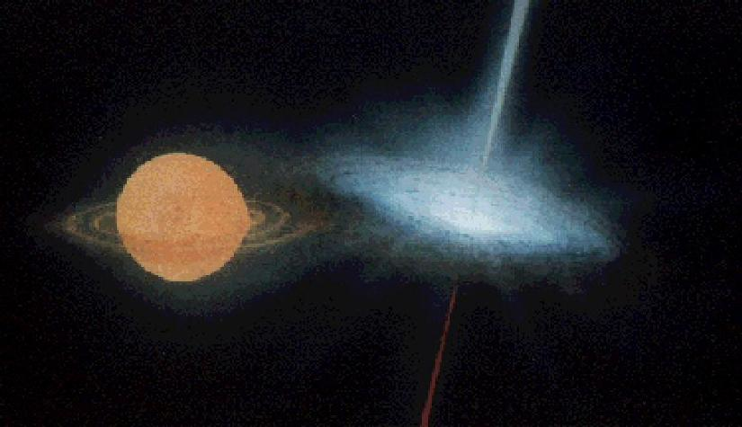
XRB populations with Chandra
      WD, NS and BH
      XRBs are individually detected
        Markers of parent stellar population
      Population studies
      Ultra-luminous X-ray sources – L_{X} > L_{E} (10M) - IMBH?
      Binary formation and evolution (field and GCs)
  Galaxy evolution

Slide 6
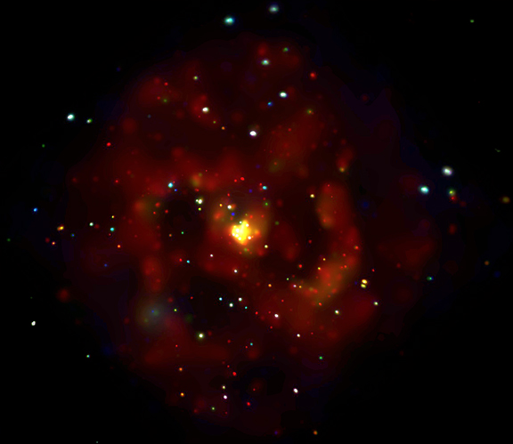
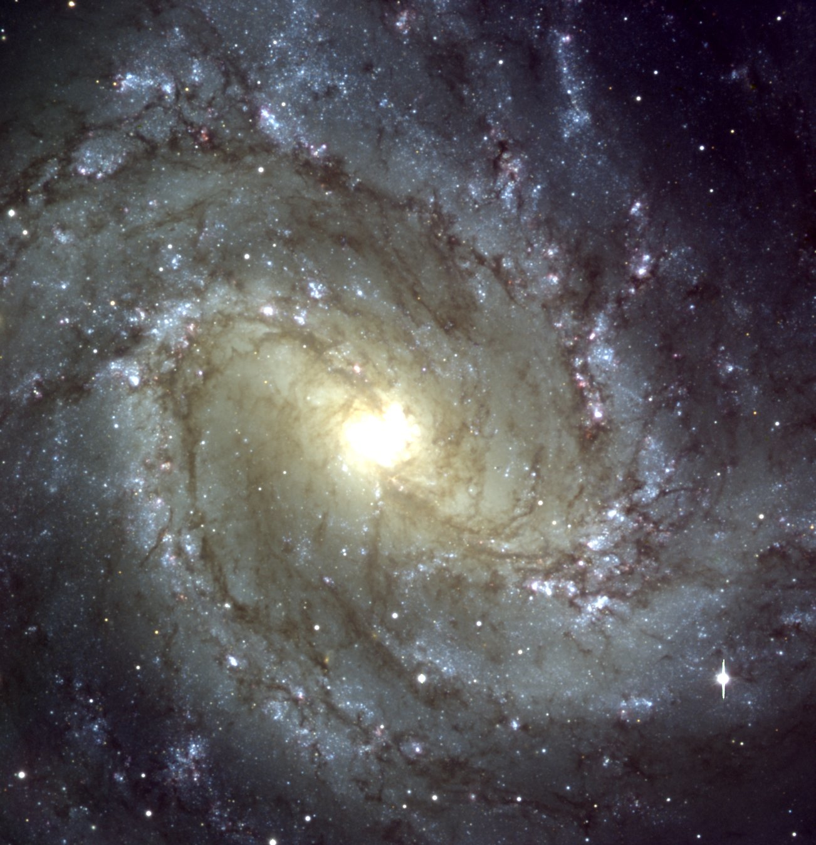
M83 – Soria & Wu 2003
ESO VLT
Chandra ACIS

Slide 7
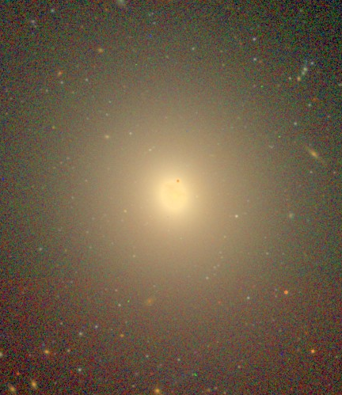
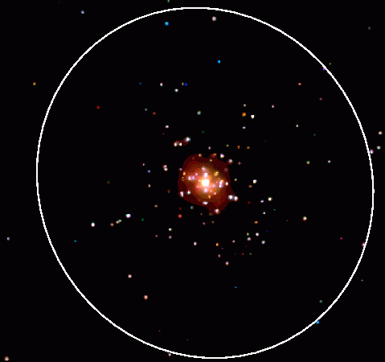
NGC4278 – Brassington et al 2009
Chandra

Slide 8
XRB populations with Chandra
Detect individual XRBs down to L_{X}~10³⁵-10³⁷ erg/s in galaxies out to 30 Mpc and beyond
  Review: Fabbiano 2006
Use the tools of astronomy
  Photometry/spectra
  Time variability
  Luminosity Functions (XLF)

Slide 9
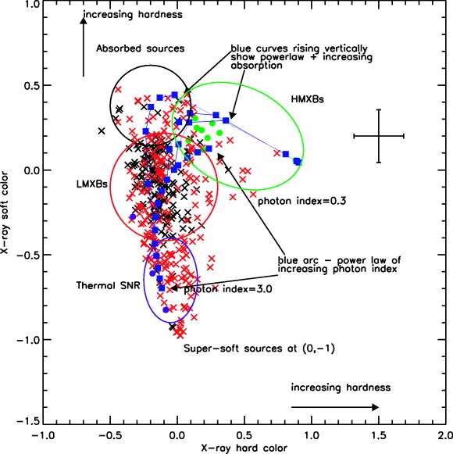
Chandra color-color diagram XRB classification
Soft color = (M – S)/T
Hard color =(H – M)/T
Where
S= 0.3-1 keV
M=1-2 keV
H= 2- 8 keV
T= 0.3-8 keV
Prestwich et al 2003

Slide 10
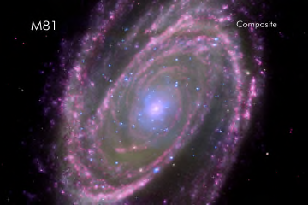
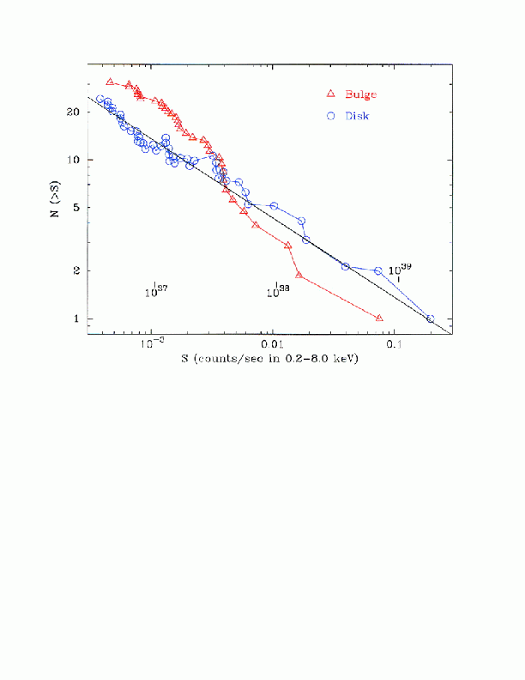
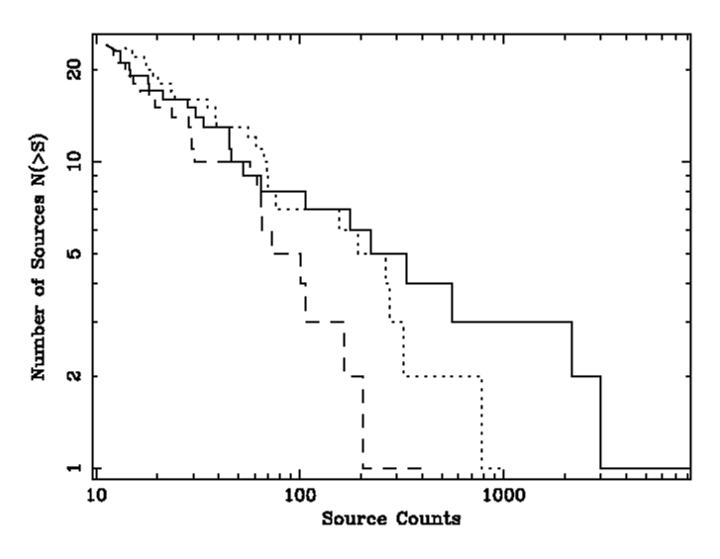
M81 – Different XRB populations have different XLF
Tennant et al 2001
Swartz et al 2002
Younger stellar population
  Flatter XLF
    More luminous X-ray sources
Zezas et al 2008
arms
disk

Slide 11
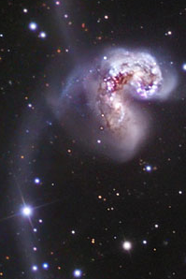
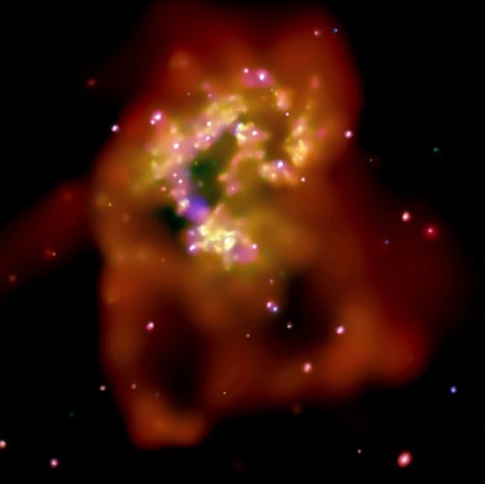
HMXB XLF and ULXs - The Antennae
Hubble
Chandra
Fabbiano et al 2004

Slide 12
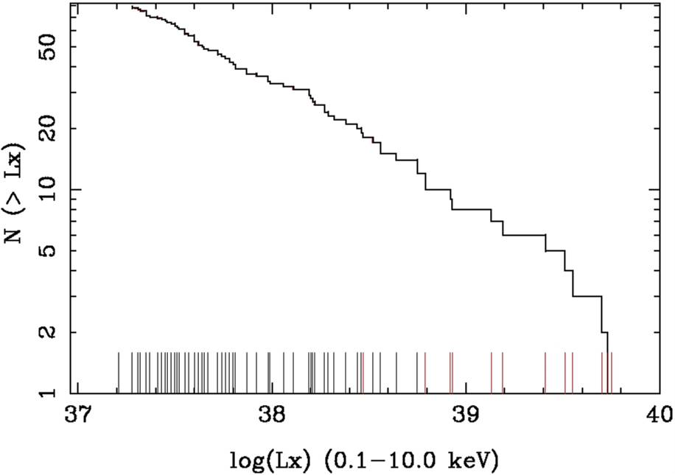
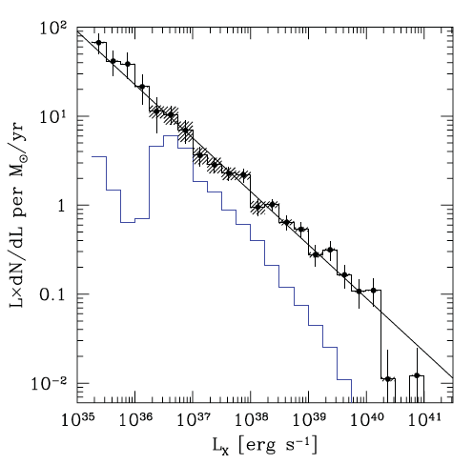
HMXB XLF and ULXs
Coadded observation
The Antennae with Chandra
  480 ks, 7 ACIS-S exposures
120 sources (see catalog, Zezas et al 2006)
~10 ULX - variable
Cumulative XLF slope ~ -0.5
Zezas et al 2007
HMXB XLF
Power-law slope out to 10⁴⁰ erg/s
Normalization scales with SFR
ULX
29 star-forming galaxies with Chandra
~700 disk/arm sources (Mineo et al 2011)
Cumulative XLF slope ~ -0.6
XLFs scale with SFR of galaxy

Slide 13
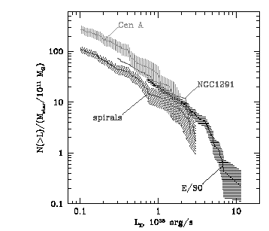
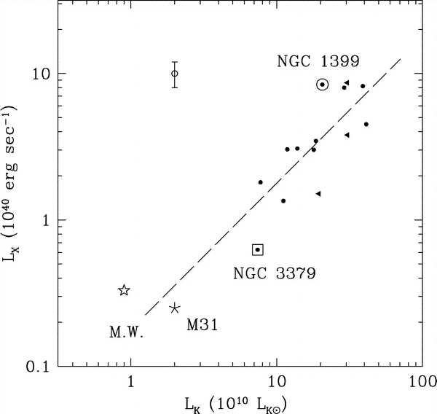
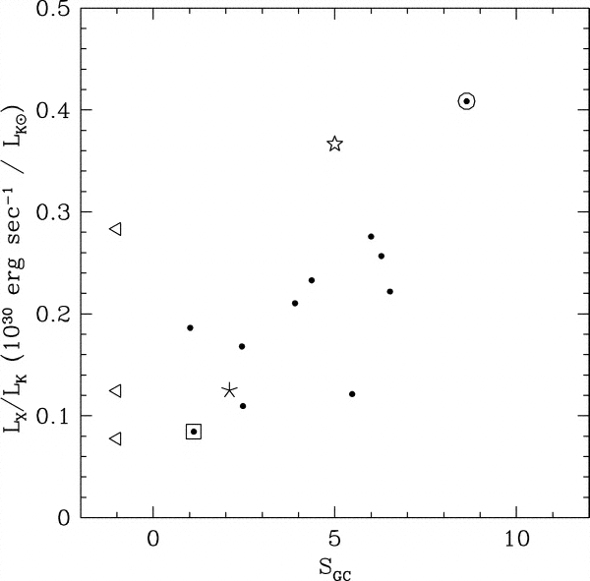
LMXB XLF - Normalization
What drives the overall LMXB content?
Galaxy Mass (Gilfanov 2004)
  Similar LMXB XLF shapes
  Normalization ~ global stellar mass
Galaxy Mass & GC content (S_{GC})
(Kim & Fabbiano 2004)

Slide 14
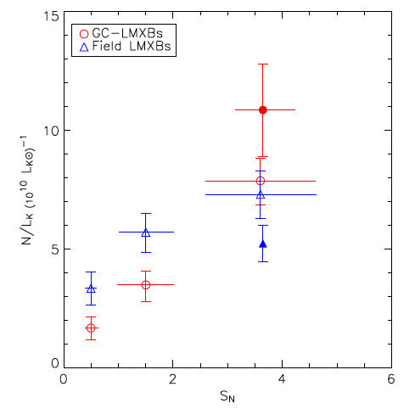
LMXB populations – Field vs GC formation
Specific density of field LMXBs less dependent on specific density of GCs than specific density of GC LMXBs
Supports 2 modes of formation for field LMXB
(Kim et al 2009; Paolillo et al 2011)

Slide 15
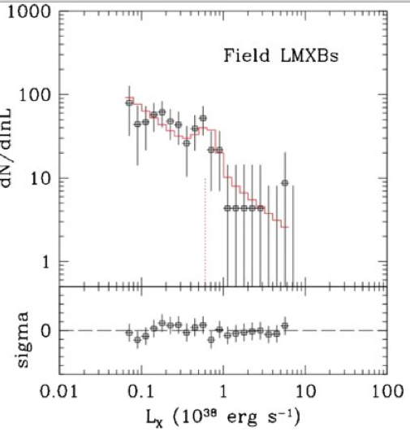
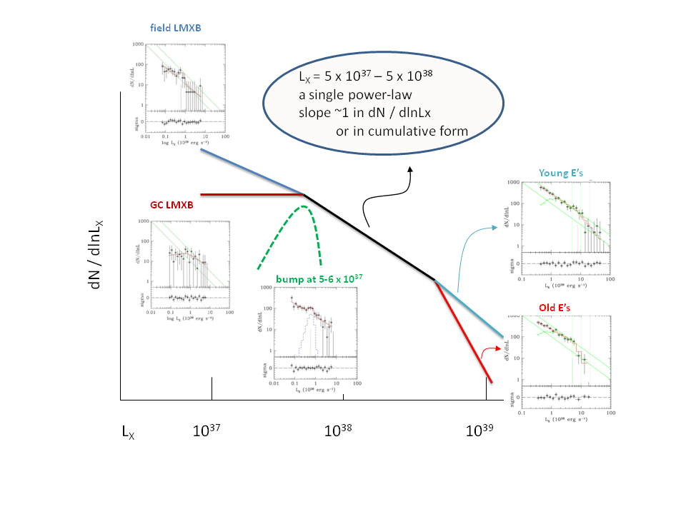
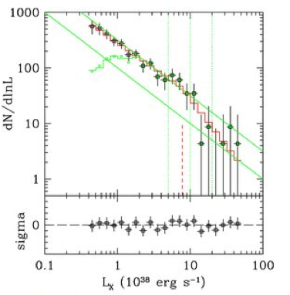
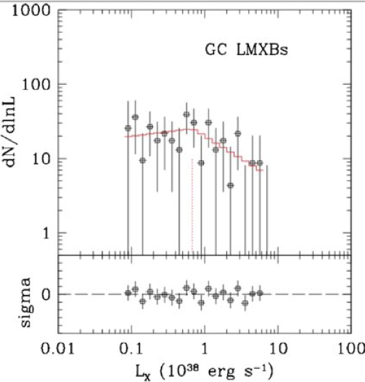
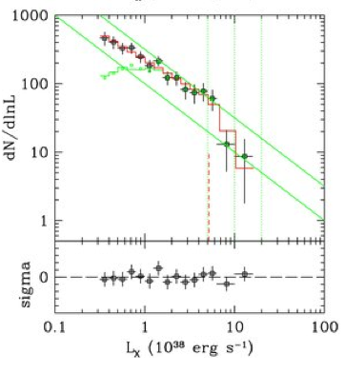
LMXB XLF – Shape – age and formation
Kim et al 2009, 2010

Slide 16
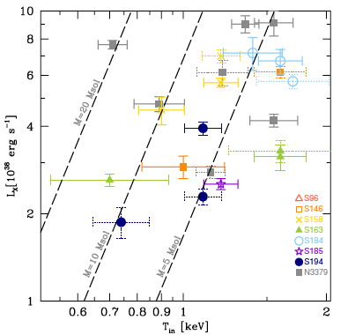
LMXB spectra and ‘derived’ BH masses
LMXBs with L_{X}>10³⁸ erg/s in NGC3379 & NGC4278 with ‘disk’ spectra (based on simulations of single model fits; Brassington et al 2010; Fabbiano et al 2010)
‘Derived’ model-dependent masses are in 5-15 Msol range of Galactic BHB – see Ozel et al 2010

Slide 17
LMXB populations -transients
Luminous field LMXBs (L_{X}> 10³⁷ up to 10³⁹ erg/s)
should be transient (Piro & Bildsten 2002; King 2002)
  evolution of relatively detached native binaries
  large accretion rates (>10^{-9, -8} Msol/yr), episodic accretion disk instabilities
Transients may also occur in GC LMXB
  L_{X} < 10³⁷ erg/s, for ultracompact NS+WD systems
  (Bildsten & Deloye 2004)
  High L_{X} transients may (rarely) occur in NS+MS or BH+MS binaries
Do we detect transients in luminous LMXB populations?
  NGC 3379, NGC 4278, NGC 4697
  (Brassington et al 2008, 2009, 2012)
How does the number compare with model predictions?
(Fragos et al 2008 PS; Fragos et al 2009)

Slide 18
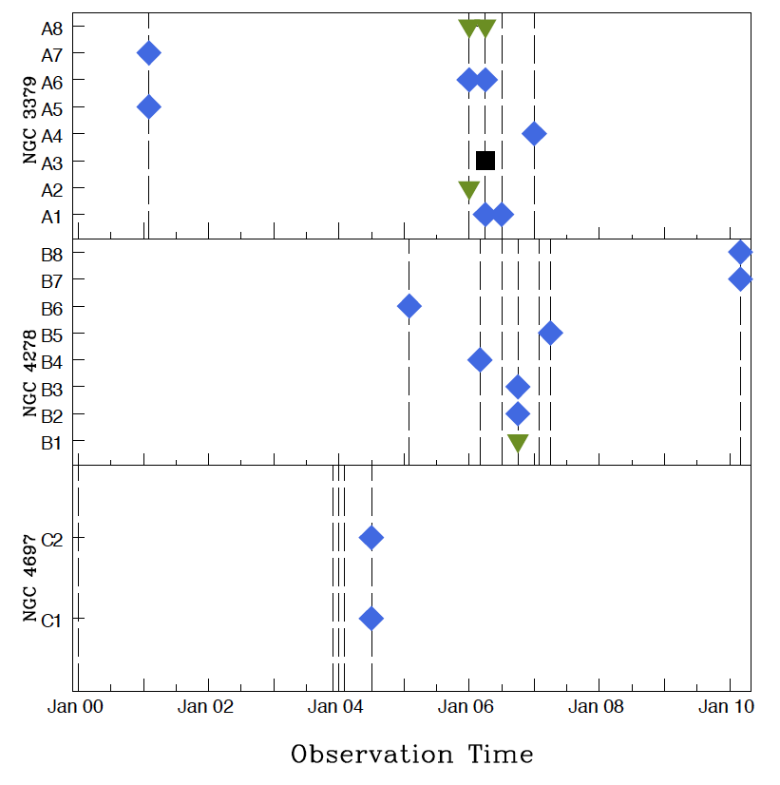
Transient LMXBs - NGC 33799, 4278, 4697
Brassington et al 2012
17 TC/PTC
  TC (> 10)
  PTC (>5)
  Considering limits
Most, 14 in field
3 in GC (A8, ULX)

Slide 19
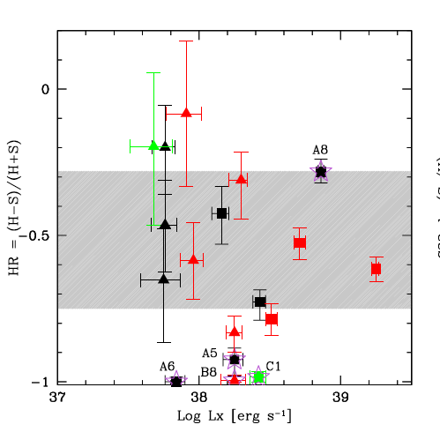
Transient LMXBs - NGC 3379, 4278, 4697
Brassington et al 2012
Colors
  2 SSS
  2 QSS
  Others ‘normal’ LMXBs
Black – NGC3379
Red – NGC 4278
Green – NGC 4697

Slide 20
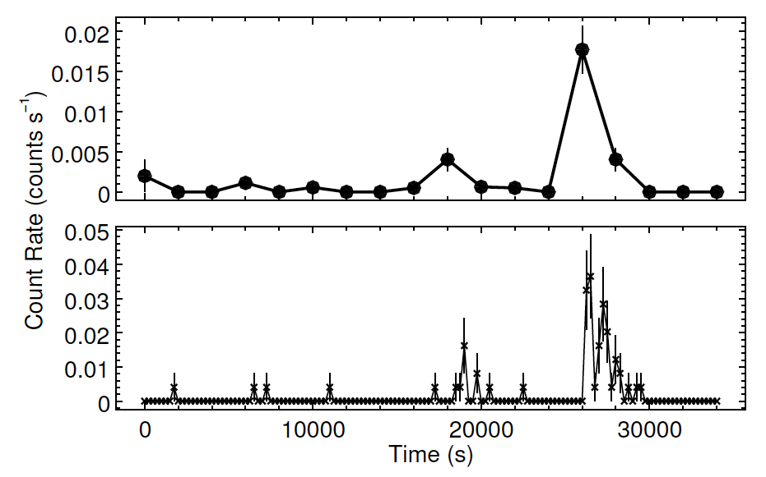
Flaring QSS – Brassington et al 2012
A5 in NGC3379
(94 B08)
  kT~220 eV
  L_{X}~1-3×10³⁹ erg/s
  (flare; τ~3000s)
L_{X}/L_{Bol}>1
  Exclude flare star
Low kT
  Exclude NS superburst
Implied radius <3.4×10⁸cm
  He Nova explosion (WD)
  Very short period double WD binary – mass transfer driven by angular momentum loss via gravitational radiation (King 2011)

Slide 21
GC BH binaries – Do they exist?
BHs are likely to sink to the core, and either form IMBH or evaporate (Spitzer 1969)
~1 BH binary / GC could be expected
(Kalogera et al 2004)
N-Body simulations show stellar mass BH may occur
(Mackey et al 2007; Moody & Sigurdsson 2009)

Slide 22
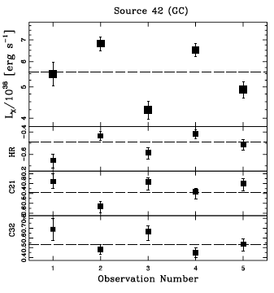
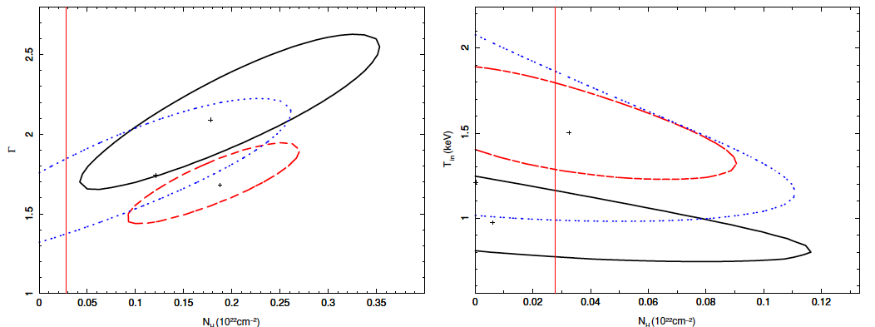
GC BH binaries – Luminous & variable LMXBs
Found in massive, both red and blue, GCs
Maccarone et al 2007 in NGC4472
Irwin et al 2010 in NGC1399 (IMBH??)
Brassington et al 2010
  S42 (NGC3379)
  (>2.5) 7– (>4) 9×10³⁸ erg/s
  Disk spectrum kT  L_{X}
  kT~1.5 kEV ➔ M ~ 4 Msol
Brassington et al 2012 (Transients)
  Outflow ULX in NGC3379
  B1 (83 B09) in NGC4278
    L_{X}~5×10³⁸ erg/s, kT~1.3 keV

Slide 23
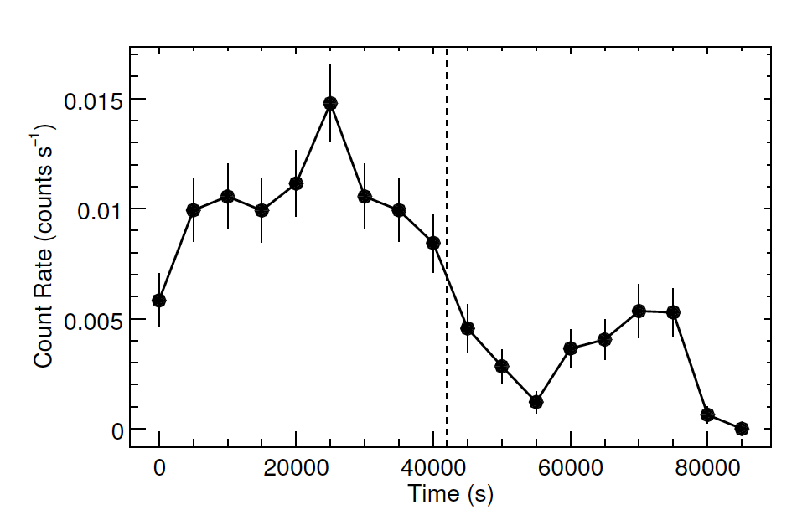
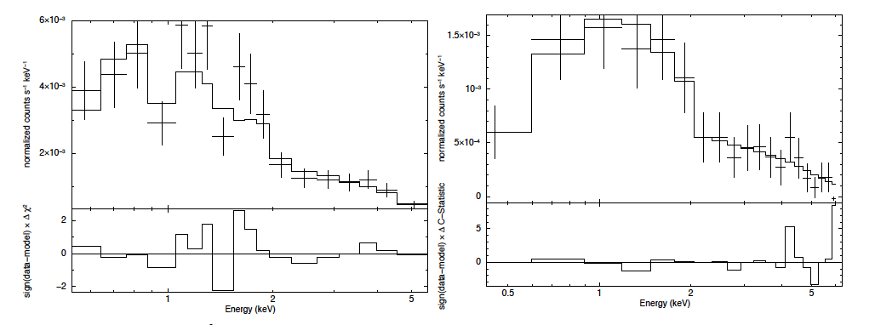
ULX in outflow in GC (Brassington et al 2012)
A8 in NGC 3379 (128 in B08)
High L_{X} (~3×10³⁹ erg/s)
  PO + ionized absorber
Low L_{X}
  PO
Similar to ‘flaring ULX’ in
NGC1365 (Soria et al 2007)
Eddington-driven outflow

Slide 24
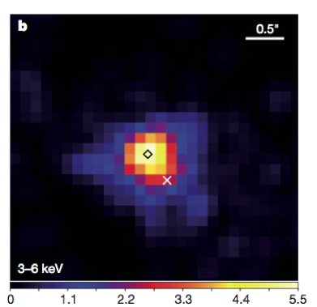
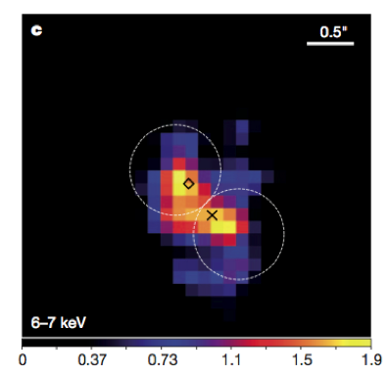
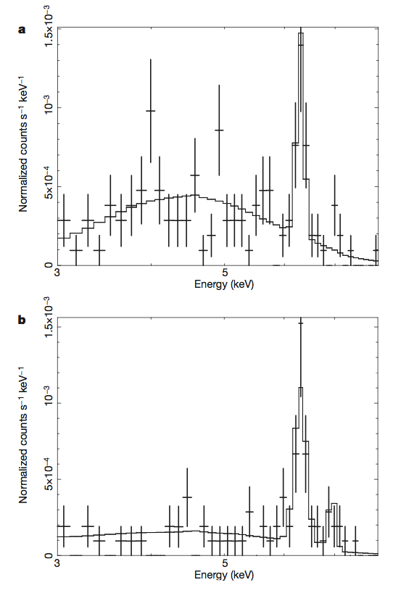
Binary Supermassive BHs / Double Nuclei
A close nuclear black-hole pair in the spiral galaxy NGC3393
Fabbiano, Wang, Elvis & Risaliti, 2011, Nature
AGN pair – 150 pc separation found with Chandra in the spiral galaxy NGC3393, previously known to host single AGN
The regular spiral morphology, predominantly old circum-nuclear stellar population of this galaxy, and the closeness of the black holes embedded in the bulge, suggests that the black hole pair is the result of minor merger evolution

Slide 25
X-ray emission & Galaxy evolution
XRB populations - Summary
➔ properties and evolution of the stellar population
➔population synthesis models
➔ diagnostic of rejuvenation (in E & S0)
➔ Double nuclei - merging and galaxy evolution

Slide 26
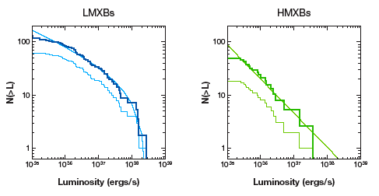
Galactic X-ray Binary Luminosity Functions
Grimm, Gilfanov & Sunyaev 2002
Volume corrected
Apparent

Slide 27
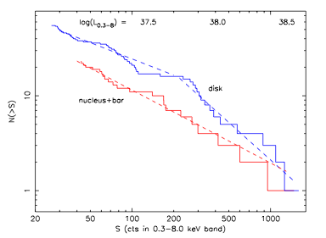
Age effect on XLF – M83
Soria & Wu 2003
Flat power-law XLF in starburst nucleus
Broken power-law in older disk
  Aging = depletion of most luminous HMXB

Slide 28
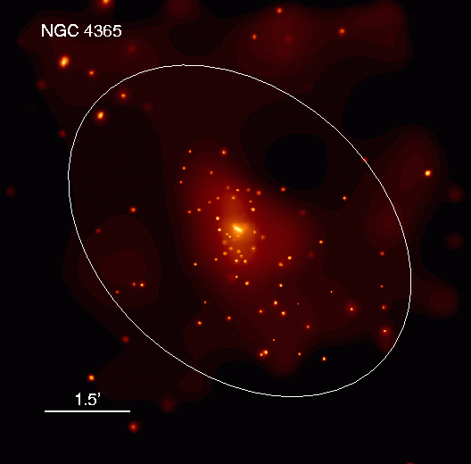
Old LMXB populations in E and S0 galaxies
Inferred 20 yrs ago with Einstein Trinchieri & Fabbiano 1985
Detected with Chandra
e.g. Sarazin et al 2000; etc.

