Slide 1

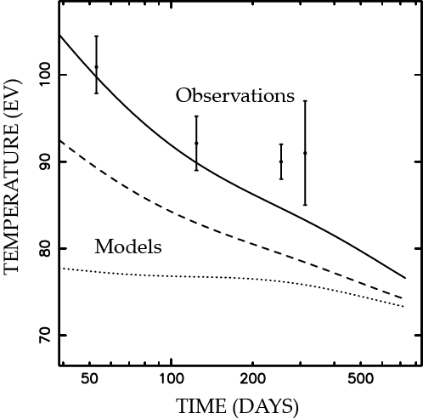
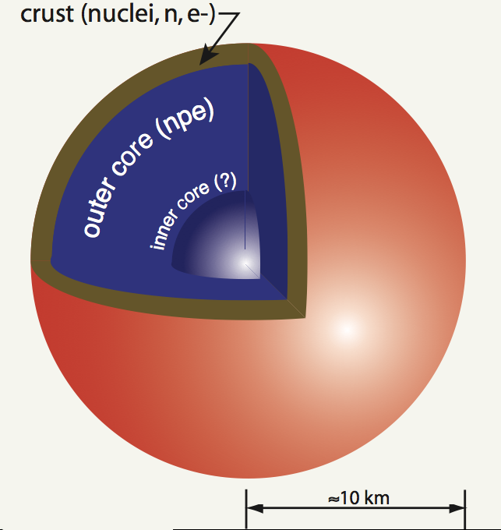
Peeking into the crust of a neutron star
Nathalie Degenaar University of Michigan
X-ray observations
Thermal evolution
Interior properties

Slide 2
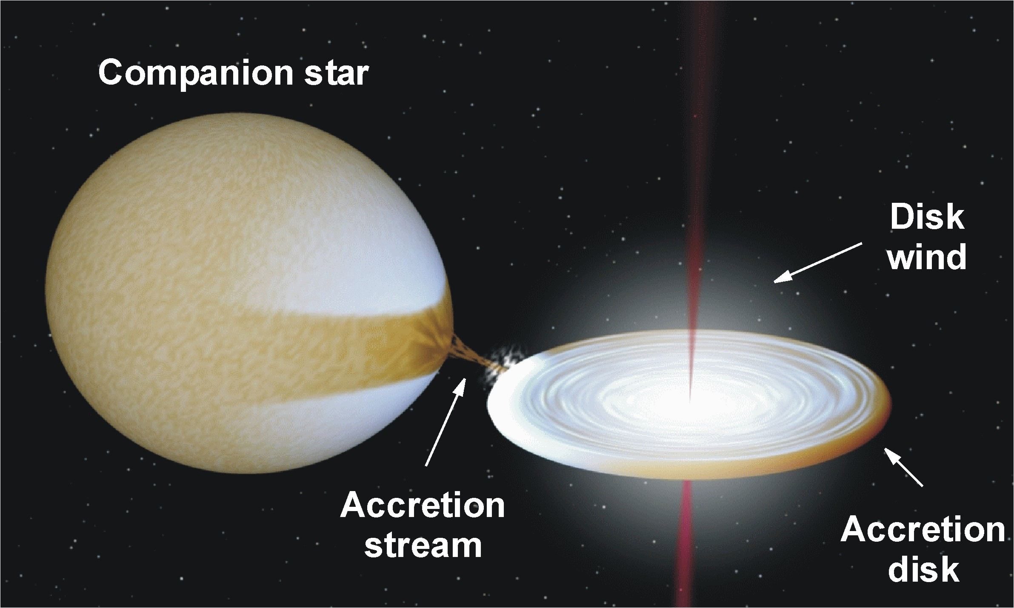
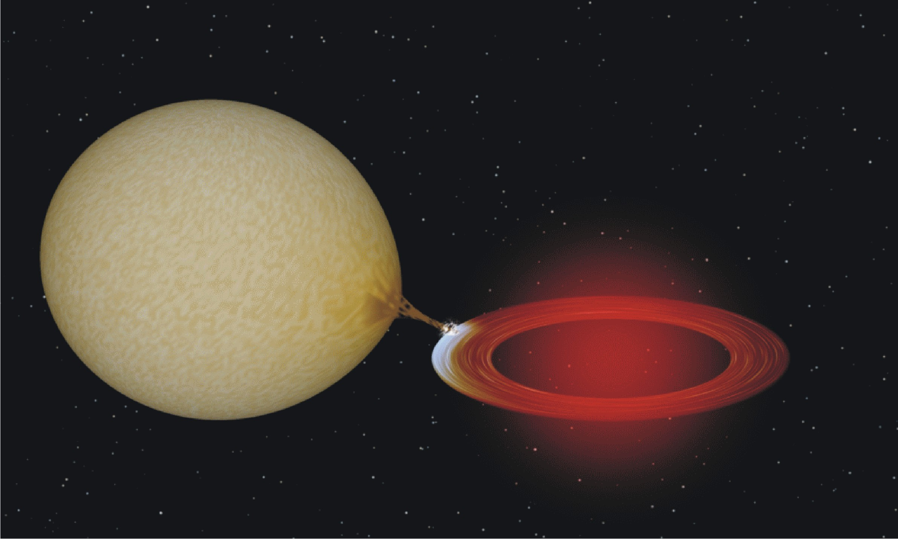
Neutron stars in transient X-ray binaries
Quiescence:
No/little accretion
Faint X-ray emission
Accretion outburst:
Rapid accretion
Bright X-ray emission

Slide 3
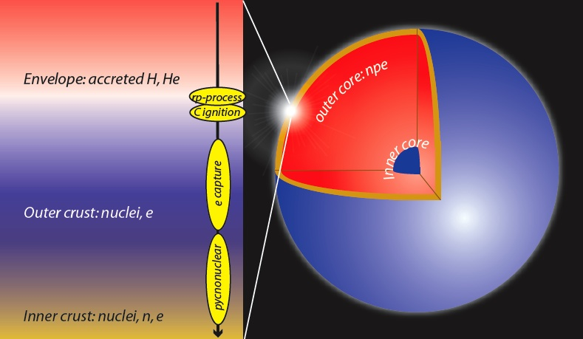
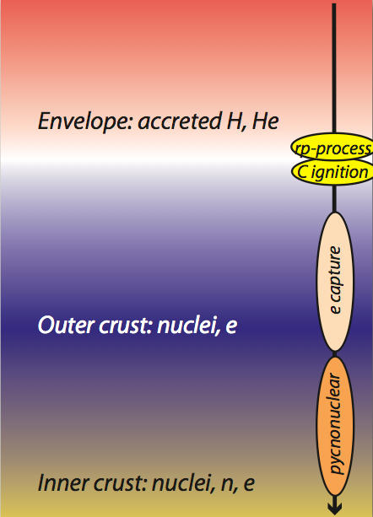
Effect of accretion
Nuclear reactions in the crust heat the neutron star
cm
10 m
~2 MeV/nucleon
1 km
10 km
Image courtesy of Ed Brown

Slide 4
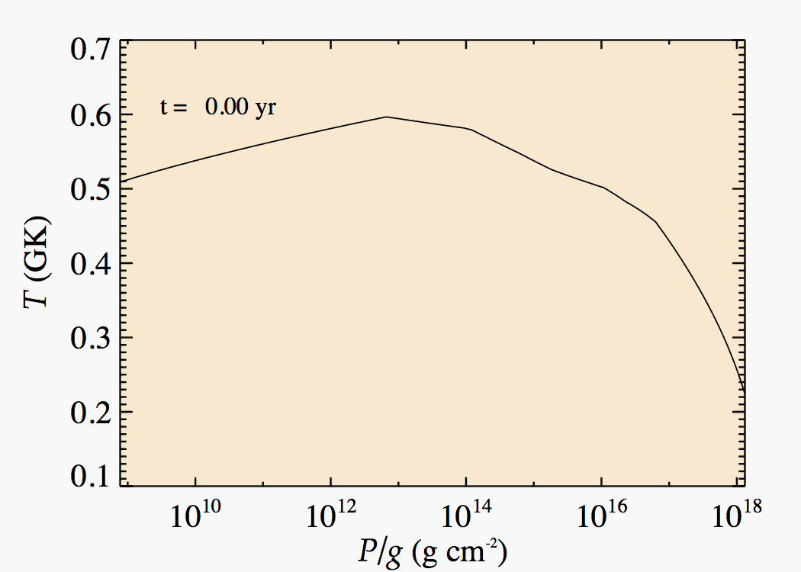
Thermal evolution crust
Movie courtesy of Ed Brown
Crust
Temperature
Surface
Depth
Core

Slide 5
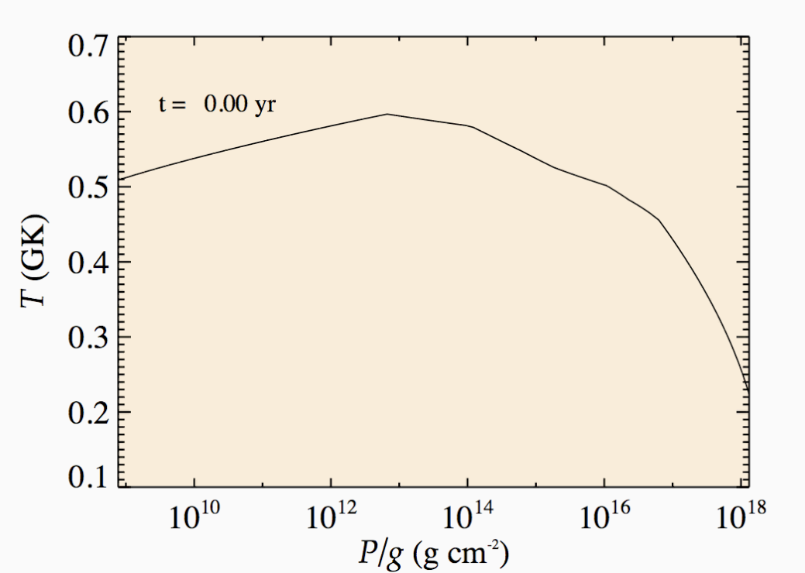
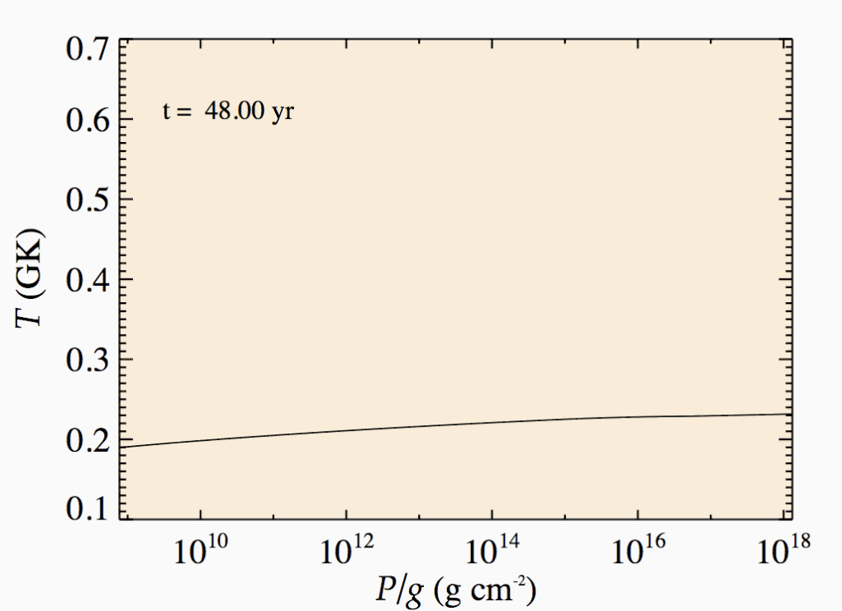
What can we learn?
Temperature profile:
Magnitude + distribution heat
→ nuclear reactions
→ properties last outburst
Cooling timescale:
Heat conduction
→ crust structure
Core temperature
→ Long-term accretion
→ Core cooling

Slide 6
Can we detect thermal relaxation of the heated crust?
Best candidates:
those with long outbursts

Slide 7
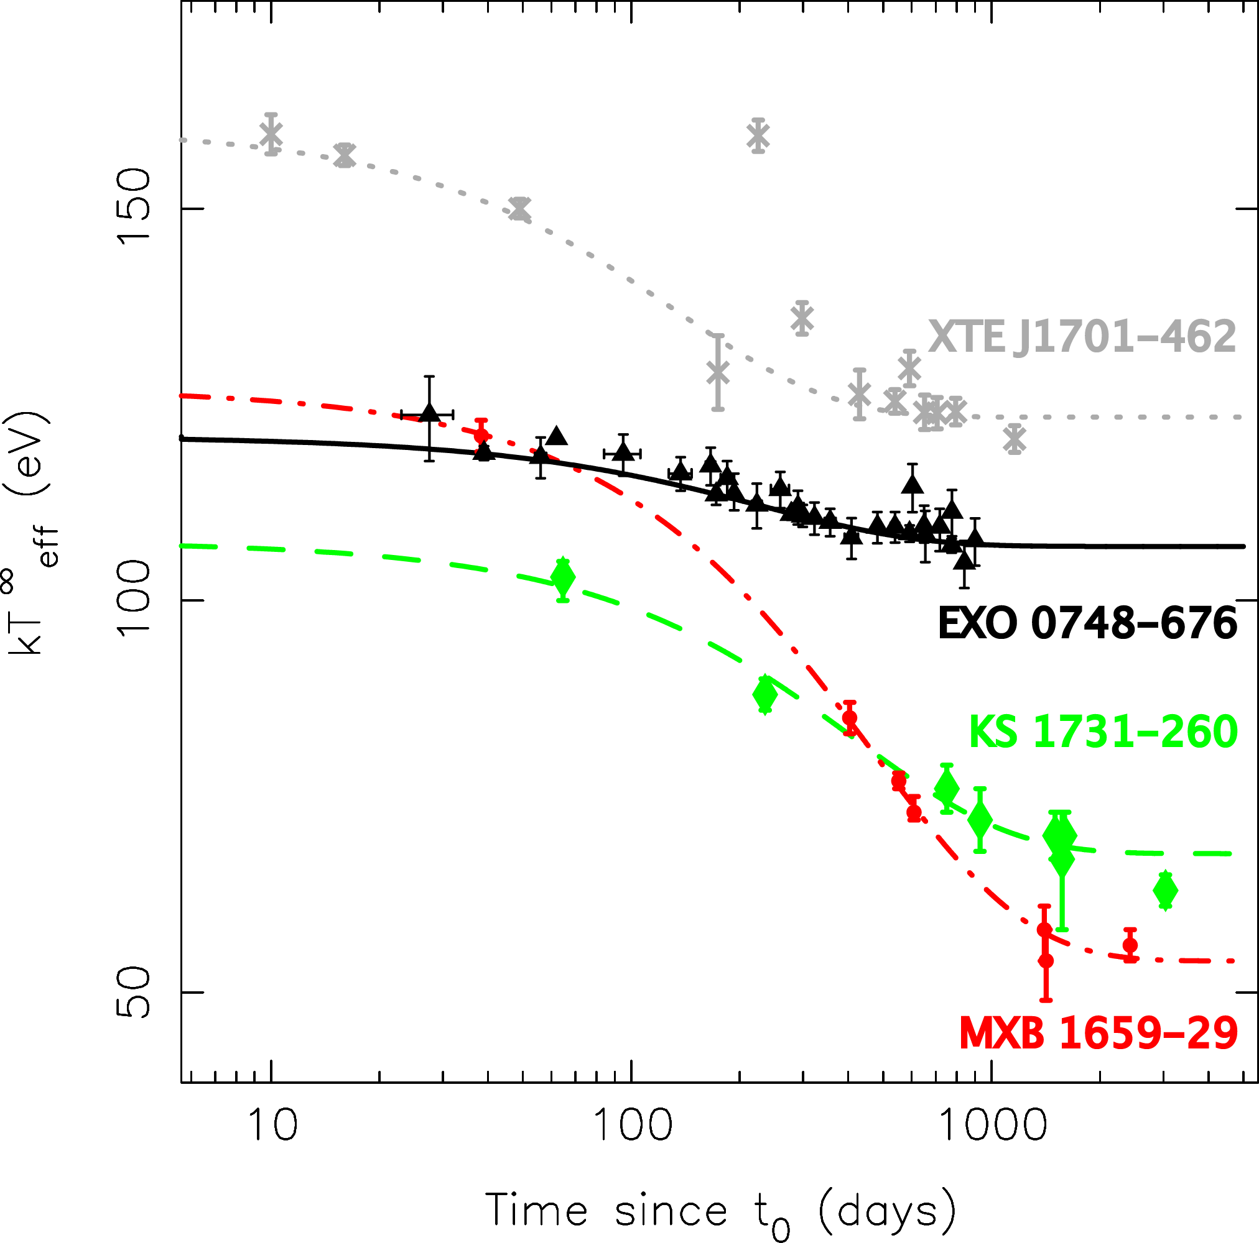
Crust cooling: 4 sources
XTE J1701-462
1.5 yr, ~10³⁸ erg/s
EXO 0748-676
25 yr, ~10³⁶ erg/s
KS 1731-260
12.5 yr, ~10³⁷ erg/s
MXB 1659-29
2.5 yr, ~5x10³⁶ erg/s
Neutron star temperature (eV)
Time since accretion stopped (days)

Slide 8
What have we learned?
Crust cooling is observable!
Cooling timescale → conductive crust → organized ion lattice structure
New challenges:
Conductive crust may be a problem
→ “superbursts” require high temperature
Additional heating in outer crustal layers?

Slide 9
Crust cooling: 4 sources
Differences due to outburst history?
Can we build a census of crust?
Observe and model more sources
Neutron star temperature (eV)
Practical issue:
Rare opportunities
Time since accretion stopped (days)

Slide 10
Can we observe this for “normal” transients with shorter outbursts?

Slide 11
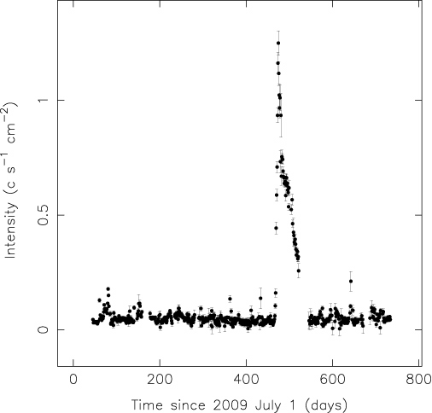
Test case
10-week accretion outburst 2010 October-December
11-Hz pulsar: relatively strong magnetic field (but <10¹¹ G)
Outburst
IGR J17480-2446
Globular cluster
Terzan 5
Quiescence:
before outburst
Quiescence:
After outburst
MAXI intensity (counts/s/cm2)
Time since 2009 July 1 (days)

Slide 12
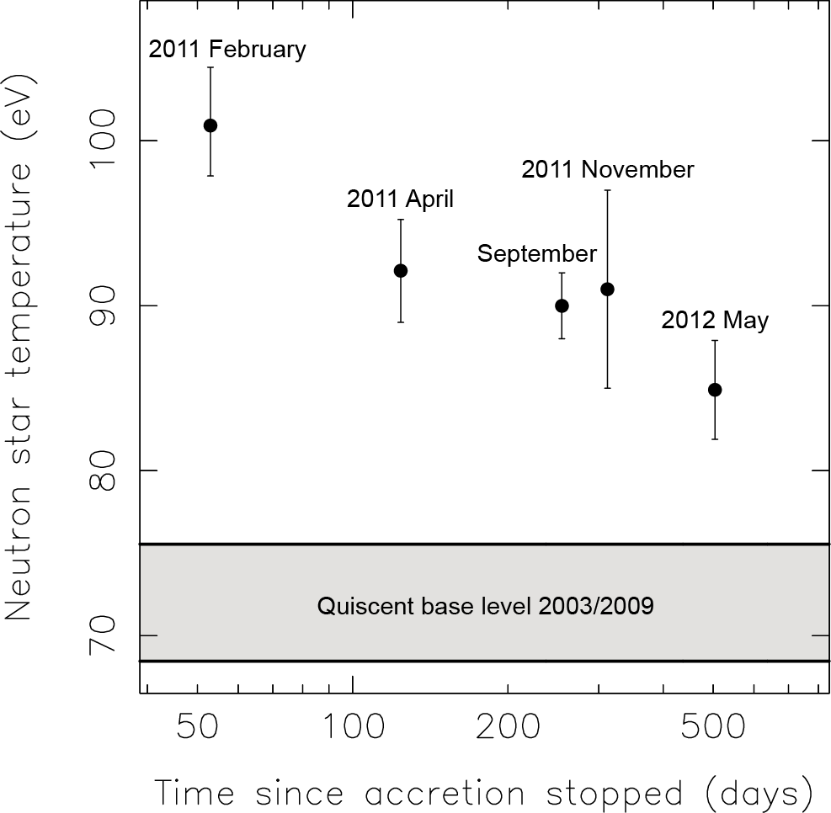
Thermal evolution: crust cooling?
Terzan 5
(Outburst: 2010 Oct-Dec)
Initially enhanced, but decreasing

Slide 13
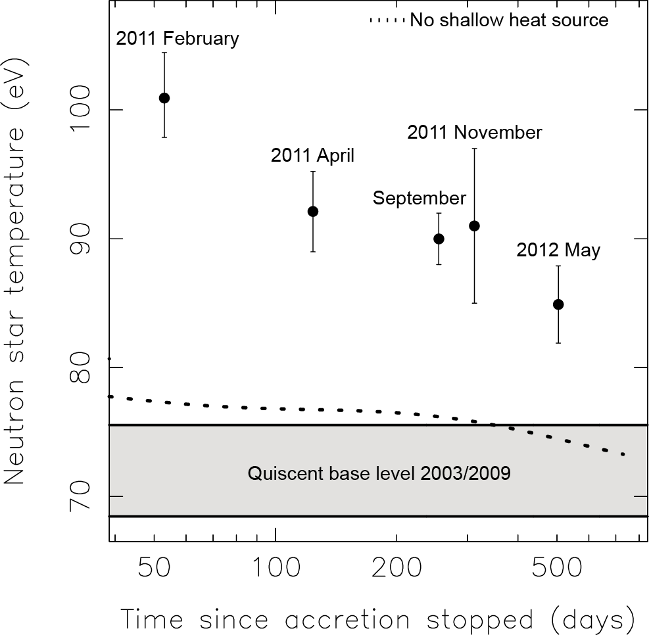
Thermal evolution: crust cooling?
(Outburst: 2010 Oct-Dec)
Initially enhanced, but decreasing
Cooling curve with standard heat:
no match

Slide 14
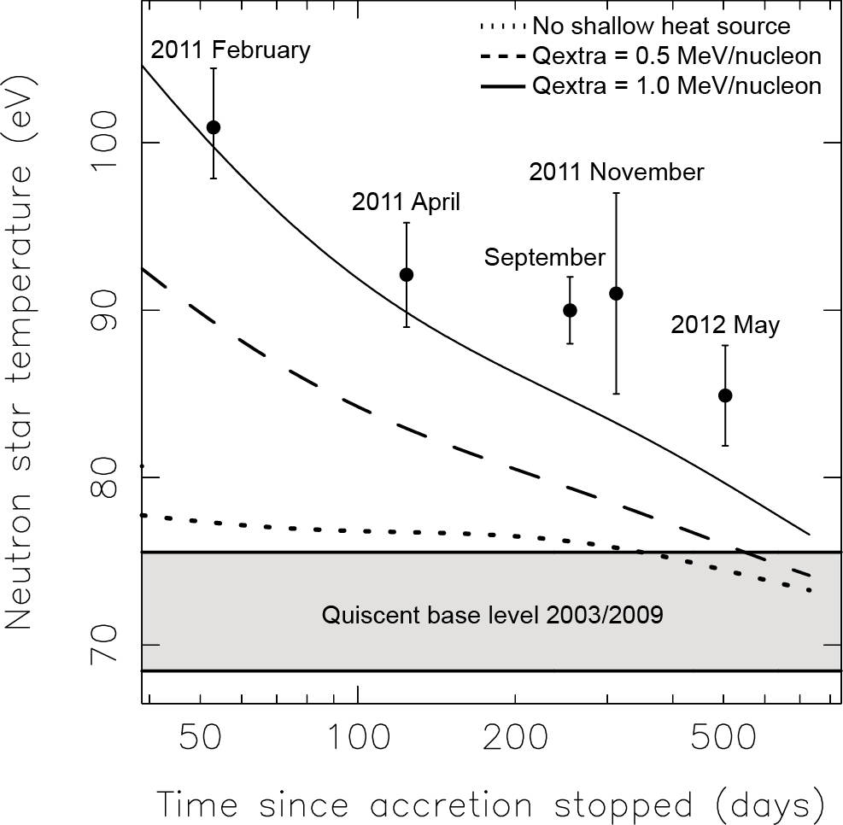
Thermal evolution: crust cooling!
(Outburst: 2010 Oct-Dec)
Initially enhanced, but decreasing
Cooling curve with standard heat:
no match
Cooling curve with extra shallow heat:
much better!

Slide 15
Thermal evolution: crust cooling!
(Outburst: 2010 Oct-Dec)
Initially enhanced, but decreasing
Cooling curve with standard heat:
no match
Cooling curve with extra shallow heat:
much better!
Quite high:
Current models
2 MeV/nucleon
Can be crust cooling, but:
substantial heating at shallow depth required

Slide 16
Work in progress…
Hope to continue observations
Cooling is ongoing
Model full curve:
How much heat?
Is it realistic?

Slide 17
Crust cooling: 4 sources
XTE J1701-462
1.5 yr, ~10³⁸ erg/s
EXO 0748-676
25 yr, ~10³⁶ erg/s
KS 1731-260
12.5 yr, ~10³⁷ erg/s
MXB 1659-29
2.5 yr, ~5x10³⁶ erg/s
Neutron star temperature (eV)
Time since accretion stopped (days)

Slide 18
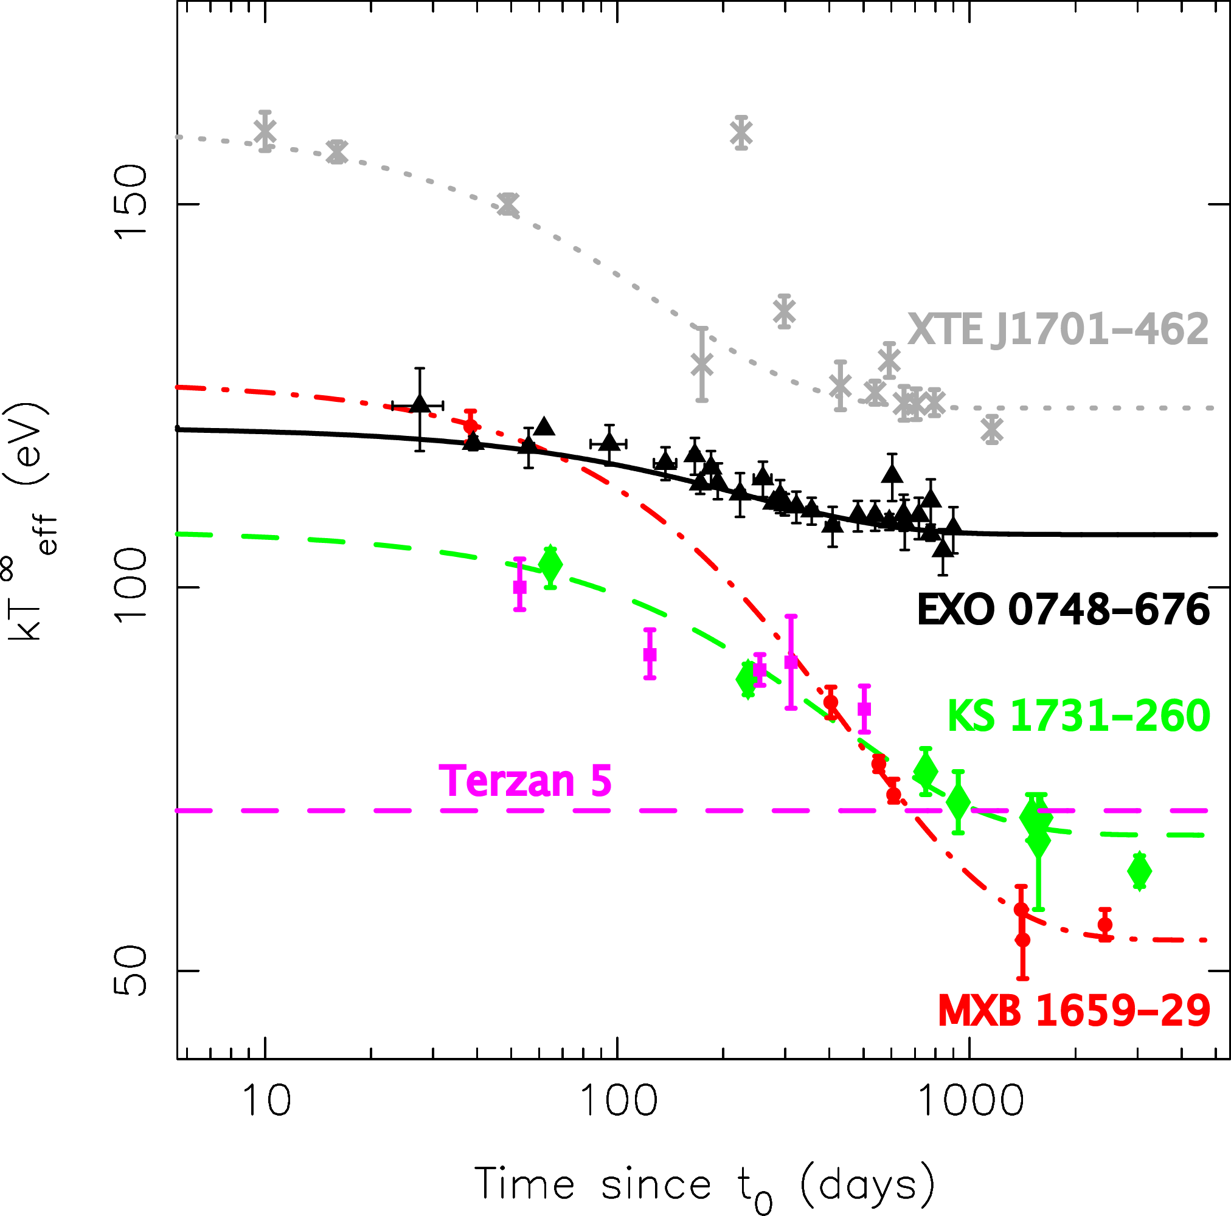
Crust cooling: 5 sources!
XTE J1701-462
1.5 yr, ~10³⁸ erg/s
EXO 0748-676
25 yr, ~10³⁶ erg/s
KS 1731-260
12.5 yr, ~10³⁷ erg/s
MXB 1659-29
2.5 yr, ~5x10³⁶ erg/s
Neutron star temperature (eV)
0.2 yr, ~10³⁸ erg/s
Time since accretion stopped (days)

Slide 19
Crust cooling observable also after
short outbursts!
More source available for study
Heating at shallow depth required:
has been hypothesized
May be large, what can it be?
nuclear reactions, magnetic field, other?

Slide 20
Work to be done
Theoreticians:
Observations of three new sources
→ modeling, can explain differences/similarities?
Source of extra heat release?
Observers:
Continue monitoring current cooling neutron stars
Stay on the watch for new potential targets
Issue of residual accretion in quiescence

Slide 21
To take away
Neutron stars in transient X-ray binaries:
Crust temporarily heated during accretion
Crust cooling observable in quiescence
Latest results:
Crust cooling after short accretion outbursts
Additional heating in outer layers of the crust

Slide 22
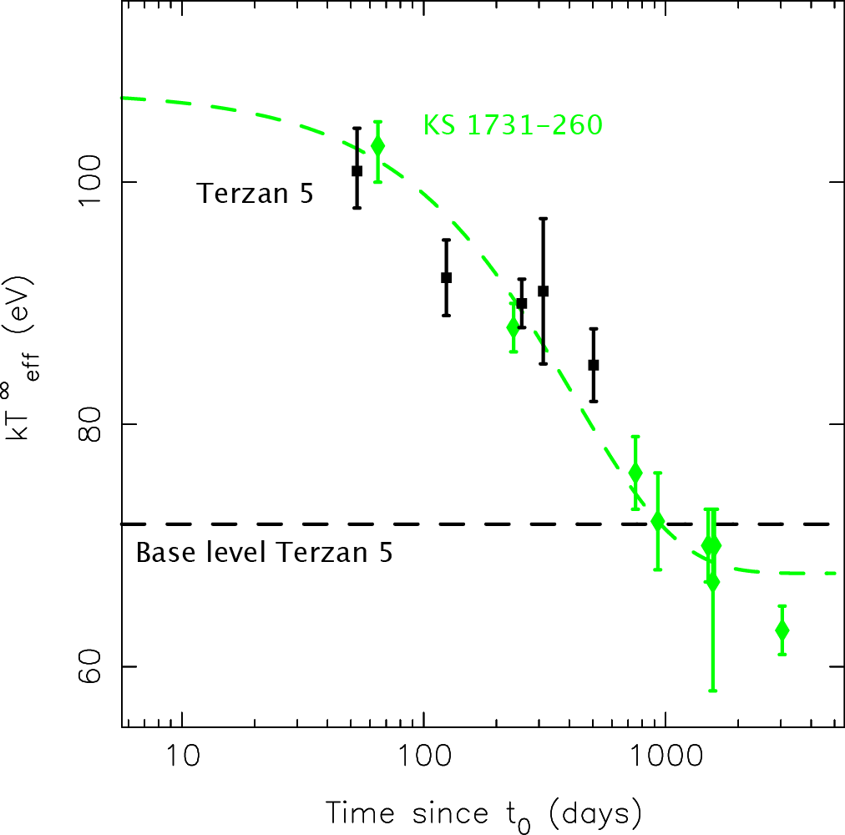
Are Terzan 5 and KS 1731 similar?
Huge difference in outburst length:
KS 1731-260
12.5 yr, ~10³⁷ erg/s
Terzan 5
0.2 yr, ~10³⁸ erg/s
Neutron star temperature (eV)
Time since accretion stopped (days)

Slide 23
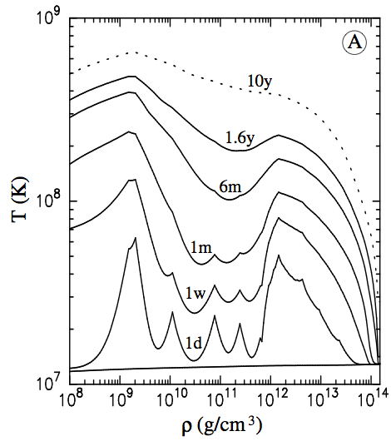
They should not be similar!
Longer outburst → hotter crust
KS 1731-260
12.5 yr, ~10³⁷ erg/s
Terzan 5
0.2 yr, ~10³⁸ erg/s
> 50 times shorter!
Less hot crust
Should cool faster
Surface
Depth crust
Core

Slide 25
Long outburst: hot crust
Longer outburst → hotter crust
More likely to observe crust cooling
Page & Reddy ‘12
Best candidates:
neutron stars with long (>1 yr) outbursts
Surface
Depth crust
Core

