Slide 1
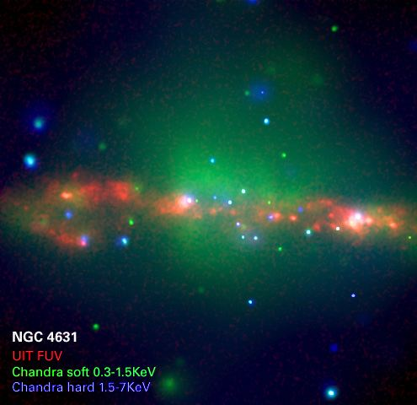
Diffuse X-ray Emission of Disk Galaxies
Extraplanar diffuse X-ray emission – a survey of highly inclined disk galaxies
  How is the emission correlated with galaxy properties?
  How are observations compared to simulations?
Nature of the emission – X-ray line spectroscopy
Q. Daniel Wang
University of Massachusetts
Notes:
A key goal of astrophysics is to understand the formation and evolution of galaxies. The least understood part is the feedback.
Edge-on galaxies are ideal sites for X-ray observations of feedback effects on the galactic ecosystems with minimal confusion with point-like sources and differential X-ray absorption.

Slide 2
1. Survey of highly inclined disk galaxies: galaxy sample
Highly-inclination angles (i > 60º)
D < 30 Mpc
Each with Chandra ACIS exposure > 10 kses
Size: 53, compared to < 10 in previous studies
Allowing for statistical analysis and comparison with cosmological simulations.
Li & Wang 2013a,b
Li, Crain, & Wang 2014
Notes:
Ranges of morphology types, stellar masses, star formation rates, and environments
Uniformly reduced (e.g., source removal and luminosity calculation)

Slide 3
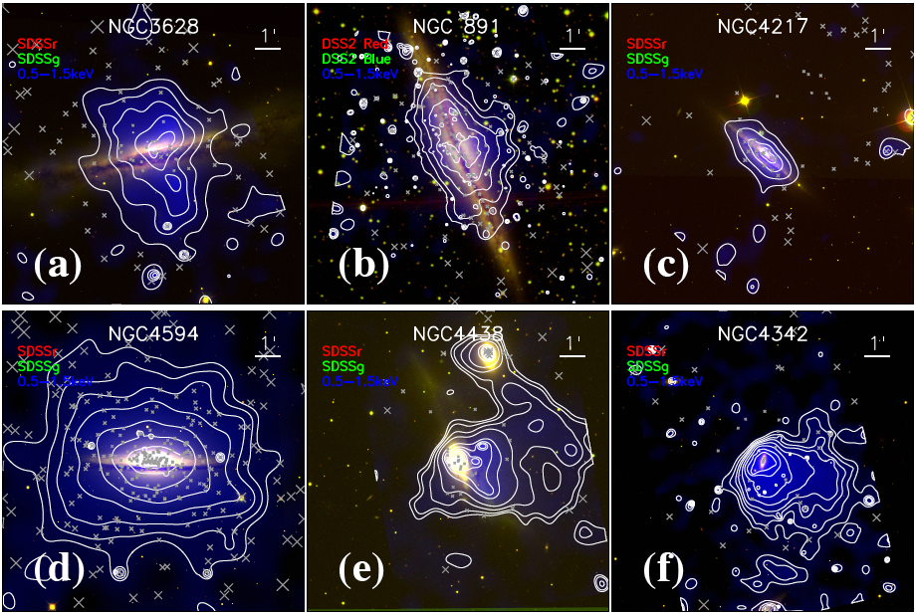
Chandra examples of diffuse X-ray emission from edge-on galaxies
Galaxy sample: i > 60º, D < 30 Mpc; 0.5-2 keV band intensity (Li, J.-T. & Wang, Q.D. 2013a)
Notes:
Including careful removal of point-like sources and making corrections for absorption, inclination angle, coverage, etc.

Slide 4
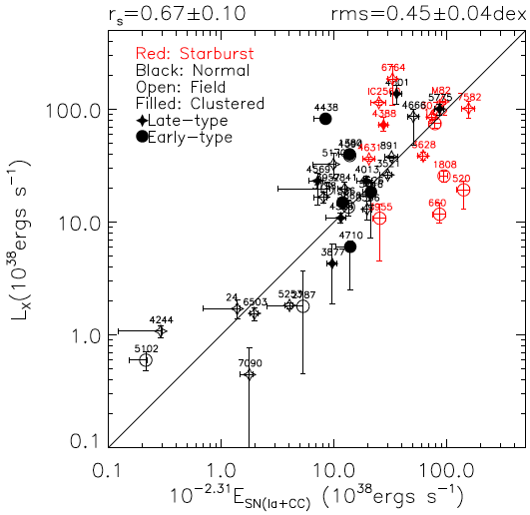
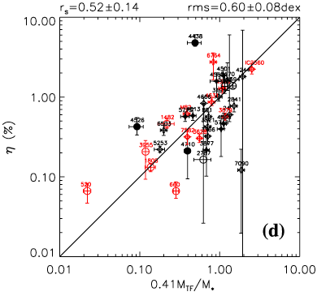
Lx vs. energy feedback rate
C
Adding Type Ia SNe to the total energy input improves the E_{SN}-L_{X} correlation for normal galaxies
L_{X}/Ė_{SN} ~ 1% and is weakly correlated with the surface mass density of a galaxy disks.
L_{X}/Ė_{SN} ~ 5% in face-on galaxies (Mineo et al. 2012).
Li & Wang (2013b)
Notes:
Ia SN energy rate is estimate from K-band lum and color.
So there is a missing energy problem!

Slide 5
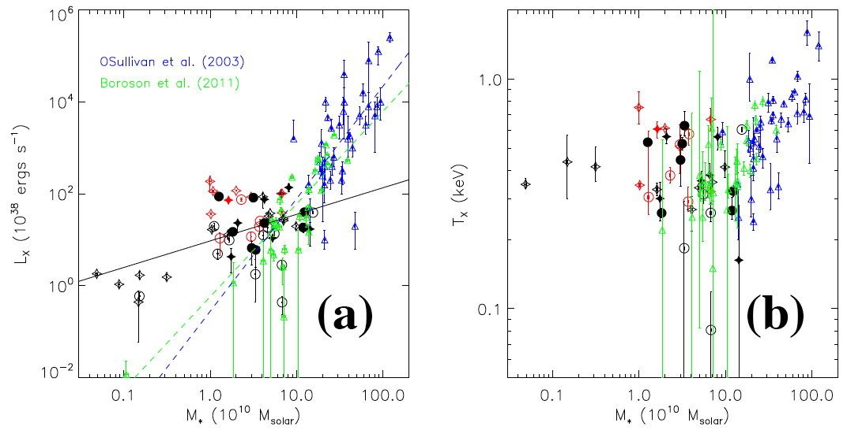
Comparison with elliptical/S0 galaxies
Why do (cool gas-rich) disk galaxies tend to have higher Lx and T than elliptical or S0 galaxies?
Notes:
O’Sullevan et al. are based on ROSAT observations. The offset from the Chandra results are due to source contamination.

Slide 6
Fe/O abundance ratio vs. galaxy type
Hot gas is Oxygen enriched in late-type galaxies, especially for starburst ones.
X-ray emission is luminosity-weighted and is mostly sensitive to metal-rich or stellar feedback materials.
Early type
Later type

Slide 7
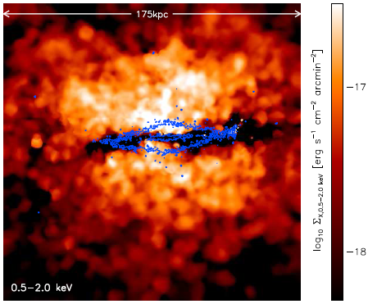
Comparison with GIMIC simulations
Crain et al. (2010)

Slide 8
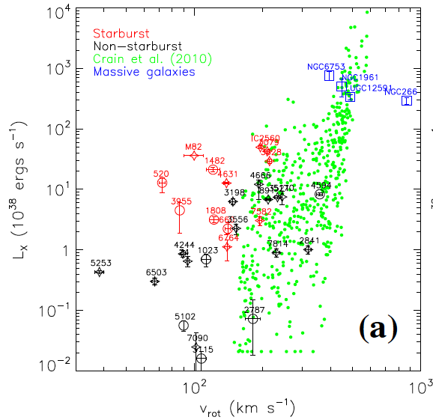
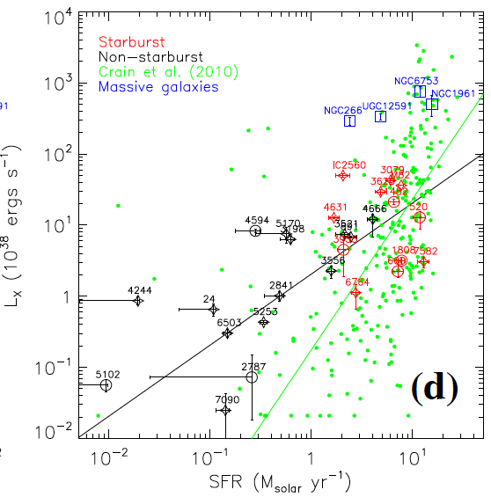
Comparison with (GIMIC) simulations
Li, Crain, & Wang (2014)
X-ray Observations can be a powerful test!
Caveats of the comparison:
The simulated large-scale, low-surface brightness emission is so far hard to detect and is even beyond the FoV covered in the observations.
Galaxy mass selection of the simulated sample: M* > 2 x 10¹⁰ M.
Observed galaxy sample is far from uniformly selected.
These caveats will be alleviated in the upcoming comparison of an XMM-Newton complete survey of isolated, high-mass edge-on galaxies with simulations from the EAGLE project.
Notes:
Measurements for Massive galaxies are from literature.
The overall trends of the observed and simulated galaxies on the LX 􀀀 SFR plot show little similarity, indicating
that GIMIC likely under-predict the role of SF in producing the X-ray emission.

Slide 9
Summary 1: survey of highly inclined disk galaxies, confronting with simulations
Detected extraplanar diffuse X-ray emission is strongly correlated with the stellar feedback energy.
The X-ray-emitting gas is apparently enriched by the stellar feedback. But only ~1% of it is accounted for by Lx.
The emission is concentrated toward the disks, while the simulation-predicted scale of hot halos is substantially greater.
The emission is also observed from low-mass galaxies for which little hot accretion is expected.
Such simulations may still miss important physical processes in disk/halo interaction regions.
Notes:
It would thus be optimal to compare the spectral properties (T, Z), as well as properly calculated L.

Slide 10
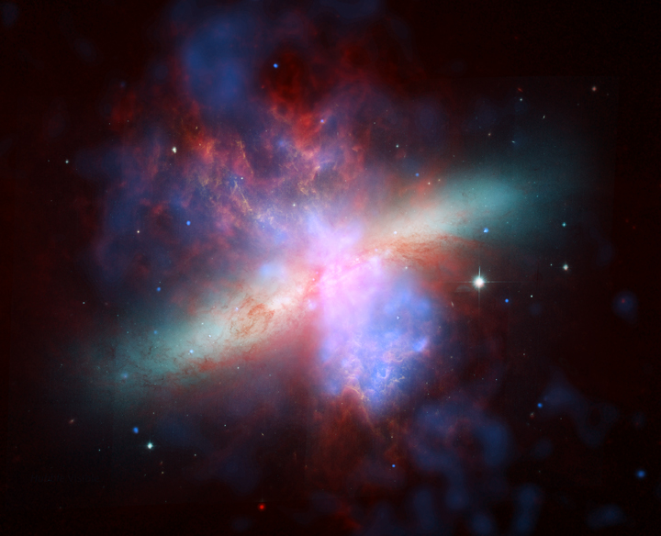
2. Nature of the X-ray Emission:
Line Spectroscopy
The resonance line is found to be weaker than the “forbidden”+”inter-recommbination” lines, which is not expected for thermal emission.
Liu, Mao, & Wang 2011
r i f
Composite of optical (HST), infrared (Spitzer), and X-ray (Chandra) images
X-ray arises at least partly from the interplay between the hot gas outflow and entrained cool gas clouds, as part of the mass-loading process!
Notes:
The resolution is far too low to resolve the interfaces between different phases of the gas.

Slide 11
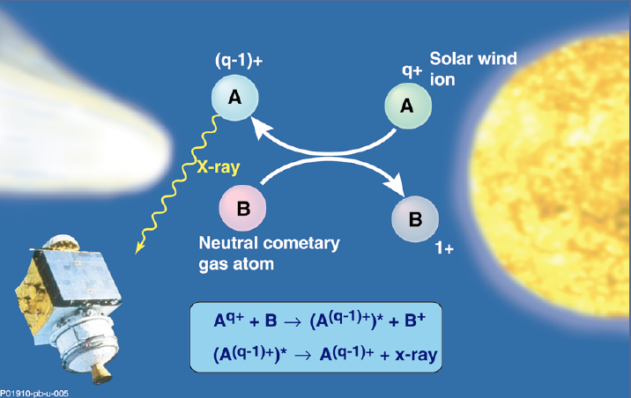
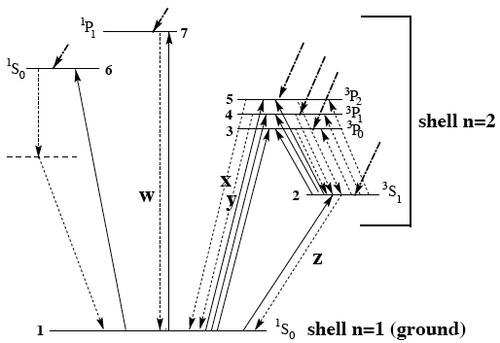
Charge exchange and X-ray line emission
r
i
f
Peter Beiersdorfer
Charge exchange (CX) nature of comet X-ray emission is confirmed, spectroscopically and temporally.
CX has a cross-section of ~10⁻¹⁵ cm⁻² and occurs on scales of the mean free path of hot ions at the interface.
Notes:
the electron is able to cross over from the target to the projectile for the favored principal quantum number

Slide 12
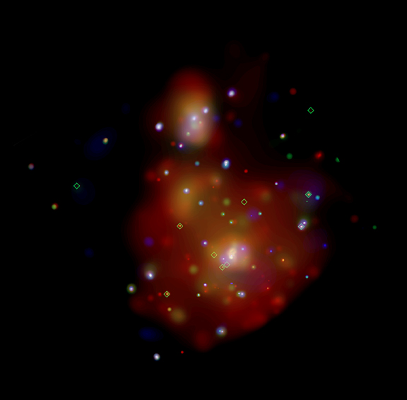
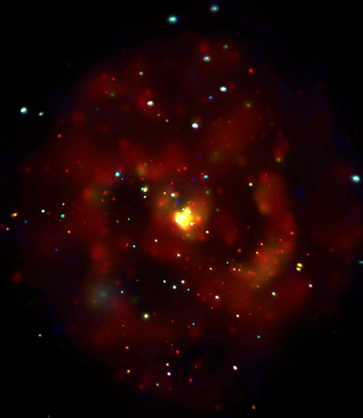
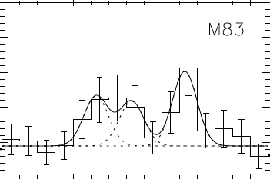
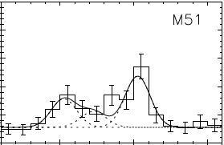
RGS Survey of nearby active star forming galaxies: examples
Liu, Wang, Mao (2012)
M83
M51
r i f
r i f
(Credit: NASA/CXC/SAO/R.DiStefano et al.)
Soria & Wu (2002)
Little evidence for significant AGN activities; fOVIII/fOVII ratios are similar to star bursts than AGNs
Soft X-ray are spatially correlated with star forming regions

Slide 13
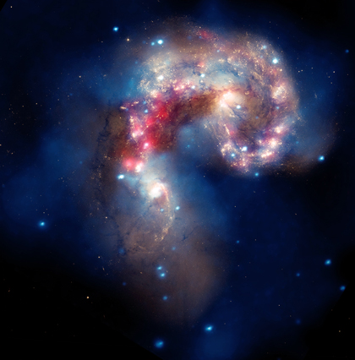
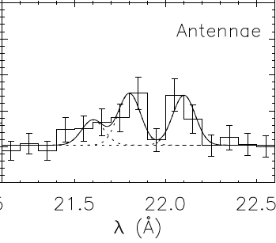
Antennae galaxy
Liu, Wang, & Mao (2012)
r i f
Optical (Yellow), X-ray (Blue), Infrared (Red)

Slide 14
Thermal plasma+charge exchange model Spectral fit to the RGS data of M82
Naturally explains the spatial correlation between hot and cool gas tracers.
CX is proportional to the ion flux into the hot/cold gas interface.
Accounting for the CX is important to determining the thermal and chemical properties of the hot plasma.
Zhang, Wang, Ji, Smith, & Foster (2014)
Notes:
e.g., the size of the interfaces is ~ 20x larger that the cross-section of the superwind in M82.

Slide 15
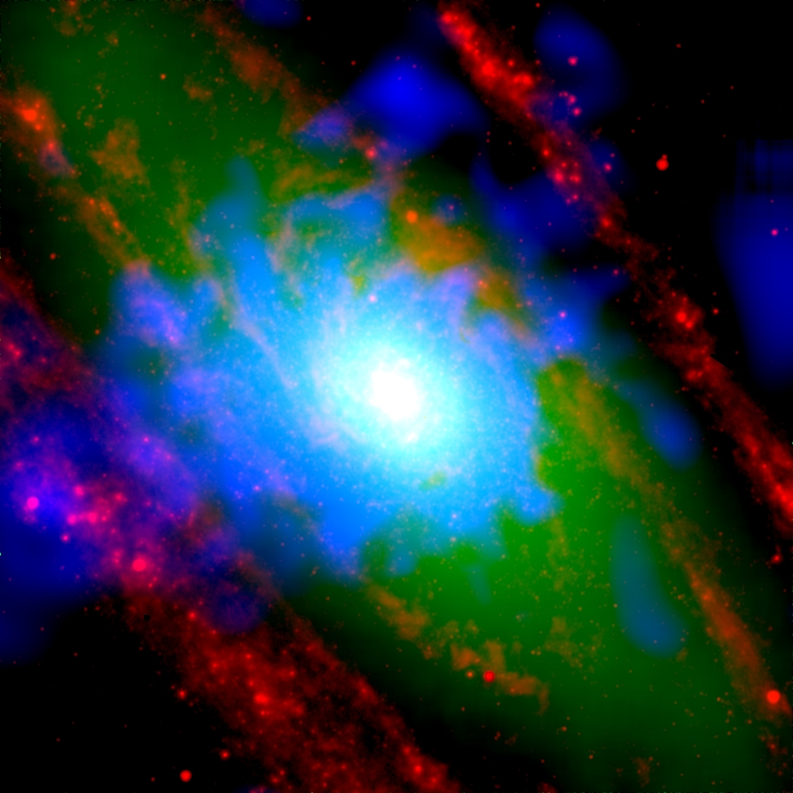
XMM-Newton RGS spectrum of the stellar bulge of M31
Strong deviation of the OVII Kα triplet from the thermal model: the forbidden line at 21.80 Å is much stronger than the resonance line at 21.60 Å.
IRAC 8 μm
K-band
0.5-2 keV
T ~ 3 x 10⁶ K
Lx~2x10³⁸ erg/s, only ~1% of the Type Ia SN energy input
Li & Wang 2007
Liu, Wang, Li, & Peterson 2010

Slide 16
Summary 2: X-ray line spectroscopy and nature of the X-ray emission
Spectroscopy shows that a substantial fraction of the diffuse soft X-ray emission appears to arise from the CX.
Such an interface mechanism naturally explains the enhanced X-ray emission in the immediate vicinity of galactic disks and the spatial correlation between X-ray and cool gas tracers.
CX measurements can potentially provide a powerful tool for probing the thermal, chemical, and kinematical properties of the hot plasma and its interplay with cool gas.
But other processes such as fast cooling of outflows and AGN relics may produce similar spectroscopic phenomena.
Notes:
Clearly, a lot is yet to be learned about the interplay between the galactic feedback and the galactic ecosystem.

Slide 17
X-ray mapping outer regions of hot halos around disk galaxies
  Questions to address:
  What fraction of the stellar energy feedback gets into the halo?
What drives outflows from SF galaxies?
  Radiation, B field/CRs, and/or hot gas?
  Strongly dependent on SF rate and stage?
Does a hot outflow expand freely?
Approach: Deep large-scale X-ray mapping
Individual observations have to be deep to remove enough background sources, which causes the the cosmic variance.
To check physical properties of hot plasma near outer boundaries if they are present.
Notes:
To minimize the contamination from CX, to understand the energetics and dynamics of the outflow, to study the implications for galaxy evolution.

Slide 18
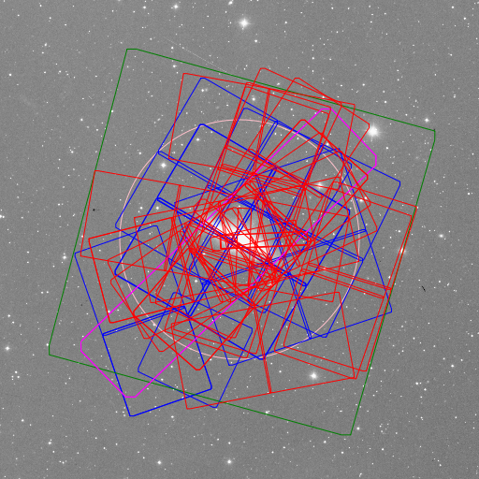
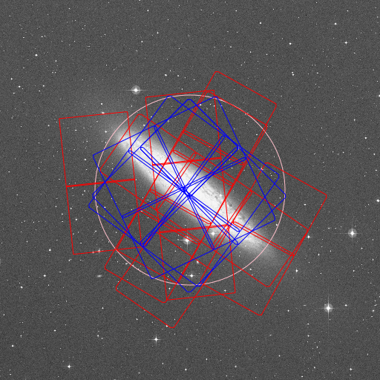
Existing Chandra observations of nuclear starburst galaxies: M82 and NGC 253

Slide 19
Galaxy-wide starforming galaxies: NGC 5775
53 ks ACIS-S

