Slide 1
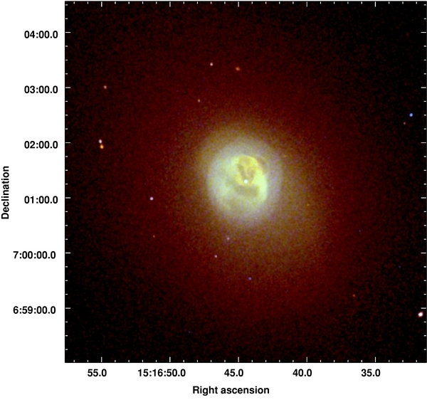
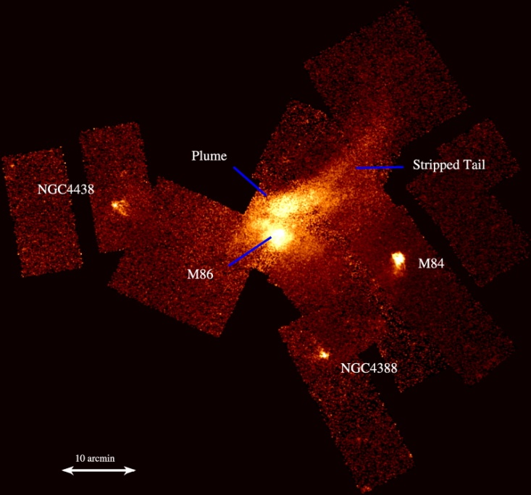
Hot Gas in Elliptical and BCG Galaxies
Craig Sarazin
University of Virginia
Abell 2052
(Blanton et al. 2011)
M86
(Randall et al. 2008)

Slide 2
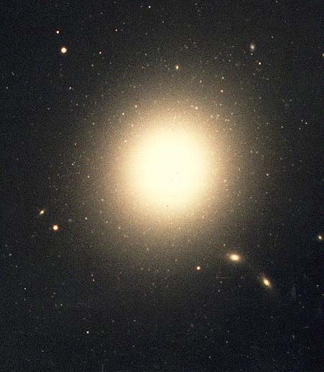
Early-Type Galaxies
Optical light dominated by bulge
Last star formation typically billions of years ago
Initially, believed to be free of interstellar gas due to winds (Mathews & Baker 1971; Faber & Gallagher 1976)
M87

Slide 3
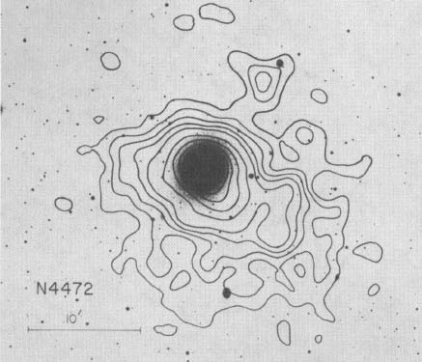
Einstein X-ray Observations
X-ray emission from normal ellipticals
Nulsen et al. 1984
Forman et al. 1985
Trinchieri & Fabbiano 1985
Canizares et al.1987
Kim et al. 1992
NGC4472 = M49
(Forman et al. 1985)

Slide 4
X-rays from Normal Ellipticals
L_{X} ≈ 10³⁹ − 10⁴² erg/s
R_{X} ~ 50 kpc
I_{X} ~ r⁻² outer regions
L_{X} ~ L_{opt}^{1.6−2.8}, big range

Slide 5
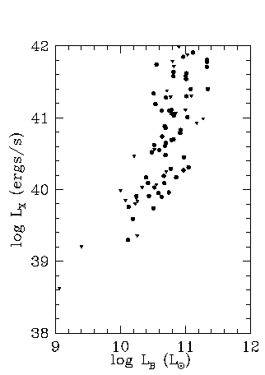
X-ray Faint vs. X-ray Bright
X-ray Bright
log ( L_{X} / L_{B} ) ≳ 30
X-ray Faint
log ( L_{X} / L_{B} ) ≲ 30
(ergs/s/L)
L_{X} ∝ L_{B}²
L_{X} ∝ L_{B}

Slide 6
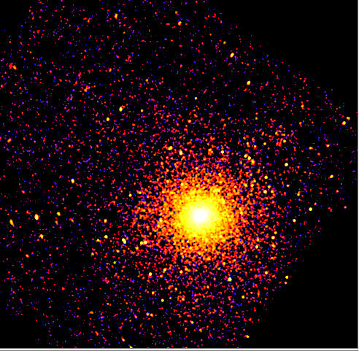
X-ray Emission Mechanisms: Hot ISM Gas and X-ray Binaries
Chandra NGC 4649
Hot ISM gas, T ~ 10⁷ K ~ 1 keV
Dominant in X-ray Brights
X-ray Binaries, Hard Emission
Chandra observations →
Dominant in X-ray Faints

Slide 7
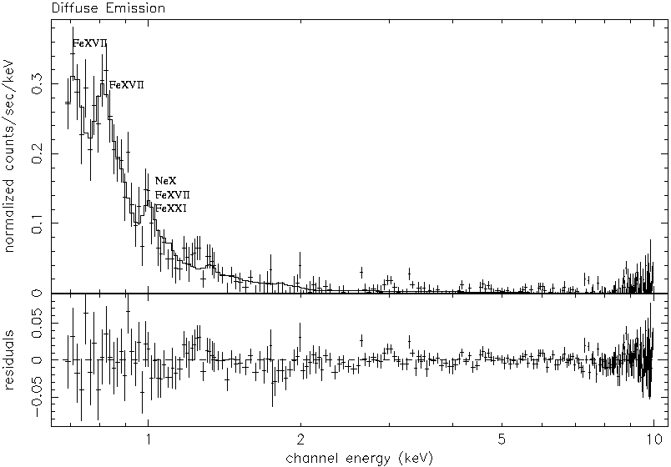
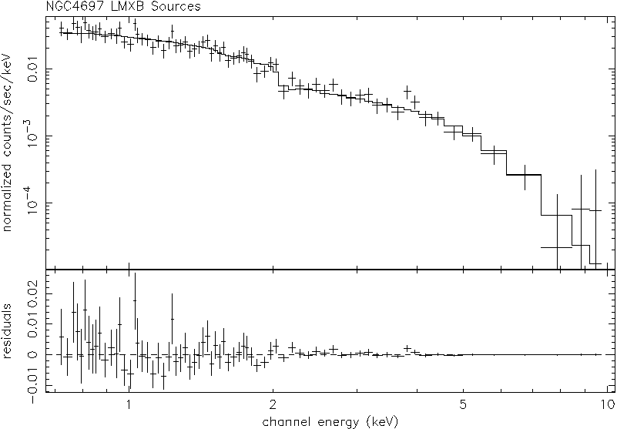
X-ray Spectra of XRBs and Diffuse Gas
Diffuse
LMXBs
Soft Component = Diffuse Gas
kT ~ 3 -10 x 10⁶ K ~ 0.3 - 1 keV
Hard Component = XRBs

Slide 8
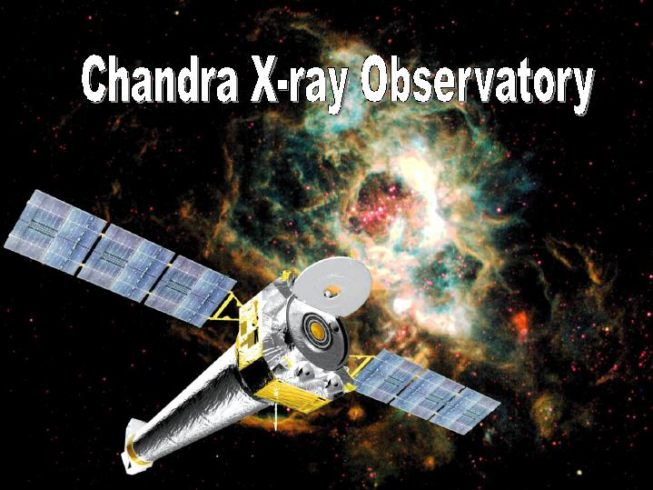
Chandra X-ray Observatory
Resolve and detect X-ray binaries
Resolve AGN
Separate LMXBs & diffuse
gas emission
Determine spectra &
properties of sources
& diffuse emission

Slide 9
Thermal Emission from Hot Gas
T ~ 10⁷ K ~ 1 keV
ρ_{gas} ~ r^{−3/2} outer regions
M_{gas} ~ 10⁹ − 10¹⁰ M
M_{gas} / M_{stars} ~ 0.02
Hot X-ray emitting gas is dominant ISM in ellipticals

Slide 10
Source of Hot Gas
Consistent with stellar mass loss at current rates (but higher in past)
Inflow?

Slide 11
Heating of Gas
Stellar mass loss (due to stellar motions)
Would give kT_{gas} ≈ μ σ², but gas is actually a bit hotter
Inflow (gravitational heating)
Type Ia supernova (> than stellar mass loss)
AGN heating (Ciotti & Ostriker 1997)
Thermal Conduction?

Slide 12
Dynamical State of Gas
X-ray Bright Galaxies
Quasi-hydrostatic cooling flows (Thomas et al. 1986; Sarazin & White 1988)
Cooling due to X-ray radiation we observe
Too much cool gas piles up in center of galaxy
Hydrostatic ➔ derive masses
(Bahcall & Sarazin 1977;
Fabricant et al. 1980;
Forman et al. 1985)

Slide 13
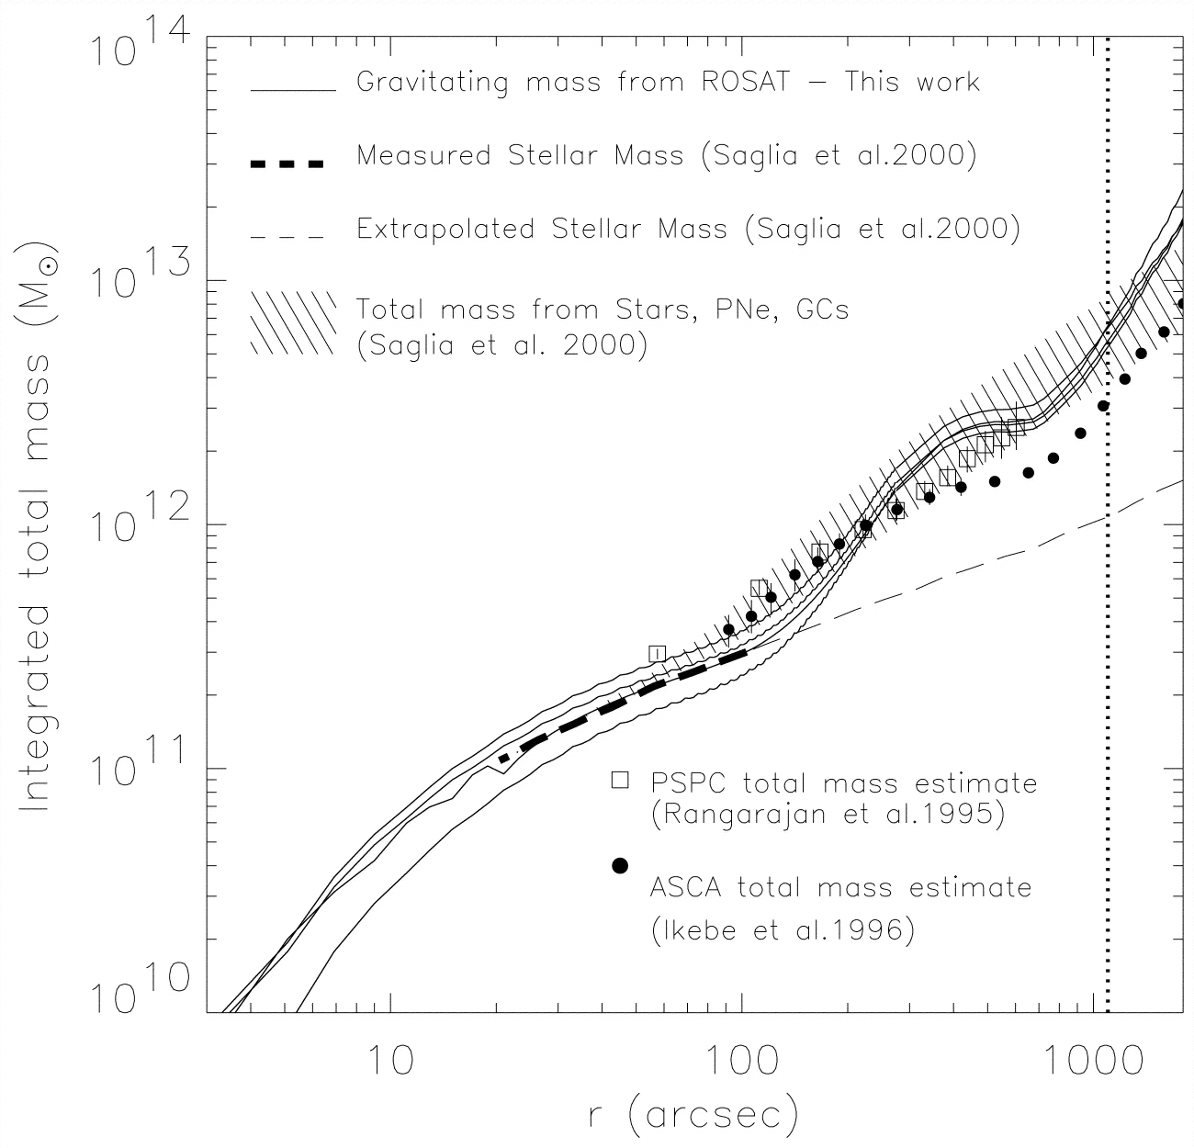
Dynamical State of Gas
X-ray Bright Galaxies
Quasi-hydrostatic cooling
Hydrostatic ➔ derive masses
Are galaxies hydrostatic in outer regions?
NGC1399
(Note: Actually BCG in Fornax cluster.)
(Paolillo et al. 2003)

Slide 14
Dynamical State of Gas
X-ray Faint Galaxies and Earlier History
Models for isolated ellipticals without AGN
Stellar mass loss and SN Ia heating
Depend on value and history of heating
Cooling flows
Subsonic outflows
Supersonic winds
Partial winds (cooling inflow in center, outflow at large radii)
(Loewenstein & Mathews 1987; David et al. 1990, 1991; Ciotti et al. 1991;
Pelligrini et al. 1997)

Slide 15
Dynamical State of Gas
Winds ➔ Subsonic outflows ➔ Cooling flows
(Ciotti et al. 1991)
L_{inj}
Wind | Inflation | Cooling flow

Slide 16
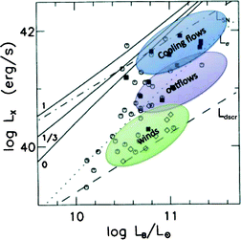
Dynamical State of Gas
Winds ➔ Subsonic outflows ➔ Cooling flows
Evolution explains wide range of X-ray luminosities?
(Ciotti et al. 1991)
L_{X} vs, L_{opt} as due to dynamical evolution
(Fabbiano 2012, after Ciotti et al. 1991)

Slide 17
Environmental Effects on X-ray Emission from Early-Type Galaxies
Are galaxies in dense environments more or less X-ray luminous than galaxies in sparse environments?
Use projected galaxy density as proxy for local (gas) density
Less luminous? White & Sarazin 1991; Henriksen & Cousineau 1999 (for pairs of galaxies), Jeltema et al. 2008 (Chandra, groups), Finoguenov et al. 2004, Sun et al 2005 clusters
Due to ram pressure (or evaporation or mergers or…)?
More luminous? Brown & Bregman 2000 (But, included central brightest group galaxies.)
Hot gas confined by intergalactic gas?

Slide 18
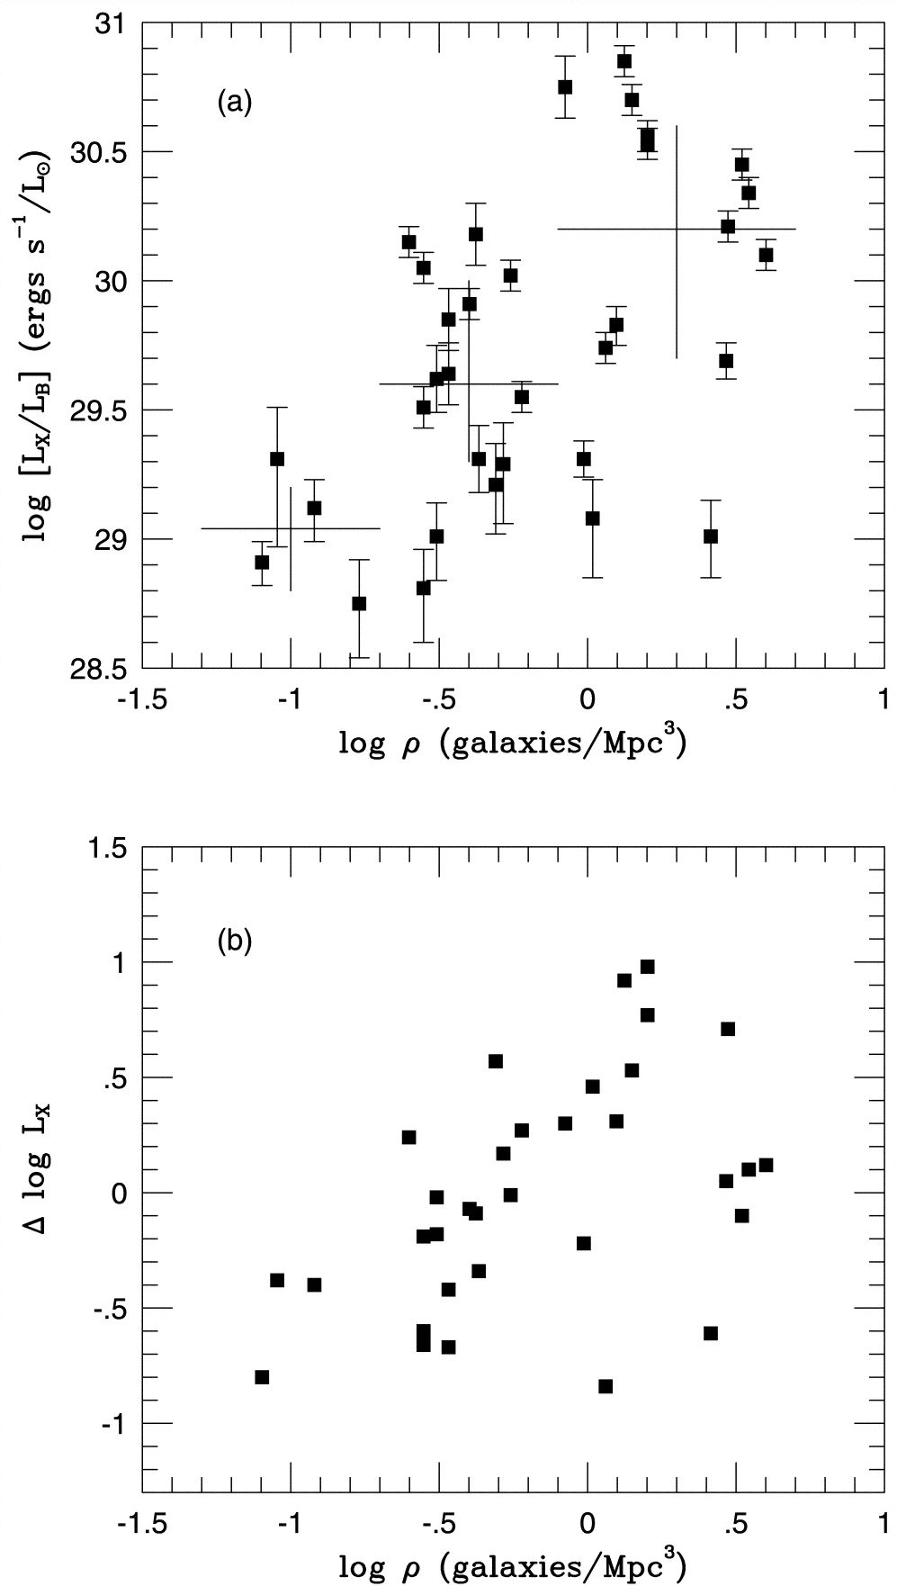
Brown & Bregman 2000

Slide 19
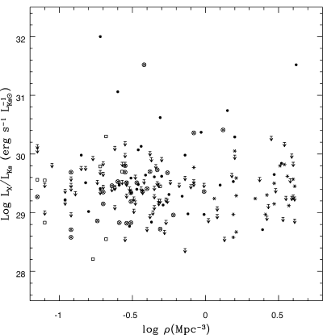
Environmental Effects (Cont.)
Are galaxies in dense environments more or less X-ray luminous than galaxies in sparse environments?
No effect? (Machie & Fabbiano 1997; O’Sullivan et al. 2001, Helsdon et al. 2001, Ellis & O’Sullivan 2006)

Slide 20
Environmental Effects (Cont.)
Complications:
Separating gas and discrete emission (Chandra)
Separating group and galaxy emission
Treat group-central galaxies separately?
Determining local density:
Projected galaxy density, but want intergalactic gas density
Projection effects
History - where galaxy is today is not where it was yesterday

Slide 21
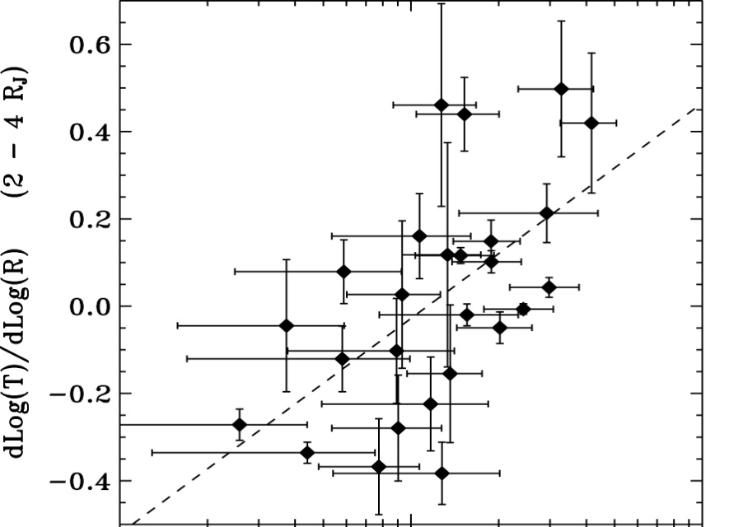

Environmental Effects (Cont.)
Outer temperature profiles depend on local density Diehl & Statler 2008
Due to intergalactic gas (confinement or thermal conduction or inflow?)

Slide 22
Ram Pressure Stripping
In dense regions (clusters), expect ram pressure stripping of most of the hot gas in elliptical galaxies (Gunn & Gott 1972). LSS simulations predict that most galaxies in clusters are significantly stripped (Brüggen & De Lucia 2008).
Many examples seen of hot gas tails behind galaxies in clusters:

Slide 23

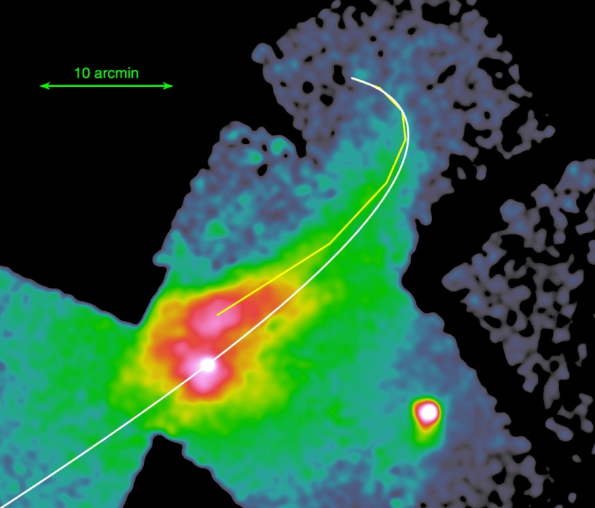
Ram Pressure Stripping (Cont.)
Many examples seen of hot gas tails behind galaxies in clusters:
M86
(Randall et al. 2008; Ehlert et al. 2013)

Slide 24
Ram Pressure Stripping (Cont.)
M86:
Tail length:
150 kpc (projected)
> 380 kpc actual length
Stripped mass ~ 1.7 x 10⁹ M
~ 3 x mass of current galaxy halo

Slide 25
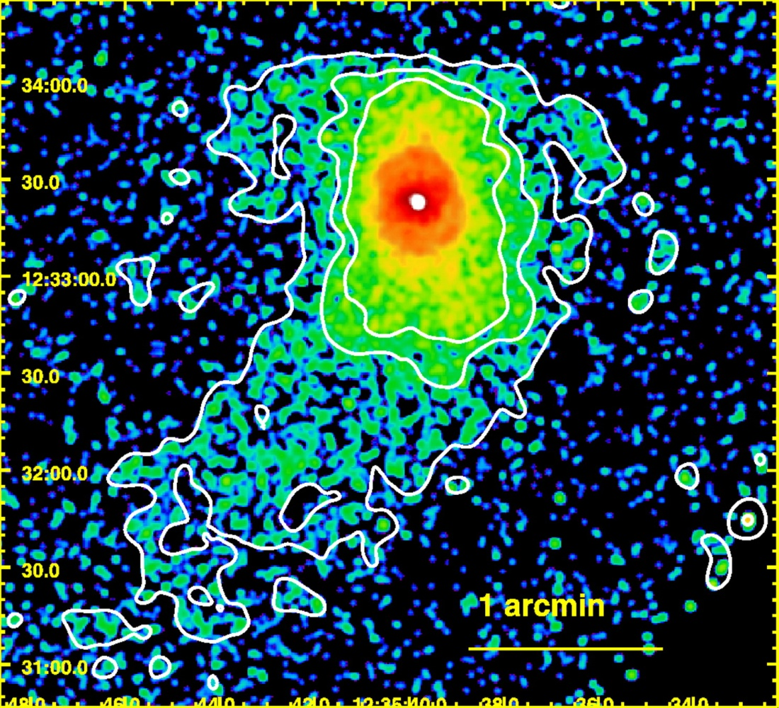
Ram Pressure Stripping (Cont.)
M89 = NGC 4552
(Machacek et al. 2006)

Slide 26
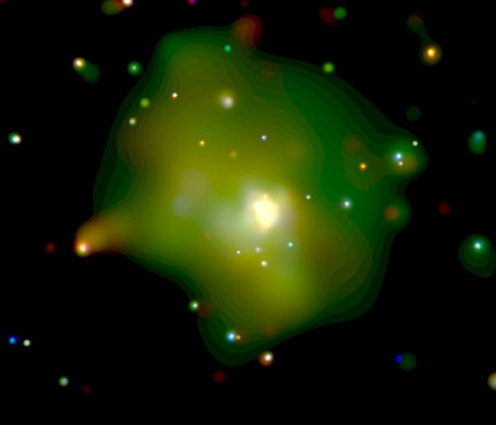
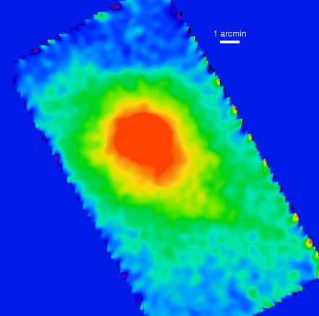
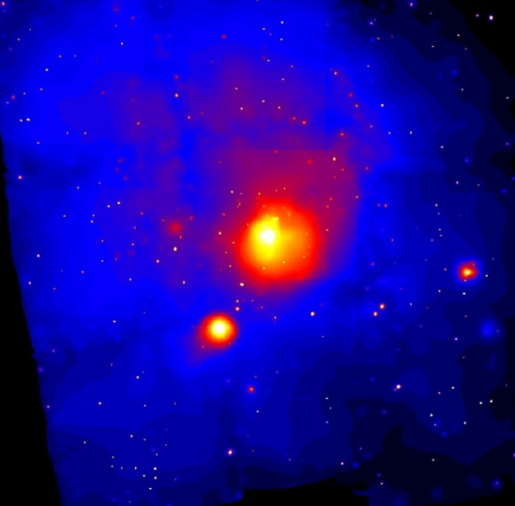
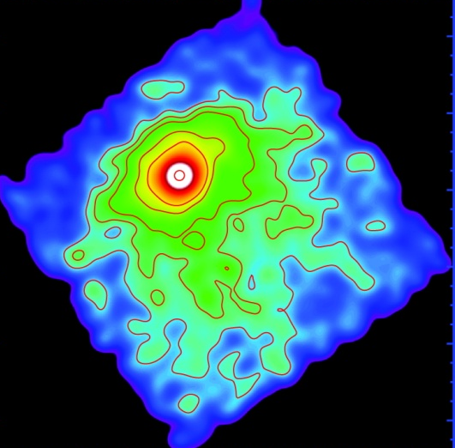
Ram Pressure Stripping (Cont.)
NGC1603
NGC4472 (M49)
NGC1265
(Sun et al. 2005)
NGC 4382
(Bogdan et al. 2012)
4C 34.16
(Sakelliou et al. 2005)
NGC4783
(Machacek et all 2007)
(Sivakoff et al. 2004)
(Biller et al. 2004)
NGC1404
NGC7619
(Scharf et al. 2005)
(Kim et al. 2008)

Slide 27
Small Coronae in Cluster Ellipticals
Are early-type galaxies in clusters completely stripped of hot gas?
No
Coma cluster, two D galaxies NGC 4874 & 4889
~ 2 kpc in radius, ~1.5 keV, M_{gas} ~ 6 x10⁷ M⊙
(Vikhlinin et al. 2001; Sanders et al. 2014)‏
NGC 3309 & NGC 3311 in A1060 (Yamasaki et al. 2002)‏
4 early-types in Abell1367NW (Sun et al. 2005)

Slide 28
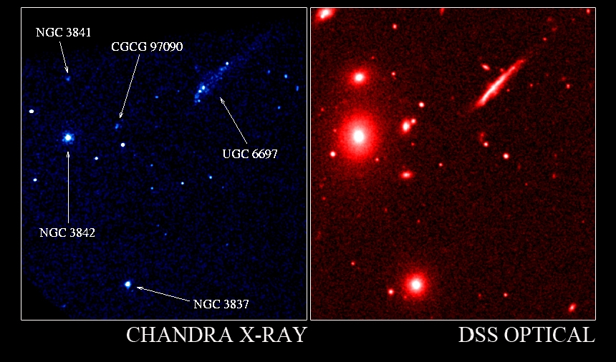
Abell1367NW (Sun et al. 2005)

Slide 29
Small Coronae in Cluster Ellipticals
Survey of 157 early-types in 25 hot clusters (Sun et al. 2005)
Most have small coronae (>60% for L_{K} > L^{*)}
~ 2 kpc in radius, ~1 keV, M_{gas} ~ 10⁷ M⊙
Corona smaller than field or group ellipticals
Negative effects of dense environment
Not fully stripped
Smaller than particle mean-free-path
Thermal conduction strongly suppressed (>10² x)
Cooling time short, require heat source
True of most nearby radio galaxies (Sun 2009)
Like cluster cool cores but smaller?

Slide 30
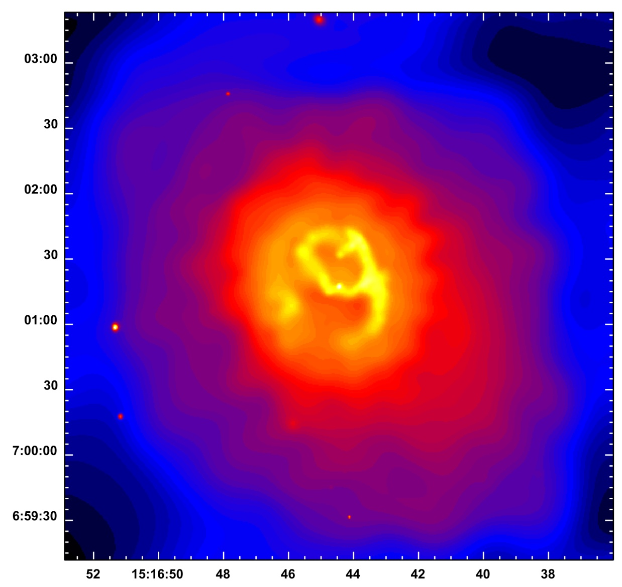
AGN Feedback in Early-Type Galaxies

Slide 31
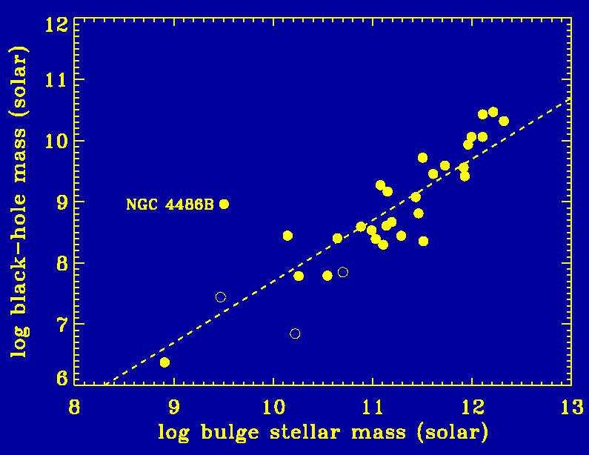
Feedback in Early-Type Galaxies
Evidence for coupling between supermassive black holes (SMBHs) and their galaxy hosts
M_{SMBH} ~ 0.2% of M_{bulge} (Magorrian et al. 1998, Tremaine et al. 2002)
grow together?

Slide 32
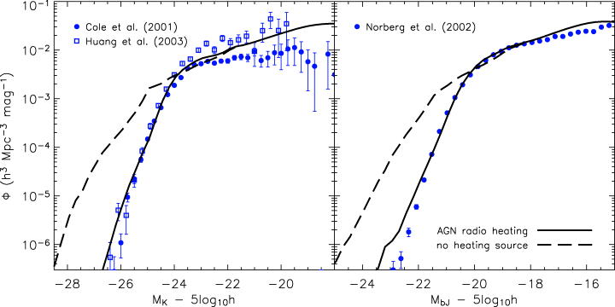
Feedback in Early-Type Galaxies
Evidence for coupling between supermassive black holes (SMBHs) and their galaxy hosts
M_{SMBH} ~ 0.2% of M_{bulge}
Luminosity function of galaxies below mass func. of dark matter halos in CDM (Croton et al. 2006)
AGN suppress star formation?

Slide 33
Feedback in Early-Type Galaxies
Evidence for coupling between supermassive black holes (SMBHs) and their galaxy hosts
M_{SMBH} ~ 0.2% of M_{bulge}
Mass function of galaxies below that of dark matter halos in CDM
“Cooling flow” problem: radiative cooling time for brightest cluster galaxies (BCGs) and some other ellipticals < lifetime, but only ≲ 5% of gas cools down to low temperatures
Heating by central radio sources?

Slide 34
A2052 (Chandra)
Blanton et al. 2001

Slide 35
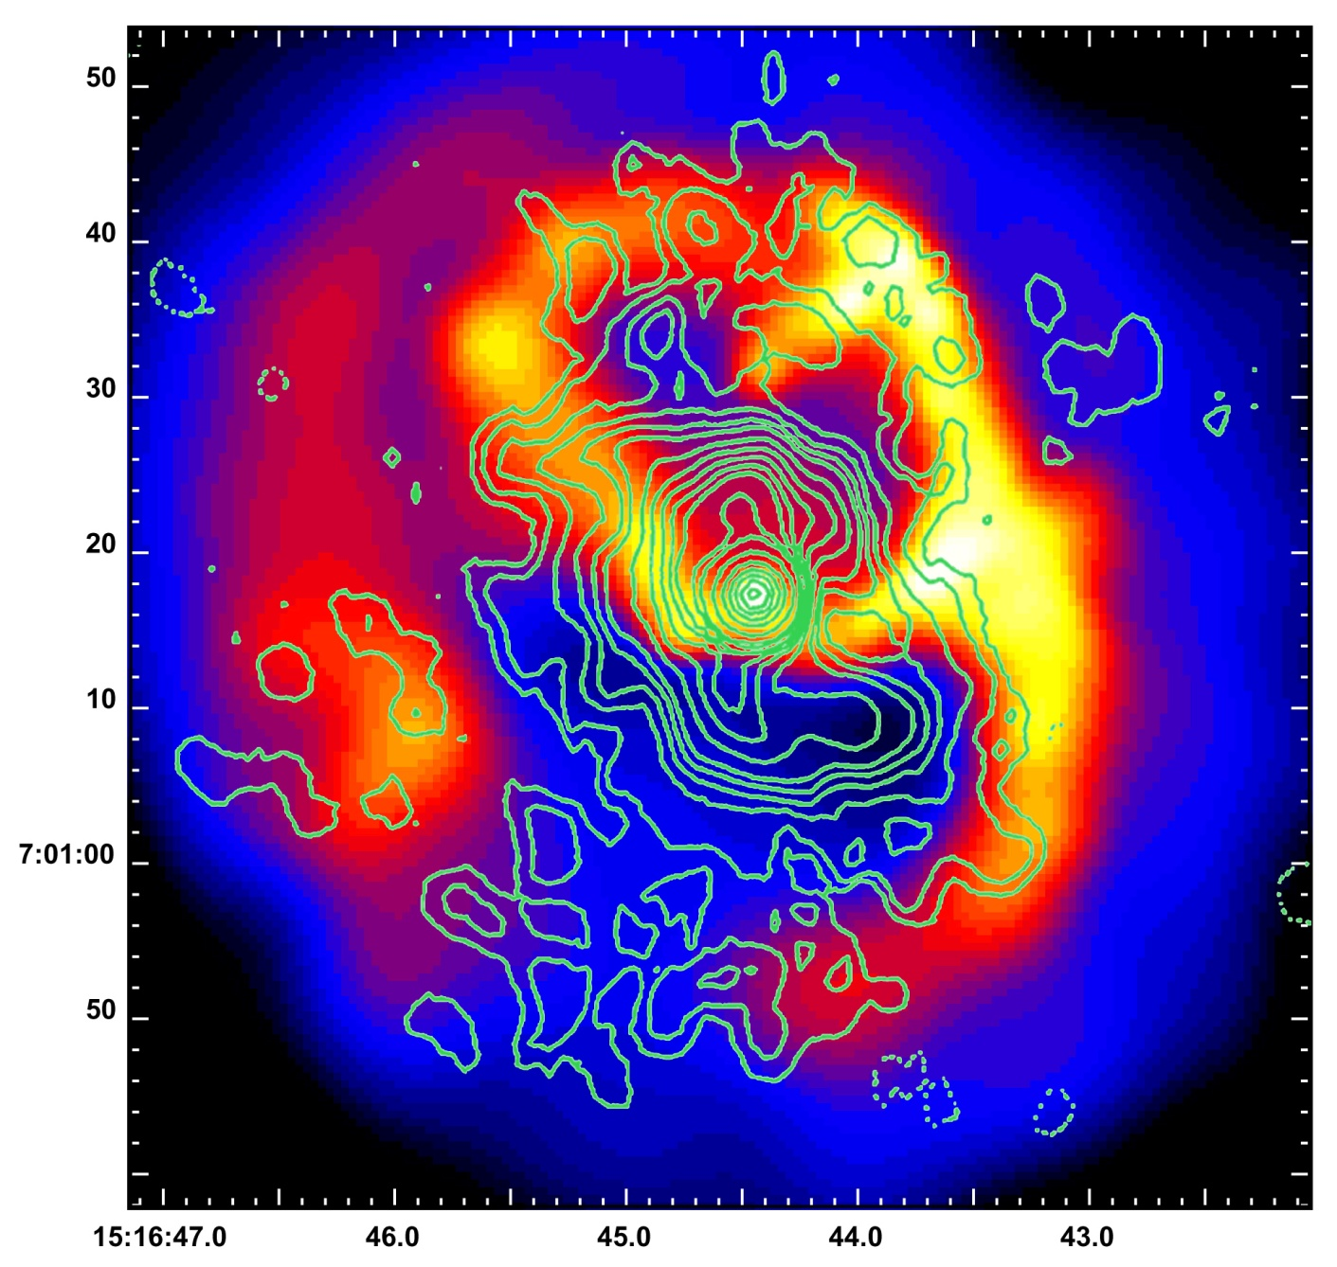
Radio Contours (Burns 1990)

Slide 36
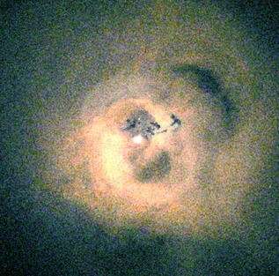
Perseus
(Fabian et al. 2003)

Slide 37
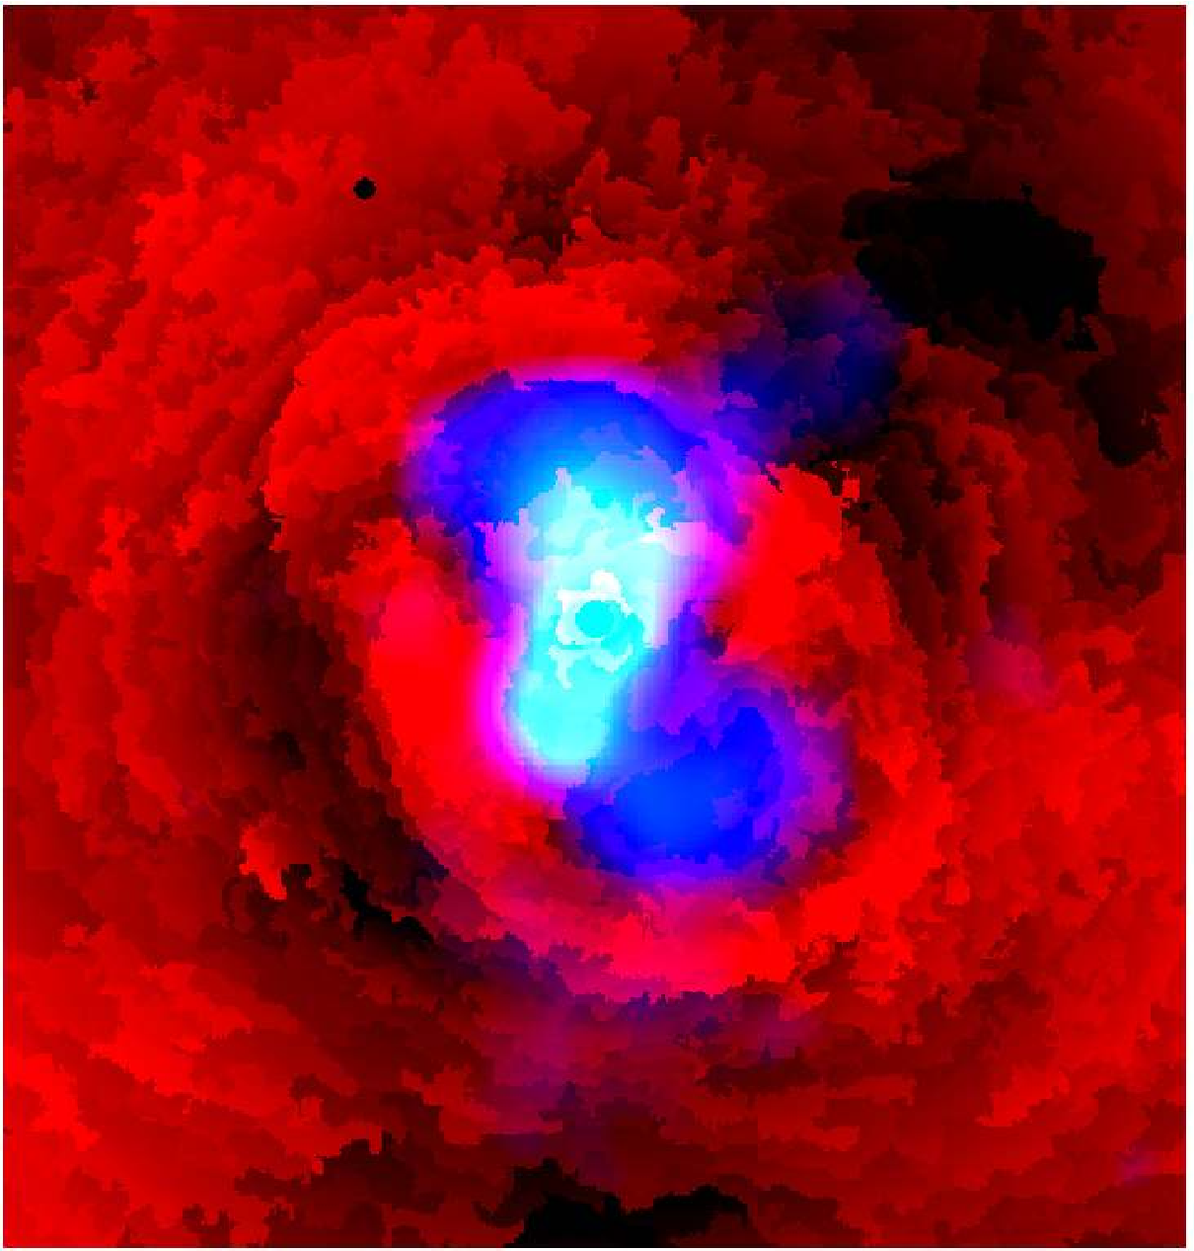
Perseus
Radio (blue) on pressure structure map (Fabian et al 2006)

Slide 38
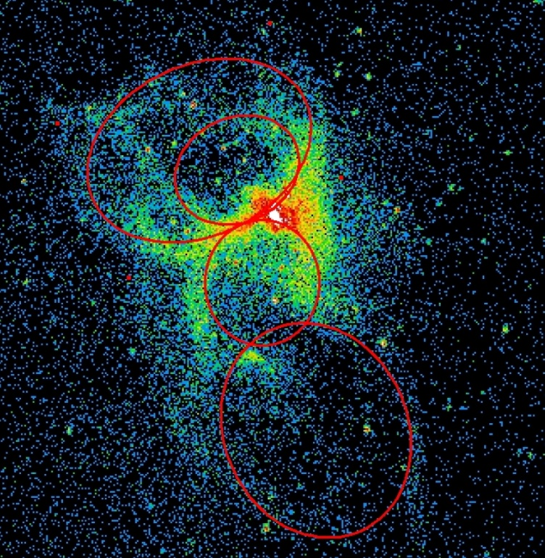
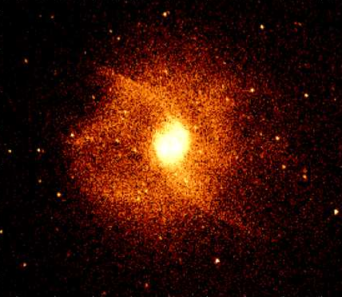
Individual Early-Type Galaxies and Groups
Radio bubbles seen in X-rays from individual early-types and some groups
M84
NGC 4636
Finoguenov et al. 2008
Baldi et al. 2009

Slide 39
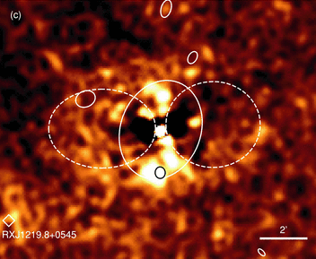
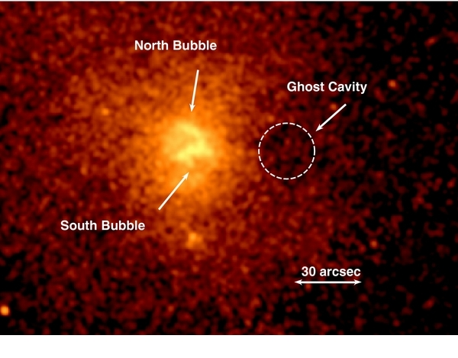
Individual Early-Type Galaxies and Groups
Radio bubbles seen in X-rays from individual early-types and some groups
NGC 4261
NGC 5846
O’Sullivan et al. 2011
Machacek et al. 2011

Slide 40
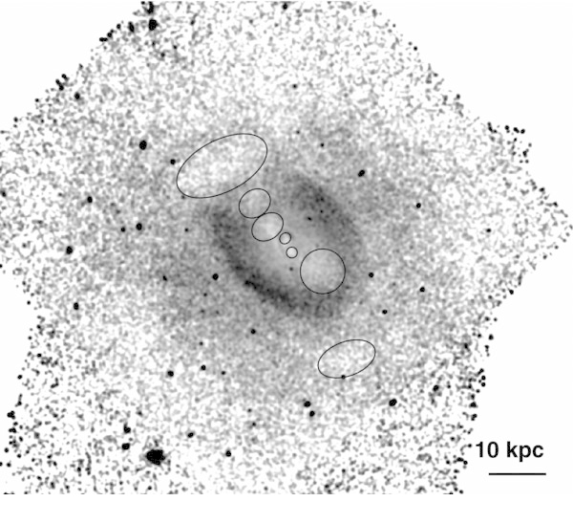
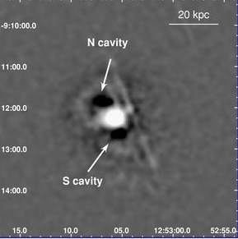
Individual Early-Type Galaxies and Groups
Radio bubbles seen in X-rays from individual early-types and some groups
NGC 5813
HCG62
Randall et al. 2011
Gitti et al. 2010

Slide 41
Individual Early-Type Galaxies and Groups
Radio bubbles seen in X-rays from individual early-types and some groups
Surveys of ellipticals:
Mathew & Brighenti 2003; Jones et al. 2007; Nulsen et al. 2007; Diehl & Statler 2008
≳25% of early-type galaxies with bright X-ray emission have radio bubbles

Slide 42
Morphology – Radio Bubbles
Two X-ray holes surrounded by bright X-ray shells
From deprojection, surface brightness in holes is consistent with all emission being projected (holes are empty)
Mass of shell consistent with mass expected in hole
X-ray emitting gas pushed out of holes by the radio source and compressed into shells
Mainly subsonic, but some have shocks

Slide 43
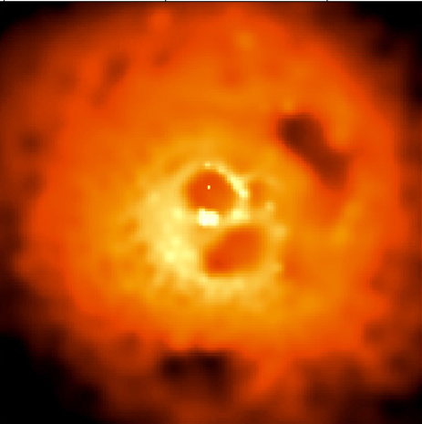
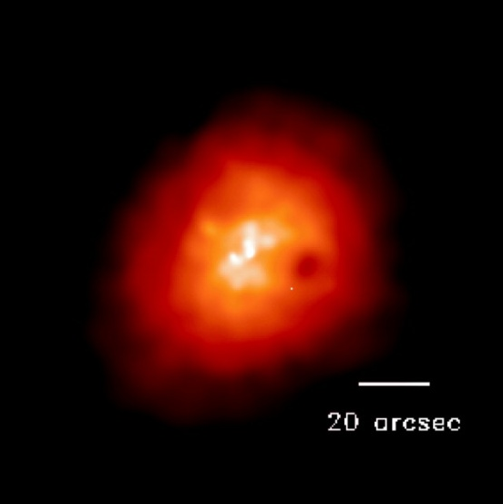
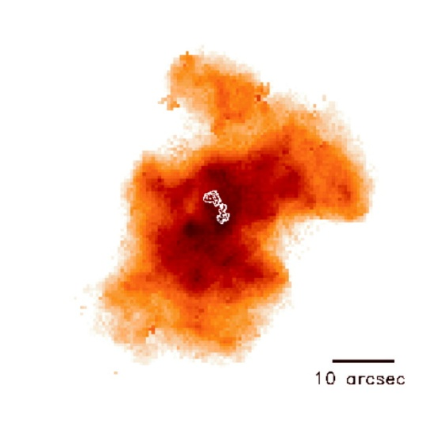
Buoyant “Ghost” Bubbles
Perseus
Abell 2597
Fabian et al. 2002
McNamara et al. 2001
Holes in X-rays at larger distances from center
No radio emission, at least at high frequencies
Old radio bubbles which rise buoyantly

Slide 44
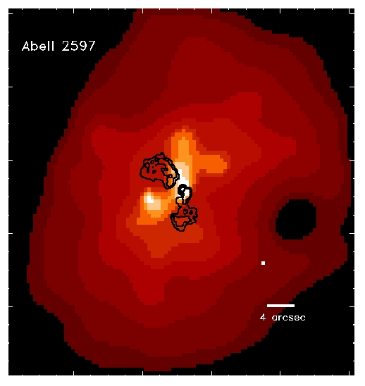
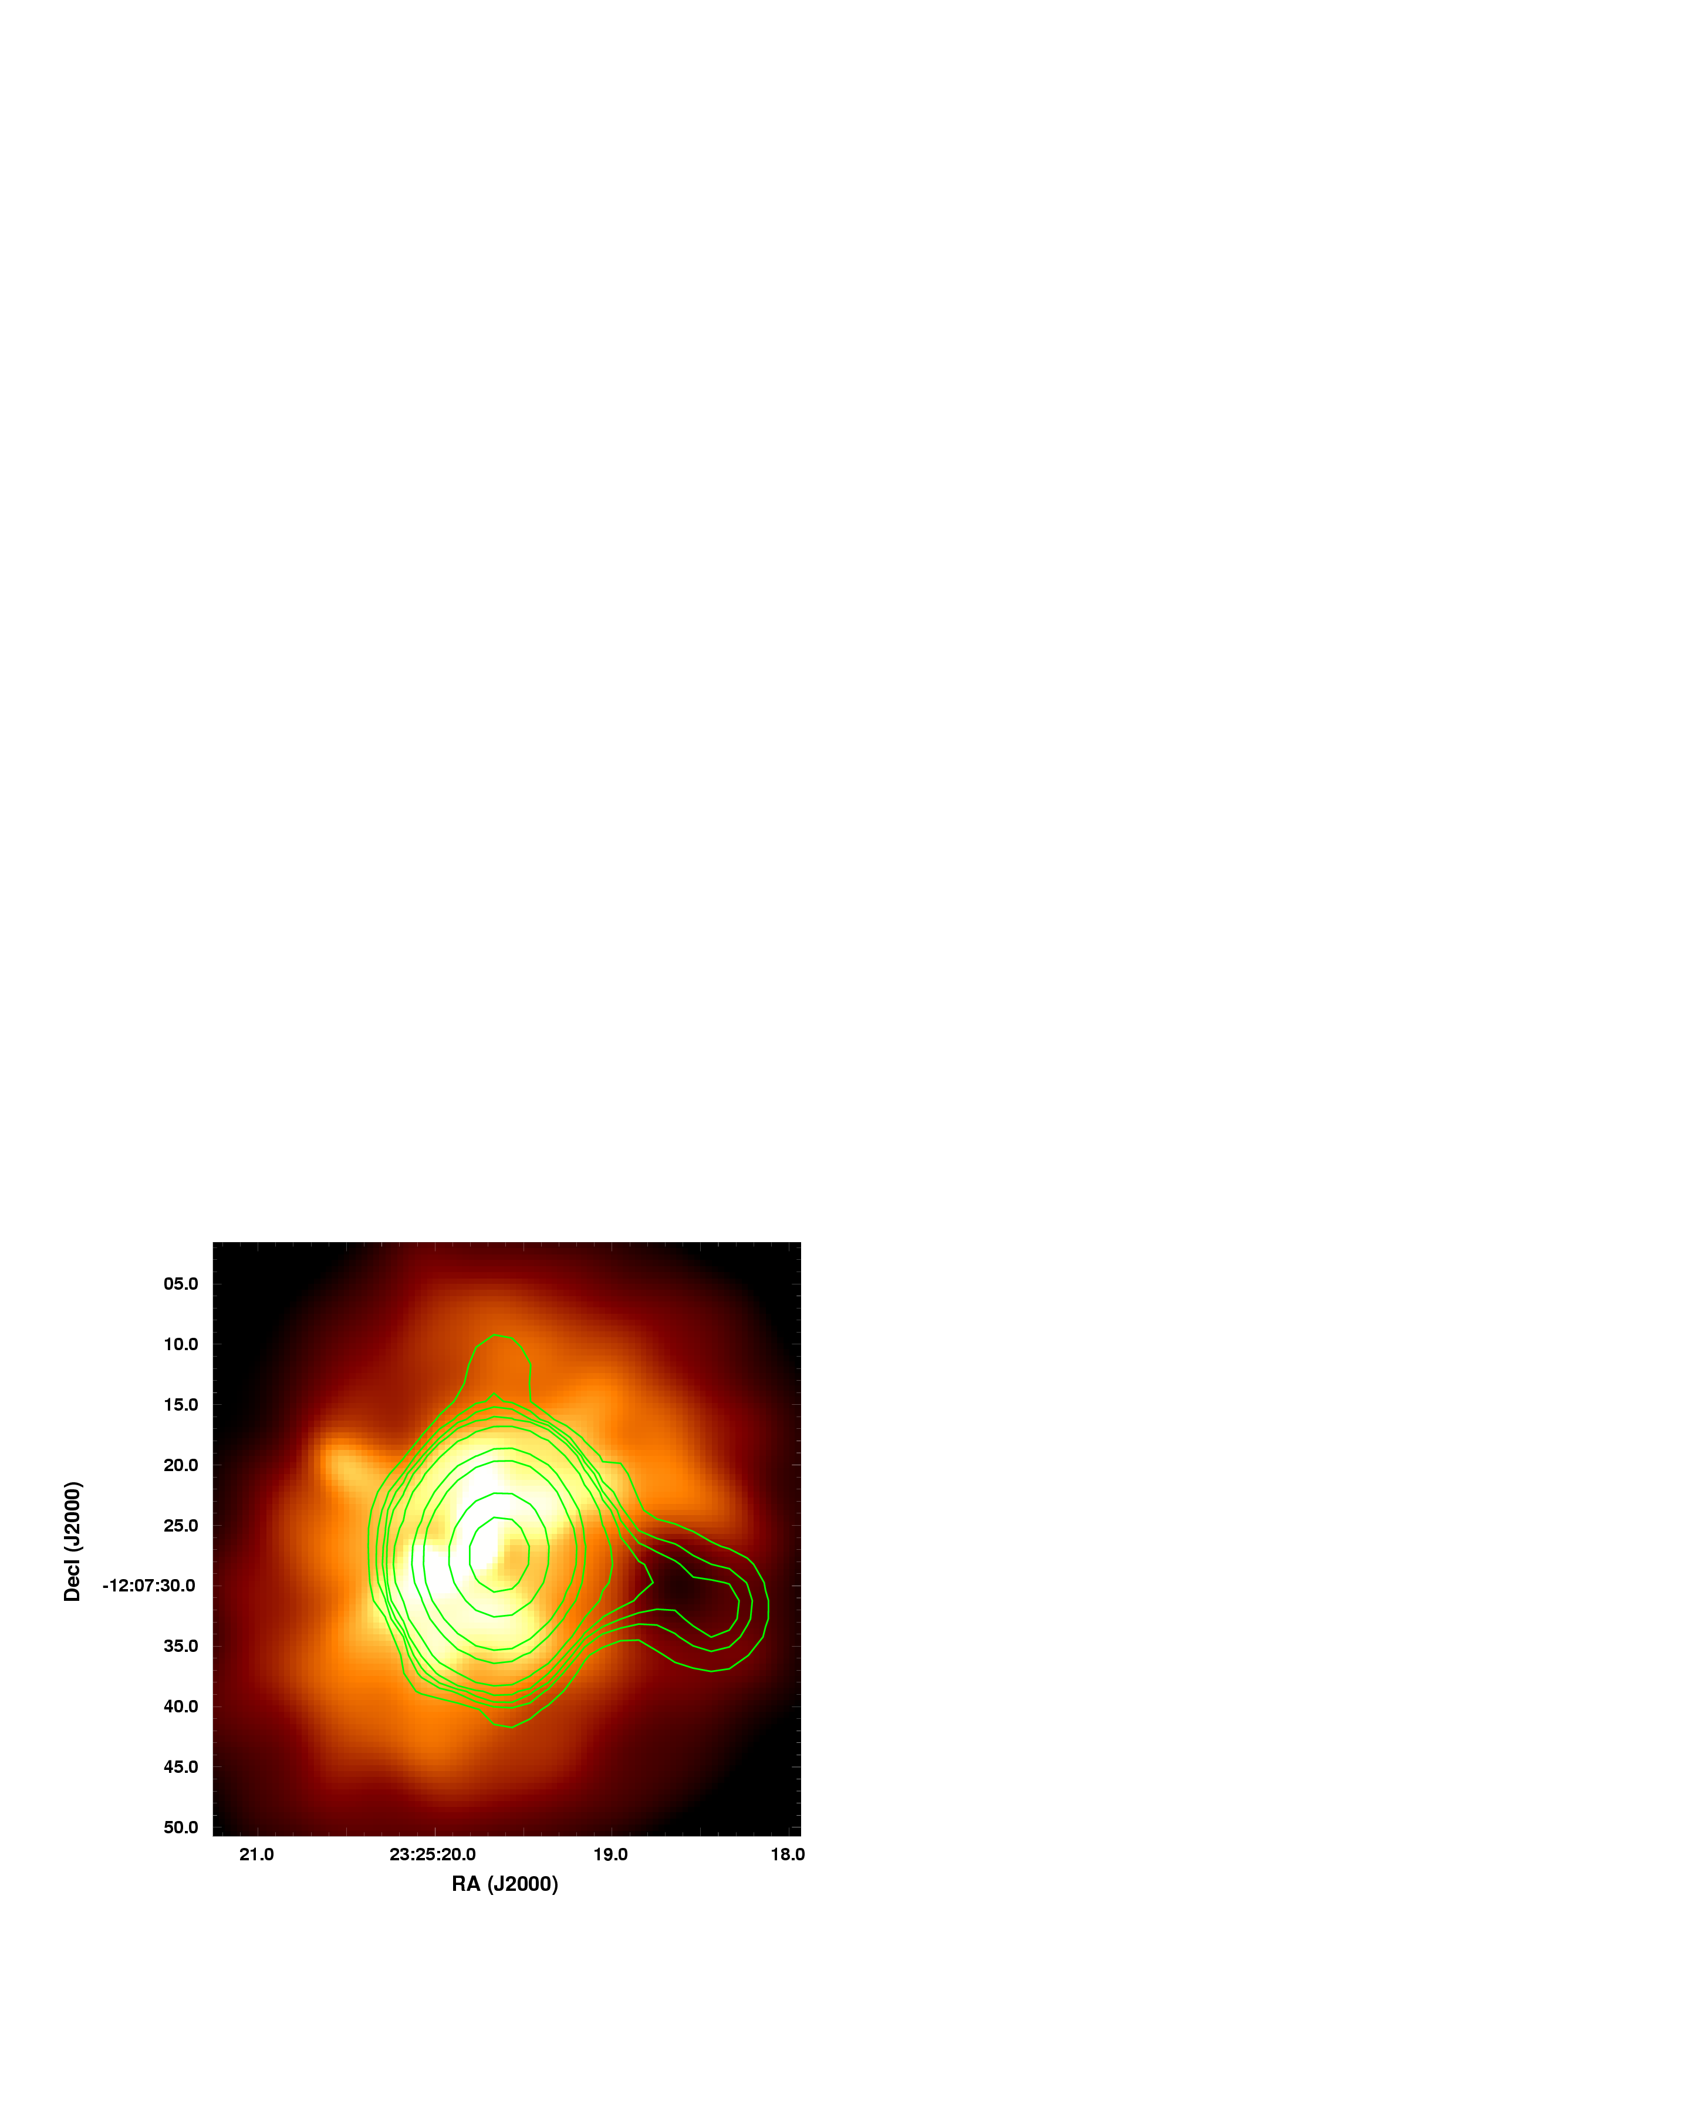
Ghost Bubbles at Low Radio Frequencies
Abell 2597
8.4 GHz radio contours ● Color = Chandra X-ray ● 330 MHz radio contours
(Clarke et al. 2005)
Ghost radio bubble filled at low radio frequencies

Slide 45
Radio Source Energies from Radio Bubbles
Energy deposition into X-ray shells from radio lobes (Churazov et al. 2002):
E ≈ 10⁵⁹ ergs in Abell 2052
Total energies typically 20x minimum energy/equipartition values from radio
Internal bubble energy
Work to expand bubble

Slide 46
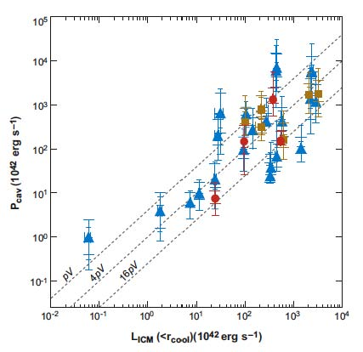
Can Radio Sources Offset Cooling?
Works in most cases, but perhaps not all
(Rafferty et al. 2006)

Slide 47
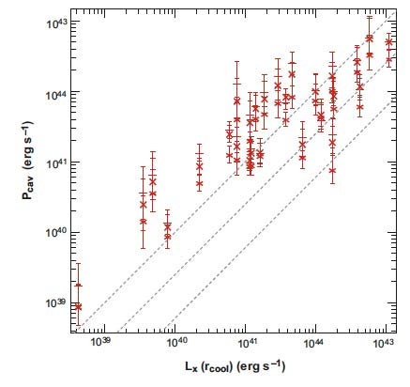
Can Radio Sources Offset Cooling?
For individual ellipticals
AGN power > cooling luminosity
(Nulsen et al. 2007)

Slide 48
Can Radio Sources Offset Cooling?
Individual ellipticals continuation of BCGs in cool cores

Slide 49
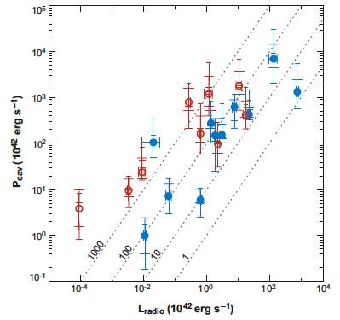
Radio Emission vs. Jet Mechanical Energy
Radio synchrotron emission is very inefficient, ~1% but highly variable
(Birzan et al. 2007)

Slide 50
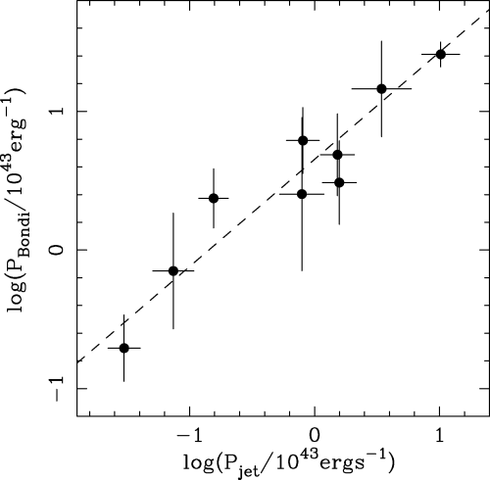
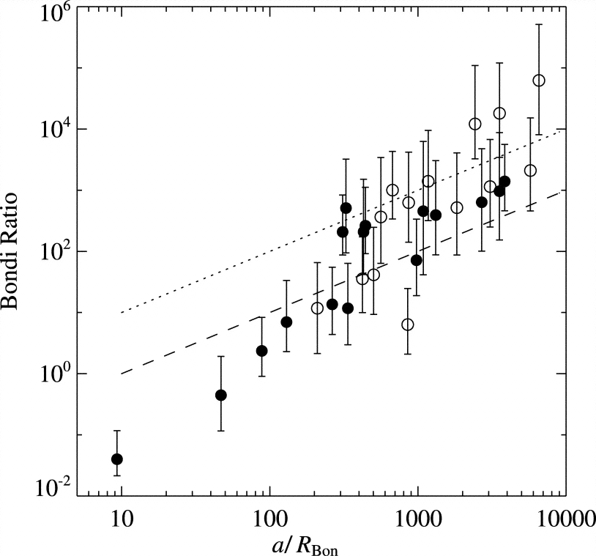
Bondi Accretion vs. Jet Power
Bondi Accretion?
Direct accretion of hot X-ray gas by SMBH
Gas density near Bondi radius resolved for nearby E’s
Works in E’s with ~1% of rest mass energy ➔ jets
May not work in BCGs in cluster cool cores
Ellipticals
BCGs in Cluster Cool Cores
(Allen et al. 2006)
(Rafferty et al. 2006)

Slide 51
Conclusions
Early-Type galaxies are bright X-ray sources
Hot gas = dominant ISM
Source of gas = stellar mass loss
Heated by mass loss, inflow, SN Ia, AGN
Dynamics (isolated galaxies)
X-ray Bright galaxies = quasi-hydrostatic inflow
Masses ➔ Dark matter halos
X-ray Faint galaxies = subsonic outflow, winds, partial winds
Environmental effects
Early-type X-ray halos smaller and fainter in dense regions?
Ram pressure stripping in clusters, tails observed
Small coronae retained
Radio AGN feedback in early-type galaxies
Radio bubbles and ghost bubbles, shocks
Give total jet energies
Can balance cooling

