Slide 1
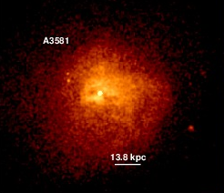
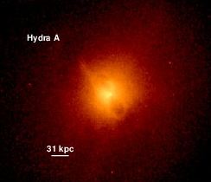
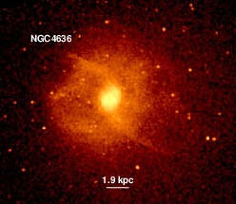
Studying AGN feedback in nearby X-ray groups and clusters
Electra Panagoulia
Institute of Astronomy, Cambridge, UK
With: Andy Fabian
Jeremy Sanders
Julie Hlavacek-Larrondo
X-ray View of Galaxy Ecosystems
11th July 2014

Slide 2
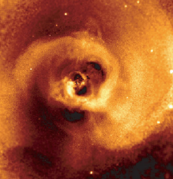
The AGN feedback loop
Main mechanism behind heating of the core ICM
Acts to offset cooling of ICM
Quenches star formation
Regulates cluster growth
0.5-7 keV smoothed composite image of NGC1275 (Fabian+ 2011)

Slide 3
Cluster entropy profiles
K = k_{B}T×n_{e}^{-2/3}
Large-scale deviations can be used to study effects of non-gravitational processes
Cavagnolo+2009

Slide 4
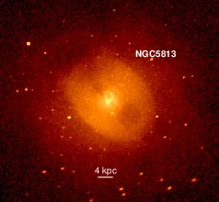
X-ray cavities
Calorimeter for energy of AGN outbursts
Main method of energy transfer between AGN and surrounding ICM
0.5-7 keV image of NGC5813 (Panagoulia+2014b)

Slide 5
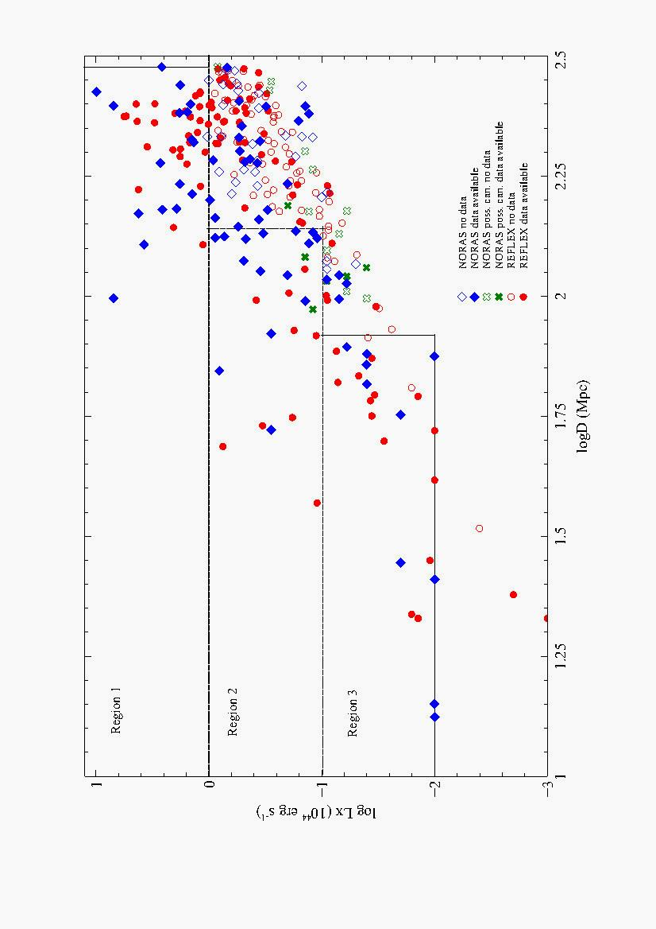
Sample selection
101groups and clusters in final sample
Panagoulia+2014a

Slide 6
Nearest means best spatial resolution
Panagoulia+2014a

Slide 7
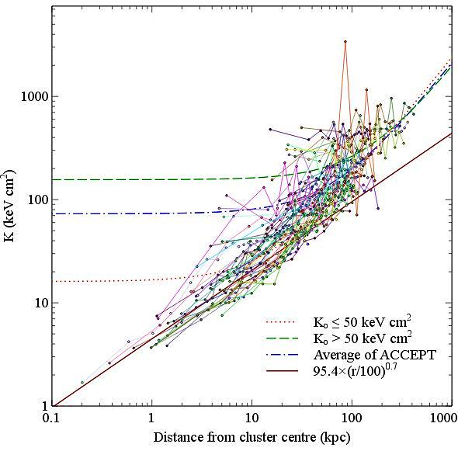
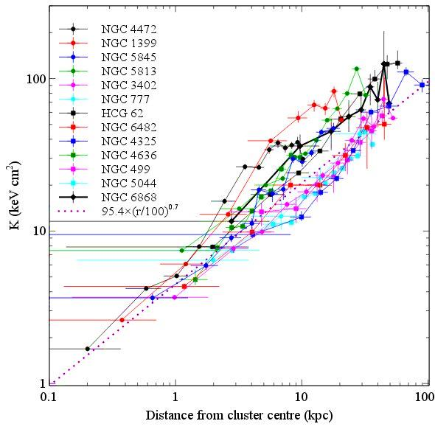
Entropy profiles: Results
Panagoulia+ 2014a

Slide 8
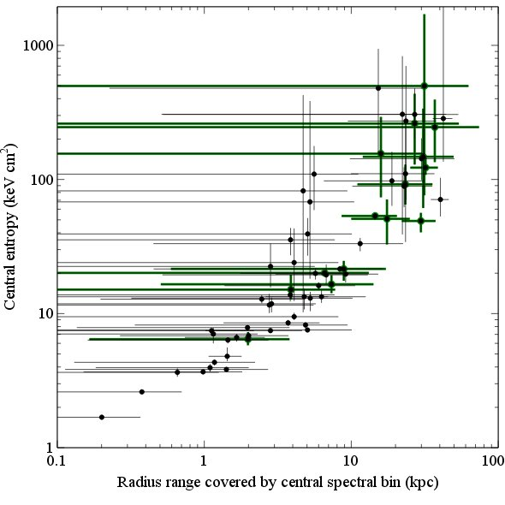
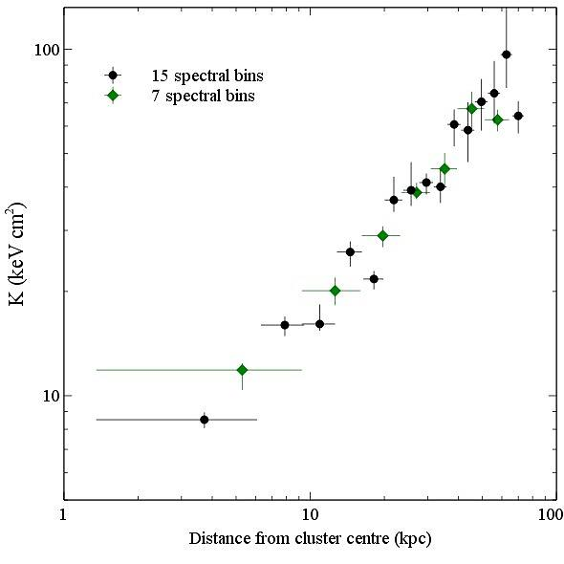
Entropy profiles: Data quality effects
Green sources: XMM data or ≤15 ks of Chandra data (Panagoulia+ 2014a)
Entropy profiles for A3581, using 15 (black) and 7 (green) spectral bins (Panagoulia+ 2014a)

Slide 9
Entropy profiles: Summary
Compiled overall entropy profile using 65 groups and clusters
Flattening of entropy profile at centre may be due to resolution effects
Non-existence of an entropy floor may have significant impact on importance of Bondi accretion onto AGN

Slide 10
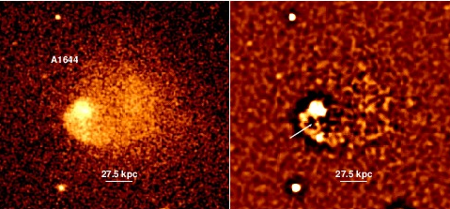
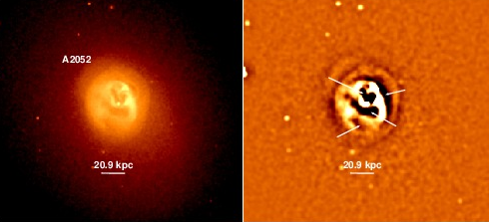
Searching for X-ray cavities
Using unsharp-masking, find cavities in 30/101 sources, all of which have a central t_{cool} ≤ 3 Gyr.
Panagoulia+ 2014b

Slide 11
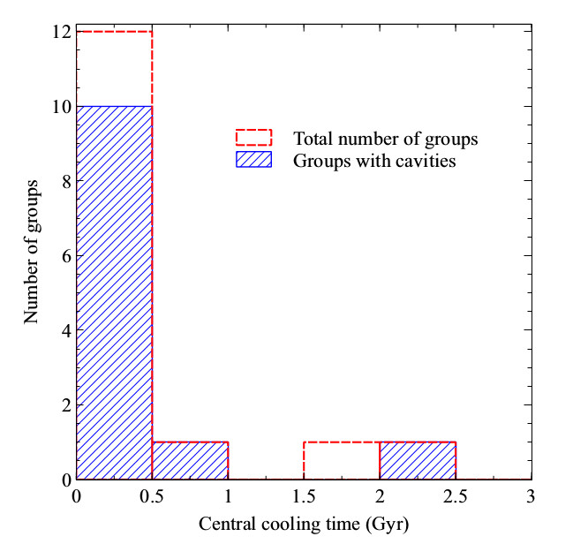
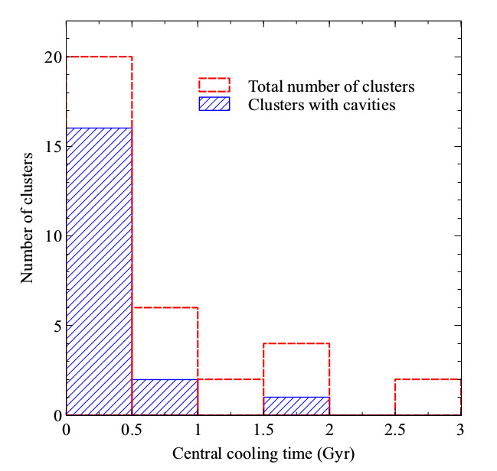
Short central t_{cool} sample
Focus on 49 sources with central t_{cool} ≤ 3 Gyr
AGN duty cycle 61%, rises to >80% for t_{cool} ≤0.5Gyr
Panagoulia+ 2014b

Slide 12
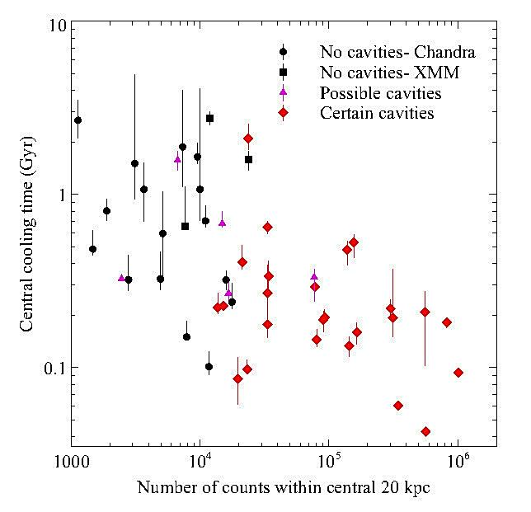
X-ray cavities: Data quality effects
Most sources with ≤ 10000 counts don’t have certain cavities
Almost all sources with ≥30000 counts have certain cavities
AGN duty cycle could be much higher
Panagoulia+ 2014b

Slide 13
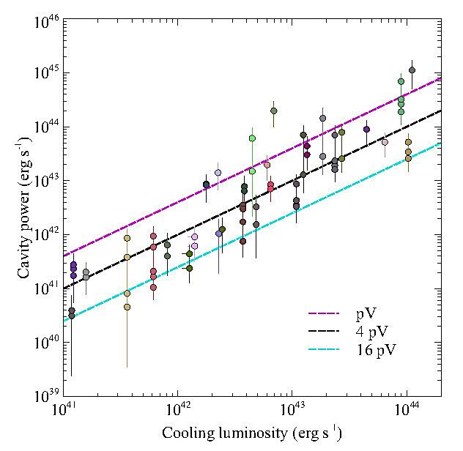
Cavity power vs L_{X} (r < r_{cool})
r_{cool}: radius within which t_{cool} ≤ 3 Gyr
Results indicate that “bubbling mode” needs to be a continuous process
See also: Bîrzan+ 2004, Rafferty+ 2006, Dunn & Fabian 2006…
Panagoulia+ 2014b

Slide 14
X-ray cavities: Summary
Find X-ray cavities in 30 sources, all of which have central t_{cool} ≤ 3 Gyr
Duty cycle is 61%, rises to >80% for t_{cool} ≤ 0.5 Gyr
Most sources with <10000 counts do not have cavities, all sources with >30000 counts do
Bubbling process has to be on average continuous to offset cooling

Slide 15
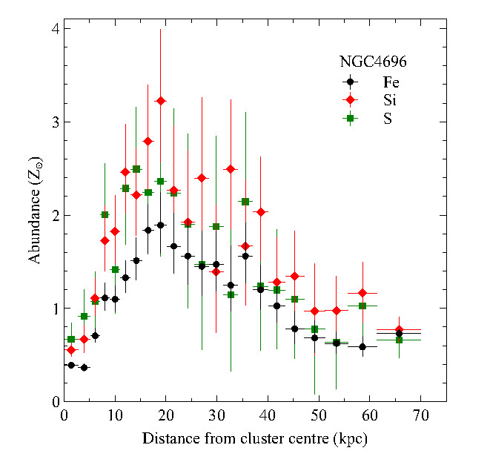
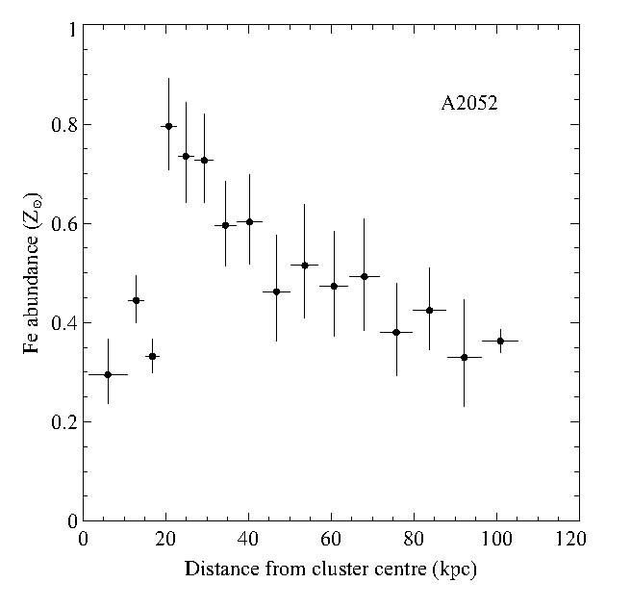
Future work: Metallicity profiles!
Drops seen in central kpc
17/30 sources with cavities have drops too
Evidence that bubbles are dragging out gas?

Slide 16
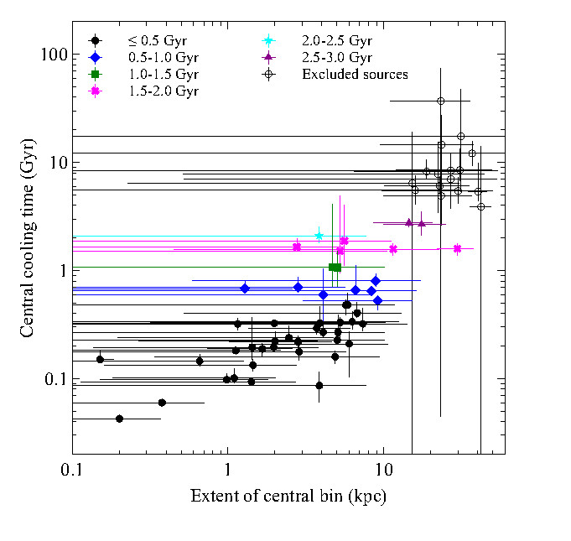

Slide 17
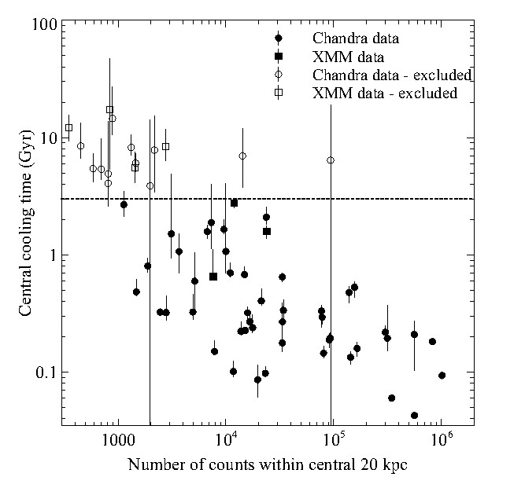
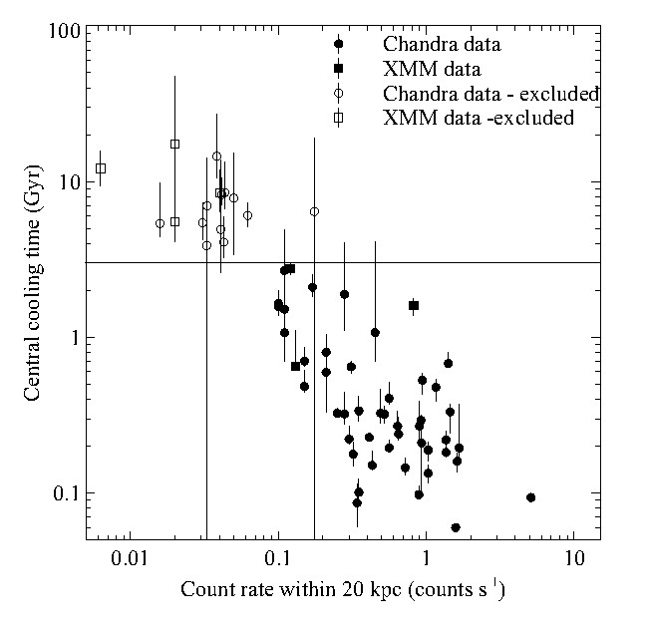

Slide 18
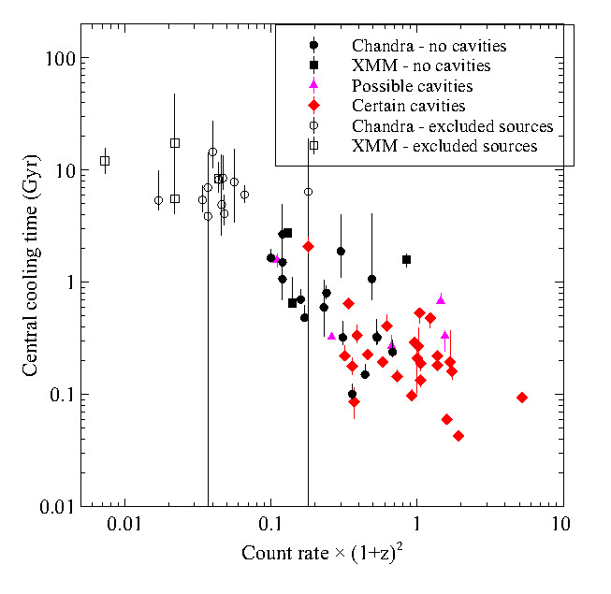

Slide 19
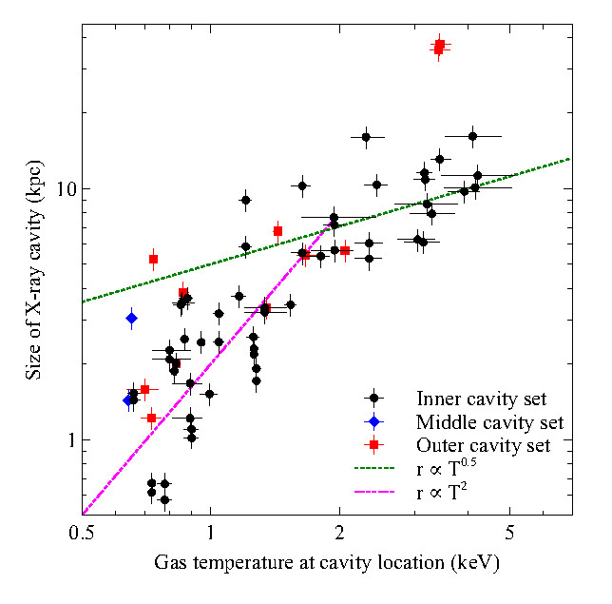
Cavity size vs temperature
Assuming pressure equilibrium, find that
r_{cav} ∝ T_{ICM}^{0.5}
Scatter below 1.5 keV may reflect scatter in
L_{X} – T_{ICM} relation
below 1.5 keV
Panagoulia+ 2014b

