Slide 1
Building the Hot Intra-Group Medium in Spiral-Rich Compact Groups
Ewan O’Sullivan (SAO)
Jan Vrtilek & Larry David (SAO) , Simona Giacintucci (Maryland)

Slide 2
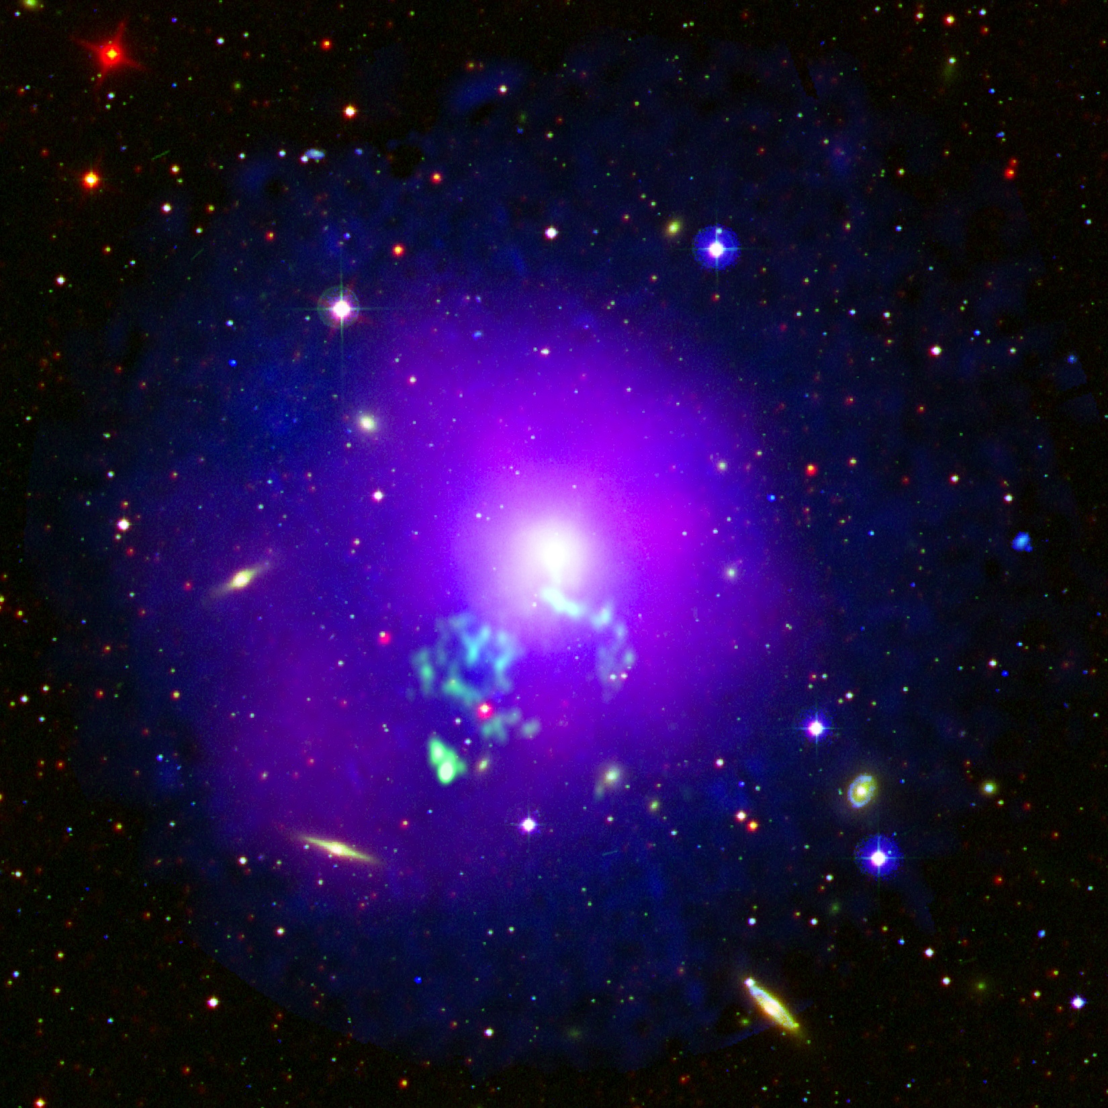
Co-evolution of galaxies and groups:
How do we build the IGM?
HCG 70
NGC 5044
MASS
Spiral-rich
Hi-rich / X-ray faint
Elliptical-dominated
Hi-poor / X-ray luminous
Transition from spiral-rich to elliptical-dominated through tidal interactions
Hot does the hot IGM form? Gravitational accretion and heating as in clusters?

Slide 3
Groups in transition:
Spiral-rich groups with a hot IGM
HCG 70
Dos Santos & Mamon (1999) HCG 16
Trinchieri et al. (2003)
HCG 92
SCG 0018-4854
Only a handful of spiral-rich groups with X-ray emitting intra-group gas are known.
Typically faint: L_{X} ≈ few x10⁴¹ erg s⁻¹
All are disturbed – filamentary structures, gas more closely linked with galaxies than group?
Is IGM formation linked to galaxy transformation?
Trinchieri et al (2008)
Notes:
HCG16 has ~3e40 in ridge, ~2e41 overall, 0.3keV
SCG0018-4854 has ~8.5e40 total, 0.2 keV
HCG92 has 5e41 (excluding shock), 0.6-0.8 keV

Slide 4
Stephan’s Quintet:
Heating Hi via collision shocks (O’Sullivan et al. 2009)
Williams et al (2005)
Tidal tails indicate multiple past interactions
900 km/s collision between infalling spiral and Hi filament visible in radio, X-ray, IR
Mass of ~0.7 keV IGM (~3x10¹⁰ M) ≈ Hi deficit (2x10¹⁰ M)
➔ Shocked Hi may make up a significant fraction of IGM
Notes:
3 spiral, 2 ellipticals, 1 foreground spiral. But is it unique?
~5e8 hot gas just in ridge

Slide 5
NGC 5903
A second Stephan’s Quintet?
HI contours on
TGSS 150MHz
TGSS 150 MHz contours
on DSS optical
Appleton et al (1990)
3x10⁹ M of HI in 100 kpc filament extending across NGC 5903 (Appleton et al. 1990)
~60 kpc wide radio structure, ~7 Jy @150 MHz, steep spectral index α=1.5±0.08
Notes:
Matched image scale and orientation, D=31.5 Mpc,

Slide 6
NGC 5903: a second Stephan’s Quintet? (O’Sullivan et al. in prep.)
~40 ks XMM, low-level flaring throughout
Disturbed 0.7 keV IGM correlated with HI!
Hot gas mass ≈ HI deficit (3x10¹⁰ M)
Collision shock as in Stephan’s Quintet?
No clear high-velocity intruder galaxy
➔ collision in plane of sky?
In SQ radio correlated with HI and X-ray
Only see a hint of this in NW spur ➔ age?
Plans:
GMRT HI observations (high-resolution maps)
Hα imaging (trace warm gas content)
Deep Chandra pointing proposed (155 ks)
XMM 0.3-3 keV
150 MHz contours
Notes:
Group velocity dispersion = 420 km/s, NGC5908 at 2565 km/s, NGC 5898 at 2122 km/s so if collision, must be in plane of sky.
Age>120-350 Myr if B=10-1 microG and we assume break is below 150 MHz. If break >5GHz, age<20-60 Myr.
Mgas in ridge=2e8, compared to 5e8 in SQ, density ~0.01 cm^-3

Slide 7
HCG 16: A spiral-only group with a hot IGM
(O’Sullivan et al. submitted)
VLA HI on DSS optical
XMM
Belsole et al (2003)
Chandra 0.5-2 keV
Hot gas detected by ROSAT and XMM but morphology uncertain
137.5 ks Chandra observation ➔ irregular ridge of 0.3 keV gas
X-ray ridge, Hi filament linking galaxies ➔ group not yet relaxed?
Notes:
7e9 Msol of hot gas in ridge, entrop = 30 keV cm^2, tcool =7-10 Gyr

Slide 8
HCG 16: Starburst winds
(O’Sullivan et al. submitted)
VLA 1.4 GHz
on DSS
2 northern spirals: Seyferts, low SFR
3 southern spirals: starbursts
HI and hot gas in ridge are densest around
NGC 838 and NGC 839
SF has been ongoing for 4-5x10⁸ yr
~10¹⁰ M of hot gas ejected in that period
~20% of IGM mass
If other group members have ejected gas at a similar rate in the past, ~40% of IGM could have come from starburst galaxies.
NGC839
NGC838
GMRT
610 MHz
on Chandra
0.5-2 keV
Notes:
SFR = 7-20 Msol/yr depending on method, galaxy.

Slide 9
Summary
Only a handful of spiral-rich groups with a hot IGM have been studied with Chandra and/or XMM
Stephan’s Quintet: demonstrates that collisional shocks can contribute significantly to building IGM by heating Hi
NGC 5903: shows that SQ is not unique – collisional shocks are short-lived, but can be detected from radio/X-ray data
HCG 16: demonstrates that starburst winds can inject significant quantities of hot gas into the IGM in spiral-only groups. Up to ~40% of IGM observed in this unrelaxed group may have been contributed by galaxy winds.
Deeper surveys are needed to identify more examples (eROSITA, low frequency radio?) with Chandra follow-up to study interactions in detail.

