Slide 1
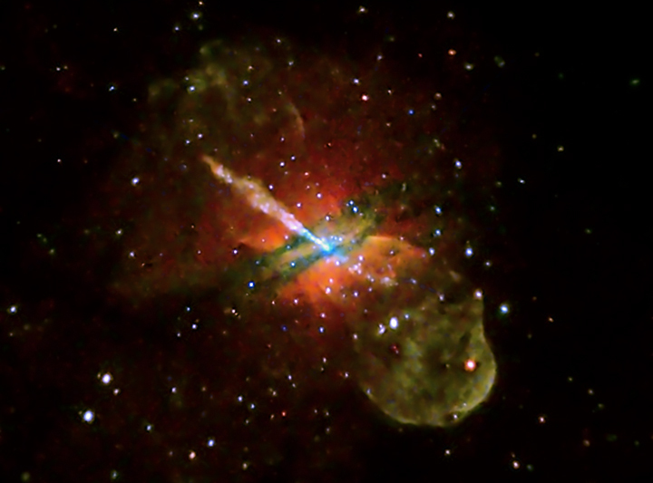
A Critical Role for Viscosity in the Radio Mode AGN Feedback Cycle
Paul Nulsen
Harvard-Smithsonian Center for Astrophysics

Slide 2
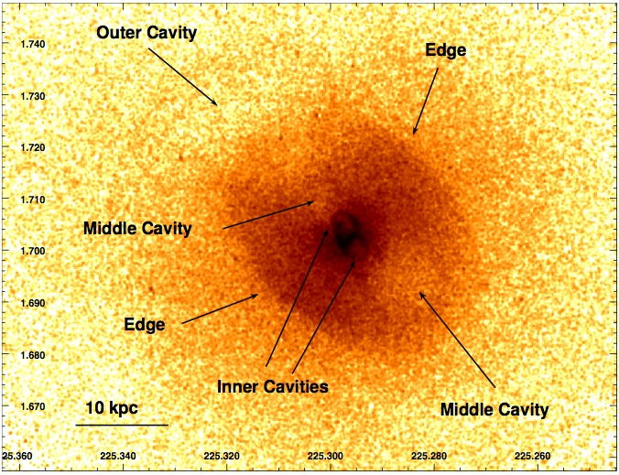
Fuel for Radio Mode AGN Feedback Cycle
Low star formation rates in nearby massive elliptical galaxies at the centers of hot atmospheres are widely attributed to radio mode feedback (Birzan+ 2004; Dunn+ 2005; Dong+ 2010; O’Sullivan+ 2011; McNamara & Nulsen 2007, 2012; Fabian 2012)
NGC 5813 (Randall et al 2011)
Feedback cycle is closed naturally if the AGN are fueled by cooled gas
Bondi accretion cannot power some systems (Rafferty+ 2006)
Systems with shortest cooling times have cold gas (Edge 2001; Donahue+ 2011; Werner+ 2014)
How is the cold gas produced?

Slide 3
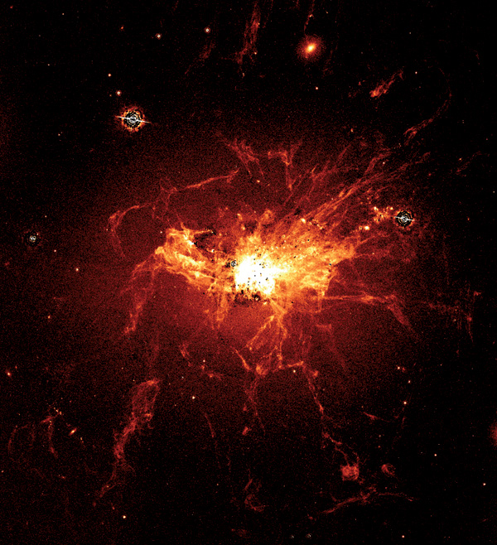
Viscosity vs Thermal Instability
Density perturbations oscillate about their equilibrium position, where the density perturbation is zero, at the Brunt-Väisälä frequency,
ie, they return to equilibrium in about the free fall time
This suppresses thermal instability unless the cooling time is short compared to the free-fall time (Cowie et al 1980; Balbus & Soker 1989)
Thermal instability in a hot atmosphere requires t_{cool} < 10 t_{ff} (Sharma et al 2012)
Optical line emitting gas (eg Crawford et al 1999) and molecular
gas (eg Edge 2001; Salomé & Combes 2003) are detected in many
systems with t_{cool} > 10 t_{ff} – how?
Gas with t_{cool} > 10 t_{ff} can cool unstably if supported by rotation
To conserve angular momentum, the viscous diffusion time at r
must exceed the cooling time, ie
Line emitting gas in Perseus (Fabian et al 2008)

Slide 4
Braginskii Viscosity is not Diffusive
Dynamically insignificant magnetic field => fluid motions plus flux freezing change B
In a collisionless plasma, particle magnetic moments, are conserved
=> varying B causes anisotropy in particle velocity distributions
Collisions isotropize proton velocities on a timescale of τ_{pp} ≈ 700 (kT)^{3/2} n_{e}⁻¹ yr (electrons ≈ 60 times faster)
Changing B due to fluid motion causes a small residual pressure anisotropy,
where is the pressure perpendicular to the field
Kunz et al (2012):
Viscous stress tensor is the anisotropic part of the total stress,
For motion parallel to uniform field, must match usual stress:
so τ_{ii} p_{i} is exactly the Spitzer (field free) viscosity

Slide 5
Conditions for Braginskii Viscosity
When decoupled from one another, changes in particle velocities parallel and perpendicular to B reflect energy conservation for work done on/by the corresponding pressures
Requirements:
Larmor radius << mean free path
Relaxation time determined by ion collisions – magnetic field not chaotic enough to reduce it (ie plasma turbulence not too strong; cf. Schekochihin+ 05, 09)
Can fail if magnetic field is isotropic on average in small volumes and
field coherence length << particle mean free path
Insensitive to the poorly known structure of the magnetic field or field topology
In contrast to thermal conduction

Slide 6
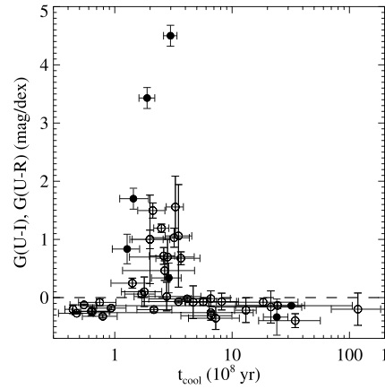
Observations for Thermal Instability
Rafferty et al (2008) found young stars in BCGs only in systems with short central cooling times
Cavagnolo et al (2008) found Hα emission in BCGs only in systems with low central entropy (short cooling time)

Slide 7
Conduction vs Viscosity
Voit et al (2009) found the minimum value of in these systems
– so they are thermally unstable by the Field criterion if conductivity is suppressed moderately
The threshold criterion on the viscosity expressed as is very similar
In fact, their ratio is almost independent of density and temperature
We can equally well interpret the result for the Field criterion as placing an upper limit on the viscous diffusion length in a cooling time, with the minimum value of
Required for gas to cool out of a hot atmosphere

Slide 8
Viscosity Takes Precendence?
Werner+ (2014): Field stability parameter is low over an extended region in systems with cold gas
The exception, NGC 6868, has a rotating disk of cold gas
Suggests global rotation in the hot atmosphere of NGC 6868
cooling gas moves on non-radial orbits
Werner+ 2014
Difficult for heating from an AGN at the center of an aspherical atmosphere to balance cooling locally throughout the atmosphere
Gas cooling into a rotating disk does not feed the AGN

Slide 9
Conclusions
Thermally unstable cooling of hot gas is a critical element of the radio mode AGN feedback cycle
Angular momentum can promote thermal instability, even if the cooling time exceeds ~10 free-fall times, if the viscosity is not too large
Braginskii viscosity is local and much less sensitive to details of magnetic field structure than thermal conduction
The Field criterion is numerically similar to the requirement on the viscosity for thermal instability, if the conductivity is suppressed by a factor of about 5
Systems with cold gas or young stars are unstable by these criteria
One exception shows evidence of global rotation in the hot gas, suggesting the viscous stability condition takes precendence

