Slide 1
X-ray Scaling Relations of Early Type Galaxies
Dong-Woo Kim
Harvard-Smithsonian Center for Astrophysics
(X-ray View of Galaxy Ecosystems Boston in July 2014)

Slide 2
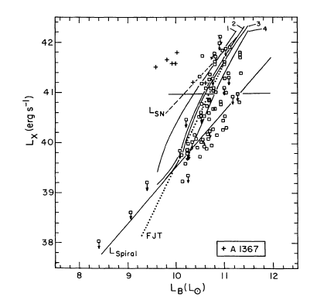
Previous X-ray scaling relations of early type galaxies
L_{X}(total) : a proxy for the hot gas content
L_{B} : a proxy for the stellar content
correlation between L_{X}(total) and L_{B}, but
large scatter (at least by a factor of 100) in L_{X}/L_{B}
one of the long standing puzzle in X-ray astronomy of ETGs
Einstein
Forman, Jones & Tucker (1985)
Trinchieri & Fabbiano (1985)
⬅Canizares, Fabbiano & Trinchieri (1987)
White & Sarazin (1991)
Fabbiano, Kim & Trinchieri (1992)
Eskridge, Fabbiano & Kim (1995)
Rosat
O’Sullivan, Forbes & Ponman (2001)
Ellis & O’Sullivan (2006)
and more …..
What makes the large scatter in L_{X}/L_{B}?
total mass (stellar + DM)
internal kinematics (rotation)
intrinsic shape (flattening)
star formation episode
AGN + SN feedback
more
confinement by hotter ICM
infall
mergers
ram-pressure stripping
more
internal effects external effects

Slide 3
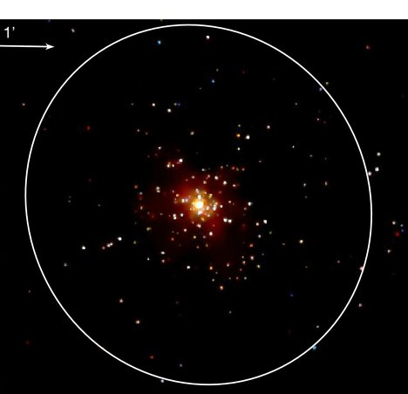
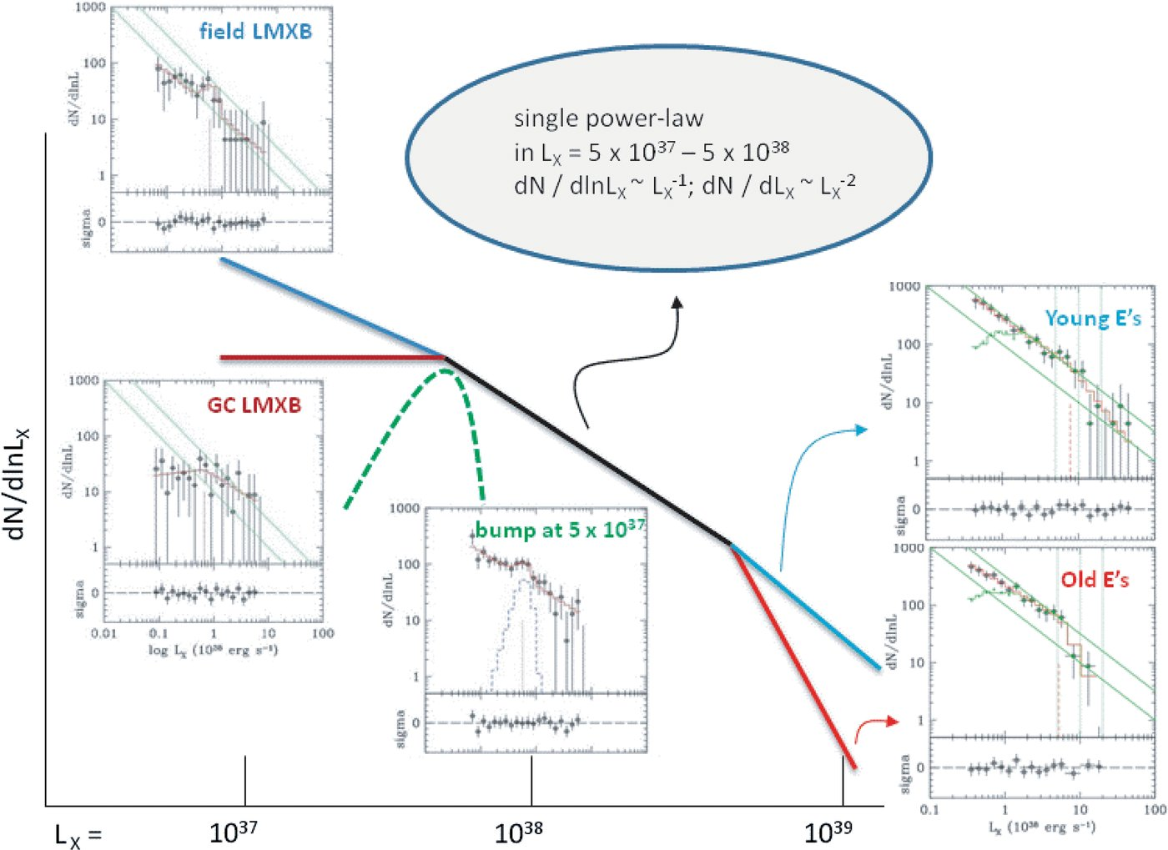
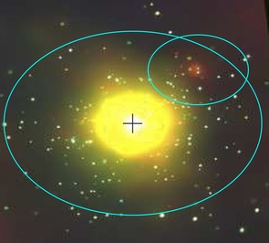
LMXBs in Elliptical Galaxies
N4278
hot gas poor E
180 points sources in D₂₅
L_{X} = 4 x 10³⁶ – 2 x 10⁴⁰ erg s⁻¹
N4649
hot gas rich E
399 point sources in D₂₅
L _{X} = 9 x 10³⁶ – 5 x 10³⁹ erg s⁻¹
X-ray Luminosity Function of LMXBs
(Kim and Fabbiano 2010)

Slide 4
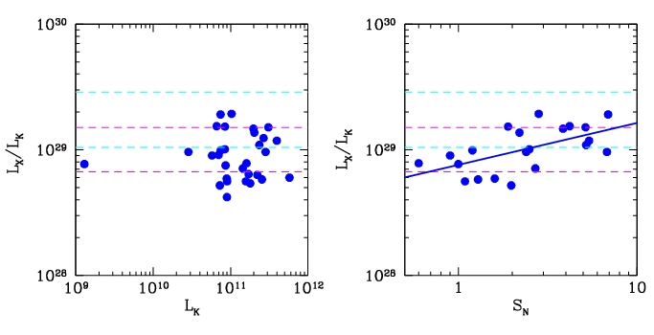
New with Chandra: X-ray scaling relation of LMXBs
Kim & Fabbiano (2004)
Boroson, Kim & Fabbiano (2011)
L_{X}/L_{K} (erg s⁻¹ L_{K}⁻¹)= 10^{29.0±0.176}
L_{X}/L_{K} (erg s⁻¹ L_{K}⁻¹)= 10^{28.88} S_{N}^{0.334±0.106}

Slide 5
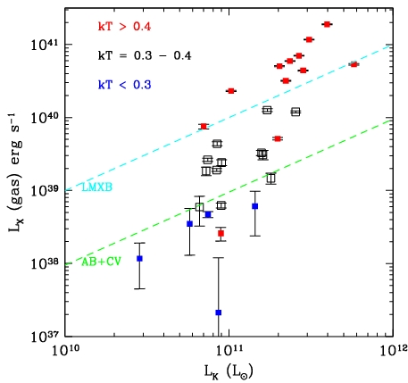
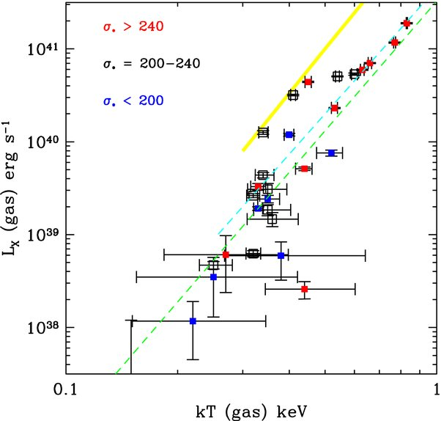
New with Chandra: L_{X}(gas) instead of L_{X}(total)
L_{X}(gas) – L_{K} relation L_{X}(gas) – T(gas) relation
L_{X}(gas) – L_{K} relation
The scatter is even larger (~1000). Similar scatter in Lx(gas) – sigma.
Sample : 30 normal ETGs (without cD) with Chandra obs and optical line indices
include more gas-poor galaxies than previous X-ray selected samples
The L_{X}/L_{K} ratios corresponding to LMXBs and ABs+CVs are marked by two diagonal lines.
Our sample consists of
1/3 L_{X}(gas) > L_{X}(LMXB)
1/3 L_{X}(LMXB) > L_{X}(gas) > L_{X}(ABs+CVs)
1/3 L_{X}(LMXB) > L_{X}(ABs+CVs) > L_{X}(gas)
L_{X}(gas) – T(gas) relation L_{X}(gas) ~ T^{4.5 ± 0.6}
tighter relation than L_{X} – L_{K}, provides a better constraint, yet to understand
steeper than L ~ T³ in clusters (e.g., Mushotzky 1984; Arnaud & Evrard 1999)
similar slope but L_{X} is lower than cD galaxies (O’Sullivan et al. 2003)
Boroson, Kim and Fabbiano (2011)

Slide 6
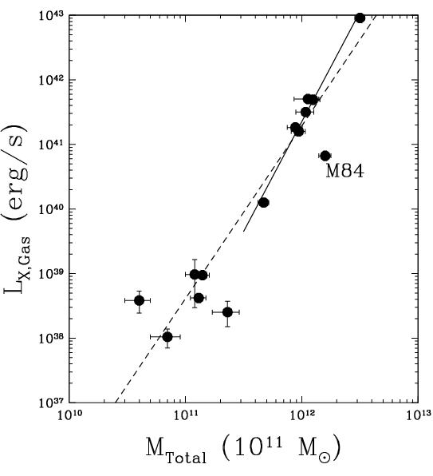
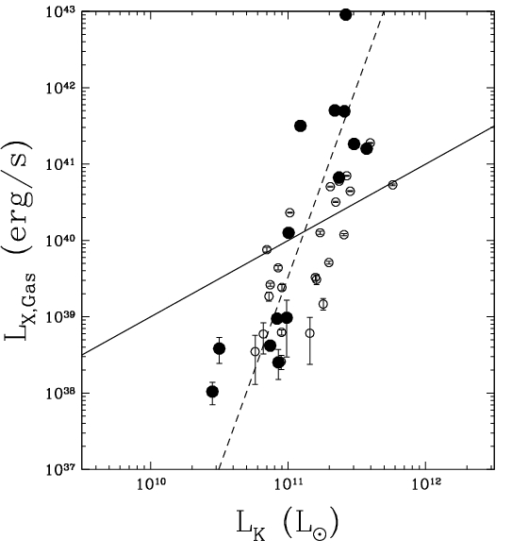
New: with M(total) instead of L_{K}
from Kim and Fabbiano (2013)
M_{Total} = M(< 5 R_{e})
measured with GCs and PNe kinematics
(from Deason et al. 2012)
➔ very tight correlation L_{X}(gas) ~ M(total)³
In the entire sample,
L_{X}(gas) ~ M(total)^{2.7 ±} ^{0.3}
In hot-gas-rich
L_{X}(gas) ~ M(total)^{3.4} ± ^{0.2}
(one exception, M84 - ram pressure stripping)
A large scatter in L_{X,Gas} by a factor of 1000
among galaxies with similar L_{K} ~ 10¹¹
The best fit (dashed line) L_{X}(gas) ~ L_{K}^{4.5 ±} ^{0.8}
Consistent with expected:
M_{Total} ~ M★^{1.7-2.5} (Moster et al. 2013).
M★ ~ L_{K}
L_{X,Gas}−M_{Total}³ ➔ L_{X,Gas} ~ L_{K}^{5-7.5}
L_{K} should not be used to predict L_{X,Gas}
M_{DM}/M_{STAR} varies widely

Slide 7
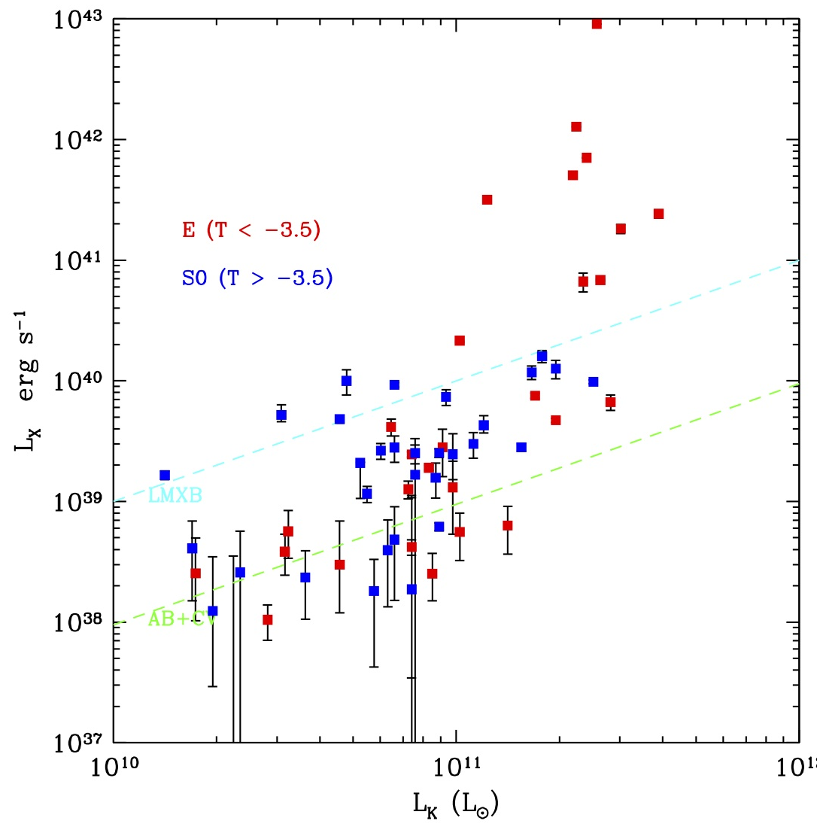
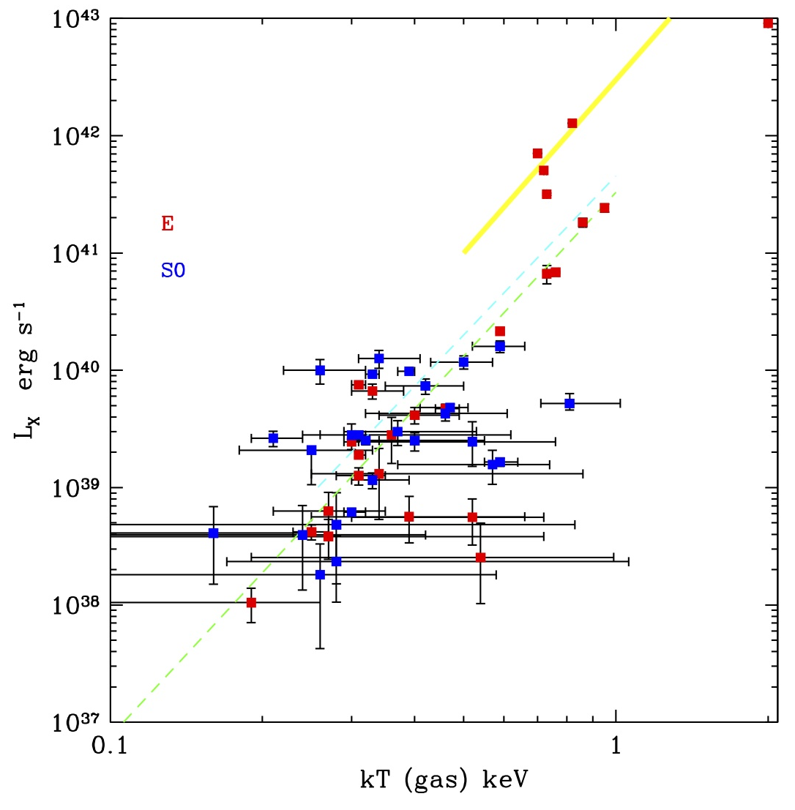
further study with Chandra archival data (Kim et al 2014 in prep.)
with the Atlas 3D sample (Cappellari et al. 2011)
V-limited 260 ETGs with M_{K} < -21.5 and D < 42 Mpc
multi-wavelength data (including integral-field spectroscopy)
detailed dynamical models of stellar kinematics
dynamical mass + rotation + intrinsic shape + accurate σ + age
61 observed with Chandra with exposure > 10 ksec
L_{X}(gas) – L_{K} relation L_{X}(gas) – T(gas) relation

Slide 8
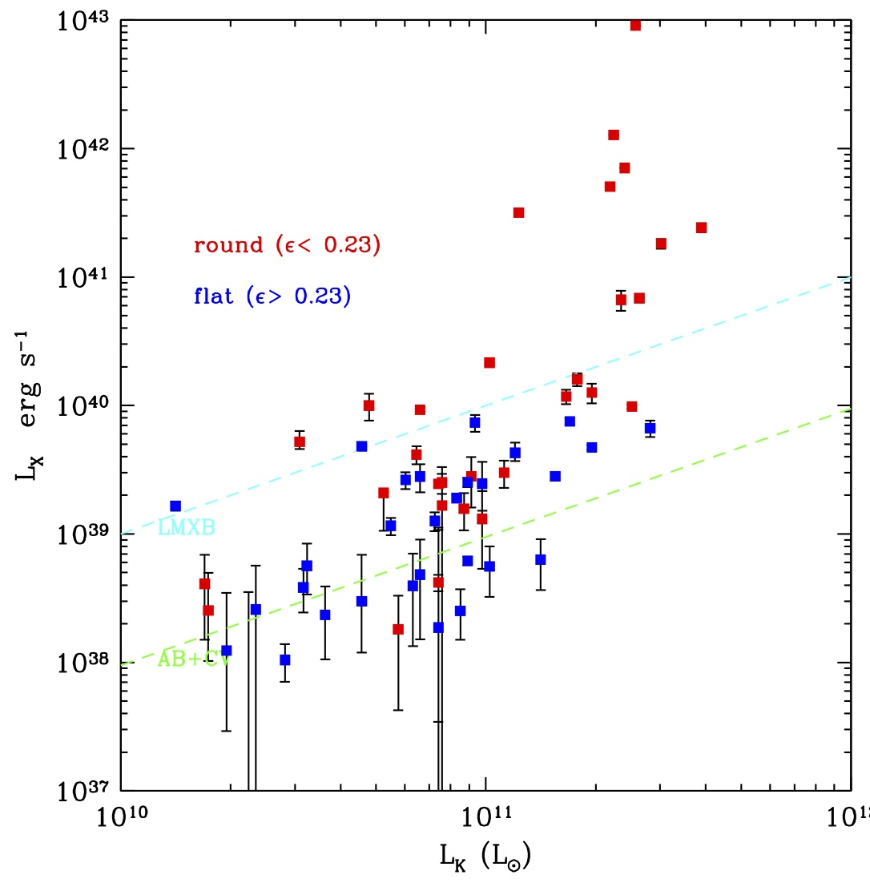
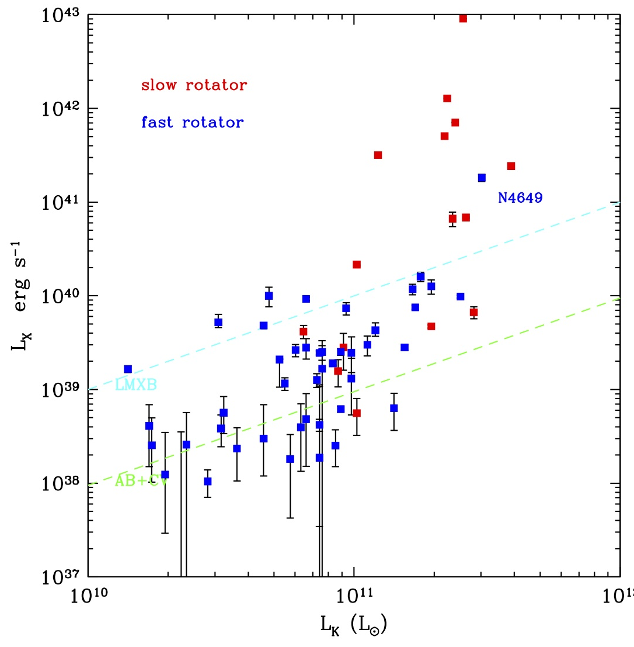
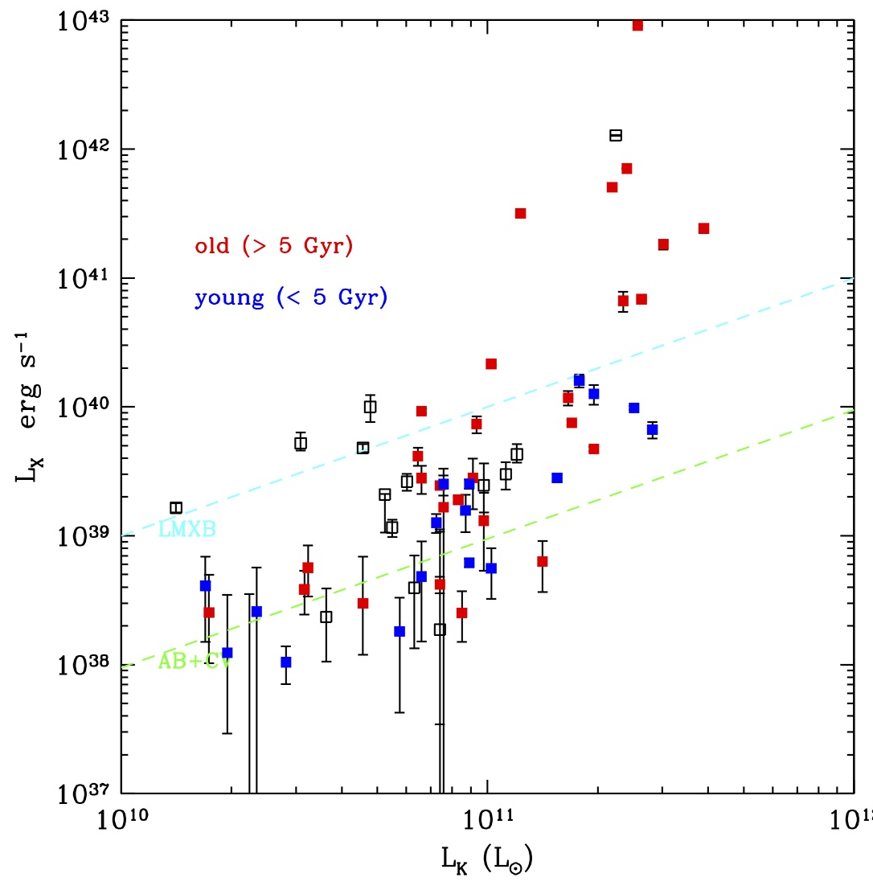
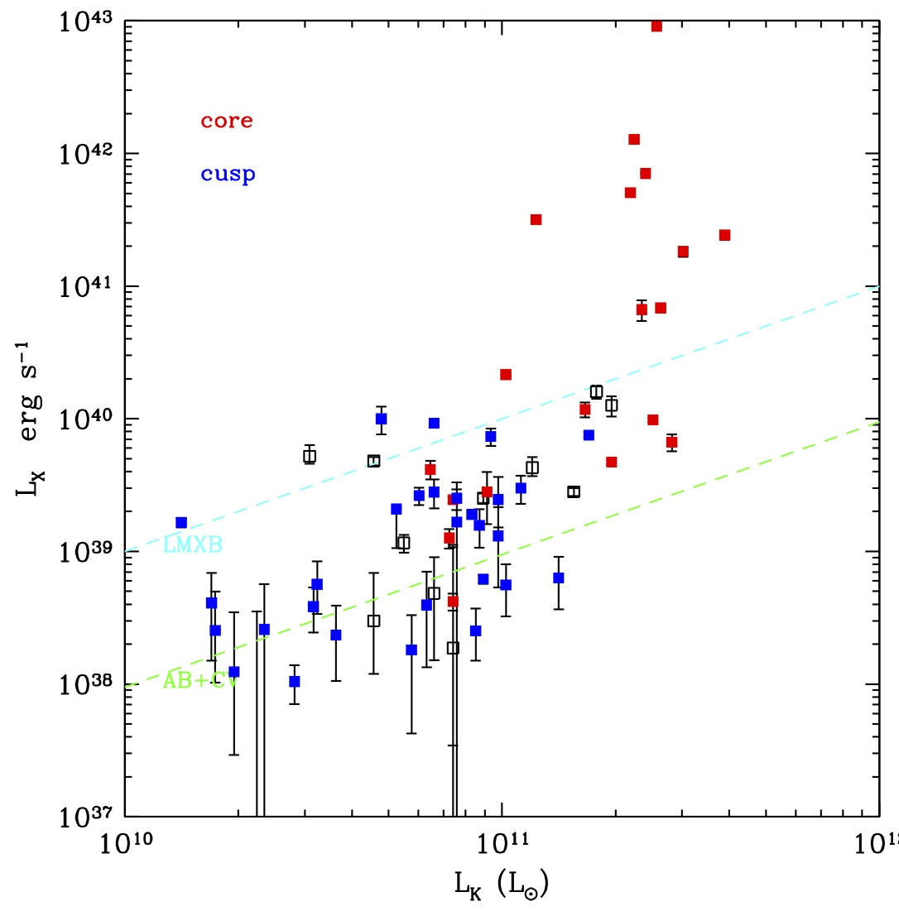
E-E dichotomy
L_{X}(gas) – L_{K} relation
round slow rotators old core
gas-rich ETGs
L_{X}(gas) > 10⁴⁰ ; kT > 0.5 keV
giant , slow, round, old, boxy, core (missing light) α/Fe*↑
?
Dry Merger
(necessary condition for gas-rich)
gas-poor ETGs
L_{X}(gas) < 10⁴⁰ ; kT < 0.5 keV
small, fast, flat, young, disky cusp (extra light) α/Fe*↓
?
Wet Merger
(sufficient condition for gas-poor)

Slide 9
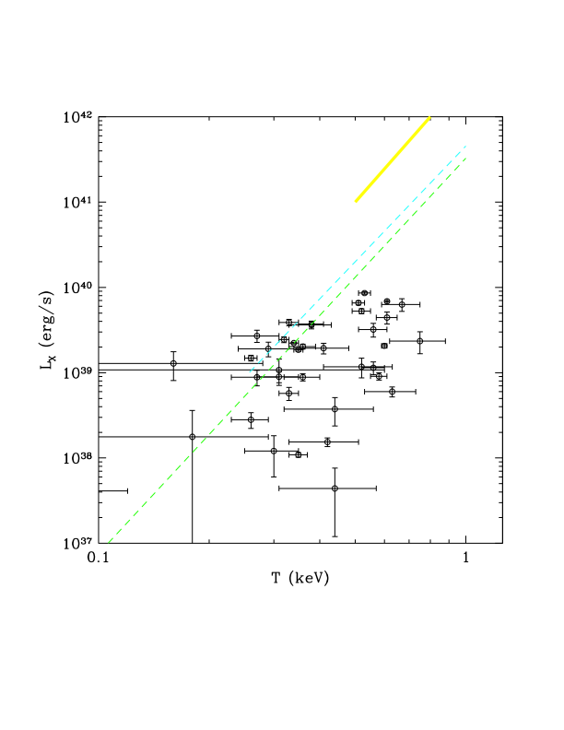
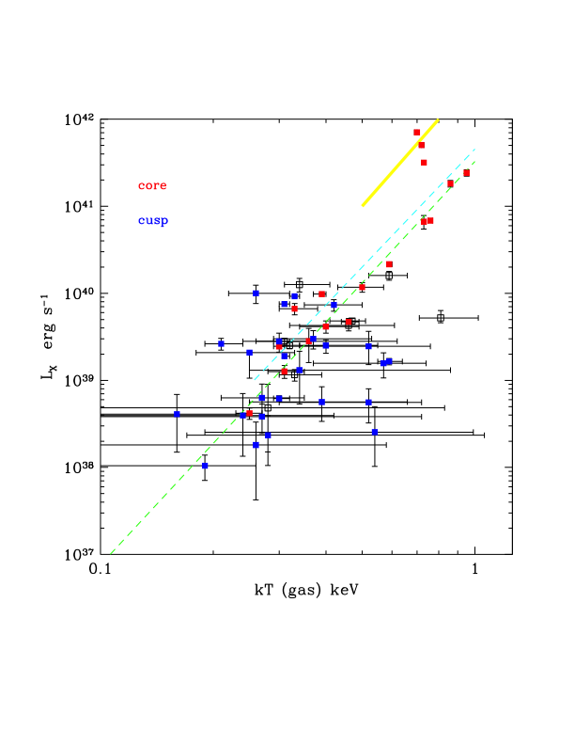
Comparison with spiral galaxies
L_{X}(gas) – T(gas) relation
ETGs spiral galaxies
from Li and Wang 2013

Slide 10
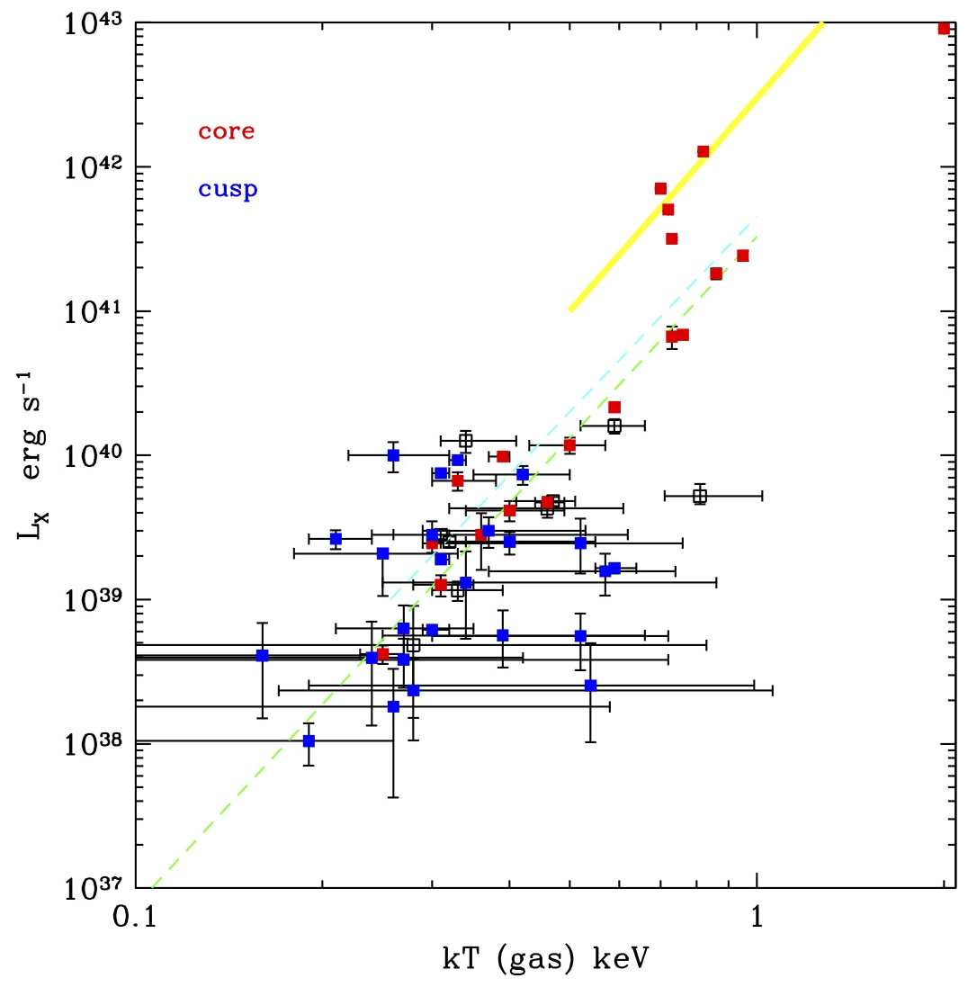
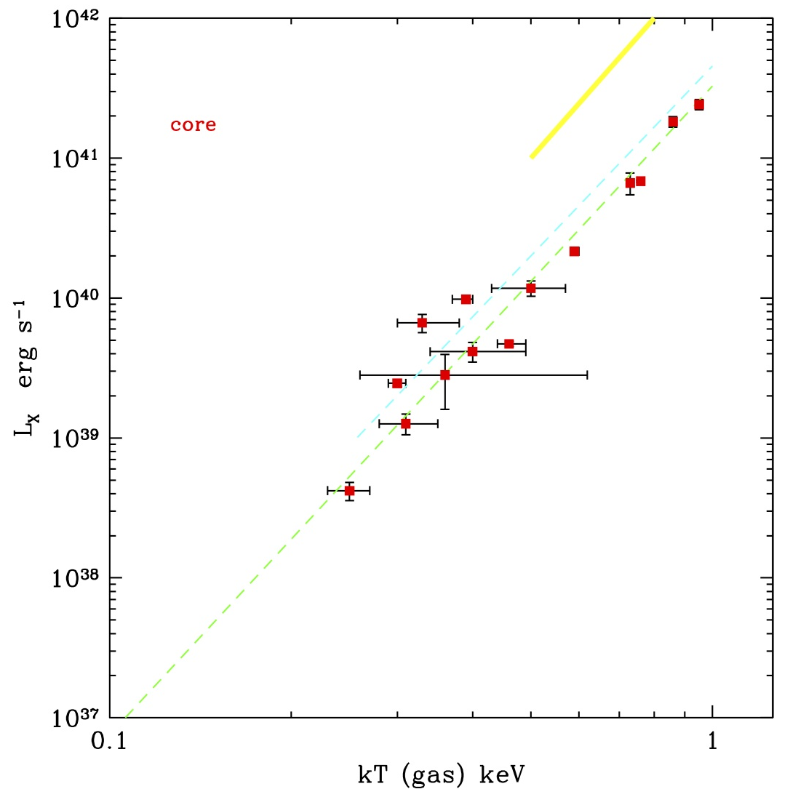
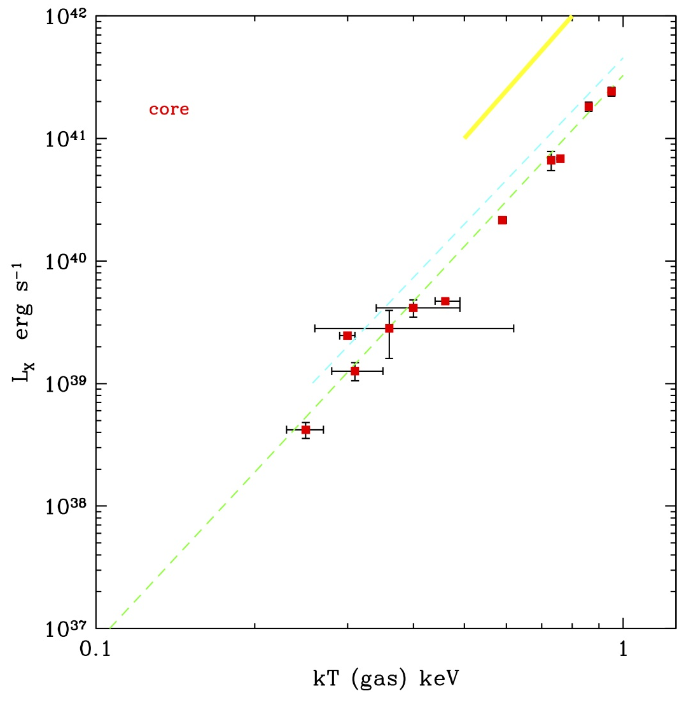
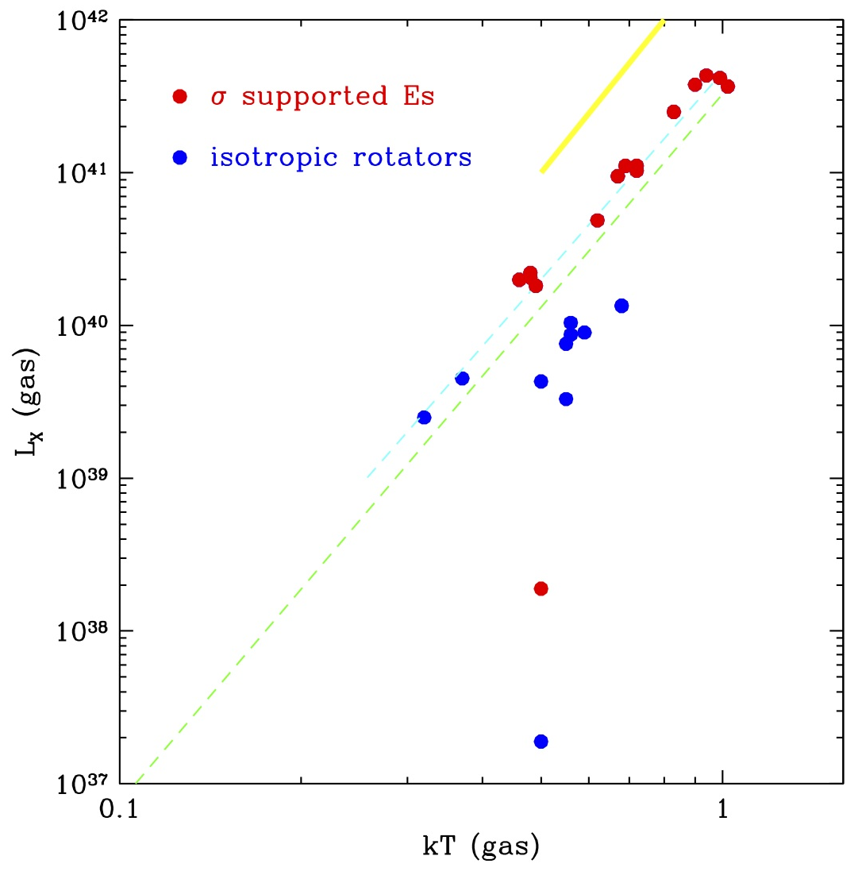
Pure Elliptical Sample
(= passively evolving, non-rotating, genuine spheroidal)
L_{X}(gas) – T(gas) relation
a
potential depth
Genuine E
cooling vs. heating
morphologically selected Ellipticals
pure bulge only – no disk (by bulge-disk decomposition)
old stellar system – passively evolving (by average stellar age)
dry merger – no recent SF (by core profile in the center)
slow rotators – no rotational support (by 2D kinematics)
(small amount of cold molecular gas)
L_{X} (gas) – T_{X} (gas) relation: tight and steep (L ~ T^{4.5})
not driven by
rejuvenating star formation (old systems)
shape and rotation
AGN (L_{AGN} varies widely and randomly)
cold gas (no CO detection)
Simulations from Negri, Pellegrini et al. (2014)
Notes:
a close balance among
heating/cooling and
a ability to hold ISM (inflow vs outflow),
given the amount of gas (fixed by mass loss x age)
Does this mean that AGN feedback does not affect globally on the galaxy scale,
while it may affect on the smaller scale and could help preventing from central cooling?
(e.g., L_{AGN} spread by a factor of 1000; L_{AGN}=10^{41.1} in N4261 = 3C270 ; L_{AGN}=10^{38.1} in N3379 )
Does cold gas affect the scaling relation? no CO detection, some HI detection (often extended in the outer region)

Slide 11
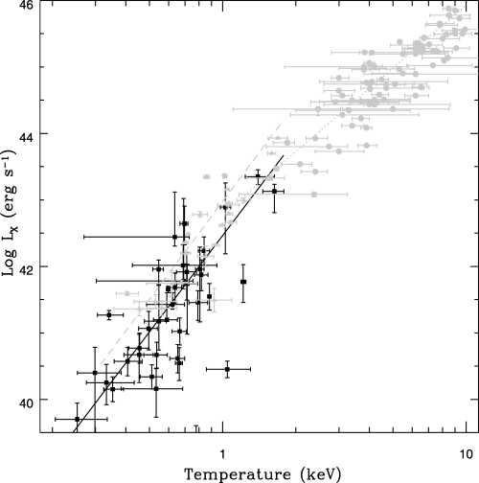
Comparison with cDs, groups and clusters
clusters
L_{X}(gas) ~ T(gas)³
groups
L_{X}(gas) ~ T(gas)^{4.5}
cDs
O’Sullivan, Ponman & Collins 2003

Slide 12
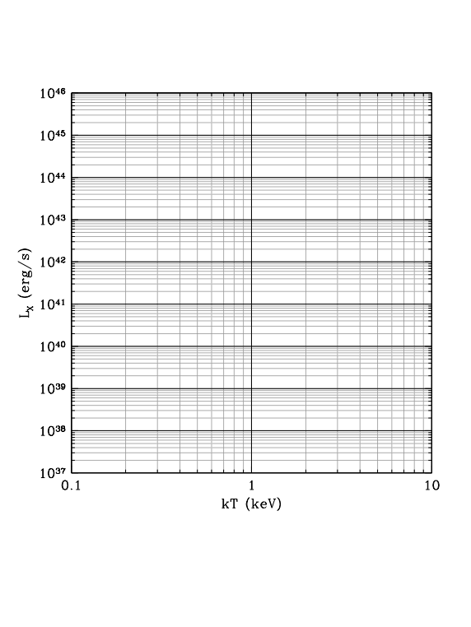
L_{X}(gas) – T(gas) relation
coreless, rotating ETGs ➔ gas-poor and large scatter
(and spirals)
pure Es ➔ tight correlation, L_{X}(gas) ~ T(gas)^{4.5}
cDs and dominant galaxies in groups
similar relation but shifted toward higher L_{X}
groups
gain similar relation but shifted upward slightly more
clusters
flatter Lx-T relation, L_{X}(gas) ~ T(gas)³
the correlation among each sample (pure Es to cluster)
➔ mainly driven by total mass
(not in coreless ETGs)
the jump from pure Es to cDs+groups
may also caused by total mass
as DM can retain the entire hot gas without losing by winds
higher L_{X} and M(gas), but similar T(gas)
Boundary I (gas-rich vs. gas-poor)
L_{X,Gas} ~ 10⁴⁰ erg s⁻¹ ; kT ~ 0.5 keV
M_{star} ~ L_{K} ~ 10¹¹ (solar unit); M_{Total} ~ 10¹² M⊙
Boundary II (with or without loss of hot gas)
M_{total}~ 3 x 10¹² Mo L_{X}~ 2 x 10⁴¹
clusters
groups
cDs
Pure Es
coreless ETGs
& sprials

Slide 13
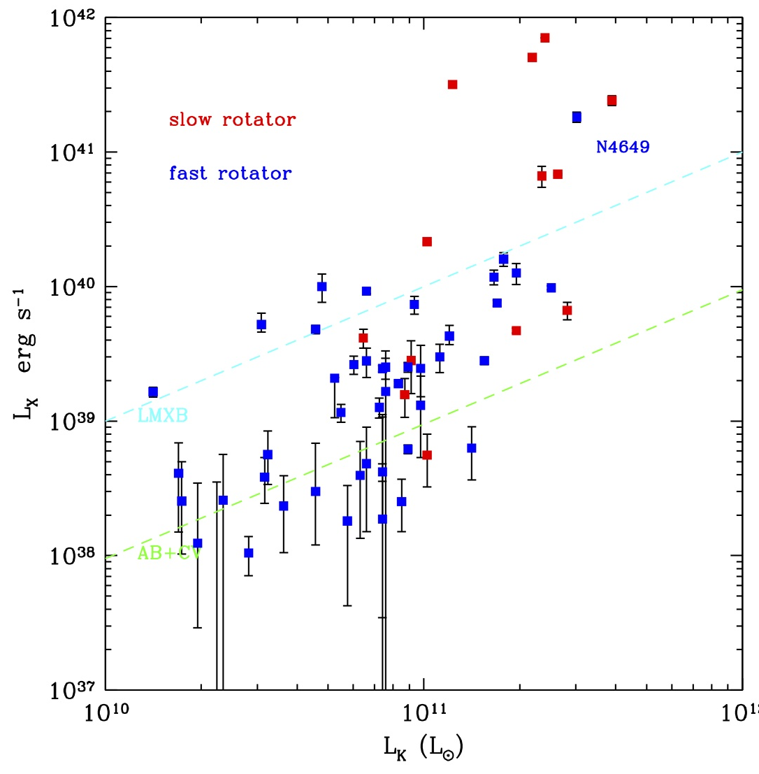
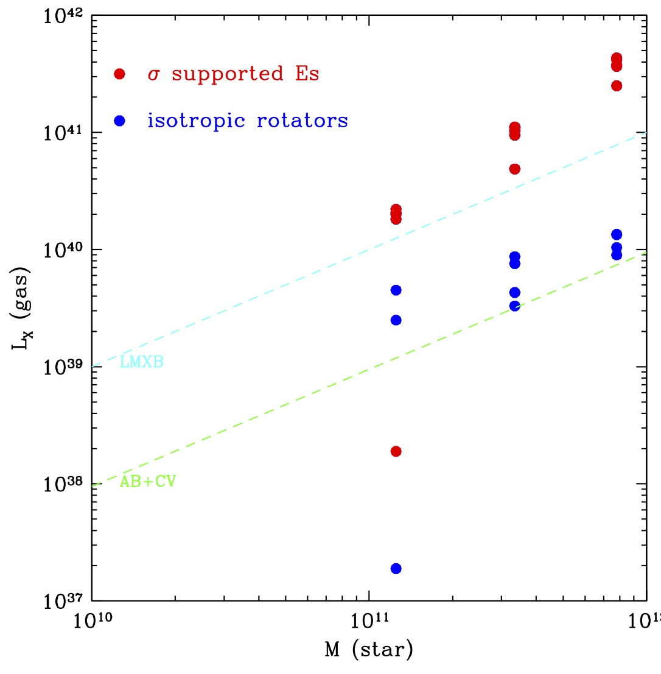
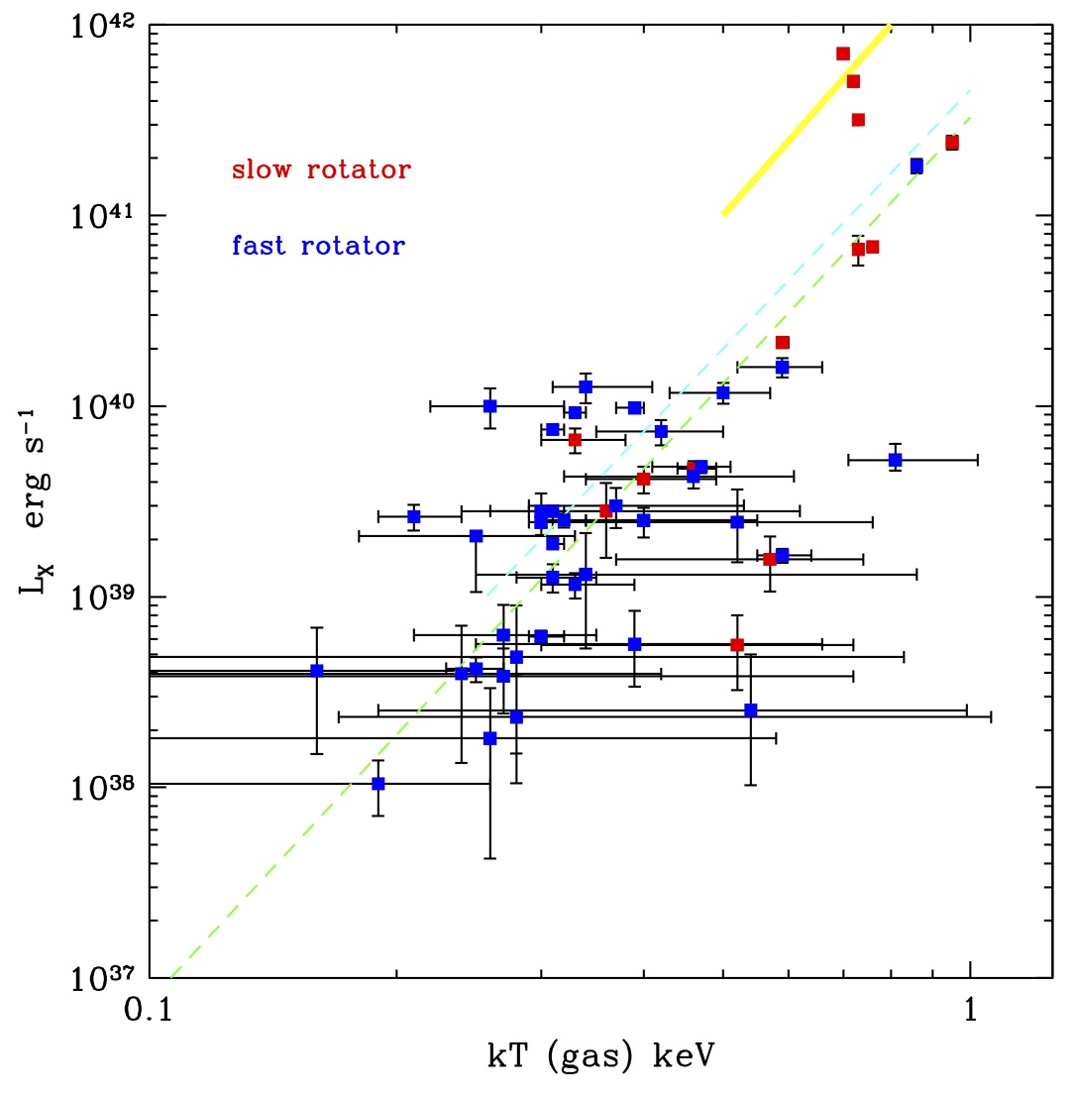
Comparison with simulations - I
Observations from Kim et al. (in prep.)
Simulations from Negri, Pellegrini et al. (2014)

Slide 14
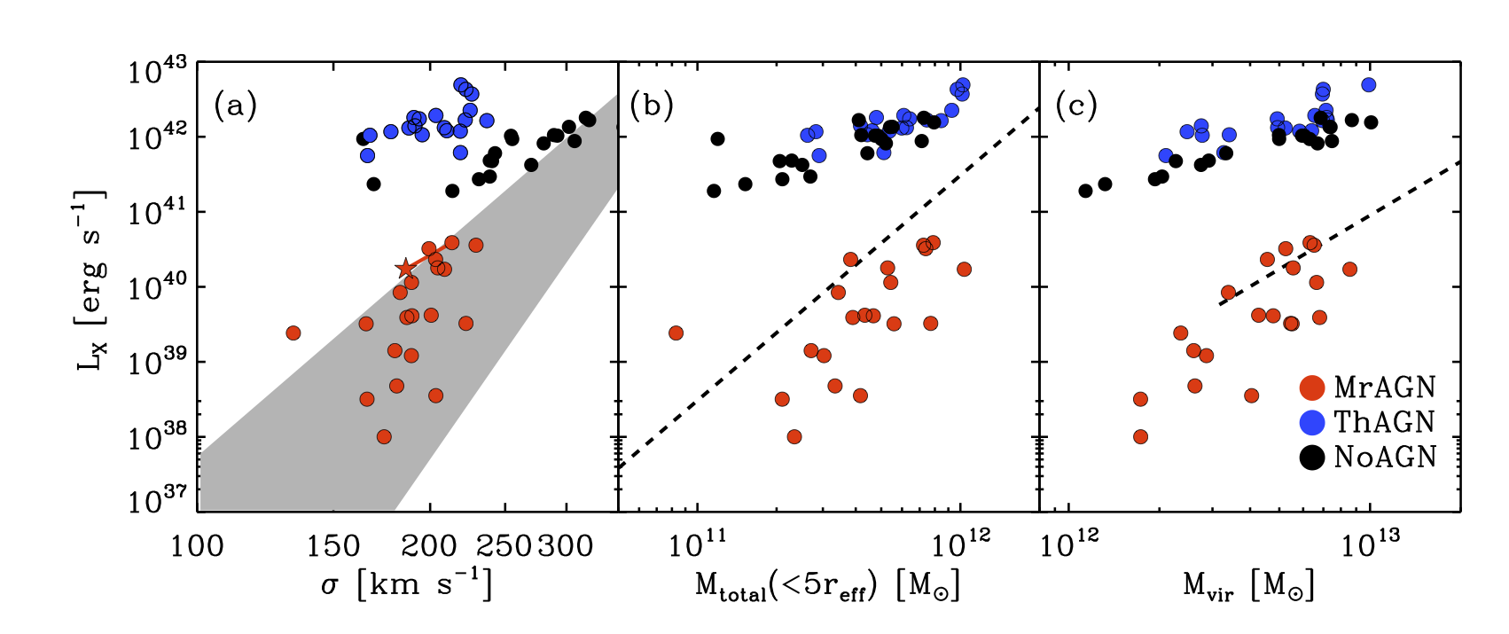
Comparison with simulations - II
Observations from
Boroson, Kim & Fabbiano 2011 Kim & Fabbiano 2013 Mathews et al. 2006
from Choi, Ostriker et al. (2014)

Slide 15
Summary
large scatter in L_{X}-L_{K} ~ mainly caused by DM
M_{DM}/M_{star} varies widely. Do not use L_{K} or M_{star} but use M_{Total} and T_{gas}.
The total mass (i.e., the ability to retain the hot gas) is the primary factor
in regulating the amount of hot gas.
scaling relations of normal ETGs
L_{X,Gas} ~ M_{Total}³
L_{X,Gas} ~ T_{Gas}^{4.5} (tight in pure Ellipticals and groups)
Among the gas-poor galaxies,
large scatter both in the L_{X,Gas}-M_{Total} and L_{X,Gas}-T_{Gas} relations.
with a smaller amount of DM, other factors become more important
(e.g., rotation, intrinsic flattening, rejuvenation of SF, cold gas etc.)
(approximate) boundary between gas-rich (L_{X,Gas}>L_{X,LMXB}) and gas-poor (L_{X,Gas}<L_{X,LMXB})
between inflow and outflow
M_{star} ~ L_{K} ~ 10¹¹ (solar unit); M_{Total} ~ 10¹² M⊙ ; L_{X,Gas} ~ 10⁴⁰ erg s⁻¹ ; kT ~ 0.5 keV
In groups, the similar relation holds, L_{X,Gas} ~ T_{Gas}^{4.5}, but shifted upwards likely due to
the group scale DM.

