Slide 1
X-ray constraints on the local super-massive black hole occupation fraction
Elena Gallo | University of Michigan
Brendan Miller, Jenny Greene, Brandon Kelly, Tommaso Treu, Jong-Hak Woo & Vivienne Baldassare

Slide 2
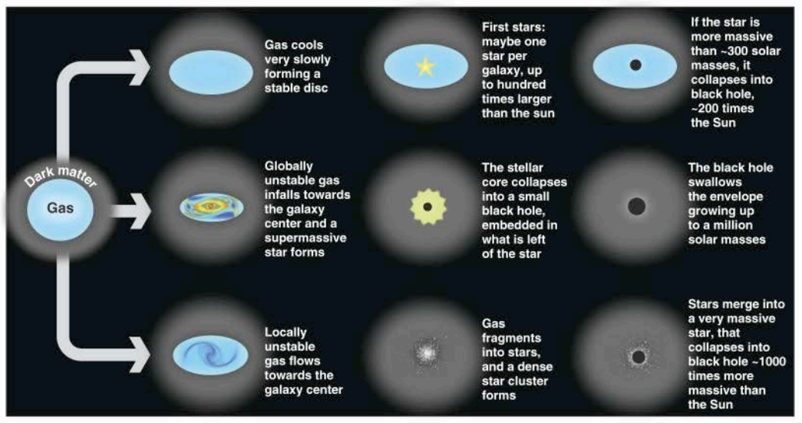
Black hole seeds (z ~ 20)
Volonteri 2012

Slide 3
High red-shift constraints (z>6)
z=7 quasar w. 2e+9 M_sun black hole (Mortlock+ 2011) requires >1e+4 M_sun seed
  Assume continuous Eddington-limited accretion and 10% radiative efficiency from z=20 (t=0.18 Gyr) to z=7 (0.77 Gy)
Light seeds preferred from unresolved XRB and stacking analysis (Treister+ 2013, Salvaterra+ 2012)

Slide 4
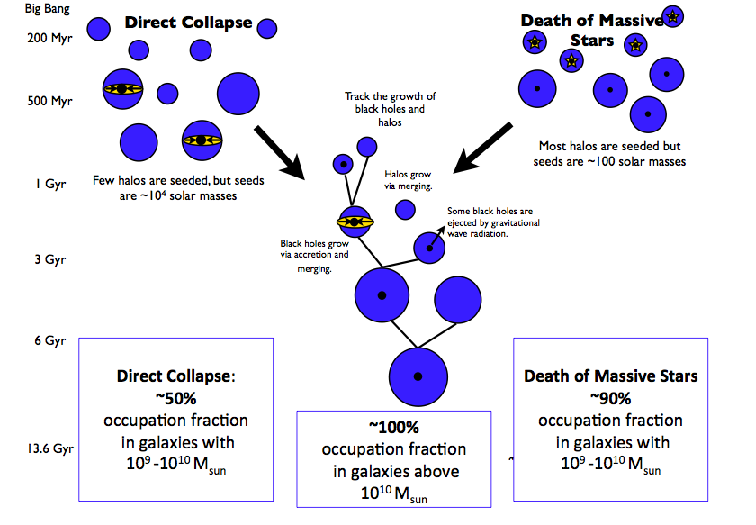
Local constraints (z=0)
Greene 2012

Slide 5
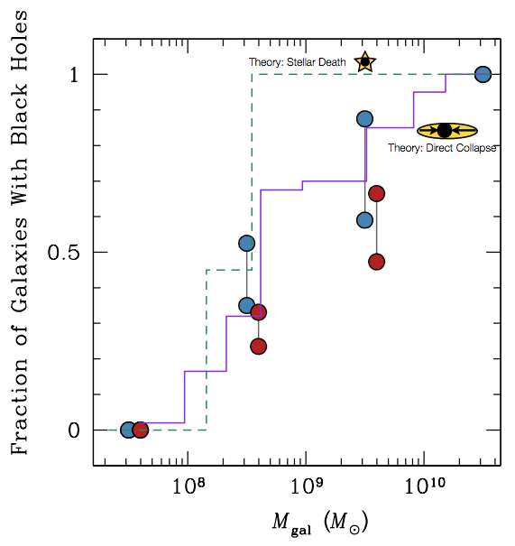
Local constraints (z=0)
Semi-analytic model predictions; BH occupation fraction in 1e+9 M_sun hosts
  Direct collapse: 60%
  POP III: 90%
Measure of occupation fraction in nearby galaxies may discriminate dominant seed formation mechanism
Observationally, need:
  Unbiased sample, clean diagnostics
  Broad stellar mass range
  Low Eddington ratios (<<1e-4)
Greene 2012

Slide 6
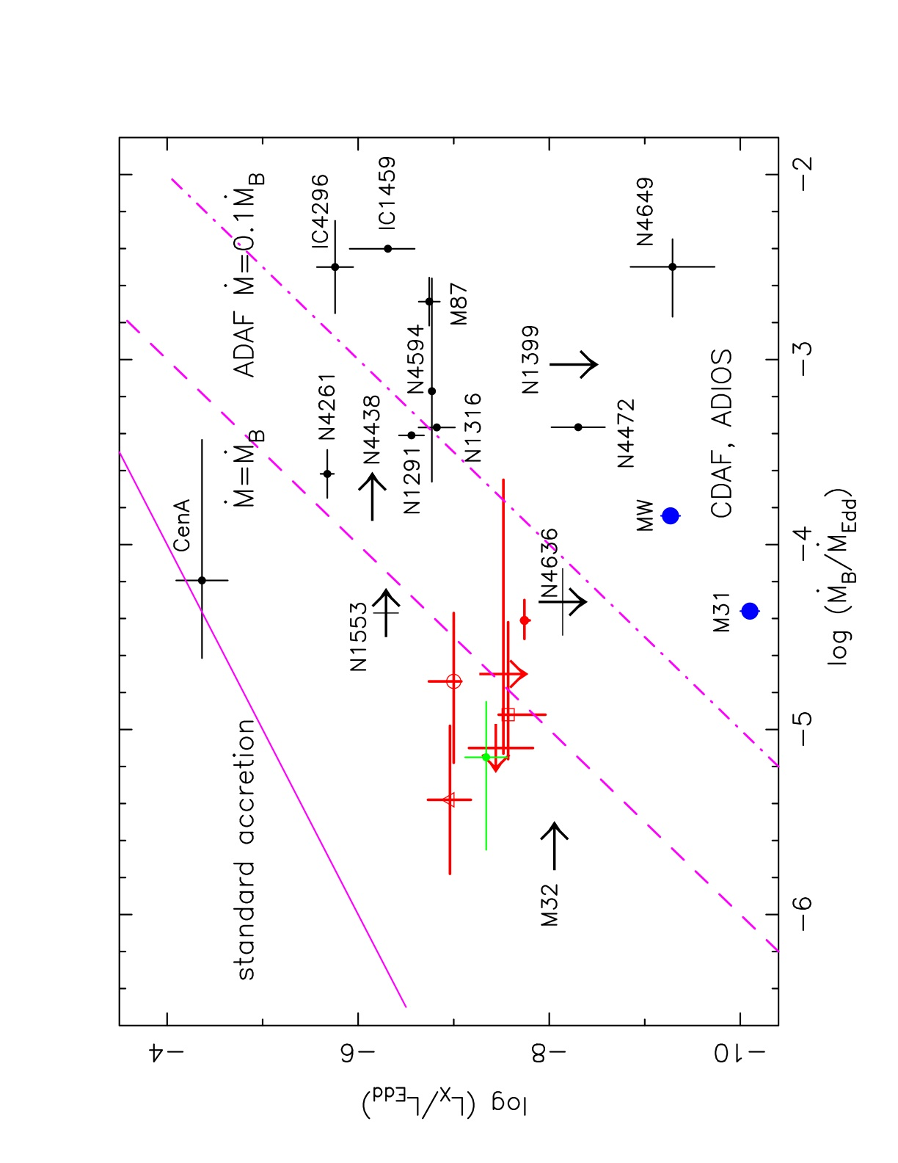
X-rays: AGN vs. ‘inactive’ galaxies
X- rays from ‘inactive’ galaxies (L_{nucl} < 10⁻⁴ L_{edd}):
ROSAT sensitive down to 10⁴⁰ erg/sec for nearby galaxies
Chandra* bridges the gap between active and (formally) inactive galaxies
*Sub-arcsec spatial resolution is crucial to correct for X-ray binary contamination
Soria+ 06

Slide 7
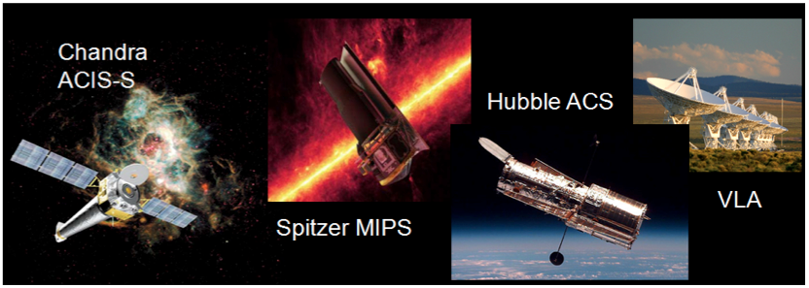
The AMUSE surveys: black hole activity at the lowest Eddington ratios
AGN Multi-wavelength Survey in Early type galaxies
Two Large Chandra programs (+HST, Spitzer, VLA) targeting a volume-limited (<30 Mpc) optically selected sample of ~200 early type galaxies unbiased w.r.t. nuclear properties. GOALS:
Provide a census of SMBH activity in the local universe
Quantify impact of large-scale environment on low level accretion
Constrain the local black hole occupation fraction
Gallo+2008,2010 (CXO, V)
Leipski+2012 (Spitzer, V)
Miller+2012a,b (CXO, F)
Plotkin+ 2014 (ULXs V+F)
Baldassare+ 2014 (HST,F)
Miller+ submitted
arXiv:1403.4246

Slide 8
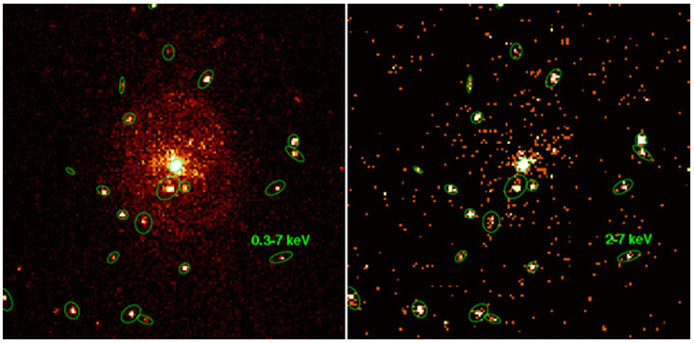
Samples & Methodology
Virgo sample: 100 early types from HST/ACS Virgo Cluster Survey (Cote’+2004)
Field sample: 103 HyperLeda E/E‐S0 galaxies with M_{B}<‐13, D< 30 Mpc, & |b|> 30º (not in Virgo or Fornax)
7.5 < log(M*/Msun)<11.5 – unbiased w.r.t. nuclear properties
Chandra surveys sensitivity : ~5e38 erg/sec, close to the Eddington limit for a few solar masses
  Search for nuclear hard X-ray sources
  Correct for bright low mass X-ray binary contamination (after Gilfanov 04, Boroson+ 11)

Slide 9
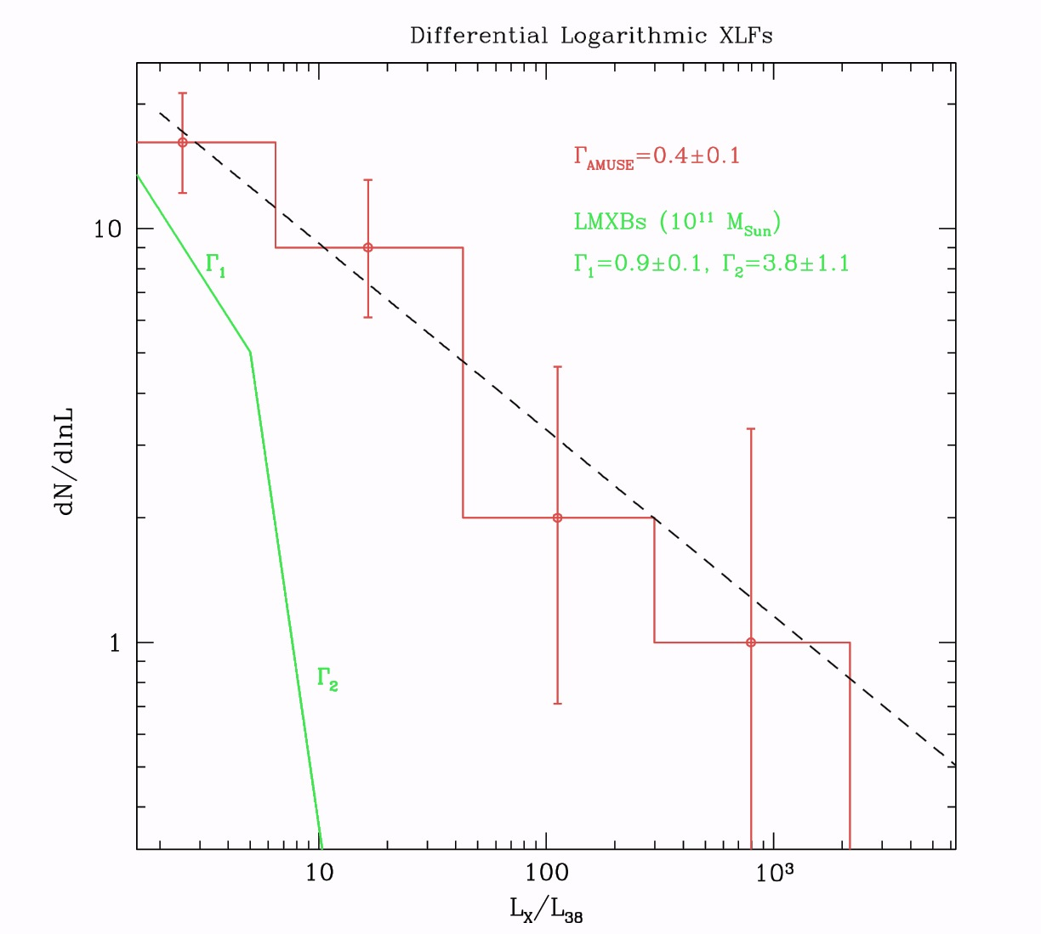
Samples & Methodology
Differential XLF of X-ray detected nuclei substantially different from XLF of LMXBs (Gilfanov 2004)
  Slope agrees with Zhang et al. 2009 (187 galaxies < 15 Mpc)
Additional contamination likely in case of nucleated galaxies (need HST resolution to assess nucleation, Baldassare+ 14)

Slide 10
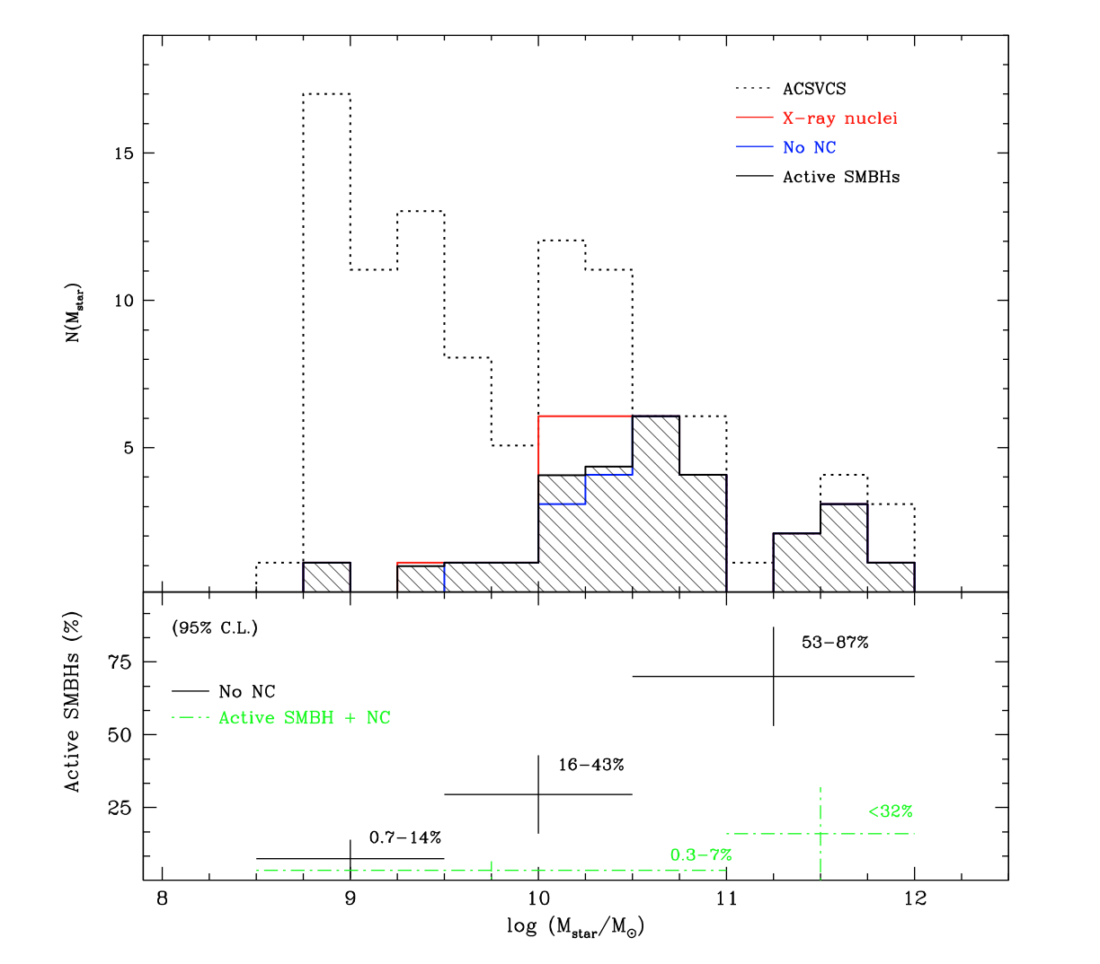
X-ray census. Virgo
Virgo: 32%±6% nuclear active fraction
Field: 50%±7% nuclear active fraction
% of object brighter than 1e+39 erg/s: 25%±5% F, 10%±3% V
Detection rate increases with M_{star} – due to “Eddington incompleteness”
Gallo+2008,2010

Slide 11
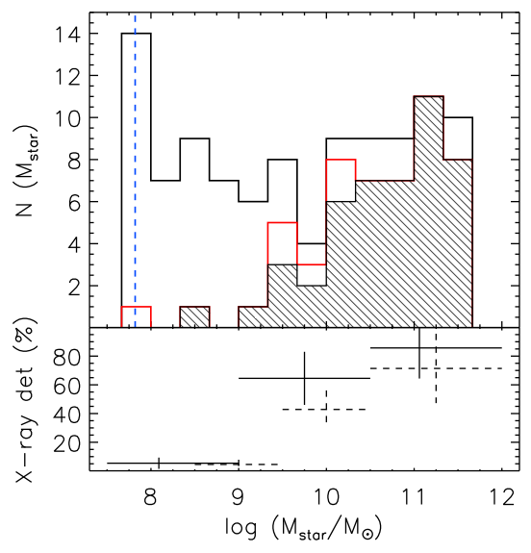
X-ray census. Field
Virgo: 32%±6% nuclear active fraction
Field: 50%±7% nuclear active fraction
% of object brighter than 1e+39 erg/s: 25%±5% F, 10%±3% V
Detection rate increases with M_{star} – due to “Eddington incompleteness”
Miller+ 2012a

Slide 12
Active fraction & downsizing
(100 Virgo + 100 field early types)
Nuclear X‐ray luminosity vs. host stellar mass: Slope of 0.6 implies <L_{X}/M*> ~ M*^{-0.4} , i.e. downsizing in black hole accretion
Field intercept 0.38±0.14 dex higher
Field galaxies marginally X‐ray brighter, consistent with Field having access to greater fuel reservoir
L_{X} α M*^{+0.6}
Miller+ 2012b

Slide 13
Active fraction, downsizing
& occupation fraction
Active fraction => lower limit to intrinsic occupation fraction (e.g. assuming a uniform ‘Eddington’ distribution)
However, a downsizing-enhanced detectability down the mass scale could bias high an estimate of the o.f. that presumes a uniform Eddington fraction
Need simultaneous constraints of occupation fraction and Lx vs. Mass
Greene 2012

Slide 14
Active fraction, downsizing
& occupation fraction: modeling
Simulate distribution of 50,000 galaxies (consistent with data)
Probability of hosting a black hole:
0.5+0.5 tanh[logM*-logM_{*,0}]x2.5^{|8.9-logM*,0|}
Impose sensitivity cut
Fit simultaneously for
  Lx/M* slope & intercept
  Lx/M* intrinsic scatter
  M_{*,0}
Full Bayesian approach, errors & upper limits included

Slide 15
Results: Occupation fraction vs. downsizing
M*<1e+10 Msun (early types)
Posterior distribution of the slope and occupation fraction below 1e10 Msun (taken as the median of 50,000 draws)
Occupation fraction prob. distribution extends from 30% to 100% (possibly slightly double-peaked near 40% and 90%)
O.F. < 20% RULED OUT
Miller+ ApJ submitted
arXiv:1403.4246

Slide 16
X-ray constraints on the local super-massive black hole occupation fraction (early types)
Miller+ ApJ submitted arXiv:1403.4246

Slide 17
Increased sensitivity / sample size
Sensitivity artificially increased by 2 orders of magnitude – arbitrary input parameters cleanly recovered
Sample size artificially increased – clean measurements (15% error) w. 1,500 objects

Slide 18
Summary
First observational constraint on the local super-massive black hole occupation fraction (& black hole downsizing) from X-rays
O.F. >20% for <1e+10 Msun galaxies. Not yet constraining for seed models.
Next:
  Same methodology applied to <1e9.5 Msun galaxies in ECDFS, CDFN + AEGISXD – 300 AGN expected (w. Greene)
  Same methodology applied to AGN in large Chandra programs targeting galaxy clusters (w. Woo)
  Application to different e.m. bands (e.g. nuclear radio emission)

