Slide 1
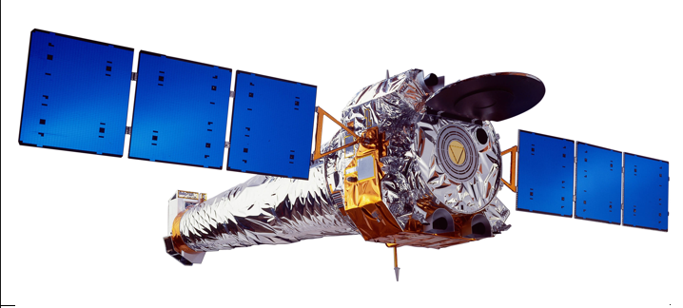
X-Ray Insight into Galaxy Evolution The ‘hot’ high-energy universe is a natural outcome of galaxy evolution
G. Fabbiano
CfA
Notes:
Good morning.. THIS IS A WORKSHOP ON THE X-RAY VIEW OF GALAXY ECOSYSTEMS. I WILL POINT OUT HOW THE STUDY OF THESE ECOSYSTEMS WITH CHANDRAIS GIVING NEW INSIGHT INTO GALAXY EVOLUTION BASICALLY BECAUSE THE HIGH ENERGY UNIVERSE IS A NATURAL OUTCOME OF THE EVOLUTION OF GALAXIES.

Slide 2
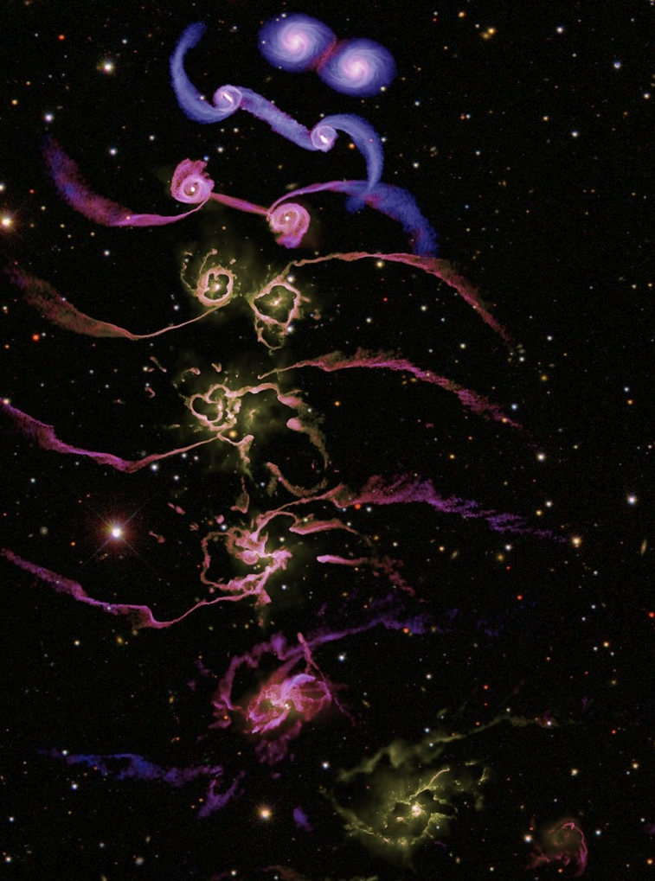
Galaxy – MBH Evolution
Collapse + hierarchical merging evolution + Feedback
Major merging
Minor merging
Accretion
gas
companions
Di Matteo, Springel, Hernquist 2005 - Nature
Notes:
In the current LCDM paradigm, galaxy and MBH evolution are intertwined.
The steps of this process include collapse and merging…
…and the effect of feedback

Slide 3
Galaxy – MBH Evolution
Collapse + hierarchical merging evolution + Feedback
Major merging
Minor merging
Accretion
Evolution of the stellar component
Evolution of nuclear MBH
Evolution of the ISM
SN
XRB
AGN
Double AGN
Notes:
With Chandra, we can observe and study the evolution of the stellar and MBH components – which both contribute to feedback energy input. Justam 2012 XRB feedback

Slide 4
Galaxy – MBH Evolution
Collapse + hierarchical merging evolution + Feedback
Major merging
Minor merging
Accretion
Evolution of the stellar component
Evolution of nuclear MBH
Evolution of the ISM
SN
XRB
AGN
Double AGN
physical
hot
chemical
Notes:
…we also study the evolution of the hot / ionized ISM which is the recipient of this feedback.

Slide 5
Outline
Chandra observations of major mergers
Halo Evolution
MBH Evolution
Direct observational study of AGN feedback on the ISM
NGC 4151
Minor merging & accretion from Chandra and Hubble
2D mapping of GC and LMXB position
ETG scaling relations at low and high z
C-COSMOS

Slide 6
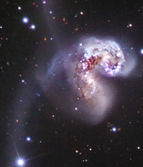
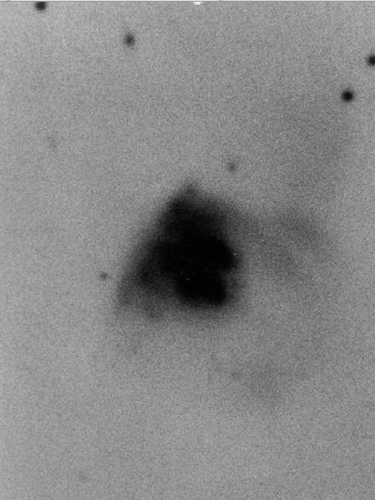
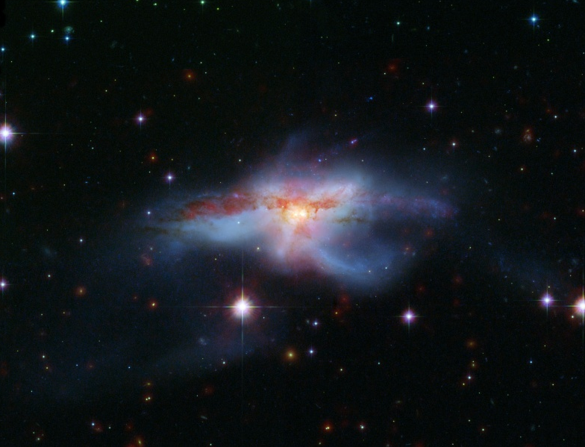
3 Major Mergers
The Antennae
NGC 6240
Arp 220
~ 20 kpc
Notes:
… a mini Toomre sequence
All plotted in the same physical scale
I will discuss the first two here as examples of halo evolution,
And NGC6240 and Arp 220 also as examples of merging MBHs

Slide 7
The Antennae NGC 4038/9 D ~19 Mpc

Slide 8
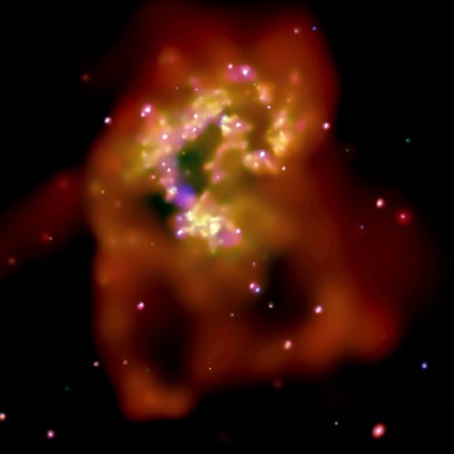
Population of luminous and variable XRBs
~10 ULXs
Total L_{X} (XRB)~10⁴¹ erg/s
Highly structured hot gaseous features
~10 kpc
Fabbiano et al 2004
Notes:
Same scale Chandra image

Slide 9
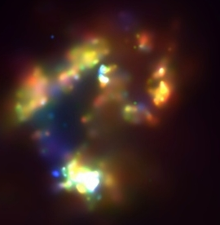
kT ~0.2 -0.8 keV
M_{gas(all)}~ 1.2×10⁷ M
τ_{c} ~ 10⁷⁻⁸ yr
Baldi et al 2006a, b

Slide 10
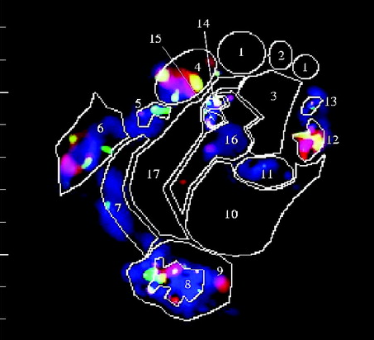
Red- Fe
Green – Mg
Blue - Si
Baldi et al 2006a, b

Slide 11
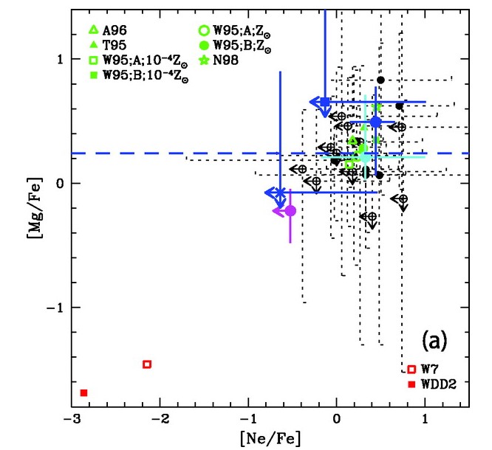
SNII
SNIa
Red- Fe
Green – Mg
Blue - Si
Baldi et al 2006a, b

Slide 12
NGC 6240
D ~ 100 Mpc
~ ULIRG

Slide 13
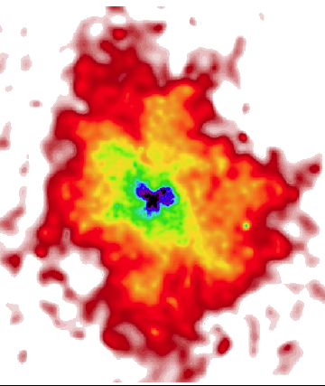

E. Nardini et al 2013

Slide 14
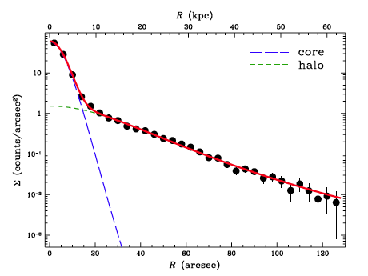
Mgas ~ 1.3 ×10¹⁰M
kT ~ 0.65 keV
Τc ~ 4 Gy
α-elements enriched
Nardini et al 2013

Slide 15
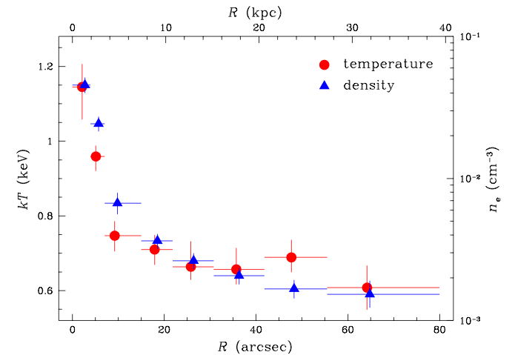
Core
steep profile
consistent with starburst wind
Halo
cooler, quasi-isothermal
pre-existing?
Binding mass ~10¹³ M
Mgas ~ 1.3 ×10¹⁰M
kT ~ 0.65 keV
Τc ~ 4 Gy
α-elements enriched
Nardini et al 2013

Slide 16
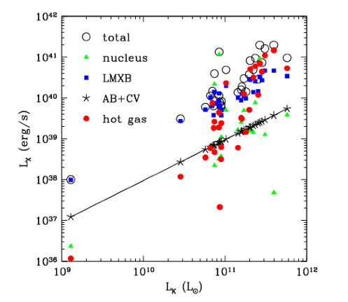
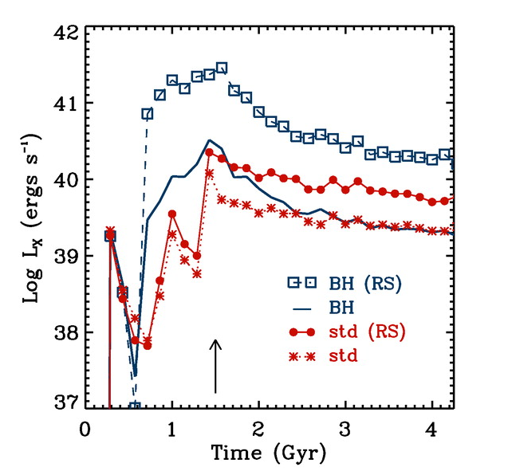
L_{K}----NGC6240-----L_{BOL}
BH & metals
Simulation of Cox et al 2006
Boroson, Kim & Fabbiano 2011

Slide 17
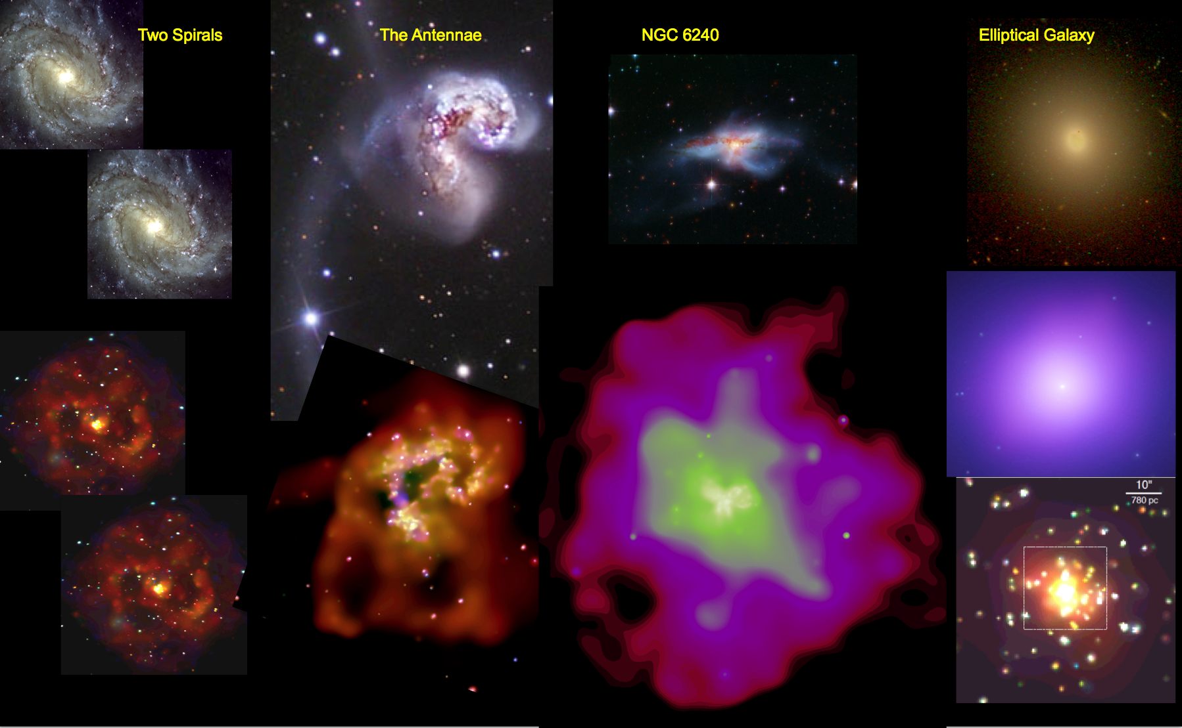
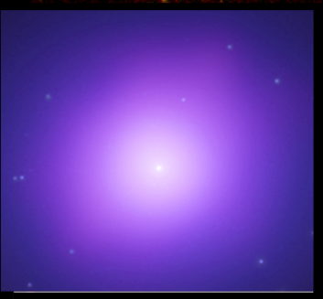
Halo merging evolution….?

Slide 18
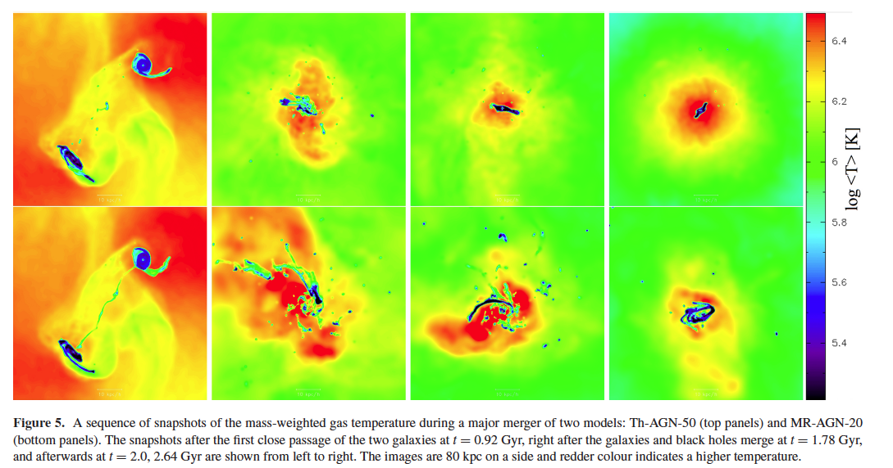
Which is which? Radiative or mechanical feedback?
Choi et al 2014

Slide 19
Merging MBH Heavily obscured (CT) AGNs and their surroundings NGC 6240 & Arp 220

Slide 20
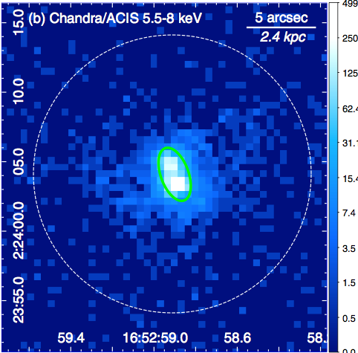

NGC 6240
double AGN – Komossa et al 2003
Chandra
Hard emission
360 Ks
Wang Junfeng et al 2014

Slide 21
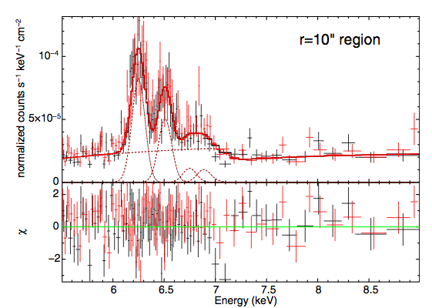
Hard kT~6 keV thermal emission
Fe Kα 6.4 keV
Fe XXV
Fe XXVI + Kβ
See Junfeng Wang’s talk

Slide 22
Hard kT~6 keV thermal emission
Fe Kα 6.4 keV
Fe XXV
Fe XXVI + Kβ
Strong winds/shocks
V_{shock} ~2200 km/s

Slide 23
Are strong shocks V_{shock} ~2200 km/s due to AGN winds?
(Feruglio et al 2013) We find them consistent with starburst winds (Wang et al 2014)

Slide 24
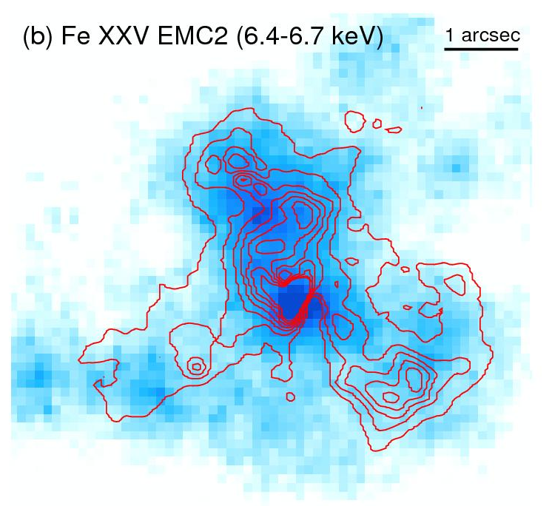
Are strong shocks V_{shock} ~2200 km/s due to AGN winds?
(Feruglio et al 2013) We find them consistent with starburst winds (Wang et al 2014)
Contours are H2 2.12 μm Max 2005

Slide 25
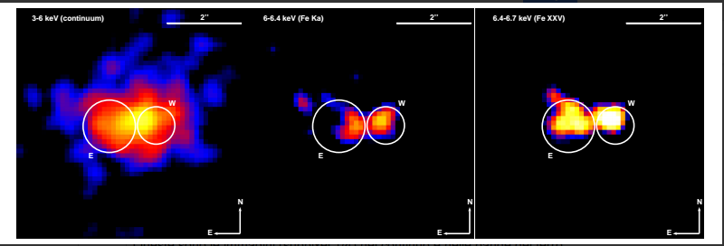

The Nuclei of Arp 220 A. Paggi et al., in preparation
3-6 keV
continuum
6.0-6.4 keV neutral Fe Kα
6.4 – 6.7 keV
Fe XXV

Slide 26
NGC 4151 – Detailed study of the interaction of a nearby AGN with the ISM
Wang Junfeng et al 2009, 2010, 2011a, 2011b, 2011c
Notes:
We have also conducted a study of the circum-nuclear regions of nearby Seyfert galaxies, to set observational constraints on AGN feedback in these systems.
These rich Chandra data should be taken into account by theorists… I am happy to say that Marta Volonteri proposes to models these AGN-feedback data..
These studies complement the observations of ‘radio mode feedback’ in E galaxies (more later in this workshop).

Slide 27
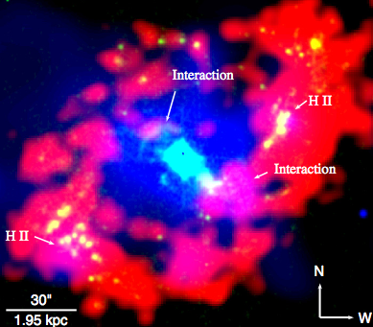
NGC 4151 – The 4 kpc X-ray filled cavity
Wang et al 2010
HI – Mundell & Shone 1999
30’’~ 2kpc
Halpha – Knapen et al 2004
Notes:
Radio mode feedback a lot later.
Here feedback in the more numerous radio quiet AGNs

Slide 28
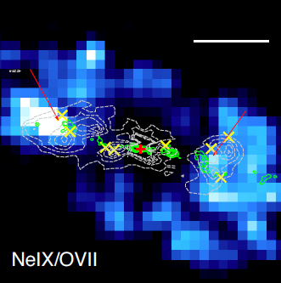
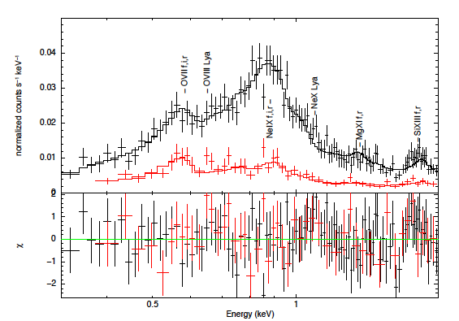
X-ray line emission and radio jet – cloud interaction
Wang et al 2011b
1”
ACIS spectra
NeIX hot spot
Model fit requires thermal kT~0.6 keV component in addition to photoionization ➔Pressure equilibrium between collisionally and photo-ionized gas
➔0.1% of jet power is deposited into the ISM

Slide 29

Fossil indicators of past galaxy accretion and minor merging: GCs and LMXBs See Poster by Raffaele D’Abrusco
Notes:
MW and Local Group observations show ‘streamers’ of GCs from accretion (and disruption) of dwarf companions (e.g. Sagittarius stream), halo of M31/M33
Can we identify similar features in large E galaxies?

Slide 30
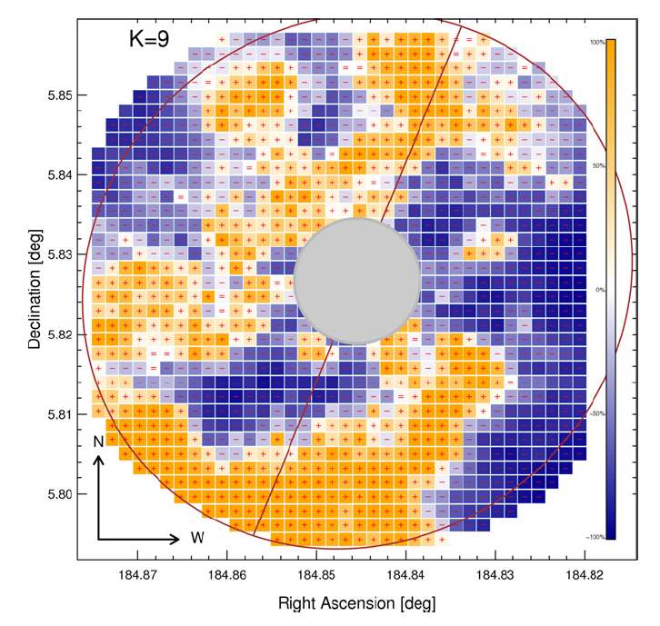
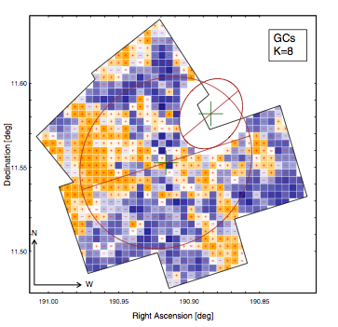
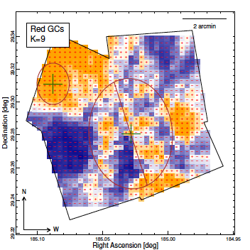
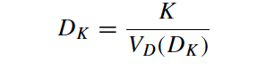
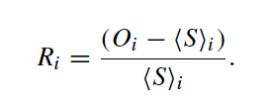
The 3 Published Examples (GC) D’Abrusco et al 2013, 2014a, 2014b
Method (D’Abrusco et al 2013)
Based on K Nearest Neighbor (KNN) density estimator of Dressler (1980)
Density maps
Residual maps (relative to smooth average distribution from radial profiles
Significance, based on Monte-Carlo simulations seeded with smooth distribution
Method (D’Abrusco et al 2013)
Based on K Nearest Neighbor (KNN) density estimator of Dressler (1980)
Density maps
Residual maps (relative to smooth average distribution from radial profiles
Significance, based on Monte-Carlo simulations seeded with smooth distribution
NGC 4261
NGC 4649
NGC 4278 & NGC 4282
Notes:
Overdensity in red
Deficit in blue

Slide 31
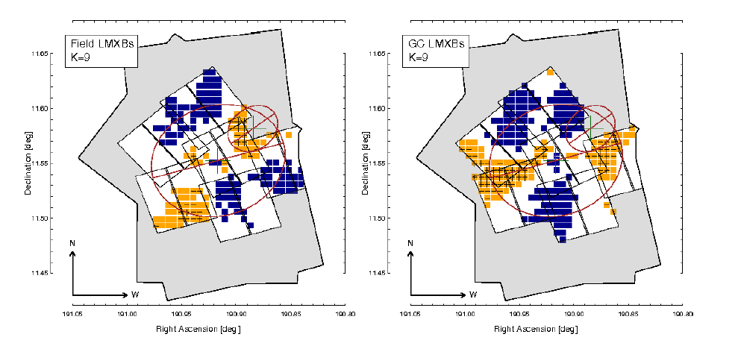
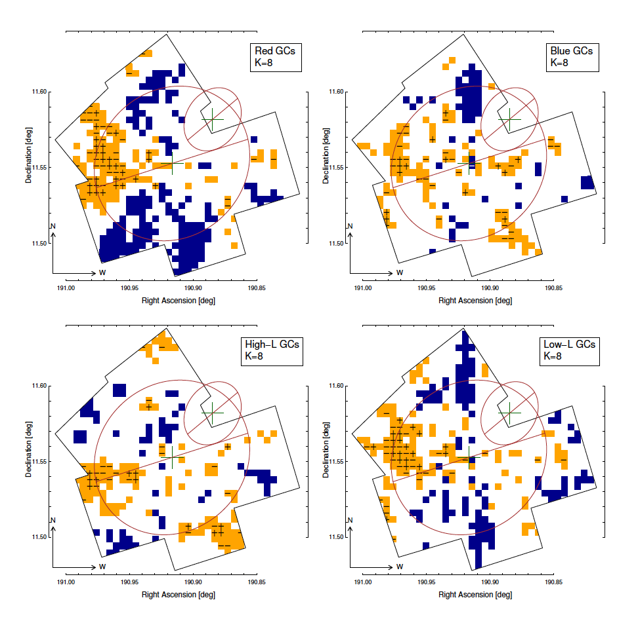
NGC4649 Inhomogeneity of GC-LMXBs follows that of Red GCs

Slide 32
NGC4649 ‘Correlated’ Inhomogeneity in Field-LMXBs

Slide 33
Tracing the Hot ISM (and AGN?) in ETG as function of red-shift

Slide 34
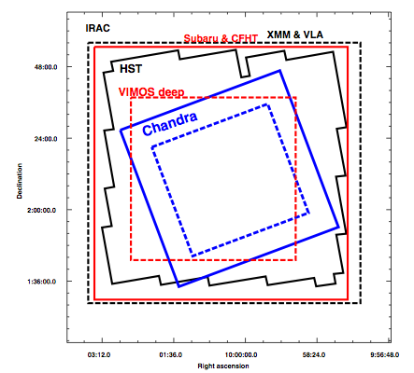
The Chandra COSMOS Survey (C-COSMOS) Elvis et al 2009
1.8 Ms, Chandra exposure of the central 0.5 deg² of the multi-λ COSMOS field
effective exposure ∼160 ks,
Outer 0.4 deg² area
effective exposure ∼80 ks.
Notes:
Dong-Woo will discuss scaling relations in nearby ETGs.
Briefly, luminous halos may be virialized…..
Hoe do these relation evolve with redshift?

Slide 35

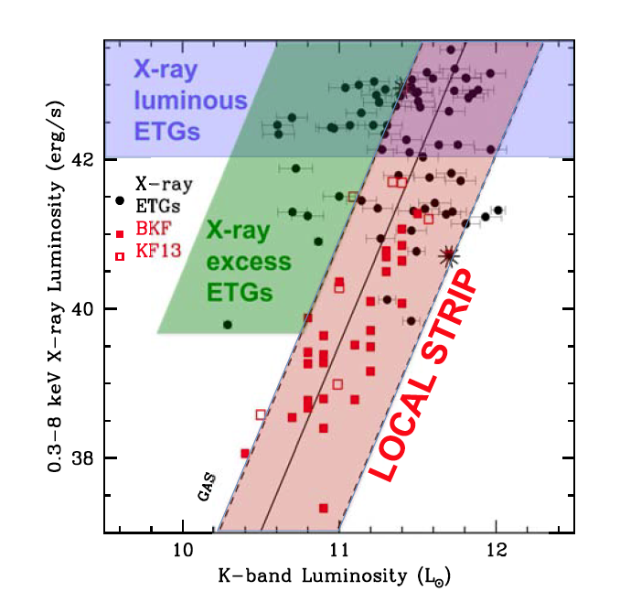
C-COSMOS X-ETG sample: results F. Civano et al 2014 (ApJ)
Hot gas
[+ AGN]
Local Strip consistent with virialized halos – KF13
D-W Kim et al
Stellar mass
Notes:
Dong-Woo will discuss scaling relations in nearby ETGs.
Briefly, luminous halos may be virialized…..
Hoe do these relation evolve with redshift?
XRB expected contribution subtracted
All related to local frame

Slide 36
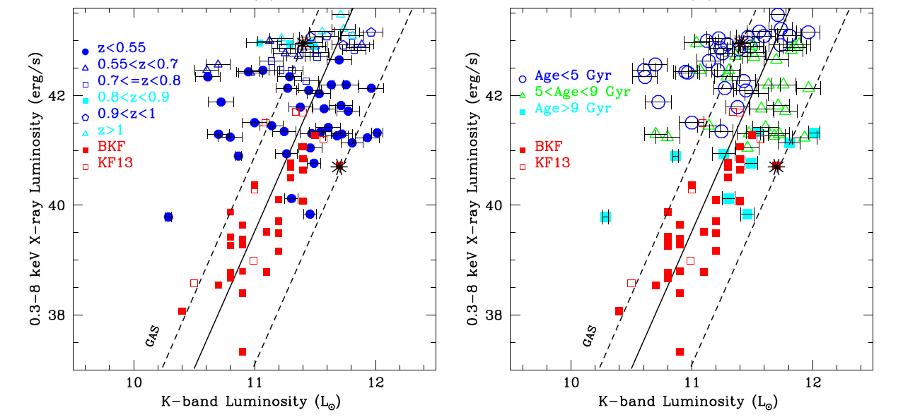
C-COSMOS X-ray luminous ETGs Higher z Younger stellar age
Hidden AGNs?
Merging-related X-ray brightening of Halo (and presence of ULXs) ?
HST images show interaction/companions

Slide 37
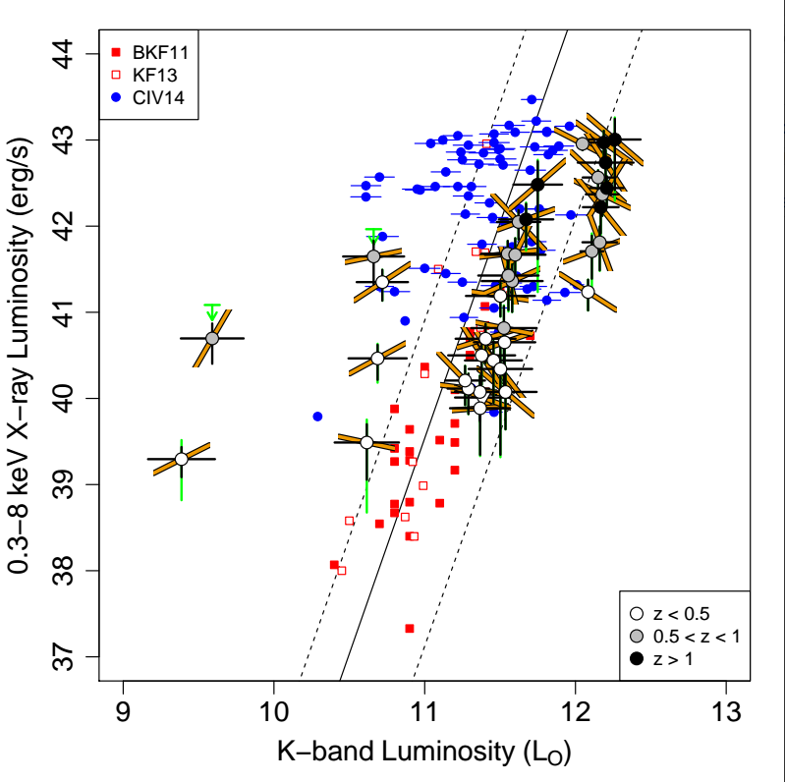
C-COSMOS stacking Paggi et al 2014, in preparation
~6,436 C-COSMOS ETGs
Binned in z, L_{K}
Subtract LMXB contribution and calculated average stacked L_{X} (Gas + hidden AGN)
All related to local frame
Calculate average HR for each stacked point
Green is z uncertainty

Slide 38
C-COSMOS stacking Paggi et al 2014
Low L_{K} points
Spectrum hard
These are ETGs so ULXs are unlikely
Hidden AGNs in low mass ETGs?
M_{BH} from Magorrian relation ~1-3×10⁷ M
L_{E} ~ 2-6×10⁴⁵ erg s⁻¹
L_{X}/L_{E} ~ 10⁻⁵ – 10⁻⁶
LMXB

Slide 39
Conclusions
The ‘hot’ high-energy universe is a natural outcome of galaxy evolution, which we are beginning to explore with Chandra
A few examples, to start the discussion
High resolution deep observations of nearby galaxies
evolution of the hot ISM
nuclear MBHs, and feedback
… to directly compare with theoretical simulations
Direct observational study of AGN feedback (e.g. NGC 4151)
2D mapping of GCs and LMXBs with Chandra and Hubble
a new way to investigate minor mergers in the evolution of giant E
Investigating the z-evolution of the Hot ISM + AGN of ETGs

Slide 40
Conclusions
The ‘hot’ high-energy universe is a natural outcome of galaxy evolution, which we are beginning to explore with Chandra
A few examples, to start the discussion
High resolution deep observations of nearby galaxies
evolution of the hot ISM
nuclear MBHs, and feedback
… to directly compare with theoretical simulations
Direct observational study of AGN feedback (e.g. NGC 4151)
2D mapping of GCs and LMXBs with Chandra and Hubble
a new way to investigate minor mergers in the evolution of giant E
Investigating the z-evolution of the Hot ISM + AGN of ETGs
These results require high angular resolution and sensitivity
They highlight the need for a future high-resolution larger area X-ray telescope --- SMARTX

Slide 42
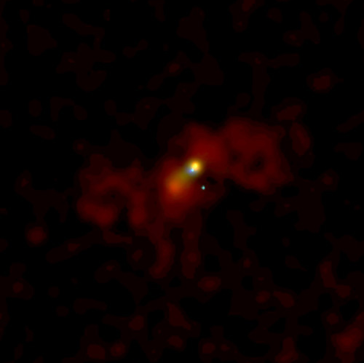
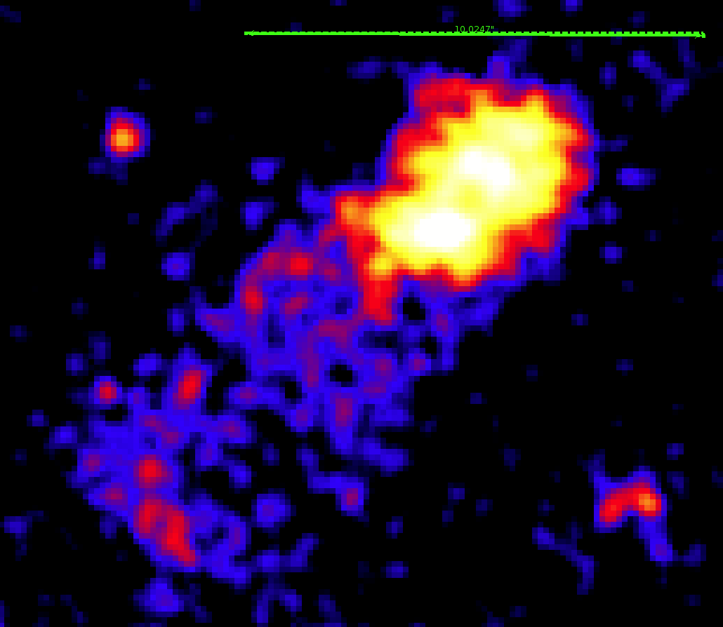
Arp 220
D ~ 80 Mpc
1 ‘
McDowell et al 2003
10 ‘’

Slide 43
The Antennae – no active MBHs
Star formation in nuclear regions
p_{X} ~ 3.5×10⁻¹¹ – 2.8×10⁻¹⁰ dyne cm⁻²
p_{X} > p_{CO} in nucleus of NGC 4038
Shock waves driven by hot gas may initiate star formation
1’

Slide 44
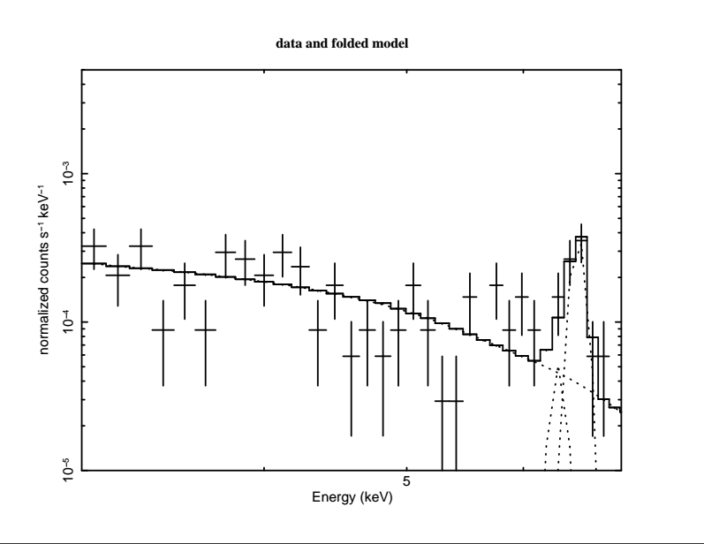
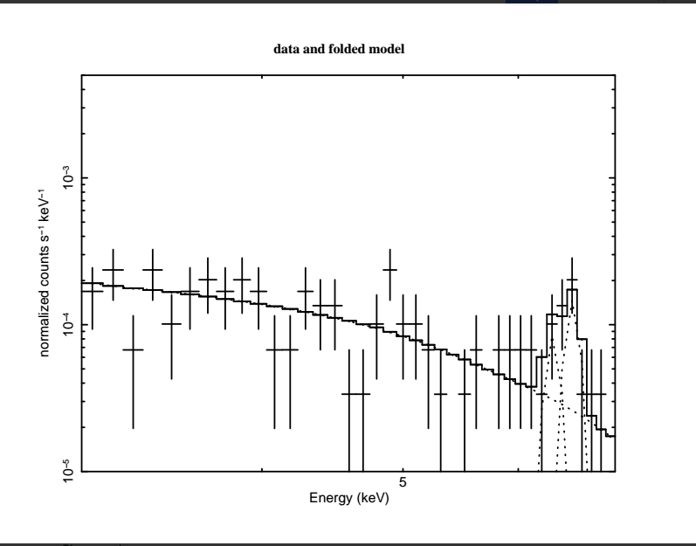
The Nuclei of Arp 220 Paggi et al., in preparation
3-6 keV
6.4 keV line
Fe XXV

Slide 45
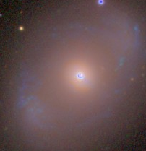
NGC 4151 – The 4 kpc X-ray filled cavity
Wang et al 2010
30’’~ 2kpc

Slide 46
Galaxy – MBH Evolution
Collapse + hierarchical merging evolution + Feedback
Major merging
Minor merging
Accretion
Evolution of the stellar component
Evolution of nuclear MBH
Evolution of the ISM
gas
companions
SN
XRB
AGN
Double AGN
physical
hot
chemical

Slide 47
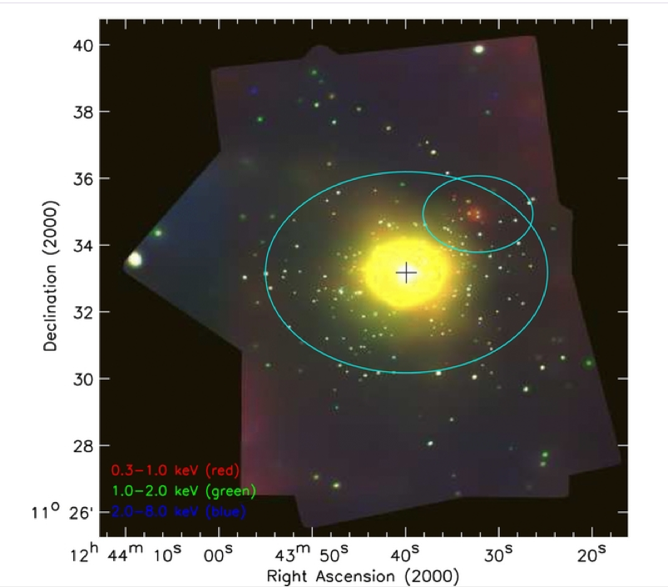
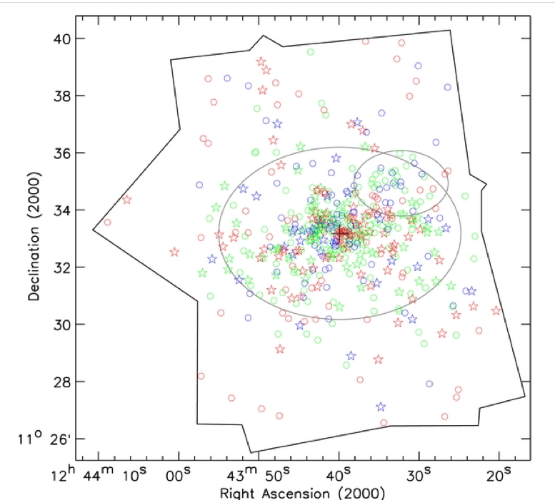
With Chandra we can decompose the X-ray emission of ETGs into its components
NGC4649 in Virgo (Luo et al 2012)

Slide 48
➔ Scaling relations in ETGs
See Dong-Woo Kim’s talk
Physical state of the hot ISM

Slide 49
➔ Scaling relations in ETGs
See Dong-Woo Kim’s talk
Physical state of the hot ISM
But Chandra can also look at the deeper universe

Slide 50
Hot ISM / Halos The Antennae & NGC 6240

Slide 51
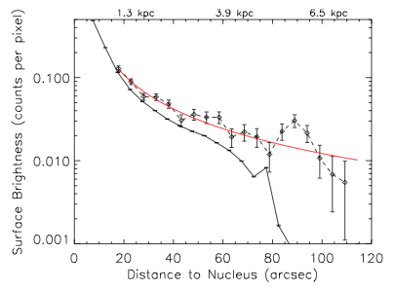
NGC 4151 – The 4 kpc X-ray filled cavity
Wang et al 2010
Stellar bulge
The X-ray emission of the cavity is not due to unresolved stellar sources
30’’~ 2kpc

Slide 52
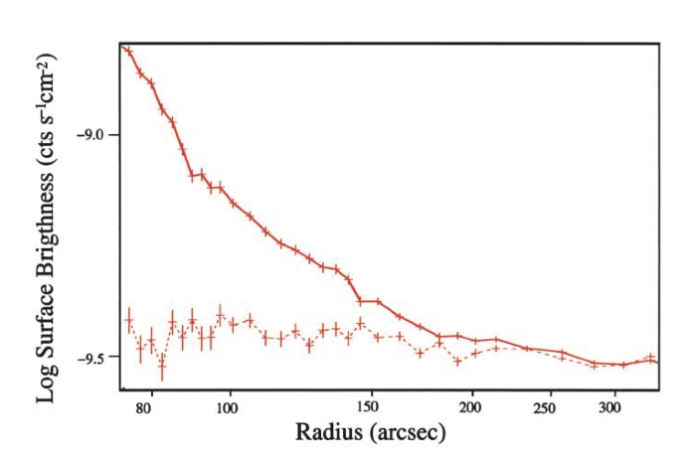
Loops + halo
kT ~ 0.3 keV
Mgas ~ 4×10⁸ M
Vexp ~ 1000 – 100 km/s
Τc ~ 1 Gy
Fabbiano et al 2004
~200” – 18 kpc

Slide 53
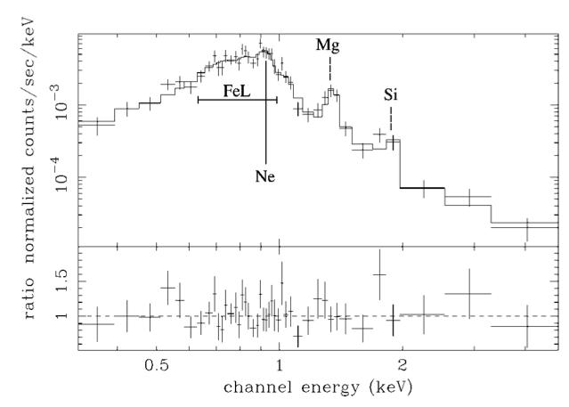
Red- Fe
Green – Mg
Blue - Si
Baldi et al 2006a, b

Slide 54
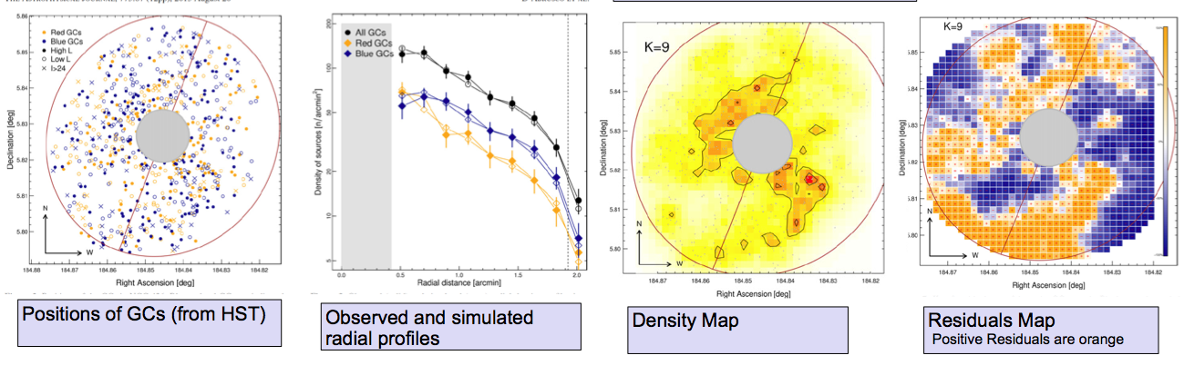
2D Mapping of GCs and LMXBs How Do We Do It? D’Abrusco et al 2013
NGC 4261
Build KNN Density Map
GC positions from Hubble
LMXB positions from Chandra
Build Residual Map relative to smooth distribution
Evaluate significance of residuals via MC simulations

