Slide 1
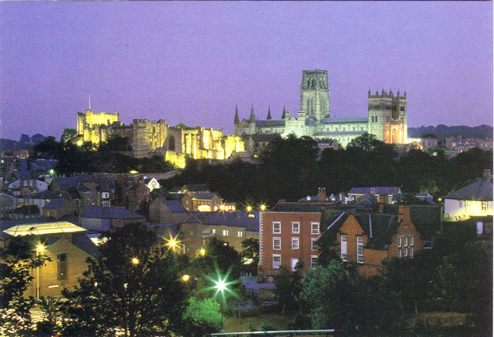
Black hole accretion disc winds
Which wind went where?
Prof Chris Done
University of Durham, UK

Slide 2
1) Continuum radiation driven Wind
Spectra are some combination of disc and tail to high energies
Disc luminosity increases towards centre
Log ν L(ν)
Log ν

Slide 3
1) Continuum radiation driven Wind
Disc luminosity increases towards centre
Effective gravity for static mass with only electron scattering
(1- L/L_{Edd}) GM/R
  LEdd
Log L(R)
Log R

Slide 4
1) Continuum radiation driven Wind
Effective gravity for material pushed from the disc (angular momentum:
(1- ½- L/L_{Edd}) GM/R
L>½ Ledd and continuum driven wind from inner disc! Ueda et al 2004
  LEdd
  ½LEdd
Log L(R)
Log R

Slide 5
1) Continuum radiation driven Wind
What we see depends on ionisation state
ξ=L/(nR²)
inner disc – R small, L large so ξ high. Material can be completely ionised unless very dense.
  LEdd
Log L(R)
Log R

Slide 6
2: UV line driven Winds ?
If substantial opacity: τ>>τ_{es} so gravity (1- τ/τ_{es} L/L_{Edd}) GM/R
Most opacity in UV resonance lines
Momentum absorbed in line accelerates wind so more momentum absorbed in line - UV line driving at L<<L_{Edd}
Log νfν
Log E

Slide 7
2: UV line driven Winds ?
If substantial opacity: τ>>τ_{es} so gravity (1- τ/τ_{es} L/L_{Edd}) GM/R
Most opacity in UV resonance lines
Momentum absorbed in line accelerates wind so more momentum absorbed in line - UV line driving at L<<L_{Edd}
Log νfν
Log νfν
Log E
Log E

Slide 8
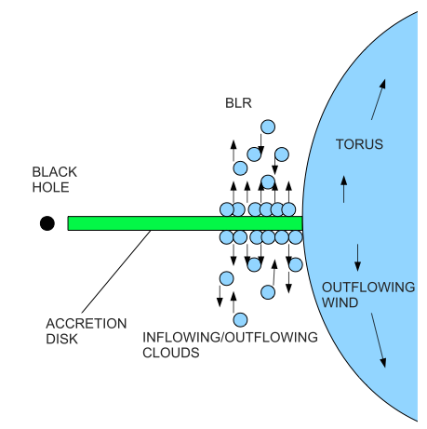
3: dust driven winds ?
gravity (1- τ/τ_{es} L/L_{Edd})
Dust has huge cross-section!
Maybe BLR arises from dust driven wind Czerny & Hryniewicz 2011
Some evidence from data – Galianni & Horne 2013
Czerny & Hryniewicz 2011

Slide 9
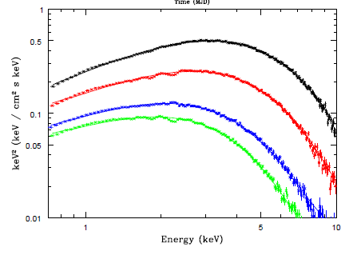
BHB spectra
Disk in Xray so too highly ionised for UV and dust
Peaks ~0.8LEdd
LEdd difficult in standard LMXB due to mass transfer rate
very evolved star GRS1915+105 (V404Cyg, V4641Sgr)
HMXRB easier: SS433 (more or less stable) and many/most ULX
LMC X3 Kolehmainen et al 2013

Slide 10
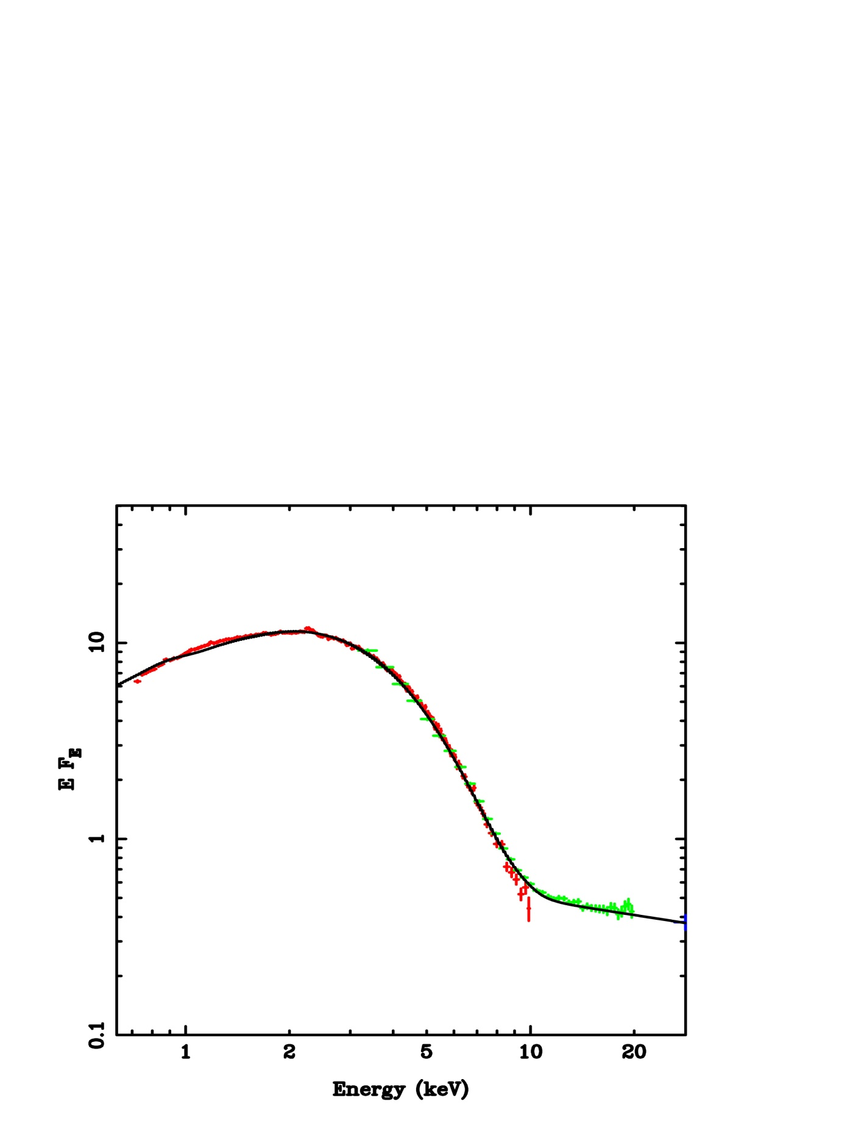
4) Thermally driven Winds
X-ray source and inner disc spectrum irradiates top of disc
Heat: ΔE=4 kT/mc²Ein
Cool: ΔE=-E/mc2 Ein
Average over photon spectrum to get Compton Temperature
TIC= E² N(E) dE
4 EN(E) dE
NOT mean <E>=L/N
Kolehmainen et al 2010

Slide 11
4) Thermally driven Winds
X-ray source and inner disc spectrum irradiates top of disc
Heat: ΔE=4 kT/mc²Ein
Cool: ΔE=-E/mc2 Ein
Average over photon spectrum to get Compton Temperature
TIC= E² N(E) dE
4 EN(E) dE
Tails are important!
Kolehmainen et al 2010

Slide 12
4) Thermally driven Winds
Hot so expands
Forms hot corona for R<Ric
and wind for R>Ric
NS mainly small systems in LMXRB – only thermal winds in the rare evolved systems
R=0.1R_{IC}
Begelman McKee Shields 1983
Jimenez Garate et al 2002

Slide 13
4) Thermally driven Winds
Hot so expands
Forms hot corona for R<Ric
and wind for R>Ric
Driven by pressure gradient
Can’t have thermal wind if launched at R<< 0.1 R_{IC} by L<<L_{edd}
Forms if heats to T_{IC} before rises to H~R_{IC} L>0.02LEdd
R=0.2R_{IC}
Begelman McKee Shields 1983
Jimenez Garate et al 2002

Slide 14
5: magnetically driven Winds
????

Slide 15
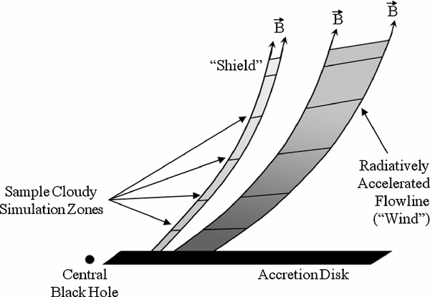
5: magnetically driven Winds
Everett 2005

Slide 16
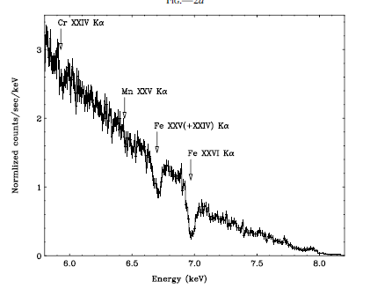
wind absorption in high inclination NS
Chandra grating gets Fe Kα ionized Nh~10²³⁻²⁴ cm⁻²
Ionisation ξ from H/He-like
Get distance ξ=Lx/(nR²) and Nh=nΔR ≈nR so R=Lx/(Nh ξ)
Tic~1.3x10⁷ K in bright NS
Ueda et al 2004 GX13+1

Slide 17
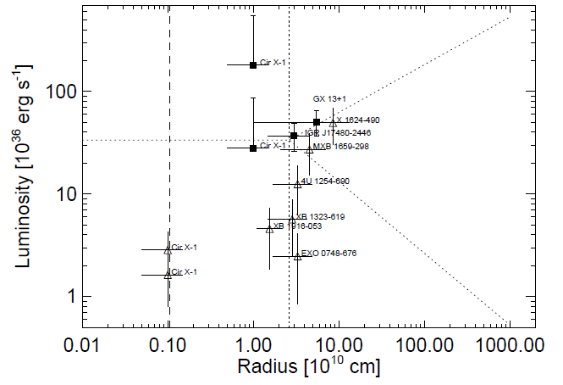
NS: Thermal winds! High inclination
Static corona
Thermal Wind
Static corona
Wind
0.1 R_{IC}
0.1 R_{IC}
Diaz Trigo & Boirin 2012

Slide 18
NS: Thermal winds! High inclination
Thermal wind Tic
Static corona
Thermal wind T<Tic
Static corona
Wind
Just not heated fast enough
0.1 R_{IC}
0.1 R_{IC}
Diaz Trigo & Boirin 2012

Slide 19
NS: Thermal winds! High inclination
L>LEdd
Thermal wind Tic
Static corona
Thermal wind T<Tic
Static corona
Wind
0.1 R_{IC}
0.1 R_{IC}
Diaz Trigo & Boirin 2012

Slide 20
NS: Thermal winds! High inclination
No evidence for magnetic driving as no winds except thermal wind
Cir X-1 probably LEdd but absorbed
0.1 R_{IC}
Diaz Trigo & Boirin 2012

Slide 21
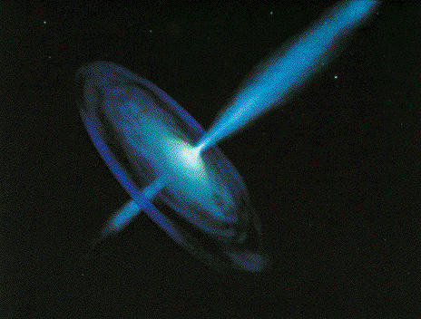
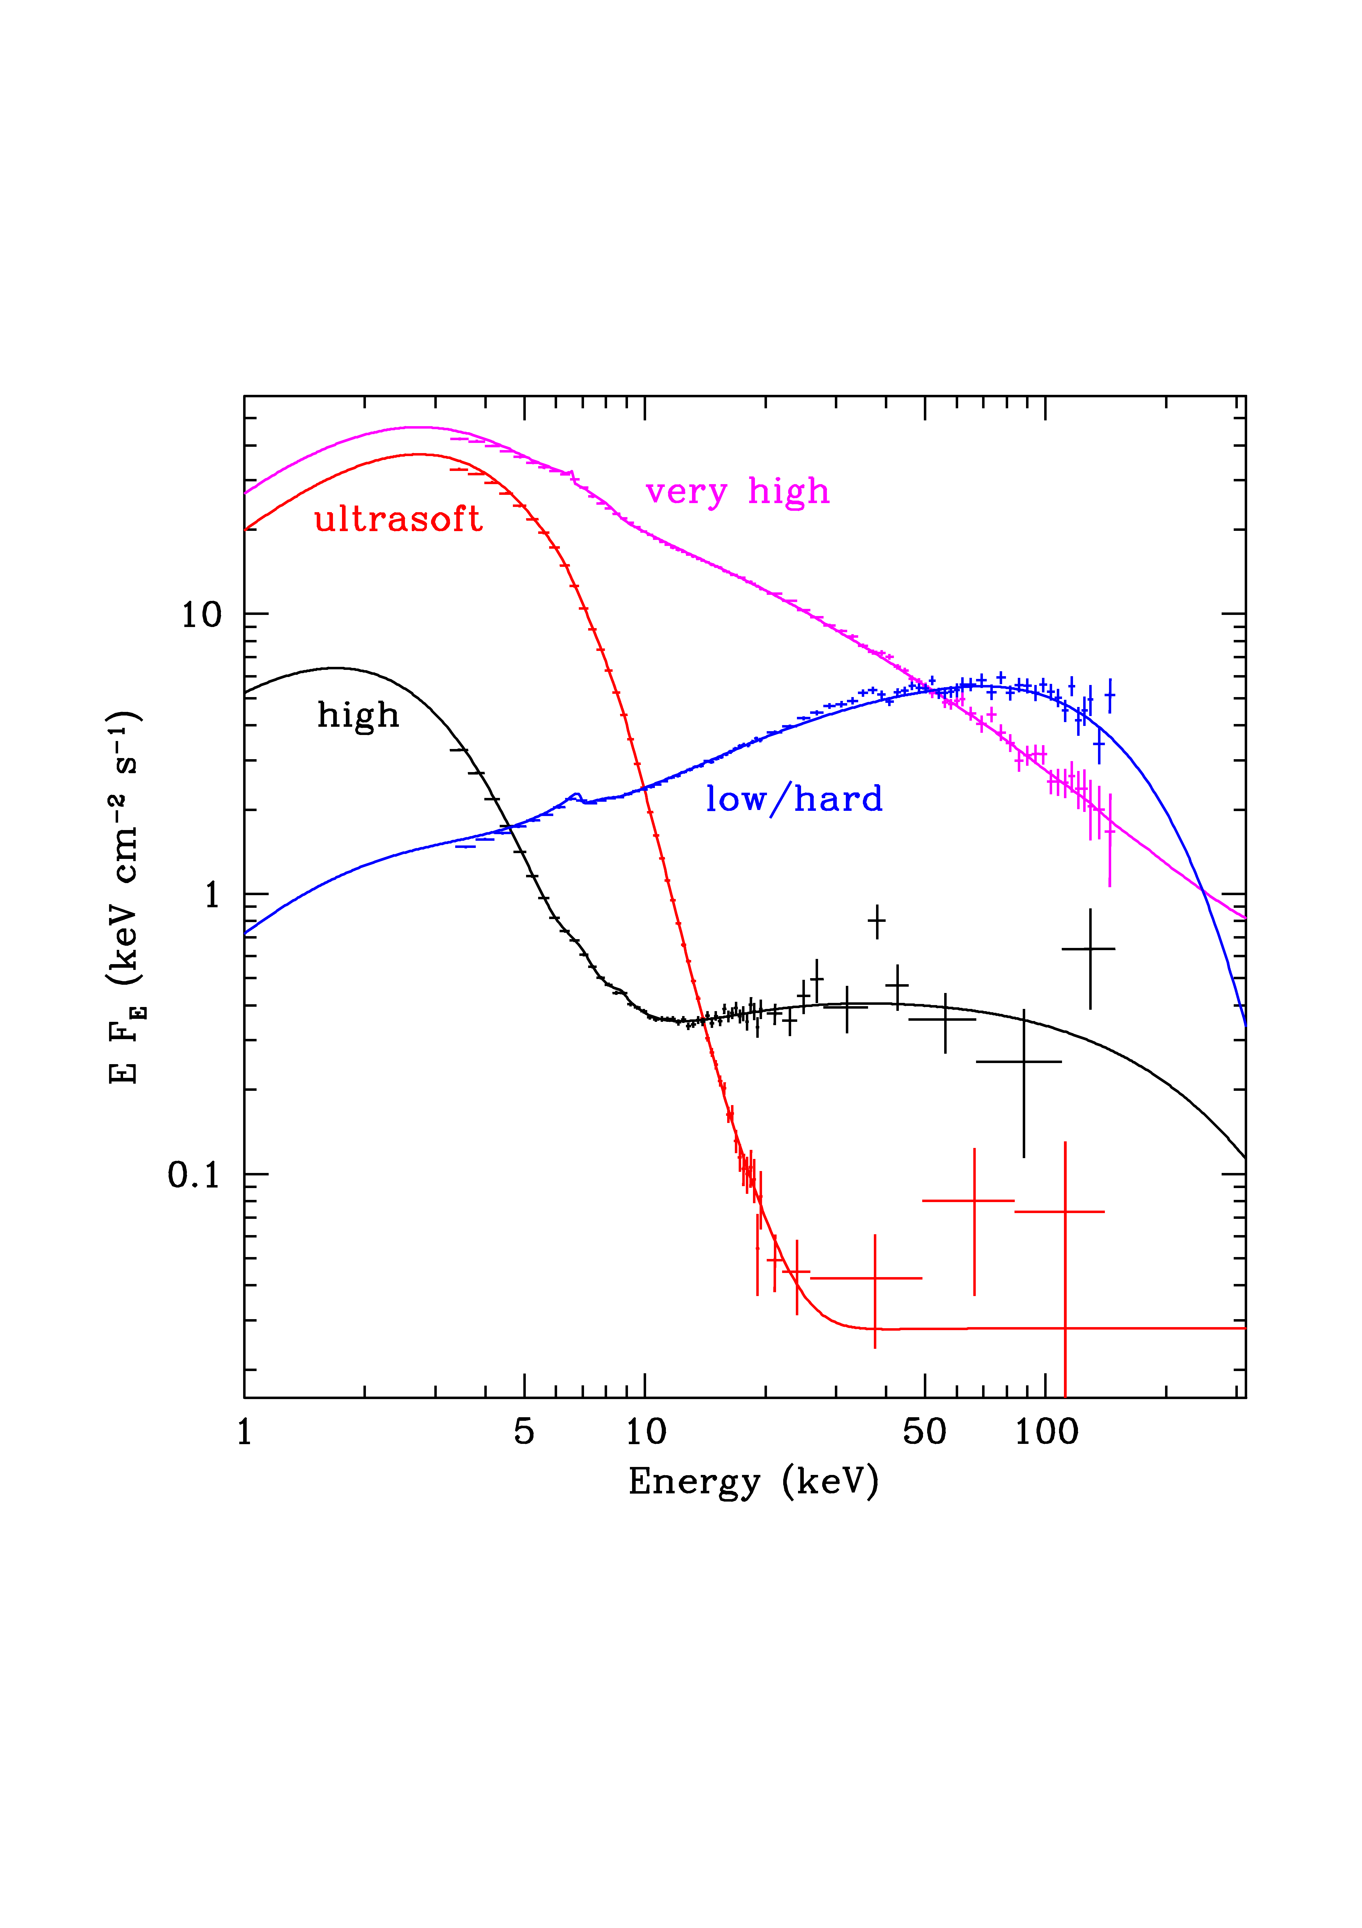

Black hole binaries: SPECTRA
Observe dramatic changes in SED with mass accretion rate onto black hole
Dramatic changes in continuum – single object, different days
Underlying pattern in all systems
High L/L_{Edd}: soft spectrum, peaks at kT_{max} often disc-like, plus tail
Lower L/L_{Edd}: hard spectrum, peaks at high energies, not like a disc (McClintock & Remillard 2006)

Slide 22
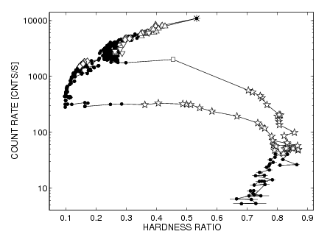
Black hole binaries: SPECTRA
Observe dramatic changes in SED with mass accretion rate onto black hole

Slide 23
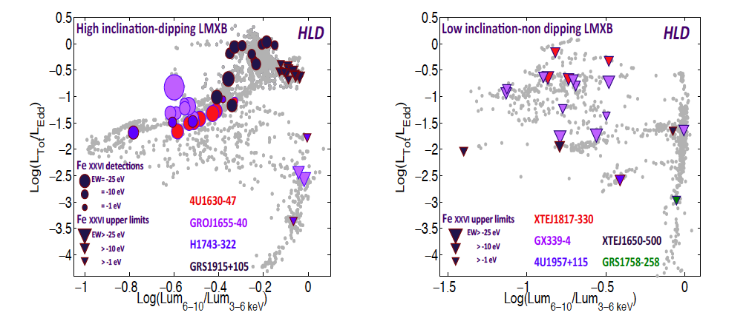
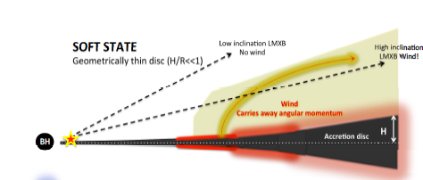
BH: absorption lines in high inc
Ponti et al 2012

Slide 24
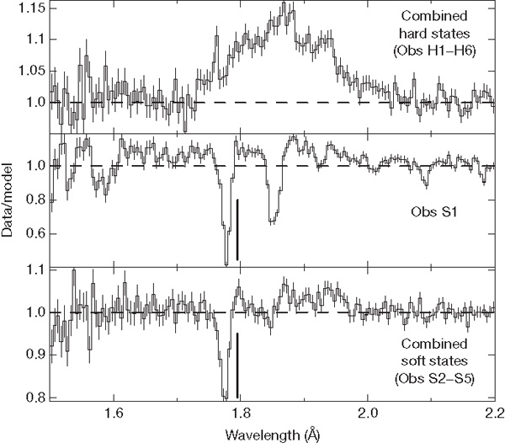
The data/model ratio for the continuum
fits to the HETGS observations of GRS 1915+105.
J Neilsen & JC Lee Nature 458, 481-484 (2009)
Change in ξ bigger than expect from change in spectrum
Absorption anti-correlates with Jet!!!

Slide 25
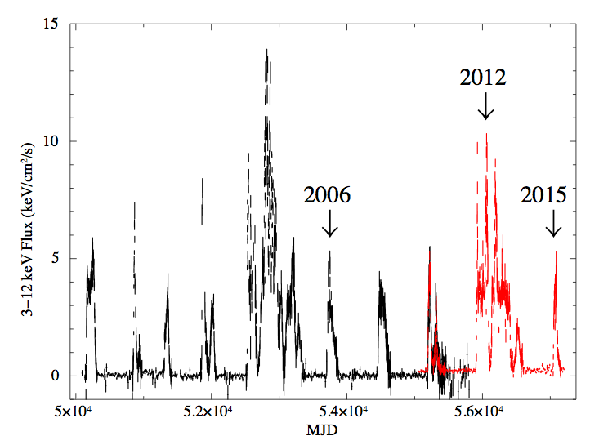
4U 1630 ASM-MAXI
2012
2006
2015
Hori, Done et al 2015

Slide 26
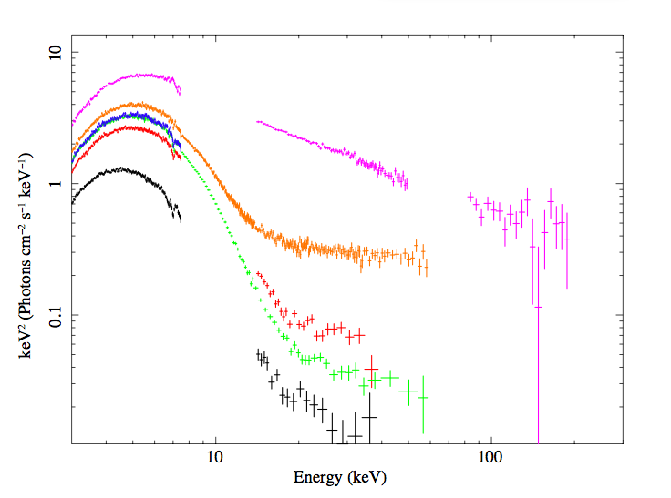
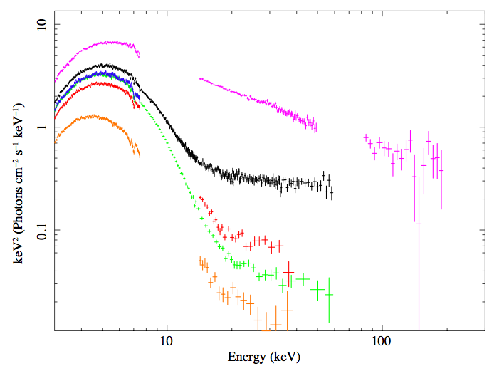
Hori, Done et al 2015

Slide 27
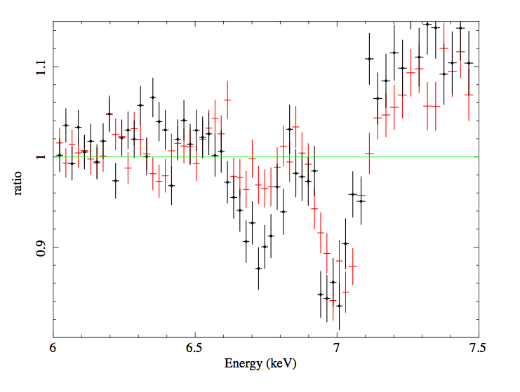
2006 maximum
2006 maximum
2015 minimum
Similar flux and spectrum
2006 minimum
Hori, Done et al 2015

Slide 28
Hori, Done et al 2015

Slide 29
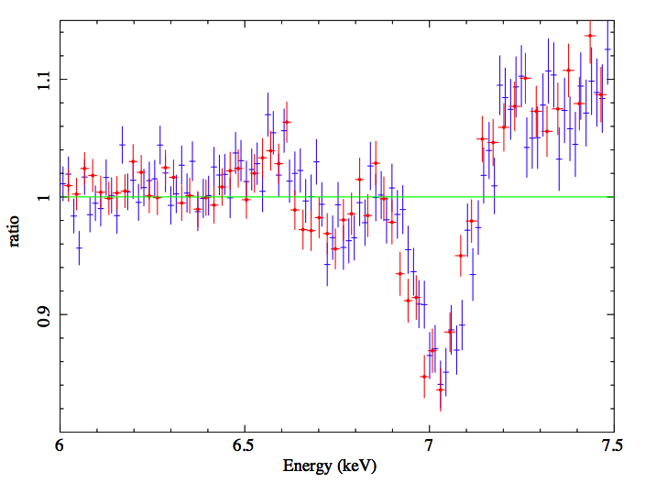
2006 maximum
2015 minimum
Similar flux and spectrum
Hori, Done et al 2015

Slide 30
Hori, Done et al 2015

Slide 31
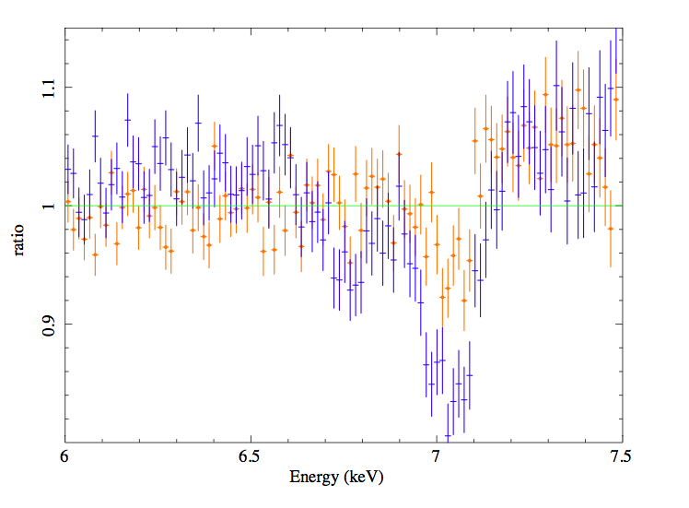
2015 minimum
2015 maximum TAIL
L similar so Nh similar
Tic=2Tic Ric=1/2 Ric
ξ=Lx/(nR²) > 4 ξ
Hori, Done et al 2015

Slide 32
Hori, Done et al 2015

Slide 33
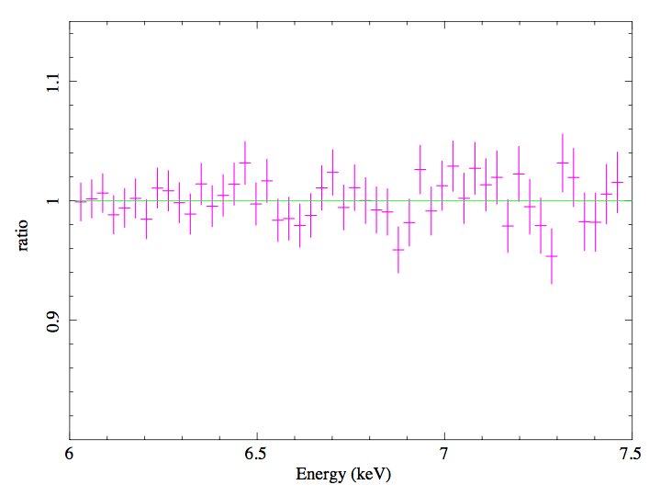
2012 strong tail
Hori, Done et al 2015

Slide 34
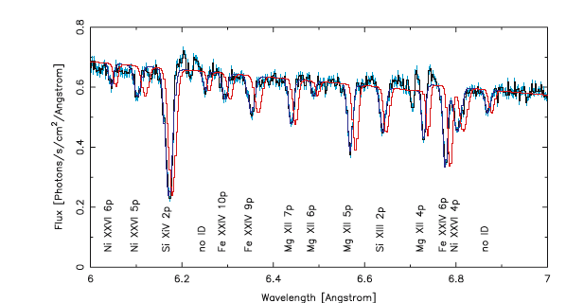
BUT: Chandra GRO1655-40
Magnetic winds? Miller et al 2006
R<<Ric as L not so bright and x low and lines give density diagnostic. BUT low vel

Slide 35
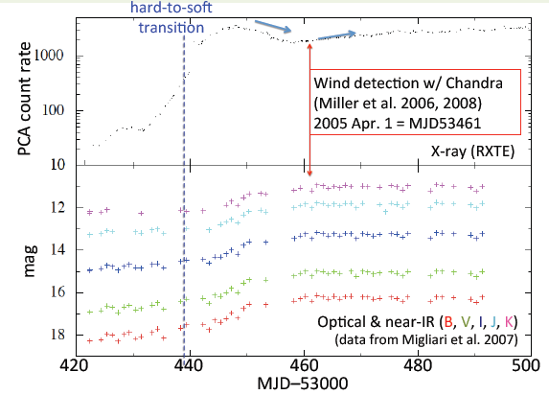
Optical monitoring crucial!! SMARTS (Buxton, Bailyn)

Slide 36
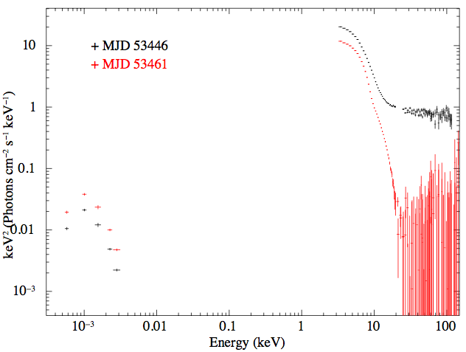
GRO1655 wacky wind
comparison of normal HSS SED with that in the Chandra epoch
Optical (outer disc, irradiation) HIGHER by factor 2
Mdot (or irradiation L) HIGHER by factor 2^{1.5}=3
But X-rays LOWER by factor 2
So L underestimated by factor 6 and tau=1.8 so Nh=3e24
normal HSS
Chandra

Slide 37
Conclusions
  Any and every NS and BHB with a big disk should have thermal wind at L>Lcrit ≈0.03LEdd
  Theory (and my new code) PREDICT Nh given L, predict Tic and Ric from spectrum, predict ξ from Lx
  Critically test on evolution of wind for CHANGING L + SPECTRUM
  Critically test with Astro-H – turbulent or laminar, steady or variable….
  Only go to B field if REALLY need
R=R_{IC}

Slide 38
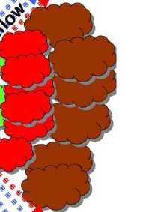
Which wind goes where? L~0.1LEdd

Slide 39
Which wind goes where? L~0.1LEdd

Slide 40
Which wind goes where? L~0.1LEdd
Warm absorbers
Strong X-ray supress UV line driven wind??
R=R_{IC}

Slide 41
Which wind goes where? L~LEdd
X-rays weak but FUV can be strong!

Slide 42
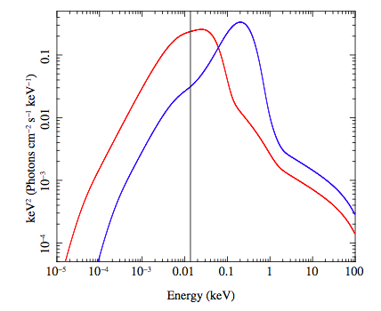
10⁶ versus 10⁹ M
Hagino et al 2014

Slide 43
Which wind goes where? L~LEdd M~10⁶⁻⁷ M

Slide 44
Which wind goes where? L~LEdd, M~10⁹⁻¹⁰

