Slide 1
Chandra Users’ Committee Meeting
November 28, 2022
CXC Manager’s Status Report
Edward Mattison, CXC Manager
☛ Mark Weber, CXC Deputy Manager

Slide 2
Topics
High Level Overview
Program Management
Mission Operations
Science Community Support
Public Communication and Outreach

Slide 3
High Level Overview (1/3)
Spacecraft and instruments are performing well, despite challenges
  With the primary exceptions of low-energy ACIS quantum efficiency and the restrictions imposed by the HRC power supply anomaly, Chandra continues to meet or exceed most mission Level 1 requirements.
    The pre-launch AXAF Level 1 requirements specify performance for a minimum of 3 years of mission operations. The Program has considerably exceeded that span.
  HRC is in the process of returning to science operations with new thermal constraints.
  Increasing spacecraft temperature, aging components, and changing orbit are making mission planning and operations more complex, thereby increasing staff effort.
Senior Review 2022
  The Senior Review Chandra Panel rated Chandra 'Excellent' overall, its highest rating.
  The Astrophysics Advisory Committee ranked Chandra 'Tier 1'.
  The Panel and Subcommittee urged NASA to fully fund our recommended overguide budget to maintain the observatory's and program's capabilities.

Slide 4
High Level Overview (2/3)
Budget
  FY22 expenditures were kept in line with PPBE budgets (Planning, Programming, Budgeting & Execution).
  The FY23 budget includes the overguide funding recommendation from Senior Review to fully maintain capabilities.
COVID-19
  Operations are proceeding without significant impact.
  Science and mission operations have successfully adapted and continued under the evolving teleworking situation.

Slide 5
High Level Overview (3/3)
Changes in Leadership Personnel
  MSFC Chandra Project Scientist:
    Martin Weisskopf retired (May 31).
    Stephen O'Dell is now the Project Scientist.
  Chandra Director's Office (CDO):
    Andrea Prestwich is on an IPA (Intergovernmental Personnel Act) assignment at NSF (Sep-2021).
    Belinda Wilkes retired from Chandra and SAO (Jul 1).
    Rodolfo Montez has taken on responsibilities from Prestwich and Wilkes.
    Thomas Connor has been hired to support tasks in the CDO.
  Flight Operations Team (FOT):
    Sabina Hurley (Northrop Grumman) stepped down as Flight Team Manager and is departing Northrop Grumman, yet will remain available as a consulting resource.
    Megan Lin (Northrop Grumman) has joined Chandra as Flight Ops Manager (Aug 1).
  Data System Operations (DSOps):
    Francesca Civano departed Chandra and SAO for a NASA position (Sep 23).
    Raffaele D'Abrusco (Archive Ops lead) has assumed the additional role of DSOps lead.

Slide 6
Program Management (1/7)

Slide 7
Program Management (2/7)
C. Canizares, PI

Slide 8
Program Management (3/7)
Current CXC contract
  Current contract extends mission ops through Sep-2024.
  Contract option for extending mission ops through Sep-2027.
  A 3-year closeout period follows the end of mission operations.
Current Funding
  Current CXC funding runs to 20-Jan-2023.
    The MSFC Chandra Program Office has received all FY23 funds, which protects us from funding gaps due to delays in Congressional budget resolutions.
  The Einstein program is funded through 2024.

Slide 9
Program Management (4/7)
Senior Review 2022
  SR22 proposal was submitted to NASA Feb 11. Virtual site visit by SR panel was Apr 4.
  Chandra received highest achievable marks:
    The Chandra Panel rated Chandra 'Excellent' overall.
    The Astrophysics Advisory Committee (APAC) ranked Chandra 'Tier 1'.
  We proposed an Overguide budget and augmentations.
    The Overguide budget maintains current capabilities:
      Compensates for inflation
      Funds 2 additional Flight Operations engineers to meet rising challenges of planning and operations
    Augmentations:
      Diversity, Equity, and Inclusion: CFaSt Minority Internship Initiative
      Time domain science: enhance data processing pipelines to identify varying targets
      Chandra grants: increase funding for added observing time in FY23–25 and to restore purchasing power lost to inflation during mission
  The SR22 APAC report recommended the following ranking of funding priorities:
    Completely fund the Overguide, reducing GO (General Observer) funds if necessary
    Time-domain science
    Increase GO program funding

Slide 10
Program Management (5/7)
FY22 expenditures were kept within current guidelines of the PPBE process.
PPBE-24 (Planning, Programming, Budgeting & Execution, Apr 22)
  NASA approved the full Overguide budget for FY23, but did not include funds for the proposed augmentations.
    The GO program was not reduced to enable this.
  For FY24 and beyond, NASA approved a partial Overguide budget (with none of the augmentations).
FY23 Budget
  The FY23 CXC Operating Plan incorporates the PPBE-24 (Apr 22) guidelines.
    We are proceeding to hire 2 additional FOT engineers.
    We anticipate being able to maintain staff levels and mission capabilities in FY23.
    The Chandra grant program remains level.

Slide 11
Program Management (6/7)
Adaptation to coronavirus pandemic and hybrid workplace
  SAO/CfA has been returning onsite from the pandemic in steps.
  Flight operations are still being carried out normally, onsite, at the OCC (Operations Control Center). Due to the current “medium” level of Covid-19 level in Middlesex County, the OCC and Chandra spaces at other SAO sites are currently working under SI-defined mitigations (led by the CDC) that have removed the requirement for social distancing and the requirement to document vaccination status. Masking is not required and there is no occupancy limitation. Public visitors are permitted.
  Other science and mission operations, and various meetings, continued successfully via hybrid-telework.
CXC-organized Reviews and Conferences
  Cycle 24 Peer Review
    Was held 21–30 June 2022 (conducted remotely)
  Science workshop: "Supernova Remnants and Their Progenitors"
    Was held 16–18 August 2022 (conducted in-person and remotely)

Slide 12
Program Management (7/7)
HQ Visit (part 1)
  On Nov 1, Chandra hosted a visit from NASA HQ personnel. In particular, we met with Mark Clampin, the new Astrophysics Division Director, and Janet Letchworth, the new Chandra Program Executive.
  This event was held at the OCC, largely in-person.
  The agenda had some conversation time and high-level presentations from all areas of the CXC for Clampin to get to know us. (He was only in town for one day.)
Quarterly #54
  "Quarterlies" are the semi-annual, in-depth, technical oversight meetings with NASA.
  This event was held at the OCC on Nov 1 (budget) and Nov 2 (technical and management), largely in-person.
HQ Visit (part 2)
  Janet Letchworth met on Nov 3 with team leads to get to know more about their science interests and team-level activities. She expressed a proactive interest in being helpful from her office.

Slide 13
Mission Operations (1/8)
Spacecraft — Overall status
  The spacecraft continues to operate extremely well.
  Temperature control is a continuing and increasing challenge to mission planning.
  Low perigee during 2022–24 requires extra mission planning effort to mitigate a variety of effects, including high gravity gradients, ionizing radiation near perigee, and Earthshine.
Science Operations
  ACIS continues to operate well.
    A new ACIS TXings patch was developed and uploaded, greatly increasing the ability of ACIS to function as a radiation monitor.
    ACIS calibration observations are now being carried out at -105 deg C, to allow relaxation of cold focal plane requirements.
  HRC A-side electronics have functioned nominally through 4 test runs. The team is working toward a return to regular science observations in Feb-2023.

Slide 14
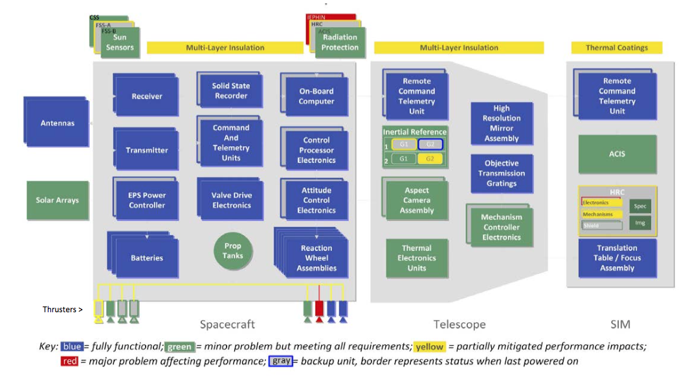
Mission Operations (2/8)
Vehicle Status

Slide 15
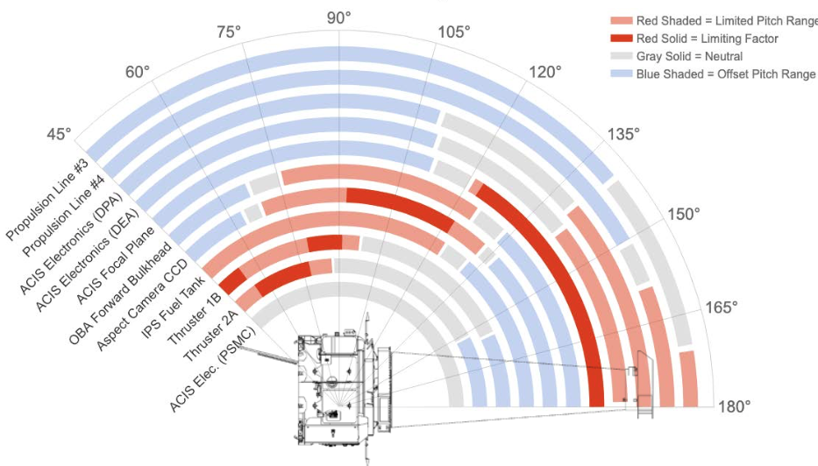
Mission Operations (3/8)
Spacecraft — Heating versus Pitch

Slide 16
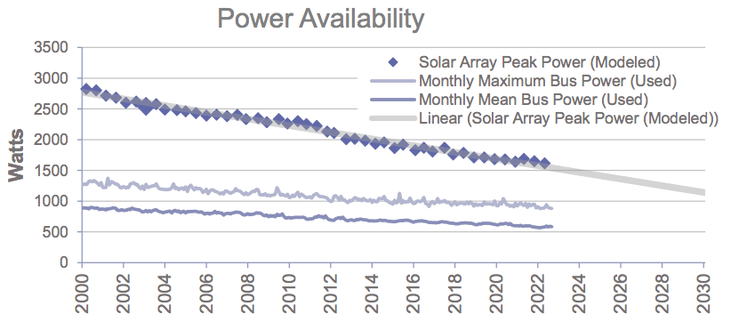
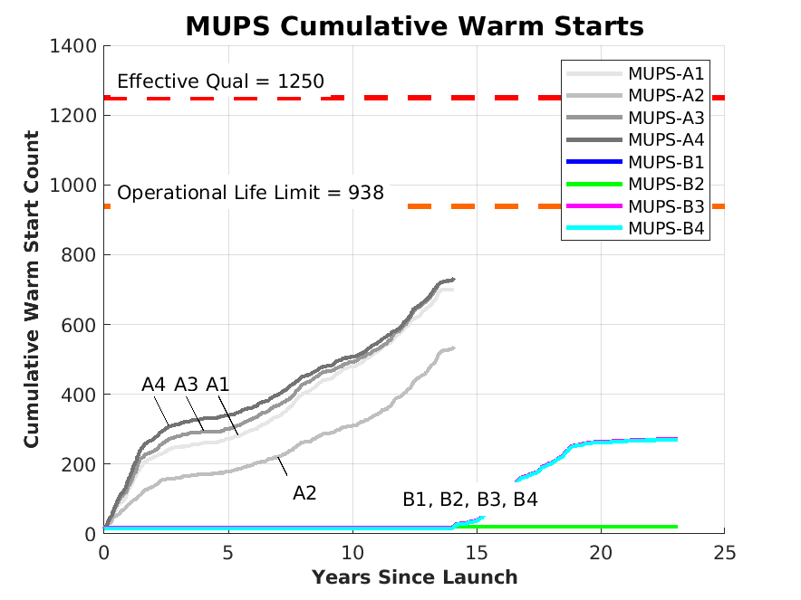
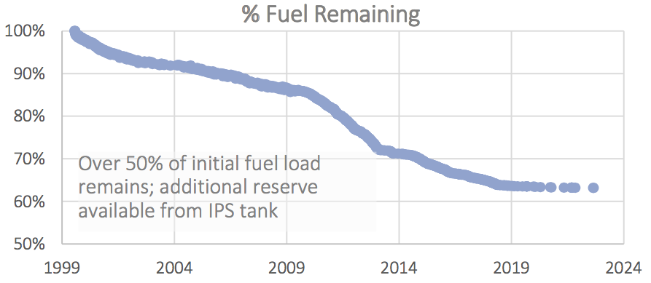
Mission Operations (4/8)
Spacecraft — Trends on Resources

Slide 17
Mission Operations (5/8)
Major Operational Improvements
  Algorithm to minimize operational risk to thrusters during angular momentum unloading, especially during low perigee period; allows optimum thruster selection
  ➥ Ready and in use
  Monitoring and notification system for automated communication of subsystem status
  ➥ In use / Beta testing
  Assistive scheduling of mission planning
  ➥ In development, new FOT engineer
  Aspect camera dynamic background algorithm
  ➥ In Beta testing, close to deployment
  General goal is to increase staff availability and operational flexibility & robustness
  ➥ Additional FOT engineers approved, started hiring process

Slide 18
Mission Operations (6/8)
Spacecraft — Interruptive events
  (Aug 11) Bright Star Hold
    Loss of ACA guide stars due to high levels of ionizing radiation near perigee
    Consequence of low perigee orbit evolution
    Science time lost = 149 ks.
  (Aug 19) Command and Telemetry Unit reset and Normal Sun Mode transition
    Root cause is likely a single event upset (cosmic ray).
    Science time lost = 257 ks.
  (Oct 20) Interface Unit-A reset and Normal Sun Mode transition
    Root cause is likely a single event upset (cosmic ray).
    Science time lost: see Oct 21.
(Oct 21) Safe Mode transition
  Root cause was a false trip of the Momentum Monitor due to a transient in computed disturbance torque.
  No credible hardware issues related to the Safe Mode entry.
  Science time lost = 398 ks (for contiguous events of Oct 20, 21).
(Nov 6) ACIS interruption
  The proximate cause was a trip of the on-board ACIS monitor in response to a violation of a thermal limit.
  The root cause was an inaccuracy in the predictive thermal model used to plan the weekly loads. The model has been corrected to prevent a recurrence.
  Science time lost = 75 ks.

Slide 19
Mission Operations (7/8)
Observation Efficiency

Slide 20
Mission Operations (8/8)
Operations Control Center (OCC)
  The OCC has maintained smooth operations.
  COVID-19 protocols have sustained spacecraft and personnel health and safety. Currently, maximum occupancy is permitted. As part of SAO, telework guidelines are evolving (subject to mission requirements).
  New version of off-line system (OFLS 12.3.1) was tested and then transitioned on Oct 11.
  New version of on-line system (ONLS 4.1.7) was tested and then transitioned on Nov 15.
  The Backup OCC is fully capable to support science operations.
Science Data Systems
  Software development and deliveries have stayed on schedule.
  Data processing and archive operations proceeding smoothly.

Slide 21
Science Community Support (1/2)
Data Delivery
  We continue to deliver data to observers within ~1.5 days of observation.
Grant Issuance
  We continue to issue grants typically within 2–3 weeks of initial observation.
  Grants <$30k are issued for total award amount.
  Grants ≥$30k and <$100k are initially issued for 50% of total award; remaining amount is awarded when 75% of initial award has been invoiced.
  Grants ≥$100k are initially issued for 33% of total award; remaining amount is awarded in multiple increments when 75% of previously awarded funds have been invoiced.

Slide 22
Science Community Support (2/2)
General Observer Program
  The Observing Cycle 24 Call for Proposals was issued 15-Dec-2021.
  There were 428 proposals submitted (360 general observer, 23 theory, 47 archive).
  Total time available: ~17.7Ms.
  Oversubscription in time: 4.2x.
  Dual anonymous peer review was held remotely, Jun 21–30.
Einstein Fellows Program
  NASA Hubble Fellowship Program (NHFP, administered by STScI) retains Hubble, Einstein, and Sagan science-based categories and their lead project scientists.
  Current fellows class had 446 applications, with 31 offers made, yielding 24 new fellows.
  P. Green (SAO) continues to provide scientific and policy leadership to Einstein fellows.
  SAO will host the NHFP Symposium in Sep 2023.

Slide 23
Public Communication and Outreach (1/3)
Overview
  The Chandra Public Communications team is very highly productive and influential.
  Their value is recognized and sought after by NASA for projects.
Accessibility
  Leading the field with projects to present science by sound and touch (e.g., sonifications, 3D printable models).
Education
  Virtual field trips with thousands of learners
  Service in ongoing working groups (e.g., web-based materials, Museum Alliance briefings, View Space products, STEM for girls and the underserved).
  "Fall 2022 Hour of Code":
    easy online access points for educators and learners
    interactive virtual activities
    downloads of paper-pencil activities for areas with low bandwidth or limited internet

Slide 24
Public Communication and Outreach (2/3)
Press Releases May 2022 – October 2022
  5 science press releases, one with sonifications of 2 James Webb images.
  7 image releases, one with sonification, one with Chandra data overlaid on 4 James Webb images.
Press Results
  Searching on... Chandra, Perseus, black hole, sonification... results in 2,165 print and web articles, including many top-tier new sites (e.g., NYTimes, WashPost, CNET, Scientific American, NBC, Today Show, USA Today, LATimes, TheAtlantic.com, NPR).
  NYTimes used their article on the Perseus sonification in a learning app and a new audio app.
Website
  The Chandra public website attracts an average of ~12 M hits per month.
  Saw waves of interest for releases of sonifications and collaboration with JWST.
  Posted 11 videos in series (formerly podcasts) and 12 blogs.

Slide 25
Public Communication and Outreach (3/3)
Social Media
  The Chandra sonification project continued to hold attention with retweets from administrative & celebrity accounts, 100k’s of views across NASA social accounts, with news articles, web traffic surges (sonifications have remained in top 50 Chandra web traffic and continue in the top 25 today), and millions of listens on NASA's SoundCloud. There are 20 sonifications, currently.
  The Perseus sonification went viral in August.
    Video views = 22 M. Likes = 498k. Retweets = 128k. Quote tweets = 36k.
  Growth:
    Followers = ~ 375k. Tripled since 2018.
    YouTube video views = > 8.5 M. Viewed more in past 3 years than previous 12 years total.
    Instagram followers = ~ 1.2 M. High growth in past 3 years.
    Facebook likes = ~ 335k. Engagement has doubled since 2018.

Slide 26
END

Slide 27
Supplementary Information

Slide 28
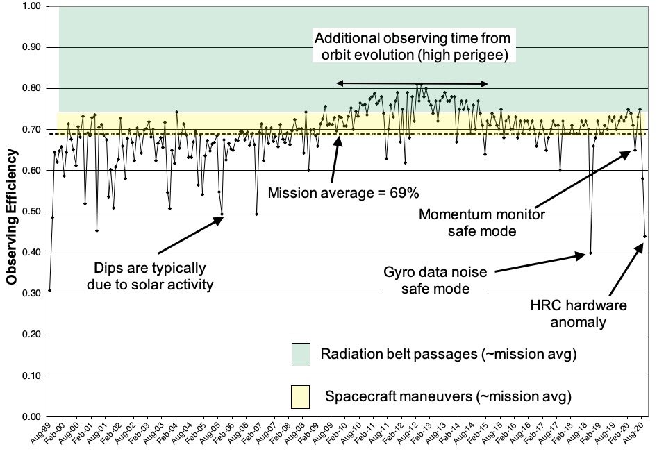
Observing Efficiency — Launch to Aug-2020

Slide 29
Mission Metric: Data Delivery Effectiveness
As of middle of following month |  |  |  |  |  |  | As of 10/5/22
Month | Number of Obs | Days to Data Delivery |  |  | Number Deliv | Number Outstanding | Number Deliv | Number Outstanding | Comments
 |  | Min | Avg | Max
Oct-21 | 83 | 0.2 | 1.6 | 10 | 83 | 0 | 83 | 0
Nov-21 | 92 | 0.2 | 1.4 | 7 | 92 | 0 | 92 | 0
Dec-21 | 103 | 0.2 | 1.8 | 19 | 102 | 1 | 103 | 0
Jan-22 | 98 | 0.2 | 1.4 | 7 | 98 | 0 | 98 | 0
Feb-22 | 68 | 0.2 | 1.5 | 8 | 68 | 0 | 68 | 0
Mar-22 | 109 | 0.2 | 1.5 | 13 | 109 | 0 | 109 | 0
Apr-22 | 126 | 0.2 | 1.7 | 24 | 126 | 0 | 126 | 0
May-22 | 130 | 0.2 | 1.7 | 11 | 130 | 0 | 130 | 0
Jun-22 | 142 | 0.2 | 1.9 | 11 | 142 | 0 | 142 | 0
Jul-22 | 124 | 0.2 | 1.4 | 6 | 124 | 0 | 124 | 0
Aug-22 | 125 | 0.2 | 1.2 | 39 | 124 | 1 | 125 | 0 | ObsId 25838 issues have been resolved.
Sep-22 | 125 | 0.2 | 1.1 | 7 | 124 | 1 | 124 | 1 | ObsId 27445 is in a ReprNoDD status because of a problem with the bias. It will have to be reprocessed once the bias has been repaired.

Slide 30
Mission Metric: Science Observation Summary
 | Total Mission through 9/30/22
 | No. ObsIDs | Total Msec
Cal ER | 1,362 | N/A
Cal | 3,102 | 25.6
DDT | 773 | 16.0
GO | 14,240 | 374.7
GTO | 2,981 | 62.4
TOO | 945 | 23.8
CCT | 249 | 3.5
Total | 23,652 | 506.0
Time since first light (Ms) |  | 729.5
Mission average efficiency |  | 69.4%

