Slide 1
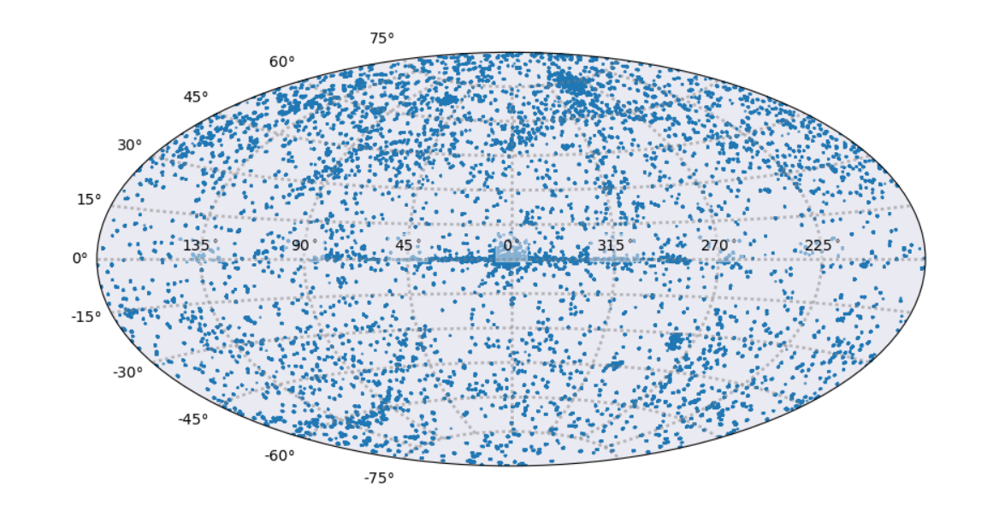
CSC 2.0 Status Update
2019 Sep 24
Ian Evans (Astrophysicist, CSC Lead Scientist)
Janet Evans (CXC Software Development Manager)
G. Fabbiano (Senior Astrophysicist, CXC DS Division Head)
Inclusive CSC report with contributions from CXCDS development, operations, and SDS

Slide 2
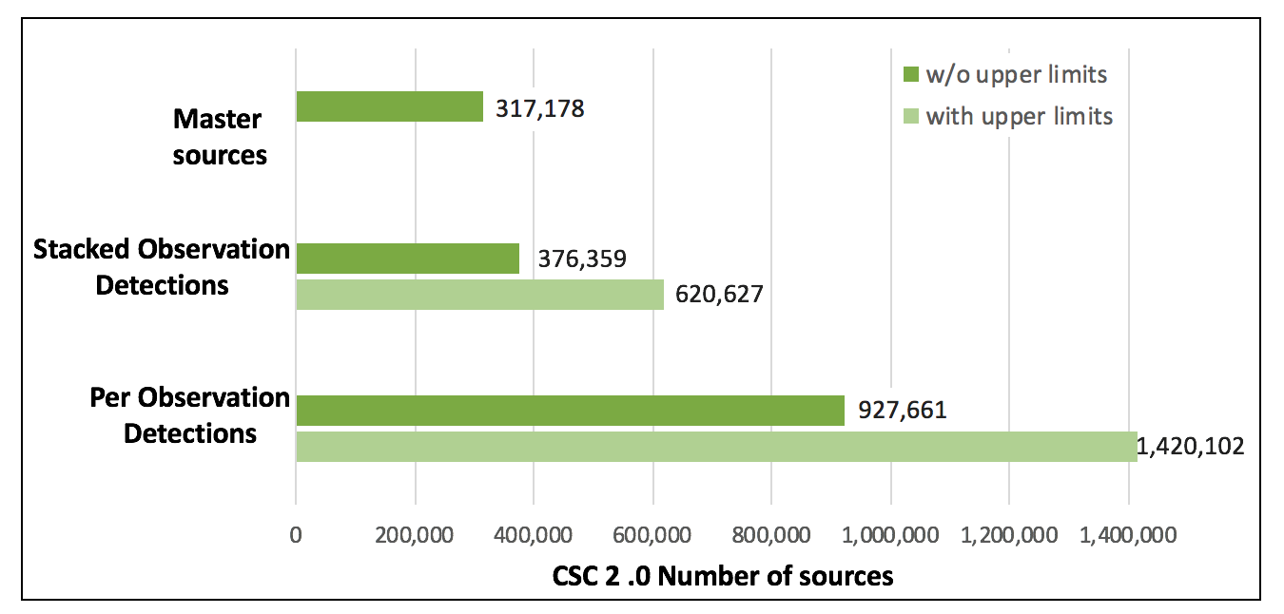
Chandra Source Catalog Release 2.0
Completed CSC 2.0 processing — Plan to release in October

Slide 3
Chandra Source Catalog Usage
Usage Statistics 2018 Sep 01 – 2019 Aug 31
CSC WWT catalog visualizer starts | 87 /month
CSCview catalog browser properties searches | 653 /month
CSCview catalog browser data product browse | 5805 /month
CSCview catalog browser data product download | 69,207 /month
Command-line (CLI) searches | 13,984 /month
Demos
  Completed: AAS (Jan/Jun)
  HEAD Meeting (Mar)
  Bologna meeting (Aug)
  Going Fwd: ADASS (Oct)
  Chandra 20 Years (Dec)
  AAS (Jan)

Slide 4
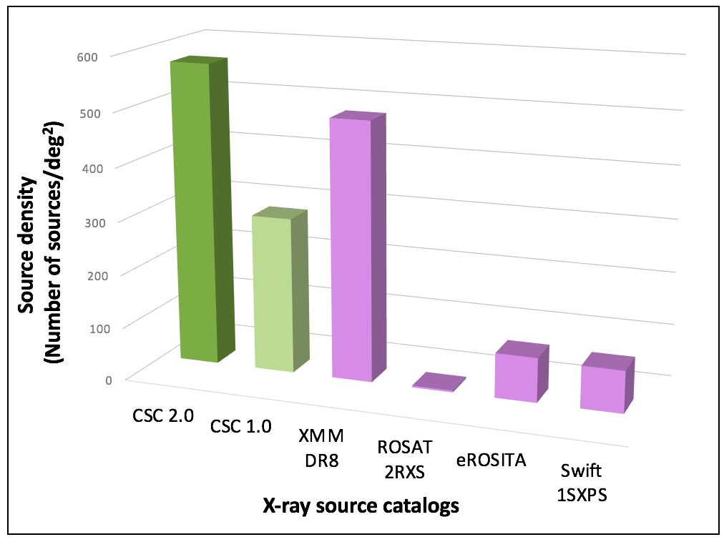
CSC2 Source Density vs. Other X-ray Source Catalogs

Slide 5
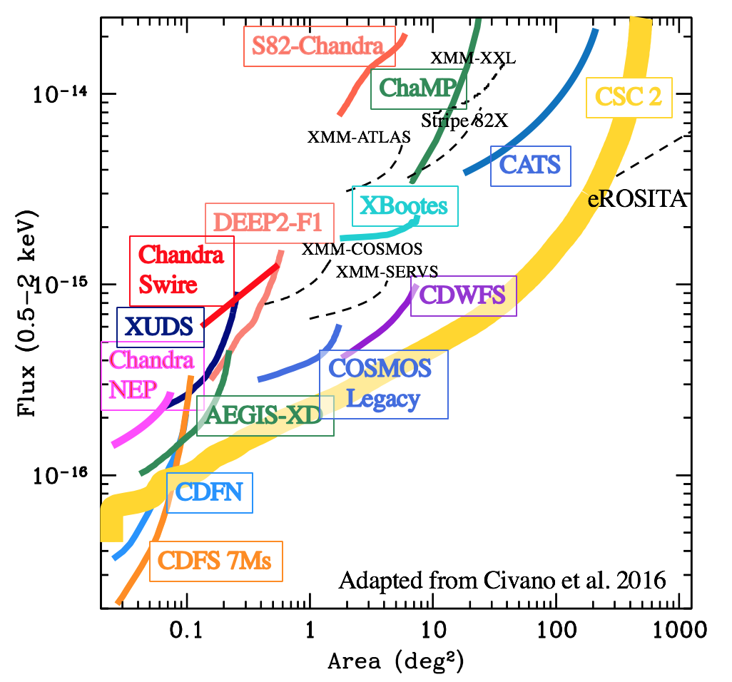
CSC2 Limiting Sensitivity
More Sensitive
Larger Area

Slide 6
Chandra Source Catalog Looking Forward
Begin CSC 2.1 production on 2015–2020 public data ~Feb 2021
CSC 2.0 Wrap-up …
  Final data QA check, catalog labeling, UI interface release
  CSC 2.0 crossmatch with external catalogs SDSS13, AllWISE, and Gaia
Steps to get to CSC 2.1 start …
  Complete migration of system to the new compute cluster
  Significantly reduce the number of manual QA’s by folding in recent Sherpa improvements for PSF fits to data
  Tie all stacked observations to the Gaia astrometric reference frame to address larger absolute astrometric errors in post ~2012 data
  Reintegrate the end-to-end processing system
  Move processing to DS Operations team
    Involves documentation and training
  Repro V starts ~Feb 2020; expected duration is 1 year

Slide 7
BACKUP SLIDES

Slide 8
Chandra Source Catalog Interfaces
CSC 2.0 Public Interface Updates
  CSCWWT — WWT interface to CSC 2.0 with connection to CSCview
  CSCview — Data archive interface
    Include addition of limiting sensitivity and JPEG display
  CSCweb — New simple graphical web interface
    Performs single/multi cone search; displays master source basic summary and limiting sensitivity in search area
  Csccli — Command line web interface for ADQL searches of the catalog; supports upload of user table and crossmatch
  Csclimsen — Command line web interface that returns limiting sensitivity for requested position
  Csc2scs — Simple cone search
  Csc2siap — Simple image access protocol
  Csc2tap — Table access protocol
  Release in October with CSC 2.0

Slide 9
Repro V
Repro V Drivers
  Apply uniformly the latest set of calibrations, including new clock correlation files
  Improve the aspect software, to obtain improved estimates of the optical axis position, and of the ACA plate scale
    Needed to avoid deteriorations of source photometry and position
  Implement a polynomial fit for a new CTI correction as ACIS is operating at warmer temperatures
  Improve de-gap correction for HRC chip coordinates that follow through to sky coordinates
  Include RMF/ARF for gratings to the Primary data product package for ease of use
  Produce and add standard unique data identifiers (digital object identifiers; DOIs) to data products
  Commitment to the Senior Review

Slide 10
Chandra Source Catalog Usage — Details
Usage Statistics 2018 Sep 01 – 2019 Aug 31
 | Release 2.0 Current Database | Release 1.1
 | Number | Number
CSCview catalog browser downloads | 314 /month
CSCview catalog browser properties searches | 653 /month | 159 /month
CSCview catalog browser data product browse | 5805 /month | 29 /month
CSCview catalog browser data product download | 69207 /month | 2233 /month
Command-line (CLI) searches | 13984 /month | 2788 /month
VO cone searches | N/A | 138355 /month
CSC WWT catalog visualizer starts | 87 /month | N/A

