Slide 1
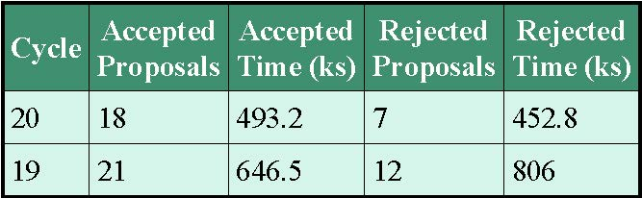
DDT Summary: Oct 2018-Sept 2019
  Notes:
  1: Rejected #s do not include informal requests
  2: 6 non-transient programs were approved since 1 Sept 2018

Slide 2
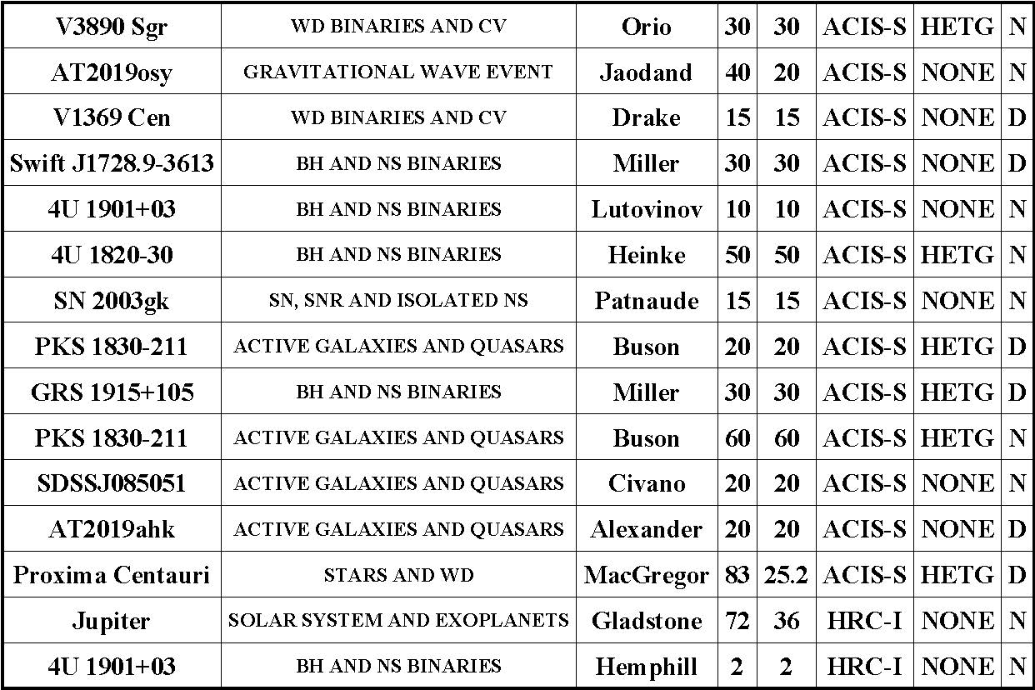
Director’s Discretionary Time (DDT)
1: AT2019osy: only EM candidate BH-NS merger, multiple requests (Obsd 22 Sept, L_{X}<2e40 cgs, GCN 25822)
2: GRS 1915+105 in a very faint state, PI reported strong absorption lines
3: Obscured, variable optical spectrum, broad-lined quasar from a CCT program
4: Jupiter to observe with Juno close to northern aurora during “attitude adjusting” perijoves

Slide 3
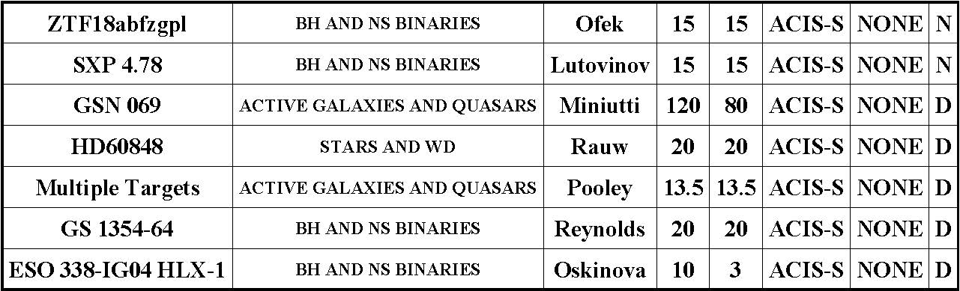
Director’s Discretionary Time (DDT)
1: Seyfert 1 GSN 069: quasi-periodic flares, 30 ks, Chandra: 3, harder and lower L, no radio; suggested: transition disk dominated -> non-disk dominated (warmer)
2: Quadruply lensed AGN search: L_{X} check of several candidates in advance of proposal

Slide 4
20th Anniversary Year: 2019
We are in the midst of a full year of celebration!
Events listed on the website:
http://cxc.cfa.harvard.edu/cdo/chandra20/
Chandra First Light Celebratory Reception
NASM, Washington DC, 26 Aug 2019
Many people have worked very hard on a wide variety of events. It has been wonderful and fun, but we are happy it does not happen every year!

Slide 5
20th Anniversary Year
Books
The Chandra X-ray Observatory: Exploring the High Energy Universe: editors: Belinda Wilkes, Wallace Tucker
  Review of 20 years of Chandra science for the astronomical community, e-book in Series: “American Astronomical Society/IOP”
  Expert authors, 11 science topical chapters and a prologue, charting the scientific discoveries and progress resulting from Chandra
  IoP: book is in production
  Hardcopies will also be available
  IoP will launch at AAS, Honolulu, Jan 2020
Light from the Void: Chandra’s Two Decades of Discovery (TBC): 20th Anniversary Chandra “Coffee-table” Picture book, Smithsonian Books, https://www.amazon.com/Light-Void-Discovery-Chandra-Observatory/dp/1588346692

Slide 6
Celebrating 20 years of Discovery
The Chandra Science Symposium
3-6 Dec 2019, Park Plaza Hotel, Boston, MA
Special events include:
  Special session honoring Riccardo Giacconi
  Astronauts session: Eileen Collins, Cady Coleman, Steve Hawley (TBC), Jeff Ashby (TBC)
  Banquet (following Astronaut session)
  Registration includes: breakfast and lunch each day and a banquet ticket
  Website:
  http://cxc.harvard.edu/symposium_2019/

