Slide 1
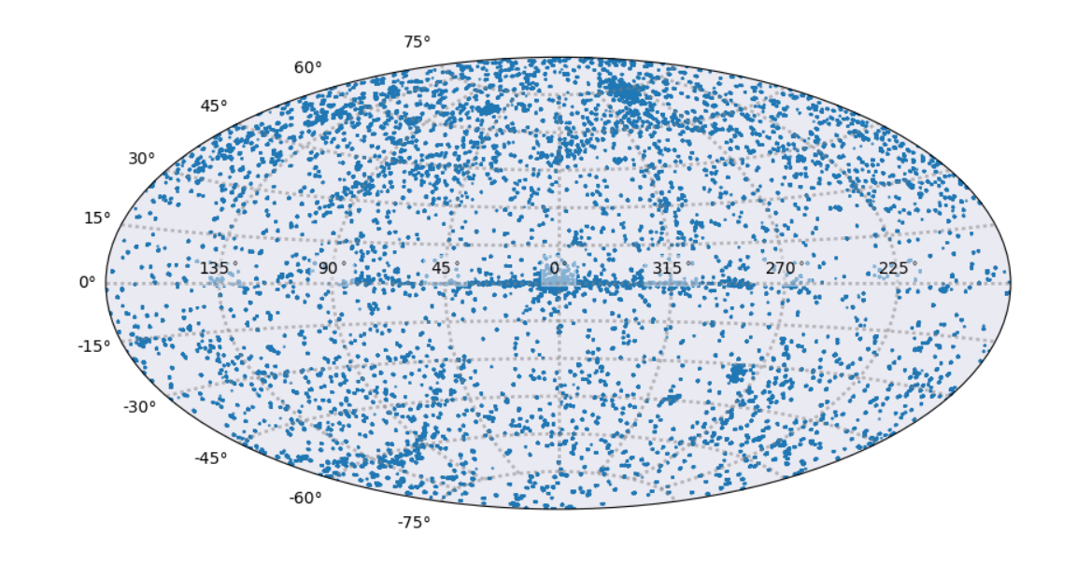
CSC2.0 Status Update
2018 Sep 13
G. Fabbiano (Senior Astrophysicist, CXC DS Division Head)
Ian Evans (Astrophysicist, CSC2 Lead Scientist)
Janet Evans (CXC Software Manager)
Inclusive CSC report with contributions from CXCDS development, operations, and SDS

Slide 2
Chandra Source Catalog
Release 2.0 Production Processing (2018 Sep 11)
  Completed
    Total number of TRUE+MARGINAL detections: 374349
    Total number of master sources: 315875
    Number of master sources completed through src_prop: 295440 (93.5%)
  To do
    4 groups of stacks to complete src_prop
      E0102, M87, M31 — currently processing
      Sgr A* — saving for last
    A set of repros — 1/3 complete
      Address bugs fixed in processing on later data
    A set of migrations on the archive — not started
      e.g., Header keyword fixes, simple calculation corrections using table data
    Limiting Sensitivity processing — not started, 10 day estimate
    Convex Hull processing — ~1/3 completed pre-PL review
      Regions of extended emission
Inclusive CSC report with contributions from CXCDS development, operations, and SDS

Slide 3
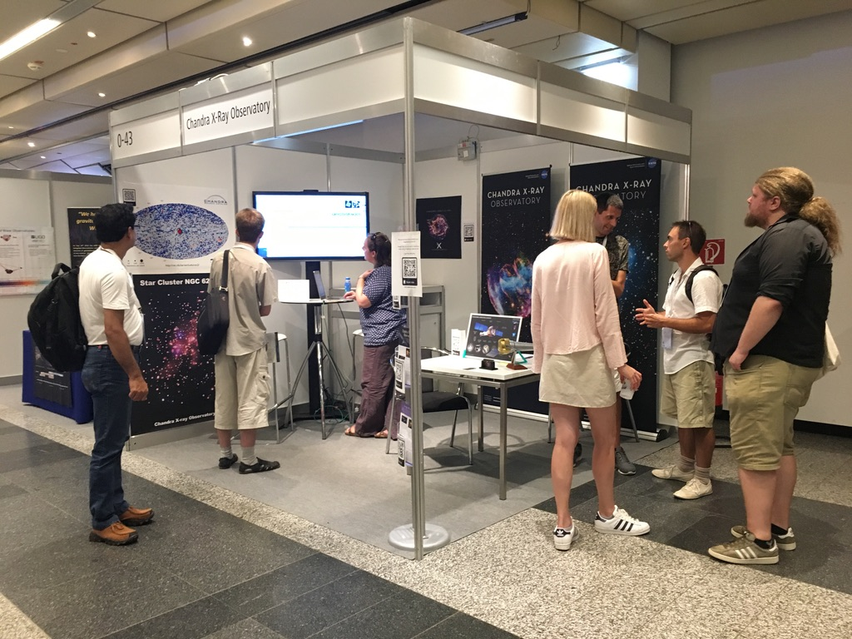
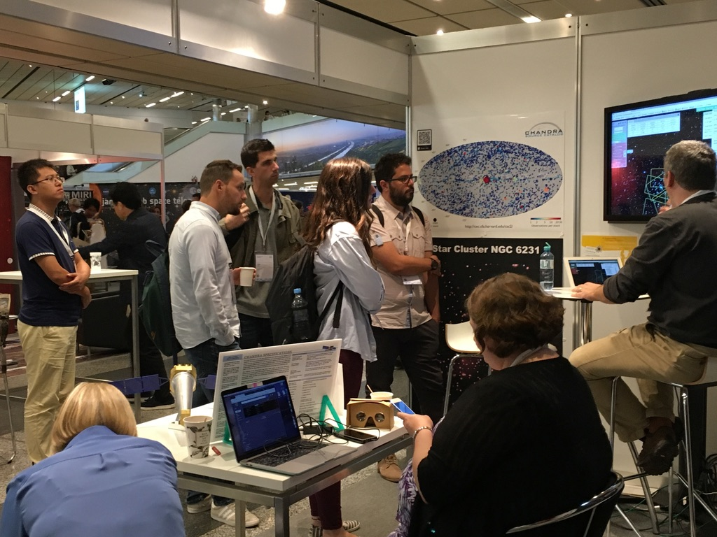
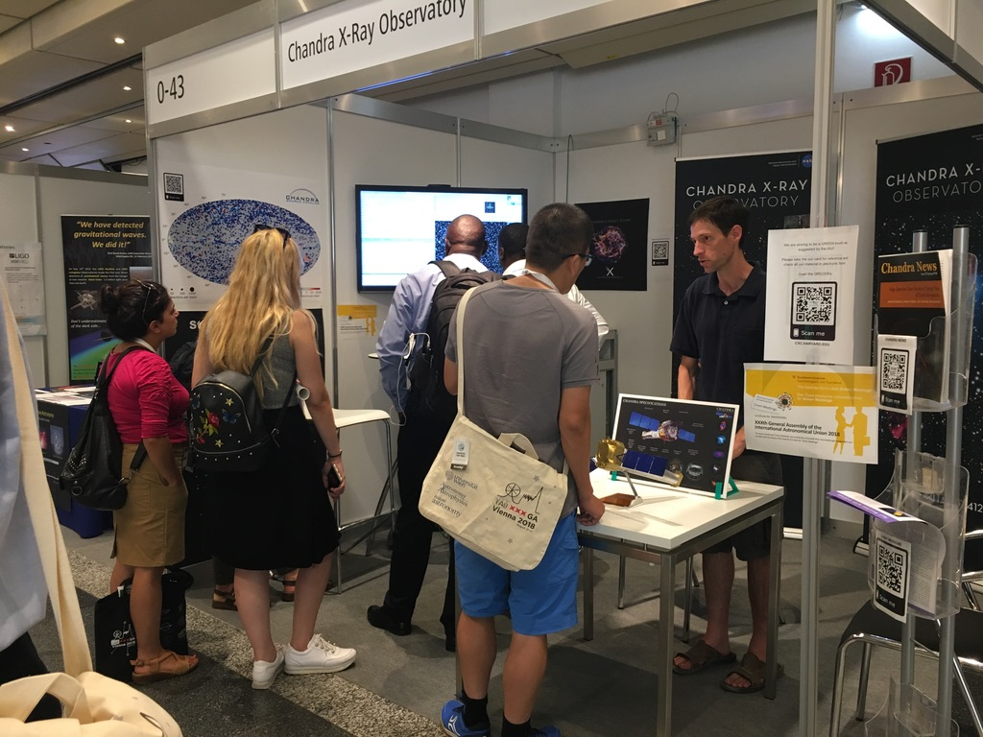
CSC Release 2.0 Outreach
Demo’d CSC2 at June AAS & IAU in August
Lots of interest — Lots of demos — Positive feedback!!

