Slide 1
Mission Planning Updates

Slide 2
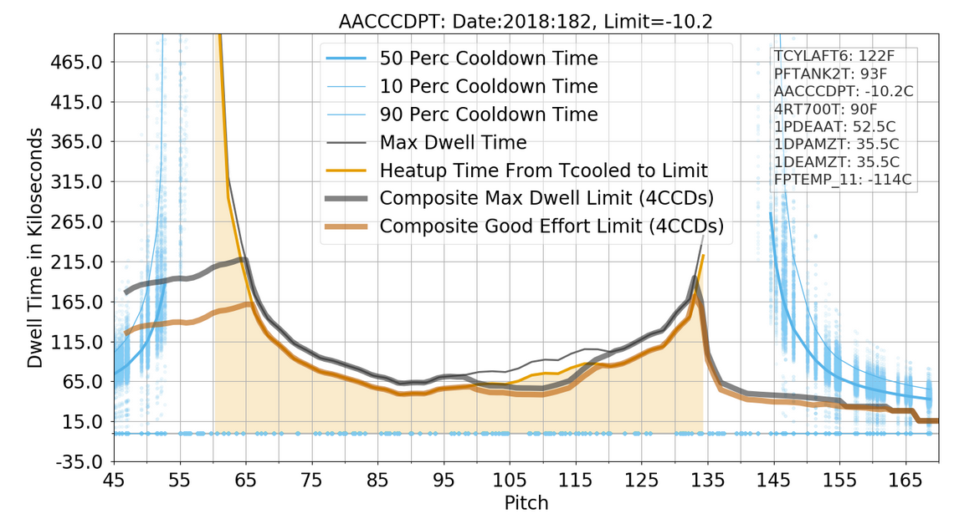

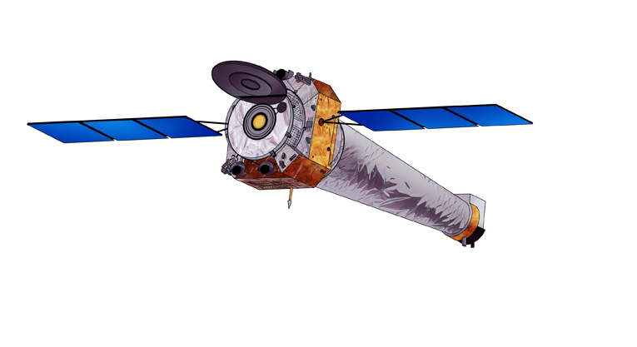
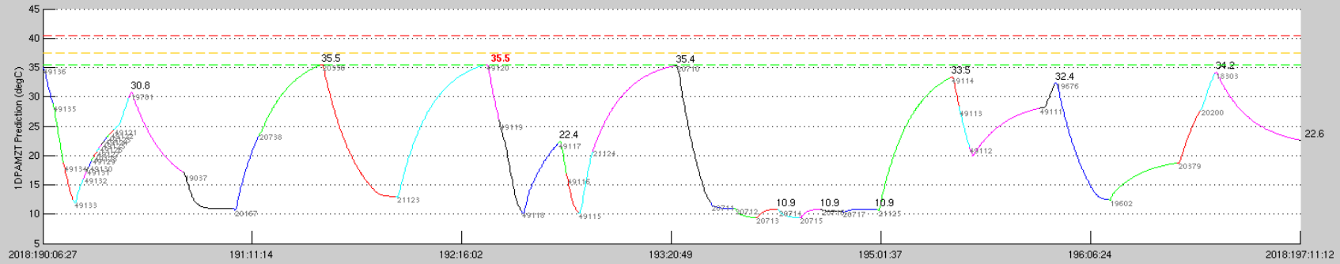
Thermal Balance: A Reminder
Maximum Dwell for Aspect Camera (~today)
Brown: maximum exposure before exceeding temperature limit (heavy is composite for all components).
Blue: minimum cooling time required to return to state from which another max dwell possible
-Z
+X
+Y
Complete Science Orbit
-Z cooling limited
by ACIS DPA
Multi-layer
Insulation
(MLI)
ObsID
RadZone
ACIS DPA
Red Limit
Planning Limit
Caution Limit
Temperature Prediction (degF)
Scheduling is a balance of heating and cooling multiple s/c components
- Observations often split to accommodate temperature limits
2
Notes:
Note that ACA cooling region requires 40-65 ks to provide sufficiently cool starting state to repeat dwells of ~50 ks at sun-normal attitudes, but that DPA limits time in these cooling regions to considerably lass than that. Can drop chips to help mitigate this, but overall it is a significant limitation.

Slide 3
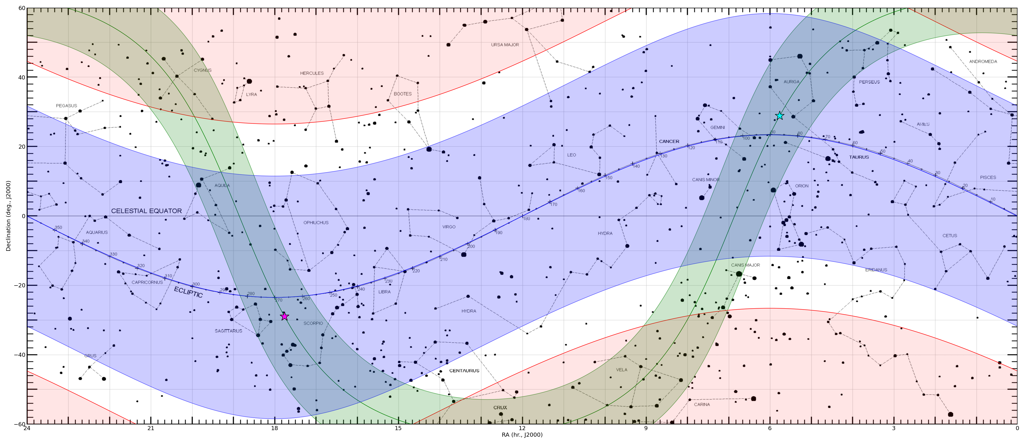
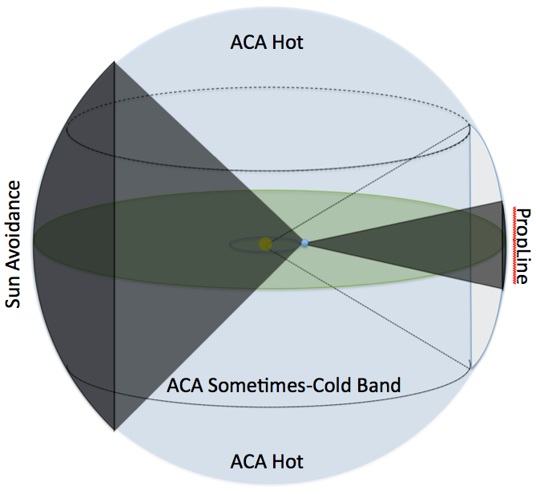
Constraints: Sky View
+60
CDF-N
ACA hot zone
Galactic
anticenter
Declination
Instantaneous
ACA cold region
COSMOS
ecliptic
SDSS Stripe 82
Galactic plane
Galactic
center
CDF-S
ACA hot zone
-60
24h
Right Ascension
LMC
SMC
0h
Sometimes-cold ACA (-Z) region covers large sky area.
- Many well-known fields can provide some cooling (e.g.,
Galactic Center, COSMOS field, SDSS Stripe 82).
- Others (e.g., CDF-N, LMC, SMC) difficult for long exposures.
Large Programs currently limited to <2 Ms within 30º
of ecliptic pole. (1.45 Ms approved in Cycle 20.)
Ecliptic Plane
Ecliptic Pole
3

Slide 4
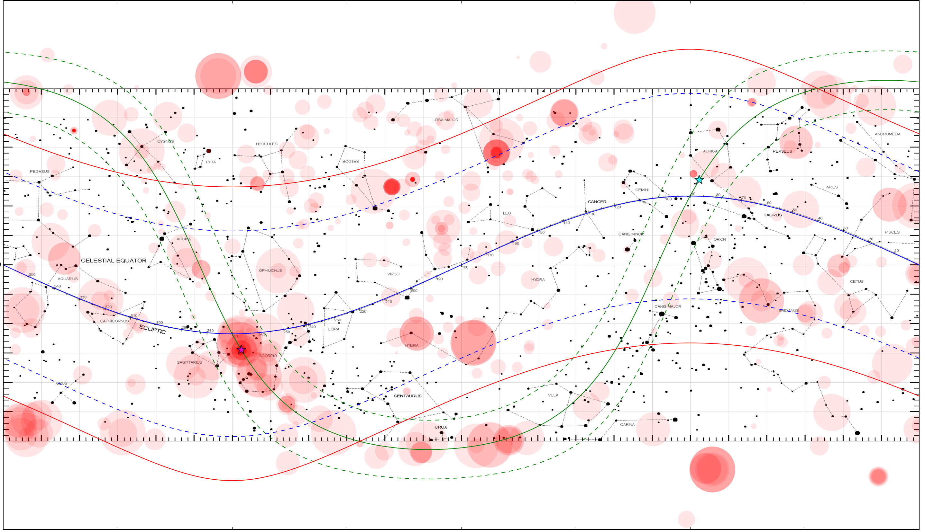
Target Distribution: Cycle 20
+60
ACA hot zone
Galactic
anticenter
Declination
Instantaneous
ACA cold region
ecliptic
Galactic plane
Galactic
center
ACA hot zone
-60
LMC
SMC
24h
Right Ascension
0h
4

Slide 5
Sample of Significant Planning Efforts
Completed in Cycle 19:
Sgr A*
- Tight windows coordinated with EHT and NuSTAR. (Also M87)
• Jupiter, coordinated w/ Juno, XMM, NuSTAR, HST.
- Tightly windowed at Juno apojoves and perijoves.
• CDWFS – 1.025 Ms at ecliptic latitude of 60∘- ε.
• GW170817 – Fast DDT (75 + 25 ks), then follow-ups (total: 300 ks).
• Abell 2146 – 2 Ms near ecliptic pole; star felon with pointing/offset preferences;
– Still underway (through May 2019?)
Coming up in Cycle 20:
Sgr A* (see above; add two 24-hr coordinations with Spitzer).
NS Merger – Four fast TOO programs totaling 640 ks with follow-ups.
N132D – 800 ks on SNR in LMC (pitch angle ~90º)
Comet 21P/Giacobini-Zinner – TOO (30 + 30 ks) – already complete.
5

Slide 6
Observation Scheduling
From 10/1/2017-08/26/2018:
Scheduled:
- 884 observations (20.0 Ms)
Executed:
- 52 TOO observations (1012 ks)
- 70 DDT observations (1146 ks)
✧ interrupted 6 operating loads
for TOO/DDT support
Coordinated Observations:
- Constraints: 31 observations (836 ks)
- Preferences: 14 observations (427 ks)
- Non-specified/Unofficial: 10 (320 ks)
- TOO/DDT coordinations: 21 (464 ks)
+
HSST, VLA, NuSTAR, Swift, XMM, Astrosat, INTEGRAL, NICER, Juno, EHT, Gemini-North, Gemini-South, Veritas, GBT, NOAO, VLT, ATCA
6
Notes:
Noteworthy: In Cycle 20, 51.3% of proposed TOO time was accepted. (58.7% if claimed trigger probabilities are not considered in totals.)
Cycle 19: 45.1% and 52.7%. Cycle 18: 42% and 47.8%. The point is that, contrary to what people often claim, Chandra TOO programs are not more difficult to get than normal observations. (And the success ratio on DDT programs, which is largely TOOs, is high as well.)

Slide 7
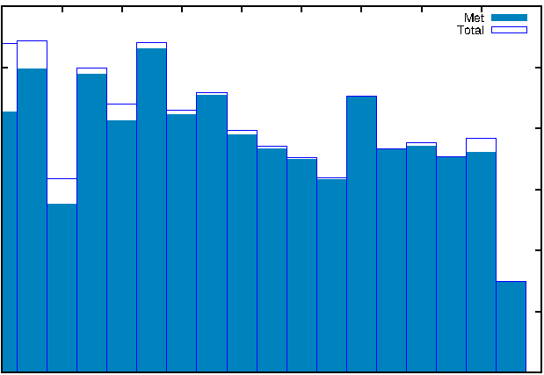
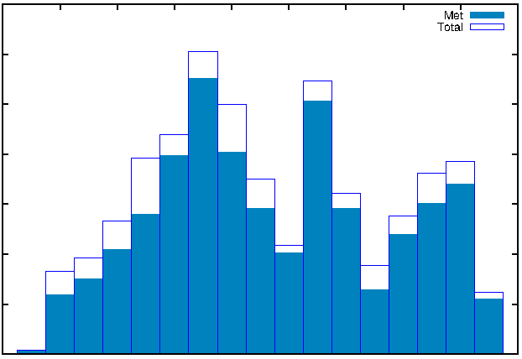
Constraints and Preferences
Constraints
Preferences
600
Met
350
Met
Total
300
Total
500
400
250
Number
200
300
150
200
100
100
50
0
0
2
4
6
8
10
12
14
16
18
2
4
6
8
10
12
14
16
18
Cycle
Cycle
Continue to successfully meet observing constraints with high observing efficiency.
Continue to support significant number of observing preferences.
- Ability to meet these is decreasing due to spacecraft constraints.
- Some programs with preferences for pointing adjustments based on roll are
becoming problematic due to star selection.
7
Notes:
Note: There were 4 missed constraints in Cycle 18: one 90 ks observation w/ uninterrupt constraint had to be split (counts as 2); one monitor constraint missed 90-110 day separation by <1 day; one phase constraint got slightly less than 90% of data in phase window. The rest indicated in plot are Ar Lac CAL targets incorrectly entered with monitor constraints rather than group constraint. Group constraint was met, but not in ObsID order (which wasn’t actually important).

Slide 8
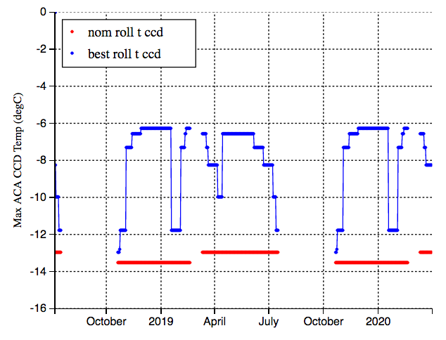
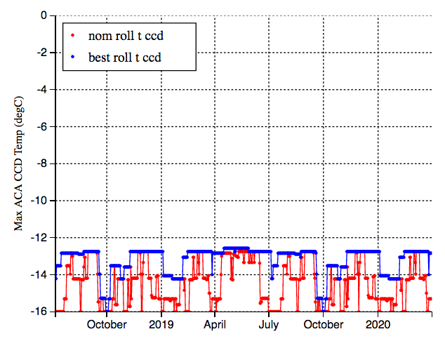
Star Selection and Mission Planning
ObsID 21509
ObsID 21144
Always need to be cold at nominal roll.
Ok at many other rolls.
Planning Limit
Always need to be cold at all roll angles.
• Star acquisition becomes more difficult as ACA temperature increases.
- Some bright stars only available at particular roll angles.
- Some faint stars can only be confidently acquired at low ACA temperatures.
• ACA team provides MP with tables for identifying best rolls for such targets.
- LTS layout needs to consider star fields for these targets.
- ~91% of targets could be acquired at T > ACA limit (some at off-nominal roll).
- About 8% have limited weeks in which acquisition is likely (like upper left).
• About 1% are never ok at temperatures near ACA limit (like upper right).
- Some can still be done if planned at a cold temperature.
- Some require “Creep-Up-and-Away” – First acquire stars in nearby field, then
move to target and observe, then acquire nearby before moving to next target.
✧ Adds about 2.4 ks of overhead.
8
Notes:
Note that the above criteria are conservative. New tools being developed to better estimate star acquisition probability, which will relieve some of the above scheduling pressure.
Actual 8/24/18 numbers, using all unobserved Cycle 17/18 targets (including TOO w/ coordinates): 811 targets; 699 have frac_nom_ok=1, 182 have frac_nom_ok<1 but frac_best_ok=1; 75 have both <1 (i.e., limited weeks); 8 are never ok at nominal; 7 are never ok (i.e., need creep-in-and-away).

Slide 9
Cool Attitude Targets
• To manage temperatures on spacecraft components, a collection of viable
science targets at cooling attitudes has become necessary: Cool Attitude Targets.
- Targets must be unconstrained, well-distributed on the sky (away from the
ecliptic poles), and have durations practical for single observations.
• Whitepapers will be solicited for catalogs of CATs: C-CAT program.
- 10 ks ≤ t ≤ 35 ks; |b| < 40º
- Total observing time per year estimated at ~1 Ms
- ~3000-5000 targets well-distributed around ecliptic will be ideal.
- Must use one of a pre-defined set of instrument modes.
- ACIS observations must use ≤ 4 chips.
- No constraints or preferences are allowed on cool targets.
- Standard completion rules apply if targets are split.
- Targets that conflict with GO targets will be removed from C-CAT.
• Weekly scheduling will proceed by having flight team work with LTS targets
and “pool” targets, as always. If additional targets are needed for thermal
(or momentum) reasons, “cool” targets will be selected.
9

Slide 10
Momentum Management in LTS
Momentum build-up per ks from solar radiation for target near ecliptic pole.
• Decreased perigee altitude in upcoming years will result in large gravity-gradient
torques, requiring considerable shedding of angular momentum.
- While propulsion fuel is not a concern, to conserve on total number of thruster
“warm starts,” we are currently limiting momentum unloads to ~1 per month.
- This is accomplished by minimizing solar radiation torques through careful
target selection.
• Momentum is now being considered in building long-term-schedule so as to
not accumulate more than can be offset with gravity-gradient torques during
perigee passes in short-term schedule.
10

