Slide 1
Einstein Fellowship
Program Update
Paul J. Green
Chandra Users Committee Meeting
Sep 26, 2017

Slide 2
Einstein Refresher
• Postdoctoral Fellowship Program sponsored by NASA, administered by the CXC.
• Fellowships awarded to recent Ph.D.s for research into ‘Physics of the Cosmos’ Science: high energy astrophysics, cosmology, gravitational wave physics.
• Missions covered include Chandra, Fermi, Planck, WFIRST, LISA, future missions and related missions (e.g. XMM, Swift).
• Research conducted at U.S. host institutions.
• Other NASA “Named Fellowship” (NNF) programs are Hubble and Sagan.

Slide 3
Einstein Refresher
• Typically 12 Fellowships were approved and accepted each year. Highly competitive (~10-15x oversubscribed).
• NASA funding reduction for 2017 class: 8 fellowsships
• New 2017 Fellows: 157 applicants, 11 offers, 3 Declined, 8 new Fellows
• Only one Einstein Fellow per Host Institution per year.
• Stipend of $68,000, with benefits, and $16,000 for research expenses
UPCOMING EVENTS
• Fellows Symposium Oct 12-13 at CfA

Slide 4
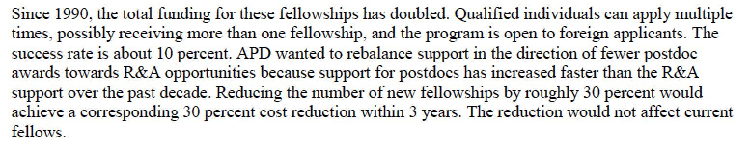
NASA Descope and Rebrand
NASA Astrophysics Division concerned about the size & cost of NNFs.
Concerns presented to Astrophysics Subcommittee, July 20, 2017.
From the public minutes available at https://science.nasa.gov/science-committee/subcommittees/nac-astrophysics-subcommittee

Slide 5
NNF Stats Provided to NASA
NNF salaries are at the mode for prize fellowships. (Mean is $69k)
>93% of NNF alumni still in astronomy. 66% are faculty.
At first, ~16% of U.S. astrophysics PhDs became NNFs
  now near ~25% (Jon Morse expanded the program when Fermi+Chandra ⇒ Einstein)
  does NOT include that ~40% of NNFs have PhDs from non-U.S. institutions
Fraction applying for more than one NNF approaches ~70%
<1% of fellows have taken both Einstein & Hubble fellowships.
~50% of all Fellows are hosted at a half-dozen institutions.

Slide 6
NASA Hubble Fellowship Program
NASA is reducing funding and consolidating administration.
The 3 NNFs will be combined under the umbrella of the NASA Hubble Fellowship Program NHFP now covering all of NASA astrophysics.
To secure a protected funding stream, funds for Fellows starting with the class of 2018 will be administered through STScI.
The 3 original categories of fellowships will be preserved under the NHFP corresponding to their relevant science questions
  How does the Universe work? – Einstein Fellows
  How did we get here? – Hubble Fellows
  Are we alone? – Sagan Fellows

Slide 7
NHFP: Implementation
Current fellowships (Class of 2017 and earlier) will be administered as before through CXC, NExScI and STScI.
For 2018 and beyond, application, selection, and administration will be through STScI.
The NHFP will be jointly managed by 3 leads, with oversight by NASA HQ (Kartik Sheth)
  Paul Green (Einstein, at CXC)
  Andy Fruchter (Hubble, at STScI)
  Dawn Gelino (Sagan, at NExScI)
Salary and benefits likely to remain at a similar level, competitive with other US prize fellowships.

Slide 8
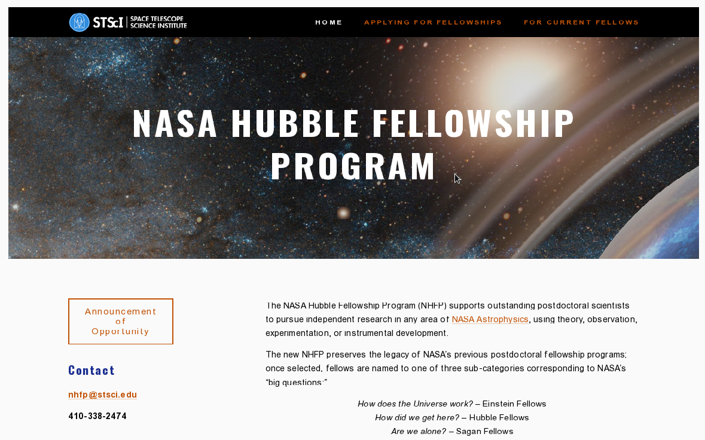
https://nhfp.stsci.edu

Slide 9
NHFP: Application
Ads and AO posted Sep 1, 2017/
  Deadline Nov 2, letters Nov 9
Expect 24 NHFP fellows for 2018.
Eligibility unchanged.
New host institution rule:
  max 2 new fellows/host/year
  max 5 in any 3 year period
  accounting begins with class of 2018
Former Einstein/Hubble/Sagan fellows can apply.
Application software adapted from Sagan. Einstein FMS still in use for <=2017 and alumni.
Year | Einstein | Hubble | Sagan | Total
2017 | 8 | 17 | 3 | 28
2016 | 12 | 15 | 6 | 33
2015 | 14 | 17 | 6 | 37

Slide 10
NHFP: Draft Selection Scheme
Expect about 350 applications.
Review 3d week of January in D.C. area; travel, lodging, meeting rooms, logistics handled by NRESS.
Planning 6 science panels, about 50 reviewers.
  Initial review/triage by 5 reviewers (~35 applications/reviewer)
  In-situ discussion and ranking of top ~30/panel
  Merging panel (MetaChair + Panel Chairs) folds together topical panel rankings to create list of ~30 finalists for offers.
Concurrence by Selection Offical and NASA Astrophysics Director.
Leads juggle hosts, assign NHFP category (Einstein, Hubble, or Sagan).
No quotas by category

Slide 11
Further Planning
No plan yet for symposia
  This year still separate; perhaps until 2020?
  NHFP Symposium would need at least 4 days (unless parallel sessions)
No specific plans yet for tracking alumni, or mentorship.
Thoughts/suggestions welcome, but N.B. all decisions now made by committee.

Slide 12
THANK YOU!

