Slide 1
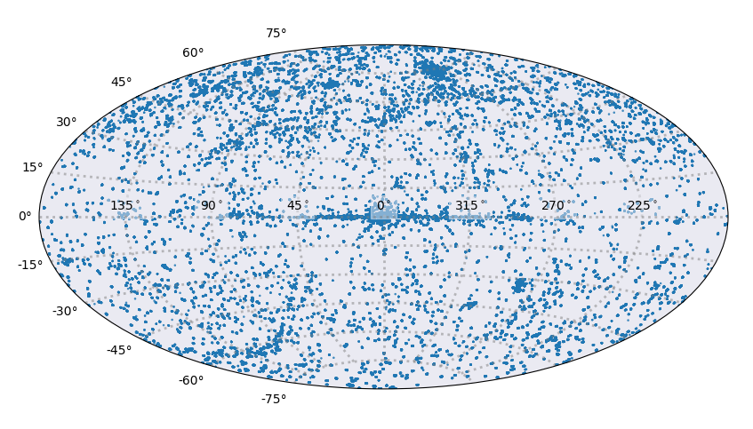


Chandra Source Catalog 2 Production and Release Status
G. Fabbiano for the CSC2 Team

Slide 2
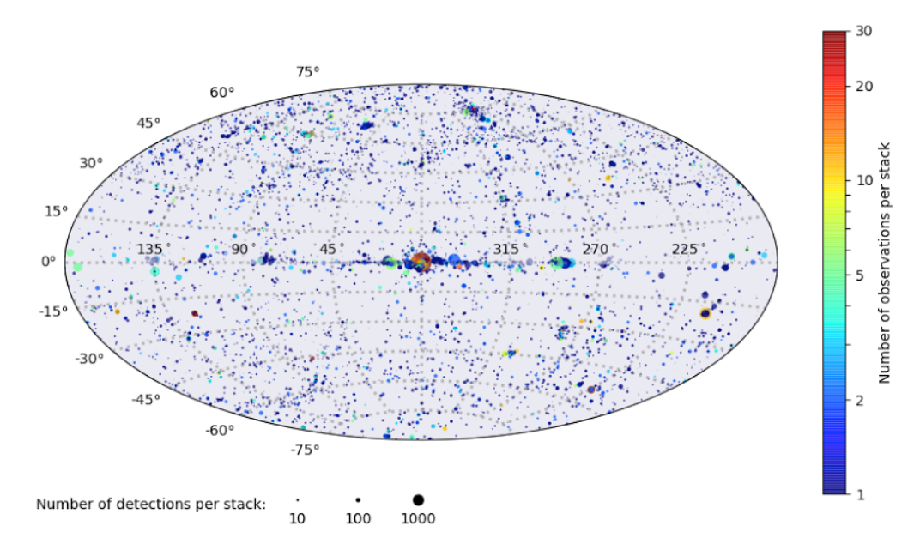
All stack detections complete
CSC 2.0 pd2 released on 9/18/2017
http://cxc.harvard.edu/csc2/ (CSC 2.0 web page)
  All data including 2014 - 7,287 stacks - 374,365 detections
  Stacks merge field with aim-point 1 arcminute
  Sources detected in different stacks are not combined
  <0.1% of detections may be rejected in final CSC2 QA

Slide 3
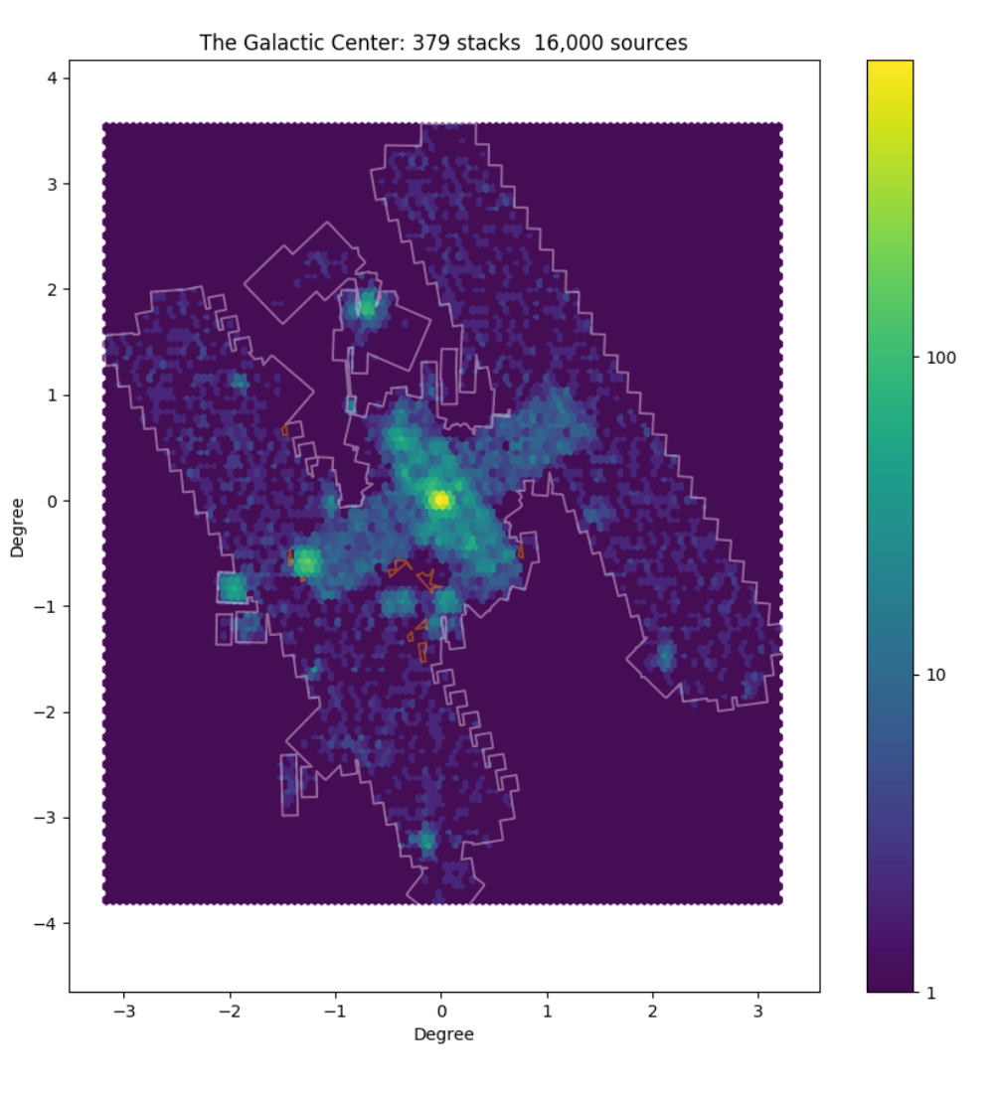
Sgr A* Region
Source Density
Sgr A* stacks detections included in pd2
Map shows detection density (number of detections per pixel)

Slide 4
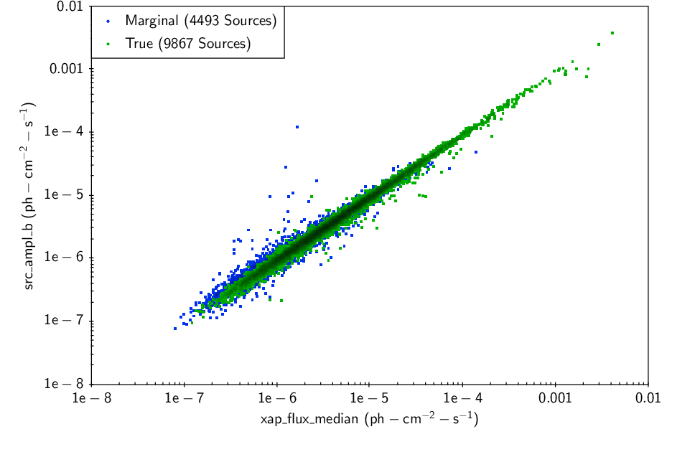
Stack Detection List
  Detection positions and amplitudes in different photometry bands
  Amplitude from MLE fit is good proxy of flux
  Conversion from the provided photon fluxes to energy requires model assumption by user
  Both model and photon based fluxes will be calculated in the source properties pipelines

Slide 5
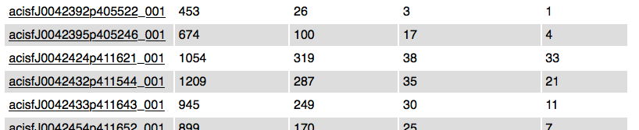
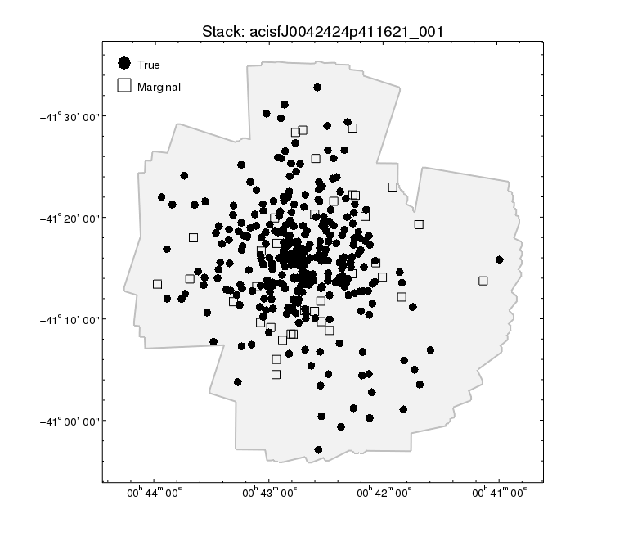
List and Properties of pd2 Stacks http://cxc.harvard.edu/csc2/pd2/

Slide 6
Detection Cross-Matching near Completion
Link detections among different stacks to create CSC2 source list
Identify regions observed where a given source was not detected
Identify ambiguous detections (contribution from multiple sources)
Data processed with CSC1 algorithm + manual Quality Assurance
Completed processing and QA except Sgr A* stacks
Sgr A* processing near completion
Pre-release Source List being prepared
  Expected in 3 weeks
  315,887 master match sources
  List will include master source positions and amplitudes in different photometry bands

Slide 7
Source property pipelines in final testing
Algorithms (see next slides)
Pipeline infrastructure (source based pipelines) - OK
Correct transmission of parameters among files – final check
Population of archive - OK
Archive interface CSCview - OK
October 6 GO/NO GO/ALTERNATIVE check point

Slide 8
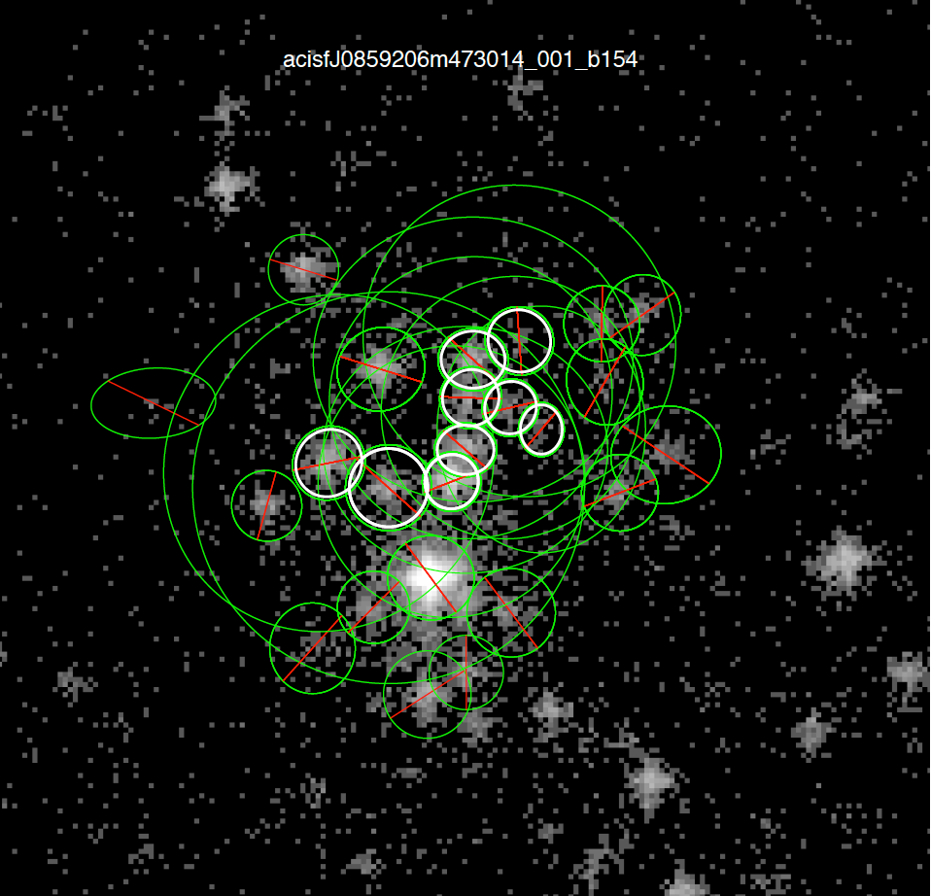
Example of Aperture Photometry Extraction - OK
Simultaneous photometry estimation in crowded field
  Based on Primini, F. A.; Kashyap, V. L. 2014, ApJ, 796, 24
Algorithm checked against simulations
Pipeline results verified against published algorithm

Slide 9
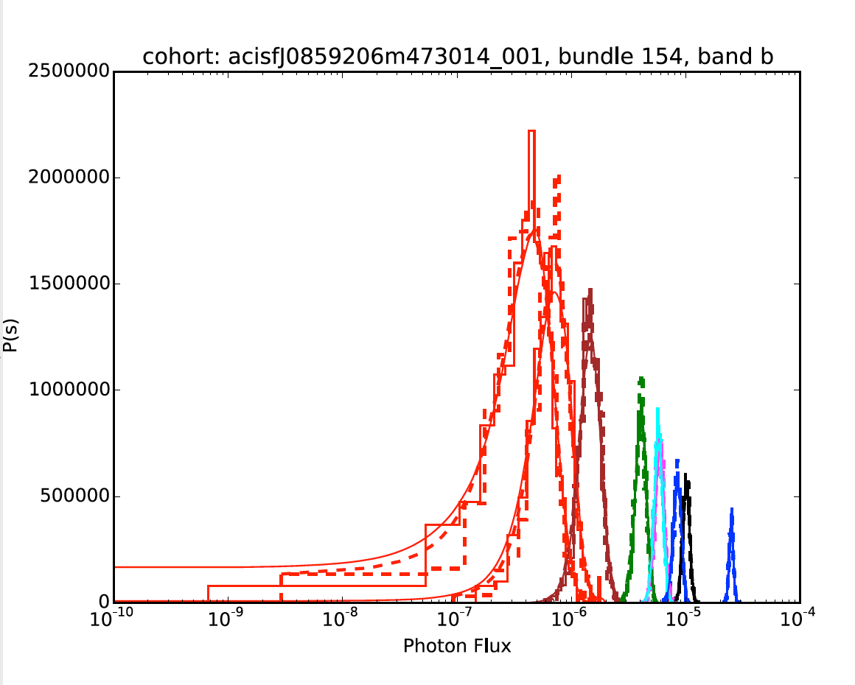
Fluxes from Probability Density Estimation OK

Slide 10
Bayesian Blocks Algorithm - OK
New CSC2 algorithm to identify spectral/time variability states
  Scargle, J. et al 2013, ApJ, 764, 167; modified to deal with probability distributions rather than value+error
For each source identify and assemble segments of light curves in photometry bands with similar count rate
  Derive source properties for each block
  Longest block displayed in CSCview
  All blocks available as data products
  Global average available for photometry
Final test included field of NGC 4278, E galaxy target of several deep visits with Chandra to study the source population ~ 500 sources

Slide 11
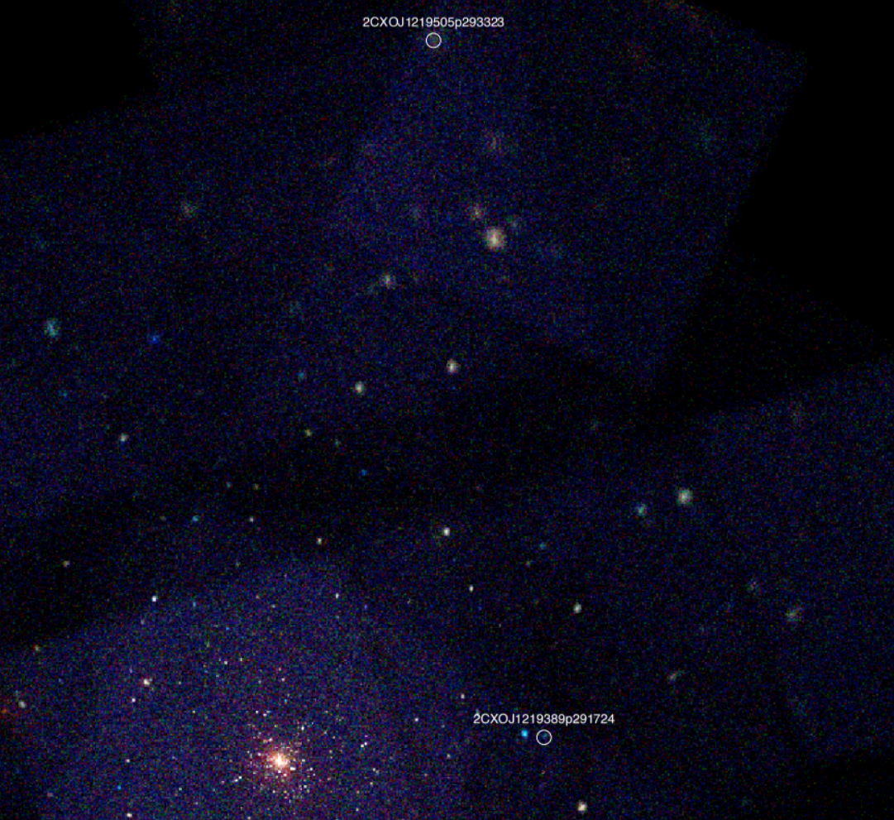
Bayesian Blocks Test field ~ 500 sources

Slide 12
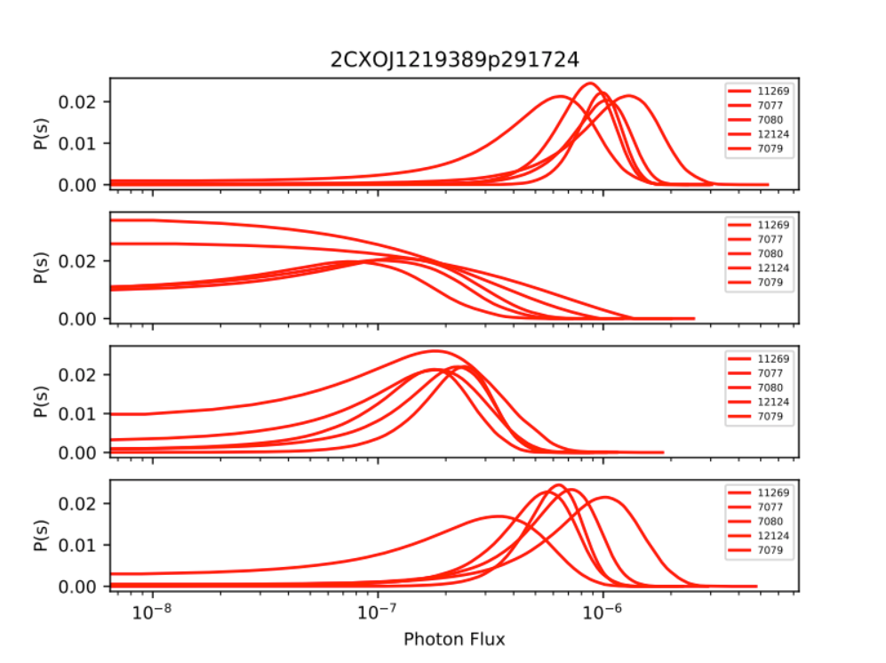
Example of successful test:
Source with no variability in each photometry band (b, s, m, h) – single Bayesian block

Slide 13
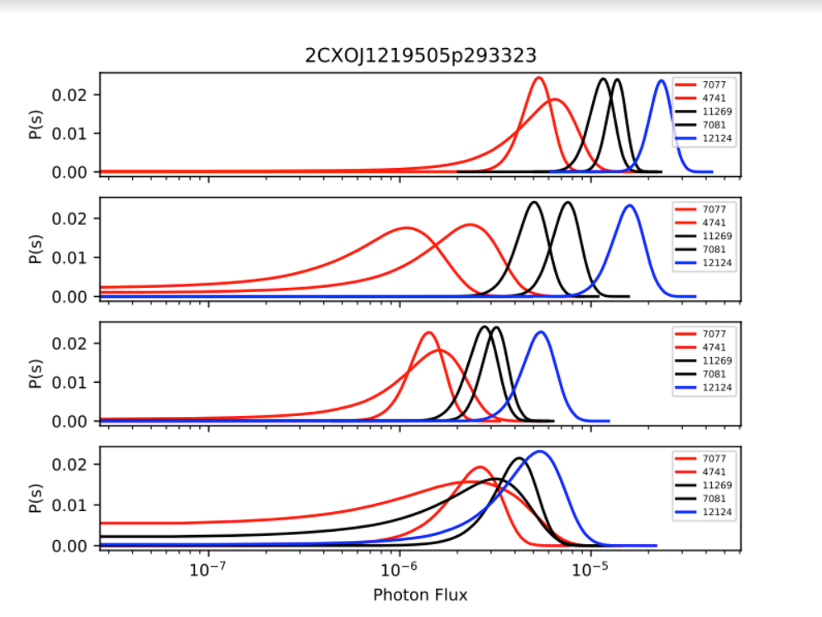
Example of successful test:
Source with variability
Multiple Bayesian blocks

Slide 14
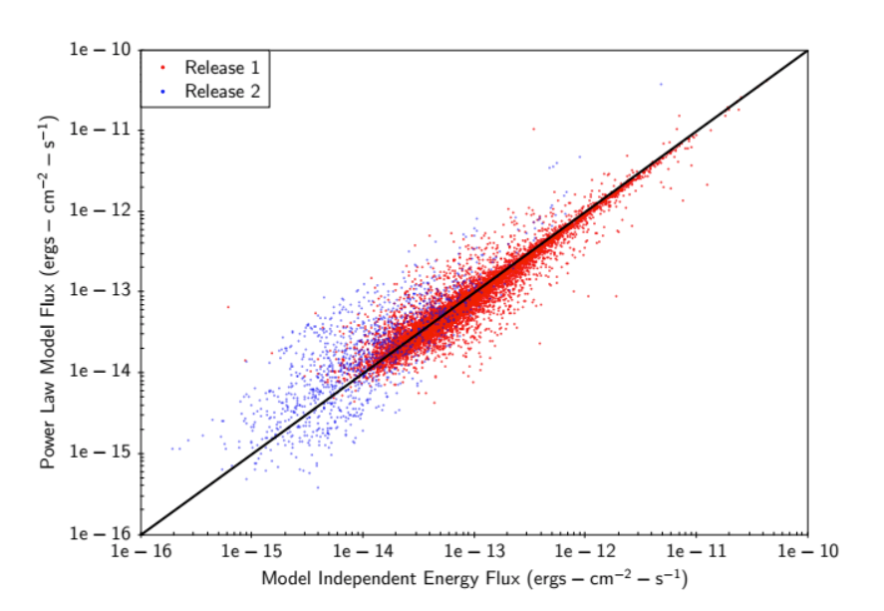
Model Flux versus Band Flux - OK
Model-independent flux is from CIAO tool eff2evt
Power-law model: Γ = 2, N_{H} Gal.
CSC2 measures fluxes ~10 times fainter than CSC1

Slide 15
Source Properties Algorithm Summary
Detections - OK
Positions - OK
Aperture Photometry (5 bands for ACIS; 1 band for HRC) - OK
Model Fluxes (power-law, BB, brems, APEC) - OK
Bayesian Blocks - OK
Timing (intra and inter-observation) - OK
Hardness Ratios [(f2-f1)/(f2+f1)] - OK
Spectral fits (power-law, BB, brems – APEC in future)
  Single observation fits - OK
  CSC1 – CSC2 comparison - OK
  Across observation fits – in test
Source Extent – in test / working bugs

Slide 16
Source Properties Outlook
Testing results are good / highly encouraging
If everything goes well, we estimate starting production Oct 17
If unanticipated stumbling blocks we may decide not to include some source properties in catalog
  This will require re-engineering of pipeline / archive interface (i.e. a delay)
Data will be accessible to users via CSCview after checking while databases get filled

Slide 17
CSC2 User Interface
CSCview adapted for release 2
The complexity of our data structures allow users to select optimal views for their research
Source parameters and associated data files available (as in CSC1)
Simple web-based user interface will also be provided for the full released CSC2

Slide 18
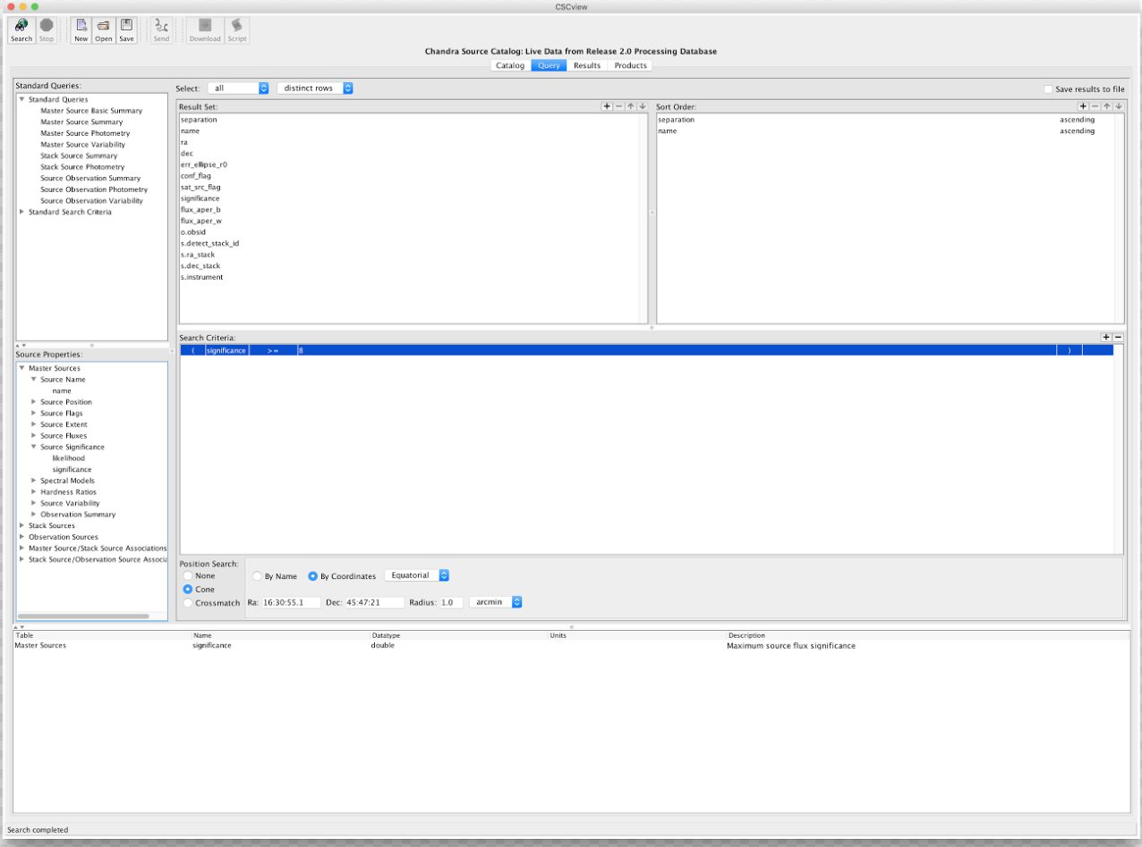
Master Sources
Name, Position, Flags, Extent, Fluxes, Significance, Spectral Models, Hardness Ratios, Variability, Observation Summary

Slide 19
Stacked Observation Detections
Per-Observation Detections
Master/Stack Source Associations
Stack/Observation Source Associations

Slide 20
CSC2 Summary and Outlook
Full preliminary stack detection list (CSC 2.0 pd2) released on 9/18/2017
  http://cxc.harvard.edu/csc2/ (CSC 2.0 web page)
Full preliminary cross-matched source list soon to be released (~3 weeks)
Aiming to start source property processing October 17
Complete production of source properties estimate ~3 months
  Preliminary source properties will be accessible in CSCview during production
Limiting sensitivity included in full release
Full documented CSC2 release Feb 2018
Convex hull (large extent) sources and properties
Catalog description and characterization papers to follow
AAS session in January 2018 to present CSC2 and demo interfaces

Slide 21
Additional Information
Master-Match QA
The Complex Data Structures underneath CSCview

Slide 22
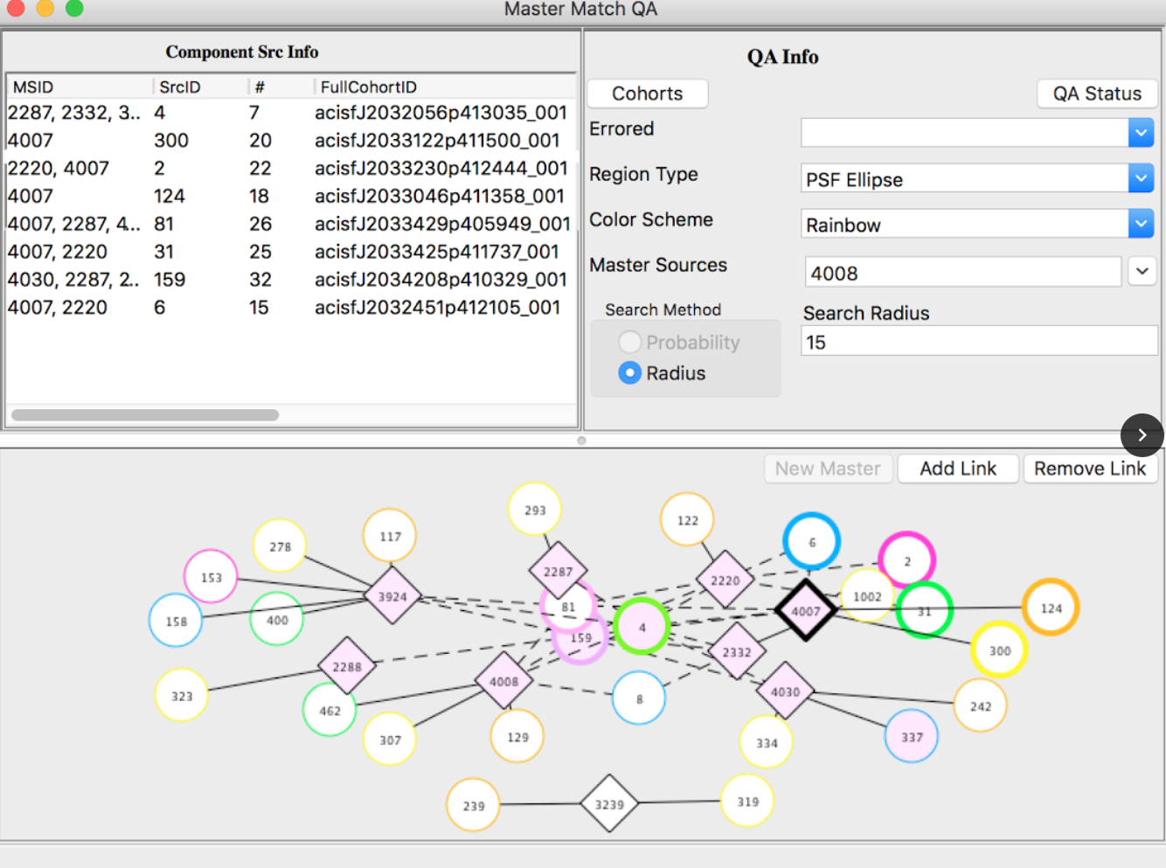
Master-Match QA

Slide 23
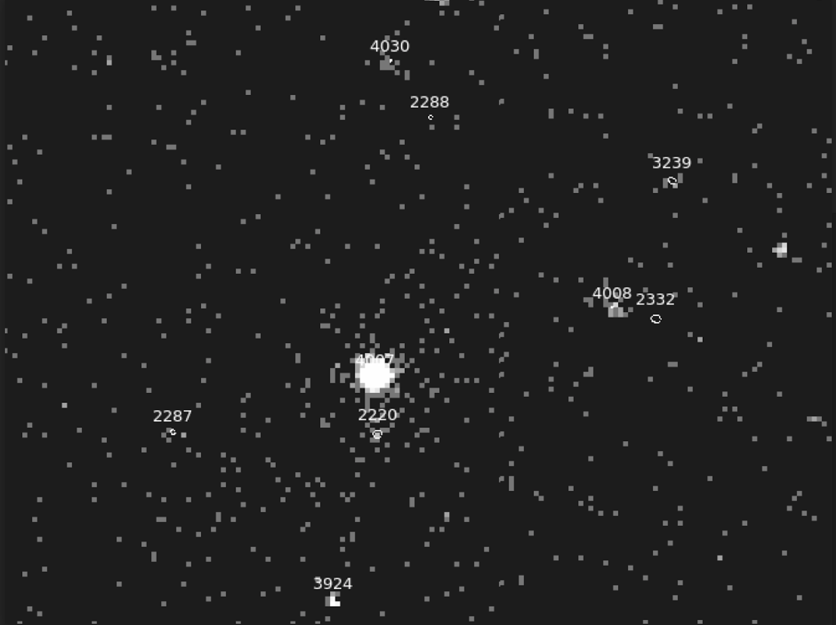
Final Master Sources

Slide 24
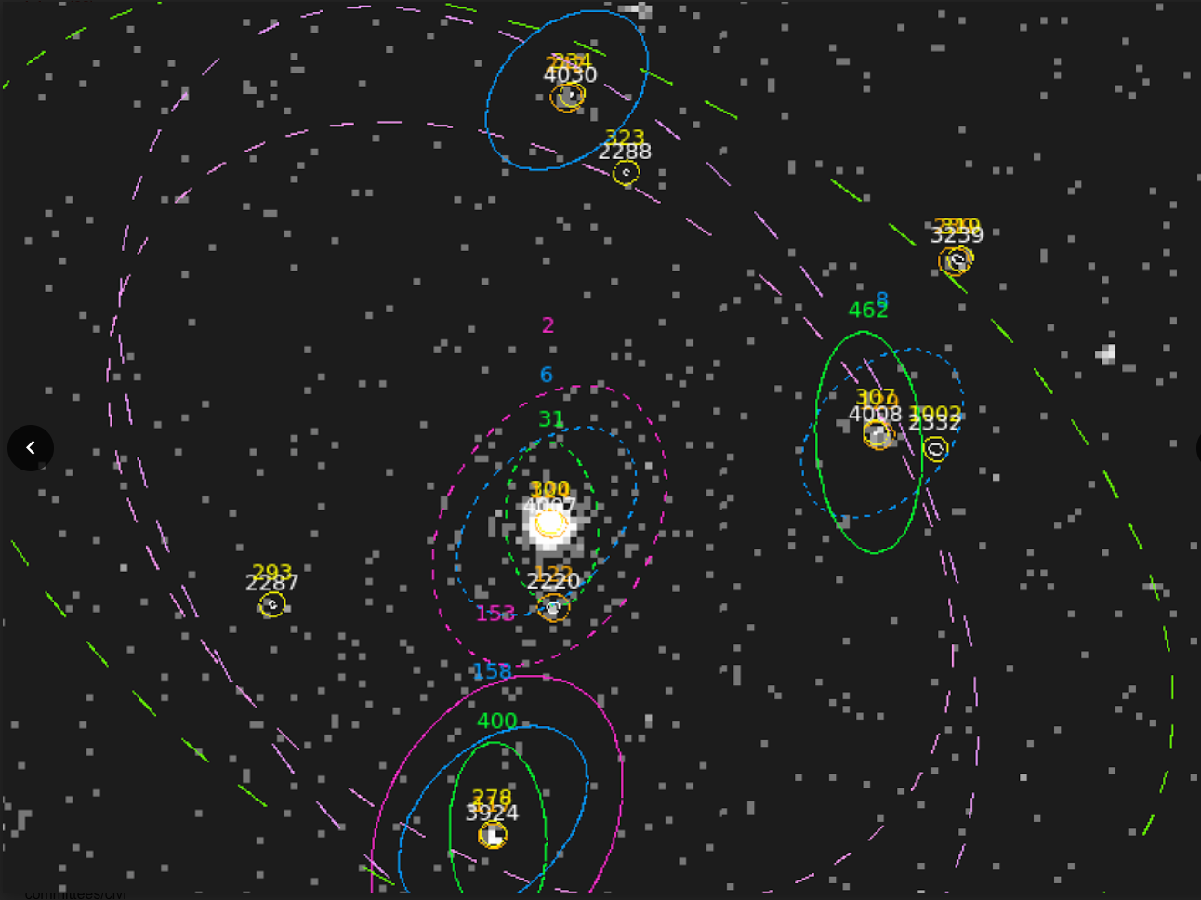

Slide 25
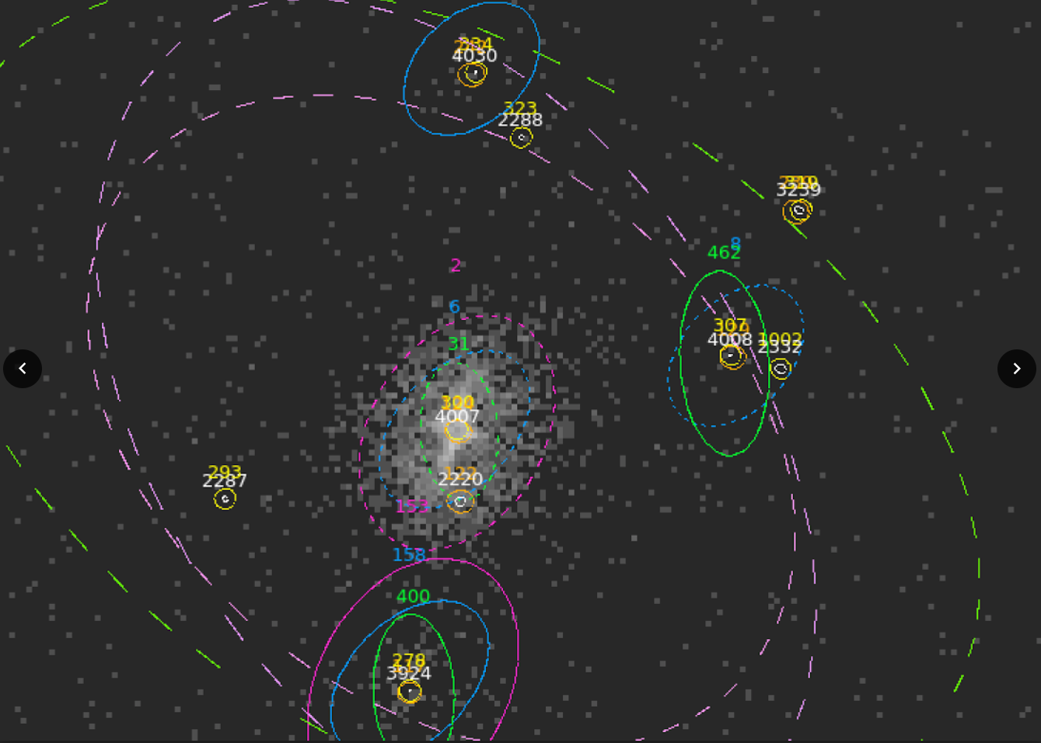

Slide 26
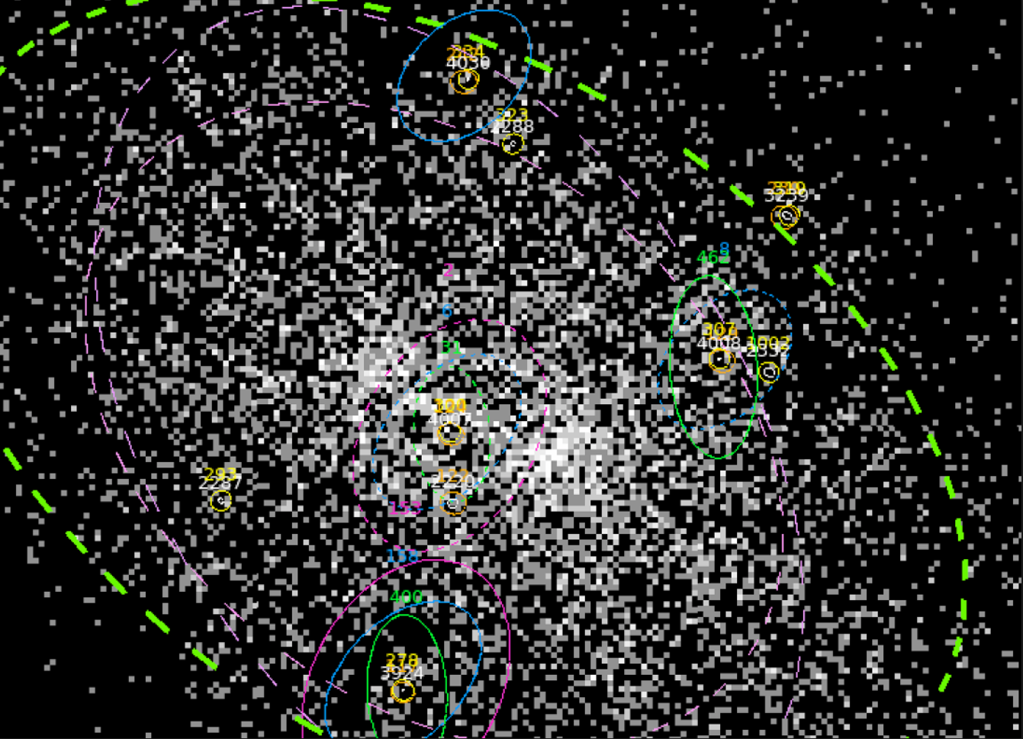

Slide 27
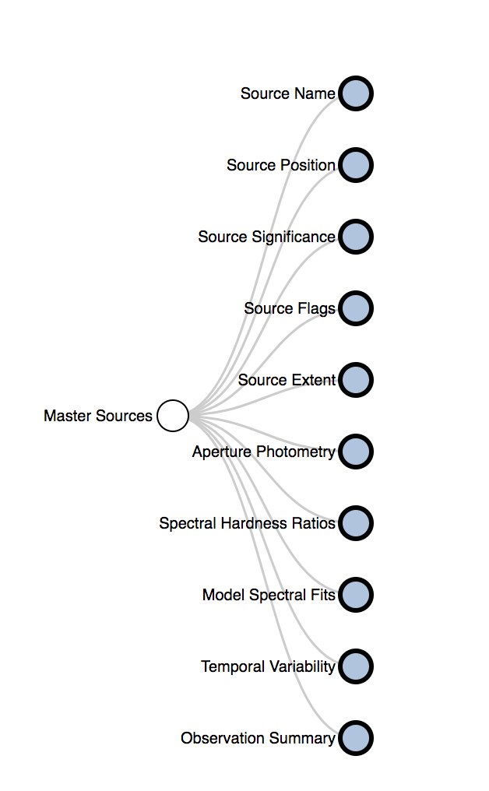
The Complex Data Structures underneath CSCView

Slide 28
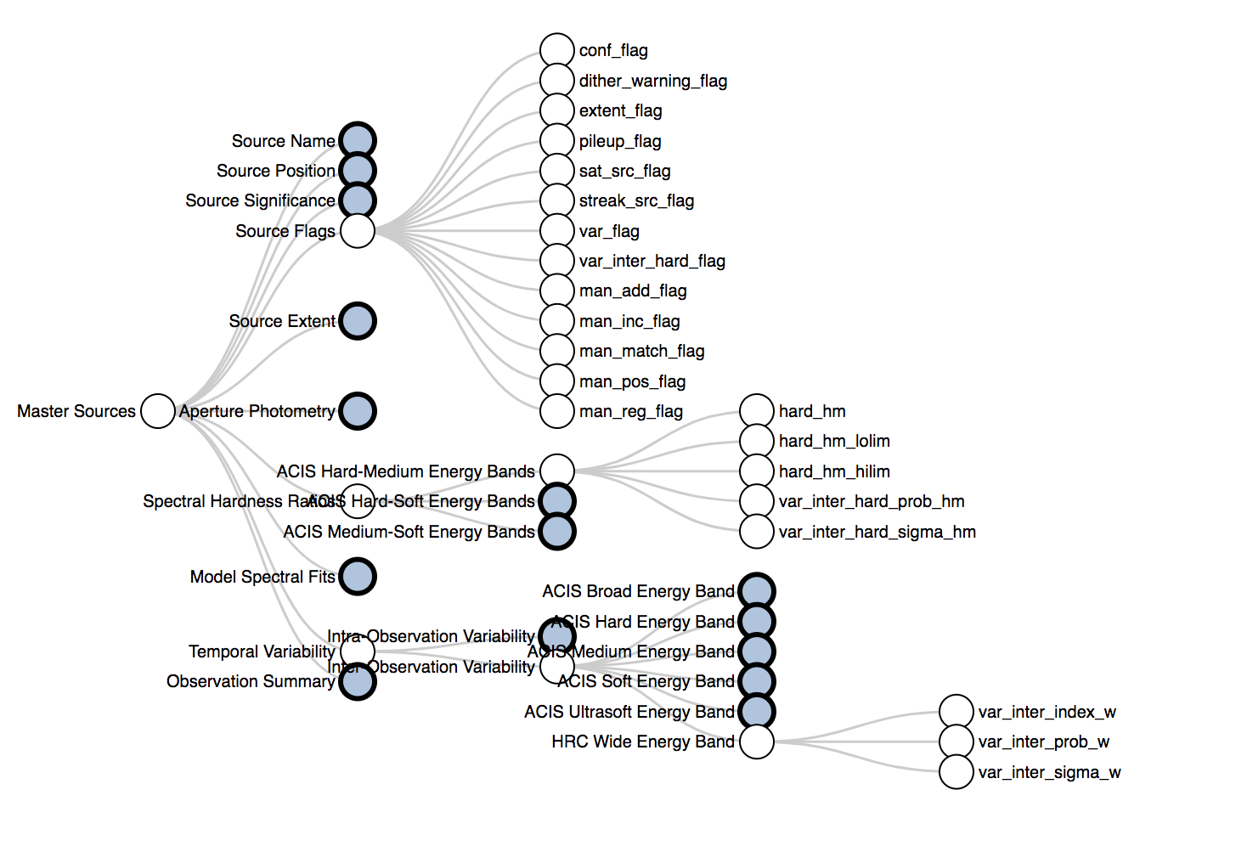

Slide 29
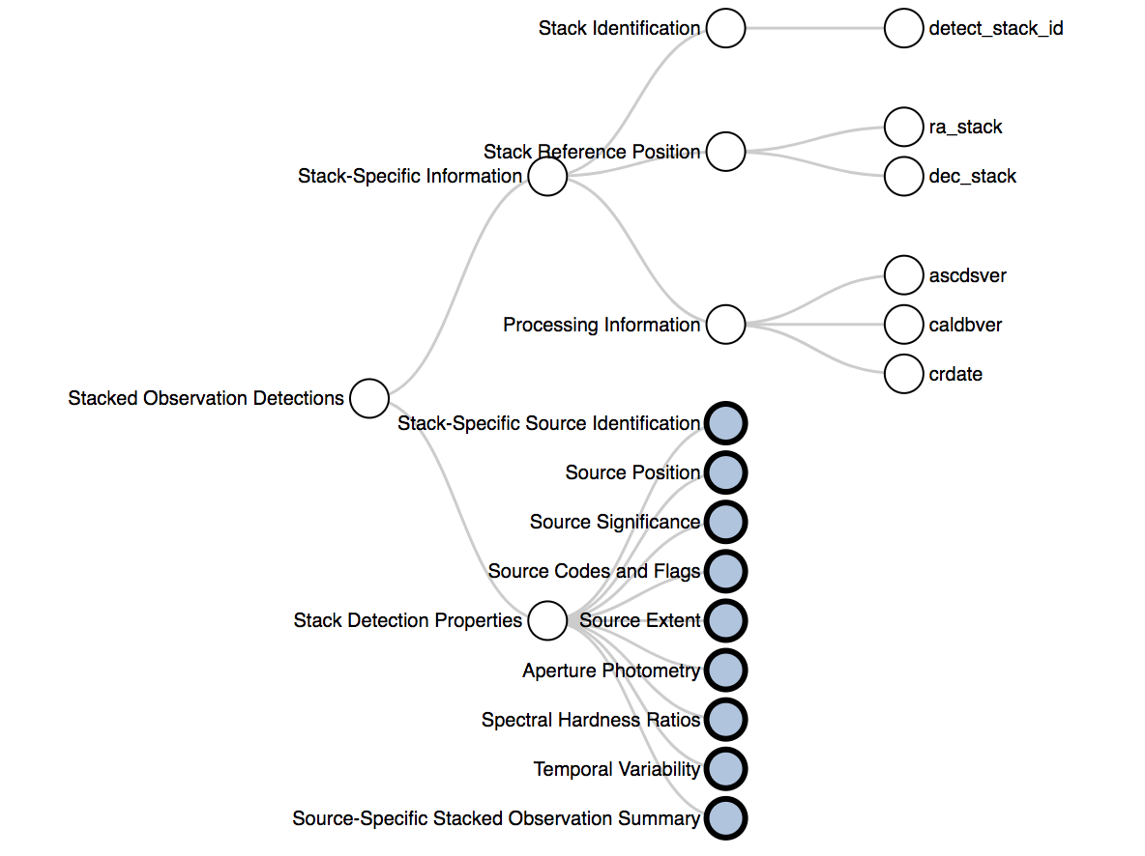

Slide 30
