Slide 1
Chandra Users’ Committee
CXC Manager’s Status Report
Roger Brissenden
CXC Manager
26 September 2017

Slide 2
Topics
Program Management
Mission Operations
  Spacecraft
  Science Instruments and Calibration
  Mission Planning
  Operations Control Center
Science Operations
  CXC Data Systems
  Calibration
  Data Processing
Public Outreach and Communication

Slide 3
Top Level Summary
Spacecraft and instruments are performing well
  There are no known spacecraft limitations due to degradation, aging or consumables that would prevent our meeting Level 1 requirements over the course of a 25-year mission
CXC contract extension
  Contract currently runs through 9/19 (mission ops to 9/18)
  NASA is proceeding on an extension through Sept 2030
  Details on extension process in program management section
Operations Control Center relocation
  OCC lease runs through 9/30/19; Draper will not renew
  Details on relocation process and status in program mgt section

Slide 4
Program Management

Slide 5
Program Management
CXC Contract Extension Status
  NASA is in process of extending CXC contract through 2030
  Baseline period through 9/30/24, plus 2 option periods
  Each period is 3 years of science observing followed by 3 years of closeout activities (analyze & archive data, secure spacecraft)
  NASA HQ delegated procurement responsibility to MSFC
Integrated Acquisition Team (IAT) process
  IAT consists of MSFC and SAO members
  Kickoff meeting 1/25/17 defined process, responsibilities
  Team reviewed budget, statement of work, proposal contents
  SAO submitted draft proposal with summary budget 7/26/17
  Final IAT meeting 9/12/17
  MSFC sent letter directing SAO to propose, 9/15/17

Slide 6
Program Management
Contract extension next steps
  ~9/30 Issue RfPs to subcontractors
  ~11/15 Send draft of full proposal to MSFC
    Includes subcontractor rough-order-of-magnitude estimates
  11/15 Receive proposals from subcontractors
  Review subcontract proposals; reiterate if necessary
  12/15 Submit proposal to MSFC
    MSFC allows for later submission if needed to accommodate subcontractors
  Proposal evaluation by MSFC and negotiation (~March 2018)

Slide 7
Program Management
Operations Control Center relocation
  OCC lease ends Sept 2019; Draper will not renew
  In process of selecting new location and moving the OCC
    Conducted survey of requirements for new OCC
    Smithsonian engaged realtor, architecture and engineering firm
    Realtor found alternative spaces; we downselected to 3 – 4 locations
    A&E firm will produce 35% engineering plans for 3 locations, to better estimate schedule and cost; final selection ~end of October 2017
  Construction planned for March–September 2018
  Equipment installation and transition ~Oct 18 – Mar 19
  Operate in parallel with current OCC ~Apr 19, followed by cutover
  ~6 months of margin in schedule

Slide 8
Program Management
Budget and Staffing
  PPBE-19 budget package and presentation materials were submitted to MSFC on 5/3/17
  The CXC’s budget and expenditures are in line with the PPBE-19 plan
  Current staffing profile is consistent with PPBE-19
  CXC is funded through 9/20/17; Einstein program through 9/30
    Federal government under Continuing Resolution through December 8, 2017. Funding to the CXC expected to carry SAO into January prior to expiration of CR

Slide 9
Program Management
CXC-organized Conferences and Reviews
  Chandra Users’ Committee meeting 27 Sep 16
  Einstein Fellows Symposium 16-17 Oct 16
  Cycle 19 Peer Review 19-23 Jun 17
  CIAO workshop 15-16 Aug 16
  Next Einstein Fellows Symposium 12-13 Oct 17

Slide 10
Mission Operations
Spacecraft
  Continues to operate extremely well
  2 solar radiation shutdowns; 280ks science time lost
  2 bright star holds and 2 normal sun mode transitions due to hot ACA hot pixels, and gyro-bias jogs
  Mitigating steps were put in place; problems have not recurred
Science Instruments
  All instruments are operating well
  “State of the aspect camera" community review conducted 9/6
    Pursuing additional mitigations to guard against star acquisition failures as the aspect camera warms in the future
  Staff additions and training
    New HRC instrument scientist (internal transfer) trained
    2 science mission planners, SOT scientist hired and trained
    MIT/Aspect scientist trained
    Flight Director tasks reassigned between Aldcroft and Wolk

Slide 11
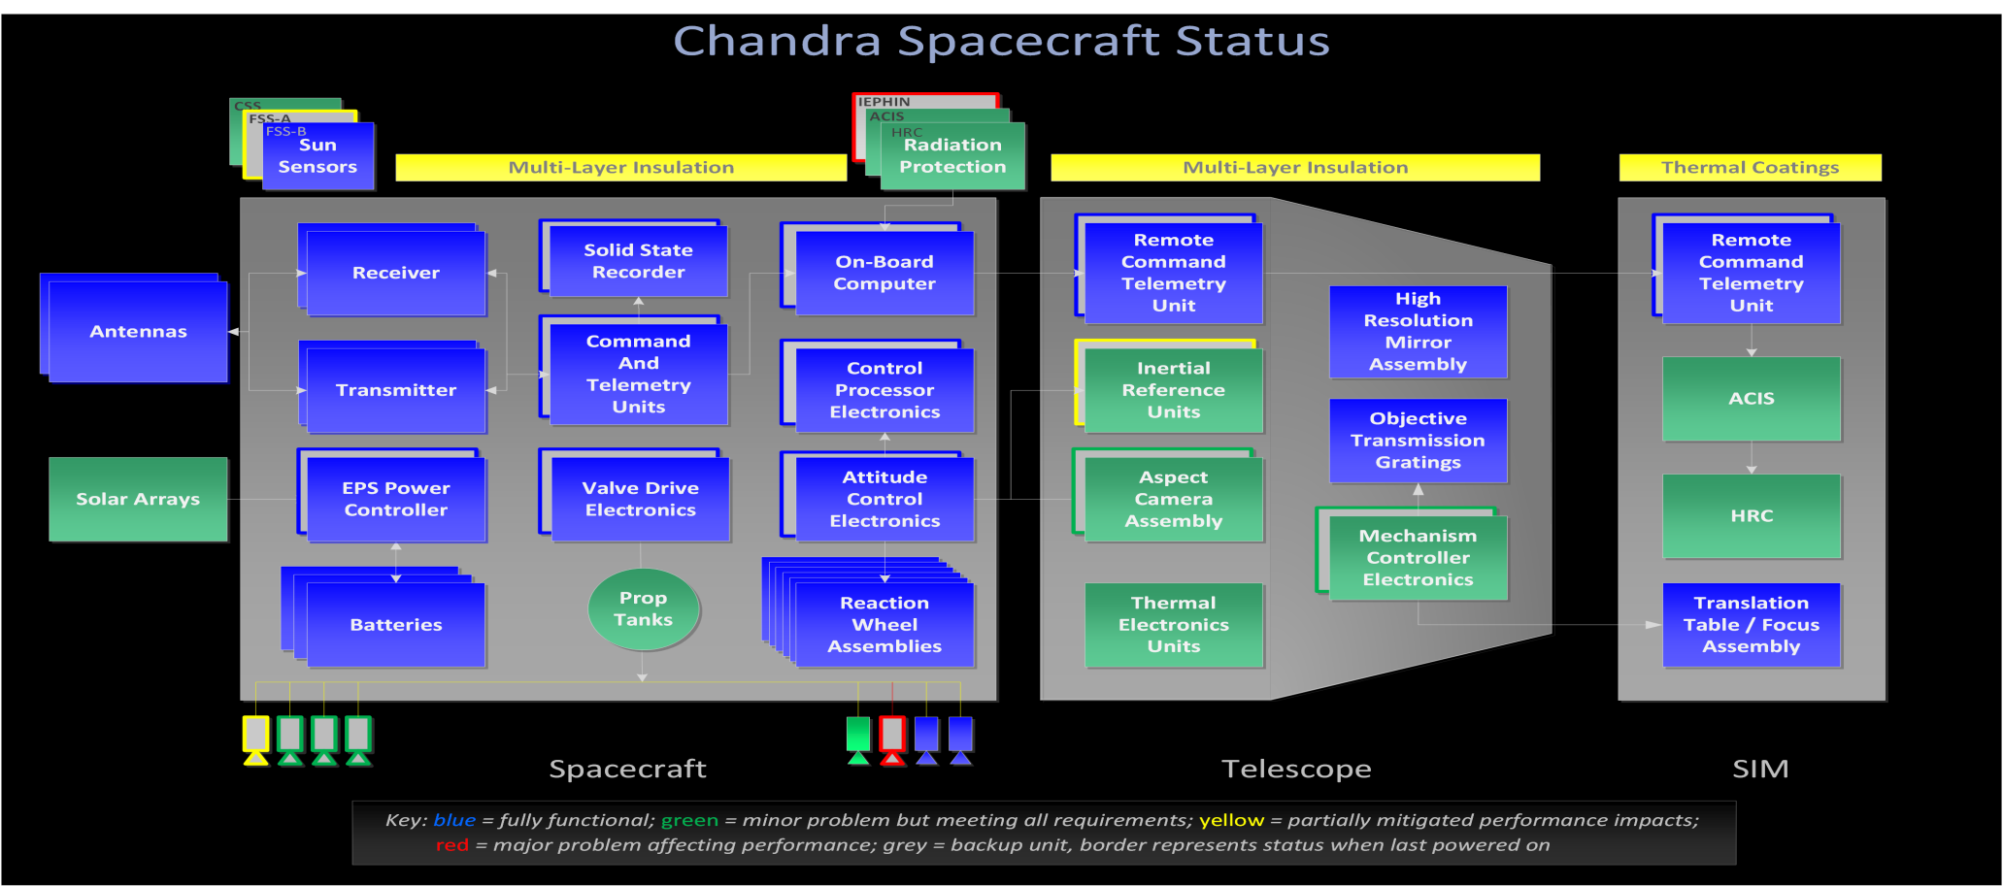
Spacecraft Subsystem Status: Stable

Slide 12
Mission Operations
Operations Control Center
  Smooth operations
  System upgrades
    On-Line system (12/16)
    Off-Line system (10/16)
    Transitioned scheduler function to Matlab ORviewer (8/17): a significant upgrade
Mission Planning
  12 load-interrupting TOO and DDT observations during this period

Slide 13
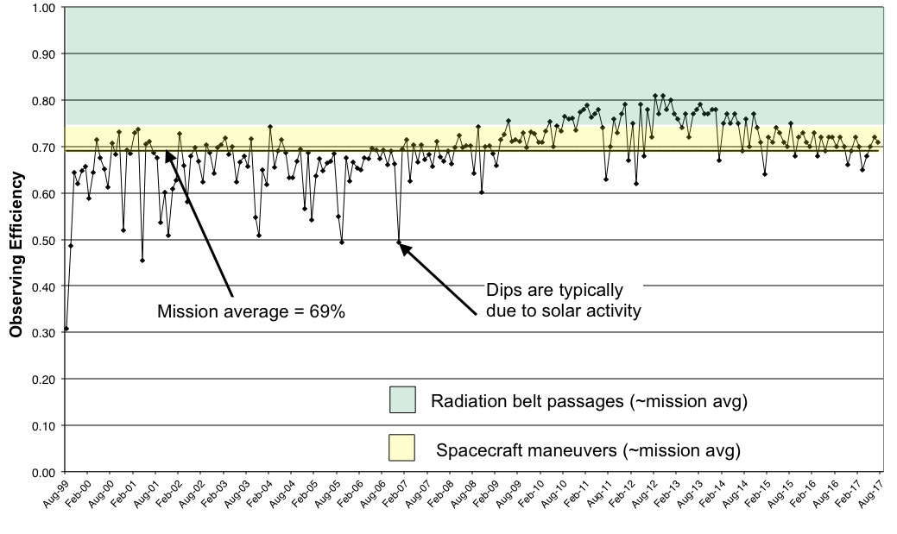
Mission Operations
Observing Efficiency

Slide 14
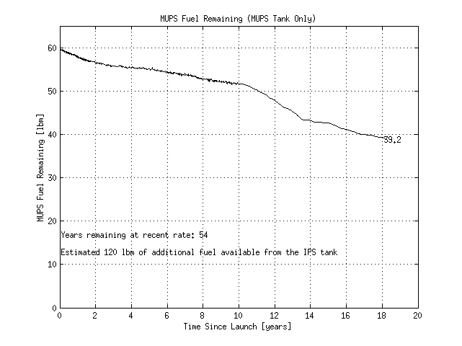
Mission Operations – Consumables
Momentum Unloading & Propulsion System (MUPS) Fuel Usage

Slide 15
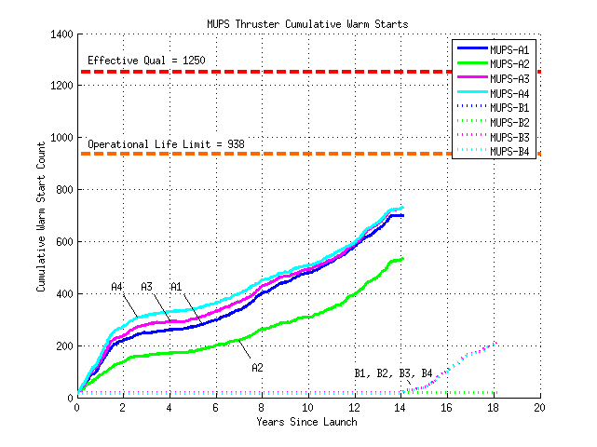
Mission Operations – Consumables
MUPS Thruster Warm Starts
A-side thrusters held in reserve;
not in normal use
B-side thrusters have plenty
of margin

Slide 16
Science Operations
CXC Data System Releases
  DS 10.5.2 Oct 26 S-Lang deprecation in data system
  DS 10.5.3 Dec 13 CfP 19 support
  DS 10.5.3.1 Jan 17 PIMMS security maintenance update
  DS 10.5.4 Mar 29 CfP 19 Panel Access Site upgrade
  DS 10.5.5 May 28 CfP19 Peer Review GUI
  DS 10.6 Jun 13 Annual DS Release
Data Analysis Releases
  CIAO 4.9 Dec 15 Annual data analysis release
  Sherpa 4.9 Feb 1 Sherpa standalone v4.9
  Iris 3.0 Mar 6 Bugfixes, enhancements, graphics
  CIAO B1 Jun 16 1st CIAO beta release (Internal)
  Sherpa 4.9.1 Aug 4 User statistics bugfix; AREASCAL
  CIAO B1.5 Aug 22 Response to B1 testing (Internal)

Slide 17
Science Operations
Chandra Source Catalog production
  CAT 4.3.24 Oct 17 Reprocessing updates for MEF, MRF, STK PLs
  CAT 4.3.25 Jan 05 Reprocessing Support
  CAT 4.3.26 Jan 22 PL bugfix; HRC likelihood parameter
  CAT 4.3.27 Feb 03 Cache Server efficiency upgrade
  CAT 4.3.28 Feb 09 Stacker PL patch for subset reprocessing
  CAT 4.3.29 Mar 14 PL repro update – corner case; AP efficiency
  CAT 4.3.29.1 Mar 22 QA cleanup/efficiency update
  CAT 4.3.29.2 Apr 08 AP QA handling update
  CAT 4.3.29.3 Jul 21 AP cleanup efficiency update
  CAT 4.4 Apr 25 Master Match release
  CAT 4.4.1 May 08 Multi-Cohort support in MM
  CAT 4.4.2 May 23 Added checks for invalid master src associations
  CAT 4.4.3 May 31 CSCview prep; Multi cohort support
  CAT 4.4.4 Jun 02 Minor update to circular errors
  CAT 4.5 drop1 Apr 15 Build CIAO 4.9 into CSC release (Integration & test)
  CAT 4.5 drop2 Jun 10 Src Properties PL for Per-ObI (Integration & test)
  CAT 4.5 drop3 Jul 15 Add Bayesian tools, PL, AP (Integration & test)

Slide 18
Science Operations
Chandra Source Catalog releases
  Master Match Apr 26 Master Match production started
  Stack Detection Sep 01 Stack processing completed
Public Release milestones
  CSC 2.0pd1 Mar 22 CSC 2.0 Prelim detection list public release
  CSC 2.0pd2 Sep 18 CSC 2.0 Prelim detection list public release
  CSC 2.0pre1 Sep 25 CSC 2.0 Prelim source list public release

Slide 19
Science Operations
Data Processing
  Automatic processing is current; mean time from end of observation to delivery to user remains at about one day
Calibration Products released
  Semi-annual ACIS detector gain maps
  Updated ACIS contamination model
  ACIS blank sky background files covering the 2012-2016 time period
  Annual HRC detector gain maps
  Annual HRC background spectrum

Slide 20
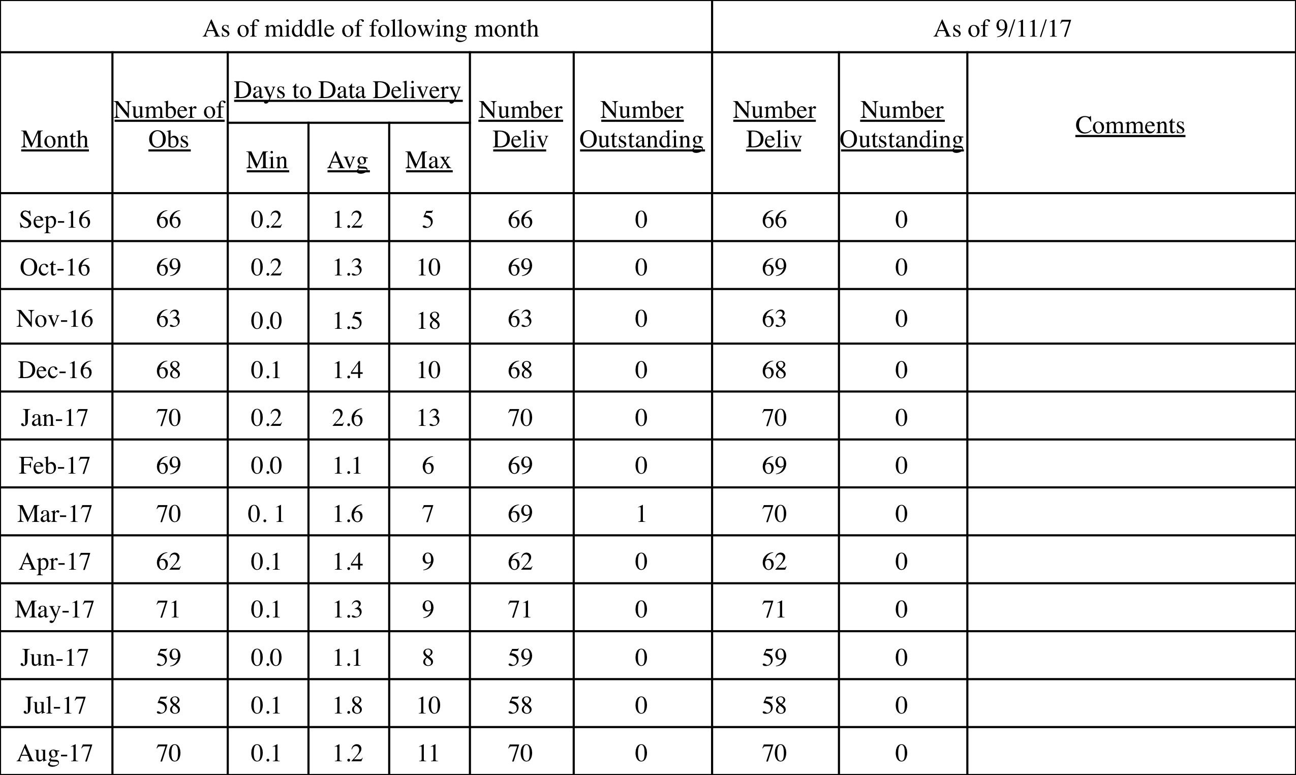
Science Operations
Data Delivery
Consistently rapid data delivery

Slide 21
Chandra Grants Program
Grant Awards
Month of Data Delivery | Federal Grants ^{(1,3)} | SAO Grants ⁽²⁾
 |  | As of the middle of following month |  |  |  |  | As of 9/15/17
 |  | Non-Federal Grants ⁽³⁾ | No. Grants Awarded | No. Outstanding | Avg days to award ⁽⁴⁾ | No. Grants Awarded | No. Outstanding | Outstanding Awards Proposal no, Comments
Sep-16 | 0 | 6 | 4 | 2 | 6 | 6 | 0
Oct-16 | 0 | 5 | 3 | 2 | 9 | 5 | 0
Nov-16 | 1 | 5 | 3 | 2 | 4 | 5 | 0
Dec-16 | 0 | 5 | 4 | 1 | 10 | 5 | 0
Jan-17* | 4 | 64 | 58 | 6 | 50 | 64 | 0
Feb-17 | 0 | 15 | 13 | 2 | 12 | 15 | 0
Mar-17 | 1 | 17 | 15 | 2 | 8 | 17 | 0
Apr-17 | 0 | 5 | 3 | 2 | 7 | 5 | 0
May-17 | 2 | 13 | 11 | 2 | 12 | 13 | 0
Jun-17 | 0 | 9 | 3 | 6 | 8 | 9 | 0
Jul-17 | 0 | 9 | 8 | 1 | 14 | 9 | 0
Aug-17 | 1 | 11 | 9 | 2 | 10 | 9 | 2 | 18800481, 18800649
⁽¹⁾ Grants awarded to scientists at Federal institutions as interagency transfers through MSFC. ⁽²⁾ Grants awarded to scientists at non-Federal institutions through SAO Contracts and Grants Department. ⁽³⁾ Number of grants eligible for award, for which data were delivered to the observer in the month. ⁽⁴⁾ Average days from data delivery to grant award does not include grants outstanding as of the middle of the following month. * Approval from MSFC to issue grant funds was received after some observations were made and data were distributed, delaying issuance of awards. The number of Federal Grants includes archive and theory awards.
Delay in funds approval
Prompt award issuance

Slide 22
Public Outreach and Communication
Selected Public Communication Activities
  14 science releases, 24 image releases yielding >3600 web, print articles
  Social media continues to grow: Twitter ~138k followers; Facebook ~855k daily users, 10.4M unique user reach. Added Instagram, ~190k followers
  Developed and printed 3D models of Chandra spacecraft and Chandra sources such as Cas A, SN1987a, V745 Sco for blind users and other outreach
Informal Education & Outreach
  “Universe of Learning” Cooperate Agreement
  Presented 26 astronomy-focused workshops at after-school & out-of-school programs, esp. for disadvantaged youth & STEM programs focused on engaging girls

Slide 23
Public Outreach and Communication
Informal Education & Outreach (con’t)
  Continued support of National Science Olympiad competitions and coaches’ clinics reaching ~200k students. DC “Urban Initiative” added 10 schools serving low income communities to Olympiad participation
  Continued public exhibits: “Here, There and Everywhere”, “Light: Beyond the Bulb” exhibits in California, Alaska, Massachusetts, Rhode Island

