Slide 1
Proposal Cycle: Updates and Plans
Andrea Prestwich,
Peer Review Team Lead
Highlights of CDO activities
Report on Cycle 16
Plans for Cycle 17 and beyond
Proposed changes to GTO target submission timeline
The “Fair Share” calculation
Notes:
Responsible for running the review this year after assisting Fred Seward for many years.
Fred is in the process of retiring and I would like to acknowledge his many years of hard work which have made this transition smooth (so far anyway)!
So – bottom line is: “It is all my fault!!”

Slide 2
Highlights
Cycle 16 Peer Review
23-27 June 2014, Hilton, Logan Airport
Target List posted 18th July
E-letters, including reports and budget allocation (where appropriate) mailed 20th Aug
Cost proposal deadline: 18th Sept 2014
Annual Chandra Science Workshop:
X-ray View of Galaxy Ecosystems, held 9-11 July, 2014
Einstein Fellows
Symposiums too be held CfA, 28-29 Oct 2014
2015 competition: Deadline: 6 Nov 2014
Notes:
Responsible for running the review this year after assisting Fred Seward for many years.
Fred is in the process of retiring and I would like to acknowledge his many years of hard work which have made this transition smooth (so far anyway)!
So – bottom line is: “It is all my fault!!”

Slide 3
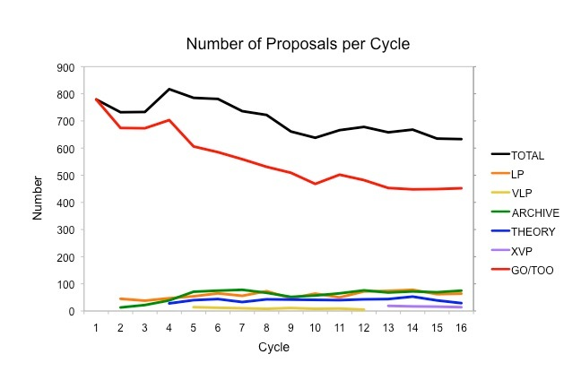
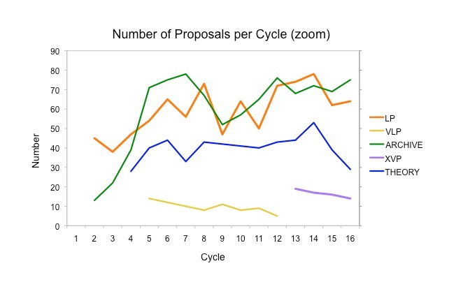
Cycle 16 Proposal Statistics
634 proposals submitted:
  GO 379
  LP 64
  XVP 14
  Archive 75 (69, Cyc 15)
  Theory 29 (39, Cyc 15)
190 approved
Oversubscription (time): 4.8
Time allocation: 22 Ms, 2 Ms from Cycle 17 for XVP call
Notes:
Responsible for running the review this year after assisting Fred Seward for many years.
Fred is in the process of retiring and I would like to acknowledge his many years of hard work which have made this transition smooth (so far anyway)!
So – bottom line is: “It is all my fault!!”

Slide 4
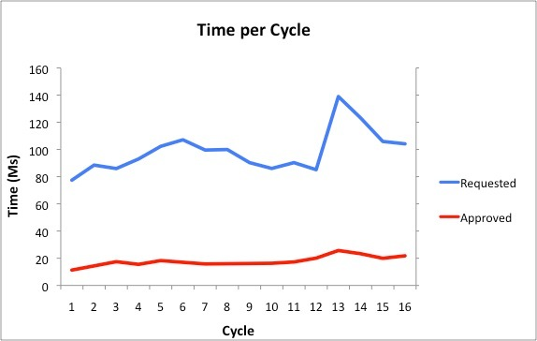
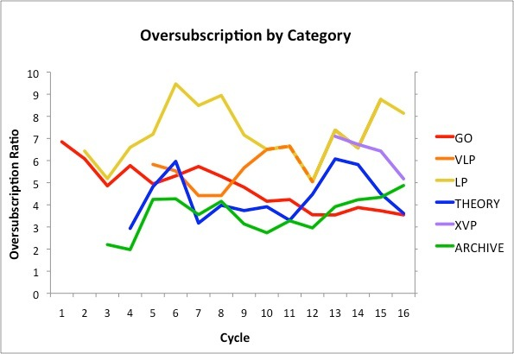
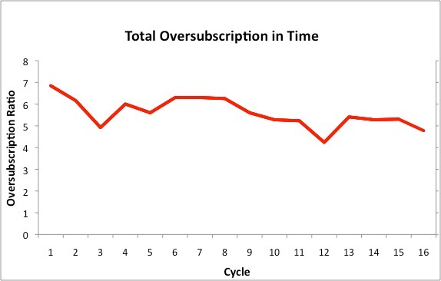
Cycle 16 Proposal Statistics
Time allocation:
Total Time: 22 Ms
(2 Ms from Cycle 17)
LP: 4.0 Ms
XVP: 5.5 Ms
Notes:
Responsible for running the review this year after assisting Fred Seward for many years.
Fred is in the process of retiring and I would like to acknowledge his many years of hard work which have made this transition smooth (so far anyway)!
So – bottom line is: “It is all my fault!!”

Slide 5
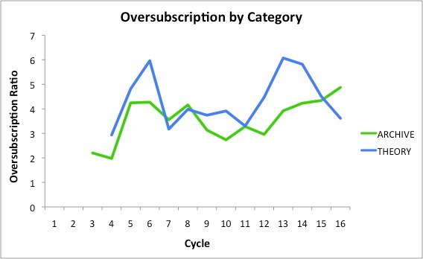
Cycle 16 Proposal Statistics
Archive:
  Budget: $1050K
  Allocated $1058K (13)
  Over-subscription: 4.9
Theory:
  Budget: $600K
  Allocated: $561K (8)
  Over-subscription: 3.4
Notes:
Responsible for running the review this year after assisting Fred Seward for many years.
Fred is in the process of retiring and I would like to acknowledge his many years of hard work which have made this transition smooth (so far anyway)!
So – bottom line is: “It is all my fault!!”

Slide 6
Cycle 16 XVPs
Fourteen proposals submitted, time range: 1.25-5.5 Ms (5.5 Ms available)
Total request: 27.7 Ms (5.1 over-subscribed)
Three allocated, for 1.25, 2.1 and 2.0 Ms:
  The Rise to Power: Half a Billion Years of Intense AGN Activity in the Merging Cluster Cygnus A (2 Ms, PI: Wise)
  Chandra mapping of the cosmic web converging on the virialization region of Abell 1795 (2.1 Ms: PI Vikhlinin)
  Black Hole Fingerprints from Cosmic Dawn to Cosmic Noon (1.25 Ms, PI Hasinger)
Process (as last cycle):
XVP panel (4 pundits) discussed all proposals and brought recommendations to BPP
Topical panels discussed XVPs and LPs, as usual
Final decisions made by BPP after discussion of highest-ranked proposals
Notes:
Responsible for running the review this year after assisting Fred Seward for many years.
Fred is in the process of retiring and I would like to acknowledge his many years of hard work which have made this transition smooth (so far anyway)!
So – bottom line is: “It is all my fault!!”

Slide 7
Triage (Review Rules 3.15)
Preliminary grades: used to triage lowest ~25% of proposals
Resurrection: e.g. due to wide grade dispersion or panelist request
Additional Triage
First item of business: decide on resurrections. Please discuss last in any particular group
18 June 2013
Chandra Cycle 15 Peer Review

Slide 8
Plans for Cycle 17
Schedule:
    Call for Proposals and associated software and documentation 16th Dec 2014
    GO Proposal Deadline, 17th March 2015
    Peer Review 23-26th June 2015
    Target list 17th July 2015
    E-letters week of 13th Aug 2015
    Cost Proposal deadline 17th Sept 2015
Joint Programs:
  HST, Spitzer, XMM-Newton, NOAO, NRAO & NuStar continued, Suzaku no longer offered
  NRAO will allocate 120 ks of Chandra time, after VLA upgrade, investigating inclusion of ALMA time
  Large Programs:
      4 Msec for LP (> 300ks), no cap, no XVP
Notes:
Responsible for running the review this year after assisting Fred Seward for many years.
Fred is in the process of retiring and I would like to acknowledge his many years of hard work which have made this transition smooth (so far anyway)!
So – bottom line is: “It is all my fault!!”

Slide 9
XVP Plans for Cycle 18 and Beyond
Decision on when/whether to re-start XVPs does not need to be made now, but we need to start thinking about it!
We are starting an in-depth study of the impact of larger projects (publications, citations, press releases etc) to help evaluate their effectiveness and how we should distribute the time
Data on the effectiveness of XVPs will just start to be available in 2015: use previous large programs as XVP “proxies”
Other factors:
  Thirteen XVPs approved Cycle 13-16
  XVP oversubscription has dropped from 7 (Cycle 13) to 5.5 (Cycle 16), with a slight decrease in number of submitted proposals
  LP pressure remains very high
Notes:
Responsible for running the review this year after assisting Fred Seward for many years.
Fred is in the process of retiring and I would like to acknowledge his many years of hard work which have made this transition smooth (so far anyway)!
So – bottom line is: “It is all my fault!!”

Slide 10
XVP Plans for Cycle 18 and Beyond
Under the assumption we will continue with the XVP program in some form, two scenarios for XVP calls:
  New XVP Call in Cycle 18, borrowing from Cycle 19
    ~5 Msec available for XVPs as soon as possible
  New XVP Call in Cycle 19, borrowing from Cycle 20
    Two Cycles without XVPs will allow ~10 Msec LP time in Cycles 17-18, relieving some of the LP pressure
Notes:
Responsible for running the review this year after assisting Fred Seward for many years.
Fred is in the process of retiring and I would like to acknowledge his many years of hard work which have made this transition smooth (so far anyway)!
So – bottom line is: “It is all my fault!!”

Slide 11
XVP Plans for Cycle 18 and Beyond
XVP call in Cycle 19
XVP call in Cycle 18
Cycle | 17 | 18 | 19 | 20 | 18 | 19
Total Science Time | 22.7 | 22.4 | 22.4 | 22.6 | 22.4 | 22.4
Time already allocated | 7.2 | 5.2 | 5.2 | 7.2 | 5.2 | 7.2
Available for Peer Review | 15.55 | 17.2 | 17.2 | 15.4 | 17.2 | 15.2
LP | 4.0 | 6.0 | 4.0 | 4.0 | 4.0 | 4.0
XVP | 0.0 | 0.0 | 5.0 | 0 | 5.0 | 0
GO | 11.55 | 11.2 | 10.2 | 11.4 | 10.2 | 11.2
Notes:
Responsible for running the review this year after assisting Fred Seward for many years.
Fred is in the process of retiring and I would like to acknowledge his many years of hard work which have made this transition smooth (so far anyway)!
So – bottom line is: “It is all my fault!!”

Slide 12
Plans for Cycle 18 and Beyond
500+
Paper counts “normalized” so that papers which have more than one dataset are assigned a “fractional” value
Paper counts are divided by the time available for publication to account for aging
Caveats:
  We have no data on XVPs
  No measure of the impact of publications (in progress)
  Catalogs are not properly accounted for
400-500
300-400
0-100
200-300
100-200
Cycles 2-12, Time
Cycles 2-12, paper counts
Notes:
Responsible for running the review this year after assisting Fred Seward for many years.
Fred is in the process of retiring and I would like to acknowledge his many years of hard work which have made this transition smooth (so far anyway)!
So – bottom line is: “It is all my fault!!”

Slide 13
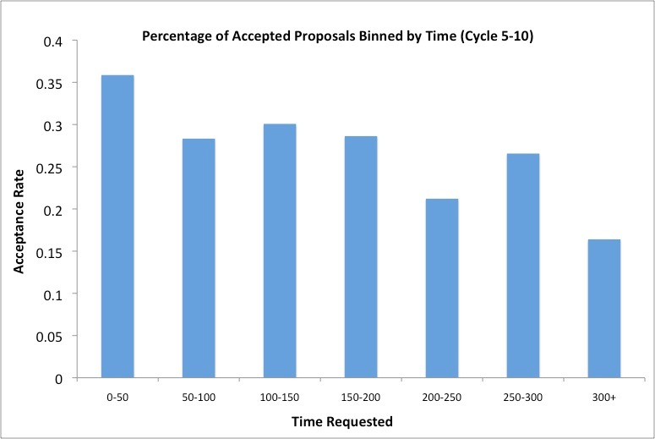
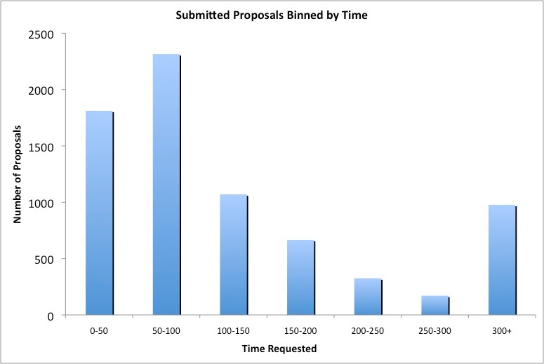
Plans for Cycle 18 and Beyond
Do we have a “problem” with medium sized proposals?
  medium -> 25% or more of a panel allocation. Proposers perception is that these have a low chance of being approved.
Not true: but there is a hole in the submission numbers at 200-300 ks
Approx 15 medium proposals approved per cycle
No suggestion that medium proposals are more productive.
Conclude: no adverse effects from 300 ks boundary condition, no motivation to increase the number of medium proposals
Notes:
Responsible for running the review this year after assisting Fred Seward for many years.
Fred is in the process of retiring and I would like to acknowledge his many years of hard work which have made this transition smooth (so far anyway)!
So – bottom line is: “It is all my fault!!”

Slide 14
New GTO target submission timeline
Overview of Chandra GTO program:
PIs of science instruments are guaranteed observing time for duration of mission
Instrument | PI | share | ks
ACIS | Garmire | 1 | 700
HRC | Murray | 1 | 700
HETG | Canizares | 1 | 700
LETG | Kaastra & Predehl | 1/2 | 350
 |  |  | 2450
Since Cycle 2 GTO have been guaranteed time but they cannot reserve targets. Any GTO/GO conflicts must be resolved by the peer review.
Notes:
Responsible for running the review this year after assisting Fred Seward for many years.
Fred is in the process of retiring and I would like to acknowledge his many years of hard work which have made this transition smooth (so far anyway)!
So – bottom line is: “It is all my fault!!”

Slide 15
New GTO target submission timeline
Current Timeline:
Two weeks before GO deadline:
    GTO targets submitted
    GTO-GTO target conflicts identified
GO deadline:
    GTOs inform us of joint GO-GTO proposals
  One week after the GO deadline:
    We inform the GTOs of any GTO-GO conflicts, excluding proposals written by GTO team members.
Three weeks after the GO deadline:
    GTOs submit science proposals for conflicted targets OR drop the targets
At the Review:
    GTO proposals are disguised as GO proposals. They are approved if the GTO proposal is ranked higher than the competing GO proposal, so long as the GTO proposal is not ranked lower than the GO and below the panel pass-fail line.
After the peer review:
    GTOs pick unconflicted targets or add time to approved targets.
Notes:
Responsible for running the review this year after assisting Fred Seward for many years.
Fred is in the process of retiring and I would like to acknowledge his many years of hard work which have made this transition smooth (so far anyway)!
So – bottom line is: “It is all my fault!!”

Slide 16
New GTO target submission timeline
Advantages:
      Minimizes load on the Peer Review and saves GTOs from writing unnecessary proposals
      GTO targets ready for early scheduling <— NO LONGER AN ISSUE
Disadvantages:
      Process is extremely cumbersome
      Requires keeping track of many details by hand, leads to mistakes
  Conflict resolution is a big problem:
      Review all GTO-GO conflicts to determine whether the conflict is “real” - should be determined by the Peer Review
      Keeping track of GTO-GO conflicts can be very complicated: multiple GTO targets in in a single proposal can be conflicted with GO targets, some of which are collaborations, some not “real” conflicts
      Two mistakes in the past 3 years, GTOs lost a target
Notes:
Responsible for running the review this year after assisting Fred Seward for many years.
Fred is in the process of retiring and I would like to acknowledge his many years of hard work which have made this transition smooth (so far anyway)!
So – bottom line is: “It is all my fault!!”

Slide 17
New GTO target submission timeline
  Disguising GTO proposals at the review:
      Recommended by the CUC in Jan 2002 because GTO proposals had a significantly higher success rate than GO proposals.
      Was useful earlier in the mission when there was much more competition for the “best” targets
  Disguise isn’t very successful!
      GTO proposals often state they are GTO in the science justification because they are part of bigger projects
      When it is successful it can waste valuable time at the review
      Proposals need to be tracked by hand
Notes:
Responsible for running the review this year after assisting Fred Seward for many years.
Fred is in the process of retiring and I would like to acknowledge his many years of hard work which have made this transition smooth (so far anyway)!
So – bottom line is: “It is all my fault!!”

Slide 18
New GTO target submission timeline
GTOs submit proposals for “First Priority” (FP) targets at the GO deadline.
  These are targets/programs for which the GTO is prepared to write a proposal
  ALL conflicts for FP targets go to the peer review.
GTO science justifications due 2 weeks after the GO deadline.
GTO proposals at the review are not disguised.
  Panelists decide if the conflict is “real”
  If no actual conflict, the GTO target is approved
  If there is a conflict, the panel will rank the GTO proposal along with GO proposals
  GTO targets are approved using the current algorithm
GTOs submit the bulk of their targets after GO targets have been ingested.
  GTOs can request any target not in an approved GO proposal.
  Requests for duplicates will be assessed by the CXC director, and may be approved if the observing mode is significantly different
  GTOs can also add time to any GO target “won” by a member of the GTO team.
There is a final conflict check to ensure no unintended GTO-GO duplications.
Notes:
Responsible for running the review this year after assisting Fred Seward for many years.
Fred is in the process of retiring and I would like to acknowledge his many years of hard work which have made this transition smooth (so far anyway)!
So – bottom line is: “It is all my fault!!”

Slide 19
The Budget Allocation (fair share) Calculation
GO budget $8.6M, Archive $1.0M, Theory $0.6M excluding DDT
PIs eligible for funding
  US Institution
  CoIs at a US institution with foreign PI (1/2 US rate)
  PIs with multiple affiliations, < 50% at a US institution (1/2 US rate)
Allocated budget procedure in place since Cycle 1. Value depends on:
  Total exposure time
  Number of targets
  Level of difficulty assigned by the peer review
  The proposal type (GO, LP, XVP)
  PI status (US, foreign CoI etc)
  There is a constant which ensures budget for small allocations does not drop below a useful level
Notes:
Responsible for running the review this year after assisting Fred Seward for many years.
Fred is in the process of retiring and I would like to acknowledge his many years of hard work which have made this transition smooth (so far anyway)!
So – bottom line is: “It is all my fault!!”

Slide 20

The Budget Allocation (fair share) Calculation
Example of formula for GO proposals:
Ld is the level of difficulty 0.9-1.1
NT is the number of targets
Texp is the approved exposure time
K1GO and K2GO are constants that change with proposal type and from year to year.
All budgets have a maximum which varies with type
Constants are varied until the total equals the GO budget for the Cycle, and transitions between proposal types are reasonably smooth
Notes:
Responsible for running the review this year after assisting Fred Seward for many years.
Fred is in the process of retiring and I would like to acknowledge his many years of hard work which have made this transition smooth (so far anyway)!
So – bottom line is: “It is all my fault!!”

Slide 21
Notes:
Responsible for running the review this year after assisting Fred Seward for many years.
Fred is in the process of retiring and I would like to acknowledge his many years of hard work which have made this transition smooth (so far anyway)!
So – bottom line is: “It is all my fault!!”

